Slide 1
46th CBM Collaboration Meeting
Detector Control System for CEE
-And some considerations regarding CBM-DCS
  Min LI, on behalf of Detector Control Team
  Institute of Modern Physics（IMP）
  October 21, 2025

Slide 2
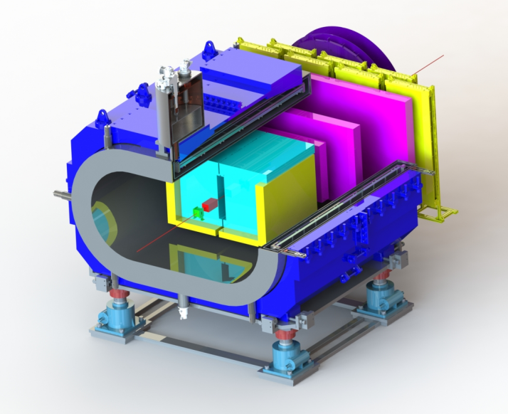
CEE: Background
CEE: CSR External-Target Experiment, it will be the first-large nulclear physics experimental device at HIRFL-CSR, heavy-ion collisions
ZDC
eTOF
Physical goals
To study the bulk properties of strongly interacting matter
To study equation of state high baryon density region
To understand the quantum chromo dynamics (QCD) phase diagram
Buget: 74,5241 million
MWDC
beam
SC Magnet
iTOF
Beam Monitor
T0
TPC
A collaborative project between -- universities and institutes

Slide 3
CEE subsystems
Superconducting Magnets
BM：Beam Monitor
TPC: Time Projection Chamber
Starting time detector (T0)
iTOF: Internal Time-of-Flight
eTOF: Endcap Time-of-Flight
MWDC: Multiwire Drift Chamber
ZDC: Zero Degree Calorimeter
DAQ: Data Acquisition System
Trigger
Technical Support
Detector Control System
Clocks
Scientific Applications
CEE
ZDC
eTOF
MWDC
beam
SC Magnet
iTOF
Beam Monitor
T0
TPC

Slide 4
Detector control system(DCS)-Objectives
Ensure the proper and safe operation of the experiment
Monitor/control all the critical parameters of the experiment->Interlocks
Provide necessary information for data corrections
Collect data from sensors and send them to local database and finally to the centralized database
Data archival
Elog
Design and set up CEE Local Area Network(LAN)
Develop accelerator event parsing system for trigger system
Realize the data interaction between accelerator and CEE LAN
Time synchronization of equipments running in CEE LAN
… …

Slide 5
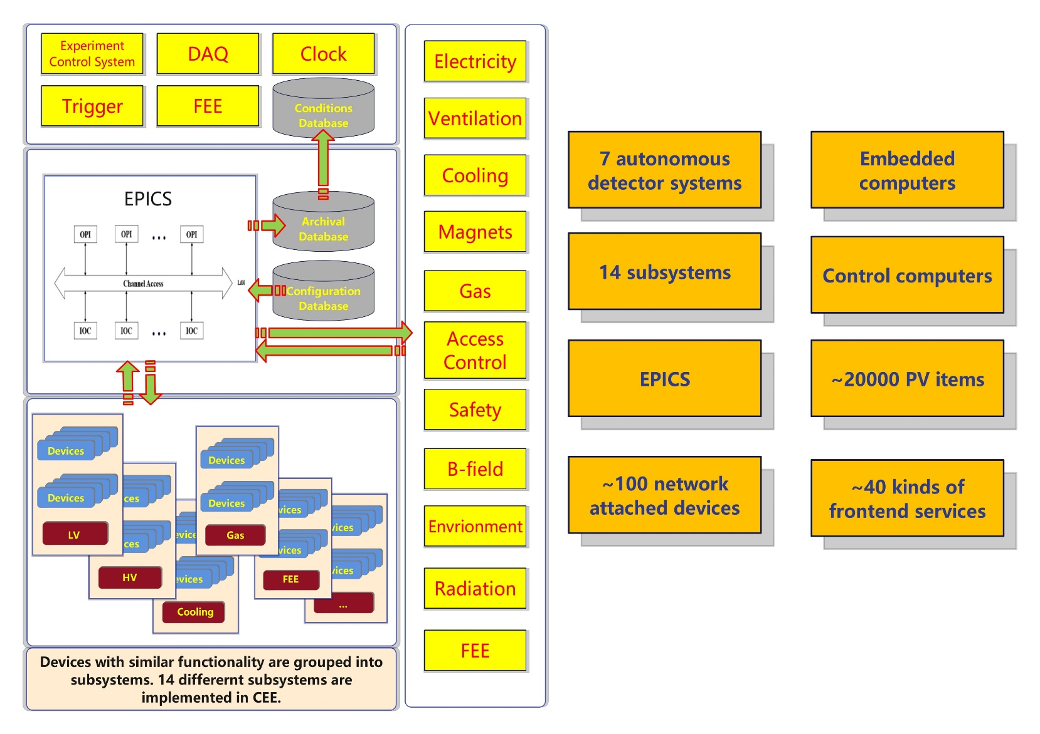
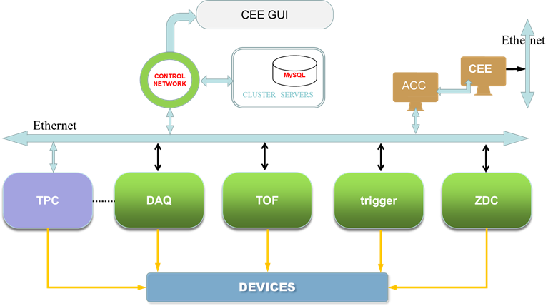
DCS context and scale
3-tiers hardware architecture
EPICS-based architecture
Open-source software

Slide 6
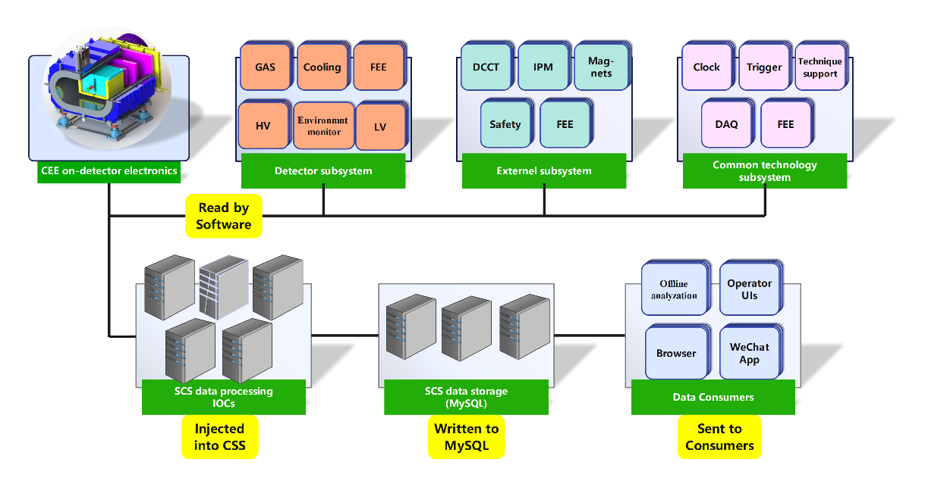
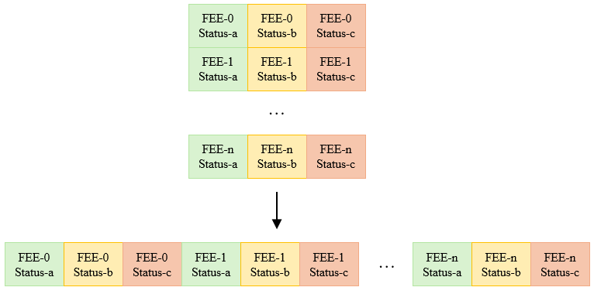
Detector control system(DCS)：Data Flow
Data communication and integration: CEE DCS communicates with hardware via PVs, integrating them into the IOC of each subsystem.
  HV, LV ,GAS control, environment parameters … …
FEE status format: one-dimensional array, organized according to the FEE pattern. This format is consistent across all detectors.
  For CBM, belongs to DAQ? With TIG stack(Telegraf, InfluxDB, Grafana or prometheus), so the next how…?
  Interlock ？

Slide 7
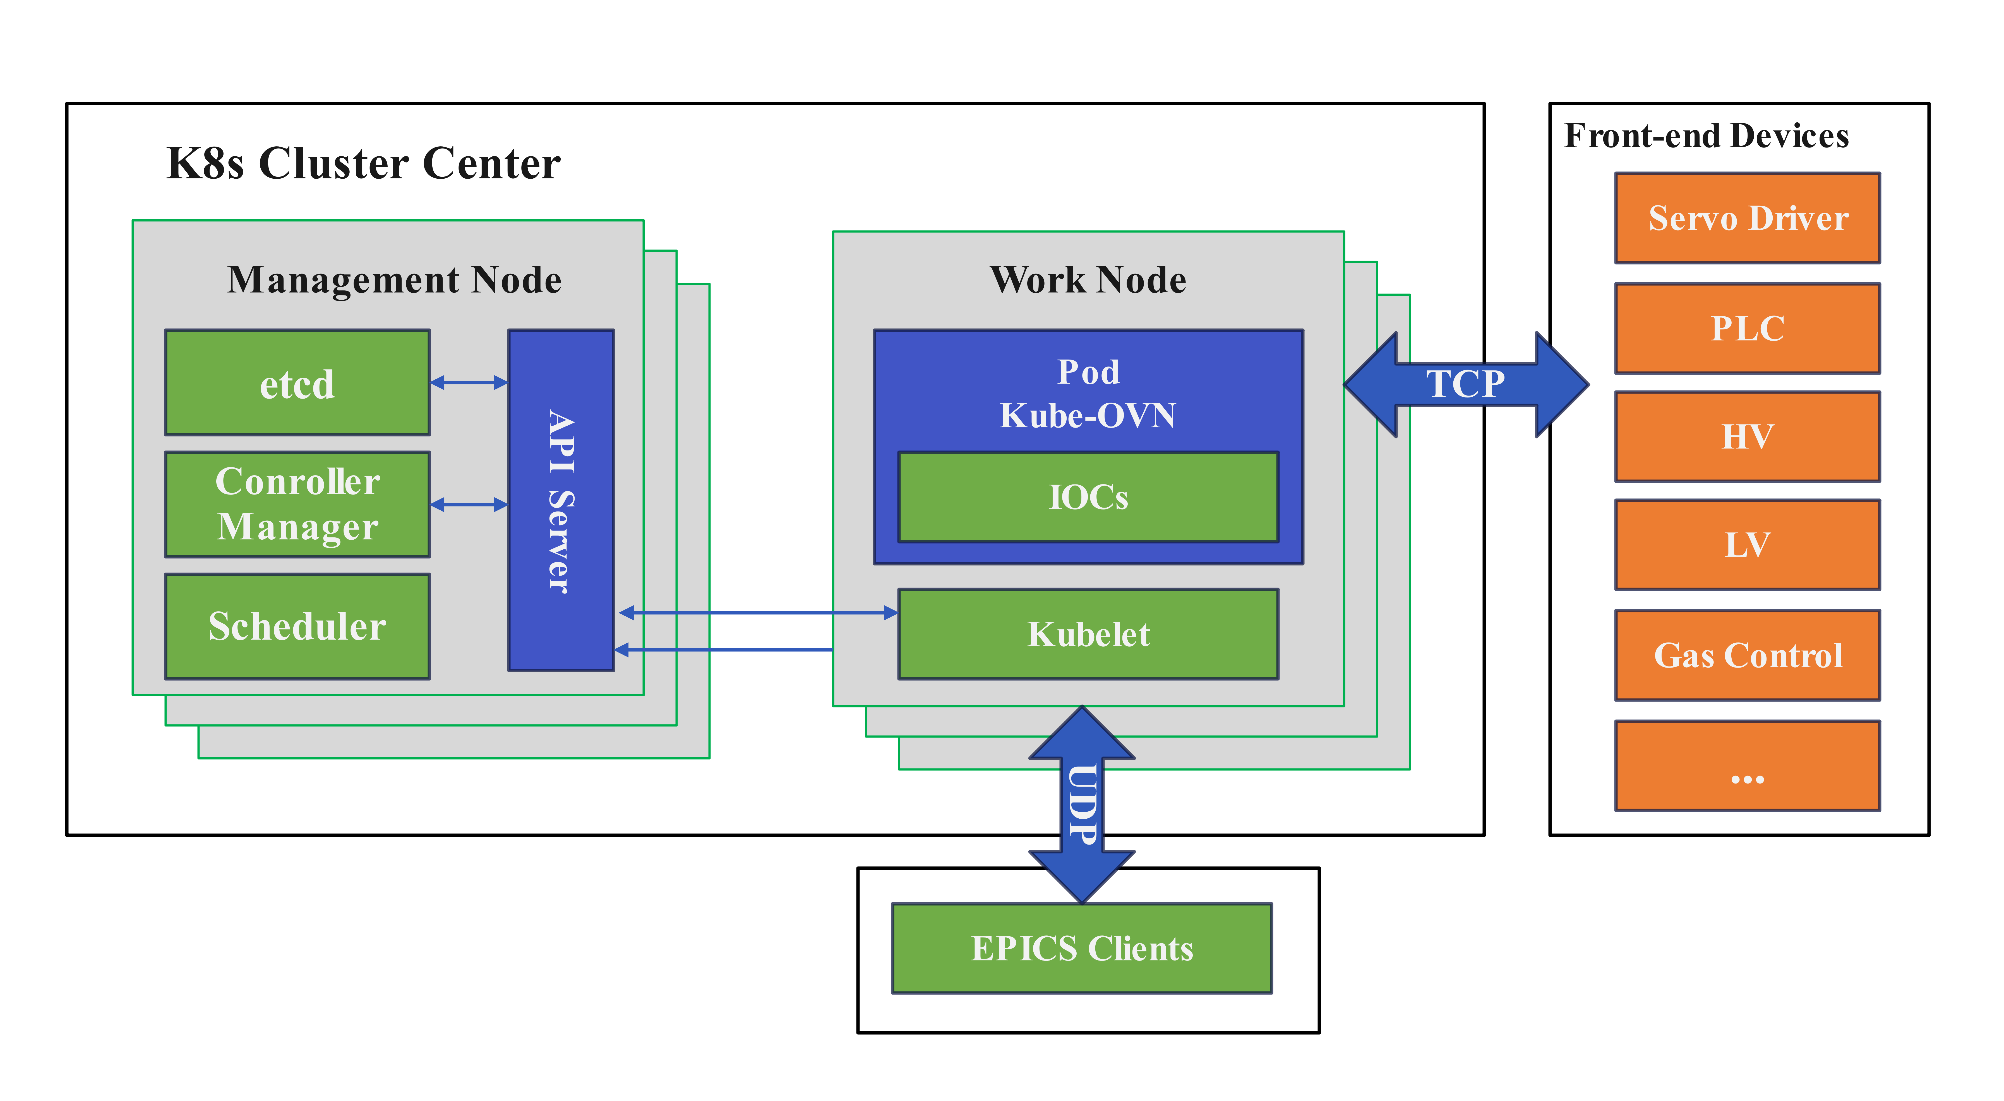
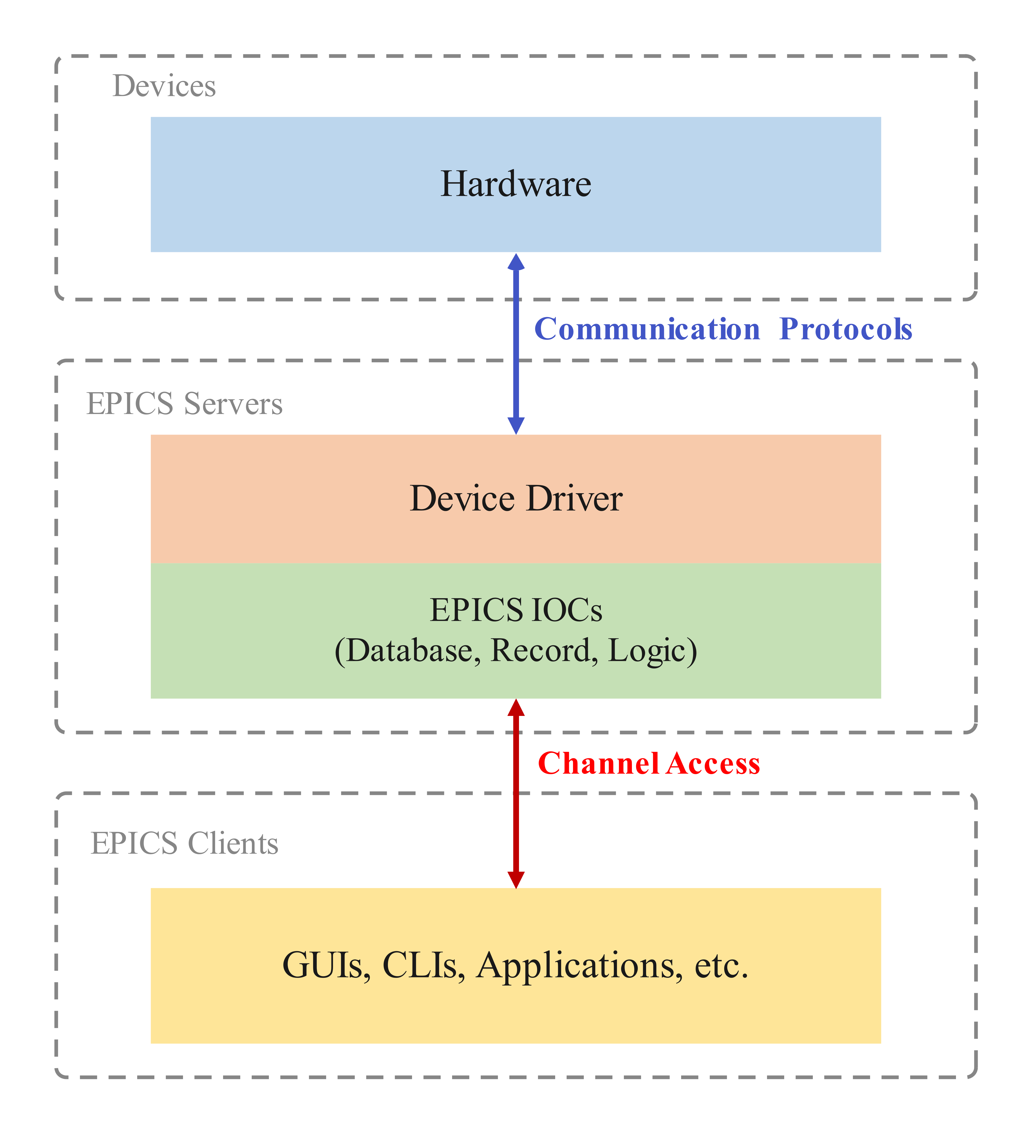
DCS implementation：IOCs
Each sub-systen has their own IOCs
Different types of front-end electronics
High/ low voltages
Motion control
Environment variables
Gas control system
Water-cooling control sysytem
......
Containerization is necessary(Podman, Singularity, Docker)
For development/ deploy efficient, upgrade…
For large scale spectrometer
For scalibility … …

Slide 8
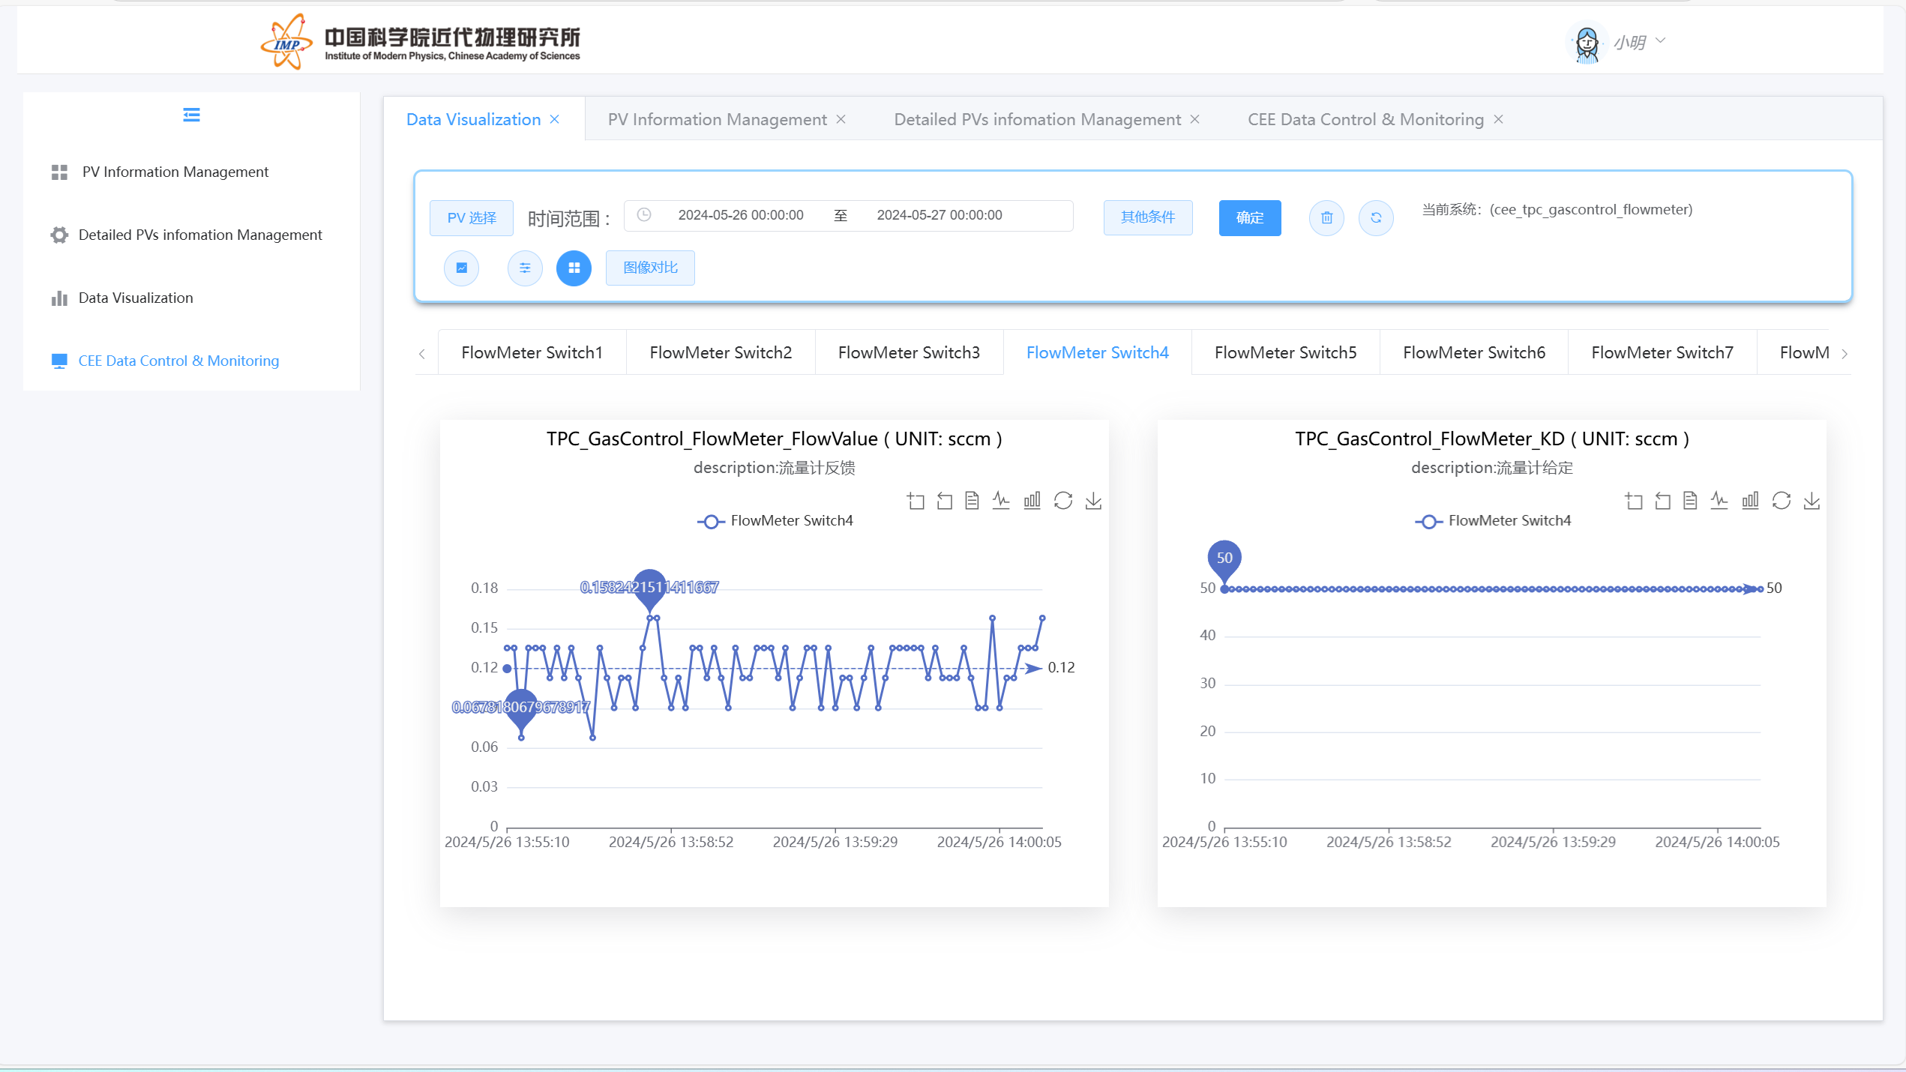
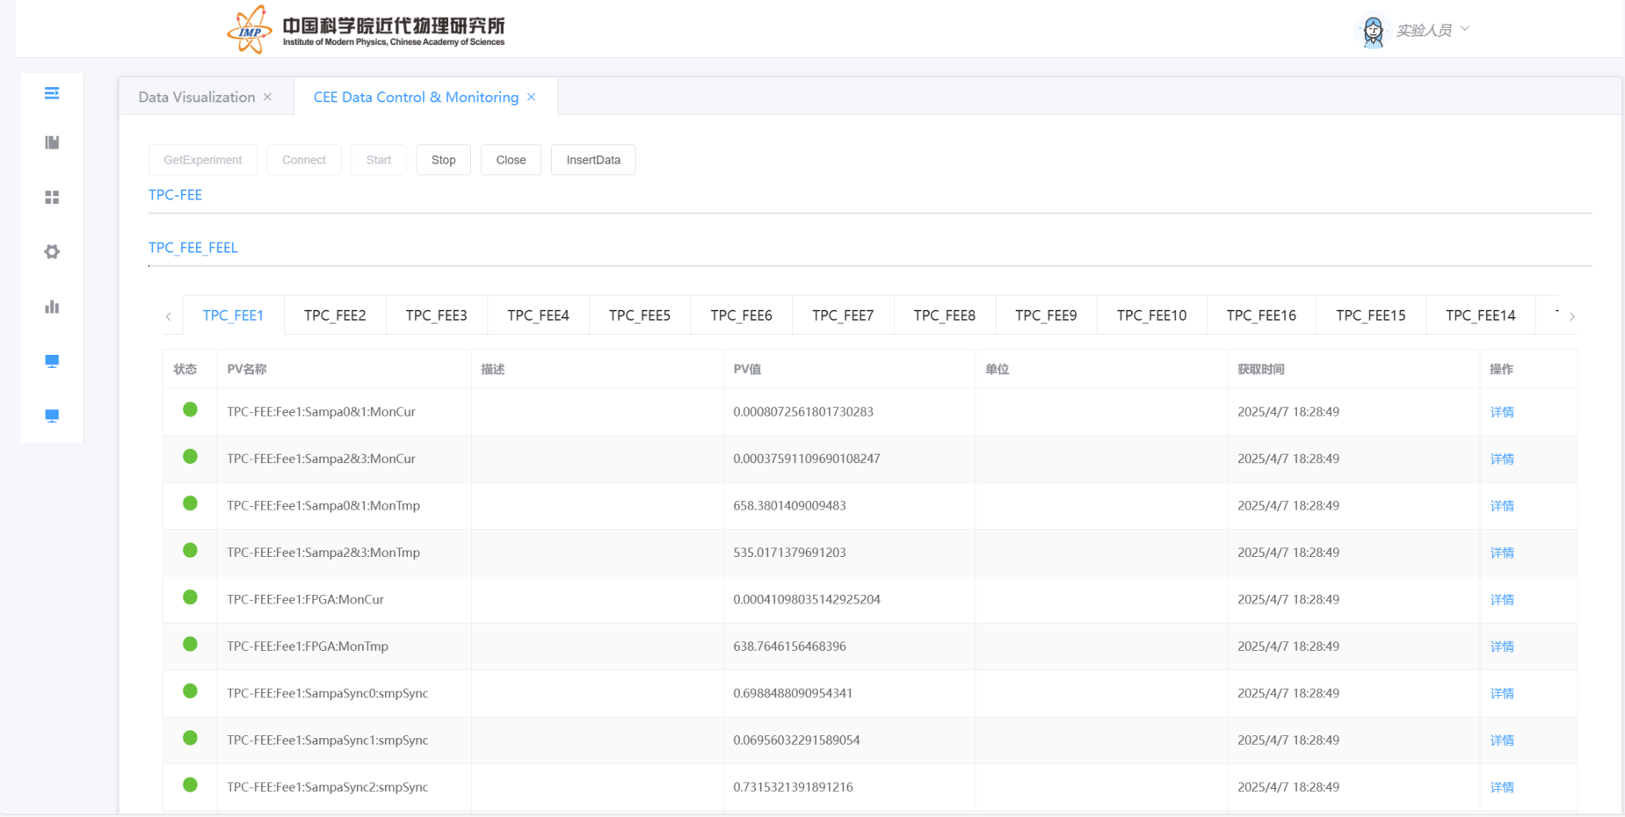
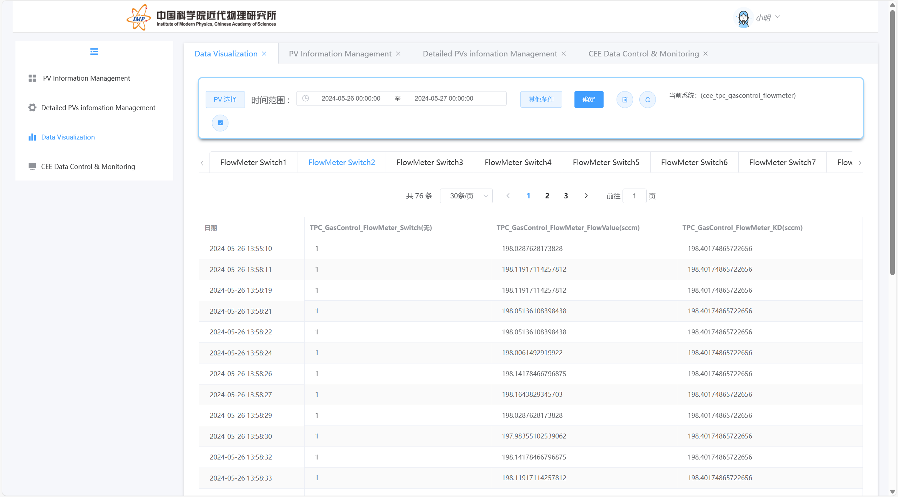
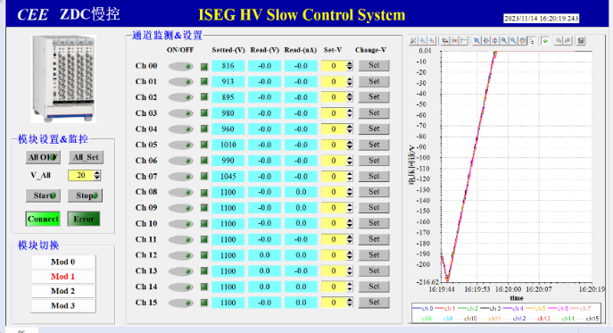
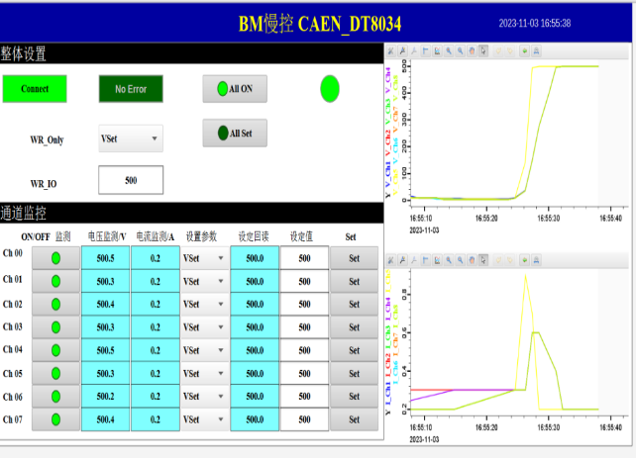
DCS implementation：GUIs
CSS or Phoebus-based and web-based GUI
CBM: Grafana, Phoebus…
Data Visualization Interface （chart）：
PV Variable Monitoring Interface
Data Visualization Interface （lists）：

Slide 9
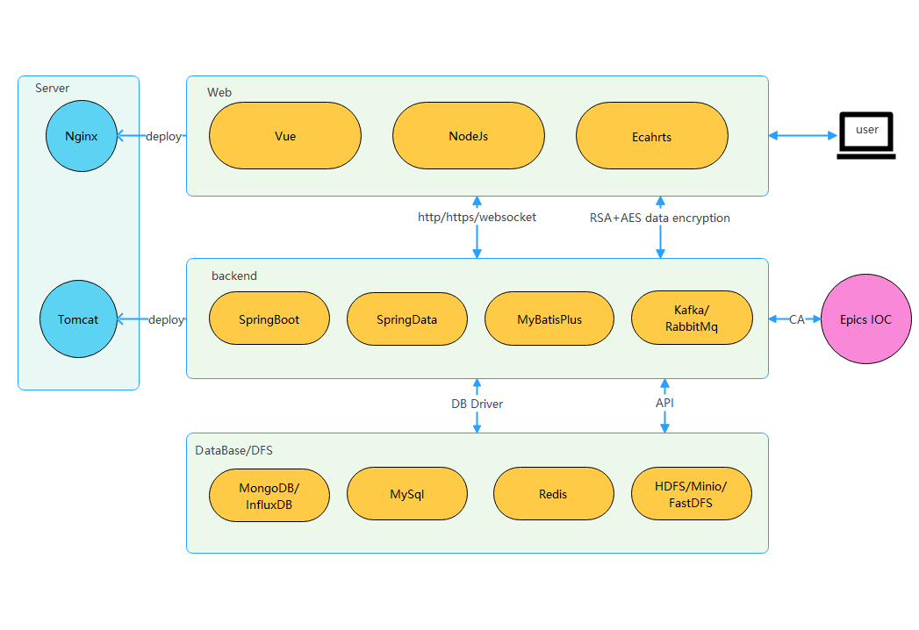
Web-based Data Visualization
System Architecture
Front-end and back-end separation development
The frontend uses Vue.js, the backend uses SpringBoot.
For Python projects, Flask or Django can replace SpringBoot.
The back-end server program interacts with the database and EPICS data
Scalability
The system is designed for distributed deployment, using message queues like Kafka and RabbitMQ for inter-system communication
Allowing seamless horizontal scaling to meet dynamic demands.

Slide 10
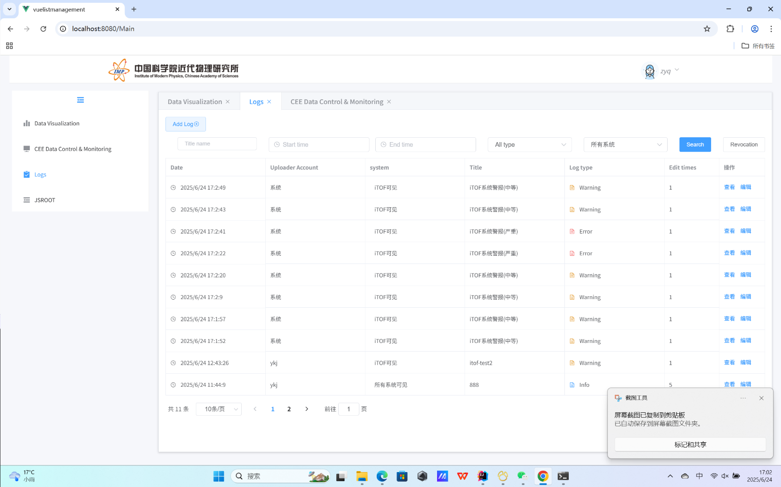
Electronic logbook
Not open source, but developed by our group
Stores operational data
supports user-defined experiment log templates
allows users to upload various file types
enables integration with other systems
maintains seamless connectivity with the alarm system
facilitates experimental scene reconstruction and tracing based on log information.

Slide 11
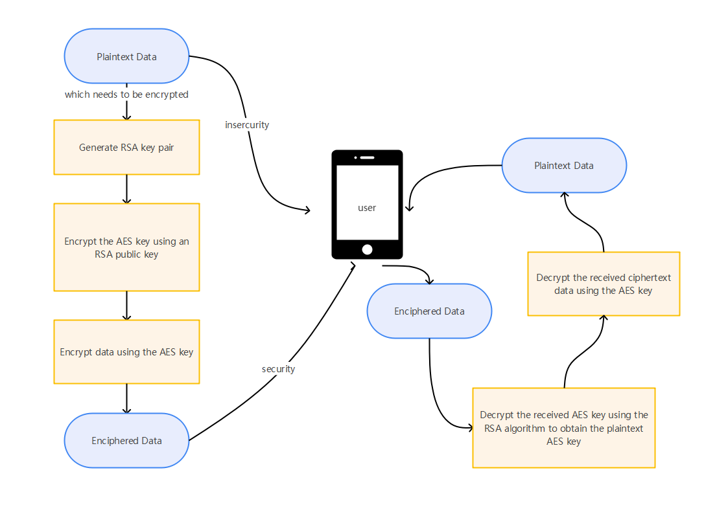
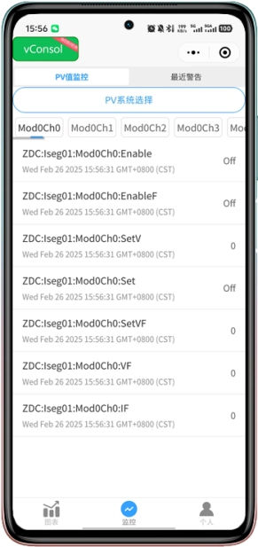
Database design & Implementation: Mobile APP/WeChat Mini Program
Mobile APP/WeChat Mini Program Monitoring Interface
push critical warning or error messages to system administrators
Data Encryption：
Hybrid encryption scheme employs RSA to encrypt the AES symmetric key followed by AES directly encrypting the transmission payload.

Slide 12
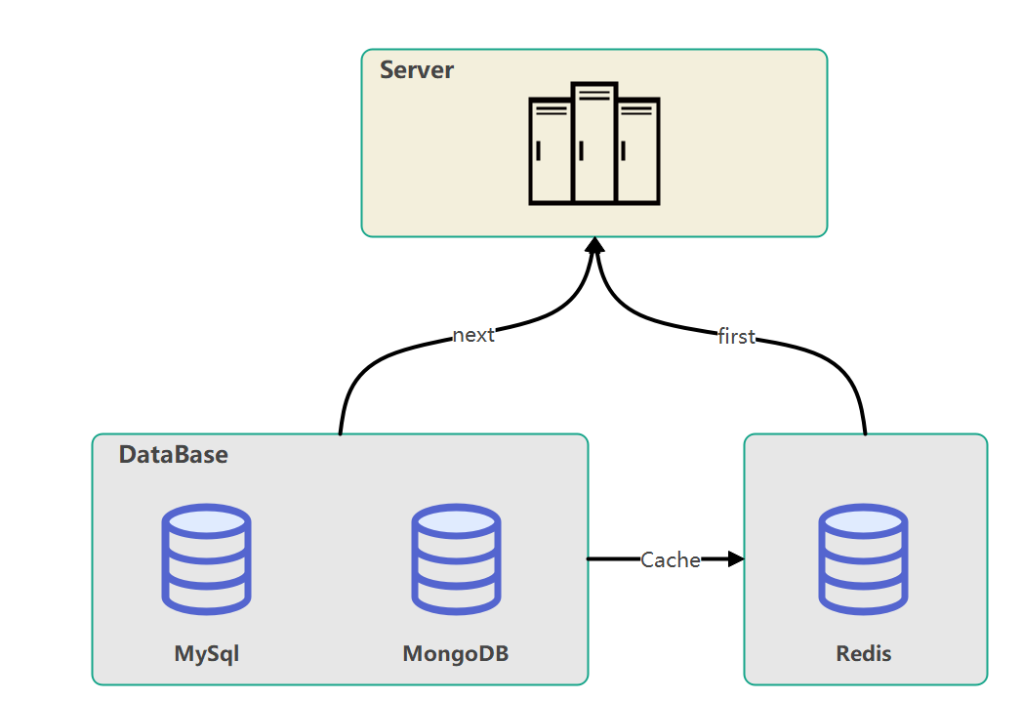
Database Framework
Hybrid architecture
MySQL is used for system data, meta data
Redis accelerates data access by providing fast read and write capabilities through a caching mechanism.
MongoDB or InfluxDB for time-series data
HDFS or FastDFS for file/image storage
Web-based GUIs
Postgres+phoebus + InfluxDB +Grafana(TOF)
EPICS Archiver(other suggested Database)
Kibana+ElasticSearch (STS)
… …
Each Sub-Detector has its own database, then upload the data to CBM-Cluster or Cloud Servers?
Or Unified database architeture ?
Each sub-System builds its database?
Relational Database + Time-series Database

Slide 13
Data Clean & Alarming
Data Clean
Data storage frequency(1~10 second)
Error data
Commissiong data
… …
Alarming: EPICS alarm handler, or PV alarms
Too many parameters
Quick check & response
… …
Feature Extraction: employ either CS-VAE or PCA for dimensionality reduction.
Fault Diagnosis (Early Warning): no labels indicating normal or abnormal status-> unsupervised learning method iForest ,labels->supervised learning algorithm LightGBM. Both methods can identify the specific feature columns contributing to the anomalies.
Self-Healing: Create corresponding recovery workflows based on the identified anomalous features.
Check the integrity, uniqueness, duplicates, and correlations of the feature columns and remove them according to the indicators.
Process the outliers and missing values found in the feature columns.
compute the correlation between the feature columns and the label, keeping only the features with strong correlations,if labels is available
Yet to do

Slide 14
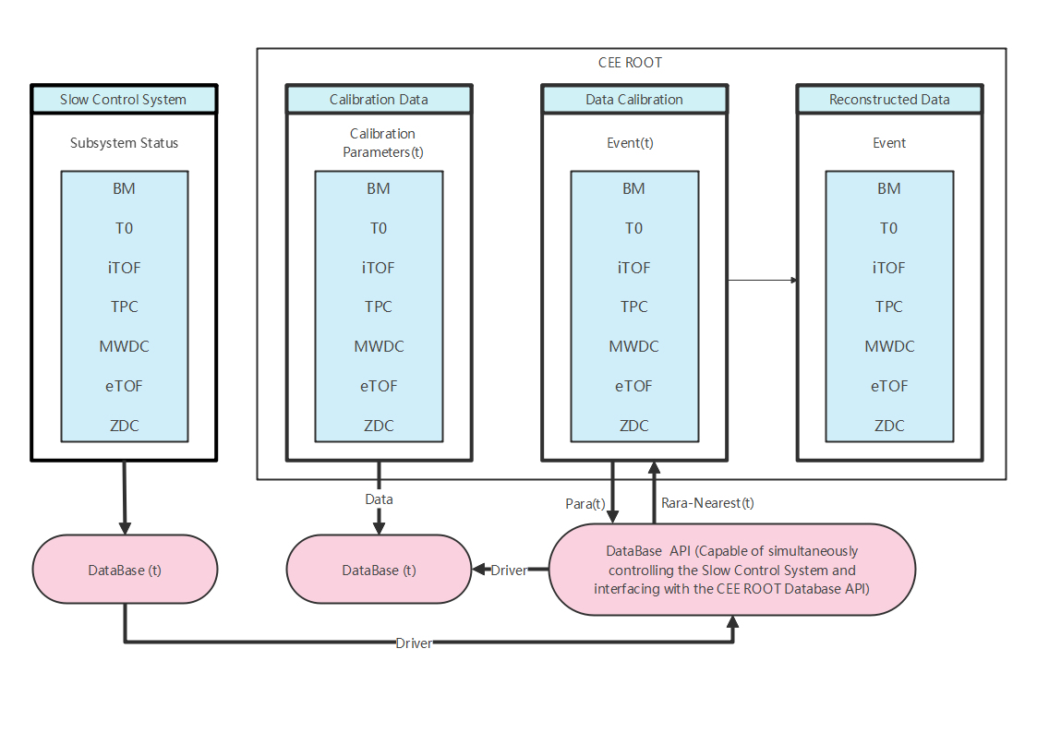
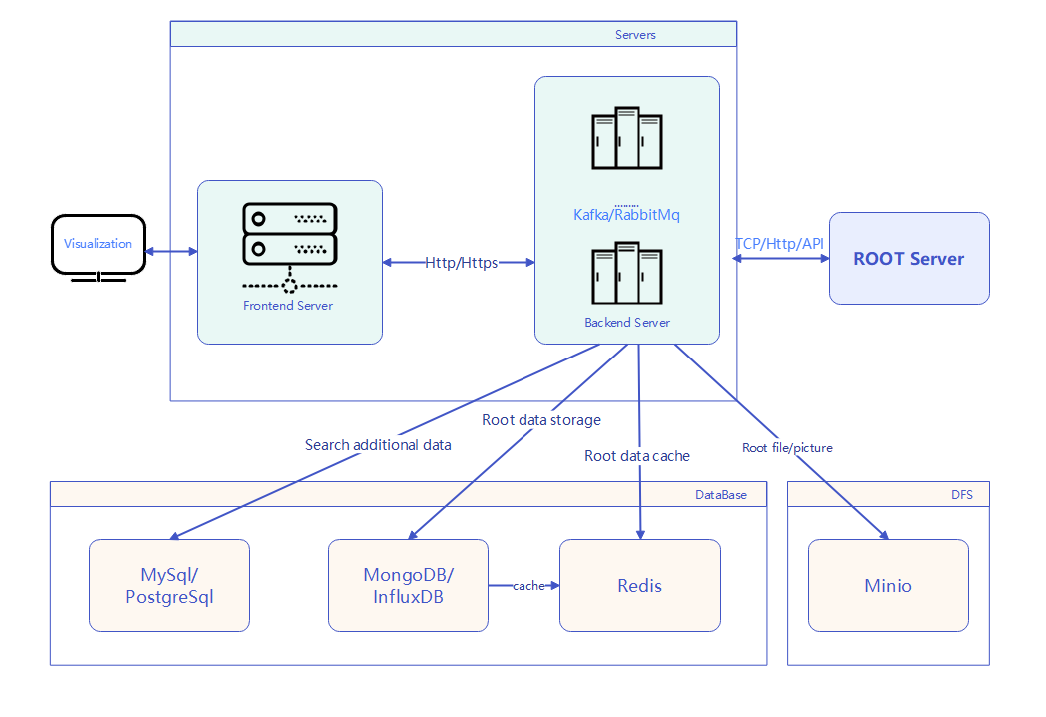
Database Update: RooT-Web Implementation
JSROOT Data Monitoring and Storage
JSROOT Project Framework
Real-time monitoring and graphical rendering of RooT data via web-based platforms
Automated screenshot capture and archival upon triggering of data-driven alert thresholds

Slide 15
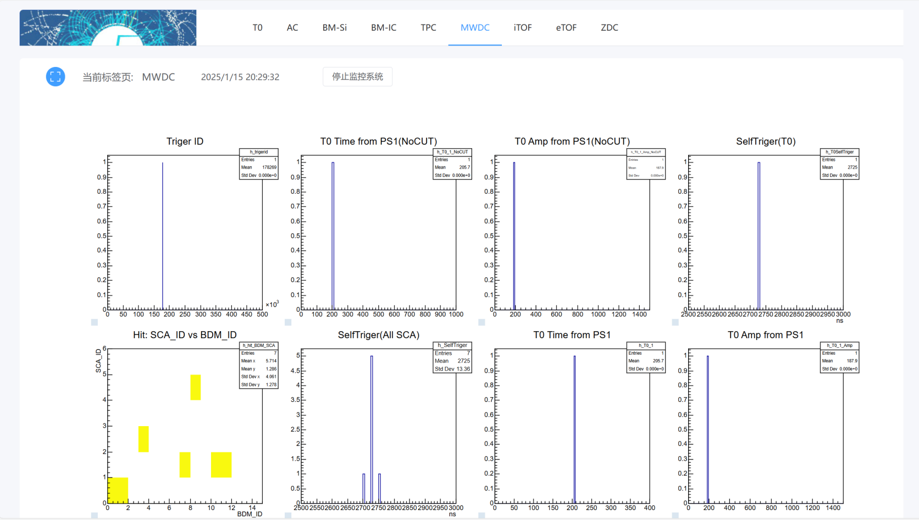
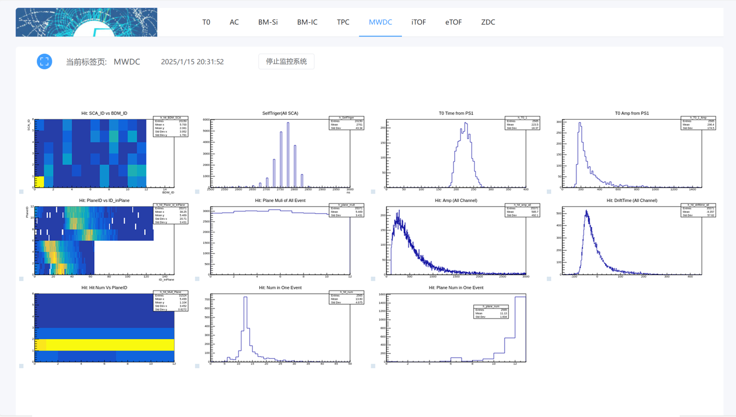
Database Update: RooT-Web Implementation
JSROOT Data Monitoring Interface
Real-time monitoring(online-data) and graphical rendering of ROOT data via web-based platforms
Automated screenshot capture and archival upon triggering of data-driven alert thresholds
MWDC measurement results with beam

Slide 16
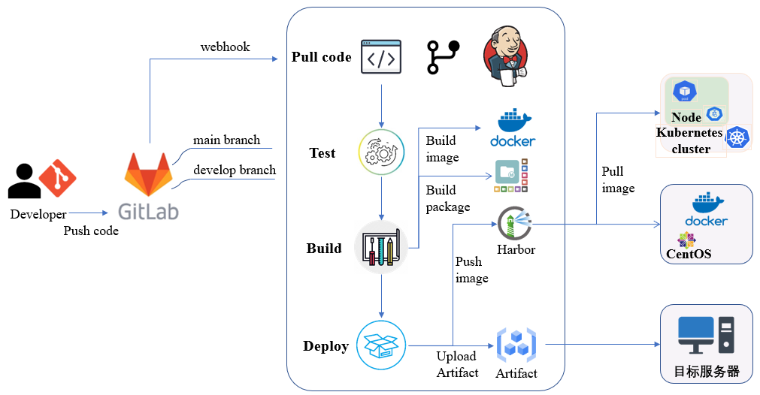
CI/CD: Workflow diagram
A method that introduces automation during the application development phase to continuously deliver applications to customers
Developers submit code to GitLab, triggering automated builds; reviewers assess based on build/test results and merge compliant branches.
Continuous Integration (CI)
Continuous Delivery
Continuous Deployment
CI/CD workflow diagram

Slide 17
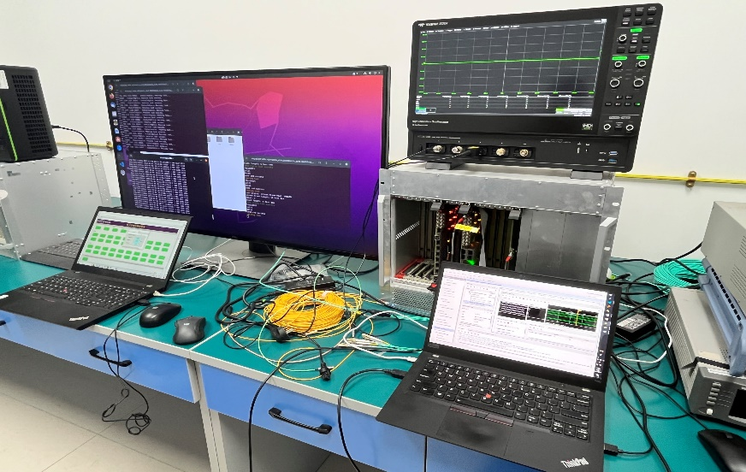
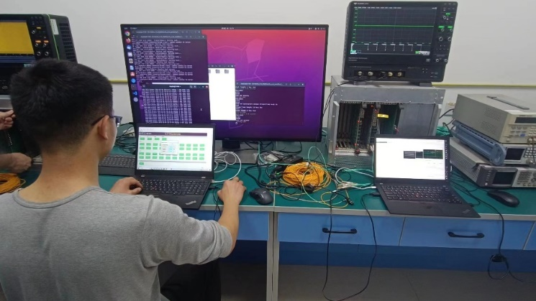
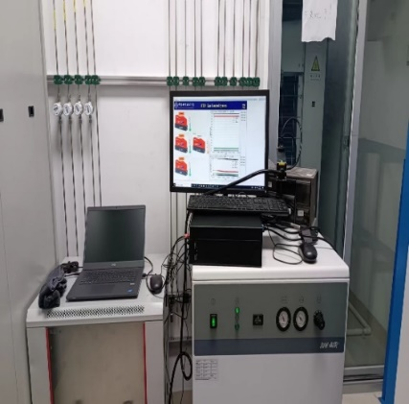
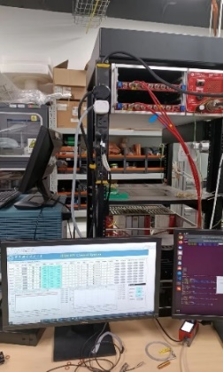
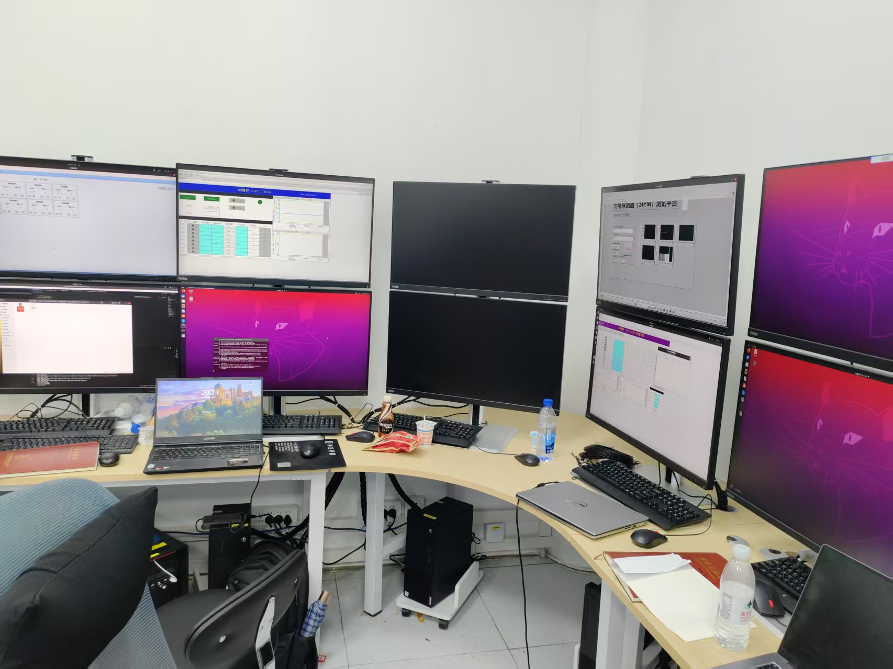
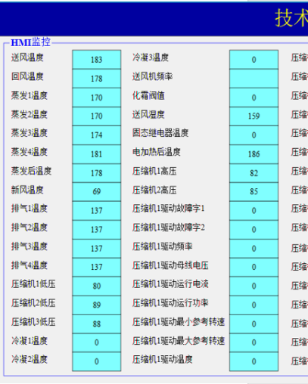
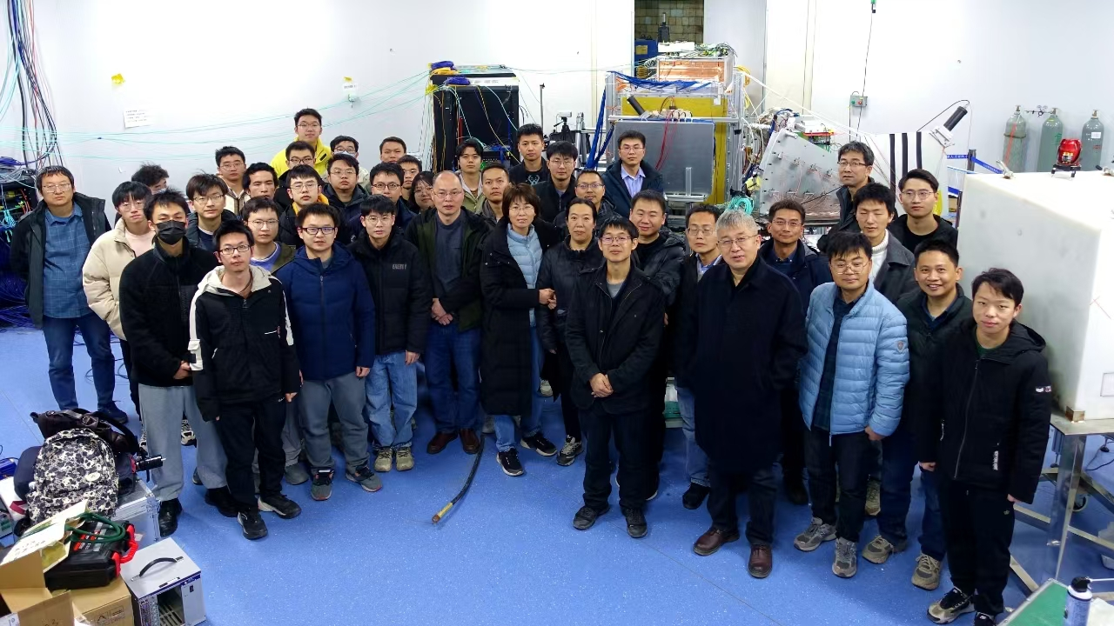
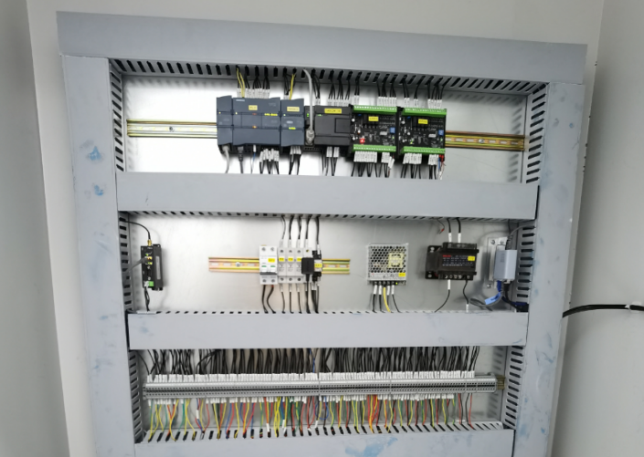
DCS implementation: software tests
The system has completed the unit tests, integration tests and field tests with beam

Slide 18
Conclusion
EPICS-based
Phoebus, CSS, Web-based GUI
Containered IOCs
Hybrid database
Alarming
Devops for efficiency
…

Slide 19
Thank you

