Slide 1
CBM DCS Detector Control System OVerVIEW
Peter Zumbruch, GSI
Oct 21, 2025

Slide 2
Project Lead
Min Li, IMP CAS
Among others Development of Control System of CEE (next talk)
Peter Zumbruch
HADES controls

Slide 3
Purpose & Objectives
Ensure the proper and safe operation of the experiment
but excluding human safety, interlocks, emergency shutdown systems, safety instrumented systems (SIL)
Task of DSS Detector Safety System
Deliver a modular, scalable, distributed, DCS on basis of EPICS, (Experimental Physics and Industrial Control System) across multiple detector units
Ensure each detector must be able to run stand-alone for testing or fallback, incl. Alarm and Archive
Each detector's distributed DCS is integrated into the hierarchy of the Experiment Control System (ECS) below the Control Agents, alongside the Readout Controls system
Replace existing local solutions by common, maintainable solutions
If feasible take local solutions into account and integrate
Leverage and integrate building blocks of the existing external DCS‘s where feasible (e.g. ACC)
Enable real-time monitoring, control, and data exchange with other industry PLC based systems (Magnet, Cryo, Gas)
Persistantly store data and thus enable DAQ and Analysis to perform (online) usage of DCS data
Provide intuitive operator HMIs via EPICS tools and/or web-based Applications
Maintainability and wide knowledge base via comprehensive documentation, open-source, training, and long-term support

Slide 4
Modular, Scalable, Distributed ...
Expected no. of Process Variables » 10⁵ (HADES) up to O(10⁷)
EPICS, proven at many sites as mature tool,
long-term, open-source, large collaboration, big players (e.g. ESS, ITER)
Containerization / Virtual Machines
Detector focussed segration of DCS networks
Configuration Database driven
automatic and reproducible, template based
IOC setup
tag based data-settings

Slide 5












Scope
ECS
“per detector“
SCA + DCA
EPICS IOC development for Detectors
Integration interfaces between EPICS and higher ECS
Sub-detector Status
Sub-detector Tasks
Automatic configuration & setup
database setup for performant data storage (archiver) and retrieval
Communication layers to PLCs (OPC UA, Modbus, MQTT)
Task/signal survey and control-logic mapping
Containerization and orchestration of all services
based on configuration databases local to the detector
Security, archiving, alarm, and data-aggregation subsystems
Segregated, subdived Network architecture
HMI/GUI development (support) for sub-detectors
DAQ
Common
Magnet
CA/PVA
Status request / direct access
State machine
DCS
Gateway
DAQ
BMON
FSD
TOF
,
DAQ
…
DAQ
DAQ
DAQ
DAQ
DAQ
DAQ
DAQ
DAQ
Configuration
DAQ
Database
IOC
TIG
TRD
MUCH
RICH
Performance
Database
Database
MVD
STS
TARGET
(time-series)
(time-series)
Analysis
GUI/HMI
Other Clients
Aggregation

Slide 6
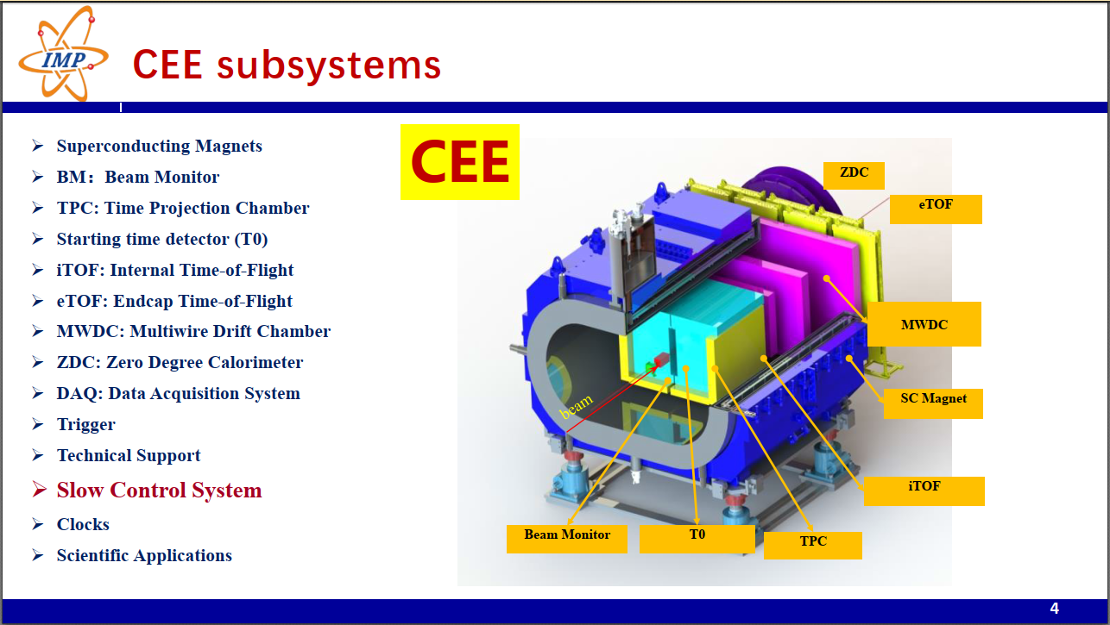
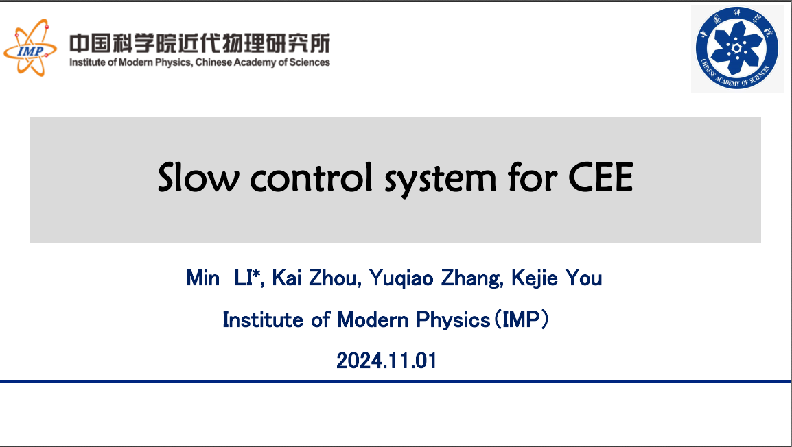
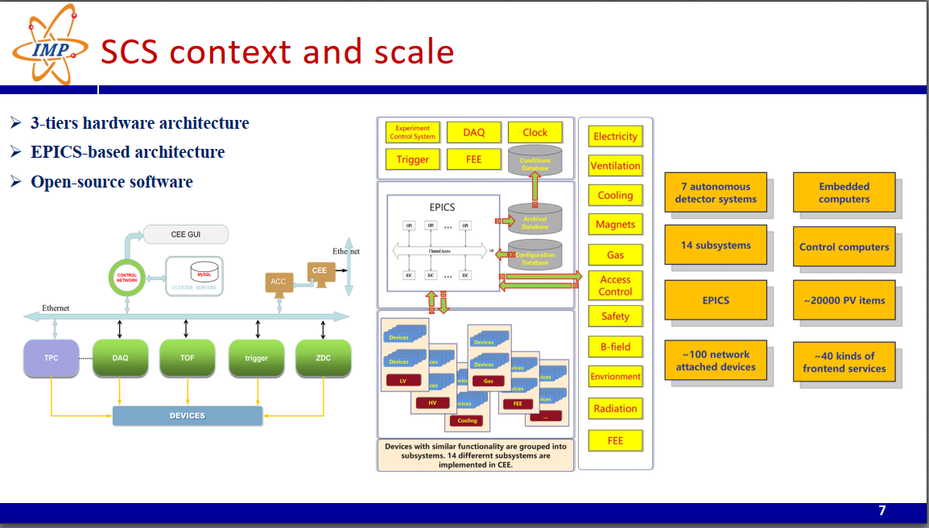
make use of experience at CEE ...
See next Talk:
DCS CEE, M.Li, IMP
https://indico.gsi.de/event/20881/contributions/93864/
(Slides from previous presentation 2024)

Slide 7
CEE … evaluate what can be used, adopted
After
getting the status quo and needs of the detector systems
during CBM DCS Workshop April 2025
Detailed survey
But not forgetting/ignoring the existing local built-up expertise and work

Slide 8
Status quo The survey
Stakeholder contacts
DCS Workshop April 2025
Survey

Slide 9
Stakeholders
Project Leader:
Min Li (IMP, CAS)
Peter Zumbruch (GSI)
Subproject Contact Persons
BMON – J.Pietraszko, GSI
Target – NN (P.Dahm,?)
Magnet – NN (P.Senger,?)
MVD – C.Müntz, IKF
STS – D.Gutierrez Menendez
RICH – C.Pauly (Wuppertal), F.Hollfoth (Gießen)
MUCH
GEM – NN (A.Dubey)
Straw - NN
TOF – E.Rubio, Heidelberg
TRD – D.Schledt, Münster
DAQ/FLES (DAQ coordinator)
FSD – NN (P.Chaloupka, ?)
External DCS Provider:
GSI Accelerator
CBM ECS System
PLC Vendors:
Magnet Control System
Gas Control Systems (Mladen, GSI ACC)
End Users/Operators:
CBM groups
CBM Analysis
DAQ/Fles
Hardware / IT support
CBM / GSI IT Hardware experts
e.g. D.Emschermann as contact ?

Slide 10
Status quo The survey
Sent to known contacts
Quite complicated to fill out
Next to evaluate and combine with detector system reports from DCS Workshop

Slide 11

Timeline & Milestones
Project Kickoff
assign leaders
define scope
Contacts, Task & Signal Survey
Ongoing, send out,
Survey evaluation including timing request
Until CM 2025/Lanzhou
Existing CEE DCS Evaluation
Design consideration of data sources/sinks
e.g. Archiver Data Base / DAQ resources / grafana
Choice of Pilot detector
small and/or mature
EPICS Architecture & Interface Design Consolidation
Code Infrastructure setup (gitlab)
Hardware platforms choice & procurement
Hardware setup
including network hierarchy
parallel per System, continously integrating
IOC Development/Configuration per Unit
HMI/GUI Development
System Integration & Testing
Documentation & Training
Final Deployment
Post-Deployment Review
Interface consolidation to external Users/ECS/DCS/CS

Slide 12
Database
CA/PVA
First Project (M.Li et al.)
setup timebased high-performance database prototype
Status request / direct access
State machine
DCS
Gateway
,
DAQ
DAQ
DAQ
DAQ
Configuration
DAQ
Database
IOC
Database
(time-series)
Analysis
GUI/HMI

Slide 13
DCS Working Group Session
Going into Details …
Getting in contact with the IMP Team
Status, Feedback, plans, ...
Wednesday 15:00 – 18:00
https://indico.gsi.de/event/20881/contributions/93946/
666 Meeting Room, 6th floor, No. 6 Building, IMP

Slide 14
Upcoming talks
IMP
Introduction to DCS of CEE
Related Activities of IMP Group
STS
Needs on Controls

Slide 15
Upcoming talks
IMP
Introduction to DCS of CEE
Related Activities of IMP Group
STS
Needs on Controls
Thank you.

Slide 17
Addendum

Slide 18
Deliverables
EPICS-based control system per unit
External DCS interface
PLC communication layer
Operator HMIs (CSS/Phoebus)
Task/signal survey docs
Training materials & manuals
Aggregated status reports to higher ECS tiers
keyword triggered automatic configuration setup
persistant database (configuration and archive)
efficient data retrieval for HMI, Clients, DAQ and Analysis
Access control
Network segregation via EPICS gateways, per Detector system
Data archiving
Alarm handling
Data aggregation
Stand-alone operation capability
Containerization (e.g., podman, singularity)
Orchestration (e.g., Kubernetes)

Slide 19
Risks & Mitigation
Risk | Mitigation
Incompatibility with external DCSs | Early evaluation & prototyping
PLC communication delays | Proven protocol bridges & rigorous testing
Resource bottlenecks per unit | Dedicated subproject leaders
Scalability challenges | Container orchestration & auto-scaling policies
Data volume overload | Shared and modularized archiving backend & optimized queries

Slide 20
Success Criteria
Reliable, real-time control across all units
Seamless integration with external DCS and PLCs
Operator satisfaction with HMIs & alarms
Independent operation of each detector
Stable performance with 10 million+ PV load
Complete documentation, training, maintainability plan
Notes:
https://copilot.microsoft.com/shares/i97mDTLZBVQxszfTqqbSc

