Slide 1

46th CBM Collaboration Meeting
Progress and status of HIAF project in China
He Zhao
Institute of Modern Physics (IMP, CAS)
2025.10.19

Slide 2
outline
Introduction
Key components of accelerator complex
Experimental terminals
Construction status
Summary
Notes:
Here is the content, firstly, I will briefly talk the background of the muon, and then an introduction the hiaf project, also the recent status and future upgrade plan of HIAF.
Then I will discuss the future muon source plan at HIAF and finally is the summary.

Slide 3






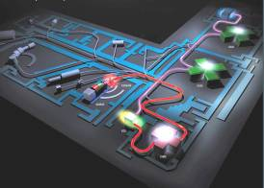
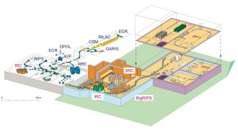
Introduction
Big questions in nuclear physics:
Explore the limit of nuclear existence
Study exotic nuclear structure
Understand the origin of the elements
Study the properties of High Energy and Density Matter
Accelerators and use of high intensity heavy-ion beams will be key to solving those questions
FRIB
FAIR
NICA
SPIRAL
RIBF

Slide 4

Introduction
High Intensity heavy-ion Accelerator Facility (HIAF)
One of the mega scientific infrastructures in China
It is proposed by IMP and being built in Huizhou City of Guangdong Province
The total budget is about 3.0 billion CNY including the civil construction
The first beam will be accelerated in 2025
Jul. 2010
May 2011
Dec. 2015
Apr. 2017
Jun. 2018
Aug. 2023
Dec. 2024
Approval
Start-up of construction
Installation
Commissioning
Proposal
Assessment
Budget

Slide 5
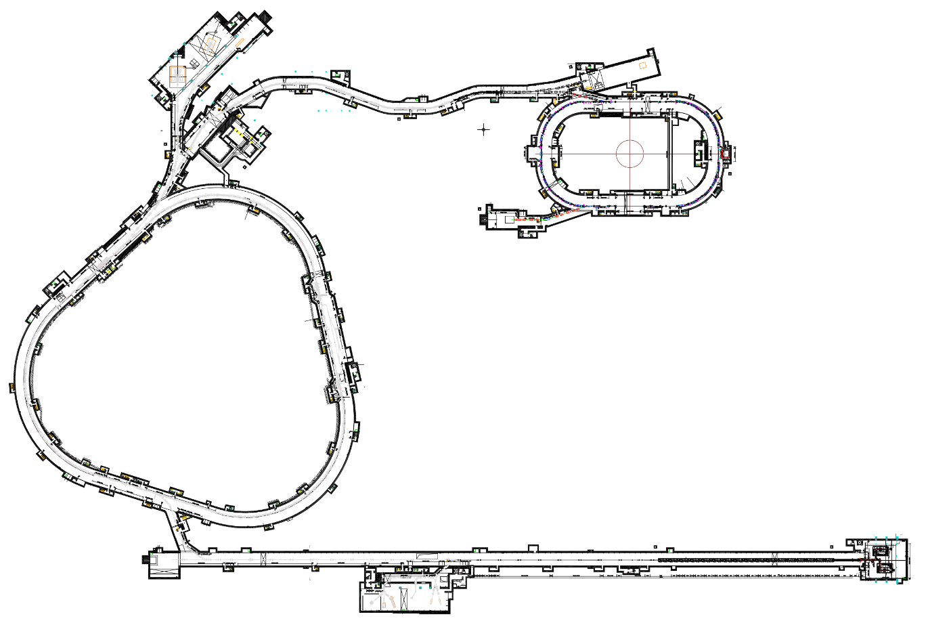
Introduction
HIAF is aimed to provide the highest intensity heavy ion beams in the world
Accelerator components
HFRS: Radioactive beam line
6
2
4th ECR ion source (SECR)
Superconducting Linac (iLinac)
Fast ramping synchrotron (BRing)
3
L: 180m, Bρ: 25 Tm
4
5
BRing
SRing:
Spectrometer ring
Circumference: 273m
Rigidity: 13-15 Tm
Electron/Stochastic cooling
Two TOF detectors
Four operation modes
Experimental terminals
Fast cycle ring
Circumference: 570 m
Rigidity: 34 Tm
Large acceptance (250/120)
Two planes painting injection
Fast ramping rate（3-10Hz）
Low energy nuclear structure terminal
High energy experimental terminal
High energy fragment separator HFRS
High precision spectrometer ring SRing
Electron ion recombination terminal
Radioactive ion beam physics terminal
iLinac:
Superconducting linac
Length:100 m
Energy: 17-22 MeV/u(U³⁵⁺⁻⁴⁵⁺)
SECR:
Superconducting
ECR source
1
Notes:
This is the whole layout of the HIAF facility, the accelerator consists of a superconducting ECR source, superconducting linac as injector, fast ramping booster, radioactive beam separator, and storage rings for in-ring experiments.
There are several experimental terminals or stations around the whole facility. Mainly for nuclear physics, high energy density physics, et al. HIAF can provide various beam conditions for these experiments.
In order to meet the requirements of radiation safety. All these accelerator components and experiment equipment will be installed in the 13m underground tunnel, and it will be covered with 5 m of soil.

Slide 6
Introduction
HIAF main parameters
 | SECR | iLinac | BRing | HFRS | SRing
Length / circumference (m) | --- | 114 | 569 | 192 | 277
Final energy of U (MeV/u) | 0.014 (U³⁵⁺) | 17 (U³⁵⁺) | 835 (U³⁵⁺) | 800 (U⁹²⁺) | 1100 (U⁹²⁺)
Max. magnetic rigidity (Tm) | --- | --- | 34 | 25 | 15
Max. beam intensity of U | 50 pμA (U³⁵⁺) | 28 pμA (U³⁵⁺) | 2×10¹¹ppp (U³⁵⁺) 6×10¹¹pps (U³⁵⁺) | ------- | (0.5-1) ×10¹²ppp (U⁹²⁺)
Operation mode | DC | CW or pulse | fast ramping (12T/s, 3Hz) | Momentum-resolution 1100 | DC, deceleration
Emittance or Acceptance (H/V, π·mm·mrad, dp/p) |  | 5 / 5 | 200/100, 0.5% | ±30mrad(H)/±15 mrad(V), ±2% | 40/40, 1.5% (normal mode)
Notes:
The goal of the accelerator design is to provide high-intensity ion beam from proton to uranium
You can see from this table, the Booster ring can provide the uranium beam at 2e11 and proton beam 3e13, which will be the world level high intensity beam.

Slide 7
Introduction
HIAF construction time schedule
2019 | 2020 | 2021 |  | 2022 | 2023 |  |  |  | 2024 |  |  |  | 2025 |  |  |  | 2026
Civil construction
 |  | Electric power, cooling water, compressed air, network, cryogenic, supporting system, etc.
ECR design & fabrication |  |  | SECR installation and commissioning
 | Linac design & fabrication |  |  |  |  | iLinac installation and commissioning |  |  |  |  |  |  |  |  | Day one exp
Prototypes of PS, RF cavity, chamber, magnets, etc. |  |  |  | fabrication |  |  |  | BRing installation and commissioning |  |  |  |  |  |  | Day one exp
 |  |  |  |  |  |  |  |  |  | HFRS installation & commissioning
 |  |  |  |  |  |  |  |  |  |  |  |  |  |  |  | Day one exp
 |  |  |  |  |  |  | Terminals installation
First beam
Complete
Installation
SRing installation
& commissioning
Complete Installation
The ion source SECR has provided first beam at the end of 2024
The low energy CW ion beam in iLinac is expected soon
The high energy pulse ion beam from BRing will be ready in the end of 2025
Notes:
With such breakthroughs, the HIAF project is going smoothly.
Here is the time schedule of the HIAF project. The first beam from the ion source is expected in this year.
step-by-step, we will have the beam in linac, bring and sring in the next several years.

Slide 8
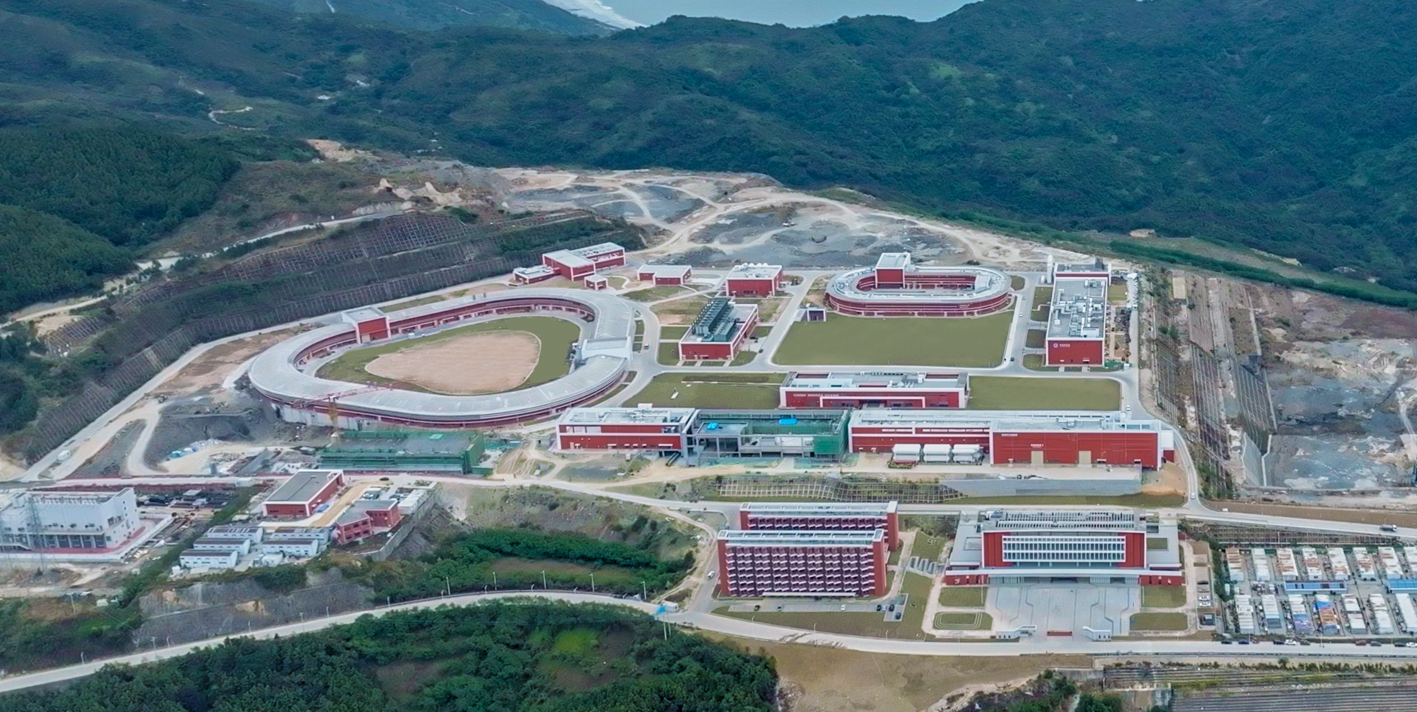
Introduction
2025.4

Slide 9
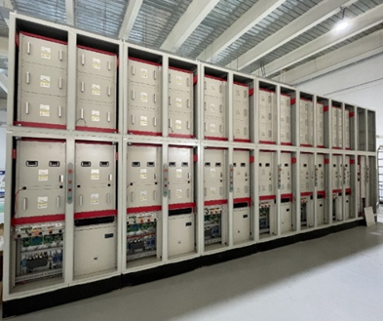
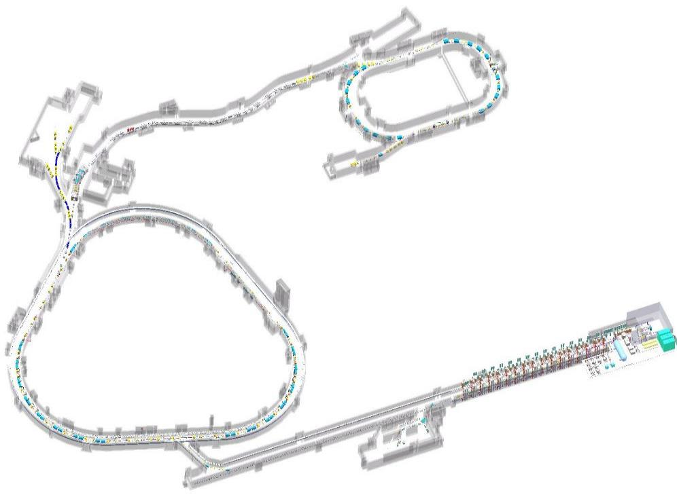
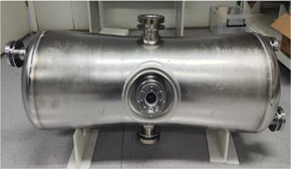
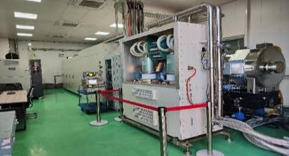
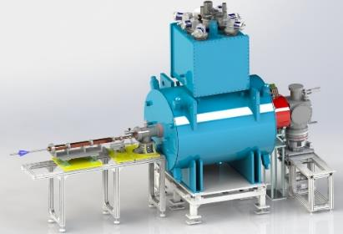
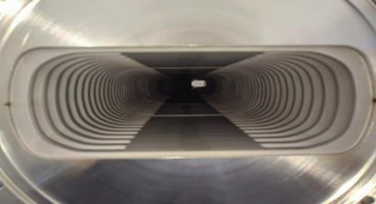
Challenges of accelerator complex
Provide the highest intensity heavy ion beams in the world
Full energy storage PS
12T/s, 38kA/s, 3Hz
SRing
Superconducting iLinac
mA level ion beam
BRing
Magnetic ally core RF
70kV, 35 kV/m
iLinac
SECR ion source
Fourth generation high current ion source
Thin vacuum chamber
SECR
0.3mm, <7×10-12 mbar
9

Slide 10
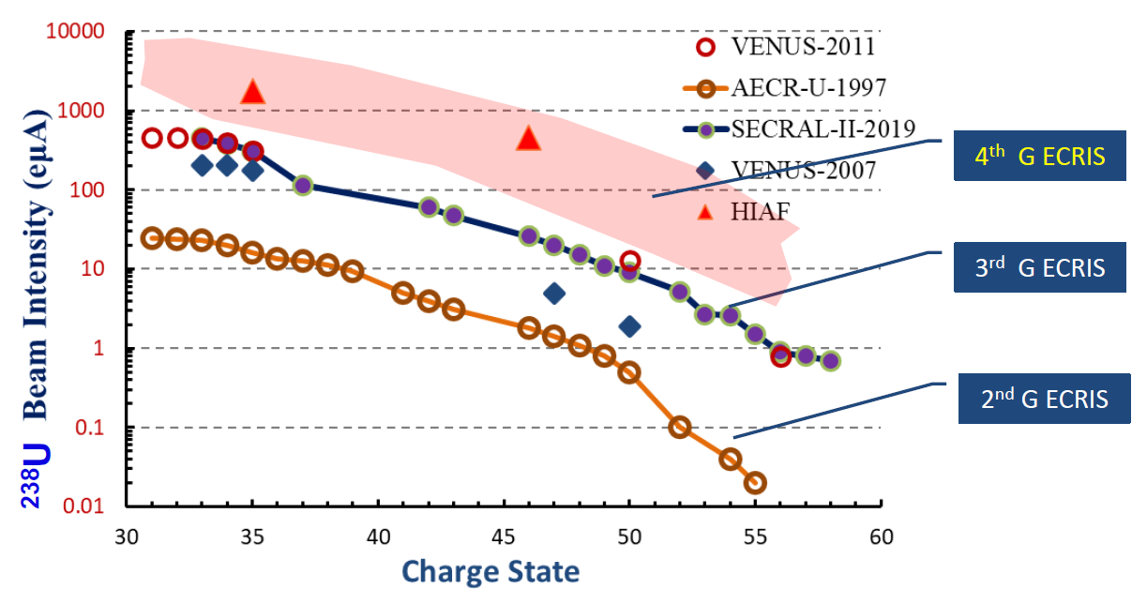
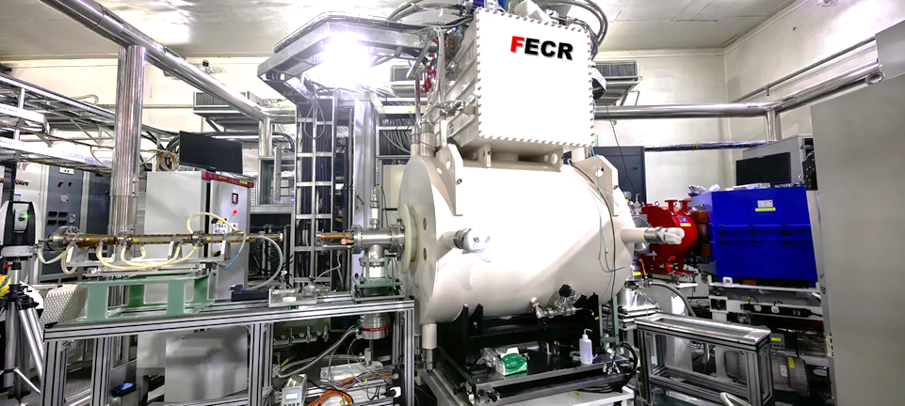
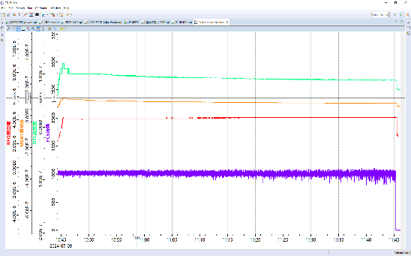
Key components of accelerator complex
Superconducting ECR ion source
The 4th generation of ECR ion source is necessary, provide heavy ion beams up to mA
HIAF goal
 | 3rd ECRIS | FECR
Frequency (GHz) | 24-28 | 45
RF power (kW) | 4-10 | 20
B_{max} in conductor (T) | ~7.0 | 11.8
Cooling capacity @4.2K (W) | ~6.0 | >10.0
1.016emA O⁶⁺
Notes:
In these challenges, the first thing is the ion source. To achieve high beam intensity, a higher magnetic field and higher microwave frequency is the most straight forward path. For HIAF, we adopt the 45GHz superconducting four-generation ECR source. The goal of this ions source is to achieve 50 particle micro ampere for Uranium. As shown in here, the prototype has been tested. At present, the components are in place for final assembly and we expect the first plasma at 45 GHz and first beam will be obtained in next year.

Slide 11
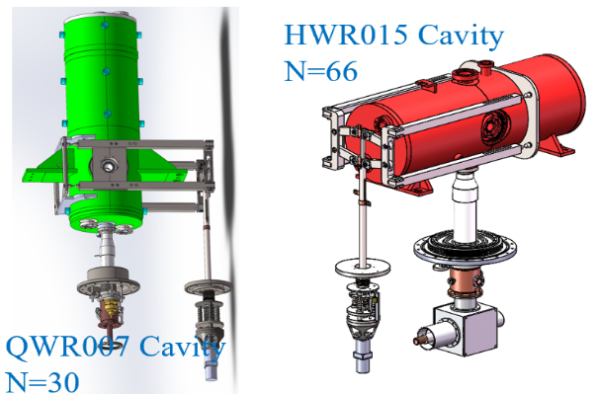
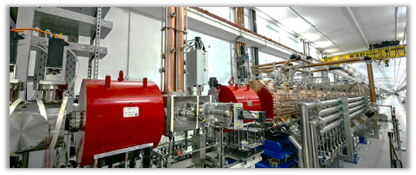
Key components of accelerator complex
Superconducting Linac
Goal：
Pulsed, 28 pμA U³⁵⁺
CW, 15 pμA U³⁵⁺
RFQ has been tested with O⁶⁺(1emA), Kr¹⁹⁺ and Bi³¹⁺
Other SC cavities are under installation
2 types of cavities: QWR 007 and HWR 015
LEBT and RFQ have been tested
Notes:
The superconducting linac can provide both pulsed beam and CW beam, the pulsed beam current is about 28 pμA U³⁵⁺, the CW beam current is about 15 pμA U³⁵⁺. It consists of a LEBT, RFQ, MEBT, and the superconducting section. To demonstrate the possibility of RFQ and CW operation with heavy ion beam, a platform has been constructed and successfully operated in CW mode, several types of SC cavities have been developed successfully. The facility shows a good performance that the total operation time >1000 hours. Now the RFQ and SRF cavities of HIAF are under fabrication.

Slide 12
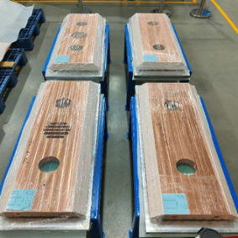
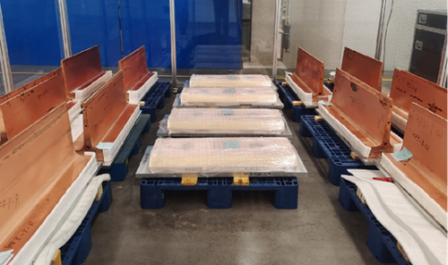
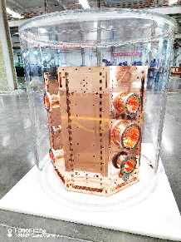
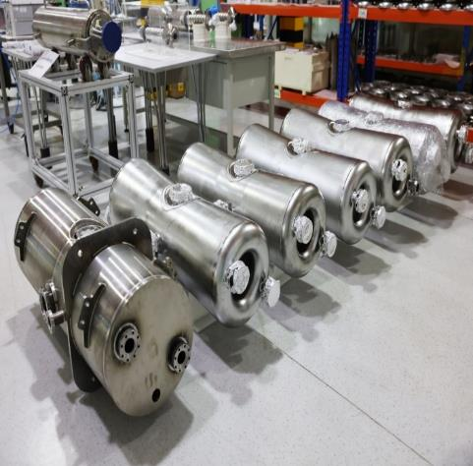
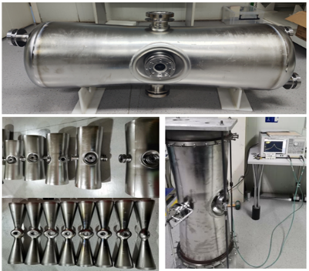
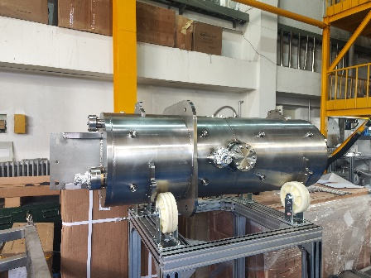
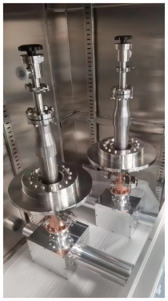
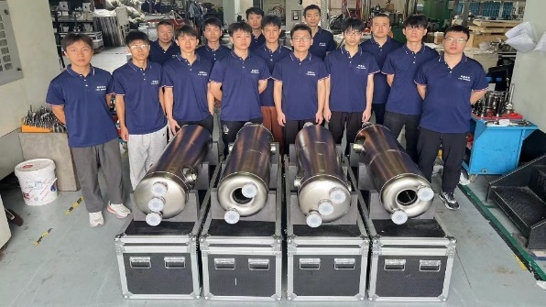
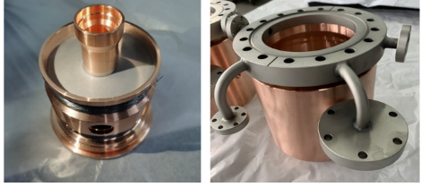
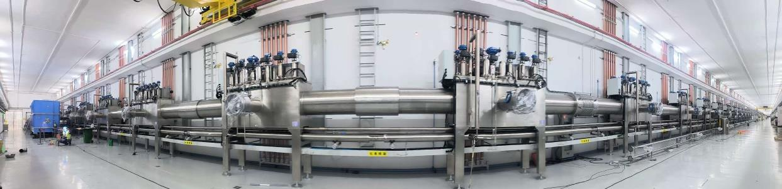
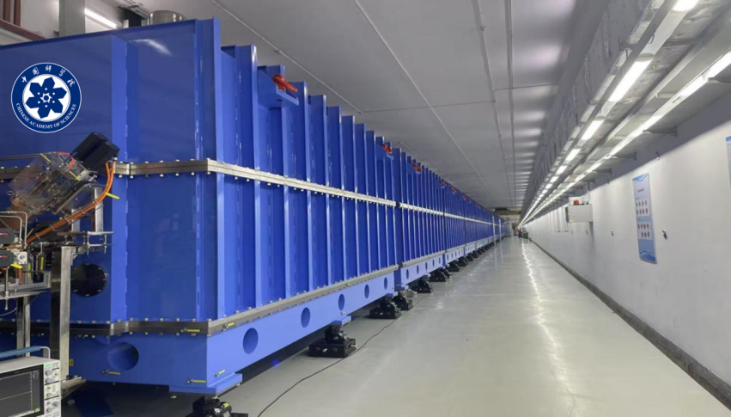
Key components of accelerator complex
RFQ cavity
HWR015 type cavity
QWR007 type cavity
SFR cavity coupler

Slide 13
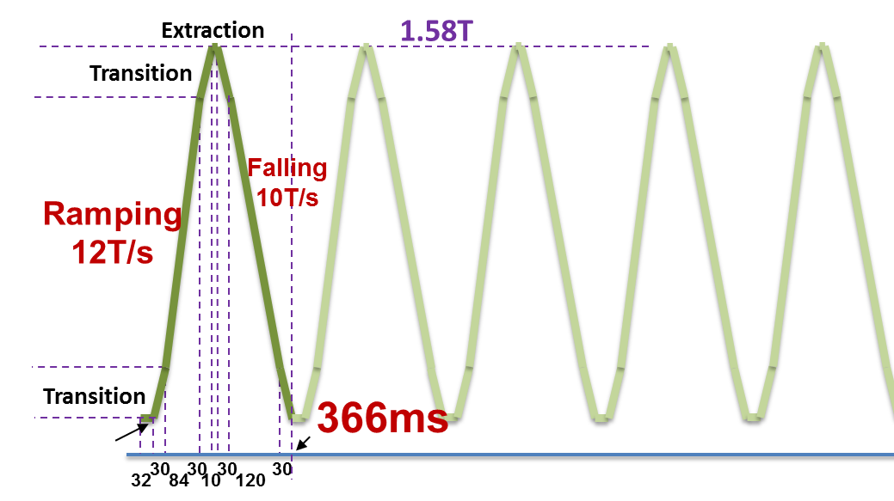
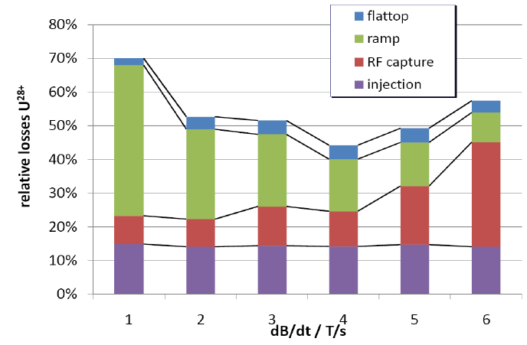
Key components of accelerator complex
Fast ramping rate synchrotron
Beam loss at high ramp rates
Due to space charge and dynamic vacuum effect, beam should be launched to the high energy as soon as possible.
Repetition rate：3-5 Hz, 5-10Hz
---courtesy of P.Spiller
The highest ramping rate for heavy ion synchrotron, challenges for power supply、RF cavities and vacuum chamber
1. Fast ramping rate full energy storage power supply
2. Magnetic alloy core loaded RF system
3. Ceramic-lined thin wall vacuum chamber
Notes:
For booster BRing, the big challenge comes from the fast ramping rate. In the high intensity case, beam should be lunched to high energy as soon as possible to avoid the beam loss due to, So fast ramping mode plays key role for BRing, the designed ramping rate reach 12T/s, that is about 40000A/s for power converter. There are some challenges for 3 key systems, thet are the power supply、Rf system and thin wall vacuum chamber. After extensive R&D work in past several years, we achieve a major breakthrough.

Slide 14
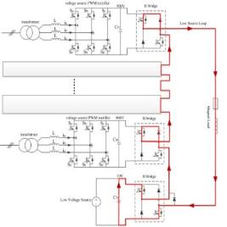
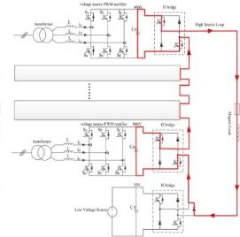
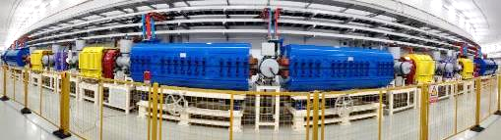
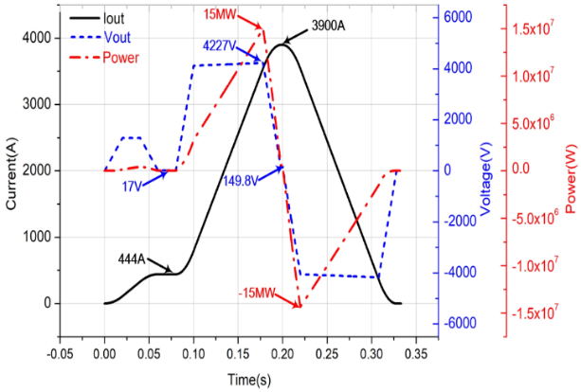
Key components of accelerator complex
Fast ramping rate full energy storage power supply for dipoles and quadrupoles
Requirement of magnet power converters featured by fast ramping rate：12T/s, ±38000A/s,
the peak power reaches 230MW totally at full load
Energy from capacitor tank to magnet load
Energy from magnet load to capacitor tank
Circuit diagram of bending magnet power supply
Energy capacitor will be used to store energy during the falling, and provide the energy for next fast ramping
The energy can be controlled by PWM rectification technology, only active power will be taken from the grid!
Notes:
Our design used full energy storage, typical rectification technology. All the requirements of BRIng have been achieved. Here show the testing results. Most importantly, the power requirement of dipoles and quadrupoles will be reduced from 230 mw to 23 mw. Now, Power units have been fabricated and are being assembled

Slide 15
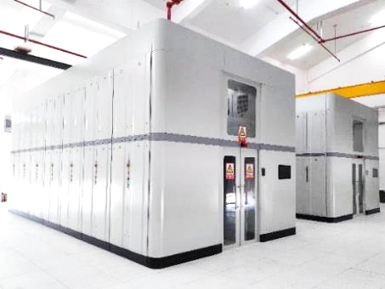
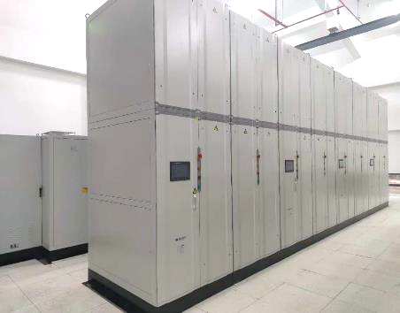
Key components of accelerator complex
Fast ramping rate full energy storage power supply for dipoles and quadrupoles
Reduce the power consumption
Items
Excitation current/voltage | 3900A/4300V
load inductance | 116mH
Load Resistance | 36.4mΩ
Current changing rate | ≤±38000A/s
tracking error | ≤±0.2A
PS of dipoles and quadrupoles in the hall
Power requirement (MVA) | Conventional | Energy storage
BRing bendng magnet | 180 | 15
BRing quadruple magnet | 50 | 6
Total of BRing | 250 | 41
Total of HIAF | 297 | 88
153 PS
Synchronization:
<40ns
Operation in 3 Hz

Slide 16
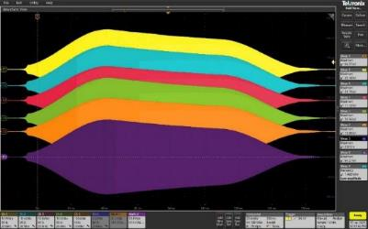
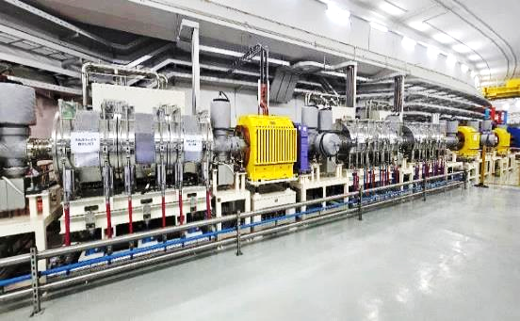
Key components of accelerator complex
Magnetic ally core loaded RF system
To satisfy fast acceleration, the voltage for total RF system should be 240 kV
acceleration
Amp. Error < ±1%
Cavities in tunnel
Facilities | Voltage (kV) | Length (m) | Gradient (kV/m)
JPARC-RCS | 41 | 1.78 | 23
JPARC-MR | 46.7 | 1.78 | 26.2
SIS18 | 50 | 2 | 25
HIAF-BRing | 70 | 2 | 35
Gradient of traditional ferrite is only ~10kV/m, long dispersion-free space is needed, challenges for beam optical design
Notes:
Up to now, a MA RF system has been constructed and power test show the good performance, such as

Slide 17
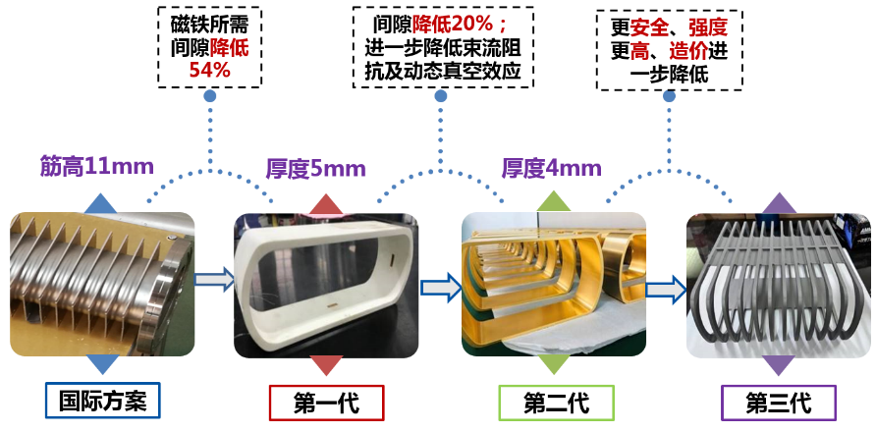
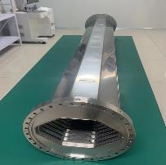
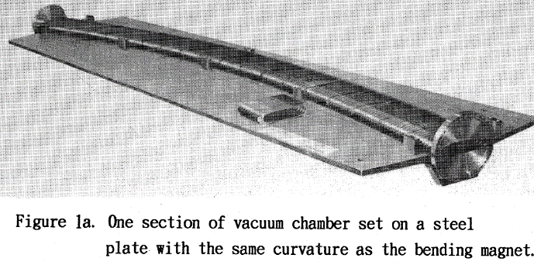
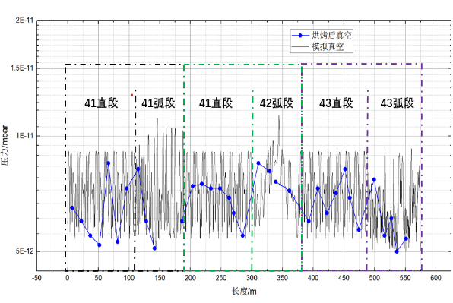
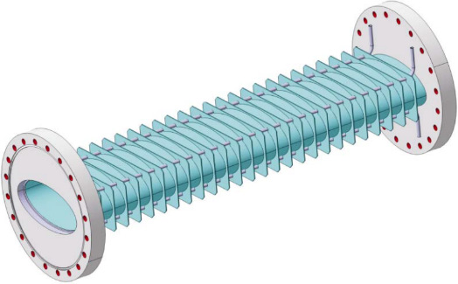
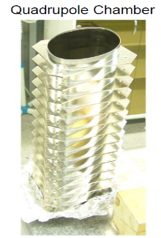
Key components of accelerator complex
Titanium alloy-lined thin-walled vacuum chamber
Problem: fast ramping of the magnets induces eddy currents:
The chamber walls are heated
Generation of additional harmonics in field
Vacuum system for HIMAC in 1993
Rings inside @ IMP
Vacuum better than 7×10⁻¹²mbar
Solution from GSI
Stainless steel-0.3mm
Rib-15mm,one side
Notes:
For the vacuum, we use the thin-wall vacuum chamber to keep eddy current at a tolerable level. The thickness of the stainless steel is only 0.3mm. To support the thin wall chamber, we tested several materials. Finally, we used the Titanium alloy cage.

Slide 18
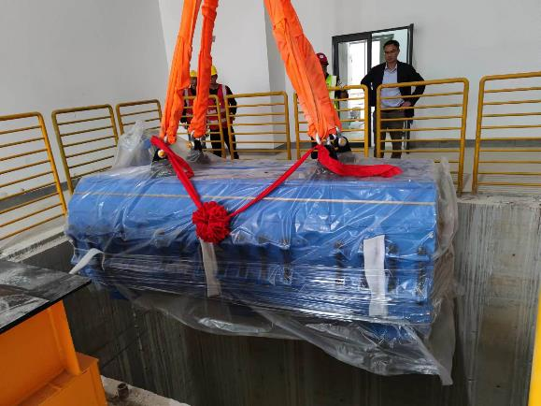
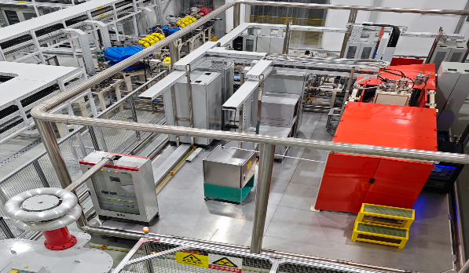
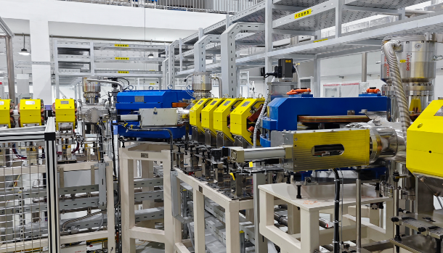
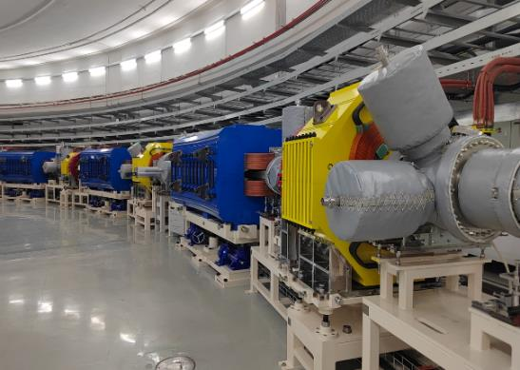
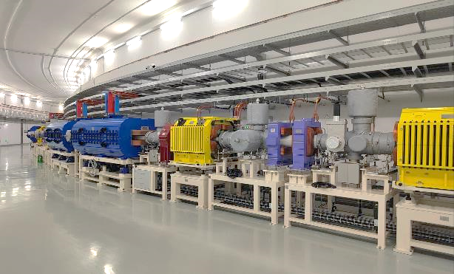
Key components of accelerator complex
Some photos in the HIAF campus
The first dipole was moved into the tunnel in 27th March, 2024
The installation has been finished in June, 2025

Slide 19
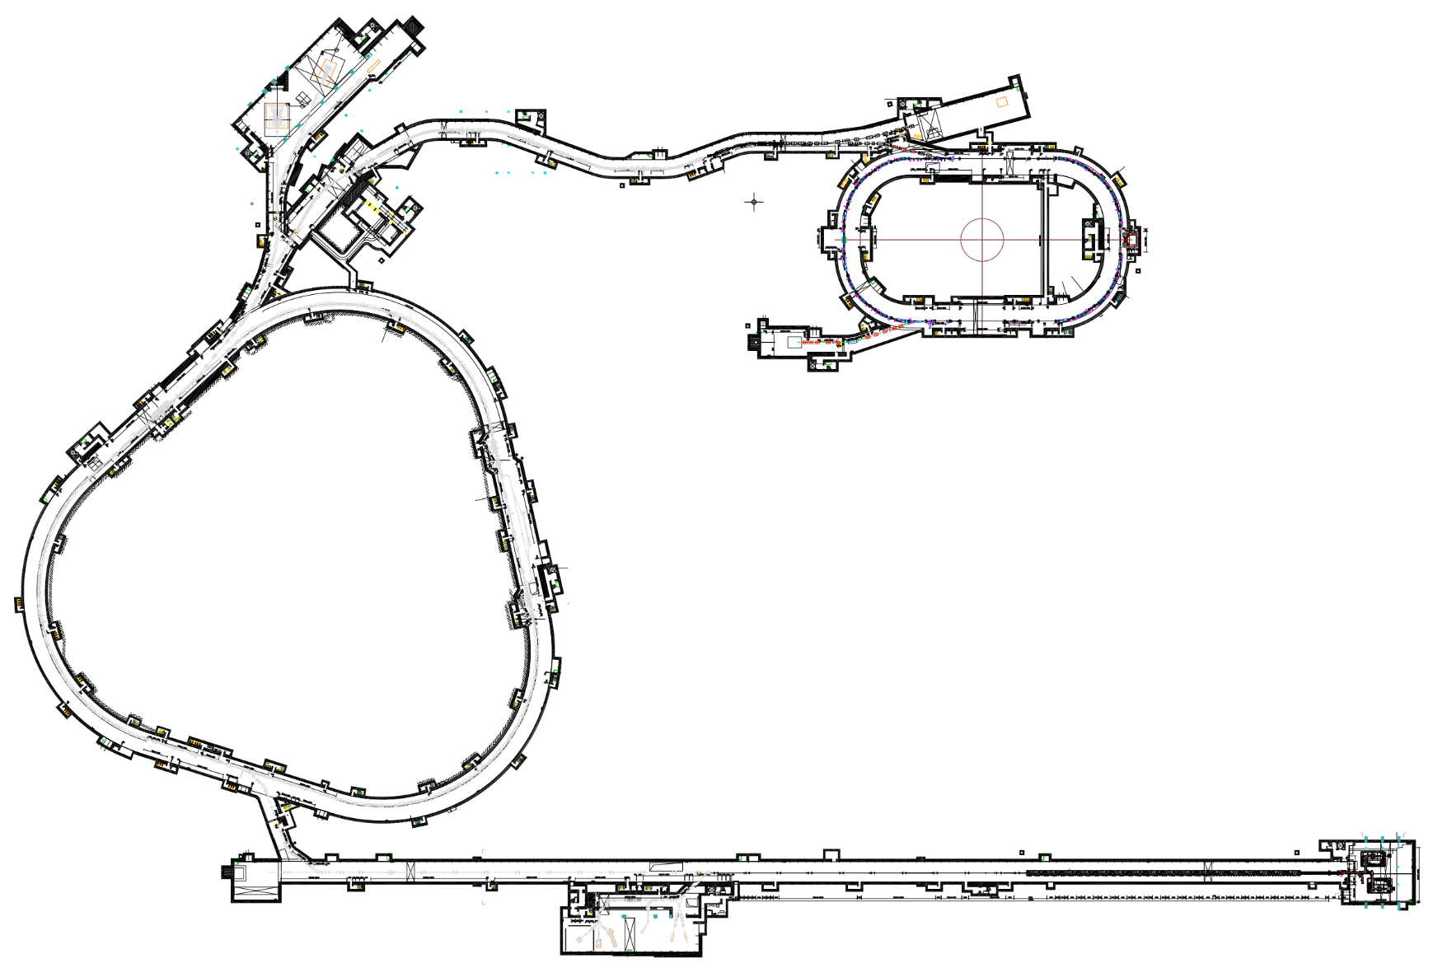
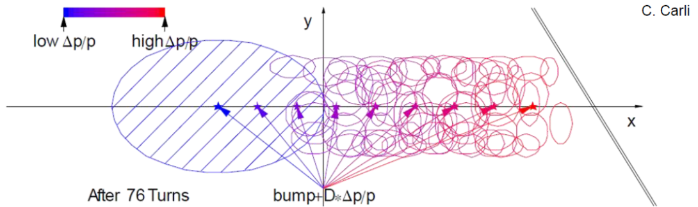
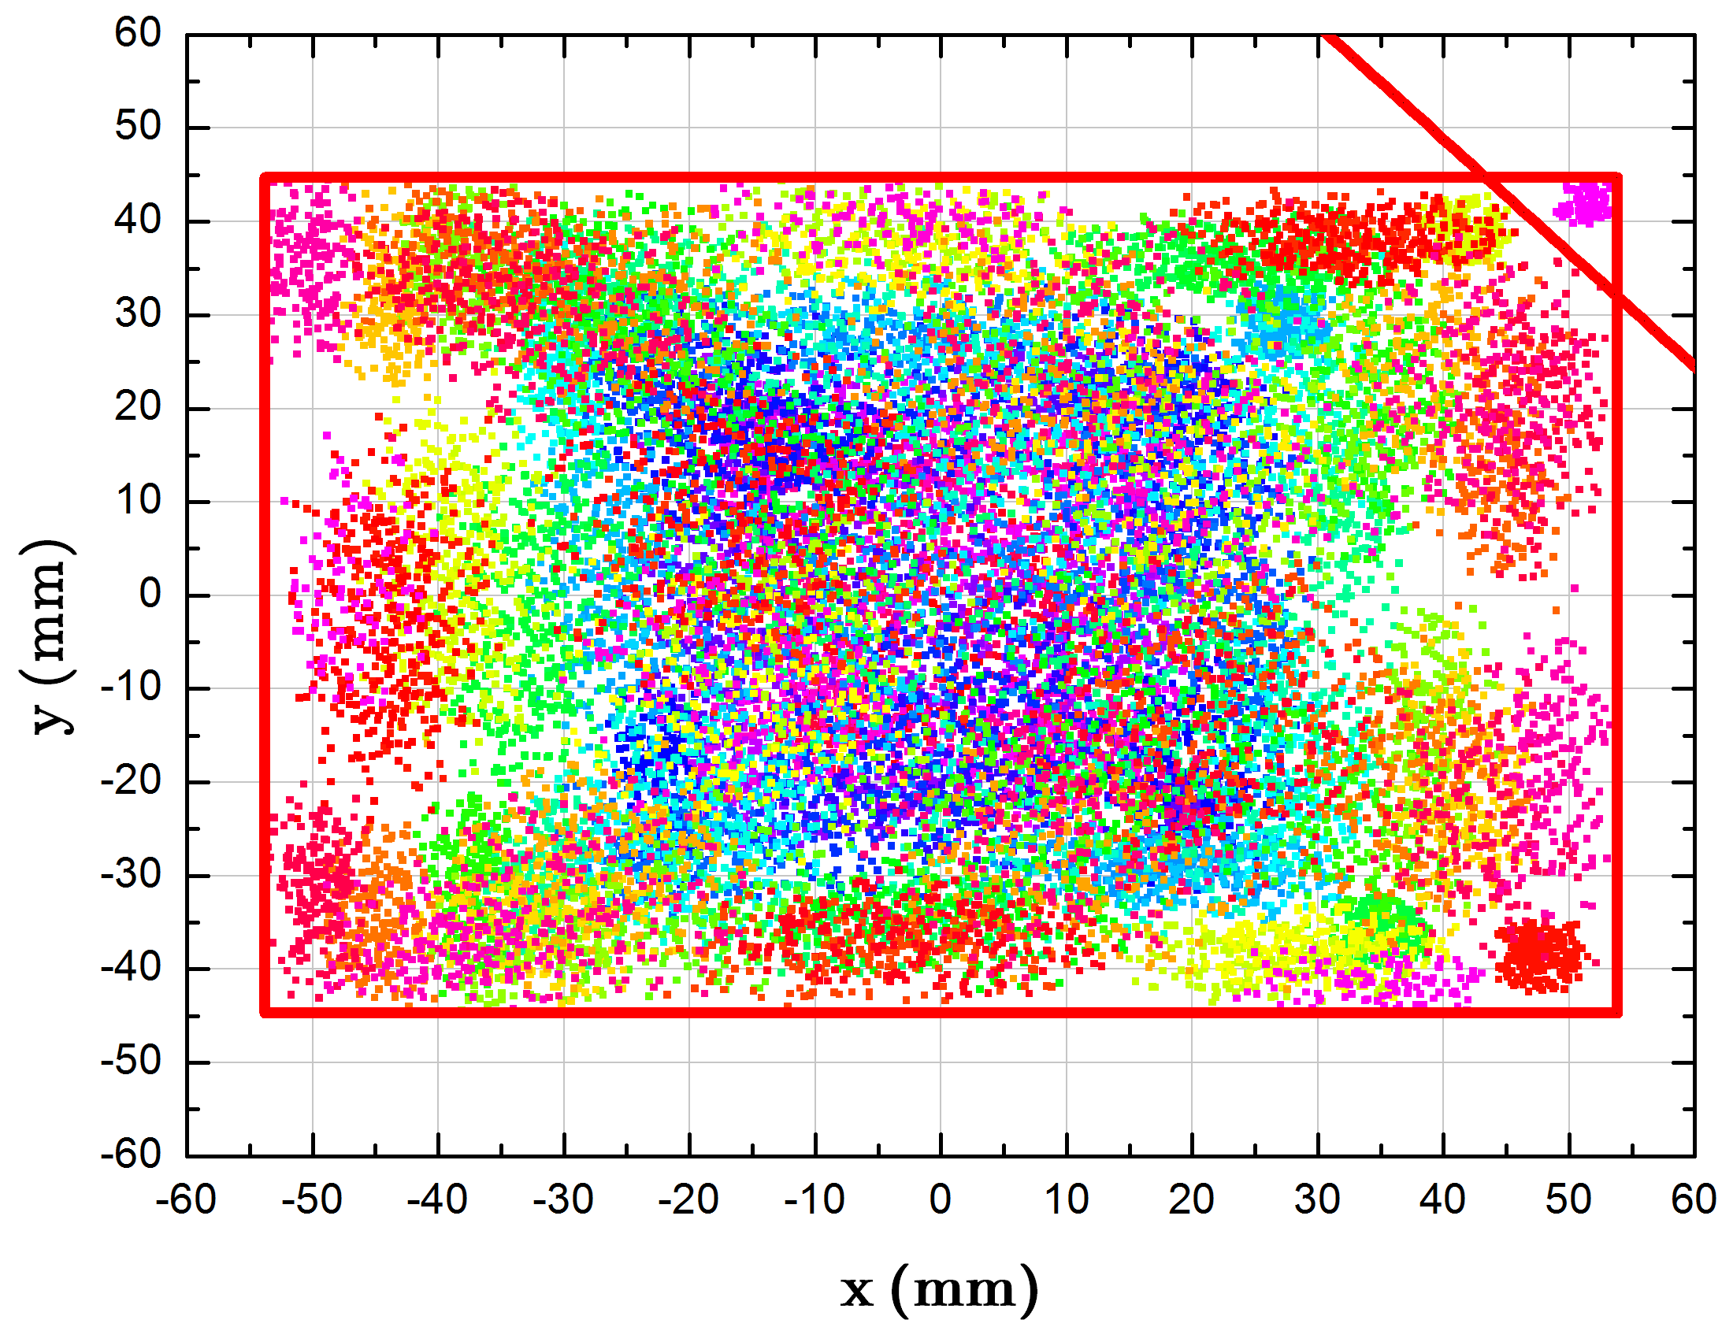
High intensity beam dynamics
2.0 ×10¹¹ U³⁵⁺, nearly 10 times over the conventional single-plane injection.
2D painting
Stripper
3-5 times Barrier bucket
²³⁸U³⁵⁺
²³⁸U⁹²⁺
HFRS
SRing
1×10¹²ppp
²³⁸U⁹²⁺
Novel two planes painting injection scheme - 2.0×10¹¹ ppp (6×10¹¹pps)
Fast ramping rate - 12T/s
High repetition frequency - 3-5Hz
Stacking longitudinally from BRing to SRing
BRing
34 Tm
0.8 GeV/u (²³⁸U³⁵⁺)
Ions | Plane | Injection Turns | Single injection
²³⁸U³⁵⁺ | H | 33 | 3.3×10¹⁰
 | V | 16 | 1.6×10¹⁰
 | H+V | 150 | 2.0×10¹¹
iLinac
SECR
Notes:
BRing is the most important component of the HIAF. With the superconducting ECR and iLinac, it is still not enough to achieve the high intensity for BRing. So we adopt the 4-D painting injection to the booster ring. Compare with the conventional multi-turn injection scheme, that only painting in the horizontal plane, this method can conduct both the horizontal and vertical painting simultaneous using a . And a nearly 10 times over the conventional injection method can be achieved.
This is the simulating results and our design of the corner septum.

Slide 20



High intensity beam dynamics
Nonlinearity and Space Charge
Large magnet apertures and large beam sizes → Strong nonlinear magnetic errors
Low and medium energy ion beams in all beam manipulations → Strong space charge effects
All 3rd order resonances driven by field errors with space charge could be compensated by correctors!
Structural resonances mQ_{x}+nQ_{y} = 36 or 39 could be driven by space charge fields in the HIAF given by the theory, which is completely verified by the CISP-GPU simulations.

Slide 21








High intensity beam dynamics
Collective Instabilities
Cover panels are employed to reduce the impedance
In the proton beams, high order transverse mode coupling instability is stimulated, as the bunch $σ_{z}$ is about 5 m while the peak of wake is at 0.1 m.
Instability stimulated by the broadband impedances from rings is stabilized by:
Chromaticity of a relatively large value ~ -5
Wideband feedback system with a band-width > 500 MHz
Notes:
Collective instabilities are also vital for HIAF/BRing, especially the wakes of titanium alloy cage supported vacuum chamber. Even we use cover panels to reduce the impedance, there is still transverse mode coupling instability. More simulations are performed to generate spectra versus intensity. As the intensity increases, we can find mode coupling, which leads to instabilities. The final instability is at modes higher than -15 because the bunch is much longer than the wake. We have designed two scheme to compensate this instability. The first one is choosing appropriate chromaticity. From the simulations, chromaticity of -5 is enough to stabilize all instabilities in the proton beams. It is less than the natural chromaticity of the BRing and is feasible. The second way is using the wideband feedback system installed in the BRing. After upgrading the band-width to 500 MHz, all instabilities could be stabilized by the feedback system.
he high intensity ion accelerators. Wakes of titanium alloy cage supported vacuum chamber are ultra-short compared to ion bunches in the HIAF/BRing, which makes the studies of related instability quite difficult. With CISP-GPU, it is the first time to study this instability. Even we use cover panels to reduce the impedance, a single-bunch instability still exists in the proton beams of HIAF/BRing. And distortion in the bunch is identified. More simulations are performed to generate spectra versus intensity. As the intensity increases, we can find mode coupling, which leads to instabilities. Between the coupling, modes are decoupled, and the bunch becomes relatively stable. So, wakes from the titanium alloy cages will introduce transverse mode coupling instability in the HIAF/BRing. The final instability is at modes higher than -15 because the bunch is much longer than the wake. We have designed two ways to stabilize this instability. The first one is choosing appropriate chromaticity. From the simulations, chromaticity of -5 is enough to stabilize all instabilities in the proton beams. It is less than the natural chromaticity of the BRing and is feasible. The second way is using the wideband feedback system installed in the BRing. After upgrading the band-width to 500 MHz, all instabilities could be stabilized by the feedback system.

Slide 22

Experimental terminals
Overview
High energy experiment station
4
Radioactive beams physics station
HFRS: Radioactive beam line
5
High precision
spectrometer ring
Hyper nuclear physics
Phase diagram of strongly interacting matter
2
3
6
e-ion recombination
spectroscopy
SRing:
Spectrometer ring
Circumference: 273m
Rigidity: 13-15 Tm
BRing
Fast cycle ring
Circumference: 569 m
Rigidity: 34 Tm
SECR:
Superconducting
ECR source
iLinac:
Superconducting linac
1
Low energy nuclear structure terminal
Notes:
This is the whole layout of the HIAF facility, the accelerator consists of a superconducting ECR source, superconducting linac as injector, fast ramping booster, radioactive beam separator, and storage rings for in-ring experiments.
There are several experimental terminals or stations around the whole facility. Mainly for nuclear physics, high energy density physics, et al. HIAF can provide various beam conditions for these experiments.
In order to meet the requirements of radiation safety. All these accelerator components and experiment equipment will be installed in the underground tunnel, and it will be covered with 5 m of soil.

Slide 23


Experimental terminals
Low energy nuclear structure terminal
Use the CW beam provided by iLinac
Booster
CW mode:
10 pμA beams with A/Q=2~5
SECR
LEBT
RFQ
QWR005
HWR010
HWR015
Energy Adjustable
Gas-filled recoil separator
Notes:
Multinucleon transfer (MNT) reactions between heavy ions at energies around the Coulomb barrier are characterized by the exchange of many nucleons between the target and the projectile with a population of relatively low excitation energy and of relatively high spins
The iLinac woks in two modes; the one is pulse mode to inject beam into the Booster Ring, and the other one is continuous wave mode to deliver intense low-energy heavy-ion beam for experiments. Heavy-ion beams are exacted at the middle point of the iLinac, and the beam energies can be adjusted finely around the Coulomb barriers of nuclear reactions. The low-energy intense beams will enable the production of very neutron-deficient nuclei using fusion reactions and particularly heavy and even super-heavy neutron-rich nuclei using multi-nucleon transfer reactions. In the envisaged future [ɪnˈvɪzɪdʒd], multi-nucleon transfer reactions employing very heavy projectile and target isotopes would be the most optimum method to produce neutron-rich heavy nuclides and practically the only way to assess neutron-rich super-heavy nuclides. Multi-nucleon transfer reactions are characterized [ˈkærəktəˌraɪz]by a large amount of energy dissipation, a large flow of nucleons between the interacting nuclei and a noticeable time delay in the reaction. With an appropriate [əˈproʊpriət] reaction system, such as U+Cm, the projectile evolves to the doubly magic nuclide and transfer neutrons to the target, and consequently very neutron-rich heavy nuclides and particularly very neutron-rich super-heavy nuclides can be produced.

Slide 24




Experimental terminals
High energy experimental station
Typical beam parameters from the Booster Ring
Pulsed beam from BRing
Study of the QCD Phase Structure
HIAF
The External Target Experiment Setup
Notes:
High-energy stable beams extracted slowly from the Booster are delivered to the high-energy experimental cave. A 9.3 GeV proton beam and A/Z=2 primary beams up to 4.25 GeV/u energy will be available. We have defined the hypernuclear physics and properties of nuclear matter as our high priority research program at the high-energy station.
The properties of nuclear matter, described by the theory of the quantum chromodynamics (QCD), can be summarized in a phase diagram just like any other form of matter. It is of utmost importance to find how the nature of nuclear matter changes as we vary the temperature and baryon density. Lattice QCD calculations predicted that the transition from the quark-gluon plasma (QGP) to the hadronic phase is a smooth cross-over at the vanishing baryochemical potential, while at the finite [ˈfaɪnaɪt] chemical potential the phase transition is of the first-order. Thermodynamically, hence, there must exist a critical point, i.e. the end point of the first-order phase transition line. The critical point would be a milestone in the QCD phase diagram and is the Holy Grail for the field of the heavy-ion collisions at relativistic energies. During 2010 - 2017, a beam energy scan was carried out in order to search for the critical point. Interesting non-monotonic behaviors as a function of collision energy were observed in the net-proton fluctuation and net-baryon first order collectivity, implying the expected criticality and softening of the equation of state, respectively. Both the observations occurred at the low energy end of the beam energy scan at RHIC. HIAF extends the coverage of the baryochemical potential to lower energy. The beam energy scan program would be incomplete without the results from the energy region at HIAF. In heavy ion collisions at relativistic energies at HIAF, the peak nucleon density can reach 2-3 times of the saturation density, which is an ideal place for studying symmetry energy in order to constrain the equation of state of asymmetric nuclear matter at high density. We will build a detector system dedicated to study the QCD phase structure and symmetry energy using various physical observables.

Slide 25




Experimental terminals
High Energy Fragment Separator (HFRS)
Physics Cases @HFRS
New isotopes in the south east of ²⁰⁸Pb (PF of ²⁰⁸Pb and ²³⁸U)
Neutron dripline up to Ni isotopes (PF of Kr and Xe)
New isotopes by ²³⁸U fission (In-flight fission of ²³⁸U)
New isotopes using two step projectile fragmentations
Synthesis of neutron rich hypernuclei
Study of tensor interactions: a basic change in structure model
Particle decay in flight of unbound nuclei
Nuclear matter radii (Interaction cross sections)
Nuclear proton radii (Charge changing cross sections)
Charge exchange reactions and β decay of r-process nuclei
Nucleon excitations in nuclei
Giant resonance of neutron rich nuclei
Elastic scattering and transfer reactions
Spectroscopy of meson-nucleus bound system
…
Requirements from Physics
Acceptance, and Momentum Resolution
Various experiments can be done at HFRS
Notes:
In order to exploit the very intense primary beams, HFRS is composed of a pre-separator and a main-separator. The exotic nuclides are produced via high-energy projectile fragmentations, in-flight fission of energetic heavy projectiles, and two-step reactions. The nuclides of interest will be separated in flight within several hundred nanoseconds and delivered to the detector systems. HFRS is characterized with a long flight path of 180 m, maximum magnetic rigidity of 25 Tm, angular acceptance of 30 mrad (x) and 15 mrad (y), longitudinal momentum acceptance of ±2.0 %, and momentum resolution of 700~1100. These challenging performance parameters are achieved with a multi-stage magnetic system, comprising intermediate degrader stations.

Slide 26



Experimental terminals
Spectrometer Ring: Multi Working Modes of Storage Ring
With fast extracted projectiles from the Booster, HFRS produces, separates and injects the isotopes of interests into the Spectrometer Ring
Experiments:
Spectrometer Ring:
Circumference:273 m
Rigidity: 15 Tm
Electron cooler
Stochastic cooler
Isochronous Mass Spectroscopy
Schottky Spectroscopy
DR Spectroscopy
In-ring Nuclear Reactions
Carbon target sustainable to beam power
Notes:
Using fast, extracted projectiles from the Booster, HFRS produces, separates and injects the nuclides of interest into the Spectrometer Ring, which is in essence a storage ring equipped with an electron cooler, a stochastic cooling device, and a deacceleration cavity. Based on the Spectrometer Ring, we will build the Dielectronic Recombination Spectrometer, Isochronous Mass Spectrometer, Schottky Spectrometer, and Setup for In-ring Nuclear Reactions, as schematically shown.

Slide 27








Experimental terminals
Bρ - recognized Isochronous Mass Spectrometry
ToF detector #1
ToF detector #2
The revolution time T and velocity$ν$ of the ion are measured simultaneously. The circulating length of the ion$C=T∙ν$
With known masses, determine the best $Bρ=f\left(C\right)$
Straight section of storage ring
$${\left(m/q\right)}_{exp}^{i}=\frac{f(C_{exp}^{i})}{{(γv)}_{exp}^{i}}$$
New masses obtained from
Conventional IMS
Bρ-recognized IMS
$$best Bρ=f(C)$$
~100 keV uncertainty
~10 keV uncertainty
Eliminate the systematic errors
Single-ion sensitivity
Applicable to short-lived nuclides
…….
Reference
New mass
Reference
New mass
Notes:
The Isochronous Mass Spectrometer: A heavy-ion storage ring coupled to an in-flight separator has been proven to be a powerful tool for direct mass measurements of short-lived nuclides. The Isochronous Mass Spectrometry (IMS) has been well developed at GSI and IMP. The masses of the ions stored are determined from their revolution times measured using a timing detector in the IMS, and typical relative mass accuracy of 10−6 to 10−7 is achieved. Since a storage ring is a large-acceptance machine, it allows to store ions in a broad range of m/q values. This feature is essential for the IMS to measure masses of a few nuclides simultaneously. In the isochronous working mode of a storage ring, the revolution times of the stored ions should be independent of their velocity spread. However, the isochronous condition is fulfilled only in first order and in a small range of revolution times. We shall develop the advanced IMS with double timing detectors, by which the velocity of stored ion is measured to correct for the effect of the non-isochronicity. In order to measure the velocity of each ion stored, two timing detectors will be installed in the straight section of the SRing. This technique was already verified in principle at HIRFL. We will focus on mass measurements of short-lived nuclides in medium and heavy neutron-rich regions using the IMS with double timing detectors.
The Schottky Spectrometer: Conventional Schottky spectrometry is an ideal method to measure precisely nuclear masses and observe exotic decay modes of highly charged ions. The stored ions have to be cooled down using electron cooler before the measurements, and the cooling process takes several seconds. Therefore, the Schottky spectrometry could not be applied to nuclides with lifetime shorter than second, which is the lifetime for most nuclides with unknown mass yet. We will develop novel Schottky spectrometry, i.e. single-ion sensitive Schottky resonator working in the isochronous mode of a storage ring. The present method takes the merits of the conventional Isochronous Mass Spectrometry and Schottky spectrometry; the ions can survive for long time in the storage ring due to the usage of non-interceptive Schottky resonator and the measurement can be started immediately after injection in isochronous mode. The new Schottky spectrometry is applicable to nuclides with broad lifetimes, and importantly nuclear mass and lifetime can be measured simultaneously.

Slide 28


Experimental terminals
Spectrometer for Dielectronic Recombination
In e-gun, the electron beam has a longitudinal temperature of less than 1.0 meV
The cooling results in a very narrow momentum spread for the ion beam of ~10^{–5}
Dielectronic Recombination: While the ion A^{q+} captures a free electron with well defined energy provided by the electron gun, a bound electron is excited simultaneously
A^{q+}
A^{(q-1)+}
Recombination Rate:
α(E_{rel}) ∝ N(A^{(q-1)+})/N(A^{q+})
To tune precisely the electron energy and count the recombined ions, fine or hyperfine spectra are obtained

Slide 29






Construction overview
7-year construction period, beam commission is scheduled very soon in 2025
Prototype R&D and testing
Civil construction start
Batch processing
Auxiliary facilities installation
Equipment installation
Offline commissioning
beam commissioning
2019
2020
2021
2022
2023
2024
2025
2019
2020
2021
2022
2024
2025

Slide 30


Construction overview
The civil construction is completed, all auxiliary facilities are in operation, the installation of accelerator equipment is basically completed, and pass the real load debugging and long-term testing
First beam has been extracted from the front end.

Slide 31






Buildings on the ground
BRing building
SRing building
Refrigeration center
Testing & Assembly hall
iLinac building
Control center

Slide 32




Auxiliary system
Electricity
AC
Cooling
Cryogenic
Transformer capacity ：87450kVA
Auxiliary
Total load：5176.9 kW
Power station: 13
Total load：26540kW，water volume：3294.2m³/h
AC station: 31
Water station: 8
500W@4.5k、10kW@4.5k、2.5kW@4.5k
Electricity
AC
Cooling pipe
Stable operation in 14 months
Temperature loss: <1℃
Accuracy: ±2℃
Accuracy:±0.2Bar，±0.1℃， Resistivity: ≥10MΩ·cm

Slide 33









Accelerator components
HFRS
SRing tunnel
ECR
BRing
BRing
BRing injection
iLinac
RFQ

Slide 34

















Experimental equipment
The conditions for Day One experiment will be met in September 2025
SRing
HFRS

Slide 35
Summary
The HIAF project can provide stable ions up to Uranium, and produce many kind of secondary isotopes
The maximum magnetic rigidity is 34Tm, which corresponds to the energy of Uranium is about 835 MeV/u and proton is 9.3 GeV
High beam intensity and fast ramping (12T/s) is the main feature of the synchrotron.
The first beam will be extracted in 2025, and HIAF will play a key role for sustainable development of heavy-ion science and technology.
International collaboration and theoretical assistance are very welcome!
35

Slide 36


Future upgrade (HIAF-II)
Nuclear matter, hypernuclei and η/μ research
Mode: BRing-S (fast/slow ext. p-U) + fixed target
High-intensity high-power beam
Nuclear matter phase transition research
Hypernuclei, η/μ physics, Λ polarization
Muon research
Nuclear matter Hypernuclei Research
Strong-field QED effect experiment
Mode: MRing&SRing merging collision
E_{cm}=4-10 MeV/u, Lumi.>4×10²⁶ cm⁻²s⁻¹
Super strong e-field exceed Schwinger limit for low-background e-p pairs generation
MRing
Ion-ion merging
High-energy-density physics
SRing
HIAF I&II
High-energy-density physics
BRing-N: 34Tm, 569m, 3Hz
SRing: 17(25)Tm, 270.5m, accumulation/compression
iLinac: 200MeV/u, superconducting
BRing-S: 86Tm, 3Hz, superconducting
MRing: 45Tm, superconducting, beam merging
Mode: BRing-N/S&MRing + beam manipulation
2MJ, ns-scale short bunches
Multimodal fixed target experiments
HEDM in strong shock wave region to create extreme matter states
BRing-N/S
ISOL
Facility | Beam (GeV/u) |  | Intensity (ppp)
HIAF-II | 3.0 | ²³⁸U³⁵⁺ | 2×10¹²
 | 9.1 | ²³⁸U⁹²⁺ | 1×10¹²
 | 25 | p | 10¹⁴
iLinac up to 200MeV/u
36

Slide 37

Thanks for your attention!

Slide 38

High-Intensity Heavy Ion Accelerator Facility-HIAF
HIAF main parameters
More typical beams
BRing
SRing
Rigidity | 34Tm，fr=3Hz
Ion | Intensity (ppp) | Energy (GeV/u)
²³⁸U³⁵⁺ | 2.0×10¹¹ | 0.84
²³⁸U⁷⁶⁺ | 5.0×10¹⁰ | 2.5
¹²⁹Xe²⁷⁺ | 3.6×10¹¹ | 1.4
⁷⁸Kr¹⁹⁺ | 5.0×10¹¹ | 1.7
⁴⁰Ar¹²⁺ | 7.0×10¹¹ | 2.3
¹⁸O⁶⁺ | 8.0×10¹¹ | 2.6
p | 5.0×10¹³ | 9.3
Rigidity | 15 Tm
Ion | Intensity (ppp) | Energy (GeV/u)
²³⁸U⁹²⁺ | (1-5)×10¹¹ | 1.1
¹²⁹Xe⁵⁴⁺ | 3.6×5×10¹¹ | 1.2
⁷⁸Kr³⁶⁺ | 5.0×5×10¹¹ | 1.3
⁴⁰Ar¹⁸⁺ | 7.0×5×10¹¹ | 1.3
¹⁸O⁸⁺ | 8.0×5×10¹¹ | 1.3
p | 2.0×5×10¹³ | 3.5

