Slide 1
Status CBM silicon upgrade
M. Deveaux

Slide 2
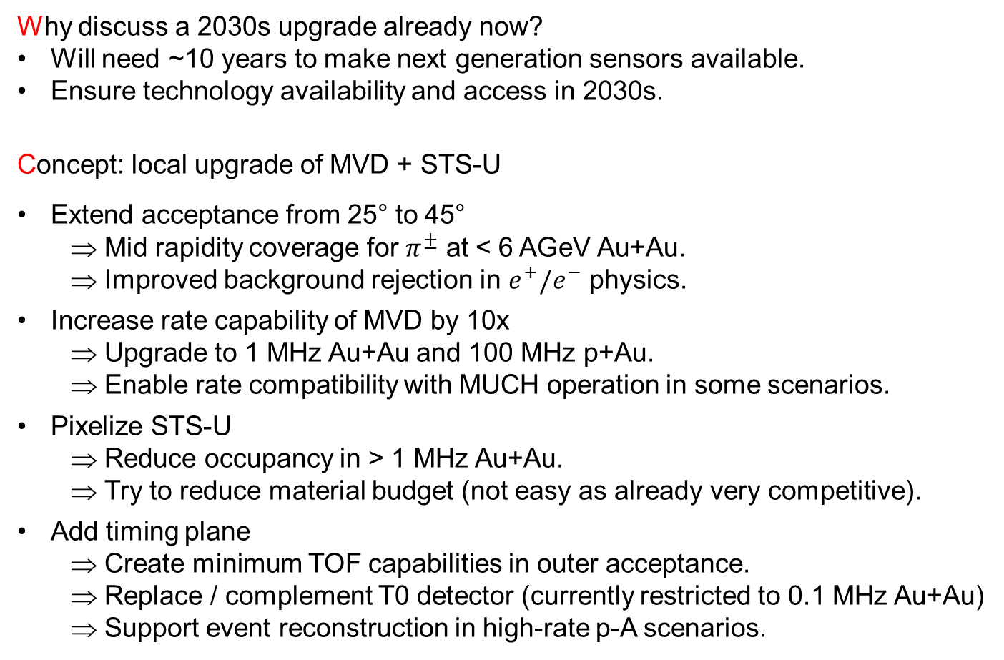
Goals of the upgrade (reminder)
Why discuss a 2030s upgrade already now?
Will need ~10 years to make next generation sensors available.
Ensure technology availability and access in 2030s.
Concept: local upgrade of MVD + STS-U
Extend acceptance from 25° to 45°
Mid rapidity coverage for $π^{±}$ at < 6 AGeV Au+Au.
Improved background rejection in $e^{+}/e^{−}$ physics.
Increase rate capability of MVD by 10x
Upgrade to 1 MHz Au+Au and 100 MHz p+Au.
Enable rate compatibility with MUCH operation in some scenarios.
Pixelize STS-U
Reduce occupancy in > 1 MHz Au+Au.
Try to reduce material budget (not easy as already very competitive).
Add timing plane
Create minimum TOF capabilities in outer acceptance.
Replace / complement T0 detector (currently restricted to 0.1 MHz Au+Au)
Support event reconstruction in high-rate p-A scenarios.
Magnet
Timing plane?
Upgraded
~45°
PID
…
MVD
Pixel
STS d
MVD
STS u+d
25°
PID
…
2028
Magnet
46th CBM collaboration Meeting, Oct. 20-25 2025, Lanzhou, China

Slide 3
Technologies of the upgrade
Present consideration:
Rely on next generation CMOS Monolithic Active Pixel Sensors.
Consider some kind of LGADs for timing plane.
Target performances:
 | MIMOSIS | CBM STS upgrade | CBM MVD upgrade
Spat. res. | ~5 µm | ~10 µm | ~5 µm
Time binning. | 5 µs | ~ 10 ns (<0.1 ns for timing plane) | ~ 10 ns
Rad. hard. | > 3x10¹⁴ n_{eq} > 5 MRad | 2x10¹⁴ n_{eq}/cm² 17 MRad per year | 1e15 n_{eq}/cm² ~50 MRad per year
Rate MHz/cm² | (20/80) (mean/peak) | 10 MHz + margin | 90 MHz + margin
Power | ~70 mW/cm² | ~ 50 mW/cm² | <100 mW/cm²
To be scrutinized
Performances (about) covered by “Moores Law of MAPS” for mid 2030.
Active contribution to R&D required to obtain technology access.
46th CBM collaboration Meeting, Oct. 20-25 2025, Lanzhou, China

Slide 4

How to get technology access (status collab. meeting Prag)?
ECFA Detector R&D Roadmap (2021)
Drive detector technology forward in common effort of different collaborations / communities.
Build specific detector R&D collaborations (DRD).
Our community of interest: DRD3 – Silicon detectors.
Plan: Propose projects still in 2024.
1st DRD3 week on Solid State Detectors R&D, CERN, 17–21 Jun 2024
Projects of interest for future MAPS:
S. Spannagel (DESY), A. Besson (IPHC) et al. – Fine pitch Sensors for the FCC
J. Baudot (IPHC) et al. - A versatile pixel matrix in TPSCo 65 nm for future trackers
Might merge
GSI detector lab declared interest in joining DRD3 and joining the above projects with IPHC (as junior partner).
Status: Request well received, discussions on project definition/proposal are ongoing.
46th CBM collaboration Meeting, Oct. 20-25 2025, Lanzhou, China

Slide 5


How to get technology access (Status today)?
1st DRD3 week on Solid State Detectors R&D, CERN, 17–21 Jun 2024
Projects of interest for future MAPS:
S. Spannagel (DESY), A. Besson (IPHC) et al. – Fine pitch Sensors for the FCC
J. Baudot (IPHC) et al. - A versatile pixel matrix in
TPSCo 65 nm for future trackers
MANTA: Monolithic Asynchronous sensor for Next generation TrAckers
Aiming for a versatile pixel Matrix serving the needs of several communities.
Conveners: J. Baudot, A. Maire, M. Deveaux
Optimized CMOS Technology fOr Precision in Ultra-thin Silicon
Currently 13 participating institutes (including GSI as junior partner).
Aiming for <20µm pixel pitch sensor optimized for vertex detector.
ASIC design team formed, R&D started.
OCTOPUS
46th CBM collaboration Meeting, Oct. 20-25 2025, Lanzhou, China

Slide 6


















The MANTA project
Participating and interested institutes (in random order)
 | Institute (in random order) | City | Country | Contact person
1 | Institut de Physique des 2 Infinis | Lyon | France | Didier Contardo
2 | University Bergamo | Bergamo | Italy | Gianluca Traversi
3 | University Barcelona | Barcelone | Spain | Raimon Casanova Mohr
4 | Instituto de Fisica Corpuscular | Valencia | Spain | Carlos Marinas
5 | Instituto Galego de Física de Altas Enerxías | Santiago | Spain | Abraham Gallas
6 | University and INFN Pisa | Pisa | Italy | Francesco Forti
7 | Marietta Blau Institute for particle Physics (MBI) | Vienna | Austria | Thomas Bergauer
8 | University Pavia | Pavia | Italy | Lodovico Ratti
9 | Universität Bonn | Bonn | Germany | Bernhard Ketzer
10 | University Münster | Münster | Germany | Denise Moreira de Godoy
11 | GSI | Darmstadt | Germany | Michael Deveaux
12 | Stanford Linear Acceleartor Center | Menlo Park | USA | Catarina Vernieri
13 | IPHC Strasbourg | Strasbourg | France | Jerome Baudot, Antonin Maire
14 | Institut de recherche sur les lois fondamentales de l'Univers | Saclay | France | Fabrice Guilloux
15 | Laboratoire de physique nucléaire et des hautes énergies | Paris | France | Giovanni Calderini
16 | University Pusan | Busan | South Korea | Sanghoon Lim
17 | Institute LPSC Grenoble | Grenoble | France | Rachid Guernane
18 | Deutsches Elektronen Synchrotron | Hamburg | Germany | Simon Spannagel
Conveners:
J. Baudot (IPHC)
M. Deveaux (GSI)
A. Maire (IPHC)
46th CBM collaboration Meeting, Oct. 20-25 2025, Lanzhou, China

Slide 7
What are the collaborations/applications of interest?
Internal survey, June 2025
Members of DRD3 Octopus: 3
About similar participation from heavy ion and particle physics. Some institutes are
interested in more than one application.
46th CBM collaboration Meeting, Oct. 20-25 2025, Lanzhou, China

Slide 8
MANTA: Mission statement
 | Spat. res. | Time res. | Power [mW/cm²] | Rate [MHz/cm²] | Rad. hard | Time constraints
ALICE3 | 10 µm | 100 ns | ~20 | < 2 | 1e14 n/cm² + 50 kGy | Critical
BelleII Trk | 15 µm | ~1 ns | 50 | < 1 | 1e11 n/cm² + 10 kGy | Relaxed
CBM | 5 µm | ~10 ns | ~50 | < 180 | 1e15 n/cm² + 500 kGy | Relaxed
FCCee Trk | 10 µm | ~1 ns | ~20 | < 10 | ? | Relaxed
LHCb UT | 10 µm | 20-1k ns | 100 | < 160 | 3e15 n/cm² + 2400 kGy | Substantial
FCC-ee PID layer | ≲10 µm | 100 ps | tbd | < 1 (tbc) | low | Relaxed
The Versatile MAPS project was started in response to the needs of several collaborations for a high performance ultra-low power MAPS detector for tracking applications.
It pursues the vision of covering the different requirements with one single sensor hardware, which may be configured to different use cases by means of slow control.
CBM timing layer?
draft requirements, to be scrutinized…
Technicological approach:
Build a sensor with resources for high performance – high power.
Clock down – switch off unnecessary resources to safe power where ever possible.
46th CBM collaboration Meeting, Oct. 20-25 2025, Lanzhou, China

Slide 9
MANTA: Technological approach (in a nutshell)
 | MIMOSIS | Future sensor
Time stamping | Time stamp by frame number: 5 µs time binning. < 1µs time walk. | Measures: Time stamp individual hit. Time walk correction (TOT) Target: ~10 ns (first stage)
Column readout | Clocked priority encoder. Delayed arrival at “TDC” due to spatial ordering. | Asynchronous (non clocked) first priority arbiter for immediate (within ~10 ns) data transfer to TDC.
Technology | TJ180 nm (highly optimized sensing node, low logic density, 1.8V) | TPSCo 65nm (Improved logic density, 1.2V, weaker sensing node).
Pixel pitch | 27 x 30 µm² => 5µm precision | Up to 50 x 50 µm² to safe power. Possibly limited to <30x30 µm²
Data transfer etc. | I²C interface, 8x320 Mbps | Not yet defined.
Goal:
Do a baby sensor submission end 2026, bigger prototype in 2027 (discussion ongoing).
=> Need input on specification ASAP.
46th CBM collaboration Meeting, Oct. 20-25 2025, Lanzhou, China

Slide 10
Summary and conclusion
Proposal for the CBM silicon upgrade:
Increase rate capability of MVD to ~1 MHz Au+Au, 100 MHz p-Au (?)
Increase acceptance of STS-U and MVD.
Possibly add a timing plane.
Status of the preparation:
Community for building next generation sensor was established and starts working.
First sensor submission possibly end 2026 in collaboration with DRD3, DRD7 and ALICE
Need to scrutinize sensor specification.
Open questions:
Running scenarios (in particular p-A physics).
Physics case?
What are the requested beam intensities?
Need to show added value w.r.t existing detectors.
We should agree soon if the proposed concept is ok.
Should we prepare a first technical write-up as foundation of this activity?
46th CBM collaboration Meeting, Oct. 20-25 2025, Lanzhou, China

Slide 11
Backup

Slide 12
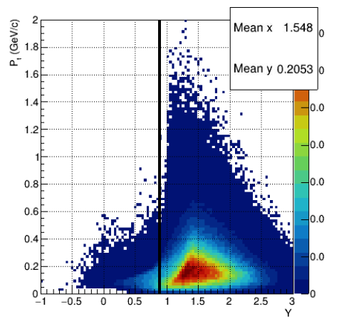
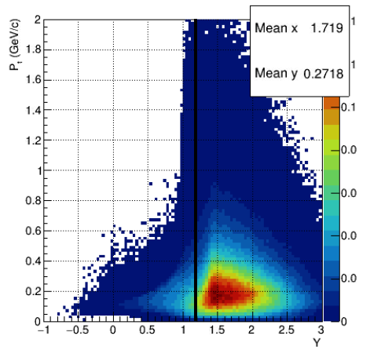
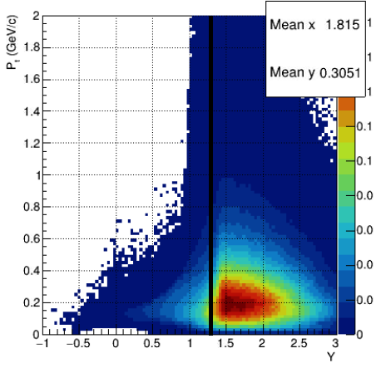
Physics motivation (input welcome)
Outer acceptance of CBM insufficient for pion mid rapidity coverage at low beam momentum
Extend outer acceptance
MVD restricted to 100 kHz Au+Au or 10 MHz p+Au. Consider rate upgrade by roughly 10x.
Helpful for e+/e- physics and proton beam hadron physics
Time stamping of MVD 5µs => Substantial (~500 events) pile-up for p+Au physics.
Improved time stamping in MVD required for event separation.
2 AGeV – 50% field
4 AGeV – 85% field
6 AGeV – 100% field
Pion
Pion
Pion
Plots: Anna Senger,
CBM collaboration
Meeting Spring 2022, GSI
42°

Slide 13
Silicon upgrade challenge – Practical constraints
Assumption:
Limited resources (as always).
=> Upgrade must be local - No way to modify magnet or PiD.
=> Develop a minimum of technologies.
Constraint:
Geometry of Magnet, STS-D, PID detectors fixed.
Need to retrofit new detectors.
Idea: Do restricted pixel upgrade:
Magnet
Inner tracker
Acceptance
upgrade.
~45°
PID
…
MVD
Pixel
STS D
MVD
STS U+D
25°
PID
CBM 2028
Replace only MVD + STS-U
Expand acceptance to ~45°
(possibly more in x as already today in the STS)
Use next generation pixels to improve performance.
Optional: Replace also STS-D
…
Magnet
Obvious open ends:
No PiD in additional acceptance.

Slide 14
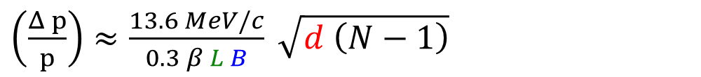
Momentum resolution in extended acceptance
Approach:
No ressources for simulations
=> Use analytic estimates.
Assumptions (simplifying the problem):
N=7 equidistant stations (3 x MVD + 4 x STS-U)
Uniform material budget per station.
Ignore vacuum window.
L = 45 cm – (1st MVD station to last STS-u station)
Apply Guckstern-Formular (multiple scattering term only):
Magnet
Inner tracker
Acceptance
upgrade.
~45°
PID
…
MVD
Pixel
STS D
MVD
STS U+D
25°
PID
CBM 2028
…
Magnet
Only free parameter: Material budget.
$\left(\frac{Δ p}{p}\right)≈\frac{13.6 MeV/c}{0.3 β L B} \sqrt{d \left(N−1\right)}$
Need to minimize material budget to compensate:
Reduced L in lower area.
Reduced B at lower beam energy.
Constraint by physics
or retro-fit

Slide 15
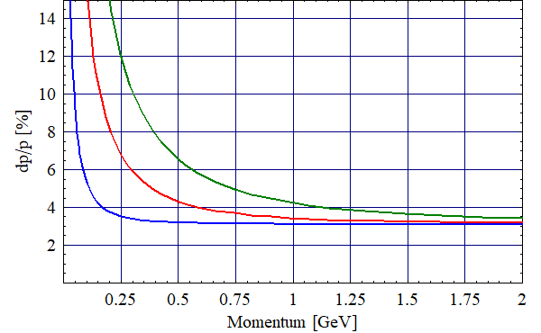
Results – Momentum (4 AGeV, outer acceptance)
p_{CM}
p_{CM}
p_{CM}
Rough estimate for the momentum resolution:
Scenario: 4 AGeV, B=50%, d=0.3% X₀ / station
Holds for outer acceptance (MVD + STS-U)
Expect better results:
For higher beam momentum (=> higher B).
Inner acceptance thanks to STS-D
Proton
Kaon
Pion
B=0.5T (50%)
Back of the envelop
Outer acceptance may reach (at best) $Δp/p≈4\%$ for p>p_{CM} , 2% for full B.

Slide 16
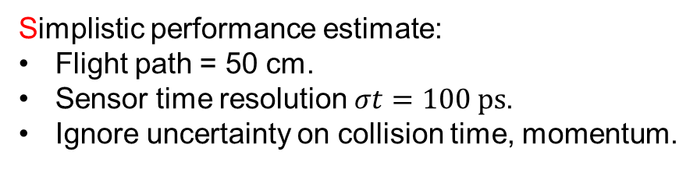
Particle Identification considerations – not subject of today
Initial Idea:
Use silicon timing detectors (e.g. LGAD)
Use plane as T0 detector for inner acceptance.
Reconstruct collision time exploiting T0 + TOF.
Use silicon plane as T1 detector for outer acceptance.
Magnet
Timing plane?
~45°
PID
…
MVD
Pixel
STS d
MVD
STS u+d
25°
PID
…
Magnet
Simplistic performance estimate:
Flight path = 50 cm.
Sensor time resolution $σt=100 ps$.
Ignore uncertainty on collision time, momentum.
Back of the envelop
Might hope for:
Kaon ID up to 800 MeV/c.
Proton ID up to 1200 MeV/c
Better/other PID? Feel free to propose!

Slide 17
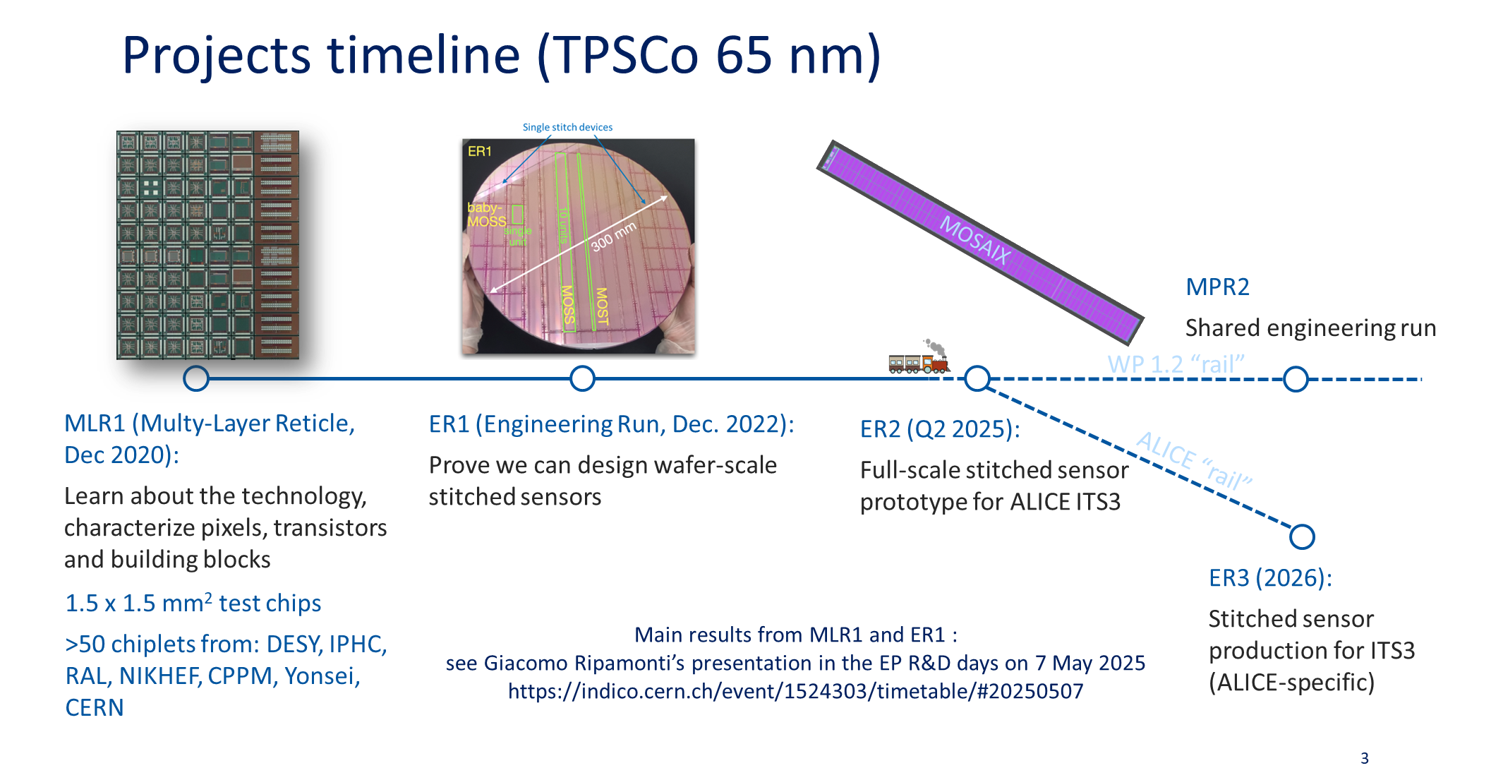
Constraining submission plans
Submissions in TPSCo 65nm (in Europe) are organized by CERN and constrained by ALICE.
Present submission schedule:
Pedro Leitao, TPCSo 65 nm ISC access framework and platform.
12. June 2025, https://indico.cern.ch/event/1553023/
Present idea: Request access to ER3 with common/coordinated design of OCTOPUS and MANTA + test structures.

Slide 18
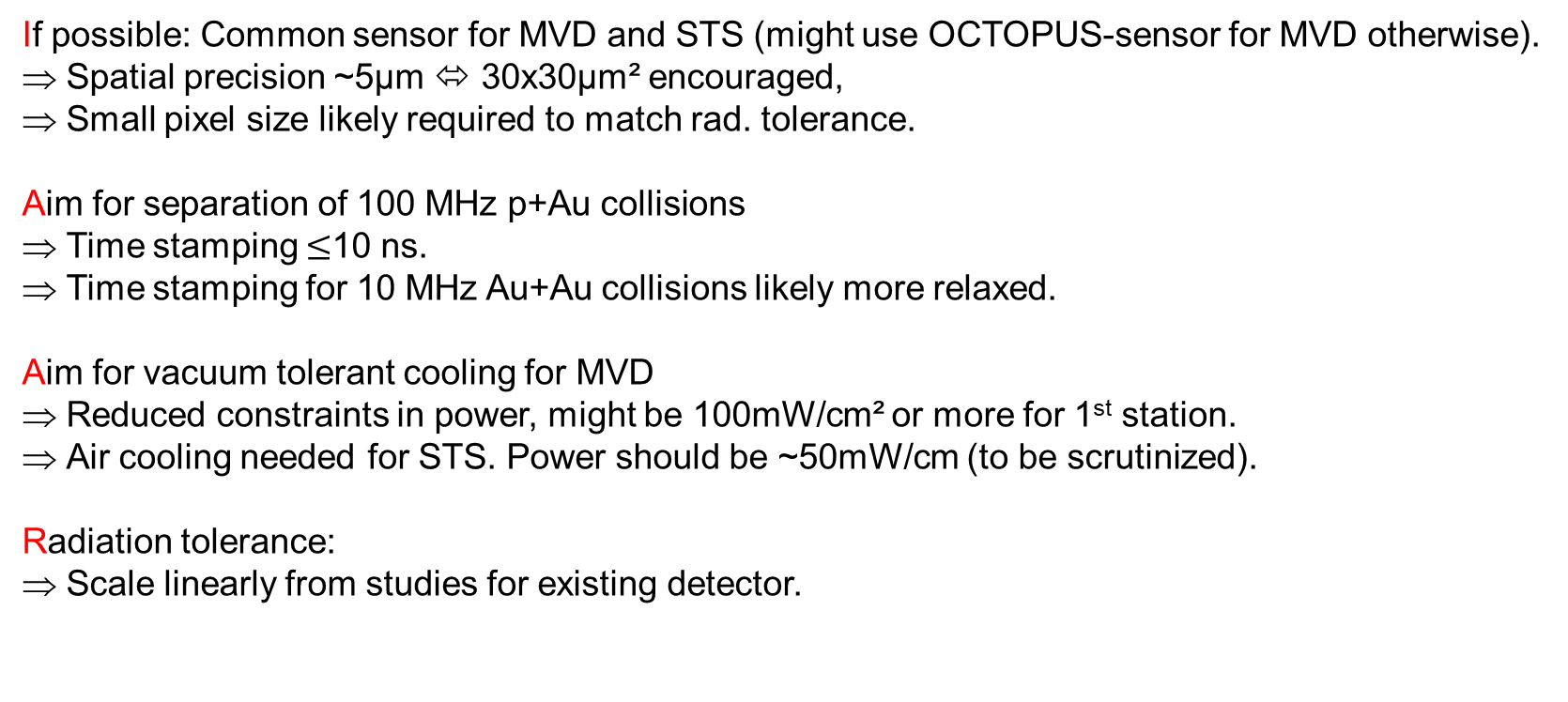
Requirements for a CBM-sensor, guiding considerations
If possible: Common sensor for MVD and STS (might use OCTOPUS-sensor for MVD otherwise).
Spatial precision ~5µm ⬄ 30x30µm² encouraged,
Small pixel size likely required to match rad. tolerance.
Aim for separation of 100 MHz p+Au collisions
Time stamping $≤$10 ns.
Time stamping for 10 MHz Au+Au collisions likely more relaxed.
Aim for vacuum tolerant cooling for MVD
Reduced constraints in power, might be 100mW/cm² or more for 1st station.
Air cooling needed for STS. Power should be ~50mW/cm (to be scrutinized).
Radiation tolerance:
Scale linearly from studies for existing detector.

Slide 19
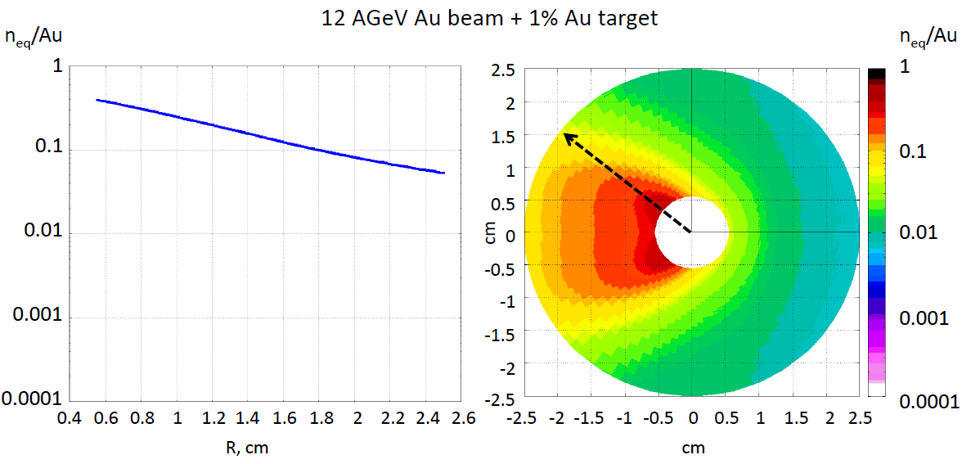
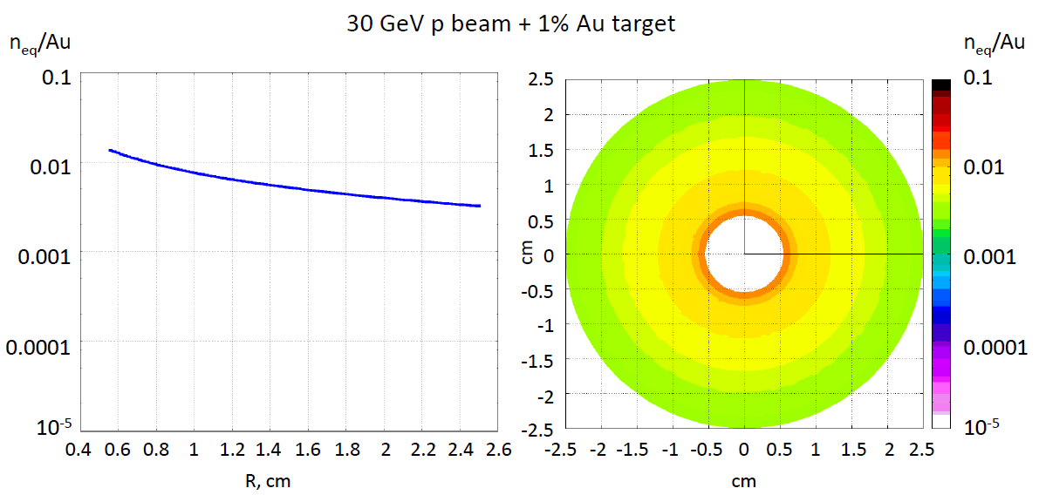
Radiation tolerance
Simulations available for MVD.
STS scaled according to 1/z².
Anticipate 5e6s beam on target (CBM year)
~0.4
Coll. rate | 12 AGeV Au+Au | 30 GeV p+Au
MVD | 1 MHz | 100 MHz
STS | 10 MHz | 1000 MHz
A. Senger 2017
 | 12 AGeV Au+Au |  | 30 GeV p+Au
5 cm | 2x10¹⁴n_{eq}/cm² | 50 MRad | 10x10¹⁴n_{eq}/cm² | 35 MRad
10 cm | 0.5x10¹⁴n_{eq}/cm² | 14 MRad | 2x10¹⁴n_{eq}/cm² | 15 MRad
30 cm | 0.6x10¹⁴n_{eq}/cm² | 15 MRad | 2x10¹⁴n_{eq}/cm² | 17 MRad
~0.02
Realistic goal (with appropriate cooling):
Some 10 MRad + some 10¹⁴ n_{eq}/cm².
=> Must be specific with p-A physics.
A. Senger 2017
Conclusion: Good first guess available on sensor properties (+/- small factor). Need to scrutinize.

Slide 20
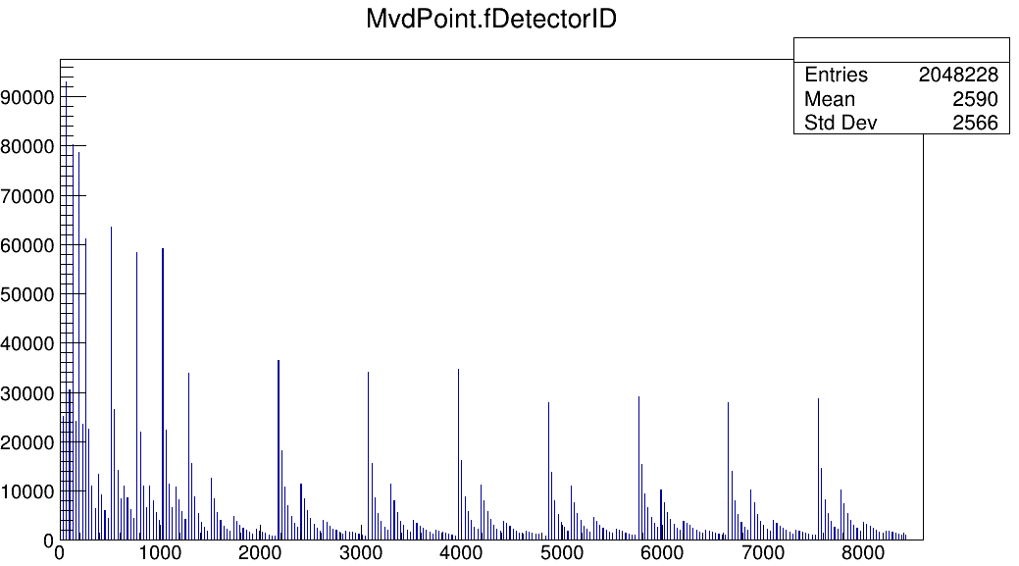
MVD rates / sensor
~20 MHz/cm²
Entries/Sensor/1e7 protons
30 GeV, p+Au, proton-on-target GEANT4
~10 MHz/cm²
fDetector ID [1]

Slide 21
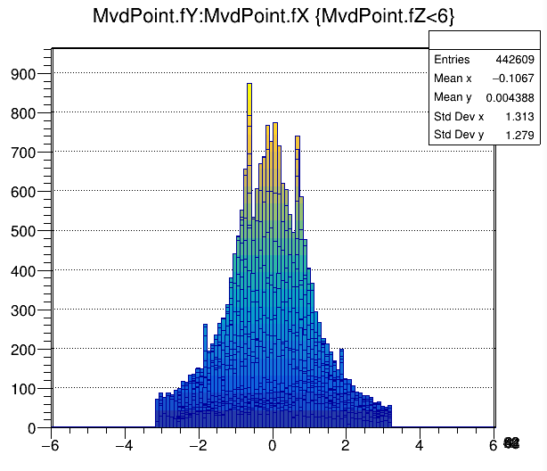
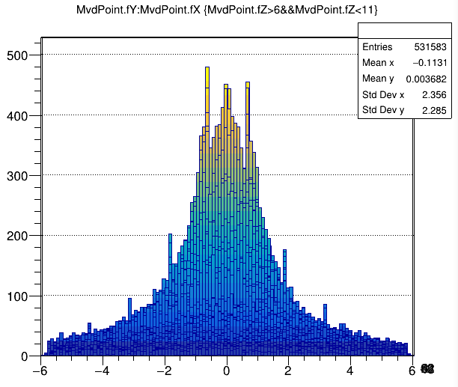
Occupancy per detector (VX – Geometry)
Target + 5cm
Target + 10cm
Entries/1e7 protons/mm²
Entries/1e7 protons/mm²
cm
cm

Slide 22
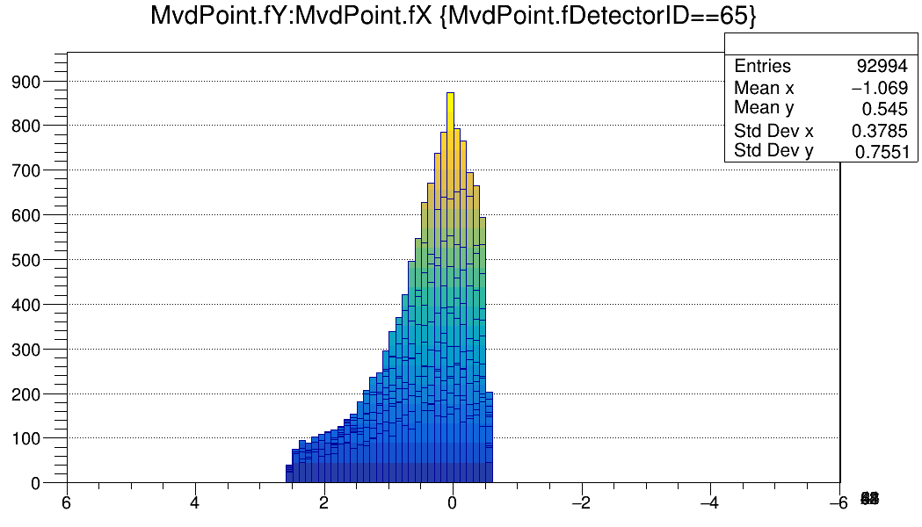
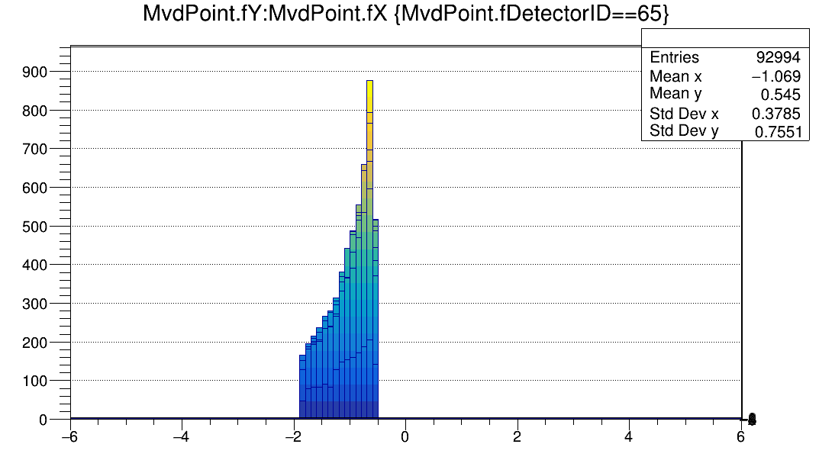
Most illuminated sensor p+Au 30 GeV/c
Entries/1e7 protons/mm²
Entries/1e7 protons/mm²
cm
cm
System | Rate | Detector | Most illuminated mm² | Most ill. sensor
p+Au | 100 MHz, min bias | MVD - Vx | 90 MHz/cm² | 23 MHz/cm²
Au+Au | 1 MHz, min bias | MVD - Tr | 20 MHz/cm² | N/A
Au+Au | 1 MHz, min bias | MVD – Vx | 80 MHz/cm² | N/A
Au+Au | 10 MHz, min bias | STS | ~10 MHz/cm² | N/A
Open issue: Safety margin for central collisions? Beam fluctuations?

Slide 23
Sensor parameters (Update Aug. 2025)
 | MIMOSIS | CBM STS upgrade | CBM MVD upgrade
Spat. res. | ~5 µm | ~10 µm | ~5 µm
Time binning. | 5 µs | ~ 10 ns (<0.1 ns for timing plane) | ~ 10 ns
Rad. hard. | > 3x10¹⁴ n_{eq} > 5 MRad | 2x10¹⁴ n_{eq}/cm² 17 MRad per year | 1e15 n_{eq}/cm² ~50 MRad per year
Rate MHz/cm² | (20/80) (mean/peak) | 10 MHz + margin | 90 MHz + margin
Power | ~70 mW/cm² | ~ 50 mW/cm² | <100 mW/cm²
This is a result of fast simulations on my laptop and educated guesses.
Scrutinization required. Results hold for SIS100 scenarios.

Slide 24
Sensor occupancies
Rate simulation in 2020:
30k Ions on target (Geant 4).
~300 Au+Au as computed by G4 default.
MVD Ver 17a; STS Ver 19a
 | 12 AGeV Au+Au MHits/s/cm² | 3.5 AGeV Au+Au MHits/s/cm²
MVD | 80 | 80
STS | 3 | 9
Must add factor ~1.5 to arrived at fired channels

