Slide 1
New MuCh geometry (v23b) for di-muon simulations
Pawan Sharma,
VECC Kolkata,
23 Oct, 2025

Slide 2
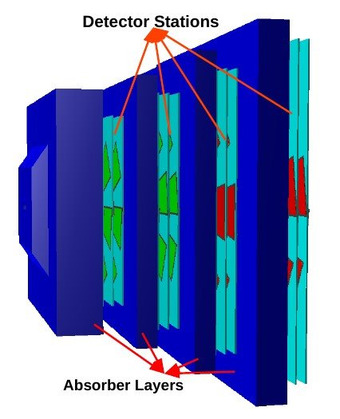
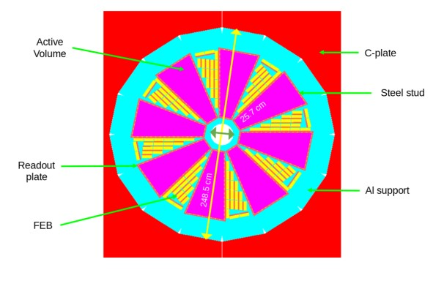
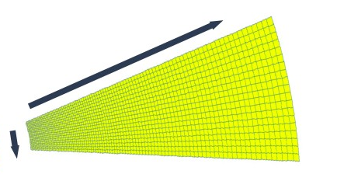
MuCh geometry
No of Stations : 4
No of layers/station : 3
Shape of Each module: Trapezoidal
No of modules in each layer :
Station 1 : 16
Station 2 : 20
Station 3 : 18
Station 4 : 18
MuCh setup
Readout plane : Segmented into progressively increasing pads.
Sector #
Ch. #
MuCh layer

Slide 3
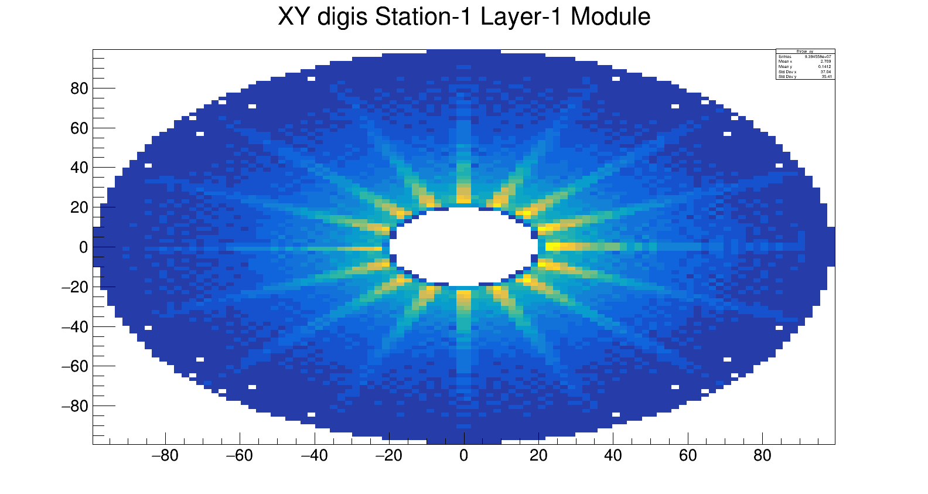
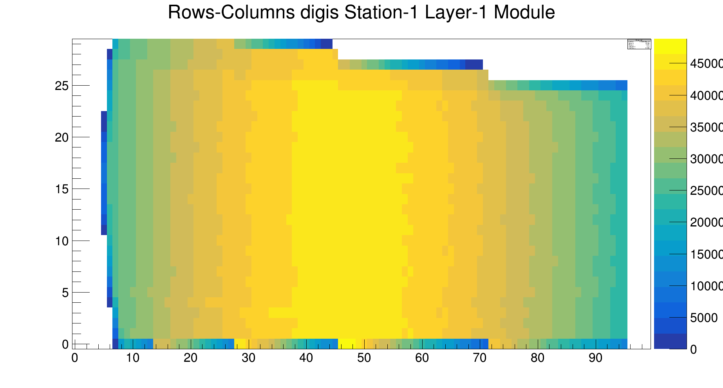

Issue with v21c (CFV) geometry
The MuCh geometry, tagged v21c was used as default geometry for muon simulations but there were some issues regarding digitization in the geometry. So, a new MuCh geometry was created tagged v23a for more realistic simulations.

Slide 4
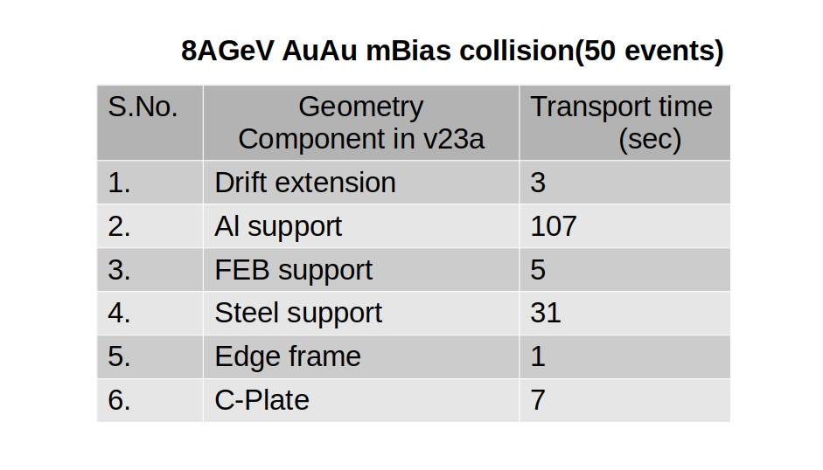
v23a geometry
Realistic material budget such as Steel pillars, inner spacers and edge frames in GEM modules and FEBs, C-plate etc have been added.
Transport time for v23a geometry is ~6 times more of v21c geometry, for 8AGeV AuAu mBias collisions. The reason could be extra material budget and complex components in v23a geometry.
To reduce the computational time,
changes have been done in some components of v23a geometry.

Slide 5
Comparision of MuCh geometries
v23a v23b v21c
(rejected) (proposed/optimized) (default)
Transport time/event: 8s 2.3s 1.4s
- Active volume - Active volume - Active volume
- GEM Foil - GEM Foil - GEM Foil
- Drift - Drift - Drift
- Gas - Gas - Gas
- Al Support (slotted) - Al support (unslotted) - Al support (unslotted)
Simplified:
- inner spacers - inner spacers
- edge frame - edge frame
- FEBs - FEBs
- Steel support - Steel support
- drift extension - drift extension
C-plate

Slide 6
Track reconstruction
Muon Simulations
Basic Simulation Info
MuCh Geometry : v23a/v23b​
Event Generator : URQMD & Pluto ​
Beam & Target system : AuAu ​
Energy : 8 AGeV ​
Centrality : central ​
Setup : SIS100 ​
No of Events: 100k
Event Generators
(UrQMD & Pluto)
Particle(pid, p, E)
Transport(GEANT)
MC points
Segmentation & Digitization
Pads & Digis
Hit & Tracking
Hits & tracks
Track reconstruction & analysis
Invariant mass distribution

Slide 7
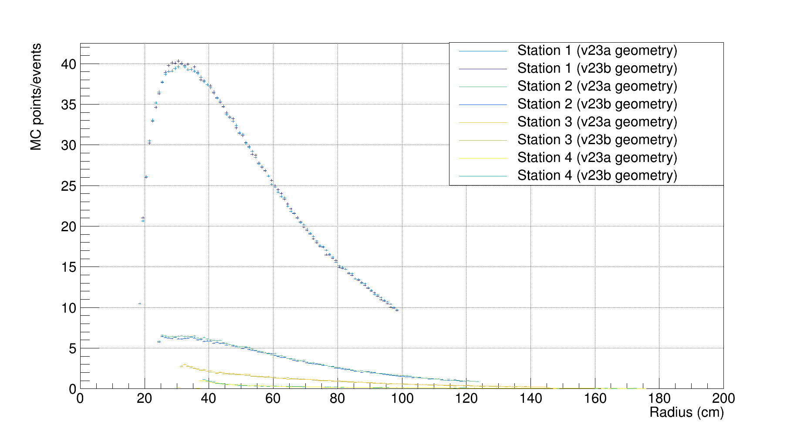
Simulation:
Radial distribution of MC points
8 AGeV AuAu
central collision

Slide 8
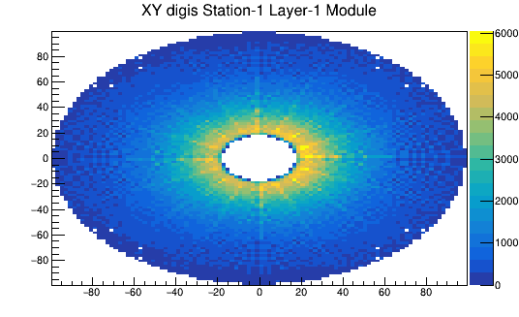
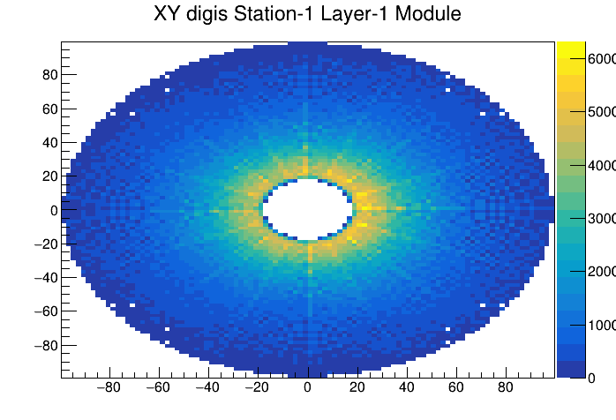
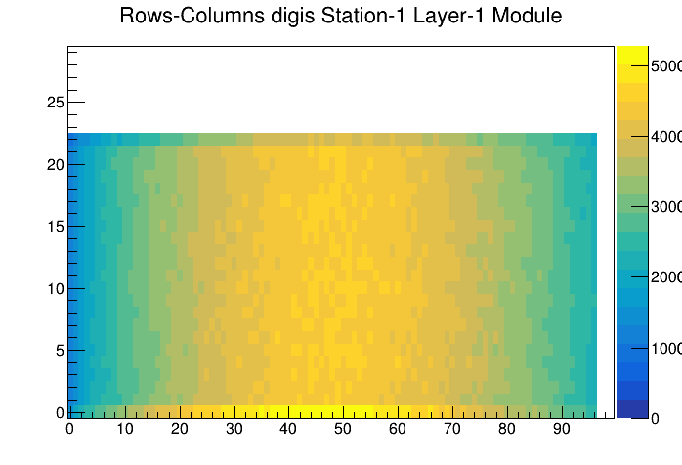
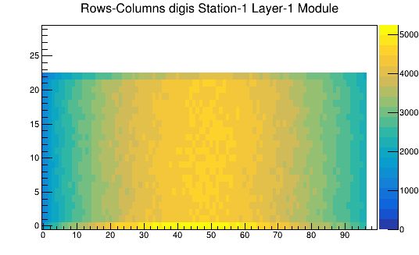
XY and sector-channel distribution of the MuCh digis
v23a
8 AGeV AuAu central collision
v23b
Y (cm) --->
X (cm) ---->
Channel
Sector

Slide 9
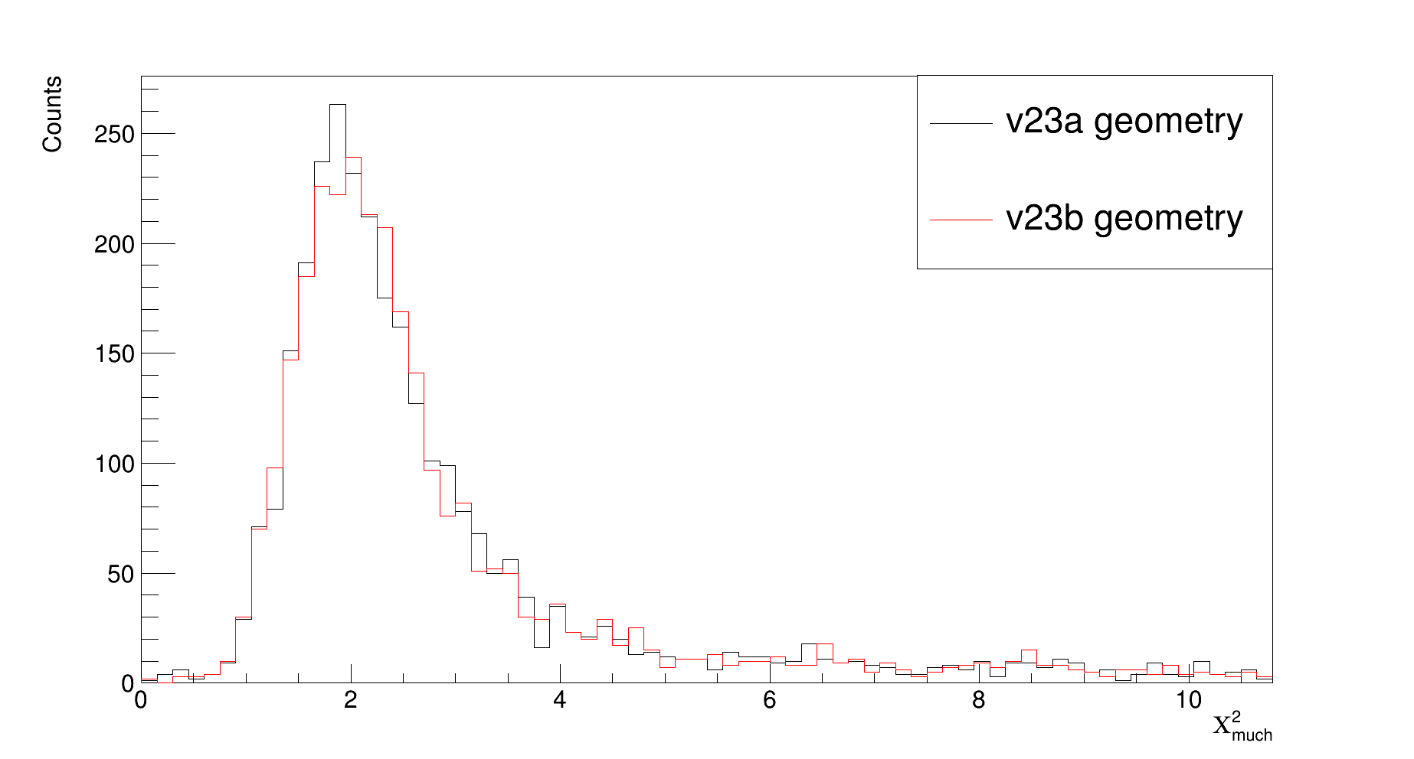
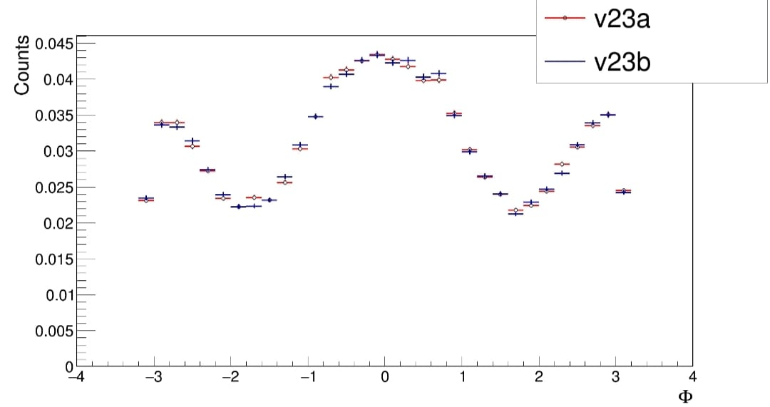
MuCh Chi2 and azimuthal angle of reconstructed tracks
8AGeV AuAu central collision

Slide 10
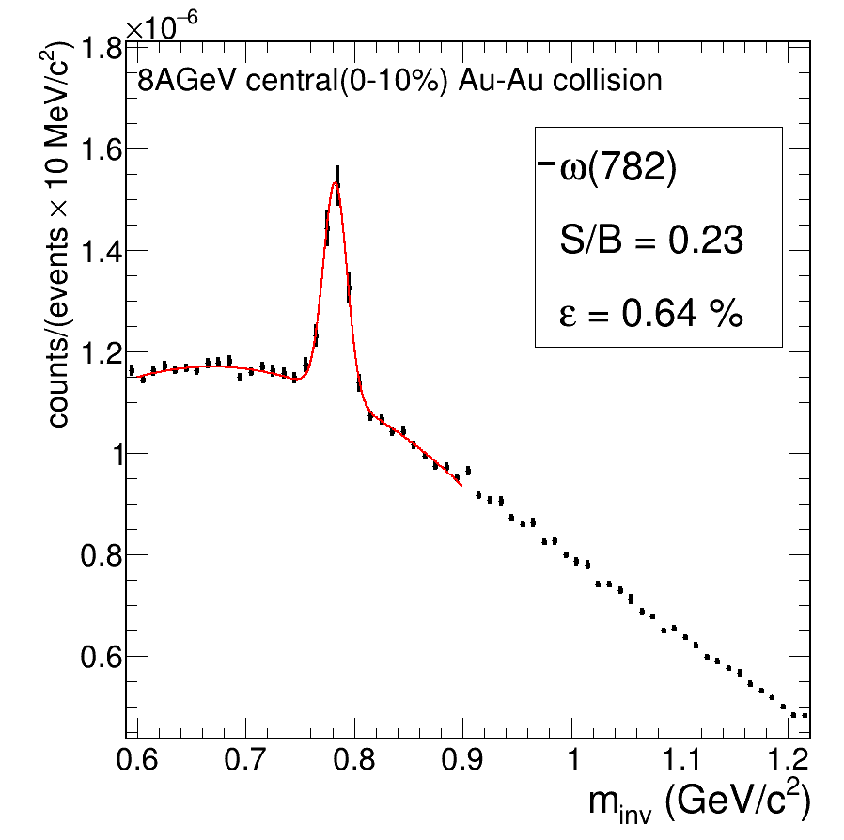
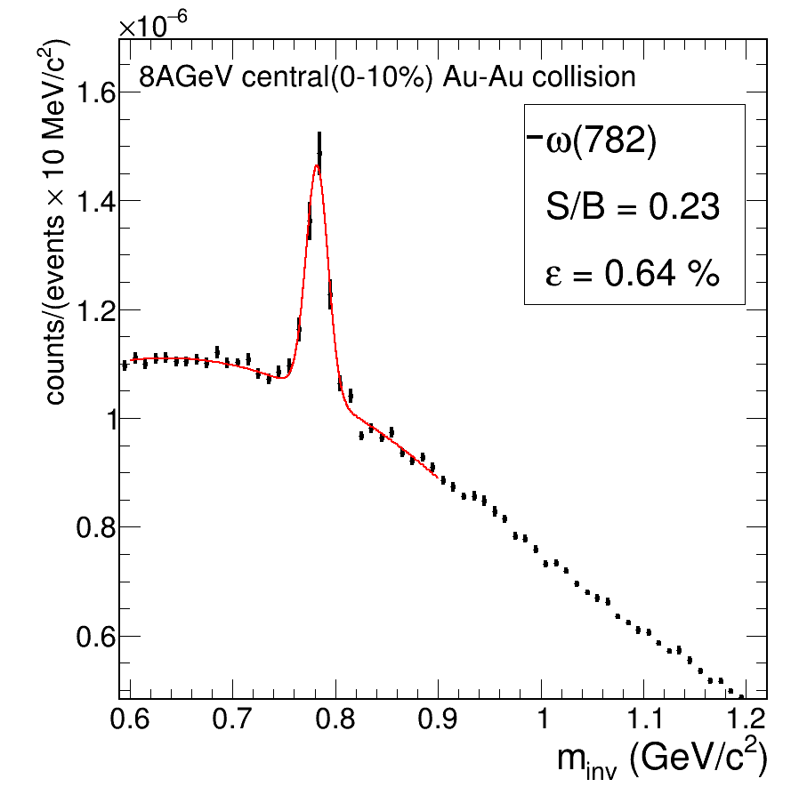
Invariant mass spectra of omega meson
8AGeV AuAu central collision *
v23a
v23b
Following selection cuts were used: Number of MuCh hits > 11, Number of STS hits > 7, Number of TRD hits > 1,Number of TOF hits > 1, χ²_{MuCh} < 3, χ²_{STS} < 2, χ²_{vertex} < 3, SigmaToFCut=2​
Similar S/B ratio and reconstructed efficiency for v23a and v23b geometry. *scaling factor with HSD

Slide 11
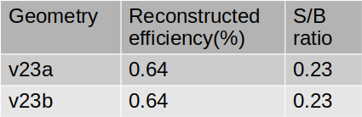
Summary
Elements consuming large time simplified and significant reduction in time was observed.
Transport time for v23b geometry which is equivalent to v23a material budget, transport time reduced from 8s/e to 2.3s/e (which is1.6 times of v21c) for 8AGeV AuAu mBias collision.
Simulation results of physics studies of both geometries are comparable, so v23b geometry is proposed as default geometry for the MuCh simulations.

Slide 12

Thank you

Slide 13

v23a geometry
Steel support, inner spacers and edge frames have been added in GEM modules.
18 FEBs have been added over the cooling and support plate. Additional copper plate has been introduced with the PCB which will be used to couple the cooling with PCB.
C-Plate have been implemented. It is used to mount cooling plates to the overhead support.
Dimensions of PCBs have been fixed and correctly implemented. An extension of PCB board to hold optocoupler based electronics is introduced.

Slide 14
Simulation:
Radial distribution of MC points
8 AGeV AuAu central collision

Slide 15

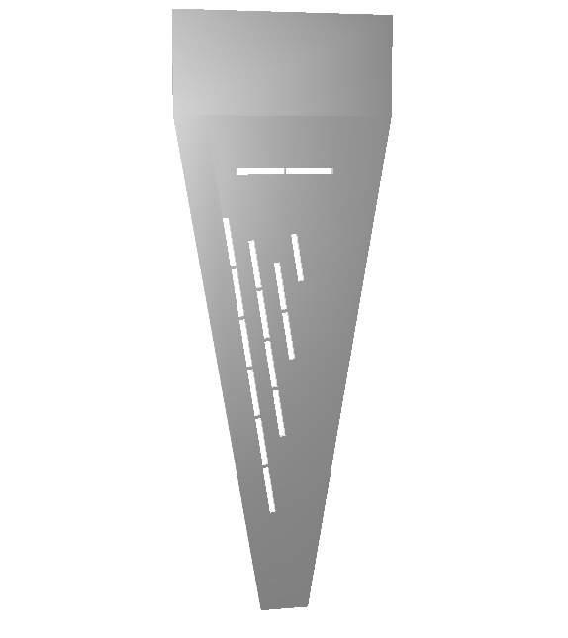

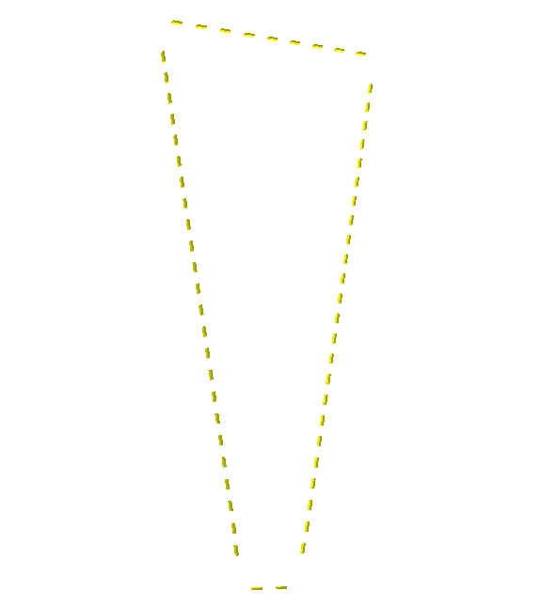
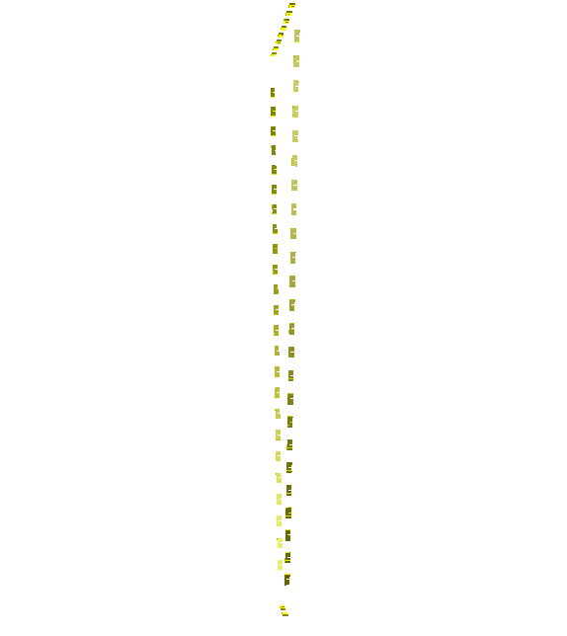
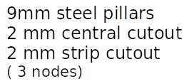


MuCh geometry components
v23a v23b
Al Support
Steel Support

Slide 16
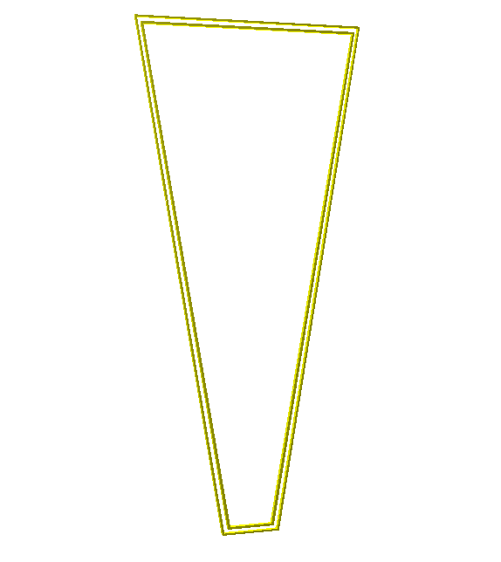
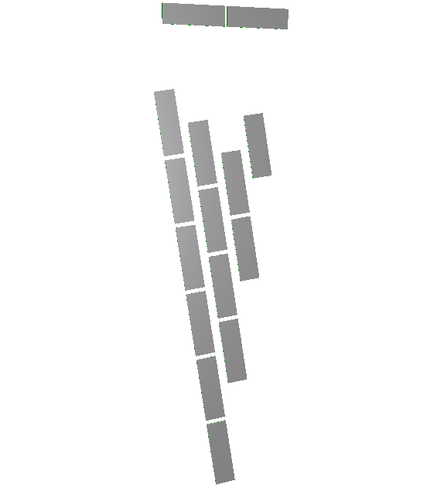

MuCh geometry components
Edge frame
FEB support layer
Drift extension

Slide 17
Sector-Channel distribution of the much digis
v23a
v23b
8 AGeV AuAu central collision (10k events)

Slide 18
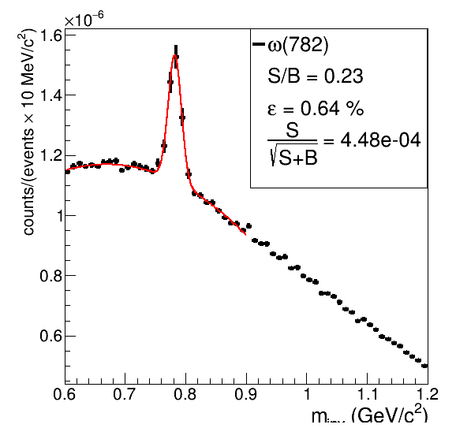
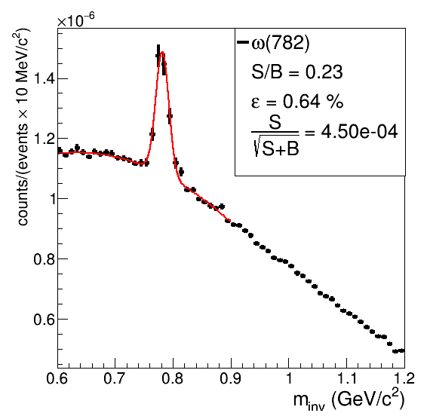
Invariant mass spectra of omega meson
8AGeV AuAu central collision *
v23a
v23b
Following selection cuts were used: Number of MuCh hits > 11, Number of STS hits > 7, Number of TRD hits > 1,Number of TOF hits > 1, χ²_{MuCh} < 3, χ²_{STS} < 2, χ²_{vertex} < 3, SigmaToFCut=2​
Similar S/B ratio and reconstructed efficiency for v23a and v23b geometry. *scaling factor with HSD

Slide 19
MuCh Chi2
8AGeV AuAu central collision

Slide 20
New MuCh geometry v23b for SIS100 lmvm setup
-> Investigation towards identifying detector layout with optimized material budget and computational time
-> Comparision of transport time for the geometry v23b with v23a and v21c for 8AGeV AuAu collisions

Slide 21

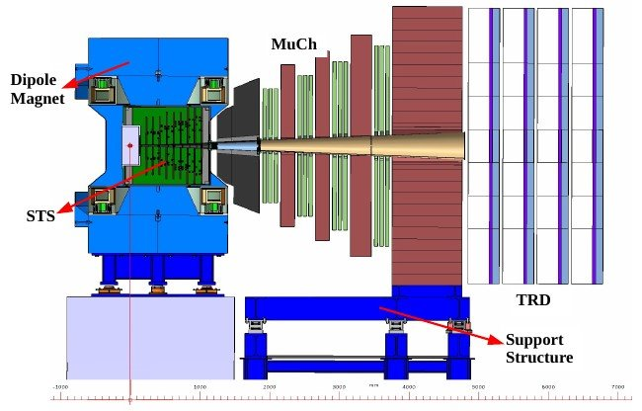
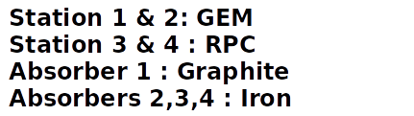
Muon Chamber (MuCh) at CBM
-> Originating from ρ, ω, φ etc
Angular Coverage~5º to 25º
Optimized Absorber Thickness:
58 cm graphite & cement + 20 cm Fe + 20 cm Fe + 30 cm Fe
->Segmented absorber allow us to
reconstruct low momentum muon

Slide 22
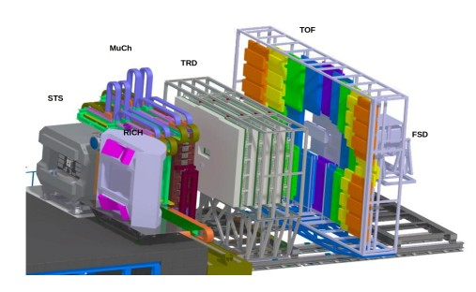
CBM Experiment
Fixed target heavy-ion experiment
Designed to explore QCD phase diagram at moderate temperature and high net baryon density
Measure rare diagnostic probes such as multi-strange hyperons, charmed particles and vector mesons decaying into lepton pairs with unprecedented precision and statistics
Interaction rates will go up to 10 MHz
Requires very fast and radiation hard detectors
CBM experimental setup

Slide 23
Dilepton study
-> As the decayed leptons leave the dense and hot fireball without further interactions, they can provide unscathed information about the fireball
-> Dilepton invariant mass can be used to find the temperature and lifetime of the fireball.
-> Di-muon cocktail includes contribution from di-muon (µ +µ−) decay and dalitz decay of ω, η, ρ, ϕ mesons, as well as contributions from thermal radiation of QGP
-> CBM experiment is important as no di-lepton data have been measured in heavy-ion collisions at SIS100 beam energies (2-11 AGeV).

