Slide 1


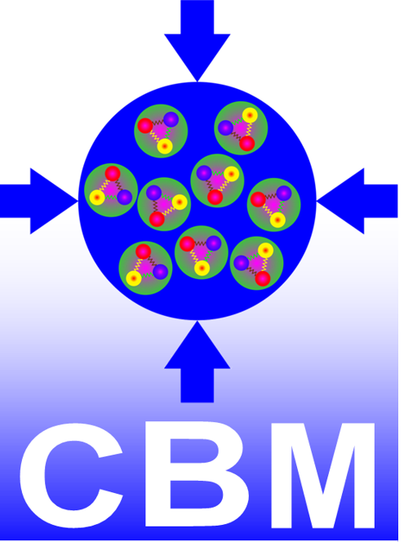

at
Hadron Physics Opportunities at FAIR
Jim Ritman 46th CBM Collaboration Meeting, Lanzhou China, Oct. 20 - 24, 2025

Slide 2
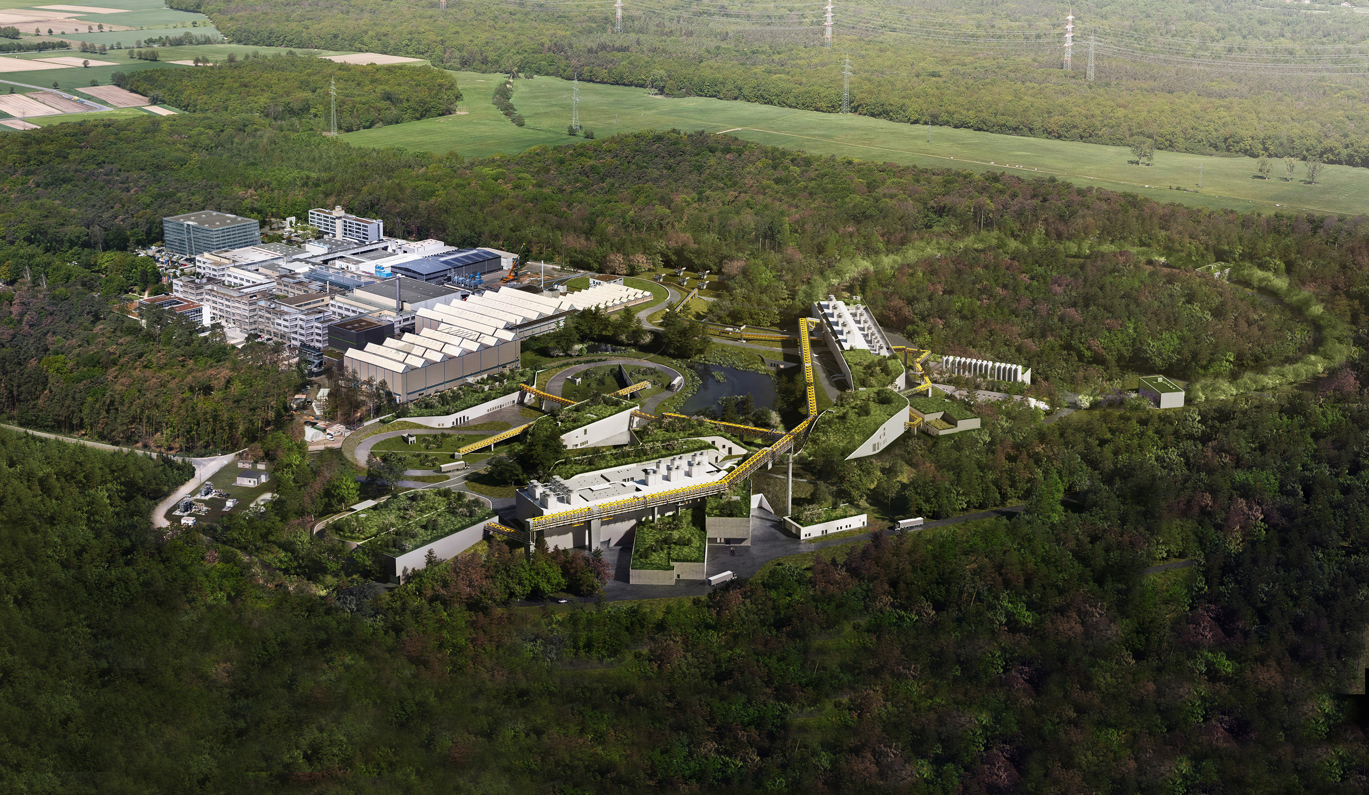
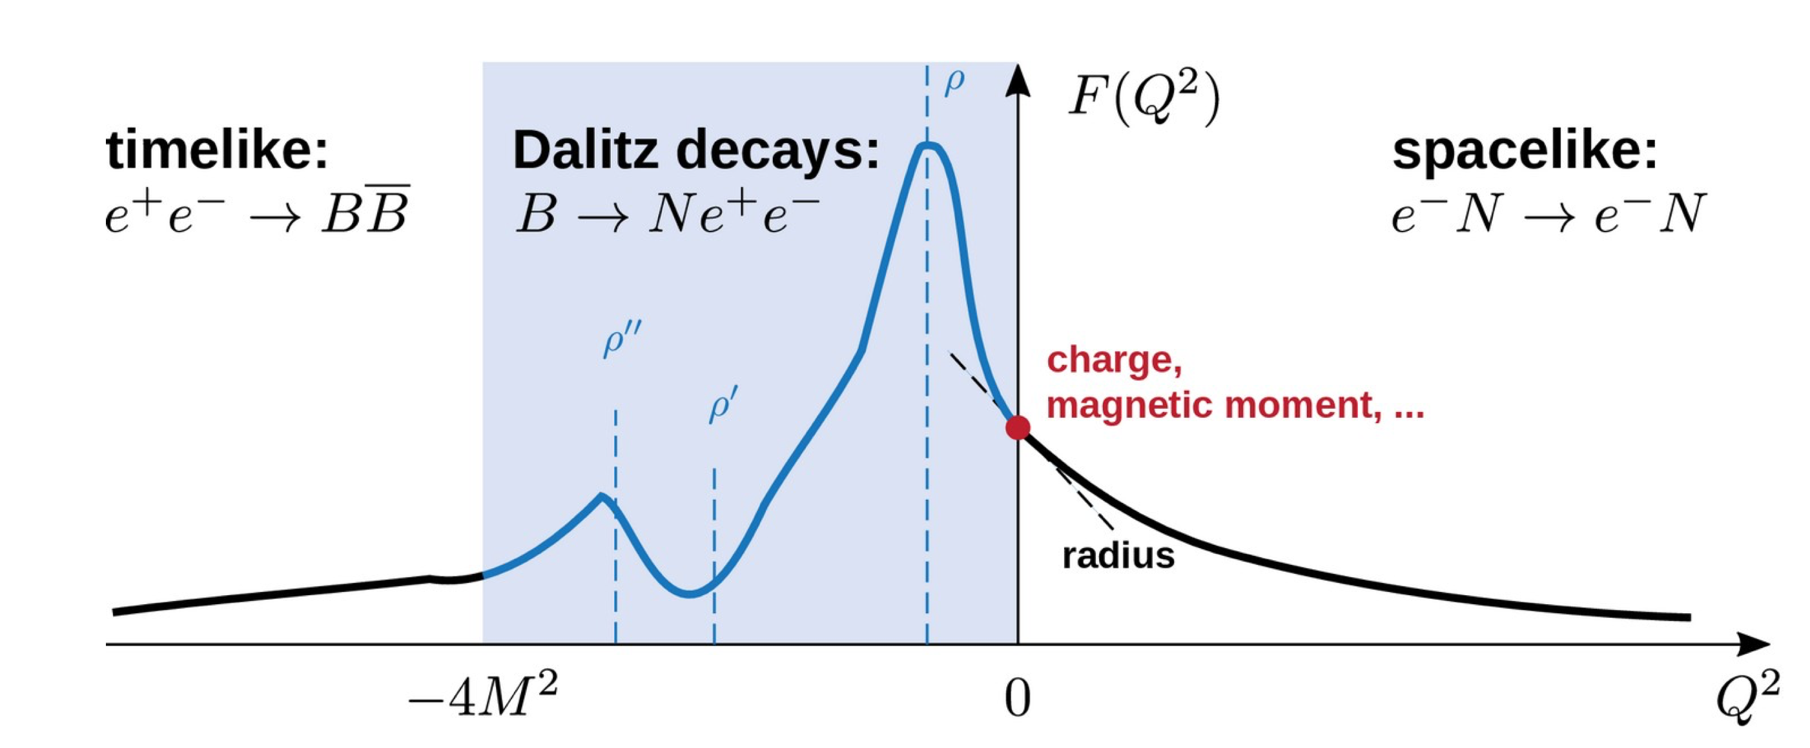
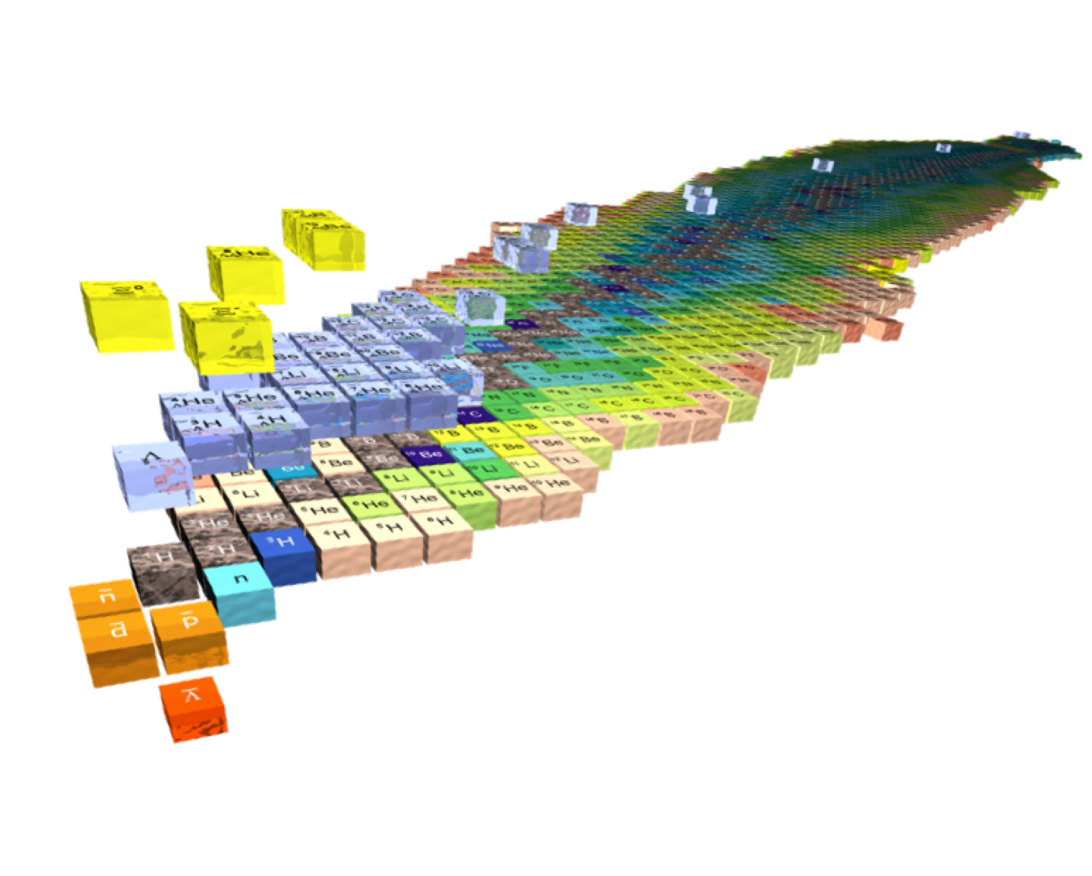
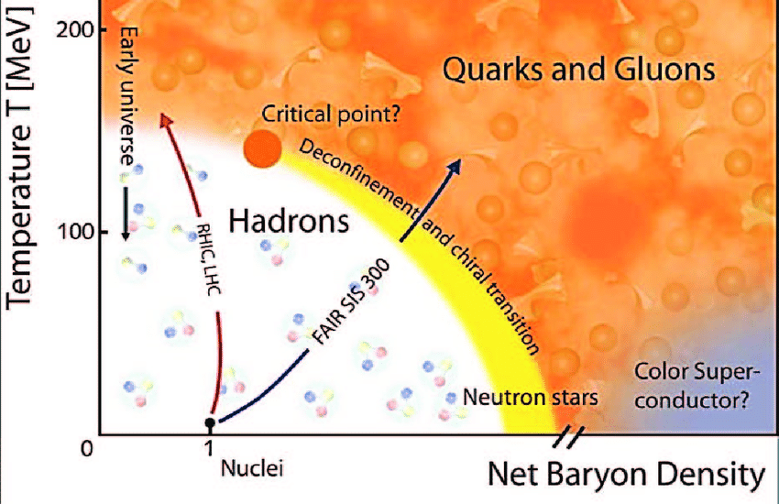
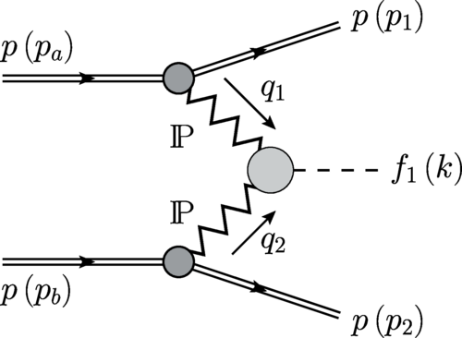
A uniting hadron-physics program
Composition of hadrons
Hadron structure
Hadron spectroscopy
Hadron beams at GSI and FAIR
Strange and charm
High interaction rates
Versatile detectors
…
Reference measurements for p+A, A+A p+p, n+p
Production mechanisms of hadrons
Few-body interactions
Hadron production
Heavy-ion dynamics
Microscopic study of hadron-hadron interactions

Slide 3
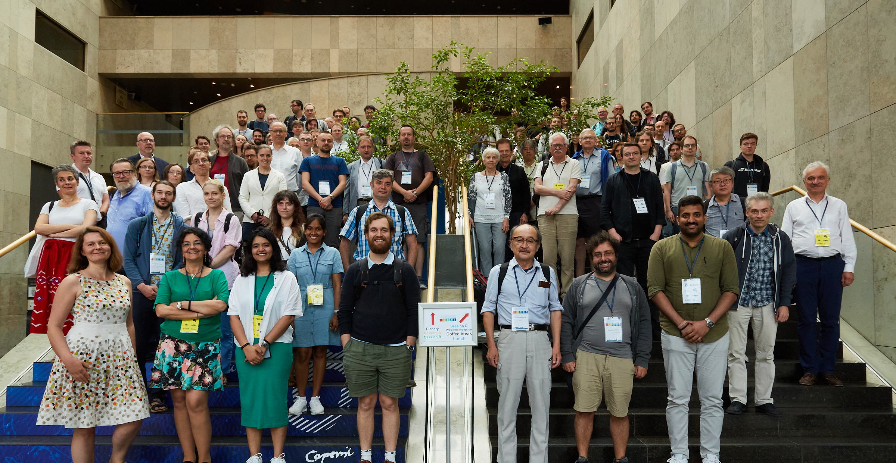
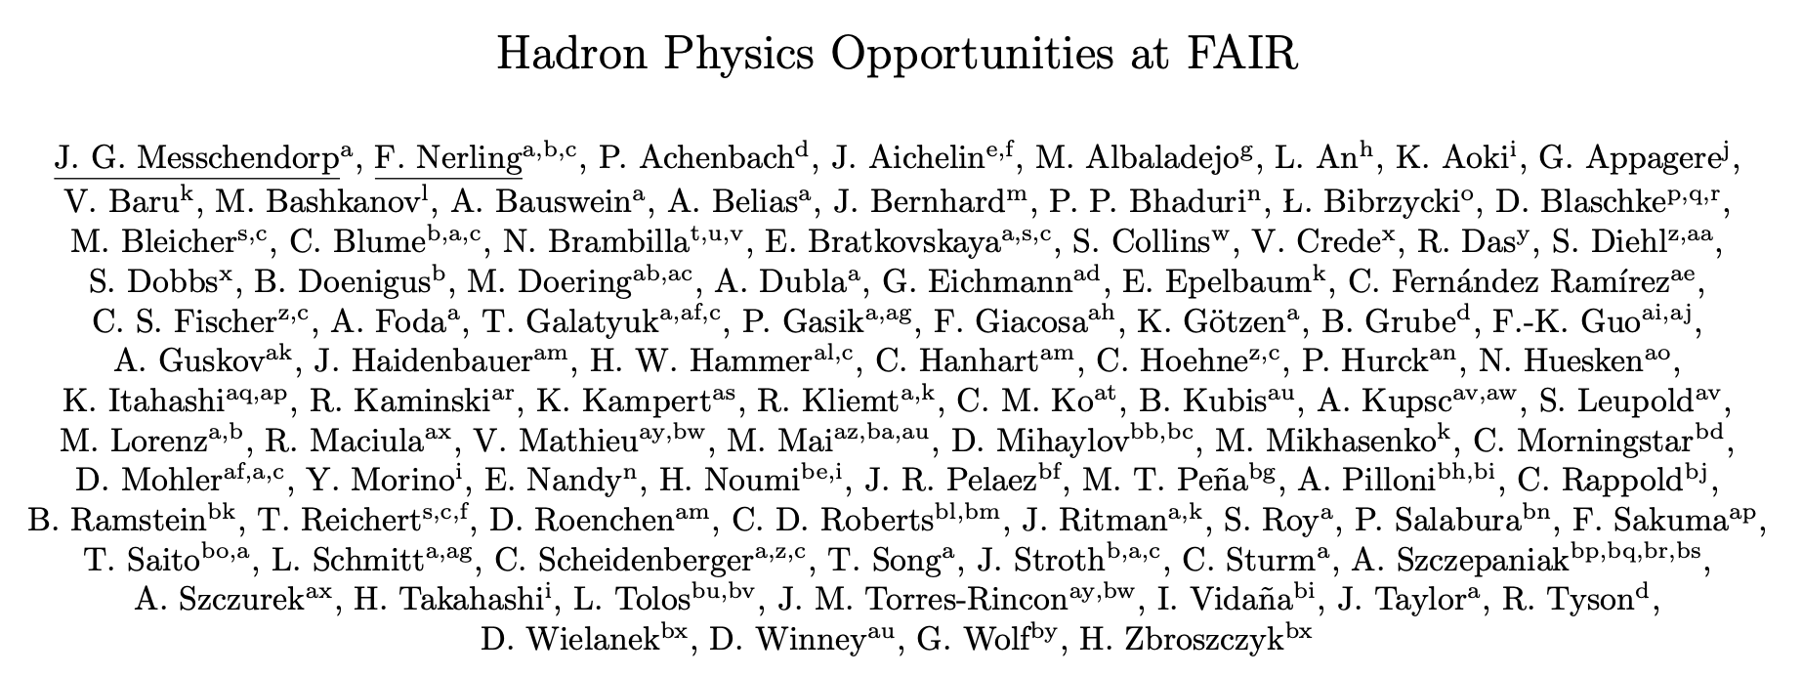
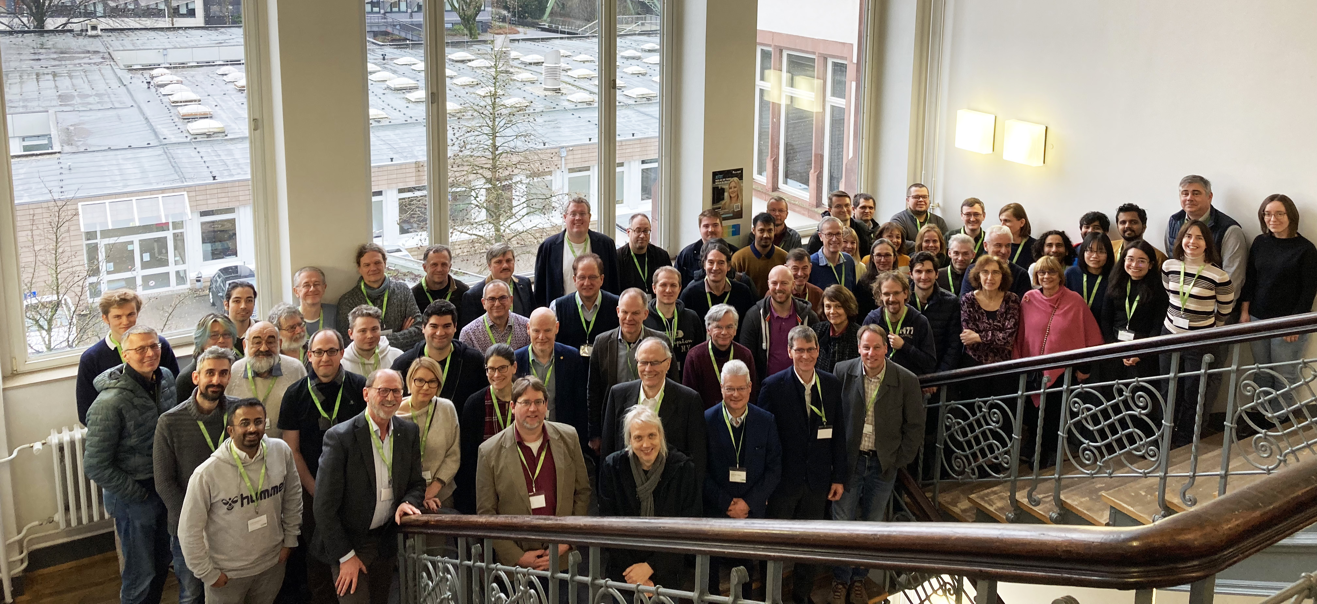
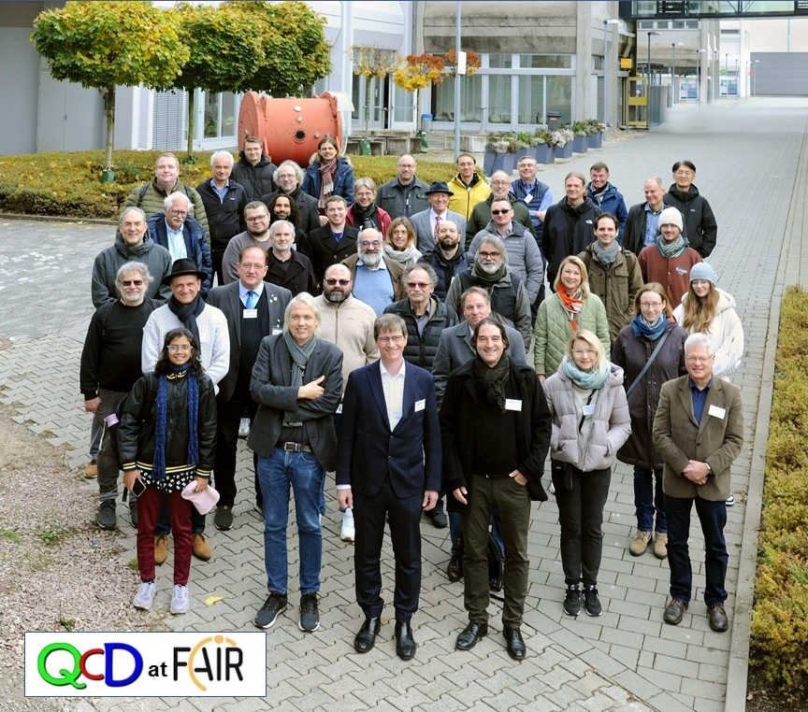
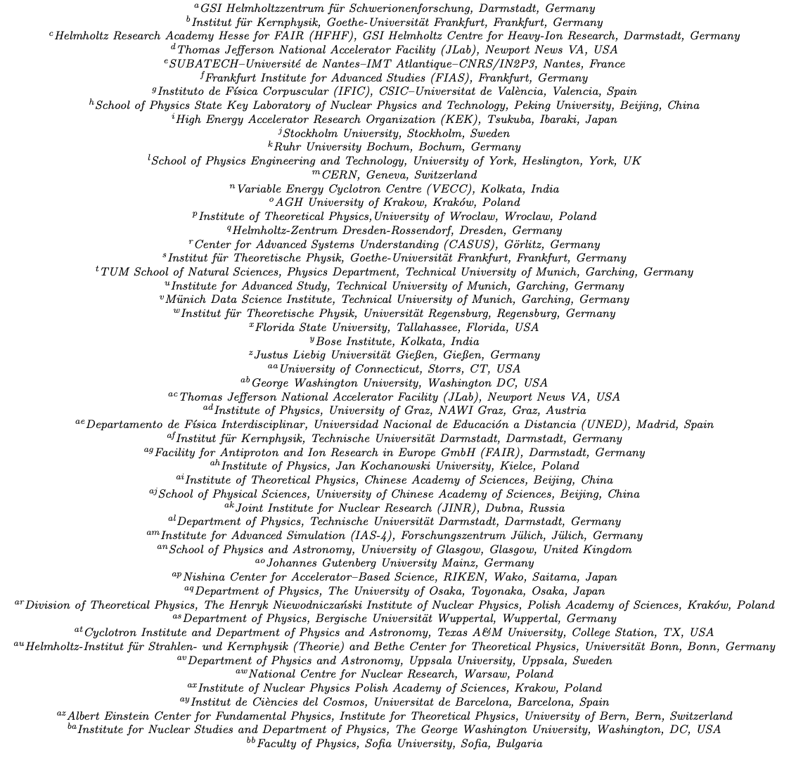
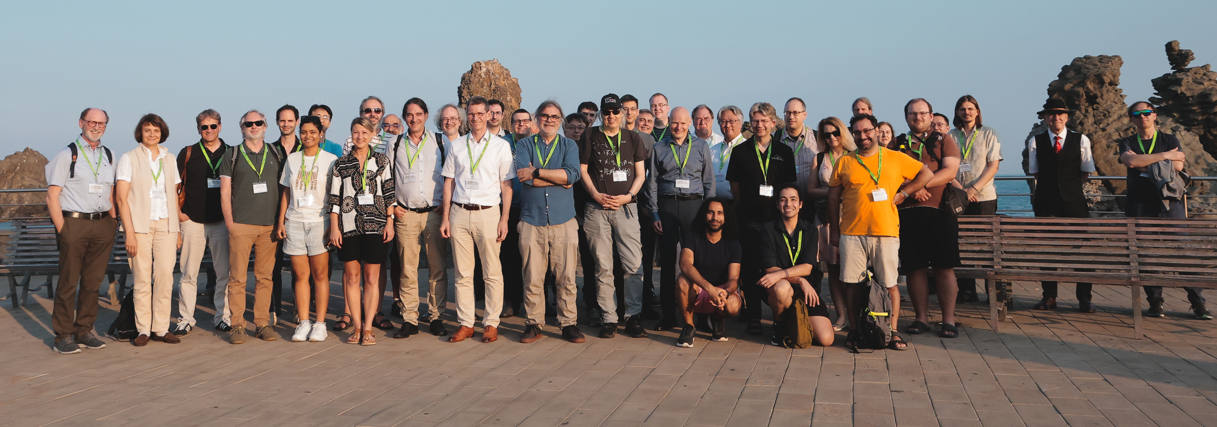
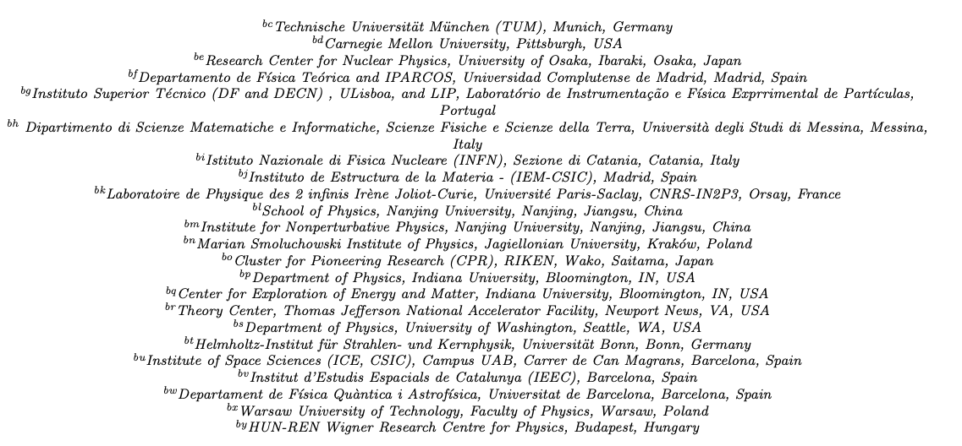
From ambition to community
MESON satellite, Cracow, Jun 21, 2023
Bring together experts from both theory and experiment
Form a community connecting the common interest among different QCD-driven scientists
Identify promising topics as a basis for a long-term hadron-driven physics program
Evaluate its complementarity with programs at other facilities
Publish a White Paper with focus on program for next decade
Wuppertal, Feb 6-9, 2024
GSI, Nov 11-14, 2024
In review by FAIR Joint Scientific Council (October 2025)
To be submitted to Progress in Particle and Nuclear Physics (December 2025)
Editors: J.M. & F.N.
~100 contributors
~270 pages
Sicily, Jun 22-27, 2025

Slide 4
Hadron Physics Opportunities at FAIR
… a White Paper: reviewing the state-of-art & outlining the program
Executive summary (J.G. Messchendorp, F. Nerling)
Key questions in strong interaction physics (J.G. Messchendorp, F. Nerling, C.D. Roberts)
Exploiting hadronic beams at GSI/FAIR (T. Galatyuk, J.G. Messchendorp, F. Nerling)
Hadron-hadron interactions (C. Blume, C. Hanhart)
Composition of hadrons (C. Fischer, P. Salabura)
Exotic hadrons (N. Brambilla, S. Dobbs)
Probing matter: from baselines to medium modifications (J. Aichelin, E. Bratkovskaya, M. Lorenz)
Connections & input to astro(particle) physics (K.H. Kampert, T. Saito, I. Vidana)
Theoretical tools and techniques (V. Crede, A. Pilloni, A. Szczepaniak)
Experimental facilities at GSI/FAIR (J. Ritman, C. Sturm)
International context (J. Ritman, C. Sturm)
Conclusions and outlook (J.G. Messchendorp, F. Nerling)

Slide 5
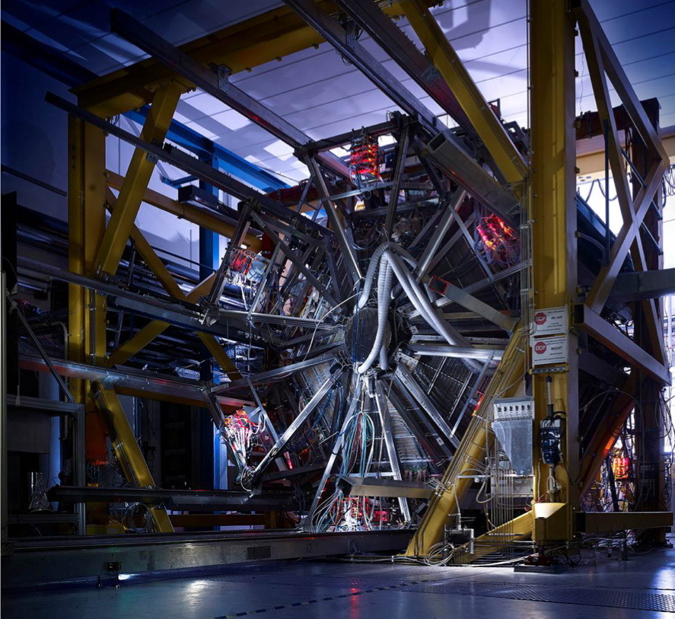
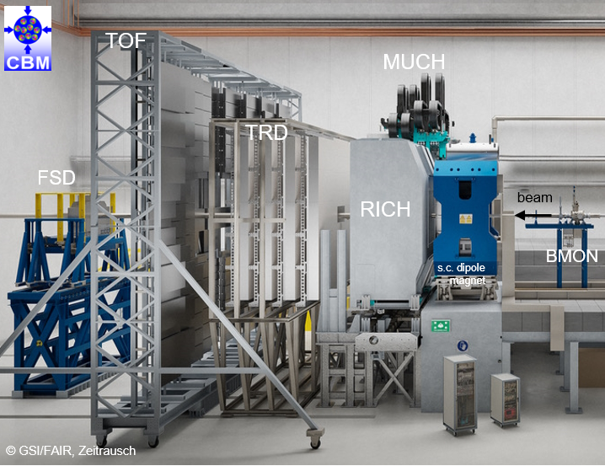
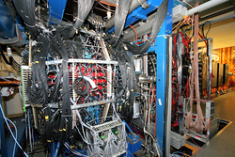
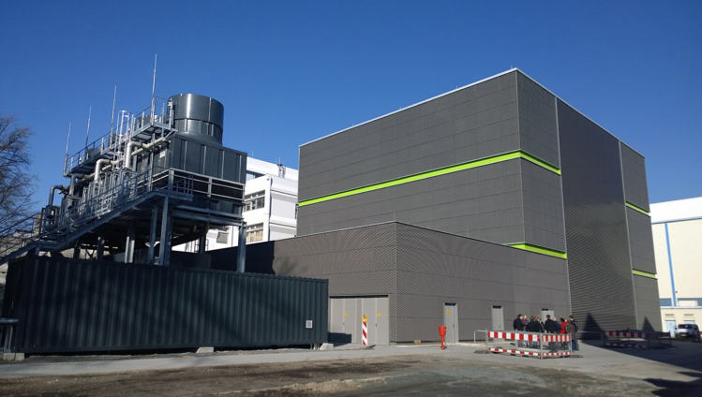
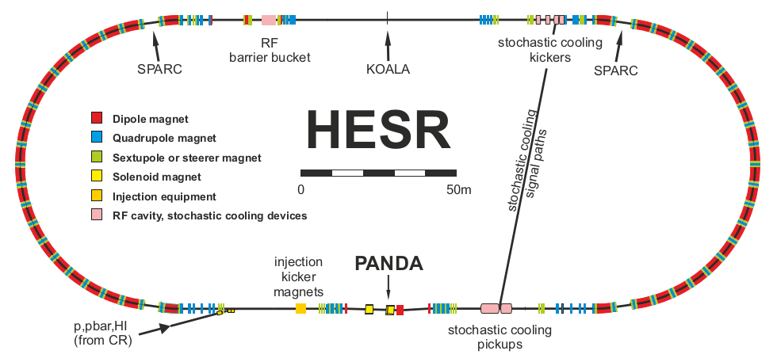
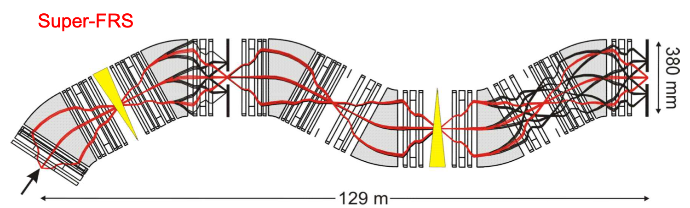
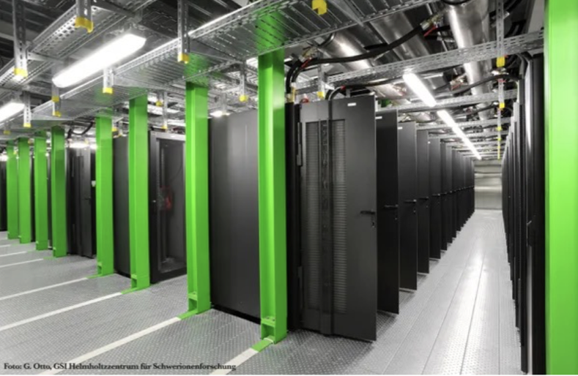


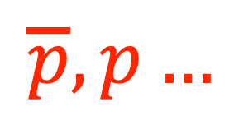
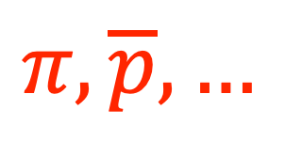
The hadron physics facilities
HADES
Coming soon
Today
WASA at FRS
$$π,p,d…$$
$$p,d…$$
Data processing, AI, …
CBM
Future
Coming soon
$$π,\overline{p},…$$
$$\overline{p},p…$$
Today
(Anti)proton experiments at HESR
Super-FRS
Green-IT Cube

Slide 6
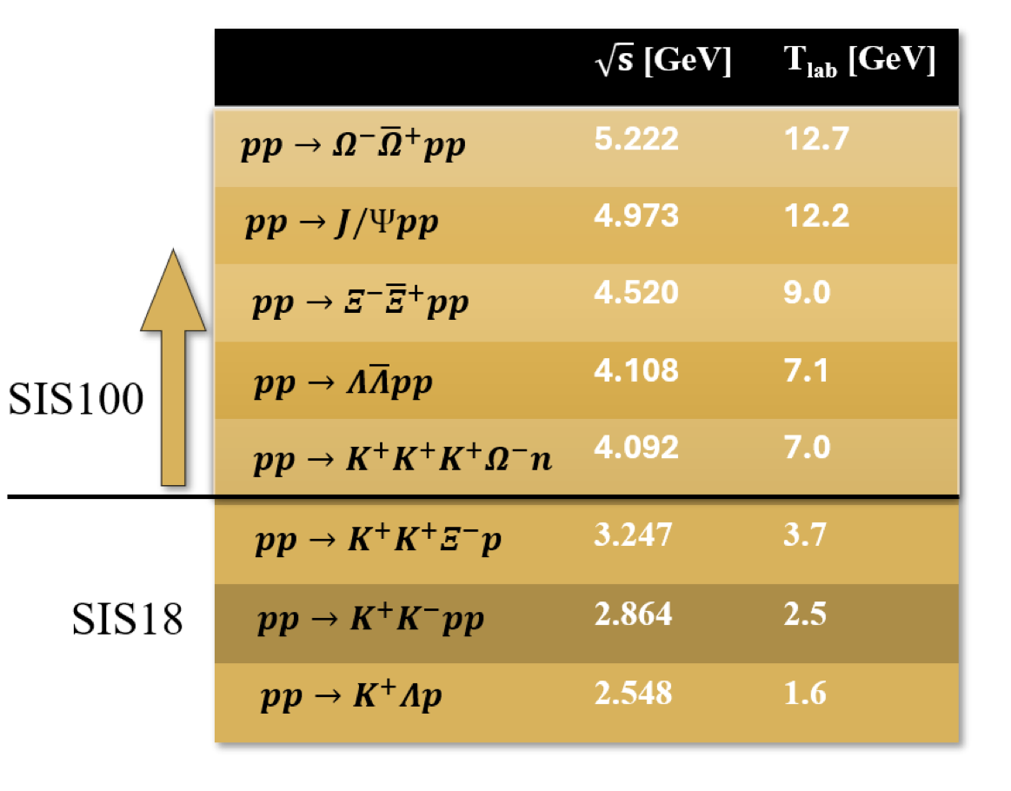

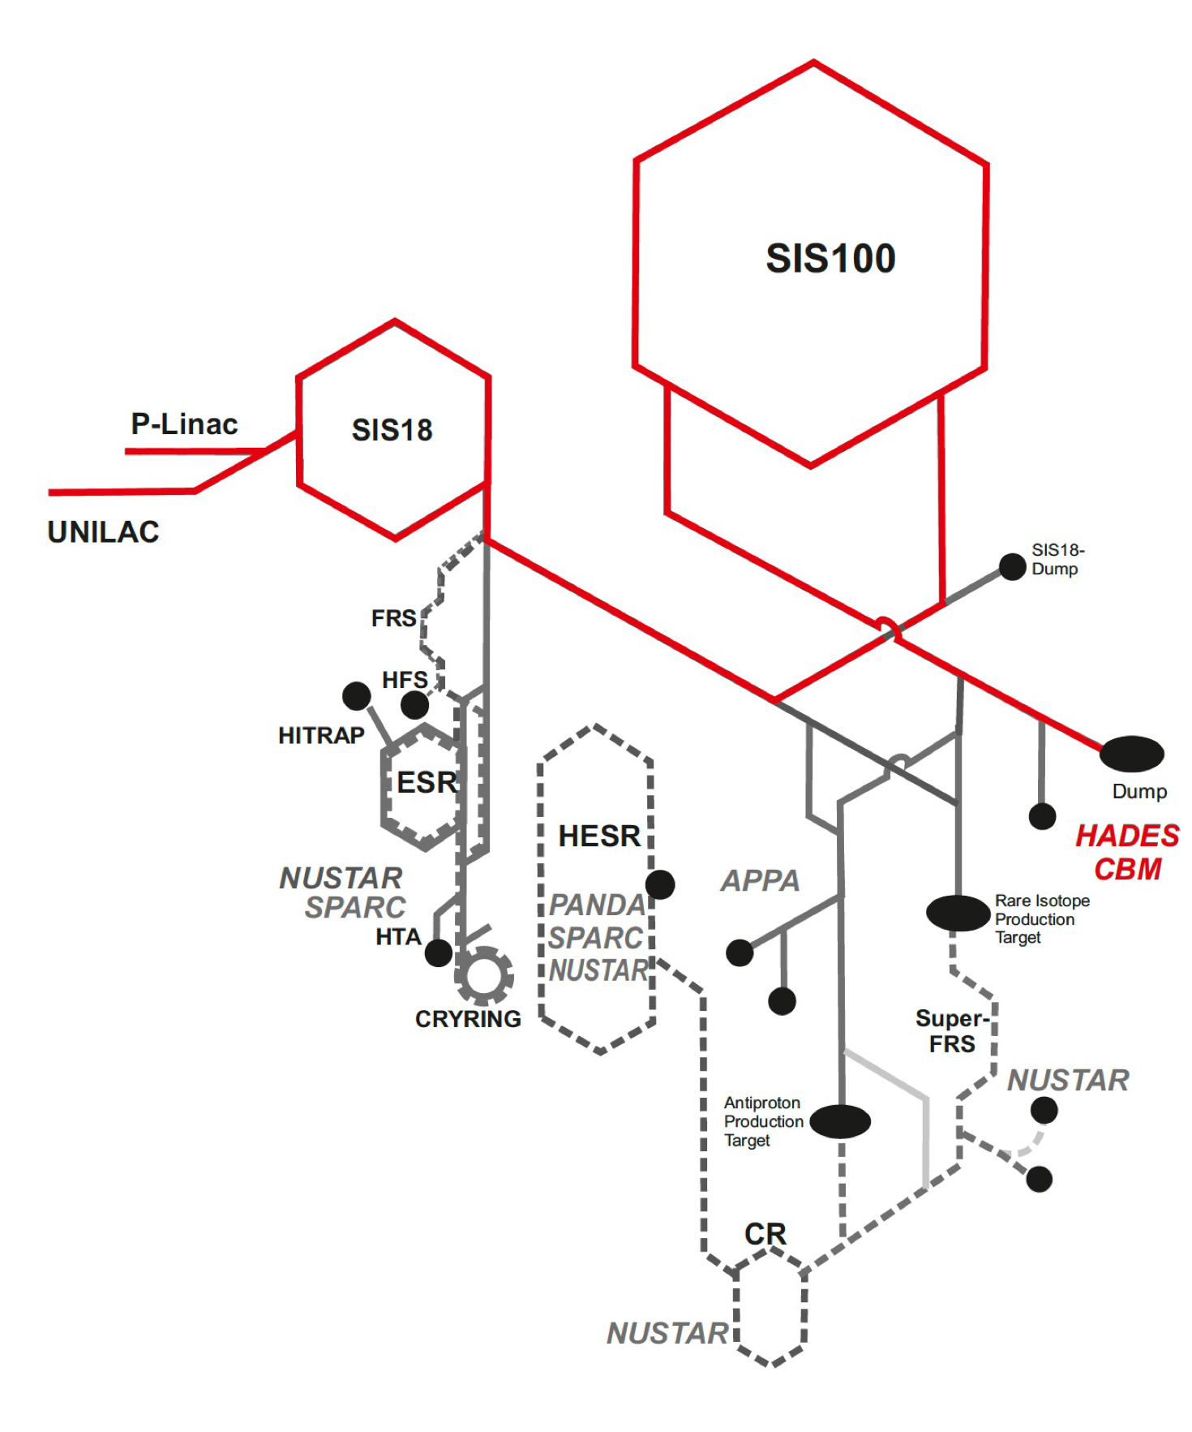
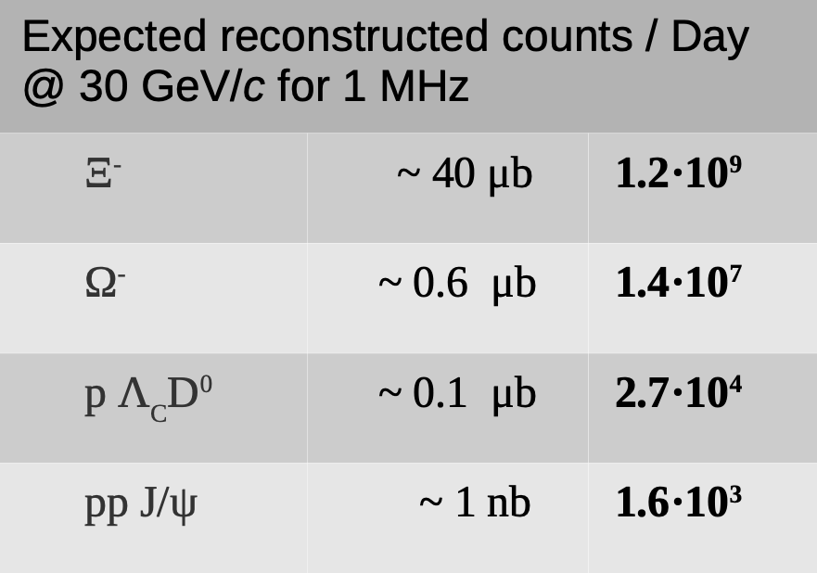
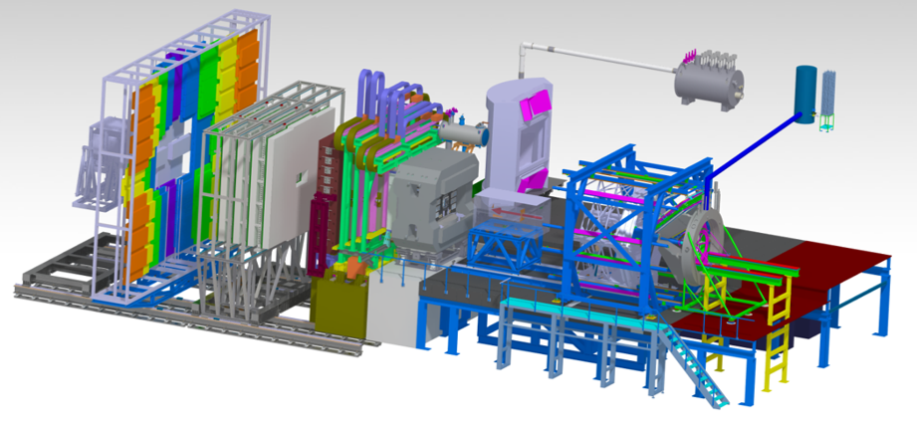

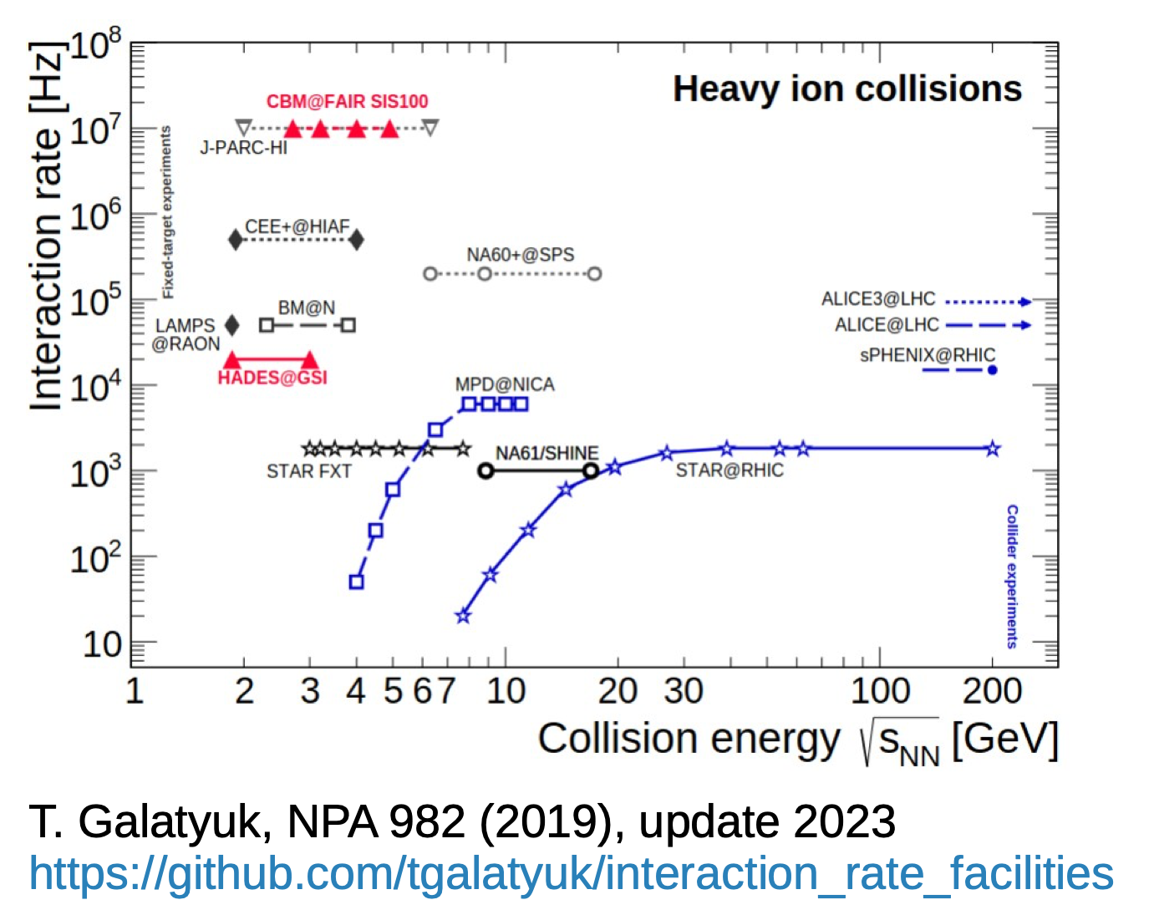
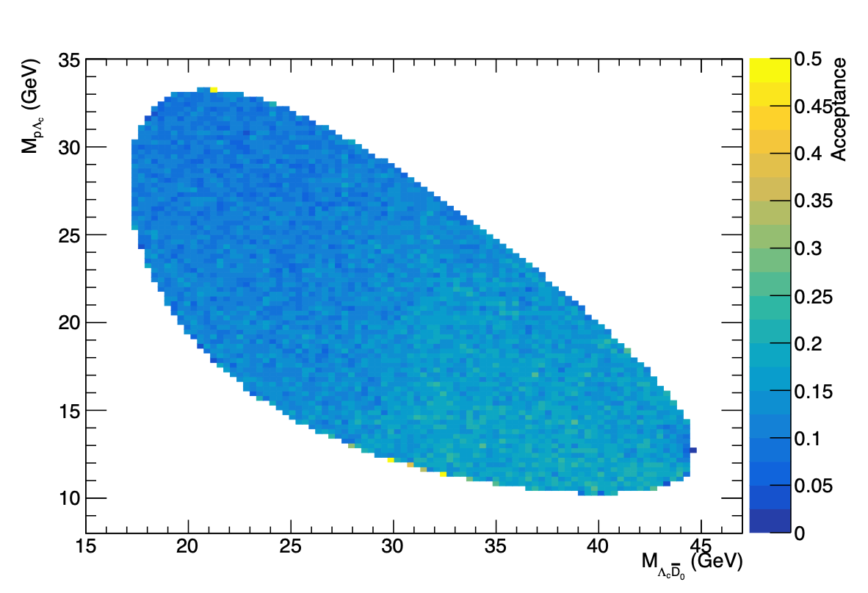





From SIS18 to SIS100
…what could that add in hadron physics with protons?
Energy upgrade:
From T=0.2-5 GeV (SIS18) to T=4-29 GeV (SIS100): $\sqrt{s_{NN}^{max}}≈3.5GeV→7.6GeV$
Opening new realm: double+triple strangeness and even charm baryons and mesons!
Significant increase in production yield of hyperons
Intensity upgrade:
From max #protons of 10¹¹/s (SIS18) to 10¹³/s (SIS100)
Detector enrichments:
Towards high-rate capabilities and free-streaming DAQs
Theory enrichment:
Terra incognita: intellectual challenges in this energy regime!
$$→Λπ^{−}$$
$$→ΛK^{−}$$
Jenny Taylor FastSim
5%
3.8%
Fast Simulations, J.M.
Notes:
—> near threshold charm production: what are the processes producing charm: multistep? Partonic d.o.f.? Is one sensitive to intrinsic charm of nucleon? Can one extract mass radius from low-energy FSI proton-J/psi?

Slide 7


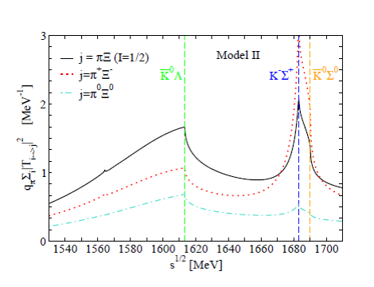

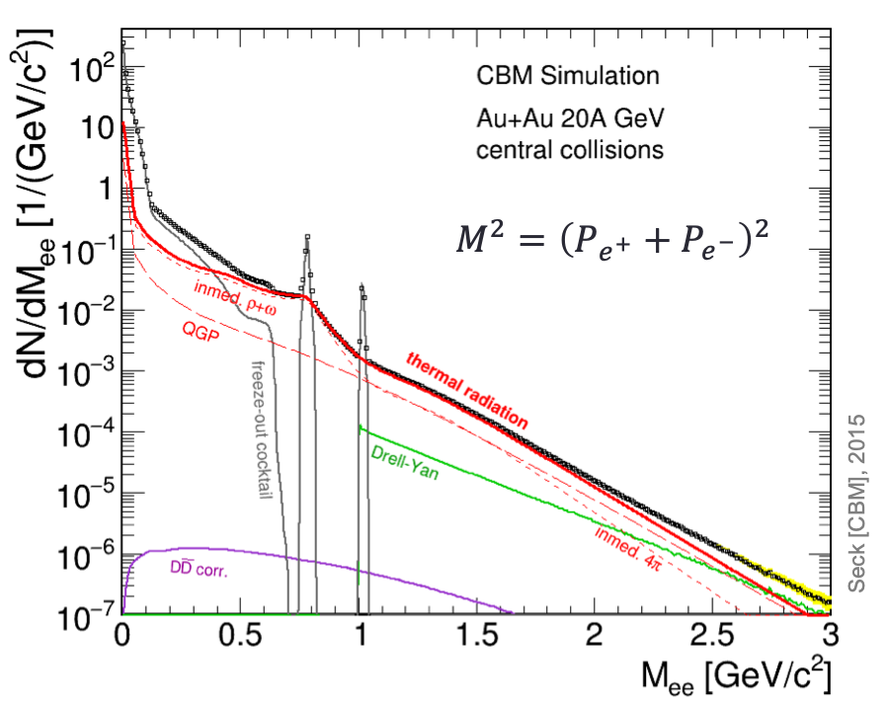

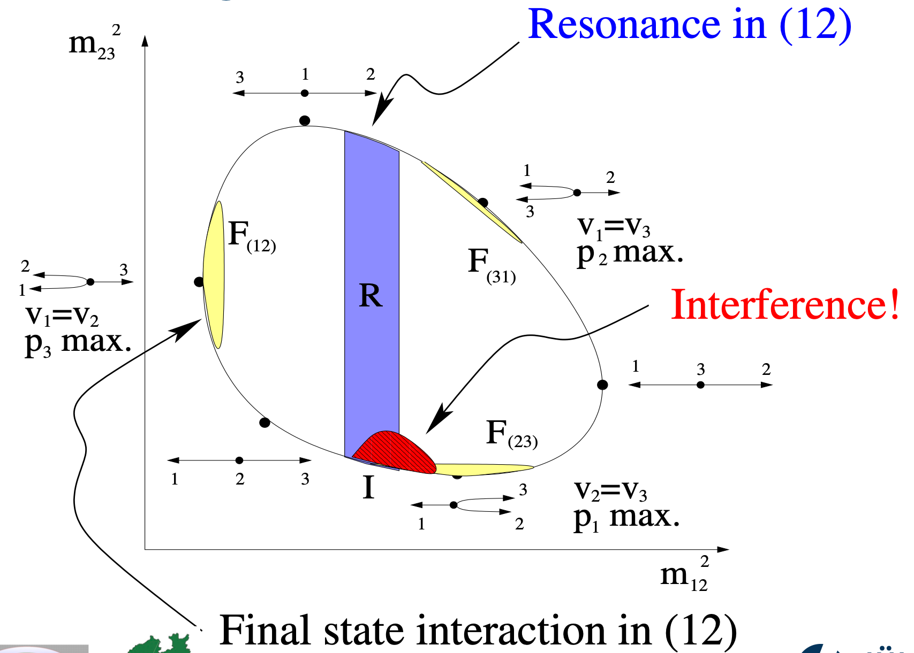

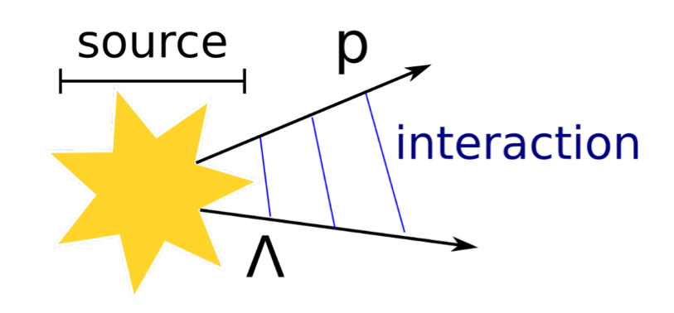

A comprehensive QCD program with SIS100!
Composition of hadrons
Hadron structure
Hadron spectroscopy
Mass-radius of the proton
Emergent Hadron Mass
SU(3) baryon-like spectroscopy
Intrinsic charm of the proton
protons@SIS100
$N→N/Δ$ GPDs via 2->3 hadronic reactions
E.m.+weak transition Form Factors of hyperons
Strange and charm
High intensity
Versatile detectors
High-rate capabilities
…
Polarisation sources
Line-shape measurements of hyperon resonances
Dilepton production sources
Near-threshold (anti) strange and charm production
Femtoscopy
Charm-nucleon interactions
Reference measurements for p+A, A+A
Production mechanisms axial and vector mesons
Search for exotic form of hadrons
Production mechanisms of hadrons
Hypernuclei via spallation
Few-body interactions
Final-state interactions using PWA
Hadron production
Nuclear modification factors
Heavy-ion dynamics
Microscopic study of hadron-hadron interactions

Slide 8

A comprehensive QCD program with SIS100!
Hadron structure
Hadron spectroscopy
C. Hanhart
Few-body interactions
Hadron production
Heavy-ion dynamics

Slide 9
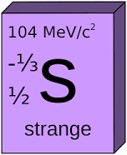
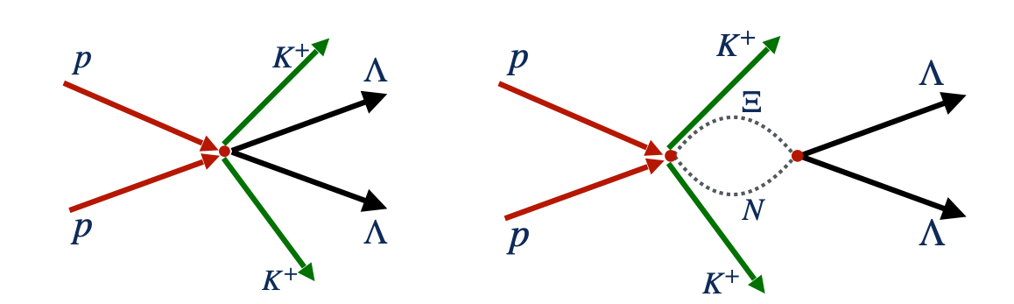

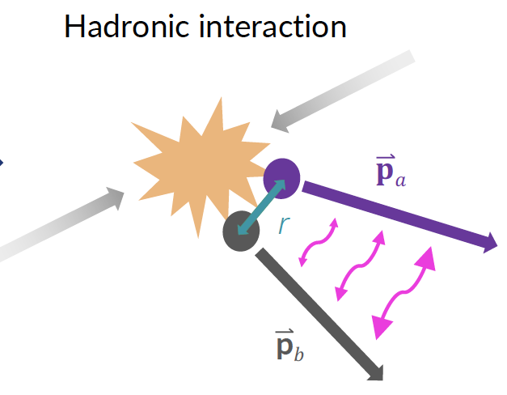


Baryonic $S=−2$ interaction studies
… scattering parameters from short-ranged production reactions
Systematic extraction of low-energy scattering parameters of two-baryon systems with strangeness $S=−2$
$ΛΛ/ΞN$: scattering lengths from threshold cusps within NREFT*
$Σ^{+}Σ^{+}$: dispersive analysis of short ranged production reactions
Complementary approach to Femtoscopy (in $pp$)
*see e.g. scattering lengths in $Λ_{b}→π^{−}pD^{0}$, [LHCb PLB 808 (2020) 135623]
R. Del Grande

Slide 10

A comprehensive QCD program with SIS100!
Hadron structure
Hadron spectroscopy
Few-body interactions
Hadron production
Heavy-ion dynamics

Slide 11
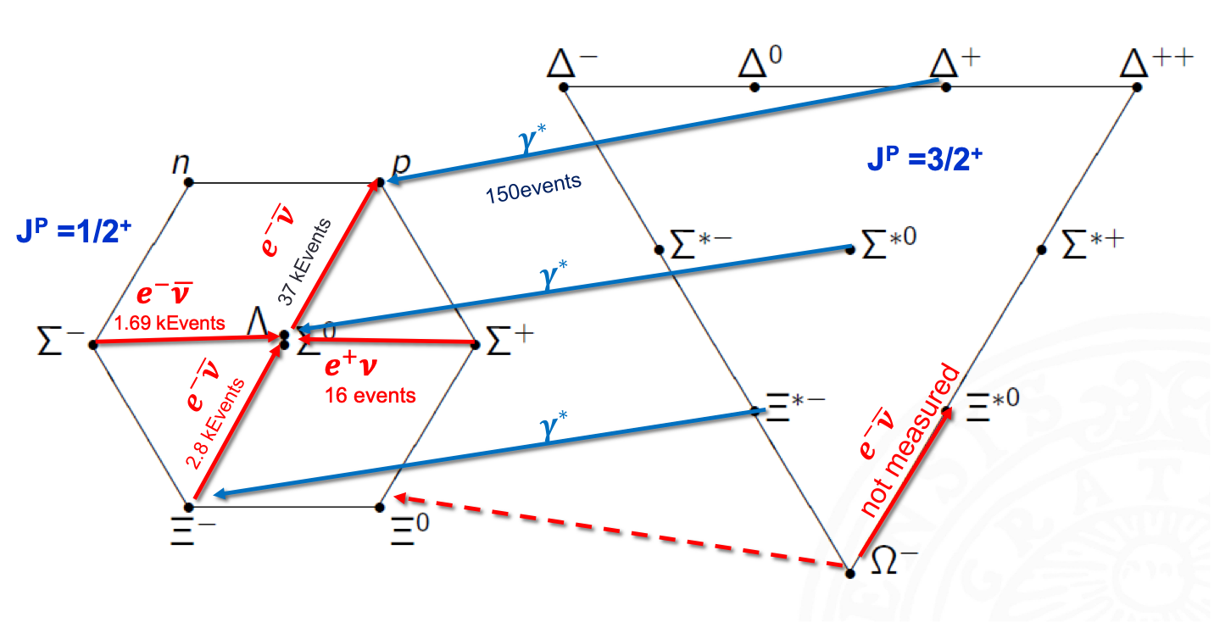
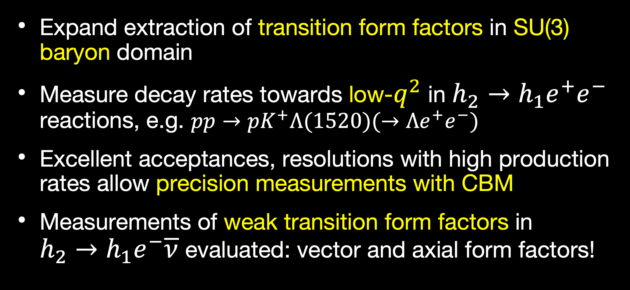
Hyperon structure
… e.m. & weak transition form factors
Expand extraction of transition form factors in SU(3) baryon domain
Measure decay rates towards low-$q^{2}$ in $h_{2}→h_{1}e^{+}e^{−}$ reactions, e.g. $pp→pK^{+}Λ(1520)(→Λe^{+}e^{−})$
Excellent acceptances, resolutions with high production rates allow precision measurements with CBM
Measurements of weak transition form factors in $h_{2}→h_{1}e^{−}\overline{ν}$ evaluated: vector and axial form factors!
P. Salabura

Slide 12
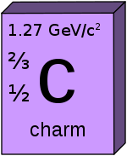

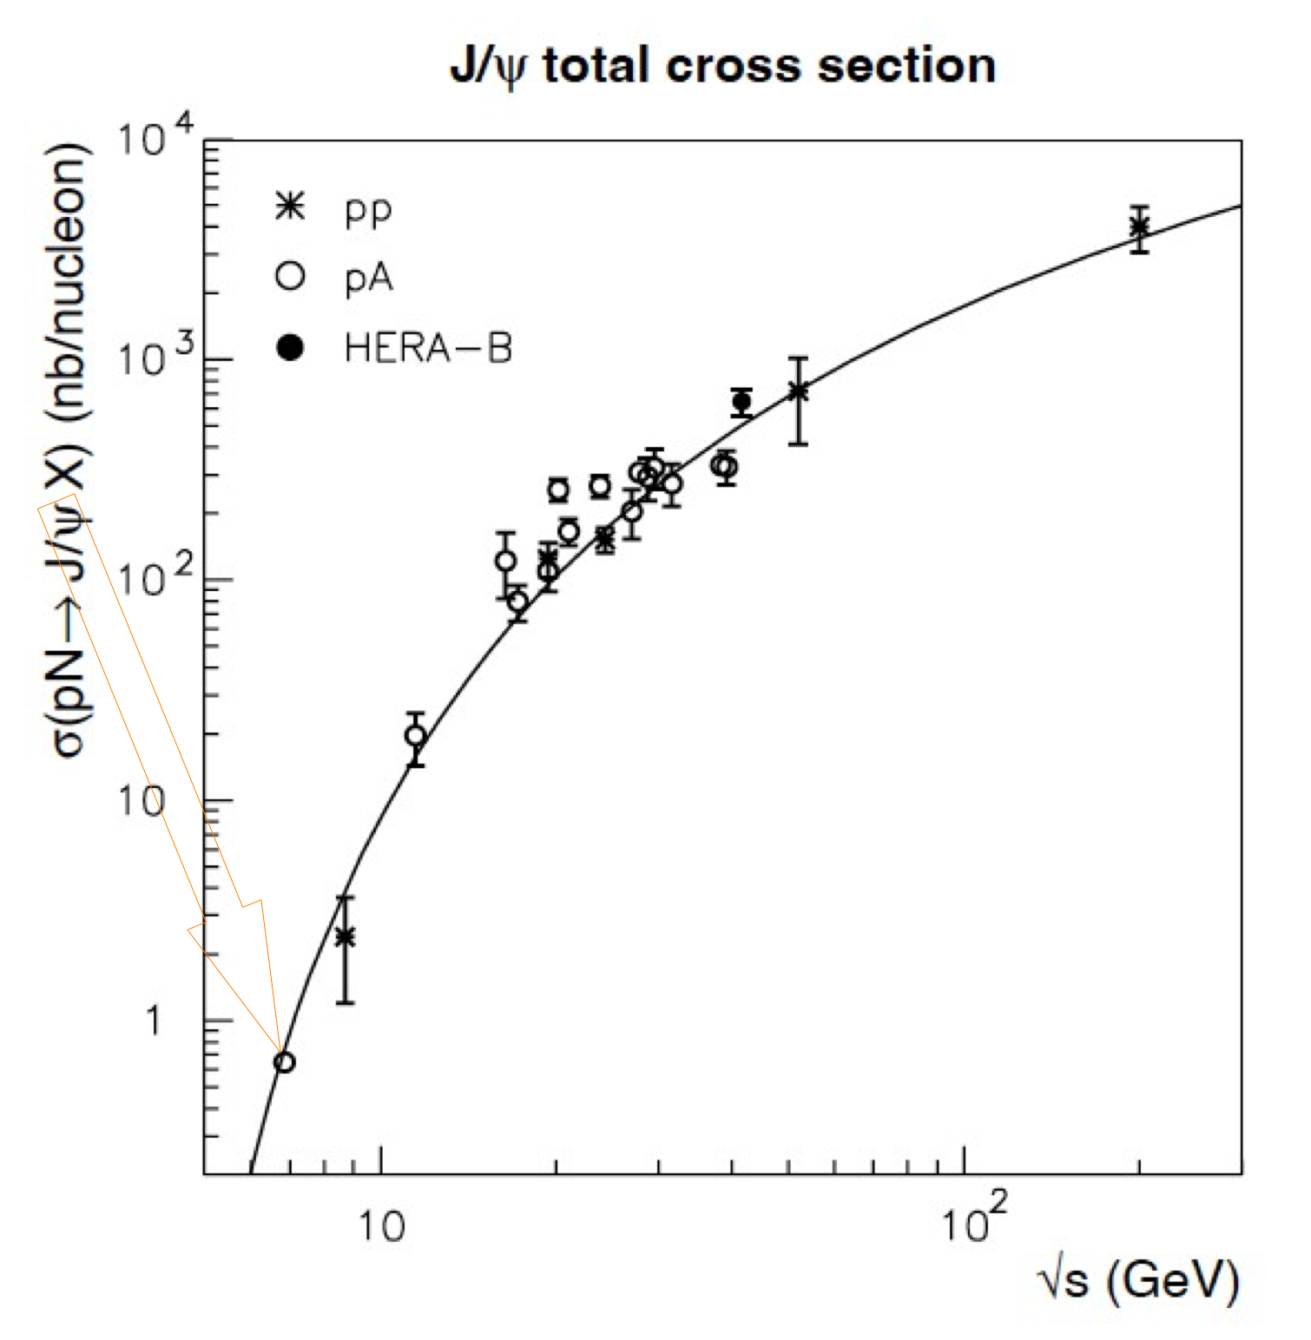

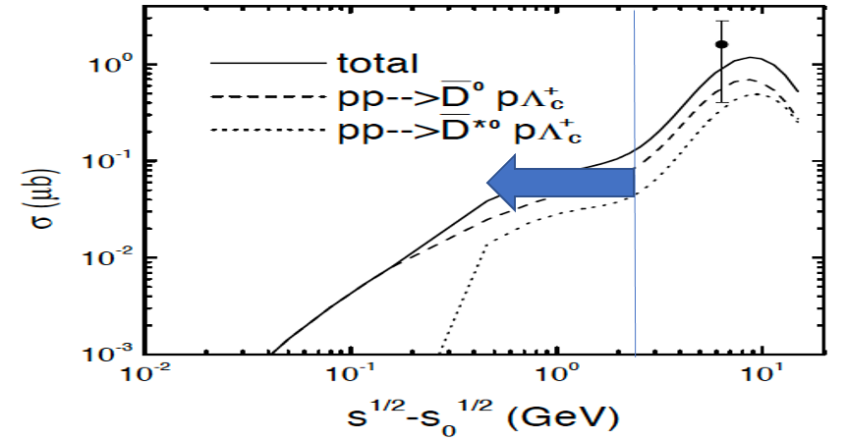
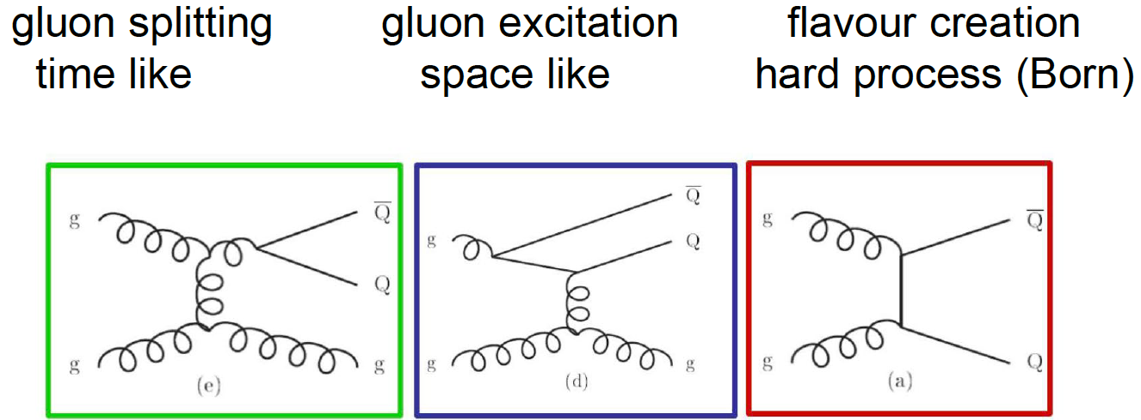
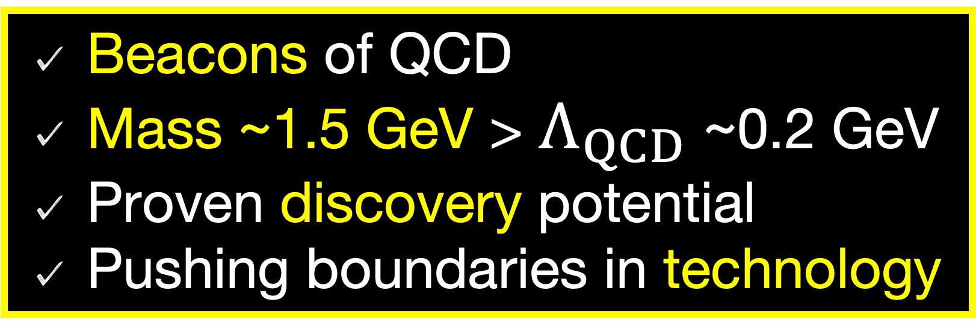
A comprehensive QCD program with SIS100!
Beacons of QCD
Mass ~1.5 GeV > $Λ_{QCD}$ ~0.2 GeV
Proven discovery potential
Pushing boundaries in technology
SIS100
J. Aichelin
Liu, Ko, Lee NPA728 (2003) 457
Notes:
Short formation time —> HI
Systematic approaches pQCD and EFT possible

Slide 13
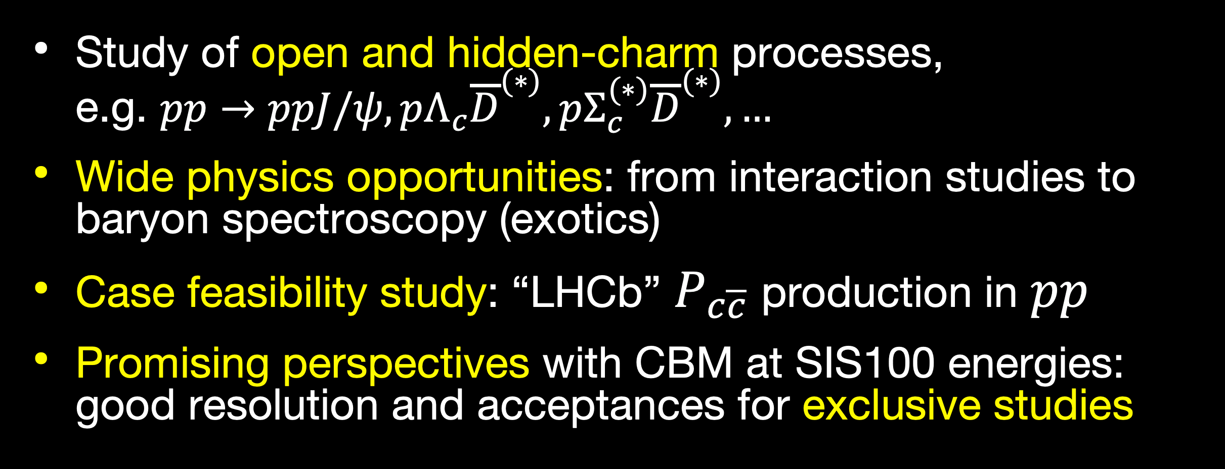
Charming baryons
… hidden-charm pentaquarks and more
Study of open and hidden-charm processes, e.g. $pp→ppJ/ψ,pΛ_{c}{\overline{D}}^{(∗)},pΣ_{c}^{(∗)}{\overline{D}}^{(∗)},…$
Wide physics opportunities: from interaction studies to baryon spectroscopy (exotics)
Case feasibility study: “LHCb” $P_{c\overline{c}}$ production in $pp$
Promising perspectives with CBM at SIS100 energies: good resolution and acceptances for exclusive studies

Slide 14
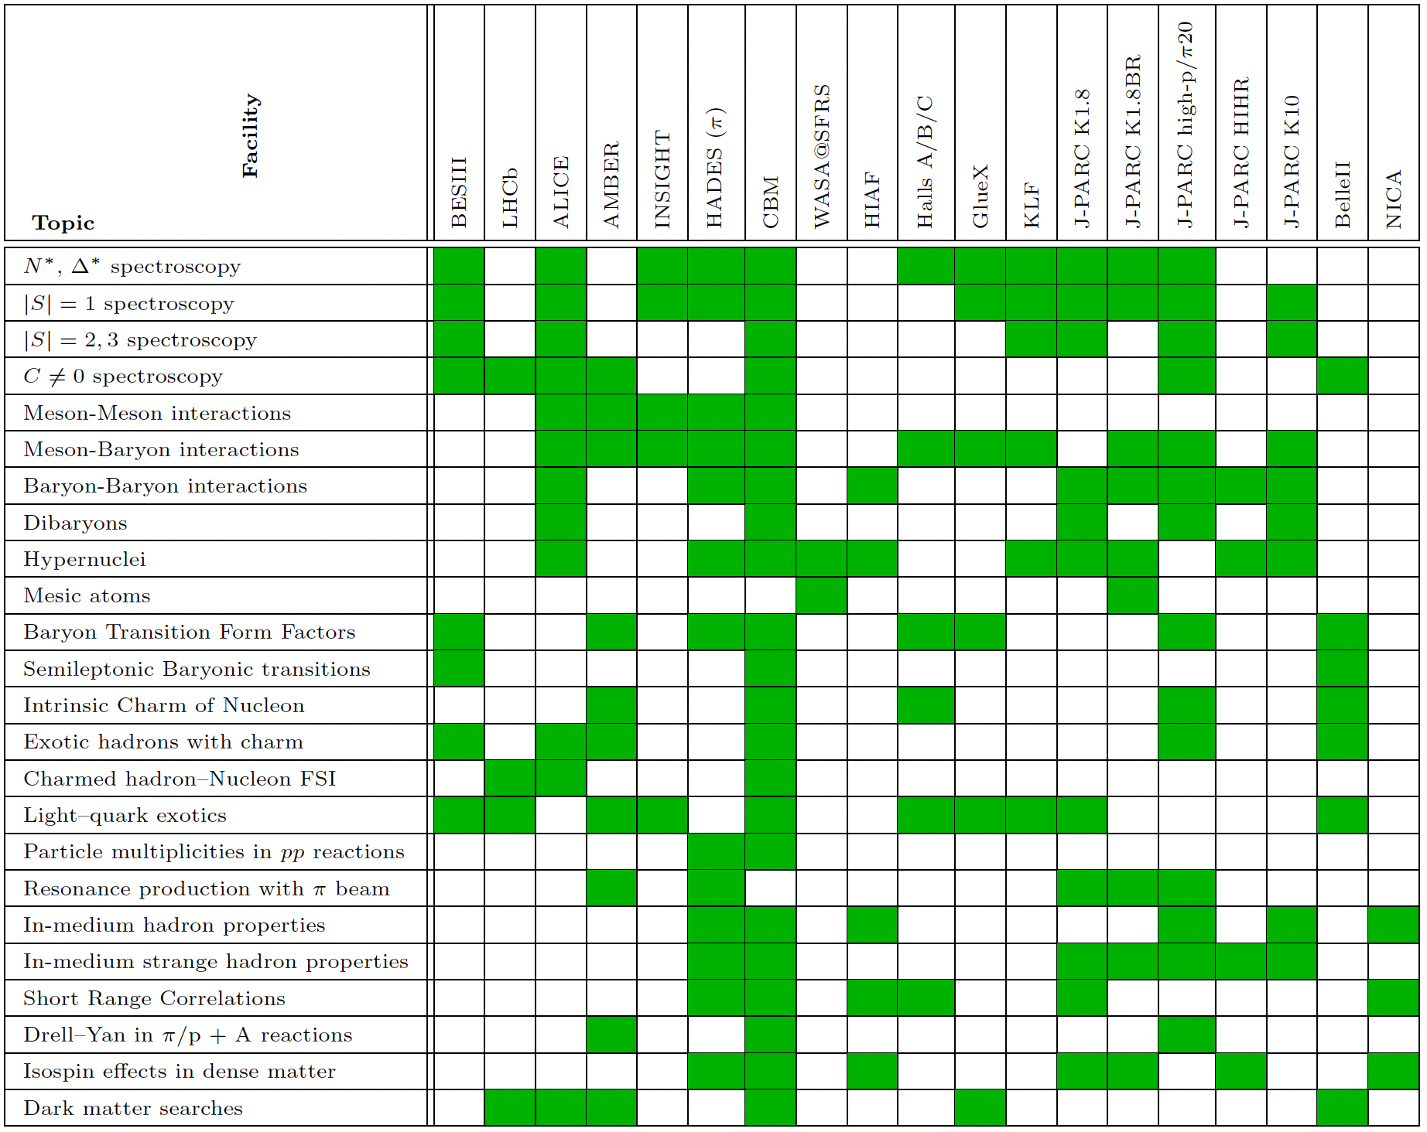
International Comparison

Slide 15
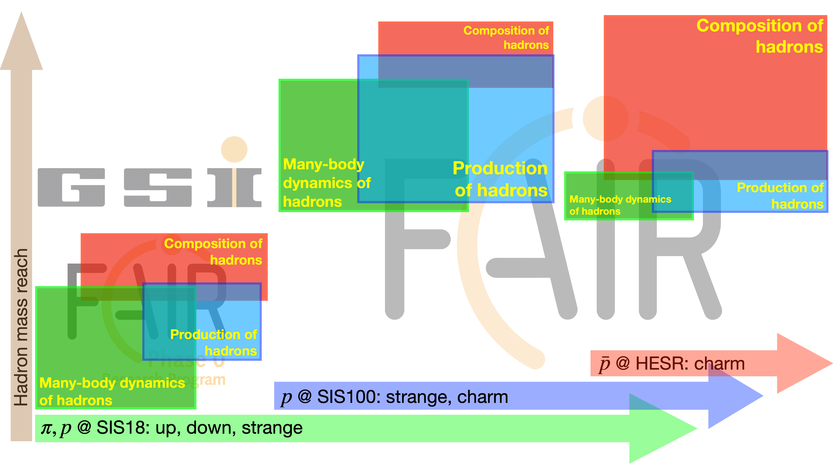
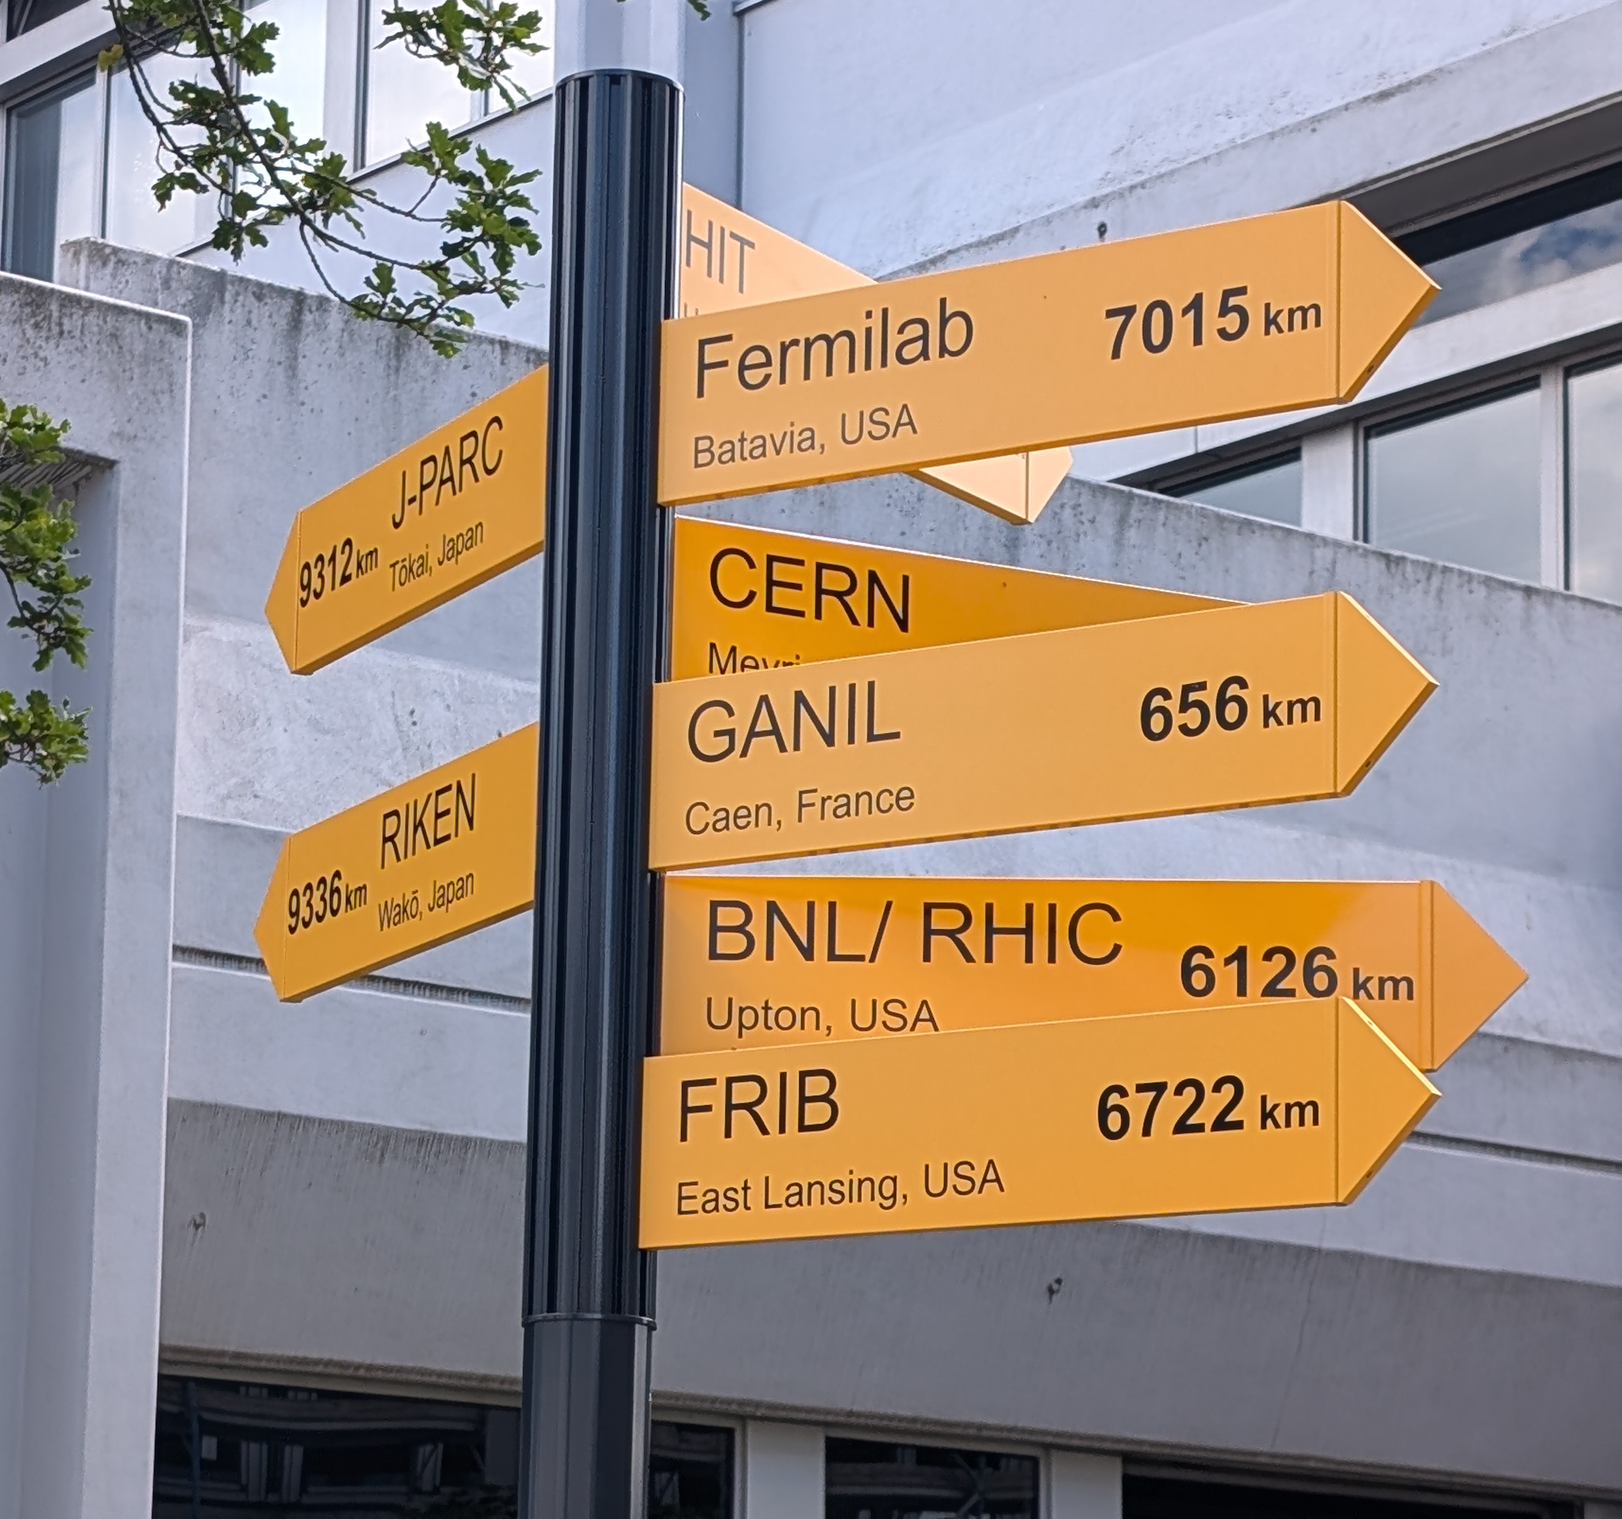
at
Hadron Physics Opportunities at FAIR
Develop a comprehensive ‘strong QCD’ program exploiting FAIR infrastructures for next decade(s).
Co-develop with the state-of-the-art in theory to stay on the scientific frontier.
Adopt an inclusive, international model uniting researchers across communities.
CBM plays a central role in this endeavor.
Achievements so-far: establish new network, White Paper draft, endorsement by FAIR management, JSC review in progress, new research group at RUB, …

Slide 16
spares

Slide 17
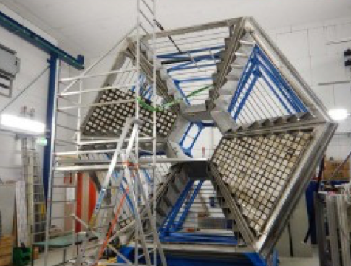














ECAL
“Hadron physics meets heavy-ion physics”
CBM
RICH
HADES
Today
LGAD
T0
$$π,p,d…$$
HADES = high-acceptance dilepton spectrometer and much more!
Outstanding in dilepton spectrometry
Excellent tracking & PID capabilities
Modular at forward angles
Additional photon detection
Good angular coverage
Designed for various SIS18 beams
Including pion beams!
Multi-purpose application
Including exclusive studies in $pp and πp$ reactions
October 2023

Slide 18



${HAD}_{RON}^{ES}$ Physics with Pion Beams
$$π$$
https://hades.gsi.de/sites/default/files/web/media/documents/proposals/HADES_Proposal_Pion_Update-1.pdf

Slide 19






The physics case
$$Δ^{++}→pπ^{+}$$
$$,(ππ),K,…$$
…with the pion-beam facility
$$,N^{∗},Λ/Σ^{(∗)},…$$
The pion-nucleon system elementary in hadron, nuclear, and heavy-ion physics
‘Simple’ initial state with spin-zero boson; ’Simple’ final states, 2/3-bodies
$\sqrt{s}$ coverage and scan up to ~2 GeV, [complementary to CB/ELSA]
Access to many observables: xsecs, BF’s, SDMEs, strangeness, polarization hyperons
Precision studies combining hadron dynamics and electromagnetic structure
Shklyar, Lenske, Mosel, PRC93, 045206 (2016)
2014
2026-20xx?

Slide 20








The physics case
$$Δ^{++}→pπ^{+}$$
…observations with high impact
$$π^{−}p→ππN$$
Adapted from I. Ciepal
Thermal emissivity
Hadron
Production
Hadron
Structure
—> 8 new entries in PDG!
arXiv:2205.15914, PRC102, 024001 (2020), arXiv:2309.13357 (accepted PRC)
Notes:
Ramalho: covariant spectator-quark model (CSM)
In-medium propagator in UrQMD

Slide 21



The physics case
$$Δ^{++}→pπ^{+}$$
…observations with high impact
dense matter studies
hadron studies
Thermal emissivity
$$Dominant:N^{∗}(1520)→Ne^{+}e^{−}$$
Rapp, Wambach, Adv. Nucl. Phys. 25, 1 (2000)
Heavy-ion
Dynamics
Hadron
Structure
HADES, Nature Phys. 15 (2019), 10, 1040
arXiv:2205.15914, PRC102, 024001 (2020), arXiv:2309.13357 (accepted PRC)
Notes:
In-medium spectral function, including thermal radiation component

