Slide 1
Closeout
Tetyana Galatyuk, GSI / TU Darmstadt
46th CBM Collaboration Meeting
October 19-24, 2025

Slide 2
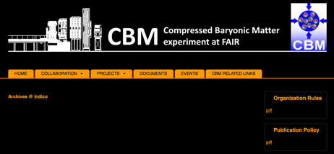
CBM Organigram
CB e-voting on CBM Bylaws (modifications regarding the implementation of the e-voting procedure and regarding the implementation of the position of the Run Coordinator instead of an Operations Board (chaired by the Operations Coordinator)
concluded on Jun 30th (Yes: 38 + 5/3 = 39 2/3 votes; No: 0 votes; Abstain: 1/3 vote)

Slide 3
CBM Organigram

Slide 4
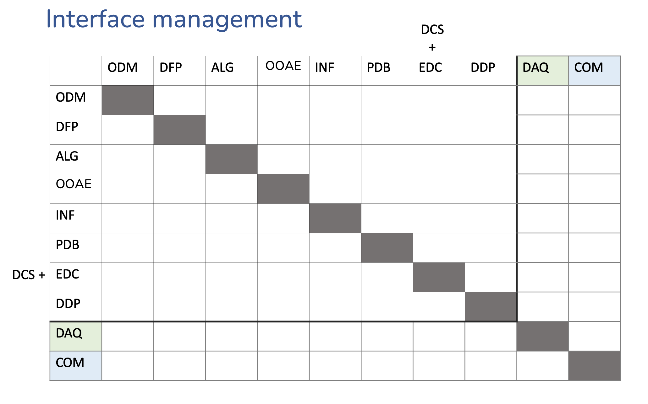
CBM computing
+
DCS
Priority: perform “data challenge” for full CBM based on realistic simulations

Slide 5
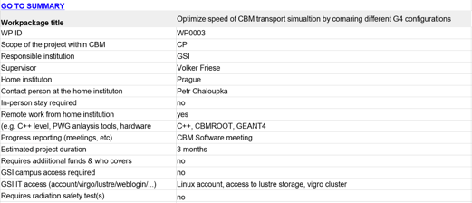
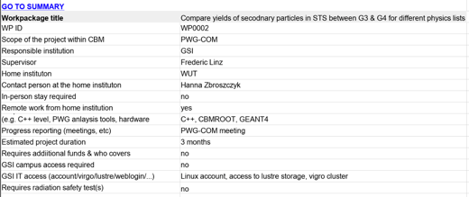
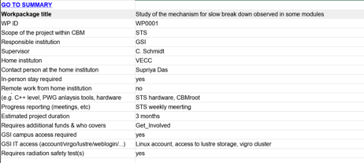
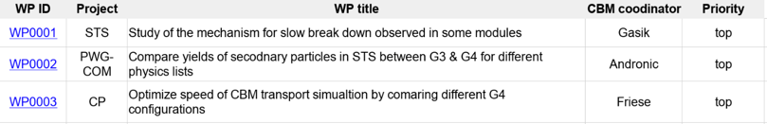
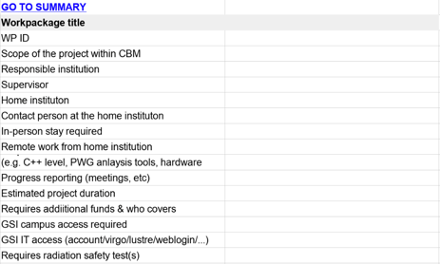
CBM Internships proposal on how to (→ Common tasks, Development tasks, Service tasks)
Proposal for general structure Chris, Ilya, TG – template available
https://docs.google.com/spreadsheets/d/1BjwLWBRvvjKs8MsWaImkUwy_B_88iBhsuhB84cPvncE/edit?usp=sharing
https://sf.gsi.de/f/5b7361f0bff94b44a833/
Send a call for proposals to be filled out following the Template and sent to TC, CC and PC
Procedure user account management, see https://cbm-wiki.gsi.de/Computing/CbmComputingAccount

Slide 6
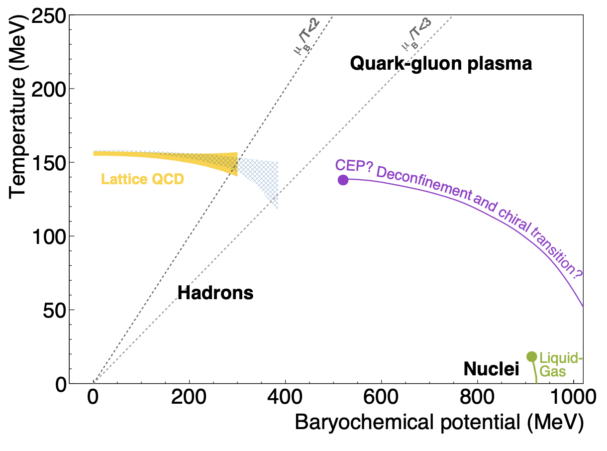

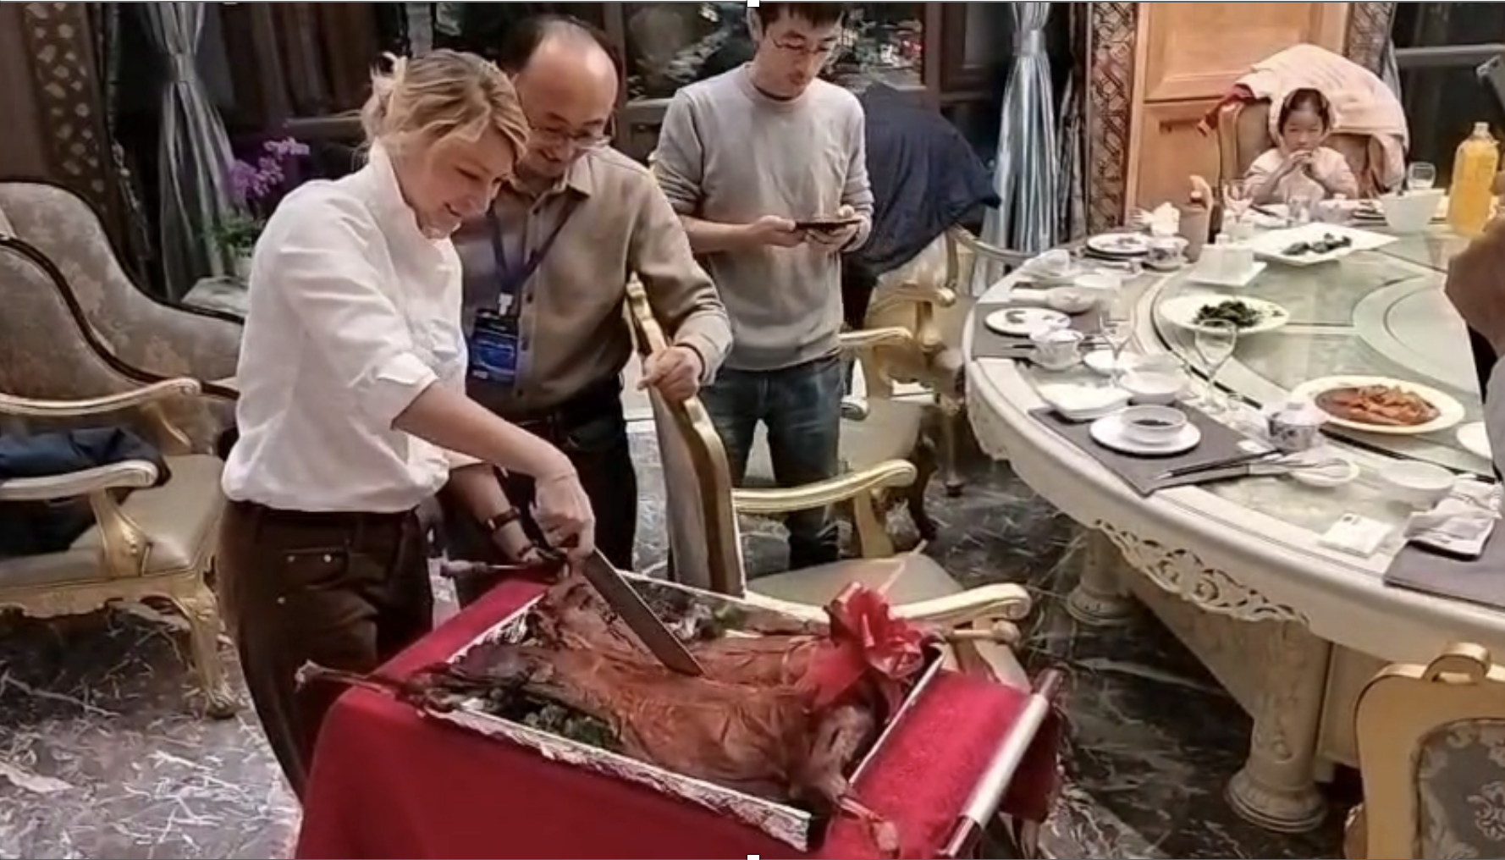
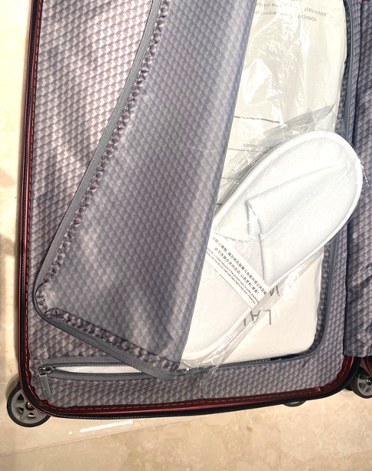
谢谢

Slide 7
