Slide 1
CAVE - CBM services
46th CBM Collaboration Meeting
Jens Thaufelder (GSI)

Slide 2
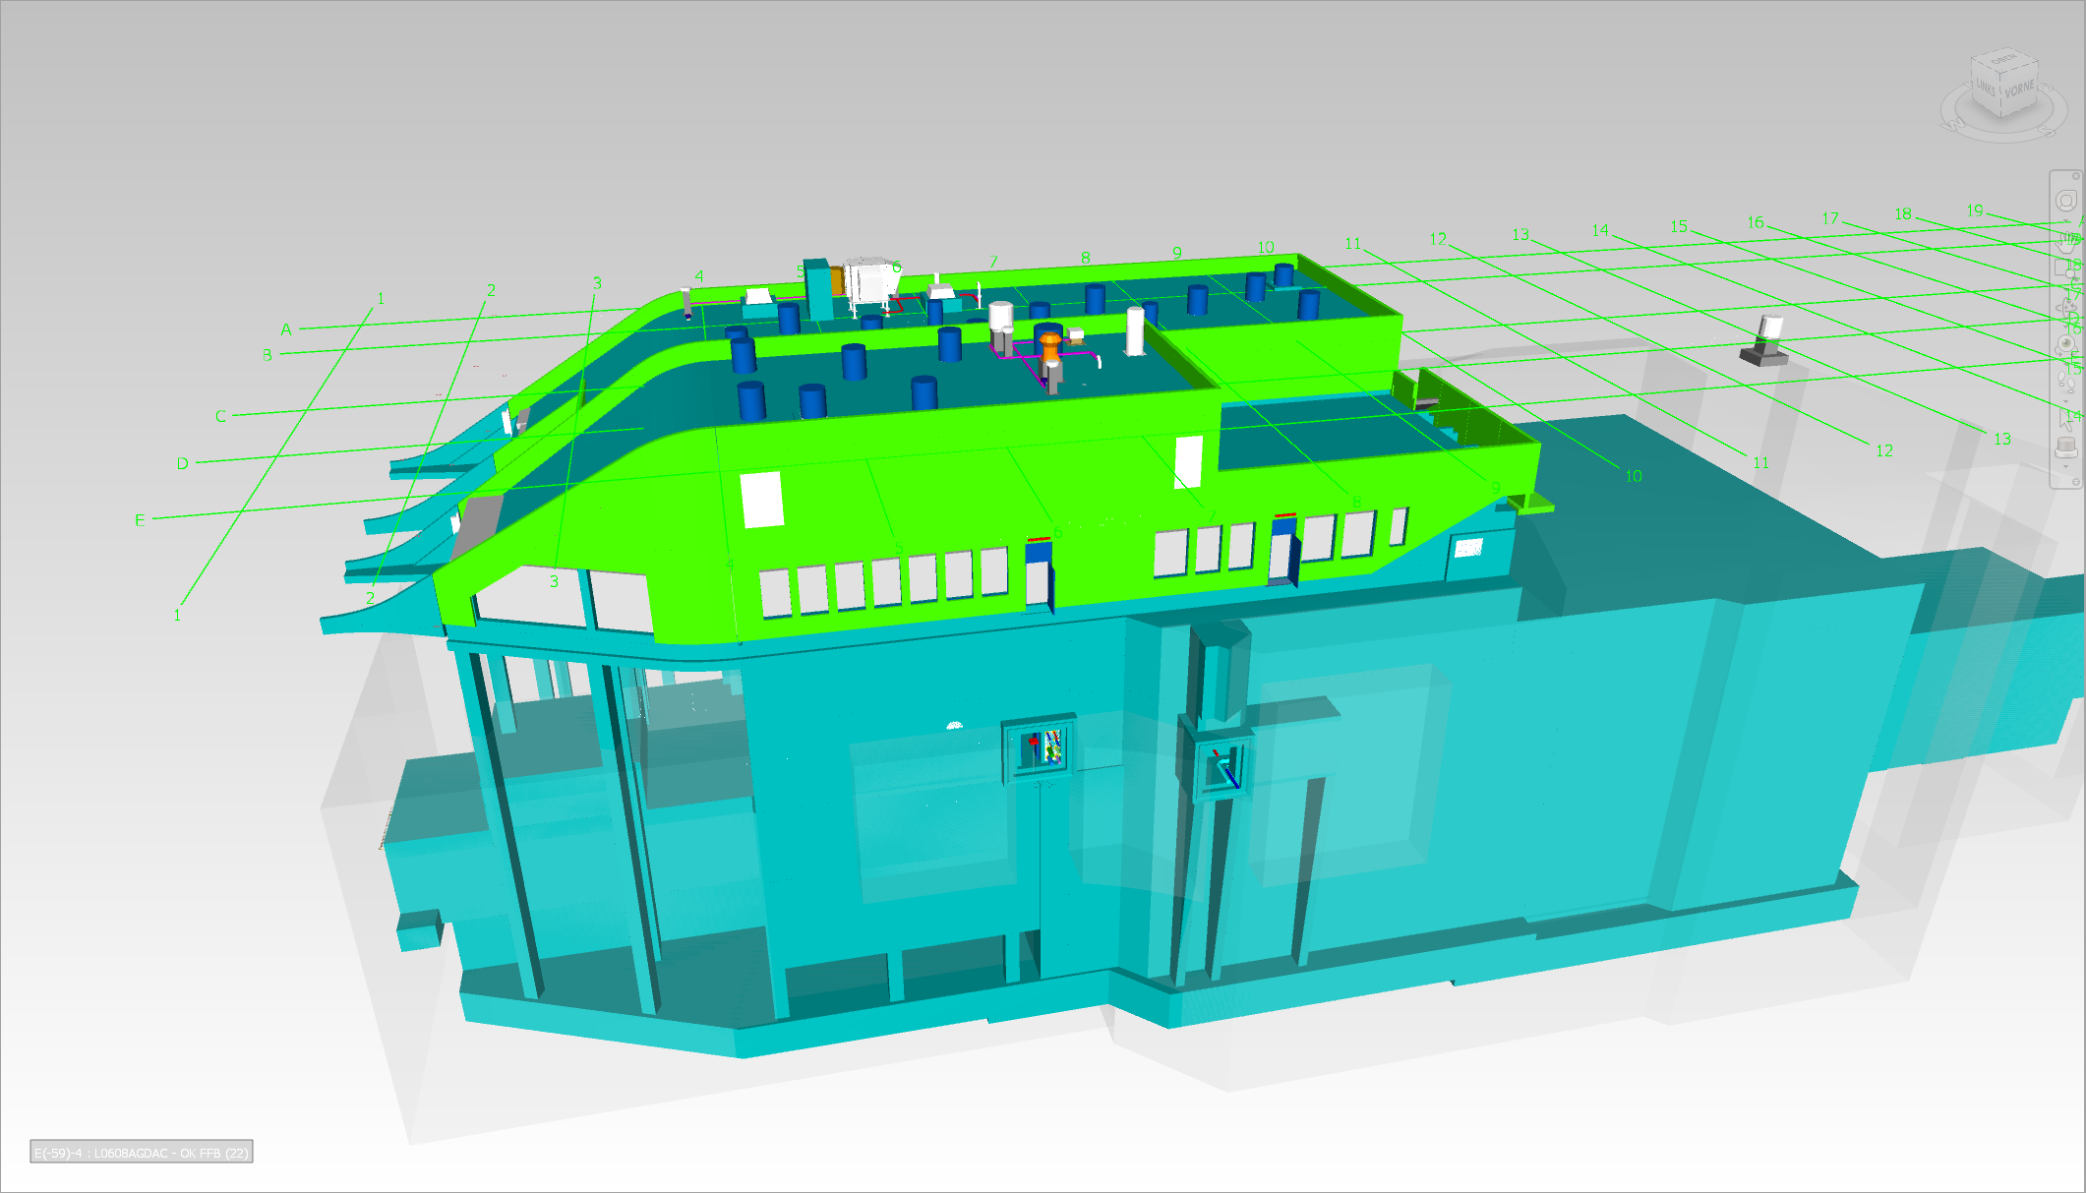
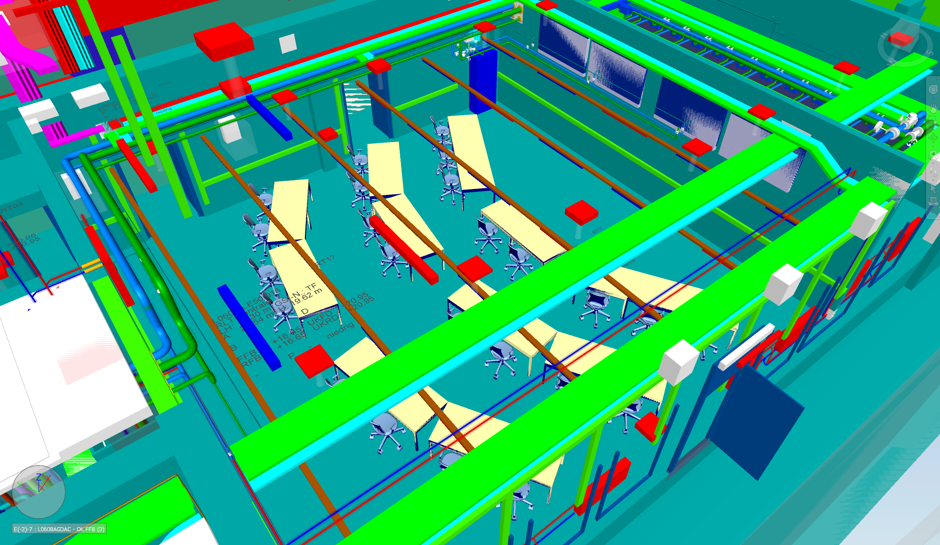
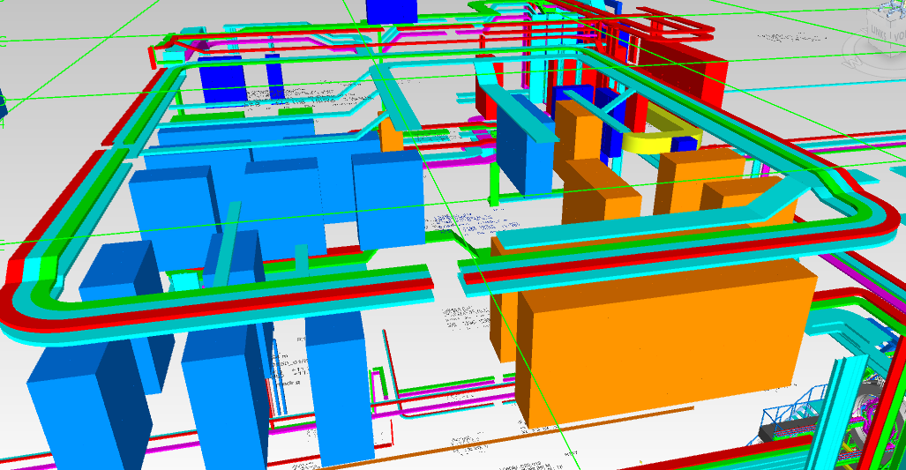
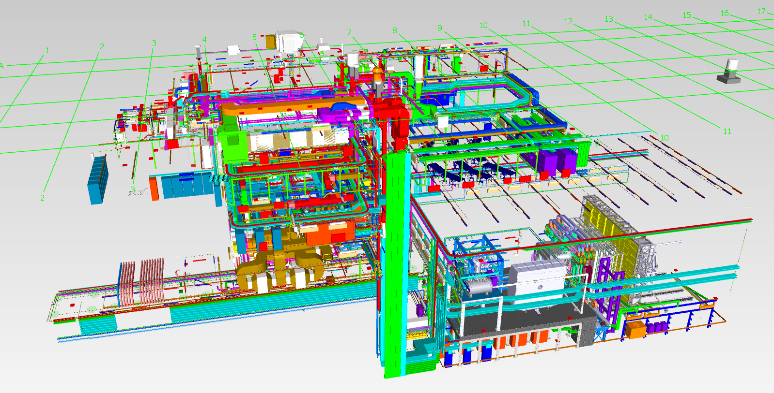
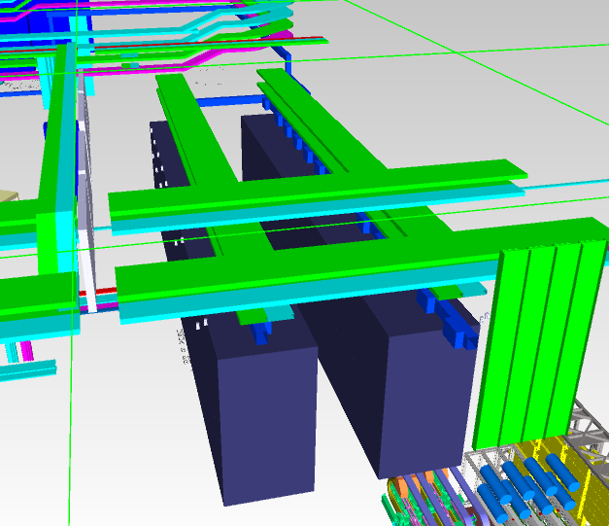
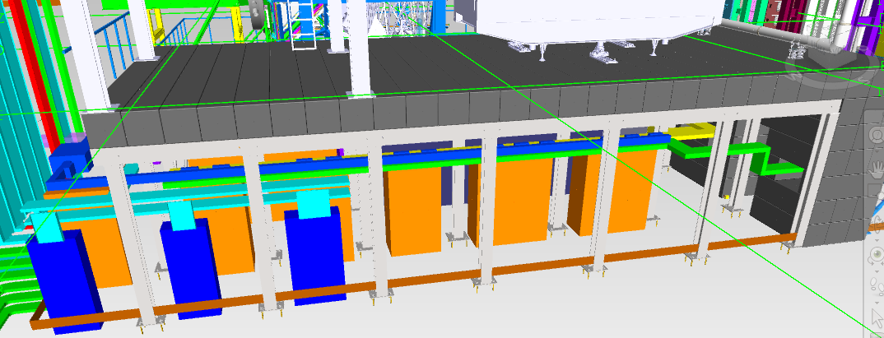
Overview Rooms of interest
LV racks under the upstream platform in the cave
HV racks and gas on the supply level E30
DAQ racks next to the control room
CBM CC E40
HV, Gas E30.012
DAQ E40.017
UP E10.003

Slide 3
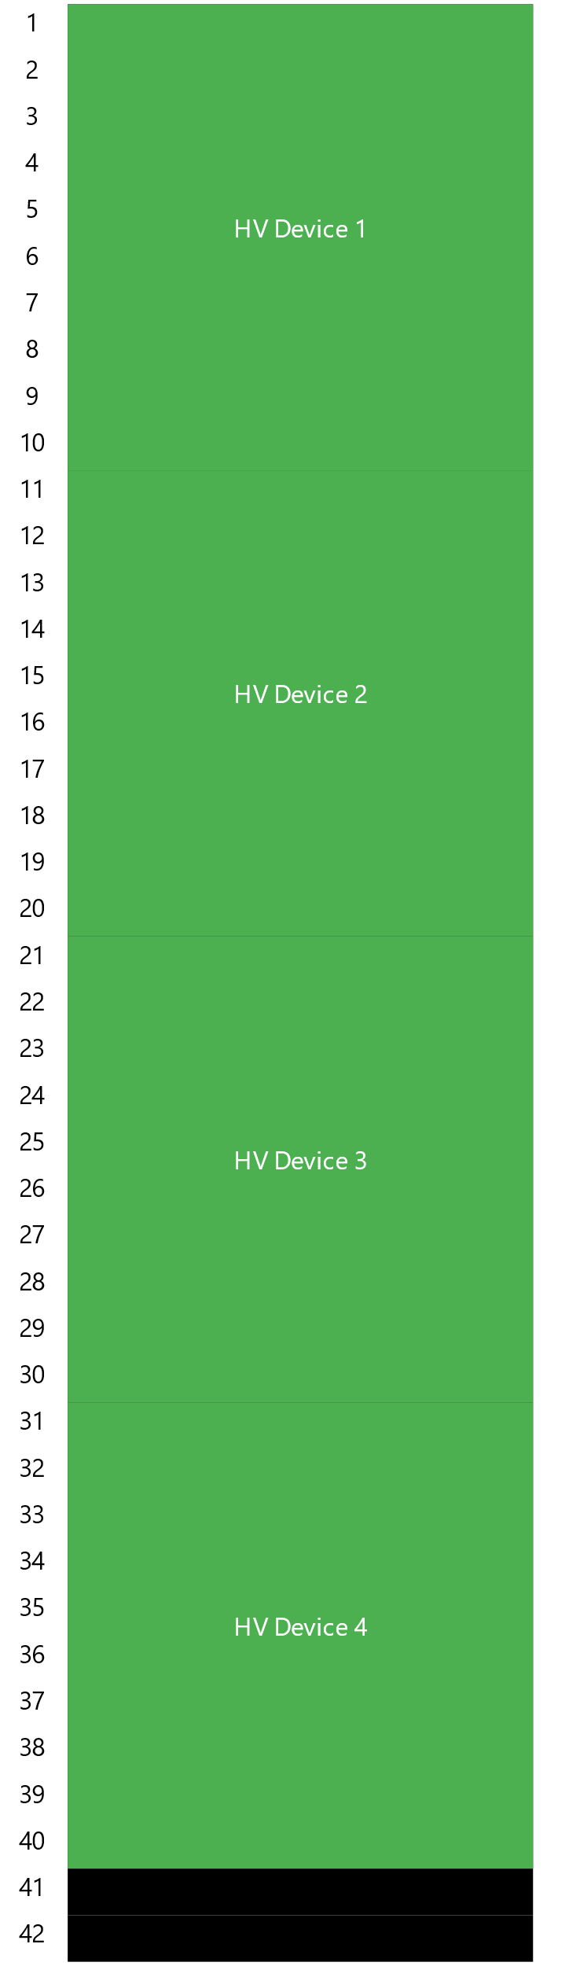
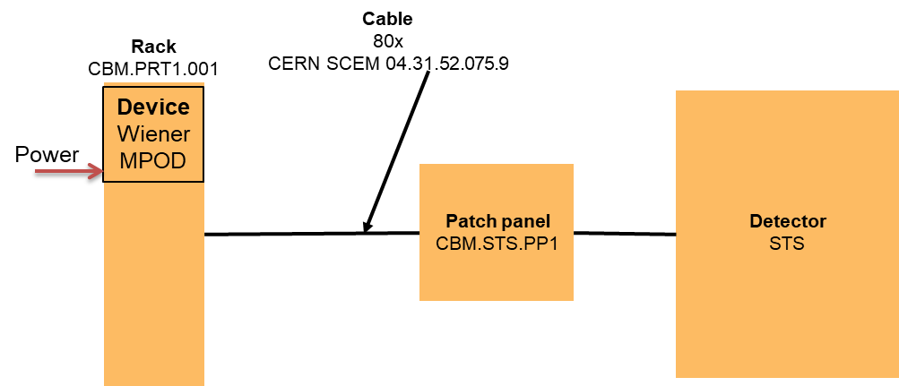
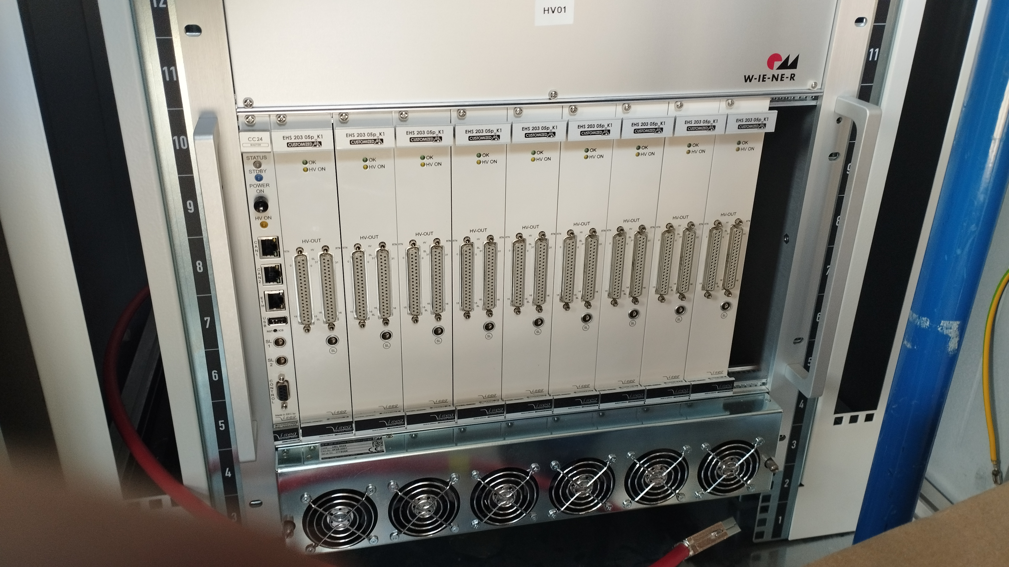
CBM Cabel planning
Cable planning was divided into two stages
Collecting cable information for HV, LV and DAQ and for planning cable cross-sections and routes
Detailed planning of racks with crates and the necessary infrastructure
LAN/DCS
Stage 2
Rack ID
Stage 1
Detector
End of FAIR CDB
planning
Device ID
HV Panel
-20 ports
LV Panel
-10 ports
Module ID
-2 ports
Cable ID
CERN SCEM 04.31.52.075.9

Slide 4
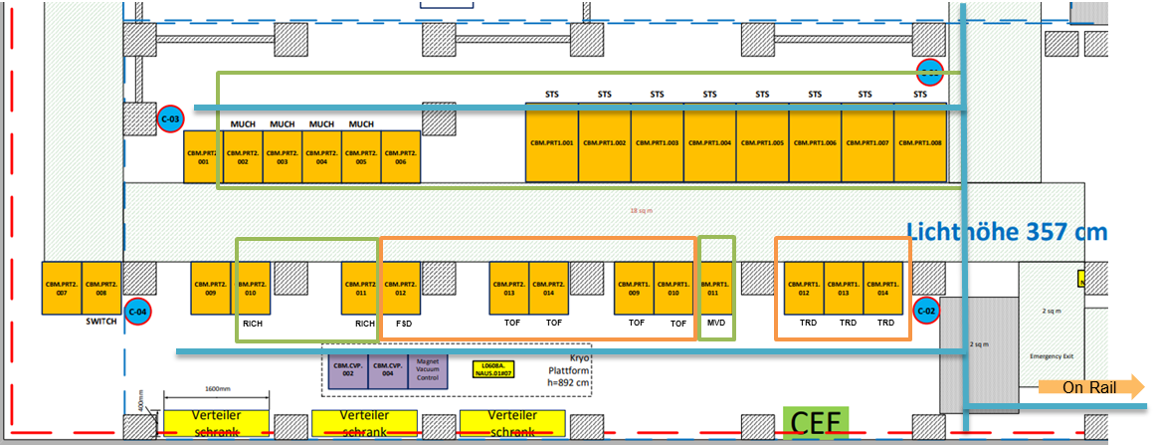
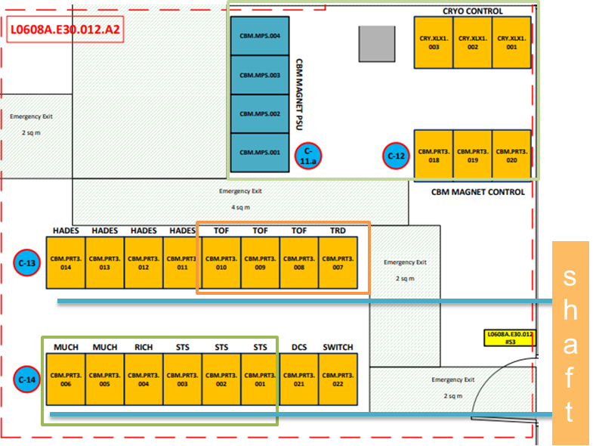
Stage 1
Racks and patch panels were defined for all systems.
Using the information collected about HV, LV and DAQ cables, routing between the racks, PP and systems was carried out in CAD.

Slide 5
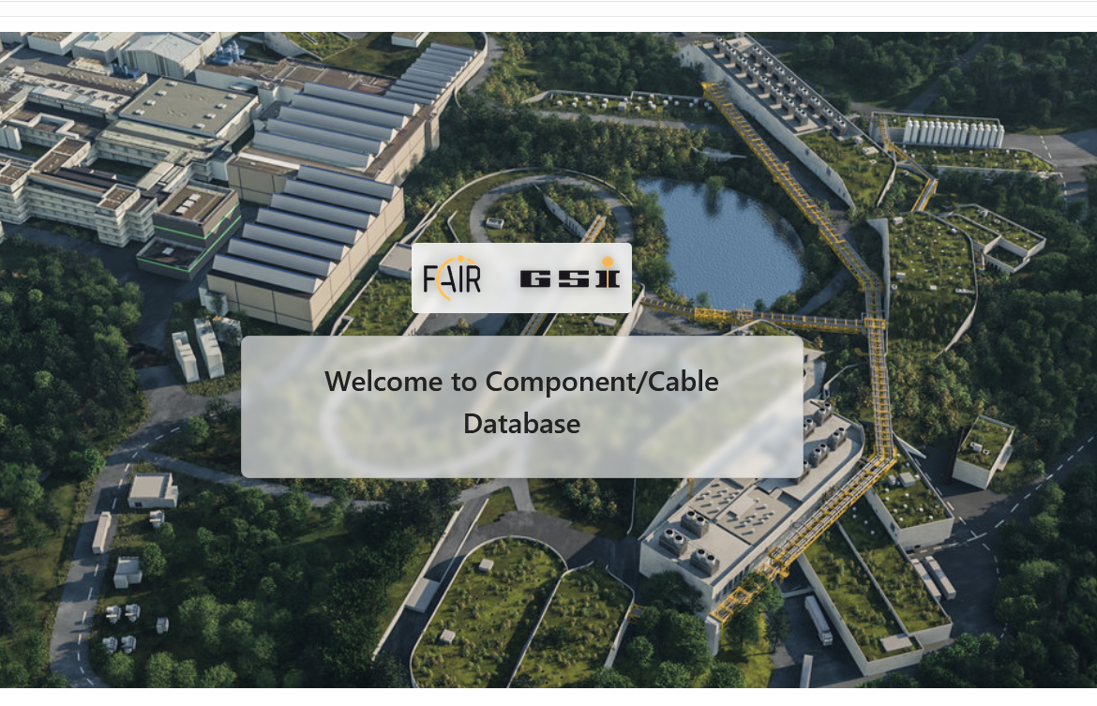
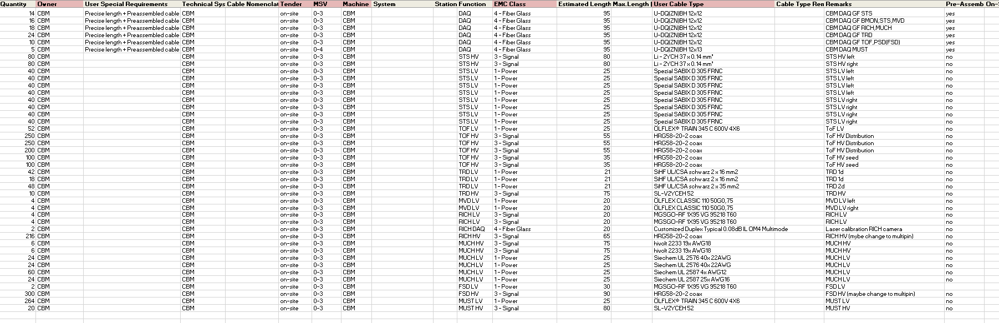
CBM Cable list
The collected cable data was prepared for the cable database and will be uploaded shortly.
The current version of the cable list can be found on EDMS, including data sheets. https://edms.cern.ch/document/3358034/1

Slide 6
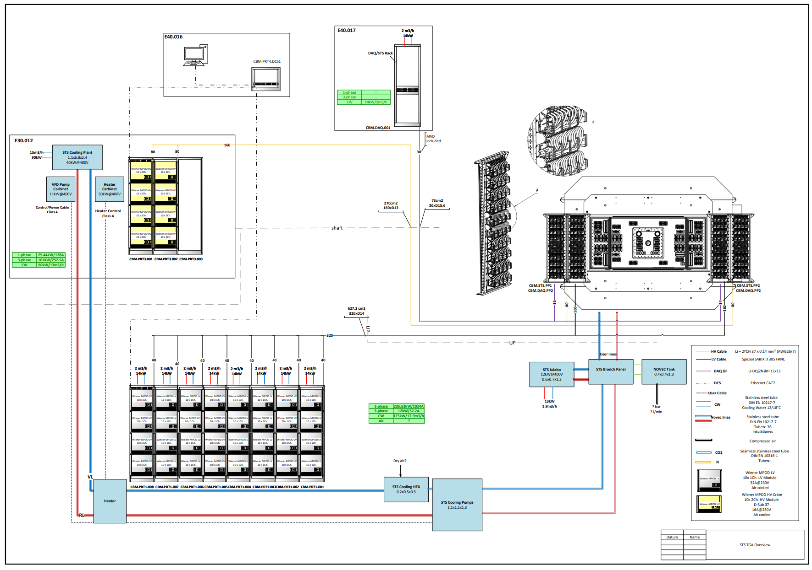
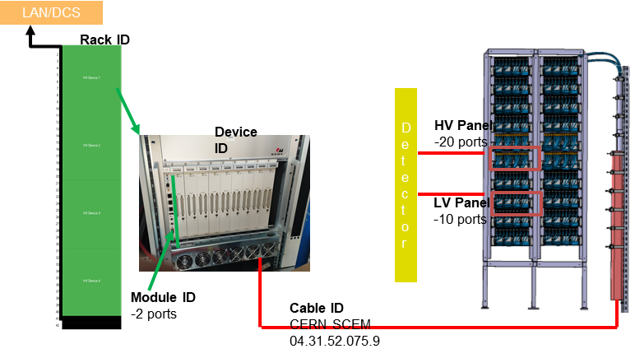
Next steps
Detailed planning of racks and crates
power requirement
space utilisation and optimisation
cooling
detailed cable routing on racks and PP
DCS cable
Additional services
gas
cooling
others

Slide 7
Thank you

