Slide 1
CBM Target region
Patrick Dahm, 46th CBM Collaboration meeting

Slide 2
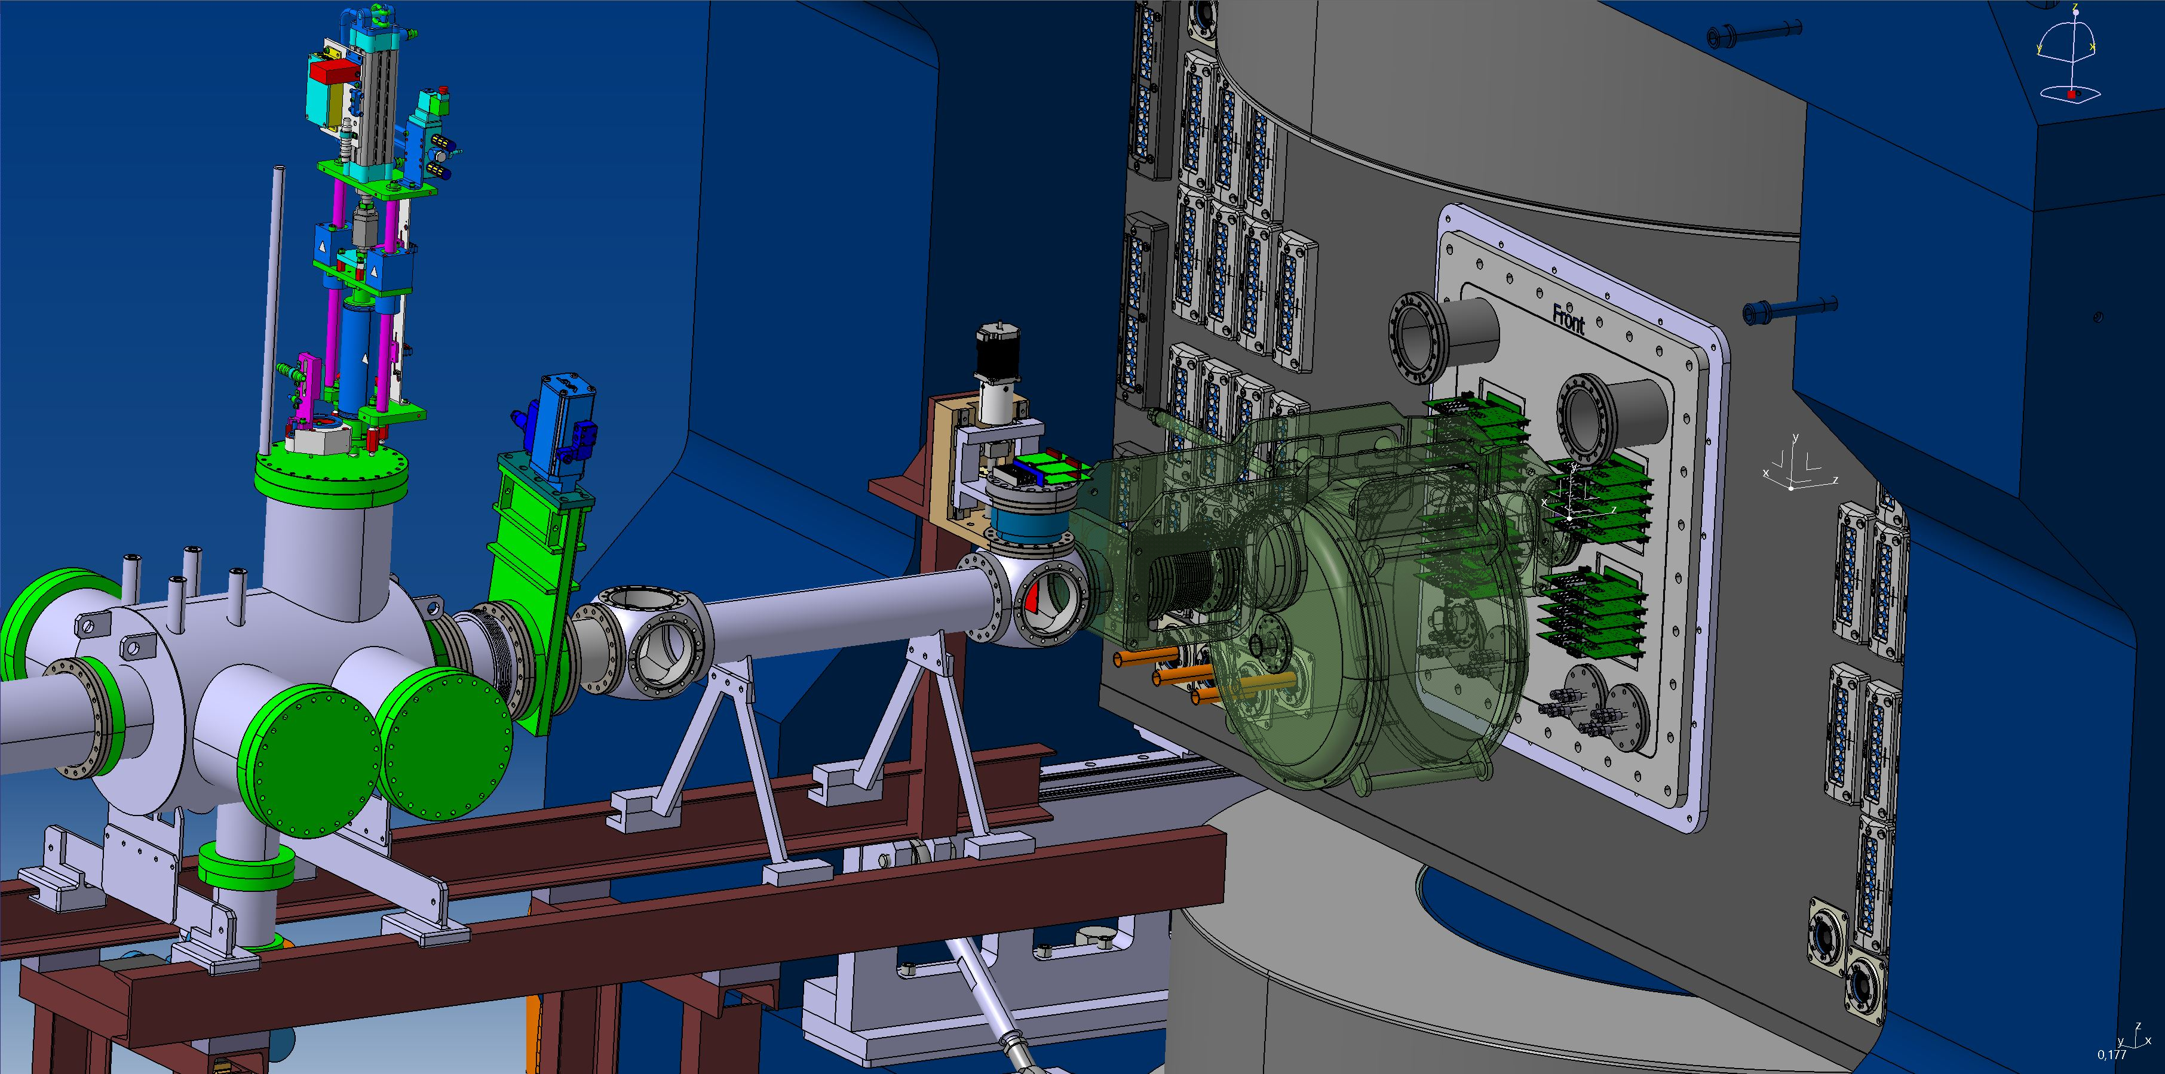
General concept
Beam diagnostics
T0
Target Exchanger
MVD Flange
Target chamber

Slide 3
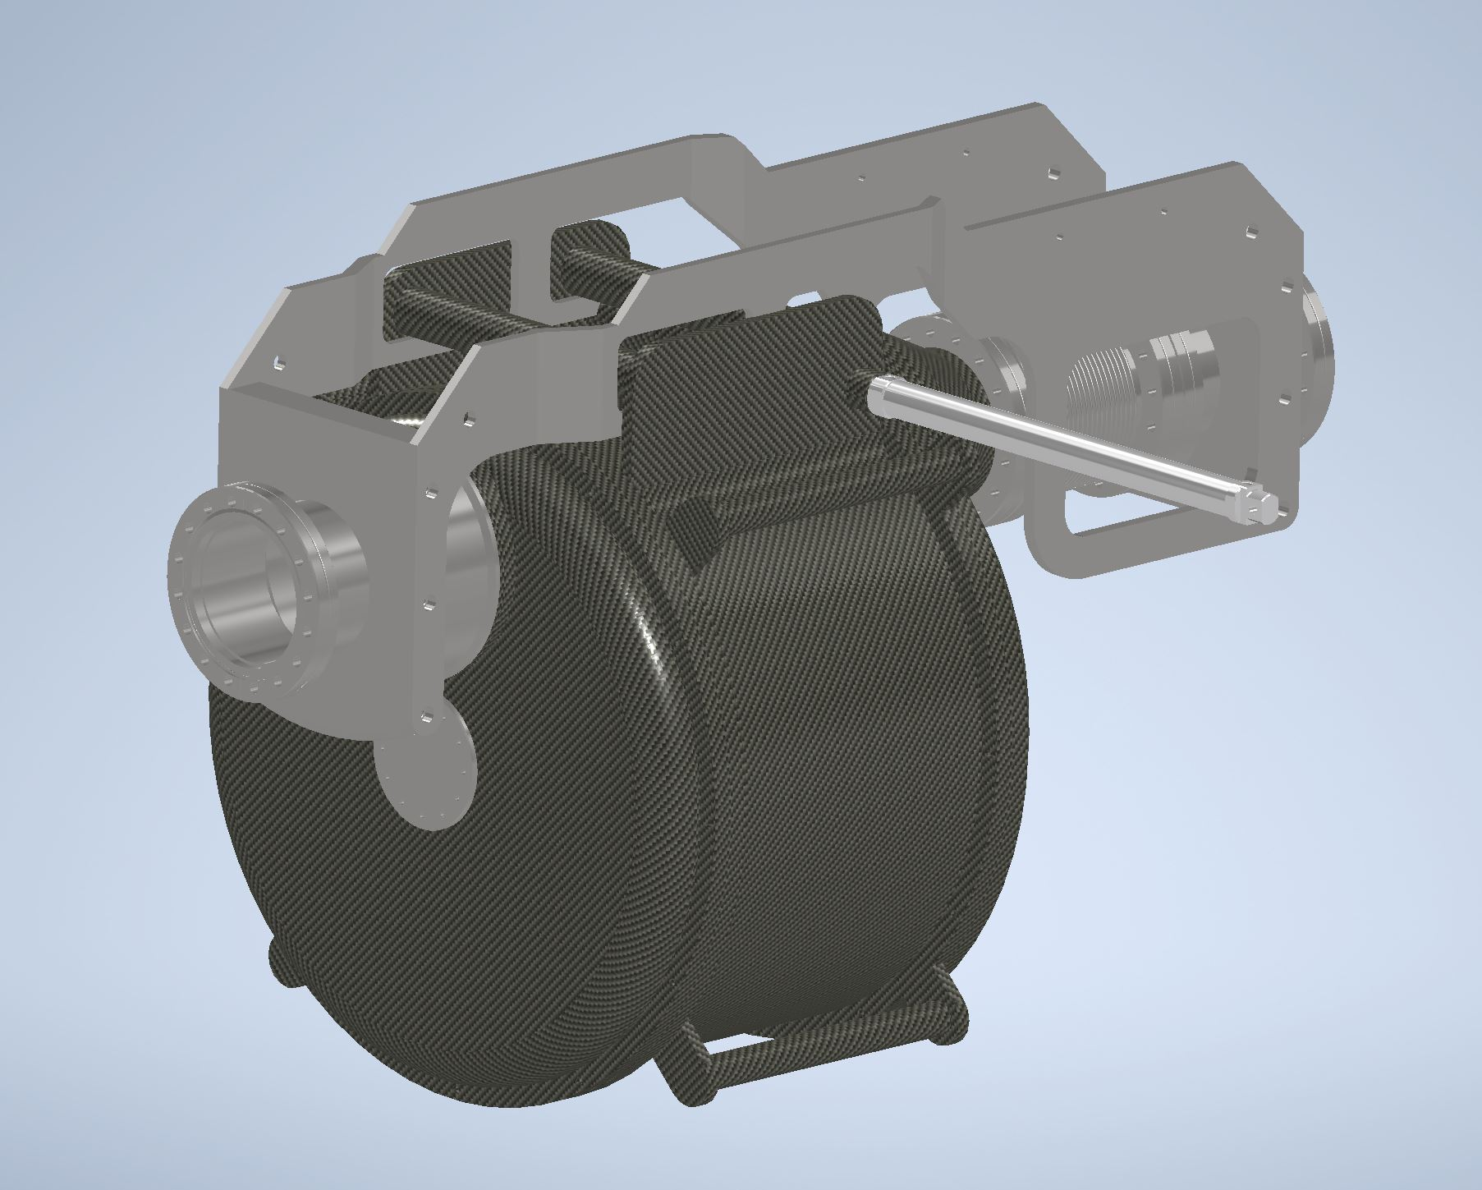
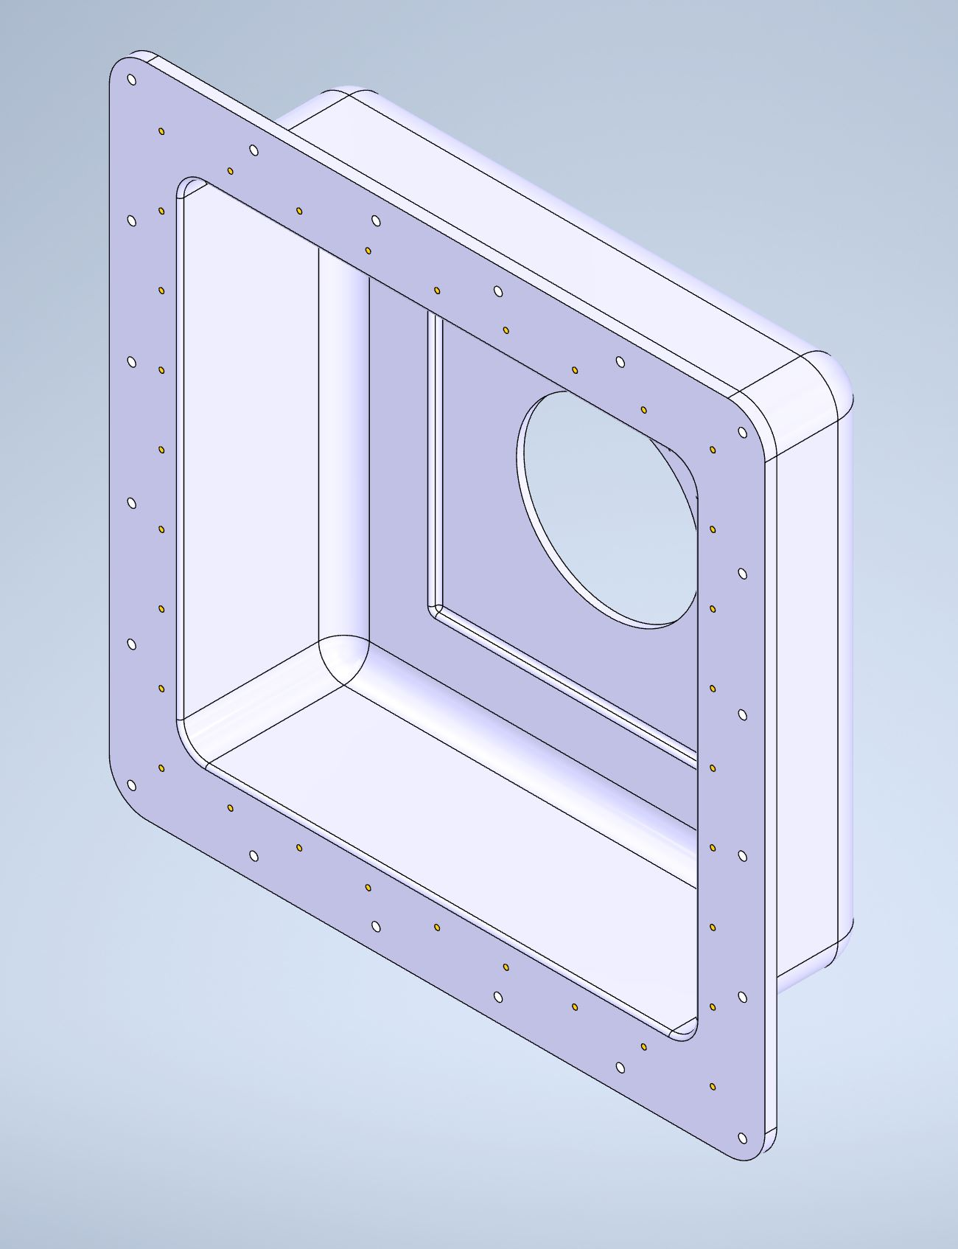
Involved Systems
Target Exchanger
Target Chamber

Slide 4
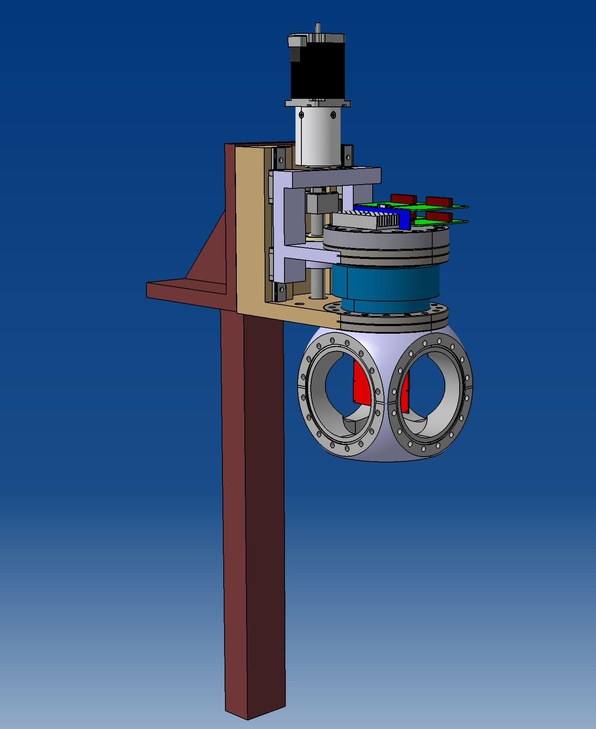
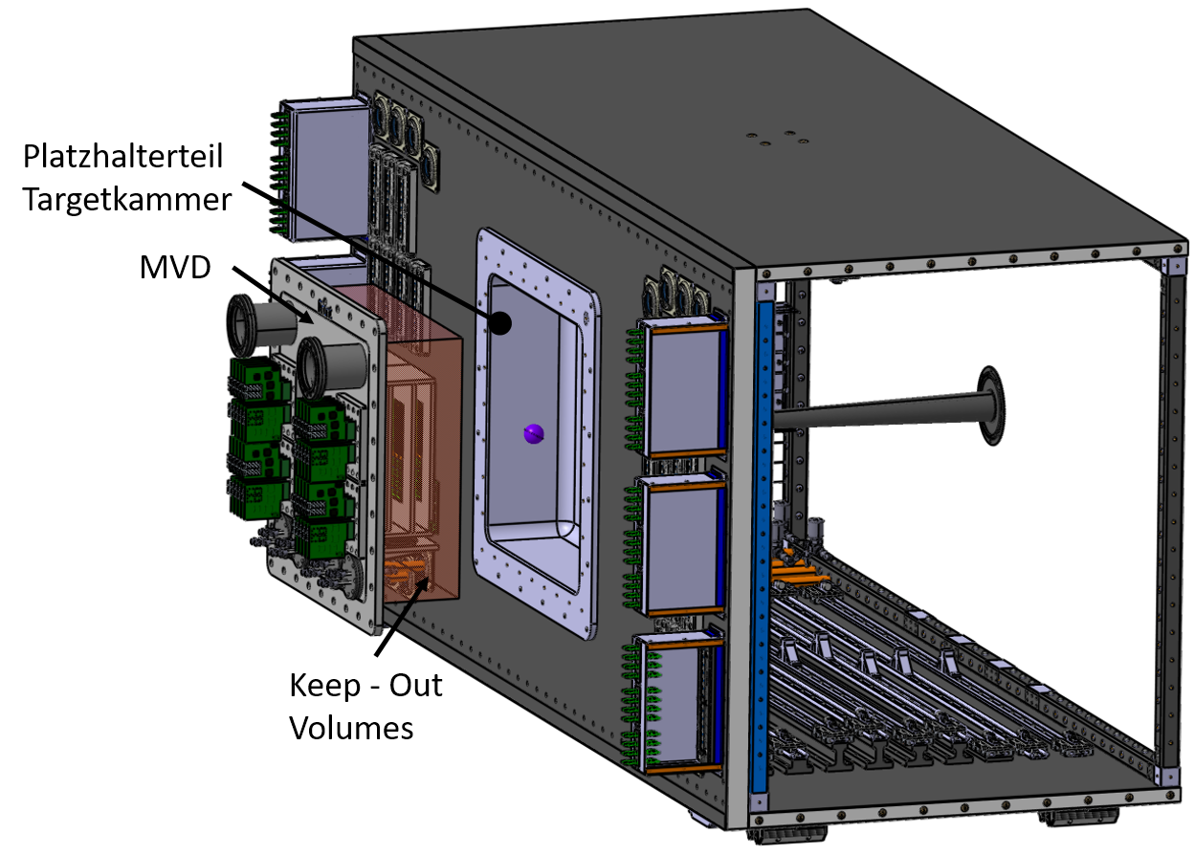
Affected systems
BMON / T0
MVD
STS

Slide 5
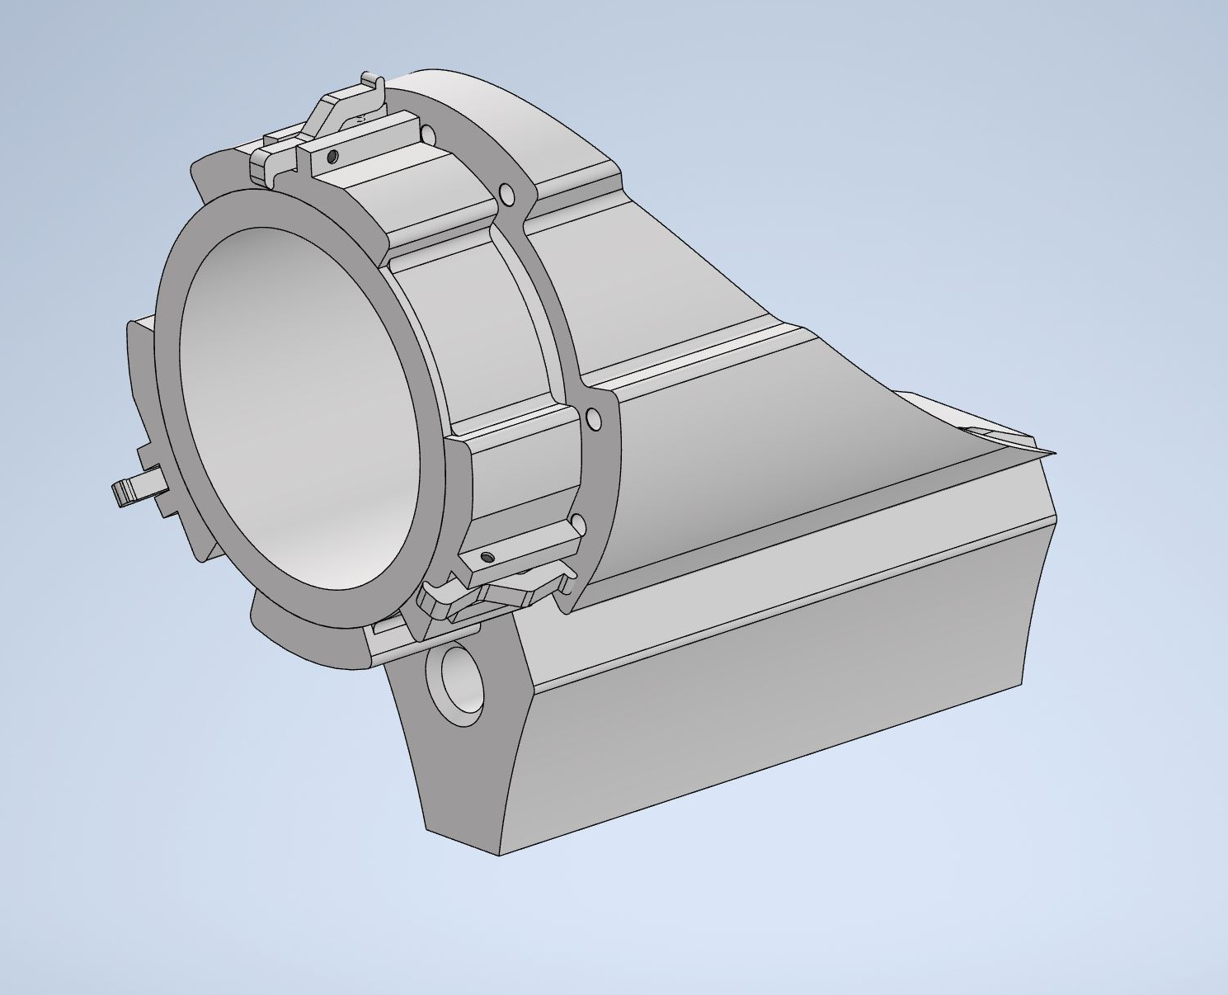
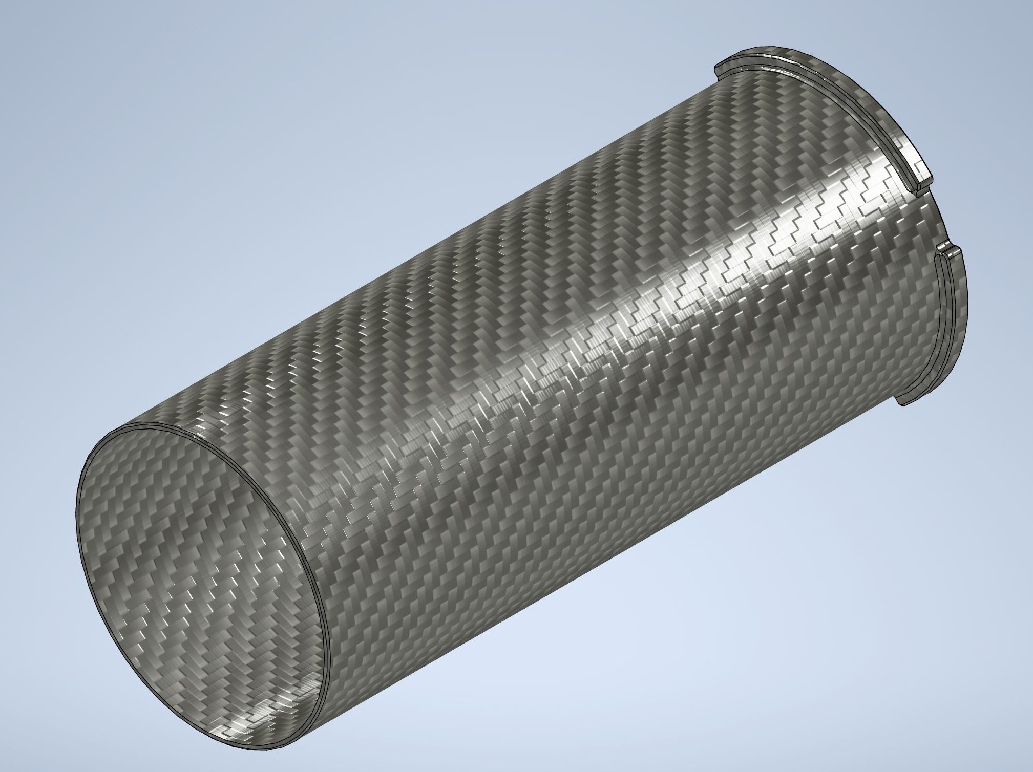
Current Status – Target Exchanger
Still in concept phase
Feature studies started
Demonstrator design ongoing
Prototyping of first parts ongoing

Slide 6
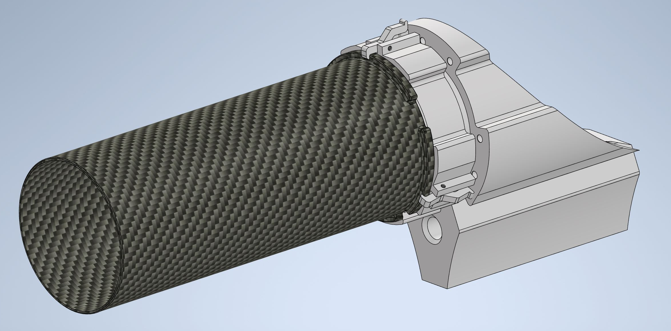
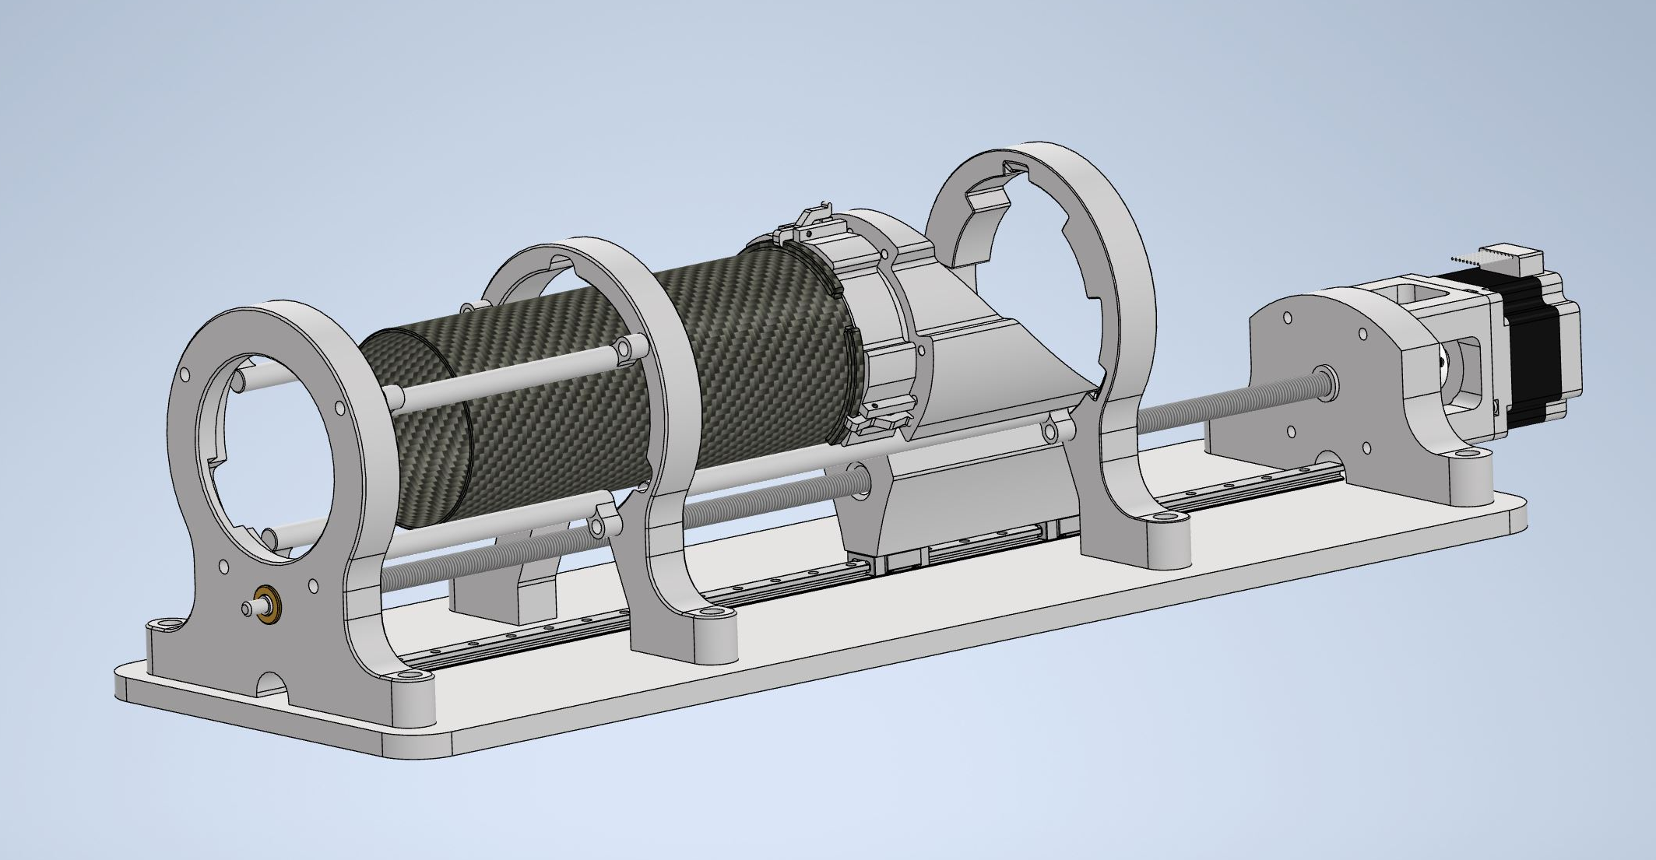
Next steps – Target Exchanger
Simulations of targets and surrounding material
Control concept
Purchase of parts
Mechanical demonstrator

Slide 7
Current Status – Target Chamber
Requirements collected
Detailed specification document created
Coordination with PWG and Simulations

Slide 8
Next Steps – Target Chamber
Execution of material studies
Evaluation of simulations
Tender of Part

Slide 9
Required Input
Required precision of target position
Evaluation of material budget
Feedback on interface solutions
Update on positions and space requirements

Slide 10
Thank you
Any questions?

