Slide 1
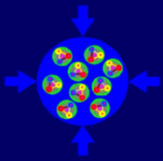
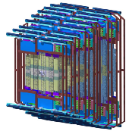
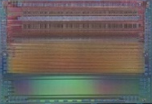
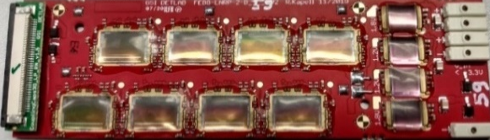
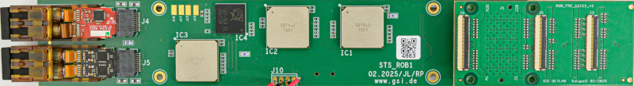
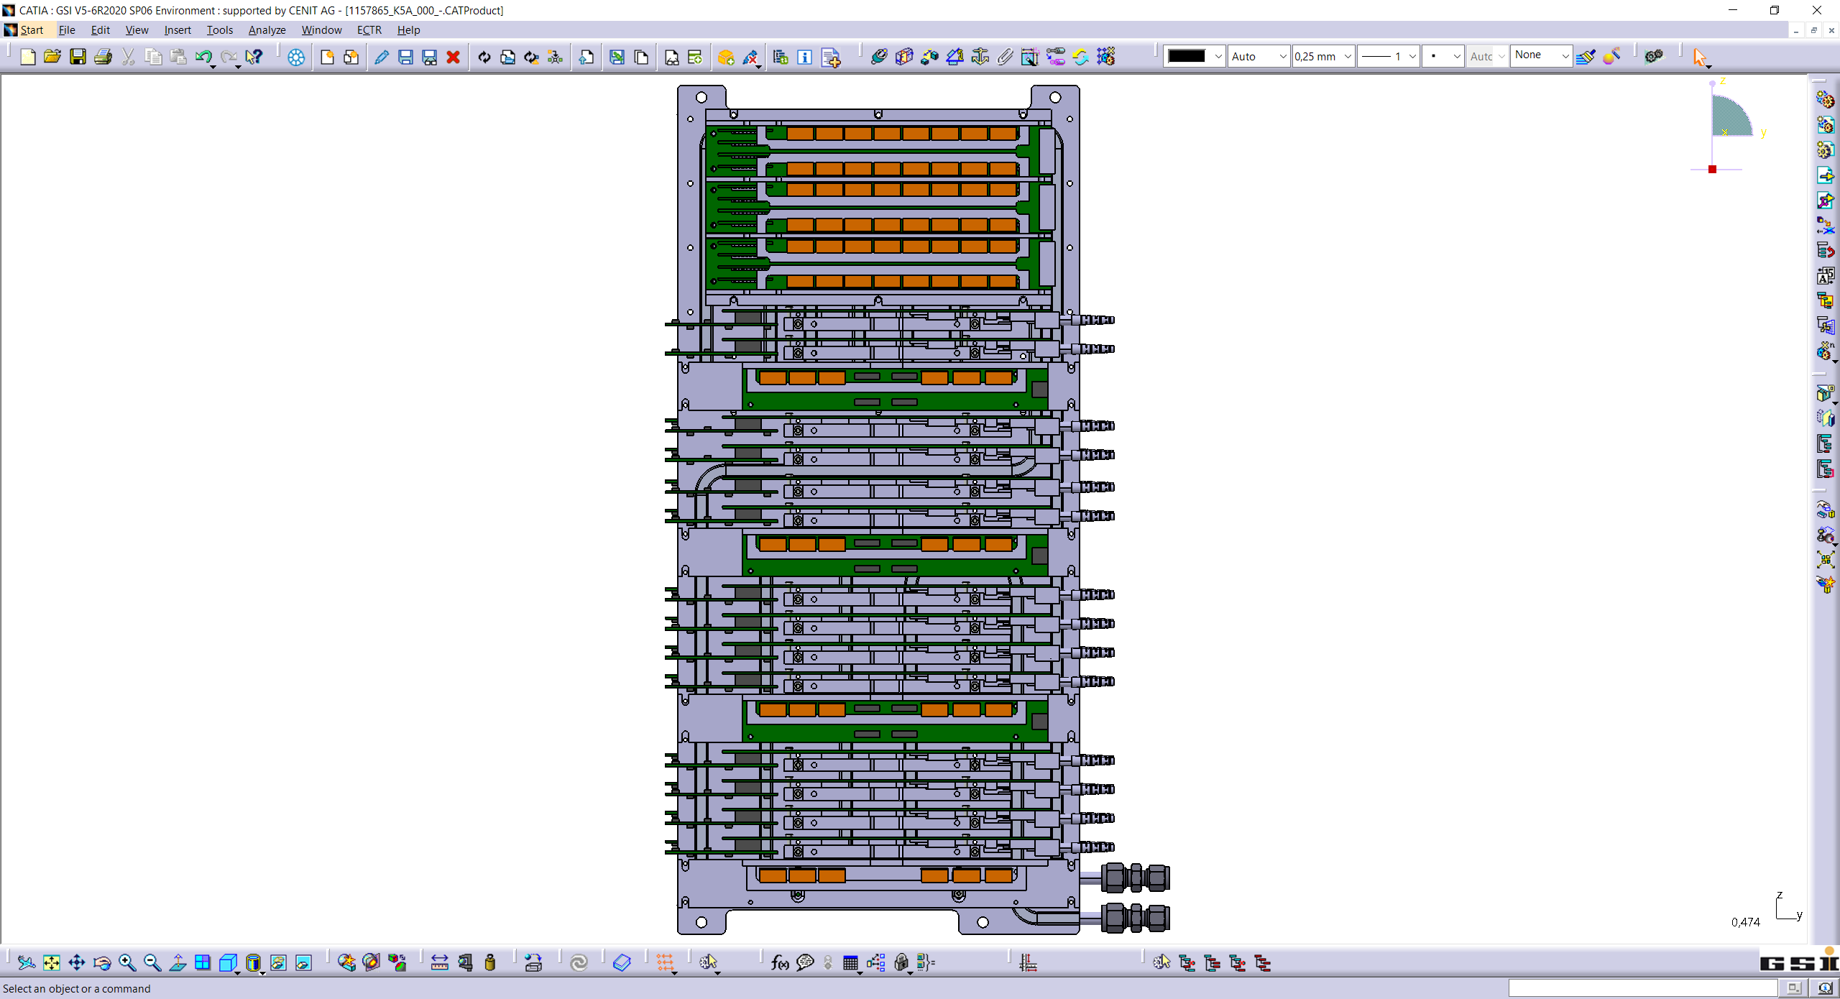
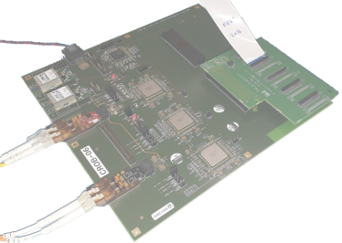
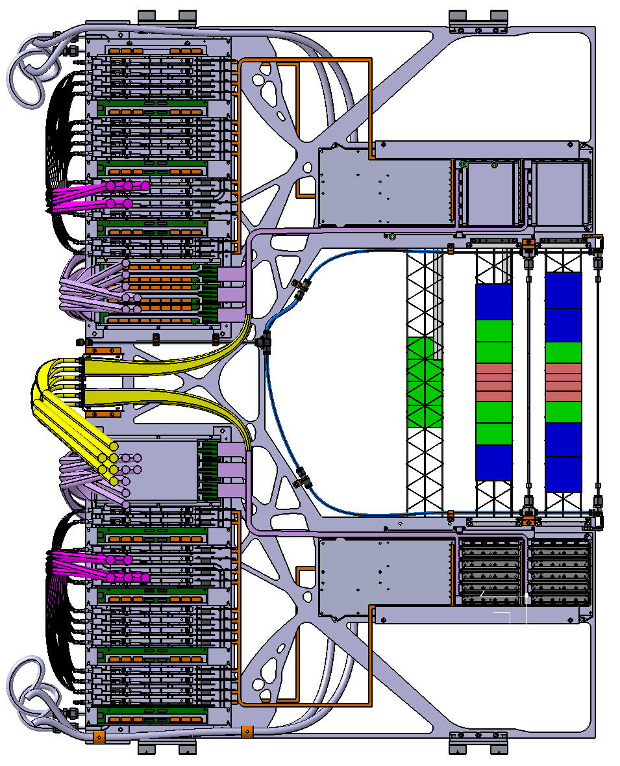
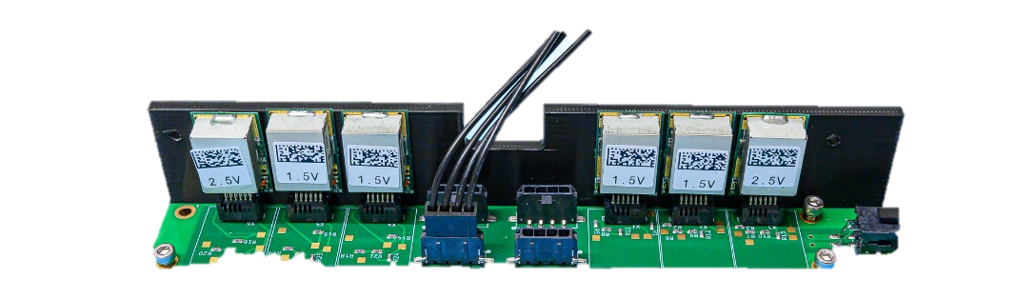


STS Readout Developments
Final Boards for STS Integration:
STS-ROB, RPOB, FPOB
S
T
S
J. Lehnert,
R. Kapell, P. Semeniuk
46th CBM Collaboration Meeting
Tue. 21.10.2025

Slide 2
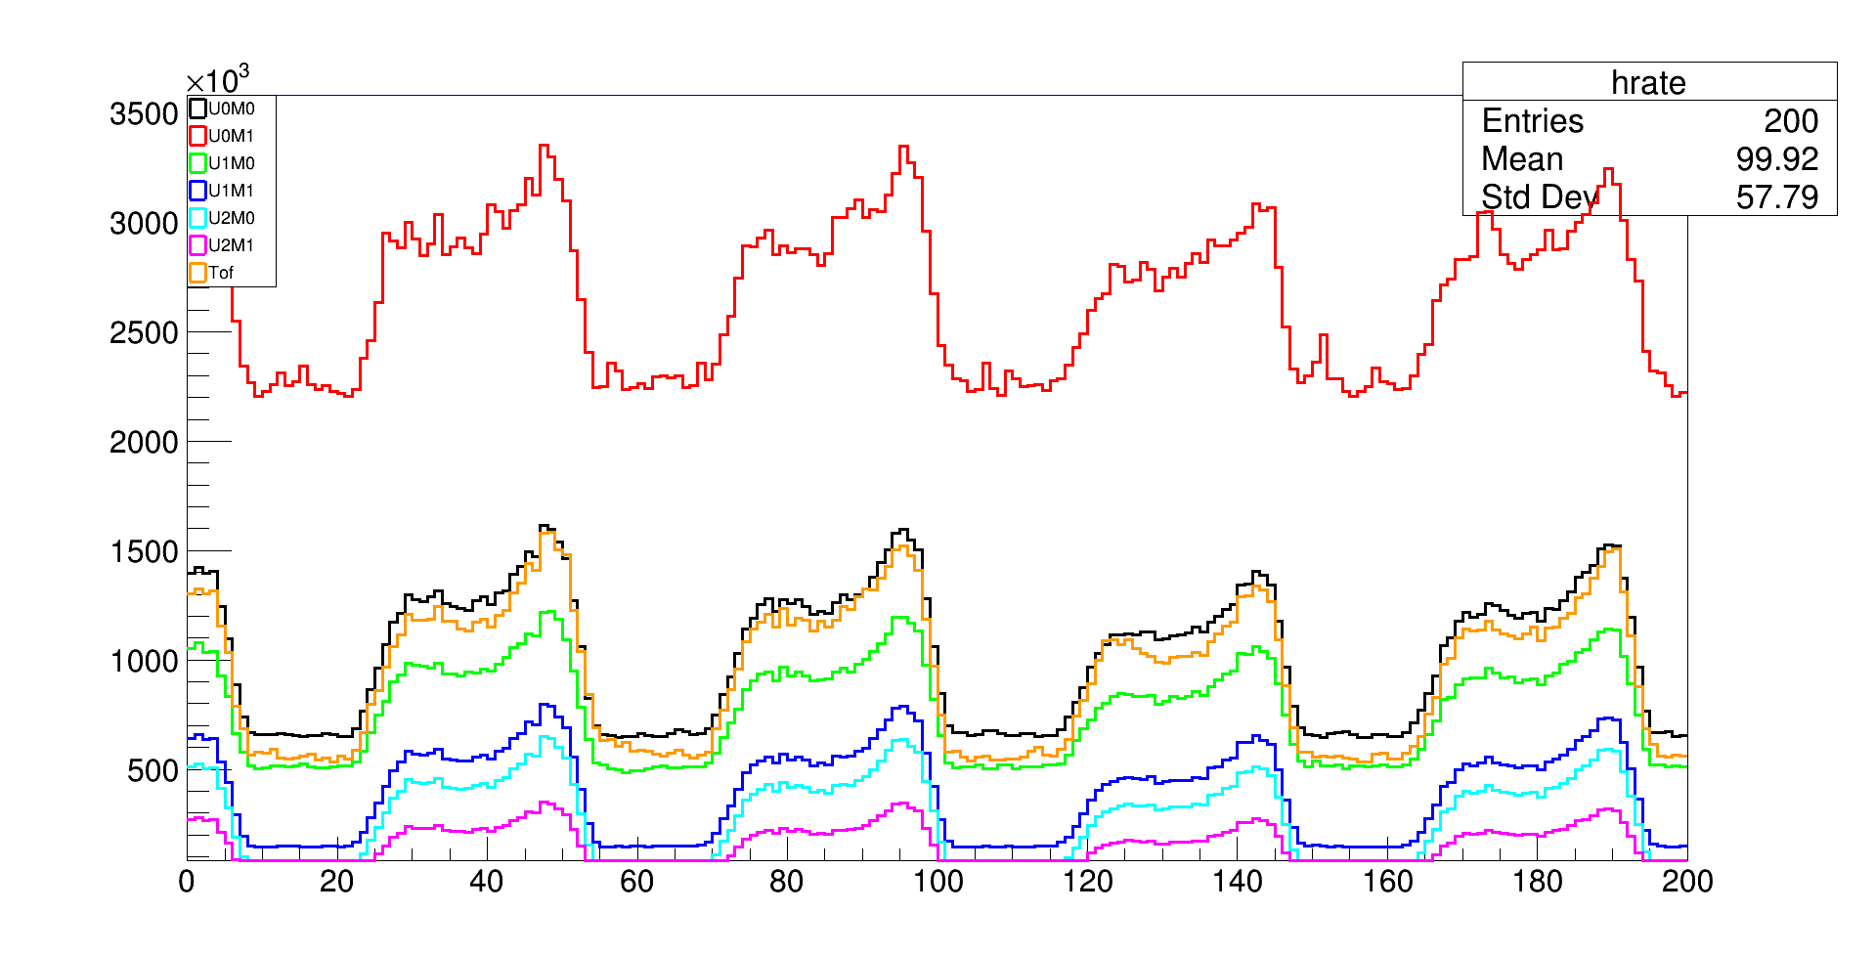
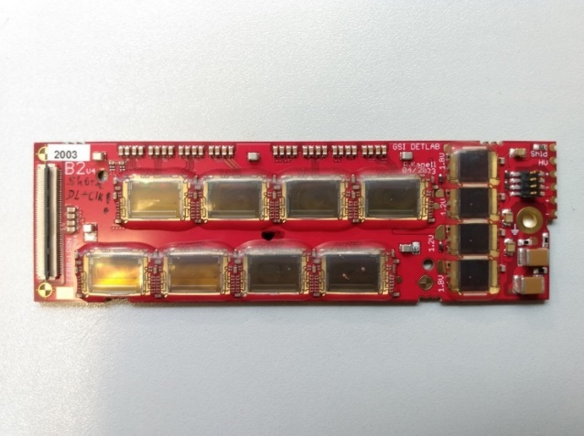
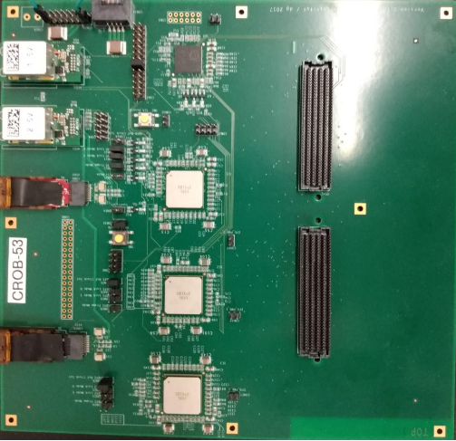
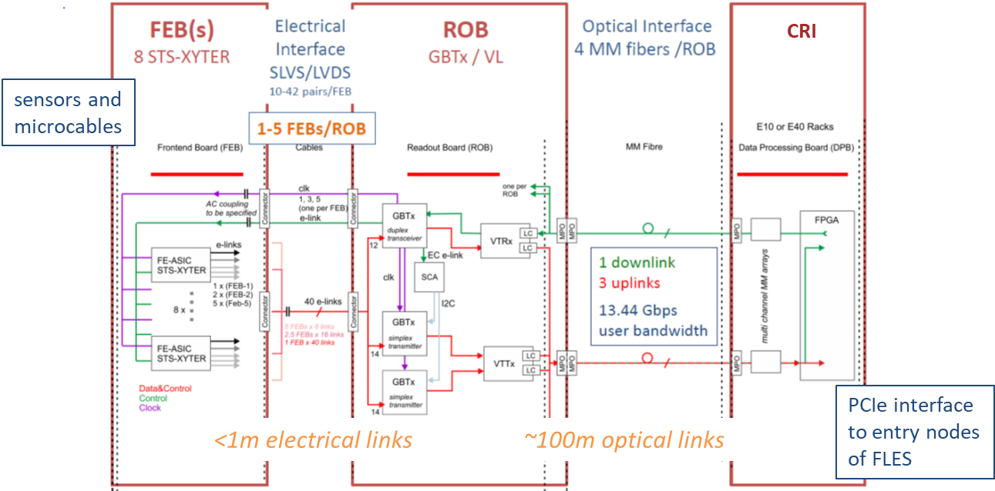
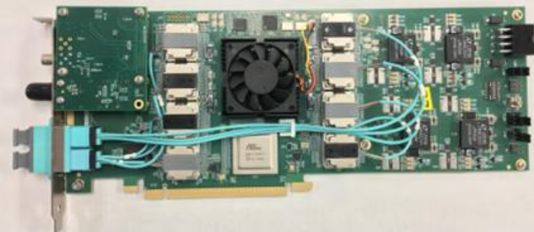
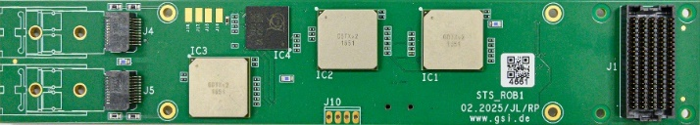
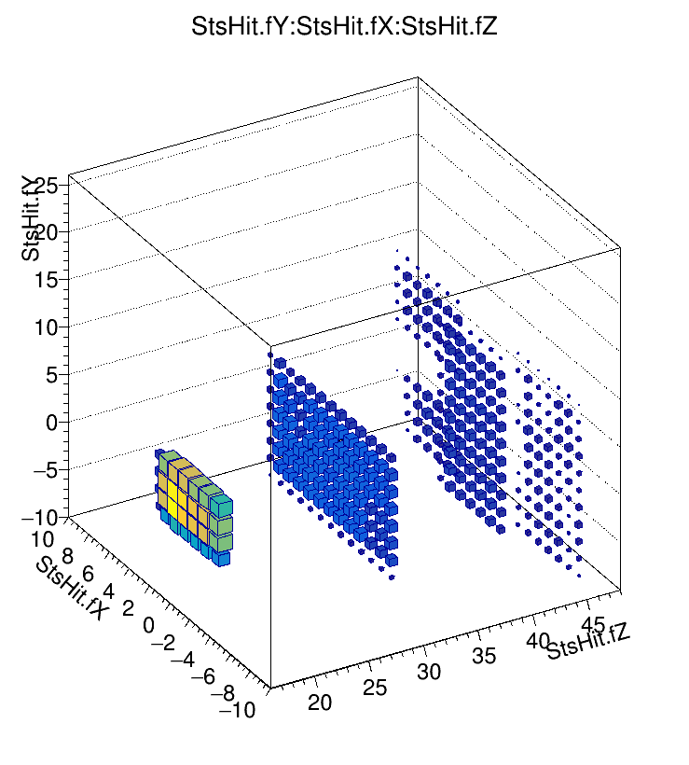
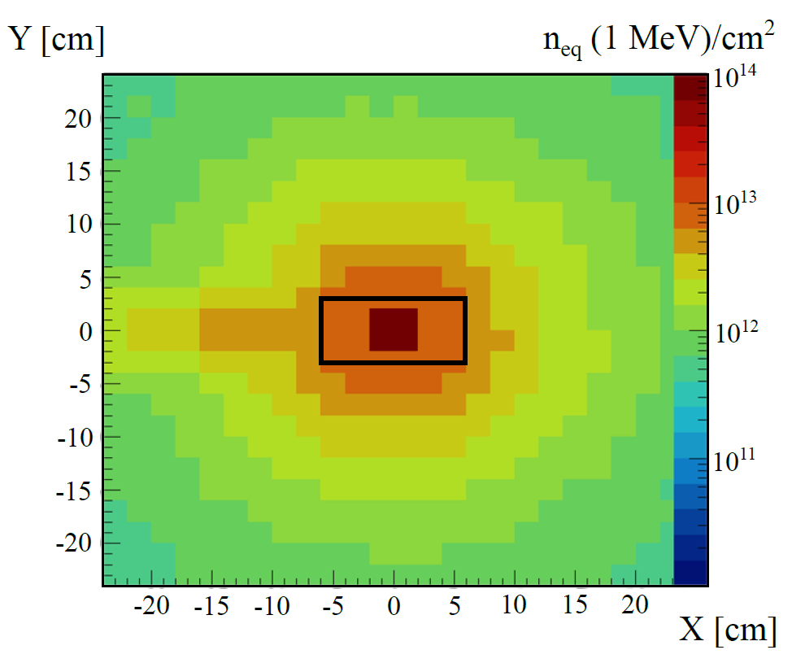
From CROB to STS-ROB
mSTS Data Rates
FEB8_1/2
STS Readout Chain
1752 FEB8 with 8 SMX ASICs
  1-5 uplinks 320 Mbps uplinks (9.4-47 MHits/s/link; 73-367 kHits/s/channel)
  common clock and downlink
576 ROB3
  data aggregation from
  40 uplinks ( 1-5 FEB8 )
76 CRI (8 ROB3 each)
  data readout, controls, TFC
CROB
CRI1
STS-ROB
significantly smaller
form factor
mSTS Reconstructed
Space Points
Irradiation at 1st STS station
Common Readout Board (CROB)
full required ROB3 functionality for STS
in use since 2018 (mCBM and test setups)
  up to 7 boards in mSTS
  also mMUCH, mTRD1D, (mTRD2D), mMVD
O(kGy)
Rad. Hard GBTX and VTRX
https://arxiv.org/abs/2505.20517

Slide 3
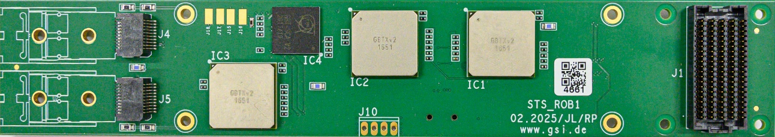
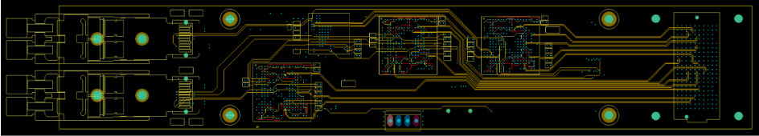
STS-ROB Design
GBT
SCA
STS-ROB PCB
14 layer design
components on top and bottom layer
5 inner signal layers
  impedance controlled (100 ohm differential)
elinks between master(25), slave GBTX(17)
and FEE connector
Slave
GBTX
Master
GBTX
FEE
Conn.
for
FMC
VTRX
Slave
GBTX
VTTX
LV In
Assembled STS-ROB
STS Readout Board
same GBTX/VL functionality as CROB
size: 201 mm x 36 mm (CROB: 208 mm x 199 mm)
powering: FEAST_MP off-board
commissioning: configuration and monitoring off-board
hardwired configuration pins
re-arrangement of GBTX/VL locations
FEE connector: 200pin
  Samtec SEAF-20-05.0-S-10-2-A-K-TR
  elinks required for STS, MVD
  custom pinout
Inner Signal Layer
Layout: R.Pursch (GSI/EE)
FMC_122 PCB (Top)
FMCs
addon board for various FEE connectivity
  ZIF connectors for each FEB8
first type FMC_11111 ( 5 x FEB8_1)
- used for full FEE connectivity tests
7 types in total (no readout cable crossing)
  FMC_11111
  FMC_122 and FMC_221
  FMC_1112 and FMC_2111
  FMC_5(t) and FMC_5(b)
Assembled STS-ROB with VTXx and FMC
readout cables
LC fibers
FMC_11111

Slide 4
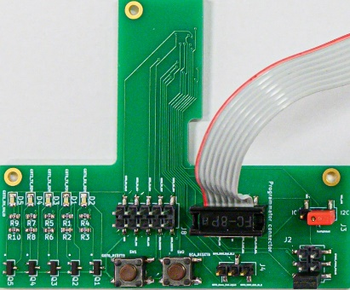
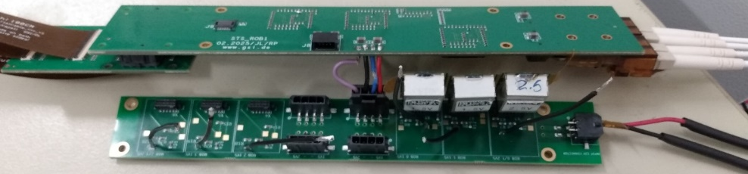
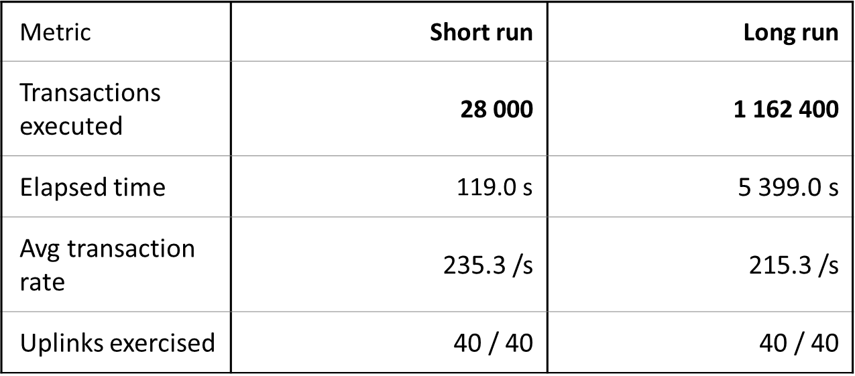
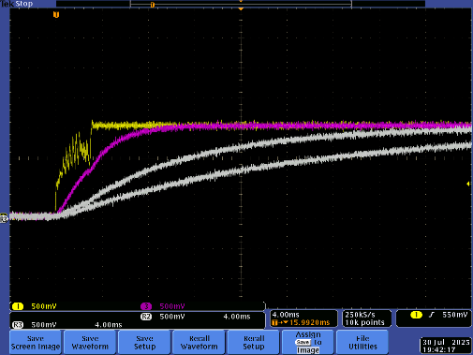
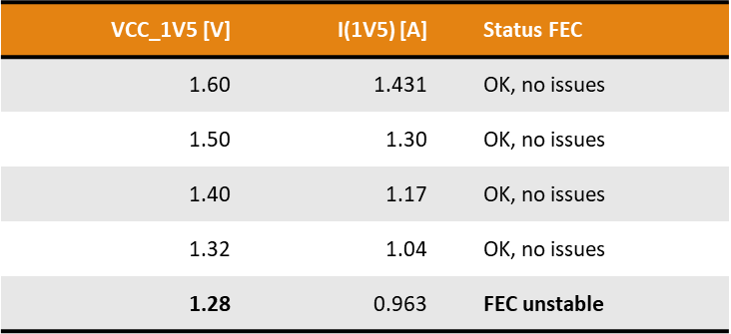
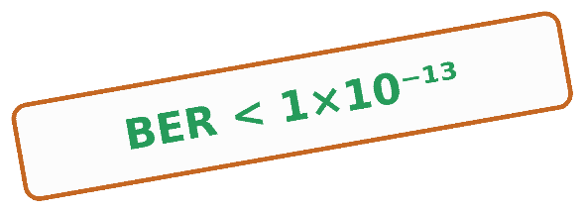
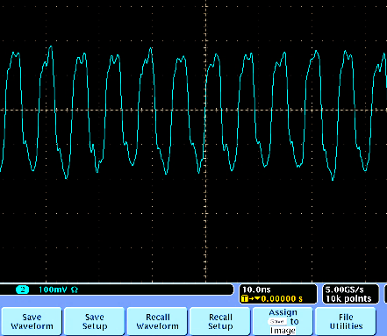
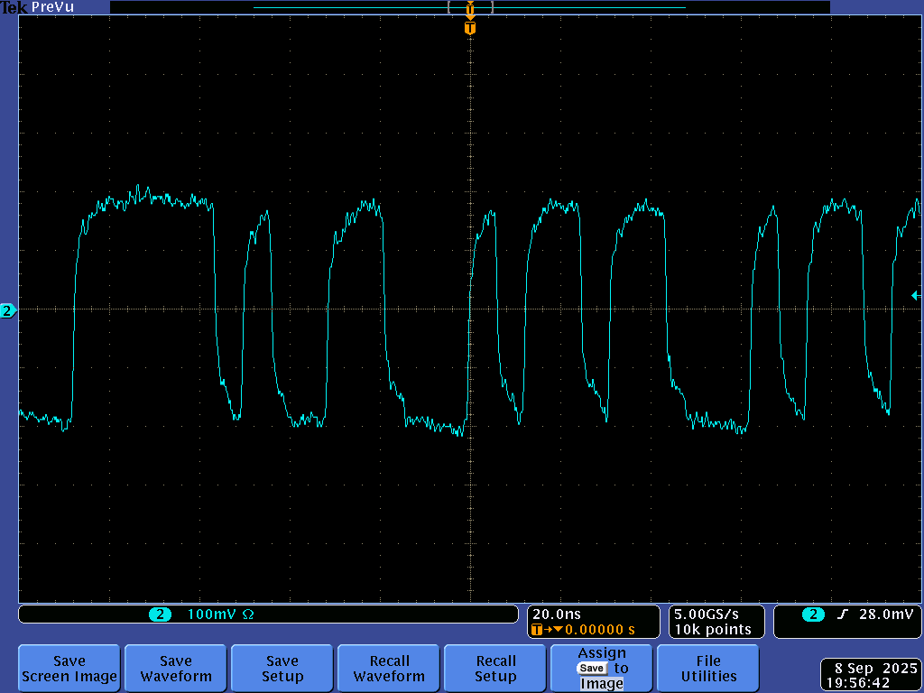
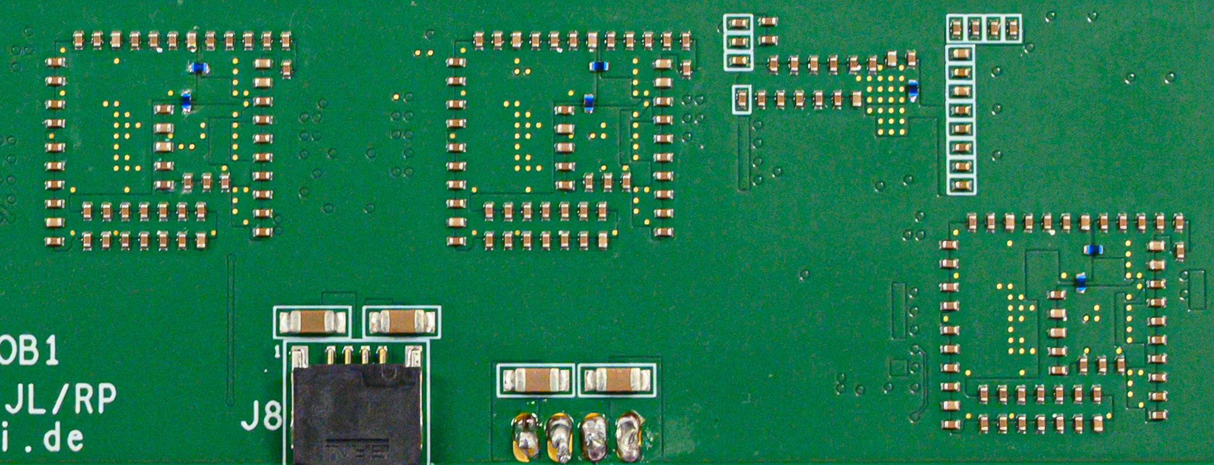
STS-ROB Testing
STS-ROB Testing
Addon Board for
Commisioning
I2C
efusing
monitoring
STS-ROB Testing and Characterization
extensive evaluation of operational
functionality and data transmission
focus on features modified wrt CROB
  layout related
optimization of selected components
Transmission Error Rates
Powerup/Startup/Reset
External Power Supply
voltage drops
operational V range
stability
Elinks
No relevant issues observed
Optical
links
Efuse Configuration
Startup: 1.5V and var.ious
ResetB settings
Signal Integrity
SCA Monitoring
Operation at var. VDD
Onboard LV Filtering
ROB Temperature
Monitoring
no active cooling
VDDRx/VDDTx Inductances
FEE Clock
FEE Downlink

Slide 5
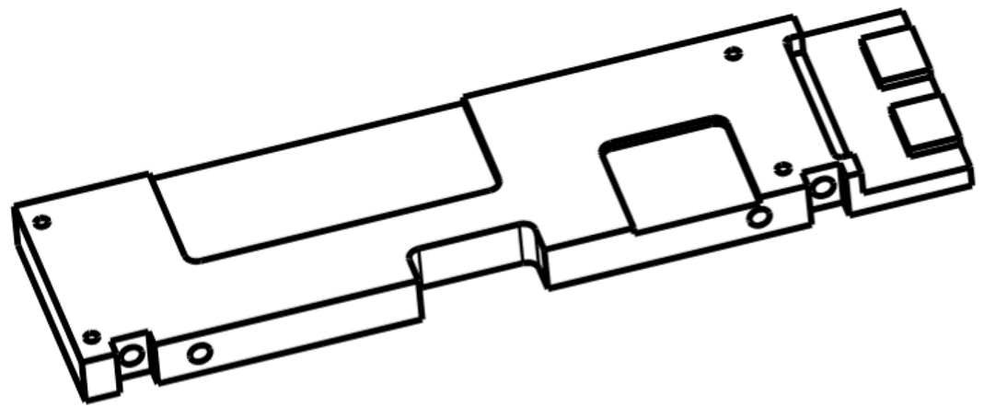

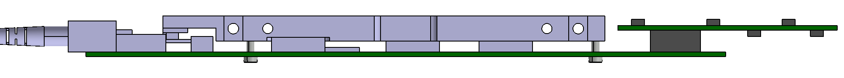
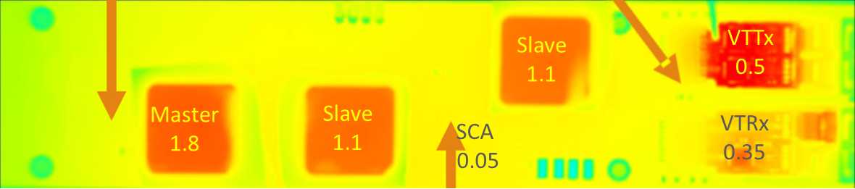
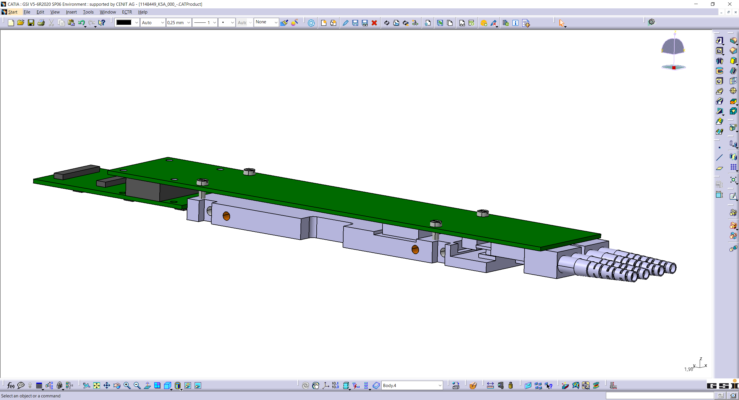
STS-ROB Integration
Mechanical Mount and Cooling
STS-ROB PCB screwed to mechanical support fin
  components towards fin
interface with thermal pads to all power dissipating devices
  structured surface to accommodate height differences
dissipated power ~5W
→ factor 4 lower than on FEB8 fin
STS-ROB Mechanical Mount
GBTX ASIC with Cooling
Interface and Thermal Pad
Side View of STS-ROB Unit with Mech. Mount, FMC and VTXx
STS-ROB Unit
Power Dissipation and Temperature (Uncooled!)
mechanics designs: O. Vasiliev (GSI/DTL)

Slide 6
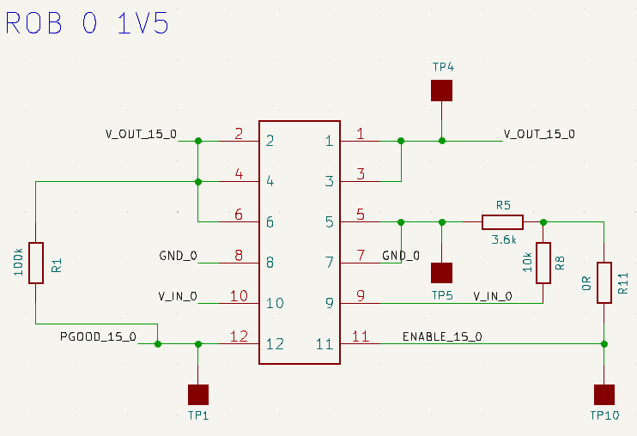
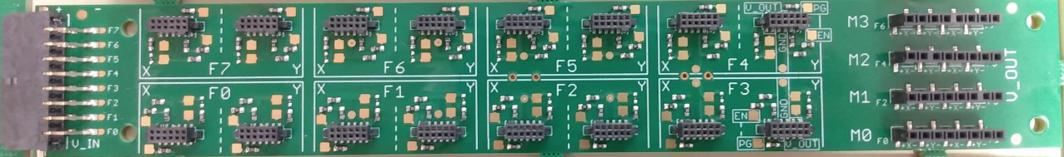
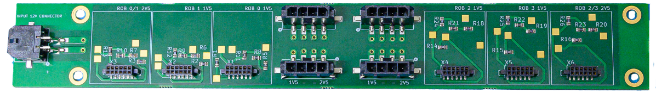
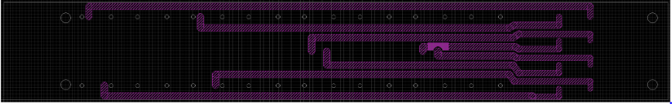
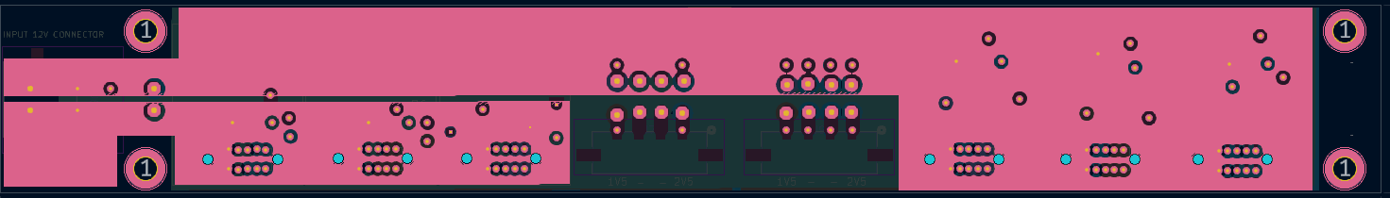
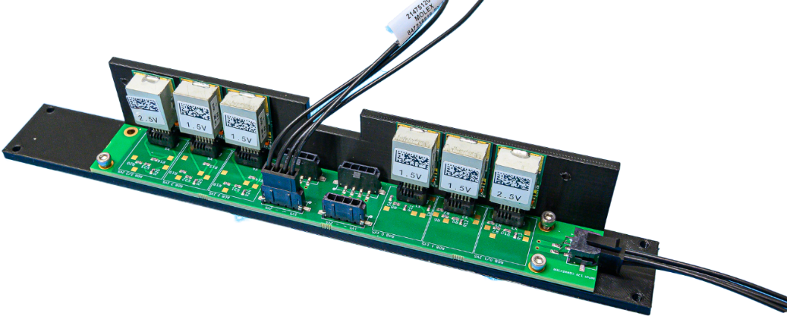
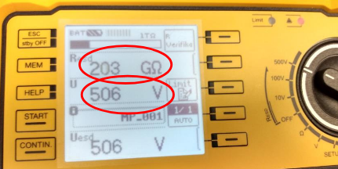
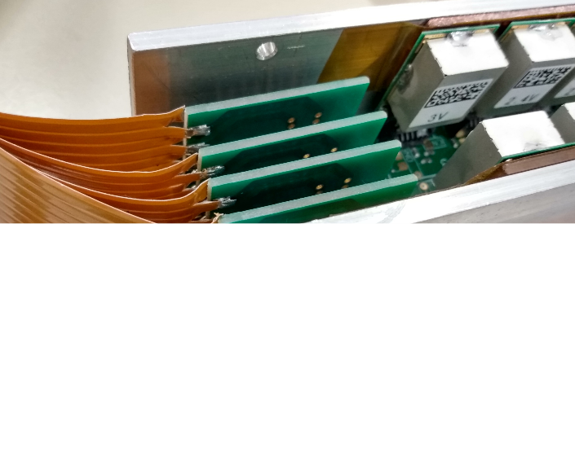
FPOB and RPOB Powering
Powering for STS Frontend Boards and Readout Boards
radiation tolerant FEAST_MP (CERN) DCDC converter
  custom CBM form factor
installed on dedicated Powering Board (PoB)
FEAST_MP
CBM form factor
Frontend Board Powering
8 FEB8 per FPOB
1 x 2.4V and 1x 3.0V FEAST_MP per FEB8
LDOs on FEB for 1.2V and 1.8V
each FEB8 and its FEAST_MP on corresponding sensor bias potential up to +/- 250V
used in mSTS
Readout Board Powering
1 x 1.5V FEAST_MP per ROB
1 x 2.5V FEAST_MP per 2 ROB
1 LV channel per 3 ROB
4 ROB per RPOB
short (4-8cm) LV cables
all RPOB and ROB on common GND
Schematics
FEAST_MP Unit
Assembled FPOB
Assembled RPOB
8 LV ch. IN
2 LV ch. IN
FPOB Internal Layer: Thick Traces
FPOB Internal Layer: Split Planes
FPOB Isolation Test 500V
FPOB with Sumida LV cables to FEBs
RPOB with FEAST_MP and L-Cooling Fin
(3D printed mockup)

Slide 7
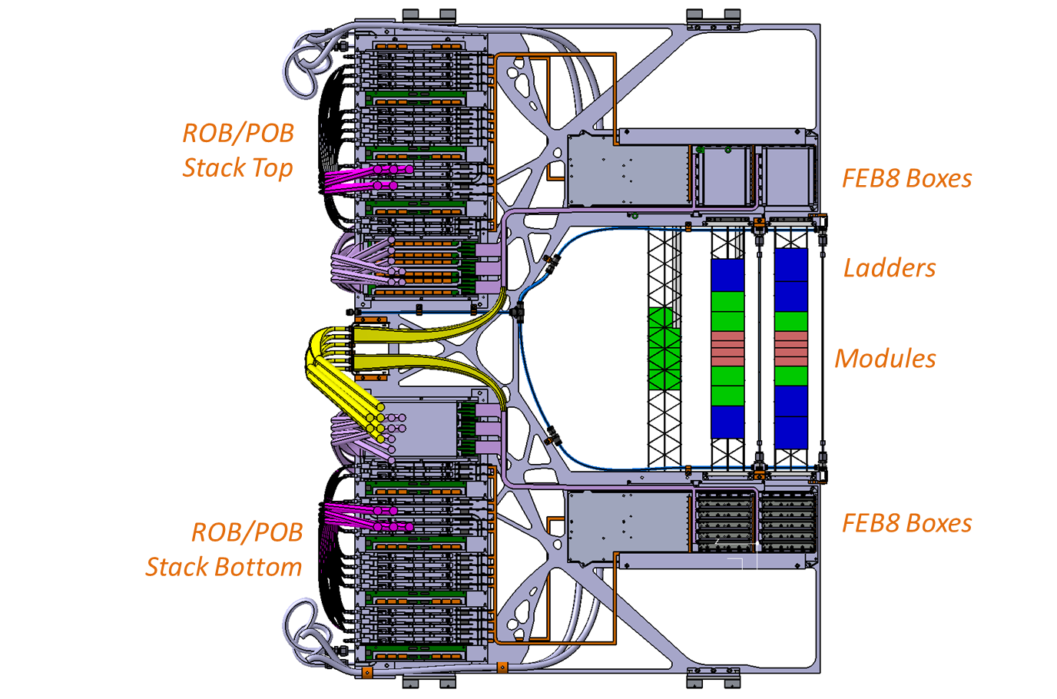
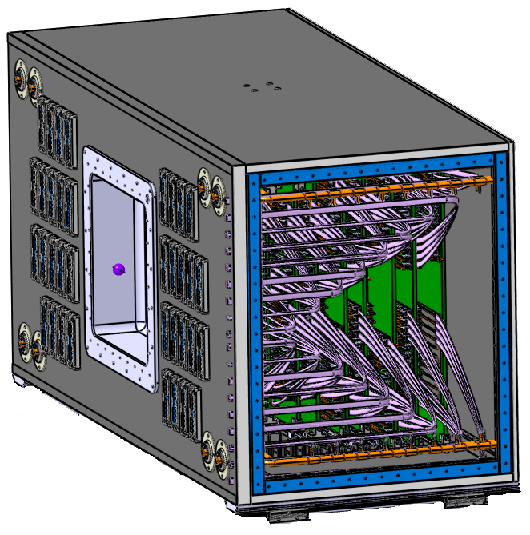
The ROB/POB Stack
ROB/POB Stack (Top or Bottom)
STS-ROB on ROB/POB Stack
ROB mounted on top or bottom of fin
  only one ROB version (no symmetric twin needed)
ROB-FMC with ZIF connectors on top/bottom
  two cable types (same/opposite side contacts)
Backend Inteface: LC Fibers to CRI & LV IN
Frontend Inteface: Readout Cables & LV Cables
ROB/RPOB
Units:
4 x ROB
1 x RPOB
C-Frame
STS Box with
20 C-frames
ROB-FPOB
Overlap
1.4 m
FPOBs
2.3 m
1.0 m
Unified Cooling Plate

Slide 8
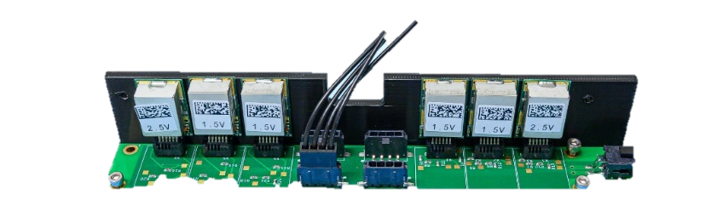
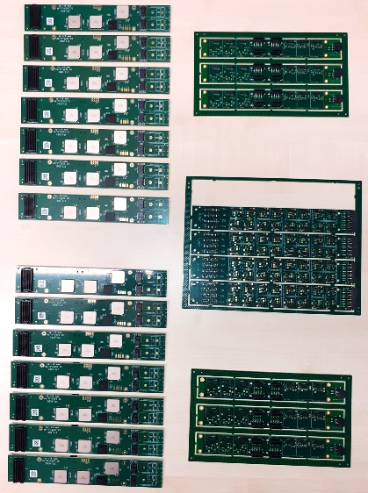
Status
components for full STS readout and powering developed, built, tested
  STS-ROB, RPOBs, FPOBs, FMC_11111 (FMC_122 in the next days)
sufficient boards available for integration of first C-Frame
when mechanics components available
  characterization of cooling performance
  assembly of first ROB/POB stack
some additional characterization work
  extended BER tests
Rev.2 with minor modifications
  mostly optimizations for series assembly and testing
Production Readiness Review for STS-ROB and RPOB, FPOB
  successfully done last Thu. 16.10.25
  https://indico.gsi.de/event/23248/
ROB and POB devices
for first C-frame

