Slide 1
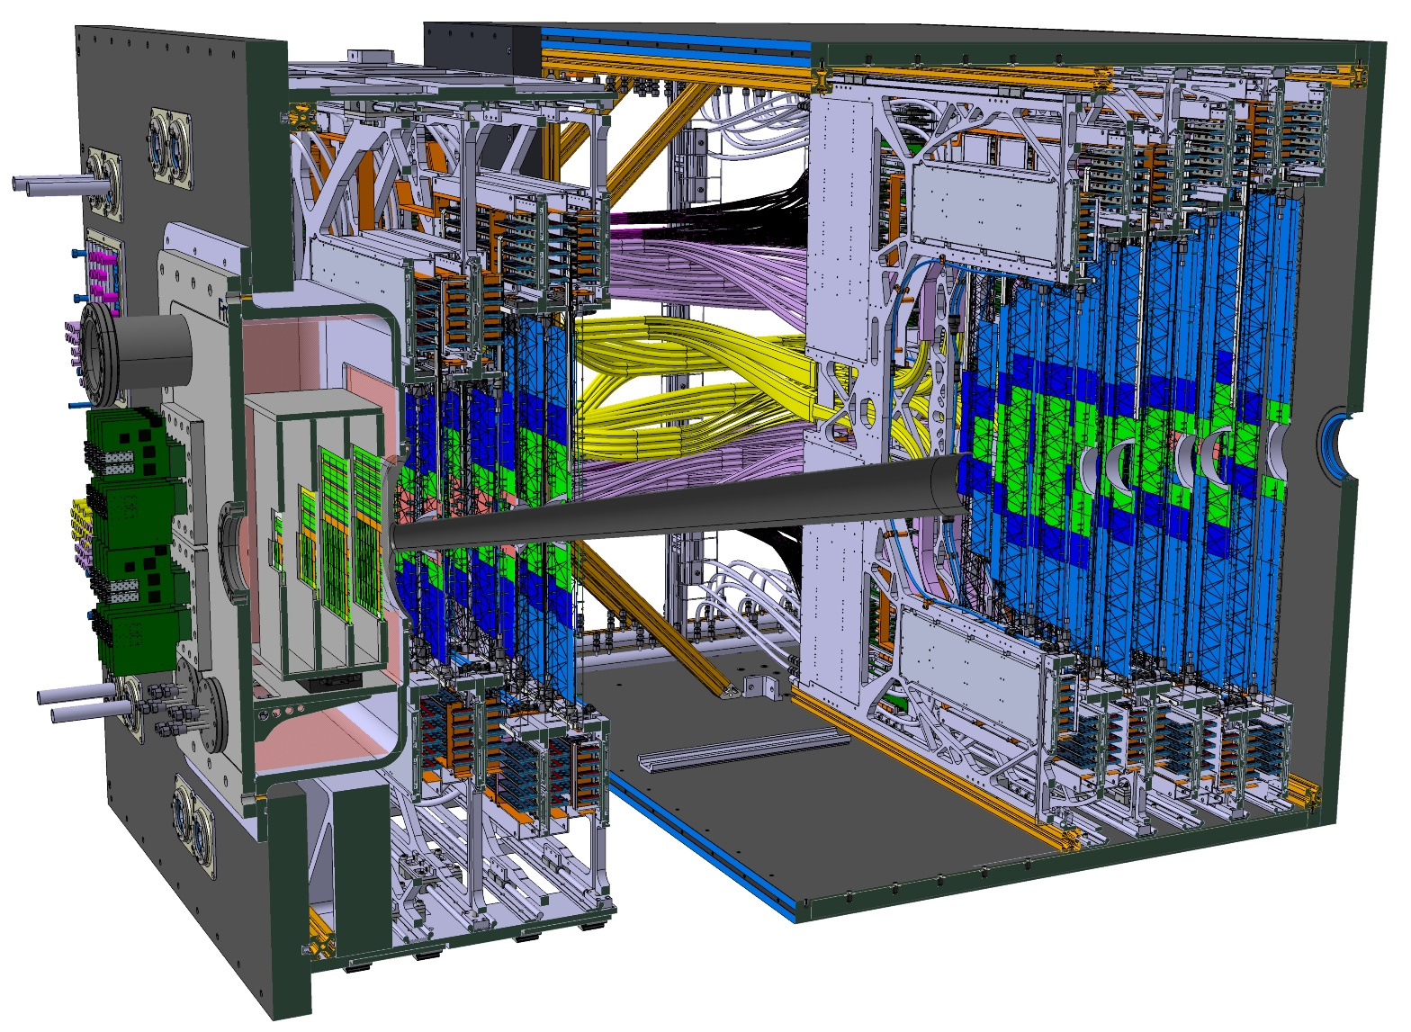
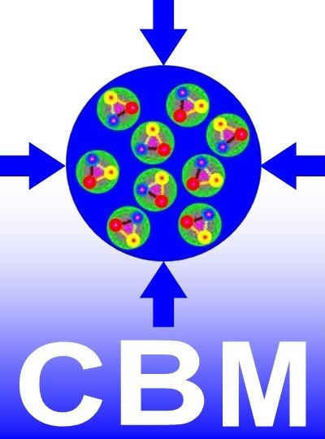
Status of STS Assembly 46th CBM Collaboration Meeting Institute of Modern Physics, Lanzhou, China Oct. 19 – 24, 2025
Christian J. Schmidt,
GSI Darmstadt,
for the CBM-STS team

Slide 2
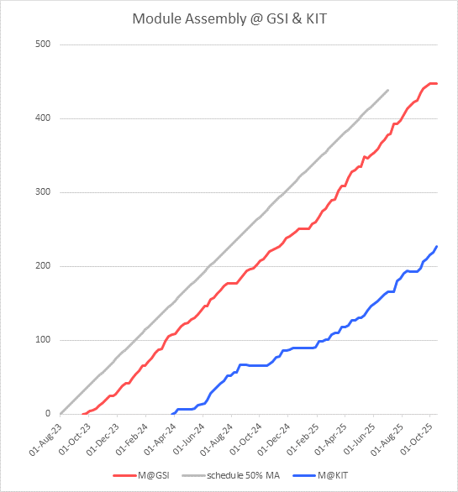
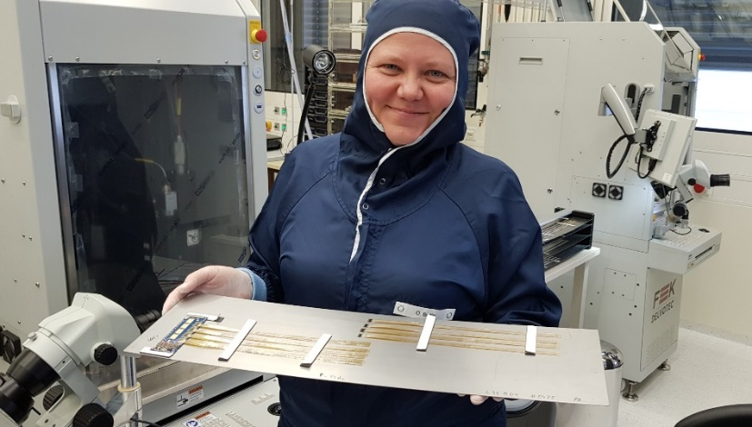
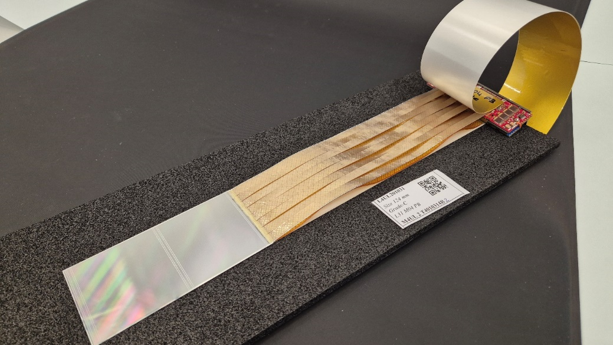
STS-Module Assembly at KIT and GSI
Total of 876 modules to be assembled in more than 160 different variants
Nominal production start Aug. 1st 2023
Assigned load: 876/2 = 438 modules at KIT and GSI
Today, 77% or 674 modules assembled
34 modules (5%) proved defective and were rebuilt (distorted reverse bias behavior, leakage current, break down, errornous assembly, spontaneous break, breakdown in further integration on ladder)
Serial assembly ongoing full blast!
slope 4.5 mod/week
STS-Module: Double Sided Micro Strip Si-Sensor with 2048 readout channels

Slide 3
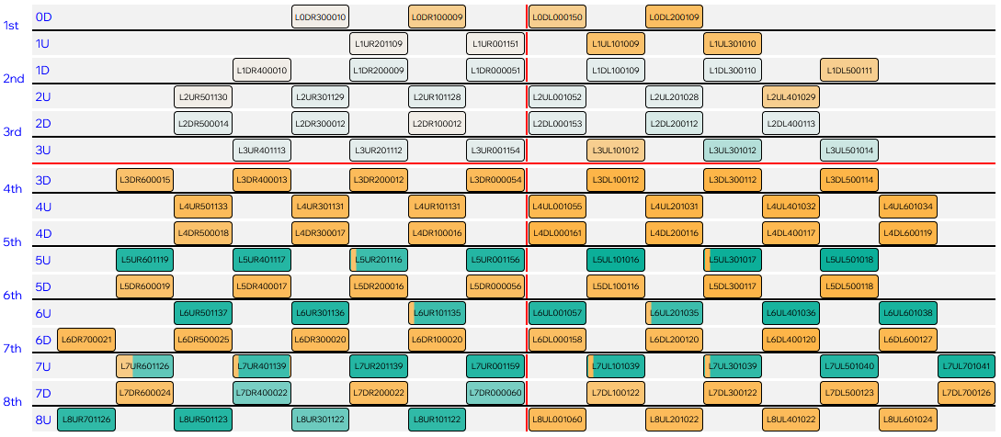
Assembled Modules: Top view onto STS, per ladder
Half Unit 3L D
green: assembled at KIT
orange: assembled at GSI

Slide 4
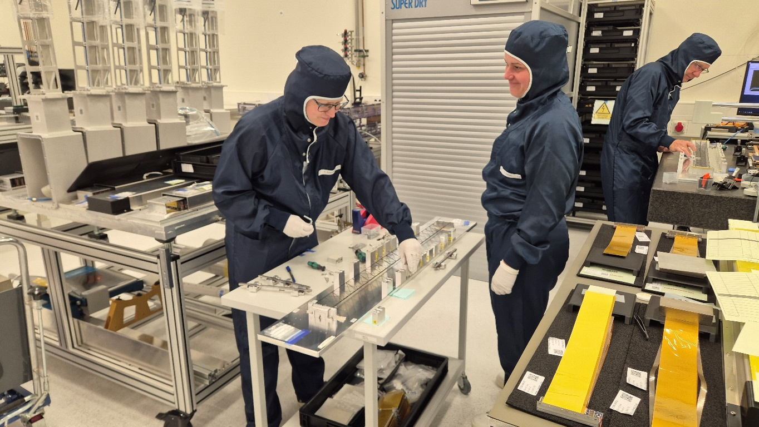
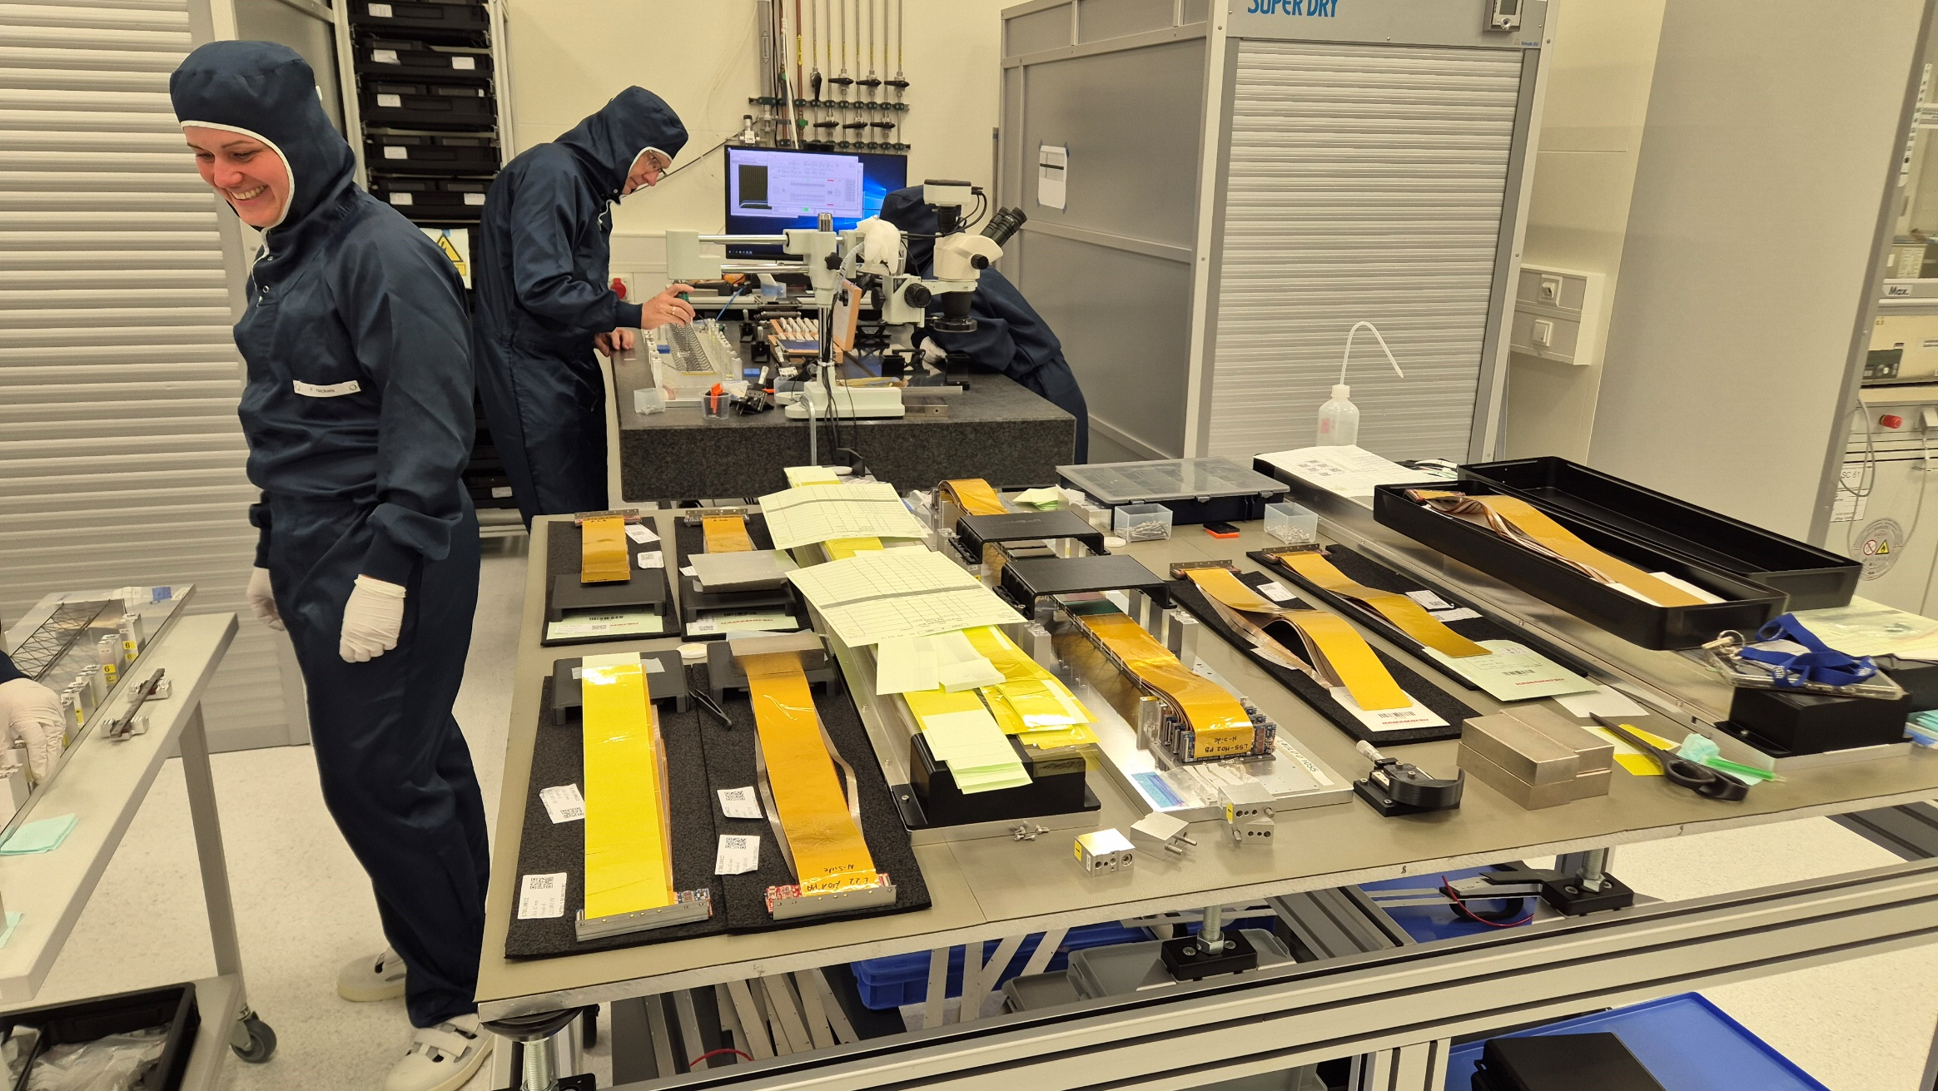
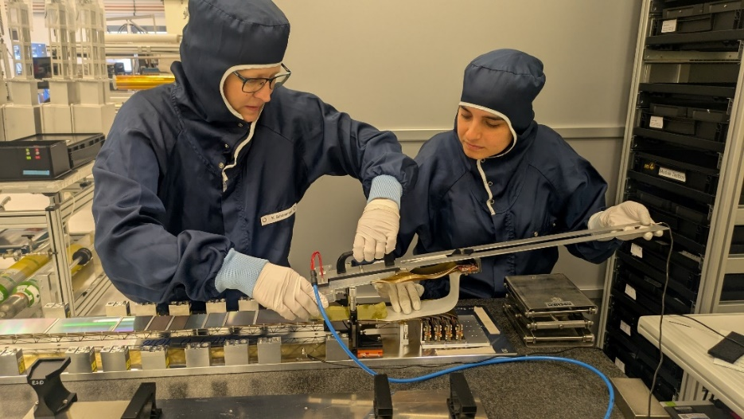
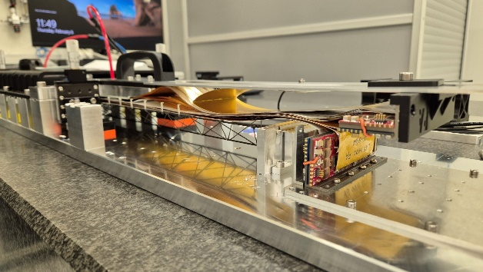
Ladder Assembly in Full Production Mode, Careful Logistics Essential

Slide 5
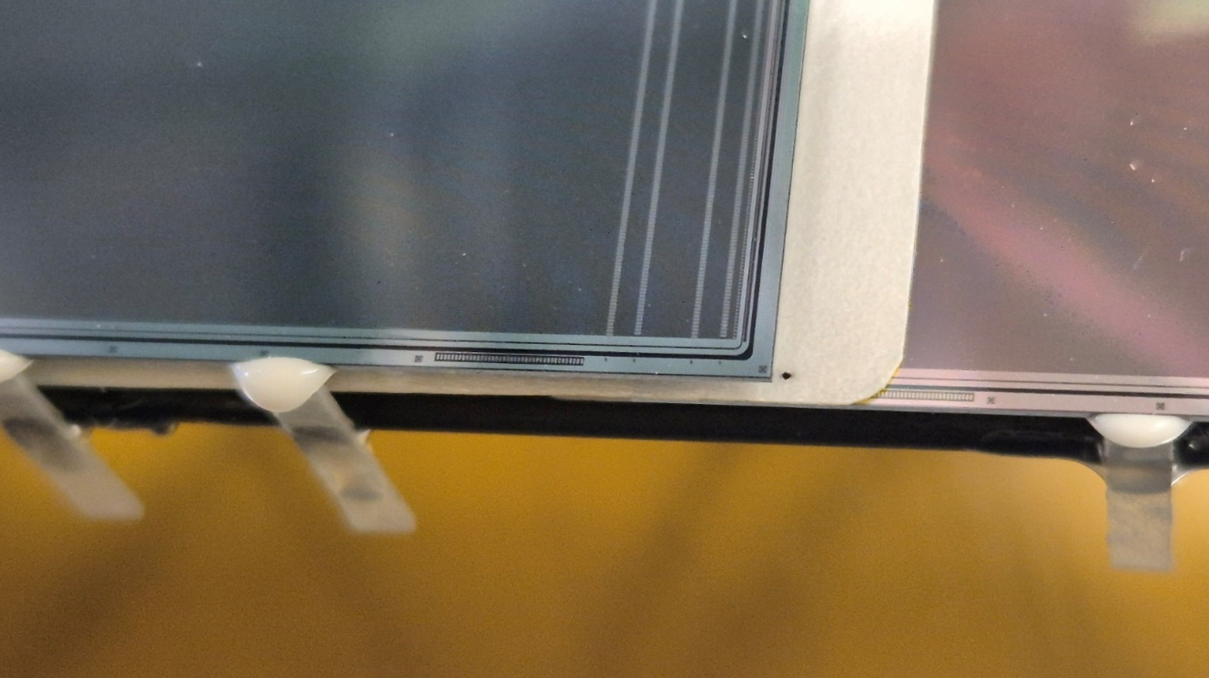
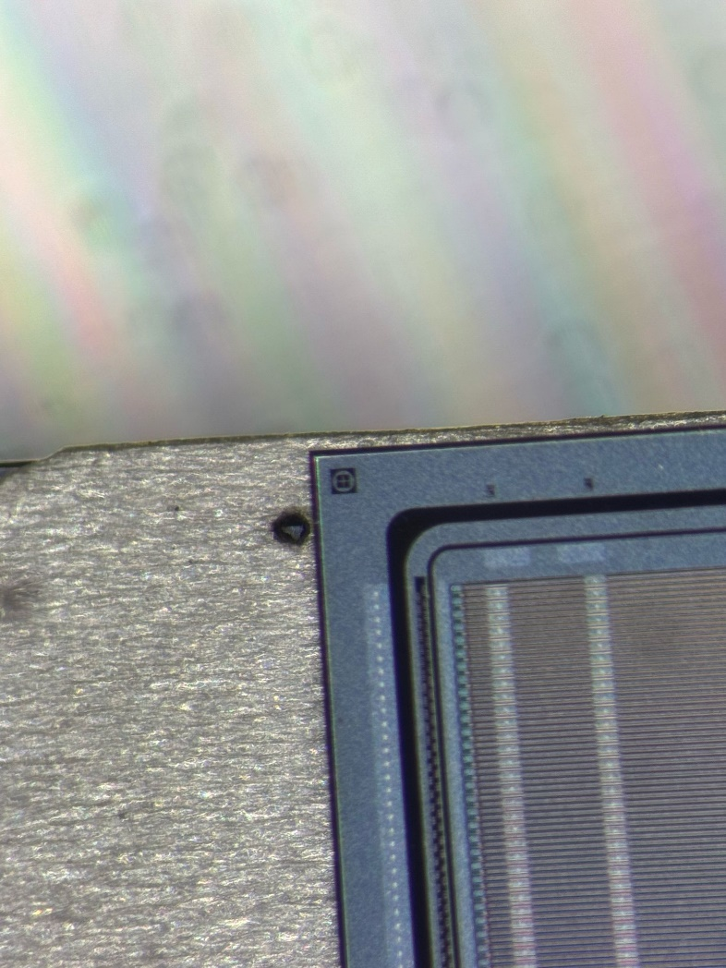
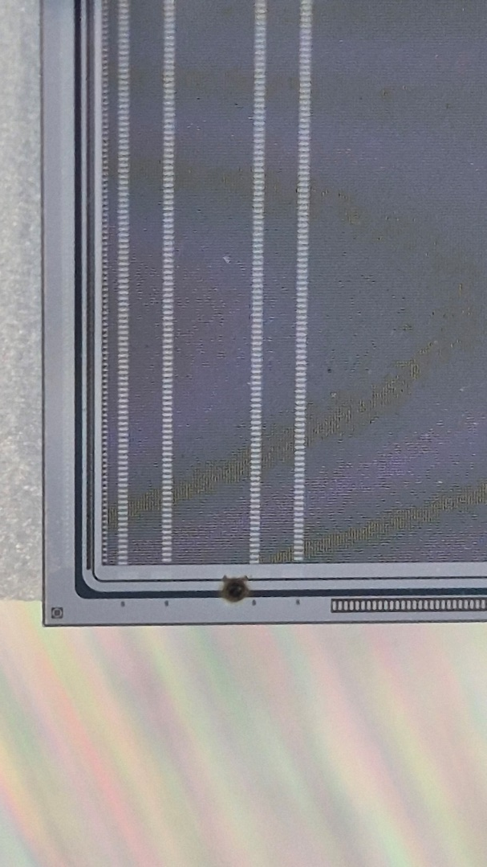
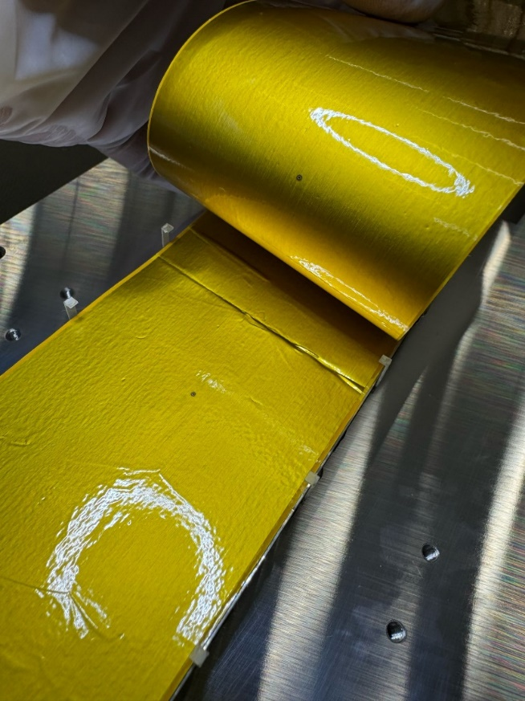
Identified locations of discharges
First ladder test with simultaneous bias on all modules utterly failed!
Suspicious black spot on T0-shielding between T0 and B0 observed → discharge killed both modules
Further discharge between shielding layers killed electronics on additional module
Two discharges between modules killed three!
T0
T0
B0

Slide 6
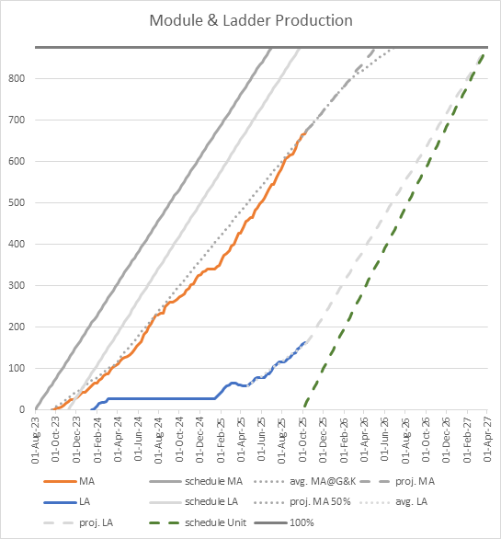
Counter measures taken, ladder assembly now at speed
Counter measures developed:
Ladder design: additional 7.5µm insulating Kapton layer added between central modules of highest bias (adds 0.003% X/X_{o})
Procedural: Biassing test at highest voltage without connection of data lines → discharges may happen but will cause no damage!
Serial Ladder Tests prepared
See Lady Maryann‘s talk
on Friday
Installed CRI for full, high bandwidth ladder testing
Operation and analysis software transferred from mSTS
Final ladder characterization will result in „module passport“ for each module to be integrated into STS
Definition being worked on

Slide 7
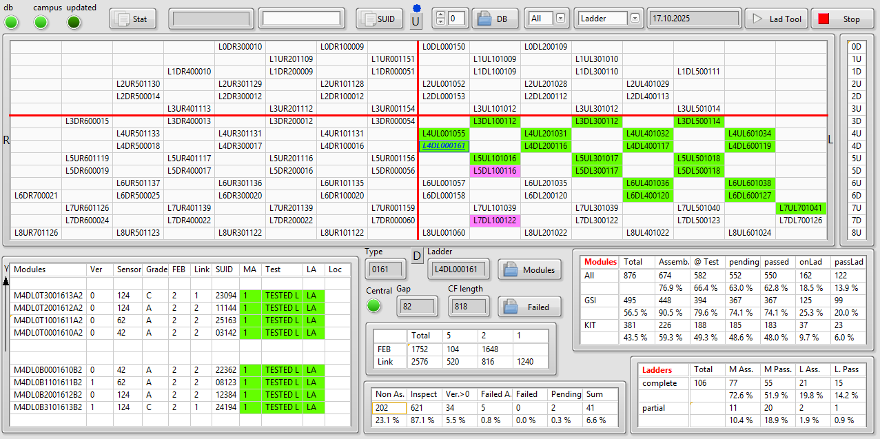
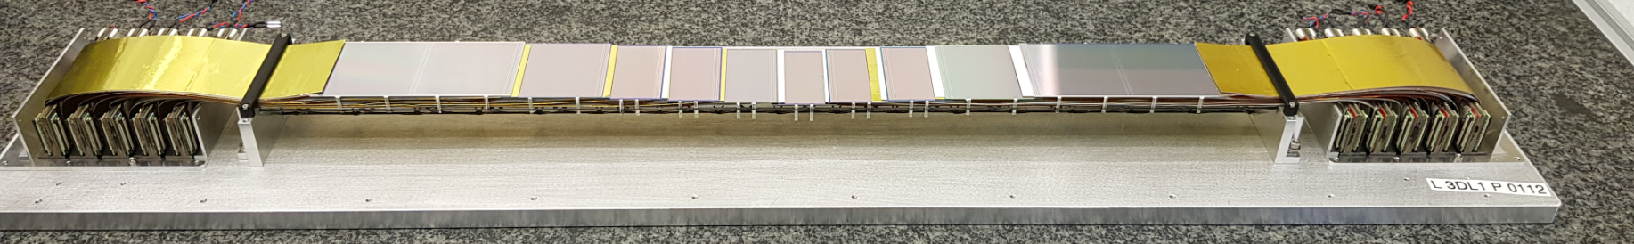
Ladder Assembly, 21 ladders (out of 106) assembled (162/876 )
module
metric
17.10.2025

Slide 8
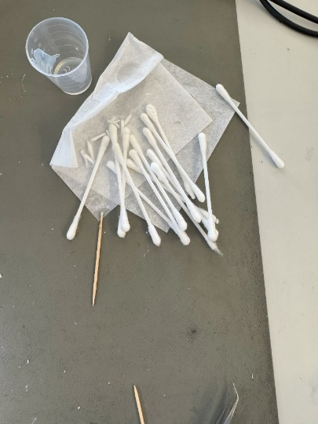
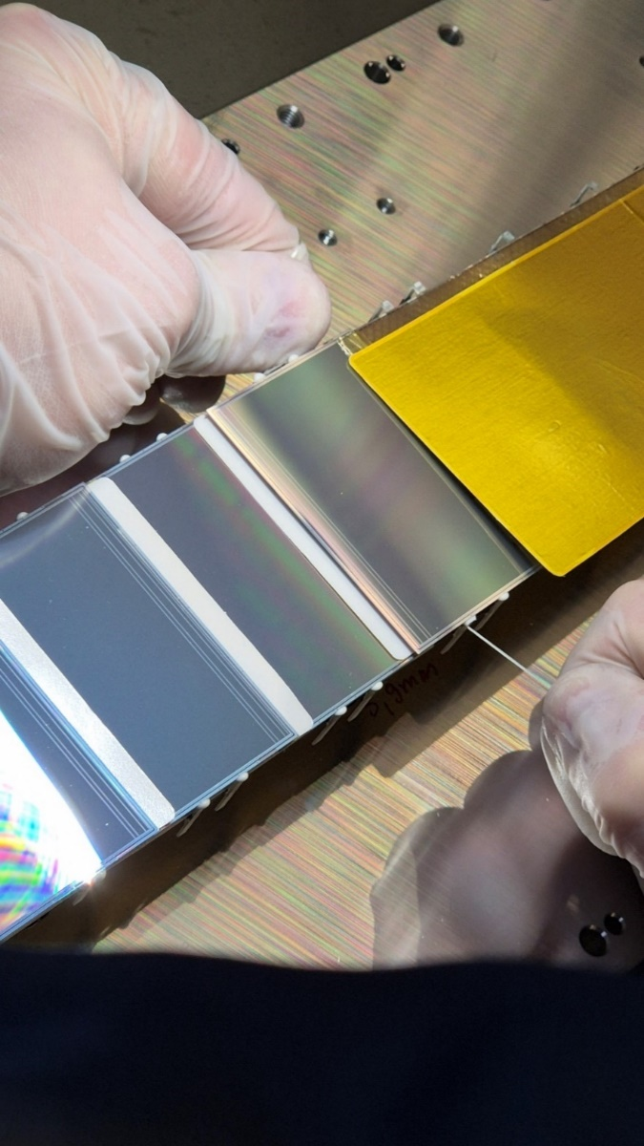
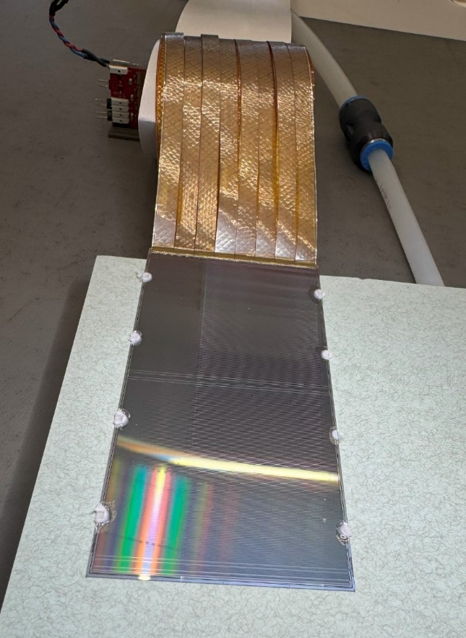
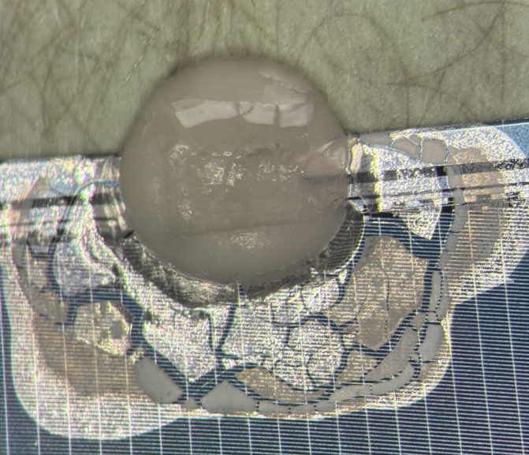
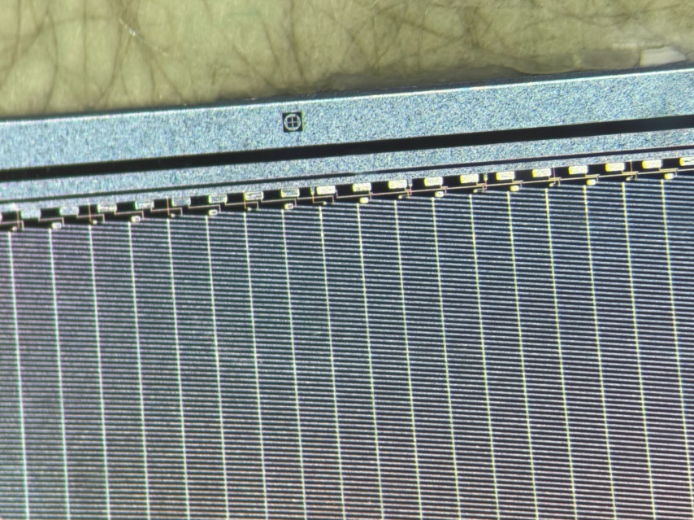
After Crisis: Ladders and Modules can now be disassembled!
Oleksandr Suddia elaborated procedure to dismount and clean modules from assembled ladder without compromizing function, using tooth cleaning silk and silicone cleaning agent
Even chip-cables may be replaced on a module!
→ This makes STS-modules and -ladders and with them the STS much less monolithic! Thorough tests on three dismounted modules confirmed: no quality degradation!
Modules may be dismounted, sensors cleaned from silicone
without degradation of IV curve or sensor function

Slide 9
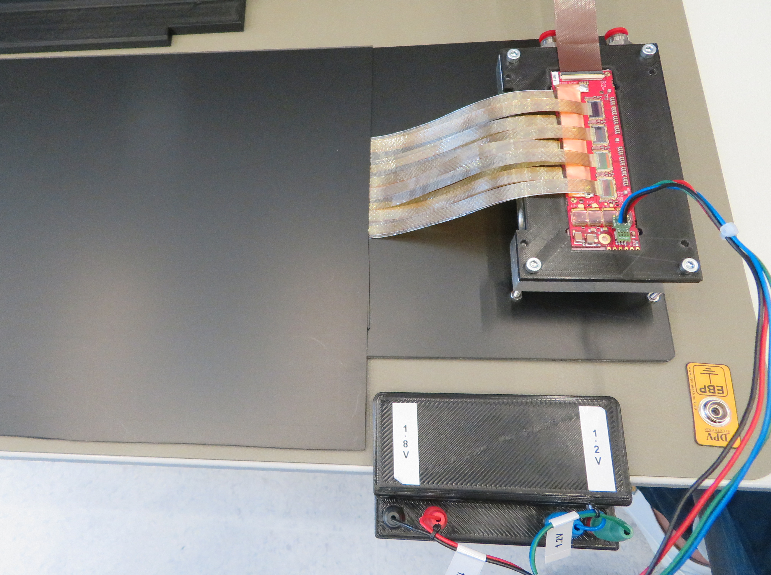
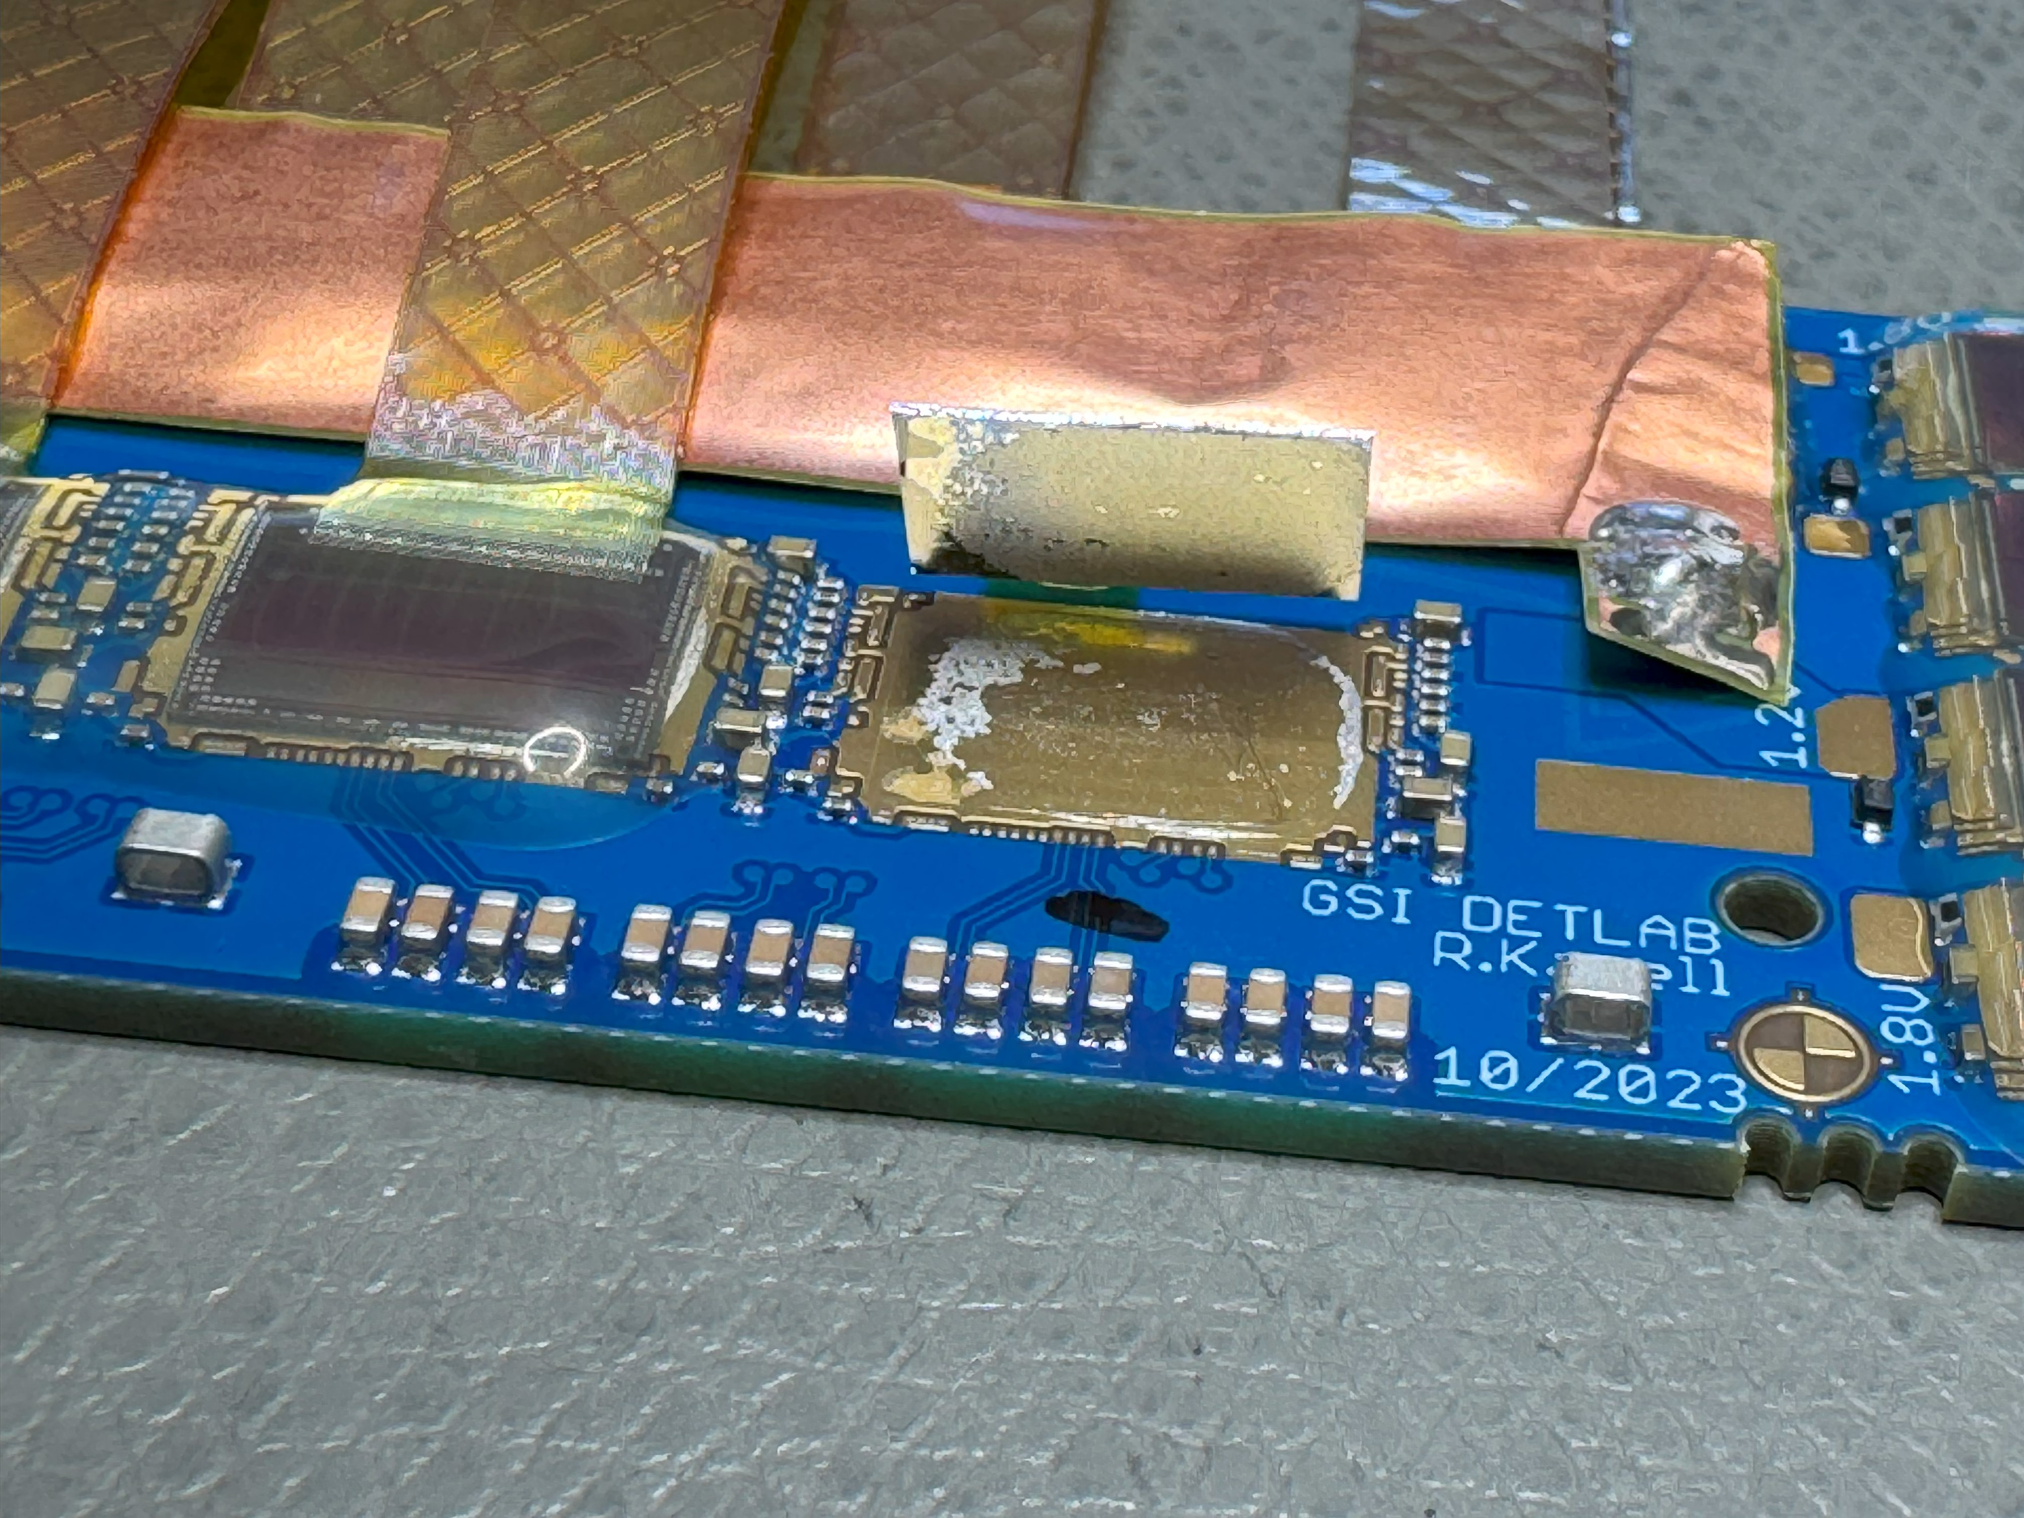
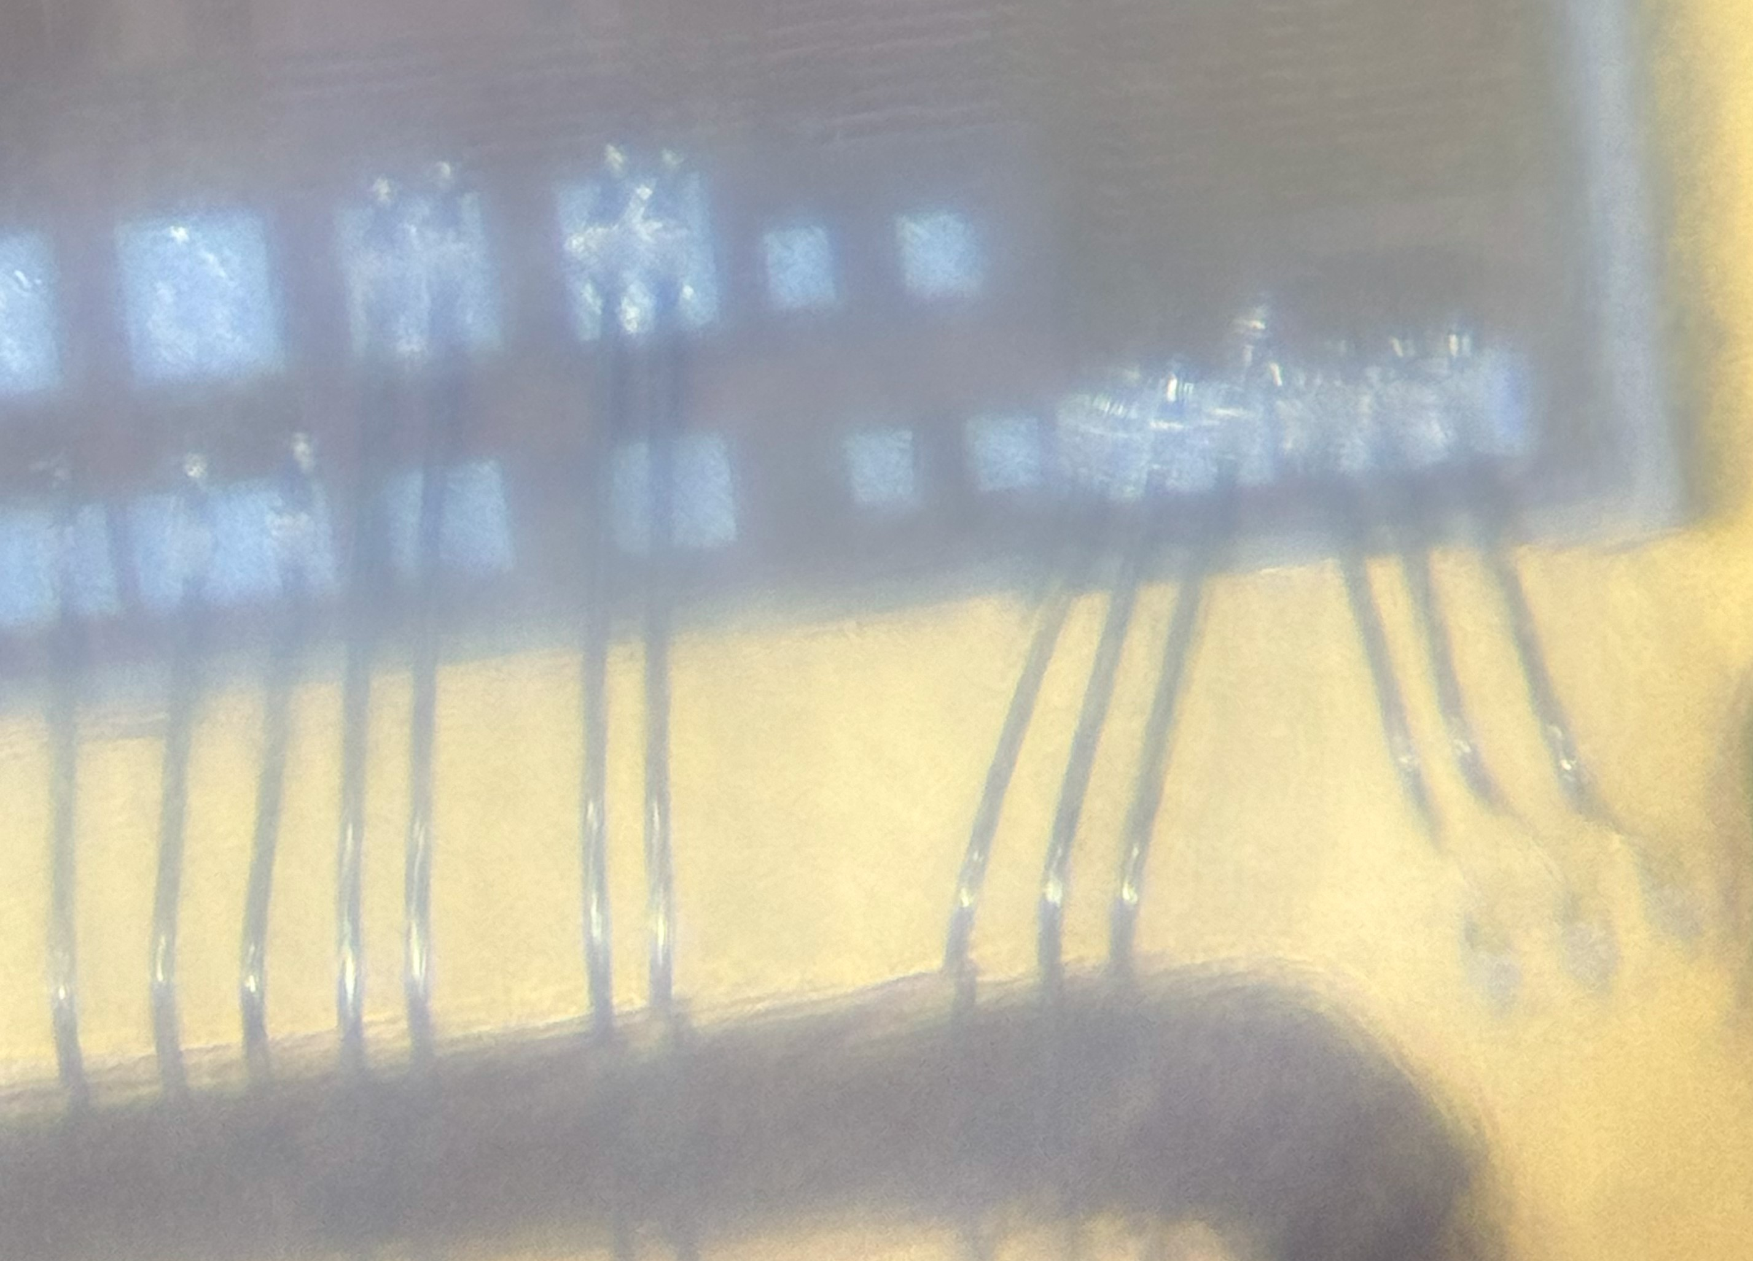
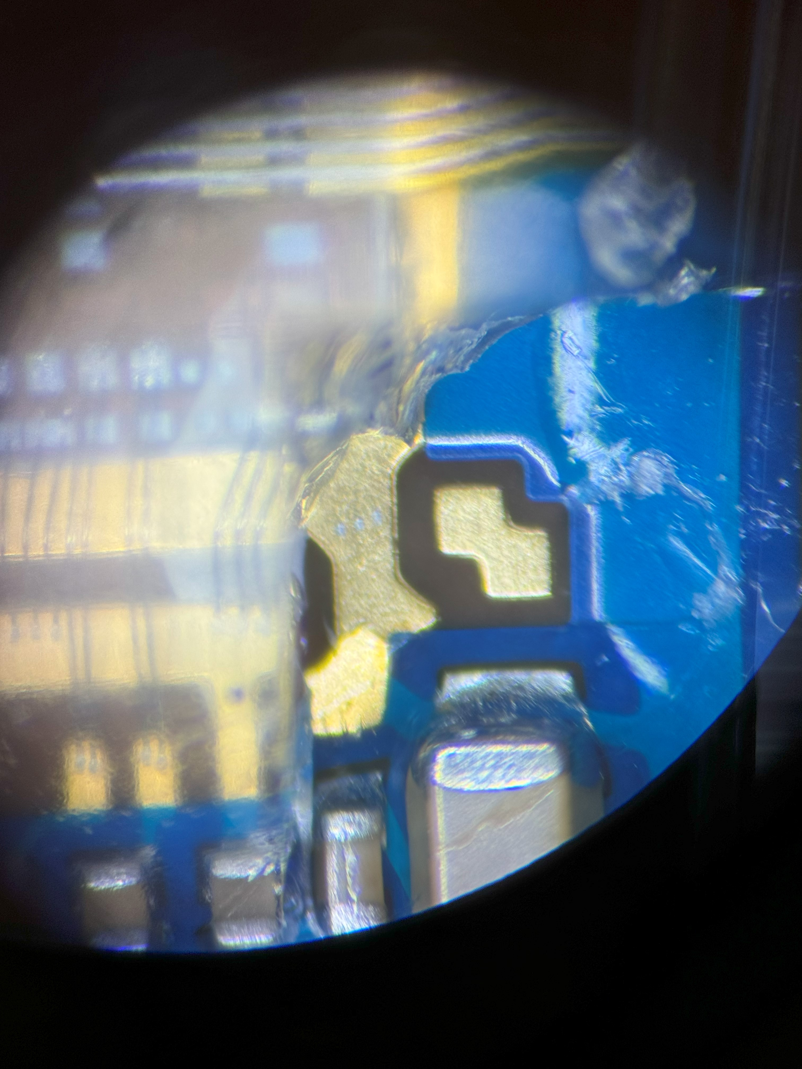
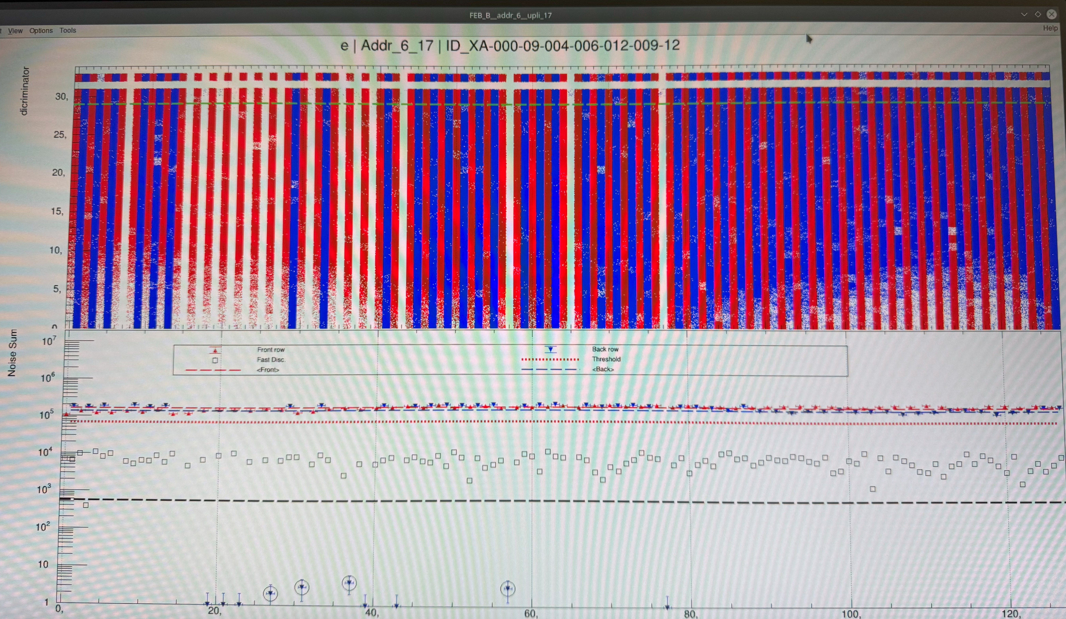
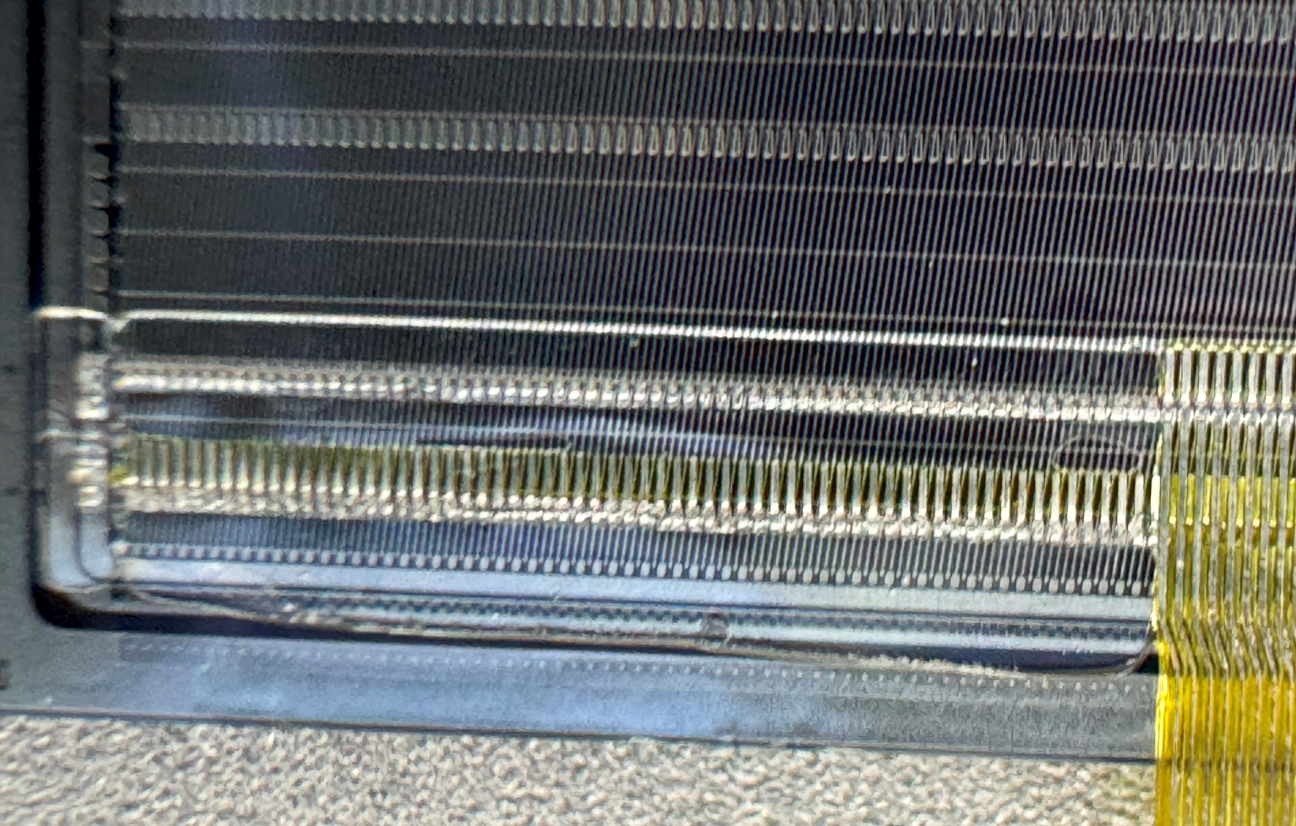
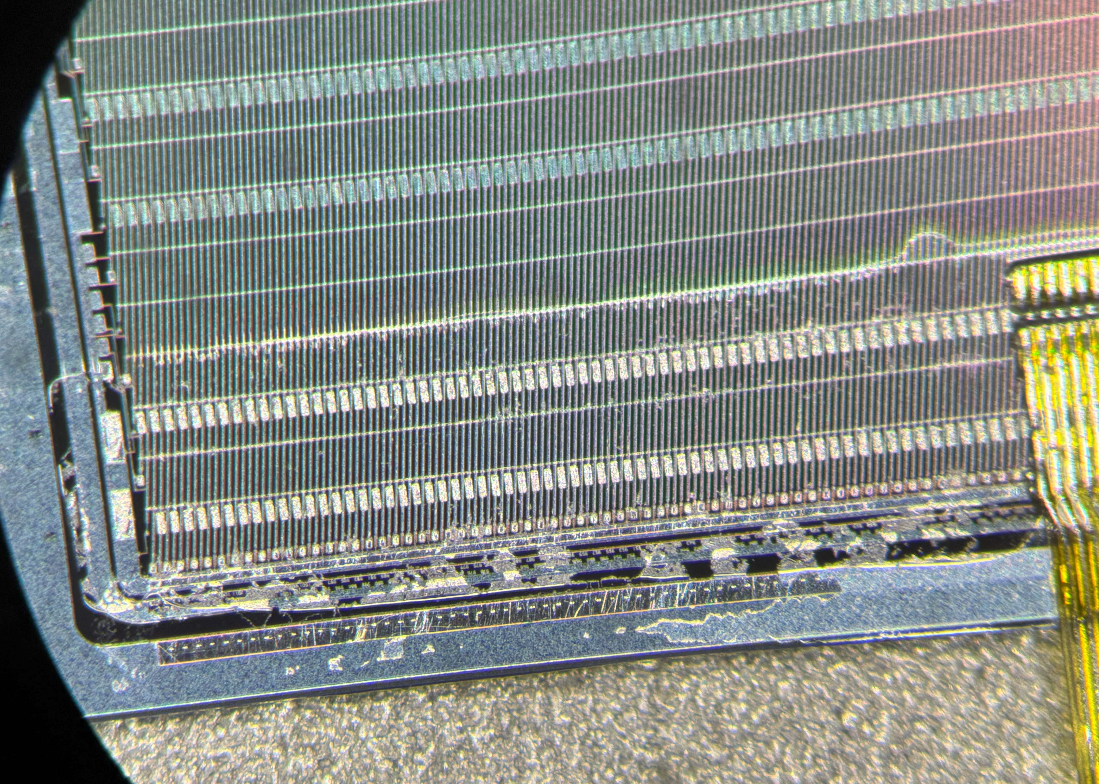
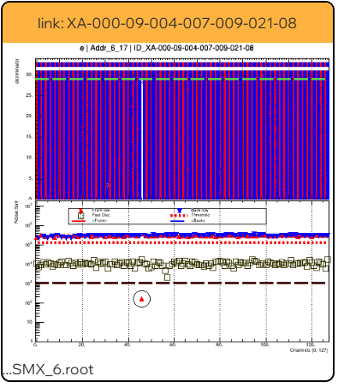
Module Rework Now Feasible!
FEB test reveals broken ASIC
short underneath
glob top
ASIC may be interchanged
cable stack removed from sensor
bond pads prepared for new bonds
bond pads may be dug out of glob top
sensor fully functional

Slide 10
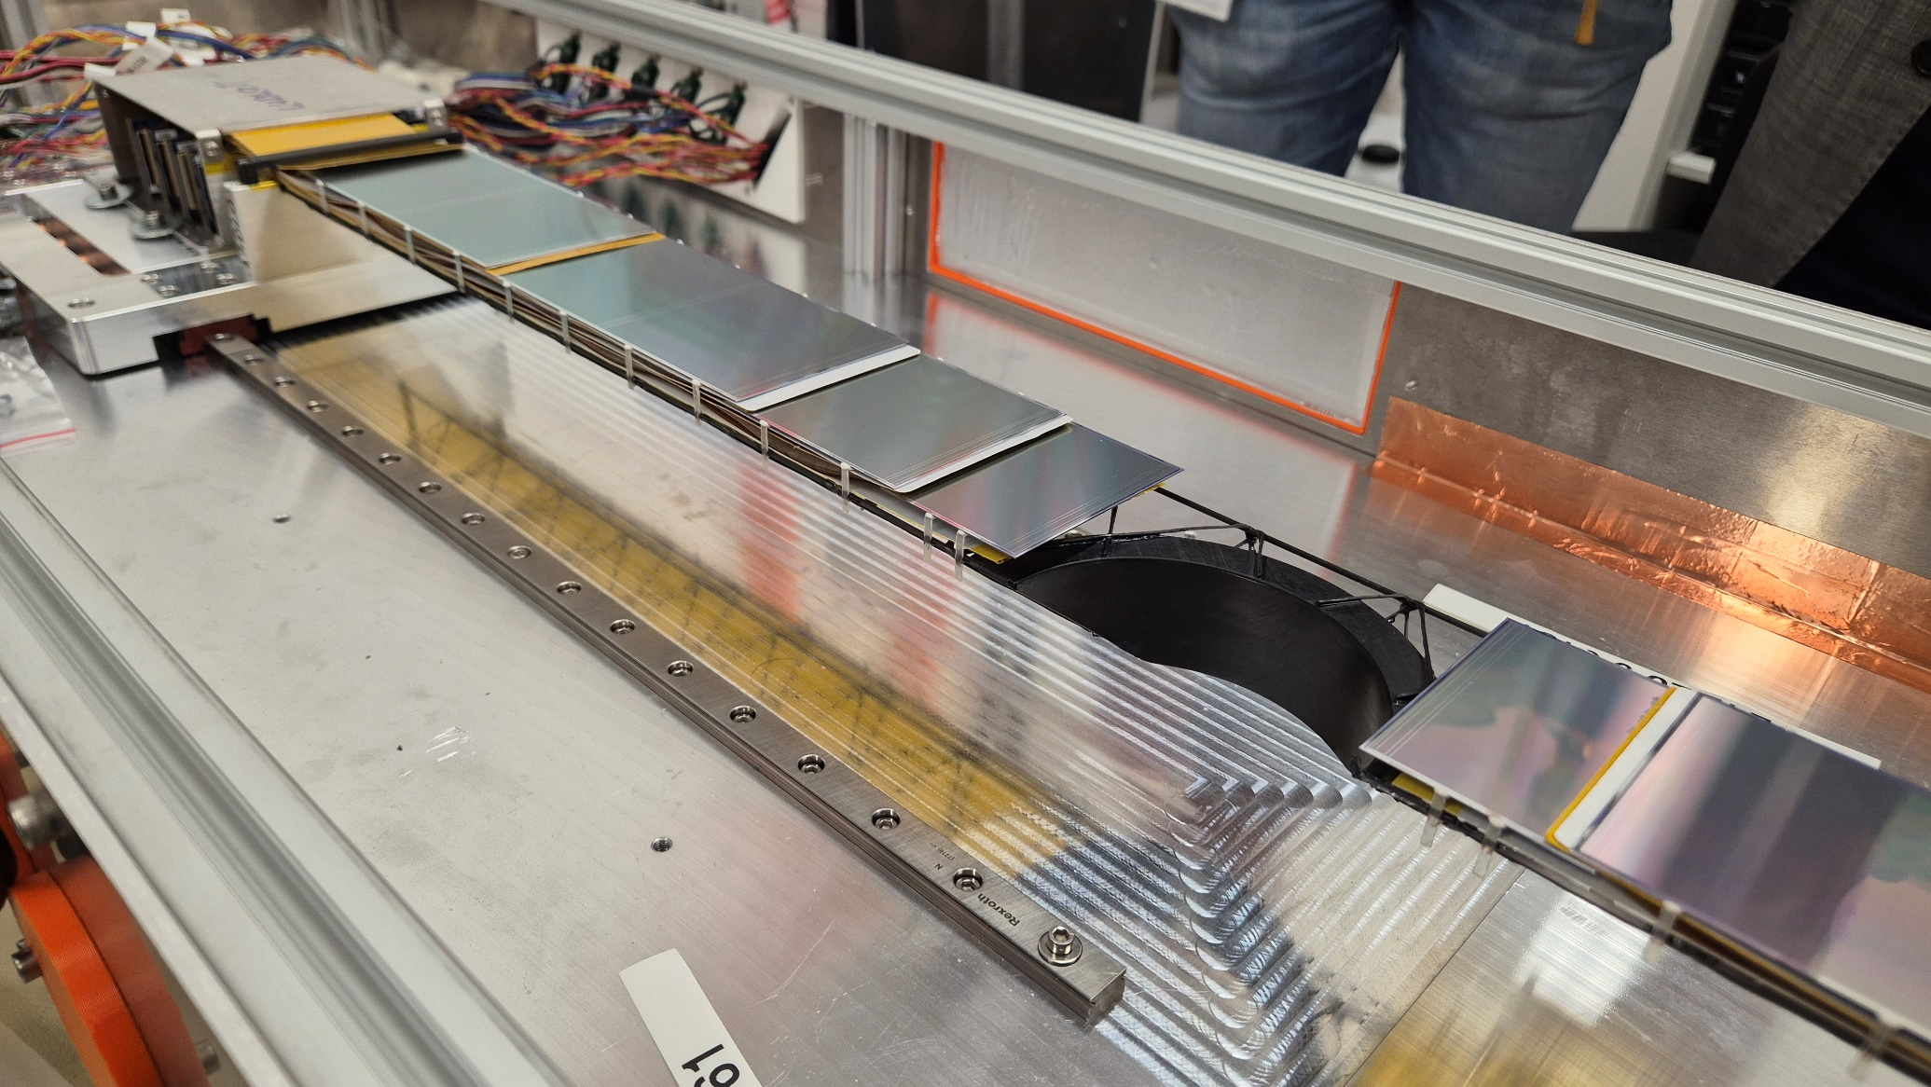
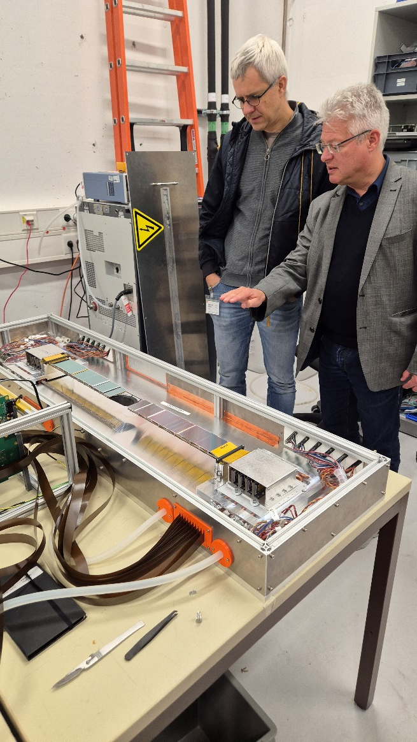
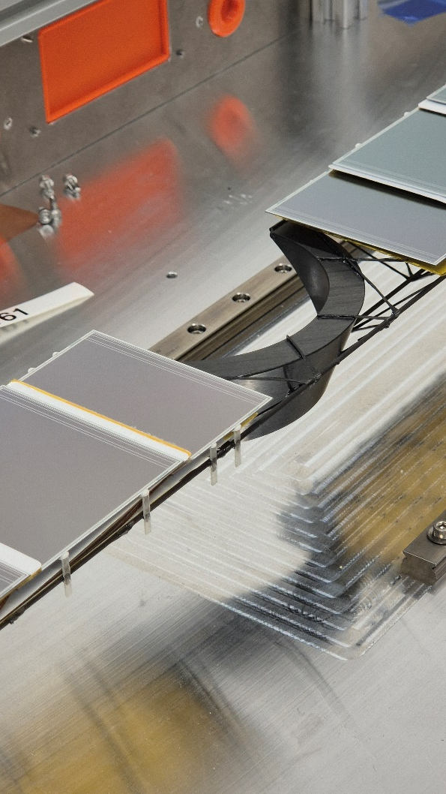
First of 16 ladders with beam-pipe cutout assembled
Christoph Möller of ICM
looking at his product
Cutout structure appearing massive, is less than 4g,
that is just +20% on beampipe material budget!
original concept: Sergey Igolkin, 2009

Slide 11
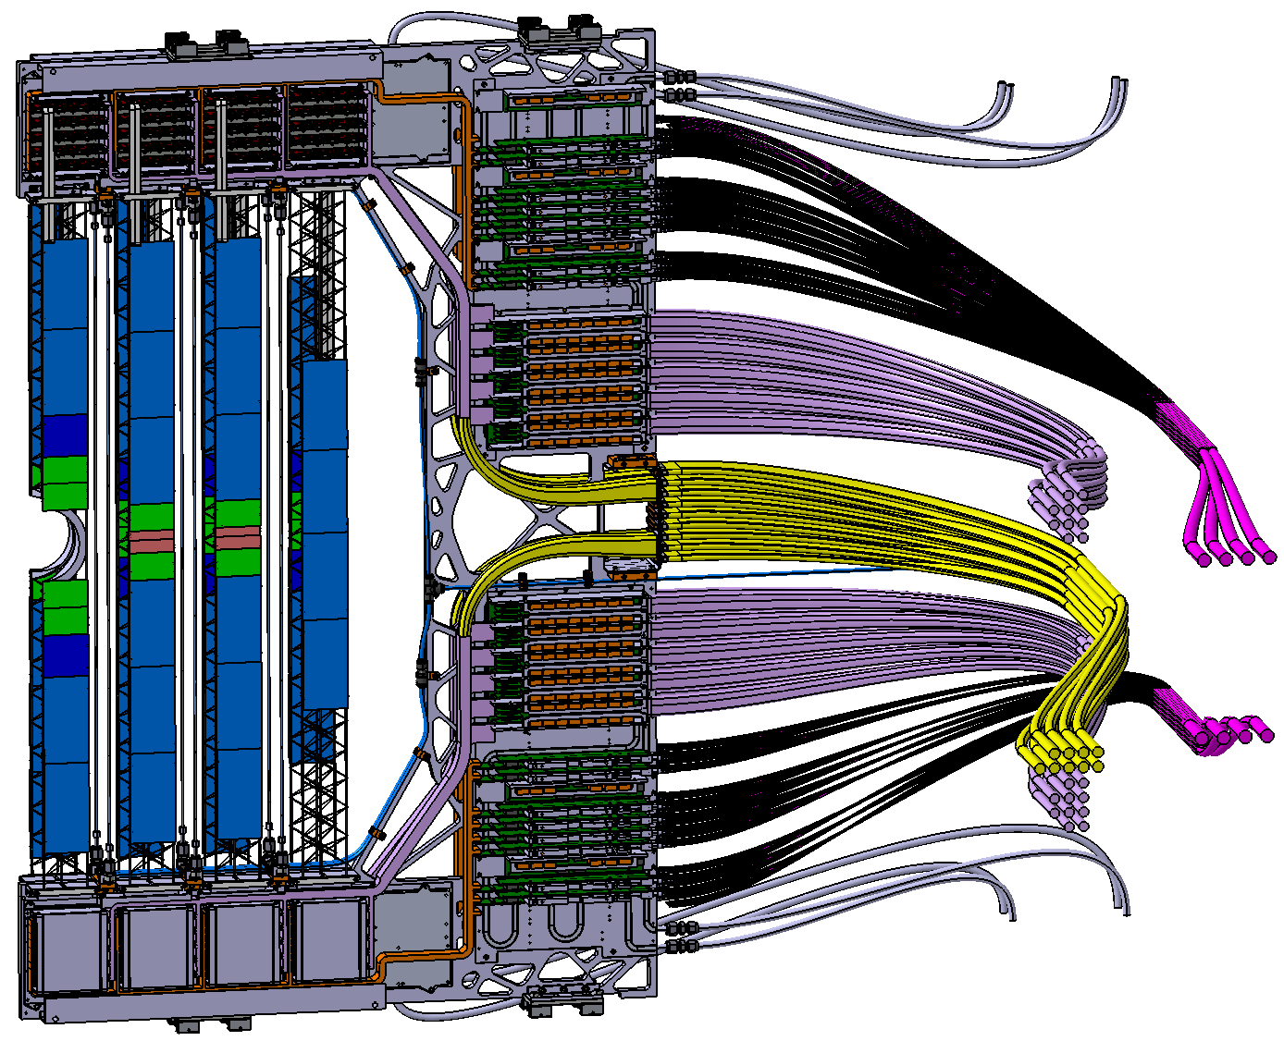

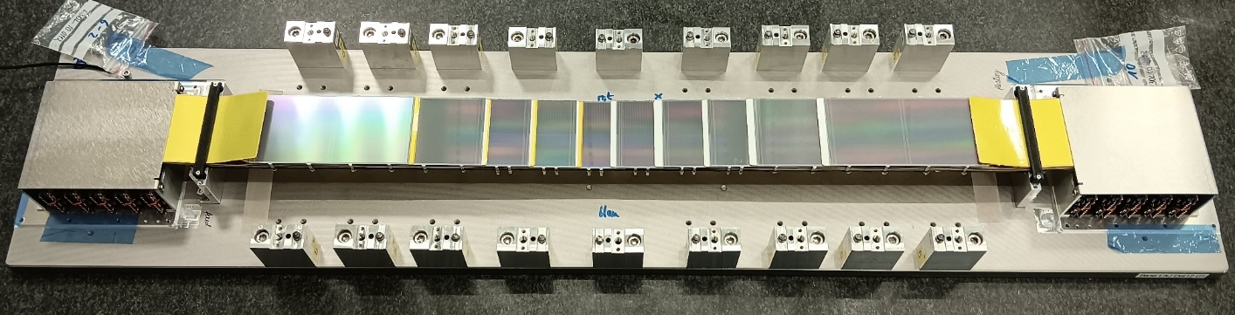
STS in full serial production, now rearrange
double ladder assembly rate to 2 ladders per week
shift personnel from modules to ladders
get Half Unit assembly started, 20 units to be built
Half Unit assembly similarly complicated as module assembly
module assembly
half unit and system assembly
ladder assembly

Slide 12
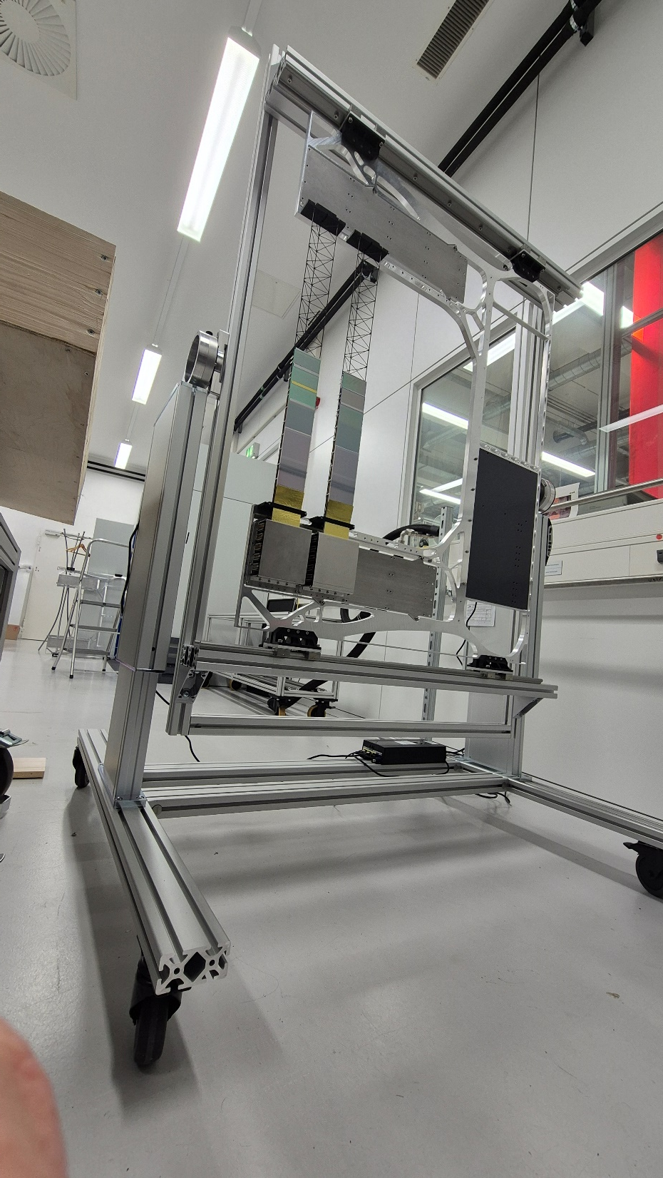
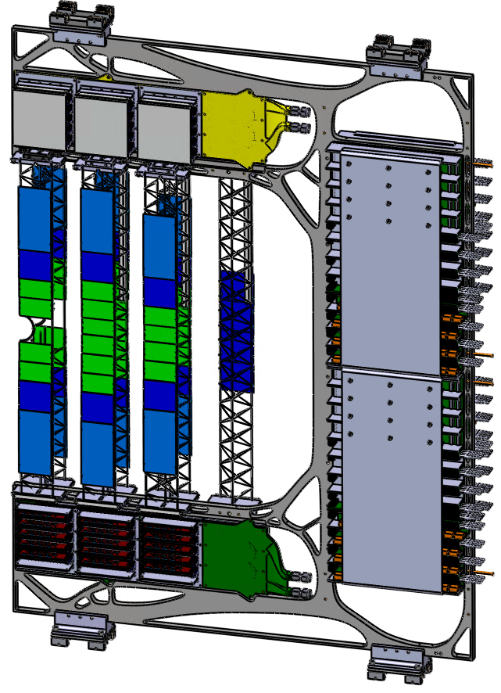
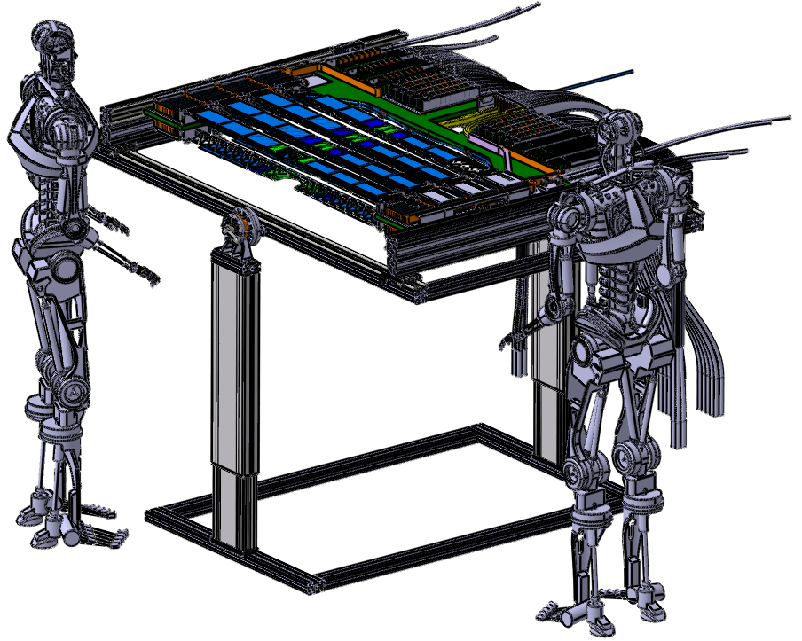
Half Unit Assembly-Jig Available
Device for mounting and cabling STS-ladders onto both faces of C-frame
Essential to proceed with integration of 20 Half Units
Assembly- and QA-Procedures for HU assembly in development
Half Unit

Slide 13
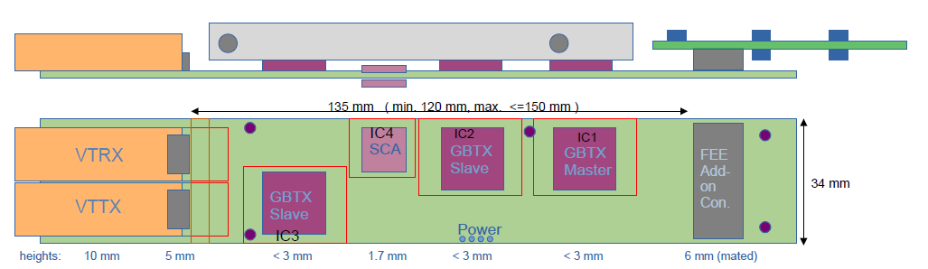
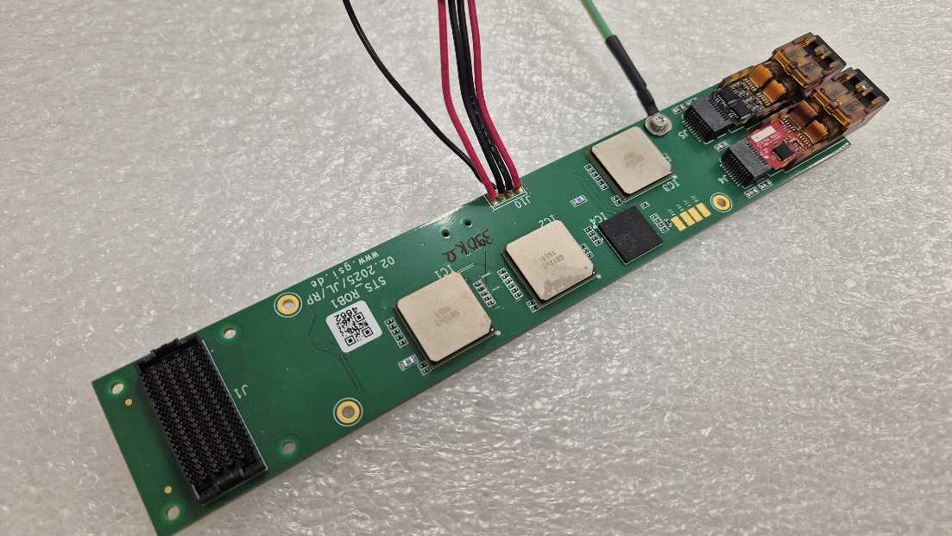
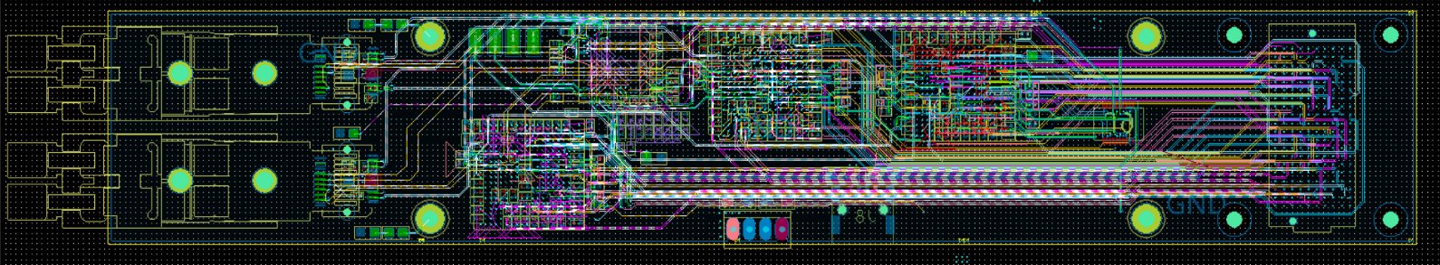
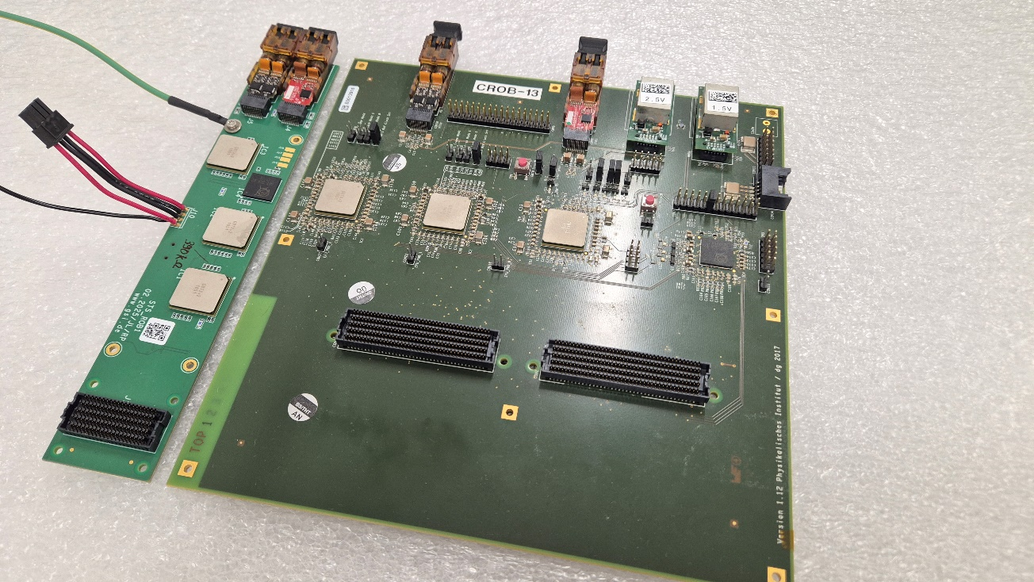
ROB-3 Development: Squeeze CROB to Size!
Schematics boiled down to essentials
Layout realized at GSI-EE department
14 layer PCB required
Intricate optimization with mechanical and cooling needs
see Jörg Lehnerts talk this afternoon
36 mm
200 mm
Discovered important spec. for GBTx for 1.5V analog supply: source resistance < 150mOhm, size of R on decoupling inductance may be critical
ROB- RPOB- and FPOB-PRR successful Oct. 16th
Full production will now be initiated
Similarly, Power Boards RPOB and FPOB ready for production

Slide 14
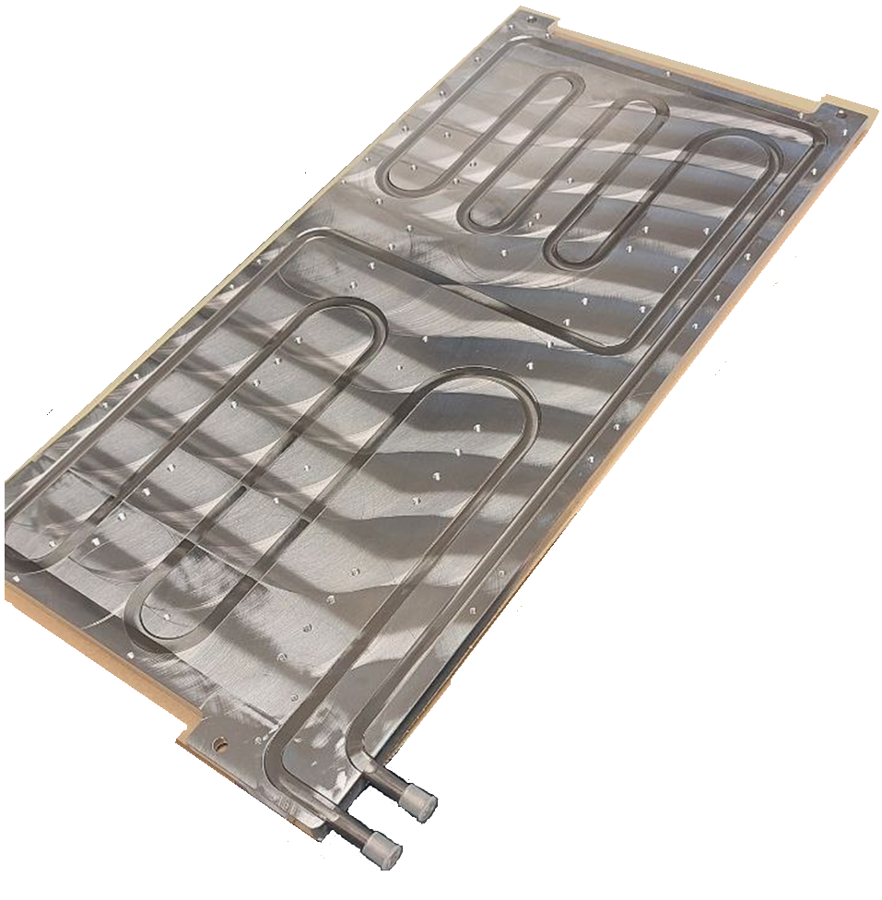
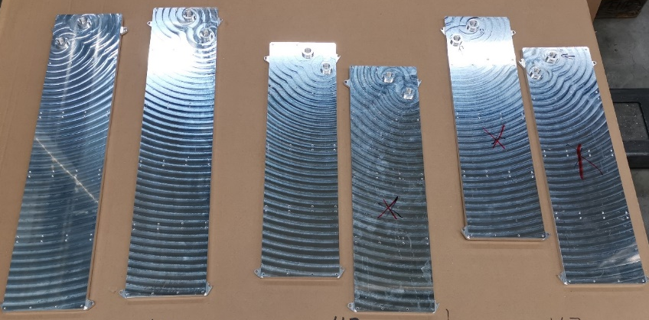






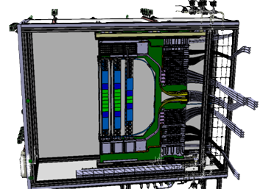
Progress in Cooling, Decision on Water Glycole Coolant
prototypes of cooling plates delivered, full amount until end of 2025
cooling test rig for Half-Unit tester complete
market analysis and negotiations for final STS-cooling plant ongoing
detailed specs for tender prepared
STS Cooling Plates by Cool Tec
comfortable, broad market
Long pending indecision on use of NOVEC and PFAS by FAIR
STS decided for plan B: Water-Glycole mixture to decouple scheduling
STS operative feed-line temperature limited to > -25°C through risk of FEB failure at extreme low shock temperatures

Slide 15
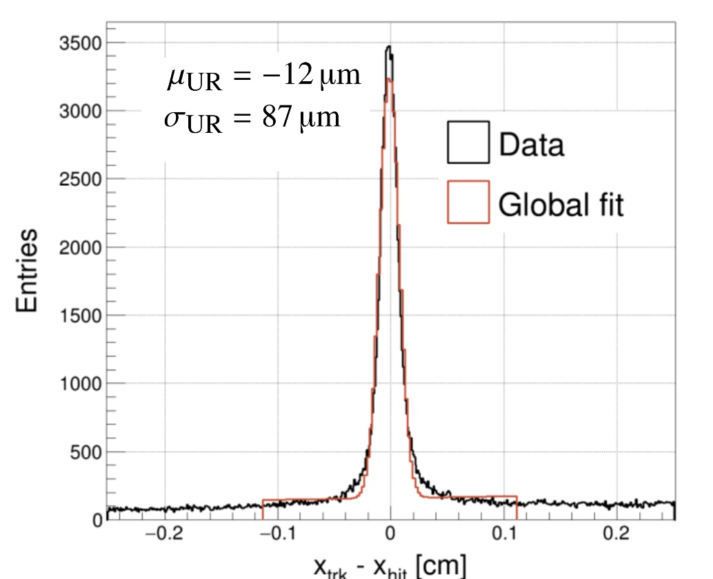
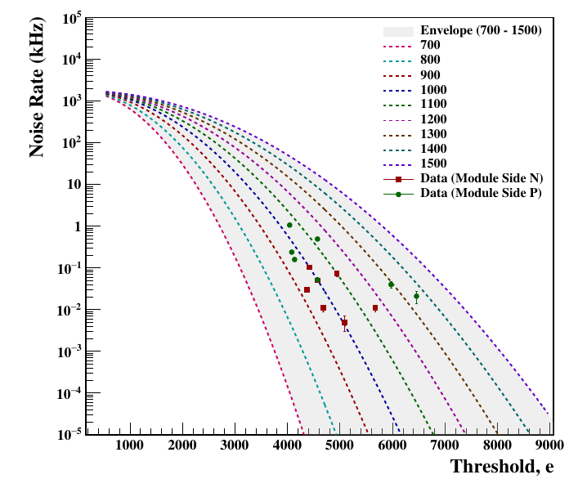
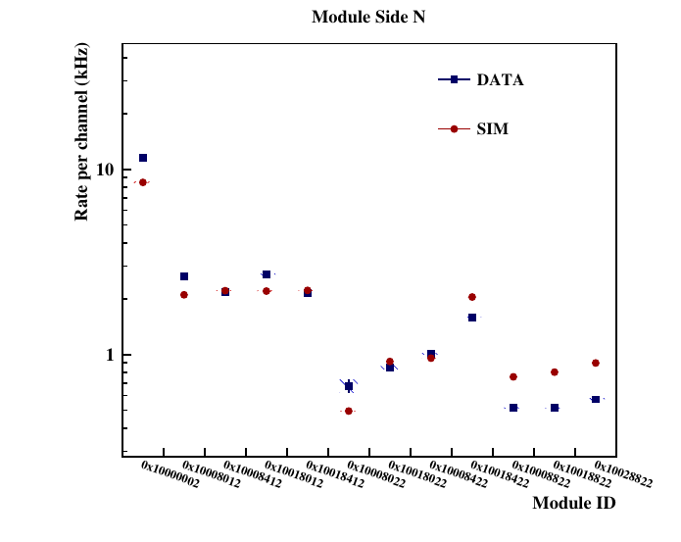
Some Simulation and mCBM Tracking Results
Beam-Target interactions
CBM PAPER on STS NIM A 1082 (2026) 171059
GEANT4
Time based simulations including: - Beam: GEANT4 - URQMD (nuclear collisions): UrQMD+GEANT4 - noise well reproduce the rate observed in experiment
beam
BMon
Target P=10%
STS tracking in mCBM
STS
Beam Rate
Nuclear Collision Rate
UrQMD + GEANT4
Dark rate (noise): 0.5 kHit∕s∕channel < 1% bandwidth saturation limit
Data rate ~ time-based Sim. rate Time-based Sim: Urqmd + Beam
STS sensor resolution < 25µm
58 µm/sqrt(12) = 17µm, some way to go
(see PhD thesis Dario Rodriguez Ramirez)
thesis Mehul Shiroya

Slide 16
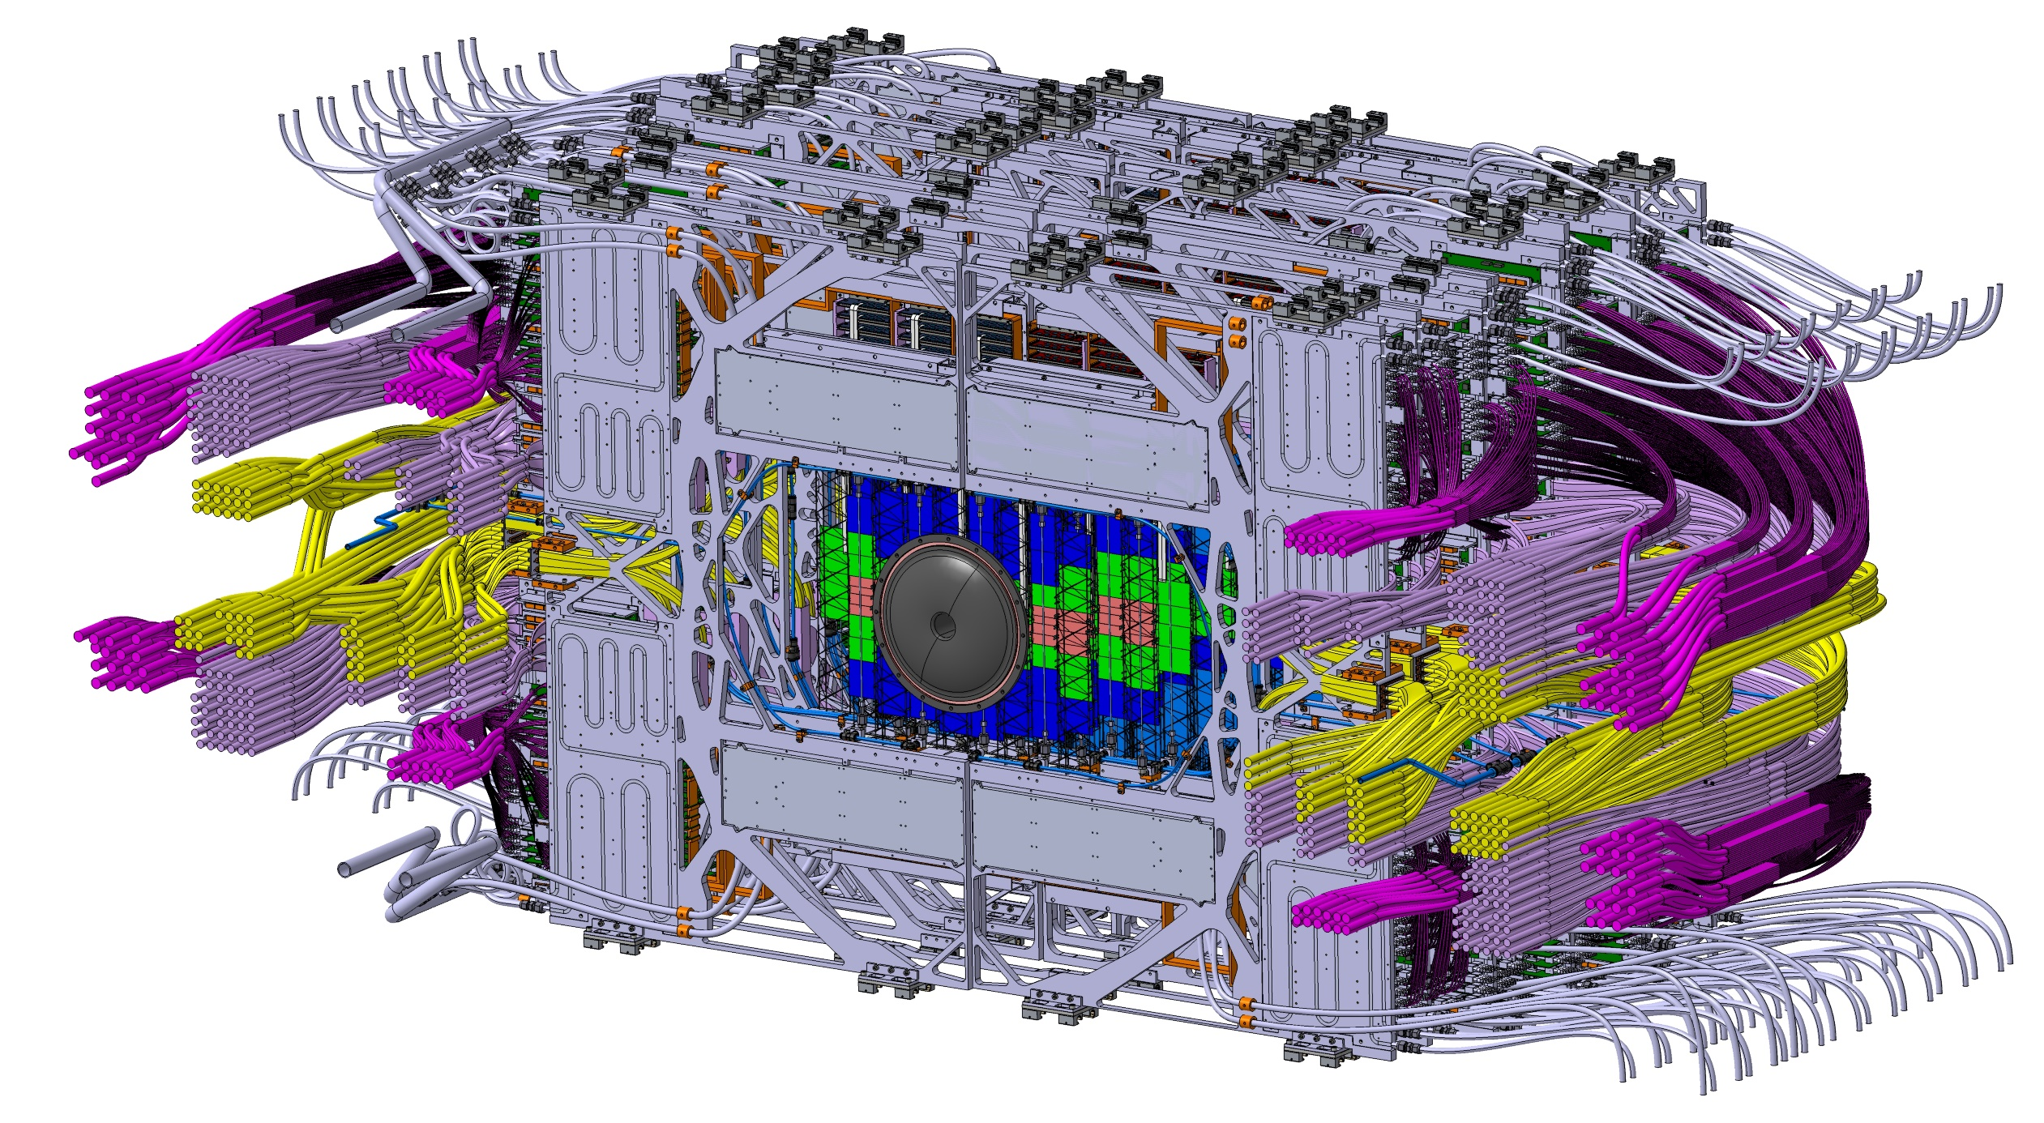
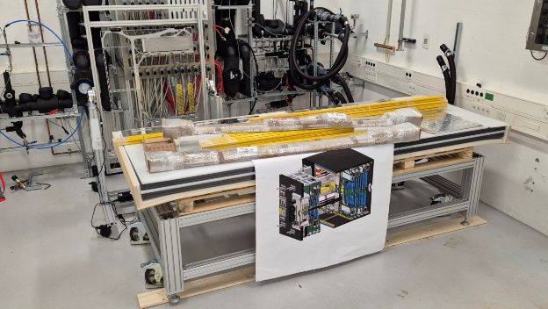
Beyond Half Unit assembly, quite some work to be done!
Insides of the STS-Box

Slide 17

There is yet much to do
in the coming 18 months toward the full STS!
Thank you for the attention

Slide 18

STS team at the CBM-STS Team Retreat
May 26 – 28, 2025

