Slide 1
Status of MIMOSIS
M. Deveaux for the MVD team

Slide 2




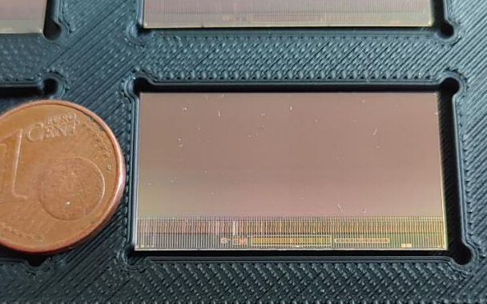

Toward MIMOSIS-3, the sensor of the MVD
MIMOSIS-0 (2018)
Demonstrate pixel concept.
Demonstrate zero suppression.
Demonstrate readout concept.
In synergy with:
MIMOSIS-1 (2020)
Full dimension sensor
Add buffer structure.
SEE hardening 1/2
MIMOSIS-2/-2.1 (Q2/2023)
On-chip pixel grouping.
Final pixels.
SEE hardening 2/2
MIMOSIS-1, 60µm thick
Discussed today
MIMOSIS-1
MIMOSIS-3
Final sensor for mass production
46th CBM collaboration Meeting, Oct. 20-25 2025, Lanzhou, China

Slide 3
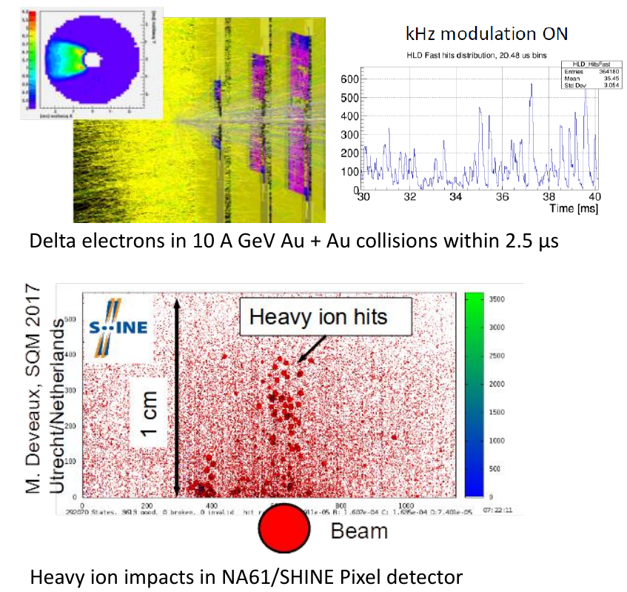
What we know
 | Requirement
Time resolution | ~5 µs
Spatial resolution | ~5 µm
Sensor thickness | ~50 µm
Power dissipation | 100 mW/cm²
Radiation doses (non-ionizing) | > 7x10¹³ n_{eq}/cm²
Radiation doses (ionizing) | > 5 Mrad
Radiation gradient on chip | 100%
HI-tolerance | 10 Hz/mm²
Open questions:
May a 50 µm thick active medium (instead of 25µm) improve spatial resolution.
Will MIMOSIS keep operating if exposed to heavy ion hits?
46th CBM collaboration Meeting, Oct. 20-25 2025, Lanzhou, China

Slide 4
Performance of 25µm vs. 50µm thick sensors
New
MIMOSIS-1
MIMOSIS-1
+ 0.5 µm for longer
pixel dimension
New
ALPIDE-like
Dark rate typically <10¹⁰/pixel (2 Hz/cm²)
driven by individual hot pixels.
Optimal number of fired pixels/particle (about 2.5)
P-stop 50µm shows superior working range and spat. precision w.r.t P-stop 25 µm.
To be shown: Radiation tolerance
46th CBM collaboration Meeting, Oct. 20-25 2025, Lanzhou, China

Slide 5
Radiation tolerance of 50µm epitaxial layer sensors
Detection efficiency MIMOSIS-2.1
p-stop 50 µm
Required
HV=10V
+ 0.5 µm for longer
pixel dimension
Room temperature
Room temperature
Dark occ. <10⁻⁶
HV=20V
3 x Required
P-stop 50µm matches rad. tolerance of P-stop 25 µm (not shown).
P-stop 50µm keeps its advantages in terms of spat. precision after 10¹⁴n_{eq}/cm²
46th CBM collaboration Meeting, Oct. 20-25 2025, Lanzhou, China

Slide 6
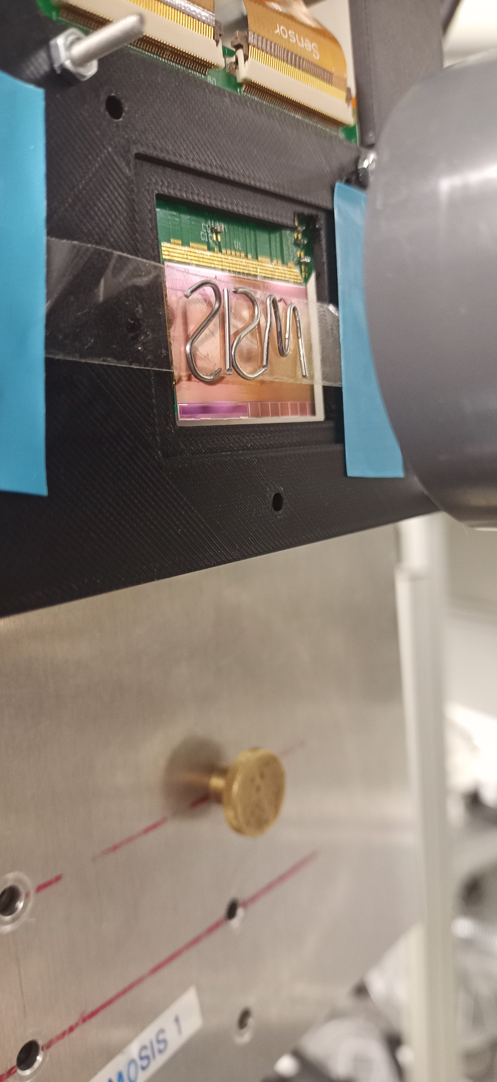
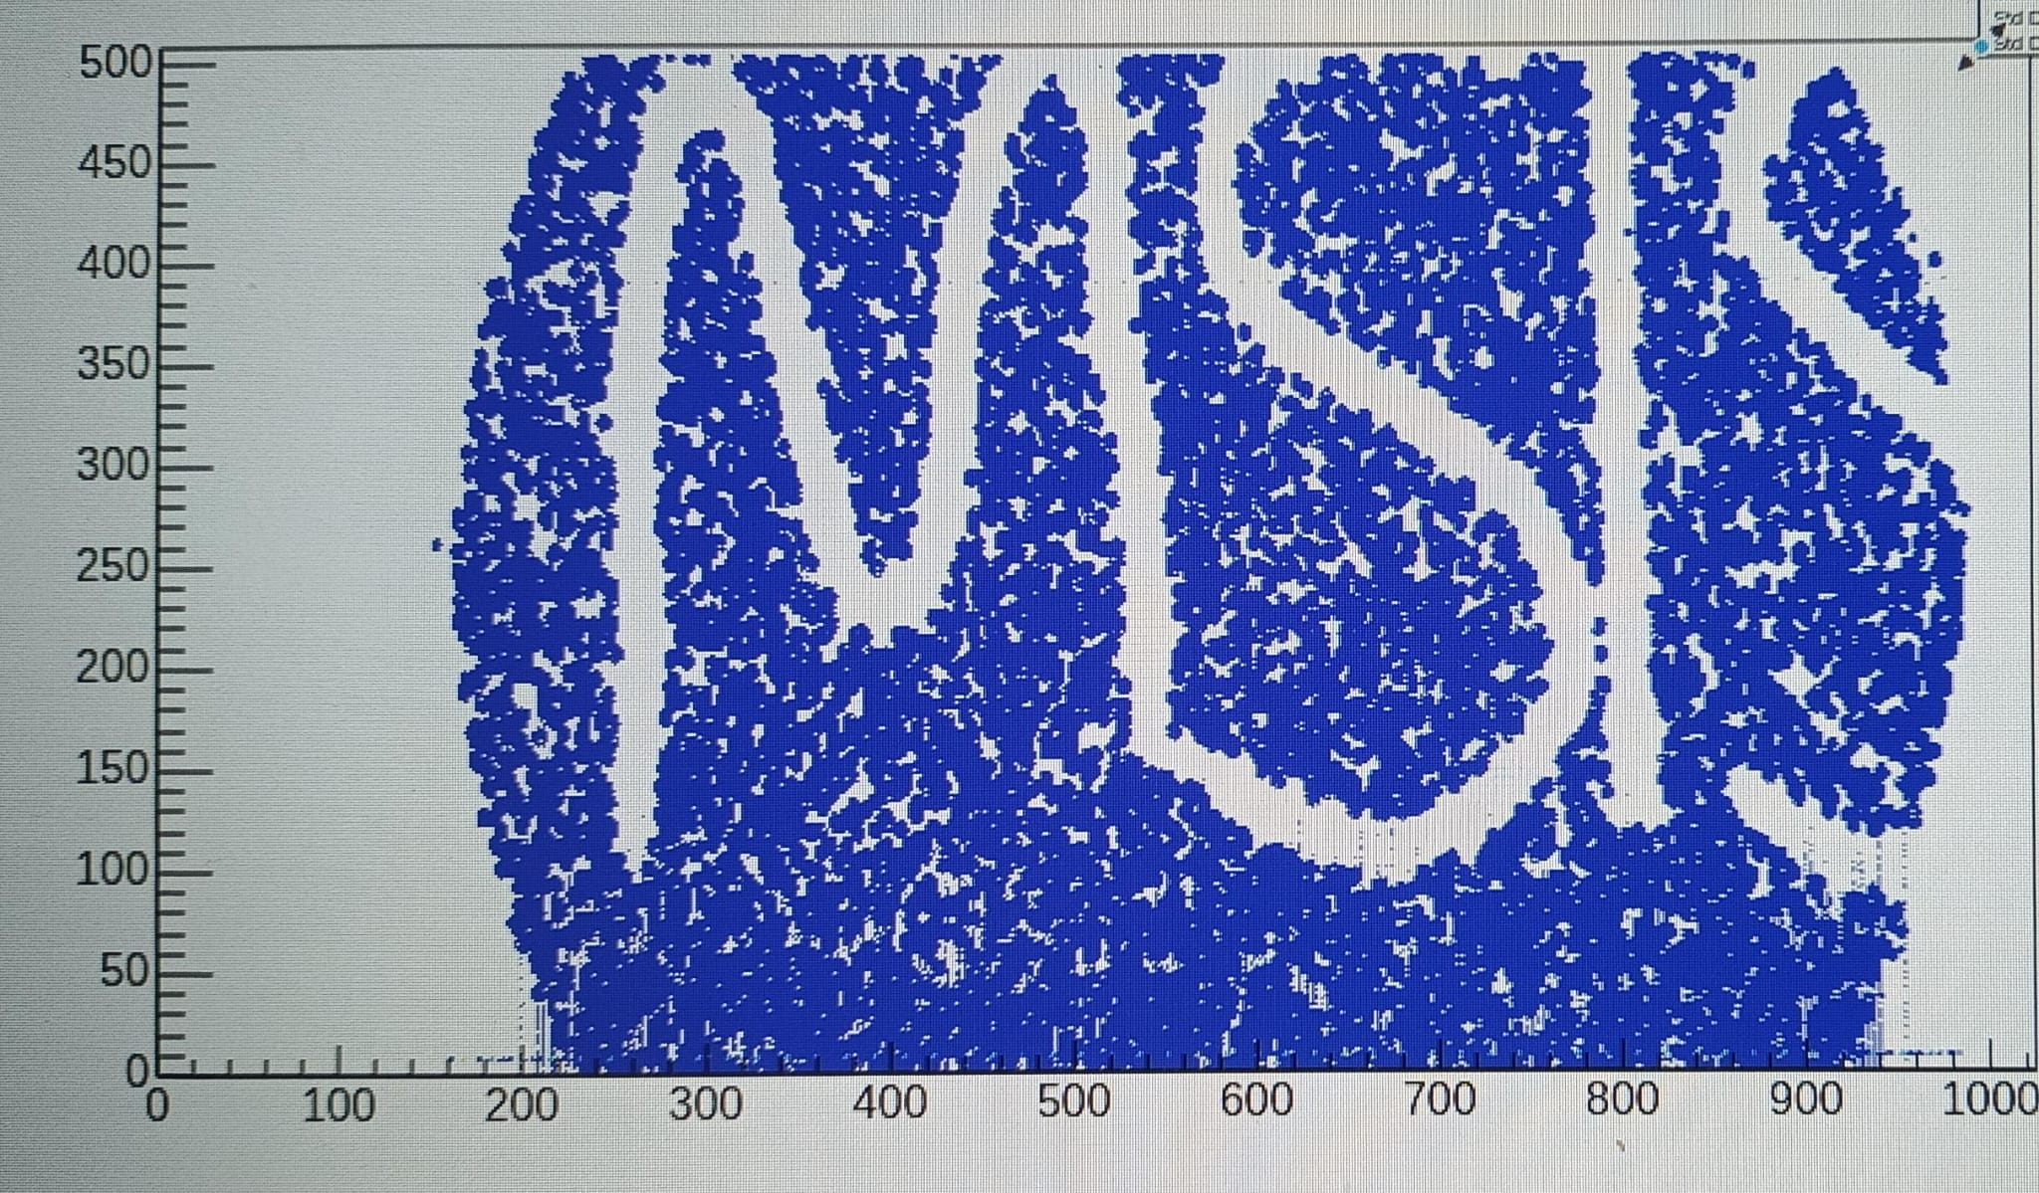
MIMOSIS prototypes – Tolerance to heavy ion impacts
Earlier:
Sensor and slow control tolerate heavy ion impacts.
No information on data output (not accessible)
Experiment:
MIMOSIS exposed to few AMeV ⁴⁸Ca beam at GSI UNILAC M3 beam line.
Estimated SEE > 20 MeV cm²/mg ions (above CBM Au- beam ions).
New this time: Access to data, confirm sensor to remain operational.
Observation:
Sensor remains operational, no restart needed.
Heavy ion impacts fire further pixels in same column
(<<1% channels affected @1kHz/cm²).
With suited threshold settings (non standard):
Work in progress
Sensor seems reasonably robust to HI impacts.
Cross-talk can be reduced by reducing HV but conflict with rad. hardness.
46th CBM collaboration Meeting, Oct. 20-25 2025, Lanzhou, China

Slide 7
Towards MIMOSIS-3
General spirit:
MIMOSIS-3 will be final sensor, no room for failure.
Lessons learned from MIMOSIS-2: Minor mistakes may cause major issues and delays
Must test and triple-check everything.
Speed vs. care is always a compromise. This time maximize care.
Known issues on MIMOSIS-2.1: The PLL-issue
Previous observation:
MIMOSIS needs PLL to convert input clock from 40 MHz => 320 MHz.
PLL shows jitter if sensor switches to new frame (once per 5µs) as switching power reduces biasing voltage.
All results shown so far hold with direct external 320 MHz clk (rescue clock).
Action:
25. Apr. : Design review, external reviewer Vladimir Gomov (Nikhef) & Stefan Biereigel (CERN)
Expect improvement by optimizing LDO biasing and load.
Issue related to powering: External <1mm² decoupling capacitor alleviates effect.
Prepare sensor for operation with external 320 MHz clk (so far 40 MHz + 320 MHz needed).
Improvements being implemented.
46th CBM collaboration Meeting, Oct. 20-25 2025, Lanzhou, China

Slide 8
Towards MIMOSIS-3: New findings
Intense system tests with realistic powering (previously test PCB) in 2025 reveal further issues:
Clock tree issue:
Detailed measurement of data outputs:
Clk shows ~420 ps phase shift / 100mV if bias is changed (also with external clk).
“PLL issue” might be caused by clk-tree rather than by PLL.
Again, digital IP-cells with insufficient analogue performance? Under investigation.
Action:
Re-simulate clock tree accounting for analogue IP-cell performance.
Identify and fix possible weak points (findings and effort still hard to predict).
Single ended output pad issue:
Observation: MIMOSIS tends to lose synchronization if slow control sends signal from sensor to DAQ.
Reason:
Pad drivers with Push-Pull architecture create over-current during switching.
Sensor GND is destabilized, Clk-edge is missed.
Action:
Redesign pad drivers (in principle easy, needs time and efforts).
In total: 7 Change requests accepted and being processed by now.
46th CBM collaboration Meeting, Oct. 20-25 2025, Lanzhou, China

Slide 9
Summary and conclusion
Important questions solved with MIMOSIS-2.1:
Demonstrated improved detection performance of 50 µm sensor at similar rad. hardness.
Demonstrated immunity to beam halo ions also on data path.
Cross talk between hit pixels and pixels of same column likely acceptable.
Conclusion: MIMOSIS fulfils all requirements in terms of detection efficiency and radiation hardness.
Toward MIMOSIS-3: Intense tests with realistic powering carried out:
MIMOSIS-2.1 shows inacceptable clock jitter related to power fluctuations “PLL + clock tree issue”.
Alleviated with external <1mm² decoupling capacitors.
Effect being studied and eliminated with help of external review.
In total: 7 changes and modifications scheduled.
Need careful preparation of submission.
Purchase being prepared together with IPHC and FAIR.
Technology choices (e.g. pixel and epitaxial layer thickness) still pending – too many good options.
Number of wafers still being discussed, likely sufficient for full sensor + further use cases.
Goal: Sensor submission end 2025 (but better save than fast).
46th CBM collaboration Meeting, Oct. 20-25 2025, Lanzhou, China

