Slide 1
Recent Results from LEBIT in the FRIB Era
Scott Campbell
campbels@frib.msu.edu

Slide 2
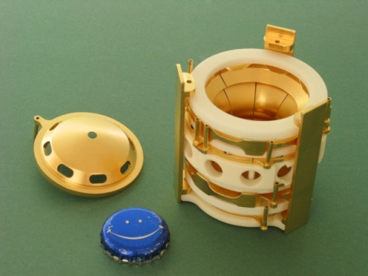
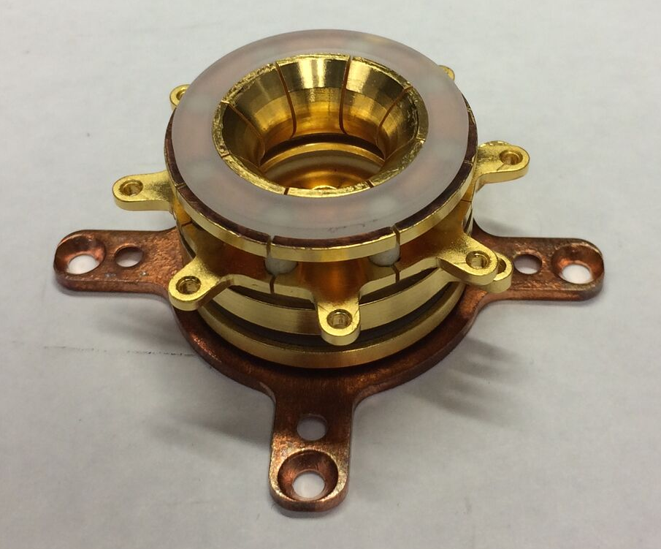
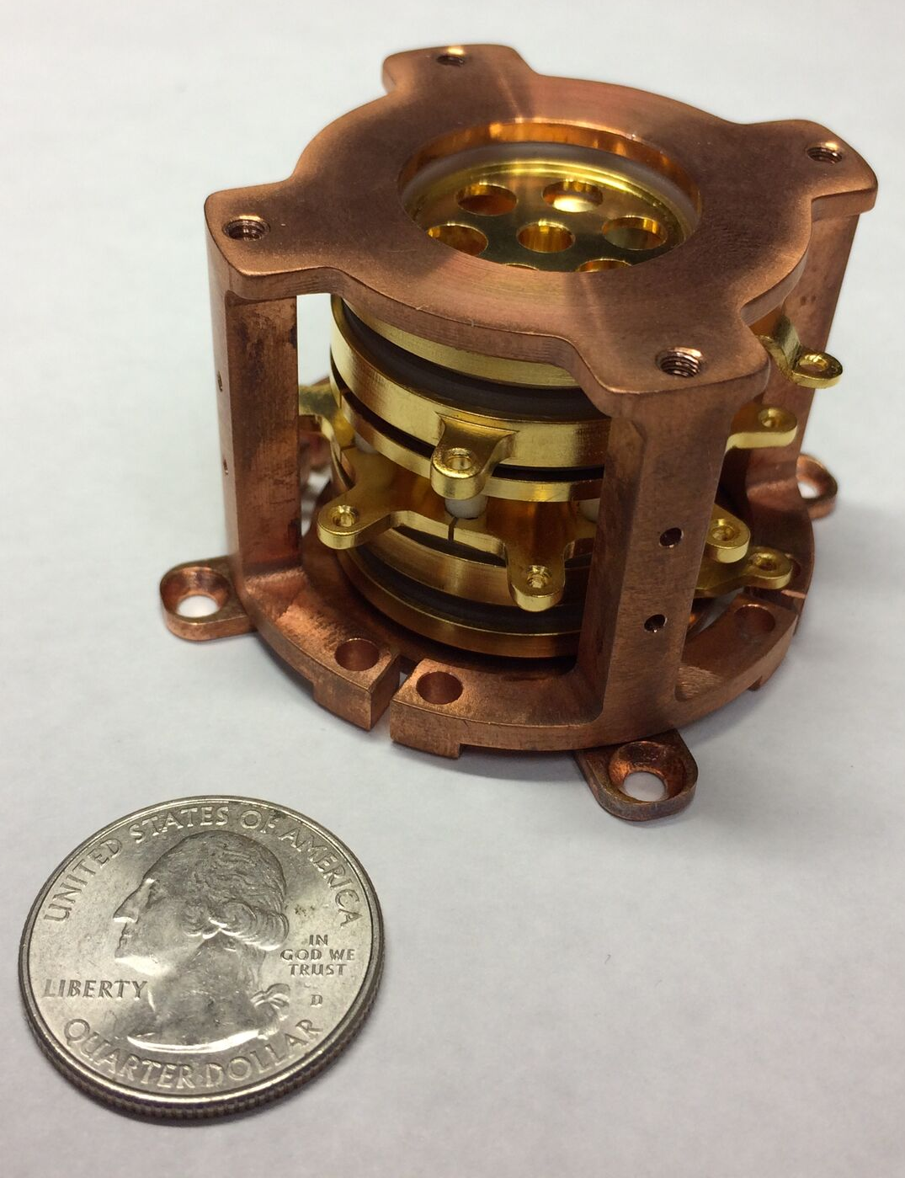
Outline
Introduce the Facility for Rare Isotope Beams (FRIB)
  Current status and operations
Stopped Beam Program
  Overview of gas stopping and stopped beam areas
  Introduction to the Low Energy Beam Ion Trap (LEBIT)
Latest Measurements from LEBIT
  Latest results for neutron-deficient isotopes
Future Science Program
  Next measurements
  Future capabilities with new techniques

Slide 3
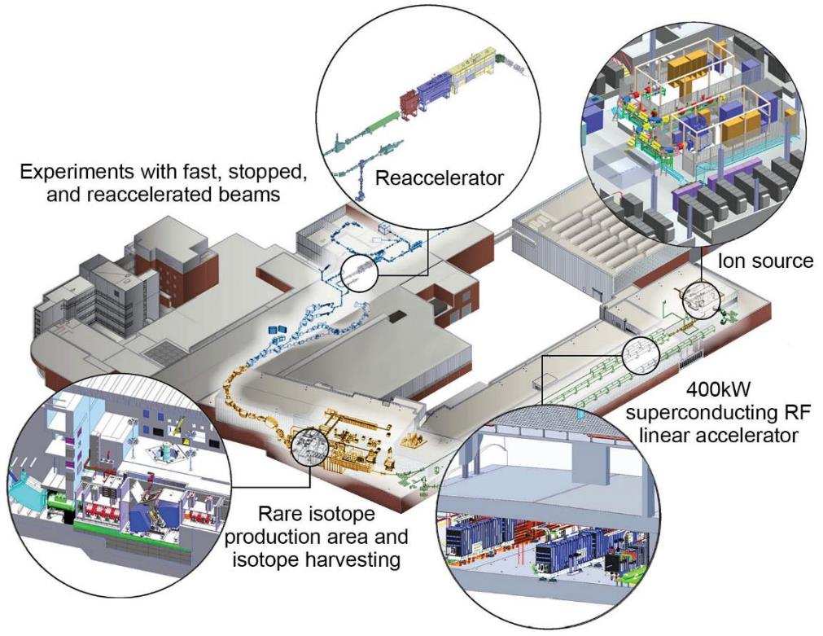

FRIB is Optimized for Science with Fast, Stopped and Reaccelerated Rare Isotope Beams
Key feature: 400 kW primary beam power
  Gradual ramp-up over several years
  Currently operating at 10 kW, move to 20 kW in near future
Production via projectile fragmentation
  Beams of all elements and isotopes with short half-lives
Rare isotope cocktail beam separated in-flight
  Fast development time for new rare isotope beams
Improvements projects, R&D, and new
equipment increase FRIB science potentials
  Stopped & reaccelerated beams are an important focus
frib.msu.edu

Slide 4
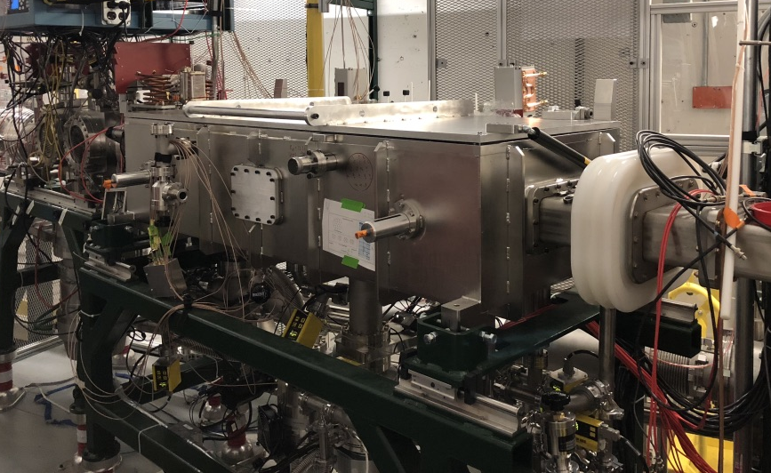
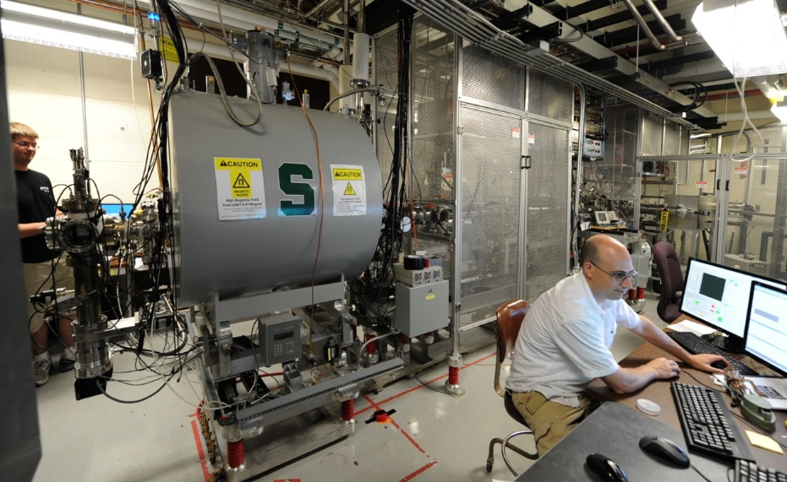
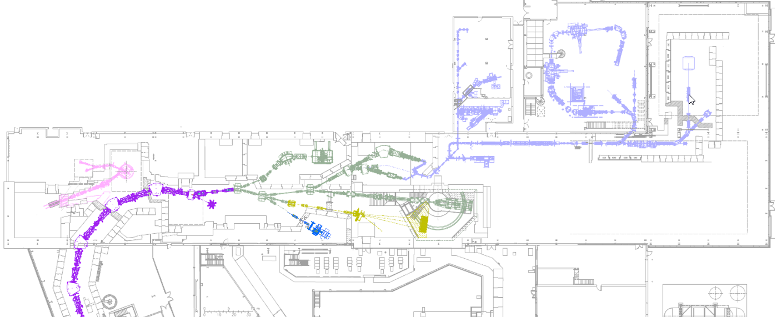
FRIB Continues to Deliver High-quality Stopped Beams
Stopped
Beams
Area
BECOLA
LEBIT
Cyclotron Stopper
Gas Stopper
ReA3
ReA6
Reaccelerated Beams Area
Fast
Beams
Area
200 MeV/u
30 keV
ARIS
In-Flight
Separator
ARIS Separator: M. Hausmann, et al. NIM B 317, 349-353 (2013)
ANL Gas Stopper: C. Sumithrarachchi, et al. NIM B 463, 305 (2020)
ACGS Gas Stopper: K. Lund, et al. NIM B 463, 378-381 (2020)
LEBIT Facility: S. Schwarz, et al. NIM B 204, 507 (2003)
Production Target

Slide 5
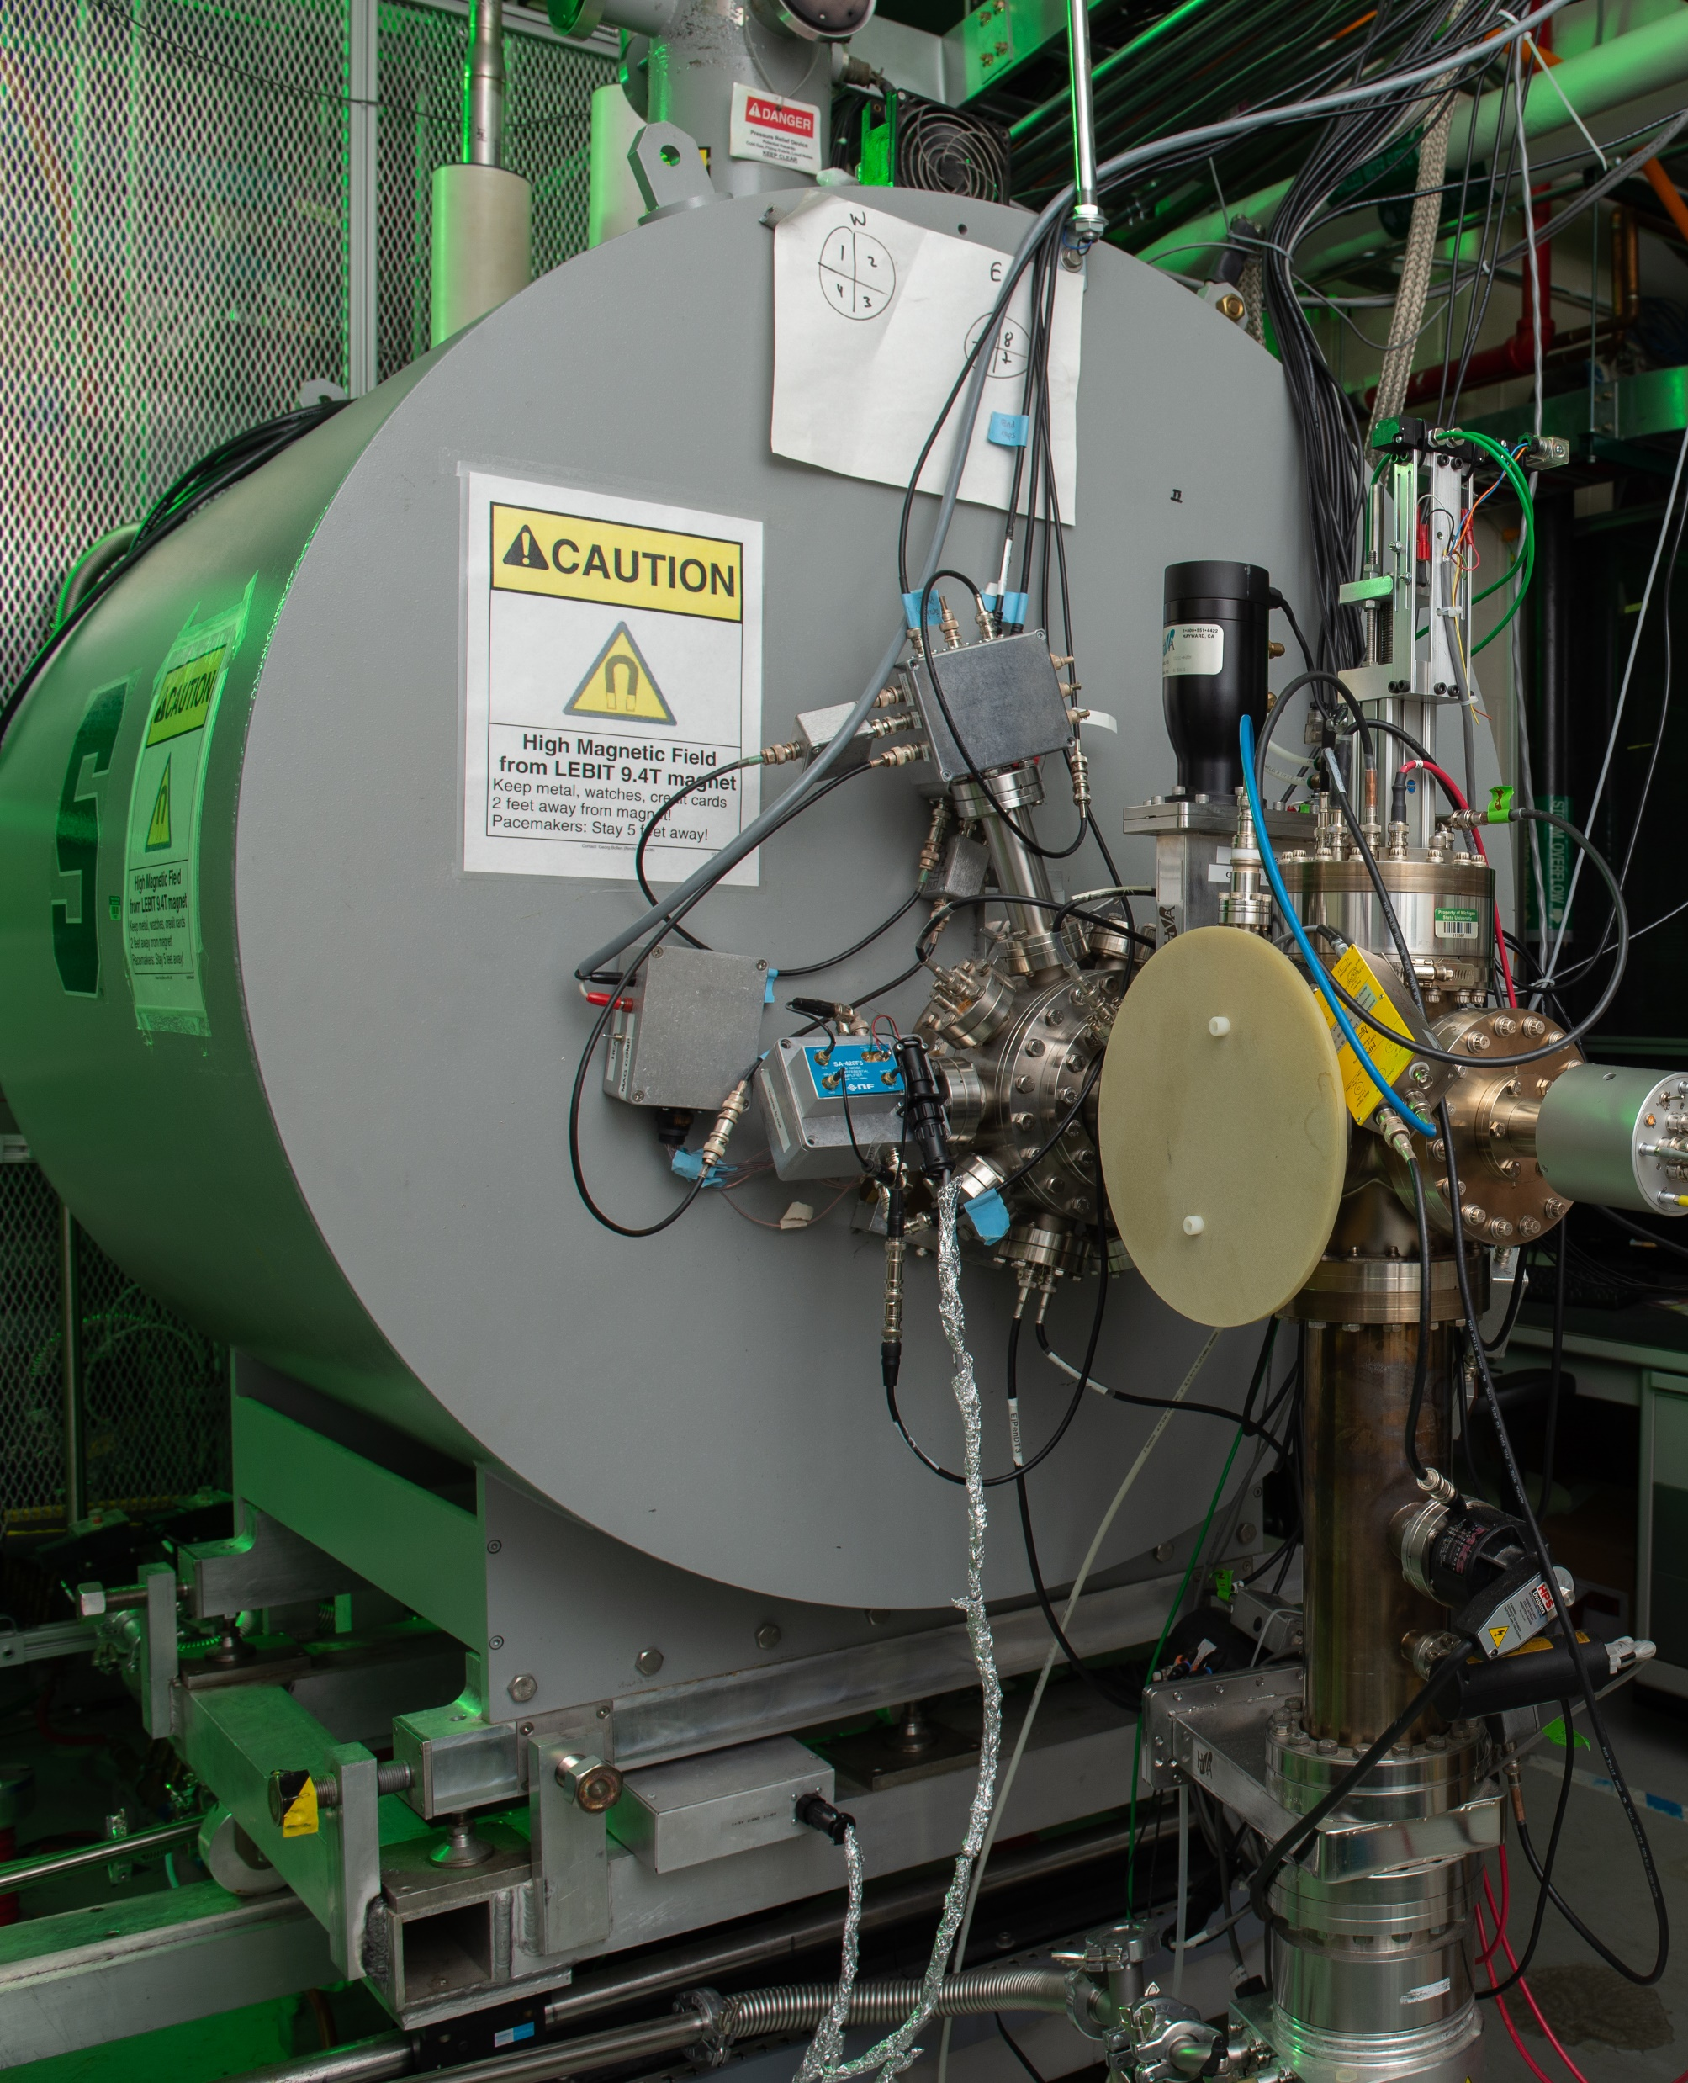
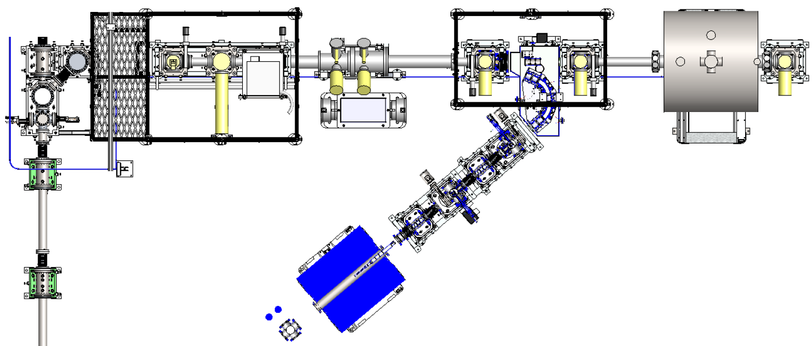
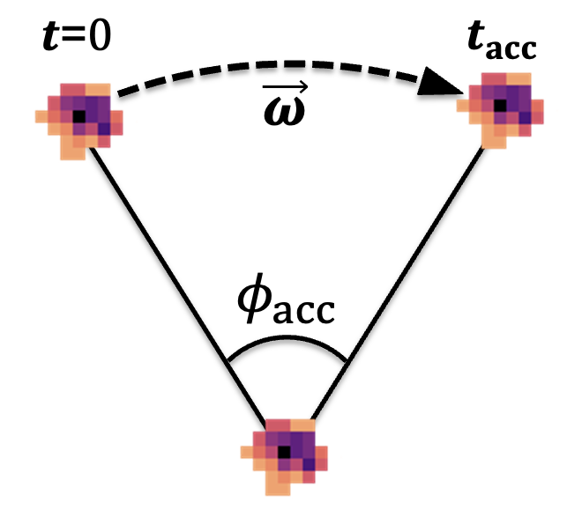
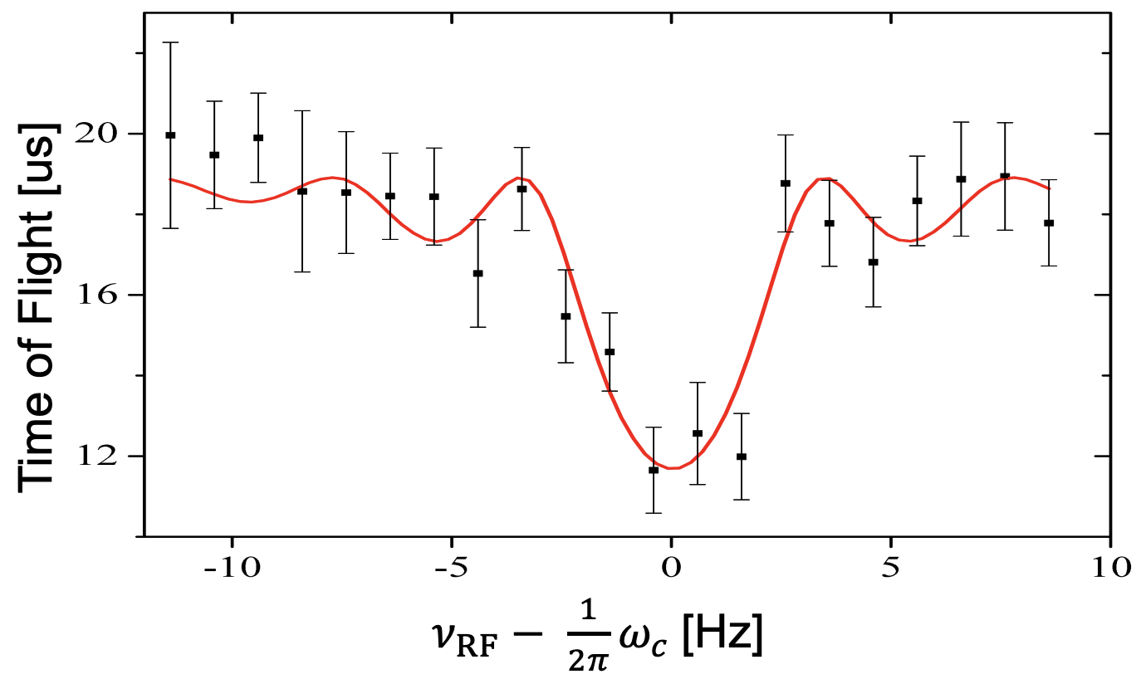
Precision Mass Measurements with LEBIT
30 kV offset
Off-line
Ion sources
Laser Ablation
RFQ Cooler
& Buncher
Switchyard
9.4 T magnet
TOF-ICR
PI-ICR
Plasma Discharge
7 T magnet
FT-ICR
Rare
isotope beam
Laser Ablation: C. Izzo et al., NIM B 376, 60 (2016)
Cooler/Buncher: Schwarz et al., NIM A 816, 131-141 (2016)
9.4 T Magnet: R. Ringle et al., Int. J. Mass Spec 349-350 (2013)
SIPT: A. Hamaker et al., Hyperfine Interact. 240, 34 (2019)
TOF-ICR: Bollen et al., J. Appl. Phys. 68, 4355-4374 (1990)
PI-ICR: S. Eliseev et al., PRL 110.8, 082501 (2013)

Slide 6
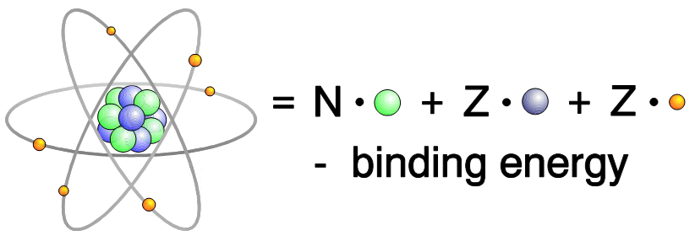
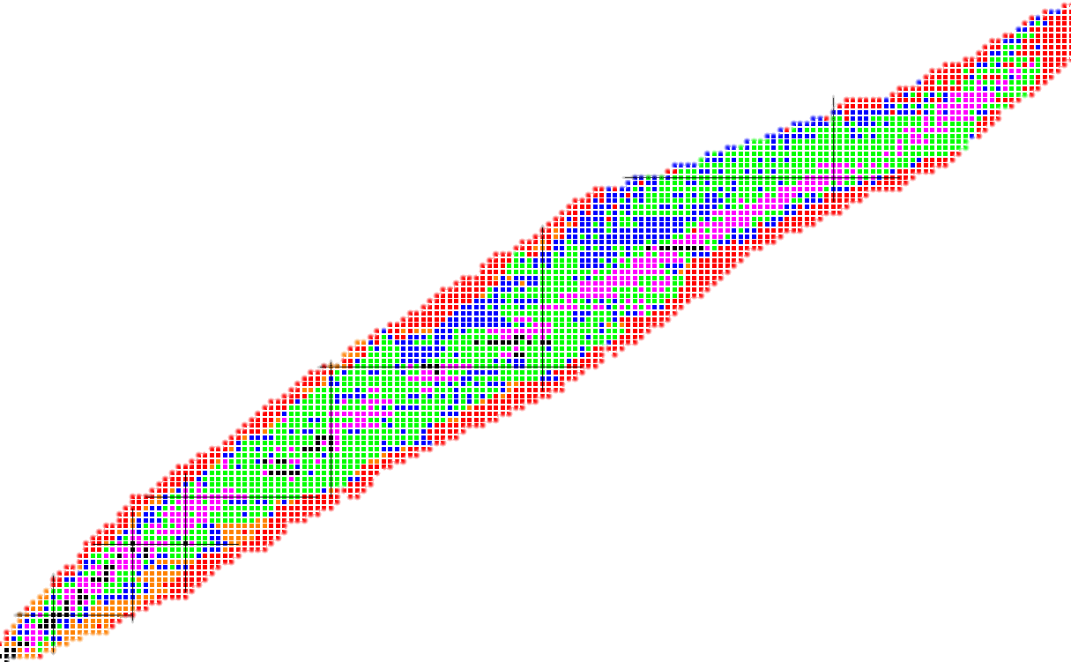
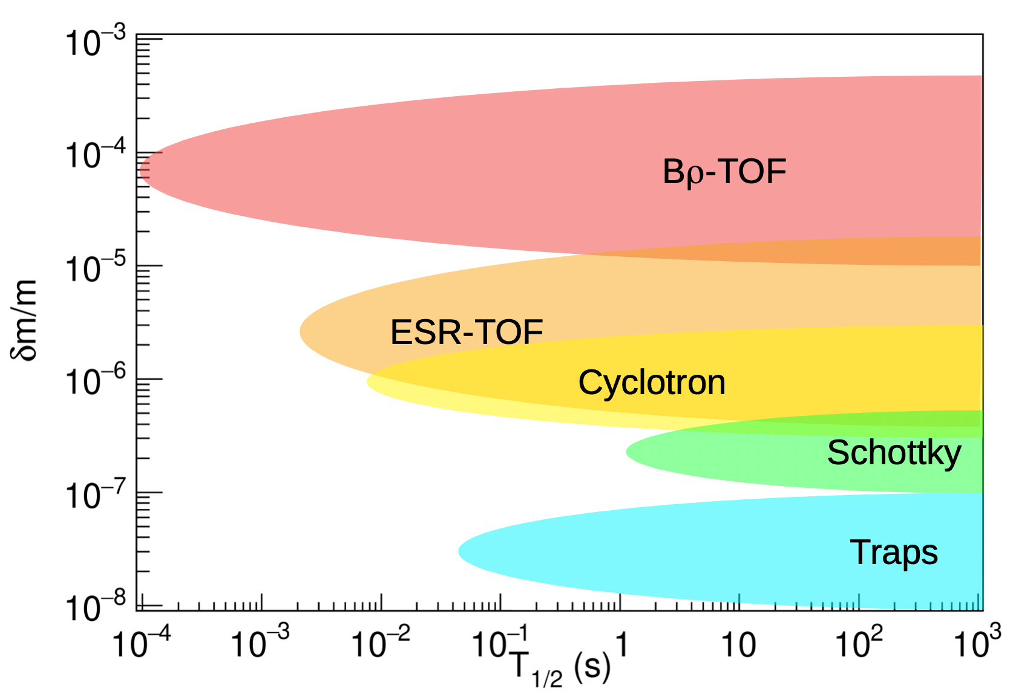
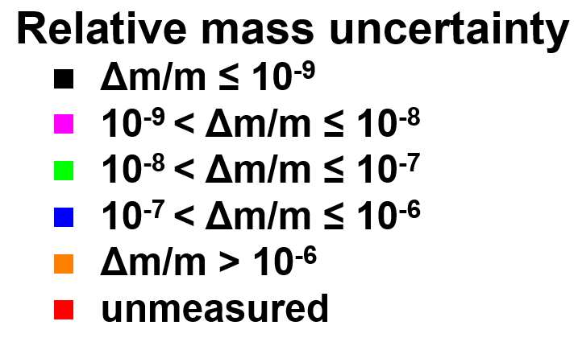
Rare Isotope Masses are Fundamental to Nuclear Science
Penning trap mass spectrometry:
most precise method for mass measurements
SHE studies
Tests of Fundamental Interactions
Δm/m < 10⁻⁶
Δm/m < 10⁻⁸
Element Synthesis
Via rp-Process
Element Synthesis
Via r-Process
Δm/m ~ 10⁻⁷
rp-process path
r-process path
Δm/m ~ 10⁻⁷
Proton number Z
Evolution of Nuclear Shell Structure
Δm/m ≤ 10⁻⁶
Neutron number N
M. Famiano, Int. Journal Mod. Phys. E 28, 1930005 (2019)
AME2020: Huang et al., Chin. Phys. C 45, 030002 (2021)

Slide 7
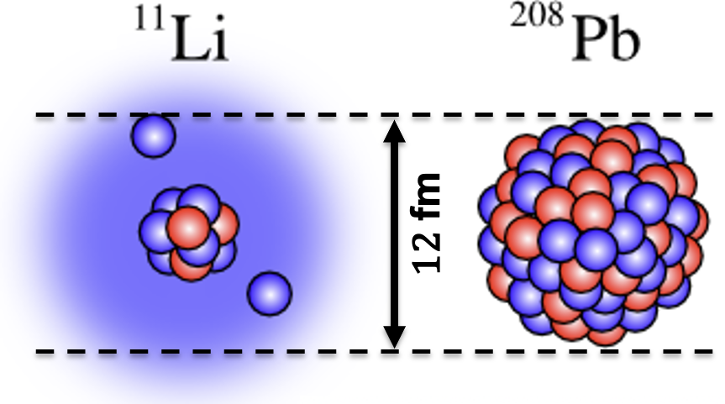
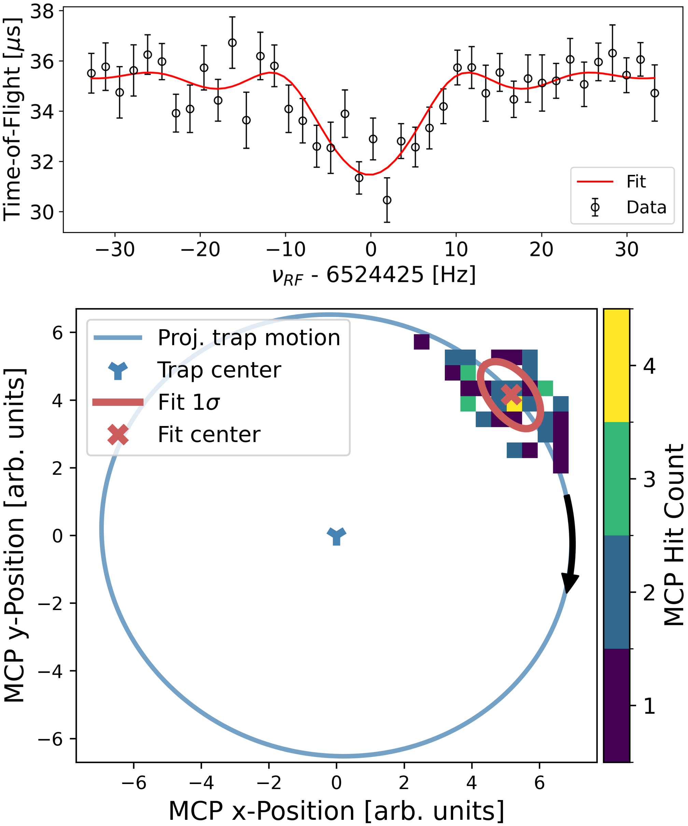
Updates on ²²Al Mass Measurement
Experiment Suggests Possible Proton-Halo?
Nuclear driplines are a rich lab for exotic structures, e.g. halos
  Challenging for theory to accurately predict
  Additional obstacles with proton halos
    Production at rare isotope facilities, confining Coulomb barrier
  Key features of proton halos
    Minimal energy required to remove a proton, S_{p}
    Valence proton favors s_{1/2} shell
    Large matter radius
Initial experimental evidence for a ²²Al halo structure^{[1]}
  Largest observed isospin asymm. in low-lying states of ²²Si & ²²O
  Significant s_{1/2} proton occ. in ²²Al g.s. → halo structure?
²²Al: first mass measurement run with FRIB^{[3]}
  ~1000x better M.E. than AME20^{[2]}
  Also measured at CSRe to 51 keV^{[4]}
  Very small S_{p} 100.4(8) keV ⇒ proton halo?
~350 ions
~50 ions
[1] J. Lee et al., PRL 215, 192503 (2020)
[2] Huang et al., Chin. Phys. C 45, 030002 (2021)
[3] S. Campbell et al., PRL 132(15), 152501 (2024)
[4] M.Z. Sun et al., Chin. Phys. C 48, 034002 (2024)

Slide 8

Theory Suggests a Halo Structure in ²²Al is Unlikely
Shell model points to unlikely g.s. halo^{[1]}
  USD shell model for 2 interaction sets
  Minimal proton s_{1/2} occ. of 0.29 restricts halo
Particle-plus-rotor model: deformation enhances halo^{[1]}
  Interplay of weak binding & deformation: lower πs_{1/2} shell^{[2]}
  Strong prolate deform. could lead to g.s. halo, if confirmed
Ab Initio calculations: halo possible in excited state^{[3]}
  IMP Collab: VS-IMSRG calculations for 4 interactions
  Halo could be present in excited state of ²²Al?
Latest theory: weak halo only with triaxial deform^{[4]}
  Deformed and triaxial relativistic Hartree-Bogoliubov in continuum
  Small s-wave component of 5%: no discernable halo
Conclusions
  Charge radius and ground state spin/parity measurement needed to resolve the presence of a halo
BECOLA at FRIB successfully measured ²²Al charge radius
  Stay tuned for upcoming publication!
[1] S. Campbell et al., PRL 132(15), 152501 (2024)
[2] K. Fossez et al., Phys. Rev. C 93, 011305(R) (2016)
[3] M.Z. Sun et al., Chin. Phys. C 48, 034002 (2024)
[4] K.Y. Zhang et al., PRC 110, 014320 (2024)

Slide 9
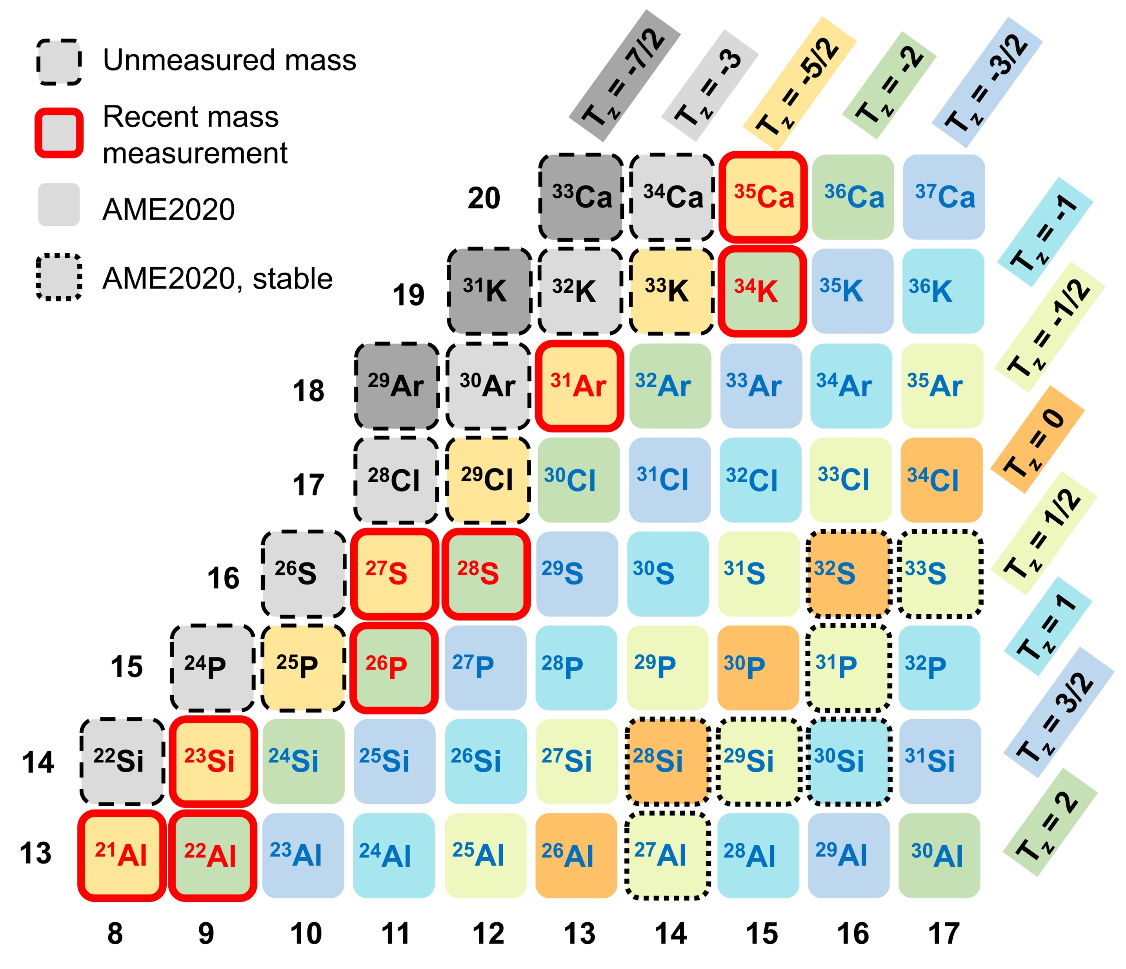
Refined Mass of ²³Si Probes Isospin-Symmetry Effects
Other recent measurements of T_{z}=-5/2 nuclei
  Rich dataset for high-isospin symmetry breaking
  Refine understanding of Coulomb force role
    Differences in binding energies for mirror nuclei
~1600 Ions
Stay tuned for an upcoming publication!

Slide 10
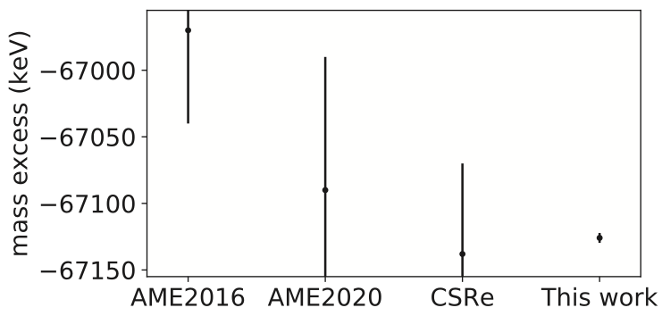
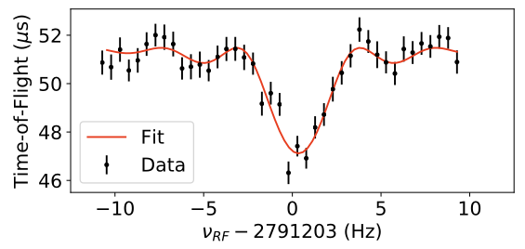
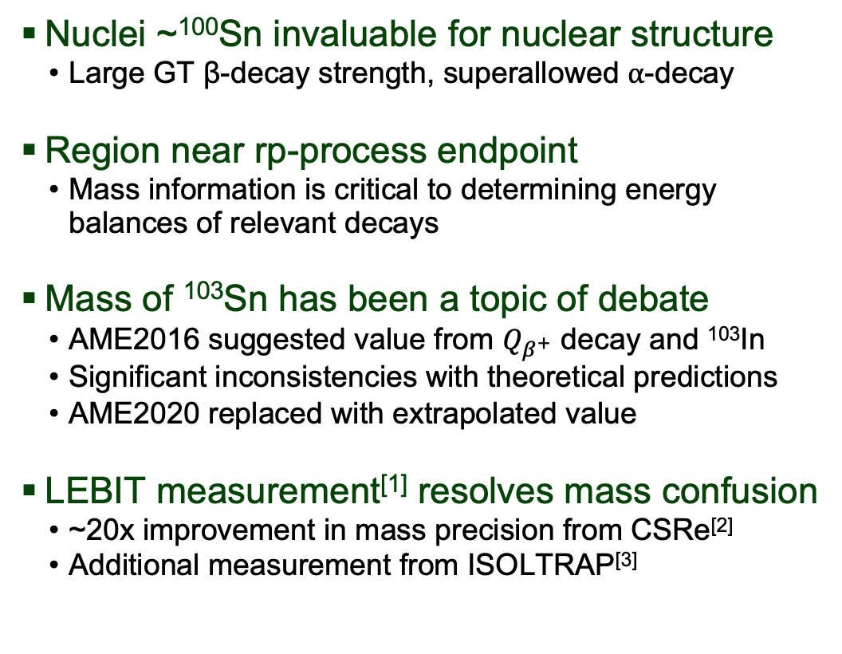
High-Precision Mass Measurement of ¹⁰³Sn
The Path Towards Doubly-Magic ¹⁰⁰Sn
Nuclei ~¹⁰⁰Sn invaluable for nuclear structure
  Large GT β-decay strength, superallowed ⍺-decay
Region near rp-process endpoint
  Mass information is critical to determining energy balances of relevant decays
Mass of ¹⁰³Sn has been a topic of debate
  AME2016 suggested value from $Q_{β^{+}}$ decay and ¹⁰³In
  Significant inconsistencies with theoretical predictions
  AME2020 replaced with extrapolated value
LEBIT measurement^{[1]} resolves mass confusion
  ~20x improvement in mass precision from CSRe^{[2]}
  Additional measurement from ISOLTRAP^{[3]}
~3200 Ions
[1] C.M. Ireland et al., PRC 111(1), 014314 (2025)
[2] Y. M. Xing et al., PRC 107, 014304 (2023)
[3] L. Nies et al., PRC 111(1), 014315 (2025)

Slide 11
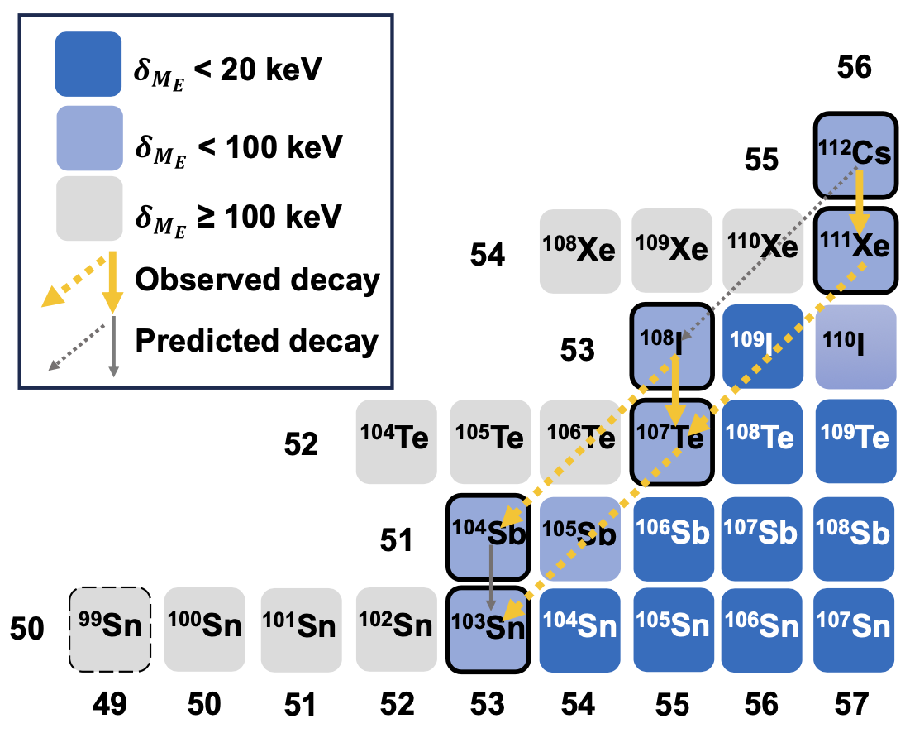
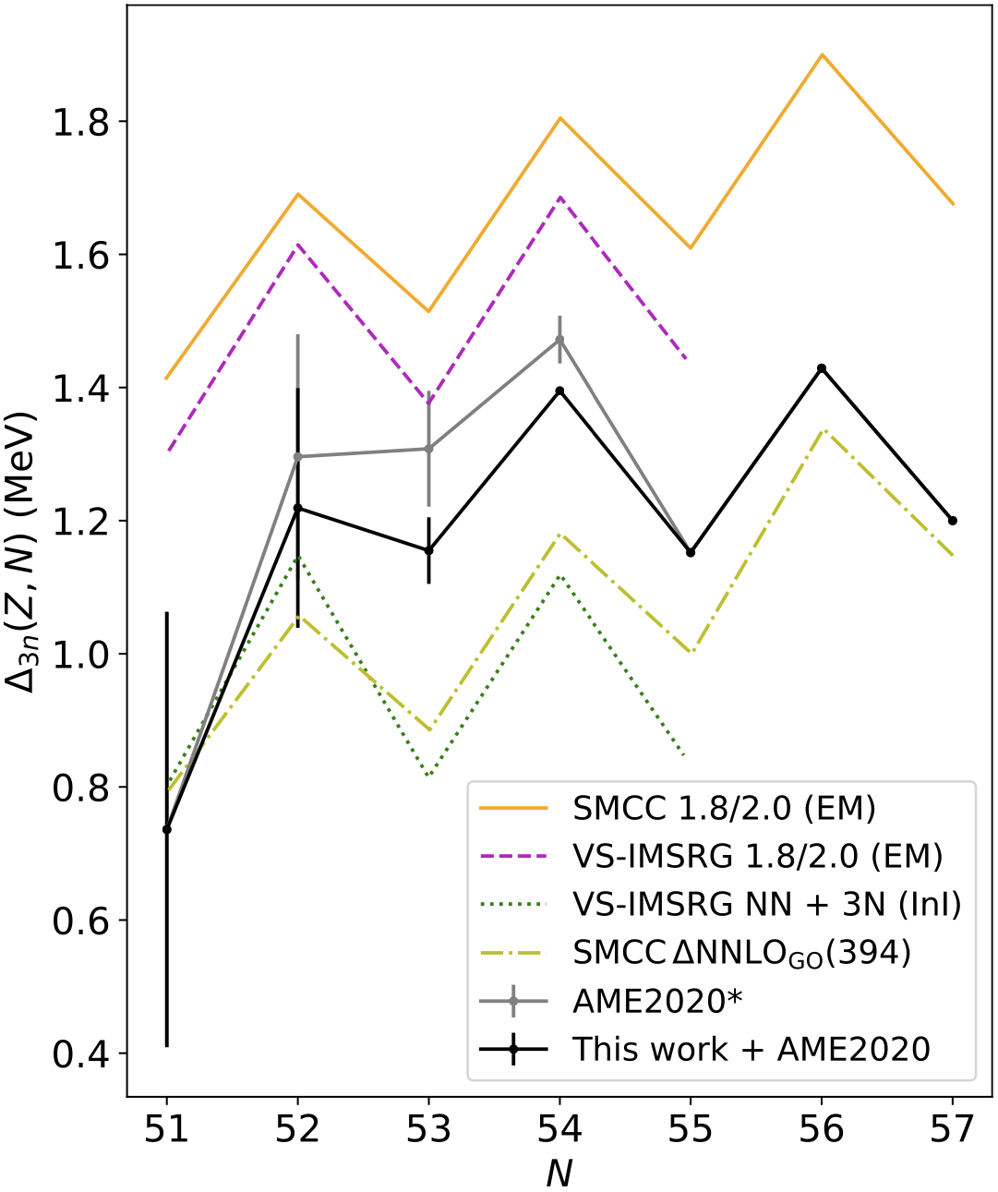
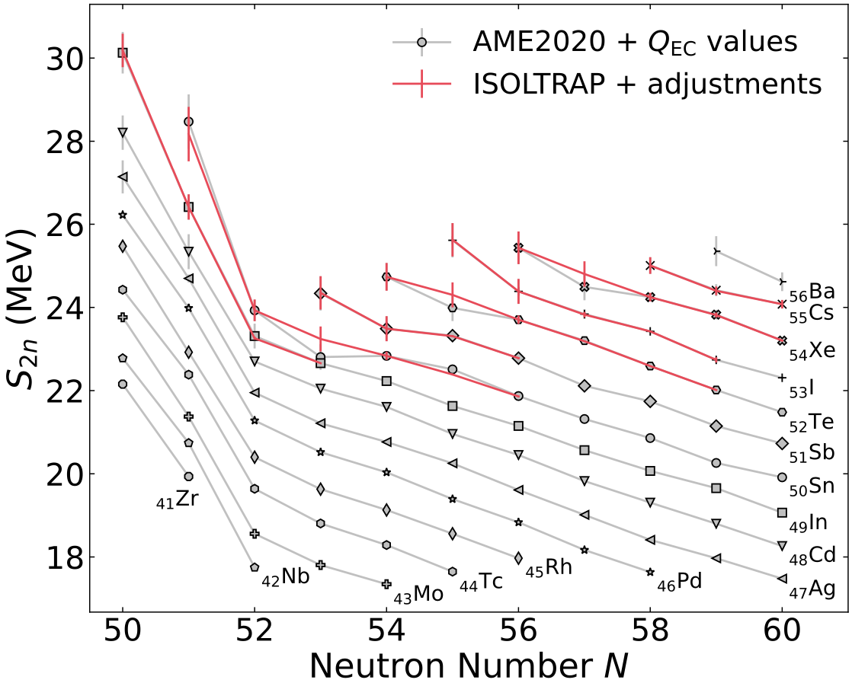
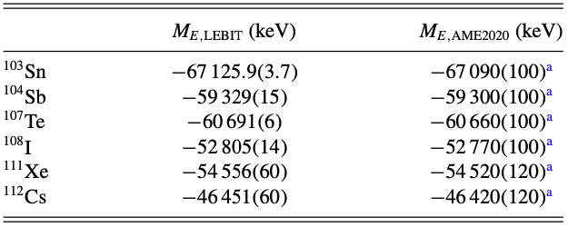
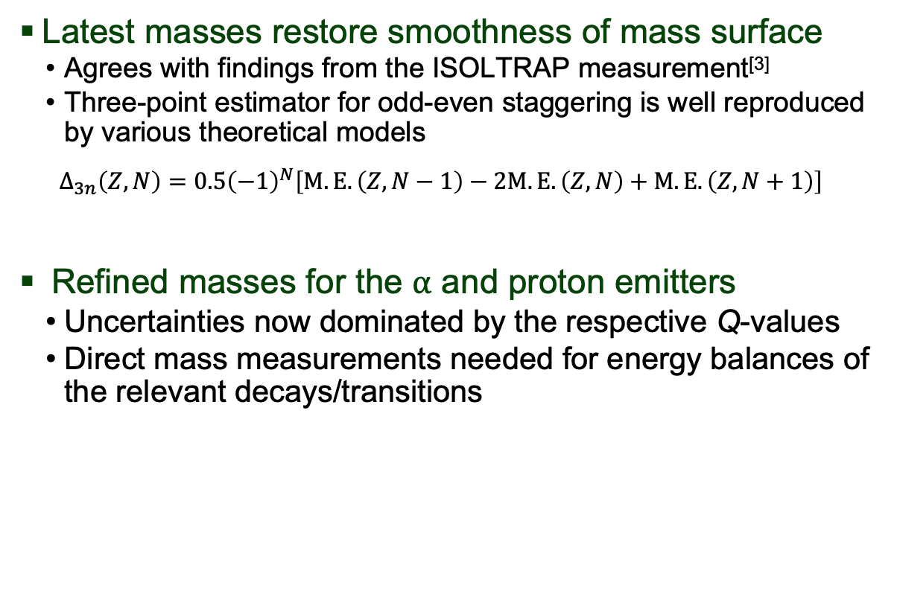
High-Precision Mass Measurement of ¹⁰³Sn
The Path Towards Doubly-Magic ¹⁰⁰Sn
Latest masses restore smoothness of mass surface
  Agrees with findings from the ISOLTRAP measurement^{[3]}
  Three-point estimator for odd-even staggering is well reproduced by various theoretical models
  $$Δ_{3n}\left(Z,N\right)=0.5{\left(−1\right)}^{N}\left[M.E.\left(Z,N−1\right)−2M.E.\left(Z,N\right)+M.E.\left(Z,N+1\right)\right]$$
Refined masses for the ⍺ and proton emitters
  Uncertainties now dominated by the respective Q-values
  Direct mass measurements needed for energy balances of the relevant decays/transitions
[1] C.M. Ireland et al., PRC 111(1), 014314 (2025)
[2] Y. M. Xing et al., PRC 107, 014304 (2023)
[3] L. Nies et al., PRC 111(1), 014315 (2025)

Slide 12
Measurement of ¹⁰¹Sn Provides Critical Insights to ¹⁰⁰Sn
Nuclei ~¹⁰⁰Sn invaluable for nuclear structure
  Large GT β-decay strength, superallowed ⍺-decay
Region near rp-process endpoint
  Mass information critical to determining energy balances of relevant decays
Tin masses extrapolated to ⁹⁶Sn
  Bayesian Model combination framework with seven DFT global nuclear models
  Proton drip line determined at ⁹⁷Sn
  ¹⁰¹Sn found to be more bound than previously thought
~130 Ions
Stay tuned for an upcoming publication!

Slide 13
Future Science Program at LEBIT
Nuclear structure at key shell closures
  N=Z=50: ¹⁰⁰Sn – FRIB PAC1
  N=28, Z=50: ⁷⁸Ni – FRIB PAC3
  N=28, Z<17
Pairing and deformation along N=Z
  Beyond ⁸⁰Zr – FRIB PAC1
  N=Z=41 through N=Z=49 regions
Nuclear astrophysics
  r-process between the second and third abundance peaks (A=130, 196) (FRIB PAC2)
  r-process in the vicinity of ¹³²Sn (N=50, Z=82)
  rp-process (⁹¹Rh, ⁸²Nb) & endpoint (~¹⁰⁸Te)
Ultra-low Q-value studies
  Two experiments approved (FRIB PAC2&3)
Many Others!
  Isospin symm limits(²⁸S,⁴⁰Ti, ⁴⁴Cr, ⁵⁵Cu, ⁵⁷Zn)
  Neutron Halos (¹⁴Be, ¹⁷B, ²⁰C, ²²C)
  Weak form of CVC? (⁴⁶Cr, ⁵⁰Fe, ⁵⁴Ni, ⁴²Ti, ⁴²Ca,
  ⁶⁶As, ⁷⁰Br, ⁷⁴Rb, ⁷⁸Y)
^{100,102}Sn
T_{1/2}: 1.2, 2.2 s
Δm: 240, 300 keV
⁷⁸⁻⁸⁰Zr
T_{1/2}: 47 ms, 56 ms, 4.6 s
Δm: 400#, 300#, 300# keV
¹³⁵⁻¹³⁷Sn
T_{1/2}: 355, 228 ms
Δm: 200#, 300# keV
⁷⁷⁻⁷⁹Y
T_{1/2}: 57 ms, 50 ms, 15 s
Δm: 200#, 300#, 80 keV
¹³⁵In
T_{1/2}: 97 ms
Δm: keV
⁷⁸Ni
T_{1/2}: 122 ms
Δm: 400# keV
AME: Huang et al., Chin. Phys. C 45, 030002 (2021)

Slide 14
Future Science Program at LEBIT
Nuclear structure at key shell closures
  N=Z=50: ¹⁰⁰Sn – FRIB PAC1
  N=28, Z=50: ⁷⁸Ni – FRIB PAC3
  N=28, Z<17
Pairing and deformation along N=Z
  Beyond ⁸⁰Zr – FRIB PAC1
  N=Z=41 through N=Z=49 regions
Nuclear astrophysics
  r-process between the second and third abundance peaks (A=130, 196) (FRIB PAC2)
  r-process in the vicinity of ¹³²Sn (N=50, Z=82)
  rp-process (⁹¹Rh, ⁸²Nb) & endpoint (~¹⁰⁸Te)
Ultra-low Q-value studies
  Two experiments approved (FRIB PAC2&3)
Many Others!
  Isospin symm limits(²⁸S,⁴⁰Ti, ⁴⁴Cr, ⁵⁵Cu, ⁵⁷Zn)
  Neutron Halos (¹⁴Be, ¹⁷B, ²⁰C, ²²C)
  Weak form of CVC? (⁴⁶Cr, ⁵⁰Fe, ⁵⁴Ni, ⁴²Ti, ⁴²Ca,
  ⁶⁶As, ⁷⁰Br, ⁷⁴Rb, ⁷⁸Y)
^{100,102}Sn
~1/hr
⁷⁸⁻⁸⁰Zr
~1/min
¹³⁵⁻¹³⁷Sn
~1/min
⁷⁷⁻⁷⁹Y
~10/min
¹³⁵In
~1/min
⁷⁸Ni
~10/hr
Expected rates detected at LEBIT
AME: Huang et al., Chin. Phys. C 45, 030002 (2021)

Slide 15
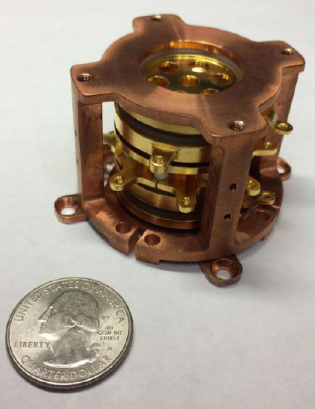
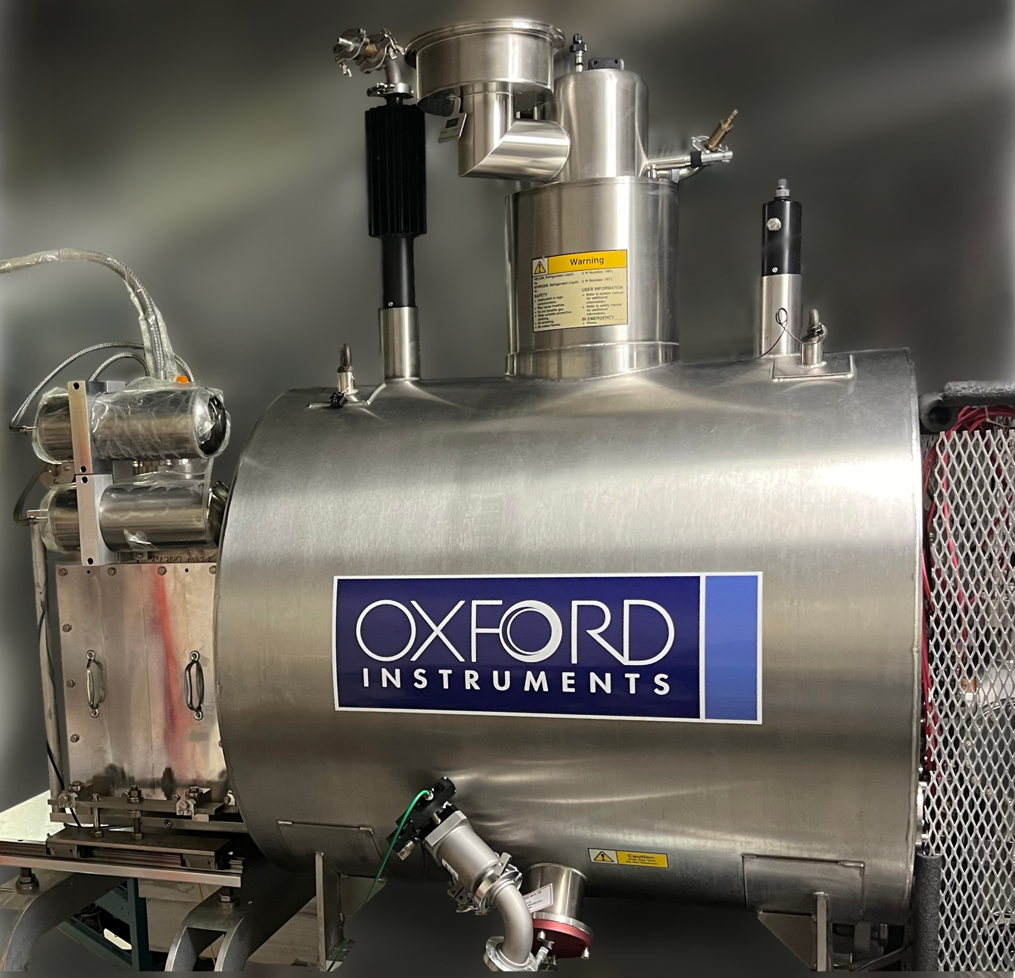
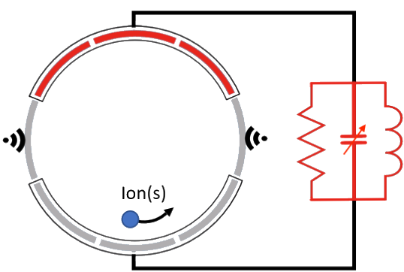
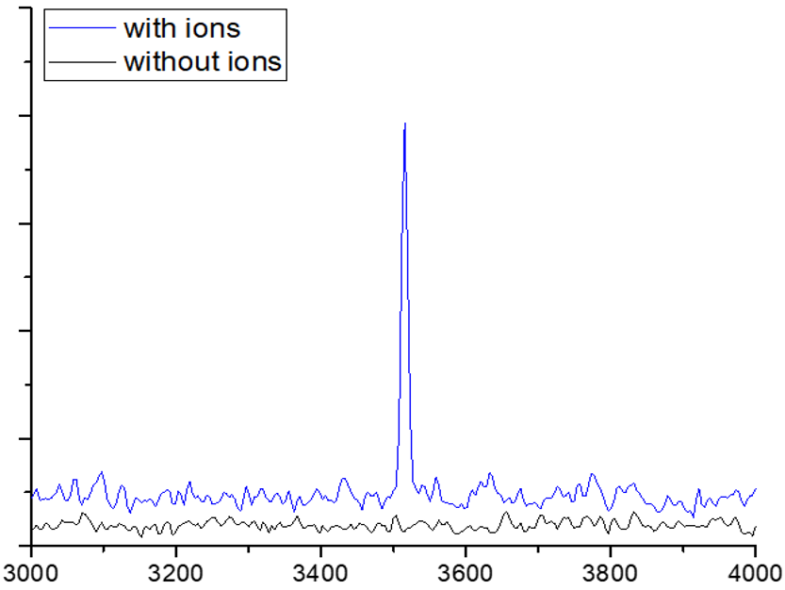
SIPT Provides Access to the Most Exotic Nuclei
Expand mass information across the nuclear chart
  Current limitations: half-life, production rates
  TOF- & PI-ICR → destructive methods, ~100 ions
  SIPT → non-destructive measurement with a single ion
Single Ion Penning Trap (SIPT)^{[1]}
  Fourier Transform Ion Cyclotron Resonance (FT-ICR)
  Ultimate sensitivity: pickup of the ion image charge
  Cryogenic (~5 K) to minimize background
Pushing Development Forward
  Single ion sensitivity validated^{[2]}
  Improving signal analysis tools
  Optimizing detector characteristics
Signal Amp [arb. units]
Relative Freq. [Hz]
[1] A. Hamaker et al., Hyperfine Interactions 240, 1-16 (2019)
[2] S. Campbell et al., Atoms 11, 10 (2023)

Slide 16
Summary and Outlook
FRIB stopped beam program continues to provide high-quality beams
  Future improvements for purified beams are underway
LEBIT has made optimal use of FRIB beams
  Five successful experiments completed: ²²Al, ²³Si, ¹⁰³Sn, ¹⁰¹Sn, ⁷⁰Cu (isomer purification)
  Support for other stopped beam experiments
Near-term science program at LEBIT
  Nuclear Structure (3 approved experiments)
  Nuclear Astrophysics (1 approved experiment)
  Ultra-low Q-value Studies (2 approved experiments)
Technical developments underway improve experimental reach and precision
  PI-ICR technique commissioned; demonstrated on two rare isotope experiments
  Single Ion Penning Trap will enable experiments at the lowest production rates

Slide 17






Thank You
LEBIT Group:
  G. Bollen, H. Erington, C. Ireland, F. Maier, R. Ringle
Collaborators:
  BECOLA Collaboration
  FRIB Gas Stopping Group
  FRIB Theory Collaboration
  K. Fossez, A. Houff, E. Leistenschneider, E. Lykiardopoulou, R. Orford, S. Porter, D. Puentes, C. Quick, M. Redshaw, A. Valverde, I. Yandow
groups.frib.msu.edu/lebit

Slide 18
Backup Slides

Slide 19
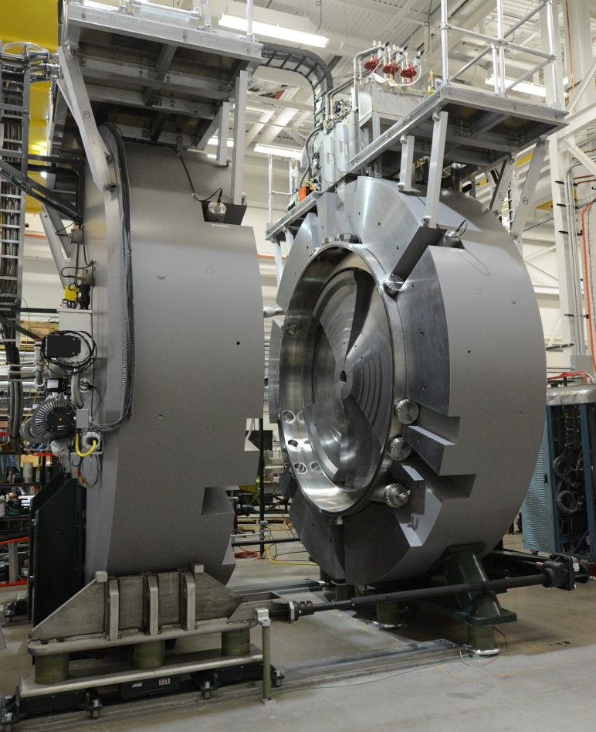
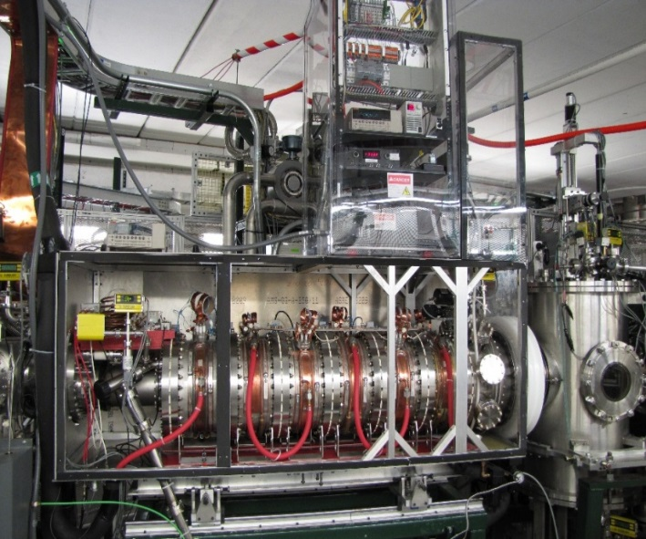
Beam Stopping at FRIB
ISOL-like Beam Properties at a Fragmentation Facility
ANL Linear Gas Stopper
Advanced Cryogenic Gas Stopper
Cyclotron Gas Stopper
Filled with ~100 mbar He, -10 °C
Ions lose energy in collisions with He atoms
DC + RF electric fields and gas flow used to transport ions through
Cryogenic (40 K) for higher beam purity
Novel geometry reduces space charge effects
Ion surfing technique for fast extraction
Optimized for good efficiency with high beam rates
Ions lose energy, spiral towards center
Spiral path provides long stopping distance
Good for light ions
Development in progress
ANL Gas Cell: C. Sumithrarachchi, et al. NIM B, 463, 305 (2020)
ACGS: K. Lund, et al. NIM B, 463, 378-381 (2020)
Cyc Stopper: S. Schwarz, et al. NIM B, 541, 109-113 (2023)

Slide 20
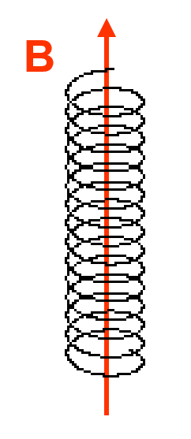
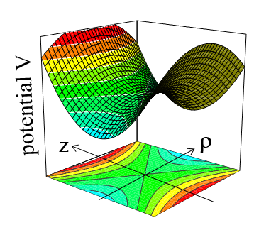
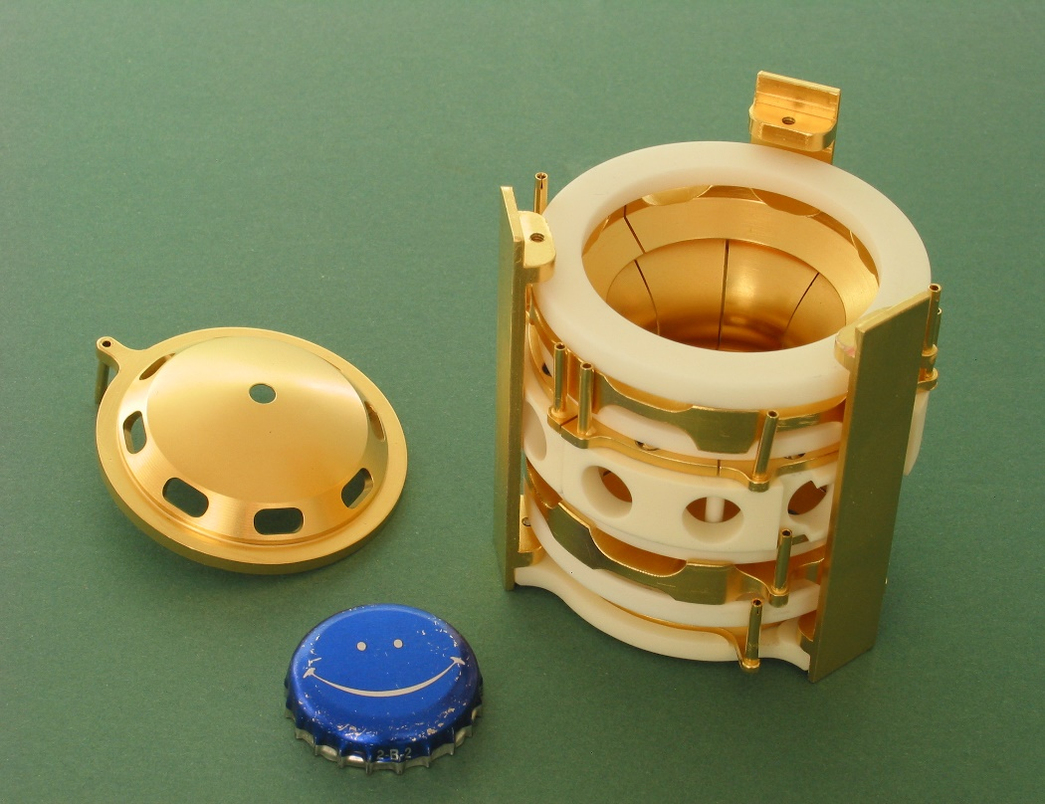
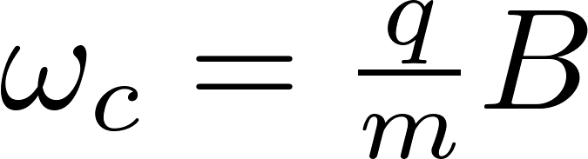
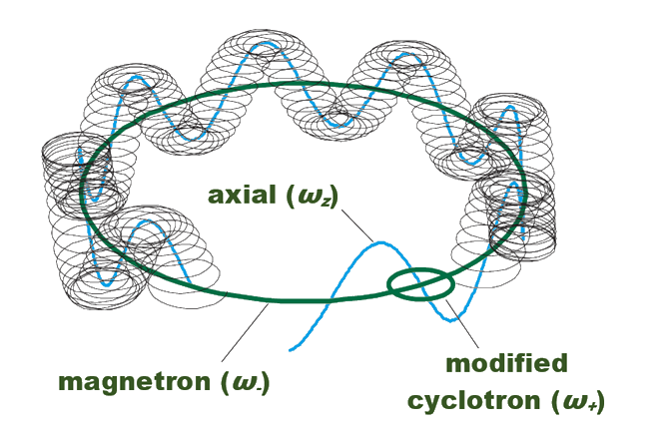

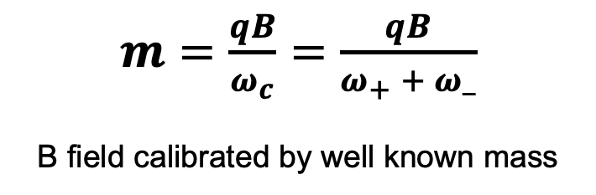
Penning Traps Enable High Precision Mass Measurements
Uniform Magnetic Field
+
Quadrupolar Electrostatic Field
=
Penning Trap
(radial confinement)
(axial confinement)
(full 3D confinement)
“cyclotron
frequency”
$$ω_{c}=ω_{+}+ω_{−}$$
$m=\frac{qB}{ω_{c}}=\frac{qB}{ω_{+} + ω_}$
B field calibrated by well known mass
Bollen et al., J. Appl. Phys. 68, 4355-4374 (1990)

Slide 21

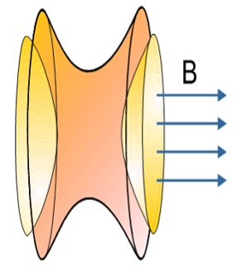



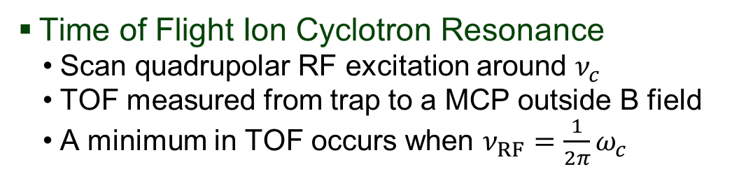


Cyclotron Frequency Measurements from Time-of-flight
Time of Flight Ion Cyclotron Resonance
  Scan quadrupolar RF excitation around $ν_{c}$
  TOF measured from trap to a MCP outside B field
  A minimum in TOF occurs when $ν_{RF}={\frac{1}{2π}ω}_{c}$
Time of Flight [us]
TOF
MCP
$ν_{RF}− \frac{1}{2π}ω_{c}$[Hz]
$$ν_{RF}$$
Magnet
G. Bollen et al., Journal Appl. Phys. 89, 4355-4374 (1990)

Slide 22
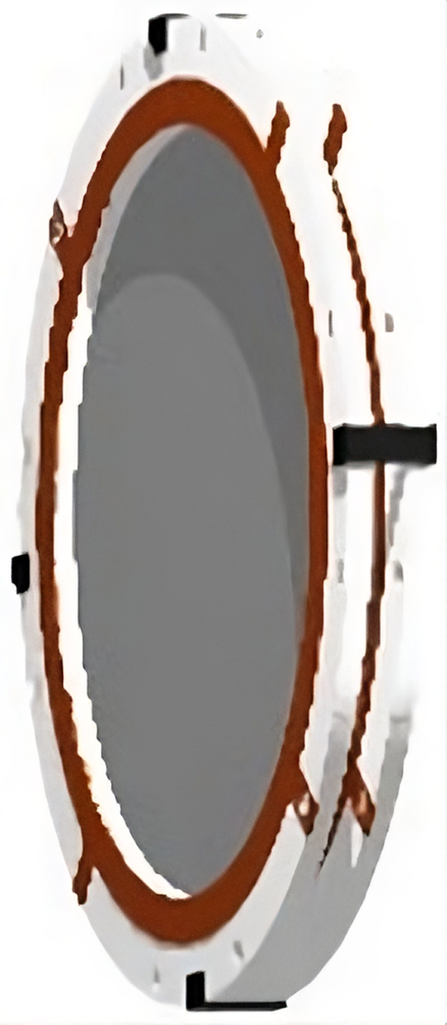

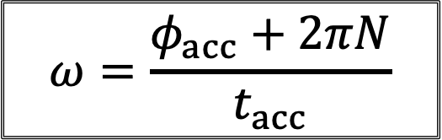





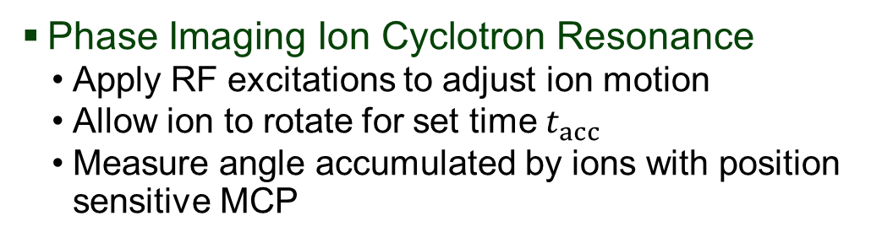

New PI-ICR Technique Enables Higher Precision
Phase Imaging Ion Cyclotron Resonance
  Apply RF excitations to adjust ion motion
  Allow ion to rotate for set time $t_{acc}$
  Measure angle accumulated by ions with position sensitive MCP
~25x better mass precision than TOF-ICR
Fewer ions needed to get precision for structure and astrophysics calculations
$t$=$0$
$$t_{acc}$$
$$\vec{ω}$$
$$\vec{ρ}$$
$$φ_{acc}$$
$$t_{acc}$$
Magnet
$$ω=\frac{φ_{acc}+2πN}{t_{acc}}$$
S. Eliseev et al., Phys. Rev. Lett. 110, 82501 (2013)

Slide 23

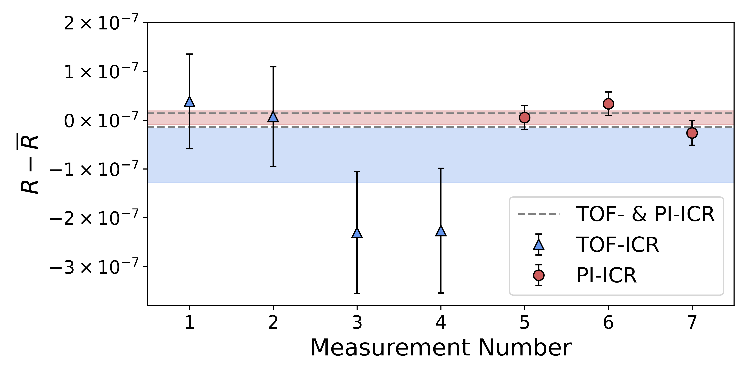
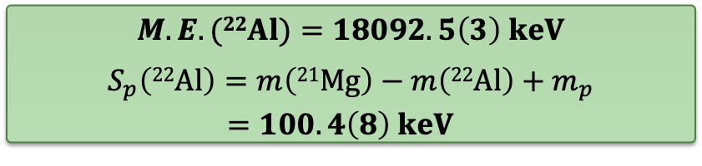
Measured ²²Al Mass Excess Reveals Exceptionally Small S_{p}
~350 ions
$M.E. (22Al)=18092.5\left(3\right) keV$
$$\begin{matrix}S_{p}\left(22Al\right)=m\left(21Mg\right)−m\left(22Al\right)+m_{p} \\ =100.4\left(8\right) keV \end{matrix}$$
~50 ions

Slide 24
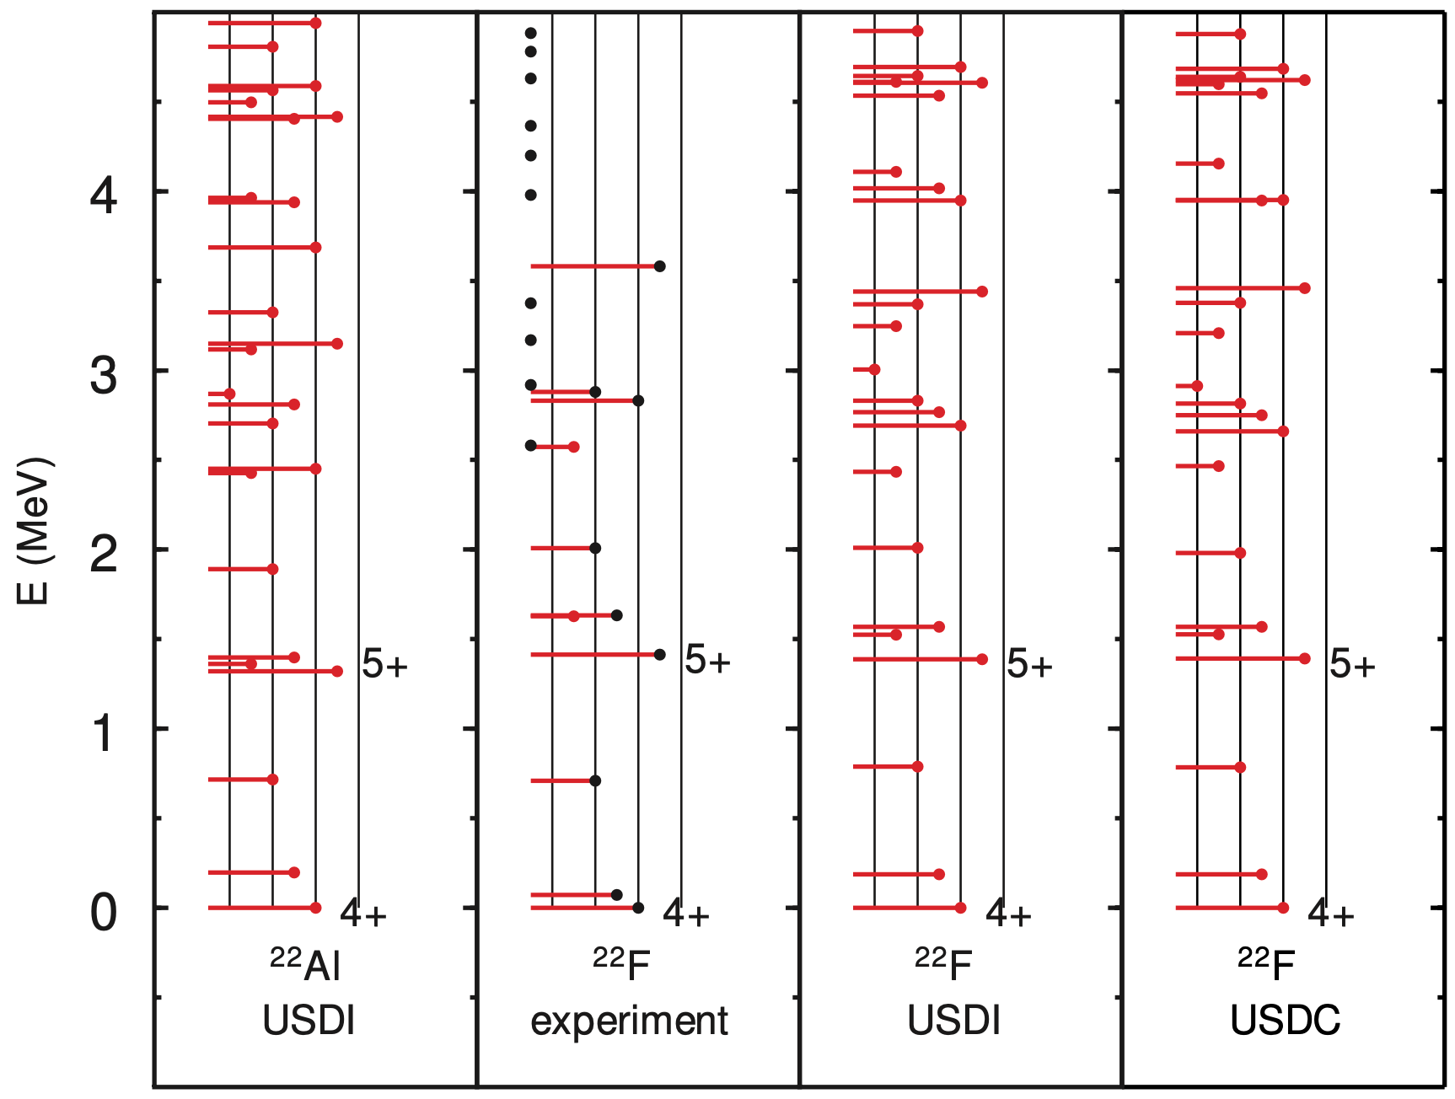
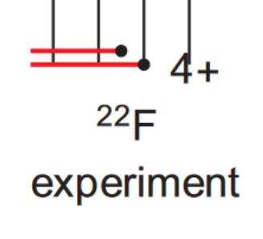
USD Shell Model: Restricted Halo Formation in ²²Al g.s.
“Universal” sd-shell (USD) Hamiltonians [1-2]
  USDC with Bonn-A [3] interaction → S_{p} = 40 keV
  USDI with VS-IMSRG [4] method → S_{p} = 30 keV
  RMS deviation of 140 keV
Thomas-Ehrman shift for proton-rich nuclei [2]
  drop in energy of a state with a valence proton
    s1/2 orbit at or near the separation energy
    due to proton’s wave function increased radial extent
  ²²Al region: excited states with TES up to -0.75 MeV
Predicted proton s_{1/2} occupations
  Use calculated β⁺ decay properties to predict g.s.
    4+ state most likely: s_{1/2} occ. of 0.29
    3⁺ state: s_{1/2} occ. of 0.38
Experiment:
S_{p} = 100.4(8) keV
0.072 MeV
3⁺
[1] B.A. Brown et al., Phys. Rev. C 74, 034315 (2006)
[2] A. Magilligan et al., Phys. Rev. C 101, 064312 (2020)
[3] R. Machidt, Adv. In Nuc. Phys, 189376 (1989)
[4] S.R. Stroberg et al., Phys. Rev. Lett. 118, 032502 (2017)

Slide 25
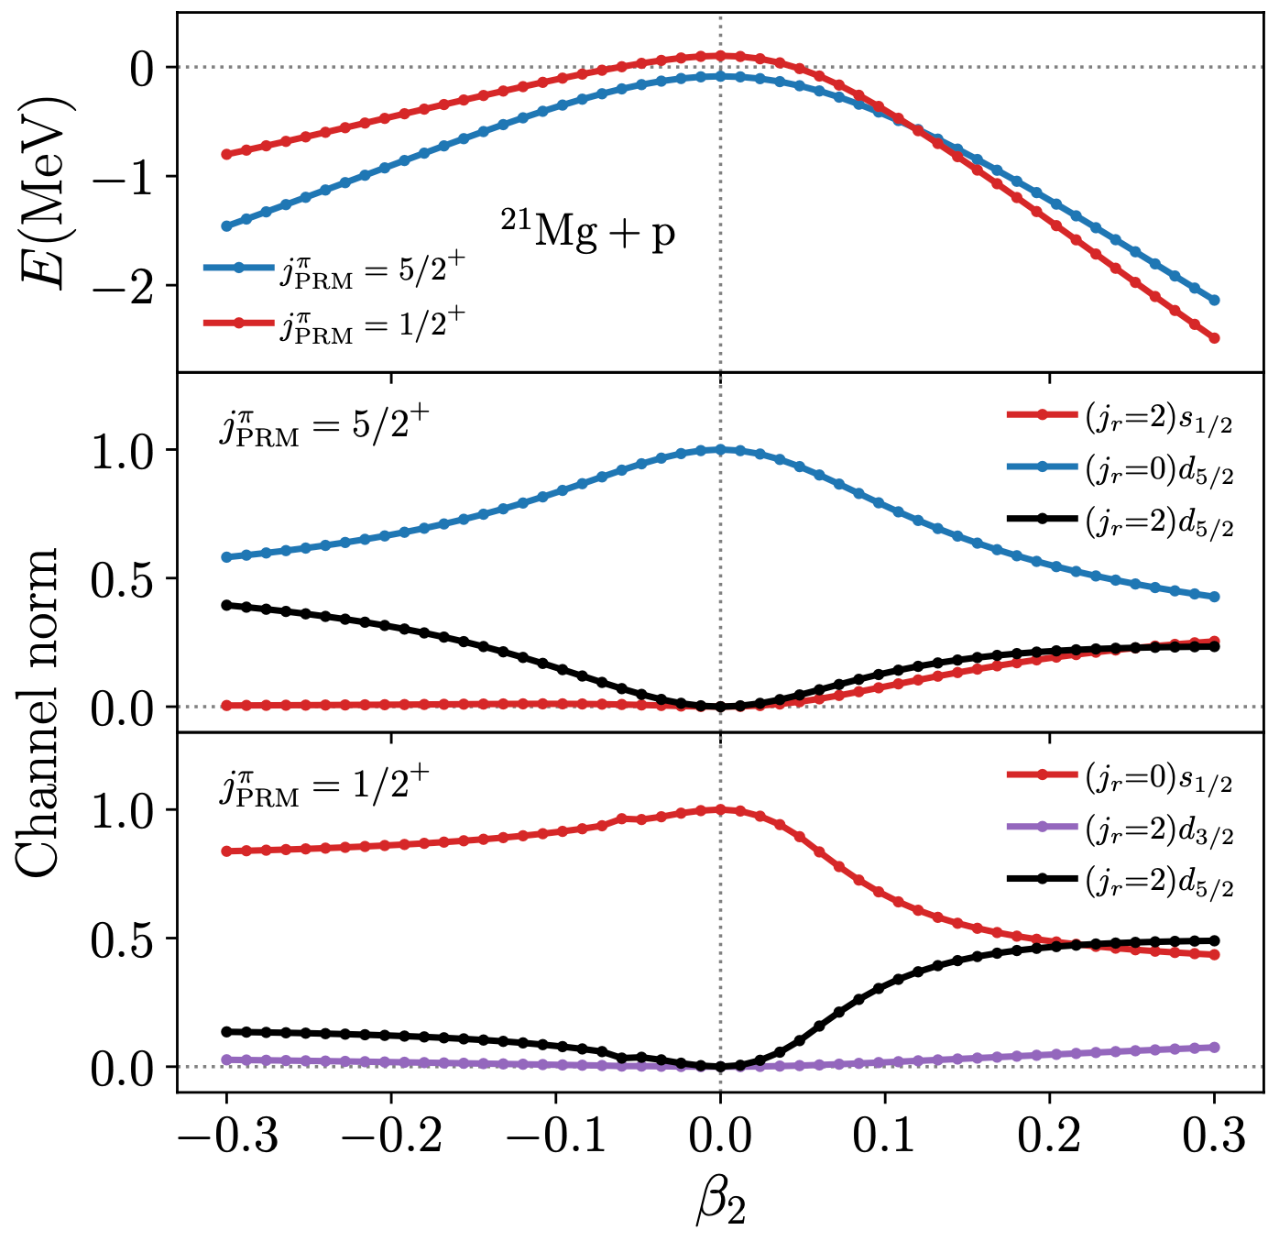
Particle-Plus-Rotor Model: Deformation Enhances ²²Al Halo
Idea: interplay of weak binding and deformation [1]
  1. Enhances the occupation of s-waves
  2. Deformation via the s_{1/2} – d_{5/2} quadrupole coupling
  → Combined, these lower the proton 1s_{1/2} shell
Model ²²Al with a valence proton and a ‘rotor’ (²¹Mg)
  Core-nucleon potential: Woods-Saxon with quad. deform
    Tuned to spherical symm in ²¹Mg, and match exp. B.E. of ²²Al
Small deformation → low s_{1/2} occupation
  Compatible with shell model
Large prolate deformation → 1/2⁺ becomes ²²Al g.s.
  Dominated by s-waves, supports halo
Shell Model
oblate
prolate
[1] K. Fossez et al., Phys. Rev. C 93, 011305(R) (2016)

Slide 26
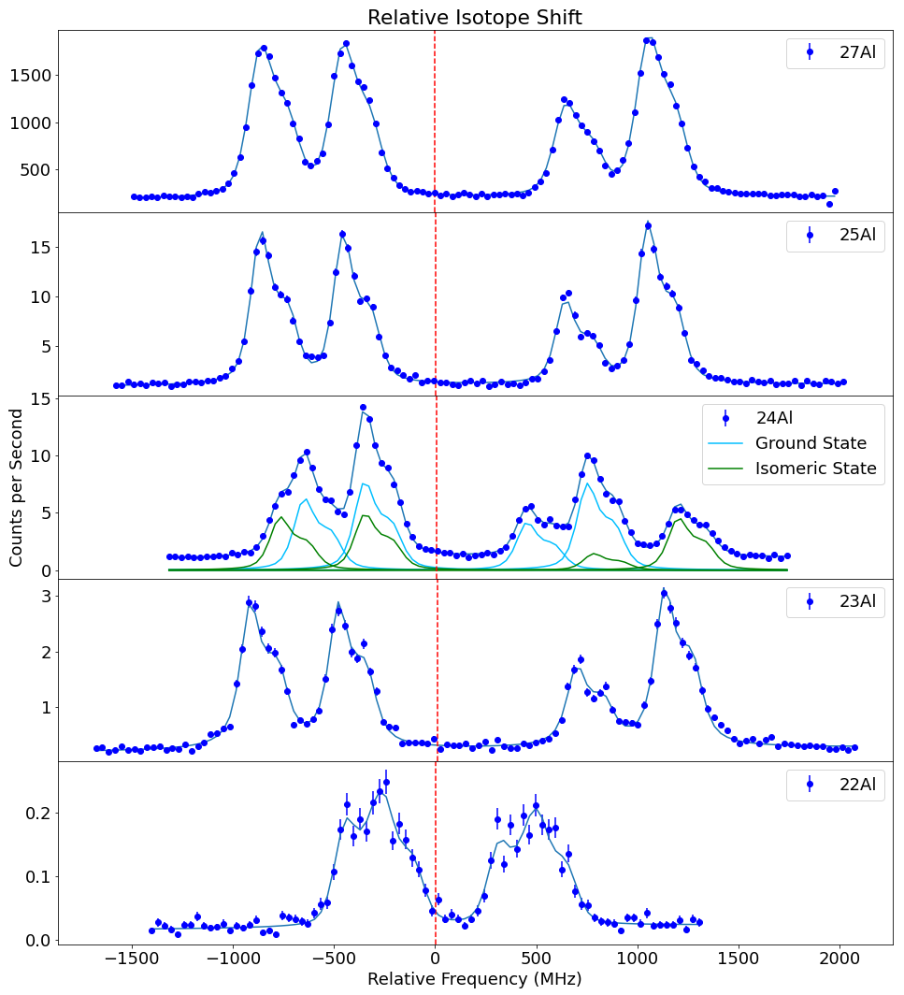
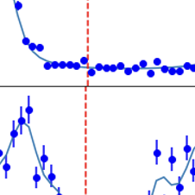

Updates on ²²Al Mass Measurement
Charge Radius Measurement to Shed Light on Halo Structure
BECOLA at FRIB measured ²²Al charge radius
  Collinear laser spectroscopy of ²²⁻²⁵Al
    Hyperfine structure of atomic transitions
  Isotope shift measurements
    $δν^{A,A^{′}}=δν_{mass shift}^{A,A^{′}}+F\left(Z\right)δ{\left\langle r^{2}\right\rangle }^{A,A^{′}}$
  Measurement was successful, analysis underway
Conclusions
  Charge radius measurement is a big step to resolving halo
  Ground state spin/parity measurement needed
PRELIMINARY
Stay tuned for an upcoming
BECOLA publication!

Slide 27







Unambiguous Signal Identification Possible with SIPT
Single ion signals: very close to noise floor
  How does one distinguish noise from single ions?
Solution: simultaneous pickup of $ω_{c}$ and $ω_{+}$
  Center amplifier between $ω_{c}$ and $ω_{+}$
  Presence of both signals is unique fingerprint
$$SNR ∝ Nq\sqrt{\frac{Q}{TC}}$$
Q: resonator quality factor ~2800
T: temperature, ~5 K
C: resonator capacitance
$$ω_{c}$$
$$ω_{+}$$
$$ω_{−}=ω_{c}−ω_{+}$$
MiniTrap: D. Lincoln et al., Int. J. Mass Spectrom. 379, 1-8 (2015)

