Slide 1
Status of NUSTAR
Zsolt Podolyák
NUSTAR Annual Meeting, 26 February 2025

Slide 2


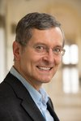
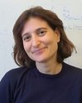
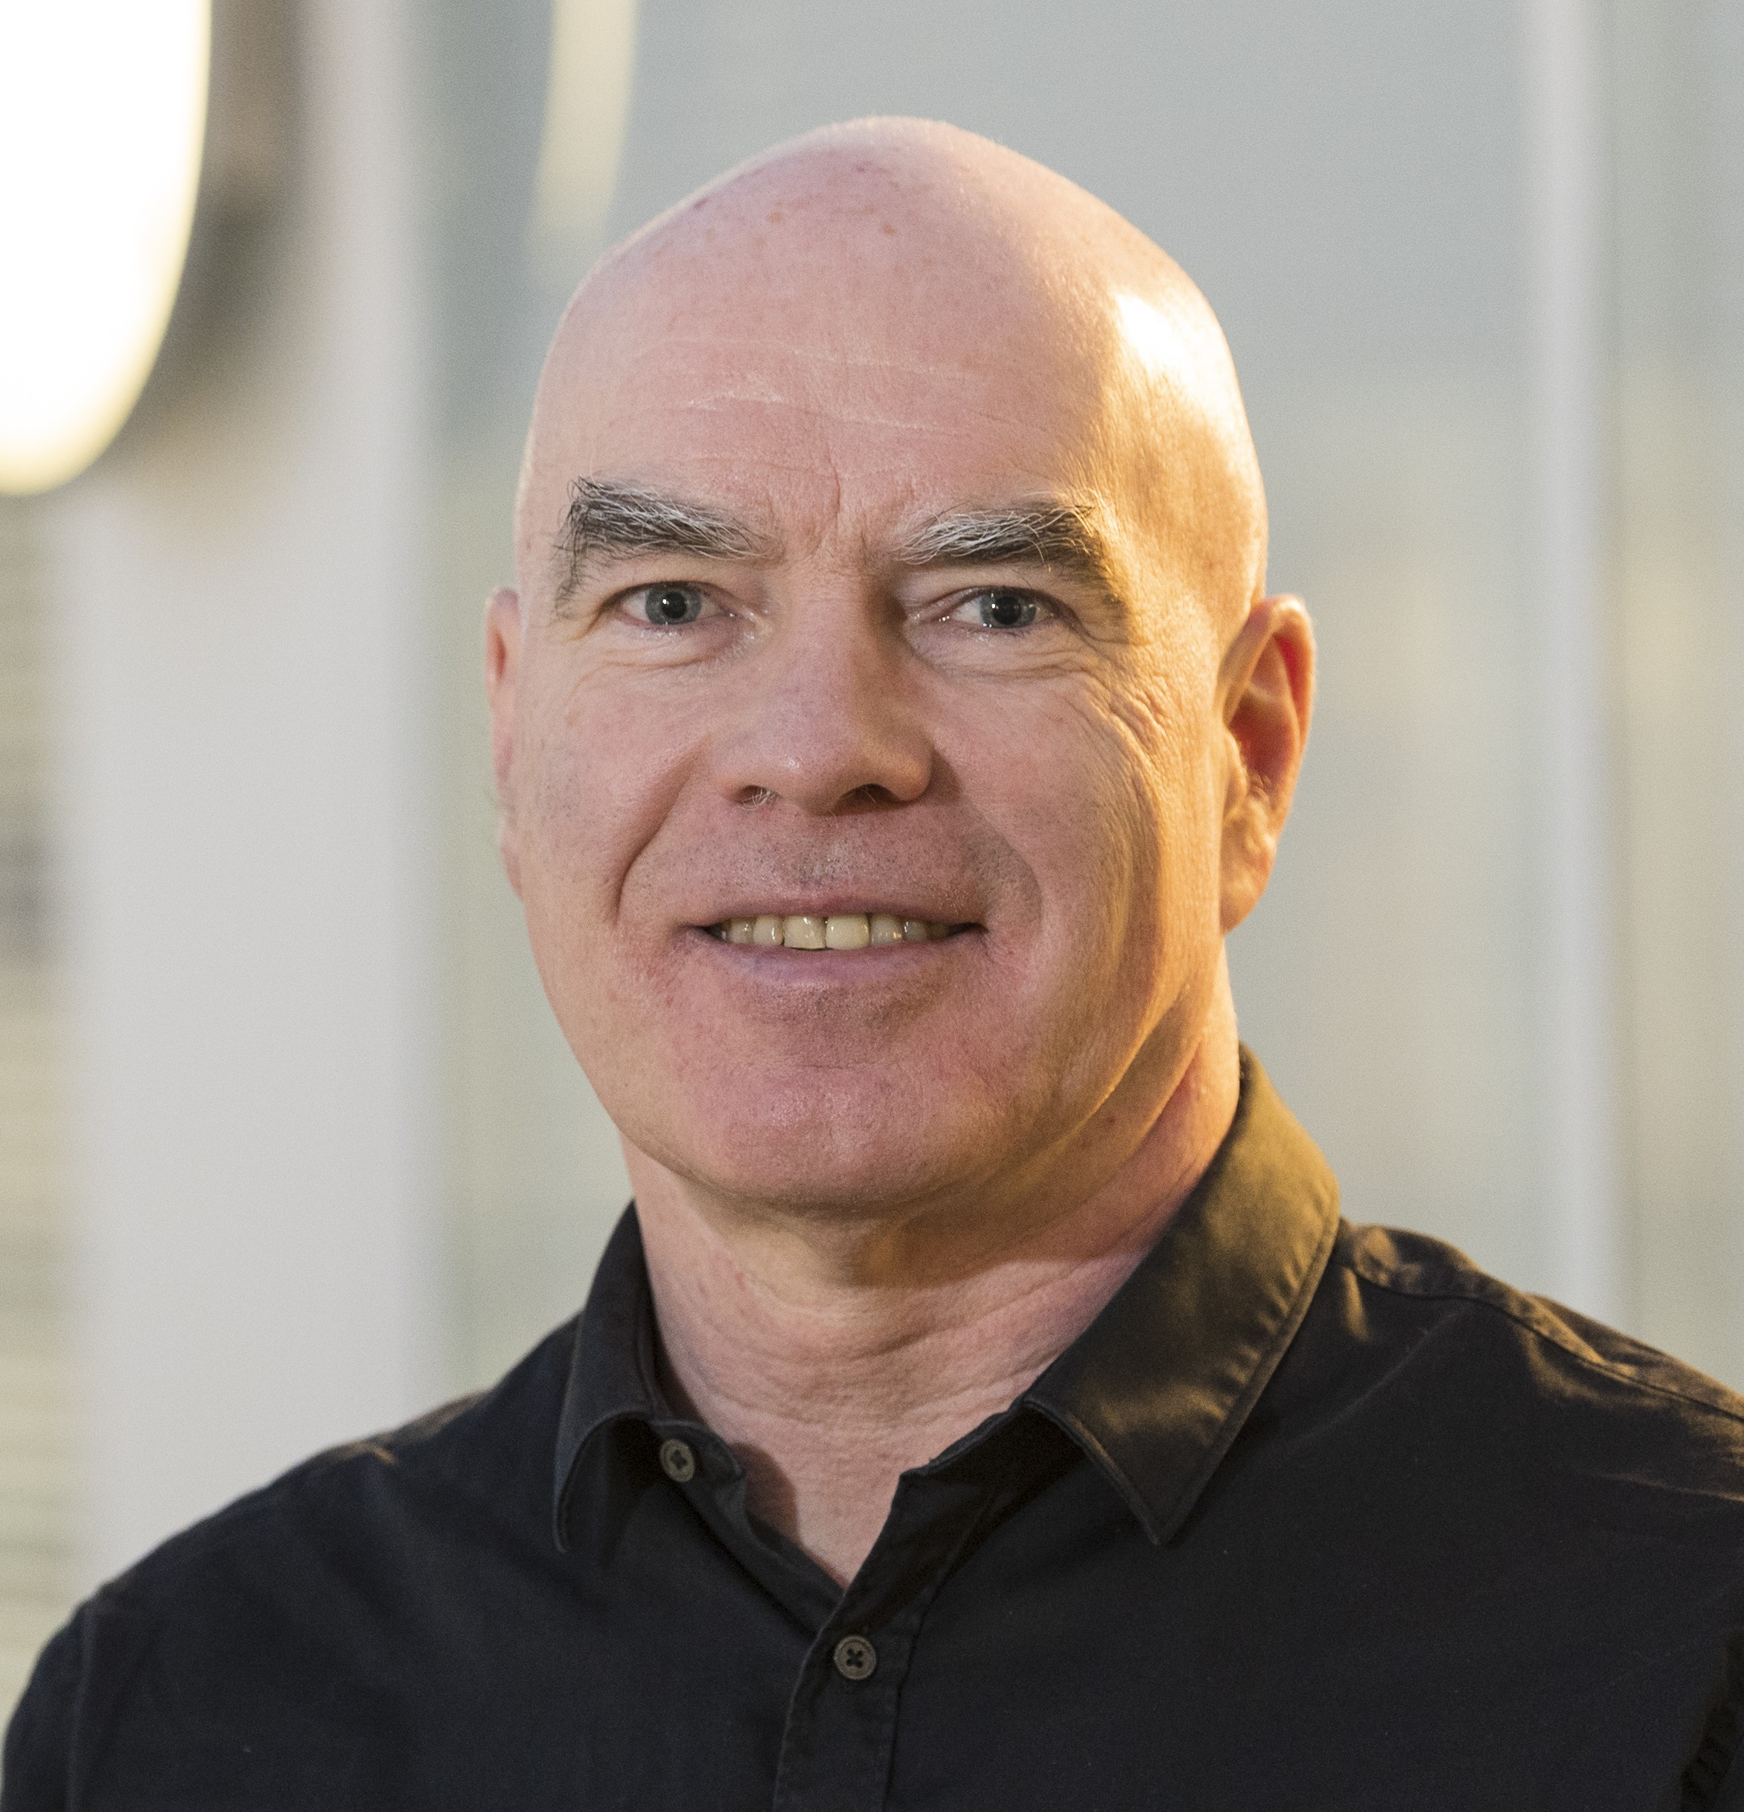
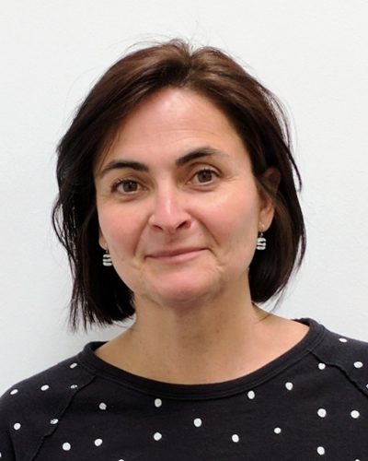
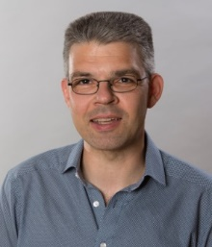
News from the NUSTAR Board of Representatives
spokesperson
Peter Thirolf Giovanna Benzoni Zsolt Podolyák Lola Cortina Michael Block
(LMU Munich) (Milano, Italy) (Surrey, UK) (Valencia, Spain) (Mainz, Germany)
Peter’s appointment ended Feb 2025; cannot be re-elected
Giovanna’s appointment ended Feb 2025; can be re-elected
Deputy spokesperson: Michael Block
https://fair-center.eu/user/experiments/nustar/nustar-collaboration/board-of-representatives

Slide 3
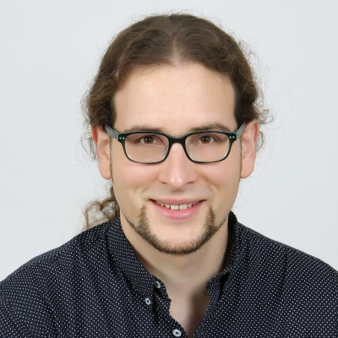
News from the NUSTAR Board of Representatives
spokesperson
Timo Dickel Giovanna Benzoni Zsolt Podolyák Lola Cortina Michael Block
(GSI) (Milano, Italy) (Surrey, UK) (Valencia, Spain) (Mainz, Germany)
Giovanna was re-elected
Timo Dickel elected
Deputy spokesperson: Michael Block
https://fair-center.eu/user/experiments/nustar/nustar-collaboration/board-of-representatives

Slide 4
Timeline 2021 –
2021-2022 FAIR-0 experiments
2023 No experiments (but there were tests)
2024-2025 FAIR-0 experiments
2026-2027 FAIR-0 experiments (G-PAC in Feb. 2025)
End 2027 -> Early Science (with SuperFRS)
End 2028 -> First Science (with SuperFRS and SIS100)

Slide 5
FAIR/GSI strategic operation scenario:
ES, FS, towards FS+
beam time
Acc. Operation total / days
134
44
140
Pre-paration works
EH
140+30
renovation
EH
140
renovation
EH
140
200
240
240
beam time
Physics beam time/ days
107
0
100
100+30
50
70
min. 120*
180
180
engineering-runs
Project phases (ES, FS, FS+)
FAIR Installation of Accelerator Components
FAIR Hardware Commissioning
FCC OP ready
UNILAC CS ready
DR
FAIR Beam Commissioning
PCP reached
Facility availability
now
included
early science (ES) →
SIS18 → SFRS → NUSTAR
still
missing
first science (FS) →
SIS100 → SFRS → NUSTAR
first science + (FS+) →
SIS100 –> CBM
UNILAC → EH, SIS18 → TH, EX, FRS, ESR → HITRAP, Cryring
2022
2023
2024
2025
2026
2027
2028
2029
2030
FAIR Phase 0
Early Science
Early Science & First Science+

Slide 6
Expert Committee Experiments/Experiment Cost Scrutiny Group, 14-16 October 2024
Committees: ECE/ECSG
The committee continues to be impressed with the NUSTAR science program performed within the framework of FAIR Phase 0
  The science results presented span from interaction cross section studies to two-photon decay and the chemistry of the heaviest elements – the NUSTAR team is congratulated to the many letter publications and the accepted manuscript on bound-state beta decay in Nature
  The new ¹⁷⁰Er primary beam and new instruments such as INCREASE and LISA will open up new opportunities
  The committee was excited to hear that there will be 130 days of beam time in 2025 for A and A- ranked experiments
The committee appreciates the NUSTAR’s planning towards responding to the JSC request to “identify the first experiment”. The choice of the neutron-skin measurement of ¹³²Sn and fission studies of relevance to the r process at R³B are indeed choices unique to FAIR. The committee appreciates the complexity of the R³B setup and urges collaboration to push for results that can be published expeditiously.

Slide 7
Committees: ECE/ECSG (cont.)
NUSTAR and FAIR are commended for their excellent coordination of the highly complex installation and commissioning timeline that has the High Energy Cave handover in 06/2026 as a critical milestone
The committee congratulates NUSTAR to the final version of the Construction MoU and the accomplishment of having 95.4% secured of the funding for the Day-One configuration related to ES and FS

Slide 8
Committees: JSC
Joint Scientific Council; 22-23 October 2024
The JSC congratulates the NUSTAR collaboration for the impressive Nature and PRL publications on the bound beta decay of ²⁰⁵Tl. The JSC also praises the collaboration for the first measurement of bond strength in a SHE-molecule and a very successful campaign of experiments using the newly developed ¹⁷⁰Er beam. The JSC looks forward to a speedy publication of high impact results obtained. It also appreciates the clear plans for the first NUSTAR experiment within Early Science and First Science

Slide 9
Many great results published recently,
many of them presented at this meeting

Slide 10

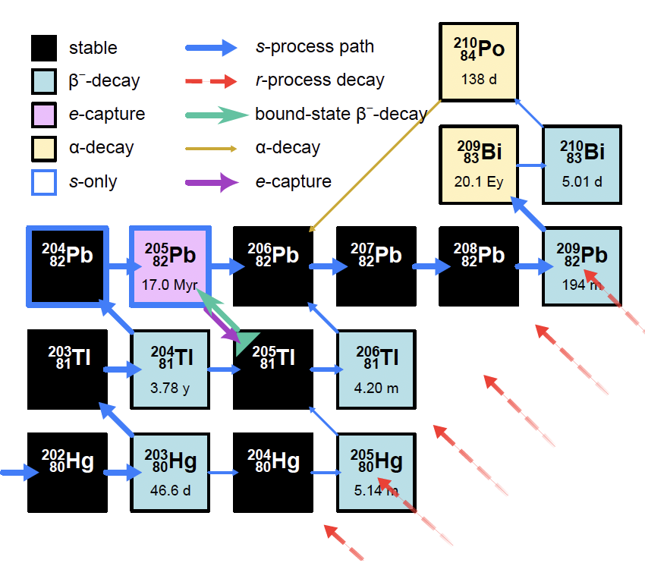
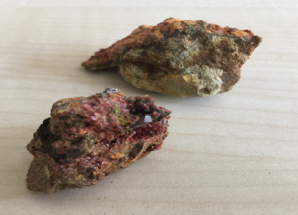
Bound-State Beta Decay of ²⁰⁵Tl
²⁰⁵Tl: Stable in neutral atoms
Radioactive in bare ions
Cosmochronometer of the s-process
Neutrino energy threshold 53 keV!
LOREX project: new solar neutrino detector

Slide 11

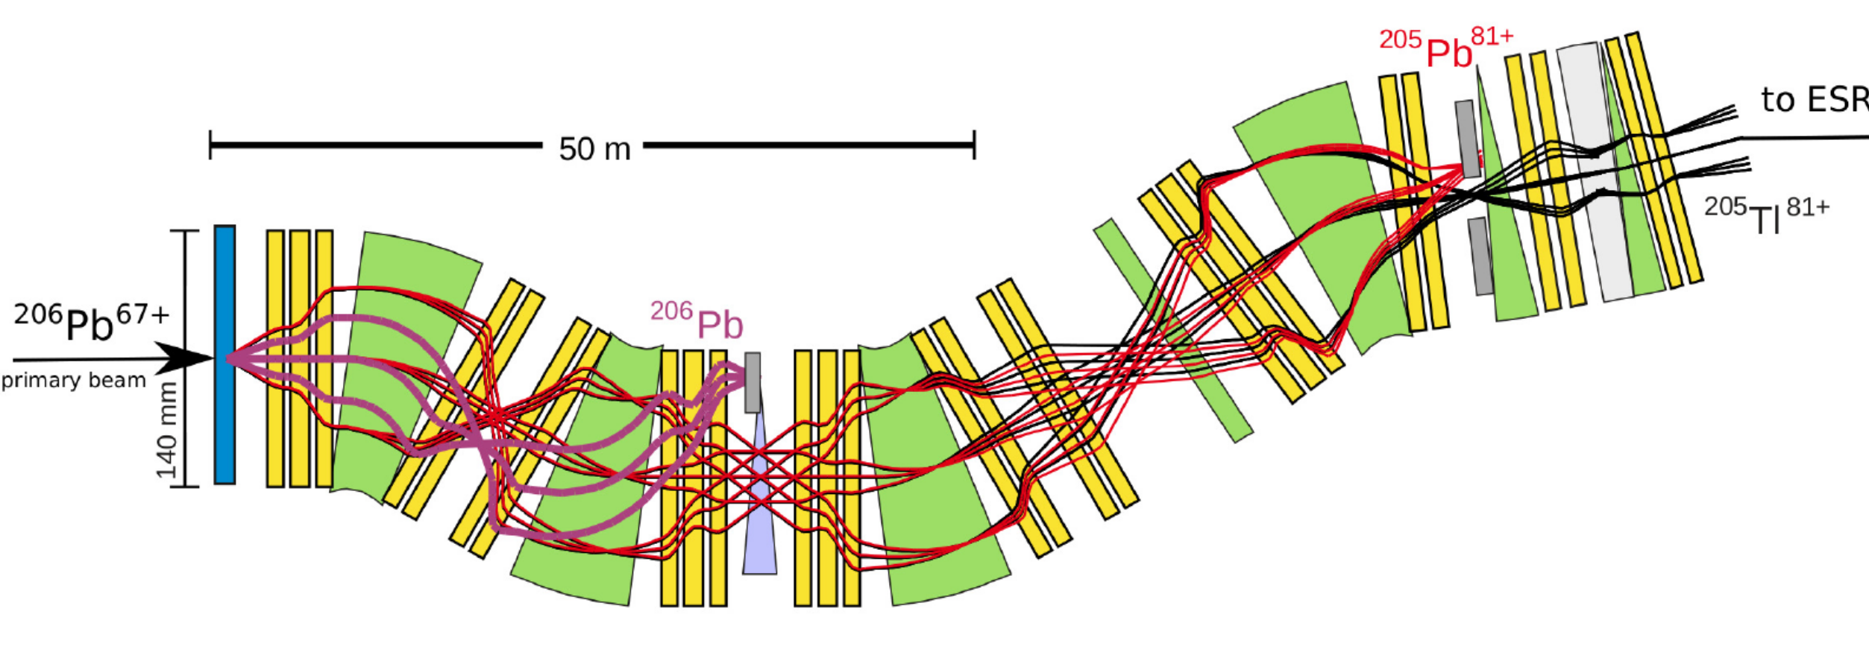
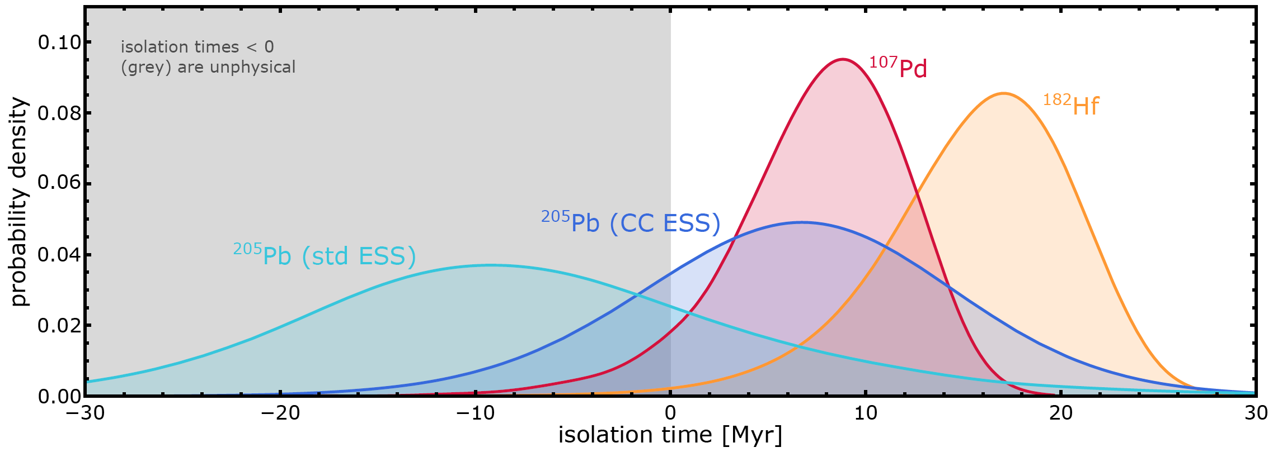
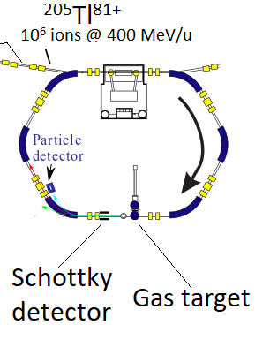

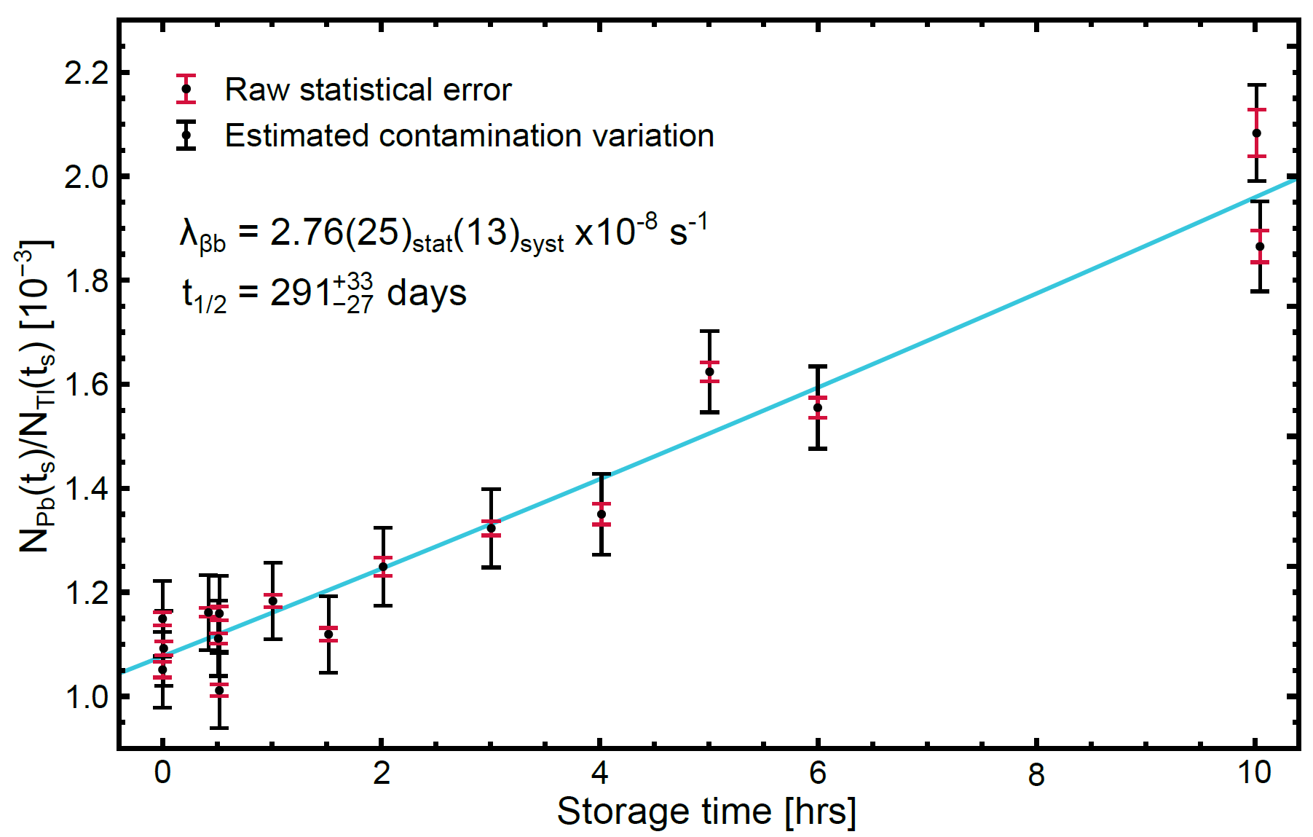




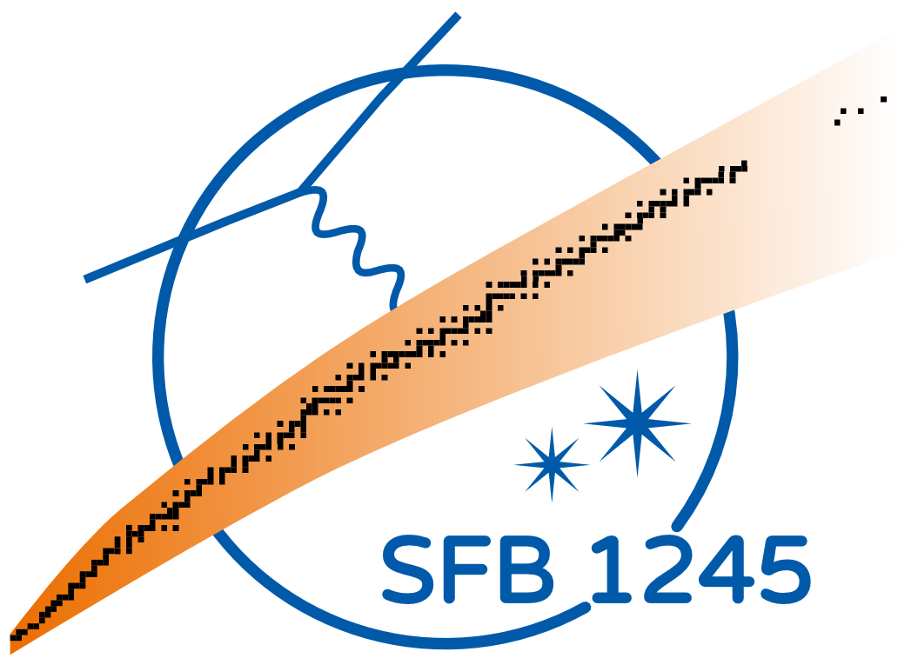
Bound state beta decay of ²⁰⁵Tl⁸¹⁺
Accepted in
Combined with meteoritic data, new ²⁰⁵Pb and ²⁰⁵Tl decay rates in plasmas, and astrophysical simulations, the isolation time of the solar matter from the last synthesis of ²⁰⁵Pb is for the first time positive!
G. Leckenby et al., Nature 635, 321 (2024)
Combined with new neutrino capture rates, the new ²⁰⁵Tl decay constant sets precise constraints on the production of ²⁰⁵Pb by solar pp neutrinos, and thus for the LOREX project aiming at measuring ²⁰⁵Pb in lorandite minerals
T_{1/2}^{the} =122 days
T_{1/2}^{exp}=291 days
ESR:
Storage times of up to 10 hours
R. S. Sidhu et al., Phys. Rev. Lett. 133, 232701 (2024)
Notes:
205Tl is stable as atom but decays if all bound electrons are removed
The decay rate is significantly different from theoretical predictions
205Tl-205Pb pair has the lowest Q-value for capturing solar neutrinos. 205Tl has therefore been a candidate for solar pp neutrino detector. LOREX is the project to determine the number of 205Pb atoms created by solar neutrinos in 3.2 My old lorandite mineral
Decay of 205Pb and back-decay of 205Tl determine the termination of slow neutron capture process in AGB stars. With new 205Tl rate, the production of 205Pb can be constrained. The origin of the solar system can be determined as well.

Slide 12

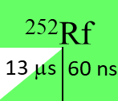

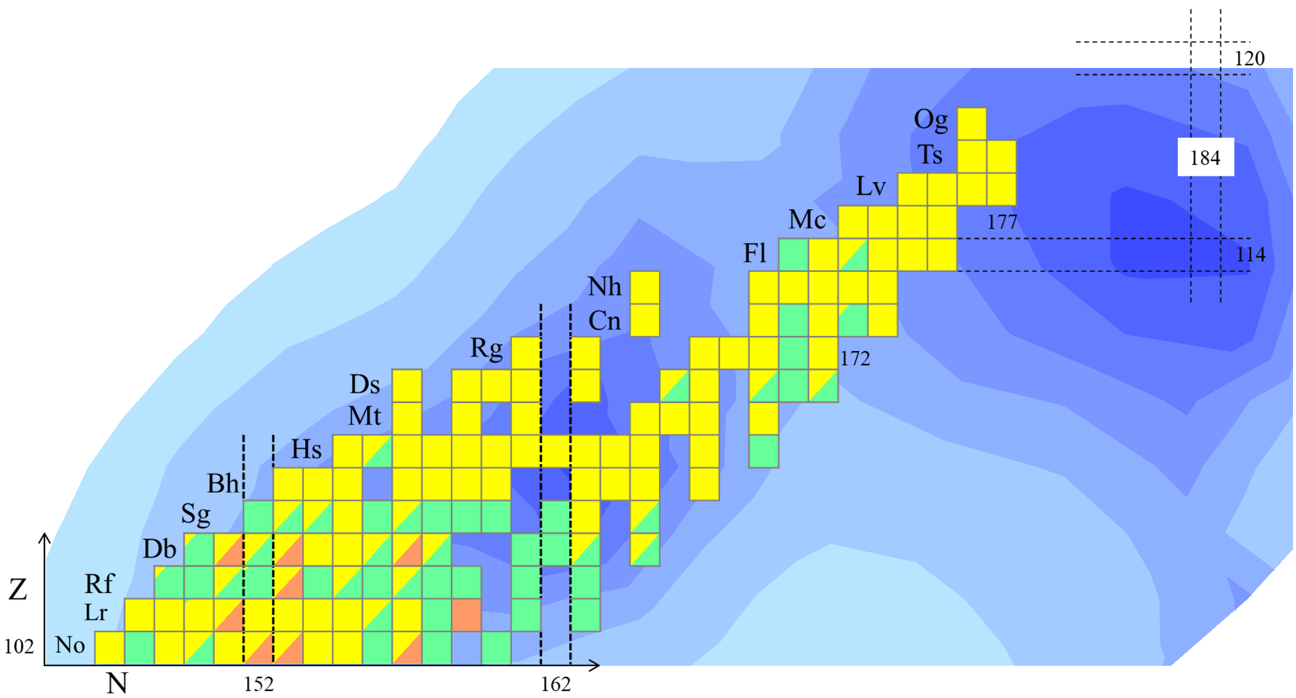

252
104
Discovery of 60-ns Rf:
Marking the shoreline of the Island of Stability
  J. Khuyagbaatar, P. Mosat et al., Phys. Rev. Lett. 134, 022501 (2025)
  Editors’ Suggestion / Featured in Physics
Prediction: “Clouds of stability” of superheavy nuclei
K-isomeric state (Rf-252m): 50 µs
Ground state (Rf-252): 100 ns
J. Khuyagbaatar, Eur. Phys. J. A 58, 243 (2022).
  Shoreline towards the Sea of Fission Instability is reached in the new ²⁵²Rf
  Detection only possible thanks to longer-lived high-K state
Experiment: ⁵⁰Ti+²⁰⁴Pb @TASCA
K-isomeric state (Rf-252m): 13 µs
Ground state (Rf-252): 60 ns
+4
-3
+90
-30
Sea of fission
instability
250 ns

Slide 13

Near future
2025: 130 days of beamtime Feb-July 2025
A and A- ranked experiments
2026-2027: experiments at the existing facility
~100-150 days
G-PAC was last week

Slide 14
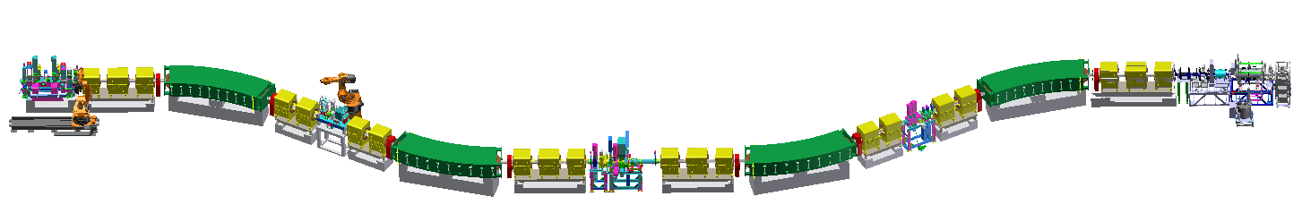
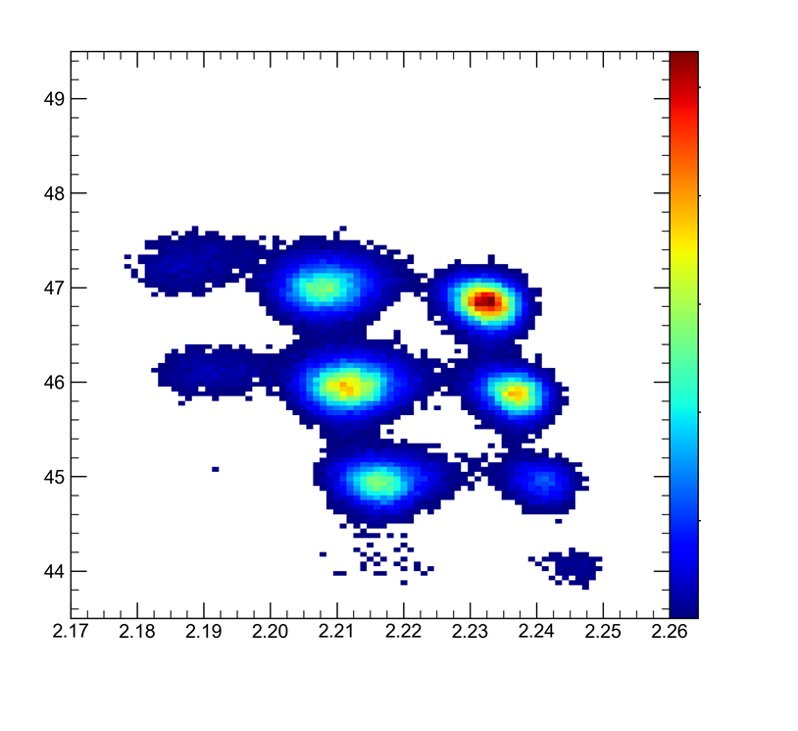
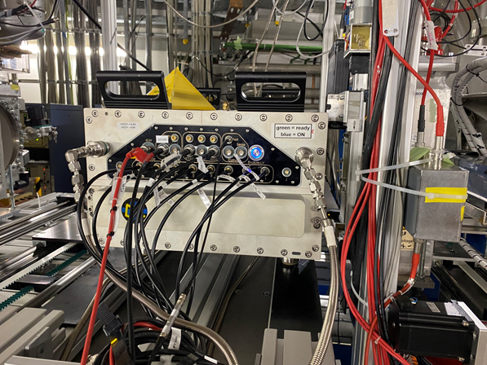
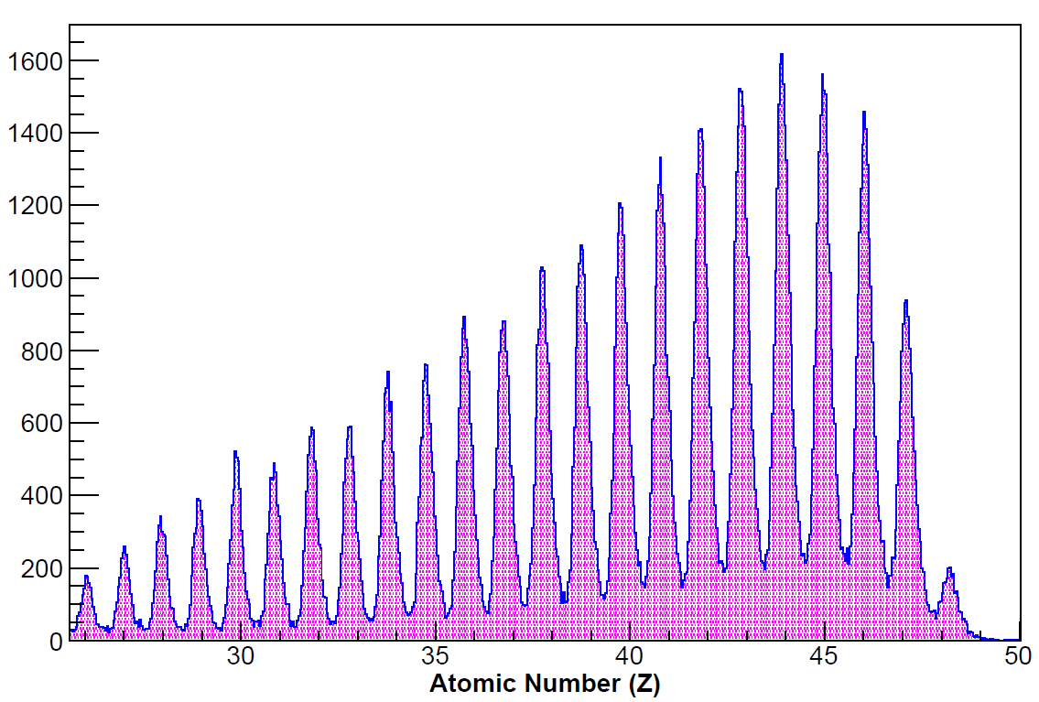

New campaign started (Feb. 2025)
New detectors and particle ID
Bρ, TOF
Trav. MUSIC @ S2
¹⁰⁵Ag
450 MeV/u Ag fragments
Ag
Z
$\frac{∆Z}{Z}=$0.45 %
A/Q
E.Haettner, I.M.Deppner, J.Eder, C.Hornung, R.Prajapat, E.Rocco, B.Voss, et al.
Notes:
G-22-00160 aims at FRS developments for APPA and NUSTAR.
Here: new Scintillator detectors at S1 (→ TOF between S1-S2) and new Travelling MUSIC detector (spare / replacement of 30-year old FRS MUSIC detectors!) allow for particle identification in first half of FRS (useful for EXPERT, LISA, and similar experiments)

Slide 15
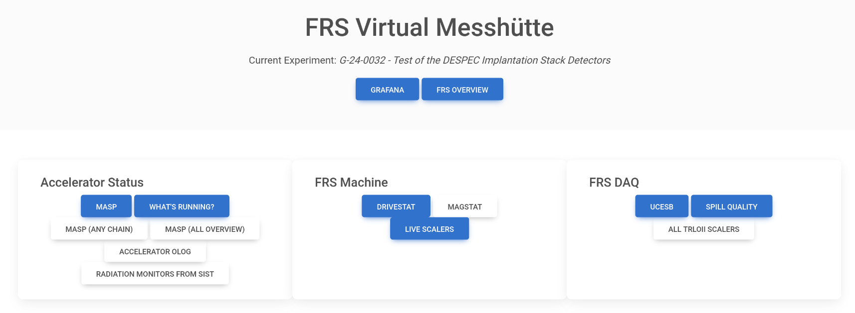

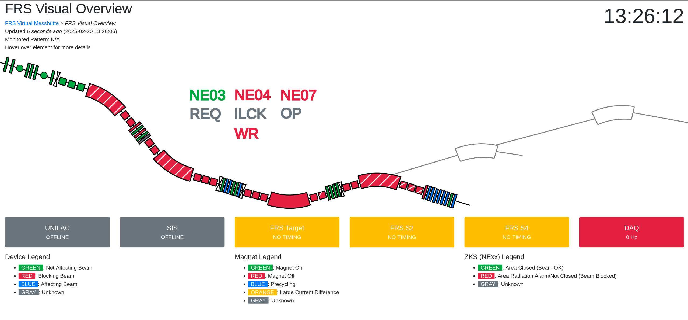
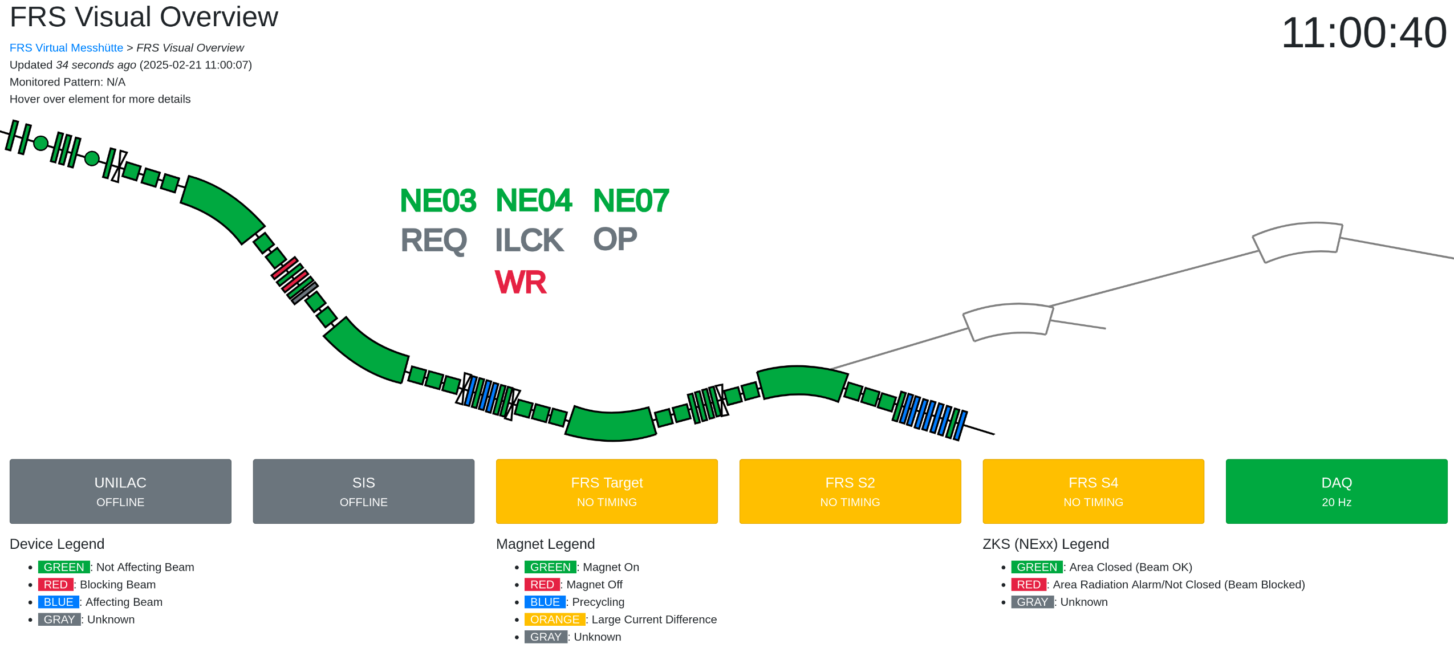
Latest news from FRS experiment G-22-00160 (run Feb. 2025)
FRS Virtual Messhuette
N.Hubbard, M.Bajzek, C.Hornung
Notes:
G-22-00160 aims at FRS developments for APPA and NUSTAR.
Here: Virtual Messhuette.
It is a new feature to monitor the FRS: very useful for both, for people in Messhuette and for remote participants.
This application is used for „read only“.
It is an important milestone on the way to FRS remote control from FCC.

Slide 16
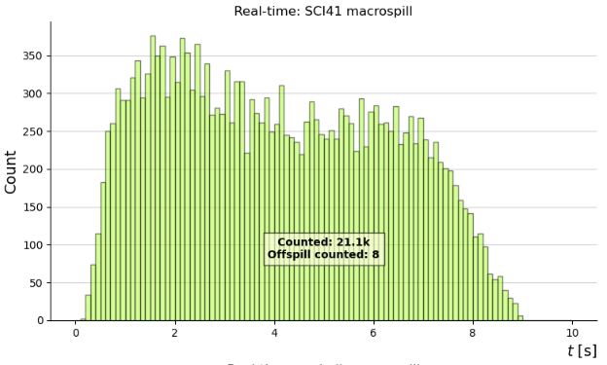
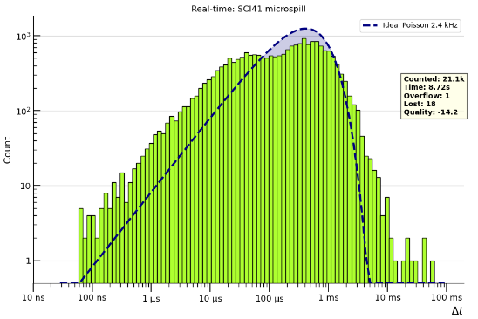

New campaign started (Feb. 2025)
FRS Virtual Messhuette
Macro spill structure Micro spill structure
0 4 8 time (s)
100 ns 10 mus 10 ms
N.Hubbard, M.Bajzek, C.Hornung
Notes:
G-22-00160 aims at FRS developments for APPA and NUSTAR.
Here: new feature to monitor the spill shape („macro spill“, left) and time structure („micro spill“, right).
This application is available at „HKR“ and will guide the operators to tune the SIS extraction (macro spill → a rectangular shape will provide the highest duty factor [maximize the „beam-on time“]) and reduce/minimize the micro-bunch structure of the extracted ions (→ minimize the event losses due to DAQ dead time and possible mis-identification).

Slide 17
Expert Committee Experiments, 14-16 October 2024
Committees: ECE/ECSG
The committee continues to be impressed with the NUSTAR science program performed within the framework of FAIR Phase 0
  The science results presented span from interaction cross section studies to two-photon decay and the chemistry of the heaviest elements – the NUSTAR team is congratulated to the many letter publications and the accepted manuscript on bound-state beta decay in Nature
  The new ¹⁷⁰Er primary beam and new instruments such as INCREASE and LISA will open up new opportunities
  The committee was excited to hear that there will be 130 days of beam time in 2025 for A and A- ranked experiments
The committee appreciates the NUSTAR’s planning towards responding to the JSC request to “identify the first experiment”. The choice of the neutron-skin measurement of ¹³²Sn and fission studies of relevance to the r process at R³B are indeed choices unique to FAIR. The committee appreciates the complexity of the R³B setup and urges collaboration to push for results that can be published expeditiously.

Slide 18
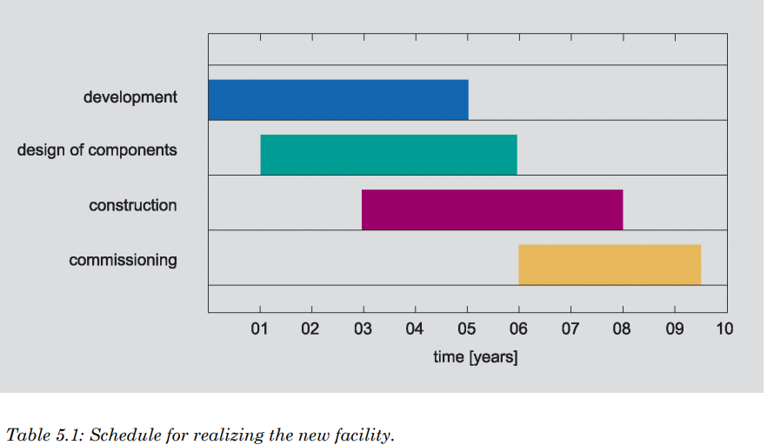
Time, strength, uniqueness
Conceptual Design Report (CDR) Operation starts 2027/2028
(Nov. 2001)
Competitors at that time: all <100 MeV/u
Mentioned as plans:
RIBF 350 MeV/u RIBF is running ~100 pnA
RIA FRIB is running
HIAF

Slide 19

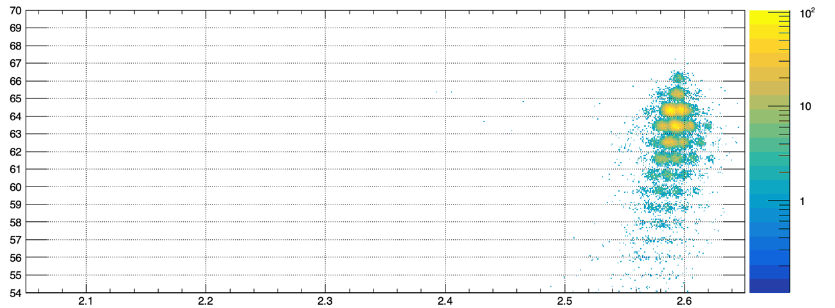
Newly-developed Er beam (unique for GSI/FAIR)
Very preliminary
Online analysis (data of first night)
¹⁷⁰Er
¹⁷⁰Er + Be reaction at 1.08 GeV/u
Stabilitätslinie:
166-Er: A/Z=166/68=2,44
130-Xe: A/Z=130/54=2,41
Element number Z
Valley of stability
Mass-to-charge ratio A/Q
◇ Wide range of cross section data serve as important basis for developments of future FRS/SFRS and
NUSTAR experiments with the newly developed Er beam, uniquely available at GSI/FAIR
◇ Similar for ¹⁰⁰Mo, ²³⁸U et al.
Y.Tanaka, E.Haettner, S.Singh, et al.

Slide 20
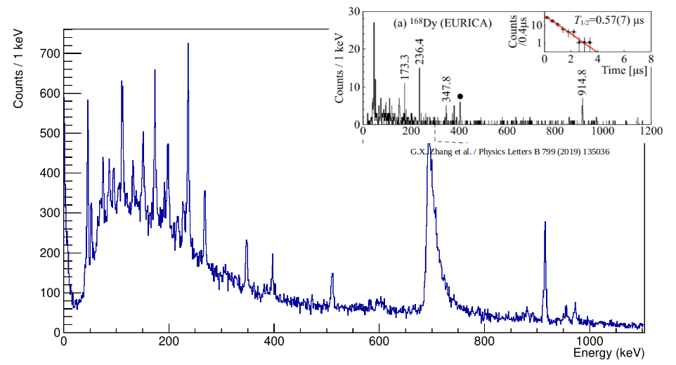
New beams: ¹⁷⁰Er, ¹⁸⁶W, ¹⁶⁰Gd
~22 shifts of data collection in April 2024
Reduced transition probabilities B(E2;2⁺→ 0⁺) are derived from nuclear lifetimes
B(E2;2⁺→ 0⁺) values access fundamental information regarding wavefunctions of initial and final states
EURICA at RIKEN with ²³⁸U
new beams
➔ new opportunities
¹⁶⁸Dy
¹⁸⁰Er beam
Subset of online data, DEGAS HPGe spectrum
H.M.Albers, T.Grahn, C.M.Petrache, V.Werner, et al.

Slide 21
Committees: FAIR Council
FAIR Council, Dec 2024 Kolkata, India
-towards CBM

Slide 22
Committees: ECE/ECSG (cont.)
NUSTAR and FAIR are commended for their excellent coordination of the highly complex installation and commissioning timeline that has the High Energy Cave handover in 06/2026 as a critical milestone
The committee congratulates NUSTAR to the final version of the Construction MoU and the accomplishment of having 95.4% secured of the funding for the Day-One configuration related to ES and FS

Slide 23
Report
from the Committee for
First-Science and Staging
Review of the FAIR Project
Submitted to FAIR Council,
October 2022 (Heuer/Tribble report)

Slide 24
Construction-MoU signature status
February 2025
Alex Herlert

Slide 25
Construction -MoU signatures selected cases (90% of all)
country | share (senior members) | comment / status
Germany | 32.3% | BMBF signed |  |  | wait for details for some institutes (one signed)
United Kingdom | 9.0% | UKRI-STFC signed
Spain | 7.8% | wait for details
Italy | 7.4% | INFN signed
France | 5.7% | CNRS signed |  |  | CEA: wait for details
USA | 4.0% | mostly no signature or CF contribution
Japan | 3.8% | mostly waiting for reply (out of 11, two signed)
China | 3.6% | wait for details
India | 3.3% | wait for details (most likely via Bose Institute)
Poland | 3.3% | wait for details
Finland | 3.1% | signed
Sweden | 3.1% | VR signed |  | wait for details for some institutes (one signed)
Romania | 2.6% | ISS: signed | IFIN-HH: signed | IFA: wait for signature
February 2025
Alex Herlert

Slide 26
Status of Common Funds contributions
CF contributions so far:
  STFC has already paid full MSV contribution
  GSI paid most of the ES/FS part (call for funds in the pipeline)
Country | expected [EUR] | share | paid [EUR]
Germany | 907555 | 32.3% | 538500
United Kingdom | 253582 | 9.0% | 254000
Spain | 220216 | 7.8%
Italy | 206869 | 7.4%
France | 160157 | 5.7% | 20000
USA | 113444 | 4.0%
Japan | 106771 | 3.8%
China | 100098 | 3.6%
India | 93425 | 3.3%
Poland | 93425 | 3.3%
Finland | 86752 | 3.1%
Sweden | 86752 | 3.1%
Romania | 73405 | 2.6%
others | 306967 | 10.9% | 4671
 | 2809418 | 100.0% | 817171
Next big thing: NUSTAR Operation MoU
Alex Herlert

Slide 27
Committees: ECE/ECSG (cont.)
NUSTAR and FAIR are commended for their excellent coordination of the highly complex installation and commissioning timeline that has the High Energy Cave handover in 06/2026 as a critical milestone
The committee congratulates NUSTAR to the final version of the Construction MoU and the accomplishment of having 95.4% secured of the funding for the Day-One configuration related to ES and FS

Slide 28
From GSI to FAIR
We need to plan the transition from GSI to FAIR
Super-FRS operation model
[There is a FAIR commissioning budget (new positions)]
NUSTAR-APPA MoU signed
Moving equipment
First experiment(s). We need to sell our physics!

Slide 29
Committees: JSC
Joint Scientific Council; 22-23 October 2024
The JSC congratulates the NUSTAR collaboration for the impressive Nature and PRL publications on the bound beta decay of ²⁰⁵Tl. The JSC also praises the collaboration for the first measurement of bond strength in a SHE-molecule and a very successful campaign of experiments using the newly developed ¹⁷⁰Er beam. The JSC looks forward to a speedy publication of high impact results obtained. It also appreciates the clear plans for the first NUSTAR experiment within Early Science and First Science

Slide 30
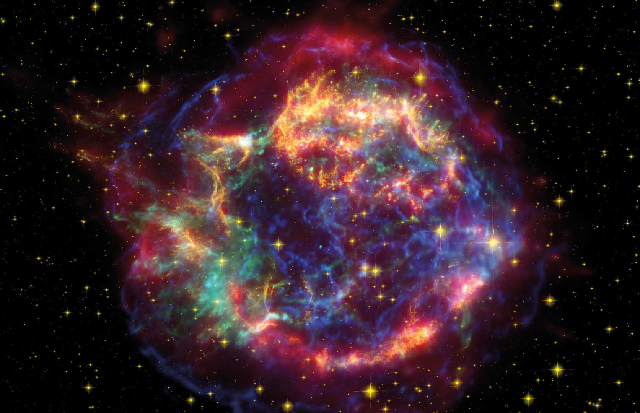
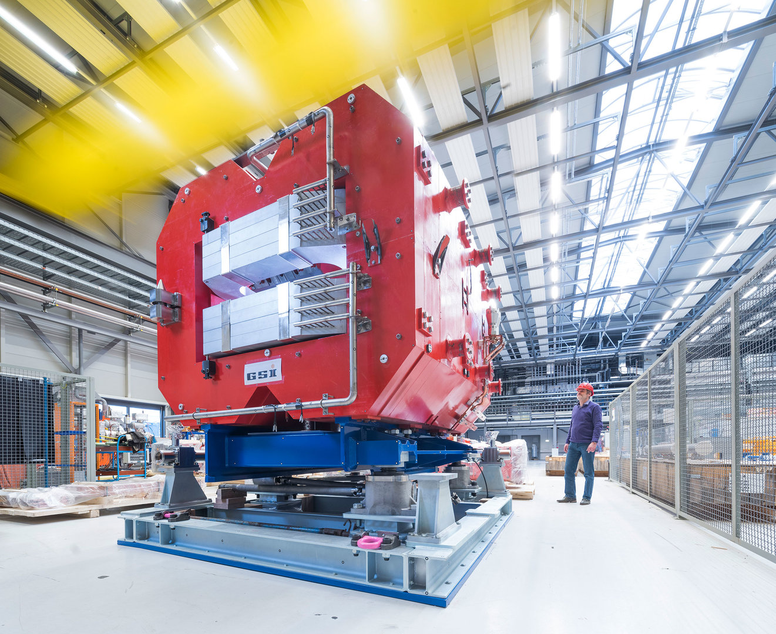
Overarching physics case: the creation of the (heavy) chemical elements
Big physics question requiring information on:
Equation of State
Limits of existence
Lifetimes
Masses
P_{xn} values
Fission
Reactions in star environments
with theory support for impact
Low energy reactions (ESR, CRYRING) ?

Slide 31
Start of FAIR: First NUSTAR experiment
Main aim to show that FAIR is running
Need to be published fast
Low risk (follows directly from SuperFRS commissioning)
Use some new capability:
secondary beam intensity
from primary beam
from transmission
higher beam energy (> 1GeV/u)
higher SuperFRS transmission
equipment
Lessons from FRIB (and RIKEN)?
.: May 2022 first exp
First publications:
PRL on new lifetimes N>28 (published Nov. 2022)
PRL on unexpected isomer 32Na (June 2023)
PRL on new isotopes 198Pt beam (Feb. 2024;
exp Feb. 2023)

Slide 32
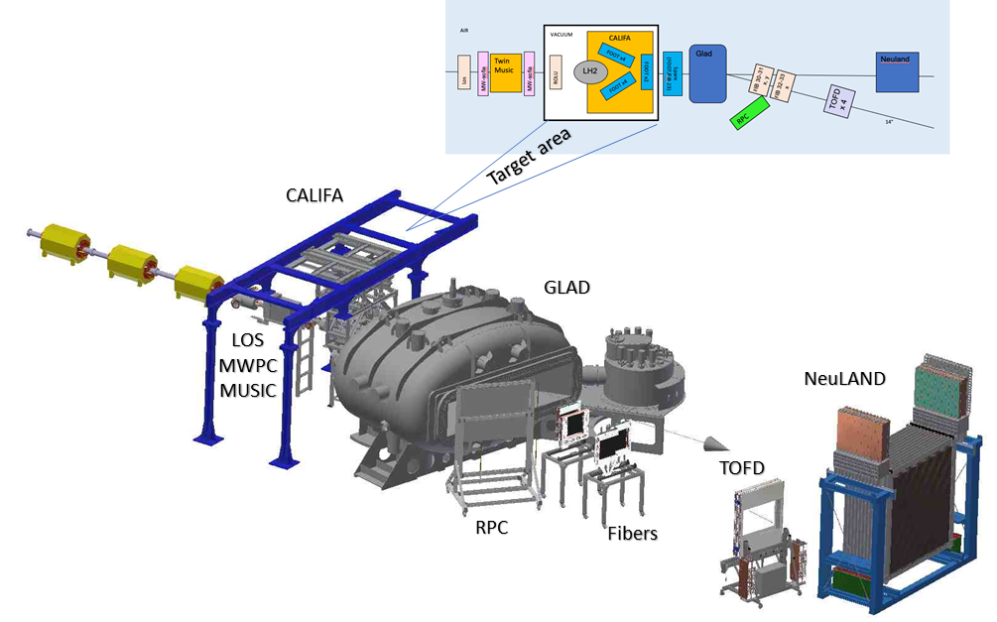
First experiment
R³B setup in the high-energy cave
Focusing on:
- neutron skin measurements
- fission
It needs commissioning in the high-energy cave.
(EDAQ coupling)
Notes:
Needs commissioning (many things can be done before in Cave C):
-new tracker recoil detector; -new proton arm spectrometer; -new vacuum system for TOF wall; -new fibre tracker; Major improvement: longer TOF=> higher mass; also better angular resolution
Supper FRS: main gain in medium-heavy Ca-Sn

Slide 33
Major improvements
Super-FRS transmission
Maximum gain for light to medium-heavy nuclei
Cleaner beams
R3B
longer TOF => identification to high mass
better angular resolution
Unique
no other place with high energy fragmentation beam

Slide 34

Neutron skin, polarizability
Most precise constraints on the neutron pressure around saturation density from measurements of neutron skins and dipole polarizabilities
Relatively low ²³⁸U intensity
needed,
enough for ~ ¹³²Sn
Elastic scattering
Neutron removal
Isotope shift
Important for
understanding
neutron stars

Slide 35
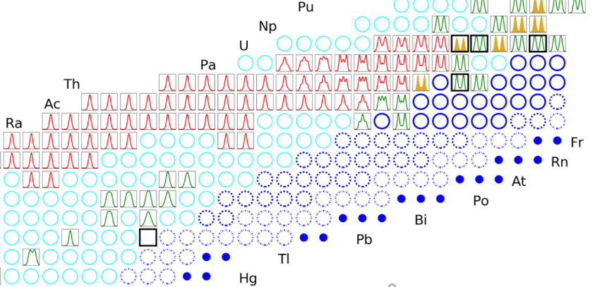
Fission
Important for r process
measured Z (red) and A (green) fission yields in actinides and pre- actinides together with the neutron-rich (dark blue circles and dots) and other nuclei (light blue circles) that can be investigated at FAIR

Slide 36
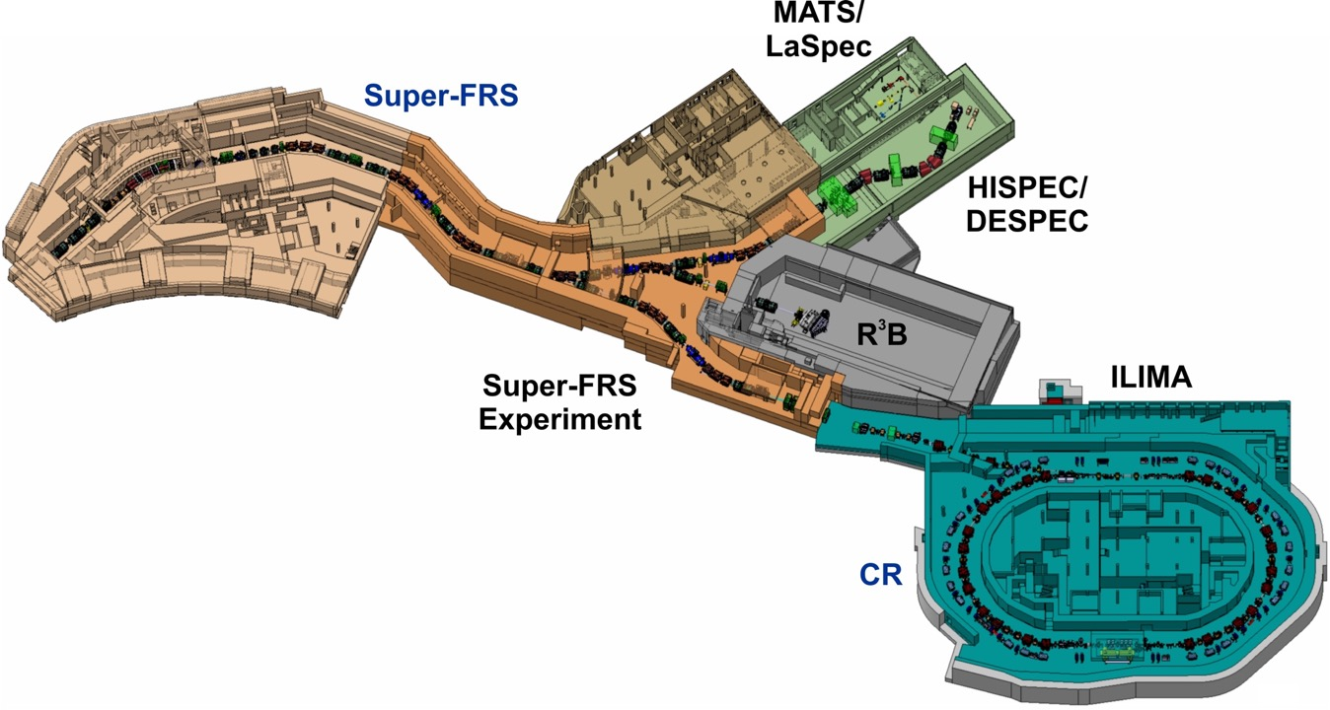
Experiment locations at Super-FRS:
ES and FS
Early Science
(with SuperFRS)
end of 2027 ->
First Science
(+ SIS100)
End of 2028 ->
FHF1
FHF2
FMF2
FHF1: Compact setups (DESPEC and SuperFRS-EC
FHF2: R3B in HEC

Slide 37
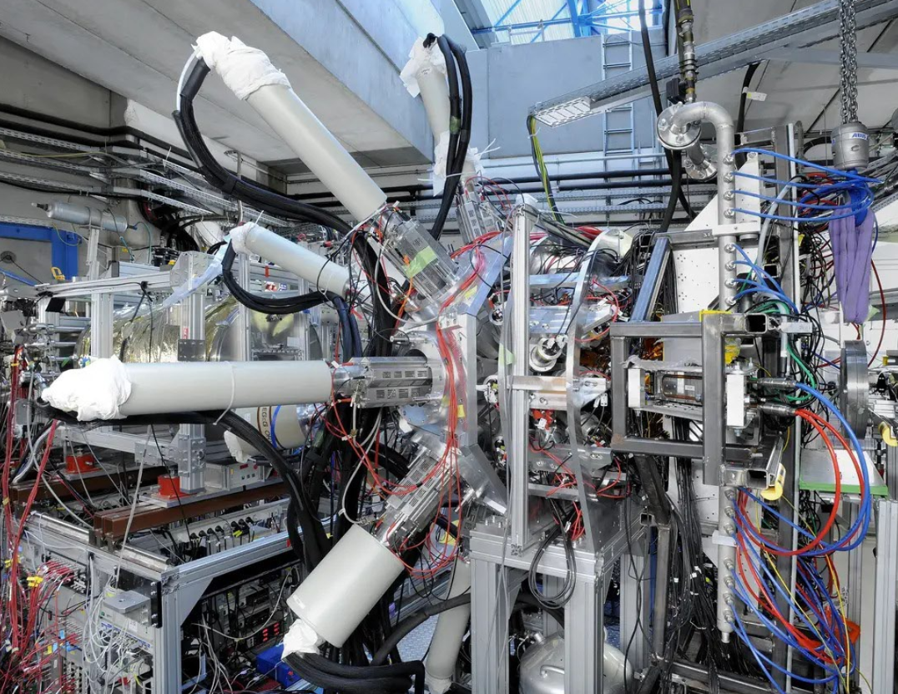
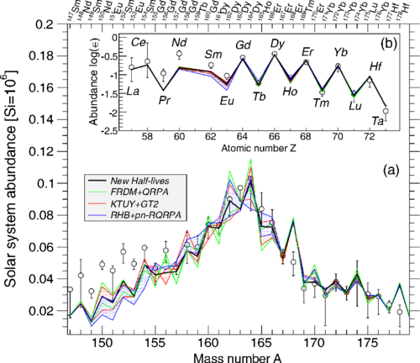
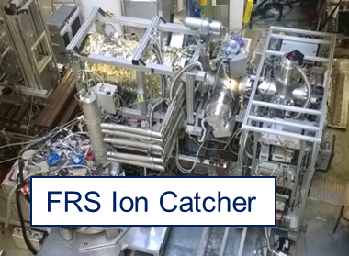
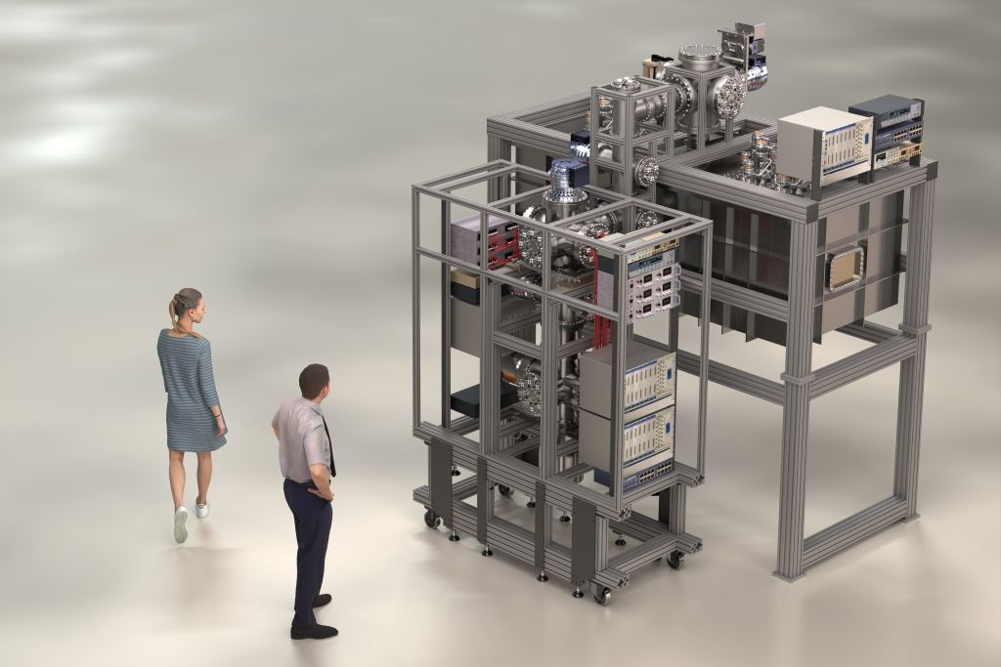
Physics in the SuperFRS tunnel
Production of exotic neutron-rich isotopes
Measurement of their beta-decay lifetimes
Measurement of their masses
Astro impact, based on theory
Decay setup
SuperFRS Ion Catcher
Notes:
New ion catcher is being built, commissioning at FRS is not planned; off-line commissioning planned for mid 2027

Slide 38
Planning
R3B setup
-will be moved from Cave C to High-energy cave
-GLAD magnet to be moved starting Q4 of 2026
Decay setup being finalised
-Implantation and decay detector
Si and segmented plastic options
-Ge detectors
SuperFRS Ion Catcher
-new, improved compared to the existing one
-offline commissioning summer 2027

Slide 39
Long term:
Report from the Committee for First-Science and Staging Review of the FAIR Project Submitted to FAIR Council, October 2022 (Heuer/Tribble report)
The committee came unanimously to the following recommendations in order to advance FAIR to science beyond Phase-0:
• First priority should be the completion of the S-FRS into the HEB cave for NUSTAR to
carry out the Early Science program.
• Completion of SIS100 needs to have the next highest priority.
• If resources are tightly constrained, completing SIS100 with beams into the S-FRS and
HEB cave, plus setting up and commissioning the CBM experiment offers an
intermediate solution for developing world-class science at FAIR.
• Completing the infrastructure and instrumenting the APPA cave should have priority
over instrumenting the additional area in LEB for NUSTAR.
• Tendering for civil construction of the West lot should be postponed, but a plan is needed for the time frame to implement PANDA.
Funded
Funded
On its way
We need to prepare
The Early Science program (SIS18 to S-FRS) is a significant step towards starting of
commissioning and starting up of the FAIR facility, but it does not in itself offer scientifically a world-leading discovery opportunity for FAIR.

Slide 40
Notes:
3 Oct. Germany unification day

Slide 41
Conclusions
Experiments running at FRS
new G-PAC for 2026-2027
new components to be commissioned
Eearly Science (with SuperFRS)
increased transmission; better detection systems
from end of 2027
First “full glory” experiment
in high-energy cave
+ Super-FRS tunnel
First Science (with SIS100)
increased primary beam intensity
from end of 2028

