Slide 1




Left Versus Right: A High Precision Determination of the Weak Mixing Angle at the P2 Experiment at MESA
+
Frank Maas,
Helmholtz-Institut Mainz, GSI, and JGU
GSI Kolloquium, January 21, 2025

Slide 2
Outline
Search for new physics beyond the standard model: Weak mixing angle
Experimental Method (partity violating electron scattering)
MESA accelerator
P2-Experiment (proton weak charge measurement) at MESA

Slide 3
Search for new physics beyond the standard model: Weak mixing angle

Slide 4
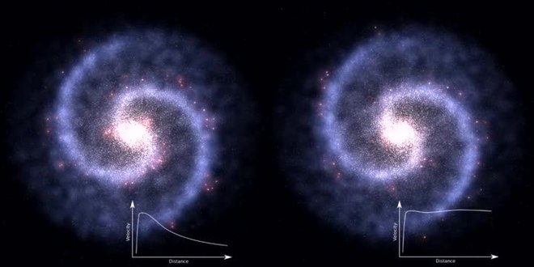
Dark Matter
Numerous astronomical observations
There is matter missing
Matter which does not interact
Only Gravitation
Observations by astronomer
Rotation velocity in galaxies
Velocity according
to visible matter
Velocity measured
radius
radius

Slide 5
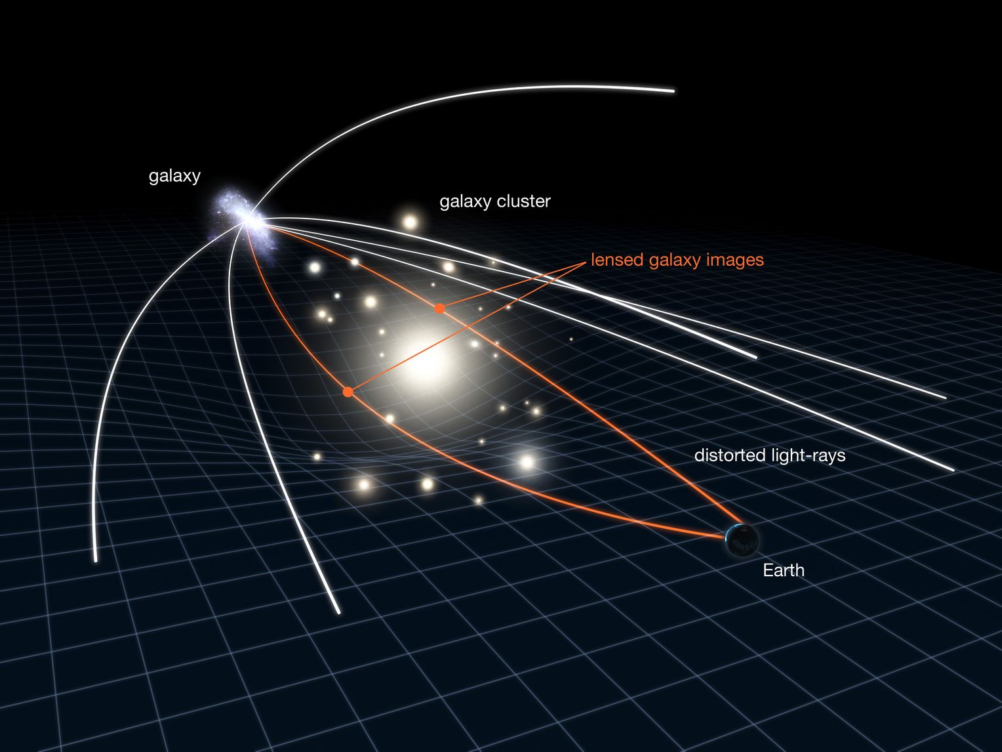
Dark Matter
Gravitational lensing

Slide 6
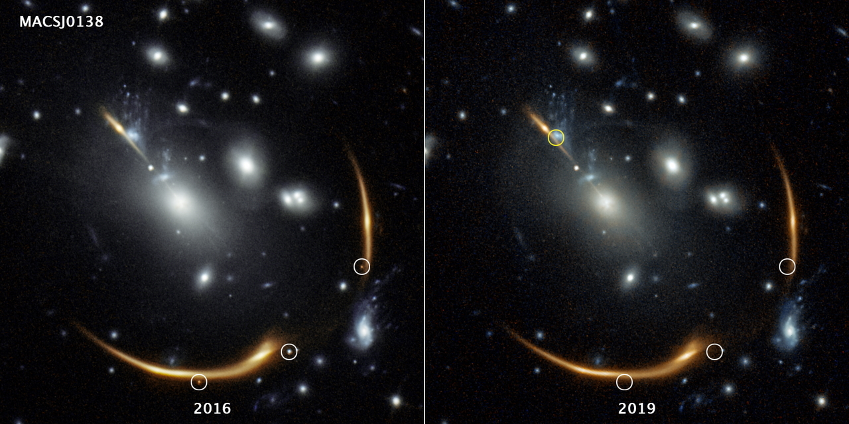
Dark Matter
Gravitational lensing by Dark Matter
Noumerous astronomical observations
There is matter missing
Matter which does not interact
Only Gravitation
Observations by astronomers
Dark Matter
Image of Galaxy
Expected supernova image in 2037
Additional Image
of Galaxy
Observed supernova images in 2016
Additional Image
of Galaxy

Slide 7
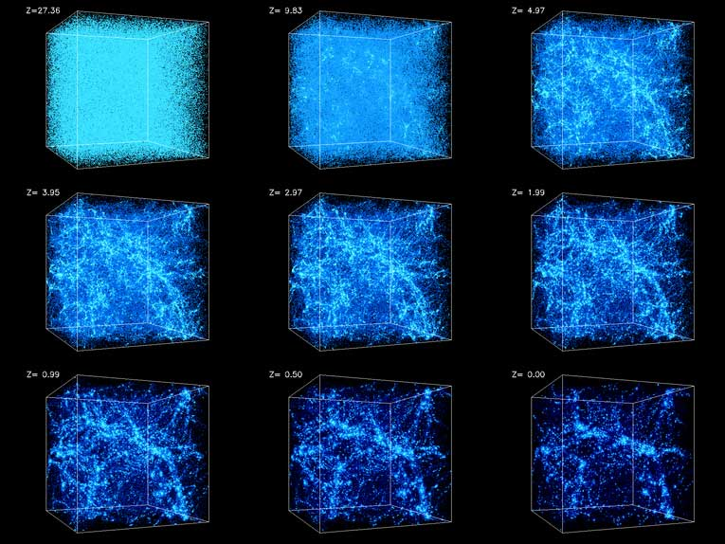
Structure formation in the universe
Structure formation since the big bang
Including Dark Matter helps forming the structures we observe today

Slide 8
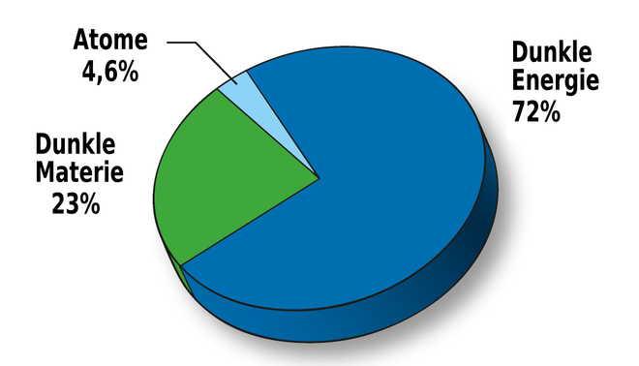
Atoms including Neutrinos: 4,6%
Dark Energy
Neutrinos: 72 %
Dark Matter
Neutrinos: 23 %

Slide 9
Search for physics beyond the standard model
Direct: High Energy (LHC)
Direct production of new particles
Indirect: High Precision
Modification of Observables
by quantum corrections of new physics particles
Anom. Mag. Moment
(g-2)_{µ,e} , EDM, sin² θ_{W}, …
Indirect: High Intensity
Forbidden decays by
Rare B-decays
at low energy
accurate theory needed

Slide 10
Search for physics beyond the standard model
Direct: High Energy (LHC)
Direct production of new particles
Indirect: High Precision
Modification of Observables
by quantum corrections of new physics particles
Anom. Mag. Moment
(g-2)_{µ,e} , EDM, sin² θ_{W}, …
Indirect: High Intensity
Forbidden decays
Rare B-decays
at low energy
accurate theory needed
V-A coupling,
Parity violating
Vector coupling,
Parity conserving

Slide 11
Measure an observable which can be measured precisesly: Weak mixing angle
Observable is modified by Standard Model quantum corrections
Need a very precise theory: Weak mixing angle
If there is new physics: the new physics particles contribute to the quantum corrections
Comparision between the precision theory observable and precision experiment
If we find a deviation between theory and experiemnt: we found an indication for new physics

Slide 12

Hans Christian Andersen:
„Physics beyond the standard Model“
Aka:
The Princess and the Pea
Detector
Nature
Weak Interaction
New Interaction or new particles (BSM)
Aka:
The Princess and the Pea

Slide 13
Direct observation versus precision measurements:
top-quark, Higgs
The last particles of the standard model have been seen in indirect searches before their direct production

Slide 14
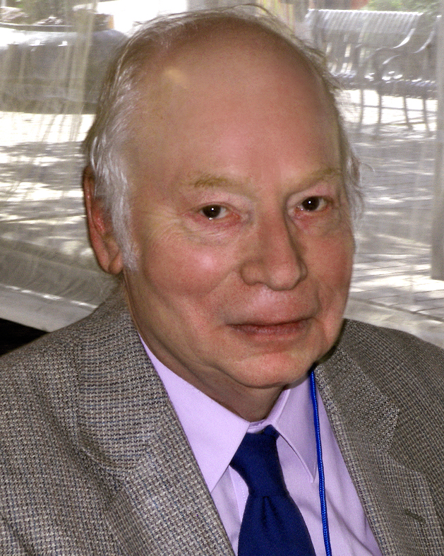
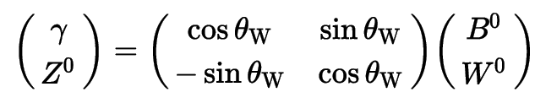
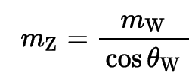

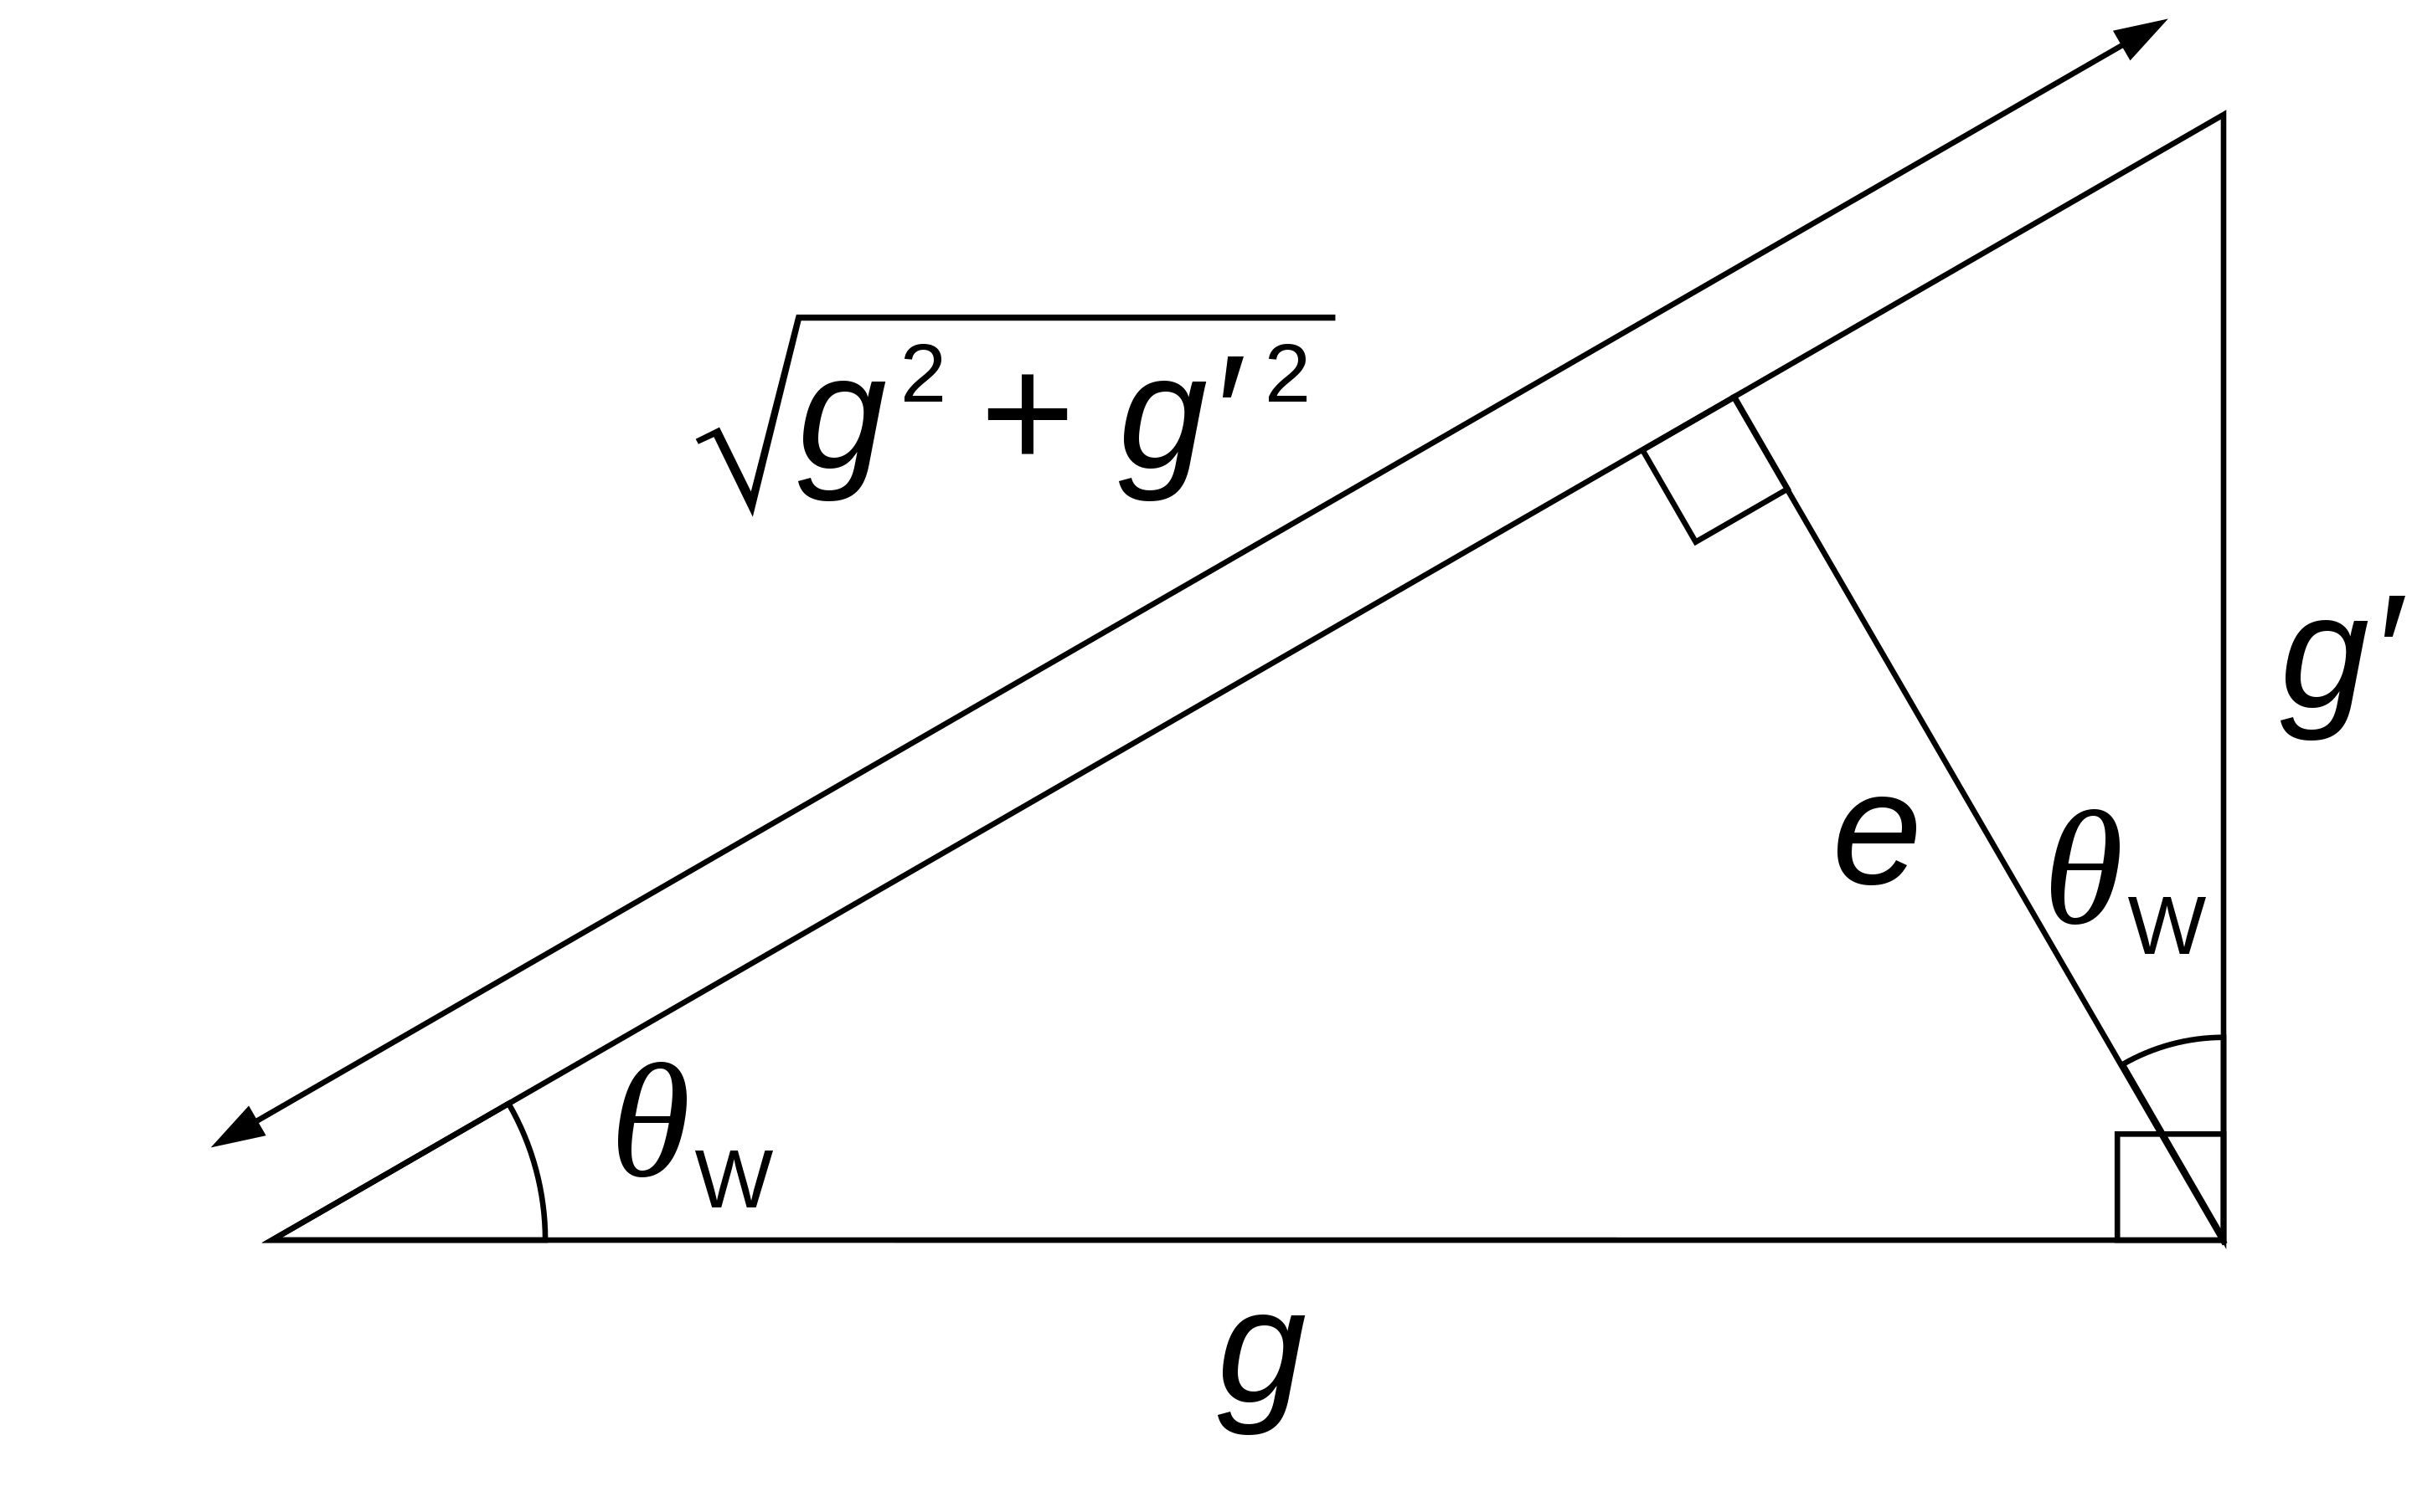
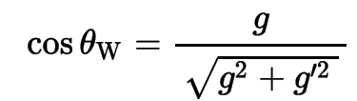
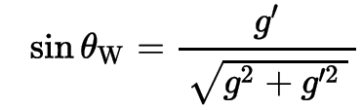

The role of the weak mixing angle
Key parameter in Electroweak sector of the Standard Model
Parametrizes the mixing between electro-magneti force and weak force
Steven Weinberg
Relates electromagnetic charge to weak charge

Slide 15
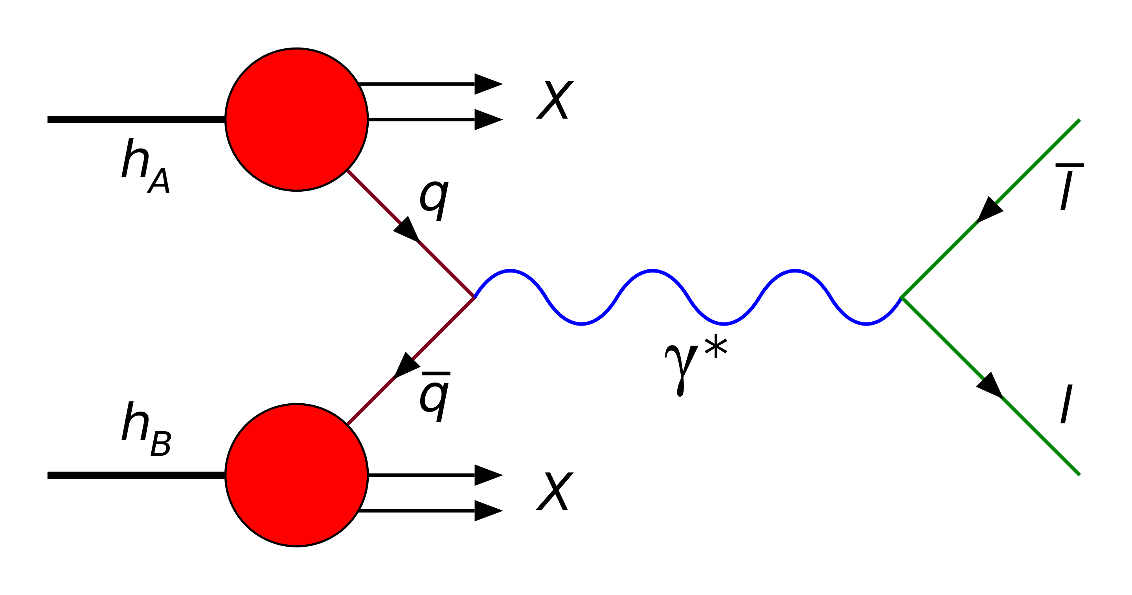
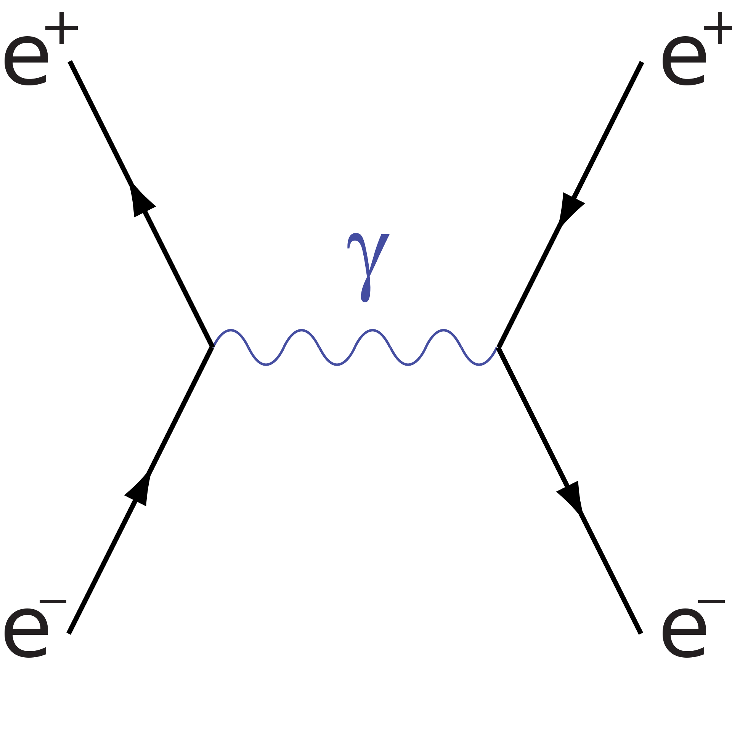
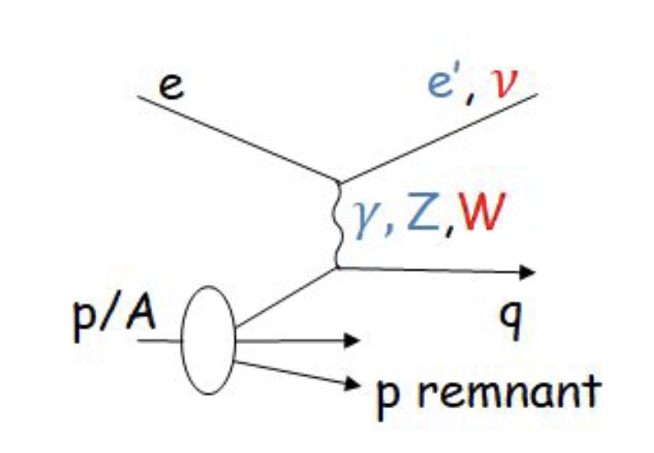

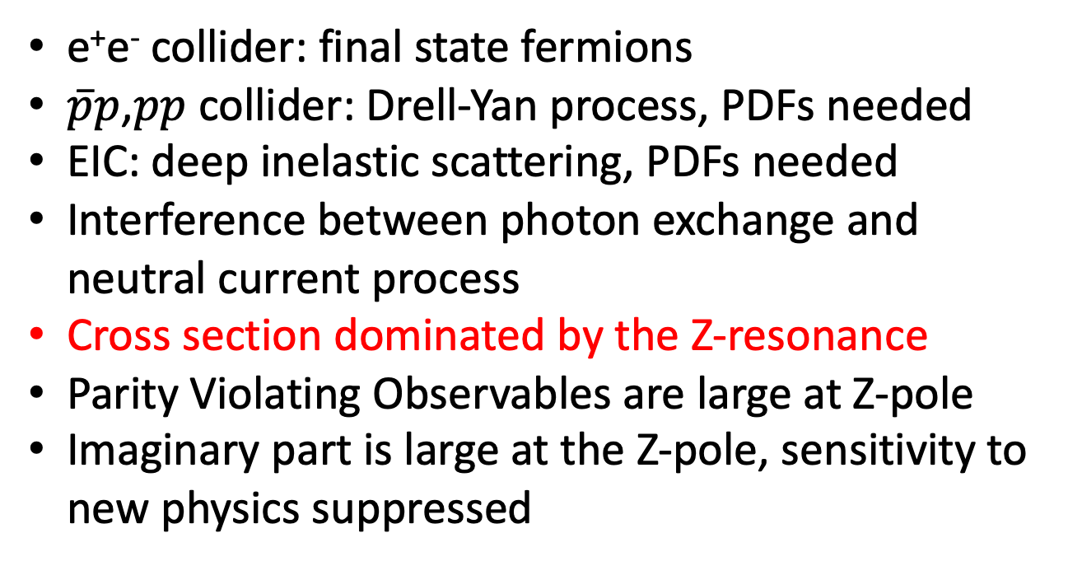



Access to the weak mixing angle at high energy
$$\overline{f}$$
$$\overline{f}$$
Z^{0*}
Z^{0*}
$$f$$
$$f$$
e⁺e⁻ collider: final state fermions
$\overline{p}p$,$pp$ collider: Drell-Yan process, PDFs needed
EIC: deep inelastic scattering, PDFs needed
Interference between photon exchange and neutral current process
Cross section dominated by the Z-resonance
Parity Violating Observables are large at Z-pole
Imaginary part is large at the Z-pole, sensitivity to new physics suppressed
*

Slide 16
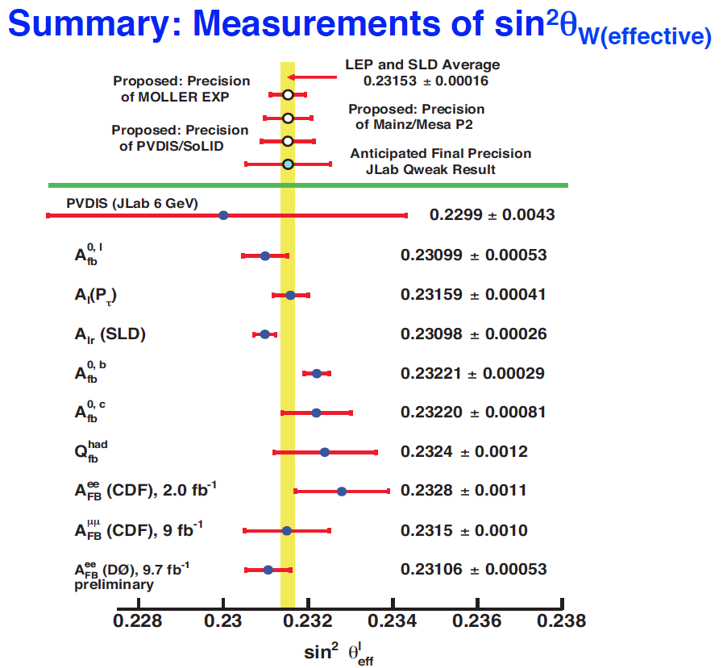
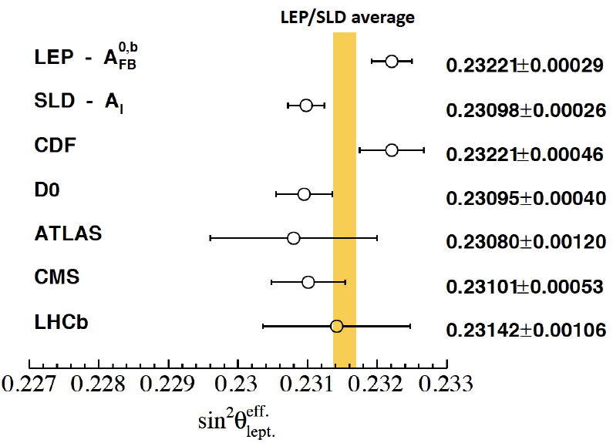


Access to the weak mixing angle at high energy (Z-pole)
e⁺e⁻
$$\overline{p}p$$
$$pp$$

Slide 17
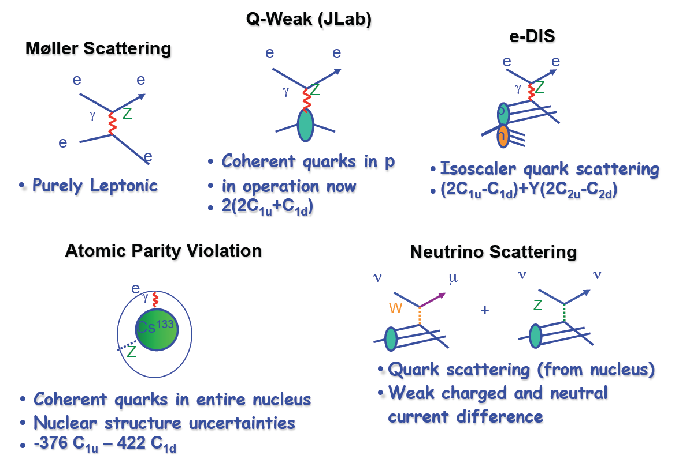
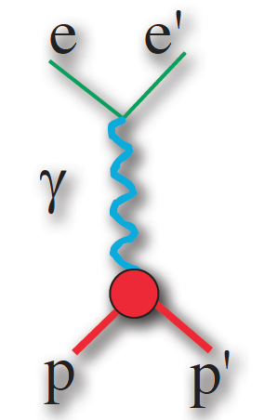
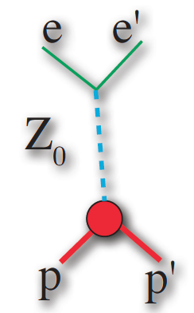
Access to the weak mixing angle at low energy
P2 (MESA/Mainz)
MOLLER (Jlab)
SOLID (Jlab)
Interference between electromagnetic and weak neutral current amplitude: Parity violating asymmetries
Yb,Dy,Sm (HIM/Mainz)
Coherent Neutrino Scattering
Cross section measurements

Slide 18
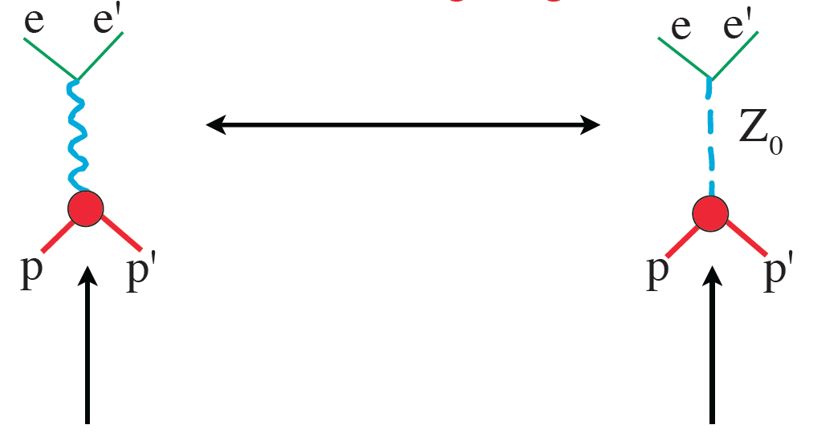
The role of the weak mixing angle
The relative strength between the weak and electromagnetic interaction is determined by the weak mixing angle: sin²(θ_{W})
Q_{e}(p) = +e
electric charge of the proton
Q_{W}(p) = 1 – 4 sin² θ_{W}
weak charge of the proton
Q_{W}(n) = - 1
sin² θ_{W}: a central parameter of the standard model accessible through the weak charge

Slide 19
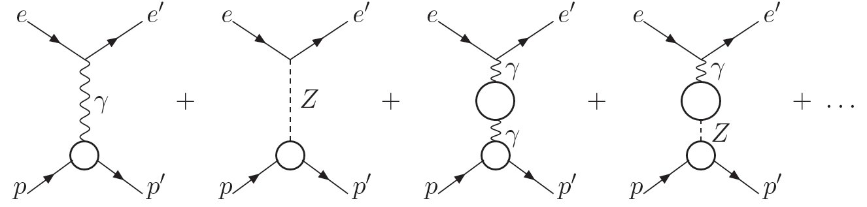
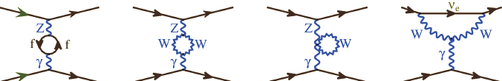
Precision measurements and quantum corrections:
running α
running sin² θ_{W}(µ)
(P2)
Universal quantum corrections: can be absorbed into a
scale dependent, „running“ sin² θ_{eff} or sin² θ_{W}(µ)

Slide 20
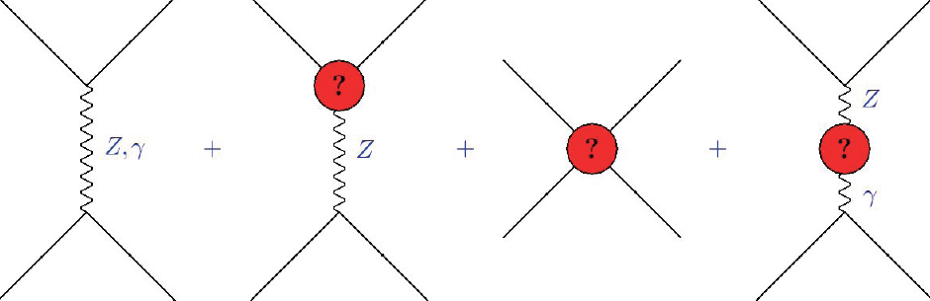
Sensitivity to new physics beyond the Standard Model
Mixing with
Dark photon or
Dark Z
New
Fermions
Extra Z
Contact interaction

Slide 21
Measurements of the weak mixing angle

Slide 22

Running of the weak mixing angle
3 %
On the Z-resonance A_{Z} imaginary and very large,
largely reduced sensitivity to new physics

Slide 23
Adam Falkowski at Mainz MITP workshop: Impact on low energy measurements

Slide 24
Constraints from PVES at MESA
Quark-vector-electron-axial vector couplings
Sensitivity down to masses of 70 MeV and up to masses of 50 TeV

Slide 25

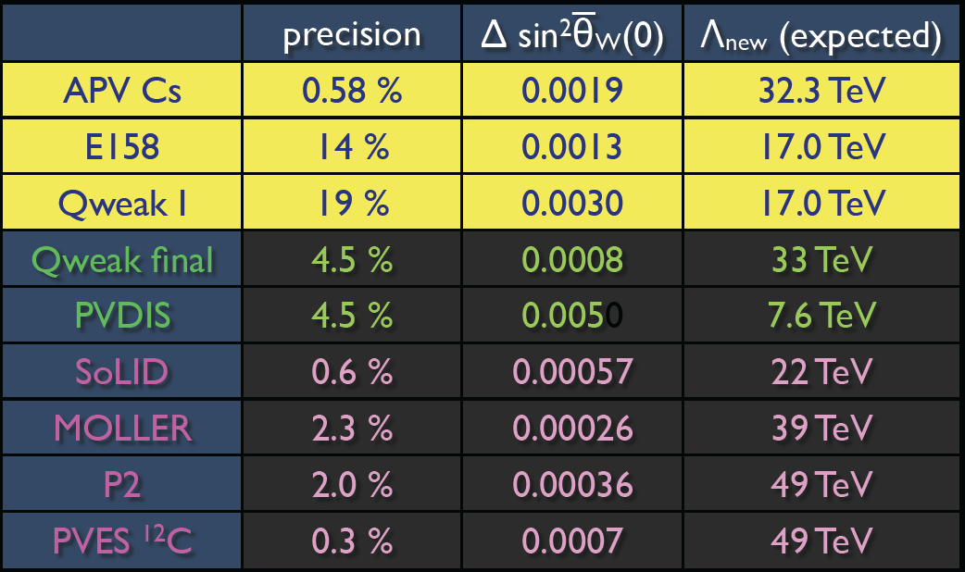
Effective field theory approach (EFT)
Jens Erler

Slide 26
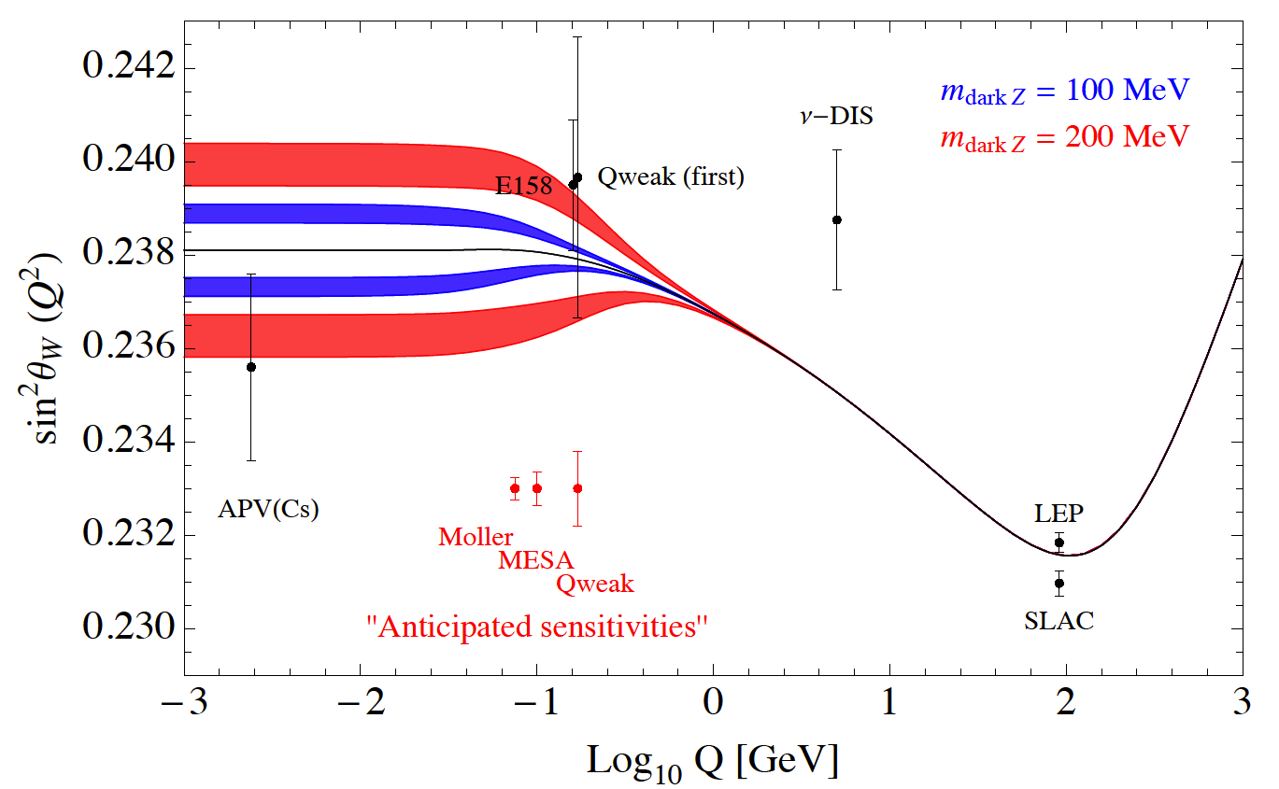
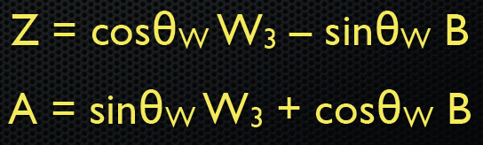
Running sin² θ_{W} and Dark Parity Violating Z
Bill Marciano

Slide 27
Three PV experiments with three different probes for new physics
Weak
Charge
Of
Proton:
Qweak (Jlab), P2 (MESA)
Weak
Charge
Of
Electron:
MOLLER
(JLAB)
Weak
Charge
Of
Quarks:
SOLID (PVDIS)
(JLAB)

Slide 28
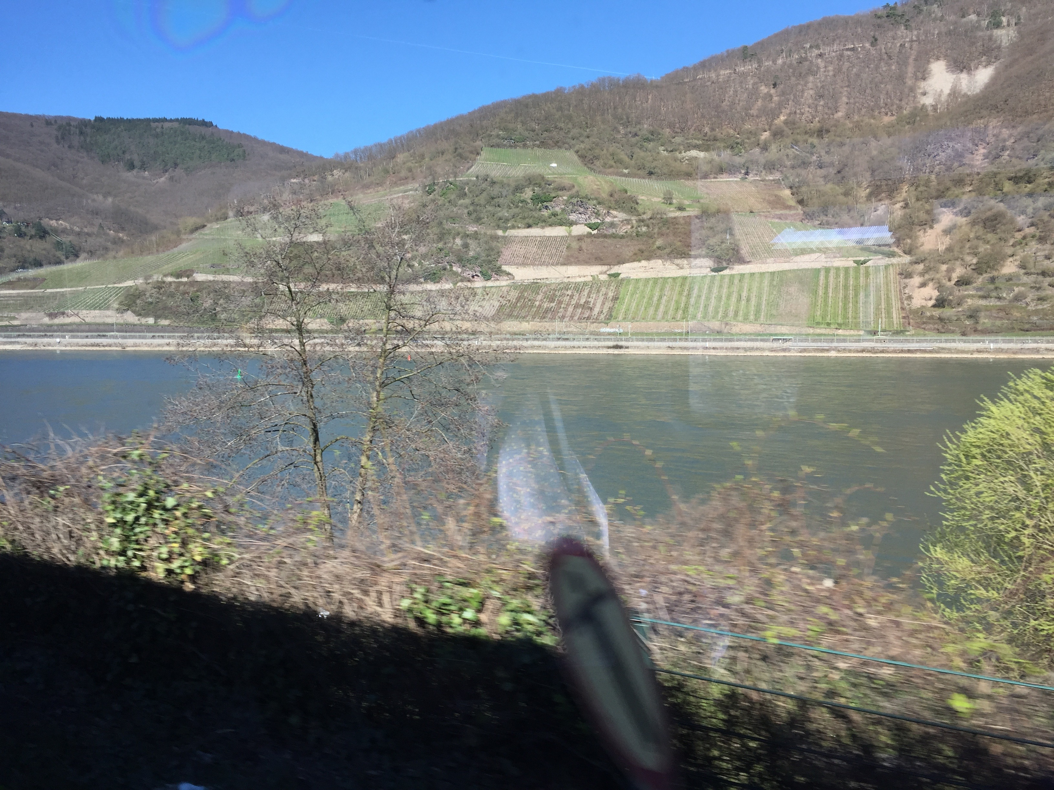
High energy value of the weak mixing angle: sin² θ_{W} = 0.231, θ_{W} = 28,7°
Low energy value of the weak mixing angle: sin² θ_{W} = 0.238, θ_{W} = 29,2°
θ_{W}
“Weinberg” German for vineyard
Around Mainz Vinyard angle θ_{W} = 29,2°

Slide 29
Outline
Experimental Method (partity violating electron scattering)

Slide 30
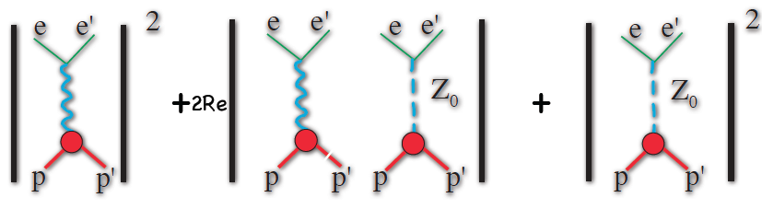
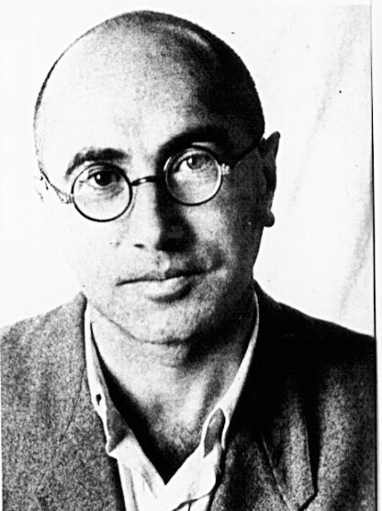
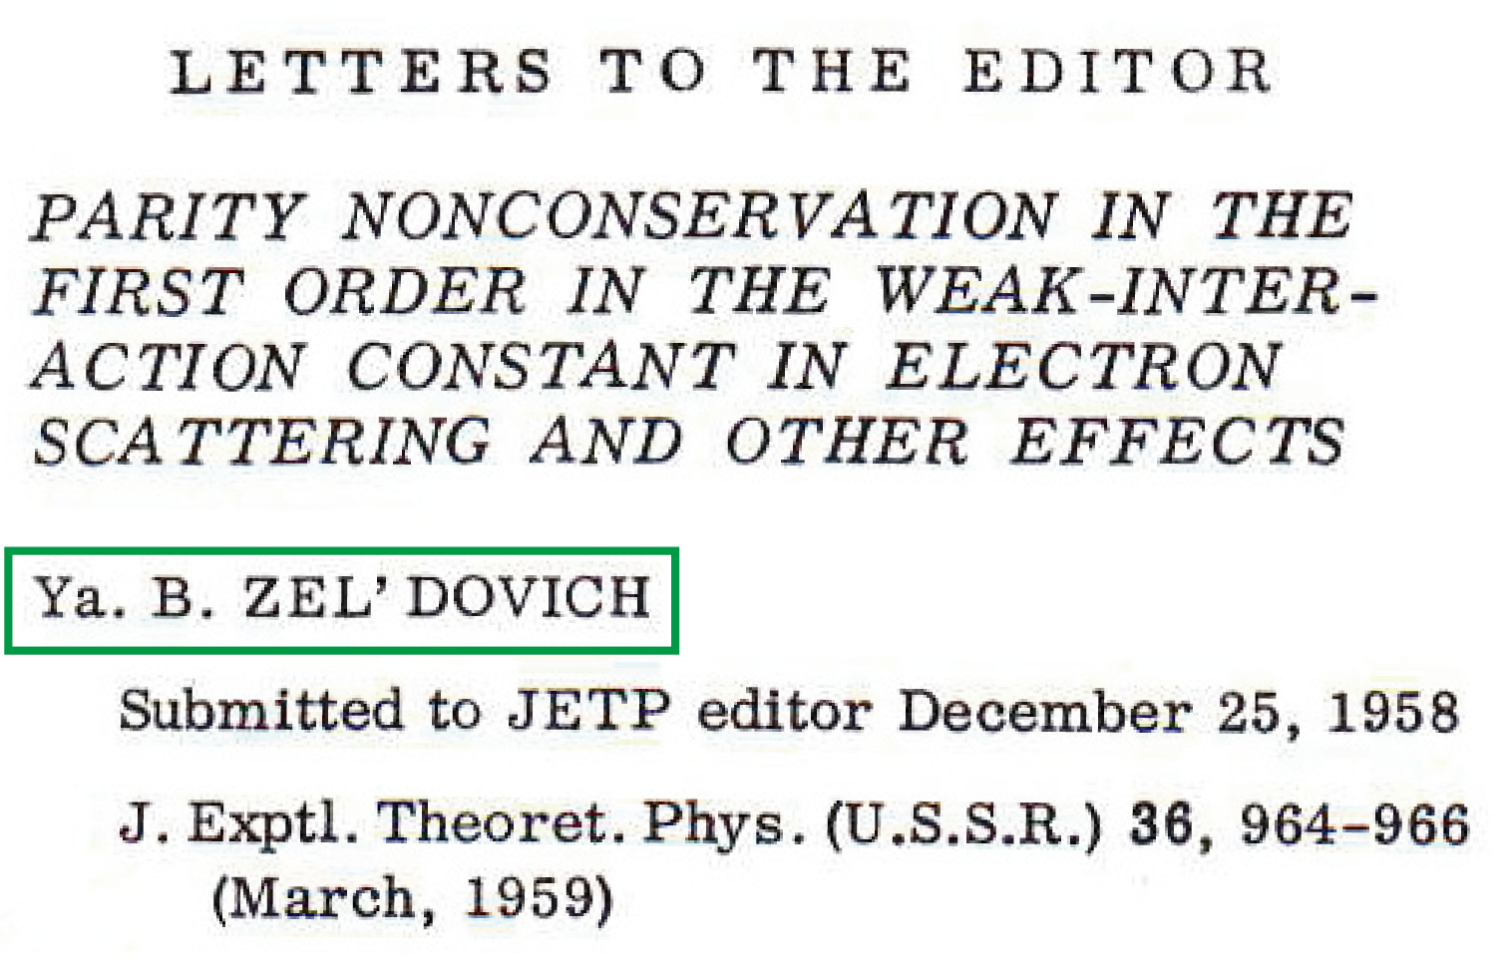
Parity Violating in elastic electron proton scattering
σ ≈

Slide 31
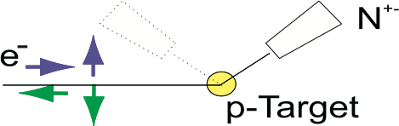
Parity Violating in elastic electron proton scattering
σ ≈
V-A coupling:
parity-violating
cross section asymmetry ALR
longitudinally pol. electrons
unpolarised protons
(V-A)_{e}(V-A)_{p}
A_{e}V_{p}+V_{e}A_{p}

Slide 32
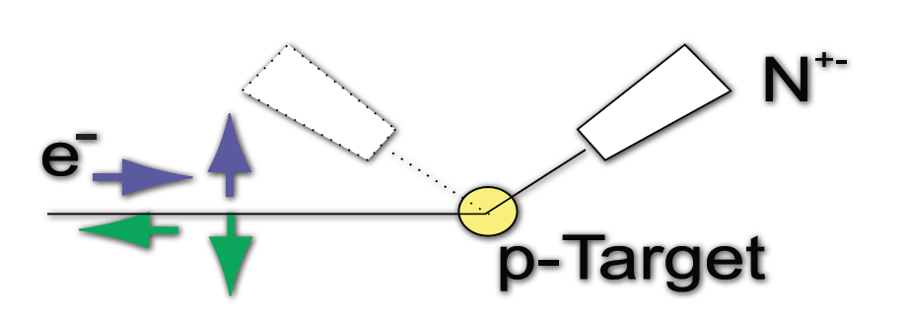
Parity Violating Electron Scattering (PVES)
Physics topics:
Electron spin longitudinal (PVES)
Weak vector charge of the proton
Weak axial form factor of the proton
Weak vector charge of the neutron (Carbon)
Neutron Skin of Ca and Lead (MREX)
Electron Spin transverse
Two photon exchange amplitude in elastic electron proton scattering
Two photon exchange amplitude in electron nucleus scattering
Conceptually very simple experiments
A = (N⁺-N⁻)/(N⁺+N⁻) ΔA = (N⁺+N⁻)^{-1/2} = N^{-1/2}
A = 20 x 10⁻⁹ 2% Measurement N = 6.25 x 10¹⁸ events
Highest rate, measure Q²: Large Solid Angle Spectrometers

Slide 33
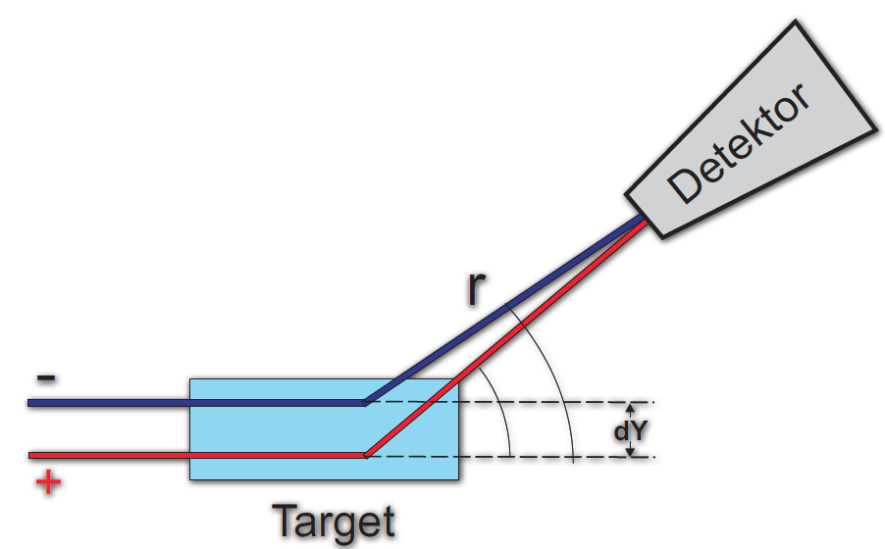
False (related to apparatus) asymmetries:
Extreme good control of beam and target
Flip Helicity fast
Extra spin flip

Slide 34
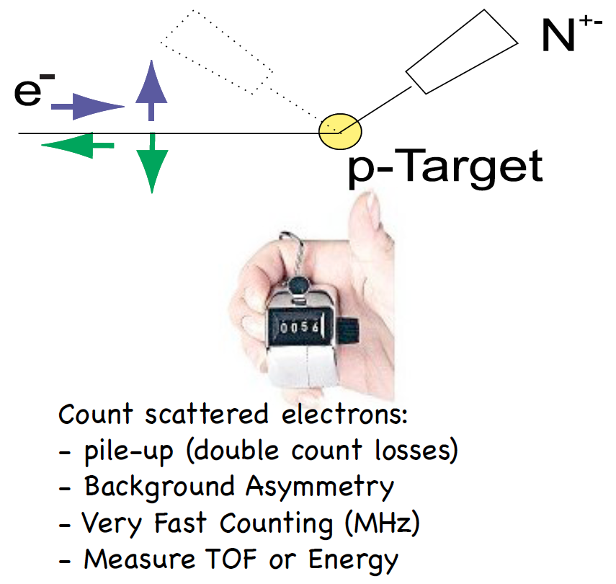
Counting Technique

Slide 35
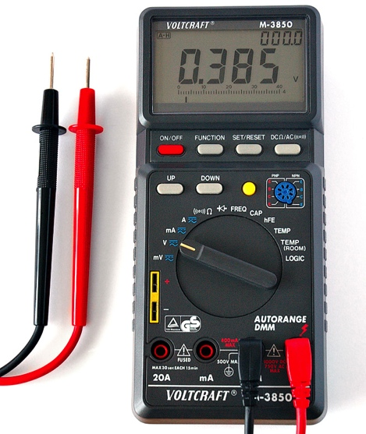
Analogue Technique
Measure Flux of Scattered electrons:
- no pile-up (double count losses)
- sensitive to small electr. fields.
- no separation of phys. process

Slide 36
Outline
MESA accelerator

Slide 37
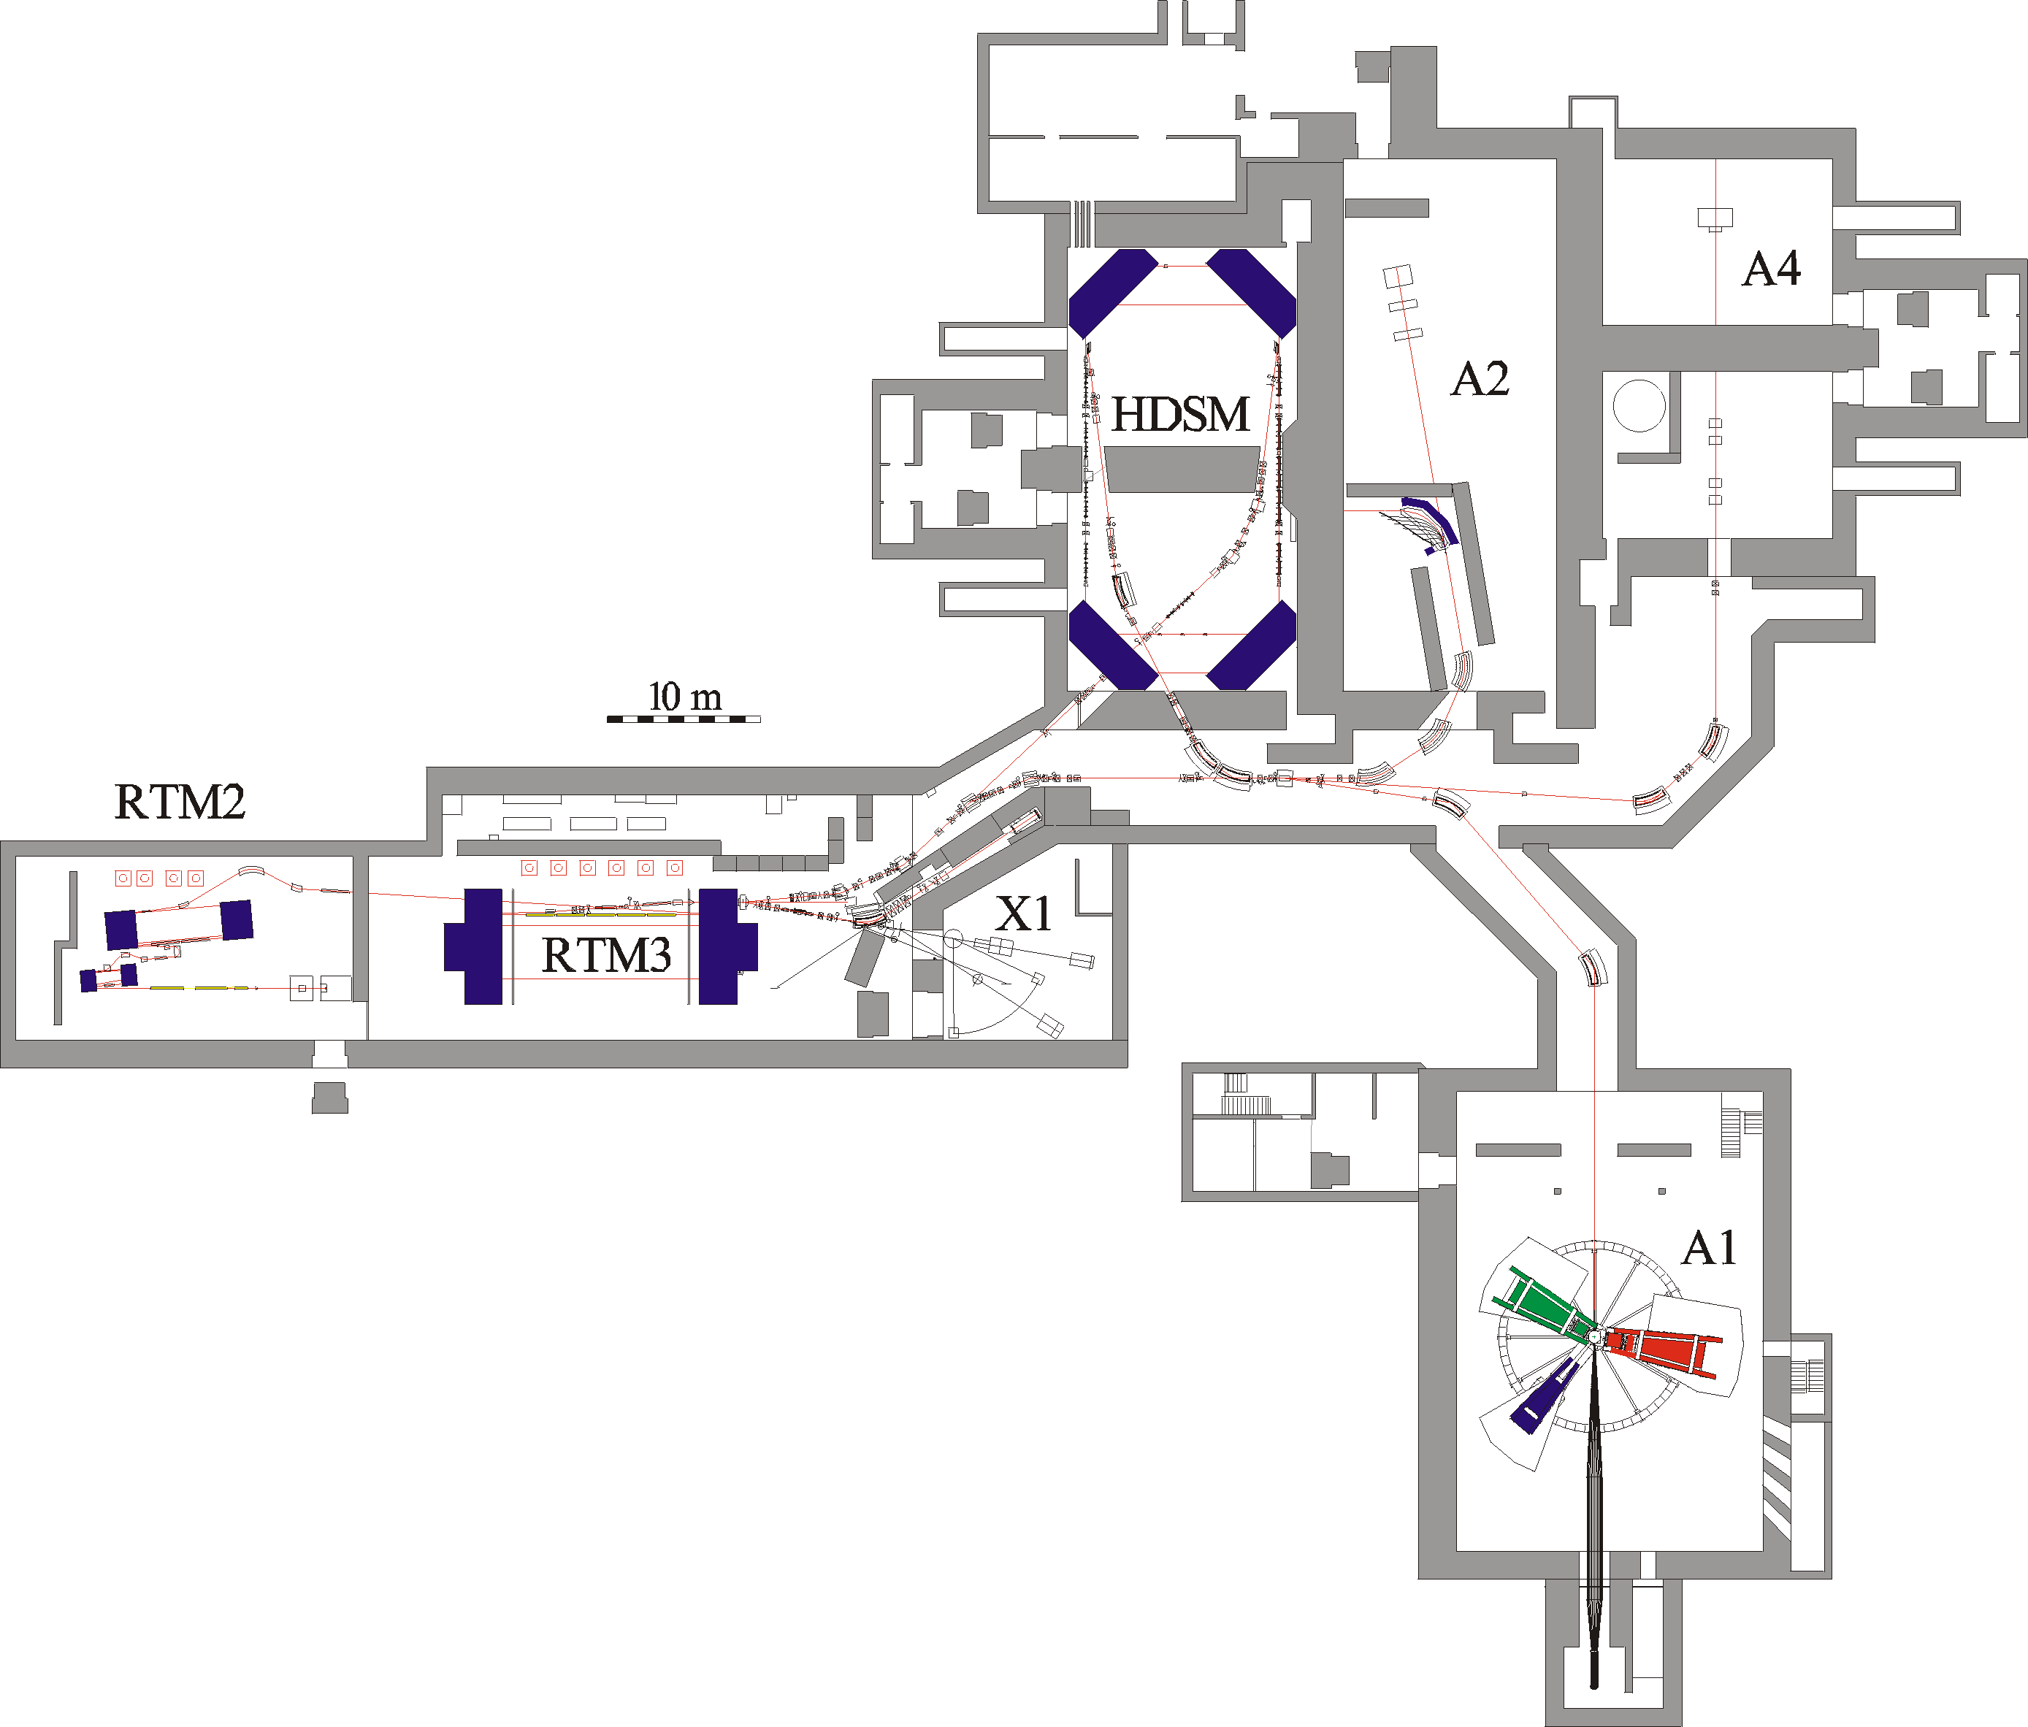
MAinz MIcrontron MAMI. Electron accelerator up to 1.6 GeV
High power beam dump
Electron Accelerator E_{max} =1.6 GeV (CW)
operated at JGU Mainz (Germany)
Hallmarks
Intensity max. 100 μA
Resolution σ_{E} < 0.100 MeV
Polarization 85%
Reliability: up to 7000 h / year
30 years of hadron physics
45 years of PVES
Experimental Hall
Shaft building
Previous parity violation electron scattering experiment: A4
Stopped data taking in 2010
EM calorimeter, fast online histogramming
Accelerator integral part of the experiment. Stabilisation of all beam parameters.
Strangeness contribution to nucleon structure: „strangeness form factors“
Nuclear targets for background subtraction
Two-Photon Amplitude
MAMI continues operation separately from MESA construction or operation
MESA takes over low energy experiments (E<200 MeV)

Slide 38
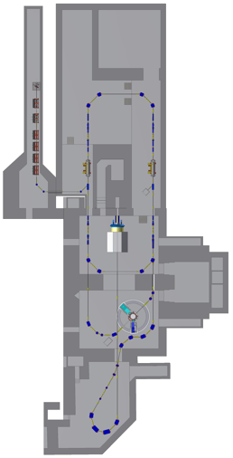
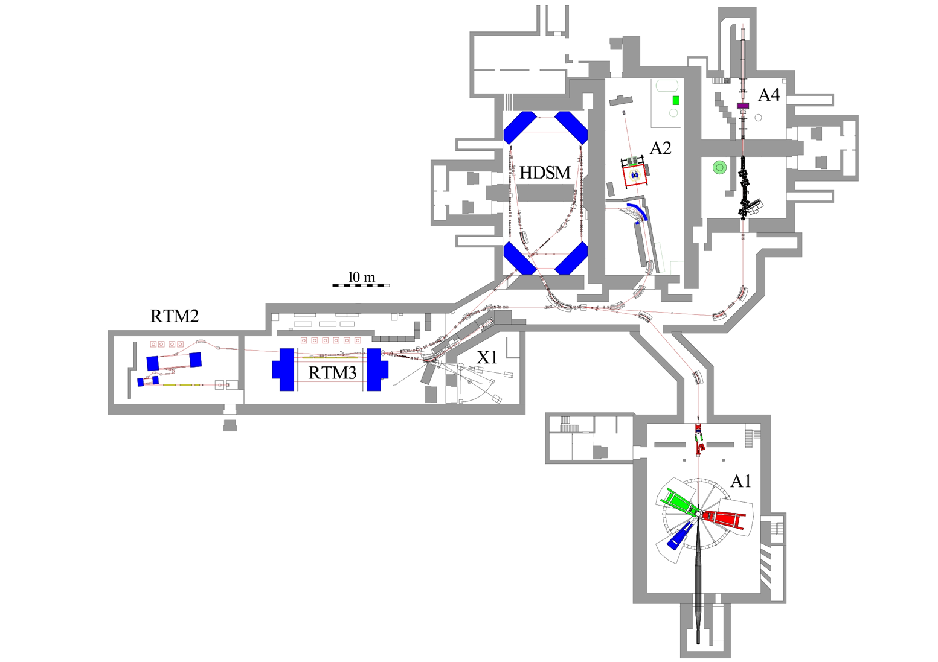
MAMI Electron accelerator
Electron Accelerator E_{max} =1.6 GeV (CW)
operated at JGU Mainz (Germany)
Hallmarks
Energy: 180 MeV up to 1.6 GeV
Intensity max. 100 μA
Resolution σ_{E} < 0.100 MeV
Polarization 85%
Reliability: up to 7000 h / year
MESA
Workshop to Explore Physics Opportunities
with Intense, Polarized Electron Beams up to 300 MeV :
Cambridge, MA, USA, March 14-16, 2013
Richard Milner(ed.),
Roger Carlini(ed.),
Frank Maas(ed.)
2013, AIP Conf.Proc. 1563 (2013) 1
MESA facility tailored to the
experimental program
Start Commissioning end of 2025
MAMI
Notes:
Very brief reminder: MAMI is a CW electron accelerator with a maximum beam energy of 1.6 GeV and with the world‘s highest ....
The accelerator consists of 4 stages of microtrons shown here on the left of the floorplan.
Mainly 3 experimental halls are served, here on the right, which are the .....

Slide 39

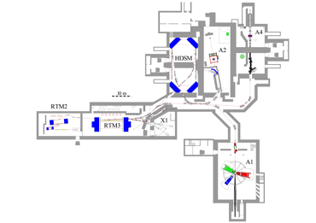
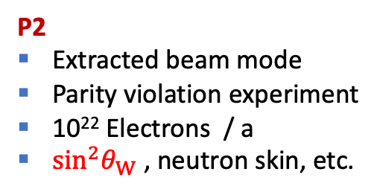
MESA experiments
DarkMESA
Beam dump experiment
Direct detection of light dark matter
PbF₂ and lead glass Cerenkov calorimeter
Staged approach
MAGIX experiment
Operated in ERL mode of MESA
Double-arm spectrometers
Internal gas target experiment
Gas jet target commissioned
at A1/MAMI already
Main components of MAGIX and P2 presently constructed in industry and assembled
in house (funding via major research instrumentation program of federal government)
P2
Extracted beam mode
Parity violation experiment
10²² Electrons / a
$\sin^{2}θ_{W}$ , neutron skin, etc.

Slide 40
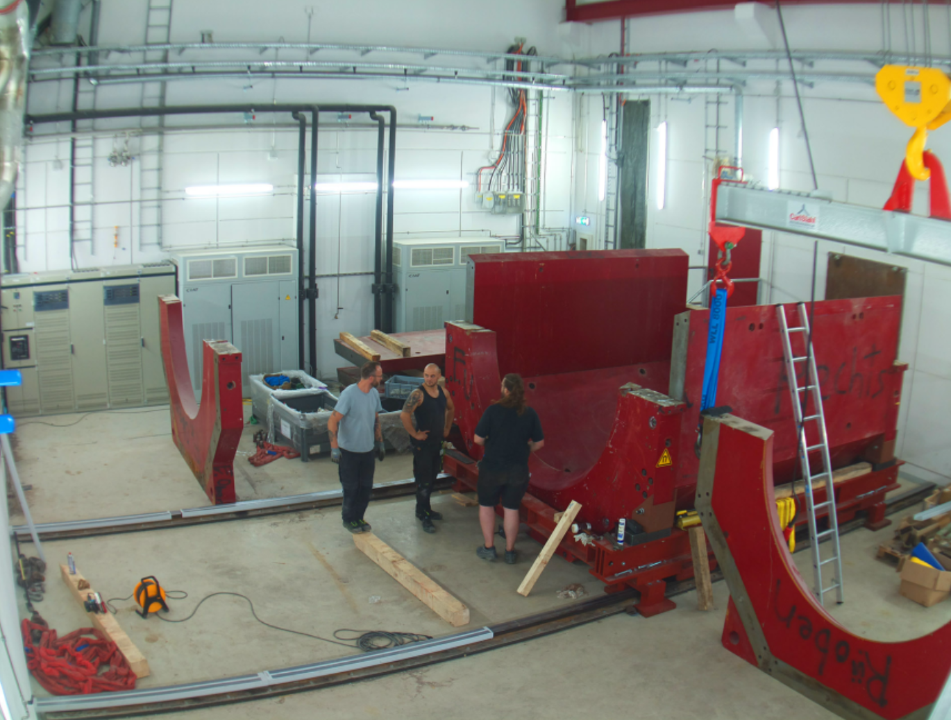
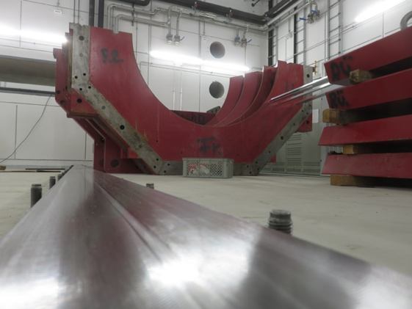
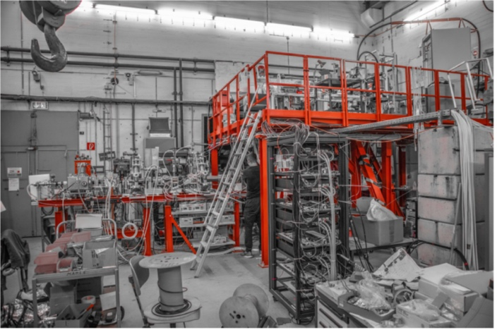
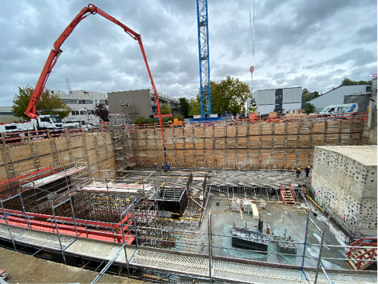
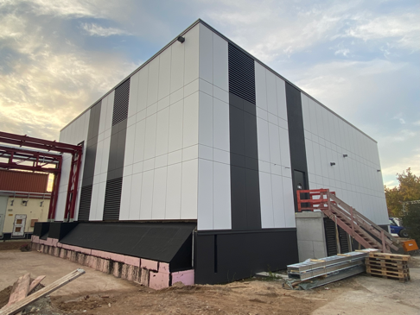
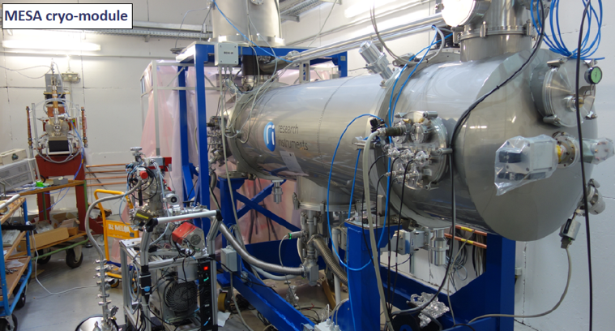
Mesa accelerator
Key parameters MESA:
Two operation modes: extracted beam (EB) or energy recovering (ERL)
Max. beam energy 155 MeV (EB), 105 MeV (ERL)
Beam current 150 µA (EB), 1 mA (ERL)
Superconducting cavities
Start commissioning 2024
New research building (par. 91b GG)
Can run in parallel to MAMI
Preparation of P2
Magnet
5 MeV
+25 MeV
Polarized Source Test Setup
+25 MeV
New underground experimental hall (par. 91b GG)
Oct. 20
Oct. 23
Cryomodules successfully
Tested and now installed
Notes:
In the last two minutes or so, I would like to present to you the status of the new MASA acelerator being in the final stage of construction
So, compared to MAMI, MESA will provide a beam energy an order .., but with beam intensities being an order of magnitude ...
You see here the floorplan of MESA with superconducting modules, the central elements of these

Slide 41
Outline
P2-Experiment (proton weak charge measurement) at MESA

Slide 42
P2:
Result of careful simulation process
Vera large acceptance
New concept of a solenoid for PVES
Optimization of scattering angle and acceptance for best accuracy

Slide 43
Parity Violation experiments need very high luminosity

Slide 44
P2 parity violation experiment in Mainz: program
Qweak@Jlab (2001-2018) | P2@MESA Hydrogen | P2@MESA Carbon | P2@MESA Calcium,Lead
A_{ep}=-226.5 ppb | A_{ep}=-28 ppb | A_{eC}= 416.3 ppb | A_{ePb}~ 700 ppb
𝛥A_{ep}= 9.3 ppb | 𝛥A_{ep}= 0.5 ppb ppb=1/√N Factor 19 After 11,000 h | 𝛥A_{ep}^{stat}= 2.7 ppb after 300 h 𝛥A_{ep}^{stat}= 0.9 ppb after 2500 h | MREX will improve the neutron skin thickness by a factor of two.
𝛥A_{ep}/A_{ep}= 4.2 % | 𝛥A_{ep}/A_{ep}= 1.8 % | 𝛥A_{ep}/A_{ep}^{stat}= 0.6 % (0.2 %) Polarimetry! | In addition measurements of transverse asymmetries
𝛥sin² 𝜃_{W}/sin² 𝜃_{W}= 0.46 % | 𝛥sin² 𝜃_{W}/sin² 𝜃_{W}= 0.15 % | 𝛥sin² 𝜃_{W}/sin² 𝜃_{W}= 0.6 % (0.3%) | Two-Photon exchange amplitude
 | Aux. measurem. backward angle | Aux. measurem. backward angle
Improvement by high luminosity, long measurement time, small systematics, lower Q²

Slide 45
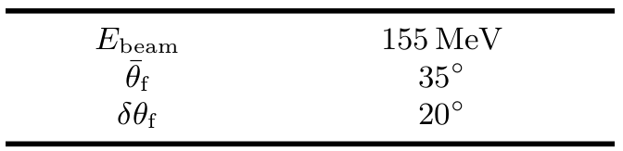
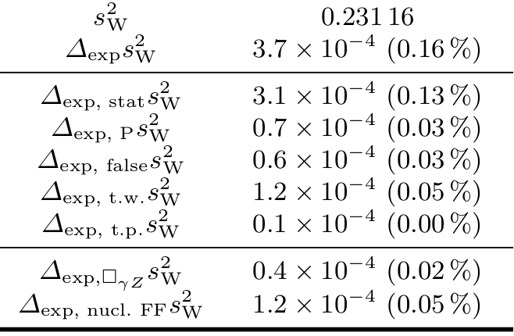
Achievable precision in sin²Θ_{W}
P2 Experiment
conditions

Slide 46
P2-experimental principle

Slide 47
P2-experimental principle

Slide 48
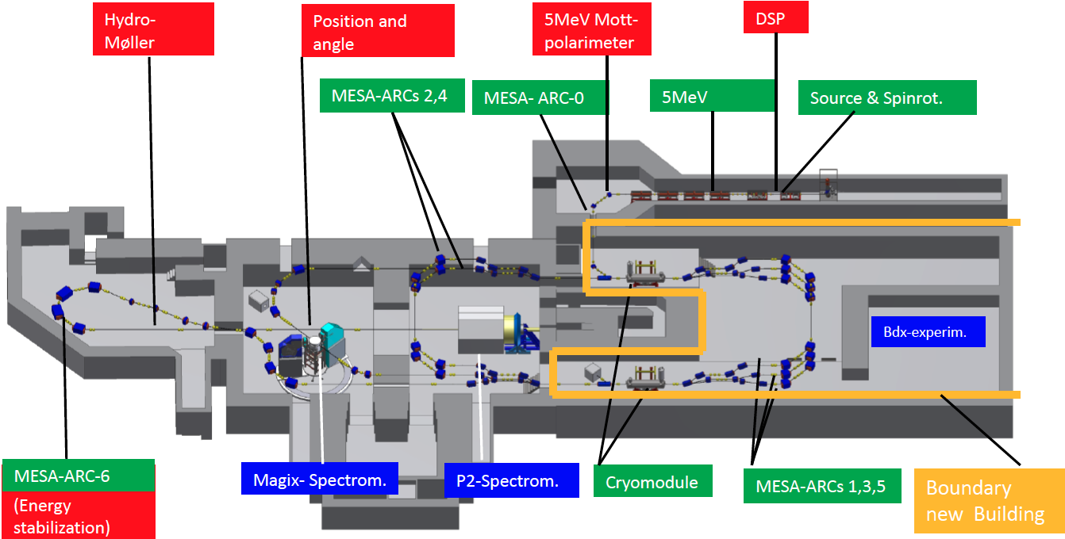







P2: Parity violating electron proton scattering
at MESA/Mainz
$A_{LR}^{exp}= \frac{σ\left(\vec{e}p\right)−σ\left(\overset{⃖}{e}p\right)}{σ\left(\vec{e}p\right)+σ\left(\overset{⃖}{e}p\right)}=−P \frac{G_{F}Q^{2}}{4\sqrt{2}πα} \left(Q_{W}\left(p\right)−F\left(Q^{2}\right)\right){+ A}_{F}$
False asymmetries: control of target and accelerator
Cross section asymmetry $A_{LR}^{exp}$
Beam polarisation $P$
Polarimetry
Low Beam Energy, Low Q2
Theory:
QED corrections
EW corrections (two loop)
Hadron structure $F\left(Q^{2}\right)$,
Strangeness form factors
Measure:
Axial form factor
Momentum transfer ${<Q}^{2}>$
Tracking system
Magnetic spectrometer
Cherenkov detector
Read-out electronics
Data acquisition

Slide 49
Optimization of PV Asymmetry measurement

Slide 50
P2-Detector response
Full GEANT4 simulation

Slide 51
P2-Detector response

Slide 52


Slide 53
P2-experimental principle

Slide 54

Integrating mode readout
Sampling ADC developed by U. Manitoba and TRIUMF
(Michael Gericke)
16 channel prototype for tests in Mainz

Slide 55


Slide 56


µPIX Tracking detector
Assembling and glueing
roboter
MuPix10 sensor

Slide 57


µPIX Tracking detector

Slide 58

µPIX Tracking forward detector
High resolution tracking for Q² measurement
Covers at least one fused silica detector
4 segments with 2 double layer detectors
50 µm HV-MAPS sensors
Resolution for track momentum ~ 2 MeV/c

Slide 59

Refrigerator for Hydrogen Target
Compressors are already commissioned

Slide 60

Backward Tracking Detector
Use 3 planes of Micromegas detectors
Position measurement with detector
  Determine momentum and vertex
18 detector modules with 1280 channels each
Cooperation with CEA Saclay

Slide 61

Fused Silica Tcherenkov Detector
Detector ring consists of 72 wedged fused silica bars
Cover angle range of 25° to 45°
Hit rate 10¹¹ Hz
  Integrating measurement
Single event detection
  Q² measurement
  Special PMT base developed
Collaboration with Manitoba
All PMTs are delivered and characterisation ongoing
All fused silica bars delivered and measured

Slide 62

Super Conducting Magnet
Superconducting Magnet (NbTi)
FOPI yoke
Operating Temperature < 6K
B-field of 0.6T at 640 A
Maximum field of 0.7 T
Power consumption of 2800 W (4V and 700 A)
Quench protection
Outer Diameter 3.3m
Inner Diameter 2.4 m

Slide 63

High Power Liquid H₂ Target
60 cm beam interacting zone
Operating temperature < 20 K
Coolant gasous He at ~ 10 K
Required cooling power up to 4000W
High, turbulant flow

Slide 64

Luminosity Monitor
Particle rate R_{lumi} = 1.12x10¹⁴s⁻¹
Mostly Moeller and elastic ep scattering
Analog integrating air Cherenkov detector for high rate environment
Only 0.1 photoelectrons at PMT for one interacting electron
Single event mode possible for evaluation
Prototypes builded and tested at MAMI

Slide 65


Slide 66


Slide 67
Summary
Parity violating electron scattering:
“Low energy frontier” comprises a sensitive test of the standard model
complementary to LHC with a sensitivity to new physics up to 50 TeV
Determination of sin²(θ_{W}) with highest precision 0.15% (similar to Z-pole), test of running of sin²(θ_{W})
P2-Experiment (proton weak charge) at MESA
Solenoid delivery in November 2024, all critical components delivered, installation of magnet yoke started, start commissioning End of 2025
New MESA energy recovering accelerator at 155 MeV, target precision is 2 % in weak proton charge i.e. 0.15% in sin²(θ_{W}),
Sensitivity to new physics at a scale from 70 MeV up to 50 TeV
Strategic series of measurements from large asymmetries to ultimate precision
Final accuracy corresponds to a factor 3 improvement over Qweak-experiment
Much more physics from P2: Neutron Skin in heavy nuclei, weak charge in light nuclei, Improvement of Vud

Slide 68


MESA Accelerator
ERLs world-wide (status fall 2022)
Energy Recovering LINAC
MESA is one of few ongoing ERL activities
The first ERL facility with a target in the beam for physics experiments

Slide 69


Quartz glas detector concept
Cherenkov detector ring consisting of 72 fused silica bars
Covering full azimuth 25° - 45° polar angle
Integrating detector
Extended experimental study
Quartz glas, PMTs, reflector
Radiation hardness
500 h with MAMI beam

Slide 70


Test of analogue integrating detector and readout
Analogue signal from electrons in quartz Cherenkov, 274pA=1.7 GHz electrons on detector
Electronics from U Manitoba
Response of detector and width as expected
System is ready to be used in the experiment

Slide 71
P2-Detector response

Slide 72




Parity violating cross section asymmetry
weak charge
hadron structure
Important input from other projects (S1, S3)

Slide 73
Auxiliary measurements at backward angles
Present status (accuracy) of electric and magnetic strangeness form factor and
axial form factor
Accuracy of electric and magnetic strangeness form factor from recent lattice QCD calculations and
axial form factor from backward angle measurement

Slide 74


$γZ$ box graph contributions obtained by modelling hadronic effects:
Hadronic uncertainties suppressed at lower energies
Low beam energy experiment:
  P2 @ MESA
P2
[Gorchstein, Horowitz & Ramsey-Musolf 2011]
Progress in Theory
Theory uncertainties in box diagrams
2 loop corrections
Hadronic contributions in loops
Auxiliary measurements
PV-asymmetry in Carbon
Dominant theoretical uncertainty:
$γZ$ box graphs, $⊡_{γZ}$
Sensitive to hadronic effects

