Slide 1
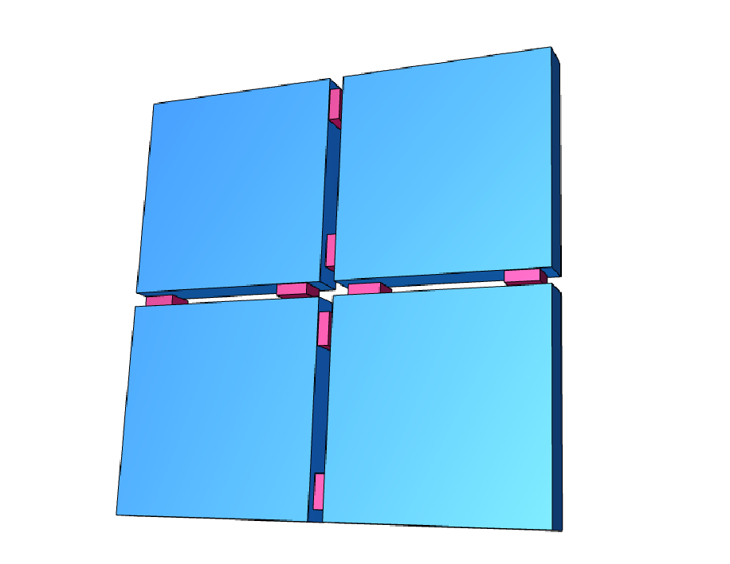
The Scintillation Tile Hodoscope (SciTil)
SciTil
C.Schwarz
on behalf of the SiPM Group at GSI
(given by A. Sanchez Lorente, HIM, Mainz)
Motivation
  Event timing/ event building/ software trigger
  Conversion detection
  Charged particle TOF (relative timing)
Requirements, Simulations
Prototype
Mechanics
Work packages
1
SiPM workshop EU(HP3) 16. Feb. 2013, Vienna

Slide 2
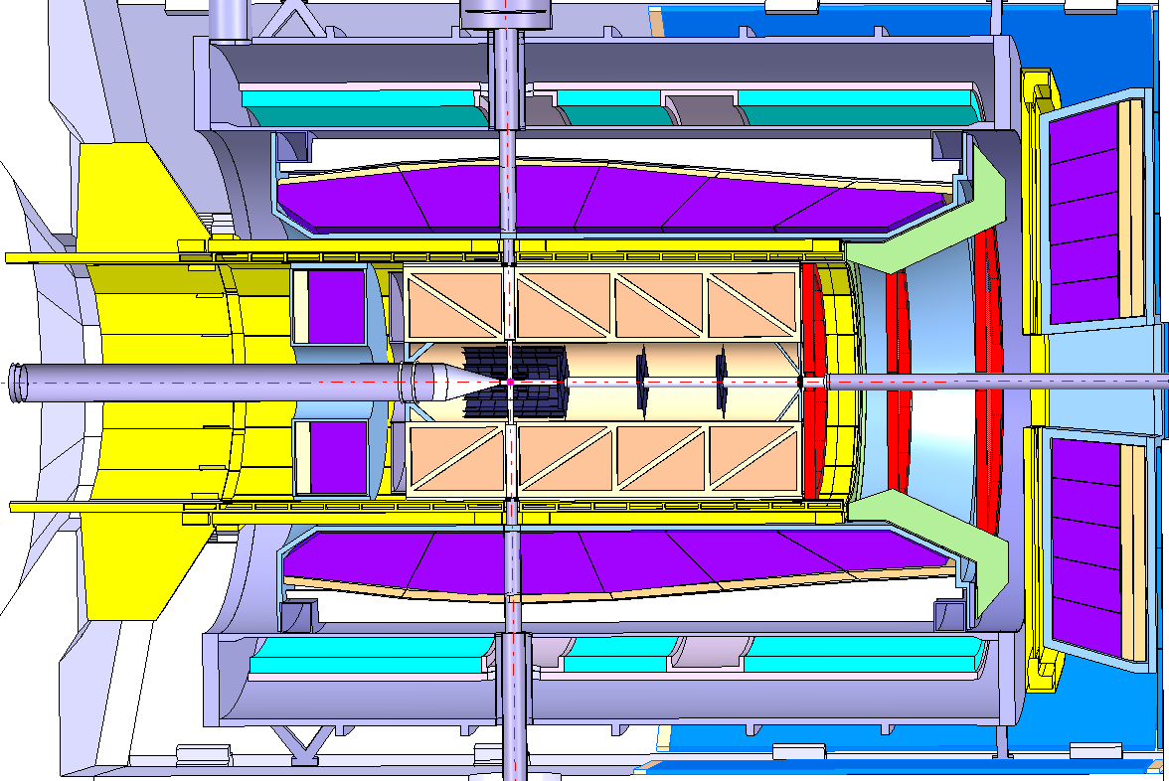
Panda Detector
PANDA interaction rate:
Average 20MHz
Peak 50-100MHz
barrel SciTil
FW end cap disc SciTil
BW end cap disc SciTil
Beam
Endcap
Barrel
2
barrel DIRC
endcap disc DIRC

Slide 3
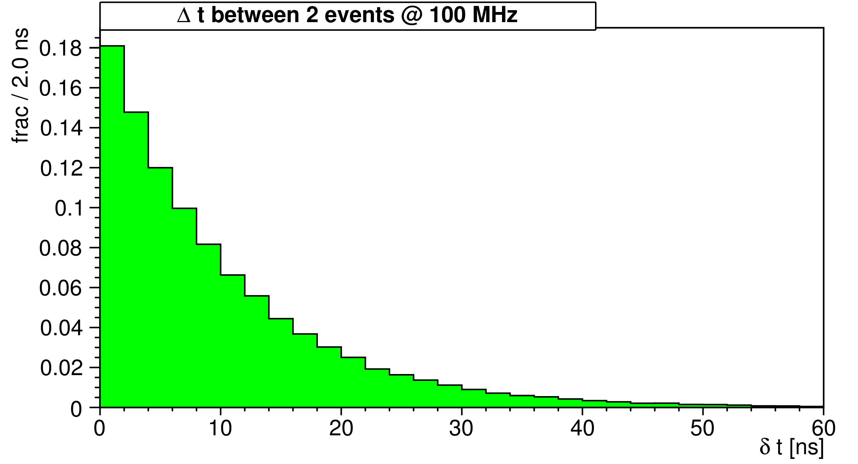
Event timing
Time between successive events are not equally spaced
but follow a exponential distribution : avg ~ 10 ns
On this time scale : all data collected to form data package
average
63% most likely below
3

Slide 4
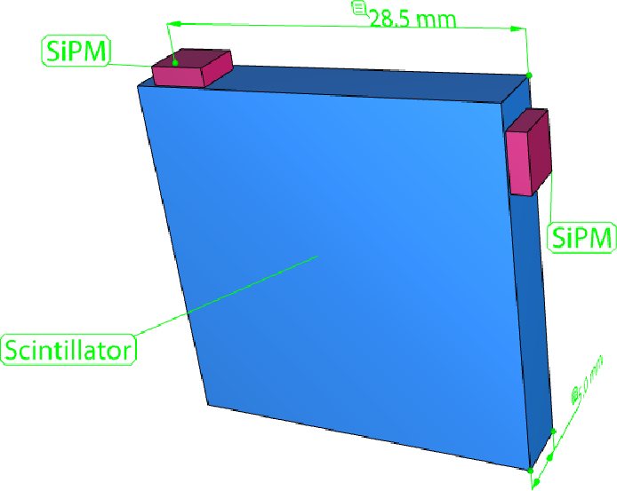
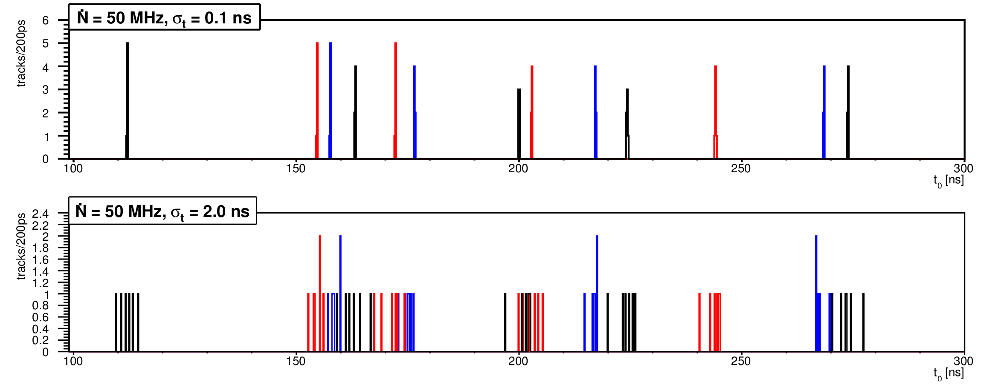
Event timing
Events 1,2,3,4,5,6,7,8... for 50Mhz interaction rate with 6 tracks
t_{i} , σ_{t}
t₀
Klaus Götzen,Influence of Particle Timing on Event Building
PANDA collaboration meeting March 2011, GSI
4

Slide 5
Fast detector assigns
accurate time stamps
to tracks.
5

Slide 6
Conversion detection
EMC
Conversion of gammas within the DIRC
can be detected with the SciTil
SciTil
1%
17%
DIRC
6

Slide 7
Relative timing
TOF
TOF
PANDA has no start detector
SciTil important for relative timing and PID
7

Slide 8
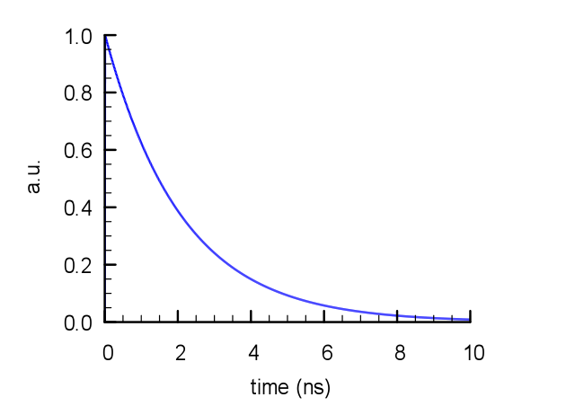
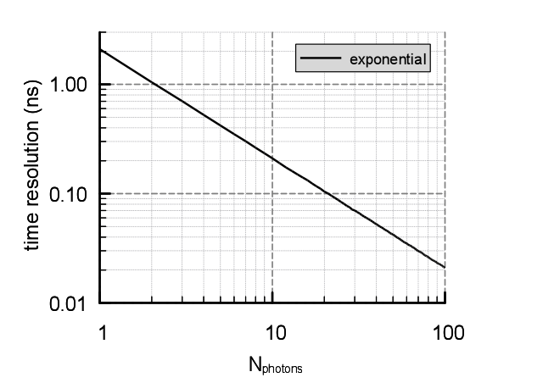
Scintillator Material
For subnanosecond timing: timing on first arriving photon
→ Time resolution depends on number of photons.
Pure exponential:
Simulation
t_{D}=2.2 ns
Time spread of first photon (RMS) for many events ~1/N
Unfortunately
→ not so simple...
8

Slide 9
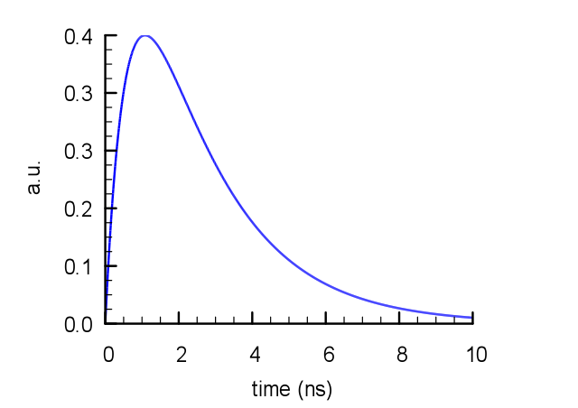
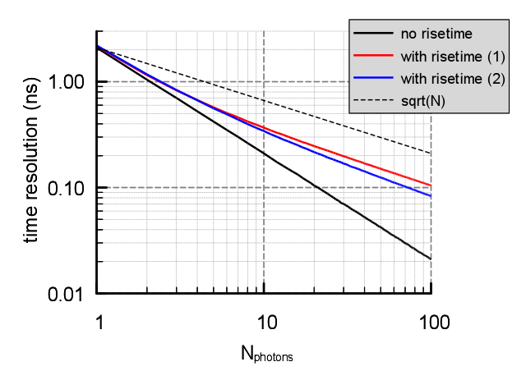
Rise time comparable to wanted time resolution
→ Additional smearing of first photon
Rise time + exponential:
Simulation
t_{D}=2.2 ns
t_{R}=0.9 ns
BC-408
Time spread of first photon (RMS) for many events ~1/sqrt(N)
BC-408: 100 ps
100 photons
9

Slide 10
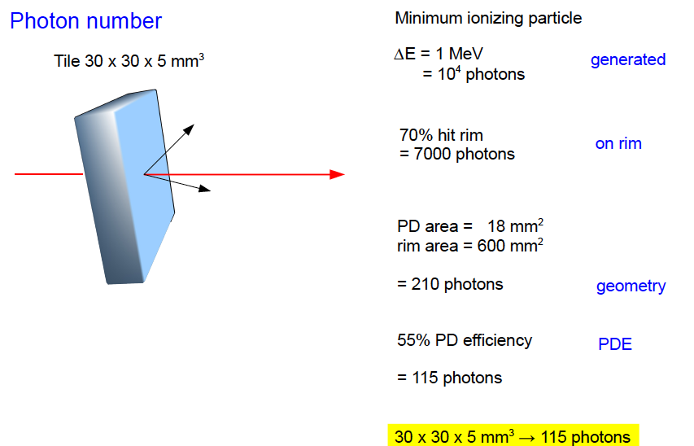
30 x 30 x 5 mm³ → 115 photons
20 x 20 x 5 mm³ → 180 photons

Slide 11
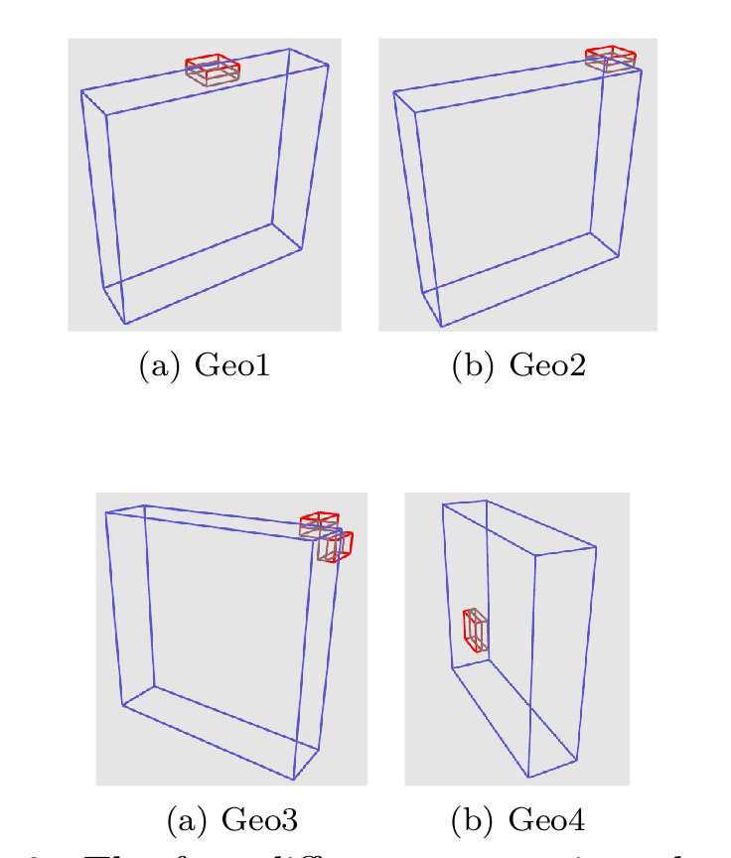
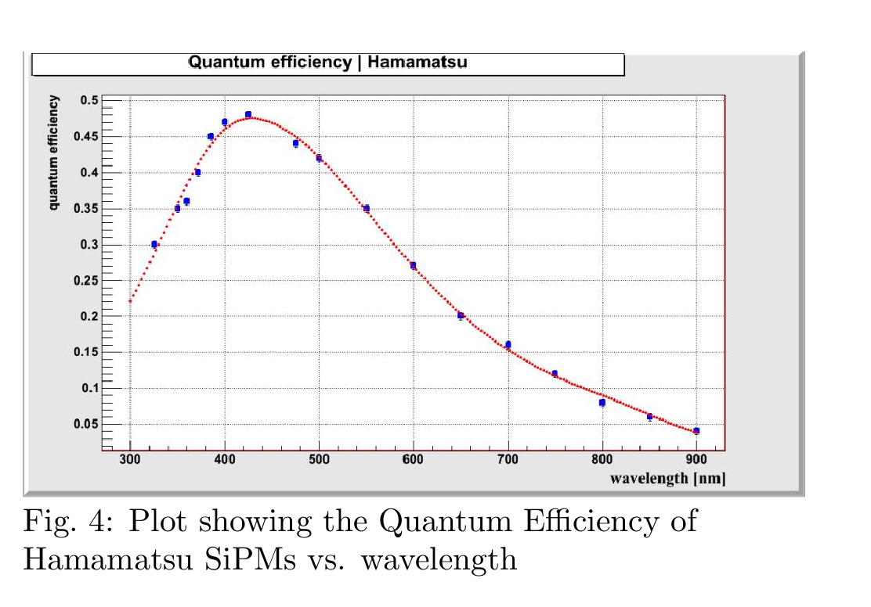
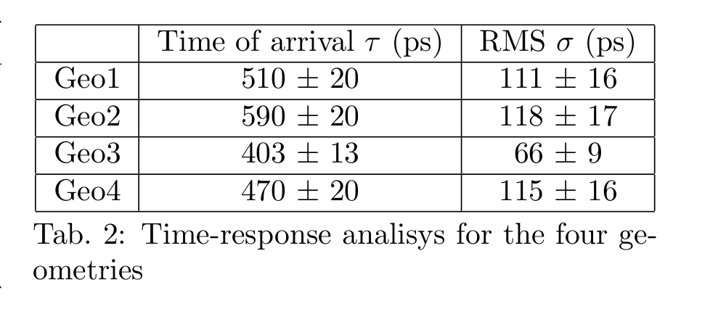
Slitrani simulations
20 x 20 x 5mm³
Stefano Casasso, University of Turin
Summerstudent program GSI 2010
Simulations agree
with above rough estimates
11

Slide 12
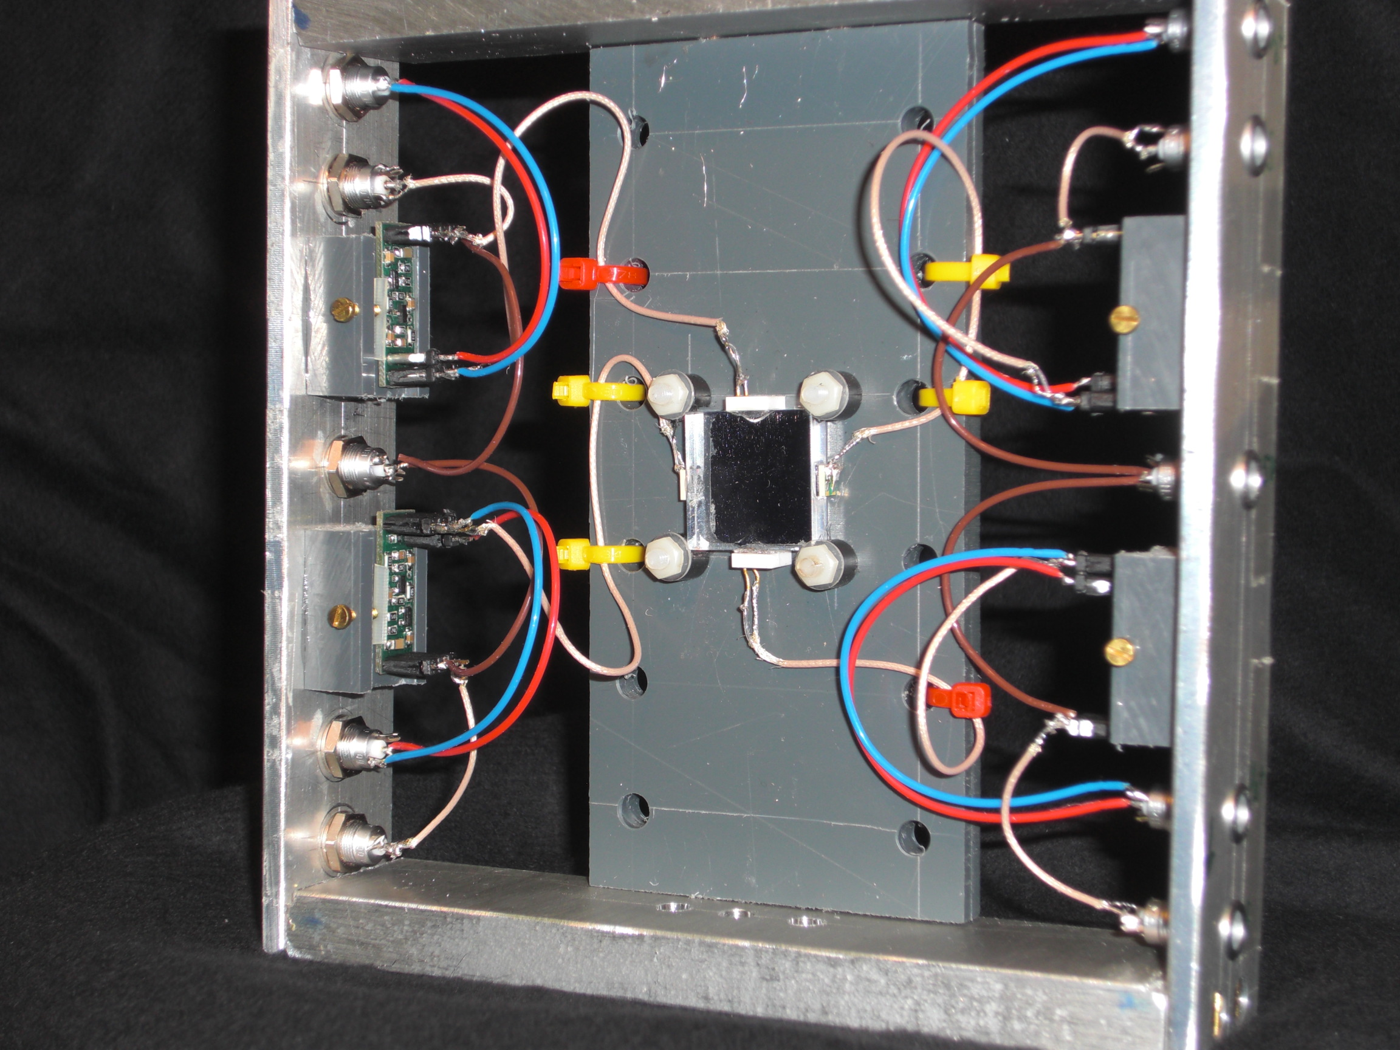
Prototype
BC408
20 x 20 x 5 mm3
Hamamatsu SiPM
S10931-050P
S10362-33-050C
Photonique
Fast amplifier 611
Readout
NINO + HADES TRB
12

Slide 13
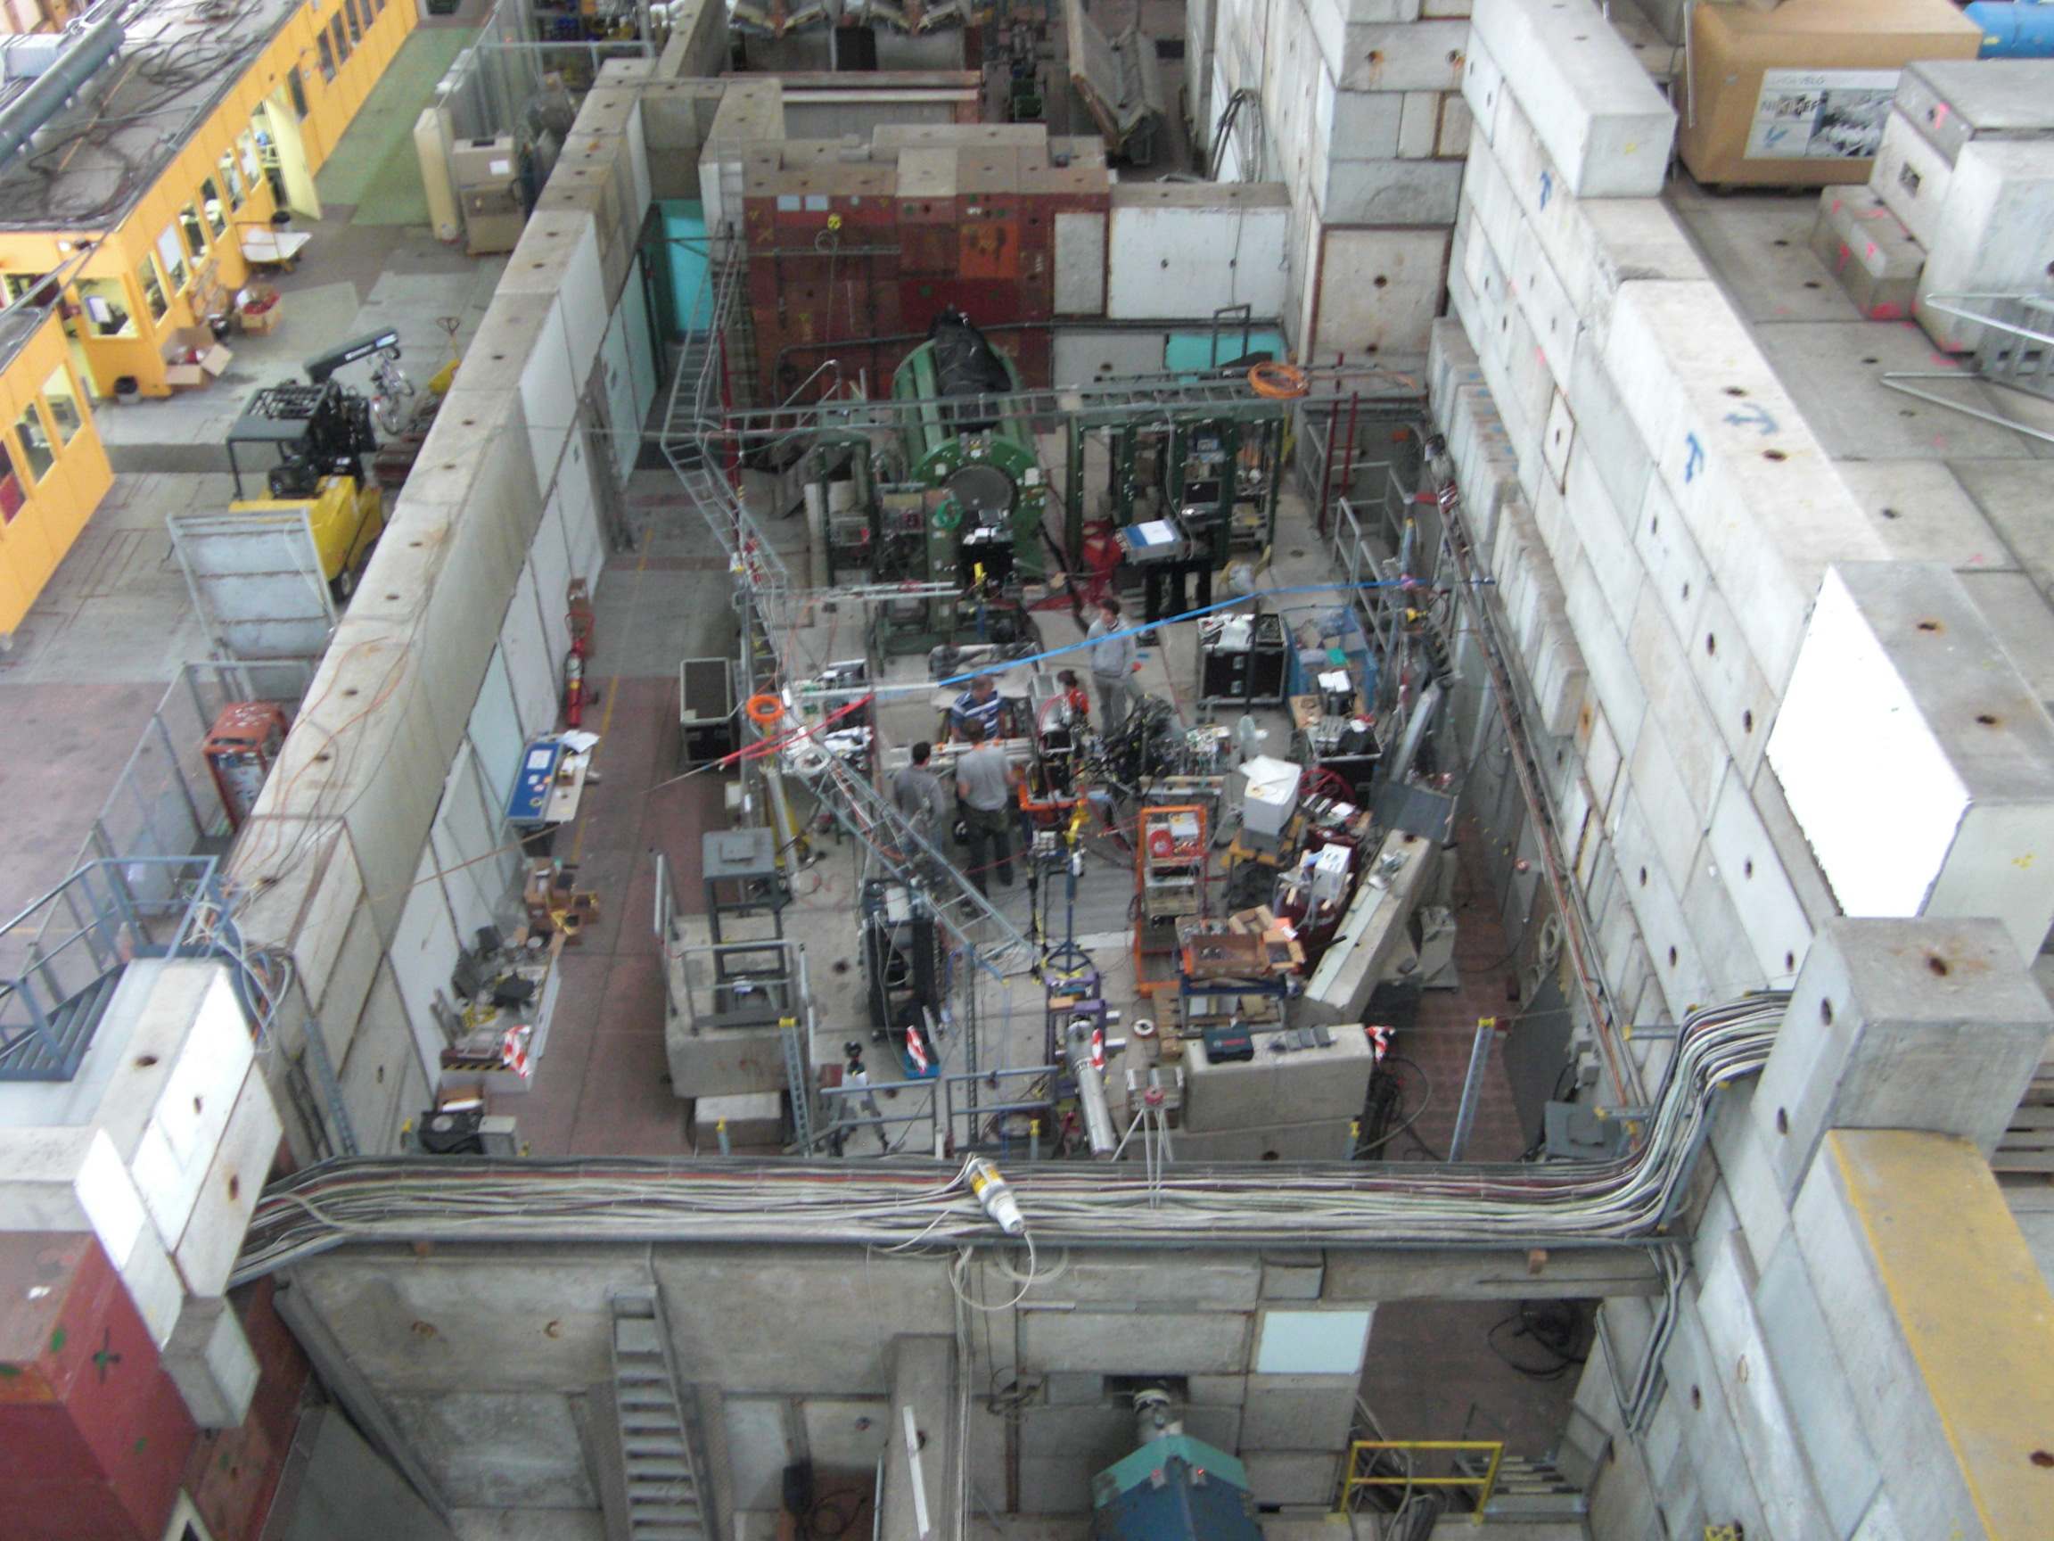
GSI, CERN DIRC prototype beam times
---> SciTil time resolution of 600ps :(
SciTil
13

Slide 14
Timing resolution of 3 detectors
CFD
Start
1
2
3
Stop
NIM-ECL
TDC
Measure t₁-t₂, t₁-t₃, t₂-t₃ , t₁→ s²₁₂ s²₁₃ s²₂₃ s²₁
And subtract 2s²_{electr.} → s^{2'}₁₂ s^{2'}₁₃ s^{2'}₂₃
s²₁ = s²_{electr.}
s^{2'}₁₂ + s^{2'}₁₃ - s^{2'}₂₃ = (s²₁ + s²₂ )+ (s²₁ + s²₃ ) - (s²₂ + s²₃ )
= 2 s²₁
For 4 detectors each s² can be determined several times
→ error bars
14

Slide 15
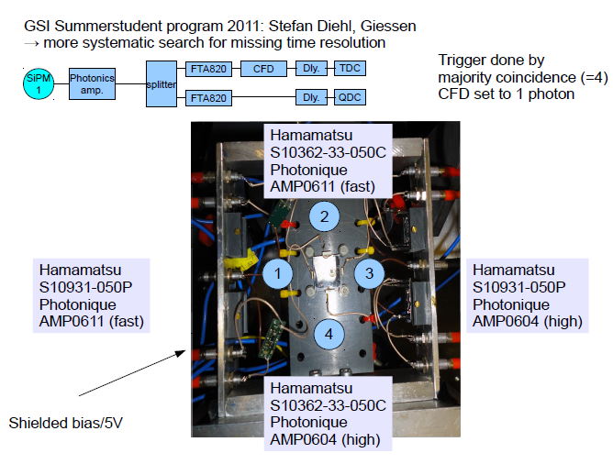

Slide 16
Bias off
Calibration of QDC spectra with PicoQuant laser to count photons
16

Slide 17
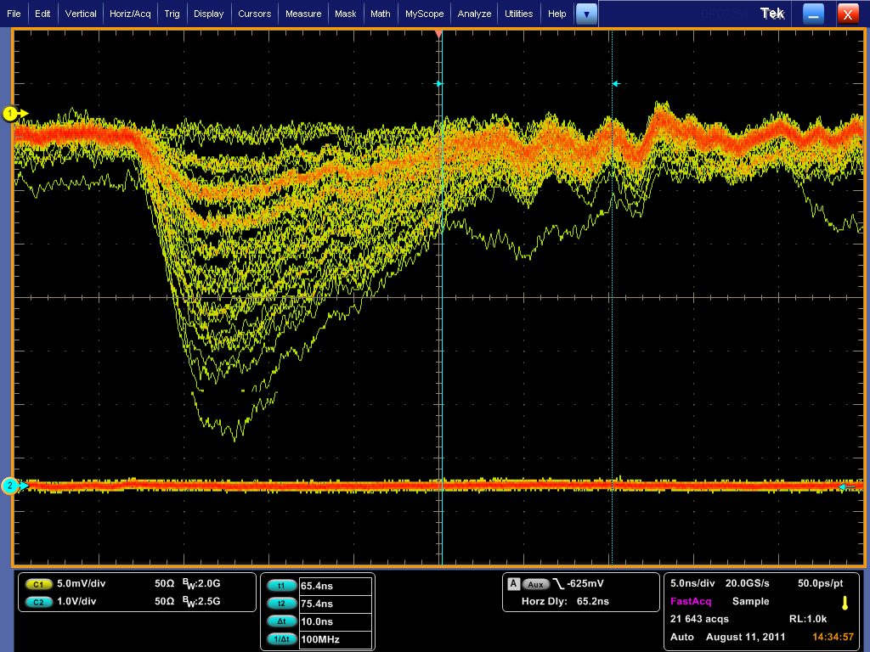
2
Fast
AMP611
17

Slide 18
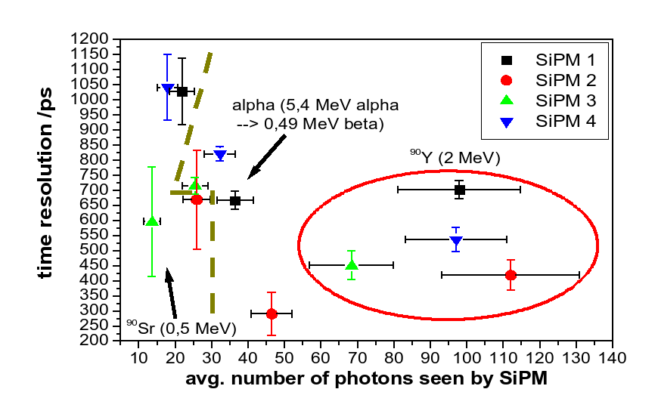
Time resolution including electronic time jitter
18
We see the right number of photons

Slide 19
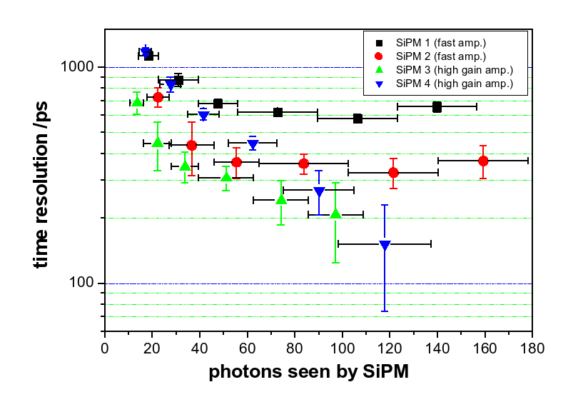
Electronic time
Resolution
(FTA820/CFD/ NIM-ECL converter)
⁹⁰Sr source, results corrected for electronic time resolution
High gain
AMP604
most promising
19

Slide 20

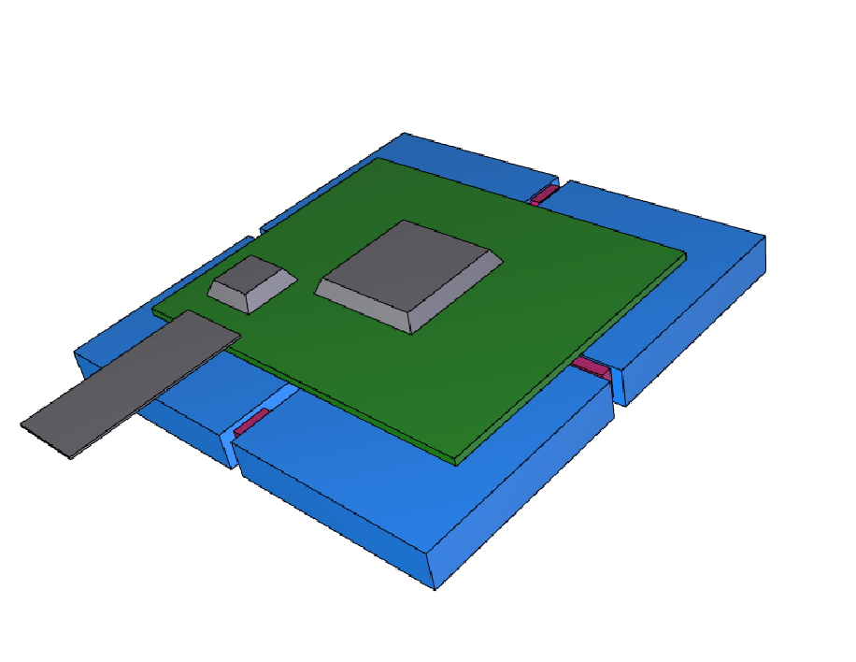
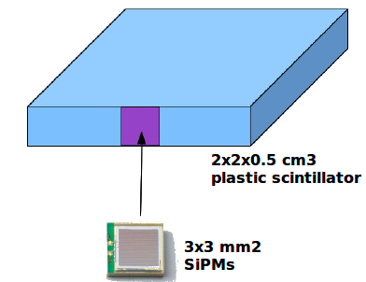
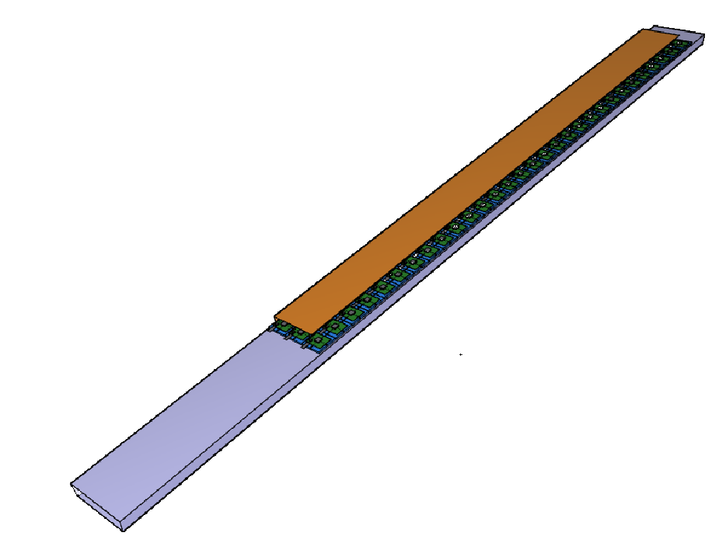
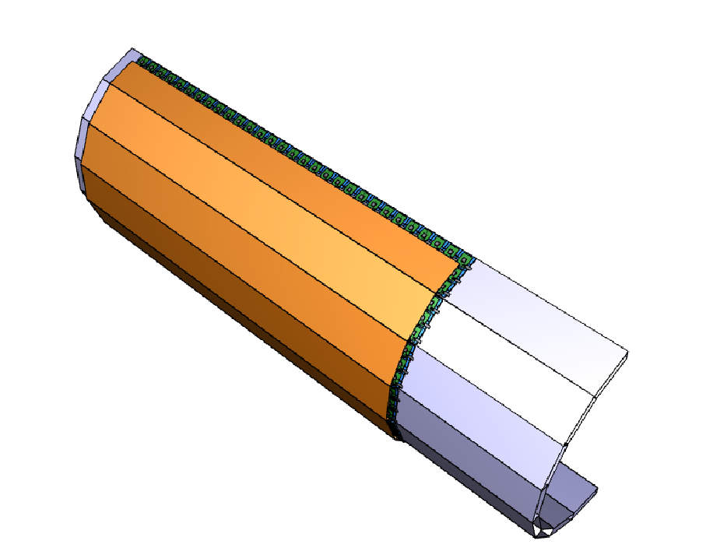
Scintillator Tile Detector Geometry
Low material budget :1% radiation length
Four tiles arranged with their SiPMs for densest packing:
A quad module with a R&D PCB based on 8-channel readout ASIC and a data transfer chip.
Supermodule : (3X30) 90 quad modules on top of a DIRC bar box.
Entire SciTil half barrel composed of 8 super-modules
SciTil
DIRC
20
Notes:
20
20
Einfachen hyperkernennen hingegen lassen sie doppelhyperkernen nur ersten durch den elektromagnetischen
Zerfall ihren angeregten zuständen und wenn dern kern den grundzustand erreicht hat, durch
Den mesonischen und nicht mesonischen zerfall ihre geladenen zerfallsprodukte.
Letztendlich durch hadronischen Zerfall.
Hadronische und mesonische Zerfälle:meist nur Grundzustand

Slide 21
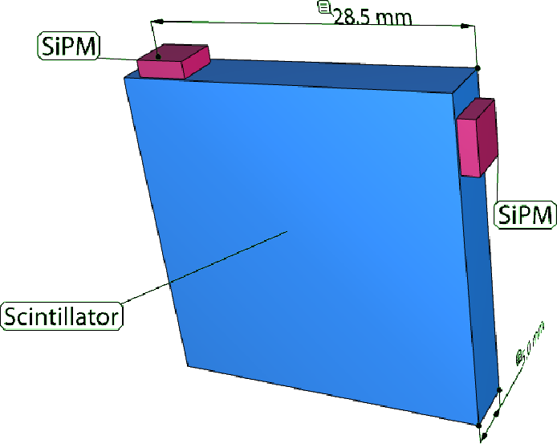

Mechanics
Quad module
With electronics
8 ch. ASIC
data transfer IC
Readout at two positions
more photons
less light path fluctuations
larger detection efficiency
21

Slide 22


Super-module = 90 quad modules
3 x 30 quads
16 super modules
outside of DIRC barrel
Radial thickness
1.8 cm
Total
5760 SciTils
Cooled by dry air
22

Slide 23
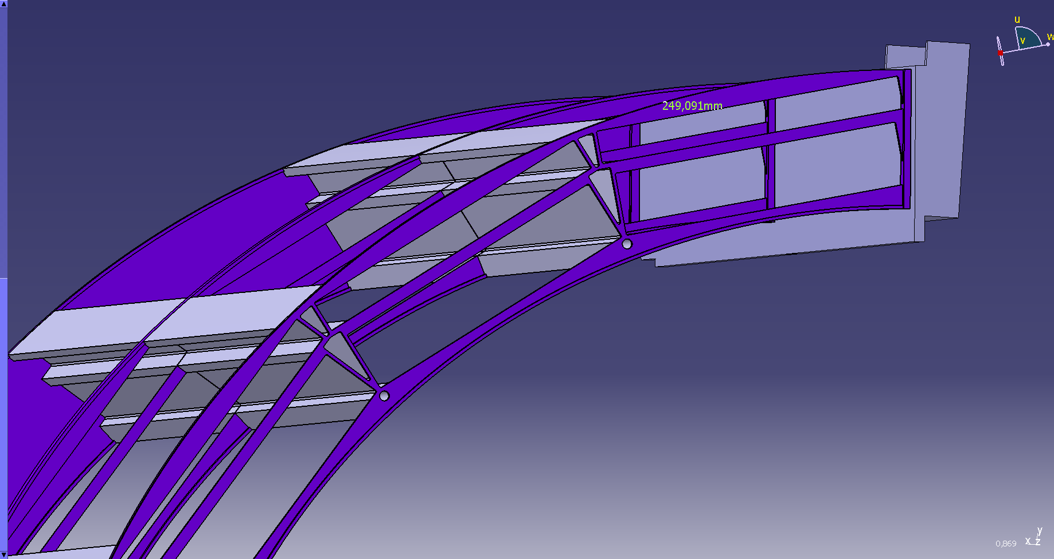
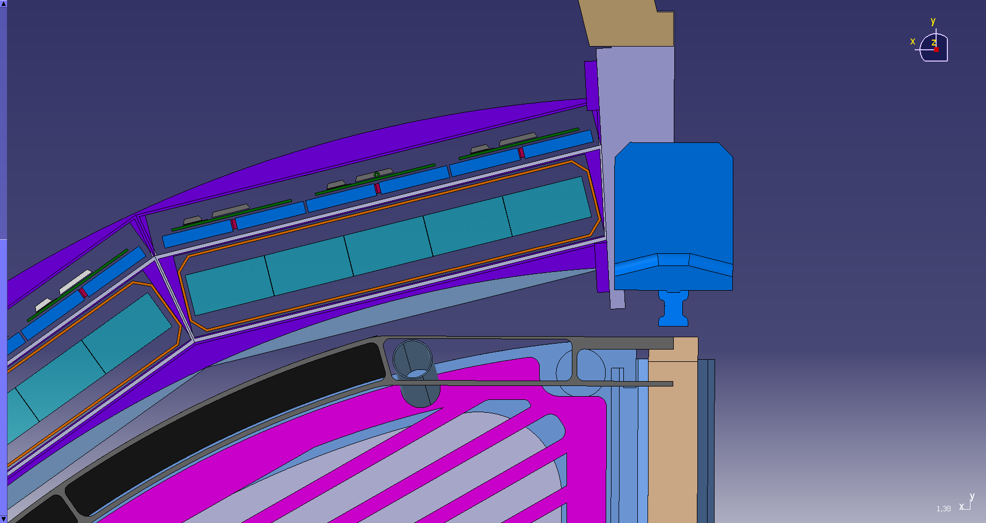
23

Slide 24
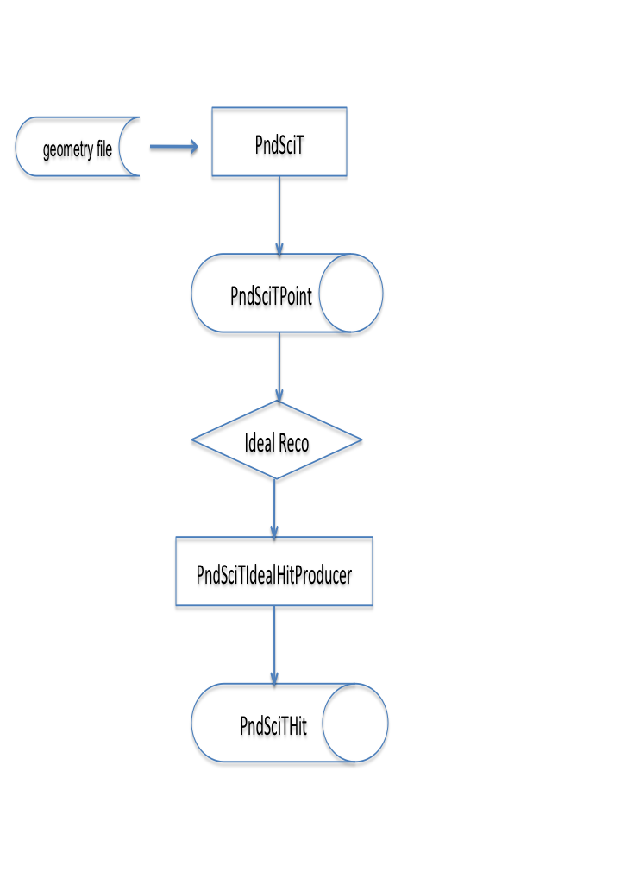
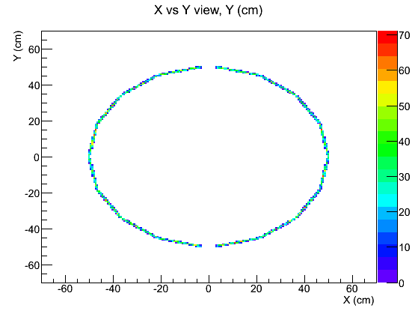
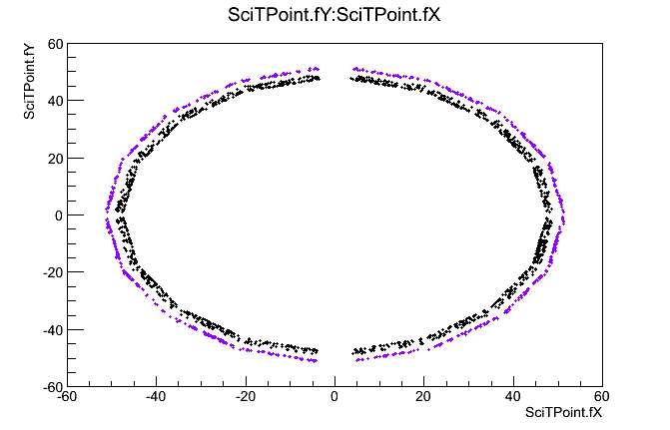
Simulation within the PANDARoot Framework
Raw MC information :
UrQMD generator :300 events, mult ~ 10 particles/event
An event takes place at a certain t_{o} . The generated particles travel for some time with a certain velocity v before they hit a timing detector.
Each particle creates a signal at wall clock time t_{i}. Assuming that the track length s can be provided the time of origin t_{0,i} is equal to t_{i} – s/v .
Uncertainties can be assumed gaussian, so these values are distributed around event t_{o} with a total time resolution σ_{t} .
Hit Position corresponds to the center
point of each scintillating tile in the submodule
Time is smeared by the expected resolution of the detector ~ 100ps
PndDrcBarPoints
PndScitPoints
Notes:
24
Der polarwinkel theta.
Der nachweiss des antihyperon und seine assoziierten kaonen erfolgt unter dem winkelbereich von 0-45grad.
2. Geschieht zwischen 45-90
3. Wird bei ruckswartswinkeln nachgewiesen wo der hadronische untergrund geringer ist.

Slide 25
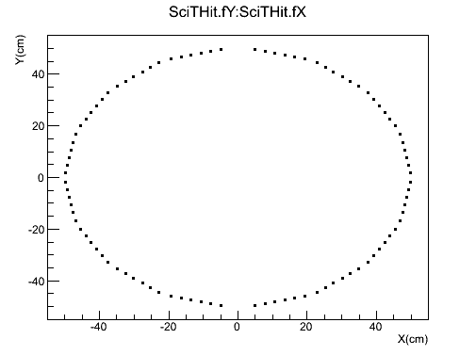
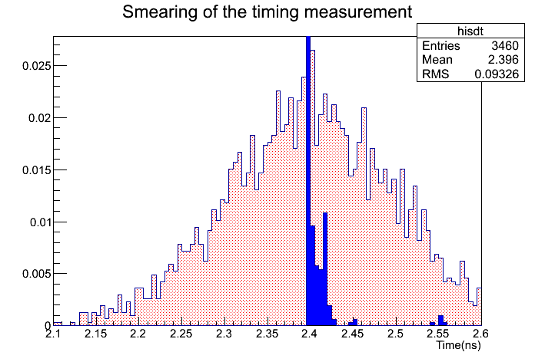
Ideal Hit Information
PndBoxGenerator ~3000 p events
P = 1 GeV/c, theta = 70 ° , phi = 40°
Smearing of MC time t by a
TMath::Gauss (t₀ + s/v, σ_{t} = 100ps)
Notes:
25
Einfachen hyperkernennen hingegen lassen sie doppelhyperkernen nur ersten durch den elektromagnetischen
Zerfall ihren angeregten zuständen und wenn dern kern den grundzustand erreicht hat, durch
Den mesonischen und nicht mesonischen zerfall ihre geladenen zerfallsprodukte.
Letztendlich durch hadronischen Zerfall.
Hadronische und mesonische Zerfälle:meist nur Grundzustand

Slide 26
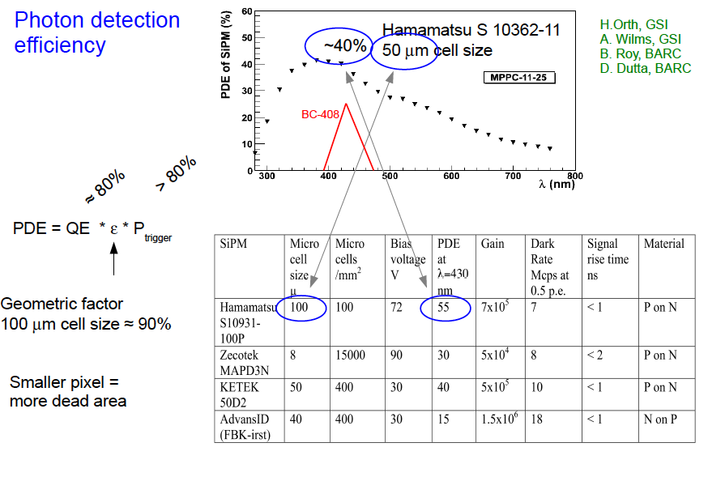
TODO : Real reconstruction Hit Collection
Light output of scintillator :
Time resolution depends on
number of photons
Signal response of a SiPM
has to be accordingly parametrized.
PndSciTHit.h Hit Position corresponds to the center
point of each scintillating tile in the submodule
Time : precise timestamp (after Amp. and Disc.) is generated
for each valid hit.
t_{i} , σ_{t}
t₀
Notes:
26
Der polarwinkel theta.
Der nachweiss des antihyperon und seine assoziierten kaonen erfolgt unter dem winkelbereich von 0-45grad.
2. Geschieht zwischen 45-90
3. Wird bei ruckswartswinkeln nachgewiesen wo der hadronische untergrund geringer ist.

Slide 27
Work Packages
27

Slide 28
Summary
SciTil for
  Event timing/ conversion detection/ relative time
Prototype works
  AMP604 pre-amps give right time resolution
  Number of photons agrees with estimates
A simple ( only Scintillator tile, no electronic) geometry detector based on the Scintillator tile hodoscope detector proposal has been implemented within the Pandaroot Framework
A more complex hit reconstruction including R&D is in progress
28

