Slide 1
Ongoing work on ASIC development
at Politecnico-Bari F. Corsi, F. Ciciriello, F. Licciulli, C. Marzocca, G. Matarrese DEE - Politecnico di Bari and INFN - Sezione di Bari, Italy
IV EU-HadronPhysics Silicon Multiplier Workshop, Vienna, February 16th, 2013
Notes:
i just would like to present you the work that has been done in Bari, aimed to the develompment of integrated front-end electronics suitable for Silicon Photomultiplier detectors.
The entire activity has been carried out whitin the framework of a project called DASIPM2, financed by the italian National Institute of Nuclear Phisics (INFN)

Slide 2
Outline
Existing realizations (BASIC32 and BASIC32_ADC)
New design: a SiGe ASIC with enhanced timing performance
Temperature compensation of SiPM gain: a new technique
Future work
IV EU-HadronPhysics Silicon Multiplier Workshop, Vienna, February 16th, 2013
Notes:
This is the outline of the presentation.
Fist of all, we needed an accurat model of the detector in order to perform reliable simulations at circuit level. So, the classical model of the SiPM has been modified by adding some relevant features which gives remarkable contributions to the electrical behaviour of the detector itself and, moreover we set up a suitable extraction procedure to evaluate the paramenters involved in the model.
After that, different front-end circuit solutions have been compared to find out the most suitable one, considering the SiPM characteristics. Some prototypes of the very first front-end have been realized and some results fromt their characterization will be shown.
The very first version of the f.e. has been equipped with more building blocks and a first version of the complete analog channel has been designed, realized and characterized. Also in this case some measurements results wil be provided.
Next, the design of an 8 channel test chip has been carried out, togheter with the architecture of the digital read-out section. The chip has been submitted to a MPW for fabrication at the end of July and we expect the delivery of the prototypes by the first part of October.
Eventually some possible future work will be described

Slide 3
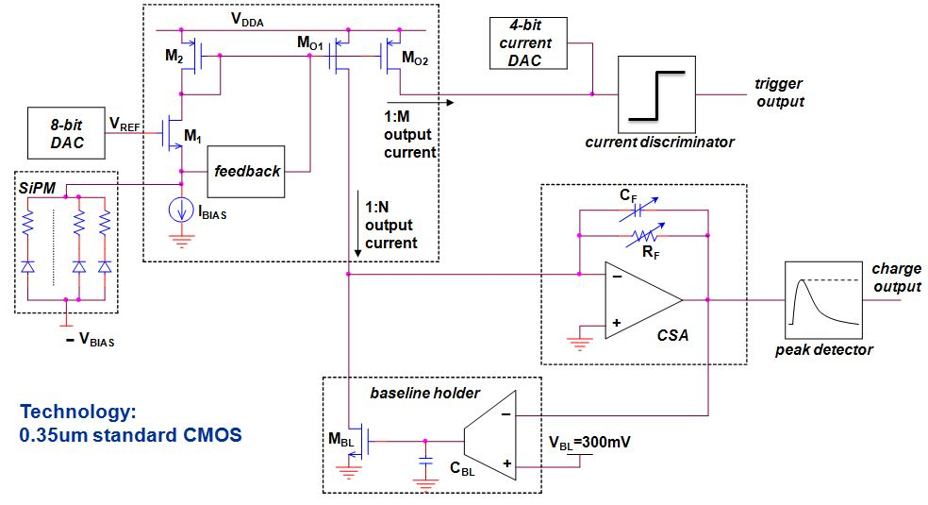
BASIC: structure of the analog channel
Low impedance (17Ω), large bandwidth (250MHz) current-mode front-end
Trigger and charge signal paths
8-bit voltage DAC (fine tuning of the SiPM bias), 4-bit current DAC (threshold setting)
Structure of the analog channel
IV EU-HadronPhysics Silicon Multiplier Workshop, Vienna, February 16th, 2013

Slide 4
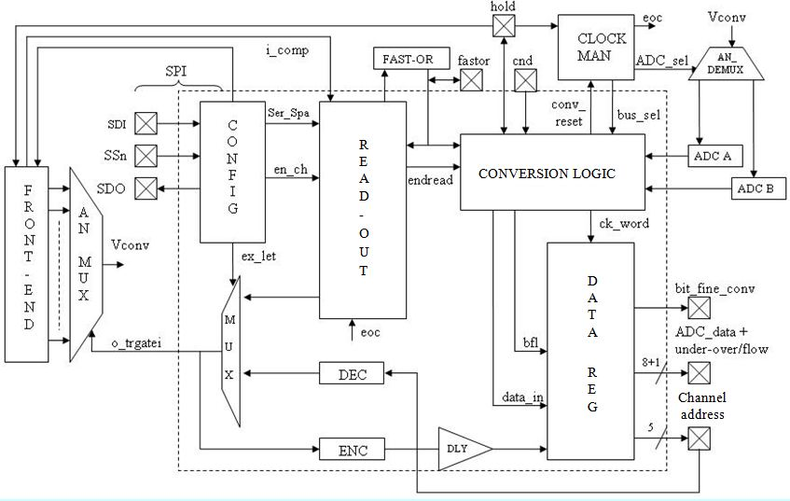
Architecture of BASIC32
Fast-OR output
SPI interface for the configuration (56 bits)
The channels share the same configuration bits
Conversion logic integrated (only for testing purposes)
Sparse and serial acquisition modes, with internal (fast-OR output) or external trigger
“Coincidence” signal (for read-out acknowledgement)
Internal reference generation (bandgap based)
Overall charge to voltage gain very close to the expected one (max. deviation ≅ 6%)
Max dynamic range ≅ 70pC @ C_{F}=3pF (1% linearity error)
Best results of energy resolution ≅ 11% (LYSO scintillator, Hamamatsu MPPC 3x3mm², ²²Na source)
Timing accuracy of the fast-OR output: σ ≅ 115ps
IV EU-HadronPhysics Silicon Multiplier Workshop, Vienna, February 16th, 2013

Slide 5
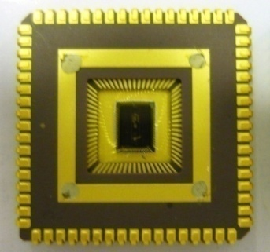
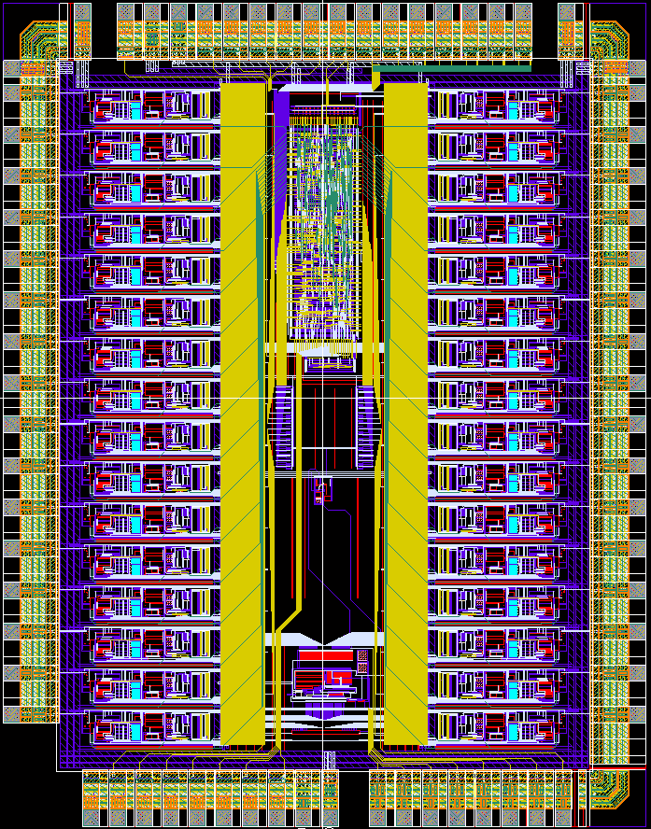
BASIC32: layout and perspective applications
≅ 2.5 cm
Few prototypes still available (less than 10) in JLCC68 ceramic package
Read-out system based on a FPGA development board, designed by INFN Turin
Application of the ASIC+read-out system: read out of SiPM matrices coupled to a continuous slab of scintillator (Pisa)
Possible future application: read out of scintillating fibers in a dose profiler, aimed at studying nuclear fragmentation in hadrontherapy (La Sapienza University, Rome)
Layout of BASIC32 (5 x 3.9 mm²)
IV EU-HadronPhysics Silicon Multiplier Workshop, Vienna, February 16th, 2013
Notes:
5

Slide 6
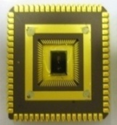
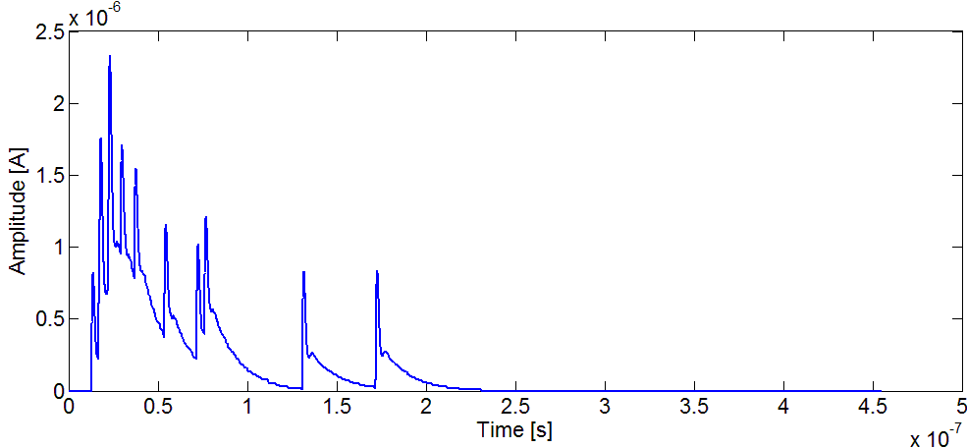
A different architecture: motivations
Application: continuous scintillator slab
The Depth Of Interaction information can be related to the asymmetry of the cluster of SiPM found over threshold on the two sides of the scintillator
SiPMs at the border of the cluster receive a small total number of photons, distributed in time according to the time constant of the scintillator
The related current signal can be under the threshold set on the current level, thus these detectors would be ignored in a sparse read-out acquisition
visible photons
γ-photon
interaction point
light cone
SiPM tile
ASIC
Example
SiPM coupled to LYSO crystal:
typical current waveform for 12 photons
Notes:
6

Slide 7
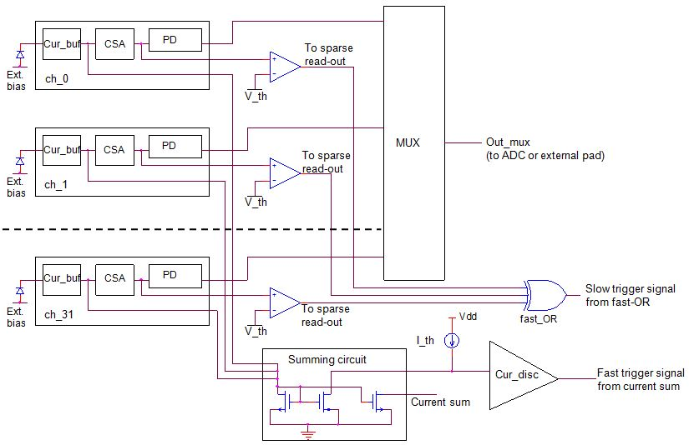
New proposed architecture: BASIC32_ADC
Sum of the current pulses from all the channels (exploiting the “fast” signal path of the FE)
Current discriminator which fires when the sum of the currents overcomes the threshold
Voltage discriminator at the “charge” output of each channel (“slow” signal path), instead of the current discriminator in the “fast” signal path, to make effective the sparse read-out operation
IV EU-HadronPhysics Silicon Multiplier Workshop, Vienna, February 16th, 2013
Notes:
7

Slide 8
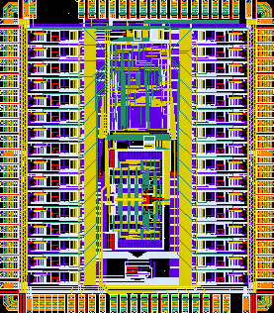
BASIC32_ADC: main features
Internal 8-bit subranging ADC
Extended dynamic range (more than 100pC)
Improved configuration flexibility (524 bits)
(channels configurable independently)
Analog current sum output
Analog multiplicity output
The internal read-out procedure can be started by the
“slow” (fast-OR of the voltage comparators)
or “fast” (current discriminator) trigger
Currently in test phase
5 mm
4.4 mm
Layout of the prototype
IV EU-HadronPhysics Silicon Multiplier Workshop, Vienna, February 16th, 2013
Notes:
8

Slide 9
New design: enhanced timing accuracy
Application: 4D-MPET project (INFN Pisa, Torino, Perugia and Bari)
a) Read out of SiPM matrices on both sides of a continuous scintillation crystal
b) Algorithm to find clusters of hit SiPM and timing implemented on a fast FPGA
c) DOI evaluation based on cluster size asymmetry on the two sides of the scintillator
Main goals:
a) very low threshold (trigger on the first photon) to maximize timing accuracy
b) Time over Threshold technique to evaluate the energy (external TDC)
Main requirements:
a) good signal to noise ratio ( ≅ 20dB for the single micro-cell event)
b) large bandwidth (≅ 1GHz)
c) effective solution to get rid of triggers coming from dark pulses
d) improved linearity of ToT vs energy
}
IV EU-HadronPhysics Silicon Multiplier Workshop, Vienna, February 16th, 2013
Notes:
9

Slide 10
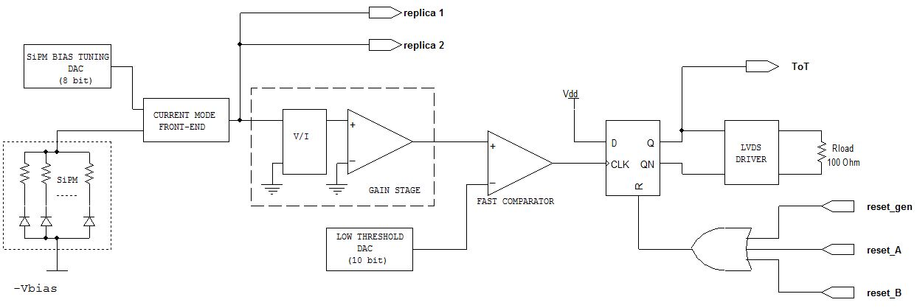
New architecture of the front-end: “fast path”
SiGe technology (AMS S35D4, fast HBT available with f_{t} ≅ 60GHz)
ToT signal starts when the SiPM current pulse overcomes the low threshold
ToT signal terminates when reset_A (dark pulse signals) or reset_B (valid signals) are generated
The SiPM current pulse is replicated two more times for a) dark pulse suppression and b) ToT evaluation
IV EU-HadronPhysics Silicon Multiplier Workshop, Vienna, February 16th, 2013
Notes:
10

Slide 11
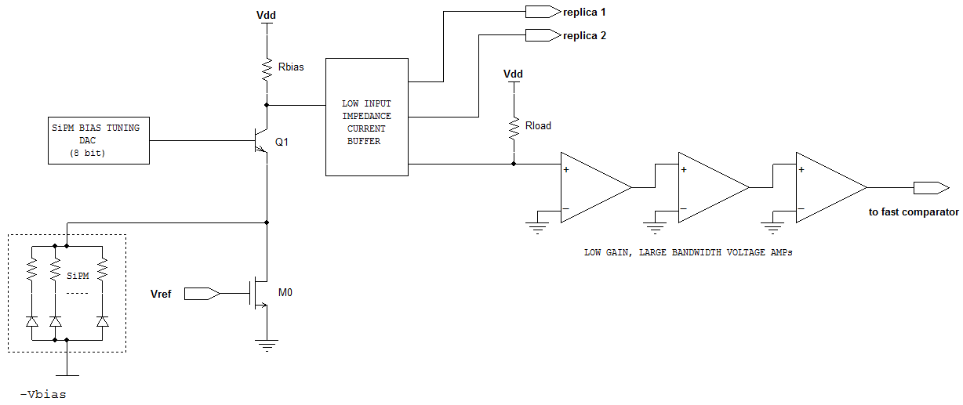
Input preamplifier
Large capacitance detectors: open loop current buffer
Overall transimpedance gain ≅ 7kΩ
Input resistance ≅ 25Ω
Current consumption ≅ 3.5 mA (Vdd =3.3V)
Signal to Noise Ratio ≅ 25dB (signal associated to one micro-cell)
Bandwidth ≅ 1 GHz
Timing jitter at the comparator output due to electronic noise ≅ 15ps
IV EU-HadronPhysics Silicon Multiplier Workshop, Vienna, February 16th, 2013

Slide 12
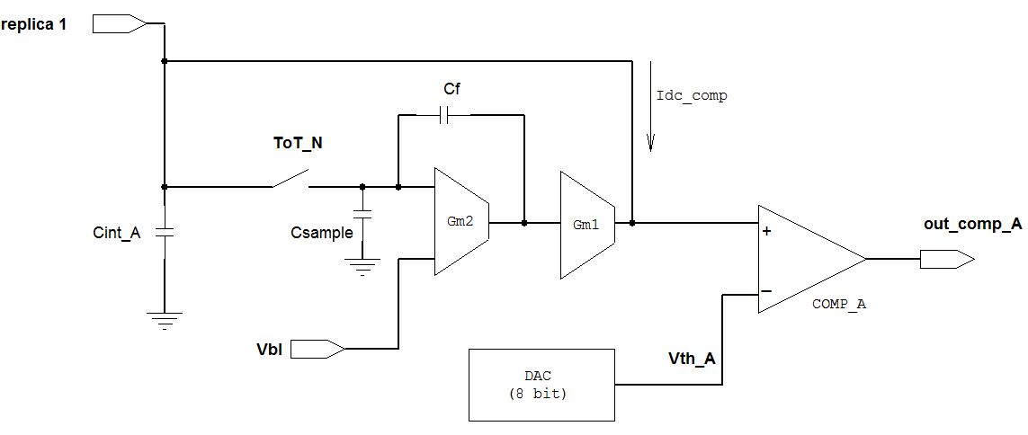
Dark pulse identification
When the ToT signal is started, two time windows are opened: TWA (few tens of ns)
TWB (more than 100ns)
A baseline restorer circuit is used to set the baseline at V_{bl} and to compensate the dc component of the
replica1 current, Idc_comp
The first replica of the SiPM current signal is integrated on C_{int_A}
The integrated charge is compared to a threshold V_{th_A}: when TWA expires, if the charge is under
threshold, the signal is considered a dark pulse and the whole system is reset (reset_A).
Thus, for a dark pulse the duration of the ToT signal is equal to TWA.

Slide 13
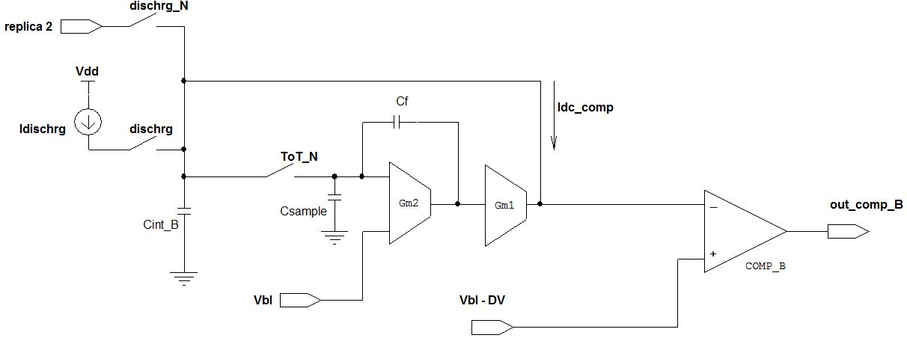
Time over Threshold: valid signals
Also the second replica of the SiPM current is integrated, on C_{int_B}
If the signal has been classified as a dark pulse, after TWA the ToT signal is reset and C_{int_B} is also reset
If the signal is classified as good, the integration goes on until the second time window TWB expires
When TWB expires, the signal dischrg is activated and C_{int_B} is discharged at constant current
I_{dc_comp} – I_{dischrg}
When the voltage on C_{int_B} goes under the baseline, COMP_B fires and the ToT signal is reset (reset_B): the duration of the discharge depends on the total charge integrated during TWB, i.e. is proportional to the energy of the event
Vbl - ΔV

Slide 14
Simulation at system level: example
Input signal
ToT
TWA
out_comp_A
out_int_B
TWB
dischrg
reset_A
reset_B
Simulation of a valid event (10 photons) followed by two dark pulses
(TWA=30ns; TWB=100ns; charge threshold for valid signals 160fC; total discharge current 20μA)

Slide 15
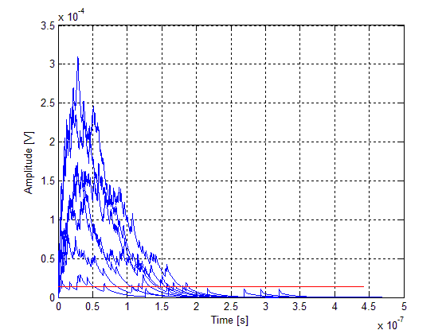
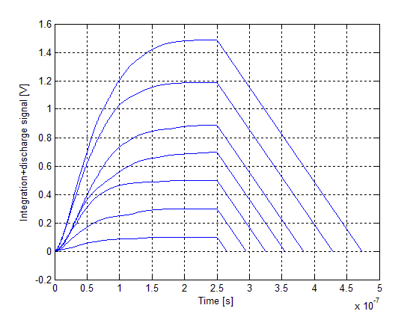
Time over Threshold: improvement of the energy resolution
a) Simple Time over Threshold technique
b) The proposed technique: integration and constant current discharge
IV EU-HadronPhysics Silicon Multiplier Workshop, Vienna, February 16th, 2013

Slide 16
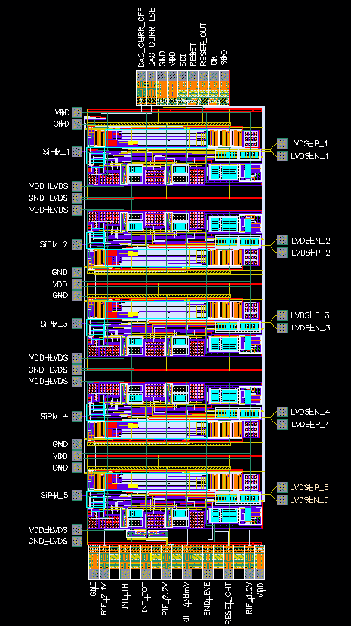
The 4D-MPET prototype ASIC
AMS 0.35μm SiGe
4+1 channels
4.9x2.1 mm²
Low Threshold: 8 bit,
LSB ≅ 1/4 of the single microcell signal
Charge threshold: 8 bit, LSB ≅ 40fC
TWA: 8 bit, LSB = 650ps
TWB: 8 bit, LSB = 2.6ns
Discharge: 4 bit, LSB=1.6μA
Submission planned on February 25th
IV EU-HadronPhysics Silicon Multiplier Workshop, Vienna, February 16th, 2013

Slide 17
SiPM gain: temperature dependence
G=Q/e=[C_{pixel} (V_{BIAS}-V_{BR})]/e
SiPM gain
C_{pixel}= total capacitance of the single micro-cell
V_{BIAS}= detector bias voltage
V_{BR}= breakdown voltage
Breakdown voltage temperature dependance:
V_{BR}(T)=V_{BR0}[1+β(T-T₀)]
β order of magnitude: 10⁻³ /°C
Gain temperature dependance:
better than APD, but still a problem to be addressed
IV EU-HadronPhysics Silicon Multiplier Workshop, Vienna, February 16th, 2013
Notes:
17

Slide 18
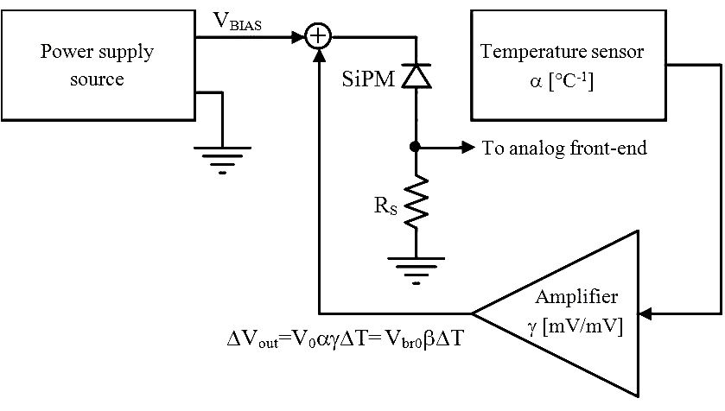
Solutions proposed in the literature
Based on open loop techniques:
Measurement of parameter β
Measurement of the temperature (using a sensor)
SiPM bias voltage adjustment ΔV_{BIAS}=ΔV_{BR}(T)
V_{S}(T)=V₀[1+α(T-T₀)]
Parameters β, α and γ must be known and/or controlled with good accuracy
IV EU-HadronPhysics Silicon Multiplier Workshop, Vienna, February 16th, 2013

Slide 19
New proposed solution
Closed loop technique:
A SiPM not exposed to incident photons (“blind” SiPM) is used as a temperature sensor
Measurement of the average dark pulse amplitude V_{PEAK} of the blind SiPM (proportional to the gain)
Blind SiPM bias voltage automatically adjusted by a feedback loop to make V_{PEAK} (thus the gain) constant and equal to a reference value V_{REF}
Main requirement: same β for the blind SiPM and the active detectors
IV EU-HadronPhysics Silicon Multiplier Workshop, Vienna, February 16th, 2013

Slide 20
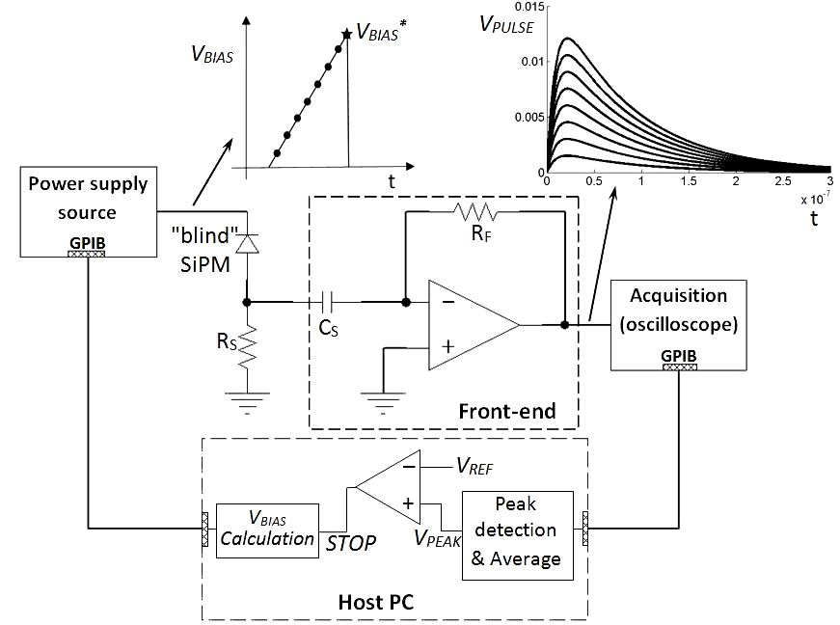
Experimental proof of principle
a. Single measurement cycle: V_{BIAS} increased linearly on the bind SiPM until the
desired V_{PEAK} (i.e. the required gain) is reached (V_{BIAS} =V_{BIAS}*)
Measurement cycles continuously applied : V_{BIAS}* tracks the temperature variations and is applied to the active SiPMs

Slide 21
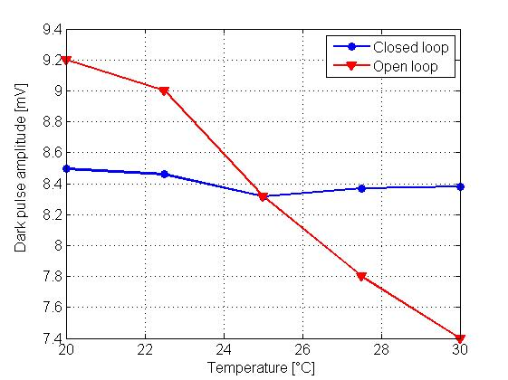
First results
Two SiPMs from FBK-irst, 400 micro-cells, 50x50 µm² used as blind and sensitive detectors
Temperature controlled by means of a small Peltier cell
Open loop variation of the gain ≅ 20%
Closed loop variation of the gain ≅ 2%
IV EU-HadronPhysics Silicon Multiplier Workshop, Vienna, February 16th, 2013

Slide 22
Future work
Submission of the 4D-MPET ASIC and characterization of the prototypes
Characterization of BASIC32_ADC
Effective circuit implementation of the temperature compensation technique
Experimental validation of an extended model of the SiPM coupled to the front-end electronics, including the parasitic inductance of the interconnections
Next design: 64 channel ASIC for application in an in-beam PET dosimeter for hadrontherapy based on SiPM (project “INSIDE” financed by the Italian government)
IV EU-HadronPhysics Silicon Multiplier Workshop, Vienna, February 16th, 2013
Notes:
This is the outline of the presentation.
Fist of all, we needed an accurat model of the detector in order to perform reliable simulations at circuit level. So, the classical model of the SiPM has been modified by adding some relevant features which gives remarkable contributions to the electrical behaviour of the detector itself and, moreover we set up a suitable extraction procedure to evaluate the paramenters involved in the model.
After that, different front-end circuit solutions have been compared to find out the most suitable one, considering the SiPM characteristics. Some prototypes of the very first front-end have been realized and some results fromt their characterization will be shown.
The very first version of the f.e. has been equipped with more building blocks and a first version of the complete analog channel has been designed, realized and characterized. Also in this case some measurements results wil be provided.
Next, the design of an 8 channel test chip has been carried out, togheter with the architecture of the digital read-out section. The chip has been submitted to a MPW for fabrication at the end of July and we expect the delivery of the prototypes by the first part of October.
Eventually some possible future work will be described

