Slide 1
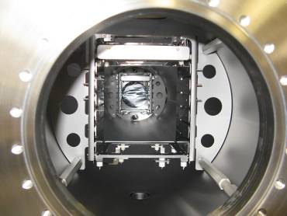
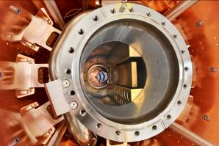
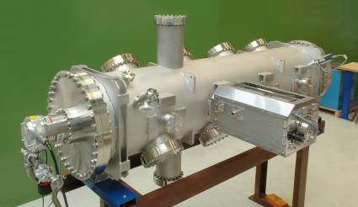
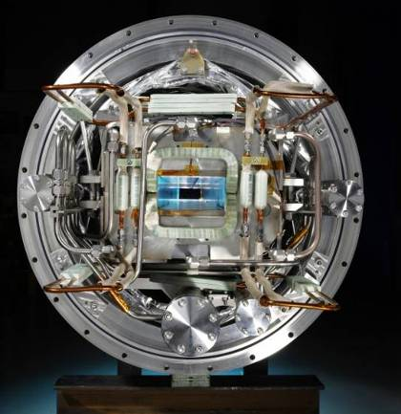
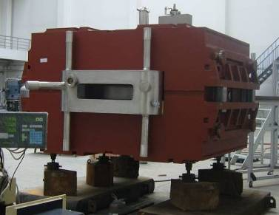
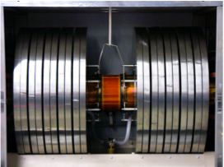
FAIR@GSI
Notes:
1

Slide 2
Tasks given by the Supervisory Board (04/12)
Create a project structure according to the requirements of the FAIR project at GSI
1. Priority → Project Management Structures (recruiting)
(Project and administration)
2. Priority → Accelerator and Common systems
3. Priority → GSI contributions to experiments
Consolidation of a master schedule
Budget and resource planning (personnel)
→ resource loaded schedule
(done)
(ongoing)
(done)
(first draft available
→ optimization)

Slide 3
Objectives of FAIR@GSI
To realize the sub project FAIR ACC successfully as
the most important project of GSI
  Focusing of GSI to the needs of the project
  Clear structure, planning, processes, documentation, communication, resources and schedule
  To adhere to the commitments given to the BMBF
  → cost, scope and schedule
FAIR@GSI delivers the GSI contribution to FAIR up to the start
of beam commissioning!

Slide 4

GSI contributions to the FAIR project
Technical supervision
  All FAIR accelerators
  (HESR together with
  Jülich)
  GSI accelerators
In-kind contributions
  To all FAIR accelerators
  (magnets, power converters,
  vacuum components,
  diagnostics, rf etc.)
  Common systems
  (Testing of SC magnets,
  controls, link to existing
  facility)
  To the experiments

Slide 5
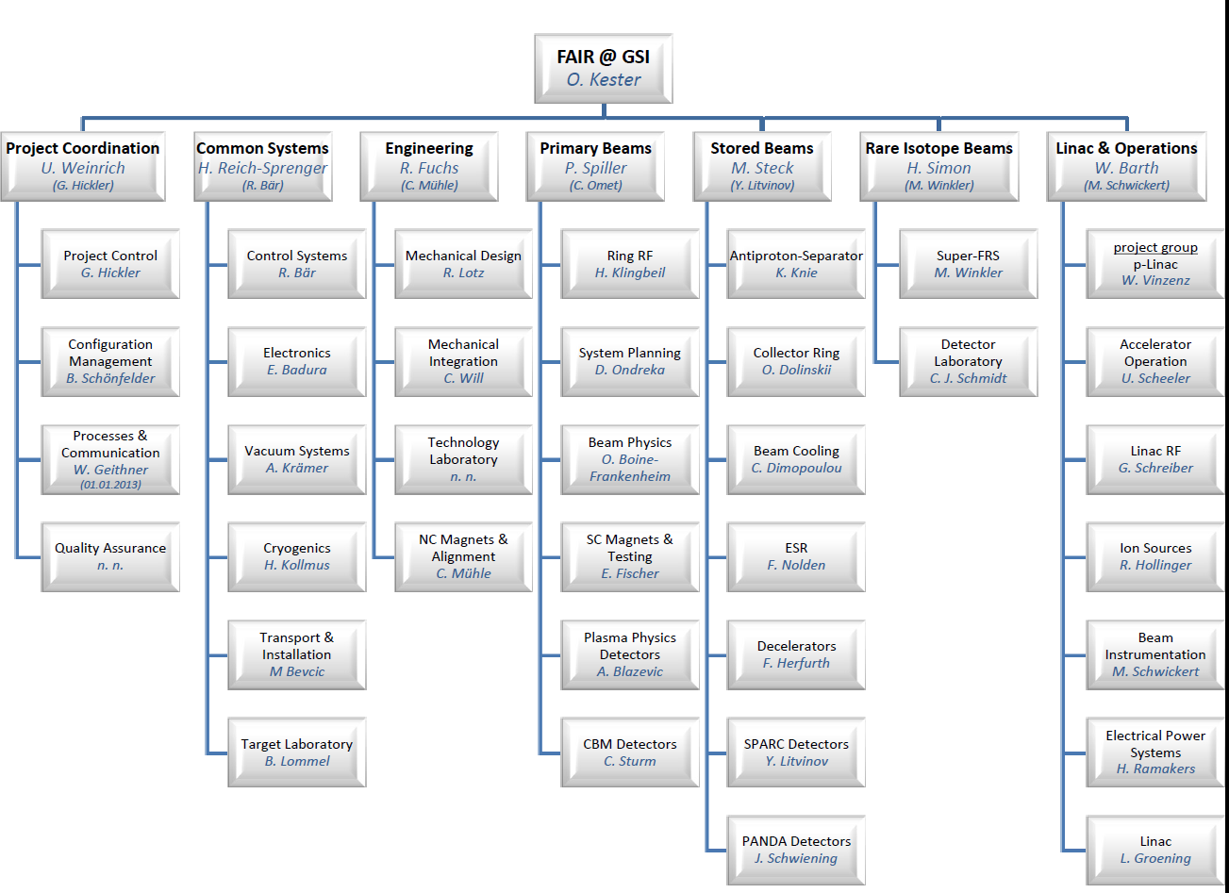
Project organisation FAIR@GSI
Divisions with
cross functional tasks
Accelerator divisions

Slide 6
Accelerator divisions
Primary
Beams
Linac&
Operations
Rare Isotope Beams
Stored Beams

Slide 7
Status FAIR@GSI
Project organization development
→ 7 divisions, 35 departments and groups
→ re-directing of 113 employees from research divisions and
30 employees from TI to FAIR@GSI
→ alignment of inter divisional work – matrix management
Harmonized master schedule
Detailed resource planning
Detailed structure and assignment of the work packages
Co-ordination/prioritization of procurements → in progress
Load planning data in the new planning tool → in progress

Slide 8
Master schedule of FAIR ACC

Slide 9
Manpower requirements FAIR@GSI
General profile FAIR@GSI (2012 status quo, as of 2013 assessment of personnel
Personnel [FTE]

Slide 10
Control of the work on technical document according to the procurement schedule
Identification of the required specifications of each procurement item
Tracking of the status of each document
Steering of the work on the technical documents
Prioritisation of the procurement of the FAIR project
Tendering processes
Priorities given by the project leader FAIR@GSI (done for procurement until July 2013) Next evaluation will extend the list of procurement until end of 2014. | All specs for the procurement until July 2013 have been identified. | Release process and status of specs is checked by the project coordination every week. | The authors of the specs get a priority list according to the procurement schedule. Short term goal are defined and personnel is released from other duties, if the work on the documents is critical.
Progress in establishing the documents is consistent with the contract milestones in the master schedule

Slide 11
Technical Supervision – HOAI Contract
Technical support of FAIR accelerator in all project phases
→ Technical documents and specifications
→ System planning – interface support
→ Integration to complete system (Digital Mock Up – DMU )
Comprises basically the full configuration-management
Technical realization for GSI in-kind contributions
    (for the Super-FRS e.g. Target area, Multiplets, …)

Slide 12
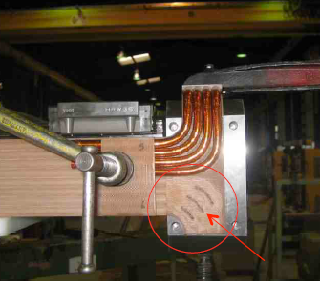
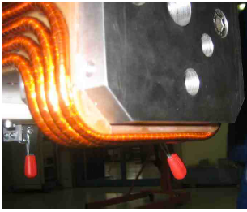
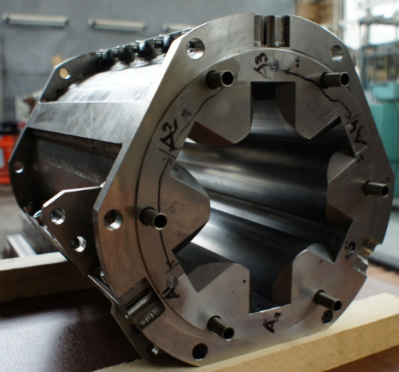
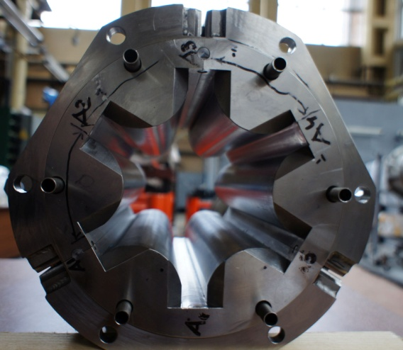
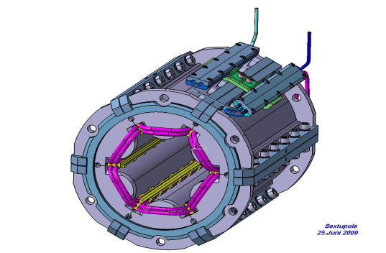
Main systems in focus: SC magnets
SIS100 dipole magnets → BNG coil production problems (QA)
SIS100 sextupole magnets → Dubna prototype

Slide 13
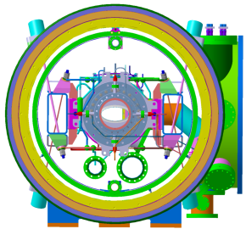
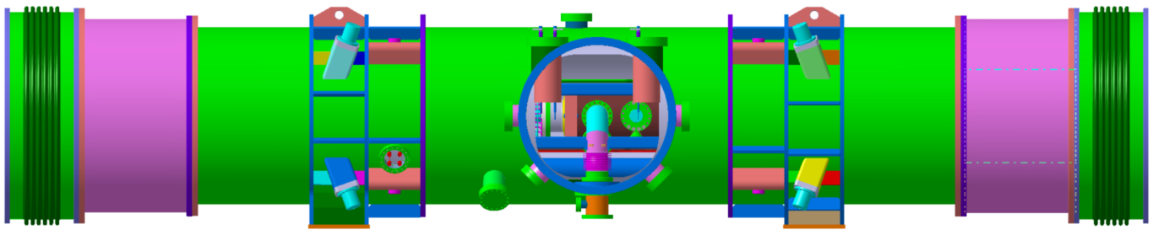
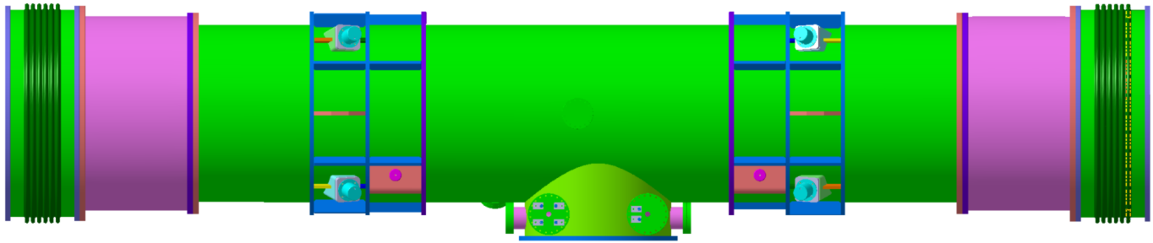
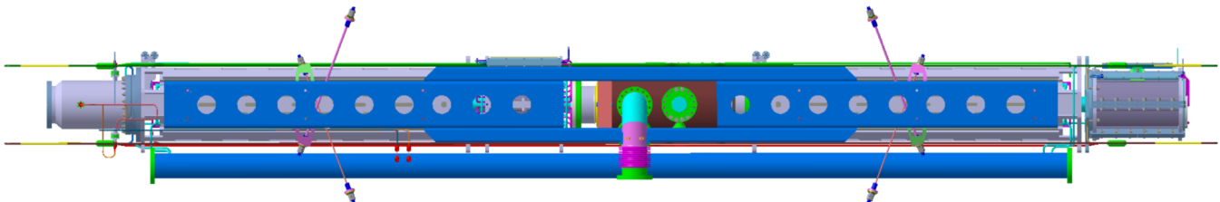
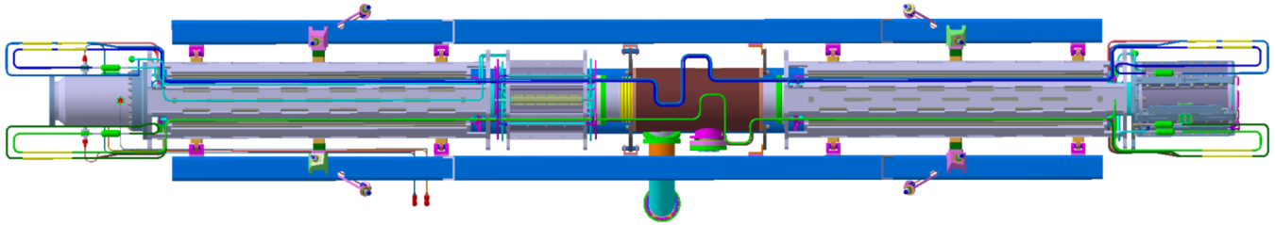
SC Magnets: SIS100 quadrupole module
Detailled design:
thermal shield
bus bar system
suspension
cooling pipes for chambers and girder
electrical systems
current leads
(Cryostat für Unittests)
beam direction

Slide 14
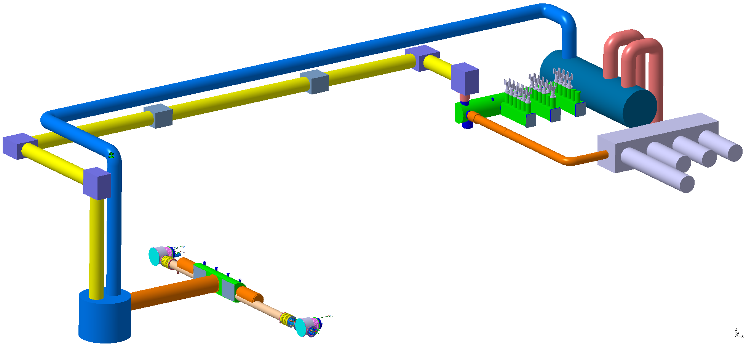
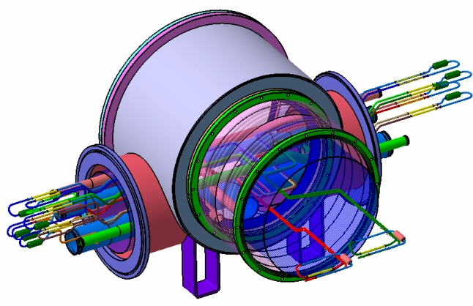
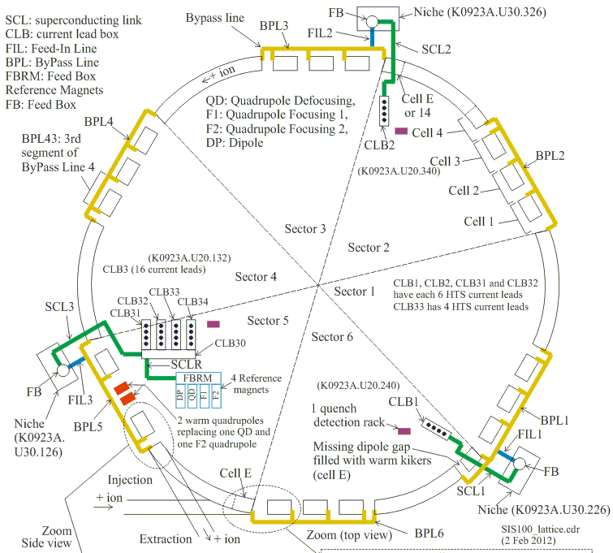
Local cryogenics (Collaboration with WUT, Poland)
Transfer line
Distribution box
Superconducting
Cold Links
No Local Cryogenics Item
No Local Cryogenics Item
PSP Code: 2.8.12.9
Feed in box
Current lead box
Feed box
PSP Code: 2.8.12.12
PSP Code: 2.8.12.10
PSP Code: 2.8.12.1
Feed in line
PSP Code: 2.8.12.11
heat load on the cryogenic system
→ capacity limit of the cryo plant

Slide 15
Procurement started for …
SC dipole magnets for SIS100
Thin wall vacuum chambers of the SIS100 dipoles
Collector ring de-buncher cavity system
(MA- ring core cavities)
The s.c. wire for all s.c. dipole and quadrupole
magnets of SIS100
HTS current leads for SIS100 dipoles and quadrupoles
SC magnet testing facilities (GSI, CERN and Dubna)
→ cryo plant and infrastructure at GSI
SIS100 bunch compressor system
.....

Slide 16
Outlook – key points for the next half a year
Recruitment and build-up of the project coordination
Redirecting and recruitment → position description,
web announcements
Establishing the communication processes (reporting)
Implementation of the planning tool
Follow up of the specification process and procurement
Establishing of the configuration management and QM/QA
Planning on office space and preparation of storage space

