Slide 1
Super-FRS higher tier control application

Slide 2
Super-FRS proposed evolution
Simulation driven operation (LISE file directly in paramodi conversion)
➔ discussion this afternoon “high level application”
Simulation driven “Setting protection”, checking danger of changes and interception of primary beam and charge states of it
➔ discussion this afternoon “high level application”
Drives moving in an out automatically setup the proper Bρ for the next section
need updated machine model including energy loss
need to remember thickness calibration
➔see machine model talk (FRS “could” operate like this today, PhD of J. P. Hucka)
Non hysteresis operation
procurement of NMR probes
➔ see talk “NMR control and operation”
Automated calibration of matter thickness will be required

Slide 3
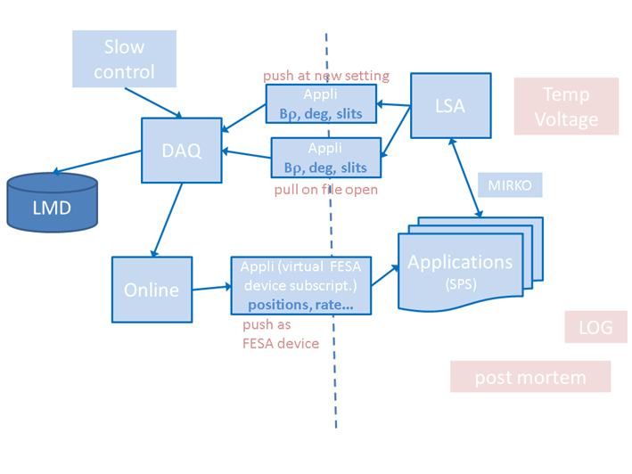
CS-DAQ information exchange
two worlds should talk
timing system same:
BuTiS
White Rabbit
From 2014 workshop

Slide 4
automatic matter calibration
Automated calibration of matter thickness will be required
Need DAQ coupling

Slide 5
Small lists of requests
PARAMODI
save and load settings
save part of beam line/load part of beam line
save all information, no hidden trim not saved
Ist/soll comparison application
Different classes of users (Expert/operators/physicists)
Machine Protection that allows us to have drives in during beam time

Slide 6
Machine model
Drives moving in an out automatically setup the proper Bρ for the next section
need updated machine model including energy loss
need to remember thickness calibration
➔see machine model talk (FRS “could” operate like this today, PhD of J. P. Hucka)
Can Paramodi drive drives? or do we need our custom application
➔ several questions on how to handle data base, write live new information and keep track of changes based on values of matter calibration

Slide 7
Setting validation system
Setting Validation System
current FRS operation➔ LISE simulation, set Brho per section, check dangerous setting from simulation
Super-FRS, more focal planes, 2 hours for each simulation
Goal: intercept request from operator, check danger, allow/warming/forbhid change
then sends information to Paramodi (.txt file or different)
2 tasks:
nuclear physics task optimize speed of simulation
interface from application to Paramodi
➔ how we integrate this in the control system (“service”?)
How much integration work is needed
Can integration be outsourced?

Slide 8
Software Interlock System
based on simulation (see point above) check if rate is what is expected at focal plane
need interface CS-DAQ, could be developed
need previous application
need CS-DAQ coupling
generate software interlock if values not like simulation ➔ outsourced?
(seems simple enough)

