Slide 1
Machine Model:
Status/Development
D. Ondreka (SYS)
SFRS Controls Workshop
GSI, 11.11.2024

Slide 2
Outlook
Role of machine models
Setting generation with LSA
Project group “FAIR Data Supply”
Status and tasks
Developments for ES and FS
Timeline
Summary

Slide 3
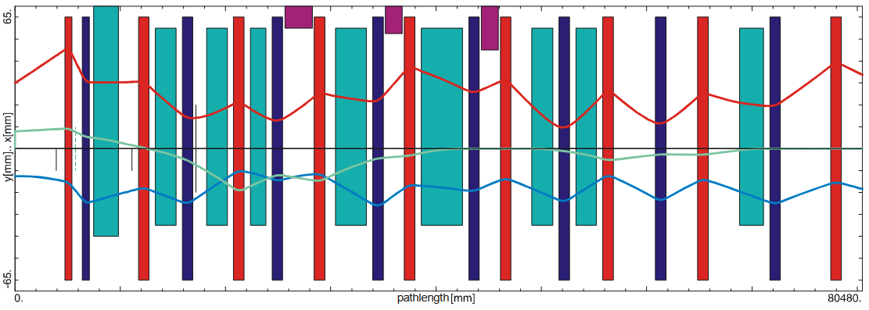
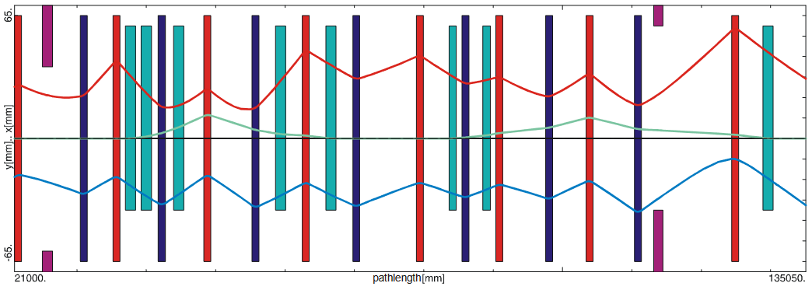
Machine Models
Early Science
  Accelerator chain for creating primary beam
    UNILAC → SIS18 → HEBT → SFRS target
  Components need to be orchestrated
    Consistent set values (currents, voltages, …)
    Consistent timing (beam/RF pulses, ramps, …)
  Must bring accelerator physics into control system
Physics-driven machine model
  Physics parameters for tuning accelerators
    Beam parameters: ion type, energy, …
    Machine parameters: beam optic, tunes, …
  Translation into consistent set values and timing
  Applications for managing settings
Relevance for commissioning
  Models required from integration tests on
Early Science
Beam optic from SIS18 to SFRS (T1S1, T1S2)
Beam optic from SIS18 to SFRS (TSX1, TSF1)

Slide 4
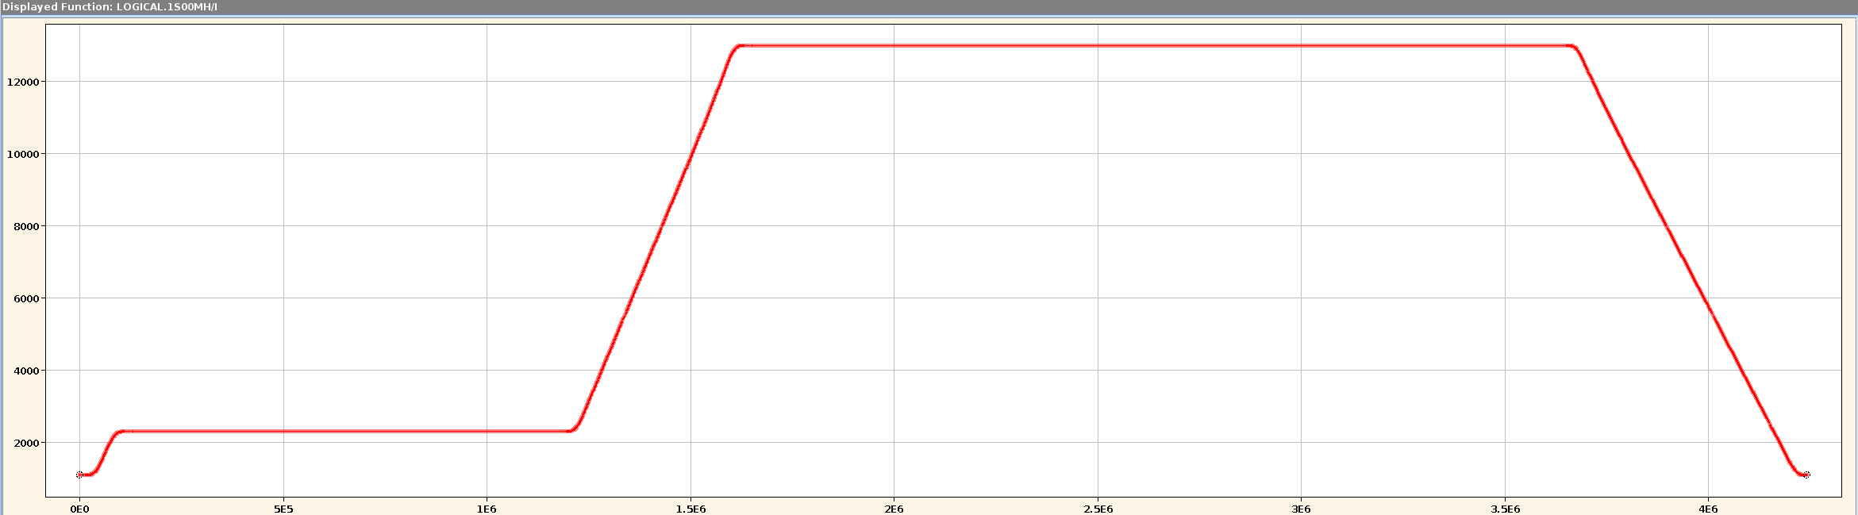




Machine modeling with LSA in a nutshell
Physics
SIS18BEAM/QH
SIS18BEAM/BRHO
SIS18BEAM/QV
Machine represented by parameters
  Linked to logical or physical devices
  Hierarchy from physics to hardware
Cycles organized in contexts
  Basic unit: beam process
  Grouping into chains and sub-chains
Values represented as settings
  Value of parameter in beam process
  Stored in LSA-DB including history
  HW settings get sent to devices
Calculations implemented as rules
  Translate from parent to child settings
  Called by LSA when values change (trim)
  Java code mostly written by physics experts
  Accelerator-specific data read from LSA-DB
LOGICAL.GS01QS1F/KL
LOGICAL.GS01QS2D/KL
LOGICAL.GS01QS1F/BL
LOGICAL.GS01QS2D/BL
Hardware
GS01QS1F/Setting#current
GS01QS2D/Setting#current
INIT
RESET
INJECTION
RAMP
EXTRACTION
Setting of tune parameter
Parameter | SIS18BEAM/QH
Beam process | P.SIS18.RING_INJECTION
Value | Constant function = 4.28
$${KL}_{n}={KL}_{n}^{(0)}+\frac{{∂KL}_{n}}{{∂Q}_{h}}∙(Q_{h}−Q_{h}^{\left(0\right)})$$
LSA DB
QH
MADX
$$\frac{{∂KL}_{n}}{{∂Q}_{h}}$$
Java code
$$Q_{h}^{\left(0\right)}$$
$${KL}_{n}^{(0)}$$
KL

Slide 5
Organization
Project group “FAIR Data Supply”
  Mission: setting generation for FAIR (since 2009)
  Cross-department organization
    Maintenance of LSA framework: 1 FTE (ACO)
    Physics model
      Core team: 2 FTE model (SYS)
      Additional contributors from machines, e.g. SFRS
Modelers’ job: physics
  Collection of requirements on models
  Parameter hierarchy and algorithms (rules)
  Provision of optics data and theory values
  Configuration of settings applications
Models needs device data
  Used to calculate and check set values
    Calibration curves for all magnets
    Device limits (min/max values) for power converters
  Must be provided by technical groups via CDB
Application
FESA DB
HW Devices
App logic
LSA DB
CDB
App config
HW params
Device data
Device limits
Calibrations
Repository
LSA Server
Hierarchy
Optics data
Calibration files
Trim logic
App config
Hierarchy files
Rules
Optics files
App config files
Rules code

Slide 6
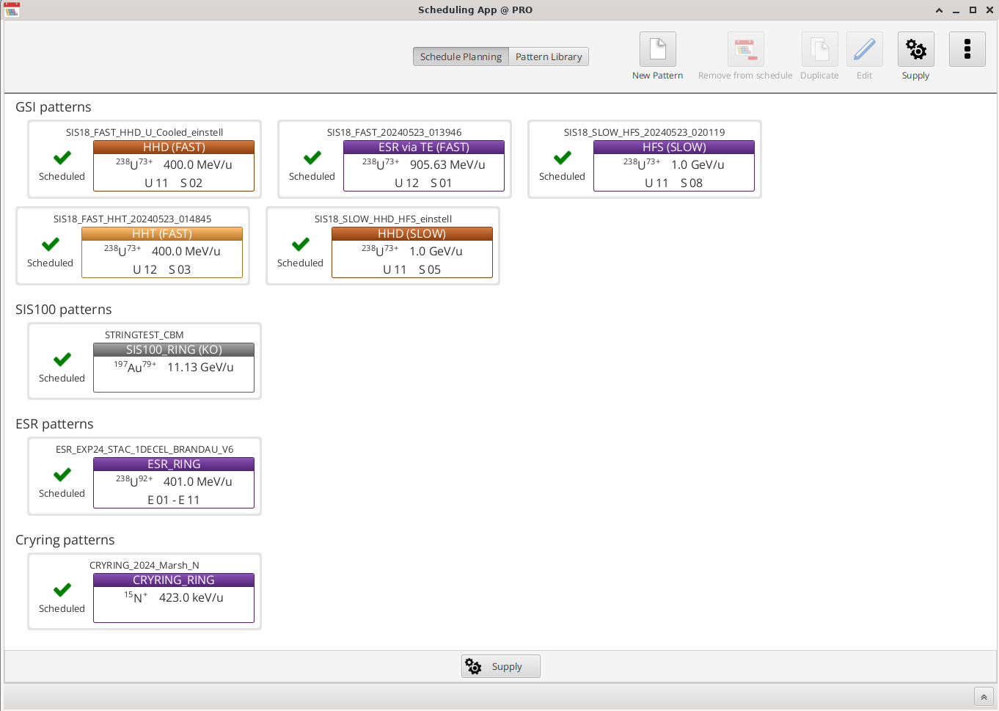
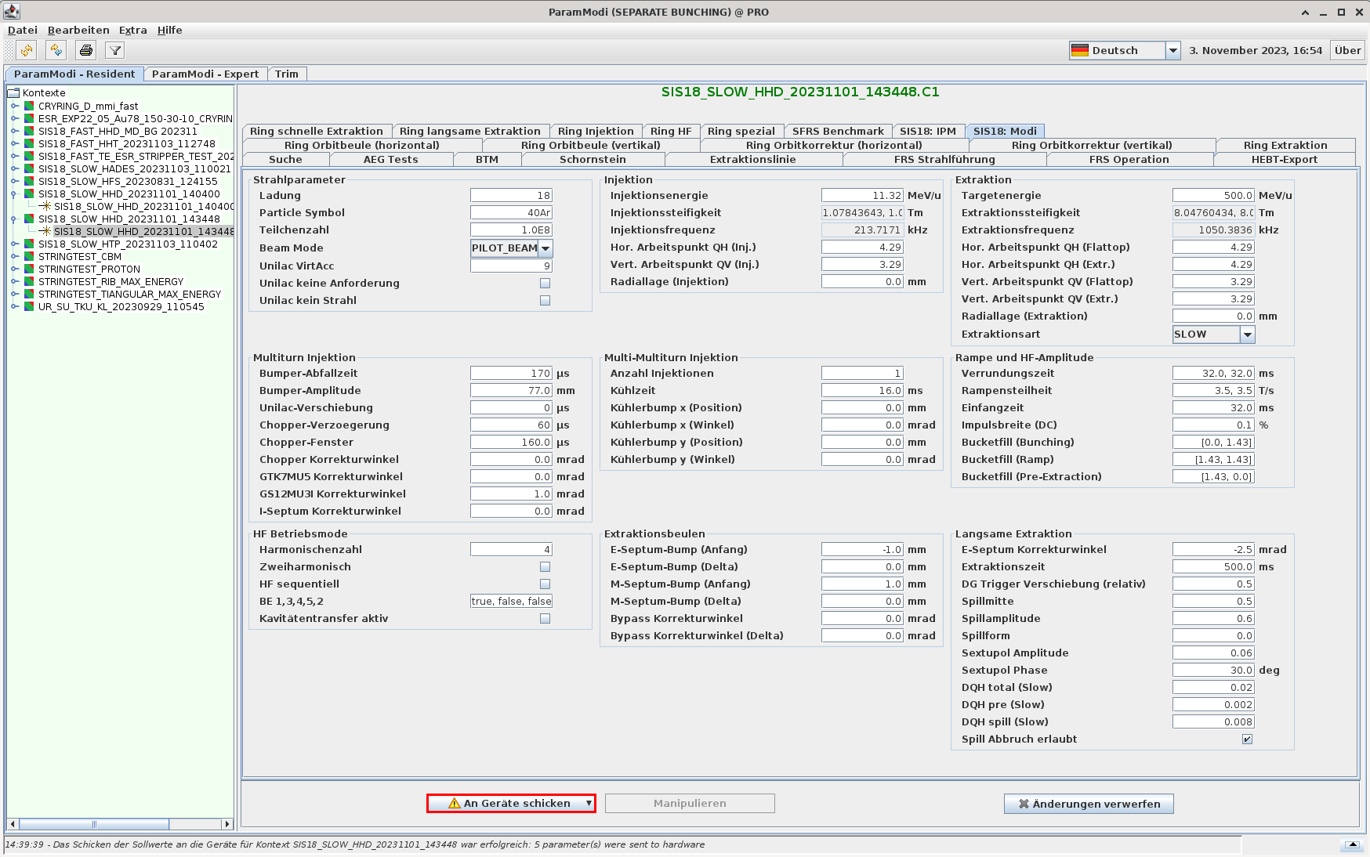
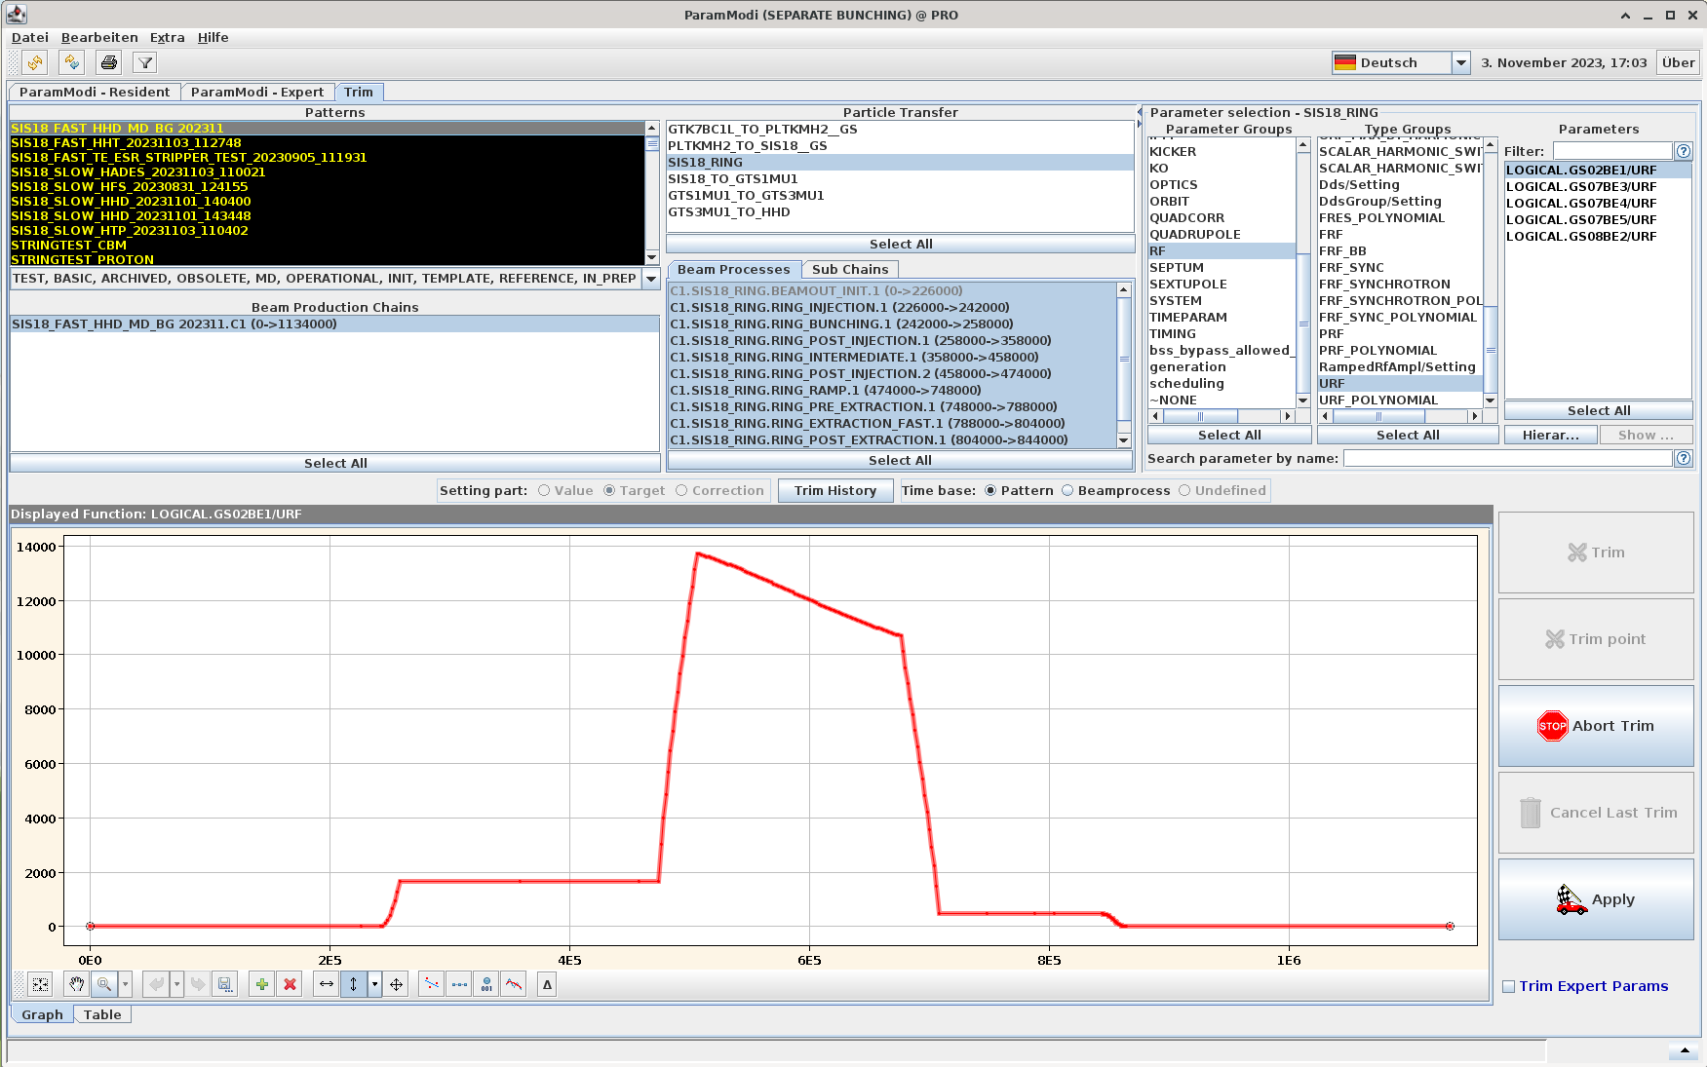
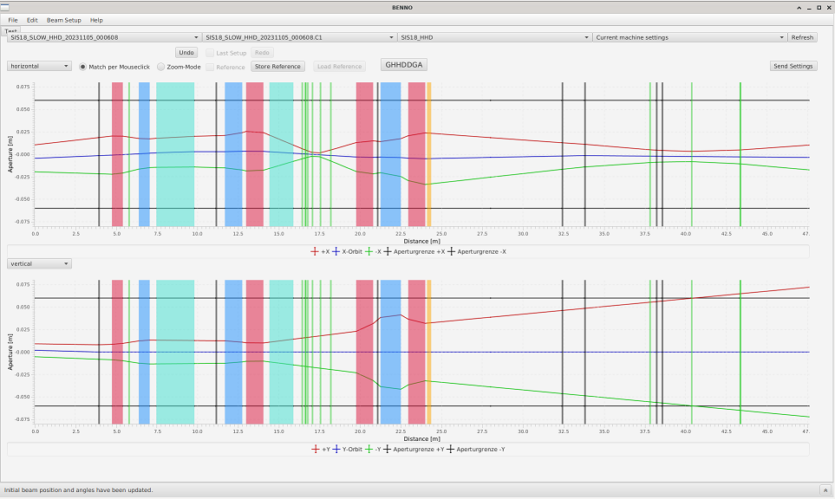
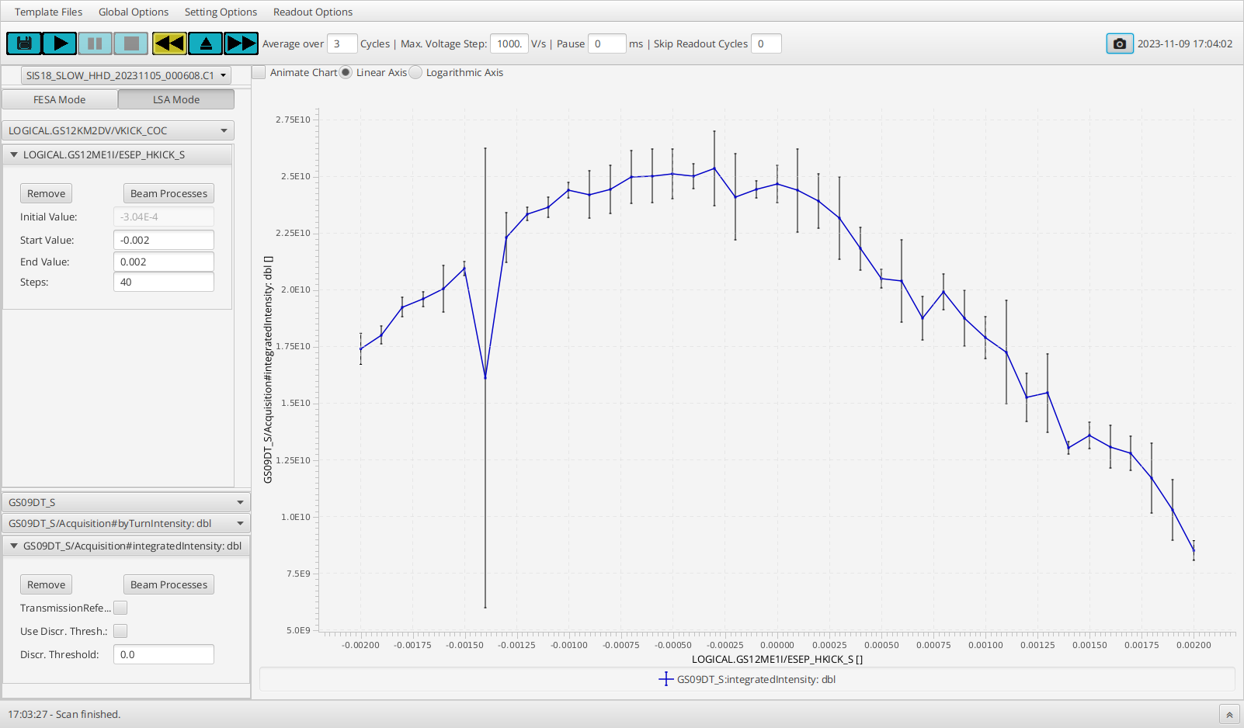
Applications
SchedulingApp: Creation of patterns
Operators need interface to models
  Applications serve as user interface
Generic applications
  Creation of patterns with initial values
  Manipulation and visualization of set values
  Import and export of top-level parameters
  Provided by ACO
Special purpose applications
  Provide higher-level functionality
  Manipulate parameters of the model
  Can be contributed by ACO or others
ParamModi: Manipulation and visualization of set values
Special purpose applications for changing set values
App. Benno (C. Heßler, OPE)
App. DeviceAutomator (W. Geithner, DEC)

Slide 7
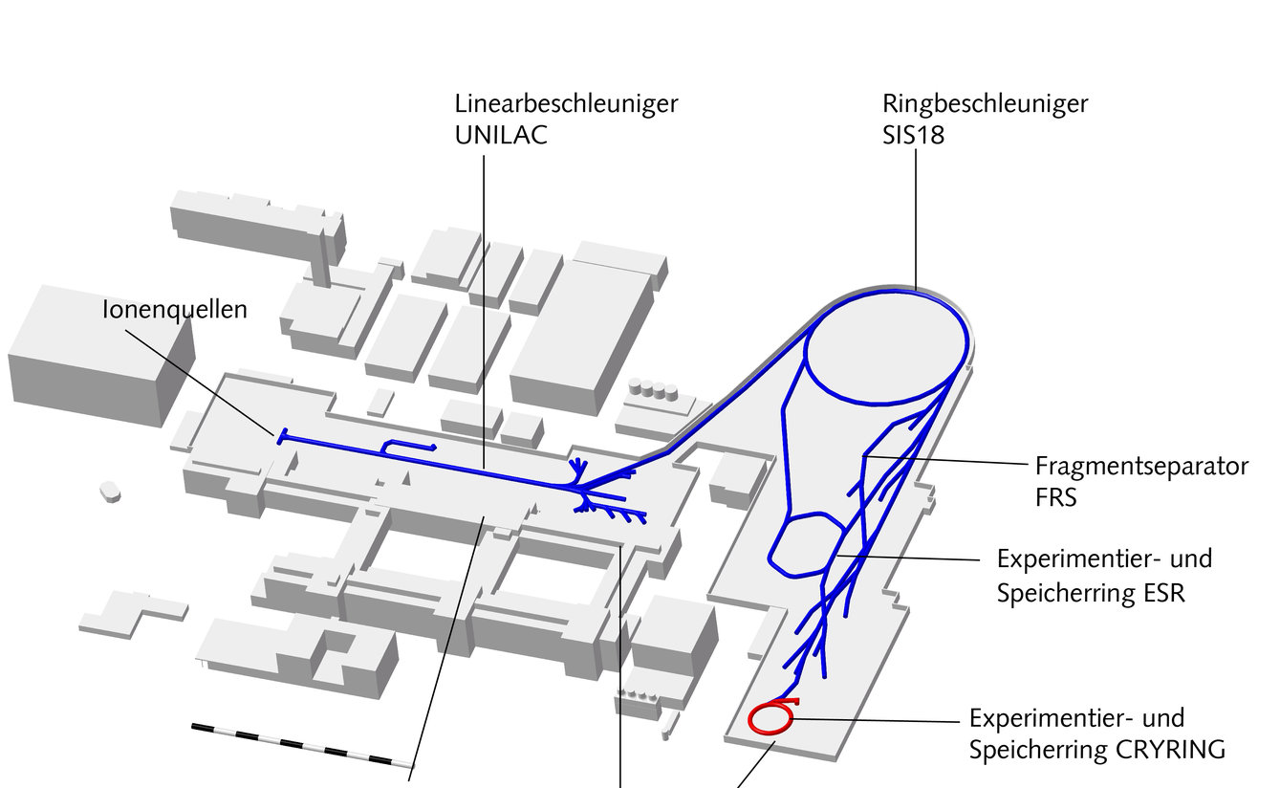
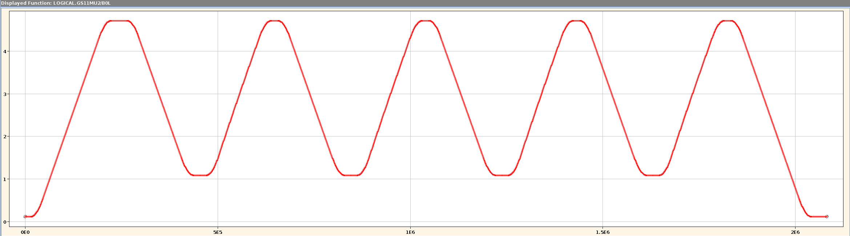
Present status and tasks
Status of machine models
  Production use
    SIS18, ESR, CRYRING
    GSI-HEBT, FRS
  Prototype implementations
    SIS100 (in use for string test)
    UNILAC (work in progress)
Present main tasks
  Developments for ES
    Machine model for ES beamline
    Machine model for SFRS
  Developments for FS
    Completion of SIS100 model
    Booster mode for SIS18
    Conceptual work for FAIR operation
  Completion of UNILAC model (mainly ICU team)
Production use of models
CRYRING (injector) | 2016
CRYRING | 2017
SIS18 | 2018
FRS | 2019
ESR | 2020
HITRAP | 2022
SIS100 (string test) | 2023
SIS18
booster
cycle
Parallel operation in FAIR: SIS100-CBM + SIS18-SFRS
UNILAC
SIS18
SIS100

Slide 8
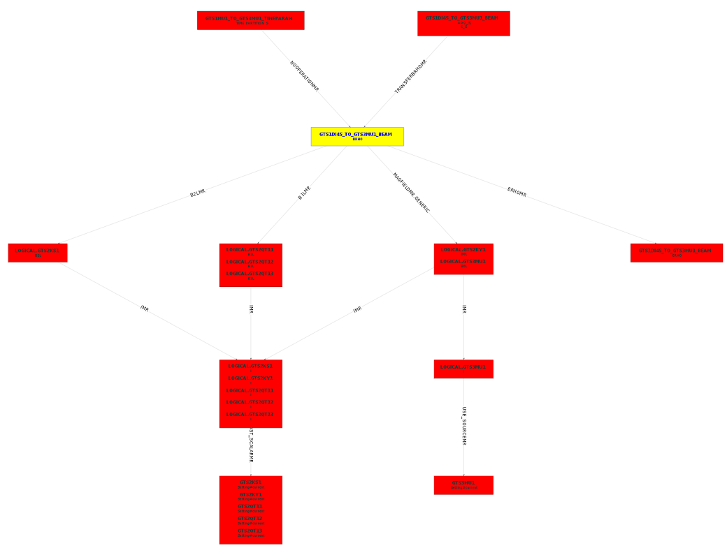
FRS Magnet Model
Completely identical to GSI-HEBT
  Originally developed by B. Schlei
  Now responsibility of I. Kraus
Simple ‘single-magnet’ model
  Strength
  Integral field
  Current (could be Hall probe voltage as well)
Requires device data in CDB
  Power converter limits (min/max currents)
  Excitation curves (current vs. integral field)
Magnet hierarchy in GTS1DI4S_TO_GTS3MU1

Slide 9
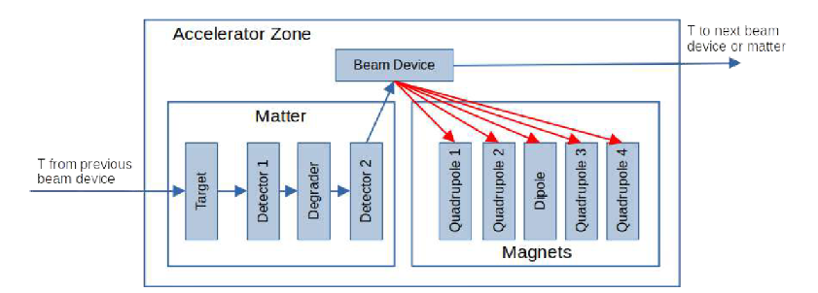
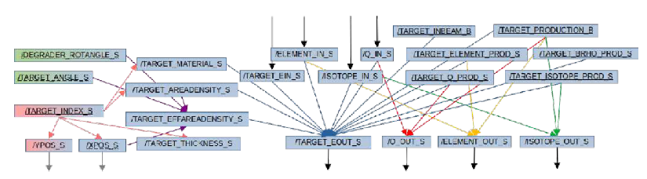
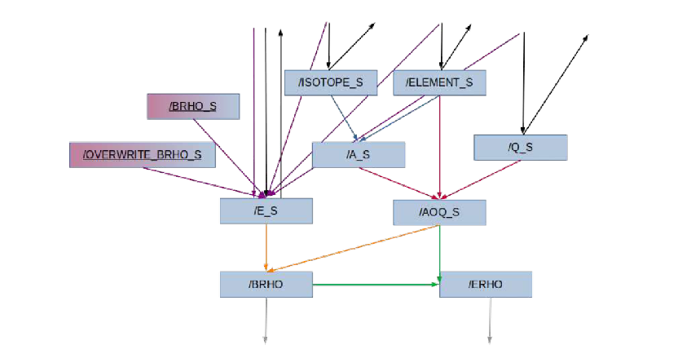
FRS Matter Model
Developed by J. P. Hucka (PhD)
General matter hierarchy
  Combine matter into blocks
    Targets, degraders, detectors
  Implement energy loss calculations
    Matter content per device defined in files
    Energy loss for projectile/material in splines
  Set values for drives calculated in model
    Presently not sent to devices (drives set manually)
Direct manipulation of rigidity
  Standard way uses ‘reference isotope’
  Model can be set to ‘direct Brho’ mode
    Users can enter desired Brho directly
Lumped matter block at start of accelerator zone
General matter hierarchy
Hierarchy for overwriting Brho

Slide 10
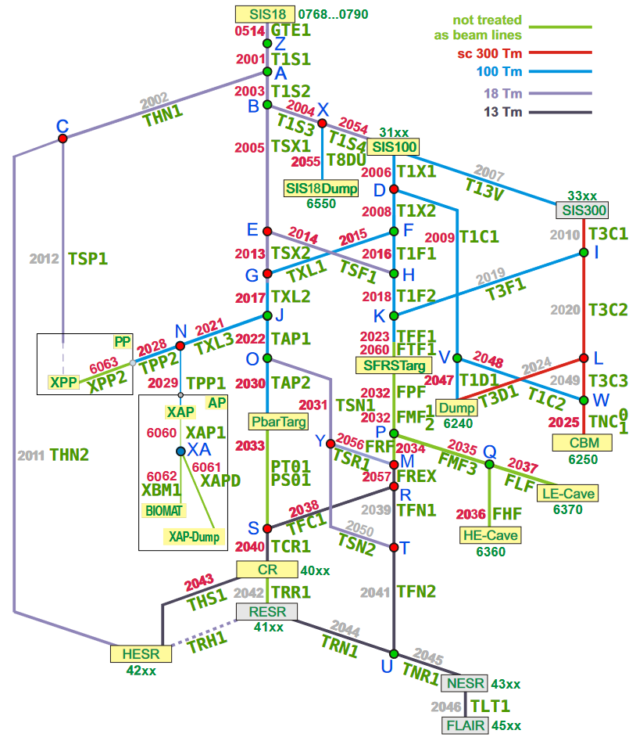
Developments for Early Science
Beamlines of the GSI facility
Machine model for FAIR-HEBT
  Responsibility SYS (I. Kraus)
  Includes magnets of SFRS
  Model identical to GSI-HEBT
  Data sources partially different
  Unified approach for GSI and FAIR in progress
  ES beamline with mock-data ready spring 2025
Machine model for SFRS
  Magnets modeled as part of FAIR-HEBT by SYS
  Matter part responsibility of SFR/SFS
    Model very similar to FRS at GSI
    Planned and executed by SFR/SFS personnel
    Support by data supply group
Production use requires real device data
  Models initially tested with mock-data
  Real data must be in CDB in time for dry runs
Beamlines of the full FAIR facility

Slide 11
Timeline
2024
2025
2026
2027
2028
Beamtime
Beamtime
Beamtime
Beamtime
Beamtime
FCC
ES DR
ES BC
FS DR
FS BC
ES device data in CDB
FS device data in CDB
ES
activities
FAIR-HEBT model
SFRS model (magnets)
SFRS model (matter)
HEBT FS
Development of FAIR pattern concept
FS
activities
SIS100 model (completion)
Patterns
SIS100 (r.)
SIS18 booster (prototype)
Booster
Booster (rev.)
Responsibility SYS
Prerequisite for production use
Participation SYS
Responsibility SFR, with support from SYS

Slide 12
Summary
Machine models translate accelerator physics to set values for devices
  For ES especially beam parameters and optic
  Applications to create and manipulate set values are provided
Implementation based on LSA framework within project group “FAIR Data Supply”
Project group “FAIR Data Supply”
Machine models in production use for GSI facility (except UNILAC)
Models for ES in preparation
Summary

