Slide 1
Magnetic field control* by NMR probes for SFRS dipoles
Erika Kazantseva, work package leader SFRS Beam dynamics
SFRS Workshop: control needs, operation concept, 11.11.2024.

Slide 2
Outline
Motivation
Hardware system
Operation principle (draft)
Remarks
Wishes

Slide 3
Motivation
Reproducible setting is a must:
The state of the art: precycle & use current control → relative reproducibility on the level of few 1e-5, but slow (~ 4 min / cycle)
Just following hysteresis branch not sufficient: different ramping & intermediate stops → errors on the level of 1e-4
Using NMR measurements + knowing calibration curve Bint(Bloc) enables accuracy of ~ 2e-5 just following the hysteresis branch, without caring of intermediate stops
Shorten the precycling → more time for physics

Slide 4
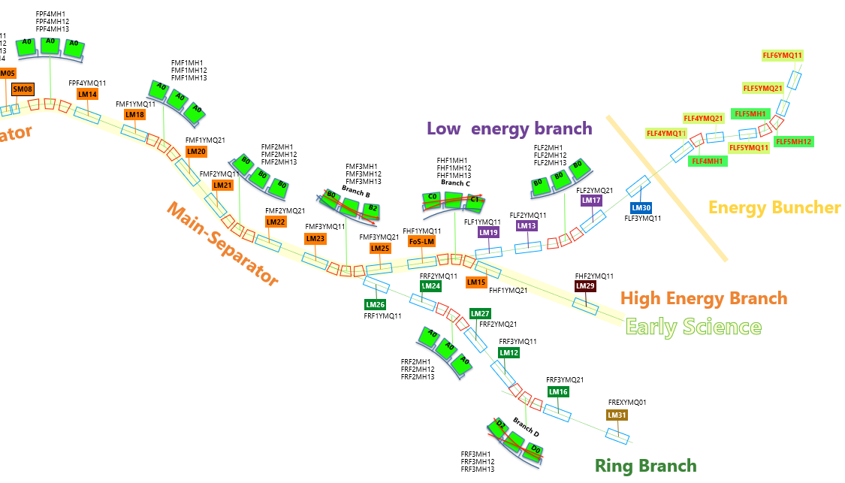
Hardware system
dipoles always on, zone 1
only one branch is on, zone 2
4
Each block = one NMR magnetometer:
Min. 3 dipoles, max. 6 dipoles active simultaneously per block
Max. 9 dipoles per one NMR magnetometer
2 probes in 1 dipole
2

Slide 5
Hardware system: connections
3-Dipole block
6-Dipole block
9-Dipole block
NMR Magnetometer
NMR Magnetometer
NMR Magnetometer
8-channel Switch
8-channel Switch
8-channel Switch
2 spare channels
3 spare channels
4 spare channels
6 Probes in 3 dipoles
8-channel Switch
8-channel Switch
8-channel Switch
12 Probes in 6 dipoles
18 Probes in 9 dipoles

Slide 6
Operation principle (draft)
Each SC dipole gets probes covering the whole B-region
Calibration of Brho(Bloc) during ion-optics commissioning with beam (to consider also cross-talk impact), also register I(Brho)*
In operation use scheme (this needs to be iterated with CS experts):
Send I-δI to the PS** of involved dipoles
set Brho
calculate Bloc(Brho), I(Brho)
Measure Bloc
dBloc/Bloc< tol?
Adjust I by increasing***
no
yes
*Accuracy of 1e-4 is good for first guess
** I-δI should be such, that you surely need to increase I to achieve set Bloc value
*** Efficient algorithm that avoids overshooting to be developed
Move to the next dipole

Slide 7
Remarks
Direct NMR field control is infeasible:
A NMR magnetometer connected to up to 6 dipoles -> ramping time multiplied by 6 for sequential direct field control
NMR probe cannot measure fast ramped field -> implementation possible but cumbersome/tricky
NMR measurement is complex process (especially for digital signal processing), has multiple setting parameters
Measurement precision depends on parameters
Optimum parameters vary for different field levels and probe locations
Ideally there are procedures for automatic parameter optimization and the optimal parameters are stored for every field value
There are C++/Python drivers for NMR magnetometers
There is an Ethernet interface to connect to the control system

Slide 8
Wishes
A flexible user/operator/expert interface to measure field in one or more dipoles
Ideally all of capabilities of the system is translated to the CS interface, including running custom scripts (expert) with measurement setting and sequence
A robust and time-efficient way to set all selected dipoles to given Bloc array (calculated from calibration curves Bloc(Brho) for each dipole)

