Slide 1
Super-FRS requirement to controls for commissioning

Slide 2
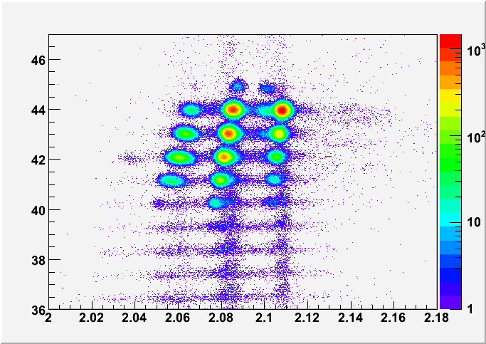
Objective of Super-FRS commissioning
Main goal of Super-FRS: select and identify ions produced in nuclear reactions at the target.
Final goal of the Super-FRS commissioning: show we can select and identify ions with it.
Confirm something like
this Nov 2027 ➔
Z of particle
Data from
FRS
AoQ of particle

Slide 3
Scope (elements) of commissioning
Goal commissioning: reach FHF2 (commission the full HEB line)

Slide 4
FHF2

Slide 5
General planning, top to bottom
first planning from installation plan
2024 start installation, 2025 ramp up installation, 2026 finish installation
2025 start commissioning, 2026 ramp up commissioning, 2027 beam commissioning

Slide 6
Phase of commisining
Phase 1: hardware commissioning (after mechanical completion)
Phase 2: remote commissioning
Phase 3.1: integration test
Phase 3.2: dry run (SAT Ba/M11)
Phase 4: beam commissioning (SAT Bb/M12)
(note, beam can be reasonably high intensity at the end)

Slide 7
Commissioning phases, sections goal
Need sectioning to breakdown the work
Allows to plan parallel installation work and/or commissioning work
Goal commissioning: reach FHF2 (commission the full HEB line)

Slide 8
System list
SCM: Super Conducting Magnets
NCM: Normal Conducting Magnets (target area)

Slide 9
Status of planning, Beam diagnostic chambers
suppose VAC phase 2 done
pressured air, power for motor drive
and patch panel connection
pressured air, power for motor drive
and patch panel connection

Slide 10
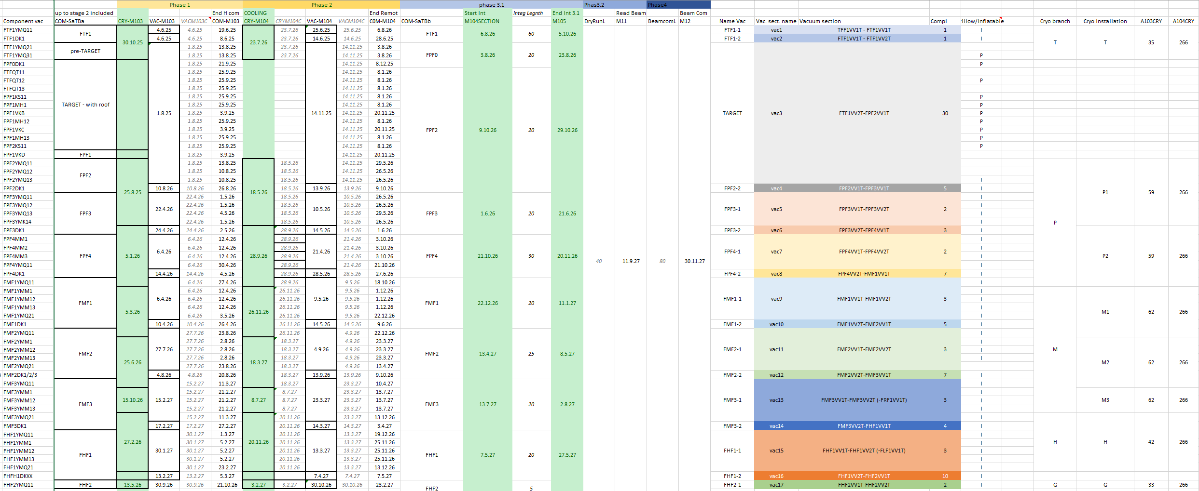
Full .xls document

Slide 11
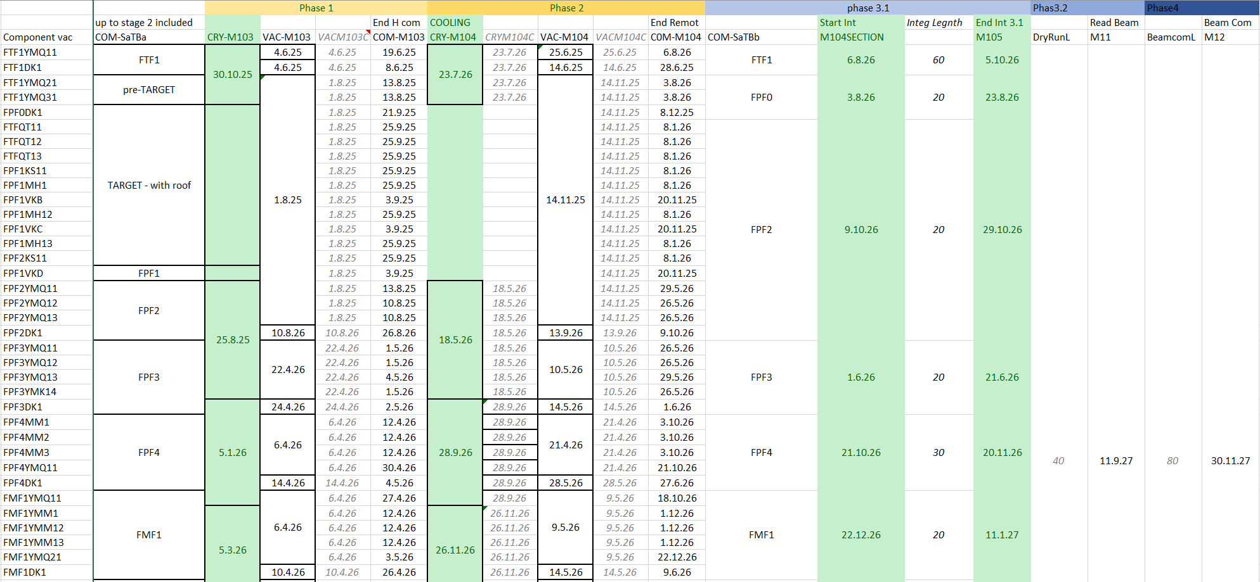
First simulations – toy model

Slide 12
Requirement
From phase 2 of commissioning:
Network infrastructure
FESA control
From phase 3.1
higher tier applications
LSA
As soon as possible
DAQ coupling so we can prepare commissioning applications
posiblity to have simple interface (python) for “ad hock” implementation

Slide 13
Requirement per system
Target area
for phase 2
➔ IND, VAC control
➔ Phytron controller
for phase 3
implementation of higher level control for beam catcher, target and magners
Normal Conducting magnets
for phase 2
network
timing
FESA

Slide 14
Requirement per system
Beam line vaccum
Phase 2: VAC control system
Cryogenics (LCM in progress)
phase 2: CRY control system
Super Conducting Magnets
phase 2:
Quench Detection subnet ready
FESA class present
timing
network

Slide 15
Requirement per system
Beam diagnostic
phase 2:
network
timing
FESA server
Super-FRS machine model needed for phase 3.1
Super-FRS ACO DAQ coupling will be tested for phase 3.1
BUT: need way to develop based on the protocol BEFORE

Slide 16
System list
Need some custom applications ready for 2027,
Learning curve for ACO application development, 4 to 6 months
No man power before 6 months at best
➔ start to be short!

Slide 17
Super-FRS requirements, color scheme
safe, will happen or mitigating actions existing
normal
mission critical request or high concern about this being present in time (based on my current knowledge)

Slide 18
Super-FRS Machine model– link to D. Ondreka
FRS machine model ready and running, includes matter
Need to be ported at Super-FRS
two operation modes (ready)
user sets Brho per section (like FRS)
machine model takes care of matter calculation (need proper matter database and matter calibration) – drives moved from Paramodi
Goal, PhD student joining late 2025, so time to implement in 2026 and person is present for commissioning/ES operation in 2027

Slide 19
Super-FRS requirement – to ACO
Vacuum and cryogenic control possible from NUSTAR control room
Vacuum controls allowing experiment installation
PARAMODI
save and load settings
save part of beam line/load part of beam line
save all information, no hidden trim not saved
Ist/soll comparison application
Different classes of users (Expert/operators/physicists)
Machine Protection that allows us to have drives in during beam time
Integration interlock from experiments (lines) and across systems

Slide 20
Super-FRS specific application (I) – CSG prio 1
FESA class for Phytron motors (5 drives)
➔ development done, test next week
Open point: integration to higher tier of the control system (Device control etc..)
Super-FRS integration of Stray filed handling in trajectory control
➔ use of Benno to be checked with Super-FRS magnets and beam dynamics experts
Super-FRS MAGSTAT/DRIVESTAT
need to be ported from FRS to Super-FRS, (0.5 FTE),
need to shows easily longer beam line for easier monitoring

Slide 21
Super-FRS specific application (II) – CSG prio 1
Super-FRS CS-DAQ coupling
➔ concept ready since 2014
➔ needed for any sequencer/automatic calibration during commissioning
➔ we understand “general one solution for all FAIR pillars” would be nice but we can not wait everybody aligns. Our requirement are written since 2015!
➔ alternative, ssh tunneling?
Super-FRS MGSKAL:
➔based on sequencer, used to cycle the magnet through hysteresis, long for FRS (2 min), Super long (~15 min) for Super-FRS
Facility control: Gas system control

Slide 22
Super-FRS specific application (IV) – CSG, prio 2
Setting Validation System
current FRS operation➔ LISE simulation, set Brho per section, check dangerous setting from simulation
Super-FRS, more focal planes, 2 hours for each simulation
Goal: intercept request from operator, check danger, allow/warming/forbhid change
then sends information to Paramodi (.txt file or different)
2 tasks:
nuclear physics task optimize speed of simulation
interface from application to Paramodi
Software Interlock System
based on simulation (see point above) check if rate is what is expected at focal plane
need interface CS-DAQ, could be developed

Slide 23
Super-FRS specific application (non CSG)
Field control from NMR probes (to avoid long cycling magnet procedure)
need discussion on implementation
man power needed in Super-FRS group (< 1 FTE)
LISE setting to Paramodi conversion (small application)
General view/monitoring of spectrometer
question is how to simply monitor 150+ magnets and 60 beam device, Device control need several screens
Sequencer APP coupled with CS-DAQ coupling for automatic mater calibration (and detector calibration)

Slide 24
Conclusion - outlook
need quite a lot of integration between ACO and SFRS for commissioning
currently every two weeks meeting with Ralph, Ralf, Frederic, Christine and me
for commissioning having a “ACO contract” for SFRS who follows the issues will be welcome

Slide 25
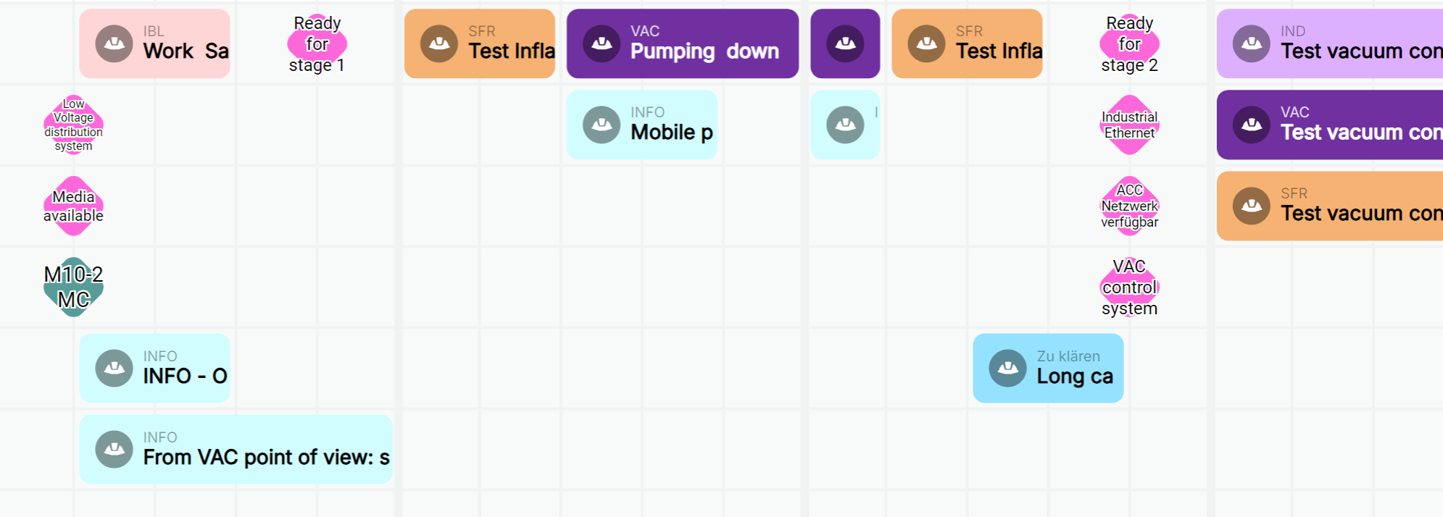
First test of commissioning
Installation started this year, commissioning starts next year
first commissioning: Vacuum pre target area

Slide 26
Future plan, phase 1 and 2
finish the LCM workshop and resource collection
consolidate sequencer operation for commissioning
organize teams for commissioning, hardware (phase 1 and phase 2)
objective : having 2 teams for VAC, SCM and BeamDiagnostic + pool of experts we can pull if needed (eg, collaborators, ext. partners) which can go along the beam line
Target and Normal Conducting Magnets are more localized
Cryogenics organization: under discussion

Slide 27
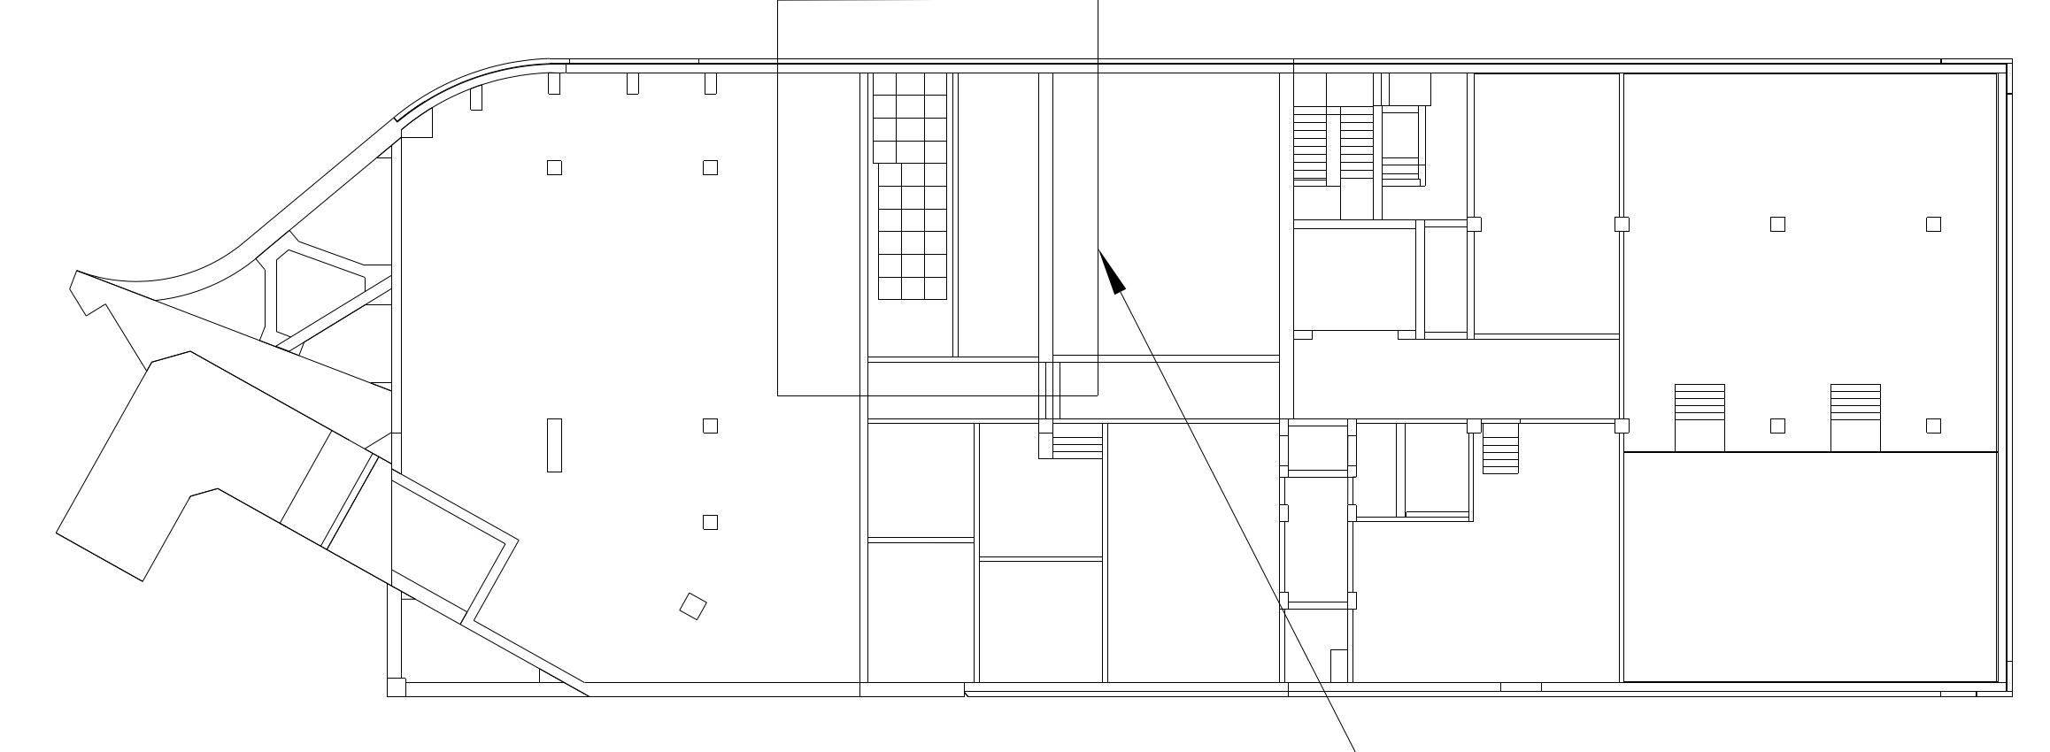
From phase 3.1 to 4
higher level expertise will be needed (harder to plan with general ressources):
SFRS EXP DAQ coupling of detectors to experiment, very few people can do it (6 people at GSI+ 2 outside)
integration to higher level control system ➔ need support from ACO
phases ran from NUSTAR control room (SFRS room):
closer access
close to our labs
modern solutions we can
easily interact with FAIR
control room
E20.008
NUSTAR
13 m
E20.009
SFRS control
L0321A ( G006a)

Slide 28
Beam commissioning
goal of beam commissioning (coarse):
test beam instrumentation
check, measure ion optic parameters
➔ for defining details we are establishing a “commissioning working group” to discuss exchange ideas on the topic (SFS/SFC)
beam requirement:
SIS18 slow extraction, 1 to 5 s
12 to 18 Tm
light to medium and then heavy ➔ example Ar, Sn and Pb/U
1e4 particle per spill to 1e8 particle per spill (end of commissioning highest intensity possible)
we could (low probability) have to go back to lighter
for final beam commissioning: ²³⁸U (or agreement with NUSTAR)
if sharing, and everything works, block mode
beam emittance requirement on the final beam instrumentation tests and for ion optic

Slide 29
End of beam commissioning
Check identification from Spectrometer with Isomer Tagging
request to NUSTAR to provide a setup for this
➔ follows return of experience from FRIB (USA) and BigRiPS (JP) commissioning

Slide 30
Phase 3.1, 3.2 and 4 commission, some thoughts
Risk/opportunities (organization)
presently all high end single particle tracking detector read in experimental network and all magnet control in accelerator network:
Super-FRS EXP DAQ (PSP 2.4.6.3.1.2), data source different format/network from ACC/BEA
we need a solution to permit automatic/advanced beam tunning for ease and speed of operation
until solution not present man power can not be engaged in development
from 2026 man power will be occupied in commissioning
….. Ralph is aware… but still something we really need soon

Slide 31
Super-FRS and NUSTAR
Link NUSTAR
need support for isomer tagging at FHF2 from NUSTAR
clear channel of communication, through Helena Albers for NUSTAR requests
final setting of our commissioning should open the first experiment done together with NUSTAR
➔ then Early Science can start

Slide 32
Idea learnt from CERN visit
Picket vs “on call”
on-call: waits for a call
picket has an active role ➔ monitors the system
Request would be picket for critical system during beam commissioning
CRY, VAC, Controls…
rotating coordinators, option for long beam time
same goal, same objectives
goal of the week given/designed clearly

Slide 33
Commissioning organization, ideas (to be discussed)
Phase 1, 2
system responsible, responsible for commissioning
up to two team working in parallel per system
coordination from commissioning teams
Phase 3, 4
commissioning more centrally managed
use of sequencer where possible
for beam operation (plan several months), rotating coordinator, daily report
weekly objective
team/operation in shifts (with shift leader)
we expect people have the same goal at hand

Slide 34
Last thought
Super-FRS commissioning will be a interesting culture mix:
Nuclear Experimental Physics (SFS)
Support from operation/machine oriented physicists (SFC/ commissioning team)
some reporting (QUA.. PMO)
…. let’s try to learn from each others!

Slide 35
My thanks to:
Seva Kamerdzhiev, Marie Cabioch, Marina Gorda, Stephan Reimann,
Heike Marcocelli, Valentina Ricciardi.

Slide 36
plans
plan your work and work you plan!!!
Installation Readiness Release (Desy)
Components detail (ESS)

Slide 37
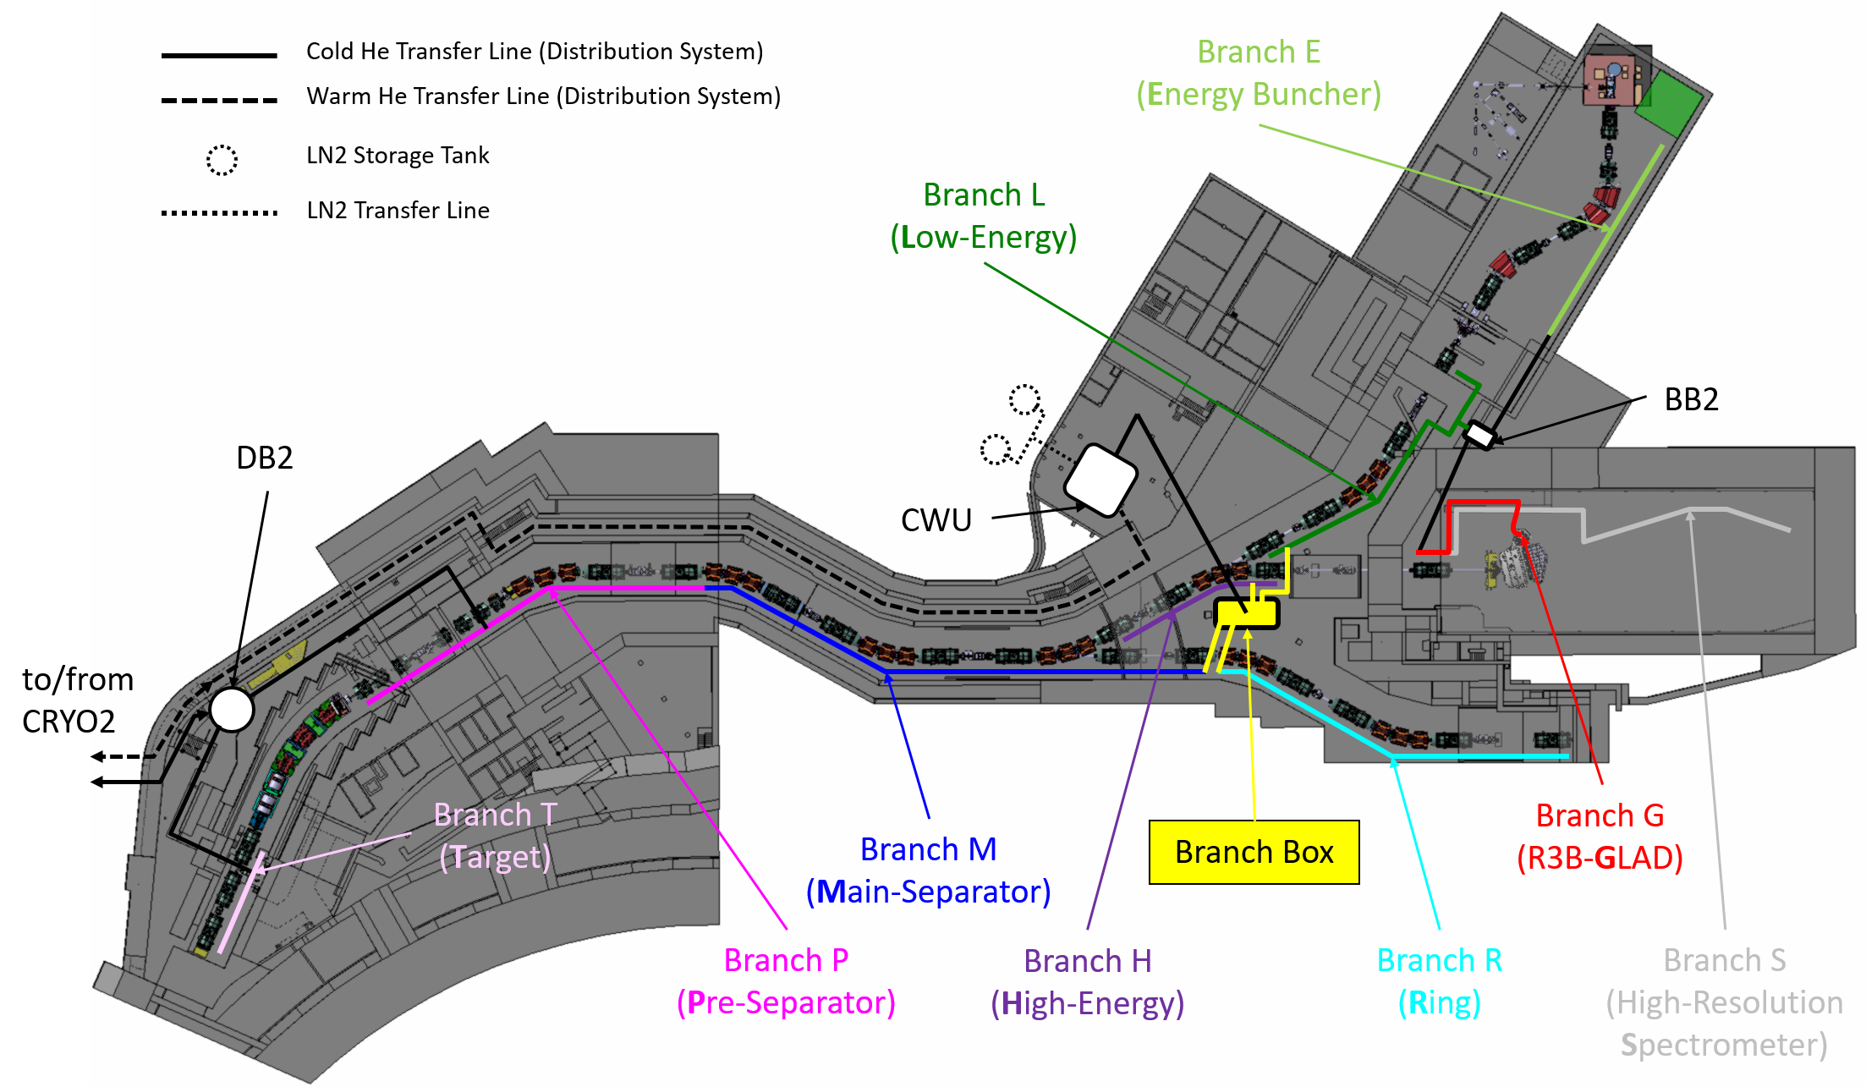
Local Cryogenics Branches

Slide 38
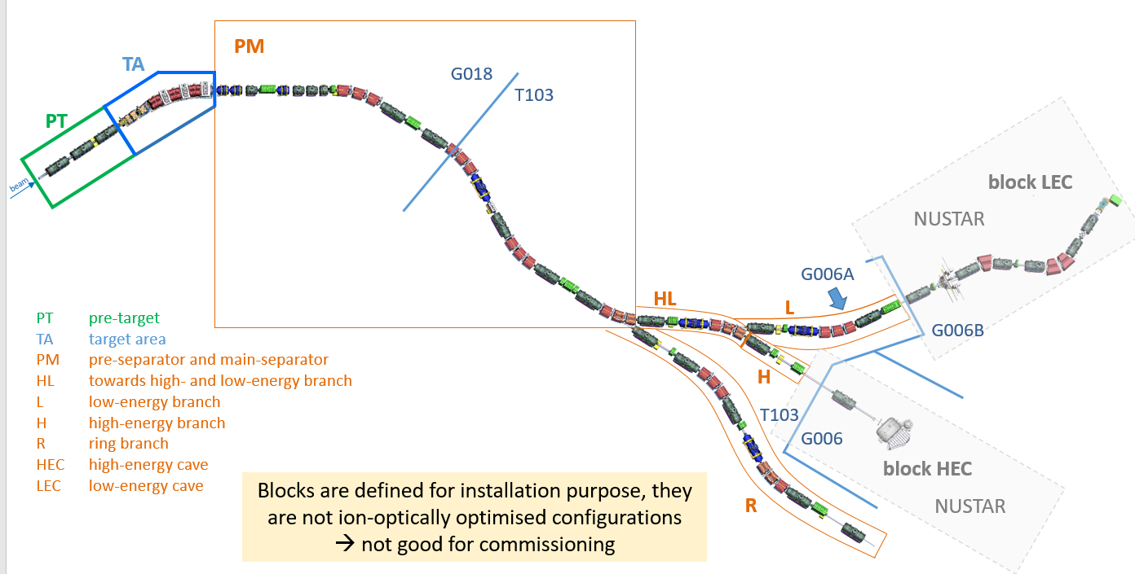
Commissioning need to be done in parallel to installation (as much as possible)
Integration test could be done “per installation block” ➔ main question: Cryo commissioning (no info possible)!

Slide 39
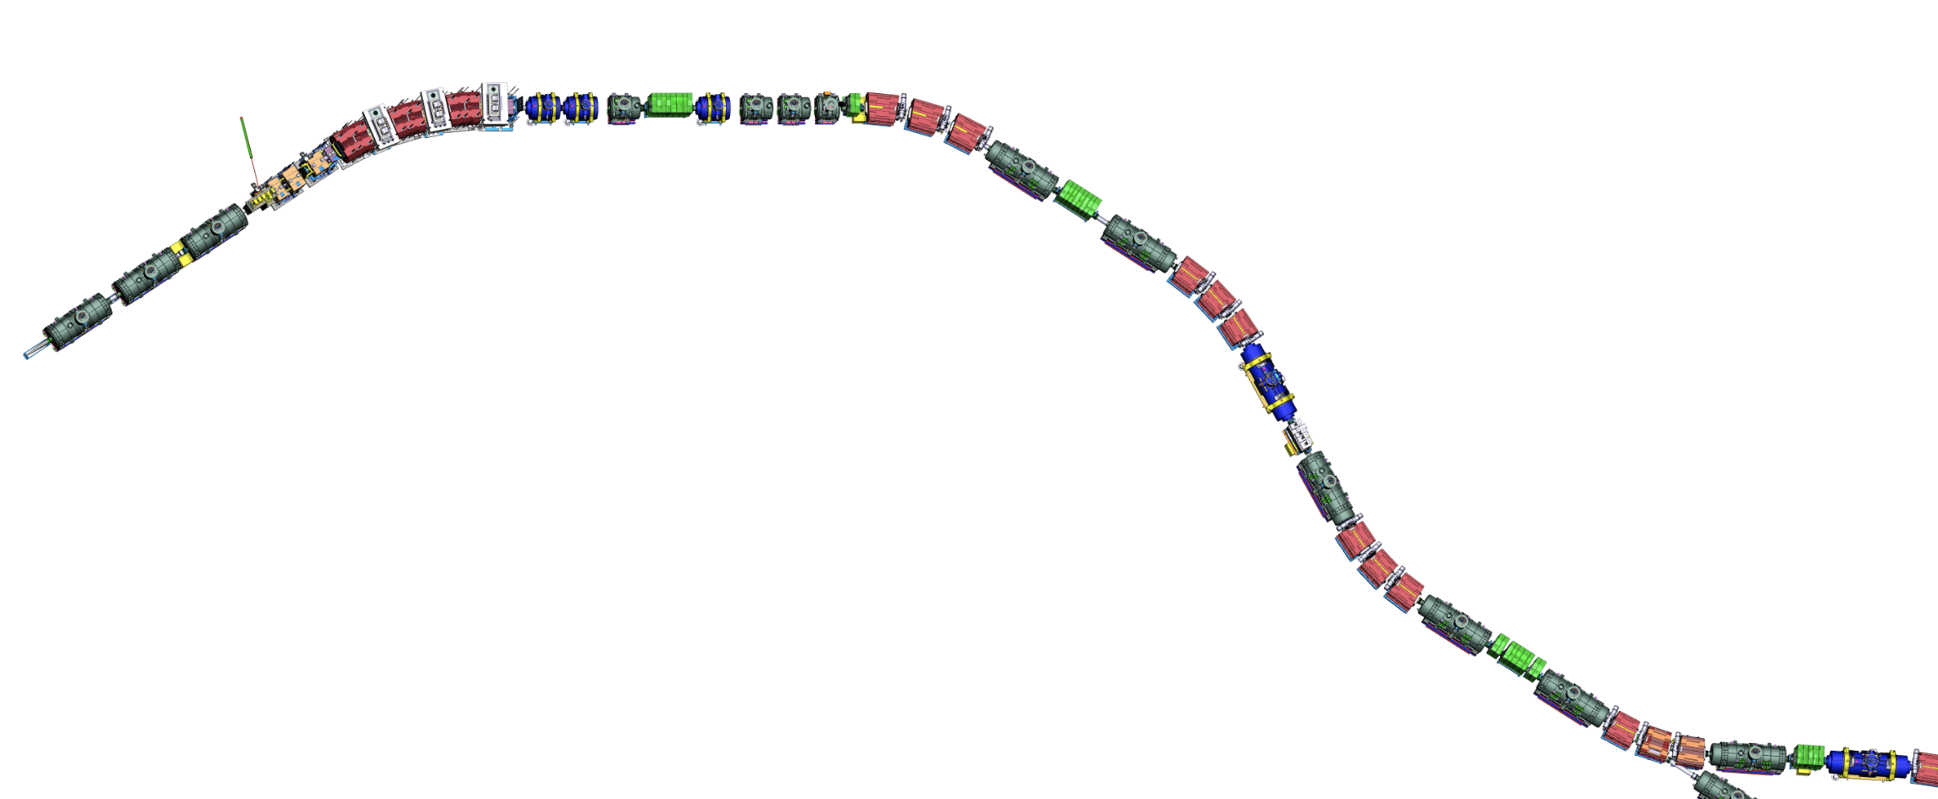
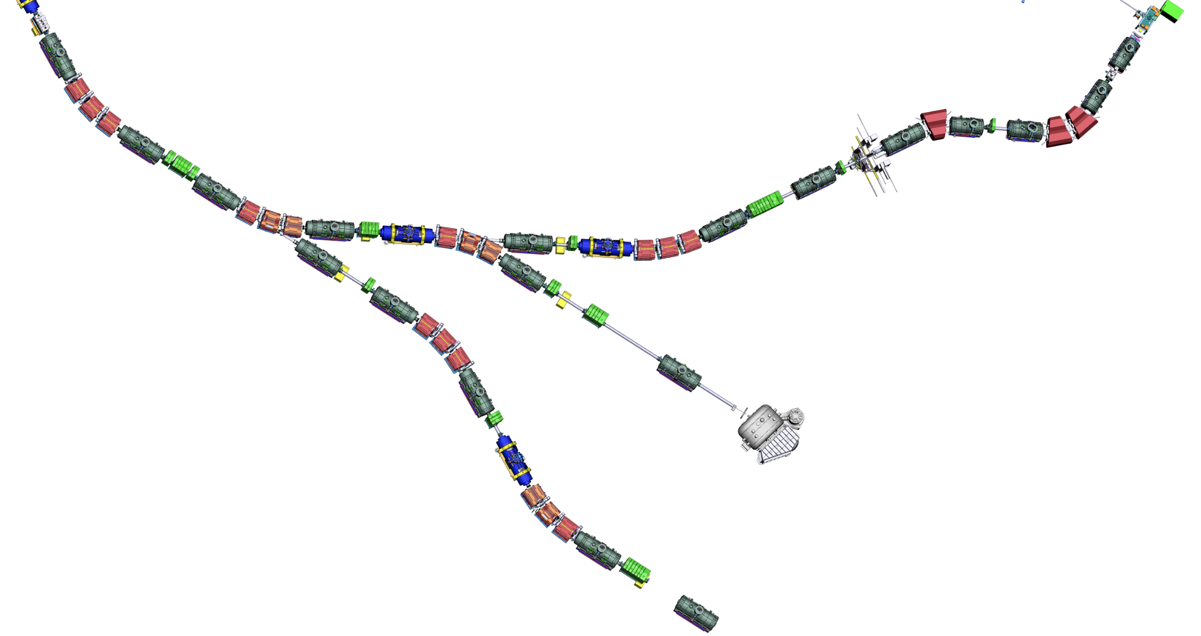
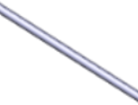
Assembly Units
Assembly Units along the beamline
SM_01
SM sc short multiplet
LM sc long multiplet
SCD sc dipole
DC diagnostic chamber
VAC beam-line vacuum
EBD EB dipole
EBM EB multiplet
TA target
NC_QQ nc quadr. 1a + quadr. 1b
NC_QS nc quadr. 2 + sextupole
NC_D nc dipole
BC beam catcher
NC_S nc sextupole
SM_02
SM_03
SM_04
SM_07
SCD_01
SM_05
BC3
DC_02
SM_06
DC_03
BC2
NC_S
NC_D2
NC_D3
SCD_02
BC1
SCD_03
NC_D1
LM_04
NC_QS
NC_QQ
DC_04
TA
LM_03
FPF1
FPF2
FPF3
LM_05
VAC_02
SCD_04
LM_02
DC_01
FPF0
FPF4
SCD_05
LM_01
SCD_06
VAC_01
FTF1
LM_06
beam
DC_05
Power converter Racks (total) 77
Control Racks (total) 336
not ATB
FLF6
Number of pieces for Early Science
(Target Area excluded)
FMF1
LM_07
DC_17
SCD_07
FLF5
SCD_08
FLF4
EBM_05
SCD_09
LM_08
FLF3
DC_16
DC_06
EBM_04
DC_07
FLF2
7 sc short multiplets
13 sc long multiplets
15 sc dipoles
10 diagnostic chambers (DC_01 not includable)
4 long/special beam pipes
DC_08
SCD_11 (branch)
FMF3
EBD_03
LM_09
SCD_14 (branch)
EBD_01
DC_15
SCD_10
FLF1
DC_13
EBM_02
EBD_02
SCD_12
LM_16
EBM_03
LM_10
SCD_13
EBM_01
FMF2
DC_09
LM_11
LM_14
SCD_18
SCD_17
SCD_15
SCD_16
VAC_06
LM_15
DC_12
LM_17
VAC_05
DC_14 (maybe)
LM_18
LM_12
VAC_07
Additional number of pieces for LEB (up to FLF3)
DC_18
DC_10
LM_19
VAC_03
4 sc long multiplets
3 sc dipoles
2-3 diagnostic chambers
1 long/special beam pipes
FRF1
SCD_19
DC_11
early science locations
SCD_20
FHF1
VAC_04
SCD_21
LM_13
LM_20
VAC_ NUSTAR
DC_19
FHF2
FRF2
VAC_08
GLAD
Additional number of pieces for completion
LM_21
BDN
SCD_22
FHF3
6 sc long multiplets
6 sc dipoles
6 diagnostic chambers
6 long/special beam pipes
5 sc Energy Buncher multiplets
3 sc Energy Buncher dipoles
VAC_09
Installation: Super-FRS
SCD_23 (branch)
SCD_24
Installation: Super-FRS
LM_22
Installation: NUSTAR
DC_20
Installation: NUSTAR
FRF3
VAC_10
LM_23
Fxxx notation defines “focal planes”
VAC_11
Last modified: Super-FRS Workshop, 15-17 Nov. 2021

Slide 40
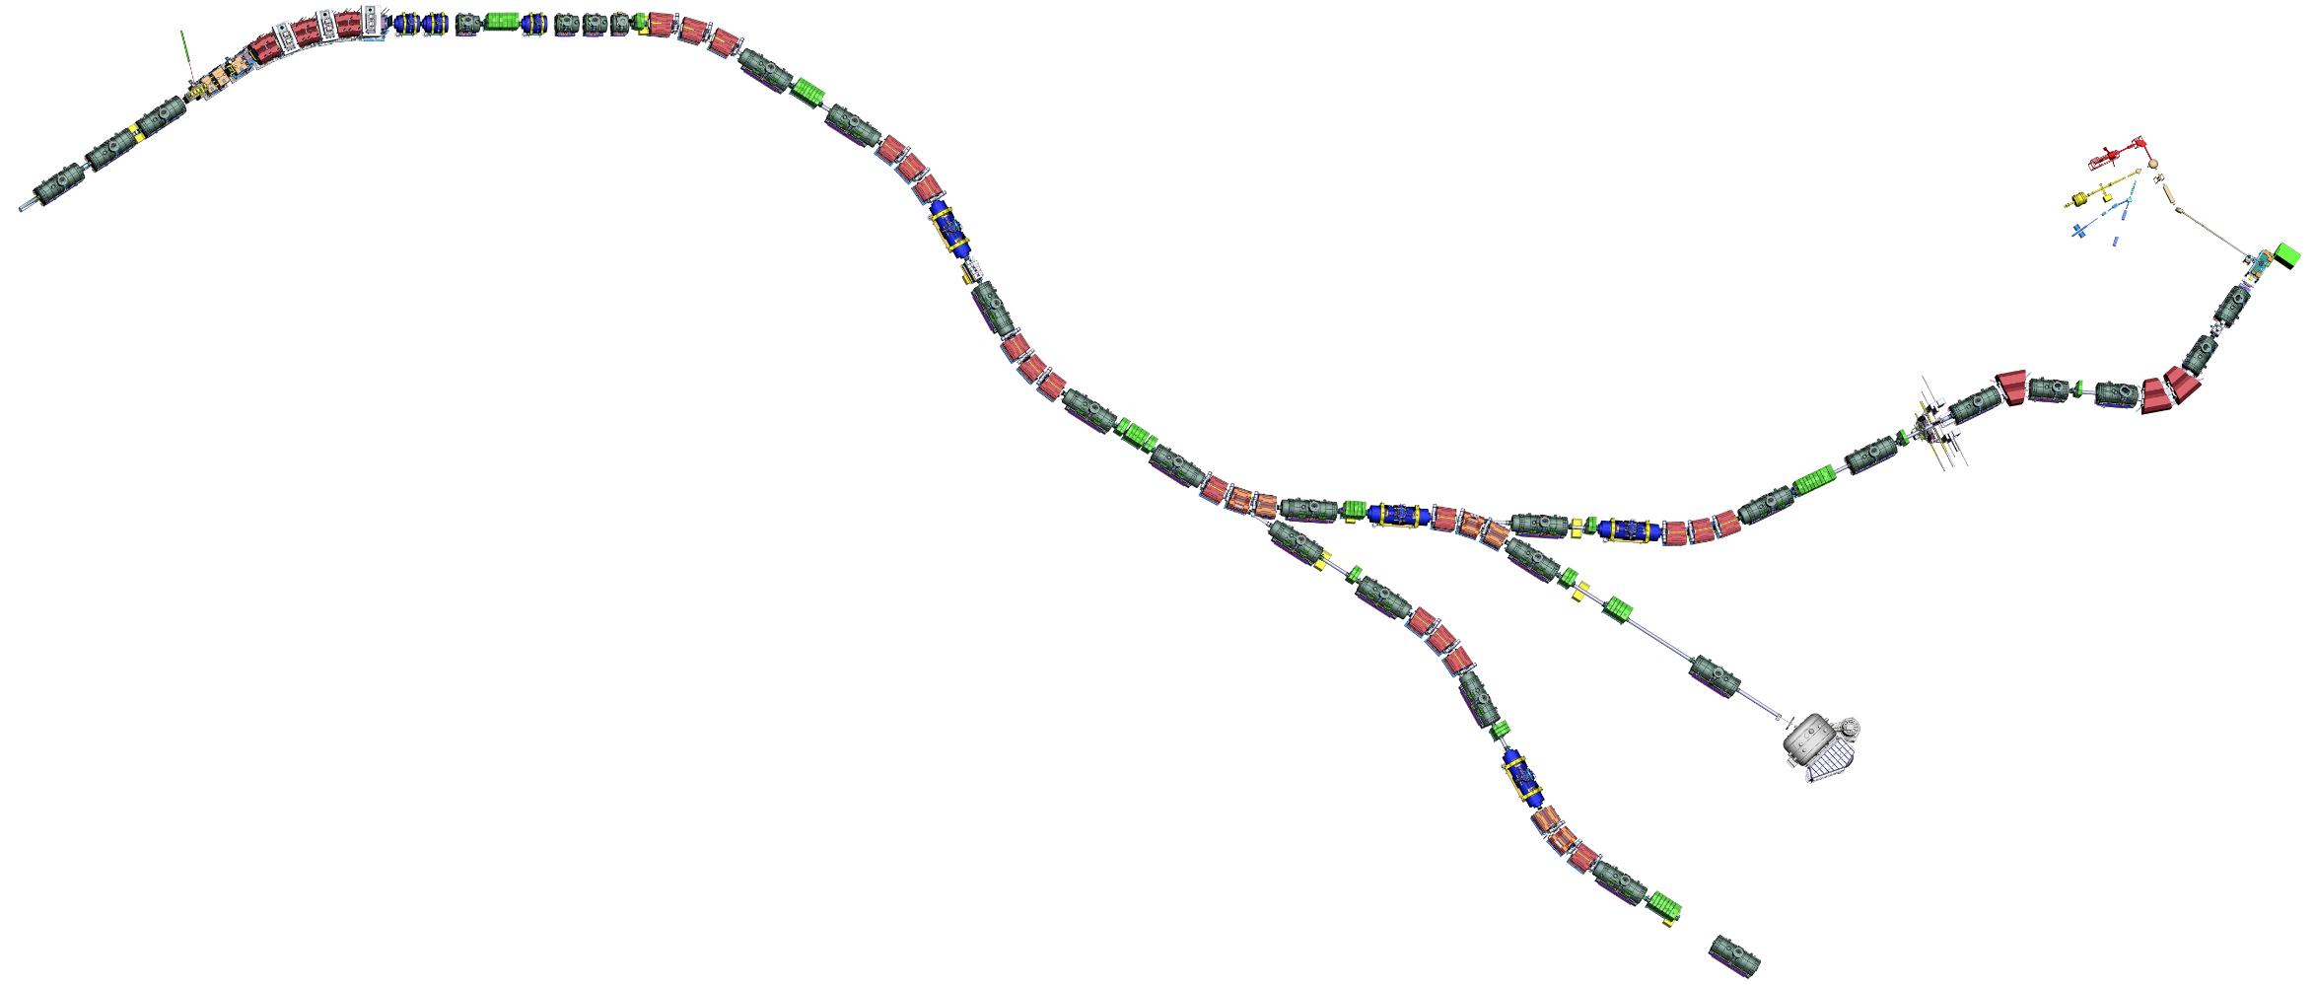
Commissioning sections along the beamline v1
FPF1
FPF2
FPF3
FPF0
FPF4
G018
T103
FTF1
All this is LEB
commissioned together
beam
FMF1
FLF6
FLF5
FMF2
FLF3
FMF3
FLF4
FLF1
FLF2
G006B
G006A
FRF1
FHF1
FRF2
FHF2
T103
blocks for machine installation
G006
sections for commissioning
FRF3

Slide 42
Local Cryogenics branches M, H, G (B optional)
Procurement and installation branch M
Procurement and installation branches H, G
Planned FAIR contracts: December 2024
Planned delivery to FAIR: October 2025 – July 2026
Planned installation: October 2025 – August 2026
Tender running
Deadline for offers: 23/10/2024
Offers from 4 bidders (3 companies + 1 consortium)
All qualified and well-known companies
Requested schedule confirmed
Negotiations starting
Risk of FAIR internal competition with cryo tenders
CE
Still to be tendered: jumpers of branches M, H, G
Overview tenders LC branches
Delivery dates of local cryogenics boxes
Local cryogenics sectors: installation completed
shielded target area
P2
P1
11.25
M1
08.25
11.25
H
M2
M3
04.26
G
T
04.26
05.26
03.25
09.26
last batch W0 Dec-24
batch W1 06.25
batch W2 09.25
batch M1 10.25
batch M2 02.26
batch M3 07.26
batch H 02.26
batch G 05.26

Slide 43
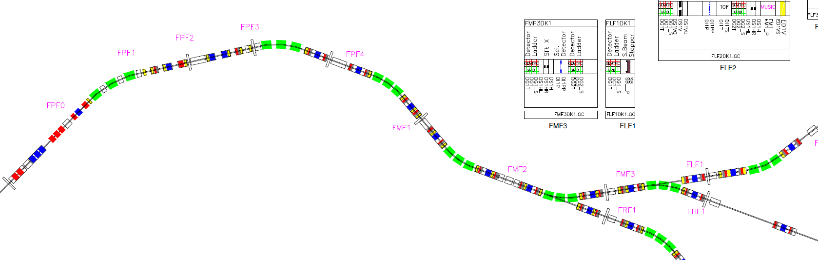

Slide 44
Super-FRS – NUSTAR : no coupling hypothesis
SFRS runs “isomer tagger” at FHF2 during its commissioning
last setting is an “isomer tagger” for NUSTAR experiment
remove isomer tagger
install NUSTAR setup
☺ | ☹
Clear separation of goals | not nice in spirit of cooperation
Low man power need from NUSTAR side (short period) | Still need to tune implantation after Super-FRS commissioning
Limited risk to damage NUSTAR unique equipment | Still need to do the NUSTAR in beam commissioning (only one region or full rescalling)
SFRS
NUSTAR

Slide 45
Super-FRS – NUSTAR: high coupling hypothesis
if several beams, to better characterize detector, several small experiments(?)
as soon as we are “safe” in beam handling, we could move in NUSTAR setup
perform small measurement along the different beams while going up in Z (supposing we start light and end up heavy)
☺ | ☹
Much more NUSTAR-SFRS integration | Could generate conflicts on goal
NUSTAR setup properly commissioned in beam during SFRS commissioning | Higher risk to damage unique equipment (but can be mitigated easily)
 | Long NUSTAR beam period, with idle times where SFRS does pure SFRS stuff
 | Not all beams with NUSTAR will yield interesting results?
SFRS
NUSTAR

Slide 46
Super-FRS NUSTAR – mid coupling hypothesis
Super-FRS perform its commissioning
when confident we remove isomer tagger and start NUSTAR beam commissioning hand in hand with Super-FRS last points of commissioning
Super-FRS commissioning end at the last setting for Super-FRS/first setting for NUSTAR, then NUSTAR experiment begings (in beam commis. already done)
☺ | ☹
Much more NUSTAR-SFRS integration
NUSTAR setup properly commissioned in beam during SFRS commissioning | (minor): need some agreement on process at the end of Super-FRS commissioning
Lower man power impact for NUSTAR than strong coupling
Reduced risk for NUSTAR experiment compared to other options
SFRS
NUSTAR

Slide 47
Open points
Would define “we finished beam commissioning of SFRS and NUSTAR here we do first experiment” be good? Or is “the first NUSTAR experiment is the end of the Super-FRS commissioning?” (first case was my assumption)
I would suggest to check feasibility of first NUSTAR experiment with Super-FRS expert, to avoid a too risky experiment
Once NUSTAR setup is better defined the discussion can start of how we couple the two commissioning (from which moment we rely on the NUSTAR setup and remove our small isomer tagger, if some light beam for tracking detectors need to be tested etc…) and what shall be done for the NUSTAR in beam commissioning
For information: we just started the discussions on the Super-FRS “no-beam” commissioning in the project side (so no urgency!)

Slide 48
End slide

Slide 49
Why isomer tagging is preferred for SFRS com.¹
5 options: counting, beta, alpha, mass, isomer tagging
counting: (step by step from Primary beam), not efficient if long jump, always a backup
beta: life time with error not unique finger print, end point measurement can be confusing if several decays (isomer/gs) and need a lot of statistics
alpha: quite rare in the chart, energy and life time are unique fingerprint, but fast alpha decay make spectra confusing if spectrometer tuned far away of where it is believed
mass: unique finger print, main issue implantation in a very thin matter, extraction, then mass measurement, when all works fine it is perfect, but many steps that can go wrong, and if the setting is not the one though, the implantation will not work, nice to confirm on an establish setup, maybe not for shooting in the dark…
isomer: quite unique finger print, more open the setting better (contrary to 2/3/4), implantation can be done quite surely (thick plate), direct correlation between ion and gamma, not a multi step process, best when shooting in the dark
1: This of course does not constrain in anyway the options for NUSTAR first science

