Slide 1
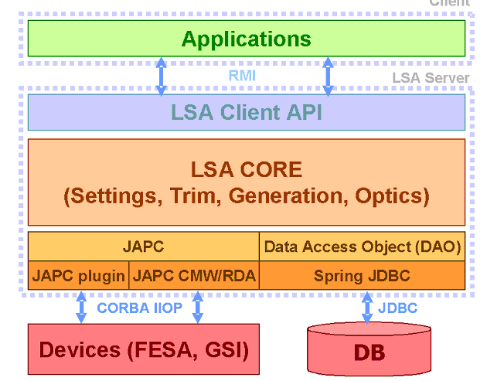
FAIR control system general
Generic layout
Presentation tier – user interface
LSA
Application tier (LSA, sequencer, etc...)
Resource tier (FESA)
Talking to the hardware
Vaccum
Cryogenics
Magnets

Slide 2
FAIR control system for the Super-FRS
UNICOS
Vaccum
Cryogenics
Magnets
Degrader,slits
detectors driv
Resource tier
Resource tier
Resource tier
Resource tier
Resource tier
Machine
Protection
System
Interlock
Super-FRS Det.
Presentation
tier
LSA
Setting
protection
system
Business tier (log,
post-mortem etc...)
Experiment
On the shelf solutions from FAIR
Specific development/implementation for Super-FRS
Concept Will be tested at FRS in 2017/18 (or other NUSTAR exp.)

Slide 3
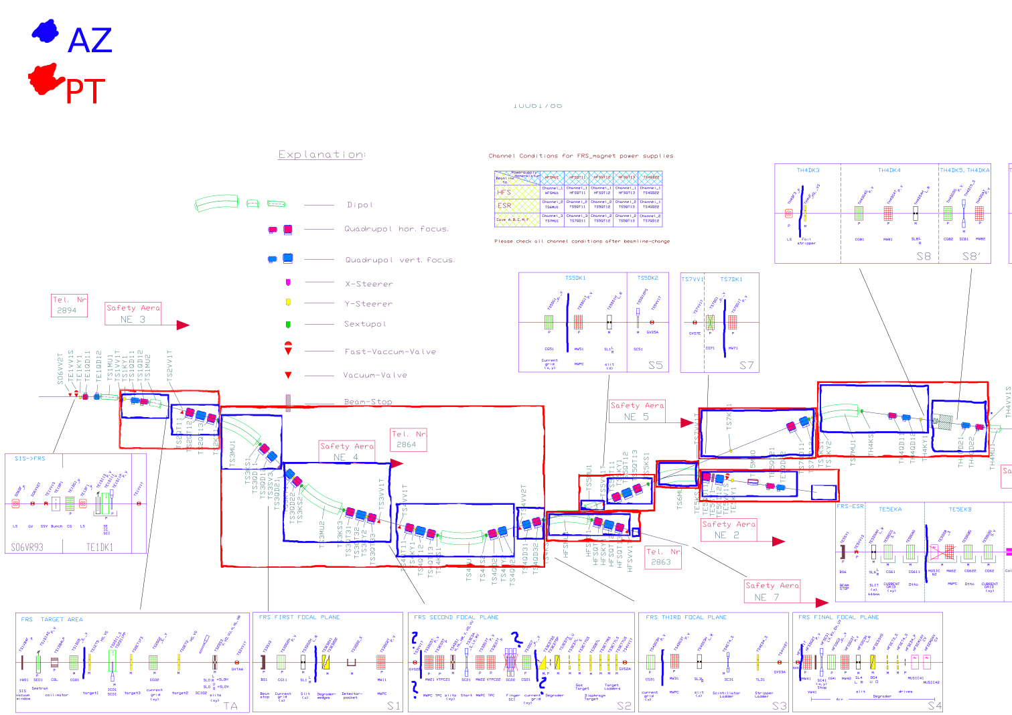
FRS in Accelerator zones and Particle Transfer

Slide 4
FAIR control system some concepts
Context: time during which a parameter has a value (think SIS magnets when different patterns/virtual accelerator are present)
Beam process: specific procedure (injection, ramp, extraction...)
Beam production chain (BPC): beam lifespan from source to beam dump, example all processes in an production for SIS+HEST+FRS+ESR
Pattern: a “collection” of BPC
Setting: value of a parameter for a given context
Make rule: how a change on a setting of a parameter affects other the setting of dependent parameters
Trim: change on one or several settings
Knob: scalable parameter with several dependent parameters (alignment for example)

Slide 5
FAIR control system for FRS 2018 - layout
toward hardware: set, towards presentation tier: read
Presentation
tier
MIRKO
Developer: ACO, SFS/FRS, BEA, OPE
WebDaV
MGSCAL
FMGSTAT
Paramodi
FDRIVE
Device Control
Lassie spill
DGX
Device Control
Machine model
Application tier
LSA
FSLD
Resource
tier (FESA)
Magnets
Drives
Seetram
CG

Slide 6
Man power
me (10/20% of my time over 10 years), Frederic (less?)
Jan-Paul Huchka: 2 years development for machine model and FLSD
Fabio Schirru : 2 years (shared with Chiara) development of FMGSTAT/FMGSCAL/FDRIVE
.. without Jan-Paul and Fabio no NUSTAR phase 0 operation
no one, in FRS or NUSTAR acknowledged the work (at the contrary!)
(taken for granted that Super-FRS uses resources to support them)

Slide 7
FAIR control system for FRS 2018 - layout
toward hardware: set, towards presentation tier: read
Presentation
tier
MIRKO
Developer: ACO, SFS/FRS, BEA, OPE
WebDaV
MGSCAL
FMGSTAT
Paramodi
FDRIVE
Device Control
Lassie spill
DGX
Device Control
Machine model
Application tier
LSA
FSLD
Resource
tier (FESA)
Magnets
Drives
Seetram
CG

Slide 8
Standard application FAIR control system
Device Control: replacement of SD, but show parameters of individual elements magnets and drives by context and particle transfer (can set drive values with it)
Paramodi: enter parameters to be sent in LSA data base, when sent to LSA if BPC is active then settings will be generated from hardware. Can load and write files of configuration. Optics is define in it (the KL values)
Sequencer: a framework to access variables in the application tier of the control system and bridge user applications to FESA or LSA
Lassie: counter for IC and SEETRAM or pulse we send (last to be tested...)
DGX: Current Grid readout

Slide 9
FRS FAIR control system specific applications
FDRIVE: monitor all drives for an active pattern in FRS, selection context “extraction” and aggregating all particle transfer
FMGSTAT: monitor all magnets, does Soll and Ist and status , reads hall probes, selection of context “extraction” and aggregating all particle transfer
Machine model: Includes ATIMA and energy loss calculation BUT plan to overwrite it for operation and set Brho (see slide 6)
Fparamodi: a Paramodi configured to make use at FRS easier, just modify the look and feel not touching the code
FMGSCAL: perform pre cycling of magnets and finish at the minimum value
FHallProble: perform the magnet gymnastic to calibrate the Hall probes
FSeqLSAtoDrive (FSLD): application which needs FMGSTAT(?) running get the active BPC and for it check the LSA drive value and send them to the drives (not multiplexed)

