Slide 1
Super-FRS operation concept idea

Slide 2
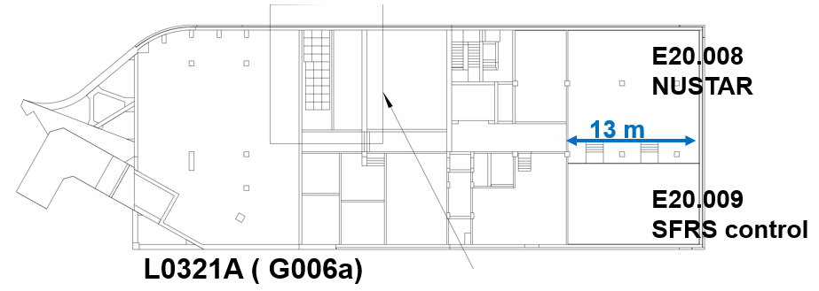
Foreword: location
Today FRS has its FRS messhute (Partially due to analog electronic still being used, we setup up TACs delay lines at each beam time with modules sometimes twice older than the PhD student doing the work :b)
FRS and Super-FRS are meant to serve NUSTAR experiments, need a strong link: same messhute
For Super-FRS : NUSTAR control room (SFRS room):
closer access
close to our labs
modern solutions we can
easily interact with FAIR
control room
need all controls from there
(CRY, VAC etc…)

Slide 3
First words
What I present here are my thoughts, based on FRS operation and various discussion with colleagues
How the Super-FRS will be operated is not completely defined yet (although most probably at the beginning how I explain here), those are concept which need implementation (not frozen in stone)
Who will be operating the Super-FRS is a hot topic in the management currently and we will NOT discuss it at this meeting (open ended discussion)

Slide 4
“We hold those statements to be true….”
Super-FRS will use primary beam from SIS18 (later SIS100)
Super-FRS has a requirement of beam focusing at the target
for ion optical reasons
for safety reasons (not too focused if fast extraction)
Super-FRS needs to intercept the primary beam in the beam catchers
Matter will be present inside of the spectrometer during operation
Bρ – ΔE –Bρ methods
Detectors (“active matter”) will be present
Effective thickness calibration of the Super-FRS at the precision of the spectrometer is needed
All standards and beam intercepting equipment are moved in and out from the ACO network

Slide 5
Matter calibration
Bρ in one section depends on the Bρ on the section before, the isotope, its energy and the matter in between the section.
We never know the thickness of the matter to the Super-FRS resolution
➔ each matter thickness has to be measured
ε
ε_{eff}
Bρ_{eff}
Bρ
E
E
Bρ depends on E and ε
Bρ_{eff} depends on E and ε_{eff}
ε_{eff} calibration works for a given small range of Z

Slide 6
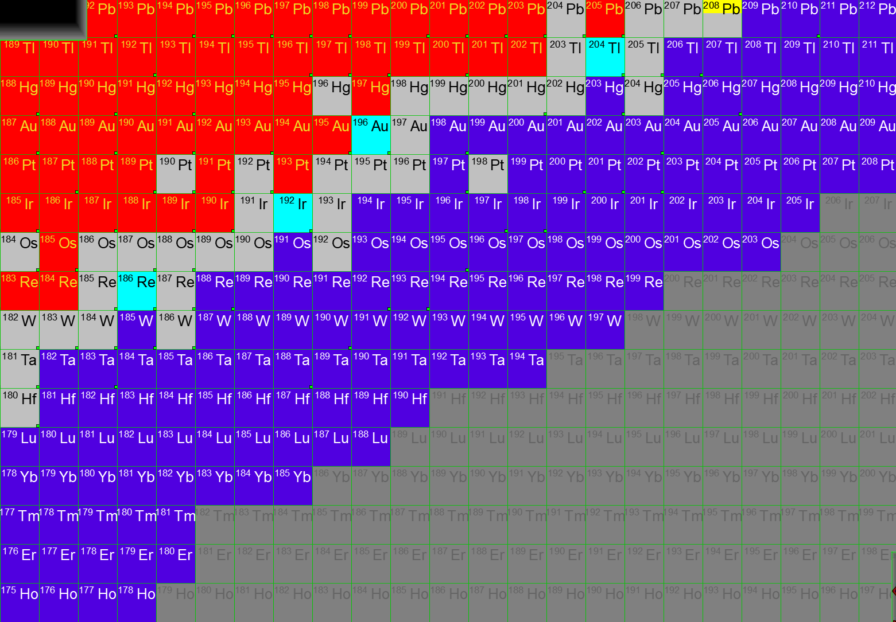
Settings - calibration
208Pb for calibration
205Au for mass measurement and mass tagging
Ancillary: Ion Catcher
S. Pietri, Super-FRS Experimental Collaboration meeting, 15th of December 2022 Darmstadt

Slide 7
Settings – mass and beta decay measurement ¹⁹³W
S. Pietri, Super-FRS Experimental Collaboration meeting, 15th of December 2022 Darmstadt

Slide 8
Settings – beta lifetime measurement ¹⁹³Ta
S. Pietri, Super-FRS Experimental Collaboration meeting, 15th of December 2022 Darmstadt

Slide 9
Settings – new isotopes ¹⁹⁰Lu (nice!)
S. Pietri, Super-FRS Experimental Collaboration meeting, 15th of December 2022 Darmstadt

Slide 10
Typical FRS experiment steps
Perform the simulation
Determine settings (mater) for detector calibration
Take beam:
Minimum matter, no target, thickness calibration, thread beam through spectrometer
Target in,
check centering
thickness calibration
Include removable detector and perform first calibration/test of detector
Different degrader thickness calibration for different calculated settings
2 to 3 settings for detector calibration (position, tof, DE)
Setting for 233Th

Slide 11
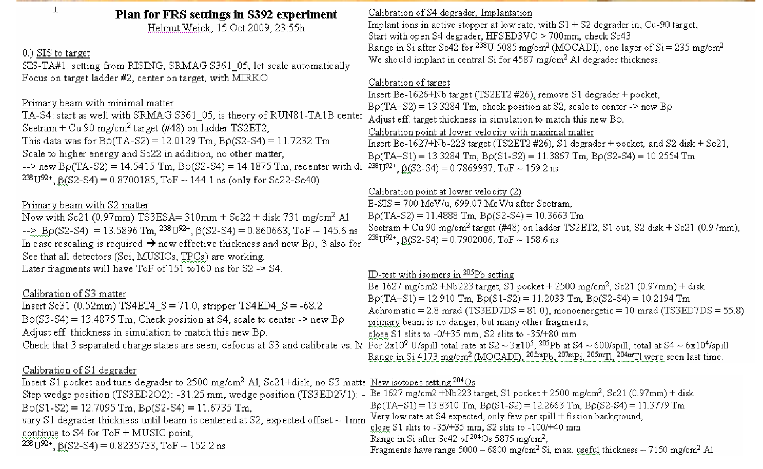
Example of run plan for FRS experiment

Slide 12
Work flow of Changing setting
Calculate by simulation the Bρ of the 4 dipoles stages
Include effective thickness : scaling Bρ1_{sim}/Bρ2_{sim} = Bρ1_{set}/Bρ2_{set}
Stop beam, (close slits)
Old control system: scale magnet and do hysteresis
New control system: set Bρ for section in PARAMODI, do hysteresis
take back the beam (open slowly slits)
➔ thus important to have reference settings ➔ long time request to have a “Save setting”
today we save a .txt file in the ASL, means we launch PARAMODI from the ASL not the console
Scripts to comment out all non FRS done by us

Slide 13
Time to setup an experiment
From scratch: 2/3 days of beam tunning and calibration
Inside of a campaign with similar beam and spectrometer configuration, ½ days
From experience: most efficient work done in “low people” configuration, where plan can be worked. Too many experts in room, too many discussion, no work done

Slide 14
FRS control system update
Note the FRS control system update (next talk) was done keeping the traditional way of operation.
Rationale was:
most of the crew was changing (4 years without beam)
the control system was changing
➔we kept the old operation mode to be able to take data quickly
Side note: created the strange situation where people knowing the old procedure are still not allowed to touch the FRS “Because they are not trained on the new control system”, while very green students who got a 5 hours course can “operate” a complex spectrometer

Slide 15
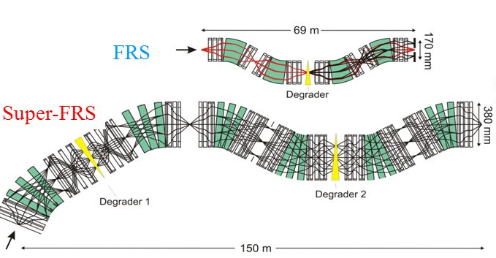
Next step
For setting up beam,
Intensities being 10 to 100 higher, 5 times more drives or magnets ➔ operation needs different than FRS

Slide 16
Super-FRS full glory

Slide 17
Super-FRS, need evolution
Reason for change
More drives (up to 60 drives in ES configuration)
Much more magnets per stage
6 stages instead of 4.
(way) longer hysteresis (2 minutes vs 10 minutes)
primary beam and its charge states HAVE to be intercept in beam catchers

Slide 18
Super-FRS proposed evolution
Simulation driven operation (LISE file directly in paramodi conversion)
➔ discussion this afternoon “high level application”
Simulation driven “Setting protection”, checking danger of changes and interception of primary beam and charge states of it
➔ discussion this afternoon “high level application”
Drives moving in an out automatically setup the proper Bρ for the next section
need updated machine model including energy loss
need to remember thickness calibration
➔see machine model talk (FRS “could” operate like this today, PhD of J. P. Hucka)
Non hysteresis operation
procurement of NMR probes
➔ see talk “NMR control and operation”
Automated calibration of matter thickness will be required

Slide 19
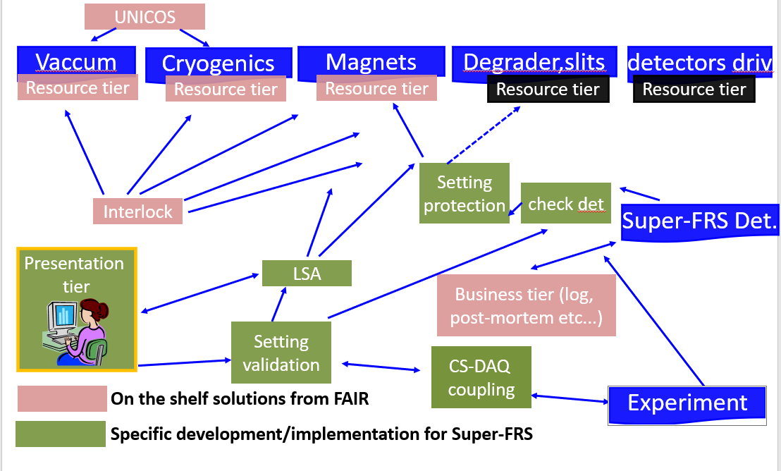
Concepts

