Slide 1
Super-FRS DAQ for detectors and diagnostics

Slide 2
Super-FRS detectors
Super-FRS is an experiment
Super-FRS is a machine
Super-FRS is a beam line
all is true
some of the instrumentation is for beam line, some for experiments
2 worlds of DAQ:
SFRS ACC DAQ (2.4.6.3.1.1) see talk of Andreas this afternoon
SFRS EXP DAQ (2.4.6.3.1.2) this talk

Slide 3
Super-FRS detector suit – beam line
Standard BEA detectors:
usually for beam characterization focal plane per focal plane
intensity monitoring
➔ all readout in ACC network, all integrated in control system
more this afternoon

Slide 4
Super-FRS “experiment”
Goal of the identify/ion optic characterisatio
need event by event readout -> mean full emitance measurement
need event by event redout for identification
➔ identficiation need at least 2 focal planes
x/y x2 and tof and Q(Z)
➔

Slide 6
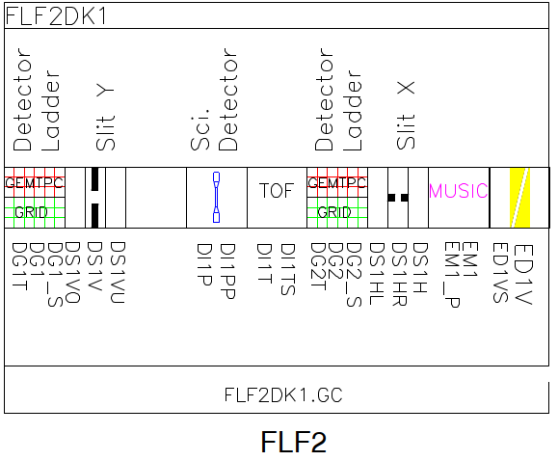
Detector main types, experiement side
Tracking detectors (X/Y for each plan, often 2 per focal plane)
time of flight ➔ plastics (scintillator detectors)
ΔE: Ionization chambers (MUSIC)

Slide 7
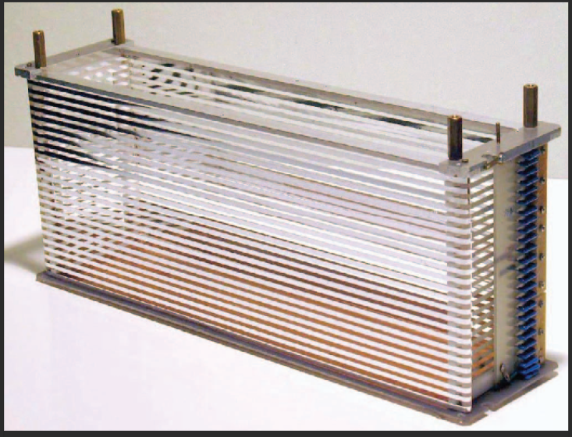
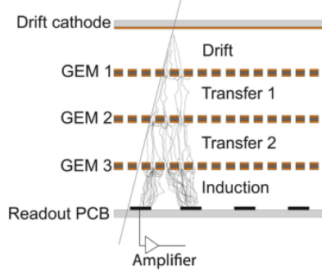
Detector main types, experiement side
Tracking detectors (X/Y for each plan, often 2 per focal plane)
developed by Helsinki
“drift chamber” with a GEM stack
position event by event,
rate up to 1e6pps,
<300 um resolution
Li to U ions

Slide 8
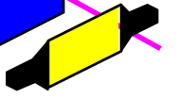
Detector main types, experiement side
Tracking detectors (X/Y for each plan, often 2 per focal plane)
time of flight ➔ plastics
ΔE: Ionization chambers (MUSIC)
Time of flight in spectrometer: 100 ns
Light propagation time in plastic: 20 cm/ns
➔ up 2 ns
Difference in time of flight for ions➔ <50 ps

Slide 9
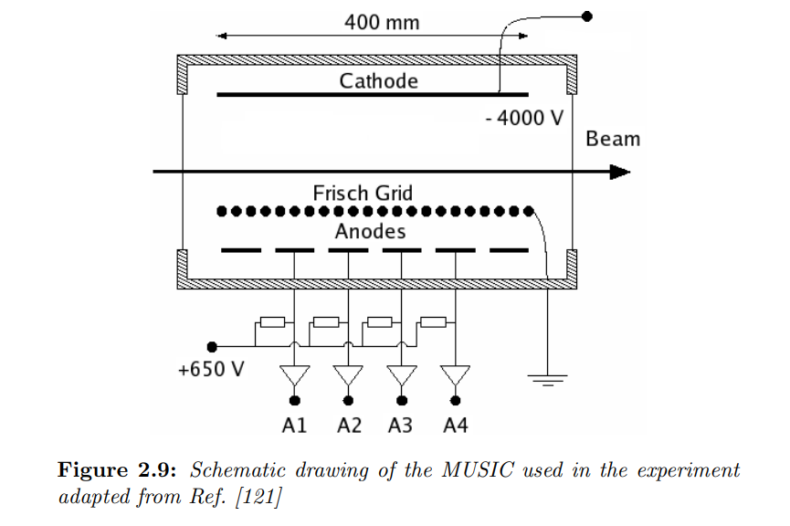
Detector main types, experiement side
Tracking detectors (X/Y for each plan, often 2 per focal plane)
time of flight ➔ plastics
ΔE: Ionization chambers (MUSIC)
ΔE ➔ amount of electrons add correction from
velocity ➔ gives the Z
In practice measure Q, but if energy high enough Q=Z

Slide 10
Conclusion
Tof give velocity
TPC give position/angle
MUSIC gives ΔE
MUSIC+ TOF ➔ give Z
Bρ = βγ . A/Q ➔ TOF give βγ
Ion optic tells us:
Bρ = Bρ₀(1-(x4-Mx2)/D)
position measurement we get the Βρ of the particule
A/q is know, Z=Q at high energy ➔ A/Q

Slide 11
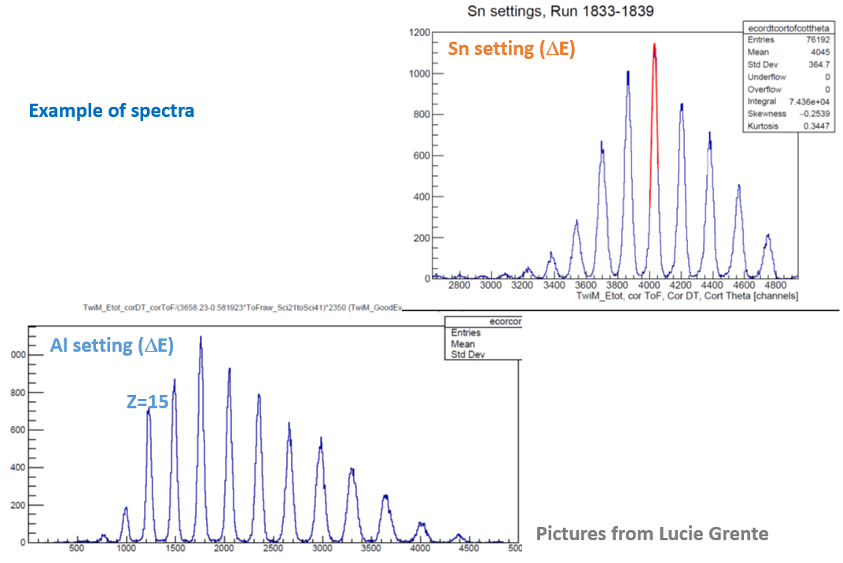
Example

Slide 12
Full identifciation

Slide 13
Early science configuration
Super-FRS: should have data reduction
FHF1, 2 TPC, 1 plastic,
1 MUSIC
1e3 particle per second
FMF2, 2 TPC, 1 plastic
➔ up 1e6 particle per second

Slide 14
DAQ request
Need to correlate event per event for a given focal plane
Need to measure between focal planes event per event
Need to correlate with DAQ of experiment

Slide 15
DAQ for experiment
Use NUSTAR DAQ (TDR 2016)
Evolution of MBS (currently two branches, MBS from EE and DRASI from Goeteborg)
FRS operation today: mostly VME crates, readout with MVLC or PCI from EE
➔ allows time stamped synchronous readout
➔ allows easy integration of asynchronous reaoudt with time stamp
time stamp protocol, general is WR (VETAR/PEXAR modules from EE)
➔ local time stamp from trigger/logic module derived from WR (ratatime)
DESPEC uses MBS, similar hardware + “full readout system” TRD from Daresbury
R3B similar hardware, similar DAQ, with more complex front end (some asynchronous)

Slide 16
Example of event

Slide 17
Example of DAQ for experiment and FRS
DAQ 2020

Slide 18
Main point - conclusion
Super-FRS will have high performance tracking detectors permiting event per event tracking on serval focal planes ➔ needed for experiments
Those detectors are readout in the “complex” DAQ of NUSTAR
higher order optical correction need to be implemented and will require precise position/angle/beam envelop at several focal planes
all magnets controls are on the ACO network
➔ Need way to talk to each other

