Slide 1
Super-FRS Control Workshop
11.11.2024

Slide 2
Old agenda

Slide 3
Aim of the workshop
First physicist result shall happen in 2027➔ Super-FRS shall run by them
Beam commissioning Super-FRS start Q3 2027!!!!
Inform operation and control group of our goals in Super-FRS
Inform/starts interactions between the different department
Establish priorities/point for urgent action

Slide 4
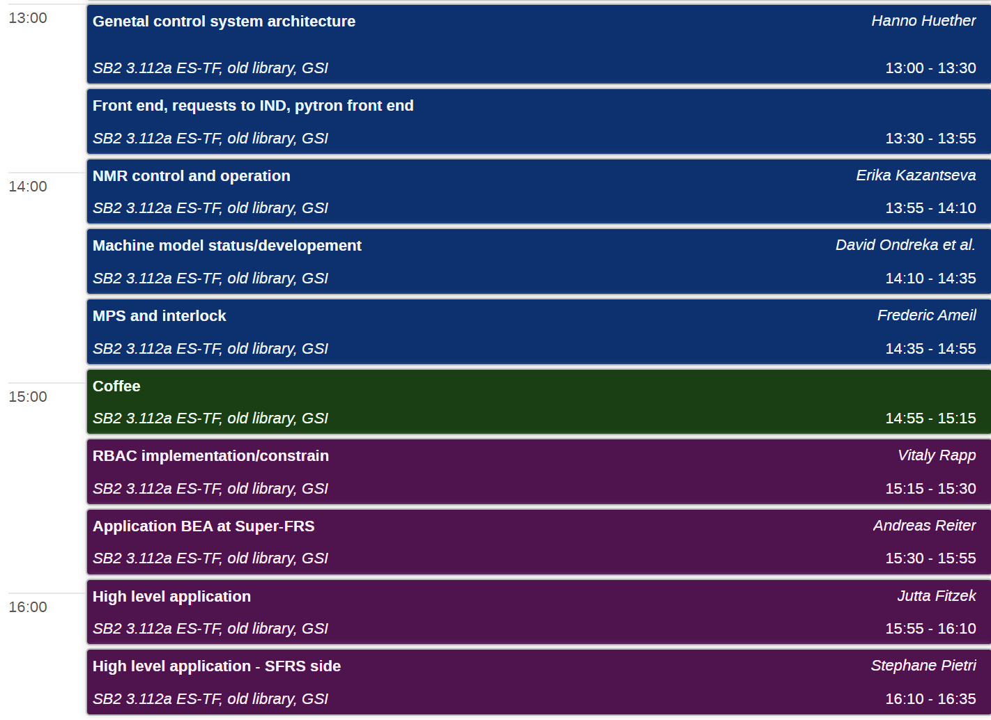
Agenda
I could be cutting discussions short so we continue in smaller group on specific topics

