Slide 1
Super-FRS: ion-optical layout and pitfalls
Erika Kazantseva, work package leader SFRS Beam dynamics
SFRS Workshop: control needs, operation concept, 11.11.2024.

Slide 2
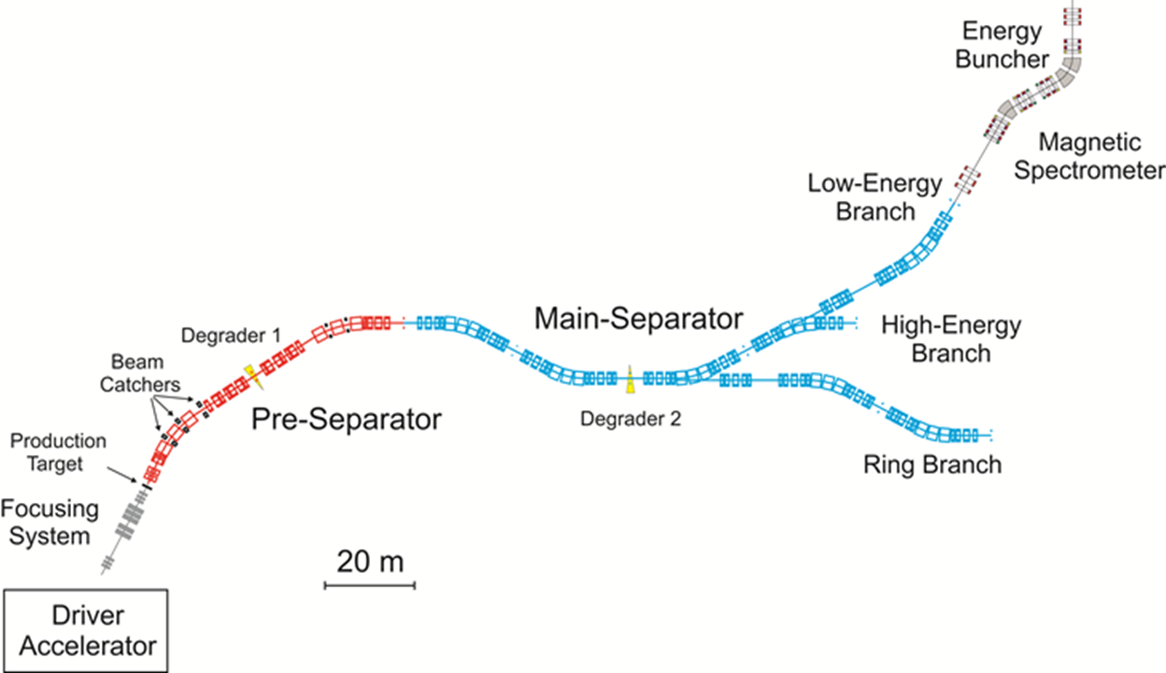
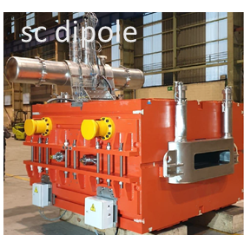

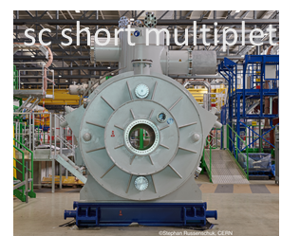
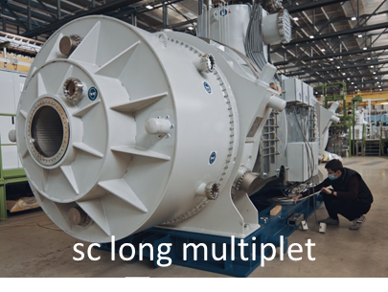
Outline
Ion optics of Super-FRS
Magnetic measurements: general
Cross talk effects
SFRS control system: cross talk impact
Summary & Outlook
Cortesy M. Winkler

Slide 3
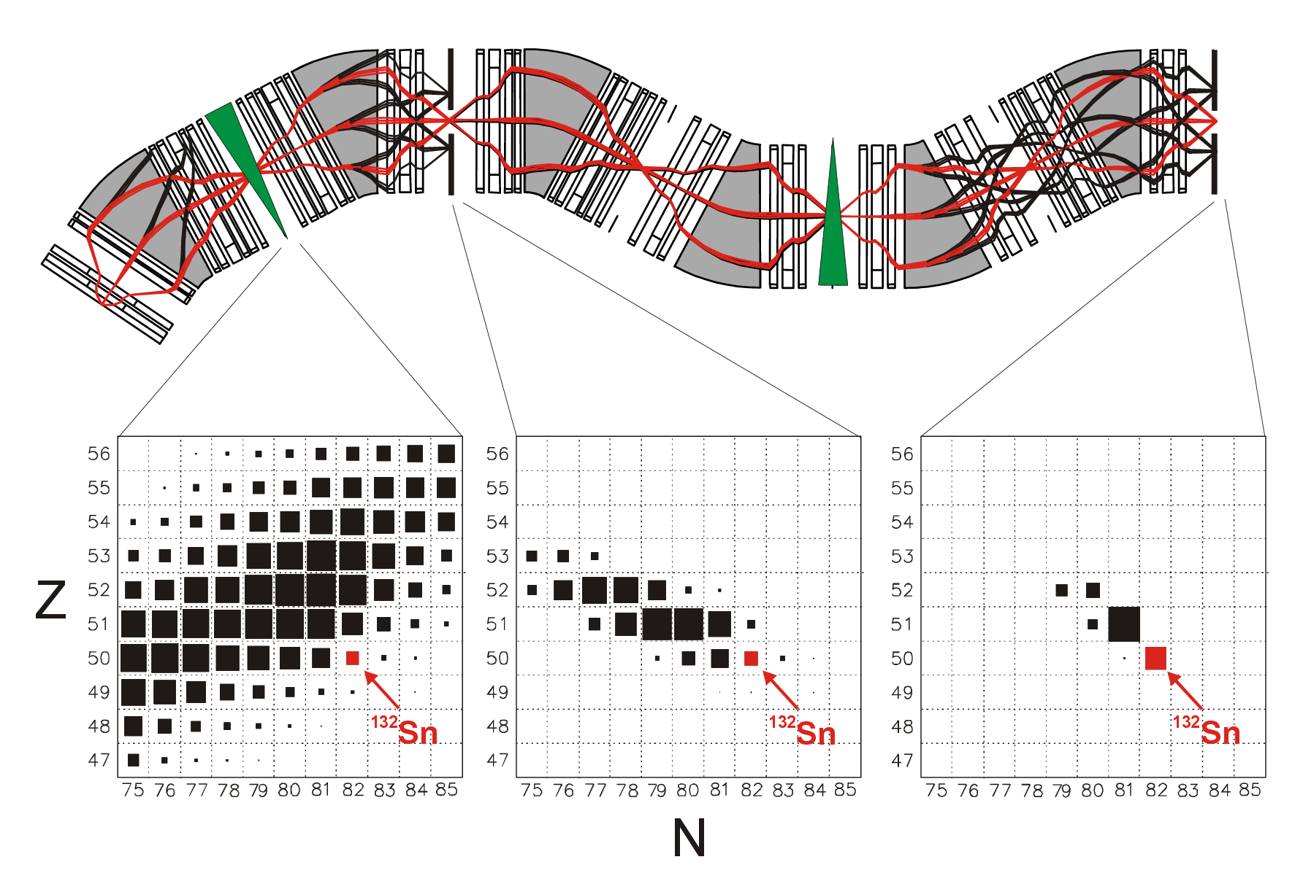
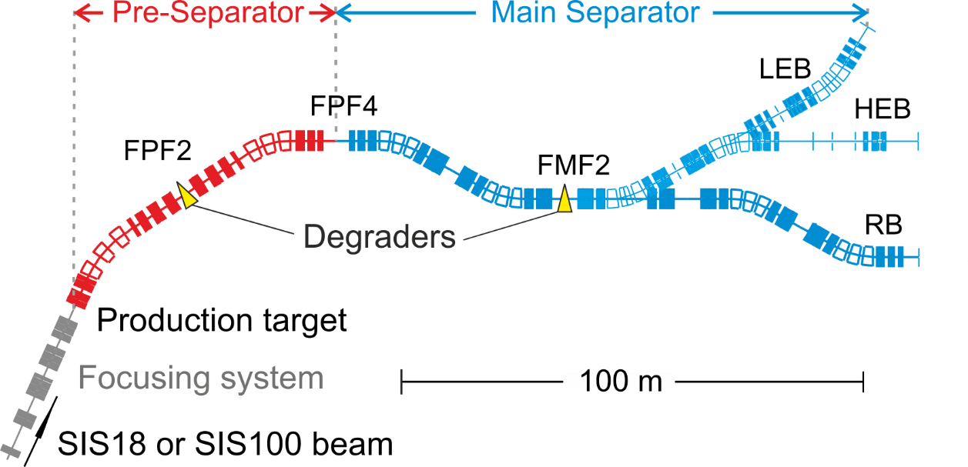
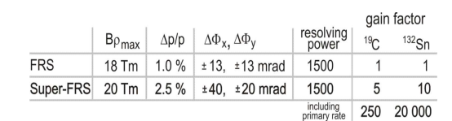
Ion optics of SFRS
A complex large aperture “transfer line”:
  18 main dipoles
  87 multipole magnets
  7 vertical corrector dipoles
Bρ-ΔE- Bρ separation with 2 stages:
  Preseparator with degrader @ FPF2
  Main separator with degrader @ FMF2
Aberrations corrected with:
  Sextupoles
  Octupoles
Single particle coordinate measurements at all foci starting from FPF2
  Accurate model needed to correct the experiment data and improve resulting PID
  Dedicated automatic online measurements needed for model update
Cortesy M. Winkler & H. Geissel

Slide 4
Magnetic measurements of SFRS magnets
Accurate measurements of integral work functions K^{n}L(I) with single stretched wire (SSW) at many I-points
Harmonics for many current levels with rotating coil (RC) and SSW
Fringe fields of multipoles with searching coil (SC = short RC)
Field maps for dipoles with translating fluxmeter (TF) and Hall mapper.
Precycling effect for dipoles, quadrupoles
Axes of quadrupoles (SSW)
Cross-talk effects measured:
  Quadrupole + Sextupole (a demonstration, not a systematic measurement for the operation range)
  Sextupole + Quadrupole + Sextupole (same)
  Quadrupole + embedded Octupole coil (operation range was covered)

Slide 5
Magnet measurements: precycling, hysteresis and axis
Only one or no precycling loops needed if the same branch is followed
  No precycling needed in case of using NMR probes (presentation at 15:25)
Otherwise 2-3 cycles needed depending on magnet (~8-12 minutes for dipoles)
  Can the power converters be switched off by following the branch in normal (not emergency) case? (I_set -> I_max -> 0 instead of I_set -> 0)
Magnetic axes of quadrupoles shift depending on current levels → variable change of steering properties

Slide 6
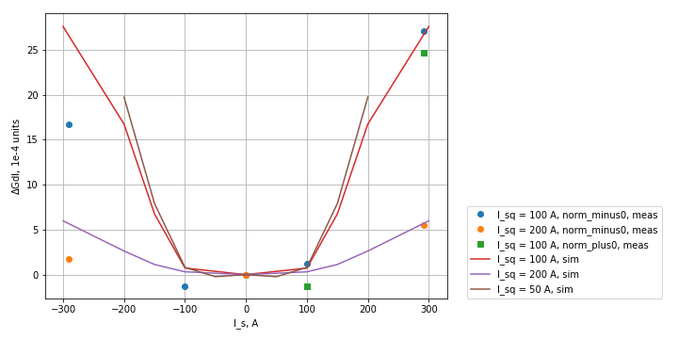
Magnetic measurements:
Cross-talk effects
Cross-talk Quadrupole+Sextupole:
  Quadrupole integral gradient (GdL) changes by > 25 units!
  Sextupole int. gradient (SdL) changes by >10 units
  Tolerance: max 2.5 units!
Cross talk Quadrupole+Octupole:
  GdL changes by up to 14 units
  OdL changes by >20 units
  Field quality (FQ) depends on:
    Currents
    Hysteresis branches
Cross talk Dipole+Sextupole
  To be simulated
  Measurements possible only with beam

Slide 7
SFRS control system: cross-talk challenges
Systematic parts of cross-talk effects on Quadrupole gradient can be considered:
  A layer for estimating GdL(Iquad, Isext, Ioct) needs to be added at some level in the Super-FRS control system
  E.g. a comprehensive model, including the corrections calculation can be used instead of scaling of list of K^{n}L of magnets of one setting
The same might be valid for dipole Bdl(Idipole, Isext)
  But needs initial measurements with beam
  These measurements are ideally done automatically including the analysis during the ion-optical commissioning
Surrogate model, and/or flexible way to make automatic focus/steering corrections is essential for reaching design goals for the whole Bρ range of Super-FRS

Slide 8
Summary & Outlook
Cross-talk effects make the settings not scalable using 1D functions K^{n}L(I) – more comlex approach needed to reach design goals
Clever powering of dipoles can save a lot of beam time
To reach the goal performance, it is essential:
  to use a complex and flexible realistic model, predicting currents of magnets including the cross-talk corrections for the setting
  and/or to have a surrogate model, able to quickly adjust the model for any given Brho
  use tracking detectors information for automatic corrections of 0, 1st 2nd and 3nd order optics in focal planes

