Slide 1
Beamtime considerations
Daniel Severin
GSI Beamtime coordinator

Slide 2



Outlook
2024
Next beamtime 2025
Physics beamtime 2026/27 and beyond

Slide 3
Next beamtime 2025
2024
Next beamtime 2025
Physics beamtime 2026/27 and beyond

Slide 4
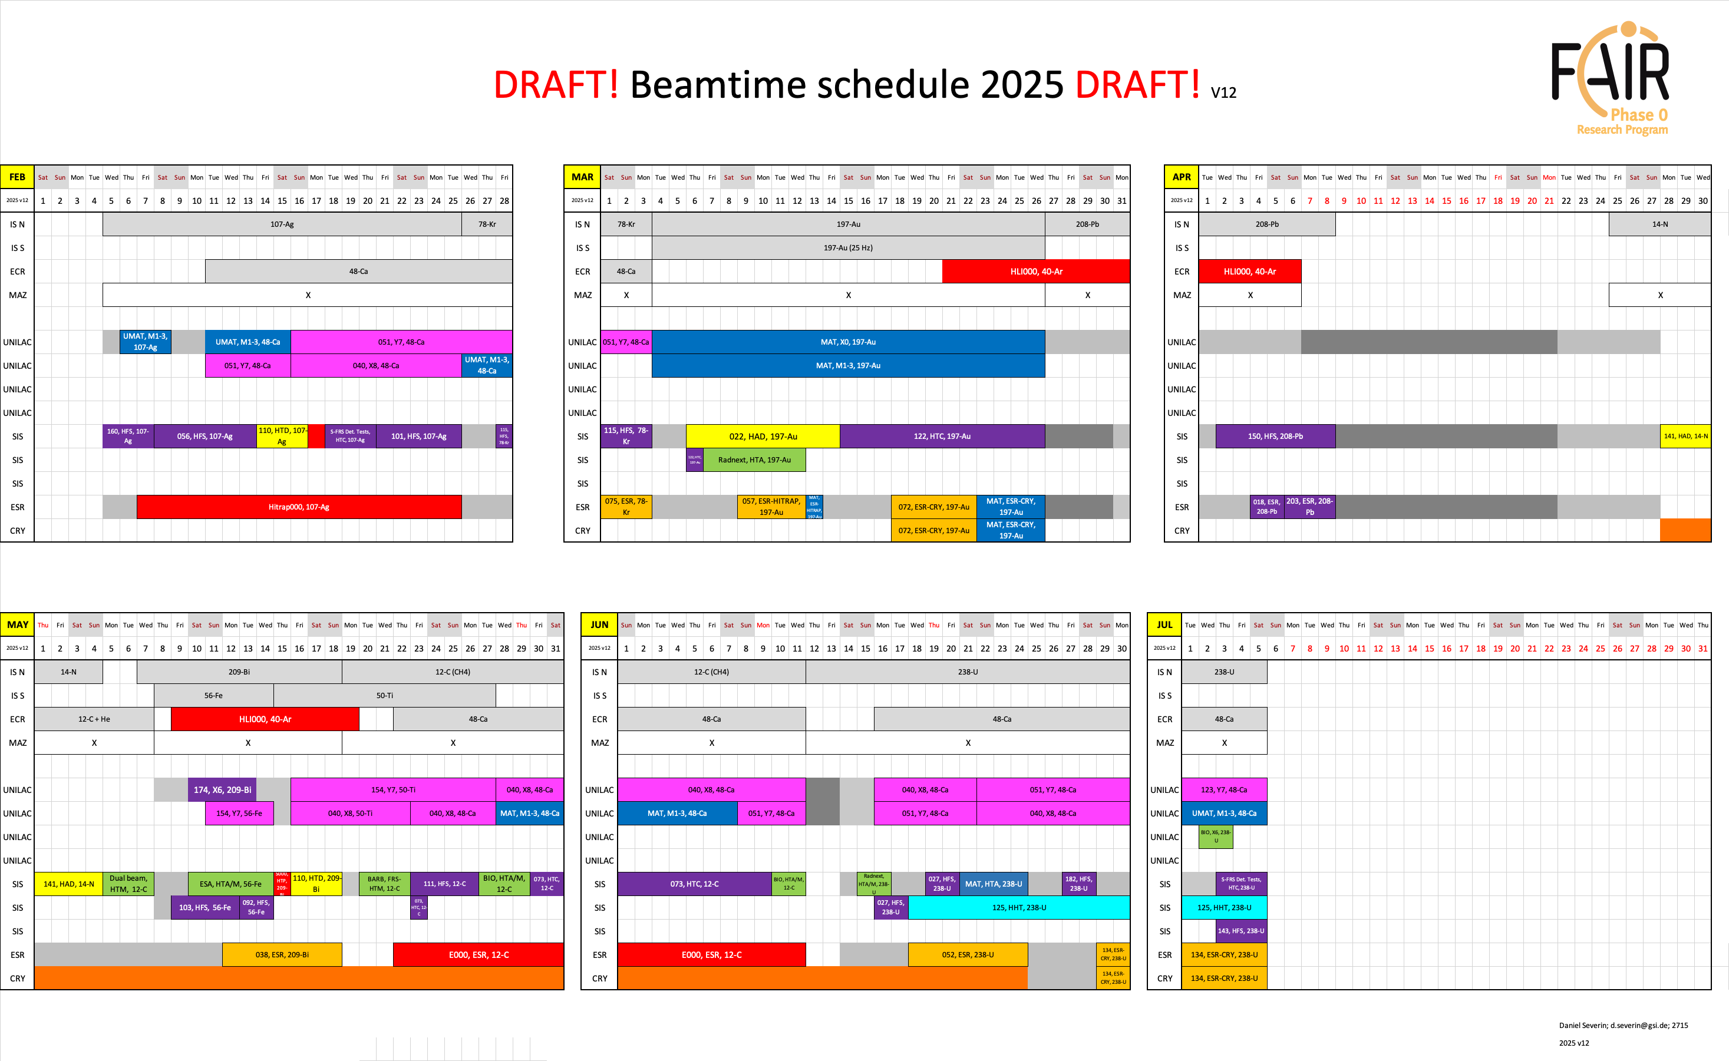

Slide 5
Physics beamtime 2026/27 and beyond
2024
Next beamtime 2025
Physics beamtime 2026/27 and beyond

Slide 6
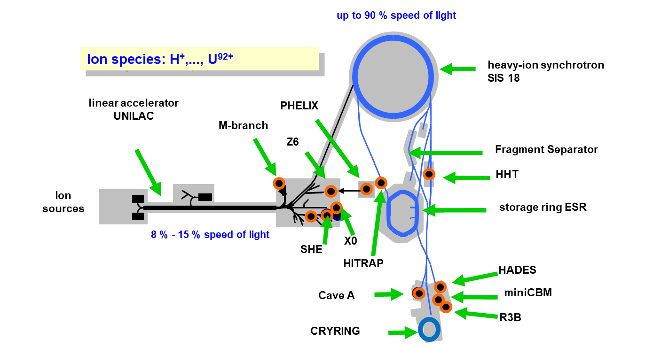

Calls for proposals
For beamtime in 2026 and 2027
Submission via GATE (https://gate.gsi.de):
  PPAC now – 26.11.2024
  G-PAC now – 2.12.2024
  Mat-PAC November – mid-January 2025
  Bio-PAC mid-January – mid-March 2025
N° of shifts to be recommended
for all PACs combined:
  350 shifts at UNILAC,
  300 shifts at SIS18,
  250 shifts in total for at
  ESR, ESR-HITRAP and ESR-CRYRING,
  100 shifts at PHELIX.
Infos on webpages of the PACs: www.gsi.de/g-pac, /ppac, /mat-pac, /bio-pac
Call for CRYRING in standalone-mode in 2025 for beam time in 2026 completed

Slide 7
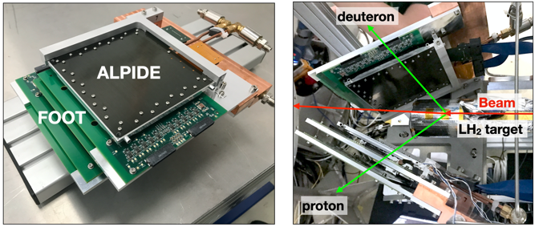
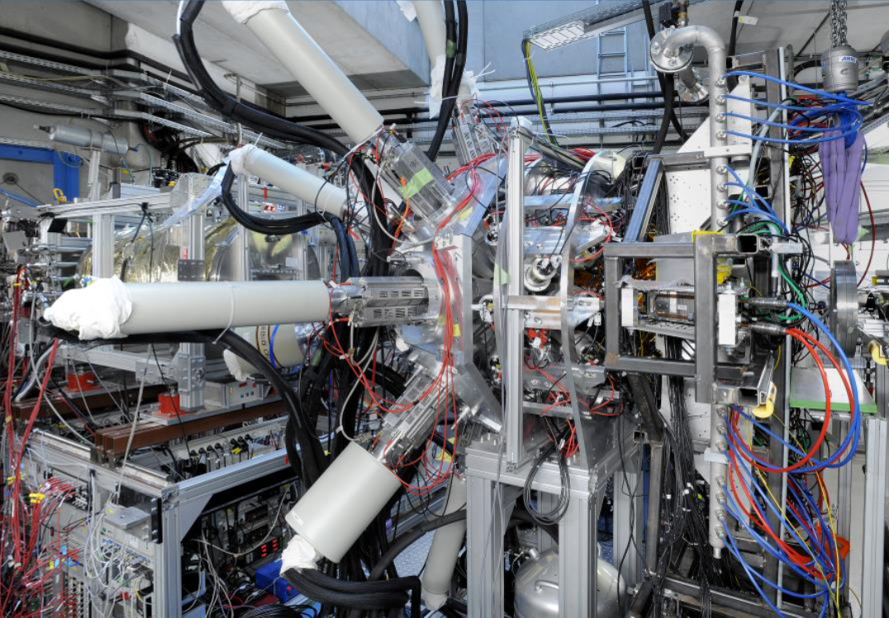
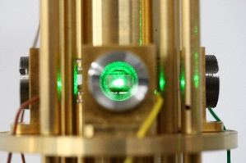
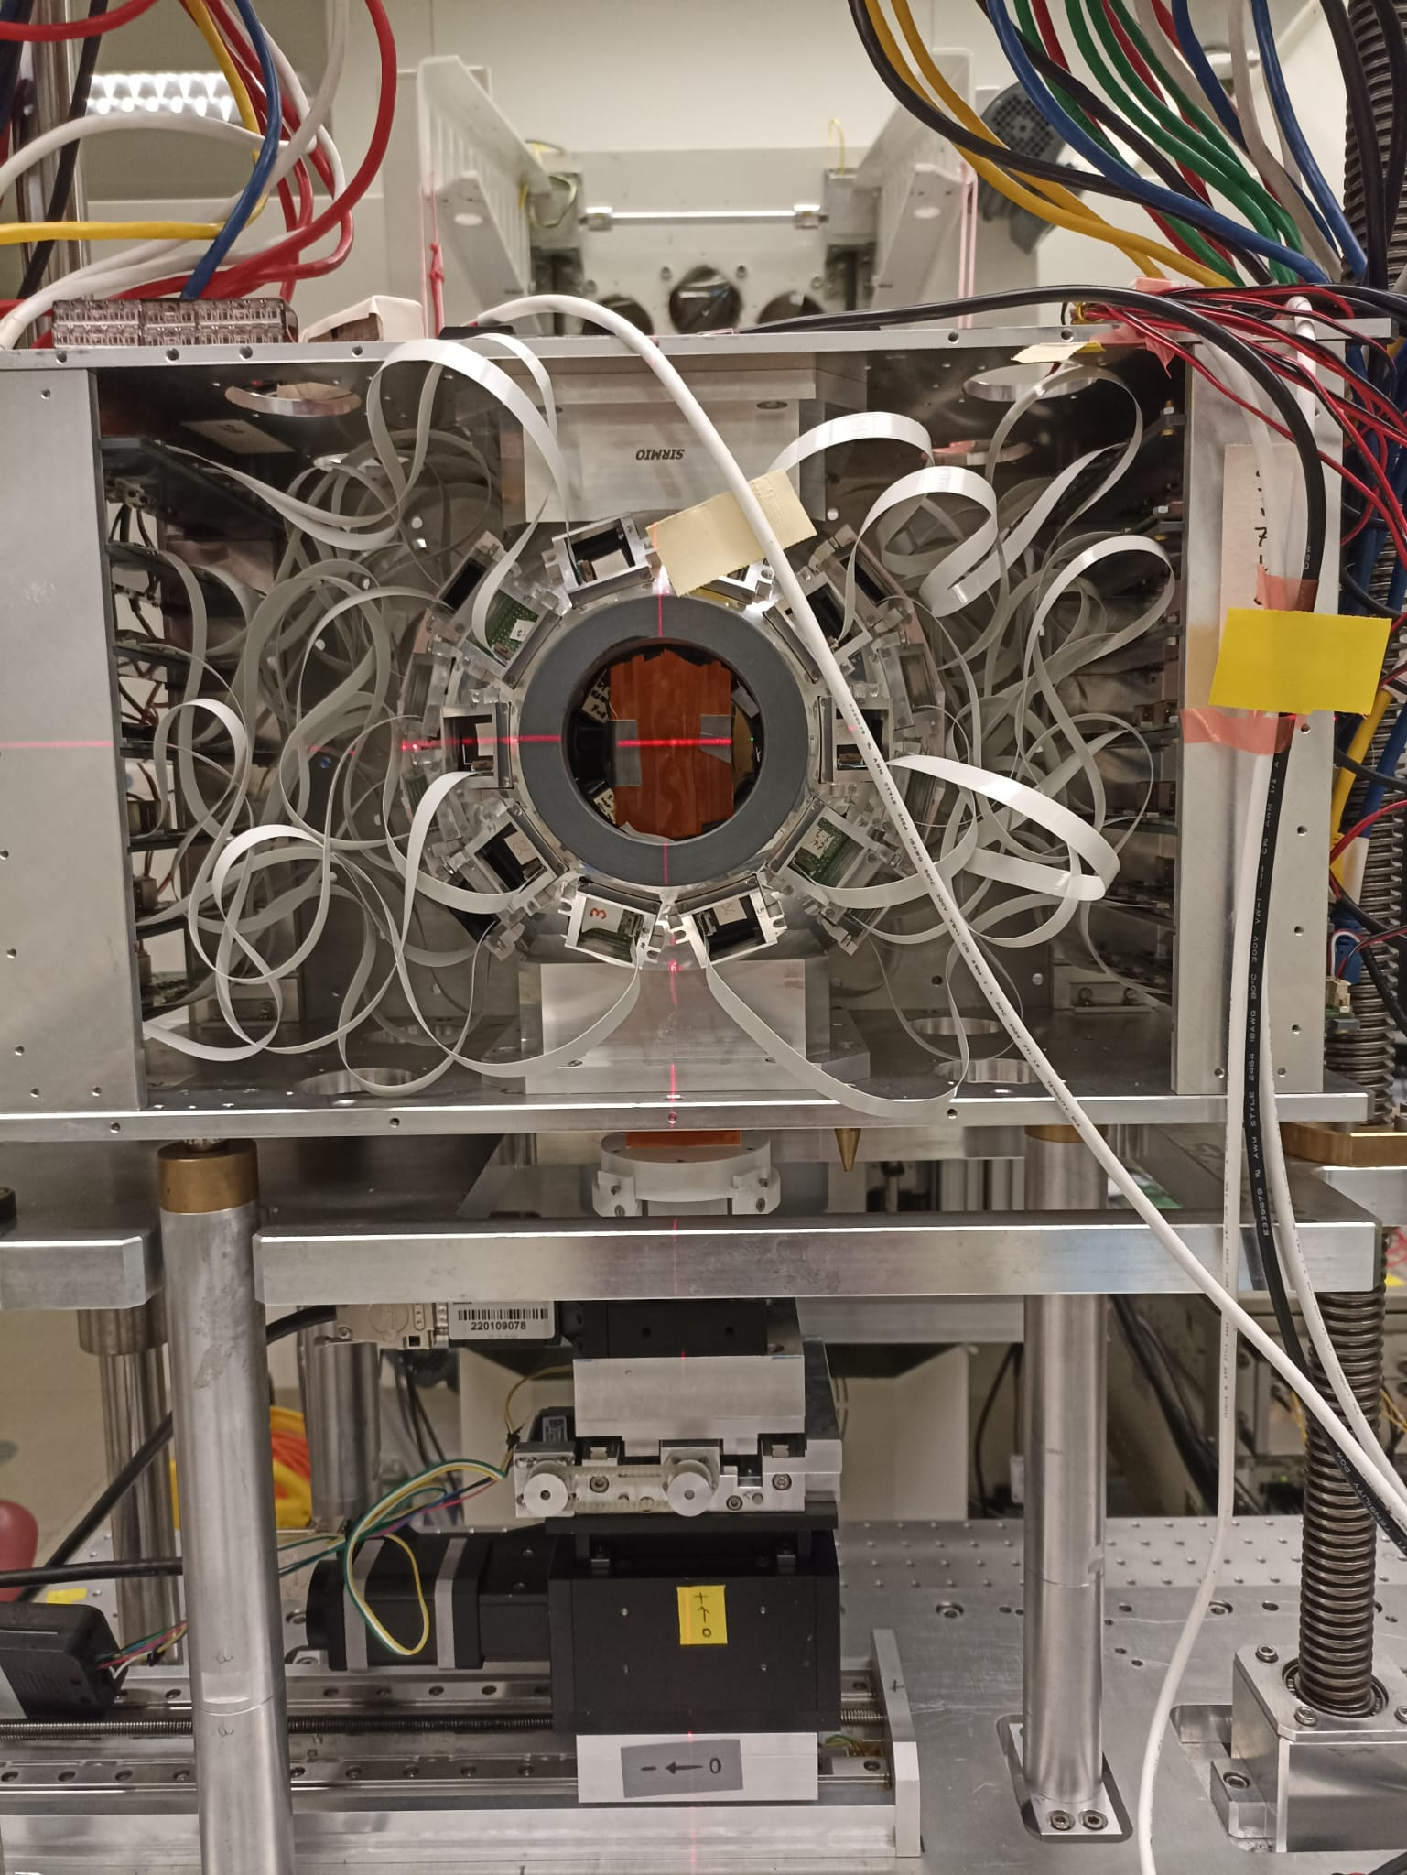
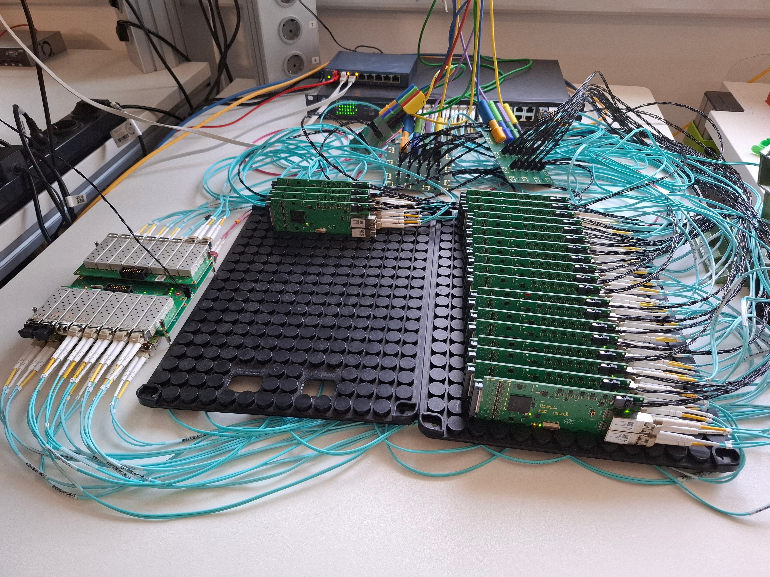
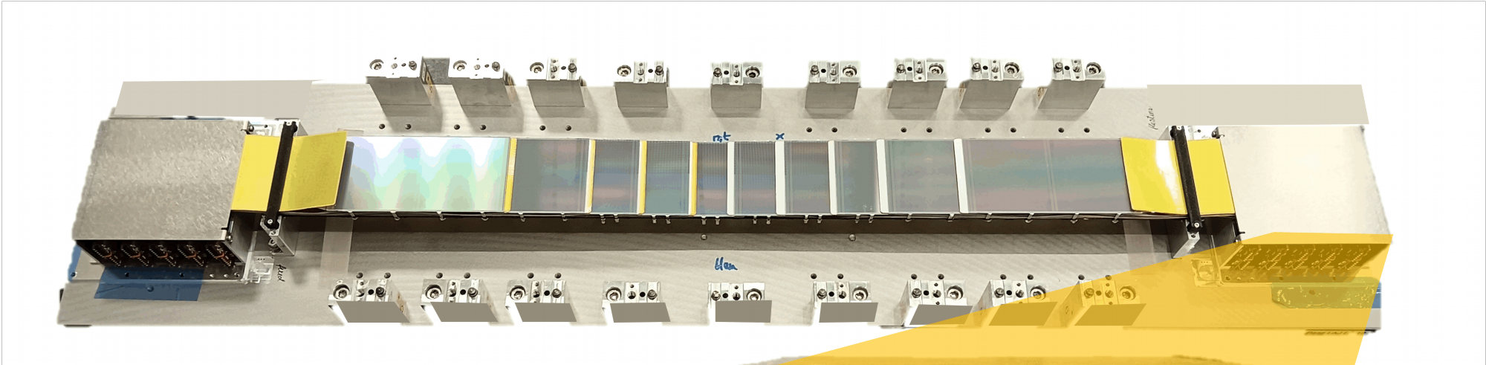
Detector tests included in call
Detector test: no direct scientific goal
Not to be submitted as regular proposals, but as “special” proposal
  short motivation and context, length of beam time, special equipment, technical requirements
Please contact respective Scientific Secretary of the PAC, e.g. Manuel Vogel for G-PAC (on special submission into GATE)
Same deadline as G-PAC proposals

Slide 8
Detector tests included in call
Detector test: no direct scientific goal
Not to be submitted as regular proposals, but as “special” proposal
  short motivation (max. 3 pages) and context, length of beam time, special equipment, technical requirements
Please contact respective Scientific Secretary of the PAC, e.g. Manuel Vogel for G-PAC (on special submission into GATE)
Same deadline as G-PAC proposals
We expect that parasitic, primary beam is used

Slide 9
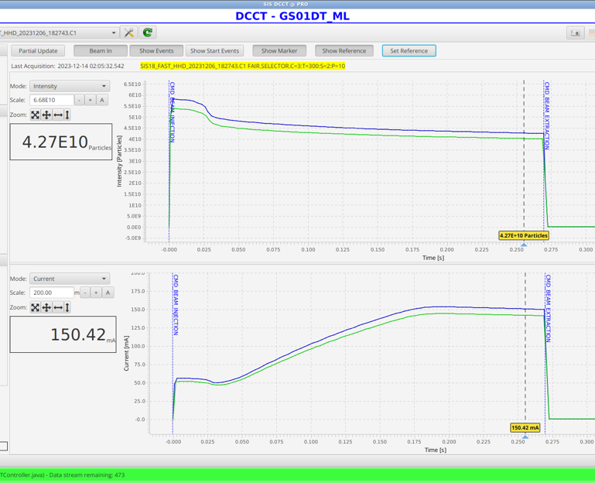
U²⁸⁺ Capability Today & Extrapolation with FAIR
Capability today:
  Defined by performances achieved in engineering runs. Best values → the machine today is capable to achieve this!
  Proven that there are no fundamental physics or technical limitations preventing this.
  Note: Routine performance is lower (typically assumed factor 1.2 at GSI) but can approach the capability with improved tools: MP, feedbacks, automatic optimization routines, AI, …
Intensity extrapolation to FAIR:
  Assume reasonable transmissions through HEBT and SIS-100, partly “guaranteed” by radiation protection
Intensity performance with selected upgrades:
  Performance predicted after some upgrades
  Upgrades selected from a long list of proposed upgrades and actions, that is being established
P. Spiller et al, U28+ at top energy SIS-18, 14 Dec 2023

Slide 10
Calls for proposals
For beamtime in 2026 and 2027
Submission via GATE (https://gate.gsi.de):
  PPAC now – 26.11.2024
  G-PAC now – 2.12.2024
  Mat-PAC November – mid-January 2025
  Bio-PAC mid-January – mid-March 2025
N° of shifts to be recommended
for all PACs combined:
  350 shifts at UNILAC,
  300 shifts at SIS18,
  250 shifts in total for at
  ESR, ESR-HITRAP and ESR-CRYRING,
  100 shifts at PHELIX.
Infos on webpages of the PACs: www.gsi.de/g-pac, /ppac, /mat-pac, /bio-pac
Call for CRYRING in standalone-mode in 2025 for beam time in 2026 completed

Slide 11
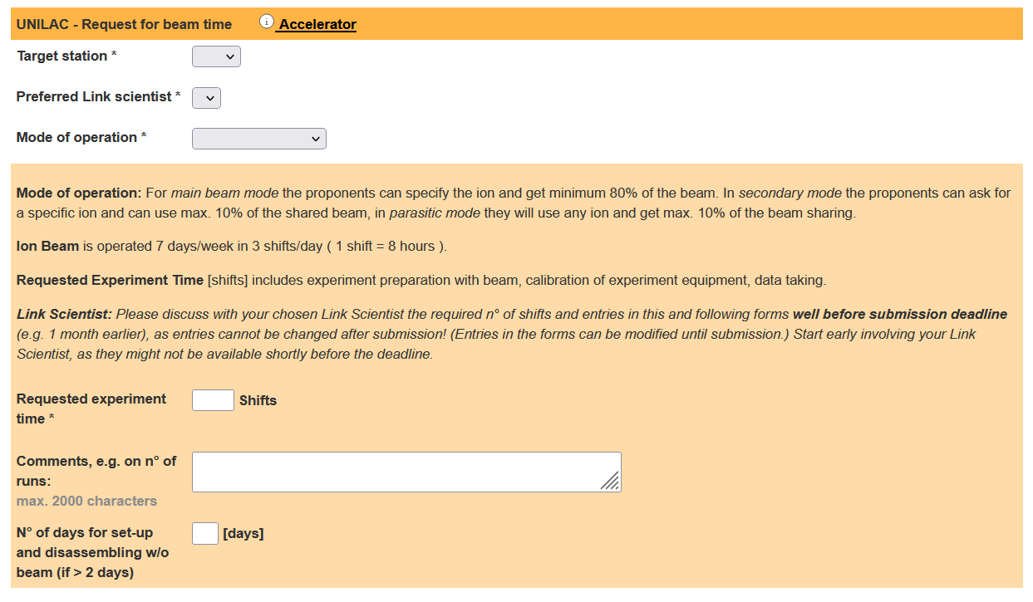
Calls for proposals
For beamtime in 2026 and 2027
Submission via GATE (https://gate.gsi.de):
  PPAC now – 26.11.2024
  G-PAC now – 2.12.2024
  Mat-PAC November – mid-January 2025
  Bio-PAC mid-January – mid-March 2025
N° of shifts to be recommended
for all PACs combined:
  350 shifts at UNILAC,
  300 shifts at SIS18,
  250 shifts in total for at
  ESR, ESR-HITRAP and ESR-CRYRING,
  100 shifts at PHELIX.
Infos on webpages of the PACs: www.gsi.de/g-pac, /ppac, /mat-pac, /bio-pac
Call for CRYRING in standalone-mode in 2025 for beam time in 2026 completed

Slide 12
Physics beamtime modes
Mode A
Physics beamtime
- highest priority on physics
- full parallel operation
- full on-call service at any time
Mode B
Best effort operation (BEO)
- priority on physics
- limited parallel operation
- on-call service by arrangement
Mode C
Second priority
- priority on FAIR commissioning
- limited parallel operation
- on-call service by arrangement

Slide 13
FAIR/GSI strategic operation scenario towards FS+
beam time
Acc. Operation total / days
134
44
140
Pre-paration works
EH
140+30
renovation
EH
?
Reno-vation
EH
140
200
240
240
30
beam time
Physics beam time/ days
107
0
100
100+30
0
?
70
min. 120*
180
180
engineering-runs
Project phases (ES, FS, FS+)
FAIR Installation of Accelerator Components
FAIR Hardware Commissioning
DRAFT
FCC OP ready
UNILAC CS ready
DR
FAIR Beam Commissioning
PCP reached
Facility availability
now
included
early science (ES) →
SIS18 → SFRS → NUSTAR
still
missing
first science (FS) →
SIS100 → SFRS → NUSTAR
first science + (FS+) →
SIS100 –> CBM
UNILAC → EH, SIS18 → TH, EX, FRS, ESR → HITRAP, Cryring
2022
2023
2024
2025
2026
2027
2028
2029
2030
FAIR Phase 0
Early Science
Early Science & First Science+
13

Slide 14
Thanks for you attention

