Slide 1
S160 FRS Developments for APPA and NUSTAR experiments
Martin Bajzek
Walldorf, October 31th, 2024

Slide 2
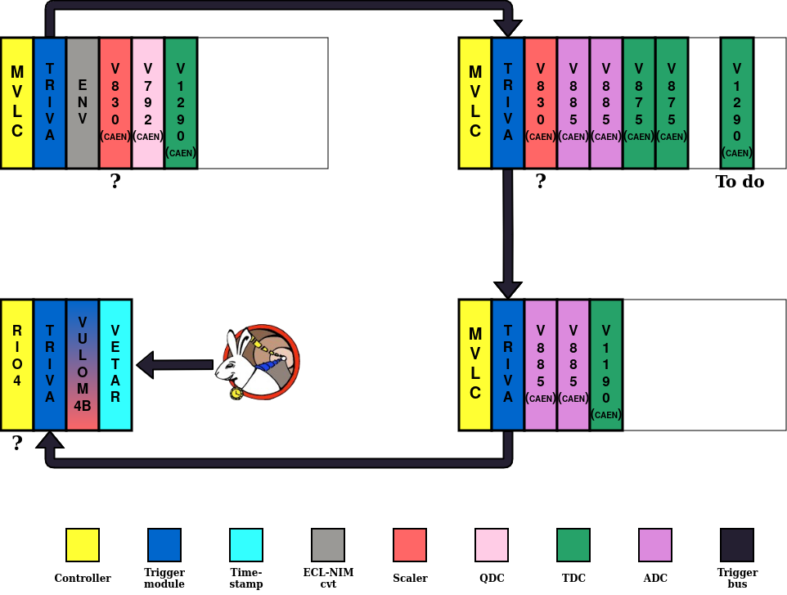
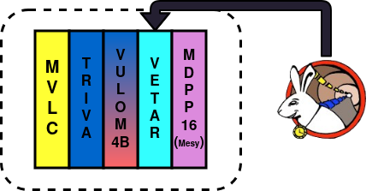
DAQ setup in S160
Four VME crate system MBS
All crates in Messhütte
Objective: precise benchmarking of DAQ performance (max rate, efficiency)
MAIN CRATE
USER CRATE
VULOM CRATE
TRAVELLING MUSIC CRATE
TPC CRATE

Slide 3
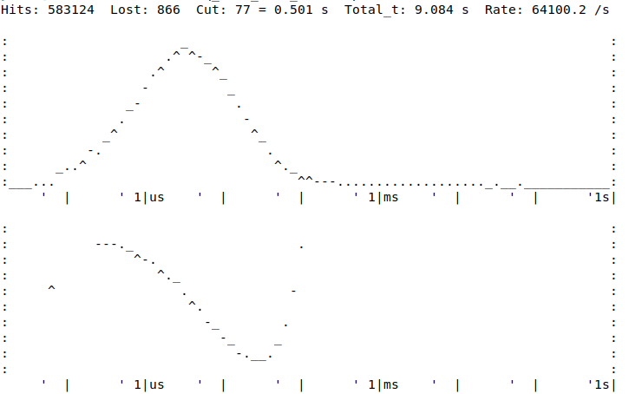
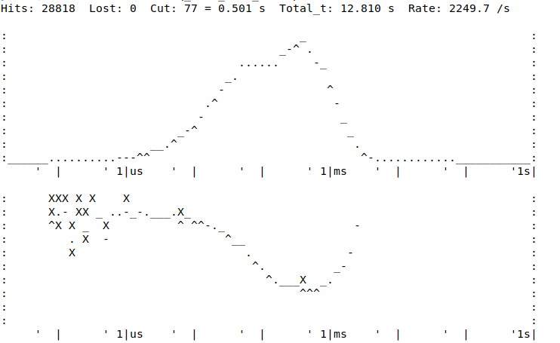
FRS microspill structure
Top drawing : Δt between two consecutive SCI 21L hits (log - log)
Bottom drawing : ratio between measured and true Poisson distribution (log-log)
A true Poisson distribution would be flat
Measured during S160 SEC experiment in May, 2024
High rate
Low rate
TOP
TOP
BOT
BOT

Slide 4
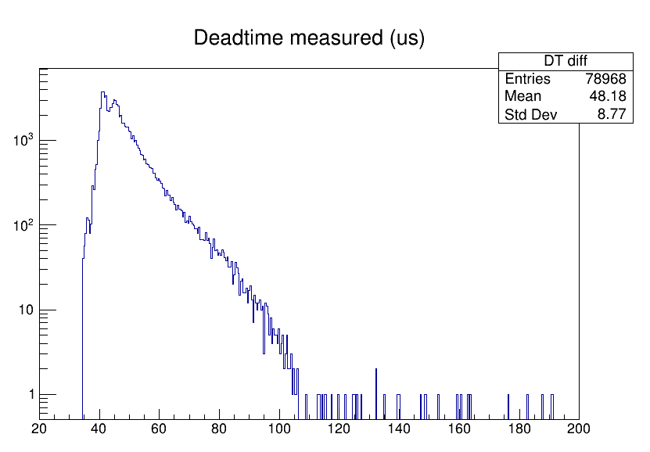
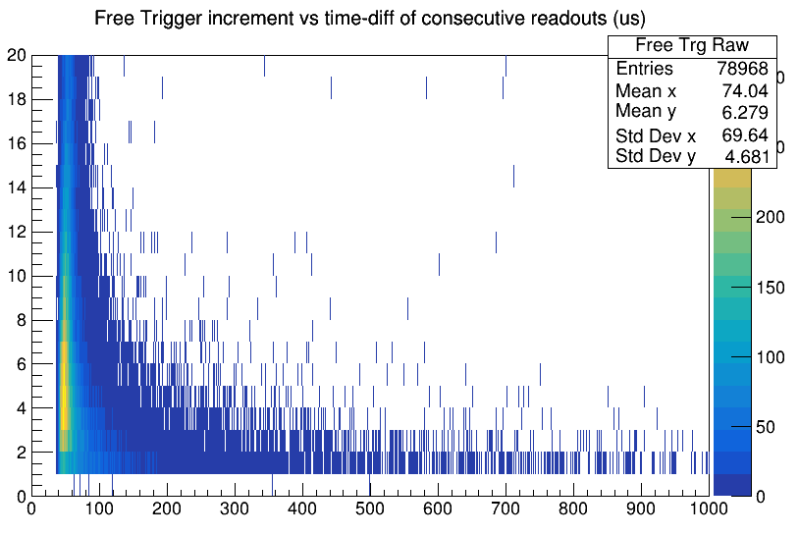
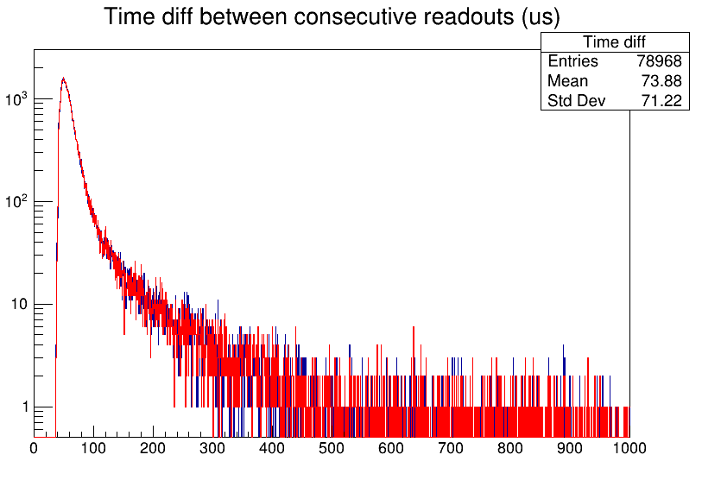
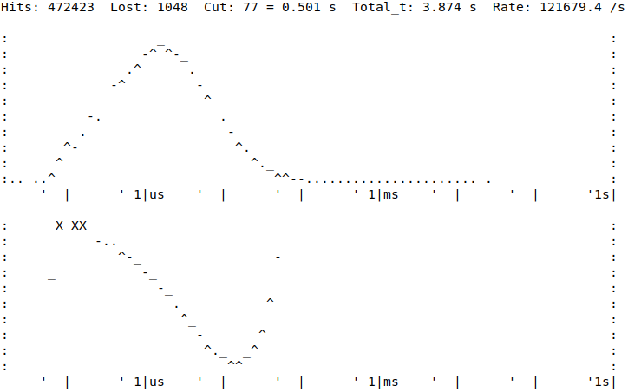
DAQ test results from S160 (I)
¹⁰⁰Mo particle rate: 250k/spill, 2s spill duration
Top figure: Multiple trigger requests (avg. 6.3) come for an accepted trigger
Mean DAQ deadtime: 48 us
Microspill structure
blue: measured by Whiterabbit,
red: measured by a 1 MHz clock

Slide 5
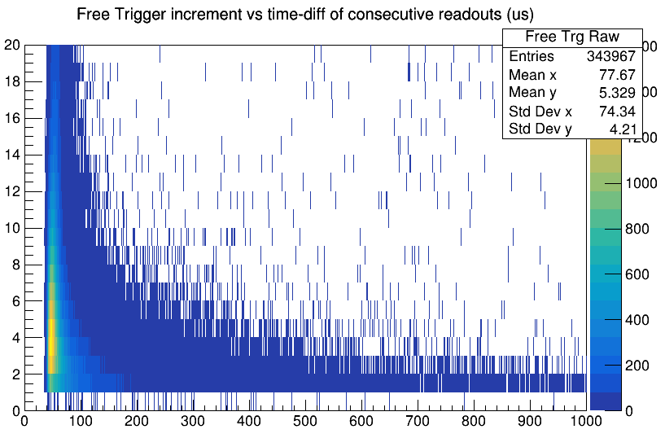
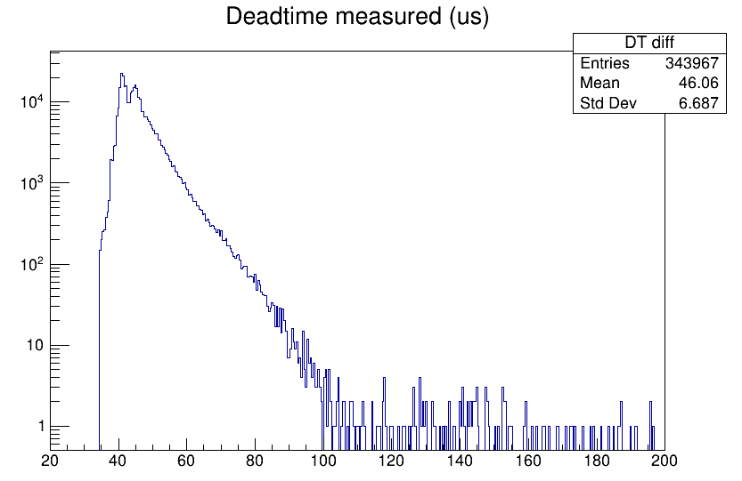
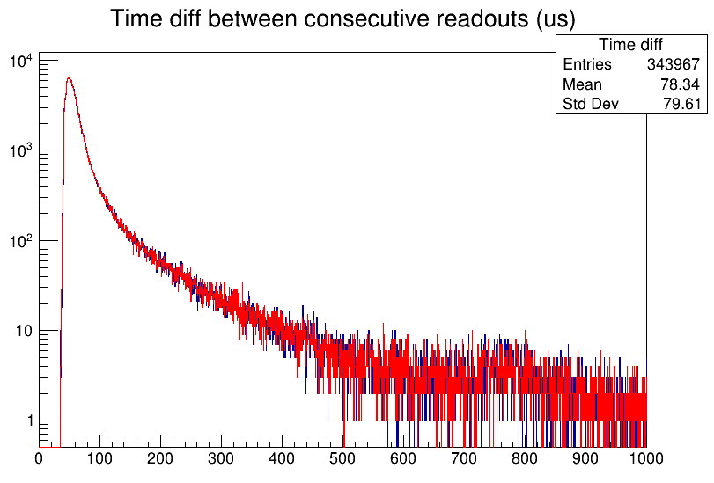
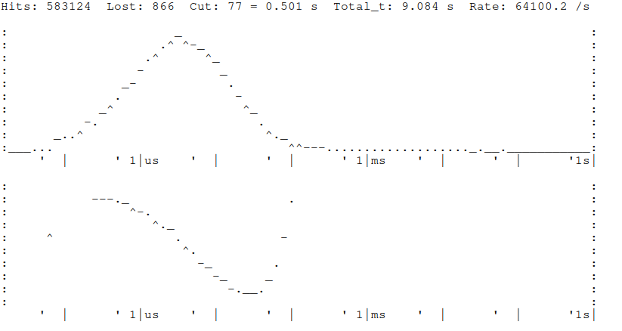
DAQ test results from S160 (II)
¹⁰⁰Mo particle rate: 140k/spill, 2s spill duration
Mean DAQ deadtime: 46 us

Slide 6
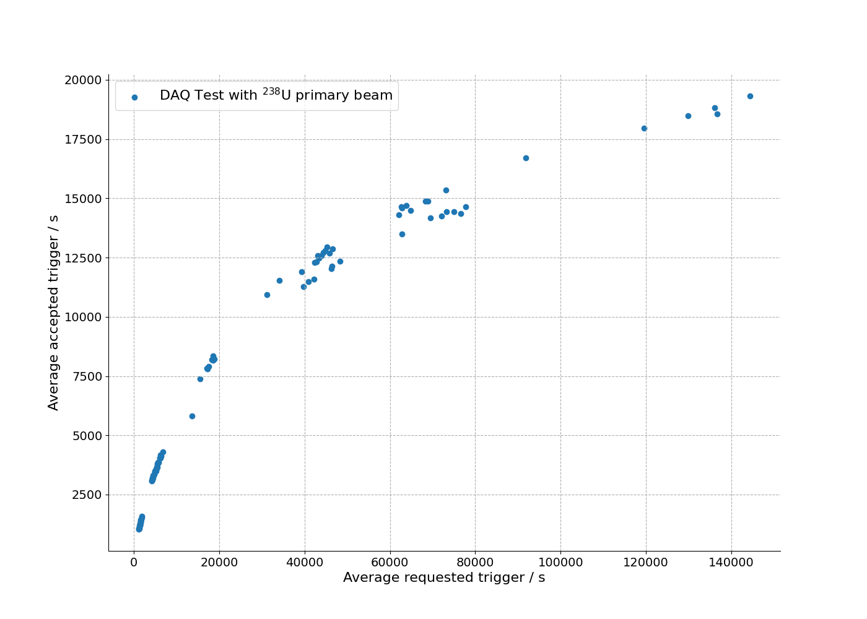
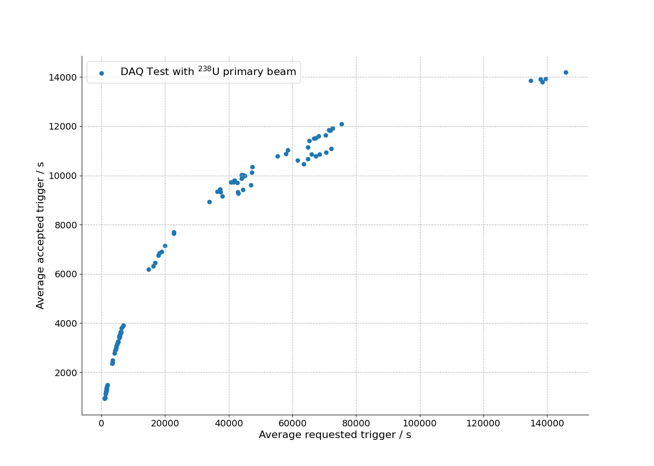
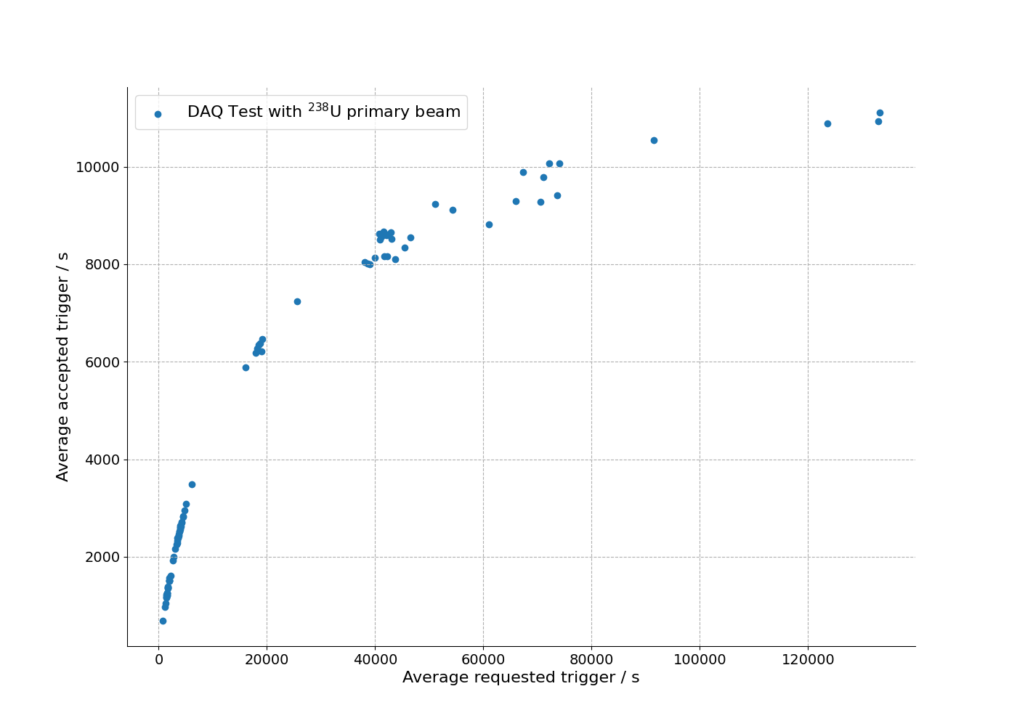
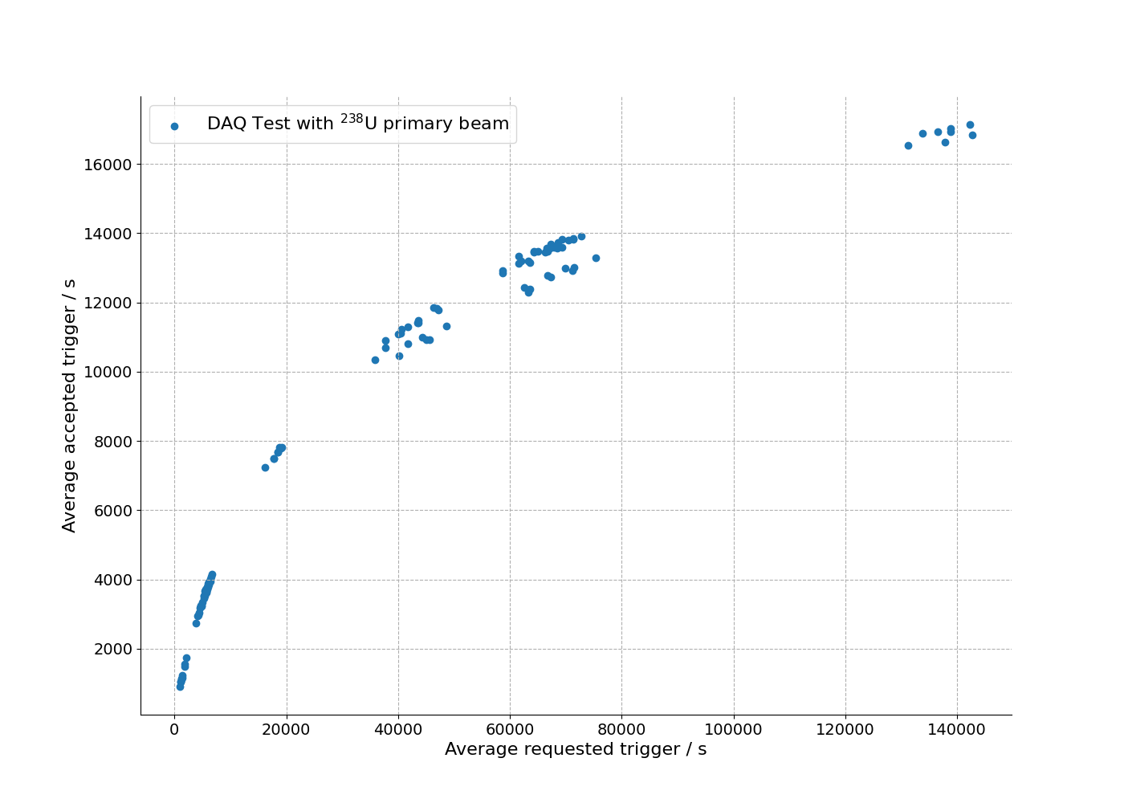
DAQ test results from S160 (III)
A point is a measurement of one spill.
VULOM CRATE
MAIN CRATE
TPC CRATE
USER CRATE

Slide 7
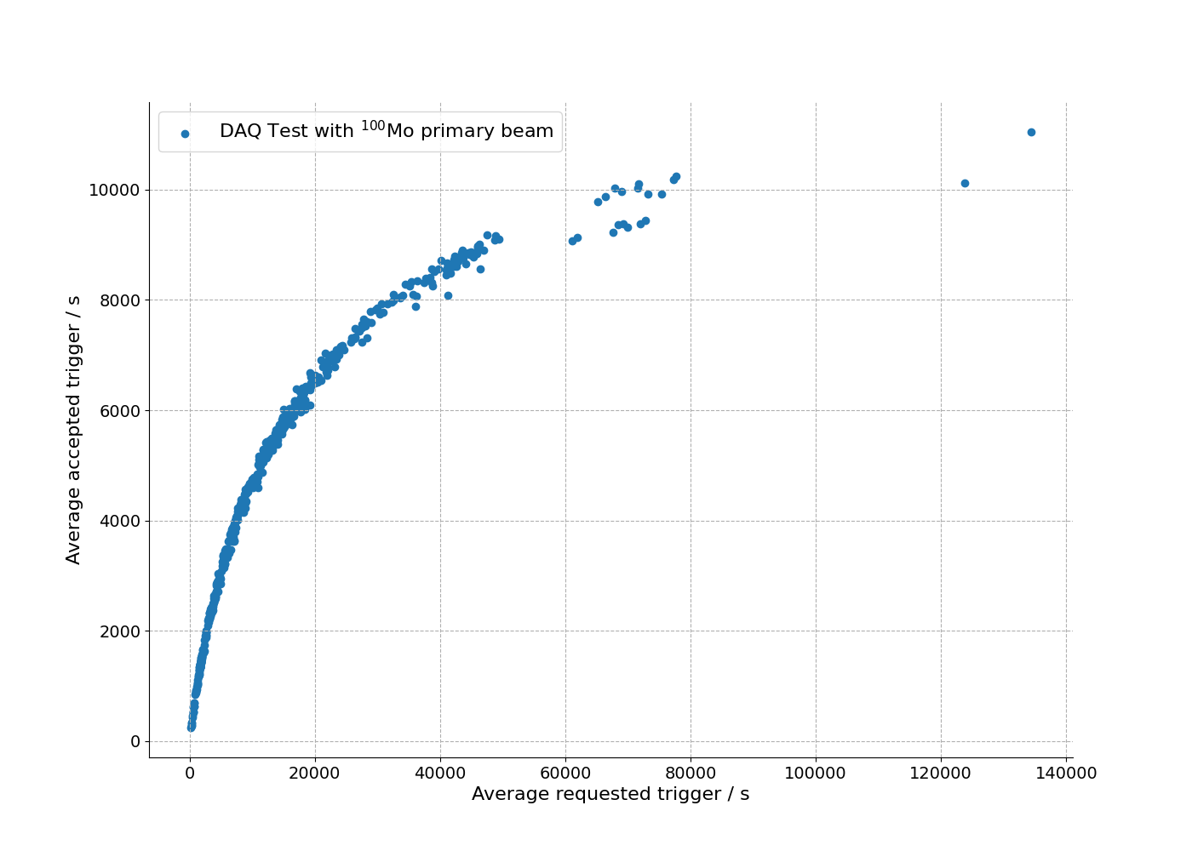
DAQ test results from S160 (IV)
FULL SYSTEM

Slide 8
Conclusion
DAQ deadtime <50 us (max rate above 20kHz)
Depends on multi-hit TDC payload
To do
Optimizing conversion times
Can go down to 6-8 us from 10-18 us.
If too low, multihit TDC data can be segmented
Consistent and more detailed measurements of microspill structure

Slide 9
Thanks to all the collaborators
Nikolaus Kurz , Jörn Adamczewski-Musch , Sergey Linev, Michael Reese
GSI Experiment Electronics
Yoshiki Tanaka, Stephane Pietri, Emma Haettner, Christine Hornung, Jianwei Zhao, Nic Hubbard
Super-FRS Experiment Collaboration
… and to my supervisors:
Ivan Mukha, Christoph Scheidenberger

