Slide 1
First Results of GSI-FAIR Performance Committee
R. Aßmann
Head Accelerator Operation & Development
1st FAIR Commissioning Workshop
7-8 Nov 2024

Slide 2
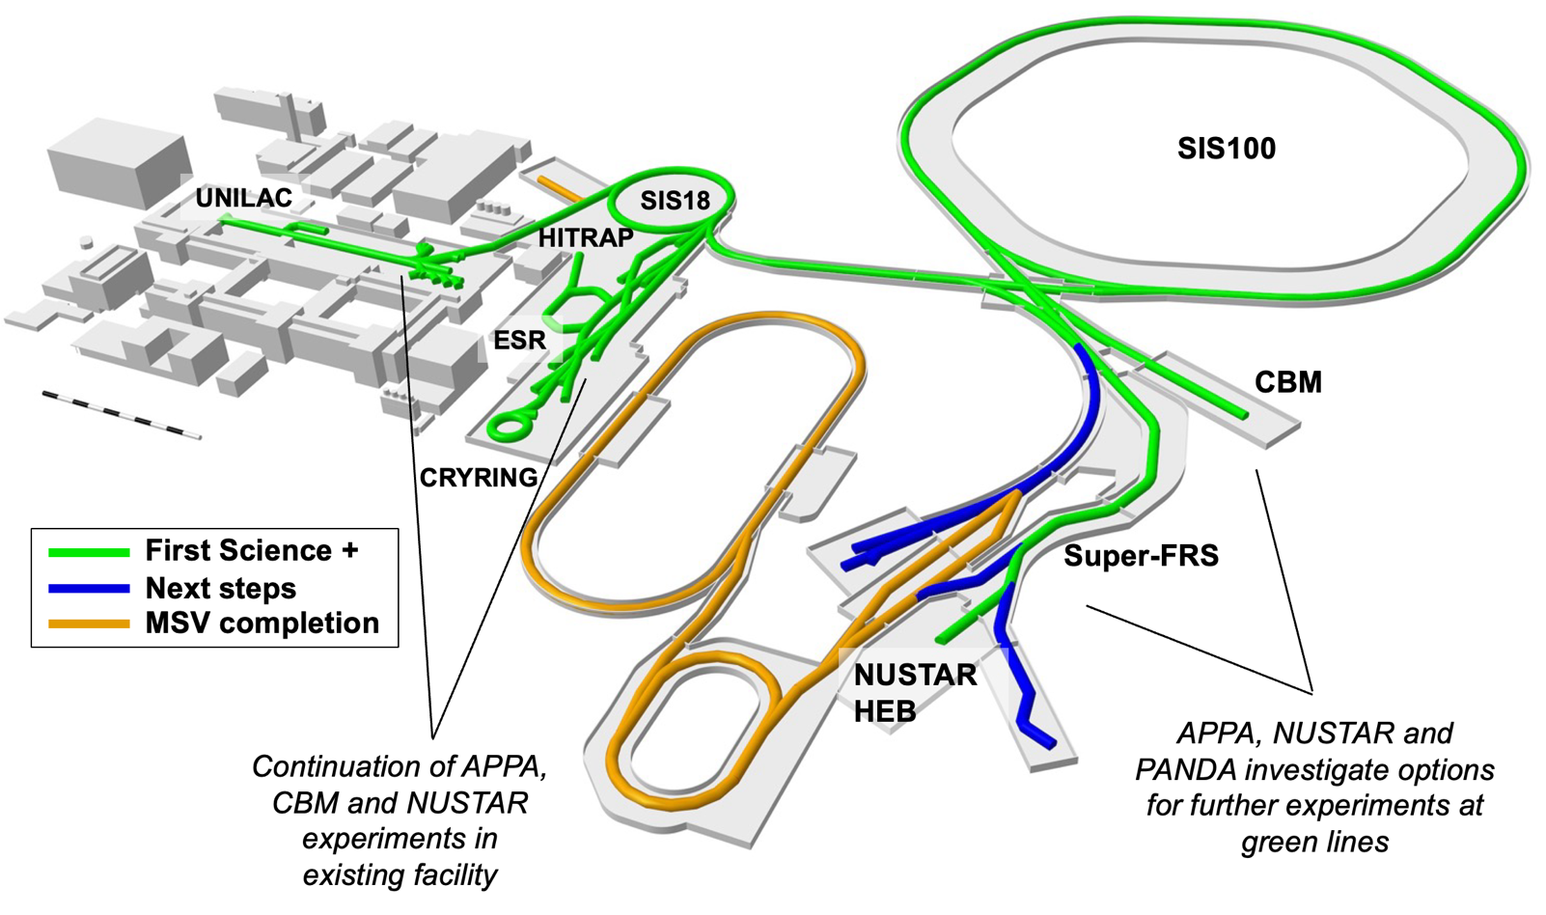

Slide 3
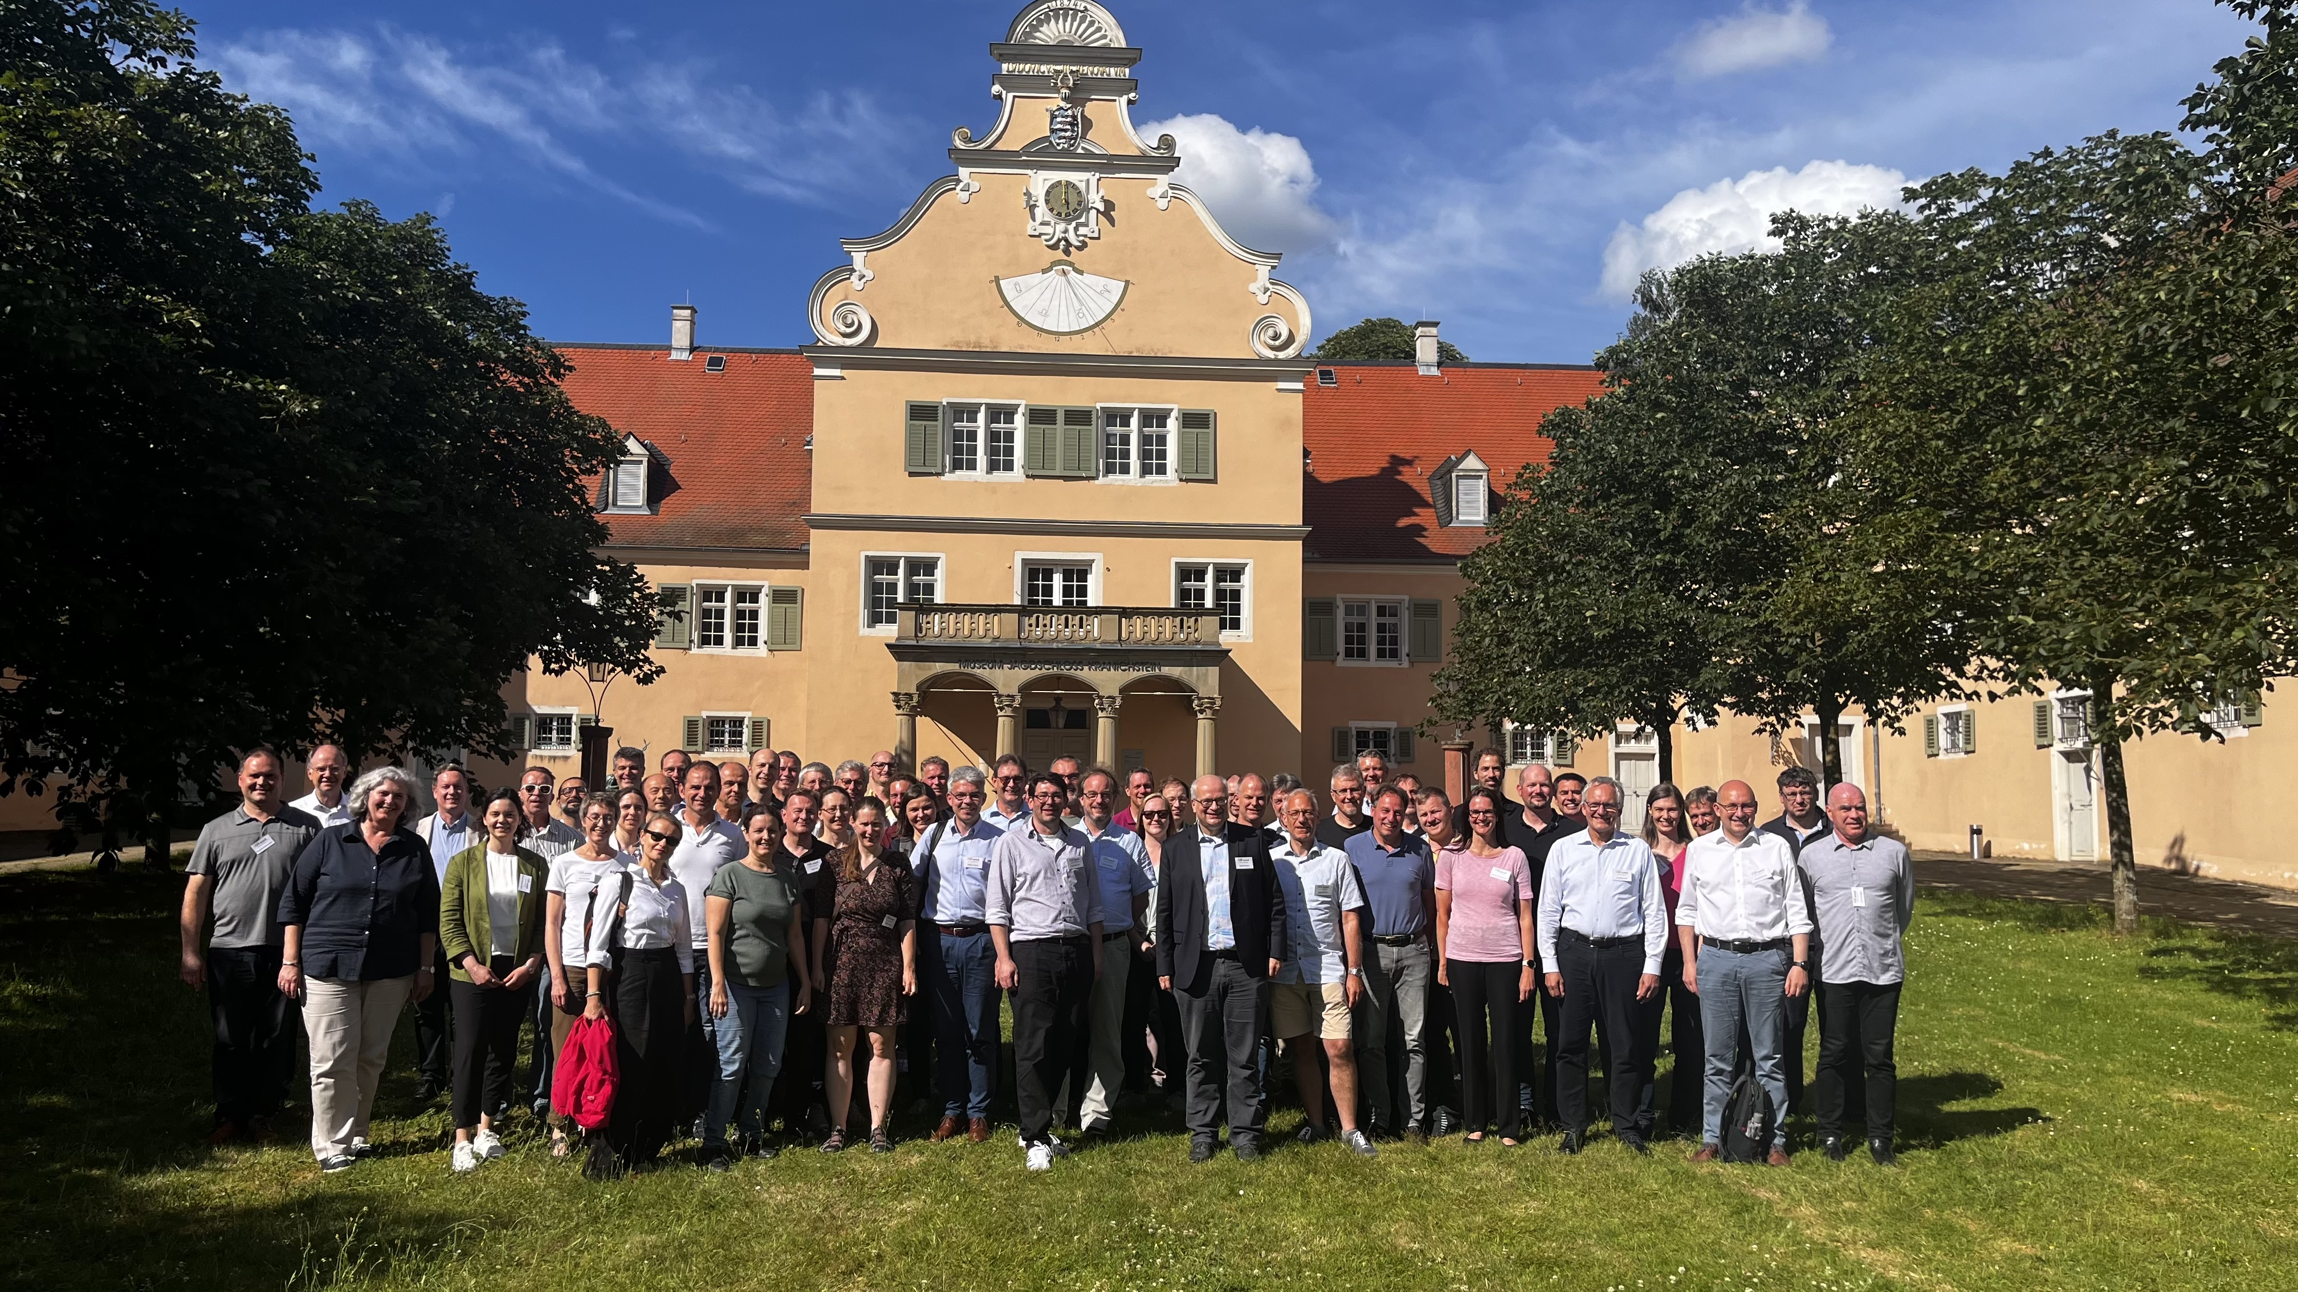

Short Summary: Physics Run 2024
(9 Feb – 27 Jun 2024)
→ Finished very successfully
  Availability beam on target:
  74% (2022) → 75%
  Number of experiment in parallel (average over run):
  2,7 (2022) → 2,8
  Failures with most time lost:
  > 100 hours SIS-18 septum
  93 hours 20 kV filter
  3% overall availability lost during last weeks of the run 2024
  Improvements from the engineering run 2023 could be translated in improved operation
Beam Time Retreat 2024
Kranichstein
11-12 Juli 2024
https://indico.gsi.de/event/18781/overview
For details see the 38 presentations on results from engineering and physics runs, including session summaries.
O. Geithner, S. Reimann, et al

Slide 4
Strong Effort from GSI Personnel
In 2024 more than 400 urgent interventions by on call duty personnel
In 2024 in total 92 person days urgent interventions

Slide 5
Performance Committee
Brings together accelerator specialists from GSI and FAIR divisions plus representatives from experiments and collaborating universities.
Central discussion forum accelerator performance and development → one understanding & one plan.
Since 1st Feb so far 13 meetings with about 3 presentations per meeting. Chair R. Aßmann. Scientific committee manager: Oksana Geithner. Technical roadmap projects: Udo Weinrich.
Goals: Develop coherent KPI’s, a quantitative performance roadmap and a common technical roadmap. Steer accelerator follow-ups and implementation or roadmaps. Provide data for expectation management.
O. Geithner & D. Severin

Slide 6
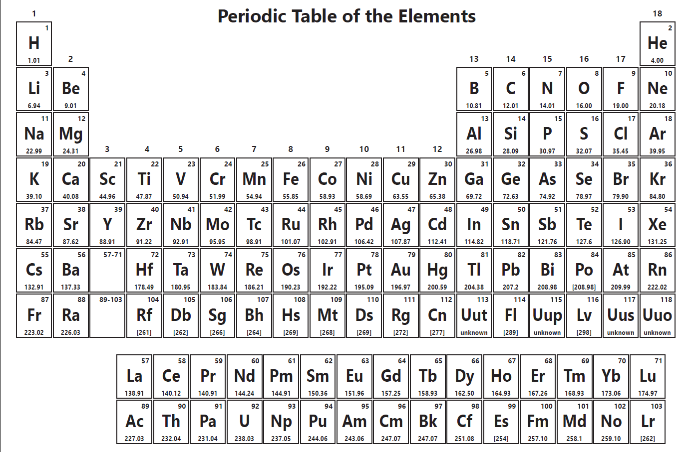
Ion Species Provided at GSI
34 elements are available for accelerator operation at GSI:
  28 - from high current sorces
  19 - from PIG sources
  22 - from ECR source
5 new elements are in development
- provided for experiments
- in development
R. Hollinger, F. Maimone, A. Adonin, A. Andreev, R. Berezov, M. Galonska, F. Heymach, J. Mäder, R. Lang

Slide 7
Performance Tracking: KPI’s
KPI Category | ACCELERATORS
KPI Category | ION SOURCE | UNILAC | SIS18 | HEST | FRS | ESR | CRYRING
Availability
Effectiveness (Beam Intensity)
Quality (Emittance, dp/p etc)
O. Geithner
Full KPI = Availability * Effectiveness * Quality
Quality, emittance → Investigate possibility to track emittance evolution with relative measurements, e.g. beam width at IPM. Absolute calibrations a few times during beamtime with emittance measurements.
Beam diagnostics effort is significant and needed, as resources allow
Manually logged in OLOG
Logged in Archiving System, Missing ZKS data -> no automatic analysis available
Not logged in Archiving System, Measurement either not possible or special with beam interruption available

Slide 8
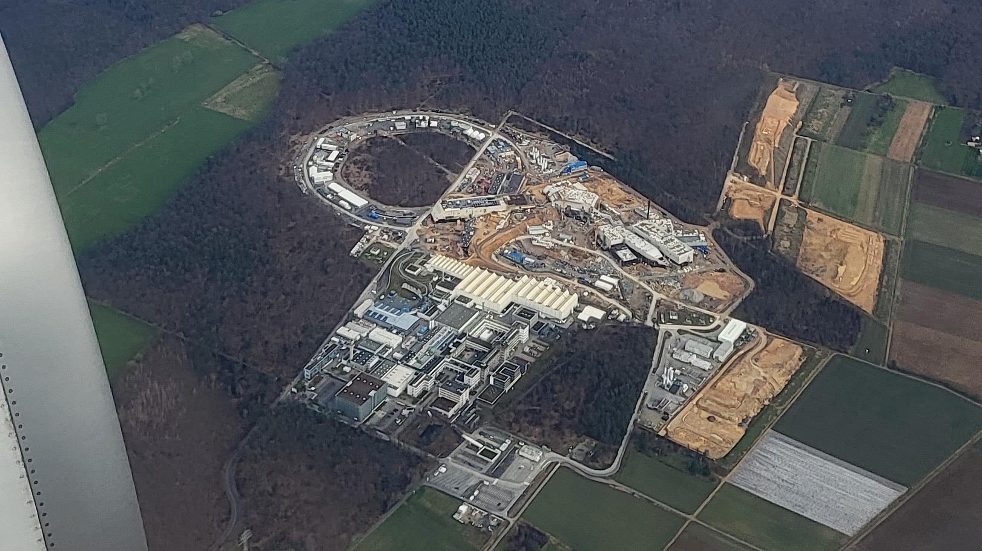


The Performance Leap Forward with FAIR
FAIR is a big leap forward in performance for our existing accelerator campus.
FAIR ES/FS extends science reach by large factors:
- Intensity reach improvement factor 4 in SIS-100
- Beam energy increase factor > 5 Au 1 → 11 GeV/u
U 0.2 → 1.5 GeV/u
- Fragment separator transmission x 1.5 – 16 (dep. on Z)
Multiplicative intensity factor → big step up guaranteed.
Working on GSI FAIR injector complex to maximize incoming beam quality (intensity, emittance) to SFRS and SIS-100.
Aerial View on 25 Feb 2024

Slide 9
Example: Leap Forward with Uranium (NUSTAR)
Science today: U⁷³⁺
Science FAIR enabled: U²⁸⁺
Factors gained for FAIR science:
  Factor 7 from not going through the TK stripper
  Factor 4 from pulse combination in SIS100
Together with present UNILAC performance:
SIS-18 Cycle SIS-100 Cycle
3 x 10⁹ U⁷³⁺ per cycle ≥ 1 x 10¹¹ U²⁸⁺ per cycle
1 GeV/u extraction E 1 GeV/u extraction E
factor ≳ 30
Aerial View on 25 Feb 2024
factor 150 for ultimate intensity
Thanks to P. Spiller

Slide 10
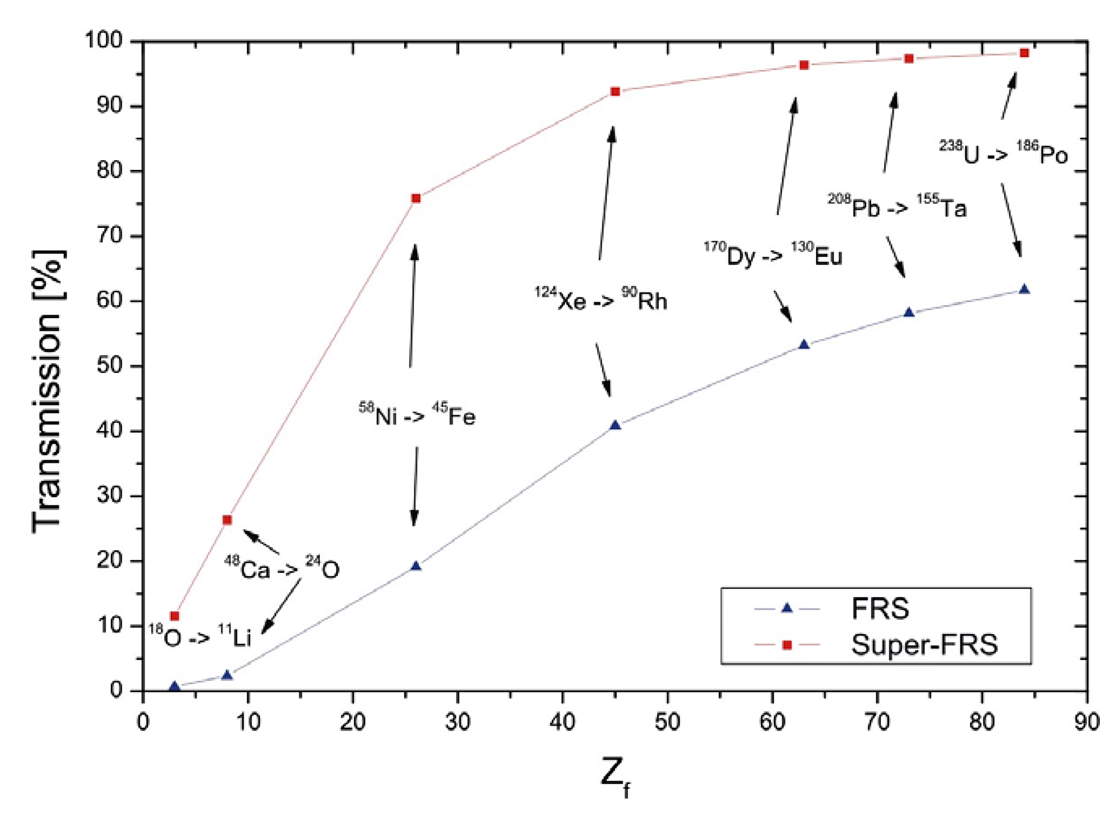
Example: Leap Forward with Uranium (NUSTAR)
Folding in the improvement from SFRS
Larger physical apertures in super-conducting SFRS magnets enable an increased transmission to the experiment → gain in performance
Fragment separator transmission improved by factor 1.5 – 16
Improvement depends on Z of primary beam, namely the projectile fragmentation reactions
Total improvement factor:
factor ≳ 50
Technical Design Report
Super FRS
December 2008
factor 250 for ultimate intensity
Thanks to H. Simon

Slide 11
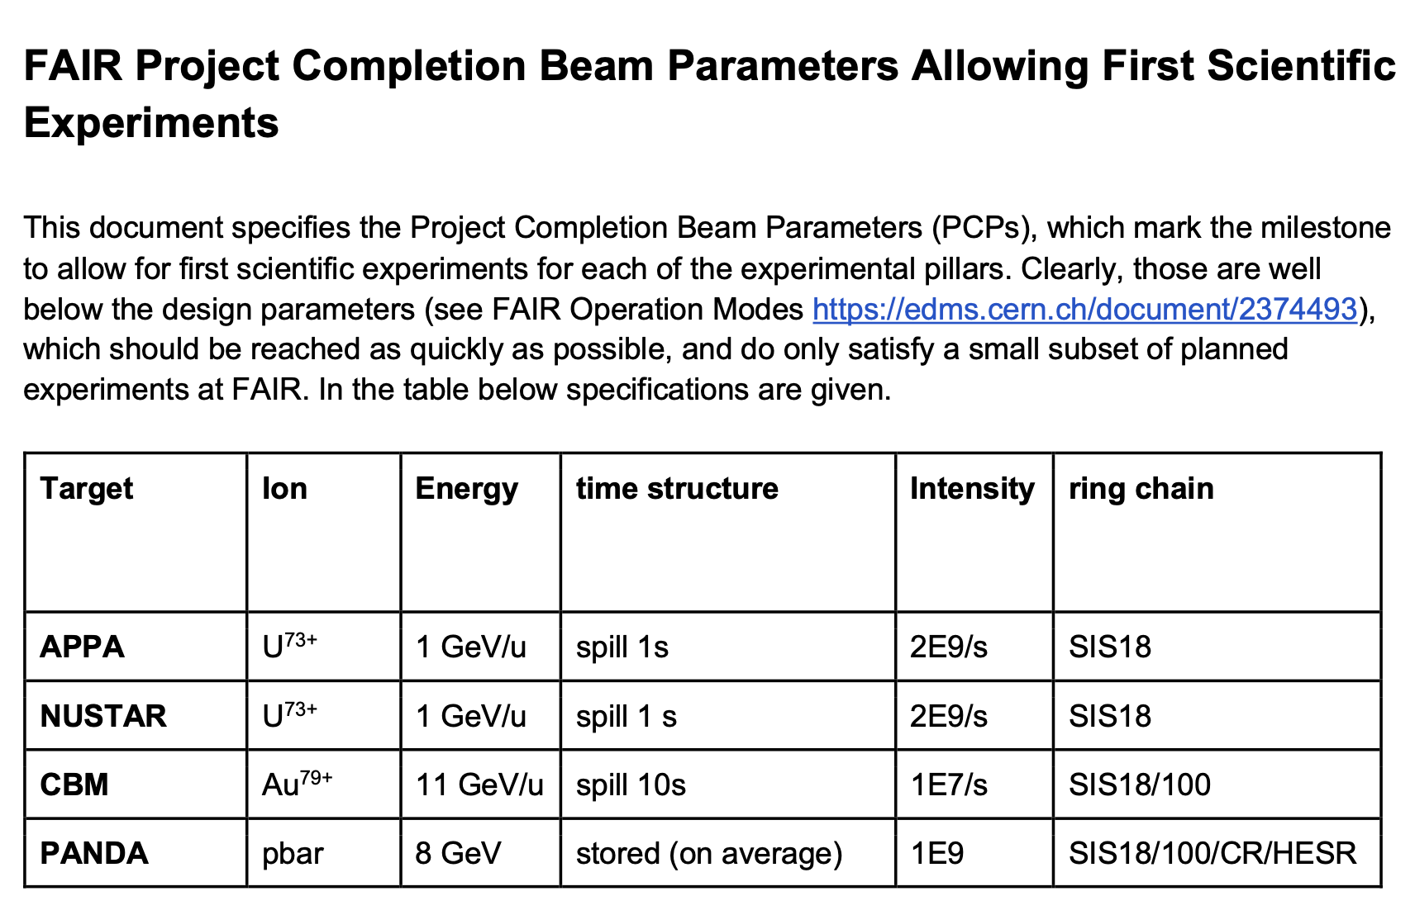
Remarks on Performance
It is one accelerator complex, from source to target
Efficient work together is the key to success
The factor 50 improvement in FAIR intensity for U constitutes roughly as follows:
  factor 7 → UNILAC + TK + SIS-18
  factor 7 → SIS-100 + SFRS
The additional manipulations in SIS-100 cost time: reduction of duty factor
  up to factor 2 loss in integrated ion intensity possible
Project completion parameters of FAIR:
  For U below today´s performance → task is to transport standard GSI beam to target. VERY FAST.

Slide 12
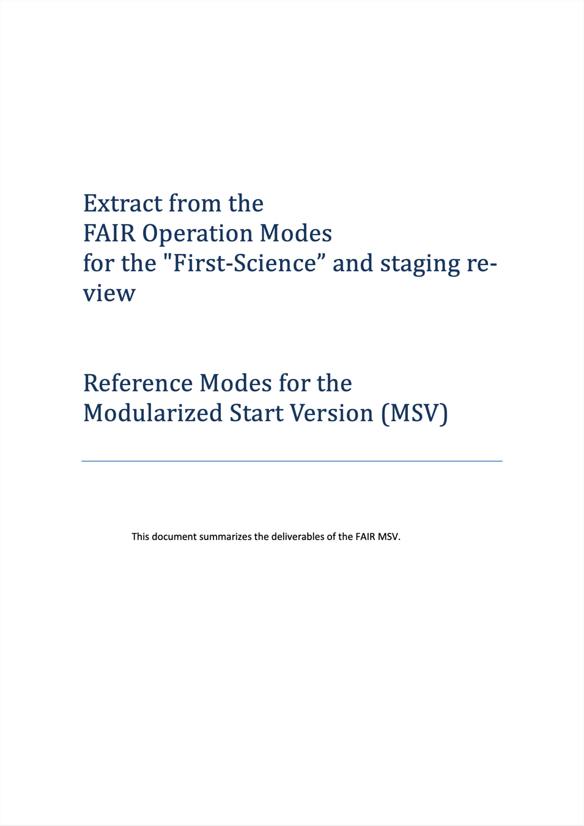
CBM: ¹⁹⁷Au Intensity
Production chain:
sources → UNILAC → SIS-18 → HEBT → SIS100 → exp
Goal (op. in MSV): 10¹⁰ / cycle
Ready for full design intensity (10¹⁰ per cycle) immediately after SIS-100 commissioning (without any add. upgrades)
1000 x FAIR project completion parameter (PCP)
Other examples for which injector complex is ready with full FAIR design intensities: Ar and N.

Slide 13
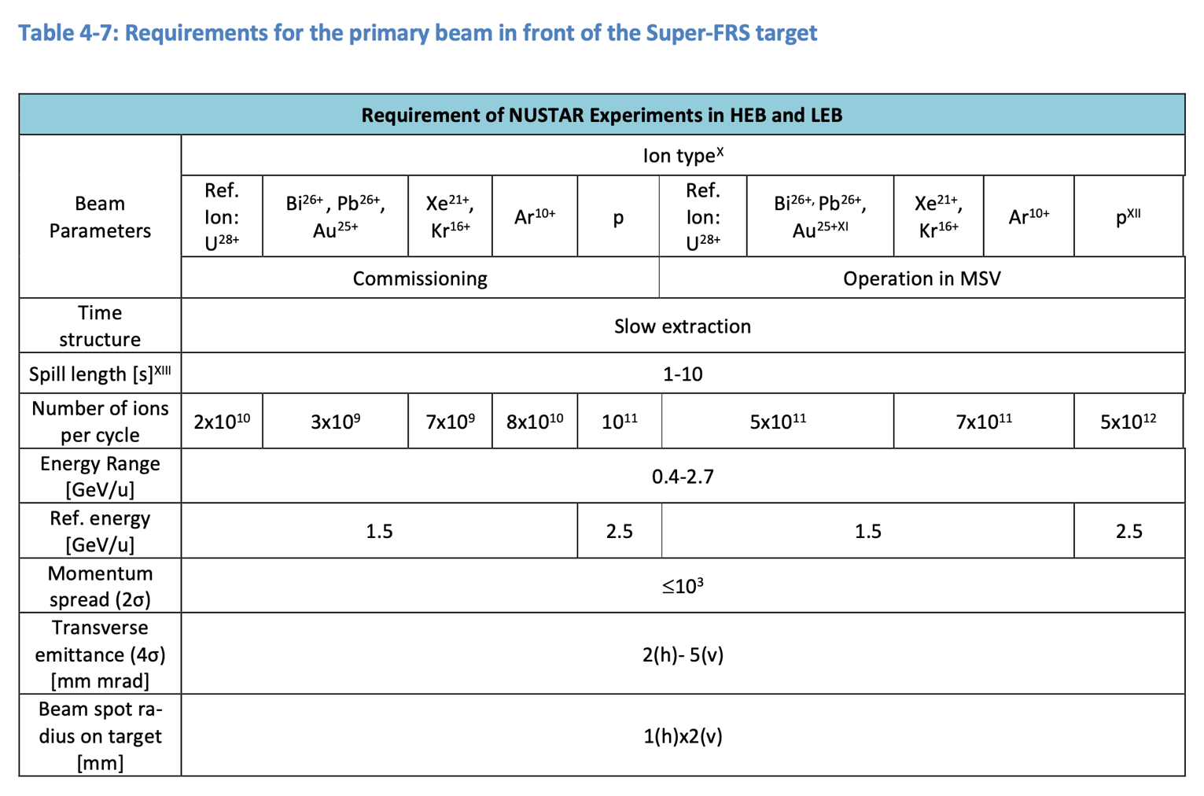
NUSTAR: U²⁸⁺ Intensity (Reference Ion)
FAIR commissioning goal: 2 x 10¹⁰ ions per pulse
FAIR operation goal: 5 x 10¹¹ ions per pulse
For accelerator physics the high intensity U²⁸⁺ beam is the most difficult FAIR goal!
Review where we stand today for the very challenging goals on U²⁸⁺.

Slide 14
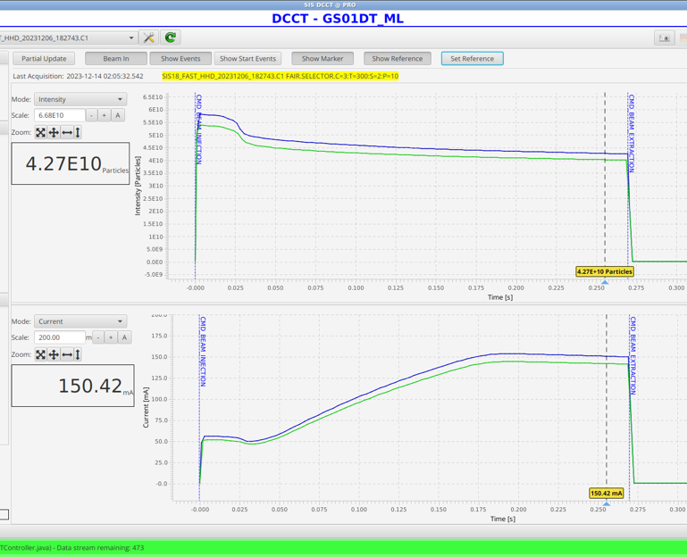
U²⁸⁺ Capability Today & Extrapolation with FAIR
Capability today:
  Defined by performances achieved in engineering runs. Best values → the machine today is capable to achieve this!
  Proven that there are no fundamental physics or technical limitations preventing this.
  Note: Routine performance is lower (typically assumed factor 1.2 at GSI) but can approach the capability with improved tools: MP, feedbacks, automatic optimization routines, AI, …
Intensity extrapolation to FAIR:
  Assume reasonable transmissions through HEBT and SIS-100, partly “guaranteed” by radiation protection
Intensity performance with selected upgrades:
  Performance predicted after some upgrades
  Upgrades selected from a long list of proposed upgrades and actions, that is being established
P. Spiller et al, U28+ at top energy SIS-18, 14 Dec 2023

Slide 15
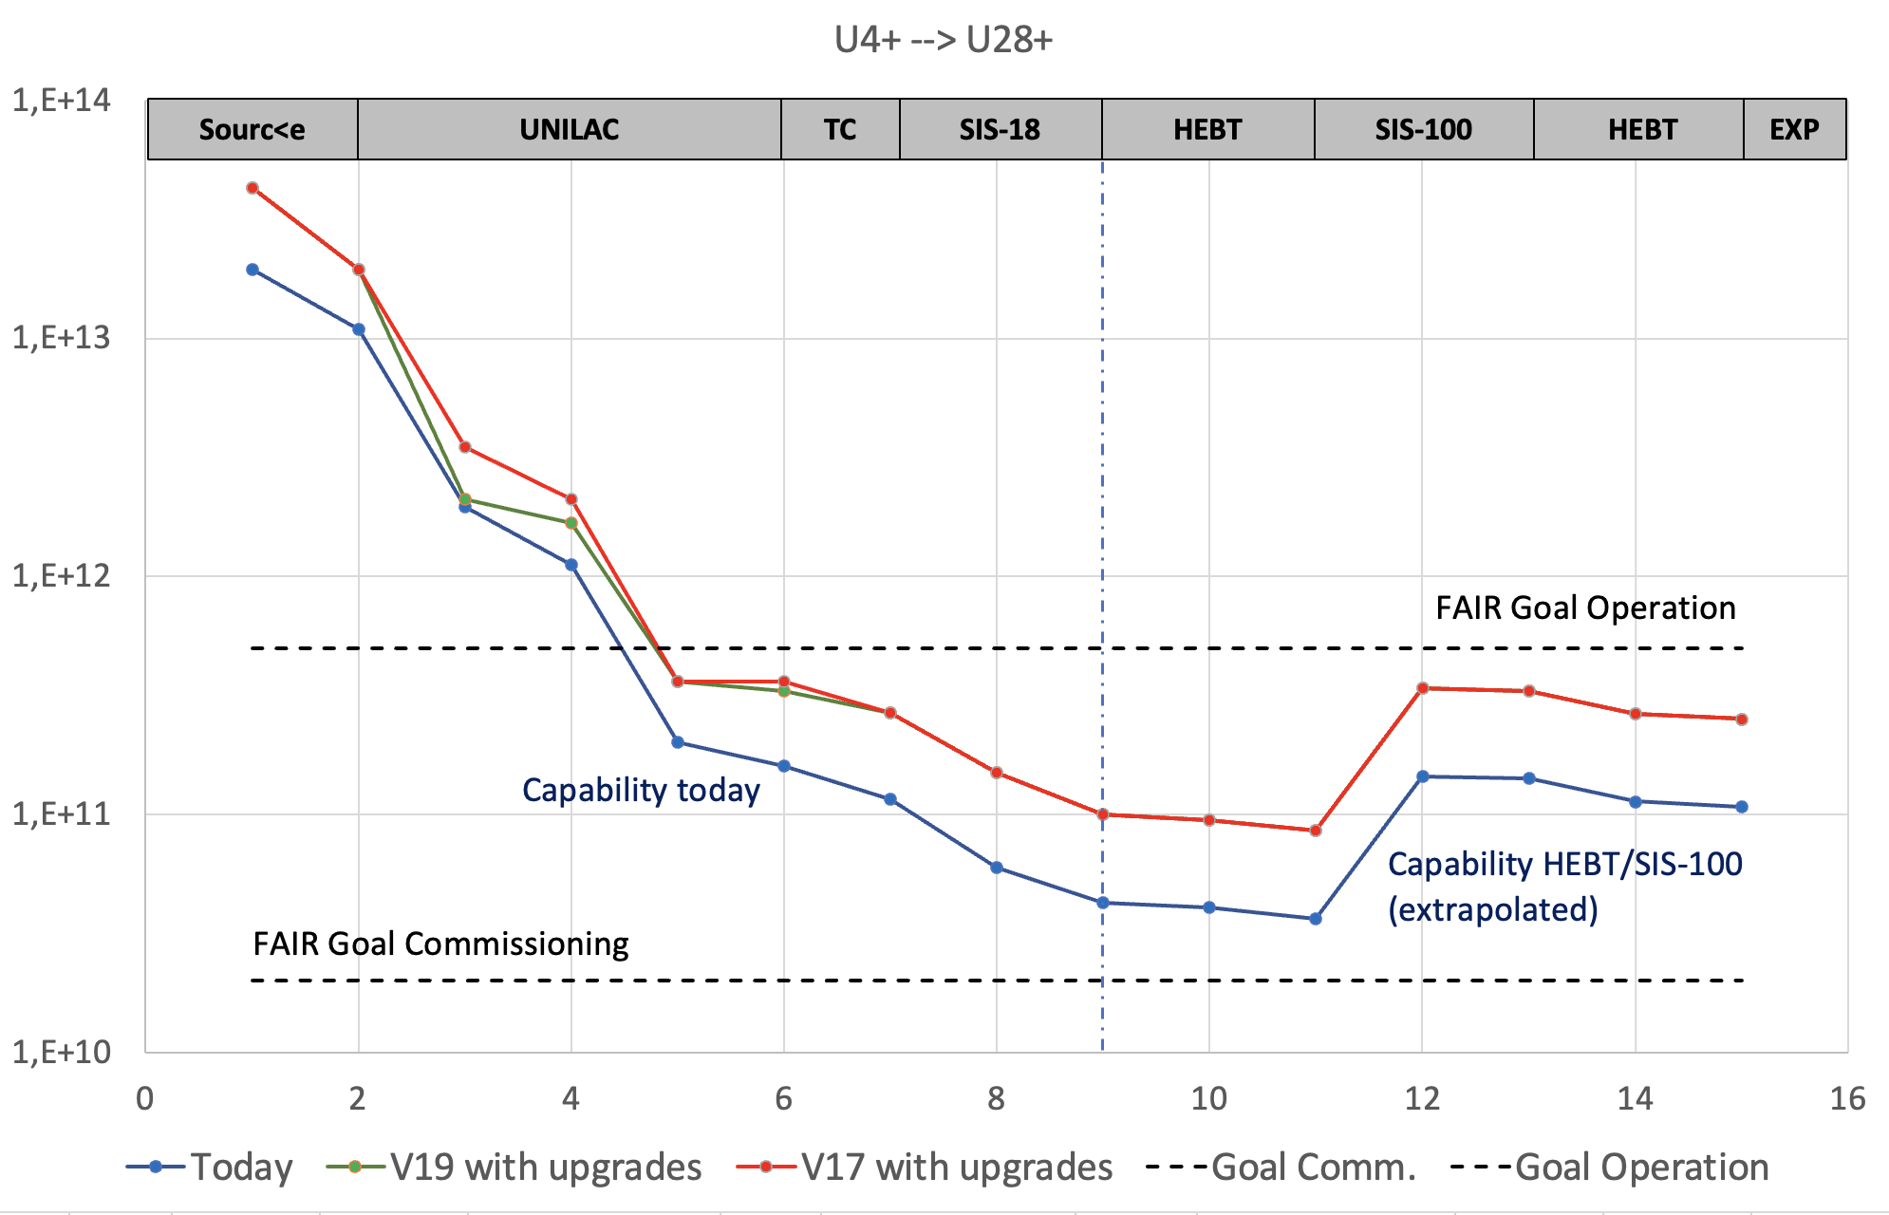
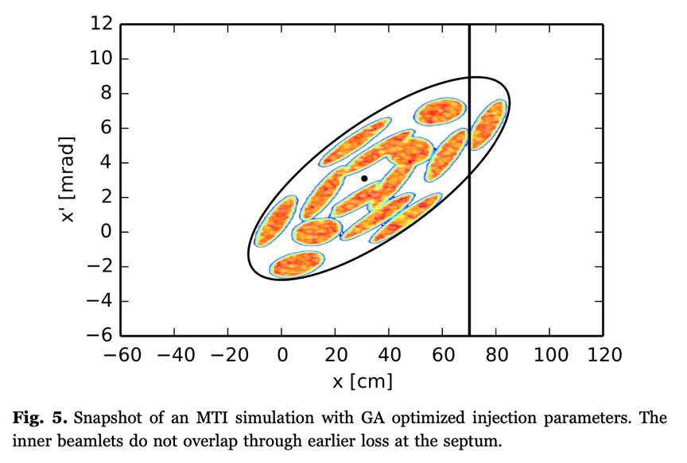
U⁴⁺ → U²⁸⁺: Pulse Intensity
← measured extrapolated →
RFQ, IH’s
Factor 5 from stripping
Multi-turn injection SIS-18
Number Ions / Pulse
S. Appel et al, Nuclear Instruments and Methods in Physics Research A 852 (2017) 73–79
Factor 10 for selecting right charge state (U4+), isolating it and selecting pulse length (500 μs → 90 μs)!
Factor 4 from combining 4 pulses

Slide 16
U⁴⁺ → U²⁸⁺: Pulse Intensity
← measured extrapolated →
RFQ, IH’s
Factor 5 from stripping
Multi-turn injection SIS-18
Number Ions / Pulse
S. Appel et al, Nuclear Instruments and Methods in Physics Research A 852 (2017) 73–79
Factor 10 for selecting right charge state (U4+), isolating it and selecting pulse length (500 μs → 90 μs)!
Diffuse cloud of gas in the source at thermal energy → ion beam with 43 billion ions at 0.2 GeV energy in a well defined volume (6D phase space).
Illustrates mastership of accelerator science and of GSI/FAIR experts in source, linac, transfer lines, strippers, choppers and the synchrotron!

Slide 17
U²⁸⁺ Performance Capability Today
Assume correct performance of SIS-100 and HEBT
At target: 1 x 10¹¹ ions of U²⁸⁺
per extracted SIS-100 cycle
Compared to goals: 500% of commissioning goal
20% of operation goal
Remember: Best performance of injector complex, include some reduction factor for average performance. Work continuing on improvements.
very good progress
For (most difficult ion) U²⁸⁺ GSI injectors at present perform a factor 5 better than required in the first year(s) for FAIR commissioning!
For full design intensity the status depends on the ion.
Prepared for Au full design intensity while for U²⁸⁺ we work on factor 5 improvement through ongoing and planned measures.

Slide 18
Evolution of Operation and Physics Time from strategic schedule June 2024
SIS 100
SFRS
“Full” operation
FAIR Control Center
“Half” operation
Commissioning period → reduced fraction of physics
beam time

Slide 19
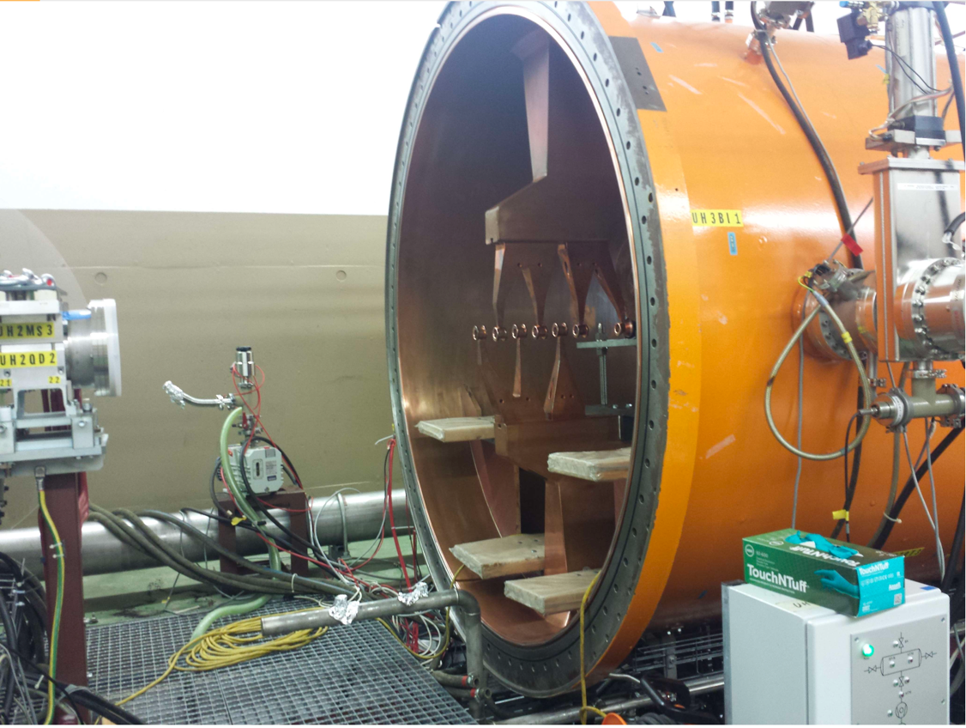
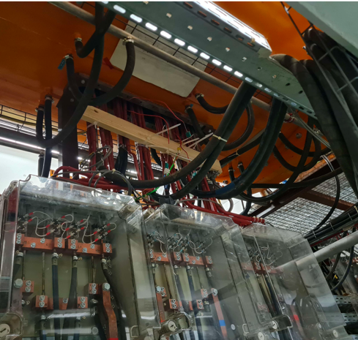
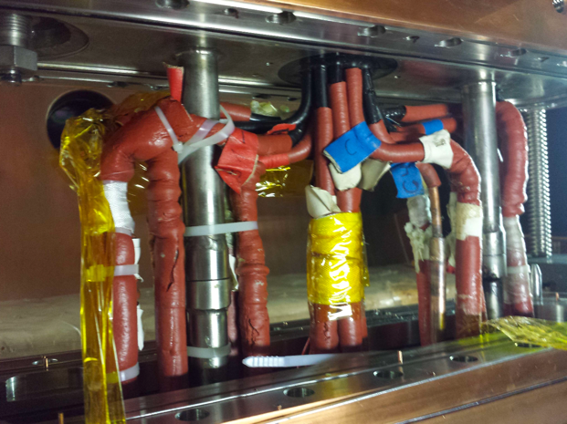
Challenge: Towards 2029 “Full” Operation
The GSI accelerator division has been scoped for “half” operation over the last decade.
“Full” operation implies a number of important challenges:
  Need for more personnel effort from ACC and technical departments.
  Need for more efficient operation (see automatic tools, ML, AI).
  Increased wear and tear of already stressed ”old” GSI accelerator equipment.
  Shorter shutdowns and limited time for repairs. Involve external support groups in shutdown work.
  Need for more spare parts.
  Need for significantly increased investment effort for the “old” GSI accelerators.
  Need for new design teams on “old” RFQ and IH devices.
Photos IH1 in HSI → single point of failure device for FAIR U operation

Slide 20
Roadmap Considerations
Accelerator performance
  Many factors contribute: availability, duty factor, versatility of ions, beam brightness
  Beam brightness characterized by conserved quantities:
    Number of ions per pulse → can only go down (without pulse combination).
    6D normalized phase space, e.g. norm. emittances → can only increase (without cooling)
Technical risks:
  Equipment and accelerator components at the end of their lifetime
  Components with low MTBF, limiting availability (including insufficient designs)
Technical roadmap: prioritize accelerator work on improvements
optimize overall performance
establish an accelerator performance roadmap coherent with research planning in the experiments

Slide 21
Technical Project List
This list only concerns the “old” part of the research infrastructure: GSI accelerators
Asked machine coordinators and technical departments for assessment of required renovations, repairs or upgrades for 30 years of FAIR operation, not yet funded.
No ranking of 200 lines on urgency, no clean up / reduction of list yet. See relative invests on right side.
Several discussions on performance impacts but detailed simulations are required.
In addition: Improved availability and reduced downtime risks with renovations / replacements.
No detailed presentation of measures nor on budgets, as further work is required.
Work proposed by machine coordinators, not yet covered by projects. HELIAC and ongoing projects are not included here. Only invest need, person-power not included here.

Slide 22
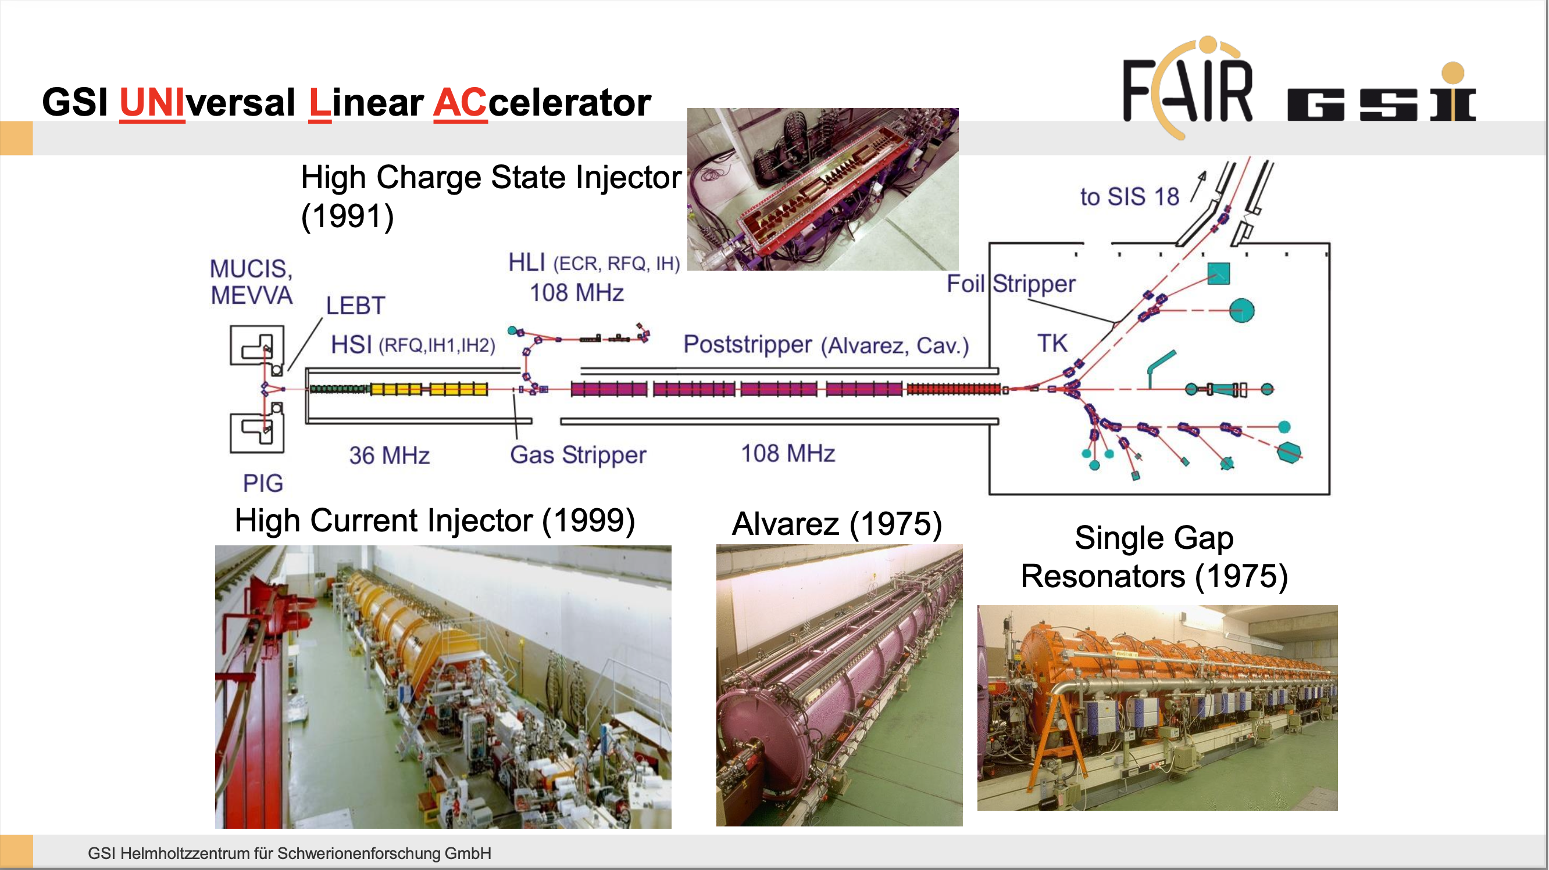

Slide 23
Alvarez Linac:
Single point of failure
PSU dep. is rebuilding the Alvarez replacement
35 M€ Alvarez2.0 project
To be installed after 2030
Not the focus here
Gasstripper:
New device from PSU

Slide 24
RFQ’s and IH’s in HSI and HLI:
Single points of failure
Heavily stressed and ageing
No complete spares for IH’s or RFQ’s
About 5 year effort for a spare
High impact: e.g. no FAIR high intensity U without HSI
Considered for roadmap
Alvarez Linac:
Single point of failure
PSU dep. is rebuilding the Alvarez replacement
35 M€ Alvarez2.0 project
To be installed after 2030
Not the focus here
Gasstripper:
New device from PSU

Slide 25
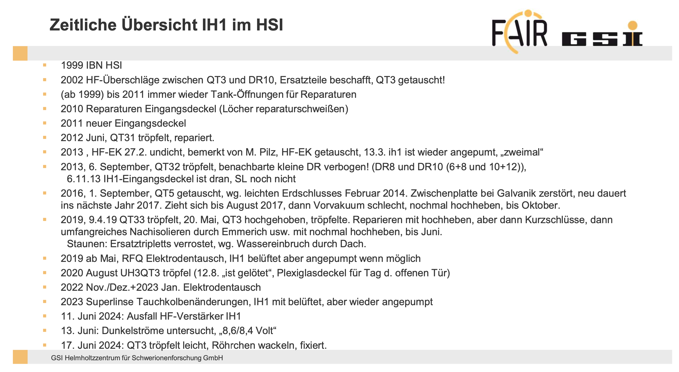
Technical Replacements Required:
Example UNILAC IH
Device: 25 years old
Repair summary from H. Vormann, status 1 July 2024.
Since then additional problems
Regular repairs required!
If IH1 fails and cannot be repaired: multi-year shutdown of FAIR
Roadmap: Setup of RFQ/IH design team

Slide 26
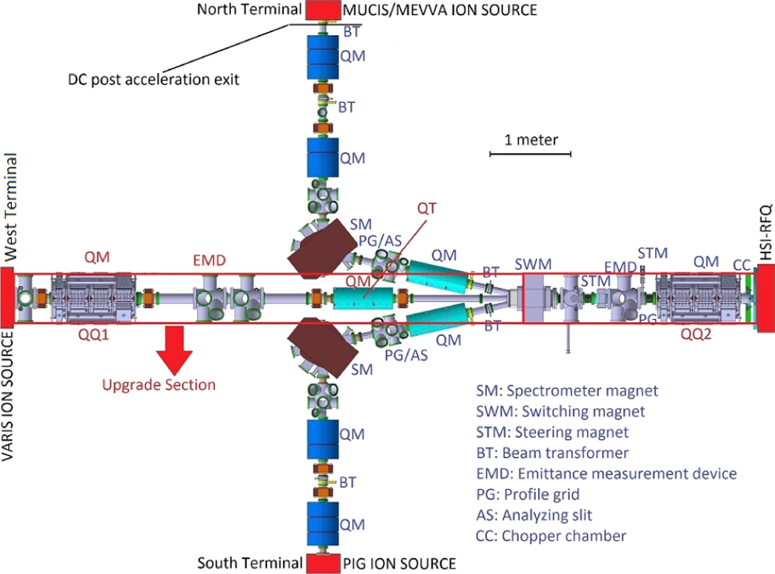
Preliminary Roadmap U²⁸⁺: Selected major upgrades for Factor 2.5 step up in performance
Injector: new Terminal West plus new LEBT: factor of 2 higher intensity at UNILAC entry
UNILAC: Alvarez2.0 and gasstripper (ongoing). A2.0 requires 1.5 year installation without beam. In addition: HSI upgrade for optimized 6D phase space, allowing higher transmission downstream. Longitudinal phase space diagnostics.
SIS-18: cryo-inserts and vacuum upgrade (vacuum pumps, new NEG-coated quadrupole chambers with bakeout system), reduced injection losses into vacuum system (2 plane inj, skew quad, collimators), requires 1 year shutdown of SIS-18. Resonance compensation, octupole damping, feedbacks, optional: e-lens space charge compensation.
Overall complex: Efficient controls systems, automatic optimization routines, use of machine learning, use of AI. High current diagnostics.
Are there upgrades with larger impact?

Slide 27
U⁴⁺ → U²⁸⁺
Pulse Intensity with Selected Improvements
Important: Present U²⁸⁺ intensity is not at fundamental physics limit.
Therefore we can and will improve it.
Measures in discussion include several factor 2 improvements.
The goal can be reached: we need more detailed work and simulations.
Number Ions / Pulse

Slide 28
Envisaged FAIR U²⁸⁺ Intensity Ramp Up
Draft for discussion and under development
“High” GSI U intensity today
FAIR beamtime | Uranium - target intensity per cycle | Beam specification
2027 | 2.0E+09 | SIS18-operation U73+ (early science)
2028 | 2.5E+10 | SIS100-operation, U28+ from SIS18, 1 injection
2029 onwards | 1.0E+11 | SIS100-operation, U28+ from SIS18, 4 bunches
1st upgrade | ≥ 2.5E+11 | After 1st upgrade (done during Alvarez2.0 installation?)
… | … | …
“High” U intensity with FAIR → reliable MP mandatory
Intensity ramp-up plan in FAIR commissioning
Side note: U⁷³⁺ operation with “short” slow extraction from SIS-18 is under study for maximum repetition rate, that is possible in SIS-18 (P. Spiller, D. Ondreka, et al).
Detailed FAIR beam commissioning plan is a multi-dimensional problem (intensity is one of several important performance ingredients) → S. Reimann et al

Slide 29
Schematic Technical & Performance Roadmap
Draft for Discussions only – in work
D
Decision point
Post-Stripper Upgrade project, Alvarez 2.0 construction
Work effort on automatic procedures, ML, AI for machine operation
 |  |  |  |  |  |  | Installation Alvarez 2.0
Beam time | …from FCC
 |  | FAIR commissioning (beam)
 |  |  |  | FAIR beam operation (full) |  |  |  |  | FAIR operation (full)
 |  | U⁷³⁺ 2x10⁹ | U²⁸⁺ 2.5x10¹⁰ | U²⁸⁺ 1x10¹¹ |  |  |  |  | U²⁸⁺ ≥1x10¹¹

Slide 30
Schematic Technical & Performance Roadmap
Draft for Discussions only – in work
D
Decision point
Post-Stripper Upgrade project, Alvarez 2.0 construction
Work effort on automatic procedures, ML, AI for machine operation
 | HELIAC project (if approved and funded) ?
 |  |  |  |  | Installation HELIAC (if funded) ?
 |  |  |  |  |  |  | Installation Alvarez 2.0
Beam time | …from FCC
 |  | FAIR commissioning (beam)
 |  |  |  | FAIR beam operation (full) |  |  | HELIAC as FAIR injector ??? |  | FAIR operation (full)
 |  | U⁷³⁺ 2x10⁹ | U²⁸⁺ 2.5x10¹⁰ | U²⁸⁺ 1x10¹¹ |  |  | HELIAC: SHE, low peak intensity, material reserach |  | U²⁸⁺ ≥1x10¹¹
D
with HI Mainz

Slide 31
Schematic Technical & Performance Roadmap
Draft for Discussions only – in work
D
Decision point
Post-Stripper Upgrade project, Alvarez 2.0 construction
Work effort on automatic procedures, ML, AI for machine operation
 | Design team critical components… …for FAIR injection (RFQ, IH, …)
 | Start to end simulation team for performance checks, upgrade decisions
 | HELIAC project (if approved and funded) ?
 |  |  |  |  | Installation HELIAC (if funded) ?
 |  |  |  |  |  |  | Installation Alvarez 2.0
 |  |  |  |  |  |  | Renovation / upgrade injector complex (if funded) ?
Beam time | …from FCC
 |  | FAIR commissioning (beam)
 |  |  |  | FAIR beam operation (full) |  |  | HELIAC as FAIR injector ??? |  | FAIR operation (full)
 |  | U⁷³⁺ 2x10⁹ | U²⁸⁺ 2.5x10¹⁰ | U²⁸⁺ 1x10¹¹ |  |  | HELIAC: SHE, low peak intensity, material reserach |  | U²⁸⁺ ≥1x10¹¹
 |  |  |  |  |  |  |  |  | With upgrade: U²⁸⁺ ≥2.5x10¹¹
with Universities F, Da, …
D
D
with HI Mainz

Slide 32
Next Steps Technical Roadmap
We have collected enough input to present an status of initial roadmap.
This is not the final roadmap but the first version of such a performance and technical roadmap, based on the FAIR reference particle U²⁸⁺. Work continues on other particles.
Timeline:
  17 Oct 2024: First discussion of the reference particle roadmap (case 5). Agree on other cases.
  24 Oct 2024: Second discussion of the reference particle roadmap. Agree on roadmap approach and concept.
  Oct/Nov/Dec 2024: Input collected from various expert committees.
  Nov 2024 – Jan 2025: Completion of all 8 cases.
  Feb 2025: Complete roadmap available.
  May/June 2025: Extra FAIR MAC on technical roadmap. External evaluation.
Note: Final roadmap priorities and sequence of technical work are driven by science priorities FAIR/GSI! Updated priorities need to be included in the future process.

Slide 33
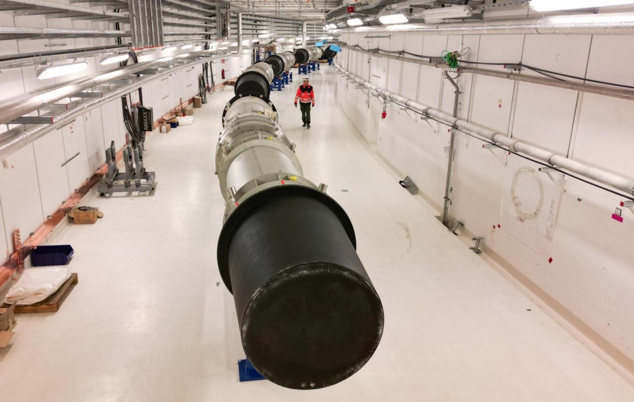
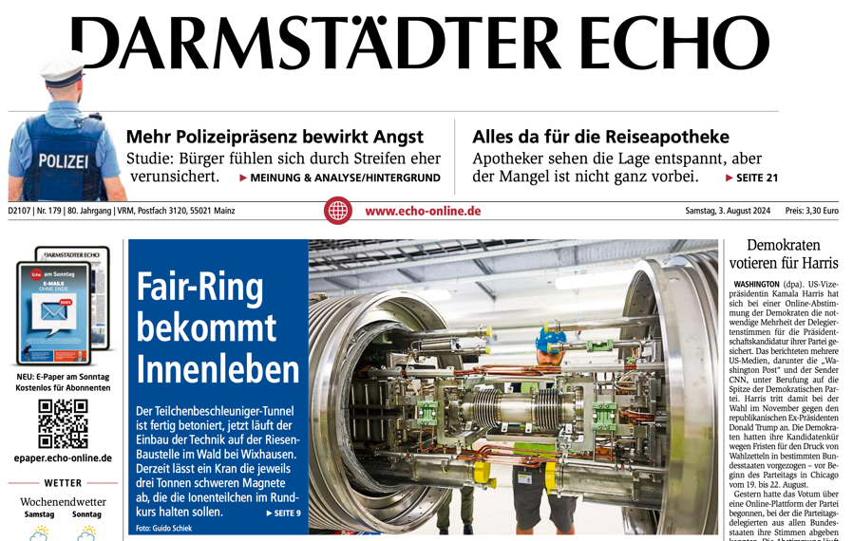
Conclusion and Outlook
The injector complex is today ready for important ion species at full design intensity (“Operation in MSV”): e.g. 197Au for CBM.
Most challenging: design intensity U²⁸⁺ chain. Recent progress: Ready for FAIR operation with 1 x 10¹¹ ions of U²⁸⁺: factor 5 beyond commissioning intensity, factor 50 beyond present capability. Improvements continue…
Technical roadmap first draft, further developments. Final roadmap priorities, sequence of tech. work driven by science priorities FAIR/GSI!
Follow-up activities: (1) setup of start-to-end simulation effort, (2) setup of AT/ML/AI effort, (3) setup of design effort for critical components.
Our goal: Technical roadmap reviewed by FAIR MAC in May/June 2025.
Strategic beamtime planning on longer time scales: discussion with
Y. Leifels started. Topics for planning: ramp up in operation time, share of time, resource needs, exploiting sustainability opportunities, …

Slide 34
Thank You for Your Attention

