Slide 1
Commissiong Workshop Commissiong SIS100 08.11.24
Picture 3. SIS100 workhsop
Peter Spiller

Slide 2
SIS100 Sectors
Sector 3
with Laser Cooling
Sector 2
Sector 4
Sector 1
Sector 5
(with Extraction System)
Sector 6
(with Injection System)

Slide 3
Perfomance Changes
 | Technical modification or issue |  | Performance impact | Reason
1. | Reduced dipole power converter power |  | Reduced maximum ramp rate 4 T/s > 2.5 T/s | Cost saving
2. | Reduced number of quadrupole power converter |  | 3 circuits > 2 circuits, no irregular optical setting and gamma_t shift in p-operation | Cost saving
3. | Reduced number of acceleration cavities |  | Reduced maximum ramp rate | Cost saving
4. | Reduced number of bunch compression cavities |  | Enhanced bunch length after fast compression | Cost saving
5. | Restrictions in maximum HV voltage in pulse cables |  | Lower injection energy. Limited maximum fast extraction energy. | Technical limits. Availability on market.
6. | No appropriate technical concept for E-septum |  | Limited maximum avergae intensity to 3E11 u/s | Radiation hardness of e-septum wires
7. | Concept not approved. Evtl. KO feed back. |  | No suitable micro structure
No major performance and beam parameter change beside # 5.

Slide 4
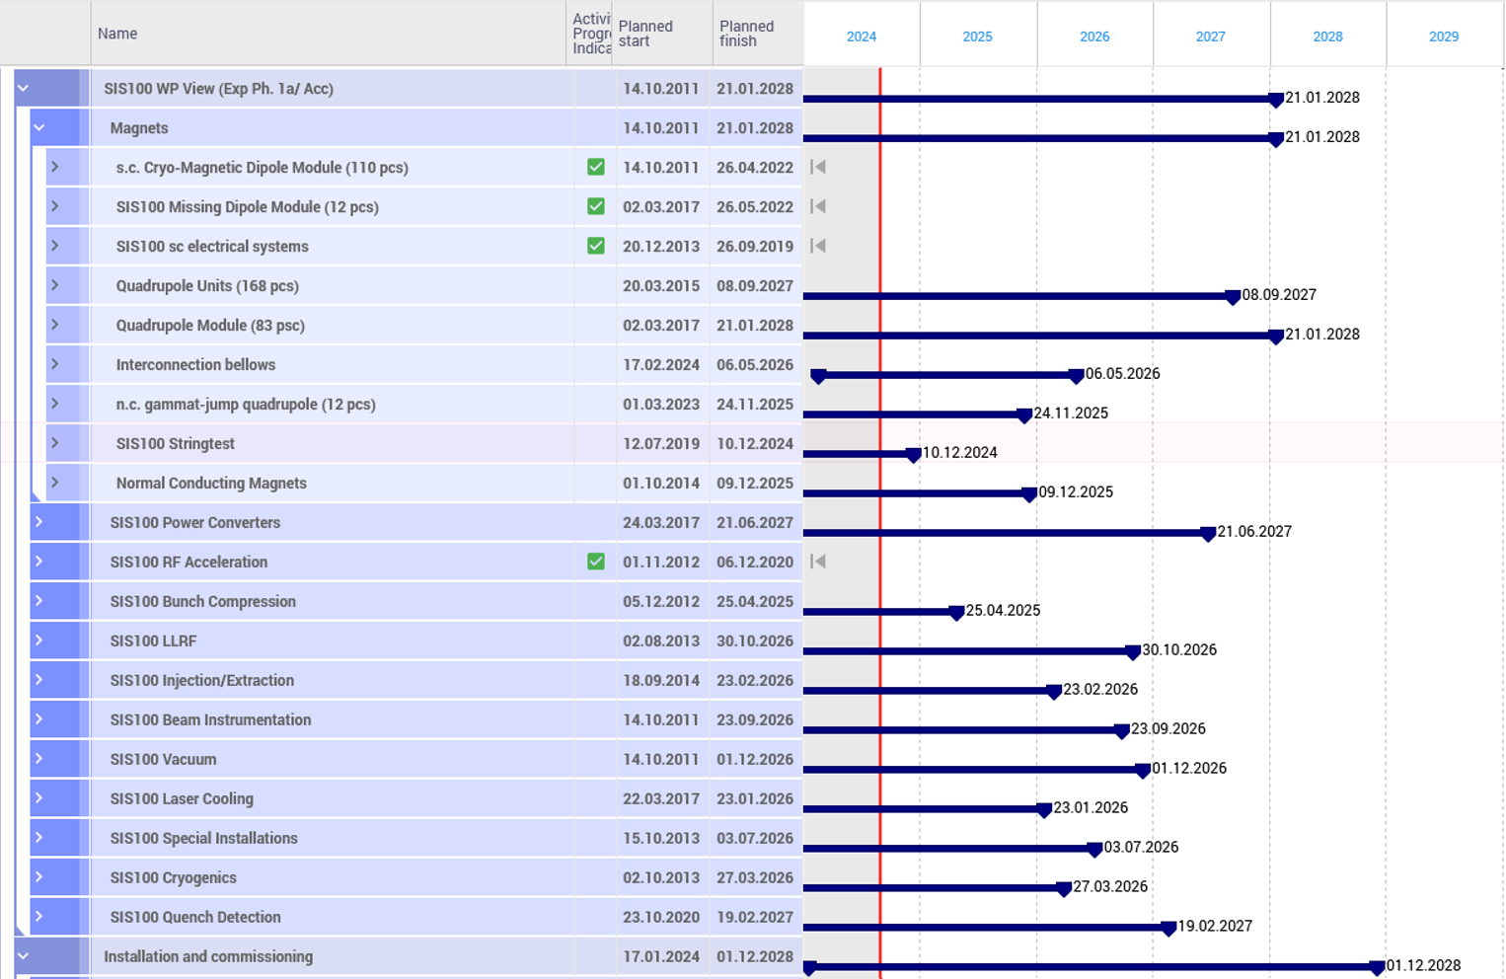
SIS100 Level 2 Plan (Procurements)
Options for acceleration
Attention required
Planning need to be corrected
Complete end of installation process is driven by the delivery situation of QDM modules.

Slide 5
Late Procurements
Most important open procurement packages:
Power Converter for Extraction Septum 2 + 3 (start of procurement in 2024)
Power Converter for Extraction Septum 1 + Lamberston Steerer
Power Converter for Fast Quadrupole + Power Converter for Radiation Hard Quadrupole
Power Converter for Lambertson Septum
Power Converter for Injection- and Extraction Quadrupole
Delivery of above PC may end in 2026-2027.
Quench detection cabinets and trigger matrices
Most critical day-one item in terms of technology development:
KO Exciter
Major technological change in comparison to SIS18 exciter based on new (transformer) approach.
Significantly delayed due to changing and leaving WPL in Ring RF.
KO extraction is reference slow extraction method.
Consequently commissioning of above PC systems and corresponding magnets can not happen before 2026/2027.

Slide 6
Late Procurements
General strategy:
All constructed space for late or non-day-one items is temperarily bridged by a beam pipe.
We attempt to procure all items of the cost book !
In case they are available before first commissioning, they will be installed or fed in later in a dedicated shut down (e.g. Q kicker, BTF exciter, broad band cavities, part of Halo collimation system)
Last room-temperature items mechanical completion in 2027
Last cryogenic items mechanical completion in 2028

Slide 7
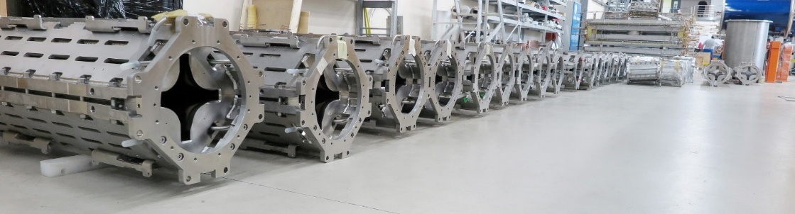
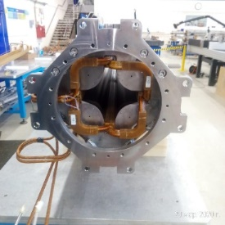
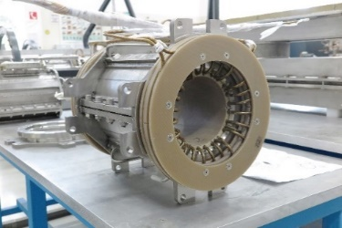
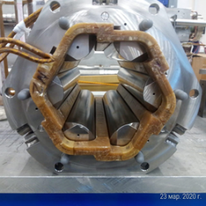
Critical Path: Unit Production at JINR
Agreed unit production schedule at JINR
Considering parallel industry production to back-up and enhance production with the potential for faster and safe completion in 2027.
Enabling a safe first cool-down Q1/2028.

Slide 8
Commissioning - Major Milestones
Major Milestones SIS100 Commissioning:
2025 - Regular current feed processes for power converter and racks.
2025 - Establishing safety organisation for upcoming hardware commissioning.
2026 - First hardware commissionings with and without load. Especially SAT Ab of main power converter systems.
2027 - Continuation of hardware commissioning with and without load for late items.
2028 - First cool down and commissioning of local cryogenics, quench detection system and cryo industrial controls
2028 - SAT Ba of main power converter systems.
2028 - First commissioning of s.c. main magnet systems and s.c. corrector magnet sytems.
2028 - Implementation of first operation cycle and beam commissioning.

Slide 9
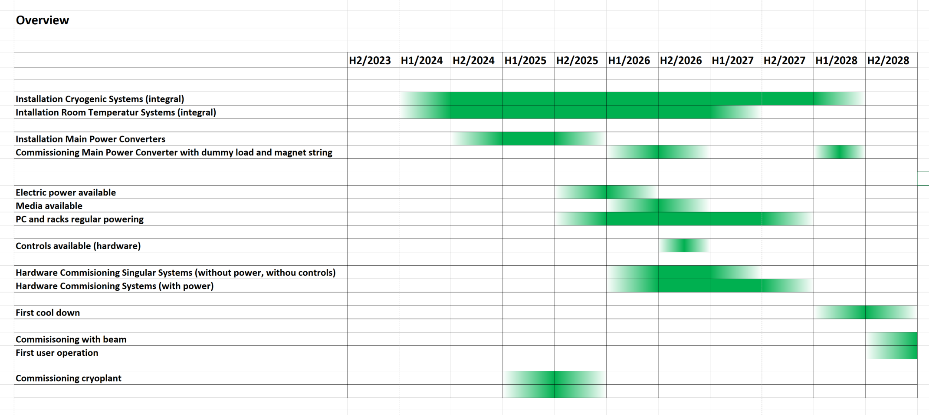
Commissioning of SIS100 – Draft Overview

Slide 10
Safety Responsibilities
Safety Organisation has to be established before start of hardware commissioning:
Assumption:
Future „Anlagenbetrieber“ = „Anlagenverantwortliche“ (equipment operator embedded in dpt) = Present WPLs
„Sicherheitstechnischer Verantwortlicher STV“ (aea safety manager) embedded in division: M. Draisbach or successor in Subproject SIS100/SIS18
Strahlenschutzbeauftragter (tadiation protection office) embedded in dpt. for Electrostatic – Septa (x-ray emitter)

Slide 11
Hardware Commissioning Room Temperature Sections
Hardware commissioning for several technical systems is identical to all other subprojects, e.g.
conventional power converter and magnet systems.
RT UHV system (with enhanced requiremens)
beam profile monitors, beam loss monitors etc.
Take-over of LCM planning from e.g. HEBT possible.
SIS100 specific hardware to be commissioned:
Injection- and extraction kicker systems
Electrostatic extraction septa
Rf acceleration and Rf compression systems
IPM monitor and Schottky system etc.
CT UHV system
Most of these systems have already been tested with final supply unit and load.

Slide 12
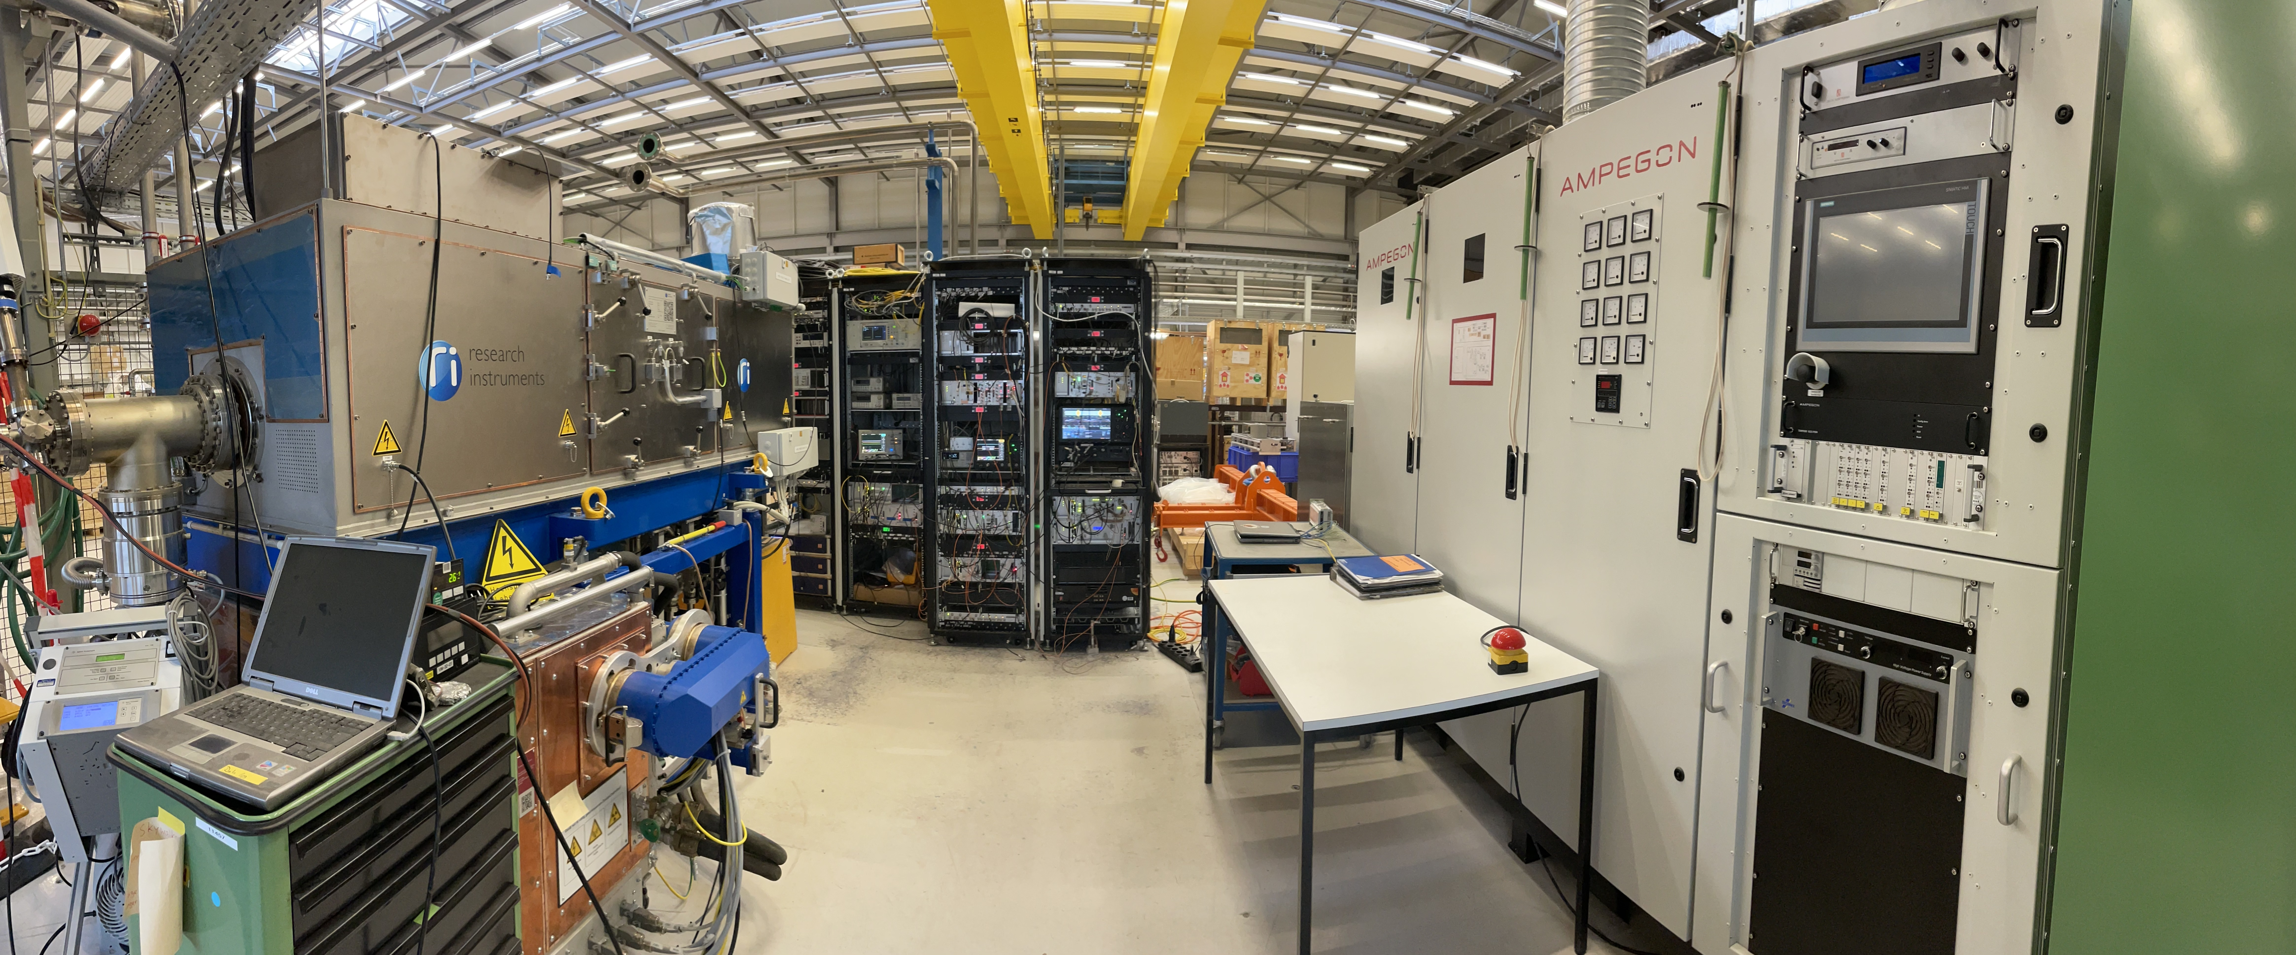
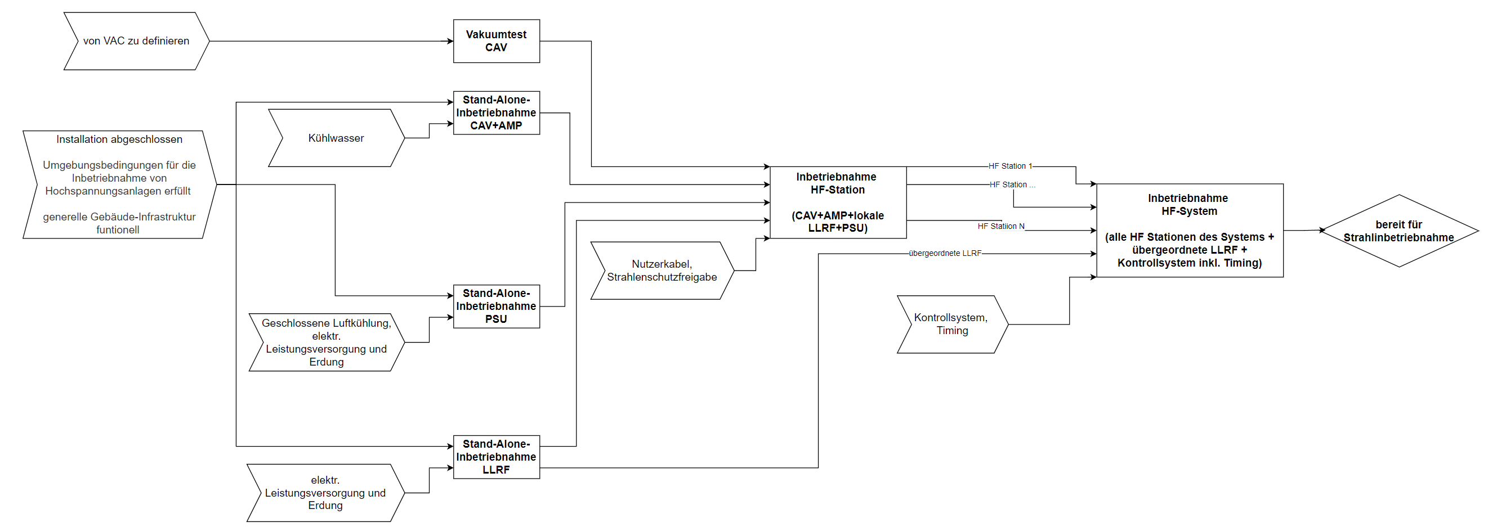
Commissioning Ring Rf
CAV
LLRF
PSU
AMP

Slide 13
Commissioning Ring Rf
Arbeitsschritt | Voraussetzung Medien | System | Arbeitsaufwand RRF Personal SIS100 Gesamt [Personen-Tage] | Arbeitsaufwand RRF Personal 1S4 (6xACC + 3xBC) [Personen-Tage]
Vakuumtest CAV | von VAC zu definieren | ACC | 31 | 13
 |  | BC | 20 | 7
Stand-Alone-Inbetriebnahme PSU | Geschlossene Luftkühlung, elektr. Leistungsversorgung und Erdung | ACC | 455 | 195
 |  | BC | 293 | 98
Stand-Alone-Inbetriebnahme CAV+AMP | Kühlwasser | ACC | 380 | 163
 |  | BC | 293 | 98
Stand-Alone-Inbetriebnahme LLRF | elektr. Leistungsversorgung und Erdung | ACC | 571 | 245
 |  | BC | 367 | 122
Inbetriebnahme HF-Station | alle aus Stand-Alone-Tests + Nutzerkabel, Strahlenschutzfreigabe | ACC | 2510 | 1076
 |  | BC | 1614 | 538
Inbetriebnahme HF-System | alle aus Inbetriebnahme HF Station + Kontrollsytem, Timing | ACC | 1134 | 486
 |  | BC | 729 | 243
Annahmen für alle Schritte:
die Umgebungsbedingungen für die Inbetriebnahme von Hochspannungsanlagen müssen erfüllt sein (Zugangskontrolle, Unterweisungen, etc.)
generelle Gebäude-Infrastruktur wie Steckdosen, Kommunikation (Internet, Kommunikation zwischen Versorgungs- und Maschinentunnel), sanitäre Einrichtungen muss funktionell sein
Zu beachten: Die Breitbandsysteme (Barrier Backet und Longitudinal Feedback), sowie das KO-System sind in diesem Umfang noch nicht enthalten. Ihre Inbetriebnahme wird erst später stattfinden.

Slide 14
Commissioning Ring Rf
Estimated total commissioning effort: ca. 8000 FTE x d
2025: Development of commissioning procedures at the Ring RF test stand in
testing hall. Documentation of procedure.
Commissioning of LLRF requires expert know-how and can not be shared with externals ! 9 FTE of REL will work continuously for commissioning of SIS100 LLRF.
In total 16 FTE of Ring Rf will work for SIS100 Ring RF commissioning full time for 2 years.
Contracting of manufacturer for cavity commissioning, e.g. for finding and analysing faults.
Focusing on acceleration cavities (no user for bunch compression systems yet).
Establishing of base funtionality and setting of of priorities (e.g. less flexibility).
FESA class development can be started in 2025. Testing from 2026.
>We need to start with hardware commissioning in 2026

Slide 15
General:
The overall equipment commissioning duration has to be estimated taking into account the estimated duration per device, the number of devices and the available number of experts. Is there work which can be done by externals/non-experts ?
e.g. PC 1 day per PC x 300 devices = 300 days
> Hardware commissiong procedures have to be launched early enough.

Slide 16
Commissioning of Main Power Converter
Commissioning of main power converter will start with the dummy loads, will be interrupted by 1.5 years and will end with the magnet string in cold state.
Commissioning will be conducted in frame of the SAT process by GE/Vernova in collaboration with the subproject SIS100/SIS18. Especially in close interaction with dpt. EPS (WP leader V. Plyusnin, H. Welker) as potential future „Anlagenbetreiber“.
After SAT Ab with dummy load, the power converters have to be maintained by regular powering etc. until final commissioning with magnet string (SAT Ba) and operation (delay generates additional cost).

Slide 17
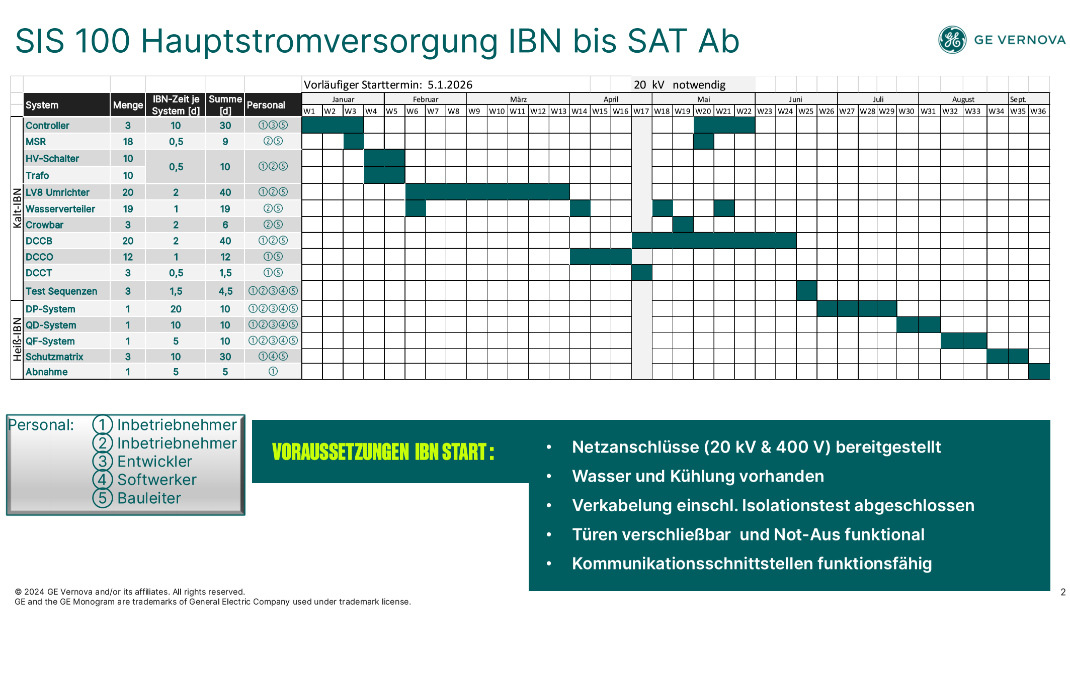
Commissioning of Main Power Converter

Slide 18
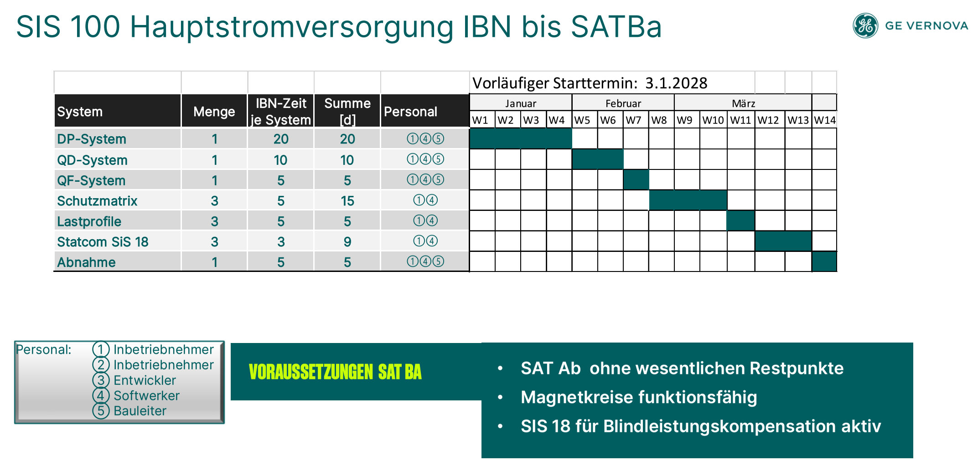
Commissioning of Main Power Converter

Slide 19
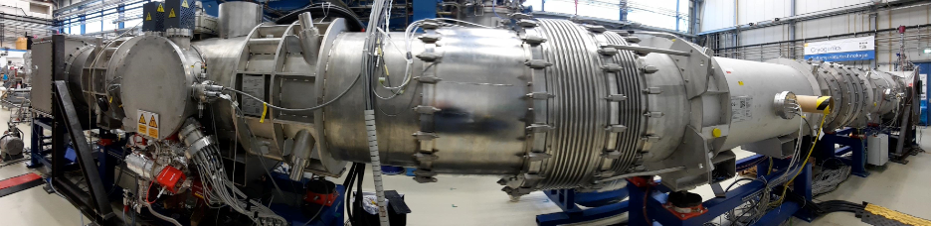
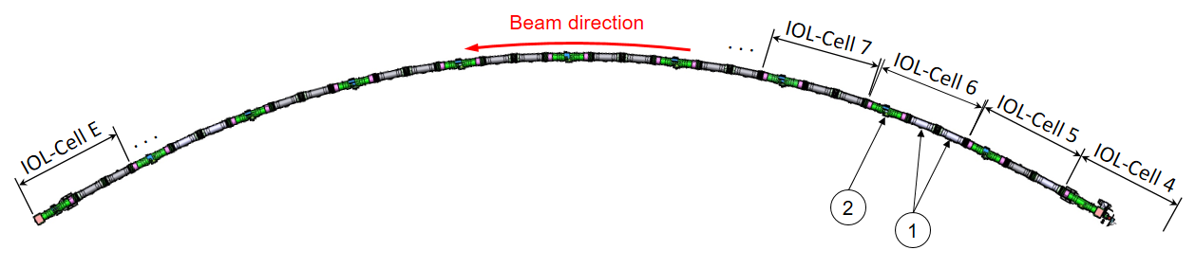
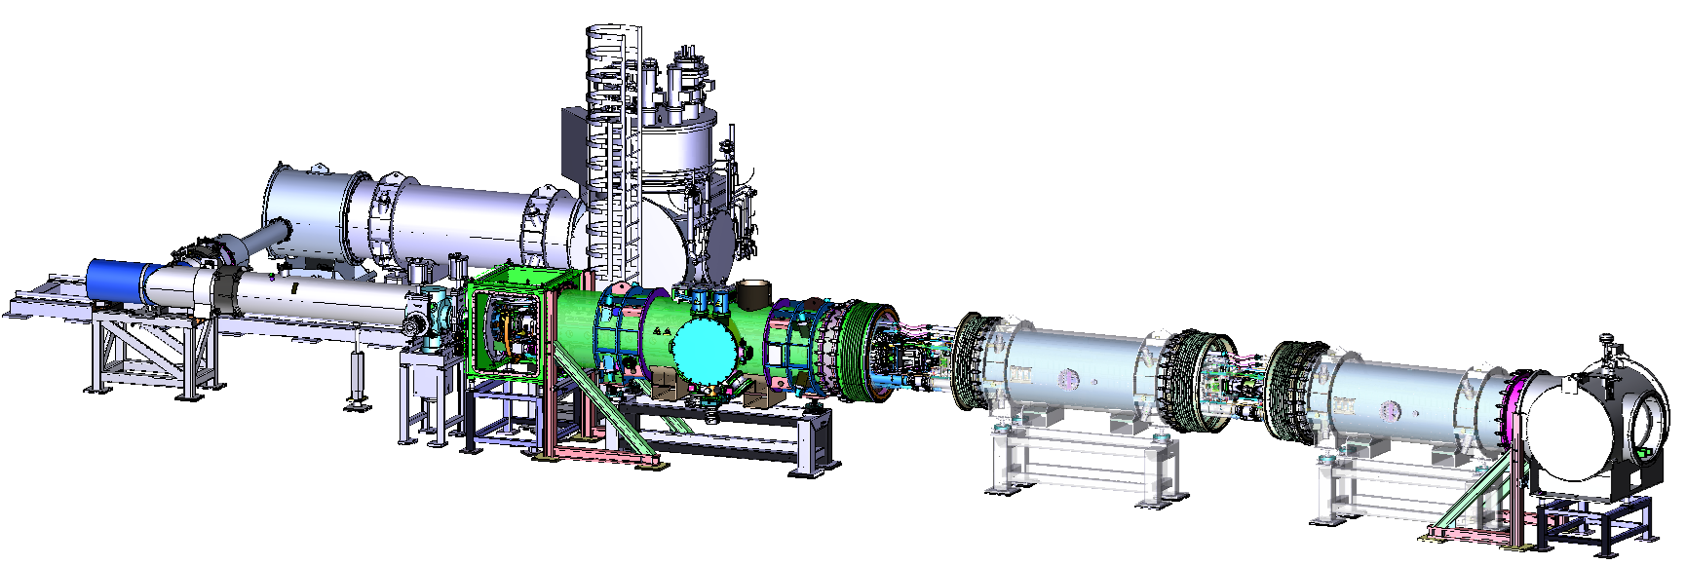
String-Test
SIS100 String test serves as a crucial preparatory for the installation, commissioning and operation of the SIS100 accelerator
Main purposes are:
establishing installation sequence and procedures
verification of design and interfaces
preparation of work procedures and quality assurance
validation of the cryogenic system
quench and protection study
powering behavior of the system
functionality of the beam and insulation vacuum system
accelerator relevant operation
Feedbox
LHe supply
SIS100 arc segment
dipole module
DPM #16
end box (EBx)
He supply
bypass line (BPL)
RT
pumping
chamber
end cap (EC)
with CWT
quadrupole
module QDM type 2.5
dipole
module DPM#26

Slide 20
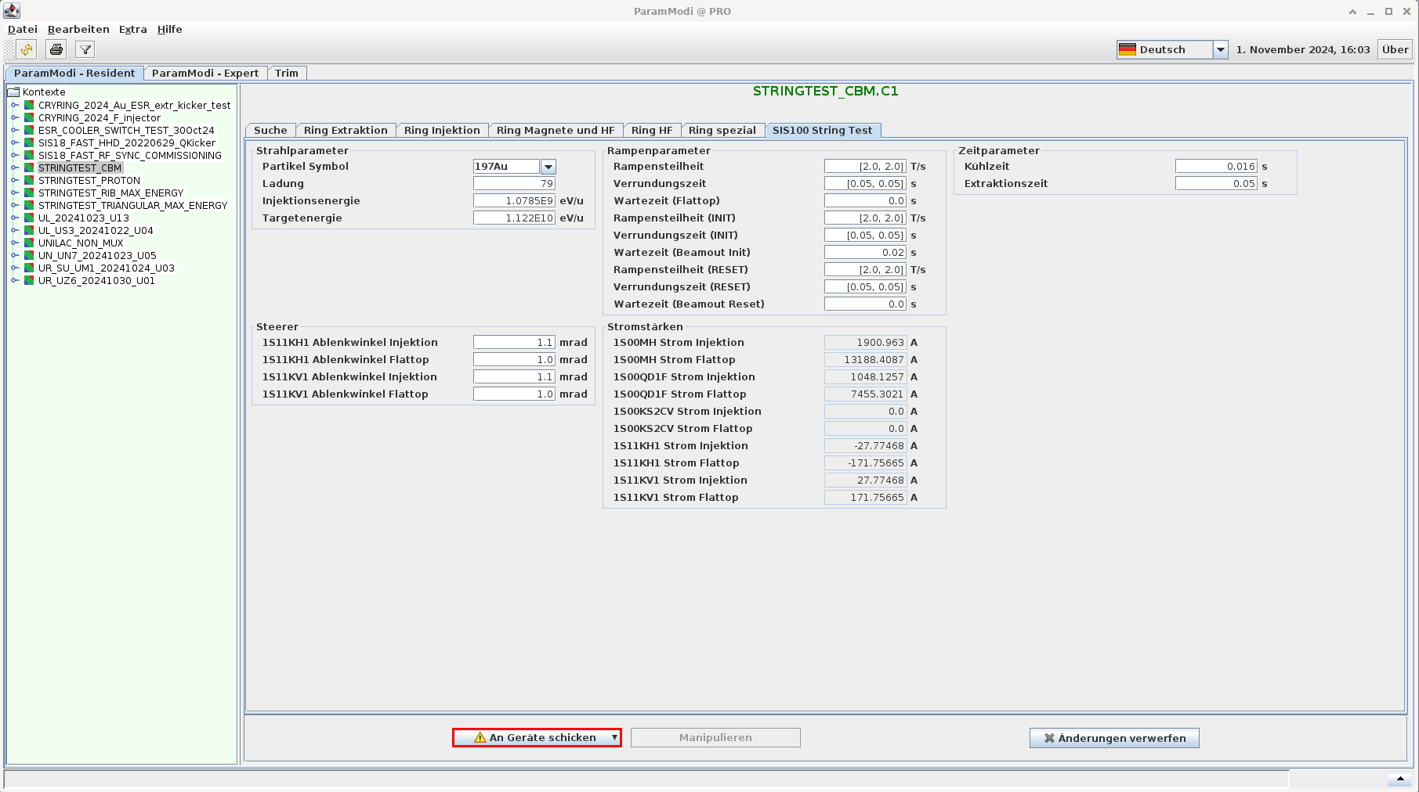
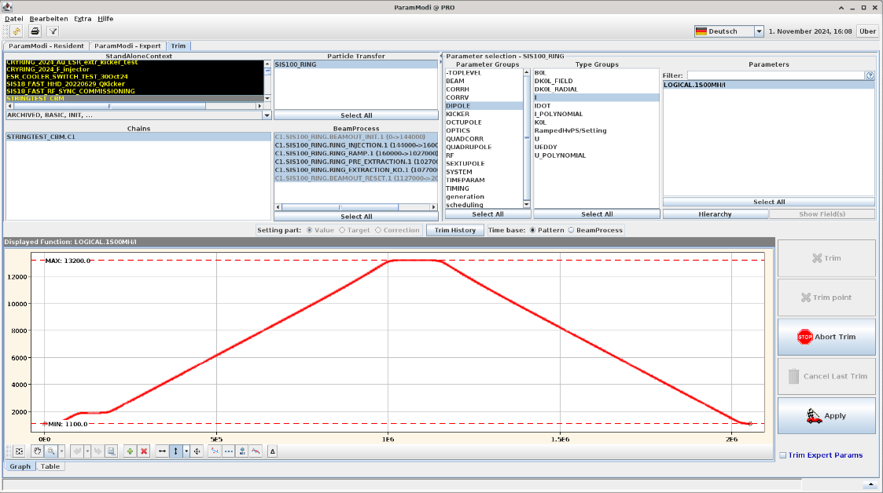
SIS100 LSA Set-value Generation
ParaModi window for SIS100 magnet cycle.
Operation of stringtest power converters using set-values generated by LSA.

Slide 21
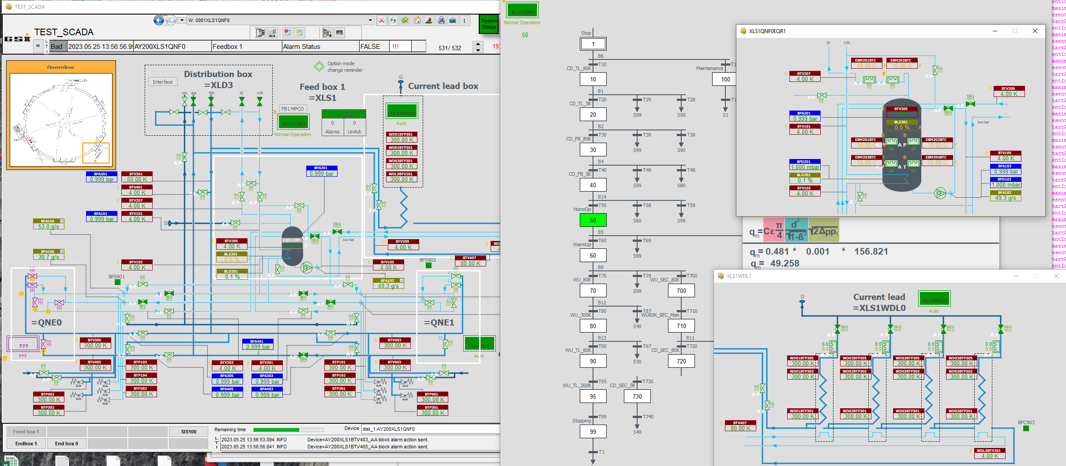
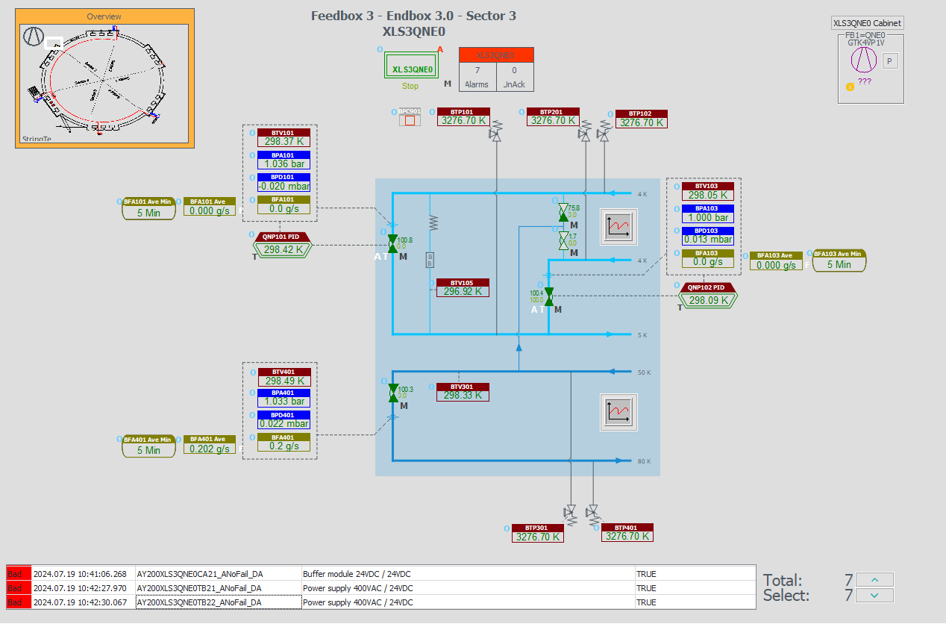
SIS100 Industrial Local Cryo Controls
Excellent progress and status in development of industrial controls for SIS100. Technical information, e.g. the data of >1600 temperatir sensors have been provided to industrial controls early.
Feed box 1 visulization (ready for cold testing in 2025
End box visualization
Feed Box
Cabinet status: Delivered
Functional analysis status: In progress
PLC software status: Completed / Semi-Automatic process
HMI software status: Visualized
Endbox Box
Cabinet status: Delivered
Functional analysis status: In progress
PLC software status: Completed / Semi-Automatic process
HMI software status: Visualized
Operation of stringtest and planned cold test of FB1 are pushing the development of LSA and industrial controls.

Slide 22
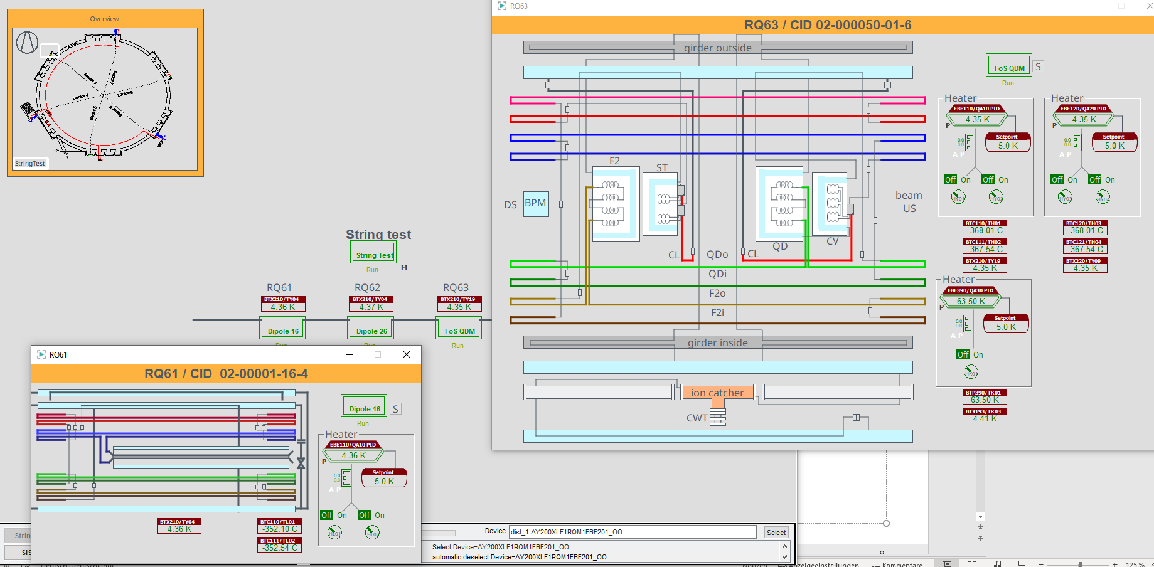
SIS100 Industrial Locak Cryo Controls
Sector visualization
Sector
Cabinet status: Design starts presumably in October
Functional analysis status: In progress
PLC software status: In progress / Test ongoing with StringTest
HMI software status: In progress / Visualisation ongoing with StringTest

Slide 23
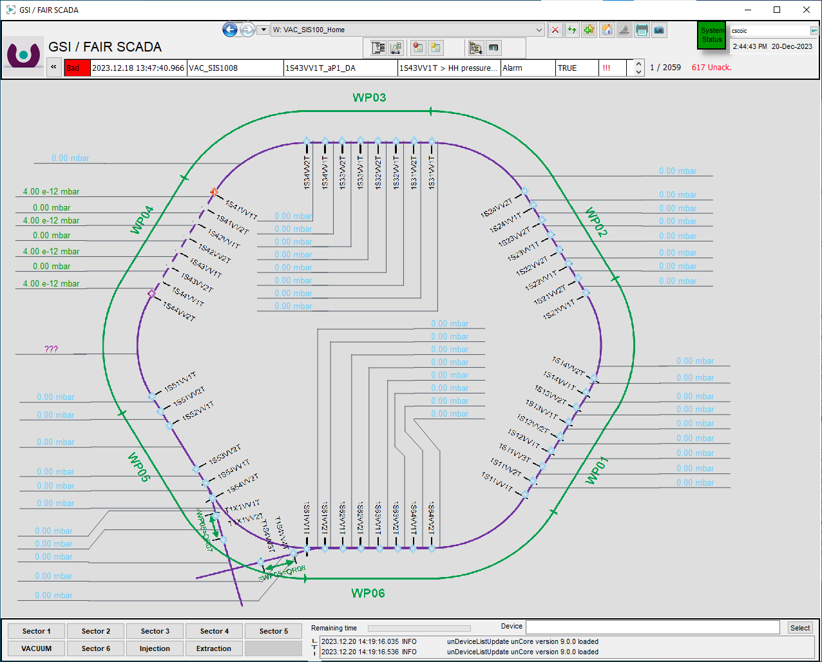
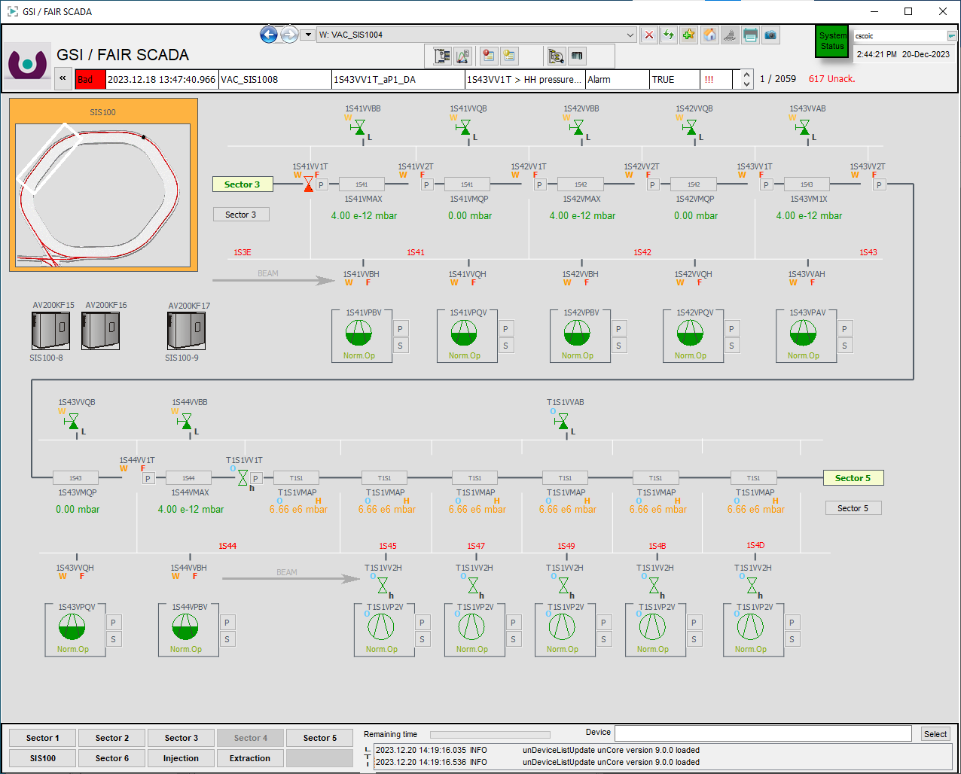
SIS100 Industrial UHV Controls
Status
Cabinet status: 12 delivered, 10 in production / Delivery in 2024
PLC software status: Completed
HMI software status: Visualized / Based on UNILAC and HEBT

Slide 24
Commissioning Coordination
Commissioning coordinators will change according to the different phases and chaninging focus at commissioning (example):
Hardware commissioning phase (without controls): P. Spiller, N. Pyka
Hardware commissiong phase (with controls): P. Spiller, (dpt. N. Pyka), D. Ondreka
Cold commissioning phase: P. Spiller (dpt. N. Pyka), M. Kauschke, C. Roux
Beam commissioning phase: P. Spiller (dpty. N. Pyka), D. Ondreka, J. Stadlmam
During hardware commissioning of room temperature systems the individual work package leaders of the (combined) system will be in charge.
During cold commissioning the group of work packages leaders for local cryogenics, superconducting magnets, quench detection and electric power systems will play a major role.

Slide 25
First Cool-Down
Separation of functional sections via feed-boxes.
Pre-Condition: Commissioning of cryo plant and cryo distribution system
All instruments and valves are online in controls SCADA and test/verification at warm / atmospheric pressure (IND + CRY, 10 min per channel) => 50 days (2 people) completed.
Pumping and purging of insulation vacuum system completed (can only be done after full integration of cryomagnetic system) 2 weeks per sector.
(Risk of leak in insulation vacuum system (telescopic bellow system)
which may delay cool-down.)
HV and continuity test of quench detection circuits.
Cool-down and cold tests (regulation loop adjustments, etc.) of two of six sectors (12 Wochen).
Cool-down and cold tests (regulation loop adjustments, etc.) of all sector (8 Wochen).

Slide 26
Hardware Commissioning after First Cool-Down
LCL heater commissioning.
Commissioning of corrector power converter with magnet load.
SAT Ba of main power converter.
> First static main magnet powering.
> First main magnet powering with ramps.
Magnet quench training.

Slide 27
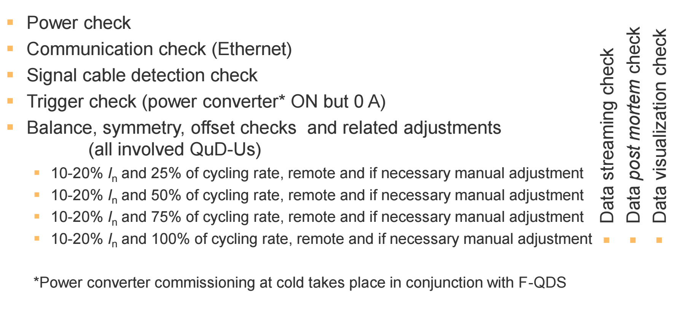
First Cool-Down . Quench Detection System

Slide 28
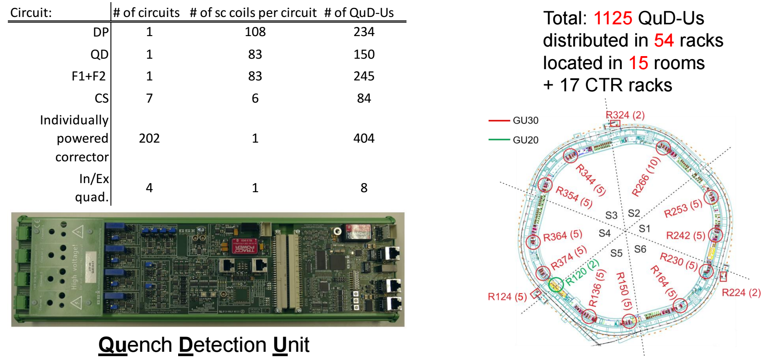
First Cool-Down – Quench Detection System

Slide 29
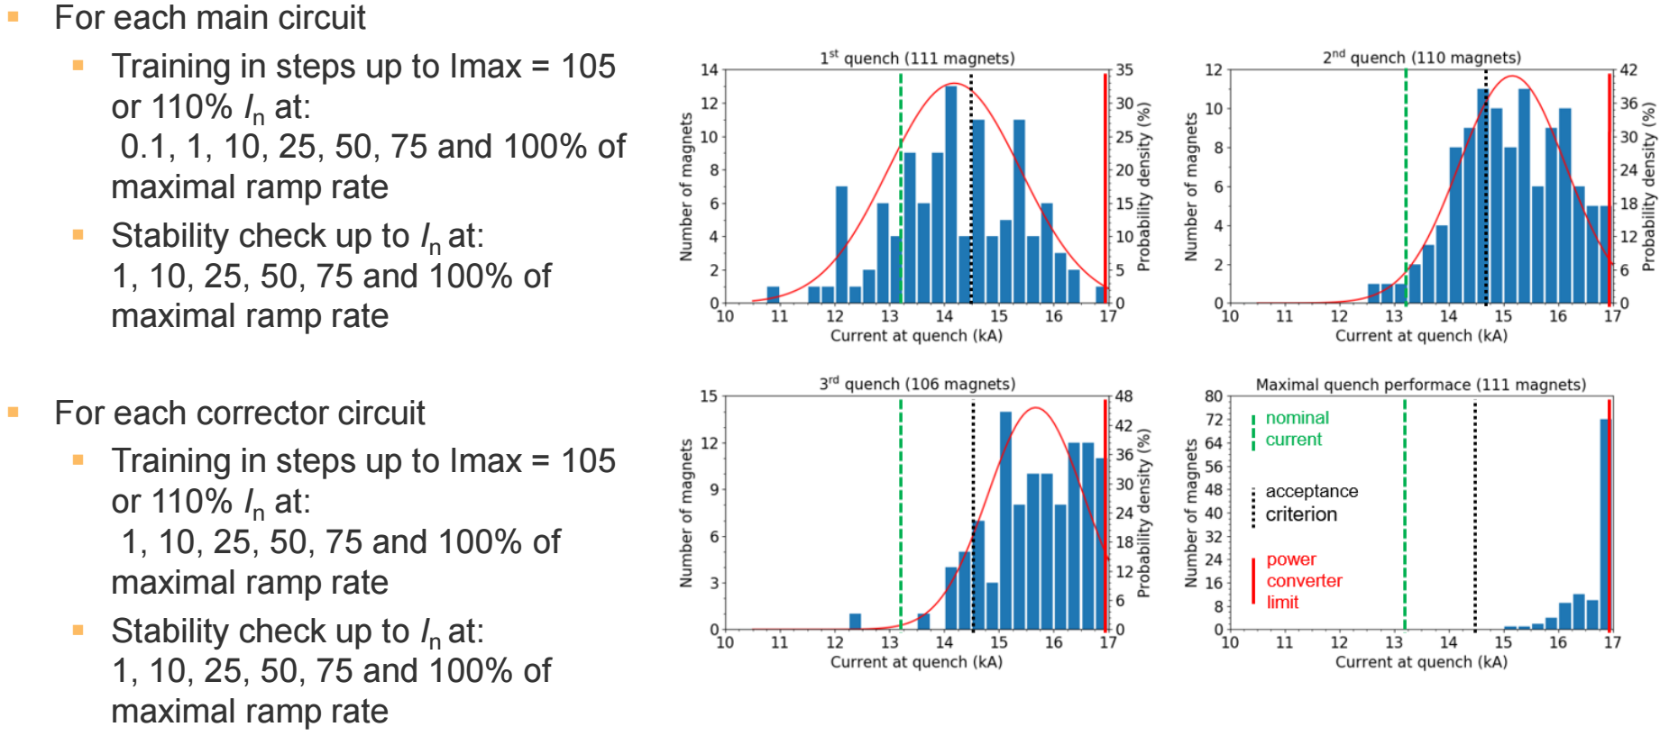
First Cool-Down – Quench Training
Quench training may be skipped ?

Slide 30
Beam Commissioning
Prefered ion species for injection into SIS100
Low Z and moderate intensity light ion
a) need to be visible on BI systems
b) should have no damage potential in case of complete uncontrolled loss)
c) beam loss should be clearly correlated with technical issues
(no intrinsic physical beam loss mechanisms due to space charge, current and charge state)
E.g. 10⁹ ions/cycle of Ar¹⁰⁺ - no partially charged heavy ions like U²⁸⁺
No Protons because of activitation.
Single injection (no stacking) at reference rigidity (18 Tm)

Slide 31
Beam Commissioning
Limiting stress to s.c. magnet and crygenic systems
Start cycle at reference injection magnetic regidity (18 Tm).
End cycle at 2/3 of maximum magnetic rigidity (e.g. 60 Tm).
Limited ramp rate, e.g. 0.5 T/s up and 2.5 T/s down and 1 s plateau.
Fast extraction onto SIS100 underground beam dump with slow extraction optics.
Setting SIS18 extraction and optimizing transport and matching with beam on injection dump.
Deflecting beam into SIS100 plane for injection.
Injection kicker system setting for deflecting the beam on reference orbit.
Section-by-section transport of beam from first-turn-chamber to first-turn-chamber.
Injection of two bunches without Rf capture (bunched > coasting beam).
Later: Injection of four batches with stacking. Commissioning and test of bunch-to-bucket transfer.
First indications for cross talk and issues with magnetic field precision.

Slide 32
Static and Dynamic Heat Load
 |  | Loss@4 K | Loss@50 K | Wall plug Power
Total Loss in magnet system DC no current (incl. current leads) |  | 1.969 kW | 7.895 kW | 0.863 MW
Additional Loss in magnet system DC full current (incl. current leads) | RIB cycle U28+ (Table I-1.2.1.) | 1.703 kW | 2.274 kW | 0.752 MW
Additional Loss in magnet system AC triangular current (incl. current leads) | triangular cycle U28+ 0.25 Intensity | 10.702 kW | 6.556 kW | 3.9 MW
The head load in SIS100 is dominated by AC loss (fast ranping) and depends a lot on the magnet cycle.
In the commissioining phase an apropriate setting for the magnet cooling has to be developed assuring a sufficiently low temperature over the full magnet string and an most energy efficient operation (two phase cooling > no liquid in return header).
Possible adjustments via supply header pressure, Helium pumos in FB and heasters in parallel magnet hydraulic circuits.

Slide 33
Preparation of Regular User Operation
Machine: (single user operation) Development of machine cycle with appropriate local cryo settings for first NUSTAR cycle.
User: First limited single cycle user (NUSTAR) beam time.
Machine: (single user operation) Development of machine cycle with appropriate local cryo setting for first CBM cycle.
User: First limited user beam time (CBM).
Machine: Development of parallel operation.
Long term : Development of fully flexible operation (like room temperature synchrotrons), with heat load prediction and coupling of LSA with cryo controls.

Slide 34
Evolution of SIS100 Klausur
2020/22: SIS100 Procurement
2023: SIS100 From Procurement to Installaton
2024: SIS100 Procurement and Installation
2025: SIS100 From Procurement and Installation to Commissioning

