Slide 1
Test Automation – Status & Outlook
O. Geithner, S. Krepp, A. Halama, K. Grigoryev, M. Müller
8.11.2024

Slide 2
Outline
Sequencer: definition
Motivation
Application Architecture
Status
Development Process
Timeline for development
Documentation
Implementation in HKR
1st FAIR Commissioning Workshop 2024 – Oksana Geithner

Slide 3
Sequencer: definition
Sequencer (GSI) is a tool for the automated execution of different tasks on different devices. It can run the tests or other tasks in parallel on selected devices.
Application talks with devices via JAPC (Java API for Parameter Control)
It can be used with and without timing from control system
Example of test steps for Power Supplies (warm, pulsed):
Connection Check
Reset Device
Wait
Check Interlocks
Switch On device
wait
Check if Power On
Drive Current to max (70%)
wait
Check present/set value
….
1st FAIR Commissioning Workshop 2024 – Oksana Geithner

Slide 4
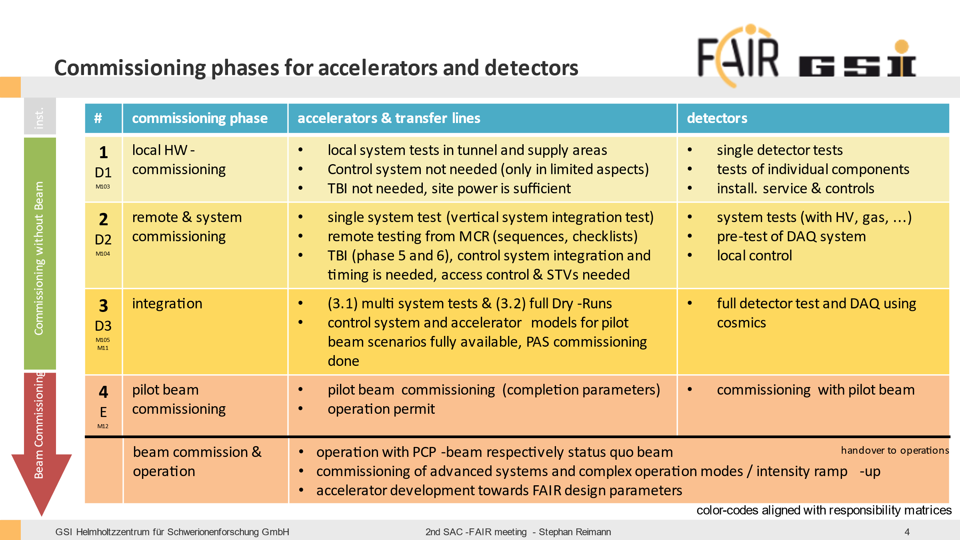
Motivation: Essential in early Commissioning Phases
Sequencer will be broadly used in commissioning phase 2 for systematic hardware tests
Checklists could be partly automized for selected device types (lowest test hierarchy) and accelerator systems (consists several device types)
Each start of dry run in commissioning phase 3
Final acceptance tests for devices for M11 (ready for beam)
1st FAIR Commissioning Workshop 2024 – Oksana Geithner

Slide 5
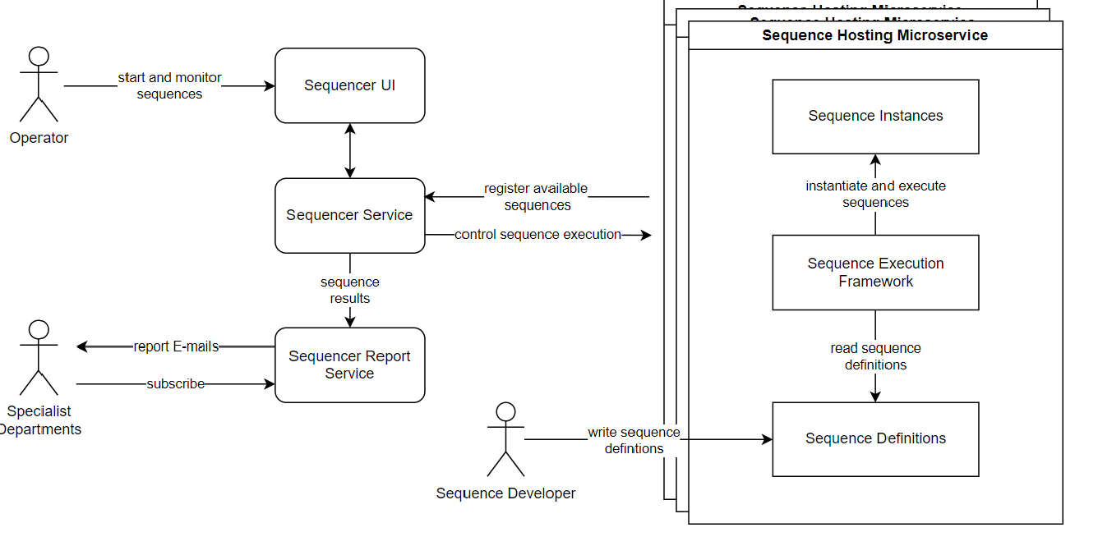
Application Architecture
S. Krepp
1st FAIR Commissioning Workshop 2024 – Oksana Geithner

Slide 6
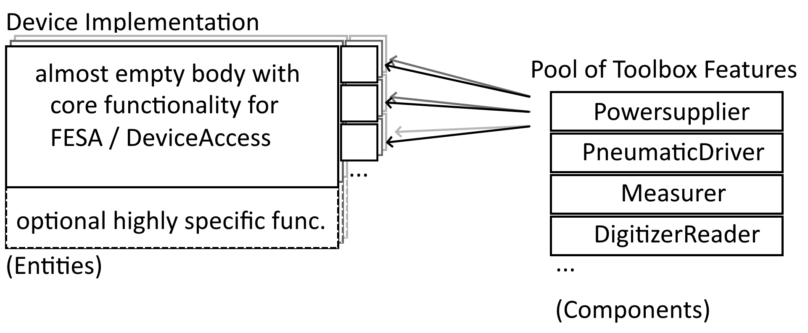
Architecture for device implementation
Toolbox design
enables easy re-use of existing features for new devices
easily extendable
reduced code duplication
A. Halama
1st FAIR Commissioning Workshop 2024 – Oksana Geithner

Slide 7
Status
An application has been developed and available in HKR Launcher (GUI, automated report with test results) -> DEMO
Selected device types are implemented for existing facility (DevAcc and FESA models)
Team is assigned to support the development (5 persons: 0.3 FTE x 5 during showdown)
1st FAIR Commissioning Workshop 2024 – Oksana Geithner

Slide 8
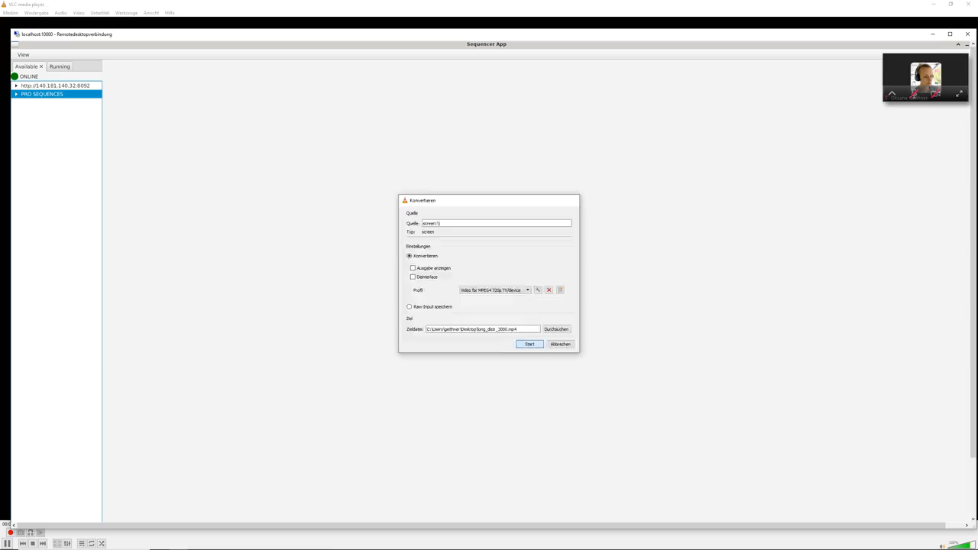

Slide 9
Development Process
Benificial for the types of equipment with the large number of pieces:
Vacuum Valves: 142 (GSI), 325 (FAIR FS+)
Power Supplies: 770 (GSI), 800 (FAIR FS+)
Beam Intrumentation: 660+ (GSI), ? (FAIR)
Identification of suitable device type
Requirements collection from expert groups
Implementation, tests, release
1st FAIR Commissioning Workshop 2024 – Oksana Geithner

Slide 10
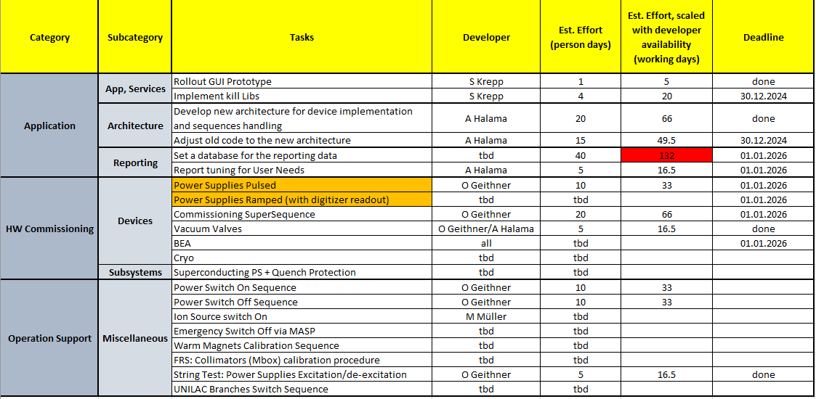
Timeline for development
1st FAIR Commissioning Workshop 2024 – Oksana Geithner

Slide 11
Documentation
How to document the test requirements and their results?
Solution at CERN: test requirements are saved as documents in EDMS and test results are saved in data base
Test requirements for HW are now required as „Questionnaire“ document
Data base solution for Sequencer has to be developed (MAC Recommendation)
1st FAIR Commissioning Workshop 2024 – Oksana Geithner

Slide 12
Implementation in Main Control Room
How to integrate the tool in operation?
Hardware is partially tested with Sequencer during the re-commissioning phase at the beginning of each beamtime in the existing facility
Large potential for automatization of some operation tasks
1st FAIR Commissioning Workshop 2024 – Oksana Geithner

