Slide 1
LSA Machine Model:
Status & Outlook
D. Ondreka (SYS)
1st FAIR Commissioning Workshop
Königstein, 08.11.2024

Slide 2
Outlook
Role of machine models
Setting generation with LSA
Project group “FAIR Data Supply”
Status and tasks
Developments for ES and FS
Timeline
Summary

Slide 3
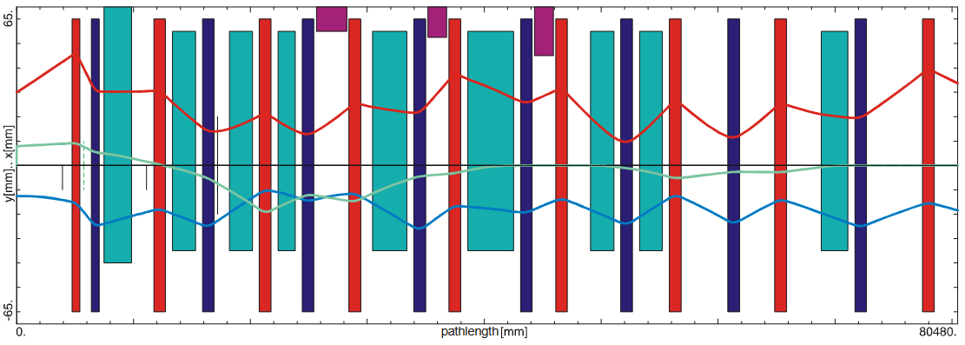
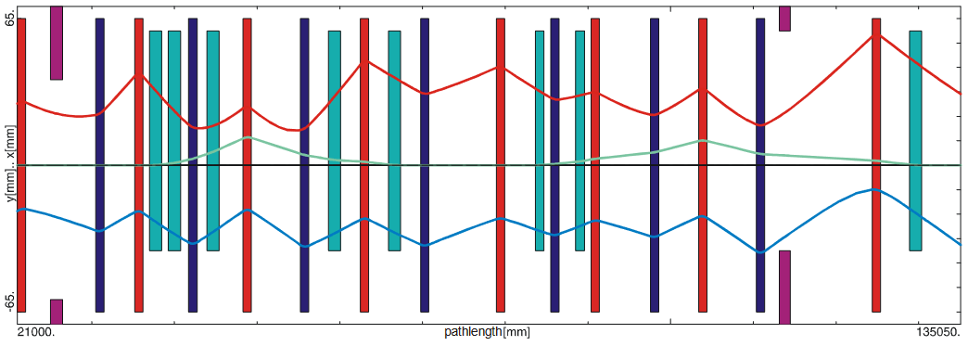
Machine Models
Early Science
  Accelerator chain for creating primary beam
    UNILAC → SIS18 → HEBT → SFRS target
  Components need to be orchestrated
    Consistent set values (currents, voltages, …)
    Consistent timing (beam/RF pulses, ramps, …)
  Must bring accelerator physics into control system
Physics-driven machine model
  Physics parameters for tuning accelerators
    Beam parameters: ion type, energy, …
    Machine parameters: beam optic, tunes, …
  Translation into consistent set values and timing
  Applications for managing settings
Relevance for commissioning
  Assumption: ES model required from phase 3.2
  Communicate earlier intended use!
Early Science
Beam optic from SIS18 to SFRS (T1S1, T1S2)
Beam optic from SIS18 to SFRS (TSX1, TSF1)

Slide 4
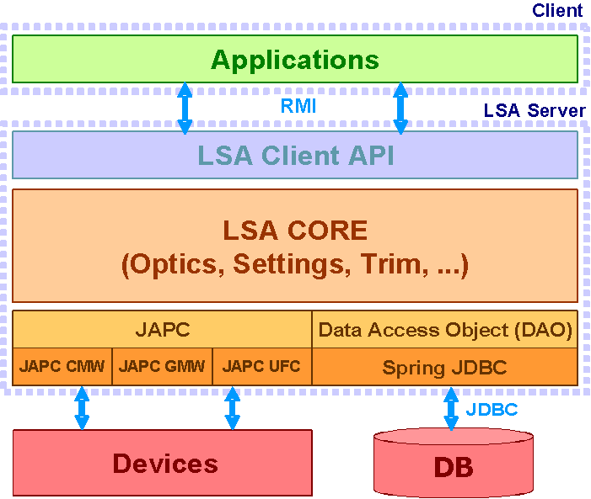



LSA Framework
LSA: Framework for accelerator modeling
  Invented by CERN, co-developed by CERN/GSI
  Data-driven system with 3-tier architecture
  Integral part of FAIR control system
Separation of expertise
  Framework maintained by IT experts
  Convenient hooks for data and physics
  Responsibility lies with owner of expertise
    Framework: controls group
    Model (physics): machine groups
    Device data: technical groups

Slide 5
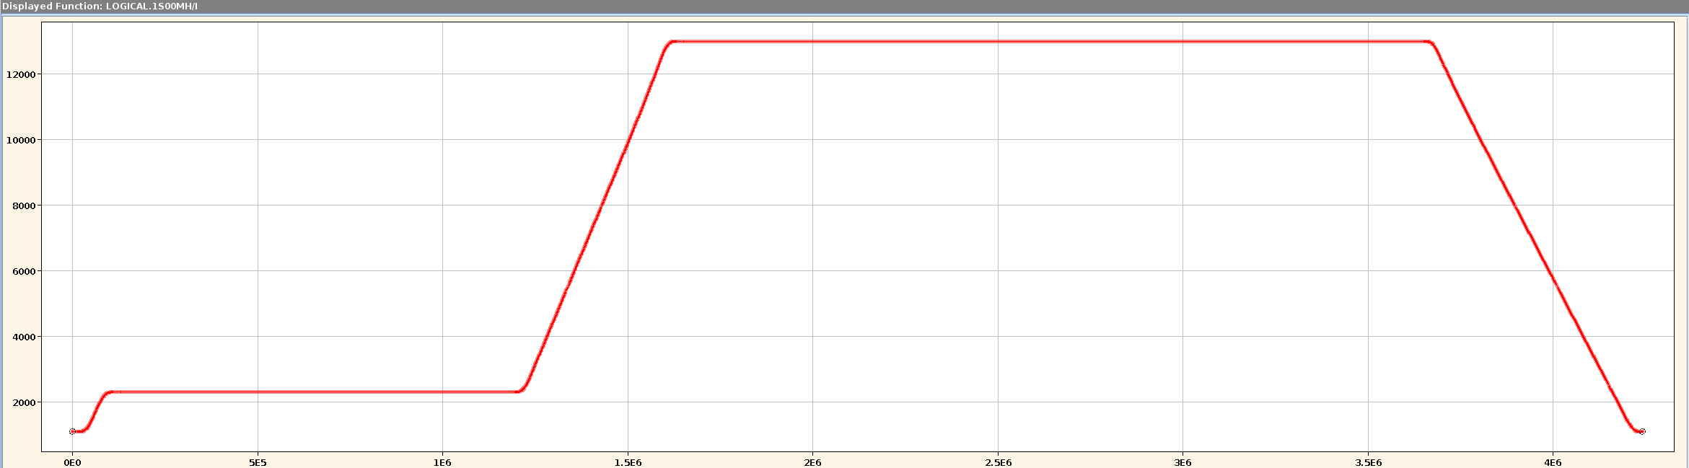




Machine modeling with LSA in a nutshell
Physics
SIS18BEAM/QH
SIS18BEAM/BRHO
SIS18BEAM/QV
Machine represented by parameters
  Linked to logical or physical devices
  Hierarchy from physics to hardware
Cycles organized in contexts
  Basic unit: beam process
  Grouping into chains and sub-chains
Values represented as settings
  Value of parameter in beam process
  Stored in LSA-DB including history
  HW settings get sent to devices
Calculations implemented as rules
  Translate from parent to child settings
  Called by LSA when values change (trim)
  Java code mostly written by physics experts
  Accelerator-specific data read from LSA-DB
LOGICAL.GS01QS1F/KL
LOGICAL.GS01QS2D/KL
LOGICAL.GS01QS1F/BL
LOGICAL.GS01QS2D/BL
Hardware
GS01QS1F/Setting#current
GS01QS2D/Setting#current
INIT
RESET
INJECTION
RAMP
EXTRACTION
Setting of tune parameter
Parameter | SIS18BEAM/QH
Beam process | P.SIS18.RING_INJECTION
Value | Constant function = 4.28
$${KL}_{n}={KL}_{n}^{(0)}+\frac{{∂KL}_{n}}{{∂Q}_{h}}∙(Q_{h}−Q_{h}^{\left(0\right)})$$
LSA DB
QH
MADX
$$\frac{{∂KL}_{n}}{{∂Q}_{h}}$$
Java code
$$Q_{h}^{\left(0\right)}$$
$${KL}_{n}^{(0)}$$
KL

Slide 6
Organization
Project group “FAIR Data Supply”
  Mission: setting generation for FAIR (since 2009)
  Cross-department organization
    Maintenance of LSA framework: 1 FTE (ACO)
    Physics model
      Core team: 2 FTE model (SYS)
      Additional contributors from machines, e.g. SFRS
Modelers’ job: physics
  Collection of requirements on models
  Parameter hierarchy and algorithms (rules)
  Provision of optics data and theory values
  Configuration of settings applications
Models needs device data
  Used to calculate and check set values
    Calibration curves for all magnets
    Device limits (min/max values) for power converters
  Must be provided by technical groups via CDB
Application
FESA DB
HW Devices
App logic
LSA DB
CDB
App config
HW params
Device data
Device limits
Calibrations
Repository
LSA Server
Hierarchy
Optics data
Calibration files
Trim logic
App config
Hierarchy files
Rules
Optics files
App config files
Rules code

Slide 7
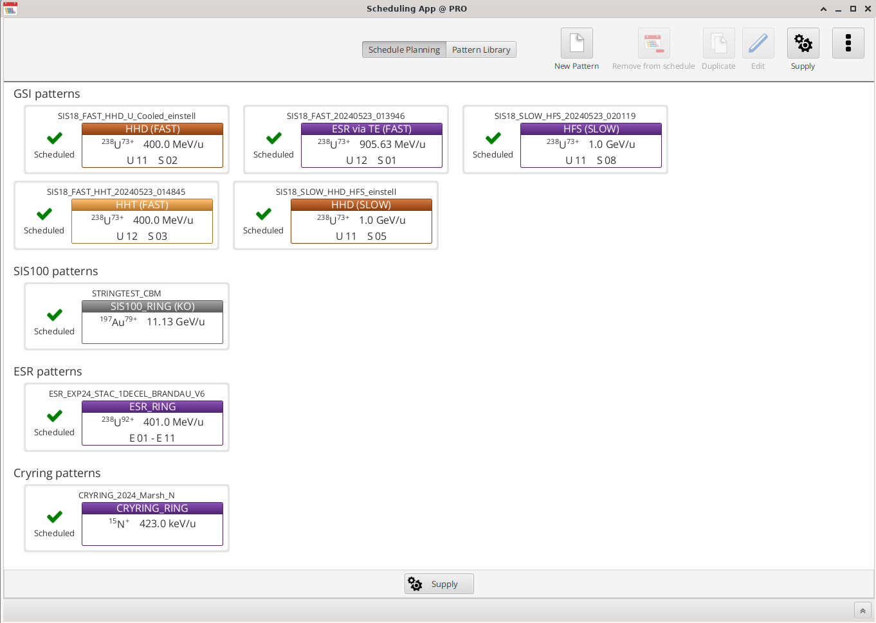
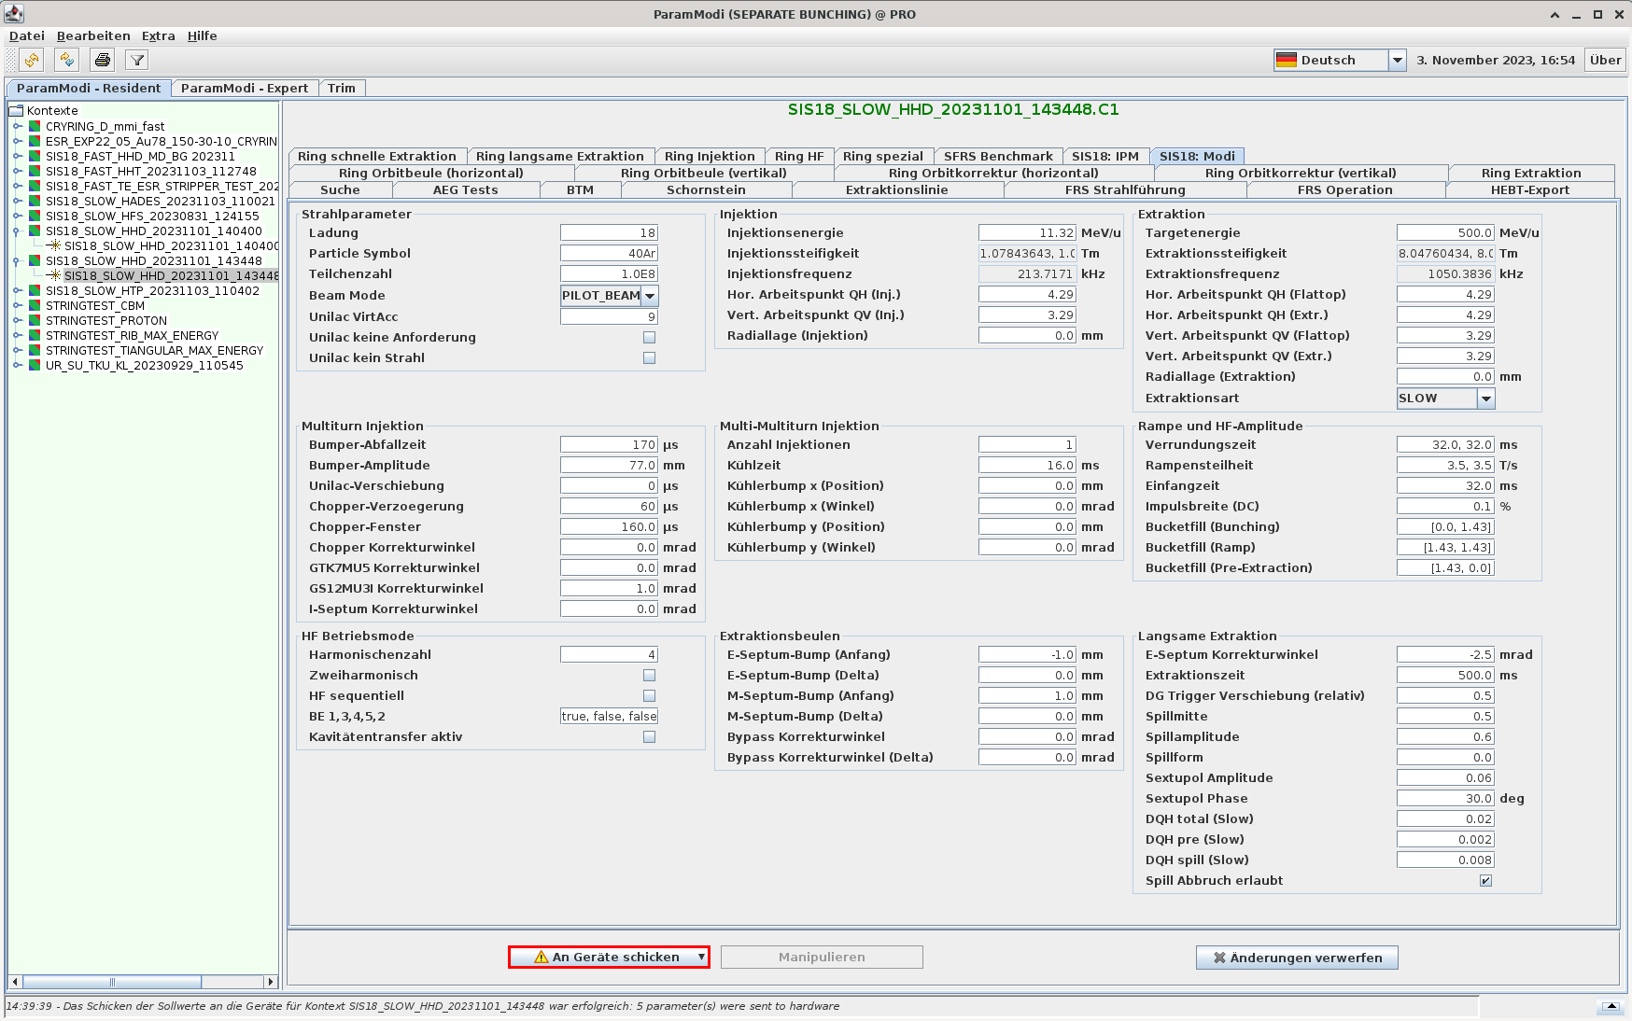
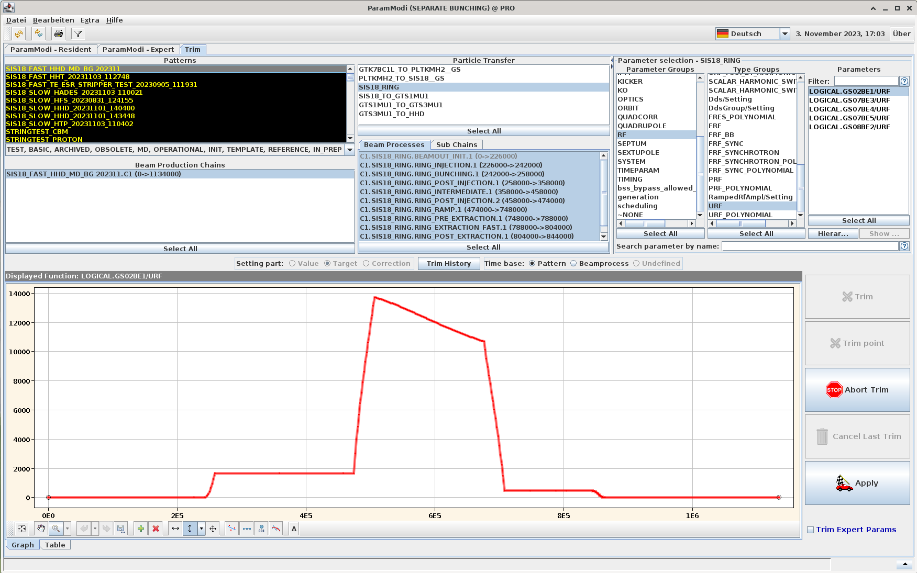
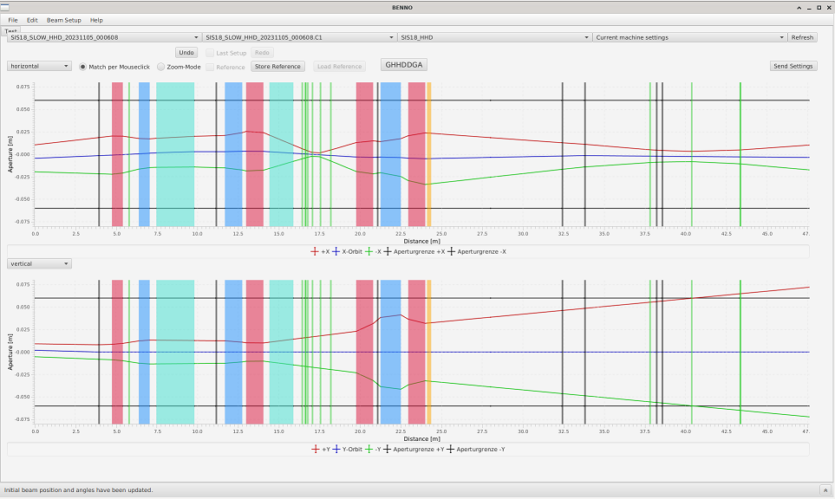
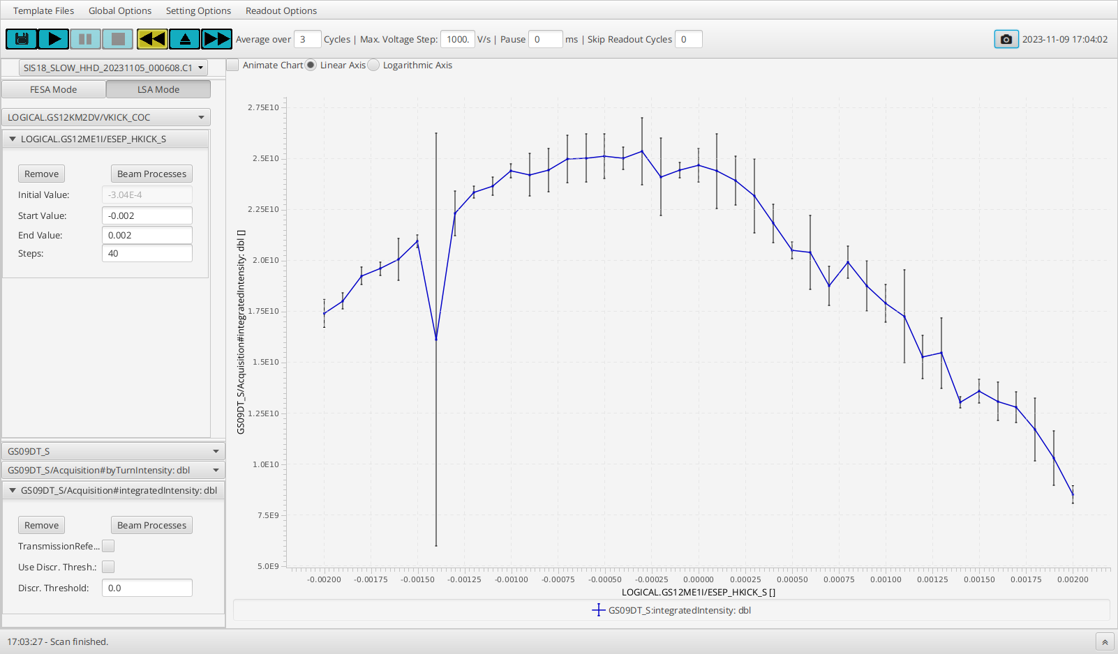
Applications
SchedulingApp: Creation of patterns
Operators need interface to models
  Applications serve as user interface
Generic applications
  Creation of patterns with initial values
  Manipulation and visualization of set values
  Import and export of top-level parameters
  Provided by ACO
Special purpose applications
  Provide higher-level functionality
  Manipulate parameters of the model
  Can be contributed by ACO or others
ParamModi: Manipulation and visualization of set values
Special purpose applications for changing set values
App. Benno (C. Heßler, OPE)
App. DeviceAutomator (W. Geithner, DEC)

Slide 8
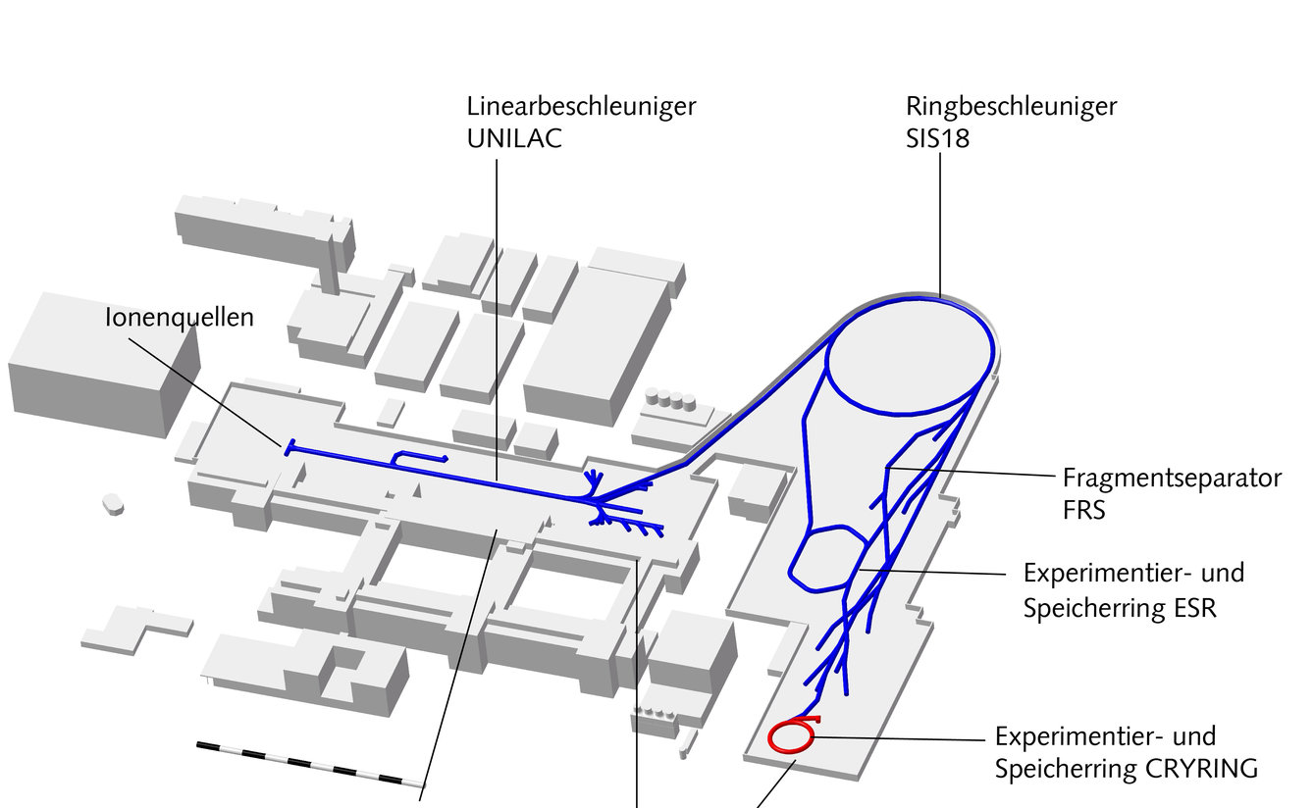
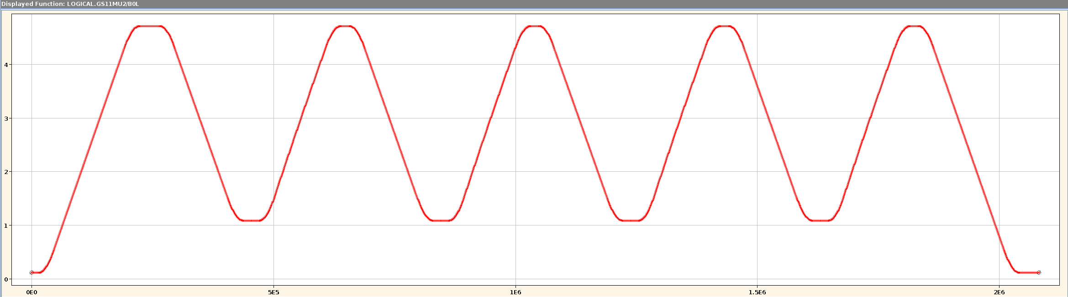
Present status and tasks
Status of machine models
  Production use
    SIS18, ESR, CRYRING
    GSI-HEBT, FRS operational
  Prototype implementations
    SIS100 (in use for string test)
    UNILAC (work in progress)
Present main tasks
  Developments for ES
    Machine model for ES beamline
    Machine model for SFRS
  Developments for FS
    Completion of SIS100 model
    Booster mode for SIS18
    Conceptual work for FAIR operation
  Completion of UNILAC model (mainly ICU team)
Production use of models
CRYRING (injector) | 2016
CRYRING | 2017
SIS18 | 2018
FRS | 2019
ESR | 2020
HITRAP | 2022
SIS100 (string test) | 2023
SIS18
booster
cycle
Parallel operation in FAIR: SIS100-CBM + SIS18-SFRS
UNILAC
SIS18
SIS100

Slide 9
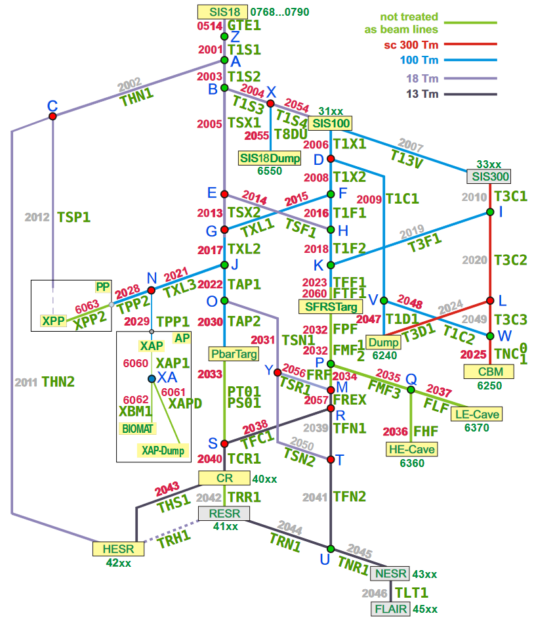
Developments for Early Science
Beamlines of the GSI facility
Machine model for FAIR-HEBT
  Responsibility SYS (I. Kraus)
  Includes magnets of SFRS
  Model identical to GSI-HEBT
  Data sources partially different
  Unified approach for GSI and FAIR in progress
  ES beamline with mock-data ready spring 2025
Machine model for SFRS
  Magnets modeled as part of FAIR-HEBT by SYS
  Matter part responsibility of SFR/SFS
    Model very similar to FRS at GSI
    Planned and executed by SFR/SFS personnel
    Support by data supply group
Production use requires real device data
  Models initially tested with mock-data
  Real data must be in CDB in time for dry runs
Beamlines of the full FAIR facility

Slide 10
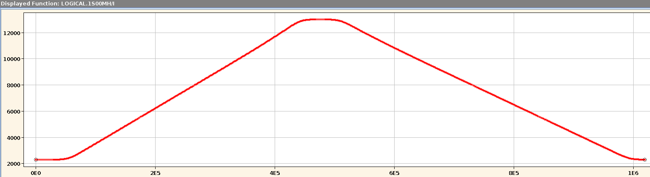
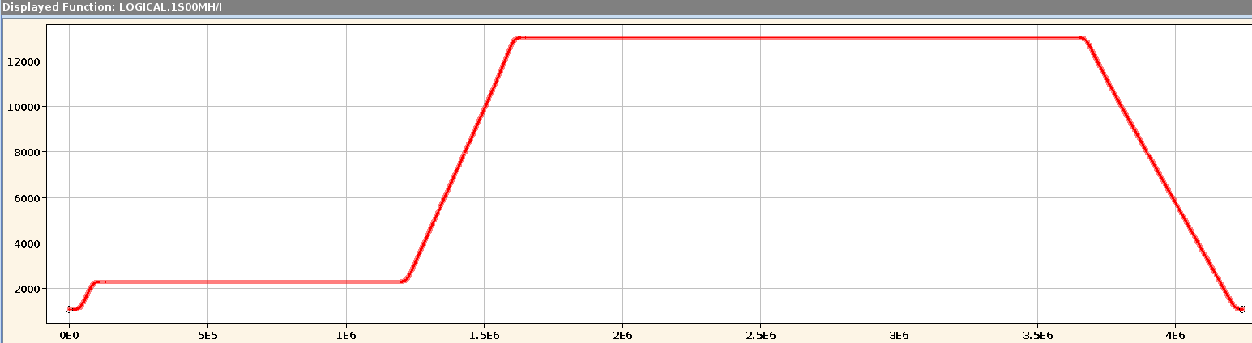
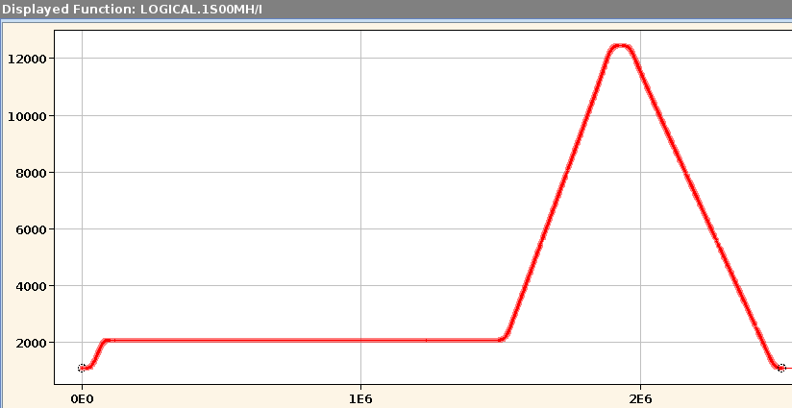
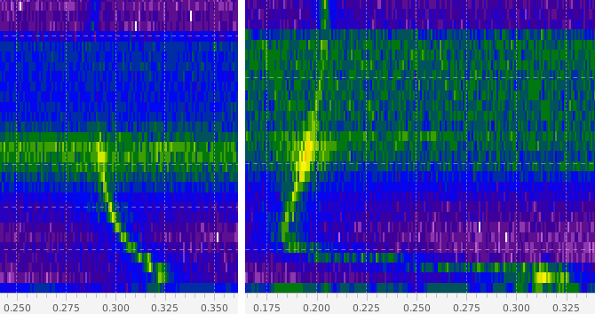
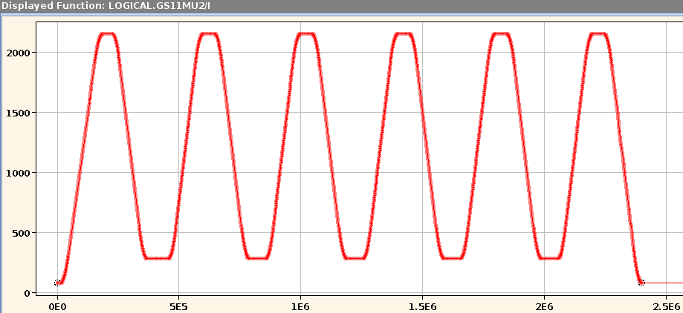
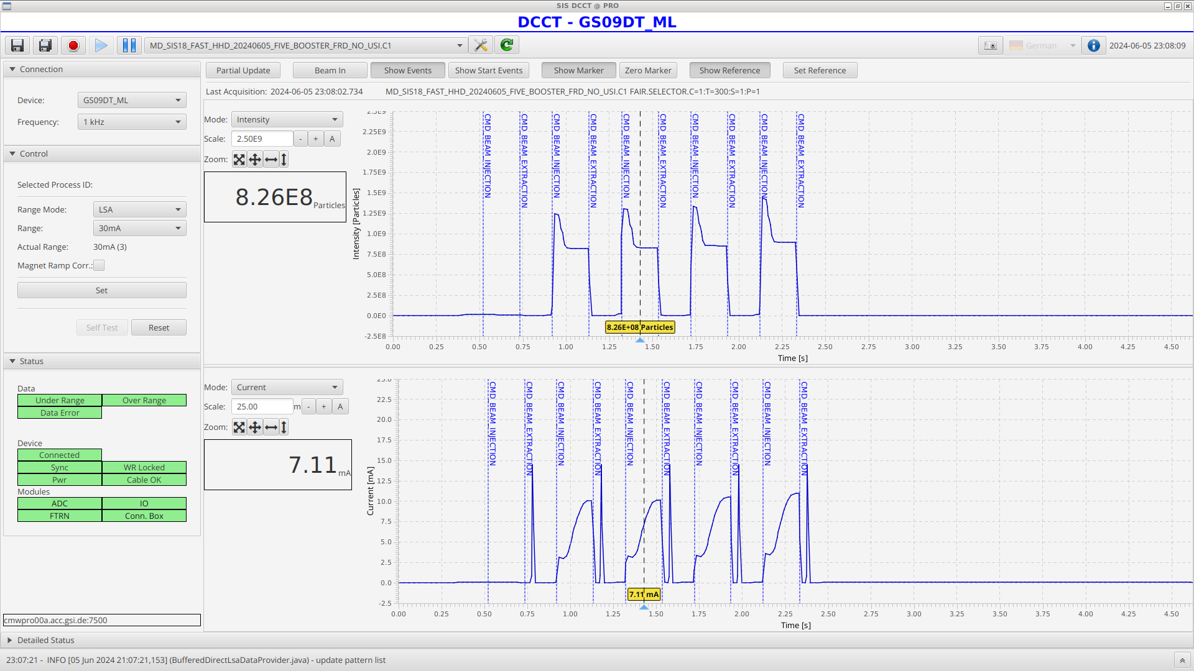
Developments for First Science
SIS100 cycles for string test operation
Machine model for SIS100
  Prototype exists, used at SIS100 string test
  Completion planned until end 2026
Modeling of parallel operation
  Requires concept of periodic patterns
    Extension of LSA/BSS under responsibility ACO
    Modelers support development of concept
    Expected to be available by end of 2026
  Adaptation of all models planned until end 2027
Implementation of SIS18 booster mode
  Prototype for machine development exists (wip)
  Model completion planned until end 2027
    Integration with new UNILAC timing system
    Adaptations to FAIR patterns
Periodic parallel operation in First Science+
UNILAC
SIS18
SIS100
CBM + SFRS (SIS18)
SIS18 booster cycle in MD operation
Q_{h}
Q_{v}

Slide 11
Timeline
2024
2025
2026
2027
2028
Beamtime
Beamtime
Beamtime
Beamtime
Beamtime
FCC
ES DR
ES BC
FS DR
FS BC
ES device data in CDB
FS device data in CDB
ES
activities
FAIR-HEBT model
SFRS model (magnets)
SFRS model (matter)
HEBT FS
Development of FAIR pattern concept
FS
activities
SIS100 model (completion)
Patterns
SIS100 (r.)
SIS18 booster (prototype)
Booster
Booster (rev.)
Responsibility SYS
Prerequisite for production use
Participation SYS
Responsibility SFR, with support from SYS

Slide 12
Summary
Machine models translate accelerator physics to set values for devices
  Implementation based on LSA framework
  Project group “FAIR Data Supply”
Machine models in production use for GSI facility (except UNILAC)
Model for ES will be ready early
Production use of ES model requires device data in CDB
  Responsibility of technical groups
  Deadline: last control system release before dry-runs (phase 3.2)
Present assumption: production use of ES model from phase 3.2
  If set values from model are required earlier, let us know!

Slide 13
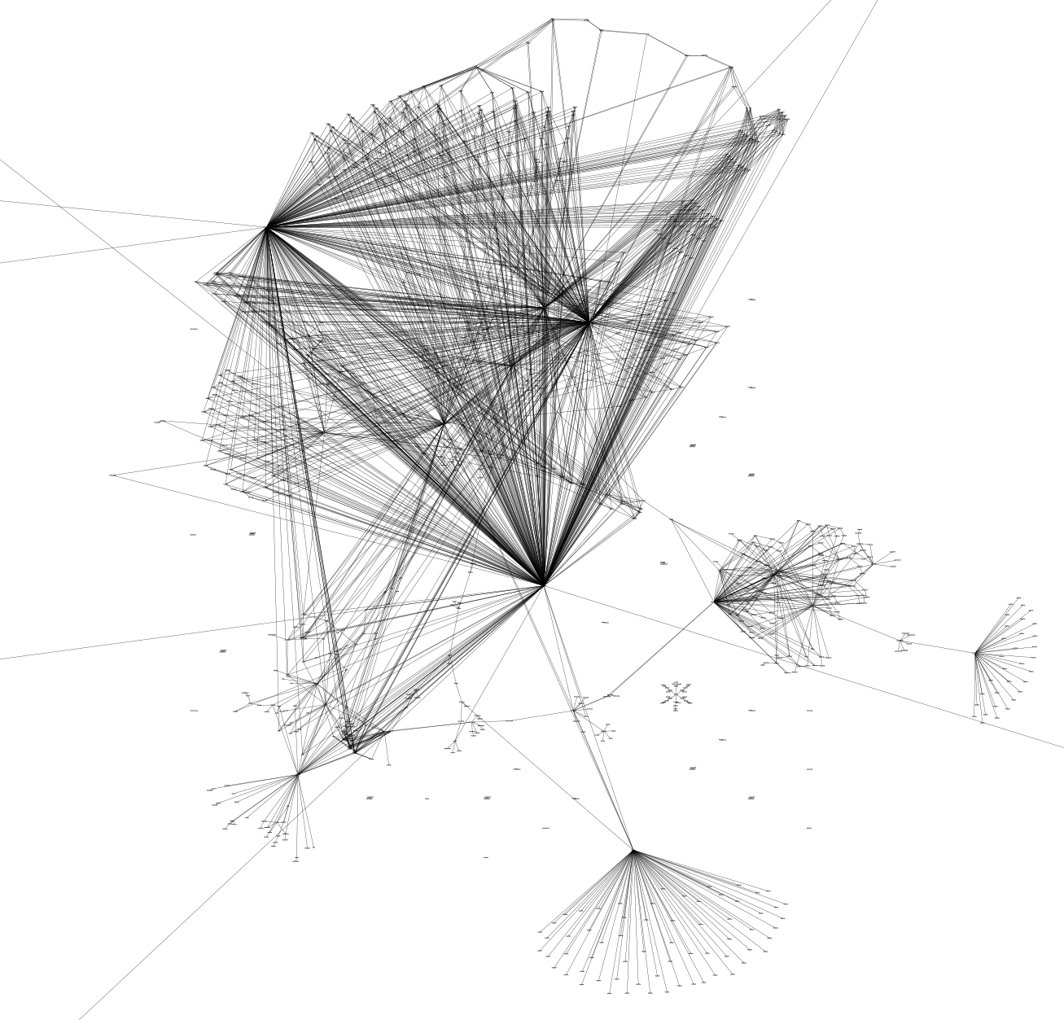
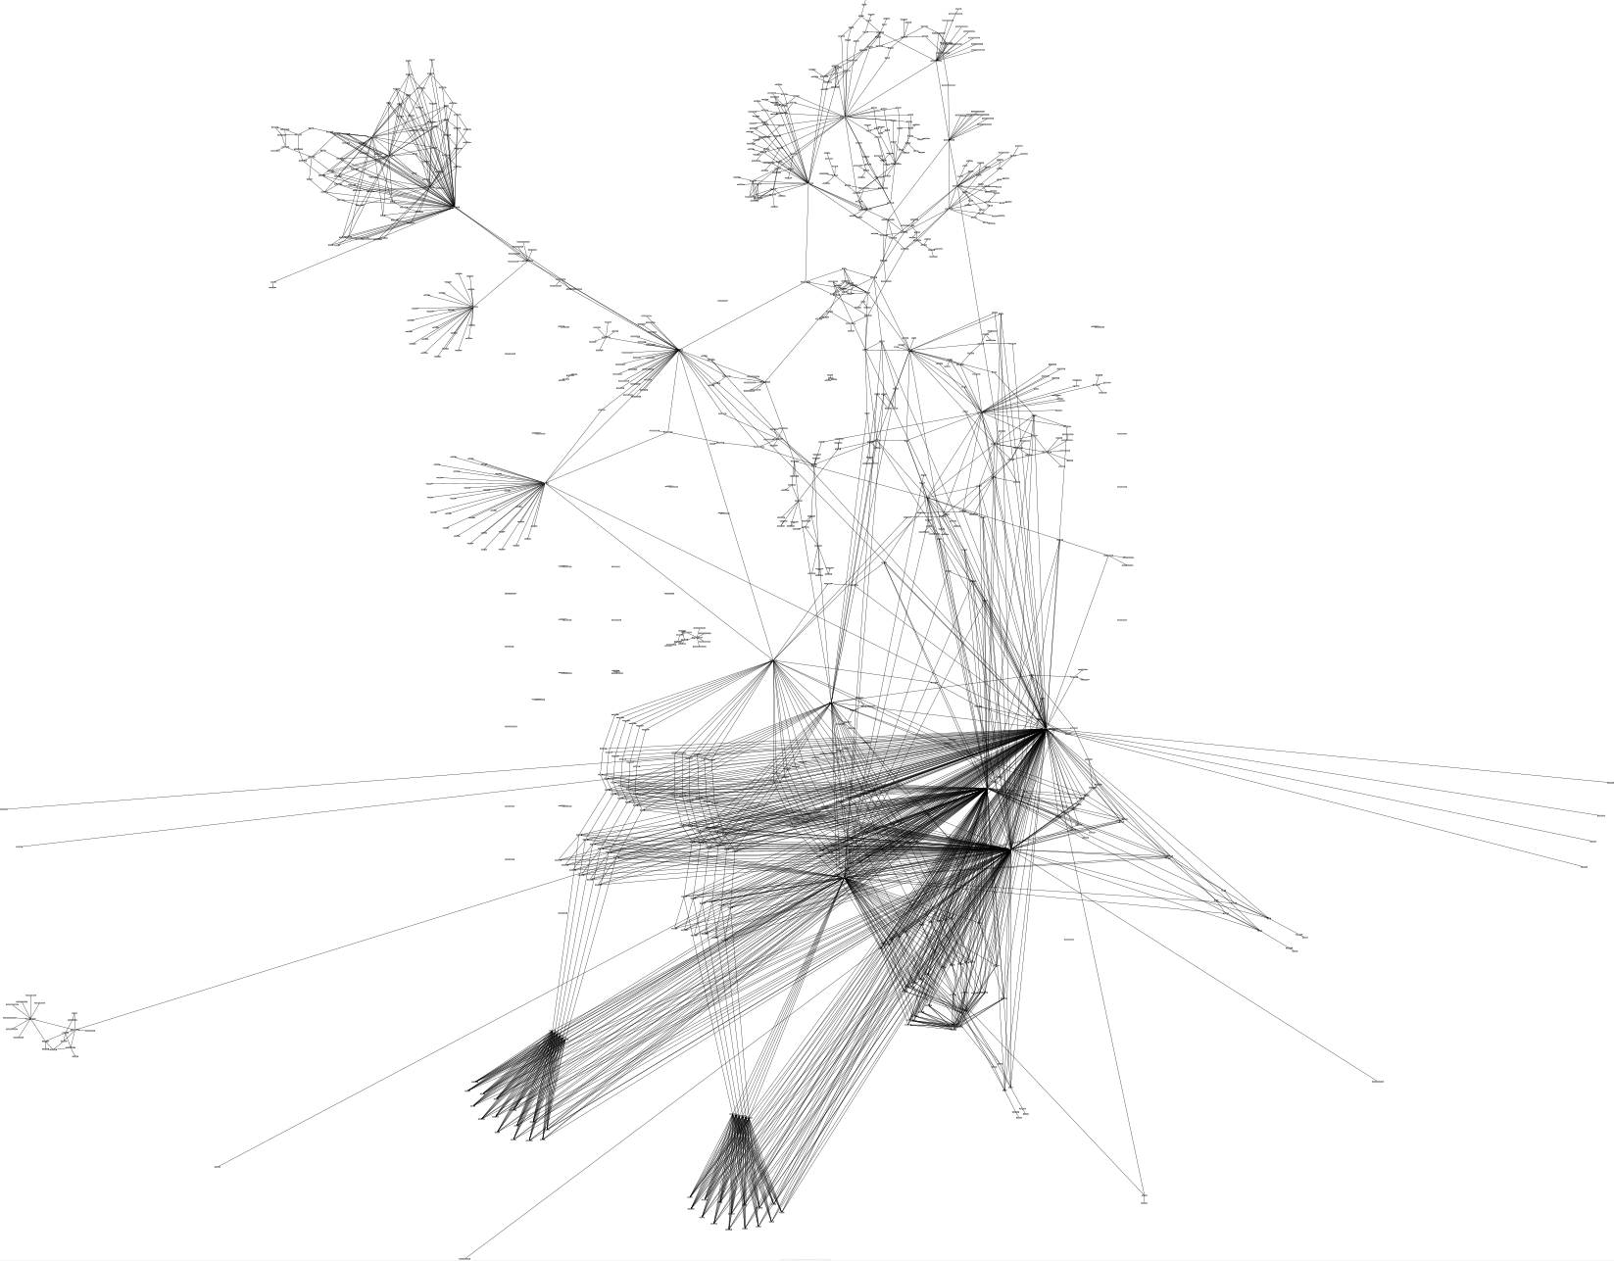
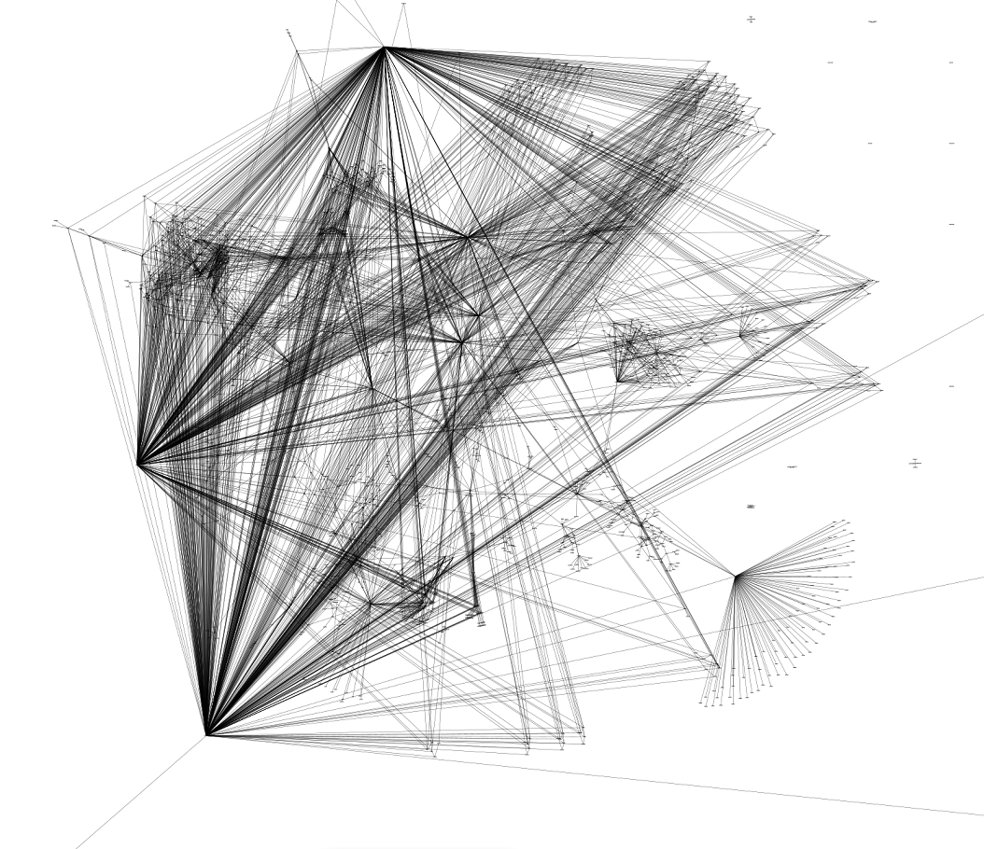
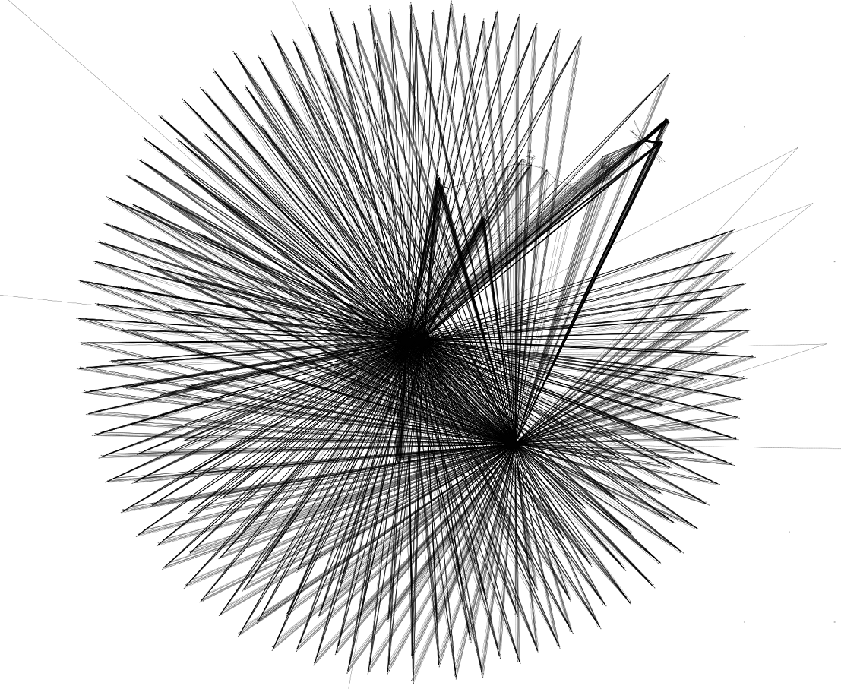
Thank you for your attention!
CRYRING
ESR
SIS100
SIS18
LSA can do dandelions, too, and more…

