Slide 1
Control System Commissioning
Timeline & Status
Ralph Bär, Accelerator Controls
1st FAIR Commissioning Workshop
08-NOV-2024

Slide 2
Presentation Outline
Control System Hardware
  Status and Outlook of Hardware
  Commissioning Planning: Schedule and concepts
Status Software Development
  Readiness of important functions for commissioning without beam

Slide 3
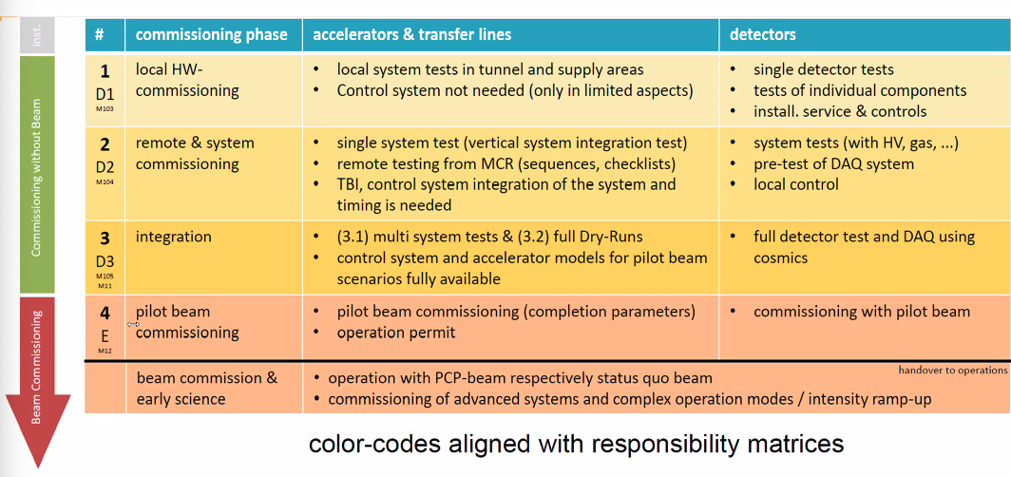
Commissioning Phases

Slide 4

Installation & Commissioning
Networks
Controls provides networks across FAIR buildings:
  Accelerator (ACC) network → communication within control system
  Timing (White Rabbit) network → time and events
  Industrial (ProfiNet) network → network for Vacuum, Cryo, PAS, Interlocks, …
Availability of networks is pre-requisite for commissioning phase 2 (maybe 1)
  → Install and commission as early as reasonably possible
Procurement situation
  All White Rabbit switches developed and ready for installation
  All ProfiNet switches ready for installation
  Part of ACC network switches ready for installation
Central Installations → (almost) done!
  All installations in BG.2.009 (and Green Cube)
  Core ACC switches already installed, commissioning in Nov 2024 (next 2 weeks)
  WR Timing → already in operation for several years
  Industrial Ethernet → ProfiNet Core installed in October 2024 (GSI ring), FAIR rings prepared

Slide 5
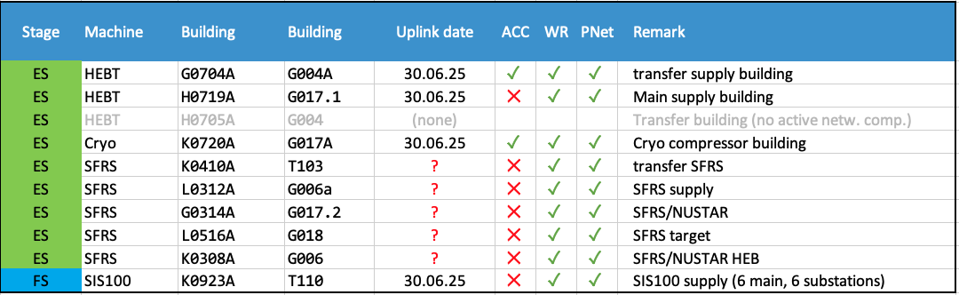
Installation & Commissioning
Networks
Essential pre-condition for network commissioning:
Installation of network racks and cabling → responsibility of FSB
Uplinks – FOC connections to BG.2.009 (“Datenanbindung FAIR zur GSI”)
Uplink northern buildings: end of Q2/2025
Uplink southern buildings: unknown
Status Overview
Availability of equipment
ready for installation (M10)

Slide 6
Installation & Commissioning
Networks
Installation works
  Equipment only for G004A and G017A ready for installation (present budget constraints)
  No equipment for T110, but building situation advanced
  Further procurement schedule not critical (KdB frame contract) – 2.3 M€ for remaining ES
  WR and ProfiNet equipment fully available
  As soon as building & cabling conditions are met → resilient building milestones required
  installation of pre-configured equipment & patching, powering test
  Installation duration: 1 week/rack estimated
Commissioning works
  As soon as uplink is established → uplink milestones for south buildings not known
  Powering equipment, communication tests → stay in operation, maintained by INN
  Commissioning duration: ½ day/rack estimated
Considerations
  T110 network equipment (FS) shall be procured and installed (700 kEUR)
  Present challenge: Timing network engineer left timing team
  → position will be opened asap

Slide 7
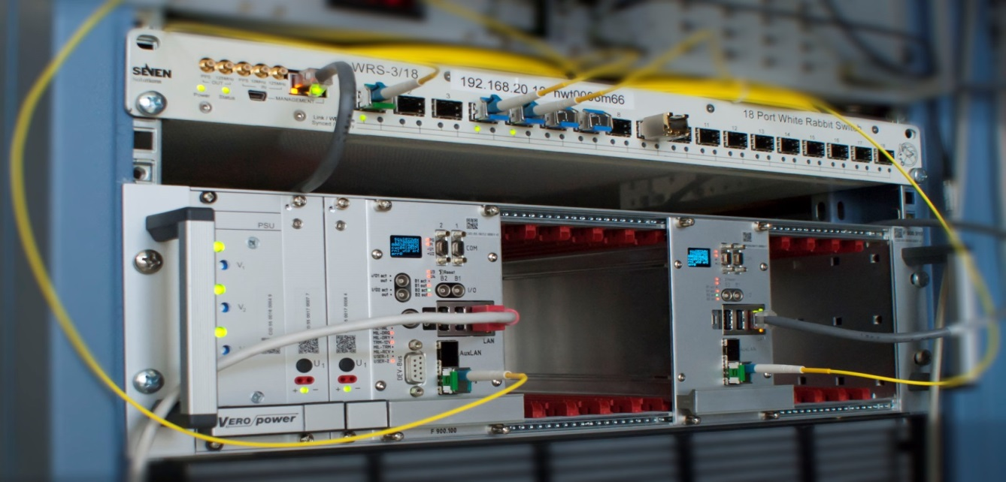
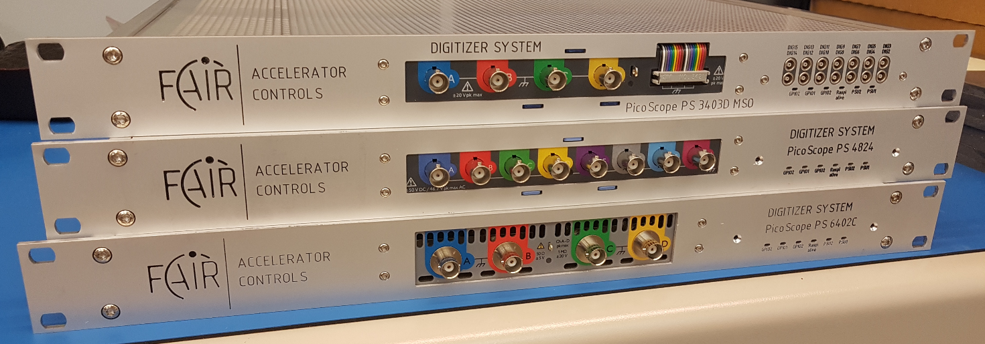
Installation and Commissioning
Front-End Controls
Equipment control installation scope
SCU FE-controllers for power converters
MBox stepping motor controllers
Digitizer Systems (FEC & Digitizer modules)
Interlock Collectors
Fast Beam Abort (FBAS) Systems
Special HEBT devices:
Fast Stripper Control (SCU-based)
Special SFRS devices:
QuD DAQ systems
NB: network-connected equipment
usually does not need local installation

Slide 8
Installation and Commissioning
Front-End Controls
Installation works (Power Converters)
  SCU standard controllers for 2025/2026 available (100 units)
  SCUv4.1 to be produced in 2025 (100 units)
  SCUv5 under development, production in 2026 for FS/ES/FS+ (600 units)
  Installation works: install SCU in power converter, cable connection ACC, WR, Interlocks, FBAS-FOC
  To be done by: Field support team (ACO electronic technicians), supported by EPS team
  Installation duration: ½ day / power converter estimated
Commissioning works (Power Converters)
  Remotely by FEC & APP/LSA teams (field support by ACO/HEL field team)
  Pre-conditions: PC released for remote operation, all data available (calibrations, interlock lists, field calibrations in DB, testing sequences available, …)
  Phase 2: Deployment of FESA class software, configuration, signal checks
  Phase 3.1: LSA integration, beam pattern execution
  Use Sequencer Service for automation (sequences available)
  Commissioning duration: ½ day / power converter estimated
Considerations
  ACO Field Support Team (FST): electronic technicians to be established & trained
✓

Slide 9
Installation & Commissioning
Vacuum Controls (HEBT & SFRS)
Controls of BL Vacuum → IND contributes to Vacuum Installation & Commissioning
Hardware Status
Beamline Vacuum (SLO in-kind)
Bake-out Control System (FAIR)
Cryo Insulation Vacuum (GSI in-kind)
Stage | Machine | Type | Beamline Vacuum |  |  | Bakeout System |  |  | Cryo Insulation Vacuum |  |  | Remark
 |  |  | need | deliv | plan | need | deliv | plan | need | deliv | plan
ES | HEBT | PLC | 5 | 5 | 0 | 2 | 2 | 0 | - | - | -
ES |  | SSR | - | - | - | 7 | 7 | 0 | - | - | -
ES |  | TB | - | - | - | 21 | 21 | 0 | - | - | -
ES |  | all | 5 | 5 | 0 | 30 | 30 | 0 | - | - | -
ES | SFRS | PLC | 4 | 0 | 4(+3) | - | - | - | 25 | 0 | 25* | *offer request ends 29.10.24
ES |  | SSR | - | - | - | - | - | - | - | - | -
ES |  | TB | - | - | - | - | - | - | - | - | -
ES |  | all | 4 | 0 | 4(+3) | - | - | - | 25 | 0 | 25
FS | SIS100 | PLC | 22 | 22 | 0 | 18 | 18 | 0 | 17 | 0 | 17* | *offer request ends 29.10.24
FS |  | SSR | - | - | - | 84 | 84 | 0 | - | - | -
FS |  | TB | - | - | - | 252 | 252 | 0 | - | - | -
FS |  | all | 22 | 22 | 0 | 354 | 354 | 0 | 17 | 0 | 17
PLC = PLC control cabinets SSR = solid state relais cabinet TB = terminal box

Slide 10
Installation & Commissioning
Vacuum Controls (HEBT & SFRS)
Installation works
  Transport & installation of (IND) control cabinets & (VAC) controller cabinets → SMG
  Cabling: Networks, inter-cabinet connections → IND team
  Cabling: to field equipment → VAC team
  Power connection: responsibility → EPS team
Commissioning (vacuum sector-wise)
  Pre-condition: vacuum sector is fully installed
  Signal testing → by IND & VAC teams
  After successful signal testing: system is commissioned (base operation)
Schedule
  aligned to vacuum system planning
  end of 01/2025: all cabinets for HEBT & SFRS ready for installation (M10)

Slide 11
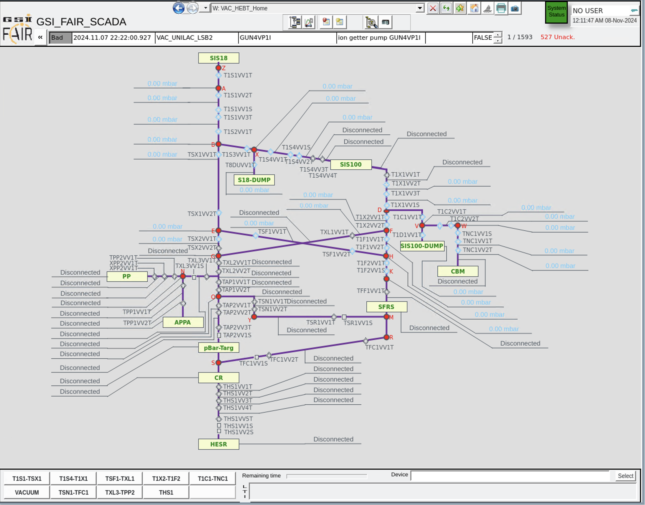
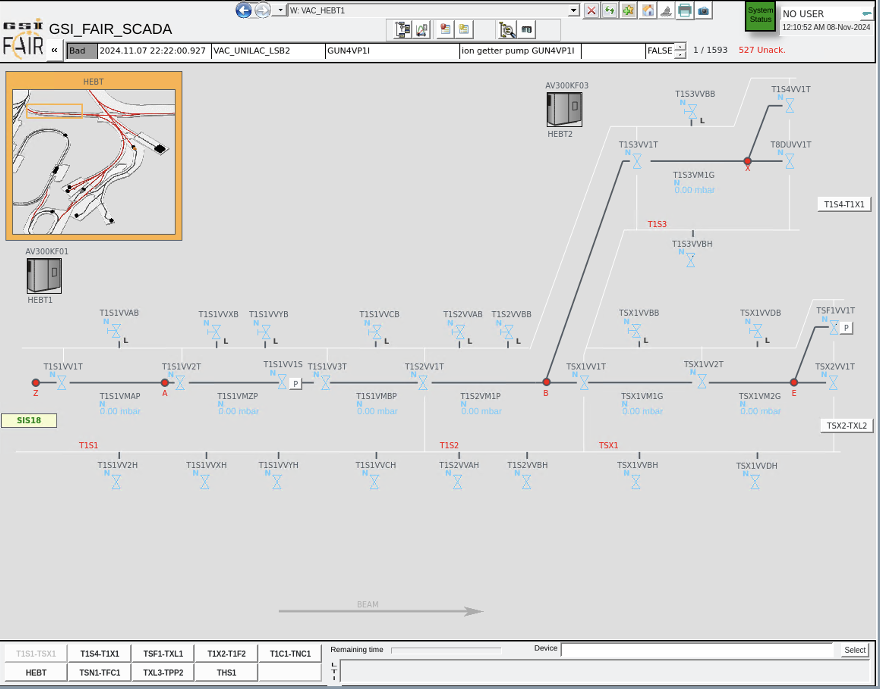
Installation & Commissioning
Vacuum Controls (HEBT & SFRS)
Development of PLC & SCADA software parallel to cabinets, already available

Slide 12

Installation and Commissioning
Cryogenic Controls (incl. INV)
Controls of Cryogenic System → IND contributes to Cryo Installation & Commissioning
  Cryo2 plant integration (data exchange PLC cabinet)
  SFRS cryo control (including DB2) cabinets
  Insulation vacuum control
  SIS100 cryo cabinets (including DB4)
Hardware status – still under development/production
  SIS100 cabinets almost delivered (M10), except sector cabinets
  Insulation vacuum control cabinets: delivery of first 50% in Q3/2025
  Manufacture of cabinets according to sorting order of tunnel installation (“back to front”)
  Design of DB2 and XLF8 can be started after instrumentation lists are defined (still in tender process) → M10 not yet defined

Slide 13
Installation and Commissioning
Cryogenic Controls (incl. INV)
Hardware Status
Stage | Machine | Type | Cryogenic Control System |  |  |  | Remark
 |  |  | need | deliv | install | plan
ES | SFRS | XLF1 | 1 | 1 |  | 0 | change request from SCM for integration of isolation amplifiers
 |  | XLF2 | 2 | 1 |  | 1 | FAT in CW46, CR request from SCM for integration of isolation amplifiers
 |  | XLF3 | 3 | 0 |  | 3 | contract signed, CR request from SCM for integration of isolation amplifiers
 |  | XLF5 | 2 | 0 |  | 2 | contract signed, CR request from SCM for integration of isolation amplifiers
 |  | XLF8 | 1 | 0 |  | 1 | Instrumentation List missing, under development change request from SCM for integration of isolation amplifiers
 |  | BB1 | 1 | 0 |  | 1 | under development
 |  | DB2 | 1 | 0 |  | 1 | Instrumentation List missing
 |  | all | 11 | 2 |  | 9
FS | SIS100 | EB | 6 | 6 | 2 | 0
 |  | FB | 3 | 3 |  | 0
 |  | DB4 | 1 | 1 |  | 0
 |  | Sec | 6 | 0 |  | 6
 |  | all | 16 | 10 |  | 6
Status: October 2024
“need” = required for stage/machine
“deliv” = already delivered
“install” = already installed
“plan” = planed but not yet produced/delivered
XLF1 = pre-target branch cabinet (T-branch)
XLF2 = pre-separator cabinet (P-branch)
XLF3 = main separator cabinet (M-branch)
XLF5 = high energy branch, towards NUSTAR (H-branch)
XLF8 = high energy branch, in NUSTAR cave (G-branch)
BB1 = branch box 1
DB2 = distribution box 2 (SFRS)
EB = end box
FB = feed box
DB4 = distribution box 4 (SIS100)
Sec = sector cabinet

Slide 14
Installation and Commissioning
Cryogenic Controls (incl. INV)
PLC software and SCADA software is already developed in parallel to cabinets and available already, already available)

Slide 15
Installation and Commissioning
Cryogenic Controls (incl. INV)
Installation works
Transport and installation of control cabinets → by SMG
Cabling: cables to field equipment → by CRY, SCM, VAC
Cabling: inter-cabinet connections, PLC modules → by IND
Commissioning works
to be executed branch-wise
Signal testing → by CRY / SCM / VAC together with IND
After successful signal testing:
→ system is commissioned (manual mode for base operation)
→ automatic mode will be implemented during cool-down and learning about cool-down procedures

Slide 16
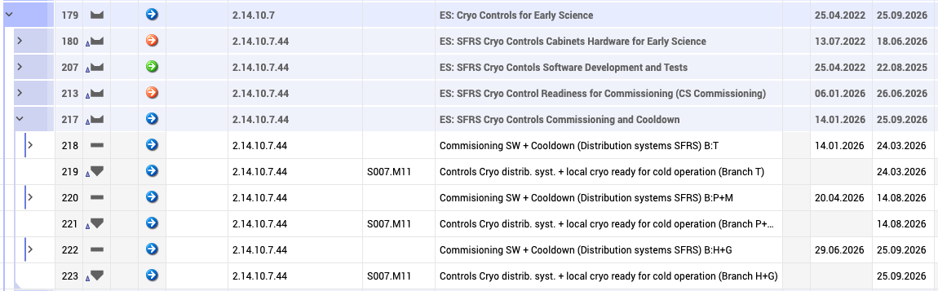
Installation and Commissioning
Cryogenic Controls (incl. INV)
Present Schedule
  aligned to overall cryogenic system planning → Talk H.Kollmus

Slide 17

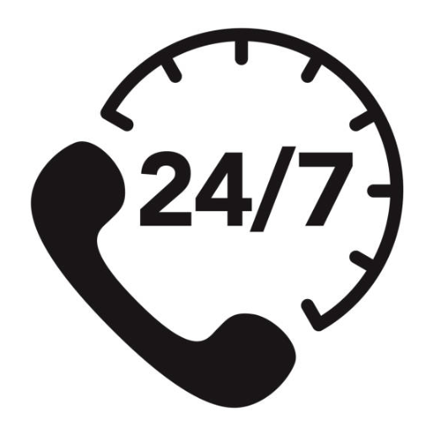
Installation and Commissioning
Industrial Controls
Further Considerations
On-call service for IND team during cooldown/cold operation
Required from mid 2026 (cooldown of transfer line to DB2)
To support: Cryo / Vaccum / PAS controls, HW interlock system
Already now, no support can be provided to UNILAC & CRYRING vacuum
→ IND team must be further enlarged (cover on-call service, reduce risk of losing key member)
long lead times to recruit and train qualified staff…

Slide 18
Status Control System
FAIR CS operated since 2018, first production run 2019, 5th physics beam time with new CS in 2024
Stable operation on SIS18, ESR, CRYRING and GSI-HEBT, sufficiently mature
Increasing stability, functionality, useability
CS architecture has shown to be stable adequate for ES
SIS100 already operated virtually and for String Test
UNILAC upgraded to FAIR control system until 2026
Basic functions and applications are already available
Some key items still to be done for ES:
  SFRS ACC-EXP data exchange gateway → until Q3/2025
  Post Mortem functionality → still to be designed and scheduled
  FBAS machine protection → CDR approved 12/2024, implementation until Q4/2026
  Improve Archiving System and integrate Industrial SCADA

Slide 19
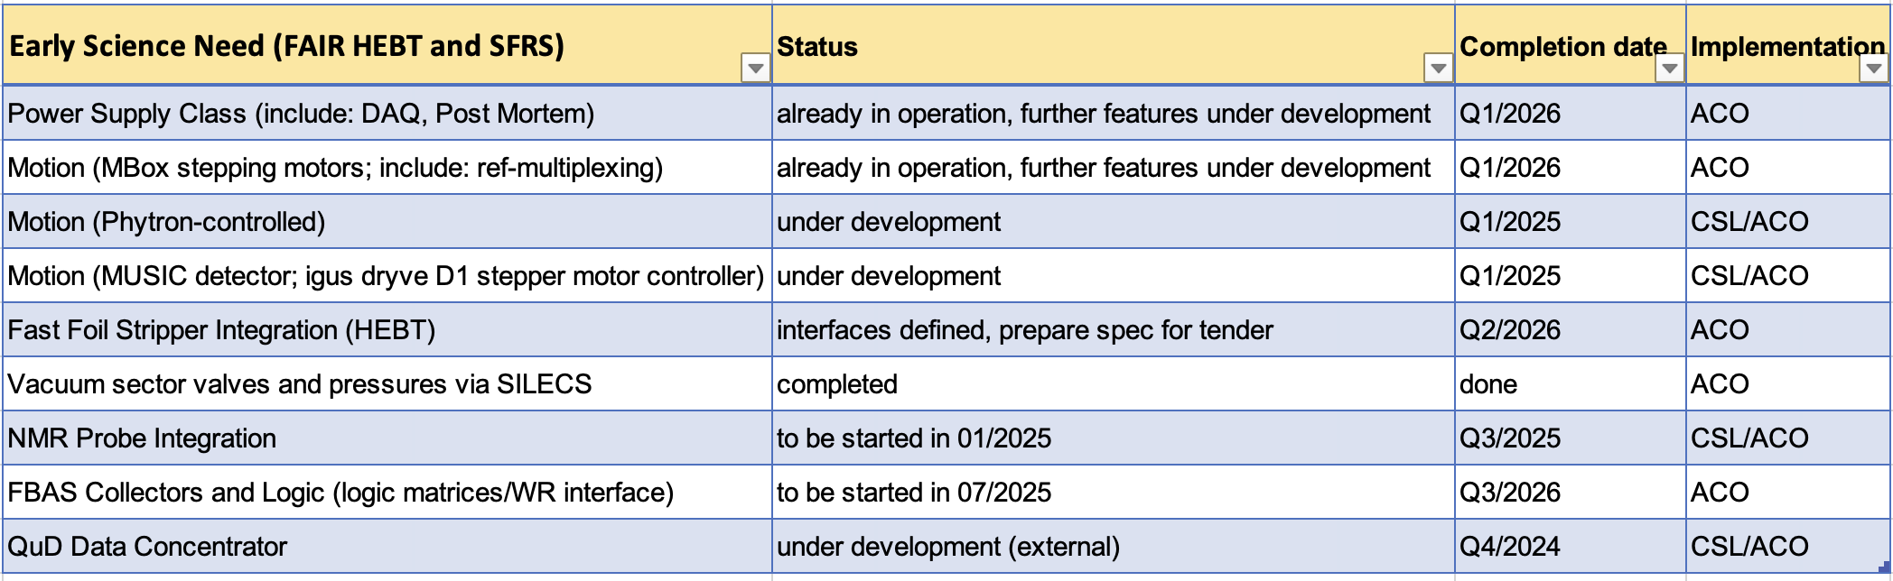
Development
FESA Software
GSI Facility is operated already with FESA for several years
Equipment control (FESA) software for HEBT / SFRS

Slide 21
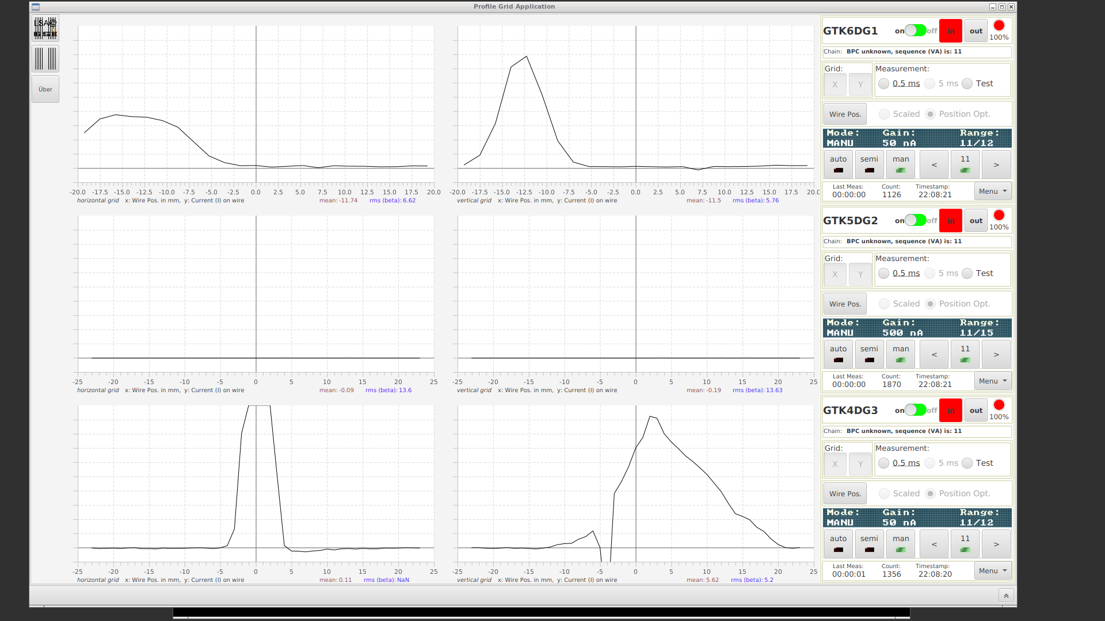
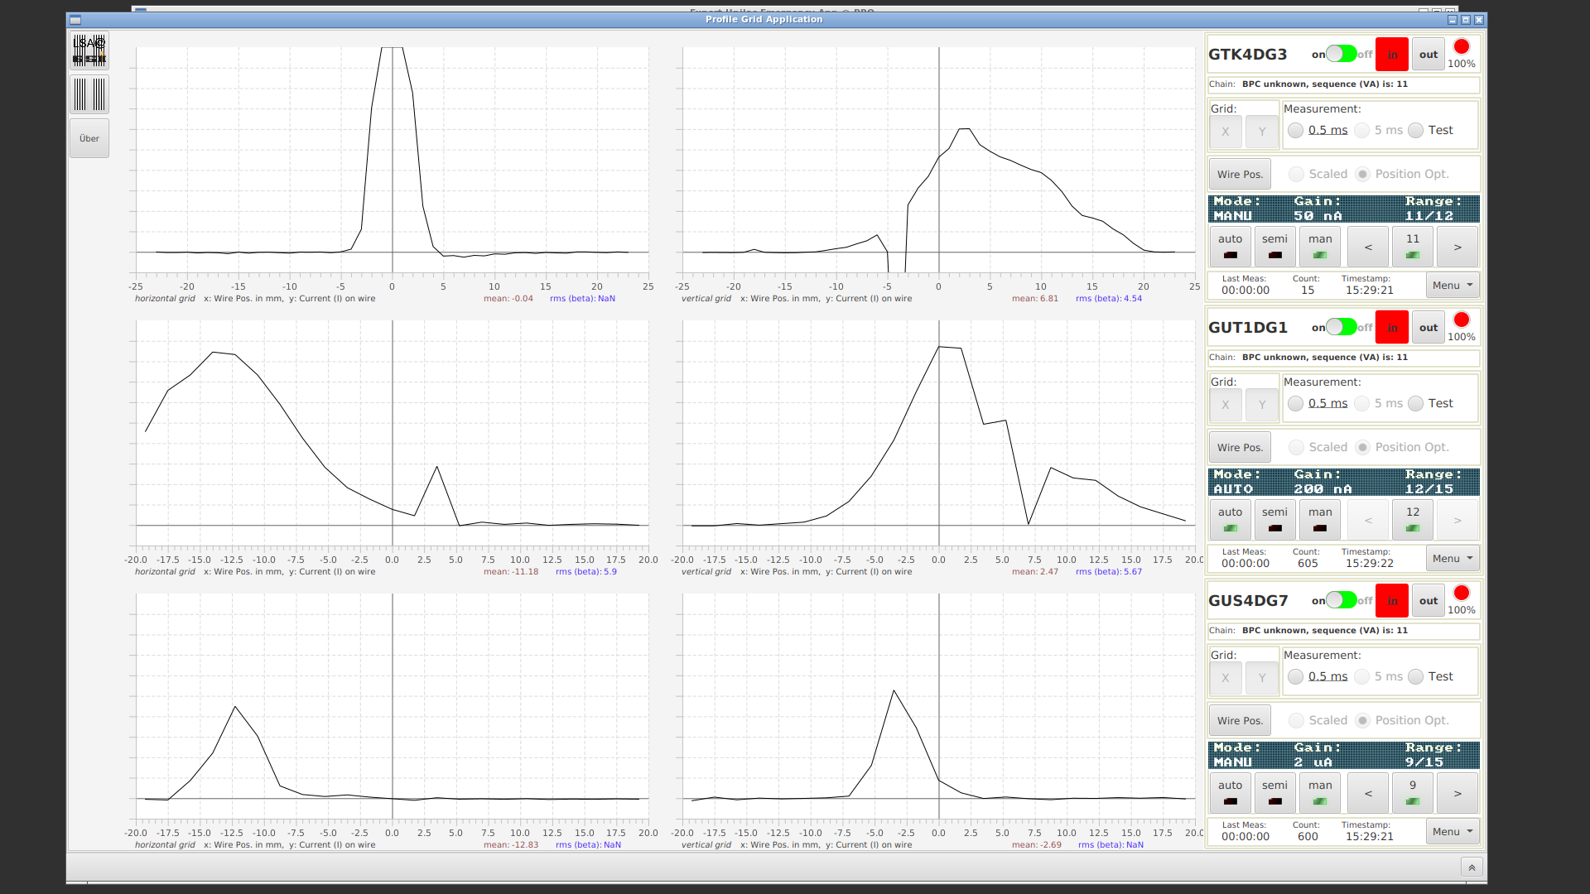
Commissioning ongoing now…
Injector Controls Upgrade
07.11.2024, 17:00
Dry/Wet Run
Test of UNILAC control system replaced by FAIR control system
Test objectives reached in time, beam transported to TK7 cup

