Slide 2
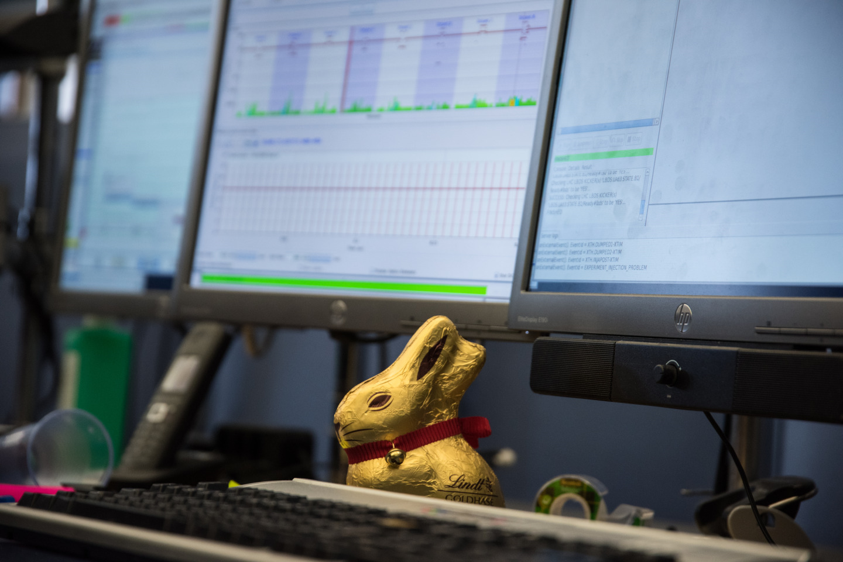

LHC Commissioning
J. Wenninger
CERN Beams Department
Operation group
1st FAIR Commissioning Workshop
7-8 November 2024
Bold Campus
Acknowledgements:
M. Solfaroli, M. Pojer
LHC “tradition” of Easter beam commissioning

Slide 3
Introduction – LHC and the CERN complex
Cooldown and circuit commissioning
Equipment checkout towards first beam
Incident
Summary

Slide 4
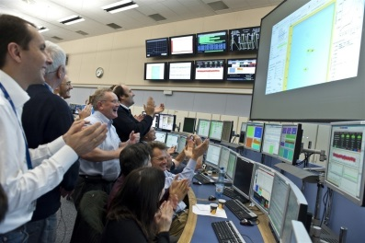
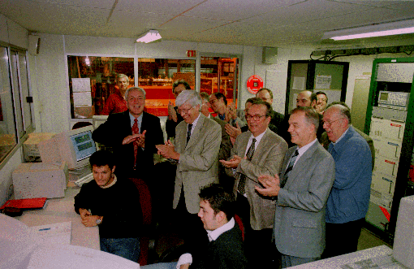
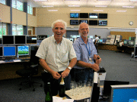
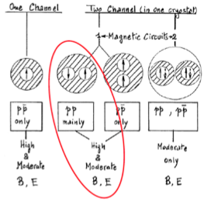
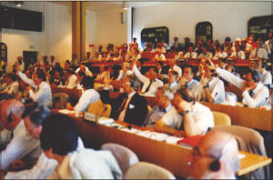
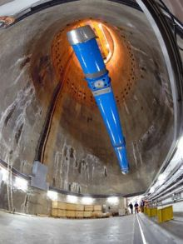
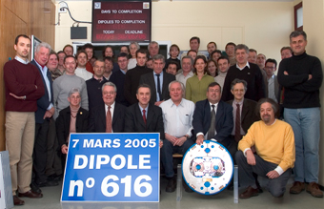
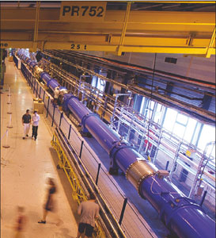
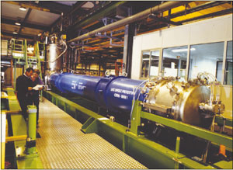
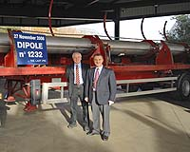
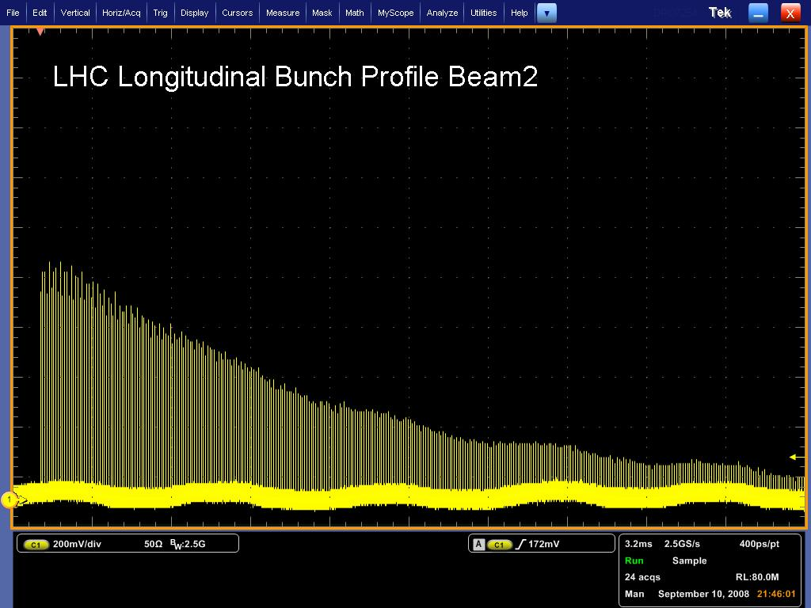
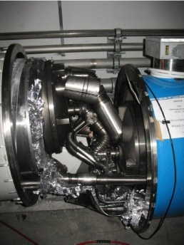
June 1994 first full scale prototype dipole
1984
ECFA-CERN workshop
June 2007 First sector at 1.9K
November 2009
Start of Run 1
April 2008
Last dipole down
Super Conducting Supercollider(SSC) cancelled by US congress
1994 project approved by council (1-in-2)
Today’s talk
2005: 50% of magnets delivered
LEP: full scale LHC “prototype”
1984
90
91
92
93
94
95
96
97
98
99
00
01
02
03
04
05
06
07
08
09
10
First set of twin 1 m prototypes
over 9 T
2002 String test
November 2006
1232 delivered
September 2008

Slide 5
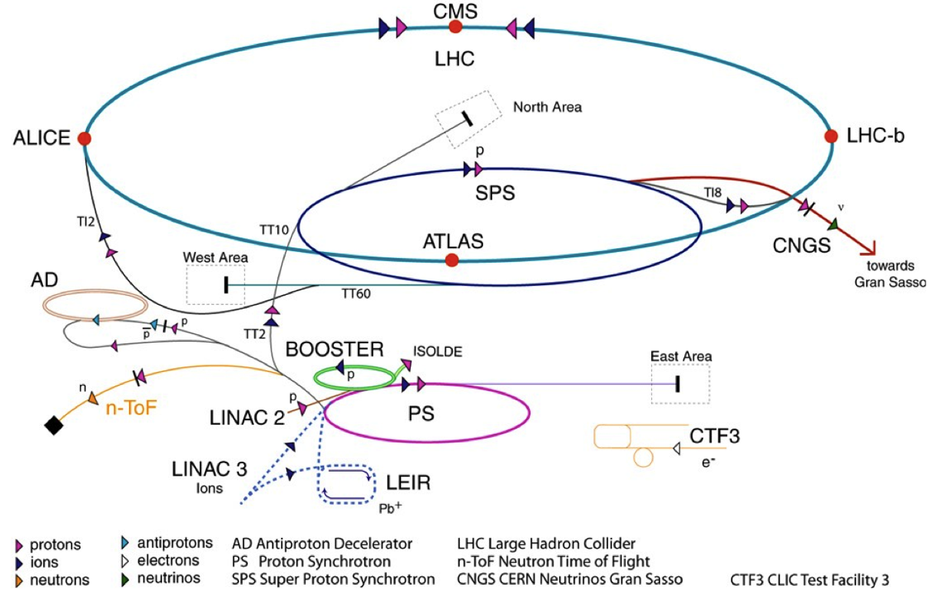
CERN accelerator complex - 2008
The state of the complex at LHC startup
 | Max. P (GeV/c) | Length / Circ. (m)
LINAC2* | 0.050 | 30
Booster* | 1.4 | 157
PS | 26 | 628
SPS | 450 | 6’911
LHC | 6’800 | 26’657
LHC proton path
Beam 1
Beam 2
*: kinetic energy
High intensity beams spend ~30 seconds in the injector complex before injection to the LHC.
Changes in 2024 wrt 2008 (upgrade for HL-LHC):
LINAC4 (H-, 180 MeV) replaces LINAC2 (p)
Booster energy increased to 2 GeV

Slide 6
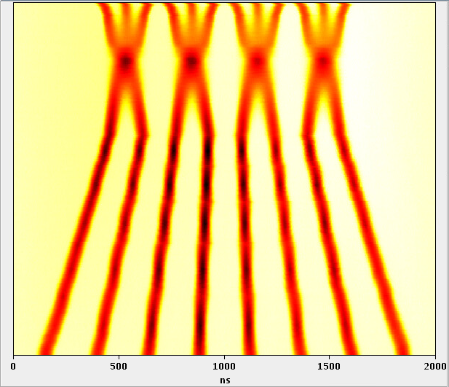
Injector complex
Splitting
LHC required the production of a new beam type: high brightness, 25 ns bunch structure.
A dedicated LHC Injectors project was setup end of the 1990’s to address the required modifications to the CERN accelerator chain.
Magnets, injection/extraction systems, RF systems, e-cloud mitigation (discovered along the way)…
Merging
time in PS cycle
Batch Compression
 | Train length [bunches] | Intensity [10¹¹ p] | Normalized emittence [mm mrad]
Design | 72 | 1.15 | 3.5
2024 production beam(*) | 36 | 1.6 | ~1.8
A key component of LHC beam production:
RF manipulations to split (or compress) booster bunched into up to 12 bunches (2x2x3) spaced by 25 ns.
(*) this beam takes advantage of the HL-LHC injector upgrade (LUI) project

Slide 7
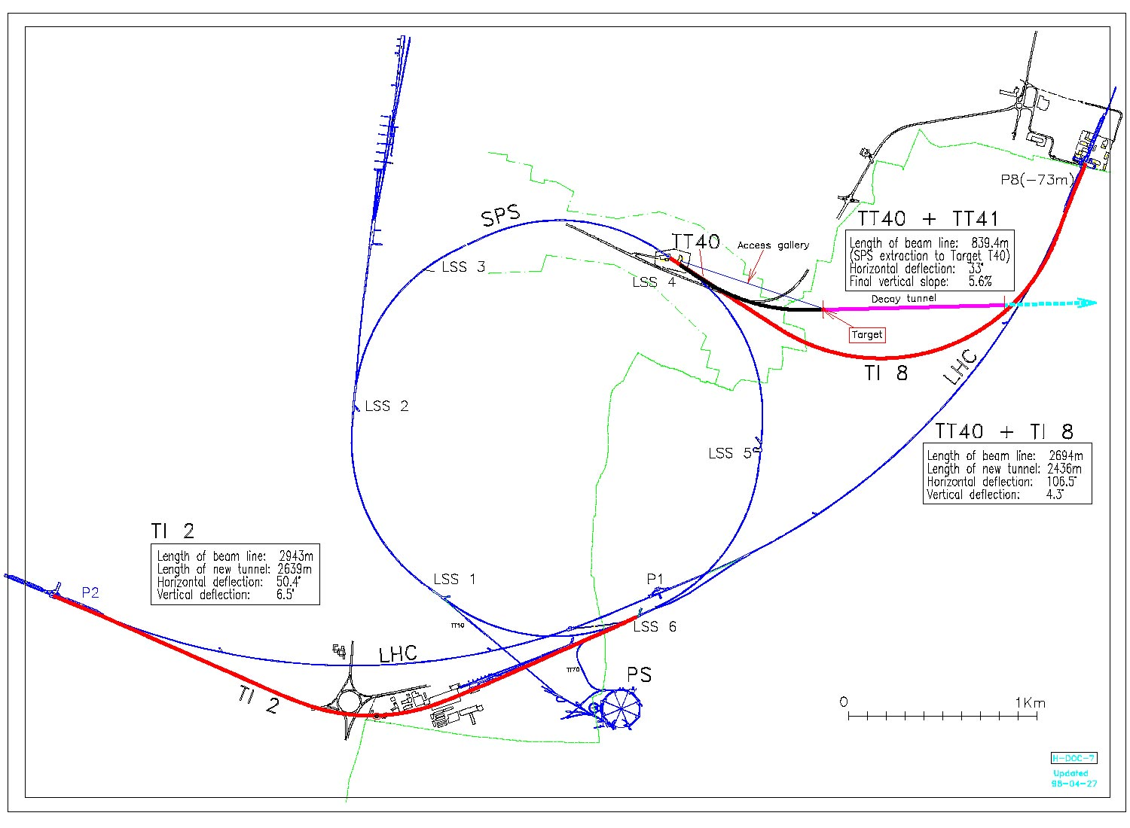
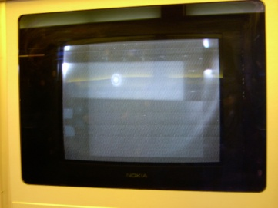
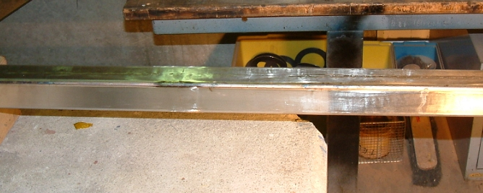
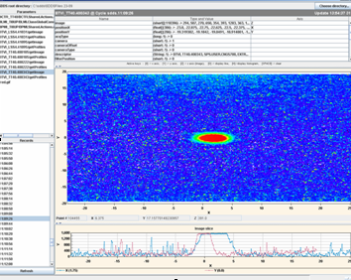
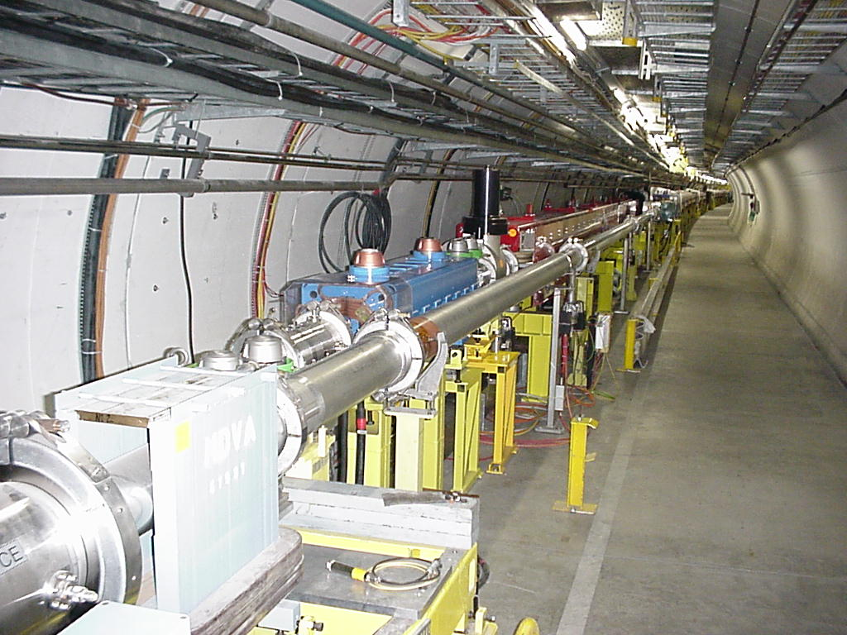
Transfer lines to LHC
2003
2004
Two ~3 km long transfer lines (TI2 and TI8, normal conducting magnets) were built to transfer the 450 GeV beams from the SPS to the LHC.
Commissioning with beam 2003-2007 (~3x24 hours/line).
Controls and beam instrumentation testbed (BPMs, BTVs).
Taking advantage of TL dumps.
2007
2004
“hole”
2003: Beam through the extraction channel and first meters towards TI8 (100 m of beamline)
2004: beam at the downstream end of TI8
2007: beam at the downstream end of TI2
2004: Drilled a hole into a vacuum chamber with the extracted LHC high intensity beam

Slide 8
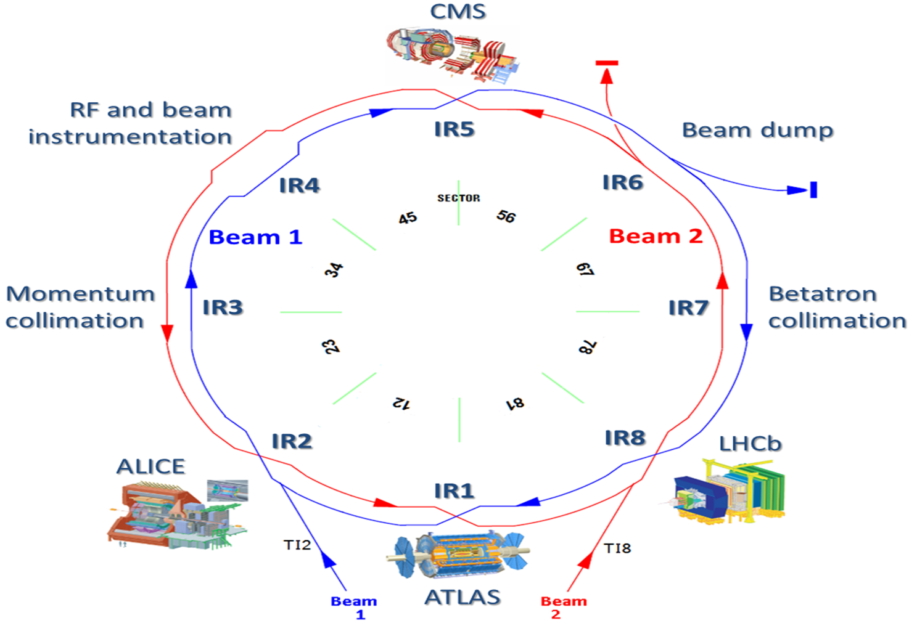


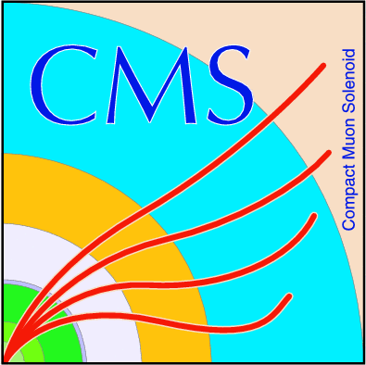



LHC layout
Total length 26.67 km, in the former LEP tunnel.
8 arcs (sectors), ~3 km long.
8 straight sections of 700 m.
Beams cross in 4 points.
Design energy 7 TeV using superconducting dipole magnets operating at 8.3 T.
Current operation energy is 6.8 TeV (forever?).
2-in-1 magnet design with separate vacuum chambers.
2 COUPLED rings.
The LHC is divided into 8 sectors (≈ one arc) that are electrical and cryogenically independent
→ parallel commissioning & installation

Slide 9
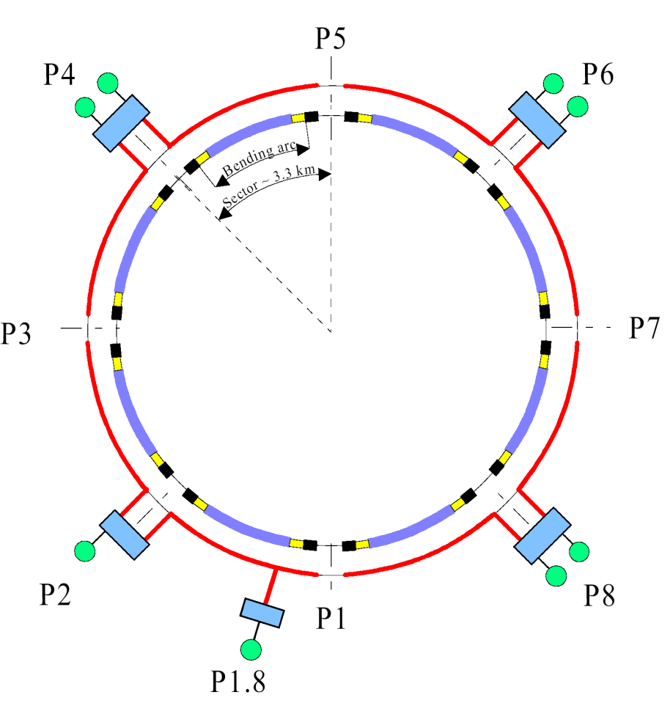
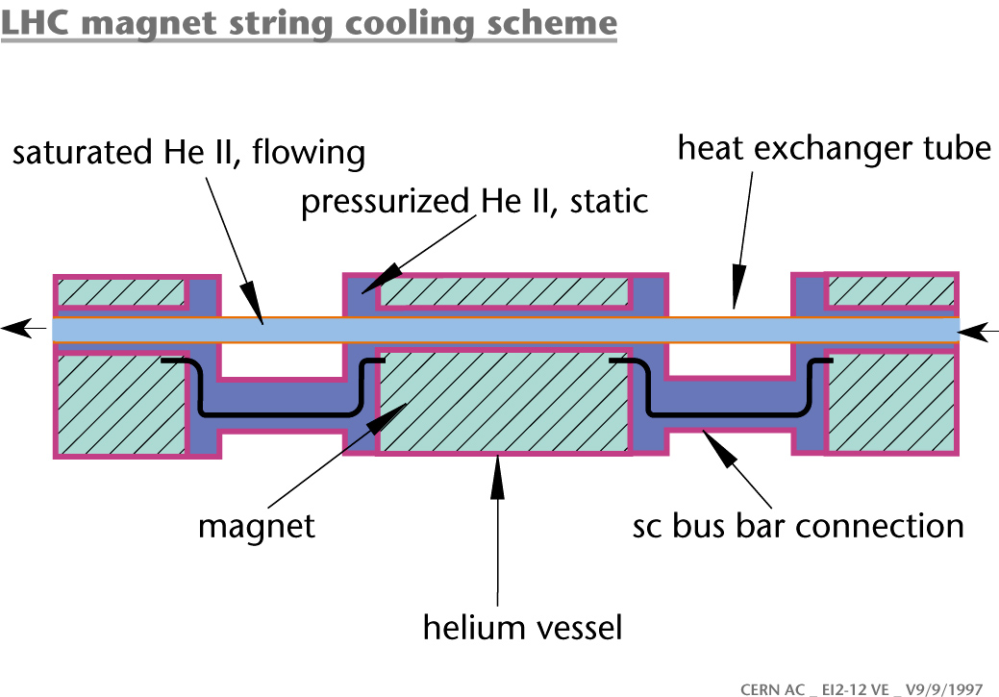
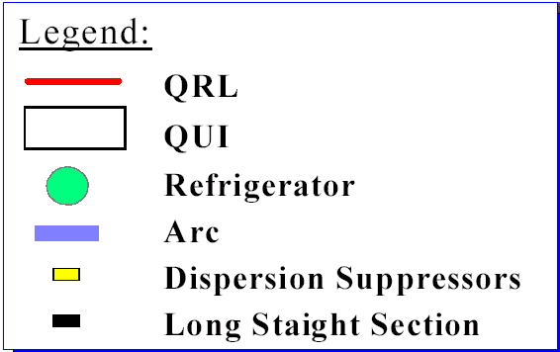
LHC cryogenic system
8 cryogenic plants for the machine and 2 cryogenic plants for experiments – 4 plants from LEP (RF).
The majority of LHC magnets are cooled with superfluid He at 1.9K.
Very low viscosity and very high thermal conductivity.
Major issues with the first arc-long distribution line (QRL) – CERN had to take over from contractor → delay ~1y.
Despite the large size the typical availability of the cryogenic system is ~95%, 97% if external failures are excluded (electricity, cooling).
24 km @ 1.9K
36’000 t @ 1.9K
130 t He inventory

Slide 10
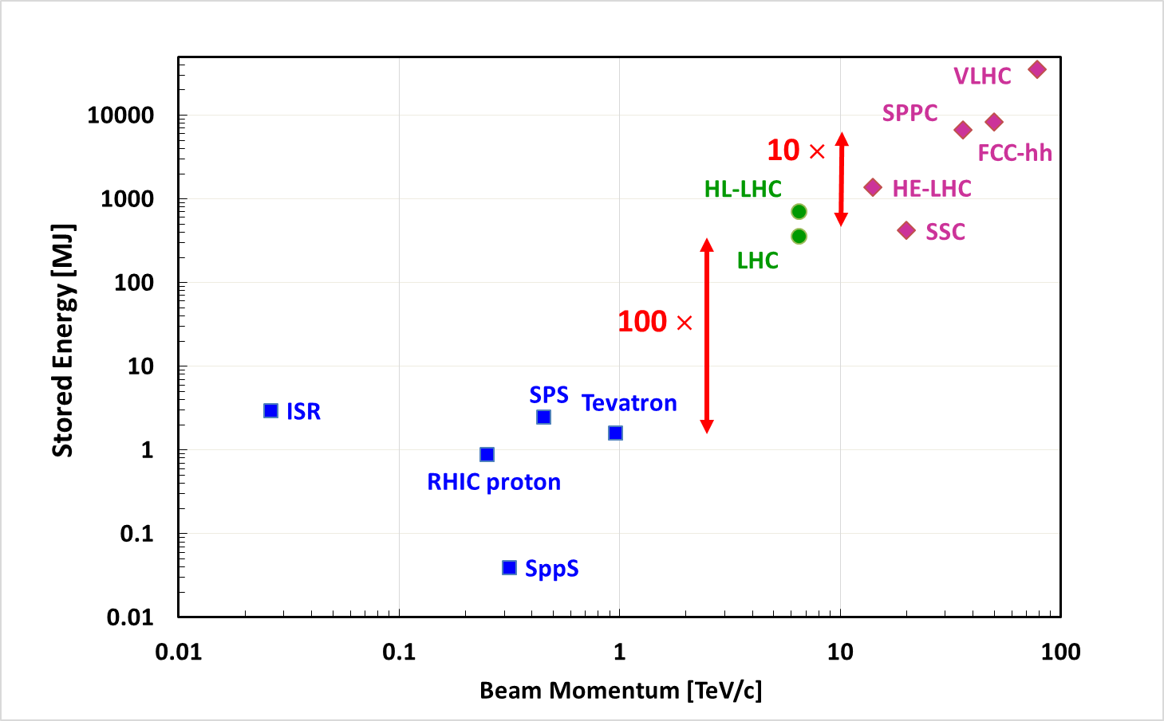
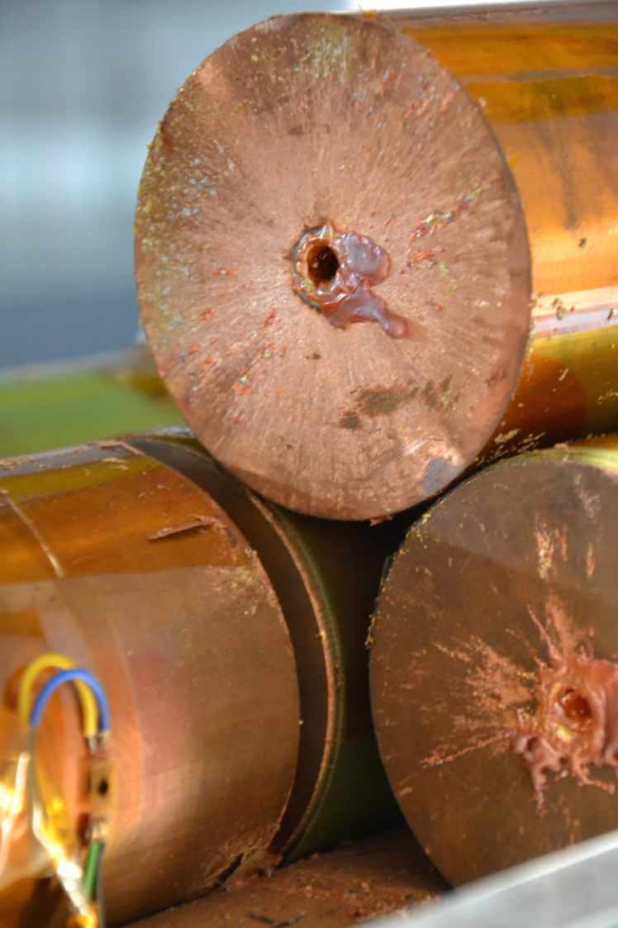
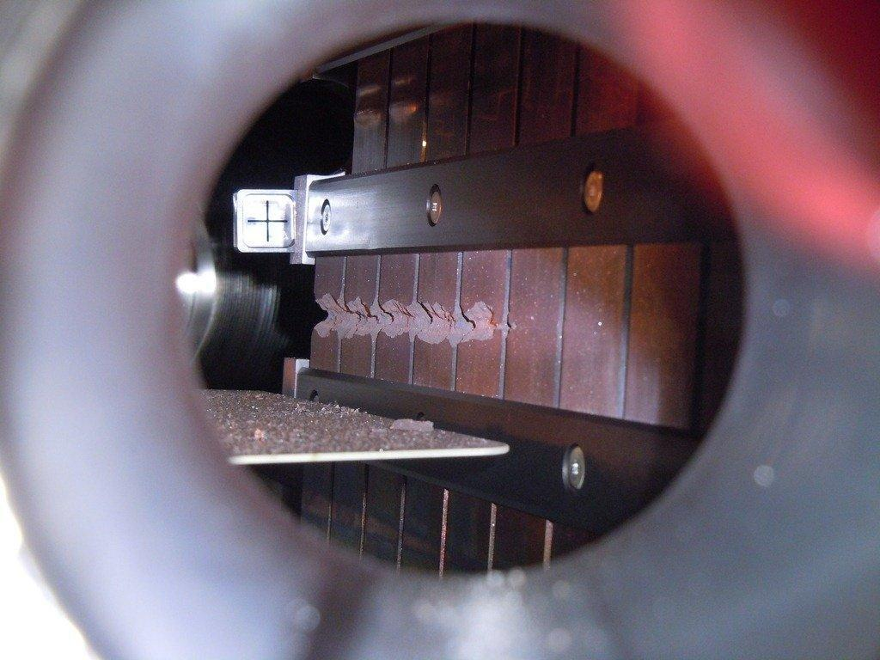
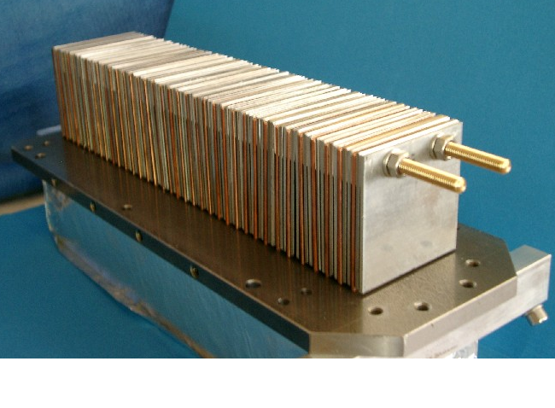
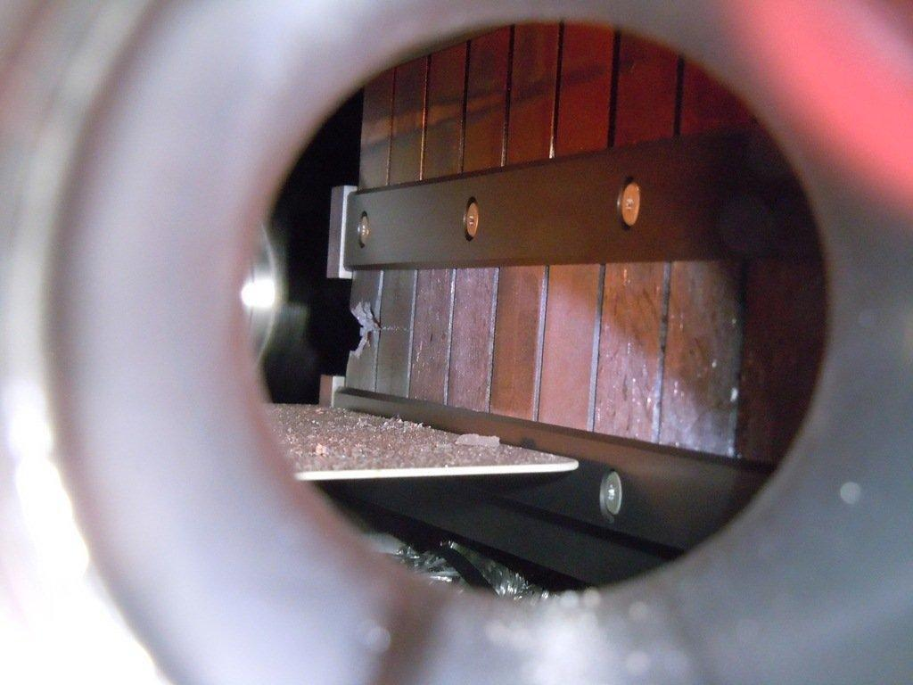
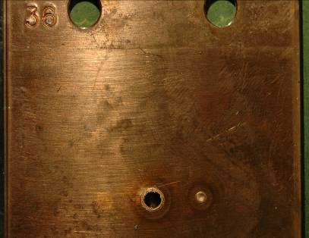
Can we handle the beam?
The LHC makes a leap in terms of stored energy in the beam by 2 orders of magnitude.
Understanding and benchmarking damage (and quench) thresholds of components became an important topic.
Initial simple damage tests evolved into a dedicated test facility for radiation to matter studies (HiRadMat).
(Un-) & controlled quench tests with beam in LHC.
Onset of ‘serious’ damage
Early damage test
(2004)
HiRadMat tests
A B D C
6 cm

Slide 11
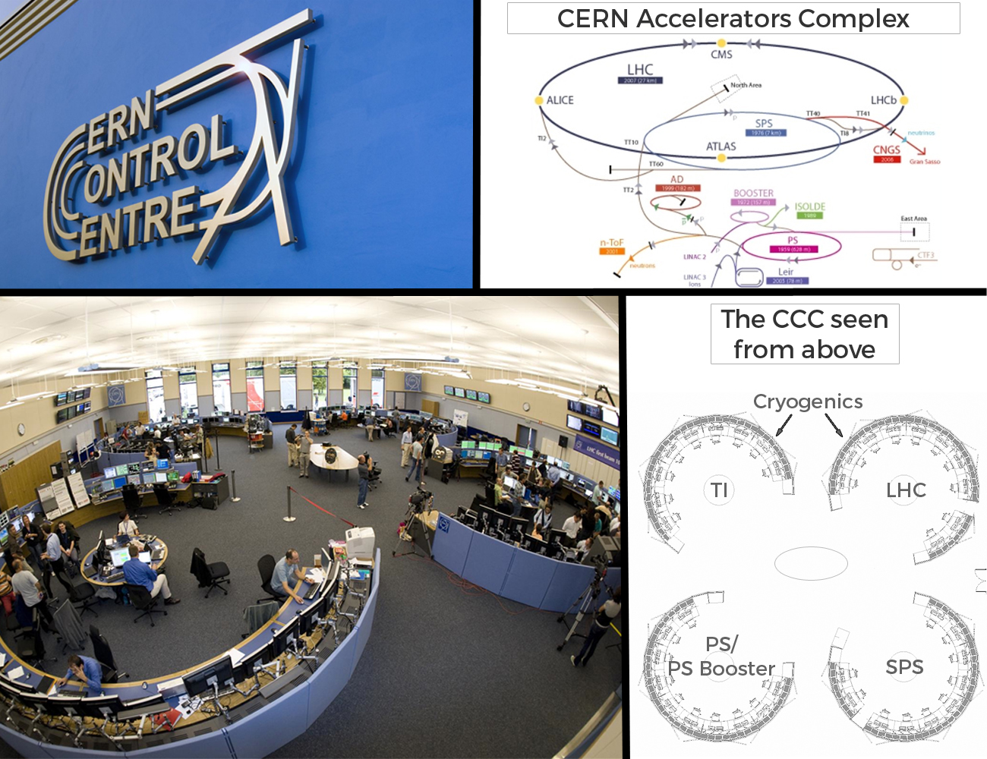
A new control room: CCC
A new centralized control room was considered a key for the success and efficient operation for the LHC area: everybody in the same room for better communication.
In 2006 the SPS was the first machine to move into the CCC.

Slide 12
Introduction – LHC and the CERN complex
Cooldown and circuit commissioning
Equipment checkout towards first beam
Incident
Summary

Slide 13
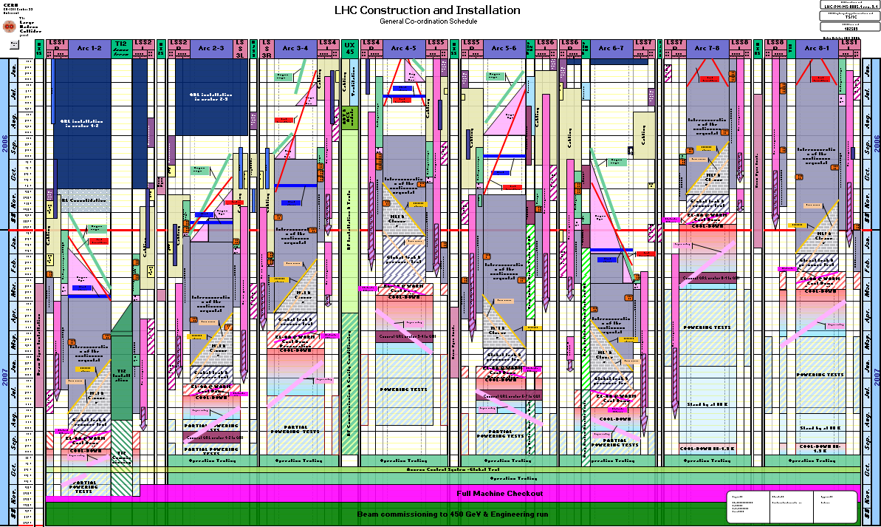
And a miracle occurred ?
A (hardly readable) schedule turned into a real machine…
When LEP was shutdown in 2000, the planning foresaw first beam in the LHC in 2005.
The startup was eventually shifted to 2008 due to technical issues and installation delays.
Provided operation with a lot of time for equipment checkout.
The time was not lost, we would not have made it for 2005 (tests, controls…).

Slide 14
Powering test campaigns
The first powering tests of LHC circuits (power converters, busbars, magnets, interlocks and quench protection) began in 2006.
Segmentation of the LHC into 8 main sub-sectors allows parallel circuit commissioning and installation.
Crucial integration tests for power converters, quench protection and circuit interlock systems.
A full commissioning campaign involves ~20’000 tests on 1600 circuits that stretch over 2-3 months. The first time(s) it took much longer.
After a winter stop without warm-up: ~2 weeks.
The campaigns end with dipole magnet training to the desired peak field / energy (> 500 training quenches to reach 6.8 TeV with all 1232 dipole magnets).
A bad surprise during commissioning: the dipole magnets detrain partially during thermal cycles.
Other circuits also experience training quenches, but they are individually powered → easier.
The first circuit commissioning (→ first beam) was led by 2 commissioning coordinators, supported by 8 “point owners”, equipment experts and the operation crew.
Each point owner supervised local equipment commissioning for all systems and was expert in the powering for his point.

Slide 15
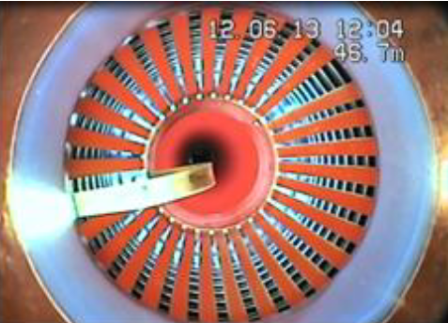
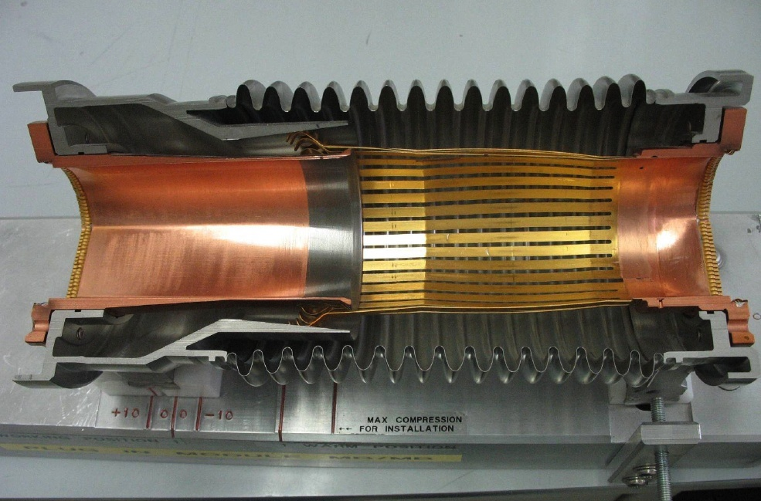
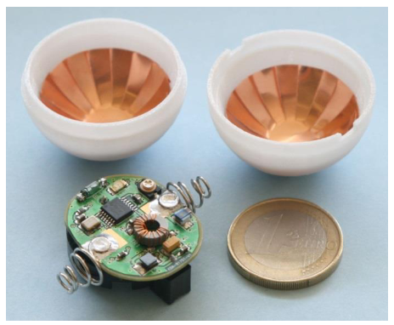
Cooldown and warmup
The transitions between room temperature and 2K/4K are delicate phases due to the thermal contraction/expansion.
The range 300K ⇔ 80K is the most delicate phase, below 80K the thermal expansion is minimal.
Personnel access to a sector is strictly forbidden during transit 80K ↔ 300K.
Most common issues during
Cooldown: faults to ground on some circuits due to busbar friction on edges.
Warm-up: Bent RF fingers in vacuum interconnection modules leading to obstruction → systematic issue at the start of LHC, many modules had to be replaced.
Position @ cold
Before cooldown, a RF-ball test is performed in the long arc to identify obstructions.
A ball with an RF emitter is blown through the ~3 km long arc vacuum chamber.
Ball localization with BPMs.
The test is not entirely fool-proof.

Slide 16
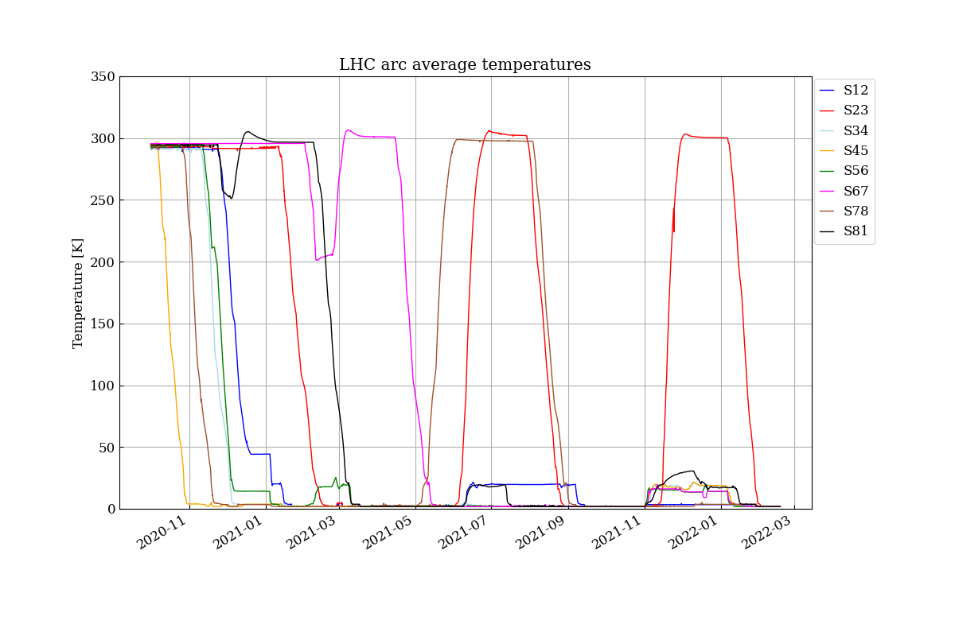
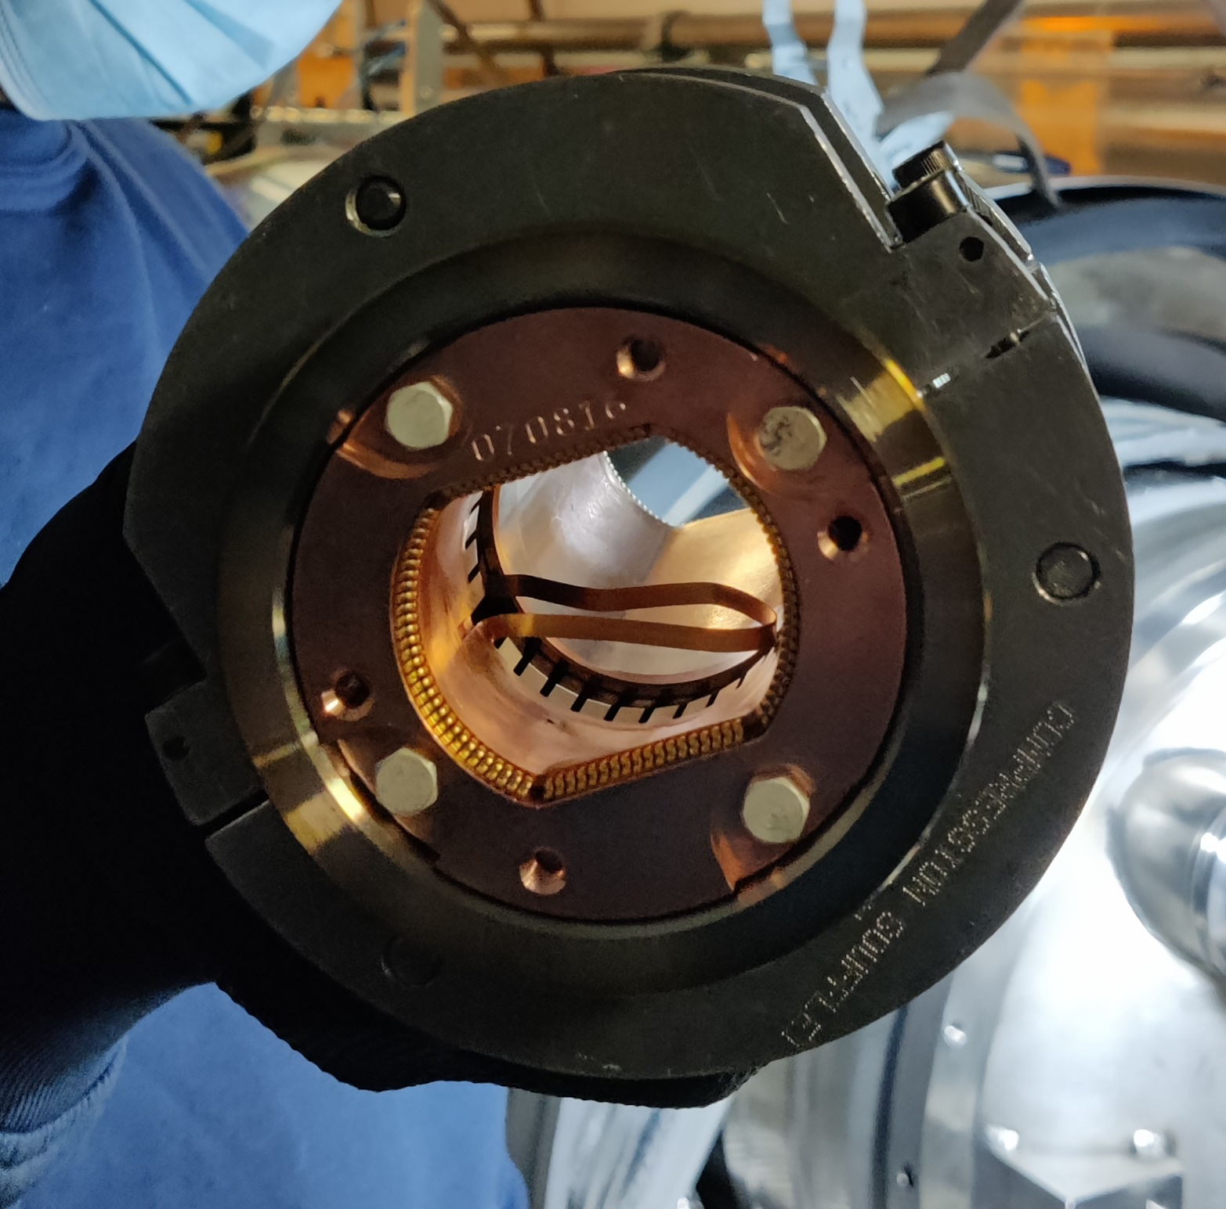
Example: 2021 cooldown
Electrical issue during magnet training
(magnet exchange!)
Earth faults during cooldown
RF contact limiting beam aperture
(beam test outcome)
The cooldown of the LHC sectors after the long shutdown was far from ideal:
2 sectors had to be warmed up after partial cooldown due to earth faults.
Known issue of moving busbars scratching on a sharp edge, concerned circuits are continuously monitored during cooldown.
2 complete thermal cycles following electrical problems on dipole magnets after training quenches.
1 thermal cycle after short beam test: an obstacle was located within the beam aperture.
LHC remains cold (2K-20K) until mid 2026
Bent RF “finger”
Beam test
Despite RF ball test !

Slide 17
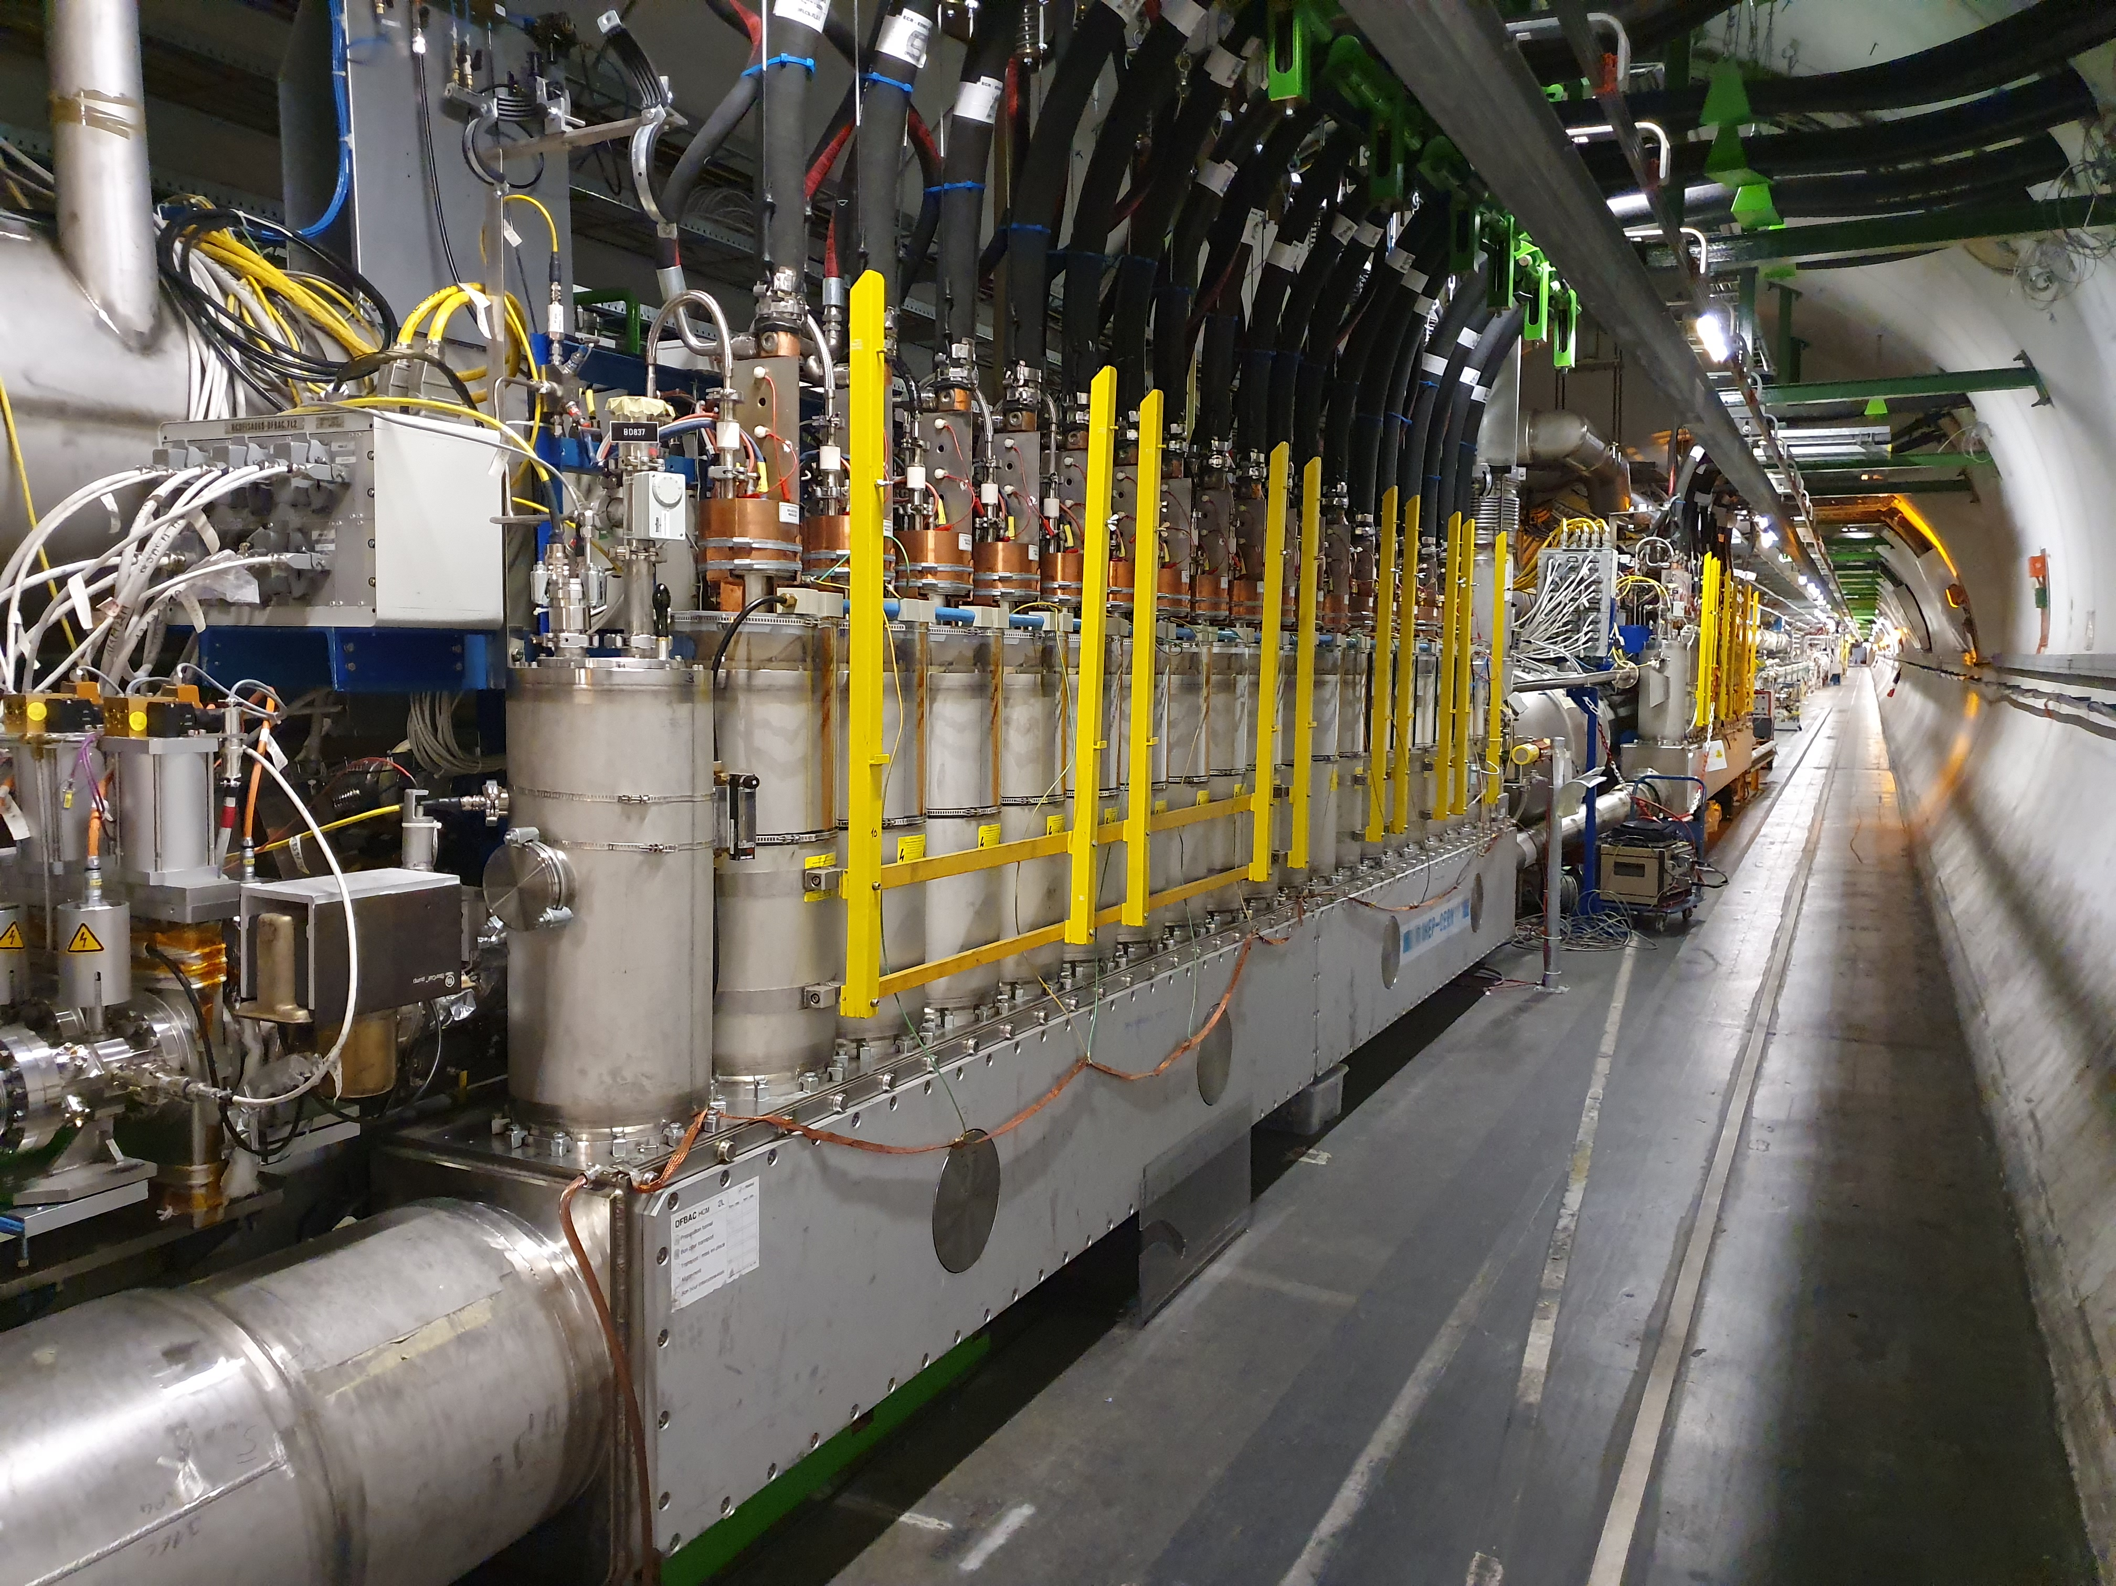
Electrical quality assurance
ELectrical Quality Assurance (ELQA) is an essential activity to ensure the integrity of the superconducting circuits. ELQA concerns:
Magnets and busbars,
Powering feedboxes (DFB) for warm-cold transition,
Magnet instrumentation.
Typical ELQA tests:
Isolation to ground,
Shorts within or between circuits, shorts to instrumentation,
Circuit impedances.
ELQA is performed at room temperature and in cryogenic conditions.
Tests are performed with the cables to the PC disconnected from the circuits.
Some circuits are monitored continuously during cooldown.
Transition 290K to 2K
SC cables to magnets
DFB
ELQA is performed after every shutdown (~15 weeks winter stop, multi-year stops)

Slide 18
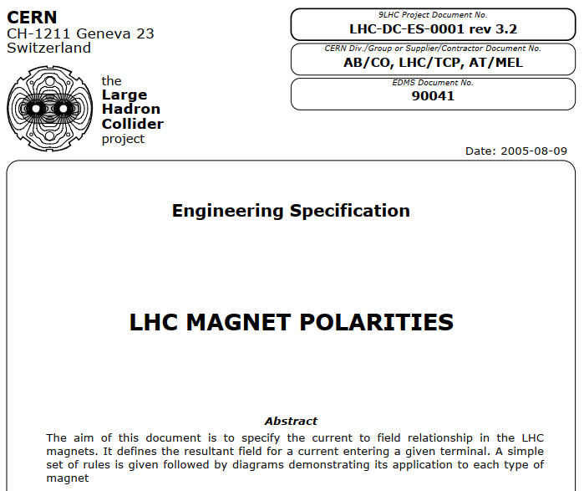
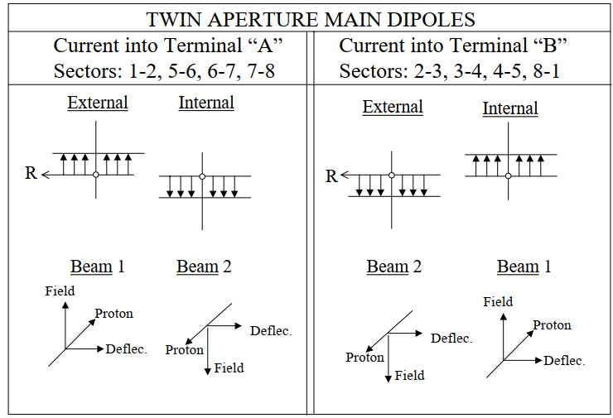
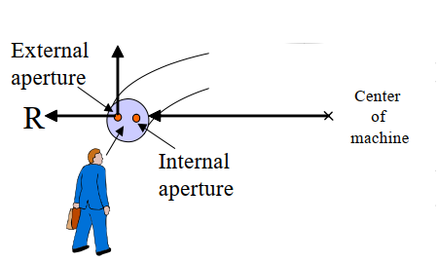
Circuit polarity
Incorrect circuit polarity: a common issue encountered during beam commissioning.
For LHC installation, a “Mr. Polarity” was nominated. His mandate was to ensure that everyone agreed on the “good” polarity for every circuit – from the magnet builders to the operation team.
Complicated at the LHC with counter-rotating beams.
LHC beams alternate between inside and outside chambers (to ensure equal orbit lengths!).
Excellent outcome: only ~3-4 polarity errors were identified during commissioning (out of 1600 circuits) .
But we cannot exclude that isolated higher order correctors (octupole, decapole…) within a string could be inverted.

Slide 19
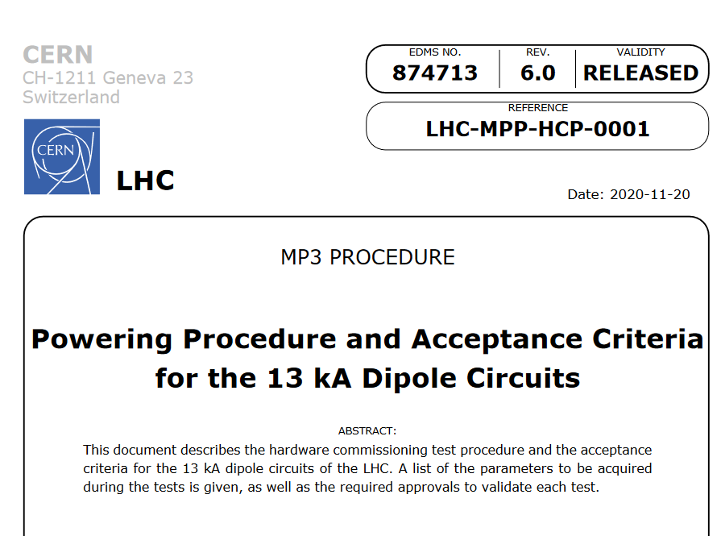
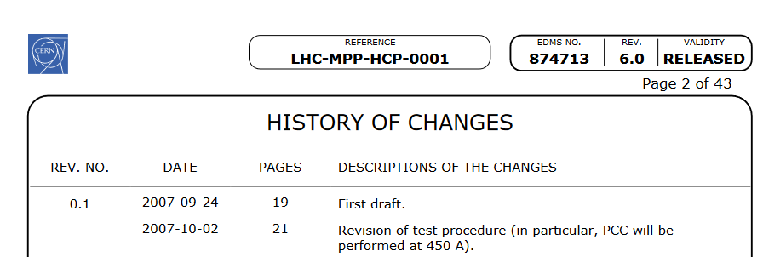
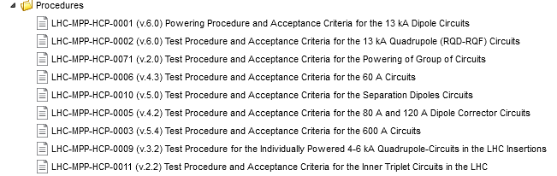
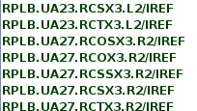
Circuit commissioning
Already for the first commissioning, test procedures were prepared to guide the commissioning.
Approved by all stakeholders.
The documents are updated for every campaign (~year) to incorporate the latest experience → trace back changes to the first commissioning.
From the beginning, it was clear that to avoid mistakes the test sequences must be automated.
1st sequencer version appeared with 1st commissioning.
Initially results were tracked by the commissioning coordinators in exel-like spreadsheets / web page.
Tedious with ~ 20’000 tests for 1600 circuits.
Error prone as circuit names are complex.

Slide 20
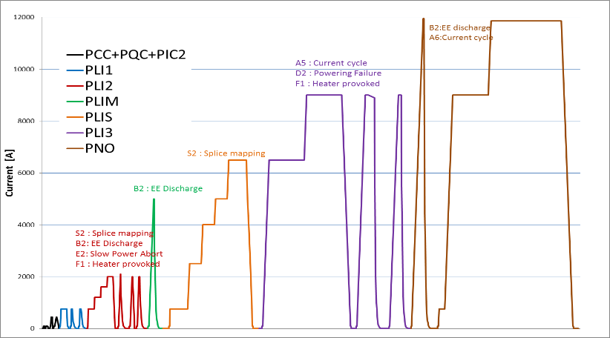
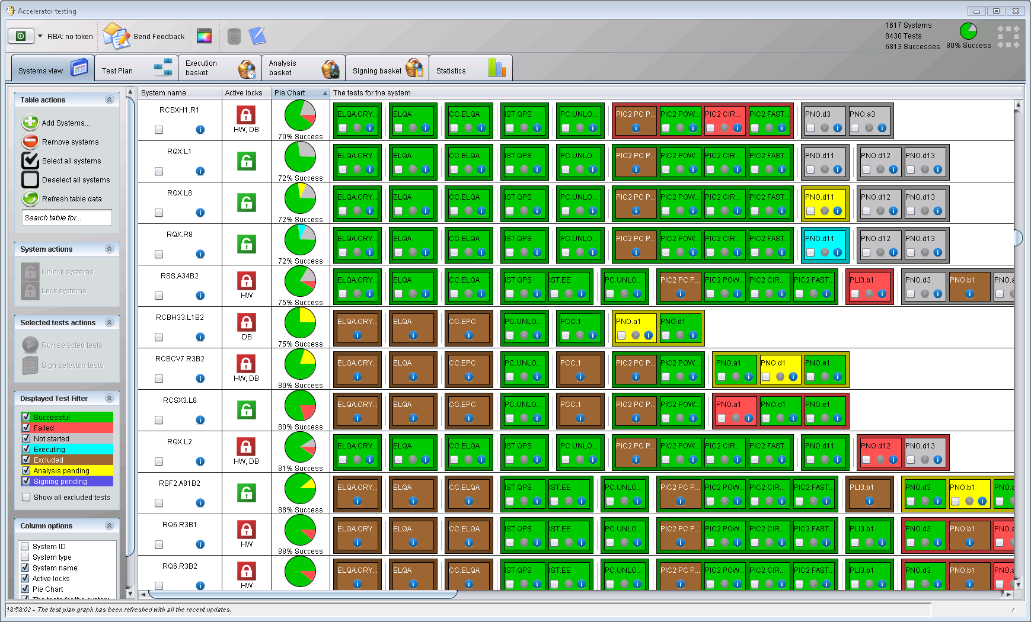
Powering test automation
The testing framework (AccTesting), in operation since 2014/2015,
is based on the approved test sequences,
automates execution of the tests (sequencer running in the back),
integrates signatures for every test (automatic, manual),
tracks results and non-conformities in a DB – no step is missed !
From the EDMS procedure
Test order
encoded in a test sequence
1 block = 1 test

Slide 21
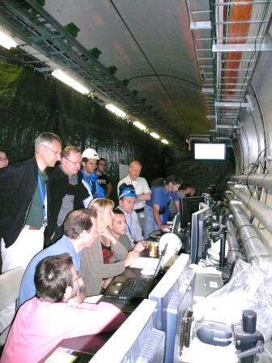
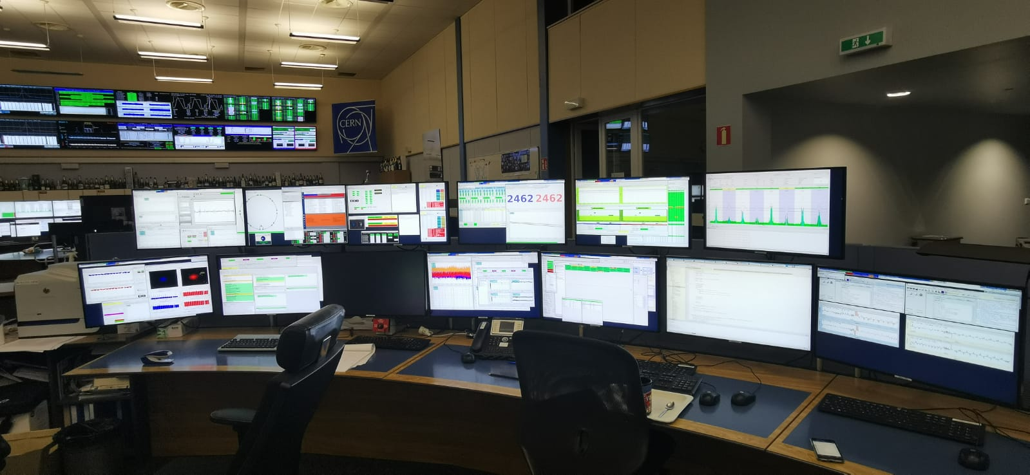
From 2006 to 2024
2006: first commissioning, locally in the tunnel
Many years of experience encapsulated in the testing framework
2024: tests run automatically while the operator is preparing coffee in the kitchen.

Slide 22


Unfortunately: non-conformities
During circuit testing, non-conformities (NC) can be encountered (mainly after a warmup cycle).
Not every NC is “lethal” for the machine → track the acceptable NCs, feed back into the test sequences.
For example: reduced max. current, ramp rate.
At the LHC out of 1600 circuits (status 2024):
12 corrector circuits have been lost.
3 low-beta region correctors (skew sextupole, octupole, …) were lost in a beam injection incident.
~50 circuits have significantly degraded performance.

Slide 23
Introduction – LHC and the CERN complex
Cooldown and circuit commissioning
Equipment checkout towards first beam
Incident
Summary

Slide 24


Software suite for LHC (and more)
Following the shutdown of LEP in 2000, software development started in view of a new control system for the SPS and for the future LHC.
Close collaboration between operation and controls (~60-70% OP, ~30-40% CO).
Some key concepts, including high level parameter control (energy, tune, chromaticity, …) were inherited from the LEP control system (SloppySoft).
The new software suite – LSA (LHC Software Architecture) – was deployed on the new transfer lines TI2 and TI8 (2003+), on the LEIR ion accumulator (2005) and finally on the SPS and LHC (2006)
LEP SloppySoft mid 1990’s
LHC LSA
2024

Slide 25


Controls for first commissioning
The development of the operational applications that rely on LSA as a central settings service was driven (and largely also written) by the operation group.
Ensure that all essential functionality is available for first beam.
In the early days of LHC, many actions were done with low-level control because there was no time to complete all high level applications.
FESA Navigator
Two key low-level tools: EquipState and the FESA navigator were the op crews’ best friends in the first year(s).
They can do everything,
But we also accidentally quenched the machine with them (mis-manipulation).
EquipState (survived from LEP)

Slide 26










Test, test, test !
In parallel to commissioning of the circuits, OP driven systematic checkout effort with regular integration tests and dry runs (2007-2008).
Systems split up among OP crew.
Lightweight internal coordination of activities.
Injection and extraction
Transfer lines
RF
Timing System
Beam Interlock System
Collimators
Vacuum
Beam instrumentation
Beam dump
Magnetic model
Sequencer
Controls, data logging
Optics model, steering
…

Slide 27




Early beam commissioning
While equipment commissioning was ongoing in some sectors, first beam activities began in August and September 2008
Injection tests of up to 4 adjacent sectors.
Essential and early checks for:
almost all HW systems.
the control system.
beam instrumentation.
optics (magnetic model) and aperture.
22nd – 24th of August
First beam trajectory
8th – 10th of August
5th – 7th of September
Evening of August 8th 2008:
First beam in the LHC after ~25 years of design and construction.

Slide 28

LHC doomsday – Earth eating black hole creation
Following a scenario that already affected RHIC at BNL, there were attempts in the USA and in Europe to halt the LHC based on the risk of micro black hole creation leading to a destruction of the planet.
Fears were widely publicized in newspapers.
Study by theoretical physicists excluded that risk.
Federal lawsuits in the USA and lawsuits in Europe were dismissed.
At CERN:
The shift crews received phone calls at night urging them to stop operating the machine.
Around the time of startup, a parcel was found at the entrance to the CCC warning that the next delivery may be more harmful (it fortunately never came).
Security was reinforced at the CERN gates.

Slide 29


A control room? A mad house ! First beam @ LHC
Great shows if they are successful, but when they fail…
The LHC incident happened 9 days after this event !
September 10th 2008

Slide 30



Preparation payed off !
Courtesy of CMS
Both beams were threaded around the ring in ~ 2 hours.
Then the 1000 guests and the press left…
With first estimates for tunes, chromaticity (tune spectrum) and orbit correction on a few turns, the beams circulated 40+ turns before debunching made measurements impossible.
Early evening: both beams were captured and circulating !
“Splash event” on collimators
Tunes
Closed orbit ring 2 – 08.09.2008 @ 20:16
Longitudinal profile turn by turn (RF off)

Slide 31
Introduction – LHC and the CERN complex
Cooldown and circuit commissioning
Equipment checkout towards first beam
Incident
Summary

Slide 32


The incident
September 19th, 9 days after first beams, magnet interconnections became a hot topic for many years
Major quality control failure !

Slide 33




A badly welded interconnection
During the LAST test of a sector, an electrical arc in a non-conform interconnection (bad soldering) triggered a Helium pressure wave that damaged ~700 m of beam line and polluted the vacuum chambers over more than 2 km.
Arcing in the interconnection
Vacuum chamber contaminated with sooth and insulation blanket debris
Over-pressure
Major impact on LHC:
Beam delayed to November 2009.
Revision of safety rules for personal access in the presence of Helium.
Major upgrade of the quench protection system.
Reduced beam energy during first run.
53 magnets had to be exchanged

Slide 34
The LHC beam energy story
Energy (TeV)
Consolidation of bypass diodes
Consolidation of all interconnections
7 TeV
Design
6.8 TeV
6.5 TeV
Magnet de-training after installation
Energy increase ⇔ no quench at 3.5 TeV
5 TeV
4 TeV
Joint problems,
incident
3.5 TeV
3.5 TeV
Long Shutdown
Consolidation
1.18 TeV
RUN 1
RUN 2
RUN 3
2007
2008
2009
2010
2011
2012
2013
2014
2015
2022

Slide 35





Teamwork
It is not just the technology !
Team spirit within the LHC operation section is a key to success, coupled to smooth interactions between operation and support teams.

Slide 36




All on board
Tradition of yearly workshops to bring together actors across all teams, review the past year and prepare the next year(s).
Very important information and discussion forum.
Emphasis on promoting young or less visible staff / students.
This tradition began with the Chamonix workshops for LEP, resumed for LHC as Evian workshops (now Montreux).

Slide 37
Summary – LHC commissioning
The LHC injector upgrade project was essential to feed the LHC with required beams.
Quality control ! Tends to concern ‘trivial’ / interface items: not looked at in sufficient detail.
Circuit commissioning was rigorously planned and executed, initially mostly “manually”, 10 years later with high level of automation.
Operation team drove the commissioning towards beam together with the circuit commissioning team. Test as soon as you can !
The early deployment of the control system on the existing infrastructure provided a head start for the software development effort.
Regular workshops to reflect on the work done, to plan the future and to foster team spirit.
Stay focused, be flexible, be reactive, remain positive !

Slide 38
Thank you for your attention !

