Slide 1
Early Science
Beam Commissioning
Stephan Reimann
1st FAIR Commissioning Workshop 07.11.-08.11. 2024

Slide 2
Outline
First Beam Event in 2026
Early Science Beam Commissioning in 2027

Slide 3
FAIR commissioning – strategic schedule
new Opportunity for
First Beam Event
2024 2025 2026 2027 2028
Beam Time
Beam Time
⬅ to be decided ➔
Beam Time
Beam Time
Beam Time
FCC Construction & Procurement of Interior equipment
equipment
Installation
move to MCR & commissioning
operation from FCC
Injector Controls Upgrade: 1st version of new production system
Injector Controls Upgrade: finalization
Controls & BI Digitization UNILAC, SIS18, ESR, Cryring, HEBT
UNILAC operation
with new CS
Cryo 2
Commissioning
HEBT-ES HW-Commissioning
Dry-Runs
SFRS HW-Commissioning
ES Beam Commissioning
Dry-Runs
SFRS Cooldown
HEBT-FS HW-Commissioning
Dry-Runs
SIS100 HW-Commissioning
FS Beam Commissioning
Dry-Runs
SIS100 Cooldown

Slide 4
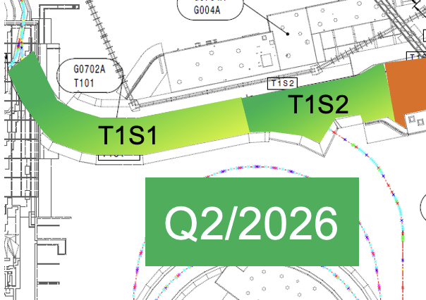
Options for staged Beam Commissioning
T1S1 and T1S2 are in commissioning phase 2-3.1
since Q2/2026
GSI-Beam is available in Q4 2026
TBI is in commissioning phase 6 since Q1 2026
FAIR Control Centre is in Operation since Q3 2026
→ The proposed shift of 2026 beamtime
opens a new window for a first beam event
Option 1: first beam event in NE1 on GSI-site in Q4 2026
Option 2: first beam event in NE1 on FAIR-site in Q4 2026

Slide 5
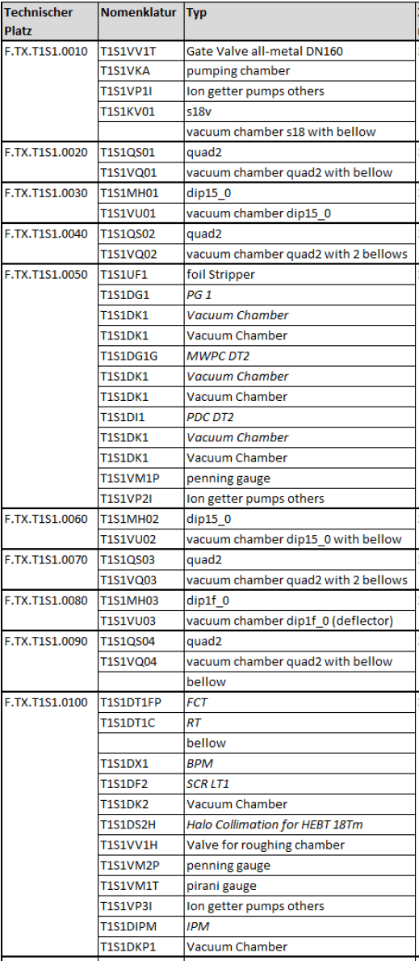
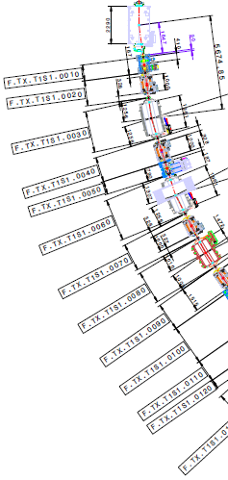
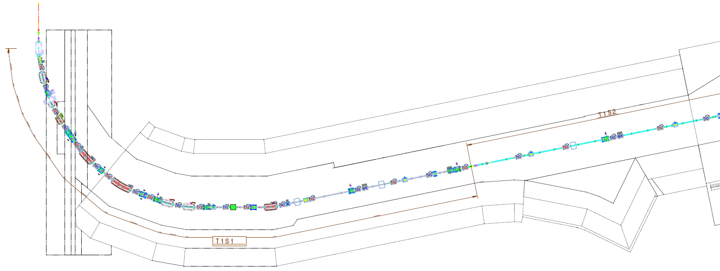
Option 1: first beam event in NE1 on GSI-site in Q4 2026
GSI/FAIR
border
beam from
SIS18
Possible Targets
T1S1DG1G (Profile Grid) on tech. position 50
T1S1DF2 (Scintillator) on tech. position 100

Slide 6
Option 2: first beam event in NE1 on FAIR-site in Q4 2026
GSI/FAIR
border
beam from
SIS18
Possible Target
T1S1DF6 (Scintillator) on tech. position 330 before las bending magnet
last bending magnet
NE1 NE22

Slide 7
Why
focus on a SMART goal
practice roles in commissioning phase (coordinator, responsible, WPLs, STV)
practice commissioning organisation and processes
practice interface to FSB (working permits)
test technical building infrastructure with load under realistic conditions
the final acceptance of at least one system of each type in HEST
lessons learned for ES Beam commissioning in 2027
morale boost for our colleagues
positive signal to shareholders, to the research community and to the public

Slide 8
to be clarified
Operation permit for NE1 on FAIR Site → SRP
Additional Shielding necessary? → SRP + SMG
Luminous target T1S1DF6 with nice FAIR-Logo? → BEA
Discussion

Slide 9
Beam commissioning HEBT – step 1
First step
favourable before first beam is directed to FAIR – measurement of beam parameters in HEST close to TS1MU1
start with nominal ion optic setting of beamline SIS18-SFRS
start with pilot beam, e.g. Ar, medium energy (12-18Tm), low intensity
use fast extracted beam for first commissioning of beamline
switch off/on HEBT branching dipoles to avoid uncontrolled beam loss in superconducting SFRS magnets
beam steering element by element (+ check functionality of beam diagnostics during this step)
beam will be dumped on SFRS beam catcher
F. Hagenbuck

Slide 10
Beam commissioning HEBT – step 2
beam reaches SFRS beam catcher
kick response measurement
aperture scan
measurement of dispersion
beam optimization (with beam as required by SFRS) to ensure hand over parameters for SFRS
F. Hagenbuck

Slide 11
Beam commissioning SFRS
goal of beam commissioning (coarse):
test beam instrumentation
check, measure ion optic parameters
establishment of a “commissioning working group” to discuss exchange ideas on the topic (SFS/SFC)
beam requirement:
SIS18 slow extraction, 1 to 5 s
12 to 18 Tm
light to medium and then heavy ➔ example Ar, Sn and Pb/U
1e4 particle per spill to 1e8 particle per spill (end of commissioning highest intensity possible)
we could (low probability) have to go back to lighter
for final beam commissioning: 238U (or agreement with NUSTAR)
if sharing, and everything works, block mode
beam emittance requirement on the final beam instrumentation tests and for ion optic
S. Pietri

Slide 12
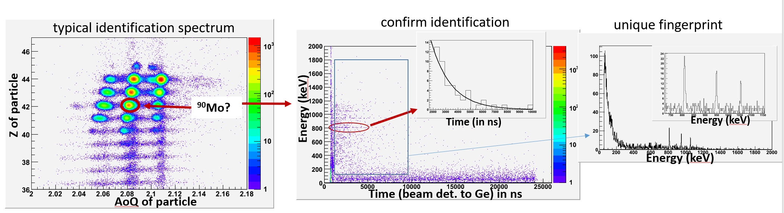
End of beam commissioning
Check identification from Spectrometer with Isomer Tagging
request to NUSTAR to provide a setup for this
S. Pietri

Slide 13
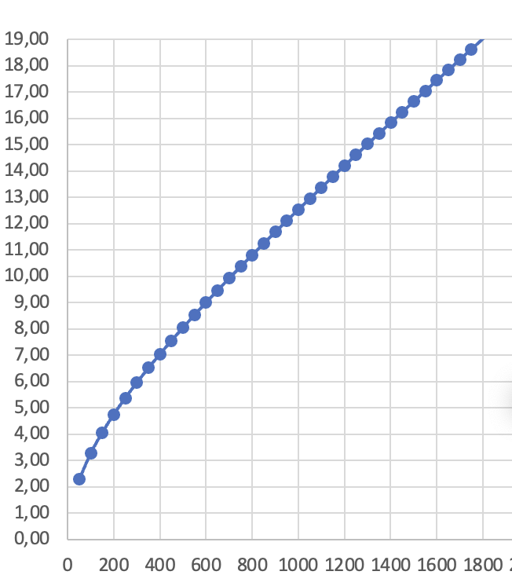


Beam Commissioning ES - 2027
Beam Parameter for first beam commissioning:
  ⁴⁰Ar¹⁸⁺-Beam from high current injector for first
  (very stable, easy to maintain, medium RF levels)
  Extraction Mode:
    starting with fast extracted beam for HEBT
    subsequently Rf-knock out extraction (cycle time 1-5s)
  Pilot beam: Intensity about 1E8 per cycle
  (or minimum needed for instrumentation to be detectable)
  Final acceptance: ²³⁸U⁷³⁺, 2E9 ions per cycle, Rf-knock out extracted
fist beam event to T1S1
beam commissioning of HEBT towards SFRS beam catcher
beam quality check
handover to SFRS for beam commissioning
check identification from Spectrometer with Isomer Tagging at NuSTAR-Cave
⁴⁰Ar¹⁸⁺
$$Bρ/Tm$$
$E$/u

