Slide 1
Super-FRS hardware commissioning
Preparation, Status, Schedule and Resources
Stephane Pietri, SFS

Slide 2
Super-FRS Commissioning
Some introduction
Sectioning
Systems
Status of planning
Next steps
Thoughts for the next phases

Slide 3
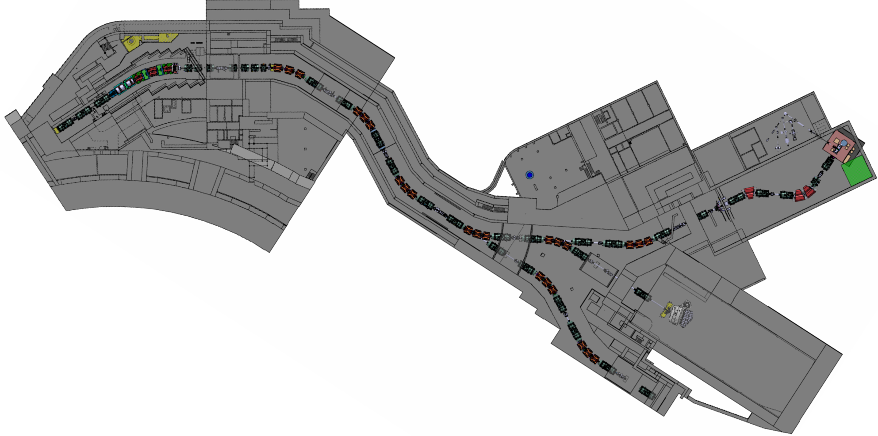
Super-FRS – general overview
Pre-separator
Supply building,
lab, control room
Low Energy Branch
not ES
Target area
Pre-target
Focusing system
FHF2, HEB cave,
R3B NUSTAR
Super-FRS stands for
Super FRagment Separator
Super for super conducting
Main separator
Ring branch, not ES

Slide 4
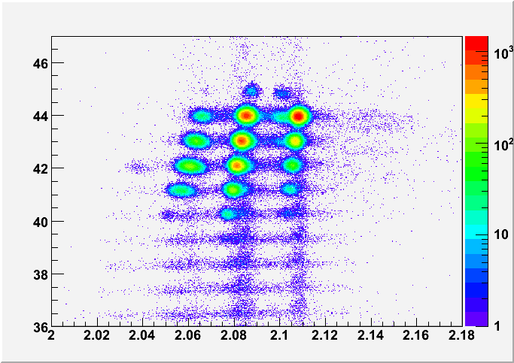
Objective of Super-FRS commissioning
Main goal of Super-FRS: select and identify ions produced in nuclear reactions at the target.
Final goal of the Super-FRS commissioning: show we can select and identify ions with it.
Confirm something like
this ➔
Z of particle
Data from
FRS
AoQ of particle

Slide 5
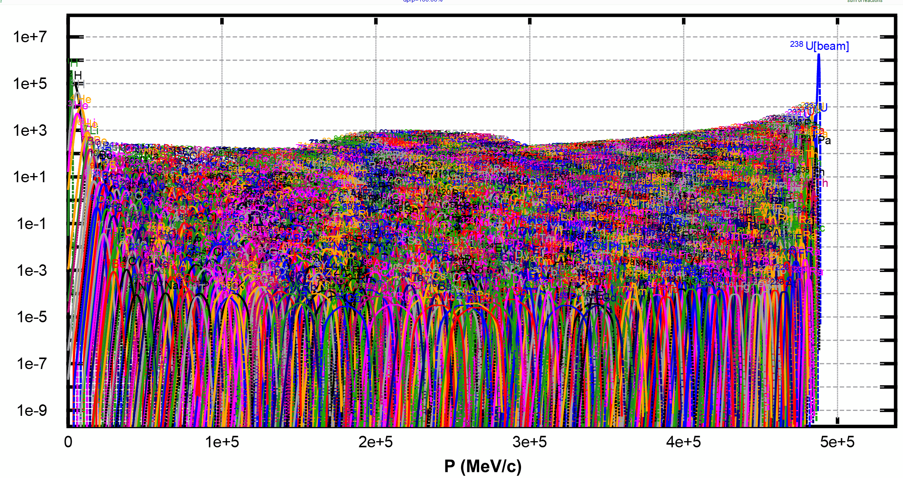
Super-FRS: Super FRagment Separator
²³⁸U from SIS18 on target to produce ²¹²Pb, ²³⁸U+¹²C@1 GeV.A ➔ ²¹²Pb
This is what is produced
at the target (yield)
3000+ isotopes
we need to select
the one we want

Slide 6
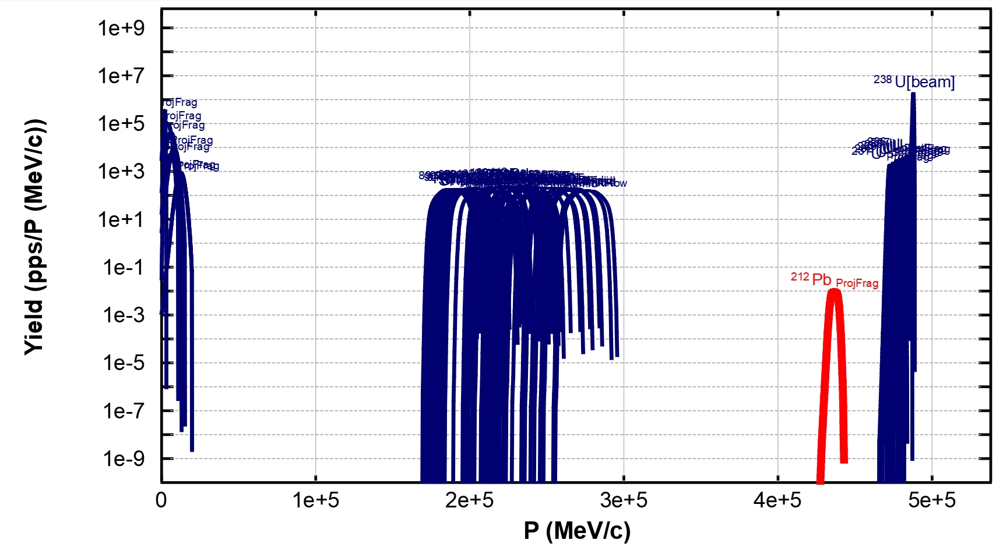
Super-FRS: Super FRagment Separator
²³⁸U from SIS18 on target to produce ²¹²Pb, ²³⁸U+¹²C@1 GeV.A ➔ ²¹²Pb
50 most produced ones
➔ red is ²¹²Pb

Slide 7
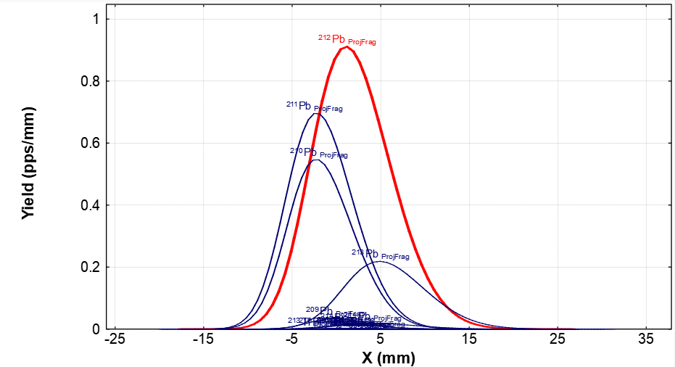
Super-FRS: Super FRagment Separator
²³⁸U from SIS18 on target to produce ²¹²Pb, ²³⁸U+¹²C@1 GeV.A ➔ ²¹²Pb
At HEB after selection

Slide 8
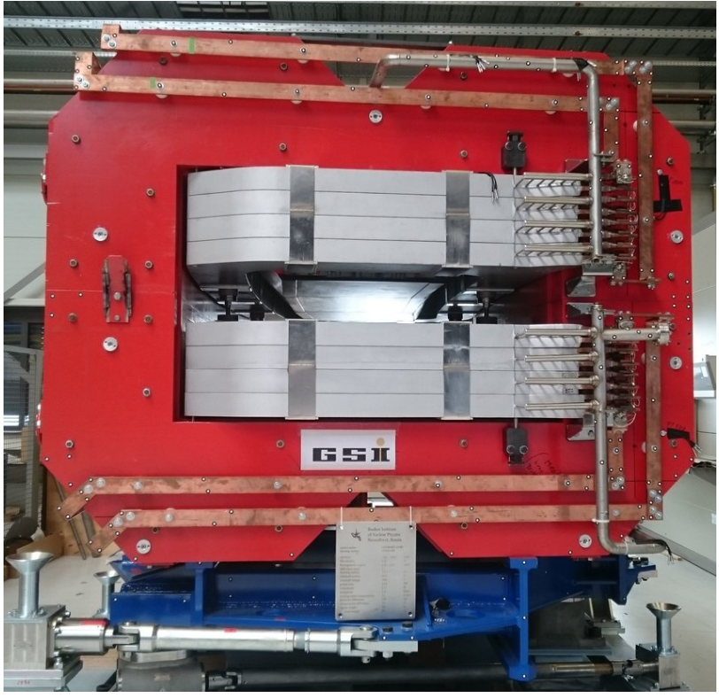
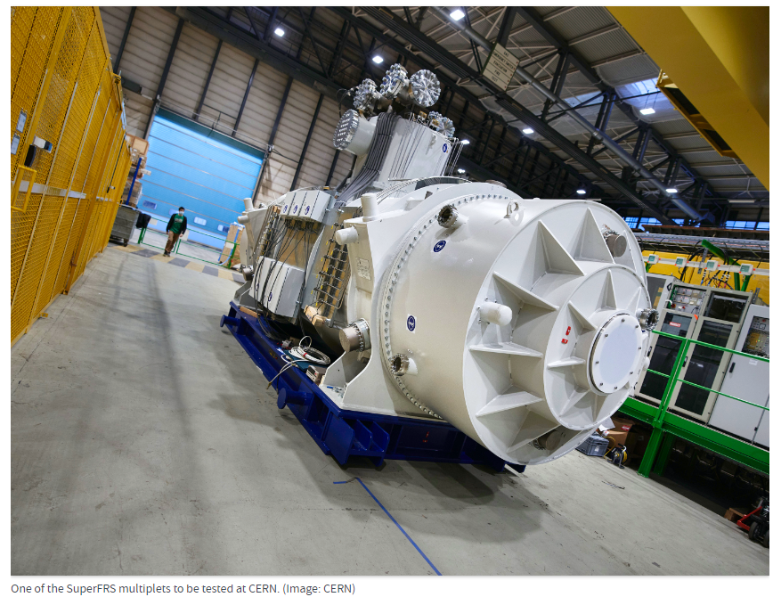
Magnets – size and constrain
Need large magnets to accept as much in momentum (40 cm openings)
This means the inductance is quite high (good for machine protection…)

Slide 9
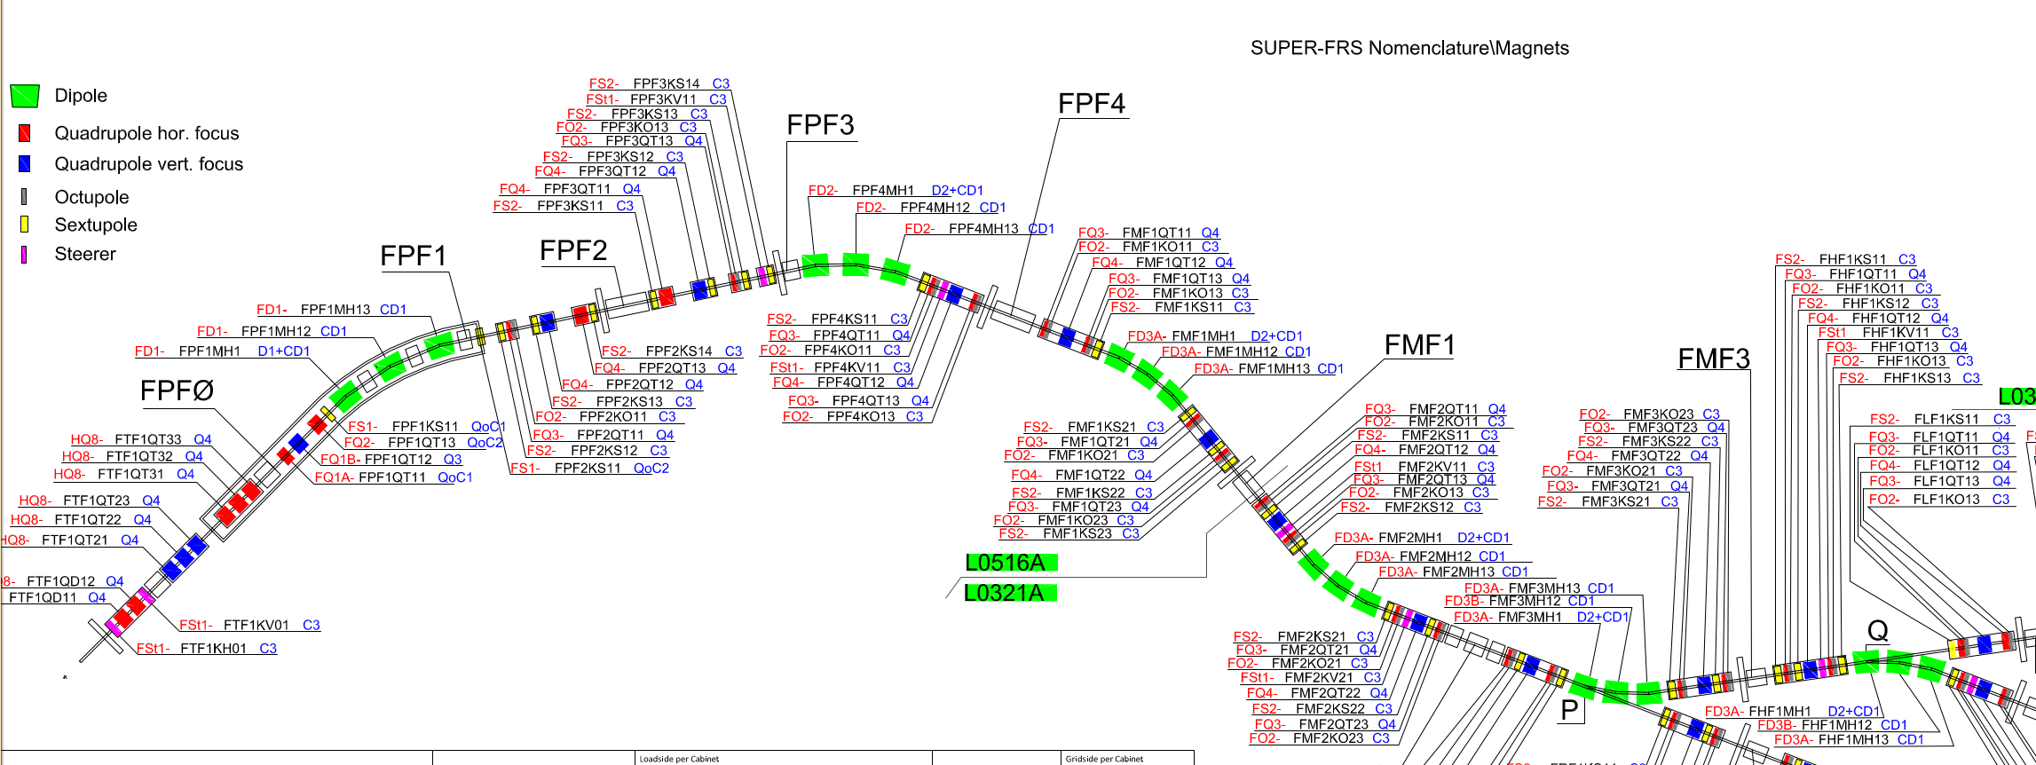
Magnets – size and constrain
Need large magnets to accept as much in momentum (40 cm openings)
This means inductance quite high (good for machine protection…)
This means need more order correction – quite a variety of multiplet

Slide 10
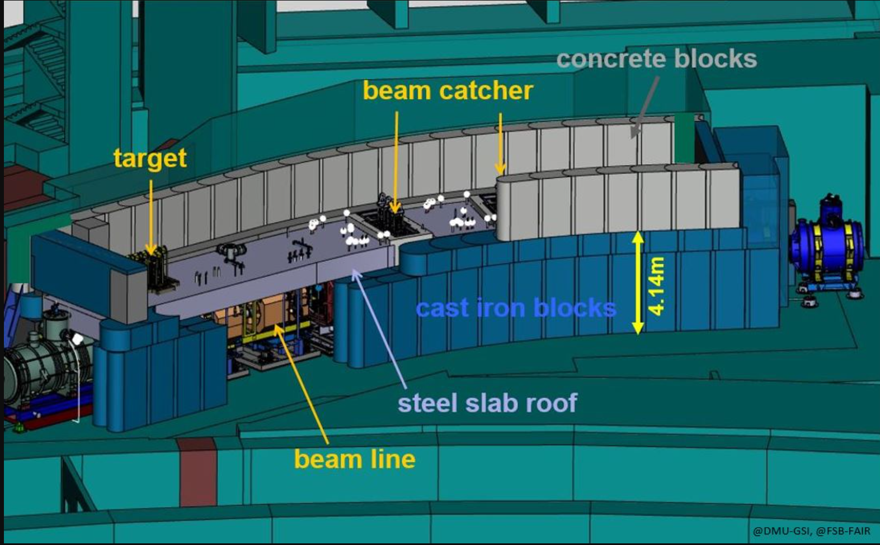
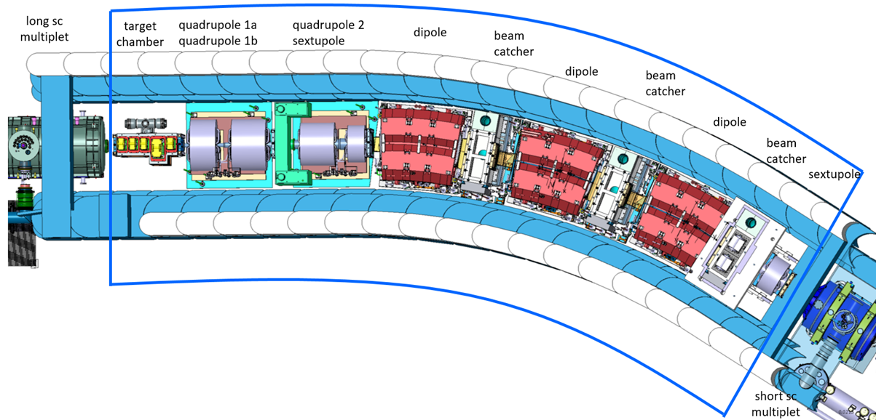
Complexity due to target
high radiation, target complexity
all elements encased in a
steel “sarcophagi”
limit access, only one vacuum
section
this is special for
commissioning and installation

Slide 11
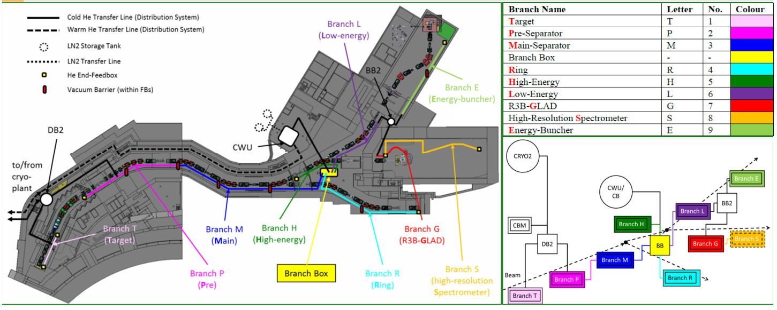
Complexity due to cryogenics
Cryogenics distribution not based on functional sections
Local cryogenics: depends on general cryogenics and deliveries
Phase 2 commissioning Super Conducting Magnets after local cryogenics commissioning
Dependency:
➔Magnet commissioning
phase 2 after cool down
per section
but P/M/H cooled
down at once

Slide 12
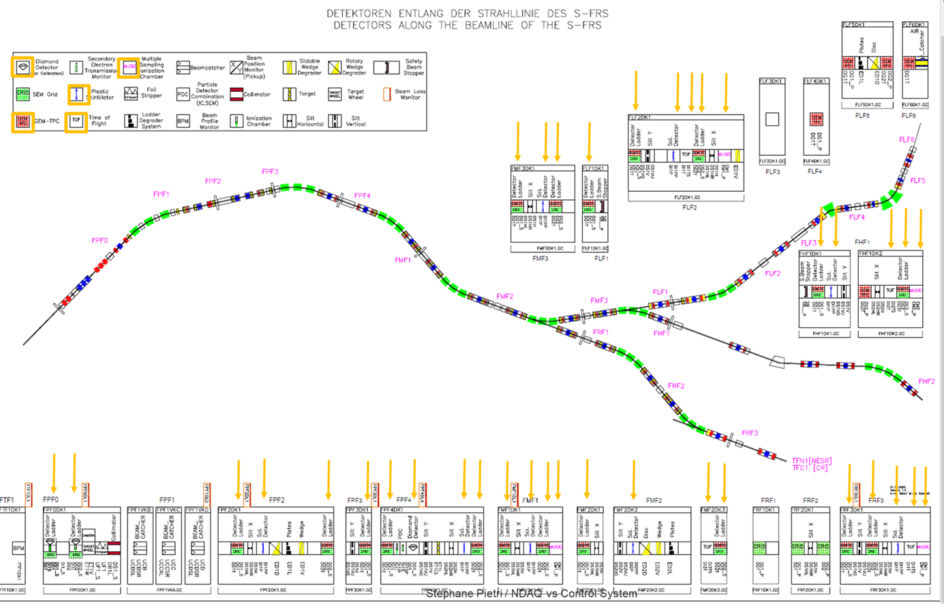
Complexity due to detectors
Main goal of detectors in the spectrometer: identification particle per particle for the experiments (detectors part of experiment)
Detectors needed also for:
  beam steering
  characterization of ion optics
  intensity monitoring
Constrain: size of focal planes
➔ heterogeneity of focal planes
Note: detectors in yellow are read
out with experimental acquisition,
separate network

Slide 13
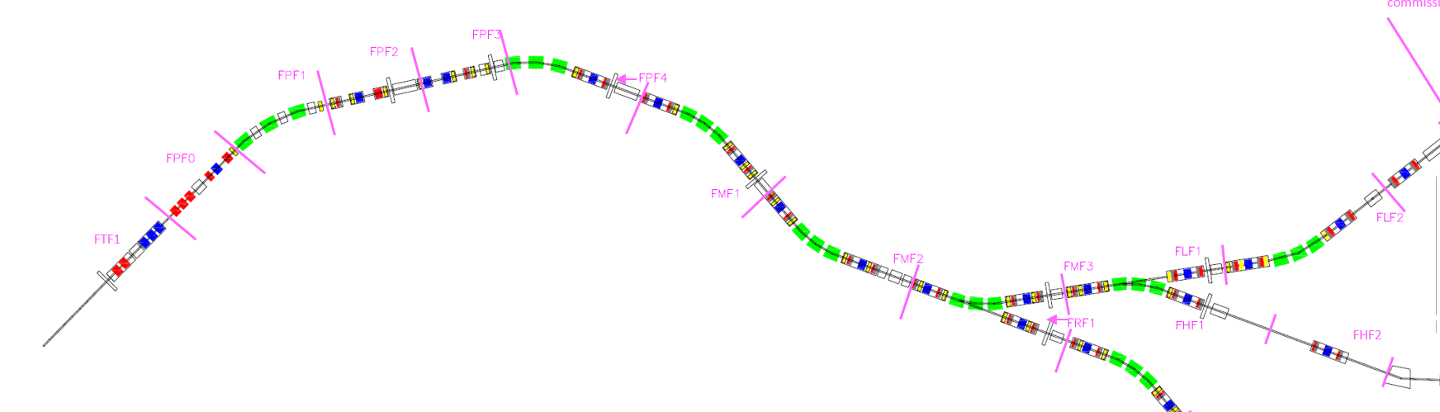
Scope (elements) of commissioning
Goal commissioning: reach FHF2 (commission the full HEB line)

Slide 14
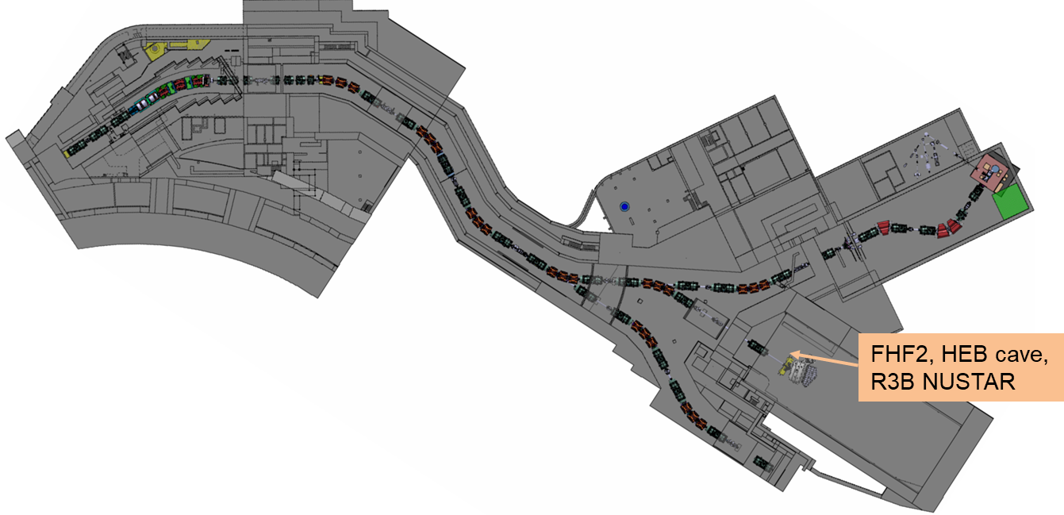
FHF2

Slide 15
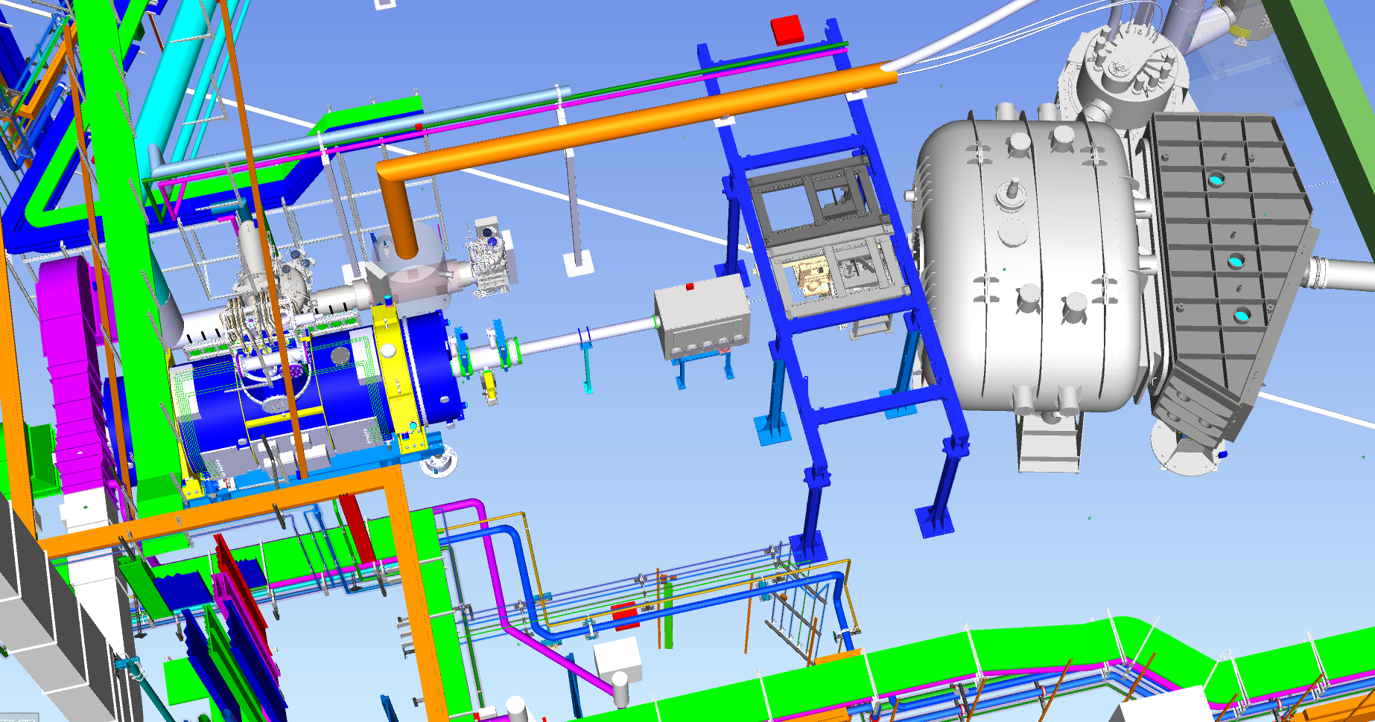
Commissioning include last multiplet at FHF2
FHF2 is in HEB, in front of the R3B experiments
SFRS multiplet
beam reach here during SFRS beam commissioning

Slide 16
Commissioning phases, sections goal
Need sectioning to breakdown the work
Allows to plan parallel installation work and/or commissioning work
First idea: functional sections, Magnets then diagnostics
Goal commissioning: reach FHF2 (commission the full HEB line)

Slide 17
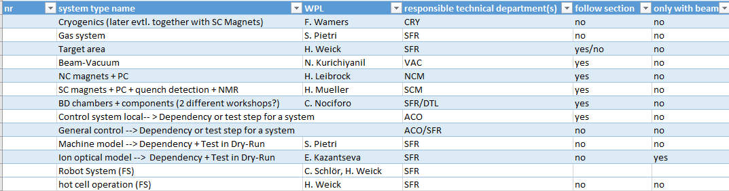
System list
SCM: Super Conducting Magnets
NCM: Normal Conducting Magnets (target area)

Slide 18
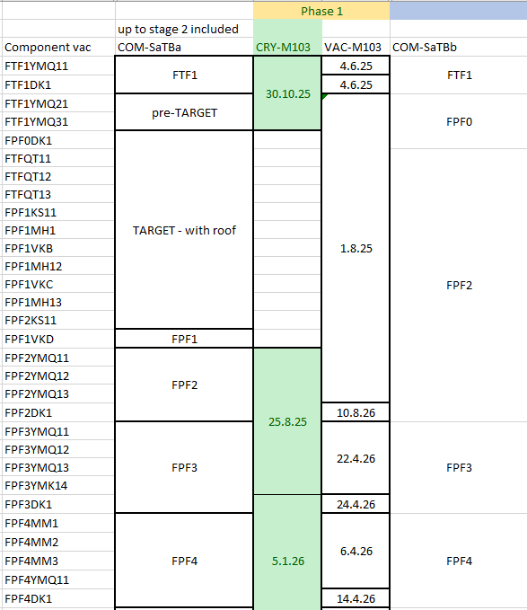
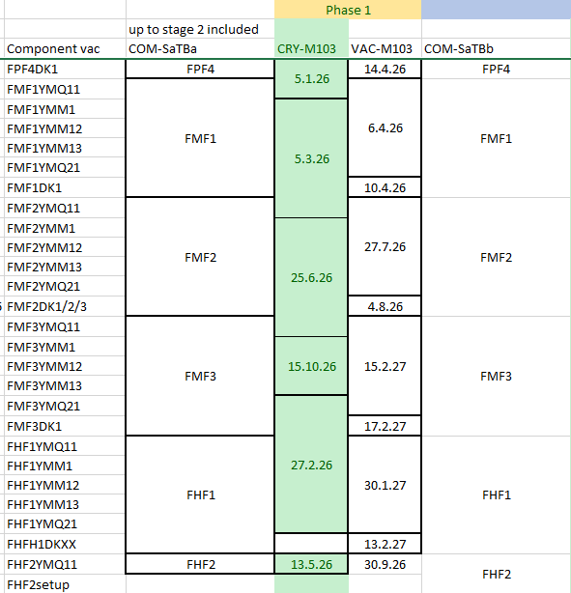
Commissioning phases, sections for phases 1/2 and 3/4
Phase 1 sections different

Slide 19
Phase of commisining
Phase 1: hardware commissioning (after mechanical completion)
Phase 2: remote commissioning
Phase 3.1: integration test
Phase 3.2: dry run (SAT Ba/M11)
Phase 4: beam commissioning (SAT Bb/M12)
          (note, beam can be reasonably high intensity at the end)

Slide 20
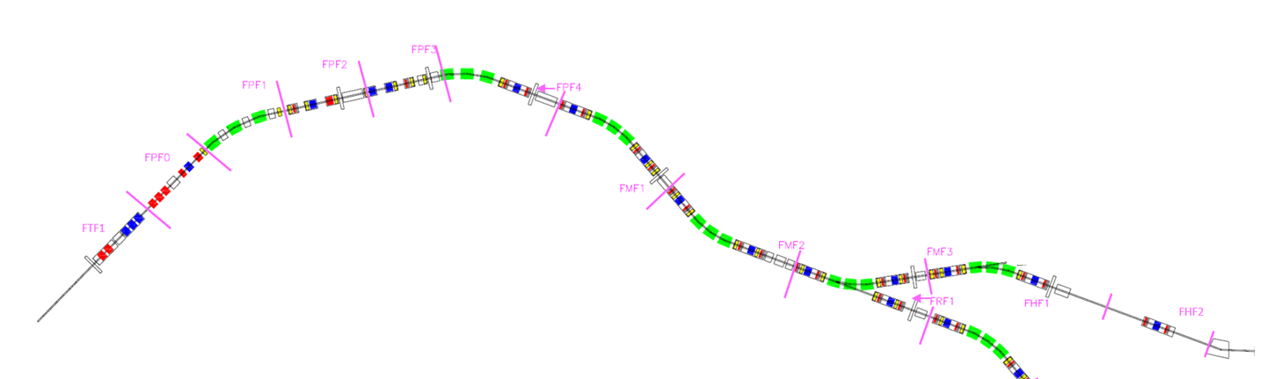
Commissioning phases, sections
for phase 1 (local) and 2 (remote):
  component in sections following assembly unit
  vacuum and cryo own section
  special treatment for target area (more on this later)
for phase 3.1 (integration), 3.2 (dry run) and 4 (beam)
  sections are based on functional sectioning (or focal planes)

Slide 21
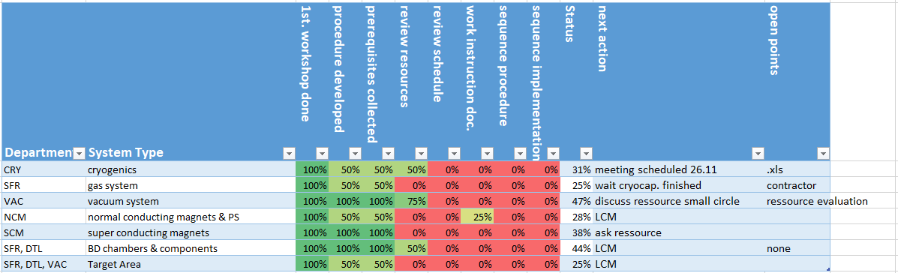

Status of planning - LCM
LCM approach for phase 1 and 2 status (co-organized by M. Cabioch)
clear dependency and requirements
reduced number of people in meetings
goal resource loaded schedule by early spring 2025

Slide 22
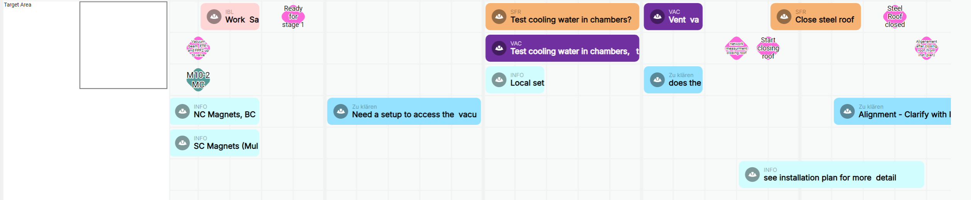
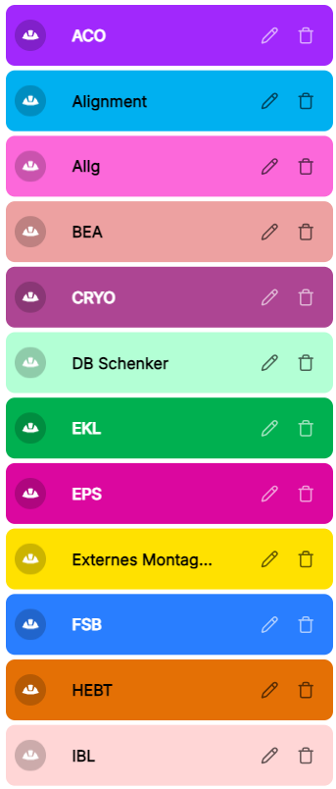
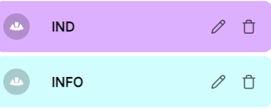
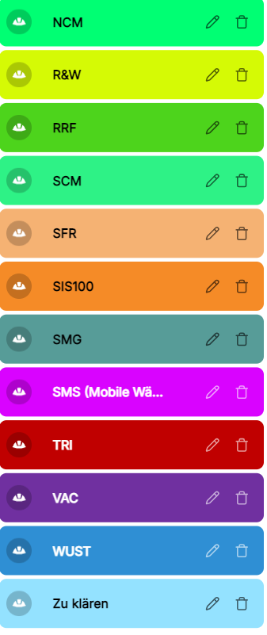
Status of planning,Target area
Example target area

Slide 23
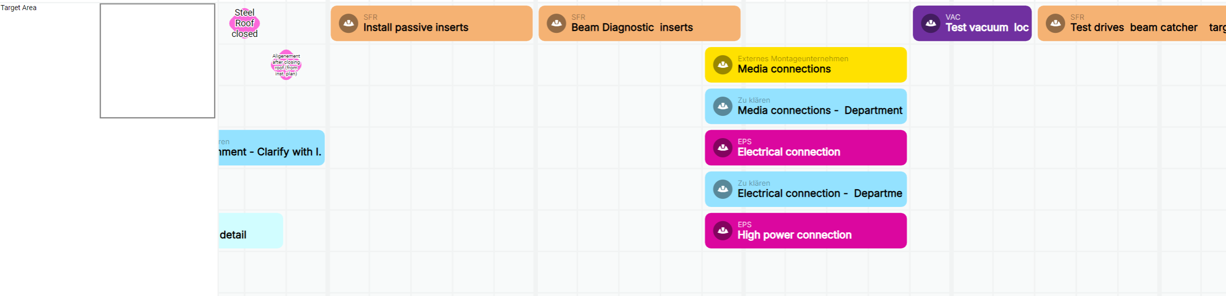
Status of planning, Target area
Example target area

Slide 24
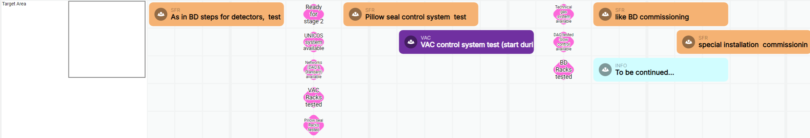
Status of planning, Target area
Example target area

Slide 25
Status of planning, Target area
Example target area
Close steel roof: is a fixed time from
installation planning (many other dependencies)

Slide 26
Status of planning, Target area
Example target area

Slide 27
Status of planning, Target area
Example target area

Slide 28
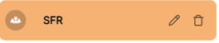
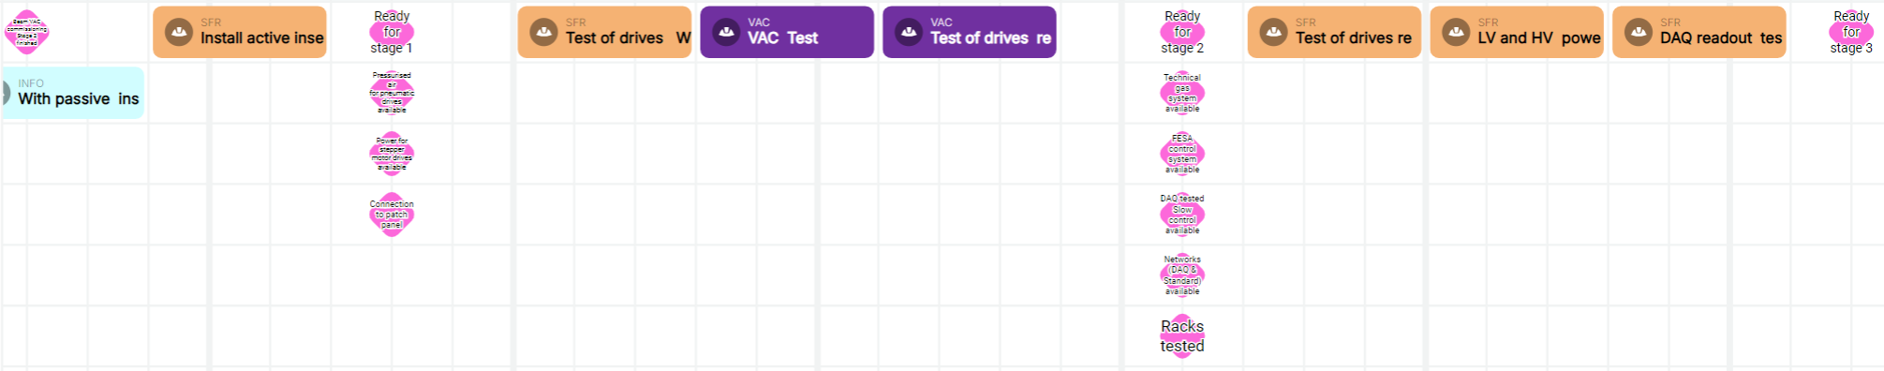
Status of planning, Beam diagnostic chambers
suppose VAC phase 2 done
pressured air, power for motor drive
and patch panel connection
pressured air, power for motor drive
and patch panel connection

Slide 29
Learn from LCM – effect of dependencies on planning
Beam diagnostic need Vacuum commissioning to phase 2 to start phase 1
Super Conducting Magnets needs phase 2 of Local Cryo (and cool down) to do to phase 2
Target area has a long “installation” activity in the middle of its phase 1 commissioning (affects Target area and Normal Conducting Magnets)

Slide 30
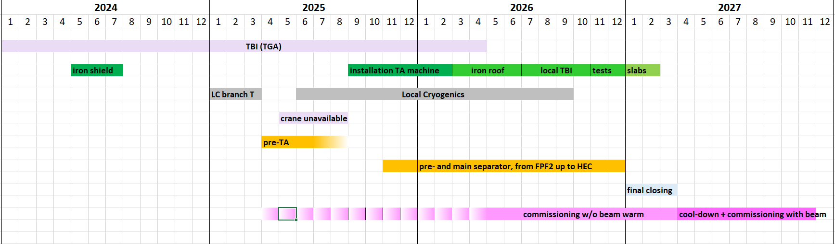
General planning, top to bottom
first planning from installation plan
2024 start installation, 2025 ramp up installation, 2026 finish installation
2025 start commissioning, 2026 ramp up commissioning, 2027 beam commissioning

Slide 31
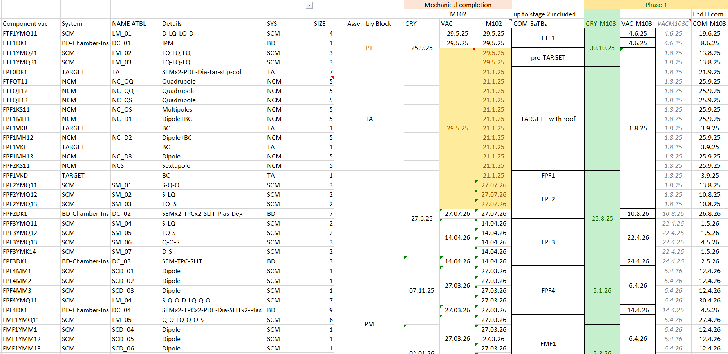
First simulations – toy model
Current planning resource estimate (not fully LCM but taking results into account)

Slide 32
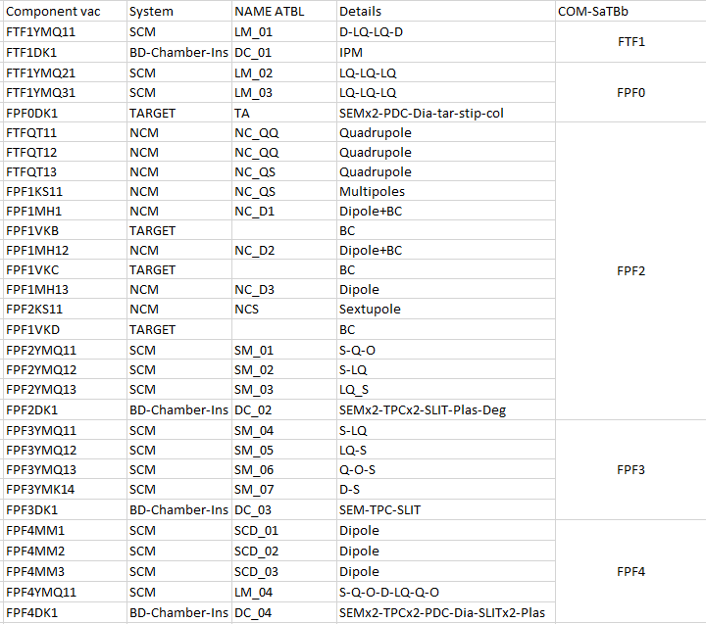
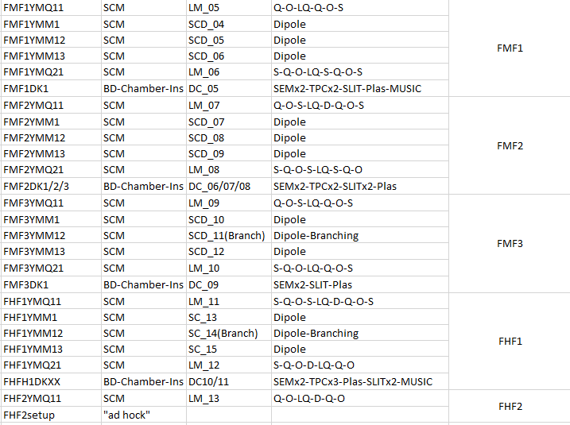
Section, element, complexity of elements
SaTBb is end dryrun

Slide 33
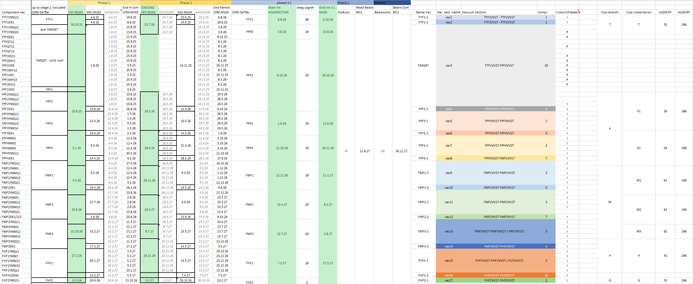
Full .xls document

Slide 34
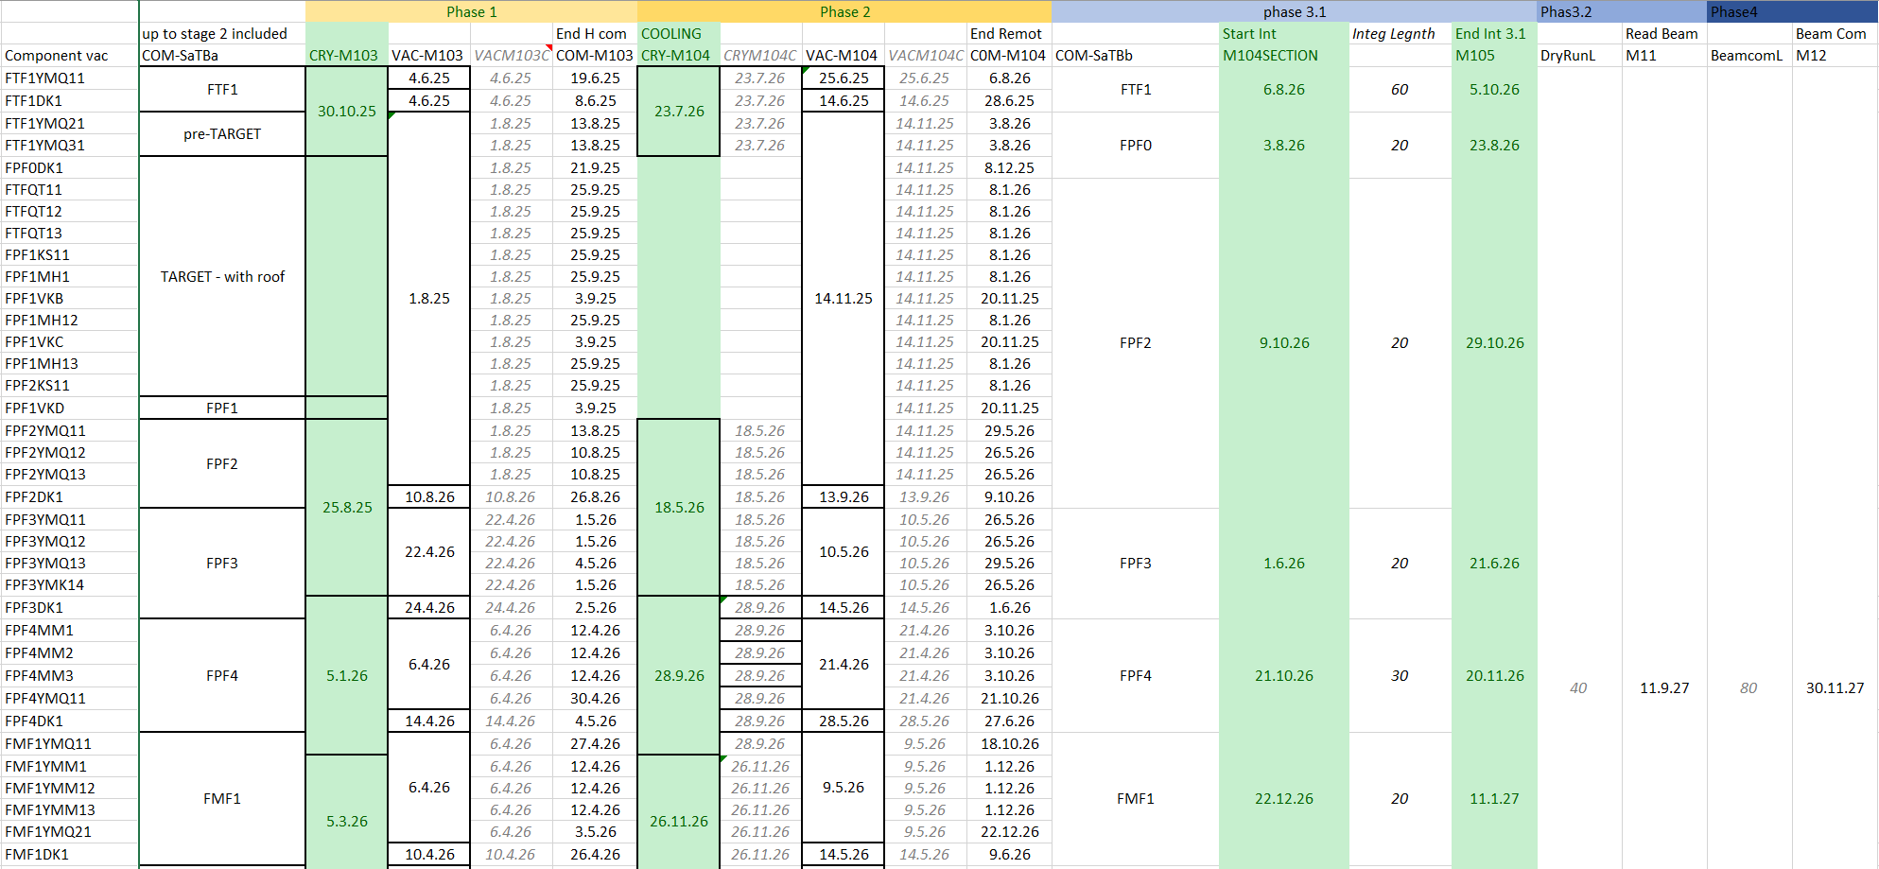
First simulations – toy model

Slide 35
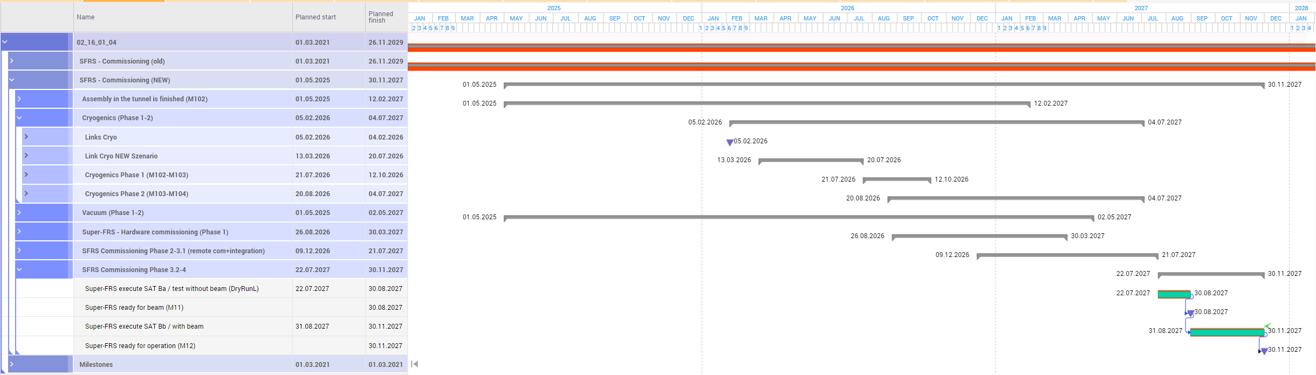
Results in Planisware
Consolidate Planisware, cooling? hypothesis Mar 27?

Slide 36
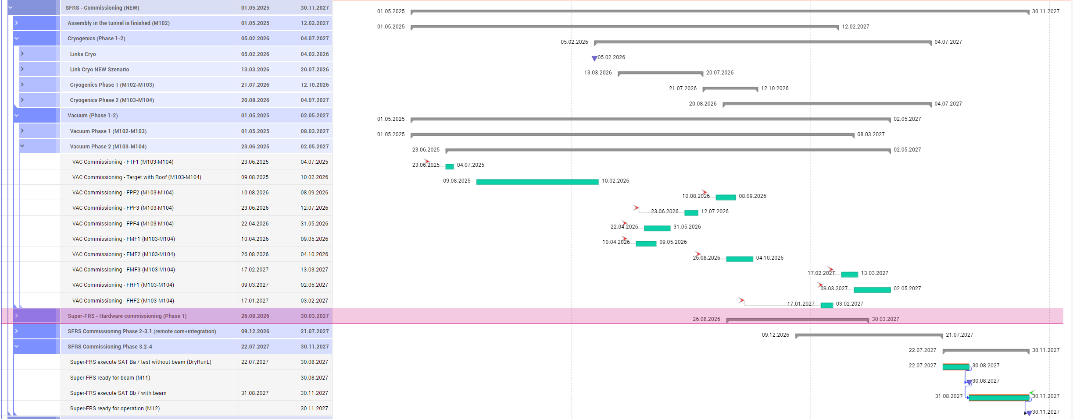
Example of detail

Slide 37
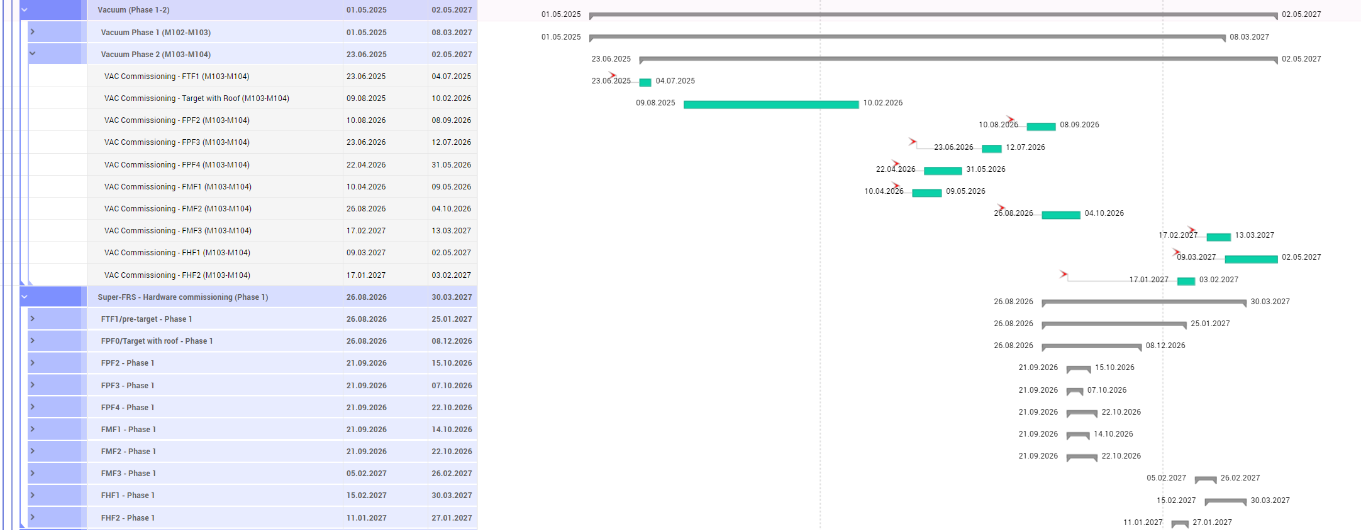
Example of details – vacuum installation
Thanks to Marina Gorda for implementing all the complexity!

Slide 38
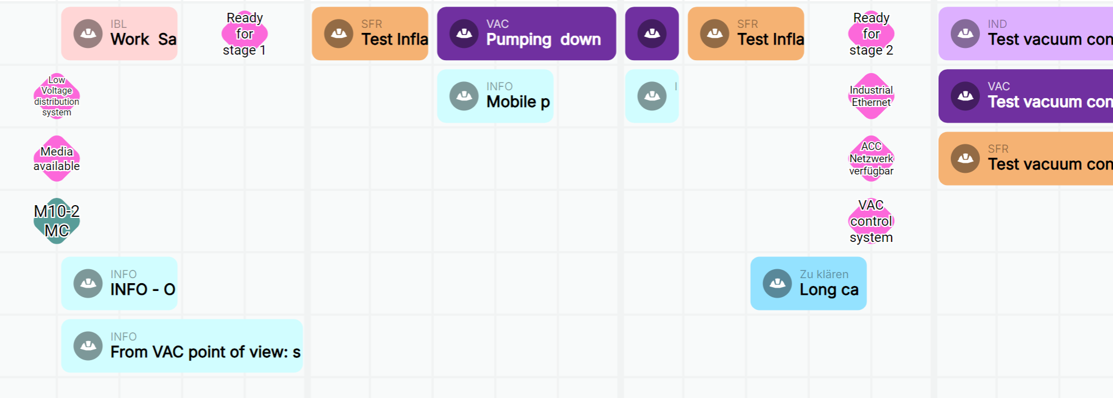
First test of commissioning
Installation started this year, commissioning starts next year
first commissioning: Vacuum pre target area

Slide 39
Future plan, phase 1 and 2
finish the LCM workshop and resource collection
consolidate sequencer operation for commissioning
organize teams for commissioning, hardware (phase 1 and phase 2)
objective : having 2 teams for VAC, SCM and BeamDiagnostic + pool of experts we can pull if needed (eg, collaborators, ext. partners) which can go along the beam line
Target and Normal Conducting Magnets are more localized
Cryogenics organization: under discussion

Slide 40
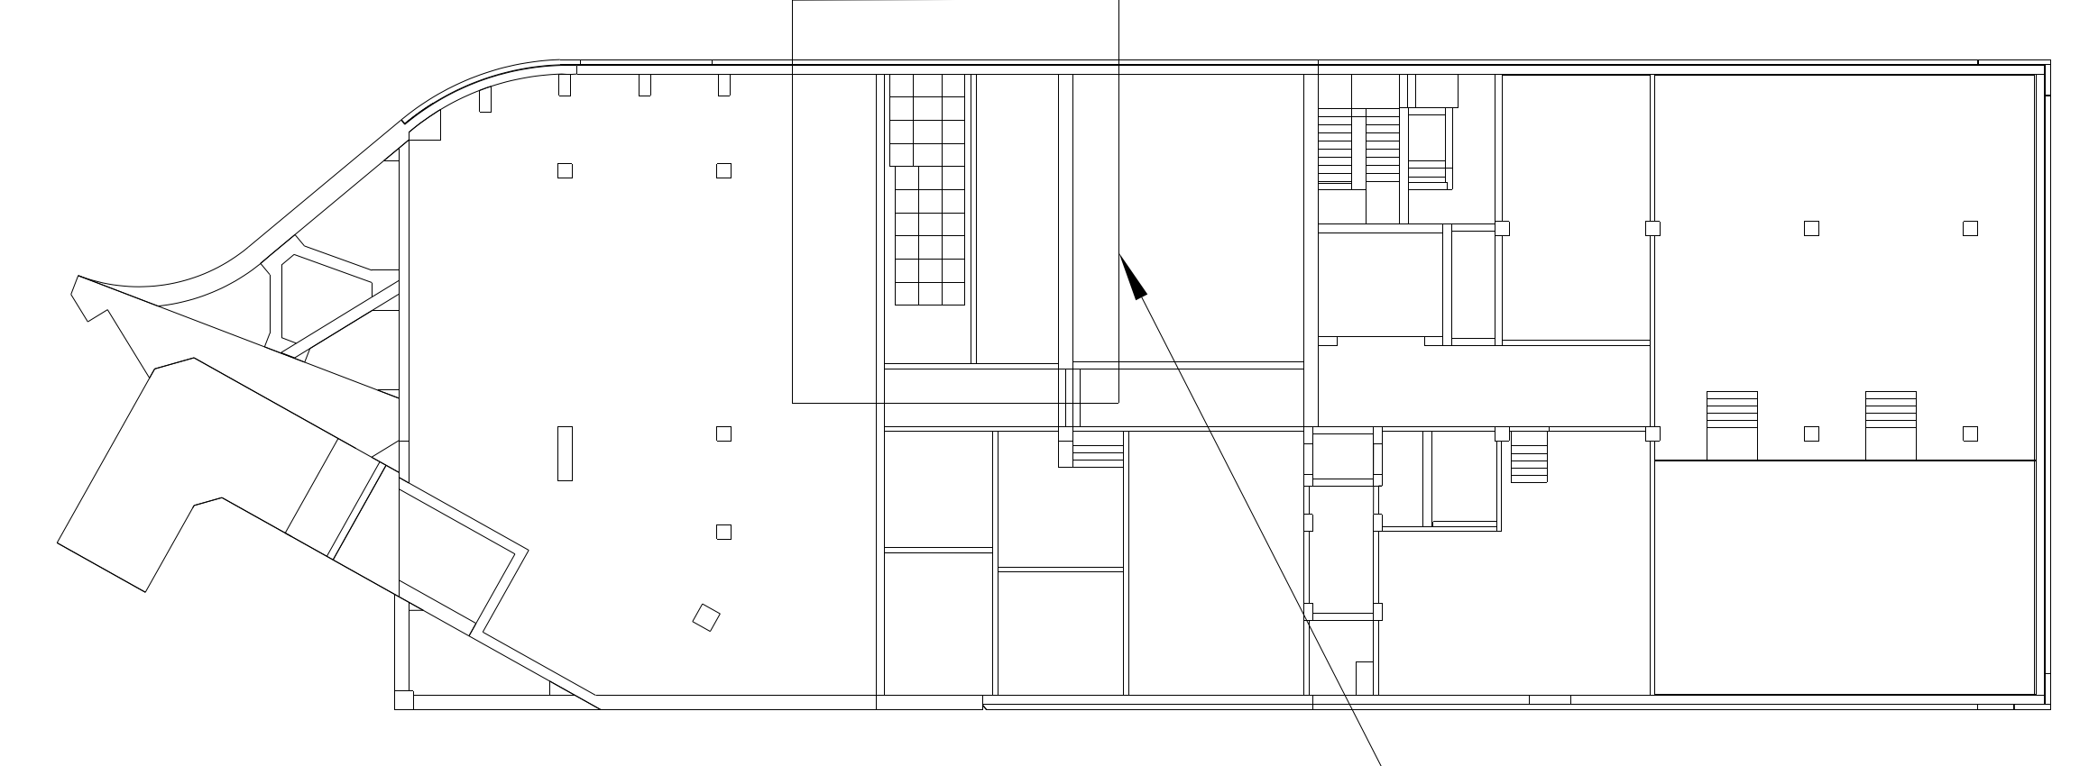
From phase 3.1 to 4
higher level expertise will be needed (harder to plan with general ressources):
  SFRS EXP DAQ coupling of detectors to experiment, very few people can do it (6 people at GSI+ 2 outside)
  integration to higher level control system ➔ need support from ACO
phases ran from NUSTAR control room (SFRS room):
  closer access
  close to our labs
  modern solutions we can
  easily interact with FAIR
  control room
E20.008
NUSTAR
13 m
E20.009
SFRS control
L0321A ( G006a)

Slide 41
Beam commissioning
goal of beam commissioning (coarse):
  test beam instrumentation
  check, measure ion optic parameters
  ➔ for defining details we are establishing a “commissioning working group” to discuss exchange ideas on the topic (SFS/SFC)
beam requirement:
  SIS18 slow extraction, 1 to 5 s
  12 to 18 Tm
  light to medium and then heavy ➔ example Ar, Sn and Pb/U
  1e4 particle per spill to 1e8 particle per spill (end of commissioning highest intensity possible)
  we could (low probability) have to go back to lighter
  for final beam commissioning: ²³⁸U (or agreement with NUSTAR)
  if sharing, and everything works, block mode
  beam emittance requirement on the final beam instrumentation tests and for ion optic

Slide 42
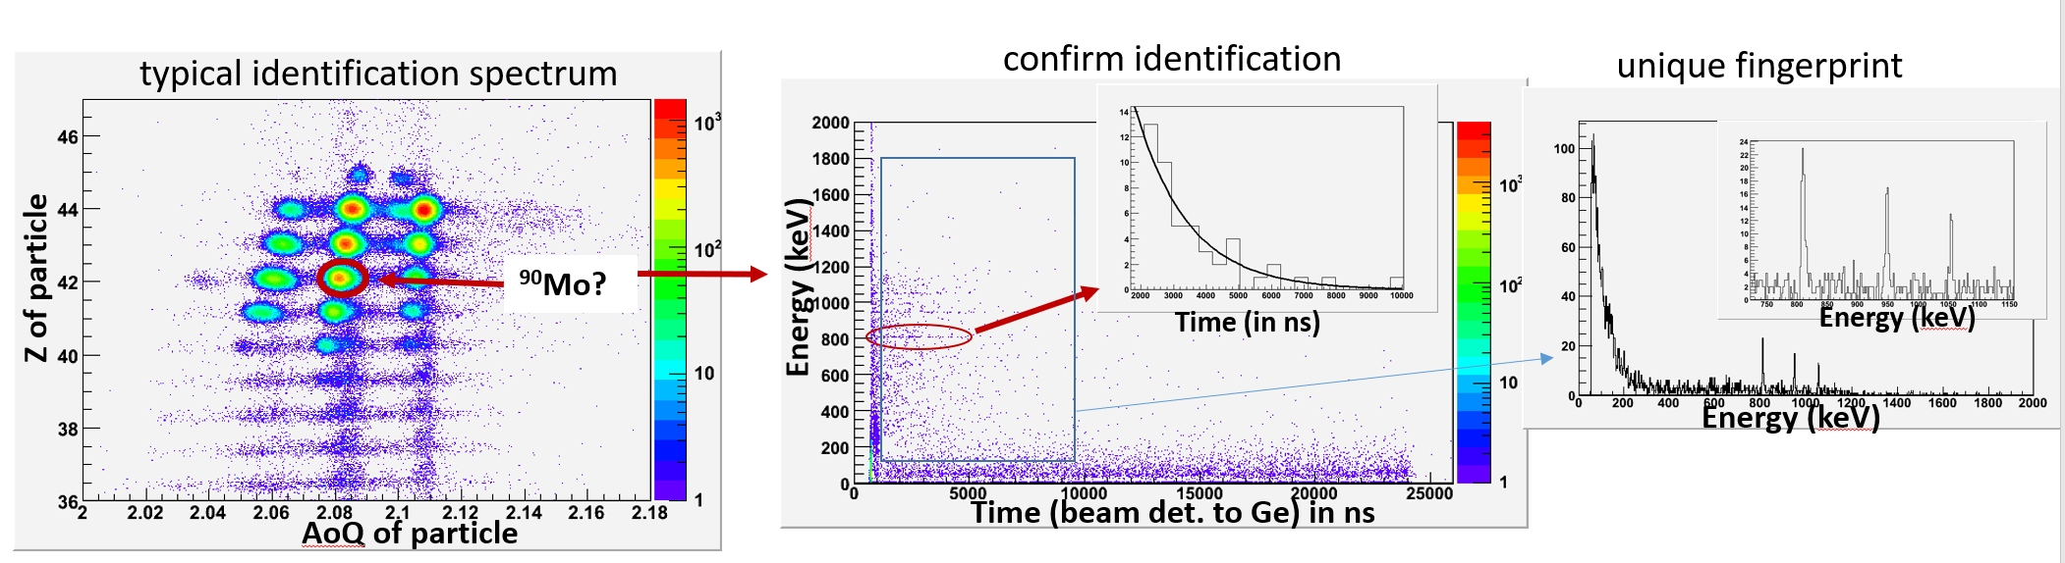
End of beam commissioning
Check identification from Spectrometer with Isomer Tagging
request to NUSTAR to provide a setup for this
➔ follows return of experience from FRIB (USA) and BigRiPS (JP) commissioning

Slide 43
Phase 3.1, 3.2 and 4 commission, some thoughts
Risk/opportunities (organization)
  presently all high end single particle tracking detector read in experimental network and all magnet control in accelerator network:
    Super-FRS EXP DAQ (PSP 2.4.6.3.1.2), data source different format/network from ACC/BEA
    we need a solution to permit automatic/advanced beam tunning for ease and speed of operation
    until solution not present man power can not be engaged in development
    from 2026 man power will be occupied in commissioning
    ….. Ralph is aware… but still something we really need soon

Slide 44
Super-FRS and NUSTAR
Link NUSTAR
  need support for isomer tagging at FHF2 from NUSTAR
  clear channel of communication, through Helena Albers for NUSTAR requests
  final setting of our commissioning should open the first experiment done together with NUSTAR
  ➔ then Early Science can start

Slide 45
Idea learnt from CERN visit
Picket vs “on call”
  on-call: waits for a call
  picket has an active role ➔ monitors the system
Request would be picket for critical system during beam commissioning
  CRY, VAC, Controls…
rotating coordinators, option for long beam time
  same goal, same objectives
  goal of the week given/designed clearly

Slide 46
Commissioning organization, ideas (to be discussed)
Phase 1, 2
  system responsible, responsible for commissioning
    up to two team working in parallel per system
  coordination from commissioning teams
Phase 3, 4
  commissioning more centrally managed
  use of sequencer where possible
  for beam operation (plan several months), rotating coordinator, daily report
    weekly objective
    team/operation in shifts (with shift leader)
    we expect people have the same goal at hand

Slide 47
Last thought
Super-FRS commissioning will be a interesting culture mix:
  Nuclear Experimental Physics (SFS)
  Support from operation/machine oriented physicists (SFC/ commissioning team)
  some reporting (QUA.. PMO)
…. let’s try to learn from each others!

Slide 48
My thanks to:
Seva Kamerdzhiev, Marie Cabioch, Marina Gorda, Stephan Reimann,
Heike Marcocelli, Valentina Ricciardi.

Slide 49
plans
plan your work and work you plan!!!
Installation Readiness Release (Desy)
Components detail (ESS)

Slide 50
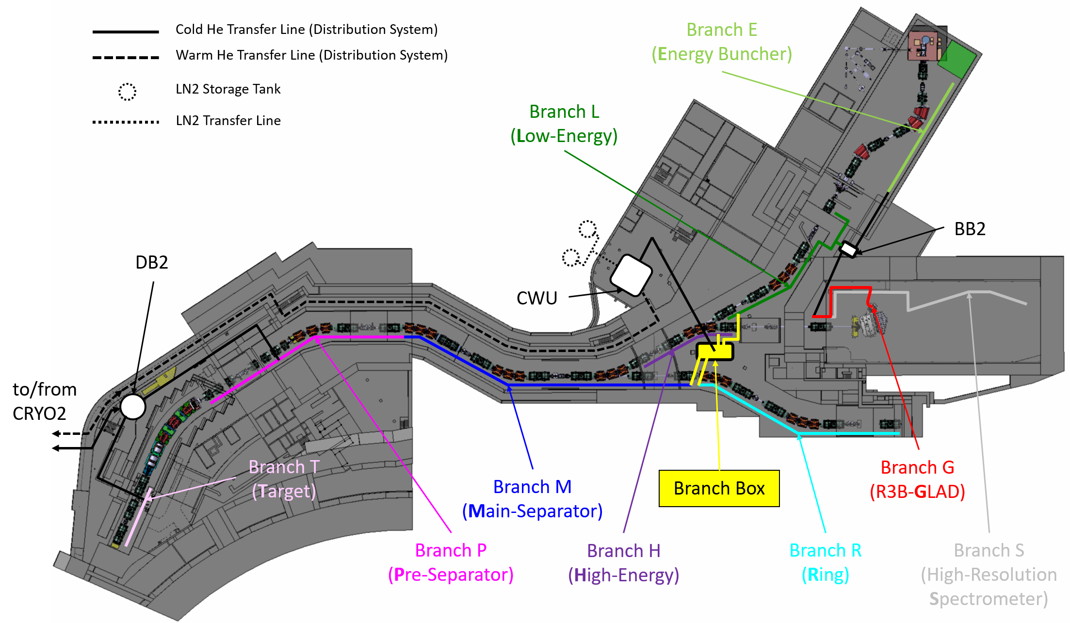
Local Cryogenics Branches

Slide 51
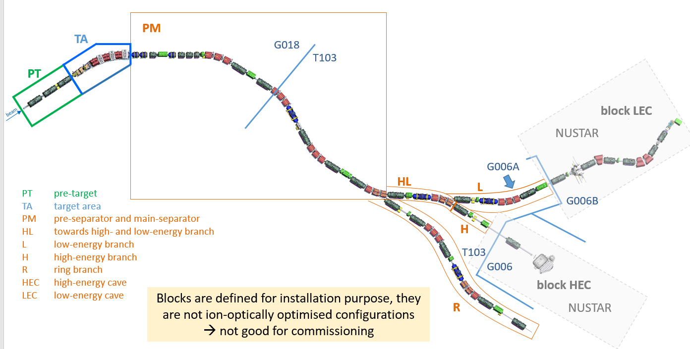
Commissioning need to be done in parallel to installation (as much as possible)
Integration test could be done “per installation block” ➔ main question: Cryo commissioning (no info possible)!

Slide 52
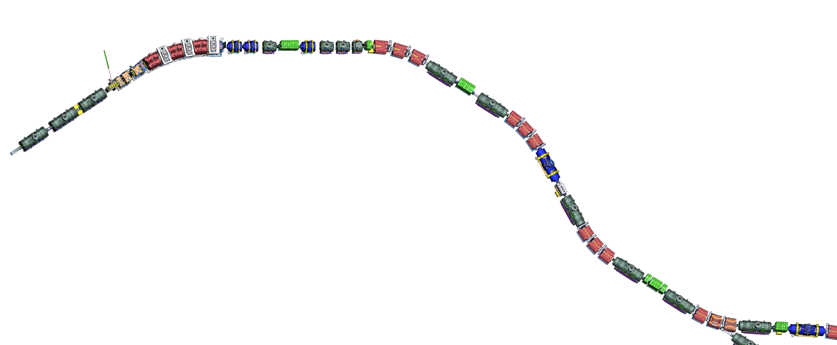
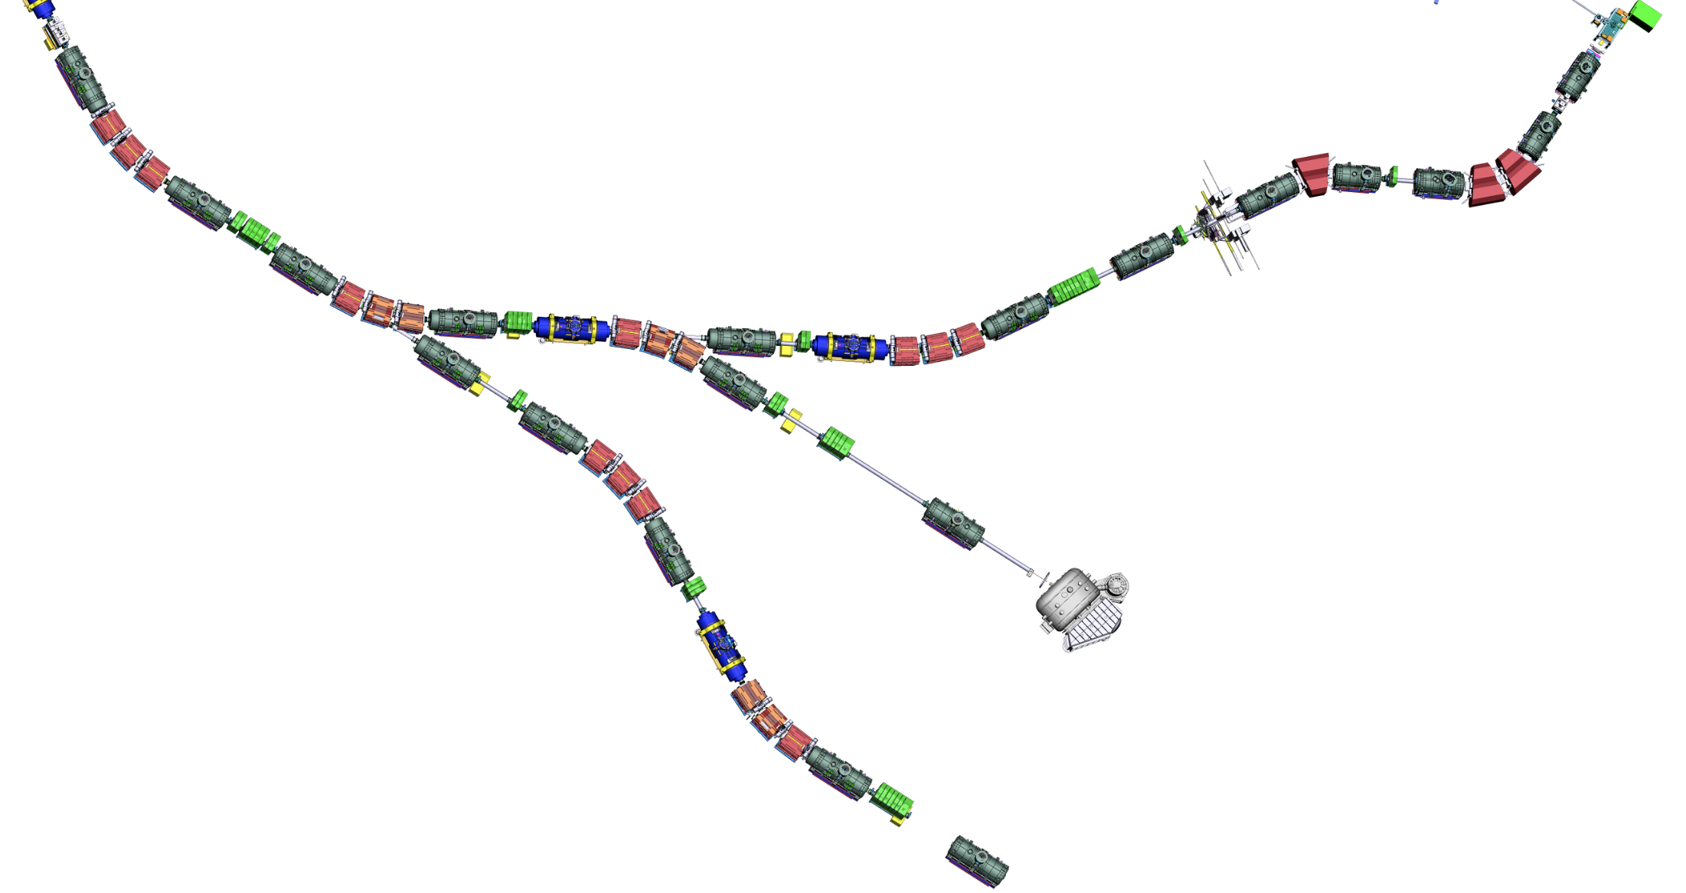
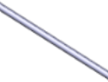
Assembly Units
Assembly Units along the beamline
SM_01
SM sc short multiplet
LM sc long multiplet
SCD sc dipole
DC diagnostic chamber
VAC beam-line vacuum
EBD EB dipole
EBM EB multiplet
TA target
NC_QQ nc quadr. 1a + quadr. 1b
NC_QS nc quadr. 2 + sextupole
NC_D nc dipole
BC beam catcher
NC_S nc sextupole
SM_02
SM_03
SM_04
SM_07
SCD_01
SM_05
BC3
DC_02
SM_06
DC_03
BC2
NC_S
NC_D2
NC_D3
SCD_02
BC1
SCD_03
NC_D1
LM_04
NC_QS
NC_QQ
DC_04
TA
LM_03
FPF1
FPF2
FPF3
LM_05
VAC_02
SCD_04
LM_02
DC_01
FPF0
FPF4
SCD_05
LM_01
SCD_06
VAC_01
FTF1
LM_06
beam
DC_05
Power converter Racks (total) 77
Control Racks (total) 336
not ATB
FLF6
Number of pieces for Early Science
(Target Area excluded)
FMF1
LM_07
DC_17
SCD_07
FLF5
SCD_08
FLF4
EBM_05
SCD_09
LM_08
FLF3
DC_16
DC_06
EBM_04
DC_07
FLF2
7 sc short multiplets
13 sc long multiplets
15 sc dipoles
10 diagnostic chambers (DC_01 not includable)
4 long/special beam pipes
DC_08
SCD_11 (branch)
FMF3
EBD_03
LM_09
SCD_14 (branch)
EBD_01
DC_15
SCD_10
FLF1
DC_13
EBM_02
EBD_02
SCD_12
LM_16
EBM_03
LM_10
SCD_13
EBM_01
FMF2
DC_09
LM_11
LM_14
SCD_18
SCD_17
SCD_15
SCD_16
VAC_06
LM_15
DC_12
LM_17
VAC_05
DC_14 (maybe)
LM_18
LM_12
VAC_07
Additional number of pieces for LEB (up to FLF3)
DC_18
DC_10
LM_19
VAC_03
4 sc long multiplets
3 sc dipoles
2-3 diagnostic chambers
1 long/special beam pipes
FRF1
SCD_19
DC_11
early science locations
SCD_20
FHF1
VAC_04
SCD_21
LM_13
LM_20
VAC_ NUSTAR
DC_19
FHF2
FRF2
VAC_08
GLAD
Additional number of pieces for completion
LM_21
BDN
SCD_22
FHF3
6 sc long multiplets
6 sc dipoles
6 diagnostic chambers
6 long/special beam pipes
5 sc Energy Buncher multiplets
3 sc Energy Buncher dipoles
VAC_09
Installation: Super-FRS
SCD_23 (branch)
SCD_24
Installation: Super-FRS
LM_22
Installation: NUSTAR
DC_20
Installation: NUSTAR
FRF3
VAC_10
LM_23
Fxxx notation defines “focal planes”
VAC_11
Last modified: Super-FRS Workshop, 15-17 Nov. 2021

Slide 53
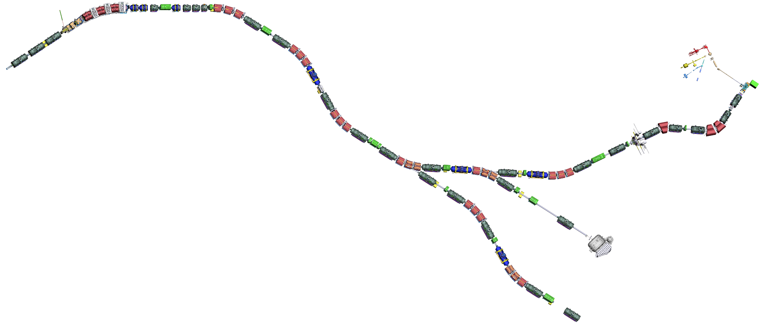
Commissioning sections along the beamline v1
FPF1
FPF2
FPF3
FPF0
FPF4
G018
T103
FTF1
All this is LEB
commissioned together
beam
FMF1
FLF6
FLF5
FMF2
FLF3
FMF3
FLF4
FLF1
FLF2
G006B
G006A
FRF1
FHF1
FRF2
FHF2
T103
blocks for machine installation
G006
sections for commissioning
FRF3

Slide 54
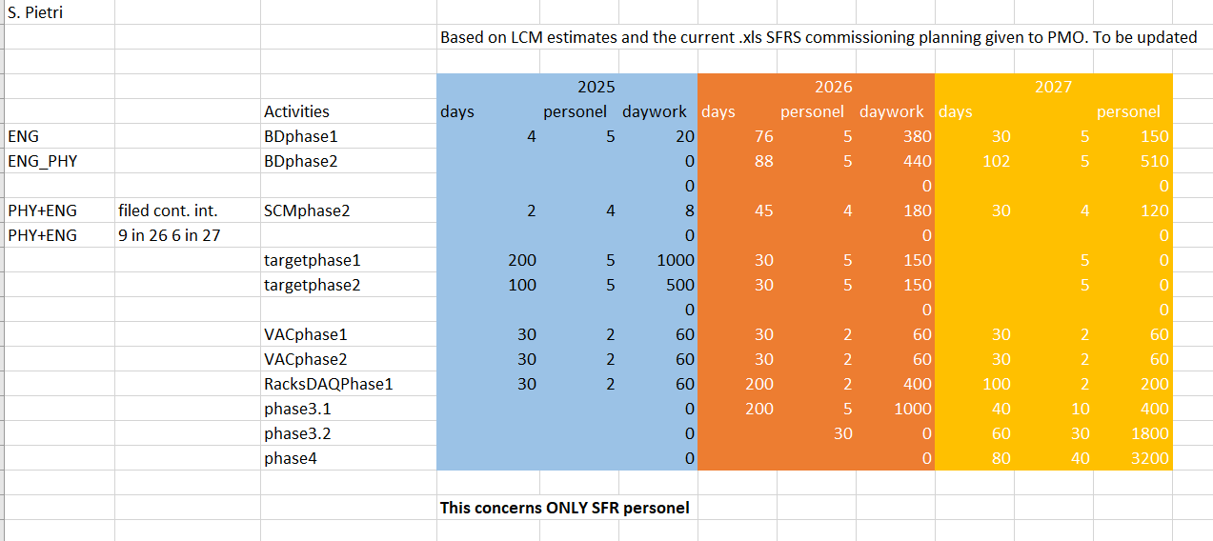

Slide 55
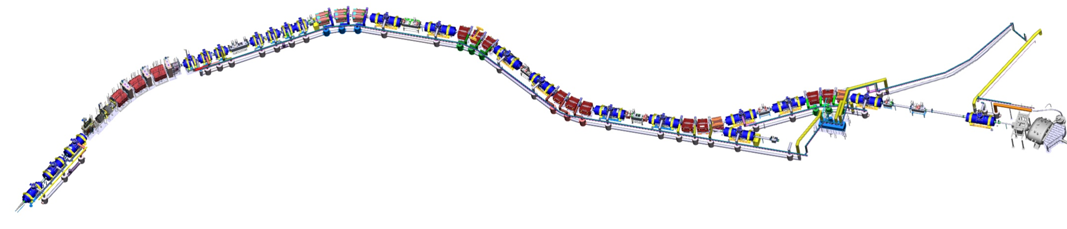

Local Cryogenics branches
M, H, G (B optional)
Procurement and installation branch M
Procurement and installation branches H, G
Planned FAIR contracts: December 2024
Planned delivery to FAIR: October 2025 – July 2026
Planned installation: October 2025 – August 2026
Tender running
Deadline for offers: 23/10/2024
Offers from 4 bidders (3 companies + 1 consortium)
All qualified and well-known companies
Requested schedule confirmed
Negotiations starting
Risk of FAIR internal competition with cryo tenders
CE
Still to be tendered: jumpers of branches M, H, G
Overview tenders LC branches
Delivery dates of local cryogenics boxes
Local cryogenics sectors: installation completed
shielded target area
P2
P1
11.25
M1
08.25
11.25
H
M2
M3
04.26
G
T
04.26
05.26
03.25
09.26
last batch W0 Dec-24
batch W1 06.25
batch W2 09.25
batch M1 10.25
batch M2 02.26
batch M3 07.26
batch H 02.26
batch G 05.26

Slide 56
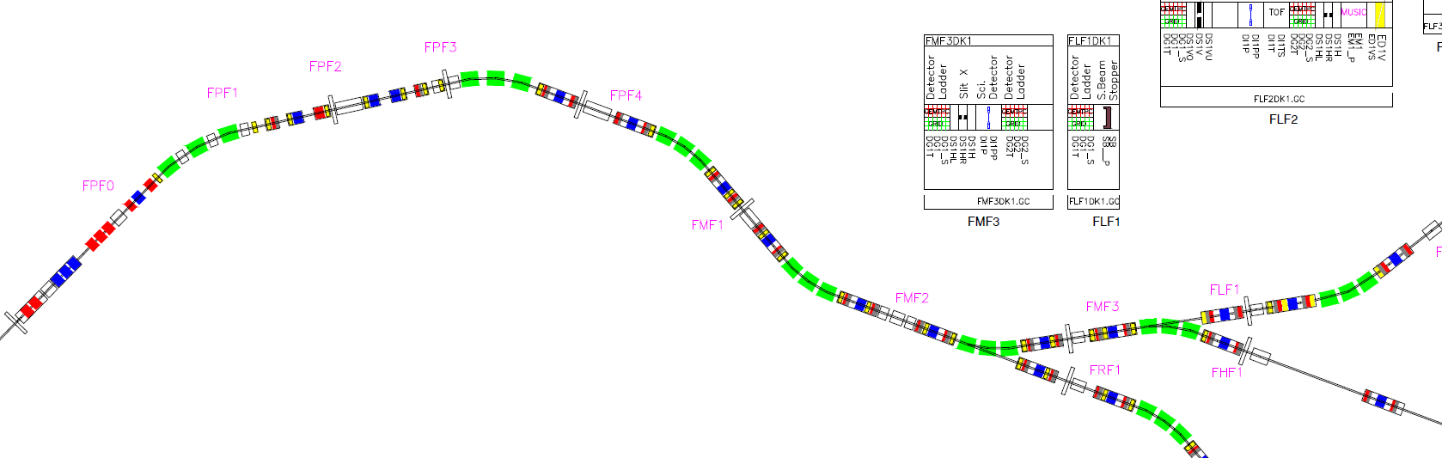

Slide 57
Super-FRS – NUSTAR : no coupling hypothesis
SFRS runs “isomer tagger” at FHF2 during its commissioning
last setting is an “isomer tagger” for NUSTAR experiment
remove isomer tagger
install NUSTAR setup
☺ | ☹
Clear separation of goals | not nice in spirit of cooperation
Low man power need from NUSTAR side (short period) | Still need to tune implantation after Super-FRS commissioning
Limited risk to damage NUSTAR unique equipment | Still need to do the NUSTAR in beam commissioning (only one region or full rescalling)
SFRS
NUSTAR

Slide 58
Super-FRS – NUSTAR: high coupling hypothesis
if several beams, to better characterize detector, several small experiments(?)
as soon as we are “safe” in beam handling, we could move in NUSTAR setup
perform small measurement along the different beams while going up in Z (supposing we start light and end up heavy)
☺ | ☹
Much more NUSTAR-SFRS integration | Could generate conflicts on goal
NUSTAR setup properly commissioned in beam during SFRS commissioning | Higher risk to damage unique equipment (but can be mitigated easily)
 | Long NUSTAR beam period, with idle times where SFRS does pure SFRS stuff
 | Not all beams with NUSTAR will yield interesting results?
SFRS
NUSTAR

Slide 59
Super-FRS NUSTAR – mid coupling hypothesis
Super-FRS perform its commissioning
when confident we remove isomer tagger and start NUSTAR beam commissioning hand in hand with Super-FRS last points of commissioning
Super-FRS commissioning end at the last setting for Super-FRS/first setting for NUSTAR, then NUSTAR experiment begings (in beam commis. already done)
☺ | ☹
Much more NUSTAR-SFRS integration
NUSTAR setup properly commissioned in beam during SFRS commissioning | (minor): need some agreement on process at the end of Super-FRS commissioning
Lower man power impact for NUSTAR than strong coupling
Reduced risk for NUSTAR experiment compared to other options
SFRS
NUSTAR

Slide 60
Open points
Would define “we finished beam commissioning of SFRS and NUSTAR here we do first experiment” be good? Or is “the first NUSTAR experiment is the end of the Super-FRS commissioning?” (first case was my assumption)
I would suggest to check feasibility of first NUSTAR experiment with Super-FRS expert, to avoid a too risky experiment
Once NUSTAR setup is better defined the discussion can start of how we couple the two commissioning (from which moment we rely on the NUSTAR setup and remove our small isomer tagger, if some light beam for tracking detectors need to be tested etc…) and what shall be done for the NUSTAR in beam commissioning
For information: we just started the discussions on the Super-FRS “no-beam” commissioning in the project side (so no urgency!)

Slide 61
End slide

Slide 62
Why isomer tagging is preferred for SFRS com.¹
5 options: counting, beta, alpha, mass, isomer tagging
  counting: (step by step from Primary beam), not efficient if long jump, always a backup
  beta: life time with error not unique finger print, end point measurement can be confusing if several decays (isomer/gs) and need a lot of statistics
  alpha: quite rare in the chart, energy and life time are unique fingerprint, but fast alpha decay make spectra confusing if spectrometer tuned far away of where it is believed
  mass: unique finger print, main issue implantation in a very thin matter, extraction, then mass measurement, when all works fine it is perfect, but many steps that can go wrong, and if the setting is not the one though, the implantation will not work, nice to confirm on an establish setup, maybe not for shooting in the dark…
  isomer: quite unique finger print, more open the setting better (contrary to 2/3/4), implantation can be done quite surely (thick plate), direct correlation between ion and gamma, not a multi step process, best when shooting in the dark
1: This of course does not constrain in anyway the options for NUSTAR first science

