Slide 1
HEBT Hardware Commissioning
Frank Hagenbuck
1st FAIR Commissioning Workshop
November 7-8, 2024

Slide 2
Outline
Introduction – HEBT Overview
HEBT Early Science
Commissioning Planning
Schedule
Roles
Summary

Slide 3
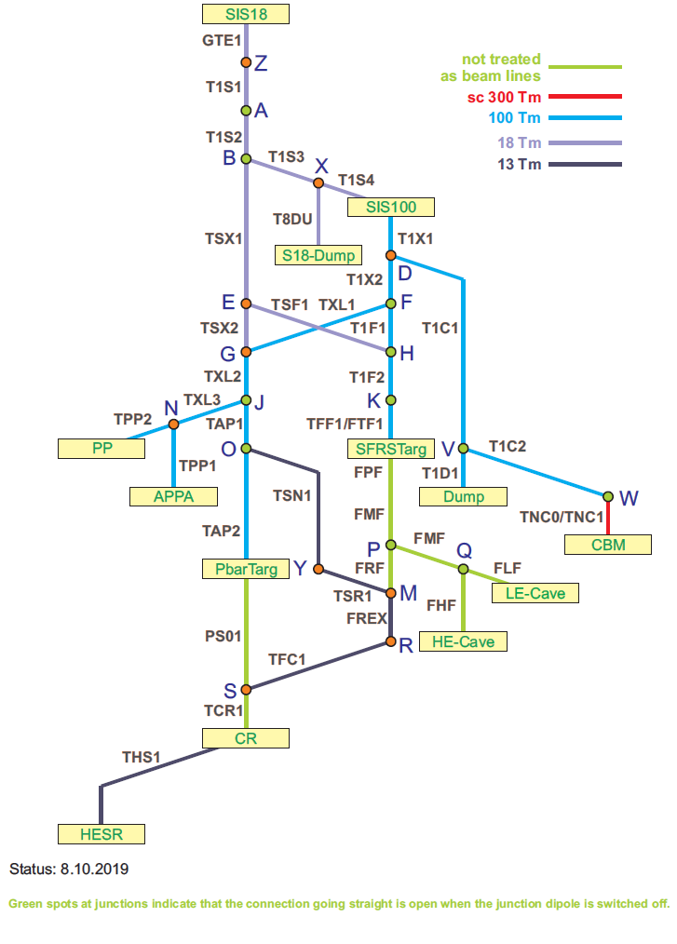
HEBT Overview – MSV (Module 0-3)
29 sections (13 connections/beam lines)
total length (HEBT) ca. 1.5km
all beam lines normal conducting
nominal magnetic rigidity 100Tm, 18Tm, 13Tm
parallel operation
full version had to be taken into account for building planning of the MSV

Slide 4
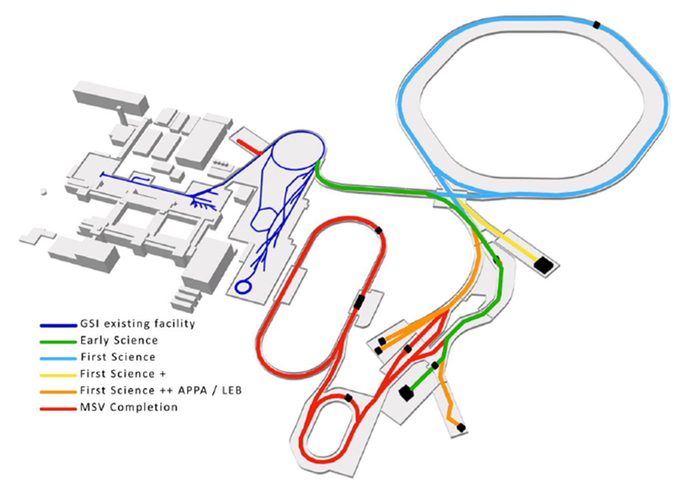
HEBT Overview – Staging
dotted lines are not part of HEBT
(*to be added to complete the scenario)

Slide 5
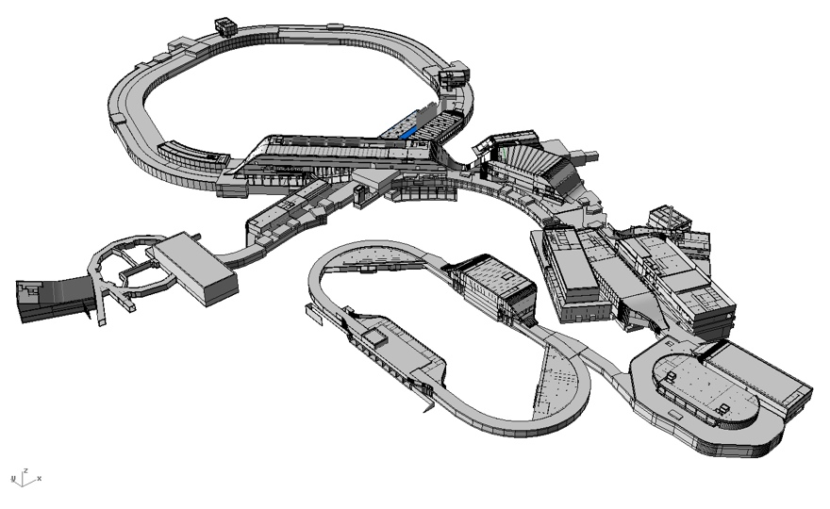
Buildings – MSV
K0923A
K0619A
H0719A
L0516A
H0705A
K0617A
K0503A
G0704A
G0418A
K0406A
G0702A
K0
321A
K0410A
with HEBT Beamline
H0307A
with HEBT Supply
G0418A
H02
09A
GAP HEBT

Slide 6
Buildings – Early Science
H0719A
H0705A
K0617A
G0704A
G0702A
with HEBT Beamline
with HEBT Supply
GAP HEBT

Slide 7
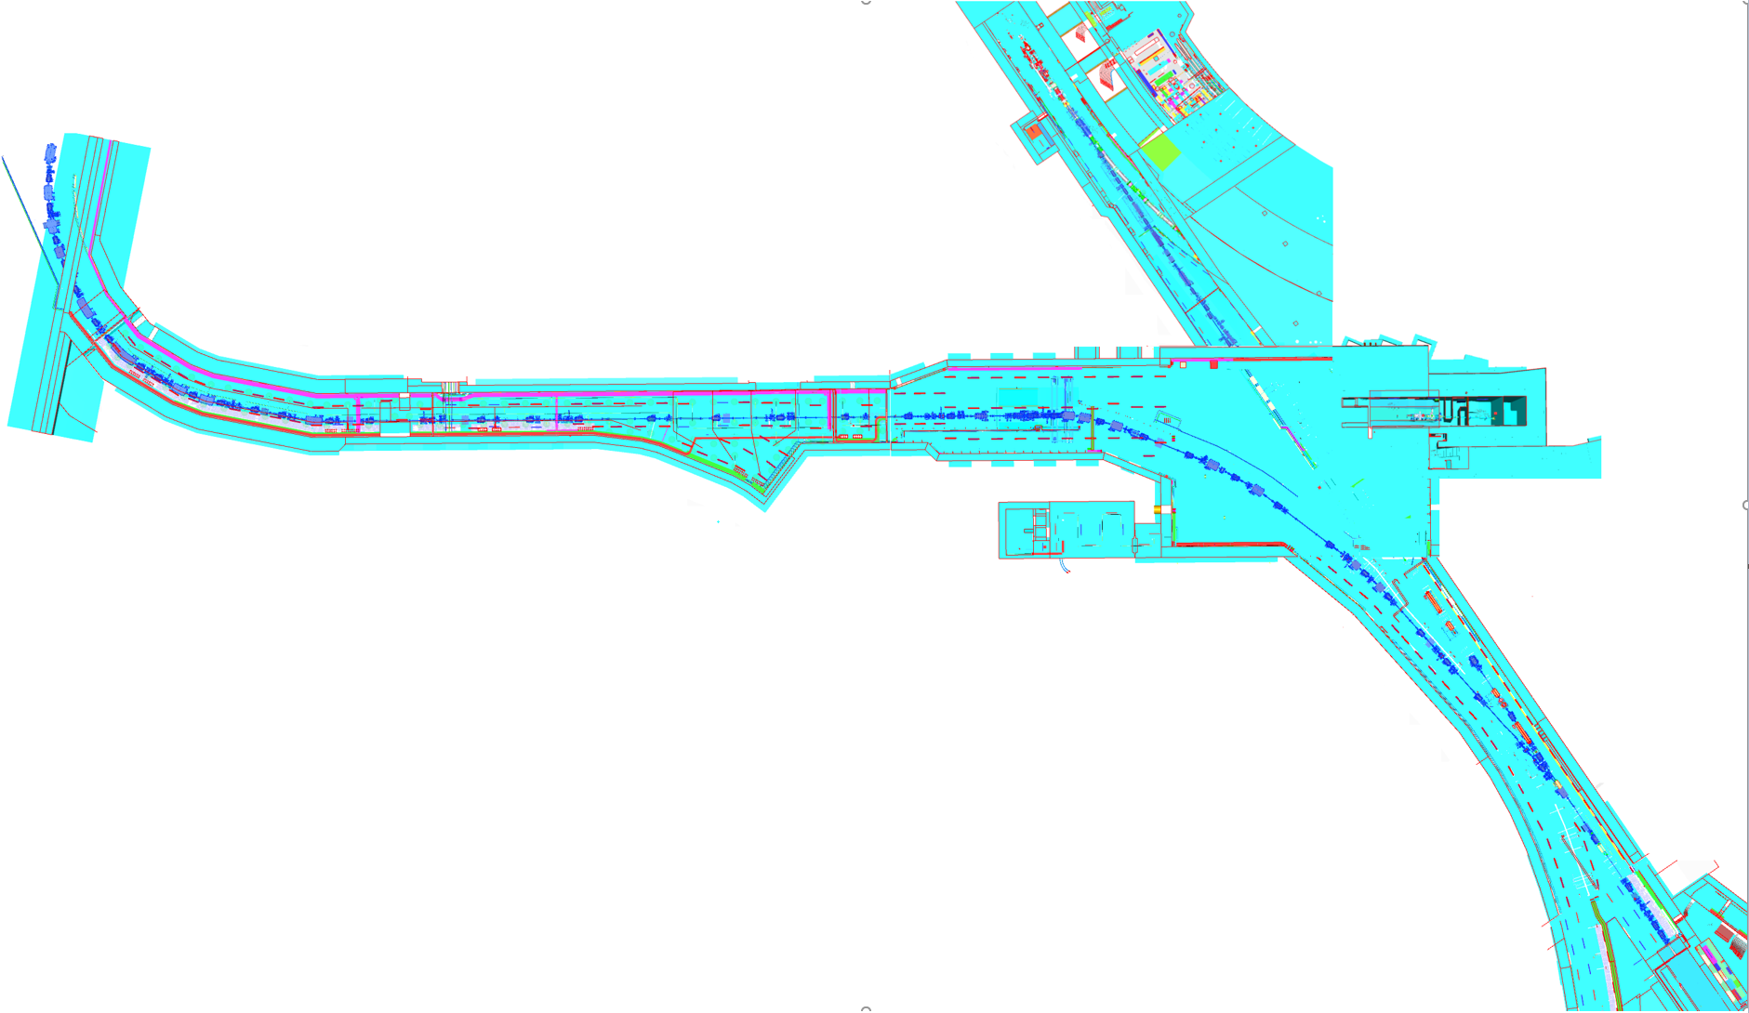
HEBT Early Science (ES)
SIS18
SIS100
TR
G0702A
H0705A
T1S1
T1S2
TSX1
K0617A
 | TR/G0702A | G0702A/H0705A | H0705A/K0617A | K0617A
 | T1S1 | T1S2 | TSX1 | TSF1 | T1F2 | TFF1 | Sum
Length [m] | 102,0 | 55,2 | 88,7 | 17,2 | 14,3 | 11,6 | 289,1
VAC Sections | 3 | 1 | 2 | 1 | 1 | 1 | 9
TSF1
T1F2
TFF1

Slide 8
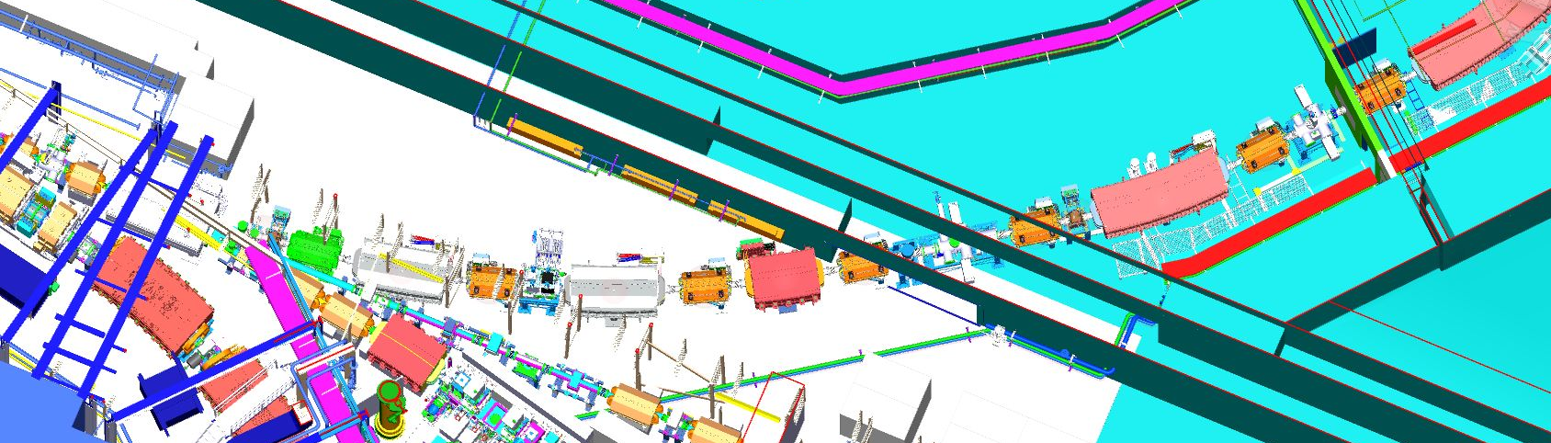
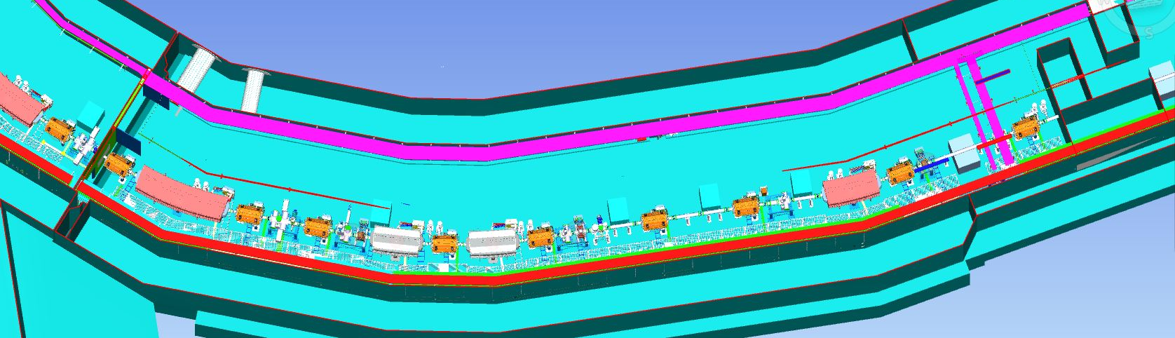
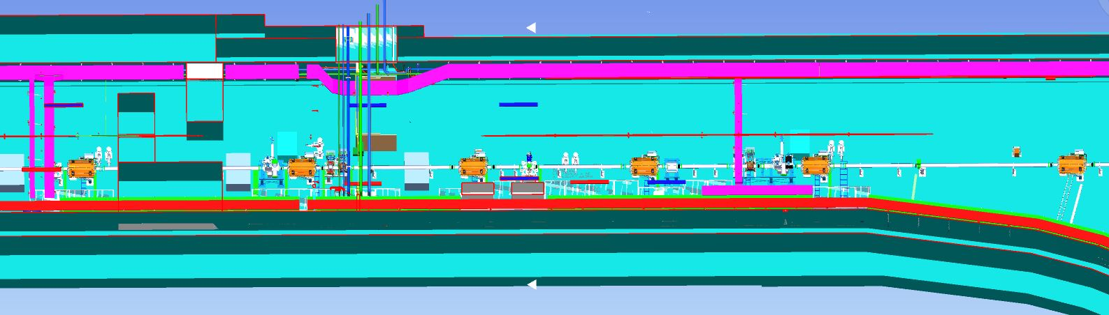
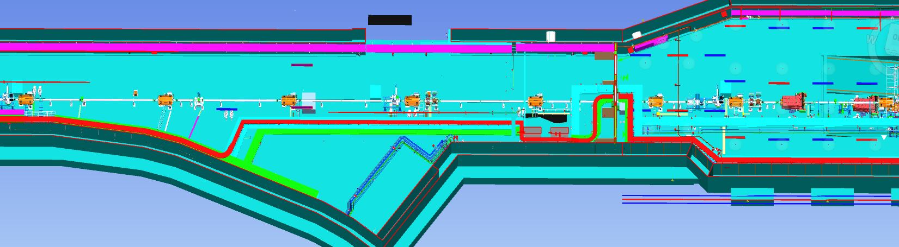
HEBT ES Vacuum Sections
T1S1 – VAC section 1
T1S1 – VAC section 2
1
2
3
T1S1 – VAC section 3
T1S1
T1S2
T1S2

Slide 9
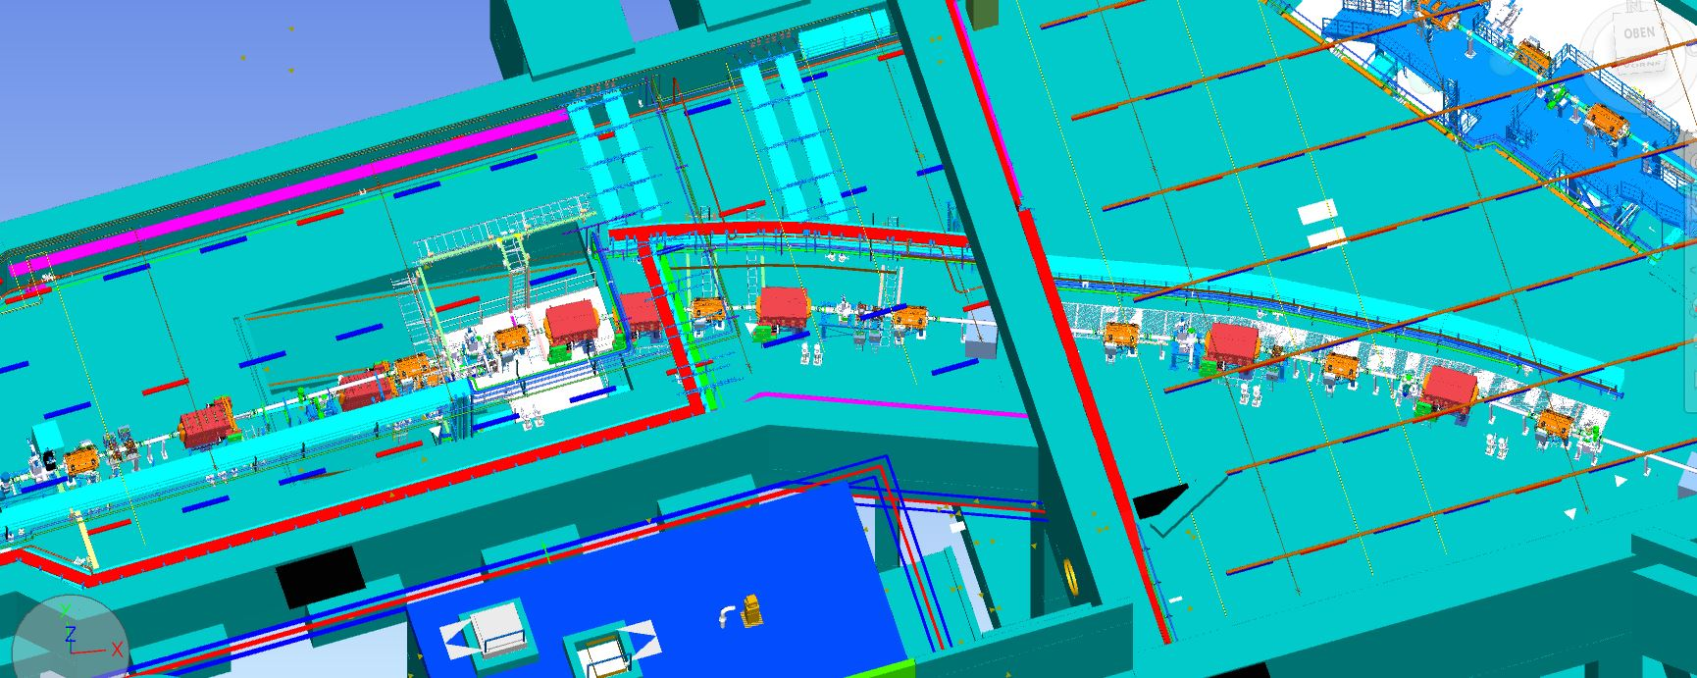
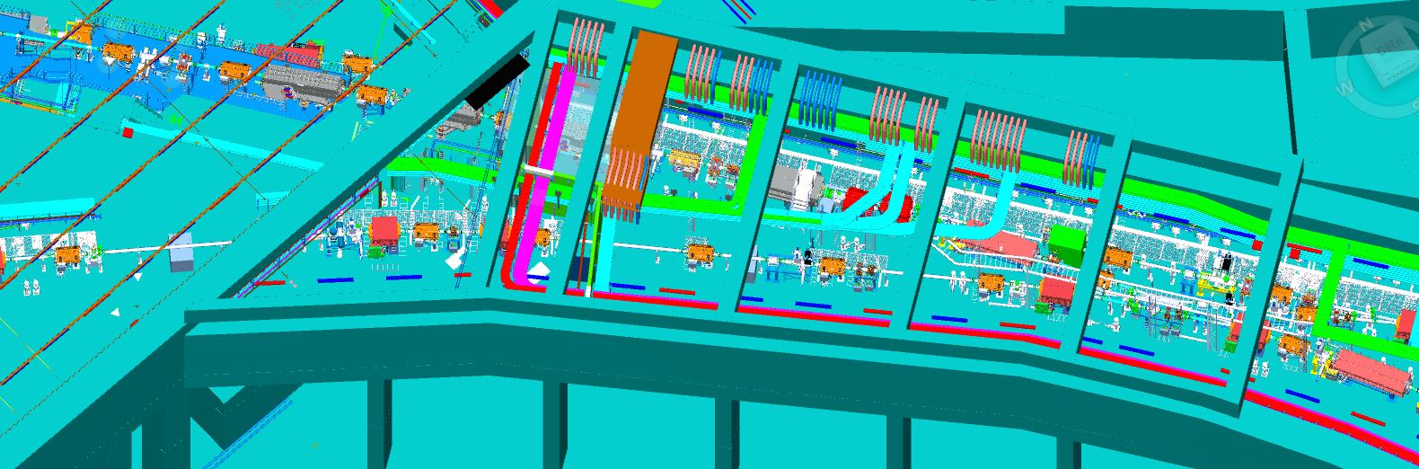
HEBT ES Vacuum sections
H0705A
1
TSX1 – VAC section 1
TSX1
2
K0617A
TSF1
T1F2
TFF1
TSX1 – VAC section 2

Slide 10
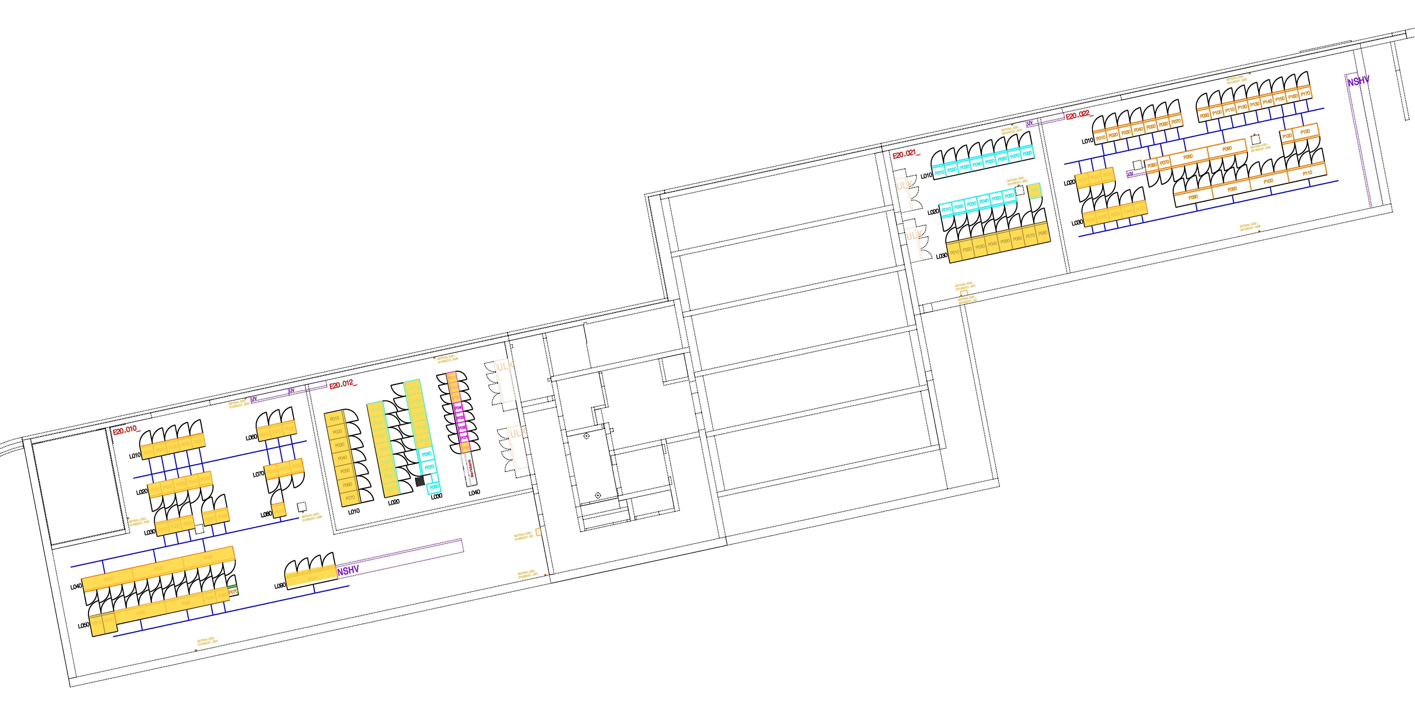
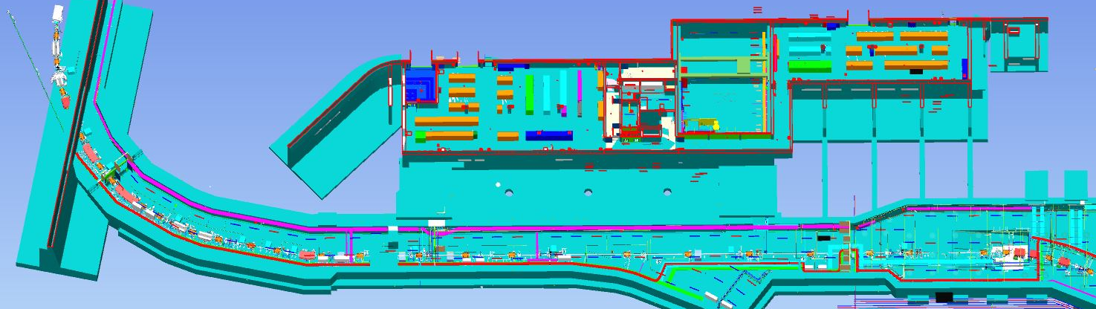
HEBT ES Components
E20.010
E20.021
T1S1
T1S2
G0704A.E20.010
G0704A.E20.021
yellow – racks for ES

Slide 11
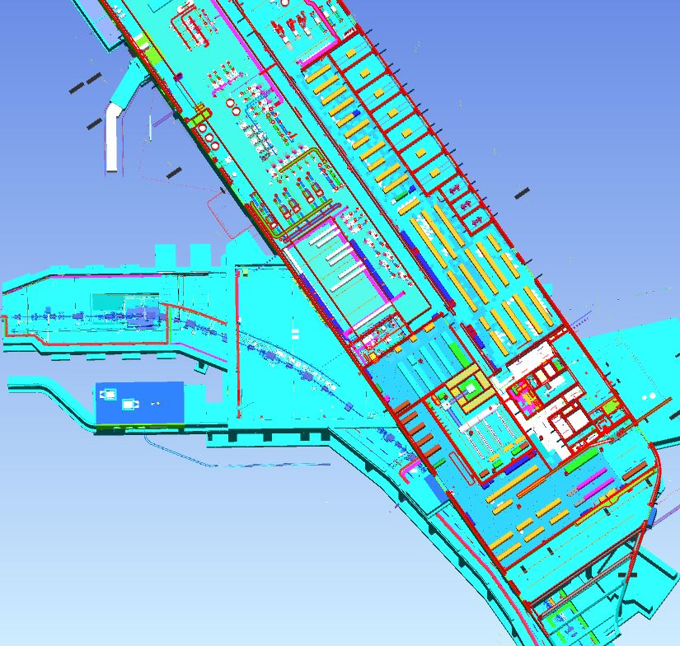
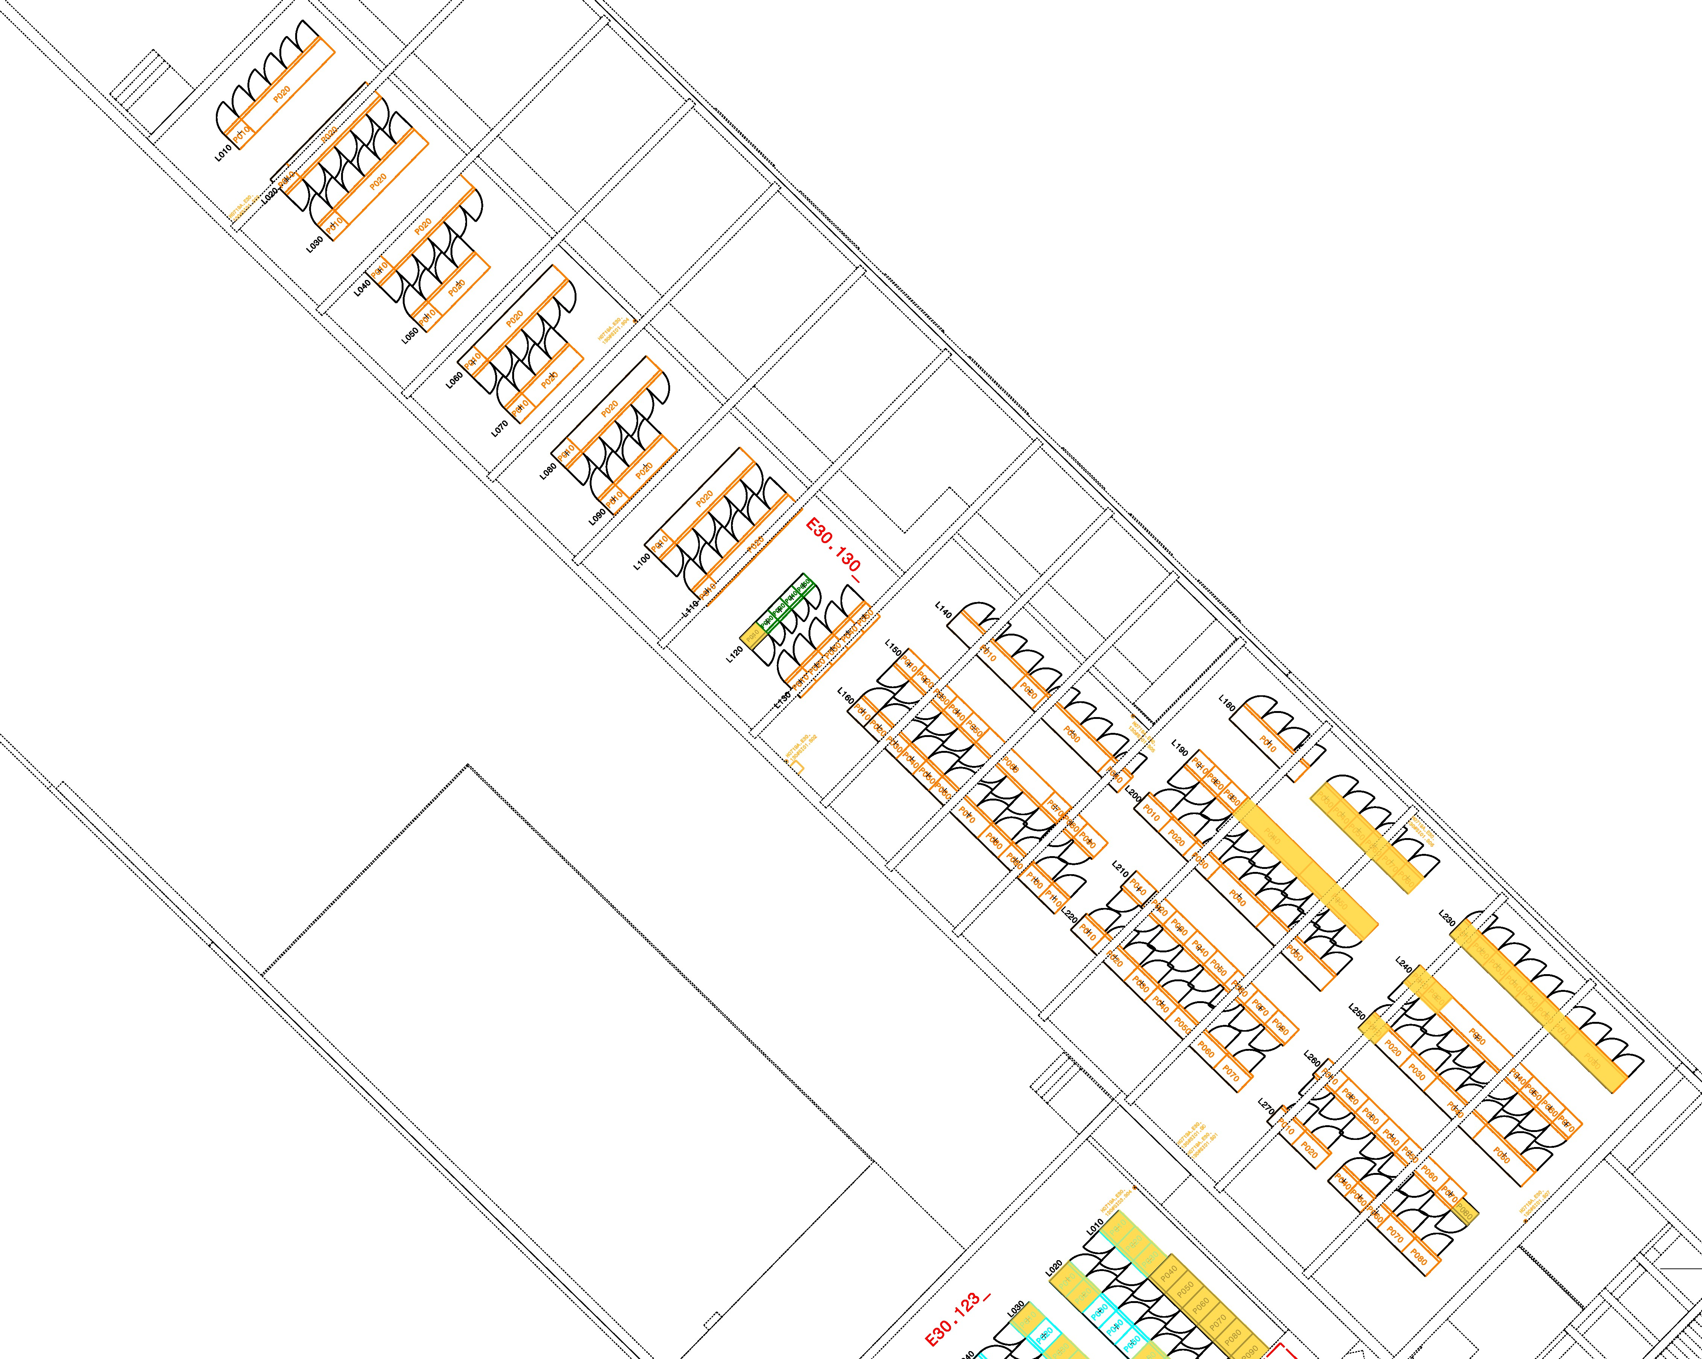
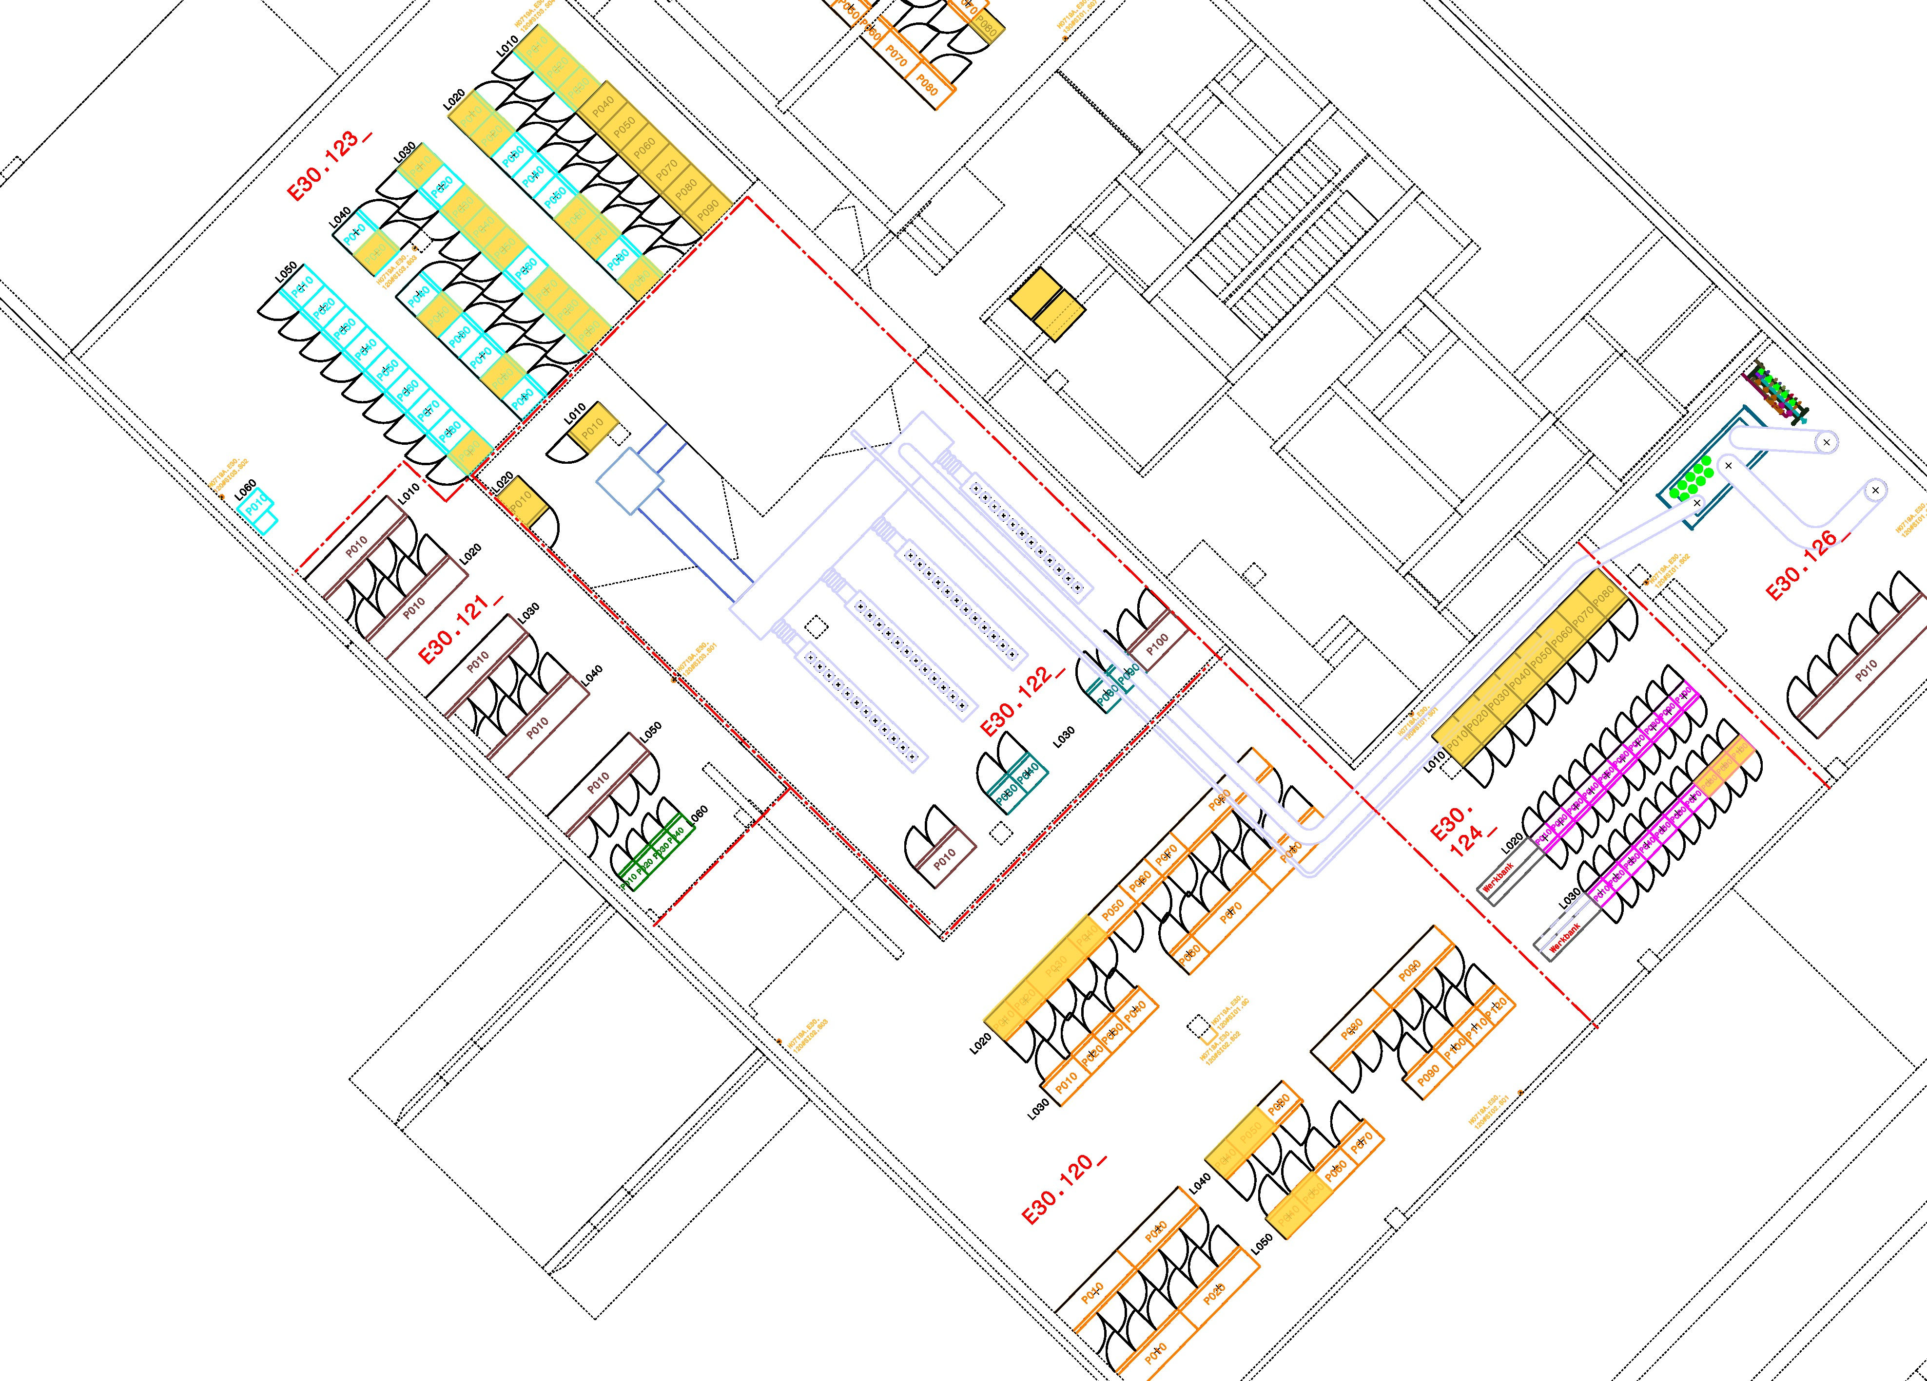
HEBT ES Components
E30.130
H0719A.E30.130
TSX1
E30.120
TSF1
H0719A.E30.120
T1F2
TFF1
yellow – racks for ES
yellow – racks for ES

Slide 12
HEBT ES Components
 |  | Beamline | Supply
 |  | all ES sections | G0704A + H0719A
Dept (WP) | System Type
NCM, EPS | Dipole Magnet | 16 | 10 HB.Dx
 | Quadrupole Magnet | 43 | 42 HB.Qx
 | Steering Magnet | 23 | 23 HB.Cx
BEA | Diagnostic Chamber | 18 | 31 Racks + Gas Mixing Station
 | Multiwire Proportional Chamber (MWPC) | 12
 | Particle Detector Combination (PDC) | 6
 | SEM-Grid | 12
 | Scintillation Screen (SCR) | 5
 | Beam Position Monitor (BPM) | 9
 | Transformer (RT & FCT) | 8
 | Cryogenic Current Comparator (CCC) | 2
VAC | Ion Getter Pump | 31 | 6 Racks
 | Penning Gauge | 17
 | Pirani Gauge | 10
 | Fast Valve Sensor | 2
 | Fast Valve | 2
 | Roughing Valve | 11
 | Gate Valve | 10
 | Venting Valve | 11
VAC (SI) | Safety Beam Plug | 3 | in Rack PAS
 | Foil Stripper | 1 | 1 Rack SI
 | Collimator | 3 | in Rack BEA
ACO |  |  | 40 Racks*

Slide 13
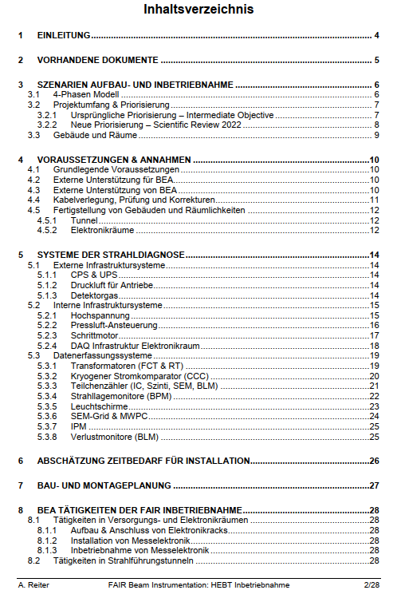
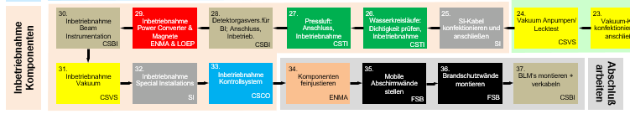
Commissioning Planning
Status
Procedures and prerequisites for commissionig of system types defined in LCM workshops
Almost all system types of ES covered
Visualization of processes in LCM started by FCO
Estimation of time and ressources provided by WPLs/Departments and discussed with SSPL
Commissioning plan has been reorganised with PPL and a new timeline has been set up for ES
Next steps
Set up new timeline for First Science
Include ressources in Planisware
HEBT commissioning workshop in Q1/2025
discuss commissioning steps and status preparation in detail with WPLs/Departments
coordinate/optimize order of activities between WPLs/Departments (order defined in 2016)
establish roles
BEA
EPS
VAC

Slide 14
Commissioning Planning - Progress dashboard
maintained by FCO-Team (*estimate by F. Hagenbuck)
Dept. | System Type | 1st. workshop done | procedure developed | prerequisites collected | review resources | review schedule | work instruction doc. | sequence procedure | sequence implementation | Status
NCM, EPS | NC-magnet & power supply (dipole, quad, steerer) | 100% | 100% | 100% | 100%* | 50%* | 0% | 100% | 30% | 73%
BEA | Beam transformer | 100% | 100% | 100% | 100% | 50%* | 50% | 0% | 0% | 63%
BEA | BPM beam position monitors | 100% | 100% | 100% | 100% | 50%* | 50% | 0% | 0% | 63%
BEA | SEM grid | 100% | 100% | 100% | 100% | 50%* | 50% | 0% | 0% | 63%
BEA | SCR luminous screen | 100% | 100% | 100% | 100% | 50%* | 50% | 0% | 0% | 63%
VAC | Vacuum sector (valves, pumps, gauges, controller, ...) | 100% | 50% | 50% | 100% | 50%* | 0% | 100% | 50% | 63%
VAC (SI) | Safety beam plug | 100% | 100% | 100% | 0% | 0% | 0% | 0% | 0% | 38%
BEA | MWPC multi wire proportional chambers | 100% | 100% | 100% | 100% | 50%* | 0% | 0% | 0% | 56%
BEA | BLM beam loss monitors | 100% | 100% | 100% | 100% | 50%* | 0% | 0% | 0% | 56%
BEA | Pneumatic drive controls | 0% | 0% | 0% | 0% | 0% | 0% | 0% | 0% | 0%
BEA | CCC cryogenic current comparator | 0% | 0% | 0% | 0% | 0% | 0% | 0% | 0% | 0%
VAC (SI) | Foil stripper | 0% | 0% | 0% | 0% | 0% | 0% | 0% | 0% | 0%
VAC (SI) | Collimator | 0% | 0% | 0% | 0% | 0% | 0% | 0% | 0% | 0%
VAC | Bakeout system | 0% | 0% | 0% | 0% | 0% | 0% | 0% | 0% | 0%
 | HEBT overall preparation status | 49%
not in ES
LCM workshop yesterday
(02.2024 29%)

Slide 15
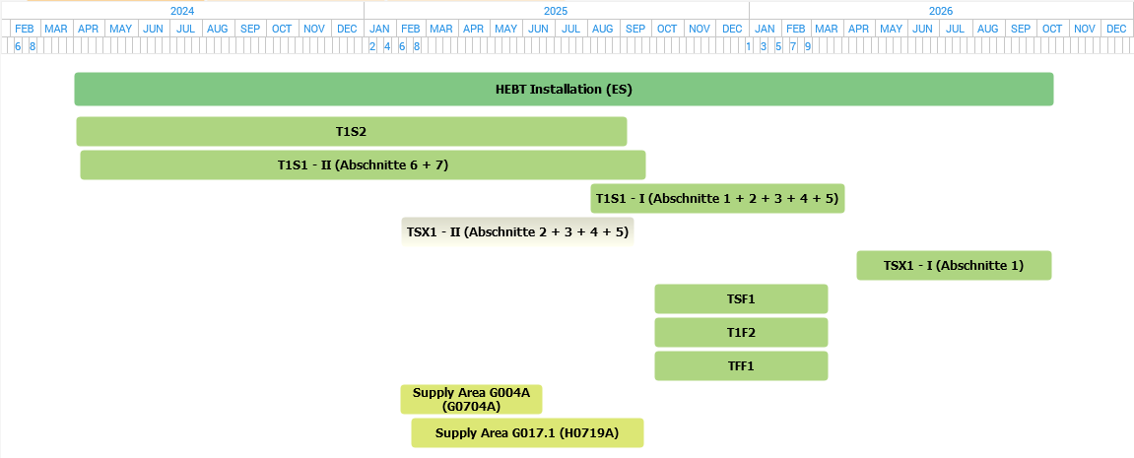
HEBT ES Installation Schedule

Slide 16
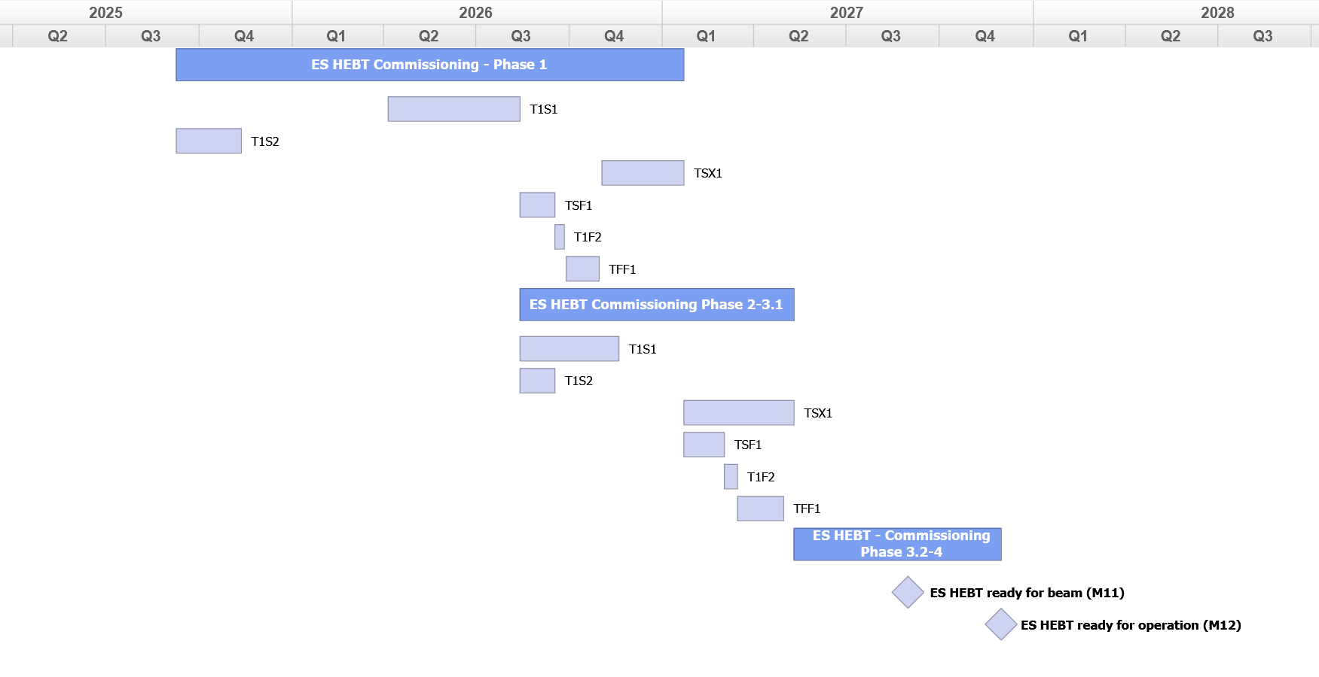
HEBT ES Commissioning Schedule

Slide 17
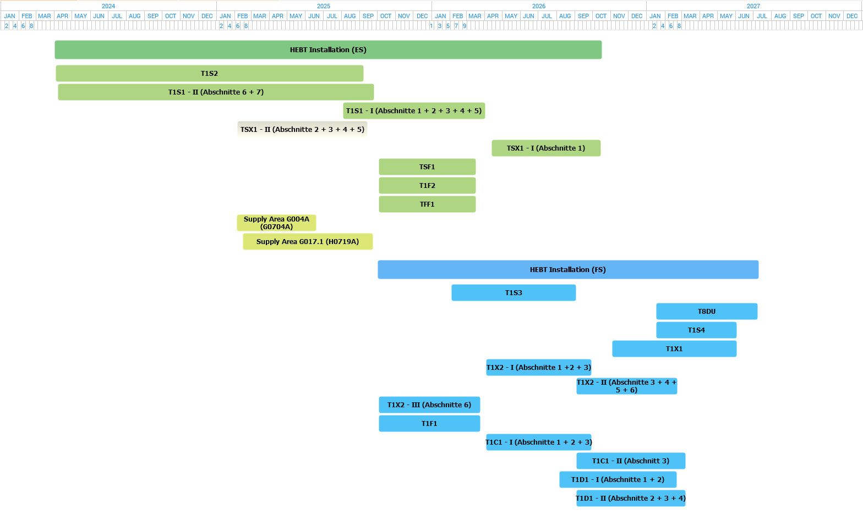
HEBT Installation (ES, FS) & Commissioning (ES) Schedule
Q1
Q2
2025
Q3
Q4
Q1
Q2
2026
Q3
Q4
Q1
Q2
2027
Q3
Q4
Q1
Q2
2028
Q3
ES HEBT Commissioning - Phase 1
T1S2
T1S1
TSF1
TSX1
T1F2
TFF1
ES HEBT Commissioning Phase 2-3.1
T1S2
T1S1
TSF1
TSX1
T1F2
TFF1
ES HEBT - Commissioning Phase 3.2-4
ES HEBT ready for beam (M11)
ES HEBT ready for operation (M12)

Slide 18
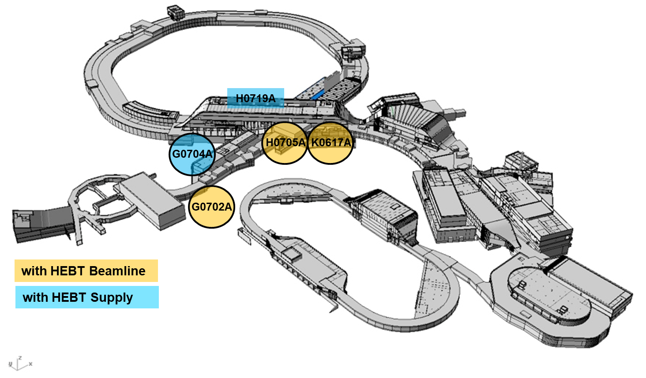
‘Staged’ Commissioning of TBI - HEBT
T1S1, T1S2 „need“ G0702A and G0704A
Start local HW Commissioning with T1S2 in 09/2025
Media supply (Stage V) in G0702A and G0702A available in 12/2025
TSX1, TSF1, T1F2, TFF1 „need“ H0705A, K0617A, H0719A
Start local HW Commissioning TSF1 in 08/2026
Power and Media supply (Stage V) available

Slide 19
HEBT Commissioning Roles
HEBT Commissioning Management (1 FTE, 2 heads – by HEB)
Overall coordination of activities
Reporting to SPL FAIR Commissioning and SPL Commons (level1)
Overall time planning
Coordination with the building activities in neighbouring areas
Authorisation to stop construction activities if needed
Define access restrictions together with STV(p) and Commissioners
HEBT Commissioners (1 FTE, 2 heads – no ressources in HEB)
Weekly coordination of activities together with STV(p) and WPLs
Weekly reporting
Daily coordination of activities on site
Activity primarily on the construction site
HEBT WPLs (+ staff from related department)
Execute Commissioning
Reporting to Commissioner
STV(p) (up to 1 FTE, 2 heads – by HEB + ?)
Preparation of safety instructions GBU, ASR …
Define access restrictions together with Commissioning Management and Commissioners
Revision of the instructions if needed
Monitoring of compliance with the safety rules

Slide 20
Summary
LCM workshops for almost all system types done
Estimation of time and ressources provided by WPLs/Departments
New timeline has been set up for Commissioning HEBT Early Science
Commissioning HEBT Early Science Phase1-3.1 parallel to installation HEBT First Science
Planned start of local HW commissioning in 09/2025 with section T1S2
Close coordination with installation required – transportation along T1S2
T1S1
TSX1
T1S2

Slide 21
Thank you
for your attention
Special thanks to the HEBT Planungsgruppe and all colleagues contributing to HEBT and this presentation.

Slide 22
HEBT beam commissioning
First step
favourable before first beam is directed to FAIR – measurement of beam parameters in HEST close to TS1MU1
start with nominal ion optic setting of beamline SIS18-SFRS
start with pilot beam, e.g. Ar, medium energy (12-18Tm), low intensity
use fast extracted beam for first commissioning of beamline
switch off/on HEBT branching dipoles to avoid uncontrolled beam loss in superconducting SFRS magnets
beam steering element by element (+ check functionality of beam diagnostics during this step)
beam will be dumped on SFRS beam catcher
Secon step (beam reaches SFRS beam catcher)
kick response measurement
aperture scan
measurement of dispersion
beam optimization to ensure hand over parameters for SFRS

Slide 23
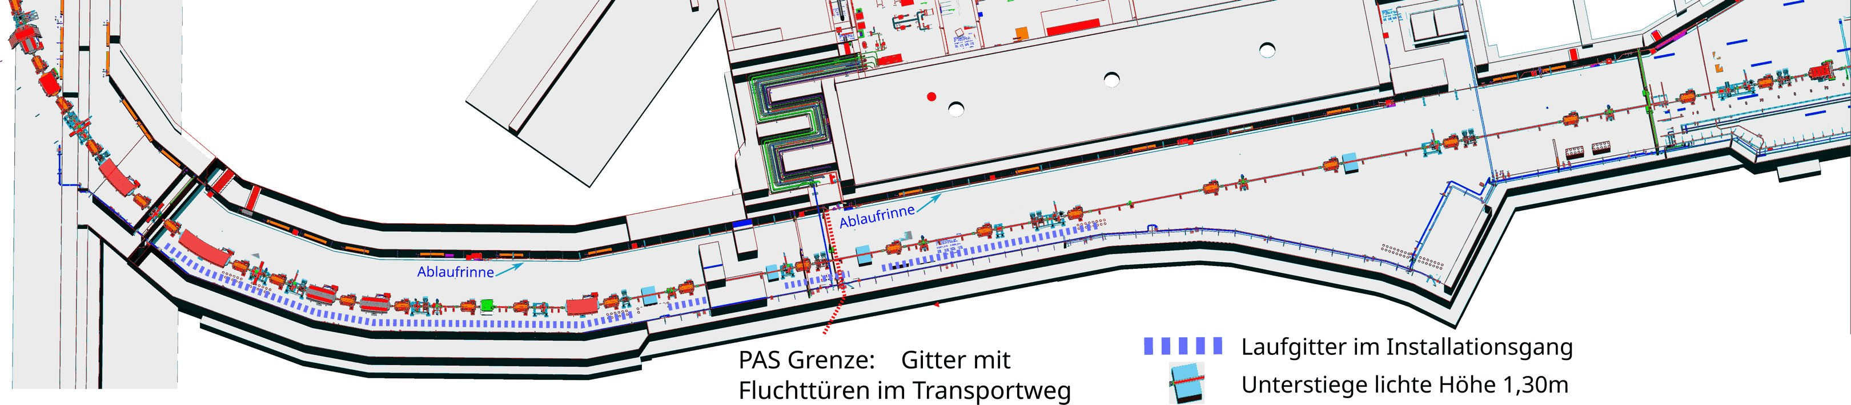
Tunnel G0702A

Slide 24
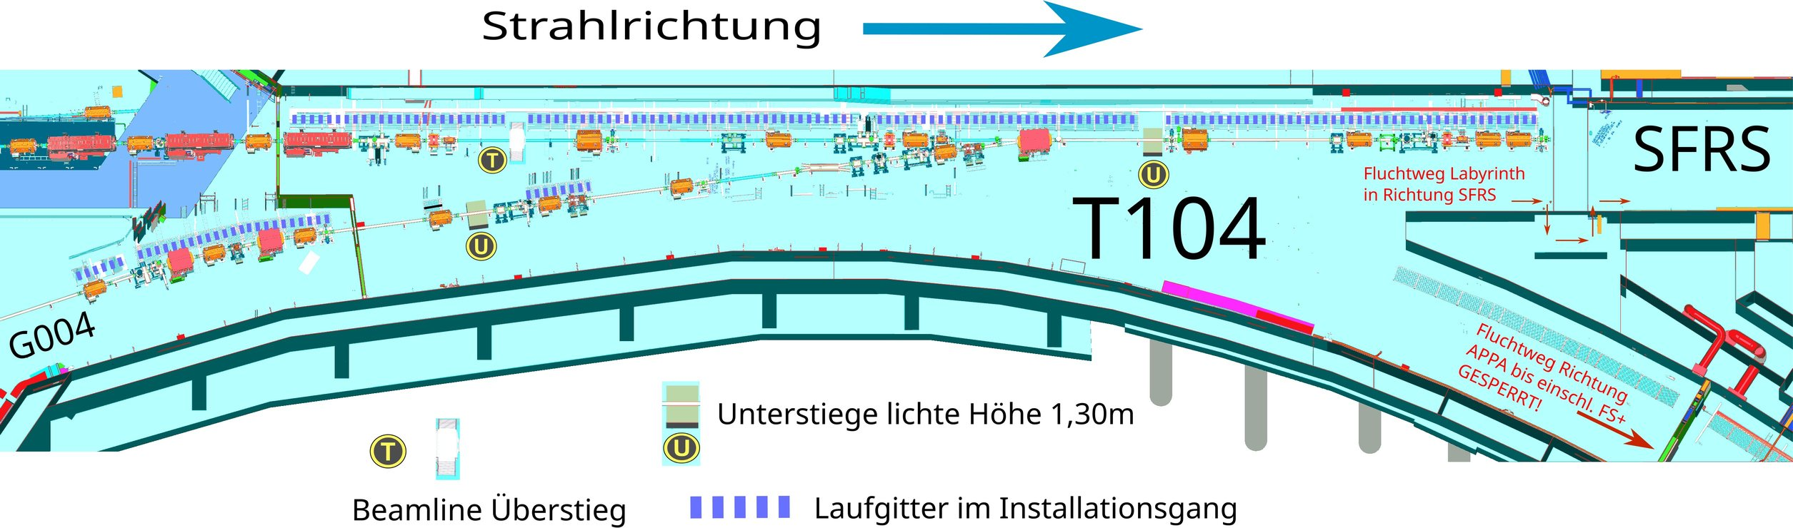
Tunnel K0617A

Slide 25

Montageplanung HEBT Tunnel
Stand: 01.11.2016
zusätzlichfürG004
1.
2.
3.
3.1
BI Komponenten
auf blaue Linie
stellen
CSTI
3.2
Vakuumkomponen-
tenauf blaue Linie
stellen
CSTI
3.3
BI Komponenten
vorjustieren
ENMA
3.4
3.5
3.6
Blaue Linien
anbringen
ENMA
Einbau Transport-
vorrichtungschiefe
Ebene
CSTI
Einbringung Beam
Dump
SI
Vakuumkompo-
nentenvorjustieren
ENMA
Mobile
Abschirmwände
stellen
FSB
DumpGrube
verschließen
(Brammen auflegen)
FSB
12.
11.
10.
Vakuumkomponen-
tenauf blaue Linie
stellen
CSTI
9.
8.
7.
6.
Sammelgestelle (mit
Komponenten) auf
blaue Linie stellen
CSTI
5.
Quadrupol auf blaue
Linie stellen
CSTI
4.
Dipol auf blaue Linie
stellen
CSTI
Montage der
Beschleunigerkomponenten
Komponenten
vorjustieren
CSTI
Sonstige
Komponenten auf
blaue Linie stellen
CSTI
SI Komponenten
auf blaue Linie
stellen
CSTI
BI Komponenten
auf blaue Linie
stellen
CSTI
Steererauf blaue
Linie stellen
CSTI
13.
Vorschließen
Vakuumsystem
CSTI
14.
Komponenten
feinjustieren
ENMA
15.
Endgültiges
Schließen
Vakuumsystem
CSTI
16.
17.
18.
19.
Wassergekühlte
Geräte: Schläuche
anschließen
CSTI
20.
Magnete Polarität
prüfen
ENMA
21.
Maschinennahe
Trassen mont. und
Kleinsignalka. aufl.
LOEP
As buildin DMU
Model übernehmen
ENMA
Mediennahe
Wasserverso. und
Wasservert. setzen
CSTI
Magnetkabel
konfektionieren und
anschließen
LOEP
Anschluss
Komponenten
30.
Inbetriebnahme
Beam
Instrumentation
CSBI
29.
28.
Detektorgasvers.für
BI; Anschluss,
Inbetrieb.
CSBI
27.
26.
Wasserkreisläufe:
Dichtigkeit prüfen,
Inbetriebnahme
CSTI
25.
24.
Vakuum Anpumpen/
Lecktest
CSVS
23.
22.
Inbetriebnahme
Power Converter &
Magnete
ENMA & LOEP
Pressluft:
Anschluss,
Inbetriebnahme
CSTI
SI-Kabel
konfektionieren und
anschließen
SI
Vakuum-Kabel
konfektionieren und
anschließen
CSVS
BI-Kabel
konfektionieren und
anschließen
CSBI
Inbetriebnahme
Komponenten
31.
Inbetriebnahme
Vakuum
CSVS
32.
33.
Inbetriebnahme
Kontrollsystem
CSCO
34.
35.
36.
Brandschutzwände
montieren
FSB
37.
BLM‘smontieren +
verkabeln
CSBI
Abschluß
arbeiten
Inbetriebnahme
Special Installations
SI
Komponenten
feinjustieren
ENMA
Mobile
Abschirmwände
stellen
FSB
Arbeitspakete / Zuständigkeiten
2.3.2.
Magnets
ENMA
C. Mühle
2.3.0.3.
DMU
2.3.3
Power Converter
LOEP
H. Welker
2.3.6
Beam Instru-
mentation(BI)
CSBI
B. Walasek-H.
2.3.7
Vacuumsystems
CSVS
L. Urban
2.3.11
Special
Installations
SIS18/SIS100(SI)
L. Bozyk
2.14.9.8
Alignment
ENMA
I. Pschorn
2.14.10
Controls
2.14.12
Installations/
Assembly
CSTI
M. Bevcic
3
Building
infrastructure
FSB
A. Fischer
ENMI
L. Heyl
CSCO
R. Bär

Slide 26

Montageplanung HEBT
Versorgungsgebäude
Stand: 01.11.2016
Aufstell-
ung
1.
Doppelboden mit
provisorischen
Platten schließen
FSB
2.
Unterverteilung
NSHV aufstellen
und anschließen
FSB
3.
4.
5.
6.
BI Racks
aufstellen und
bestücken
CSBI
7.
8.
Vakuum Racks
aufstellen und
bestücken
CSVS
9.
Montage
Umluftkühlgerätefür
Druckbelüftung
FSB
Power Converter
und Netzgeräte
aufstellen
LOEP
Control Racks
aufstellen und
bestücken
CSCO
SI Racks
aufstellen und
bestücken
Sonstige
Komponenten
aufstellen
SI
NN
18.
Nutzertrafos
anschließen
LOEP
17.
16.
Potentialausgleichs-
schienen für alle
Racks anschl.
LOEP
15.
14.
13.
SI Kabel
konfektionieren
und Kabeltests
12.
BI Kabel
konfektionieren
und Kabeltests
CSBI
11.
Controls-Kabel
konfektionieren
und Kabeltests
CSCO
10.
Power Converter
Kabelkonfektionieru
ng und Kabeltests
LOEP
Primärkabel an
Racks anschließen
FSB
Sonstige Kabel
konfektionieren
und Kabeltests
NN
Vakuum-Kabel
konfektionieren
und Kabeltests
CSVS
Anschluss
Komponenten
SI
19.
20.
Kühlwasser an H₂O-
Kabel anschließen
LOEP
21.
22.
23.
24.
25.
26.
Brandschotts
schließen
FSB
27.
Doppelbodenplatten
durch endgültige
Platten tauschen
FSB
Kühlwasser an
Racks anschließen,
füllen, entlü., spülen
LOEP
Interlock-und
Controls-Kabel
anschließen
LOEP+CSCO
BI Kabel
anschließen
CSBI
SI Kabel
anschließen
Vakuum-Racks
anschließen
CSVS
Brandmelder im
Doppelboden
montieren
FSB
Abschluß
arbeiten
SI
33.
Inbetriebnahme
restliche
Komponenten
NN
32.
Inbetriebnahme
Vakuum
CSVS
31.
Inbetriebnahme
SI
30.
Inbetriebnahme
BI
CSBI
29.
Inbetriebnahme
Power Converter
LOEP
28.
Inbetriebnahme
Control
CSCO
Inbetrieb-
nahme
SI
Arbeitspakete / Zuständigkeiten
2.3.2.
Magnets
ENMA
C. Mühle
2.3.3
Power Converter
LOEP
H. Welker
2.3.6
Beam Instru-
mentation(BI)
CSBI
B. Walasek-H.
2.3.7
Vacuumsystems
CSVS
L. Urban
2.3.11
Special
Installations
SIS18/SIS100(SI)
L. Bozyk
2.14.9.8
Alignment
ENMA
I. Pschorn
2.14.10
Controls
2.14.12
Installations/
Assembly
CSTI
M. Bevcic
3
Building
infrastructure
FSB
A. Fischer
CSCO
R. Bär

