Slide 1
Start of Commissioning & Cryogenic Operation @ FAIR
Holger Kollmus, FAIR Commissioning Workshop

Slide 2
Outline
Status of the cryogenics for FAIR
CRYO2 and DB3
Distribution Systems
Local cryogenics
Commissioning Scenario for ES

Slide 3
Cryogenic System for FAIR
One central cryo plant, the CRYO2: 15 kW cooling power @ 4,4 K (-269 °C) 50 kW cooling power @ 50 K (-223 °C)
Main users:
SIS100 located in the north
Super-FRS located in the south
Transfer system of approximately 1.5 km of vacuum insulated lines + distribution boxes (DB2, DB3 and DB4)
DB3 ➔ central DB close to CRYO2
DB2 ➔target area of SuperFRS, distribution to T, P and CBM
DB4 ➔ SIS100, niche 5

Slide 4
Topologie of FAIR cryo systems

Slide 5
Status of Procurement/Installation
Installed
Procurement
Delivered
Production

Slide 6
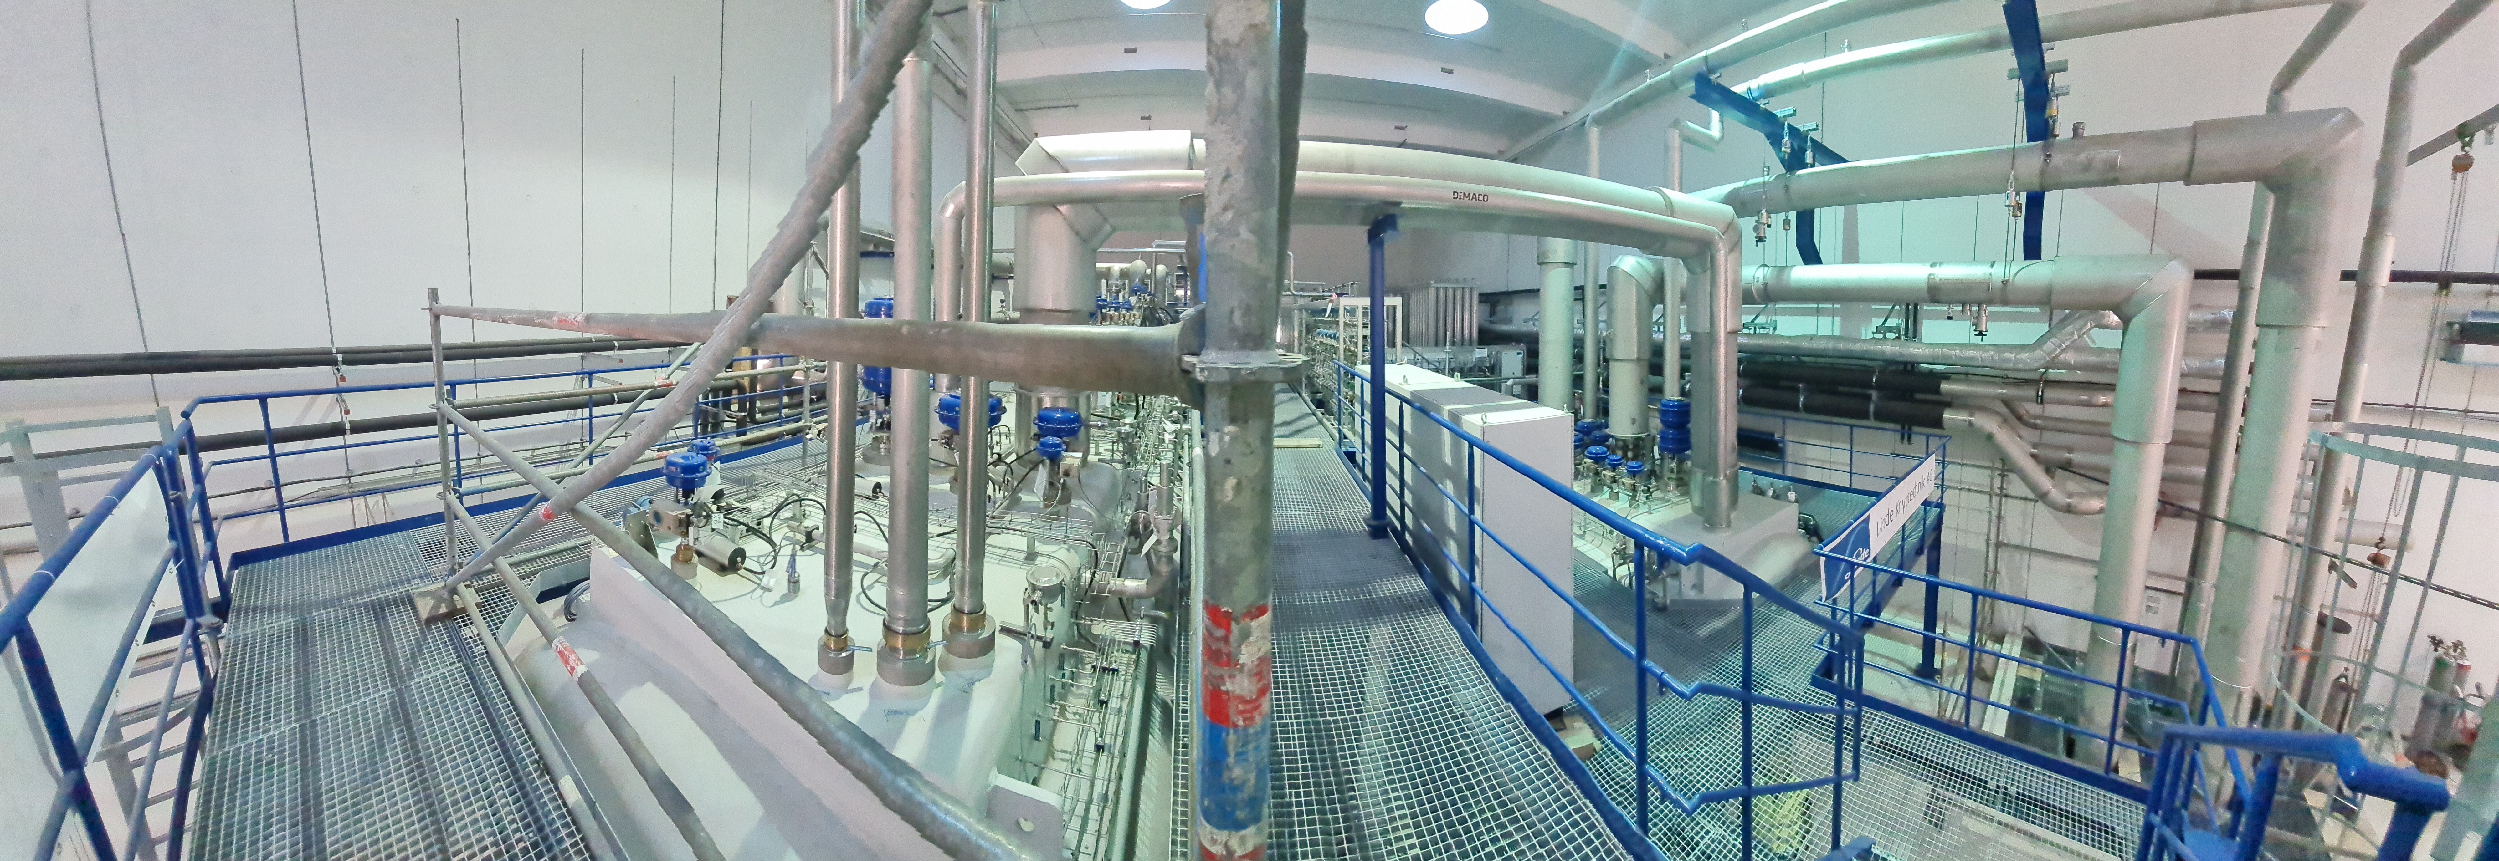
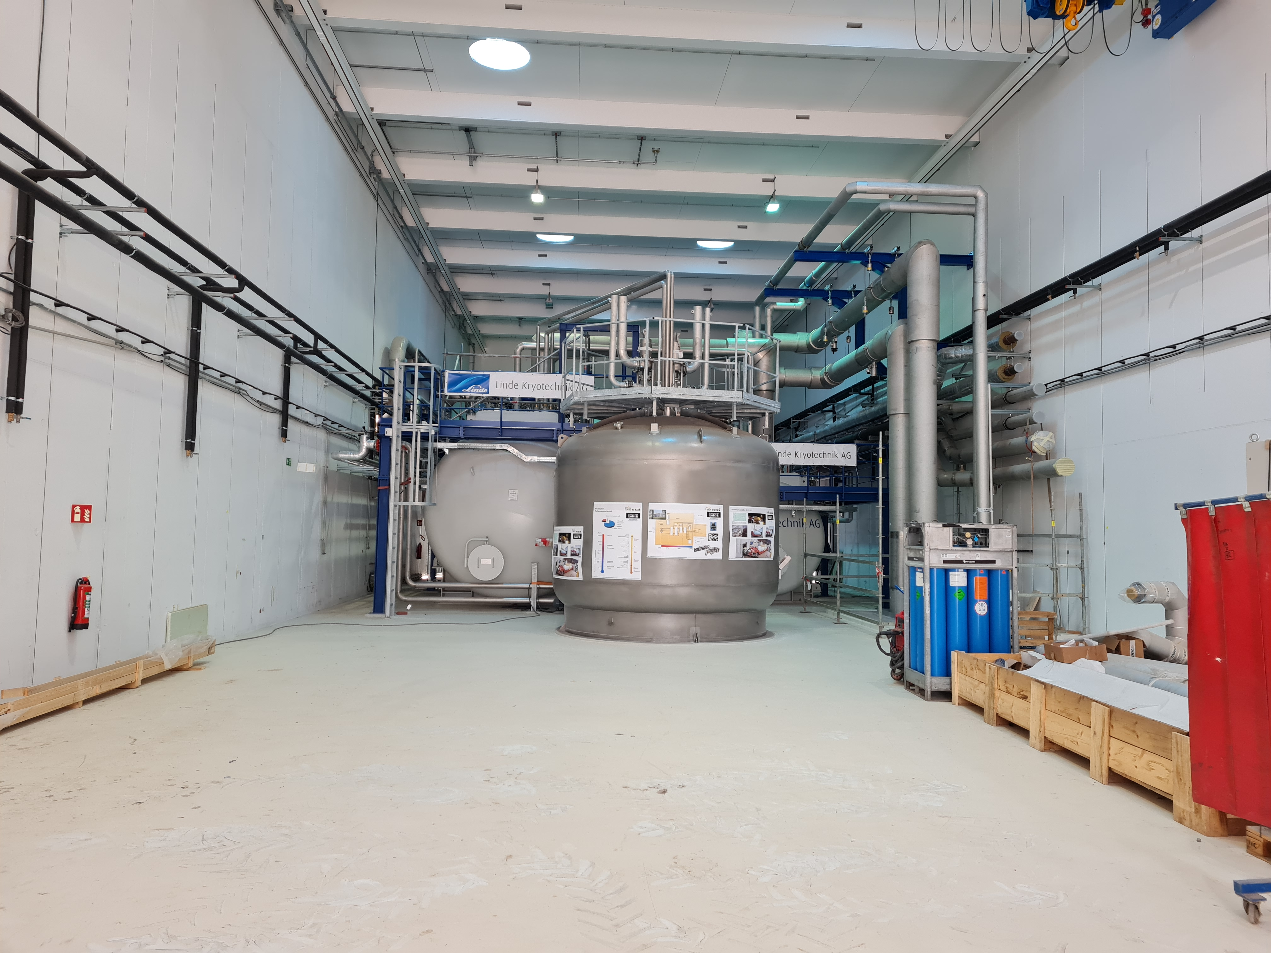
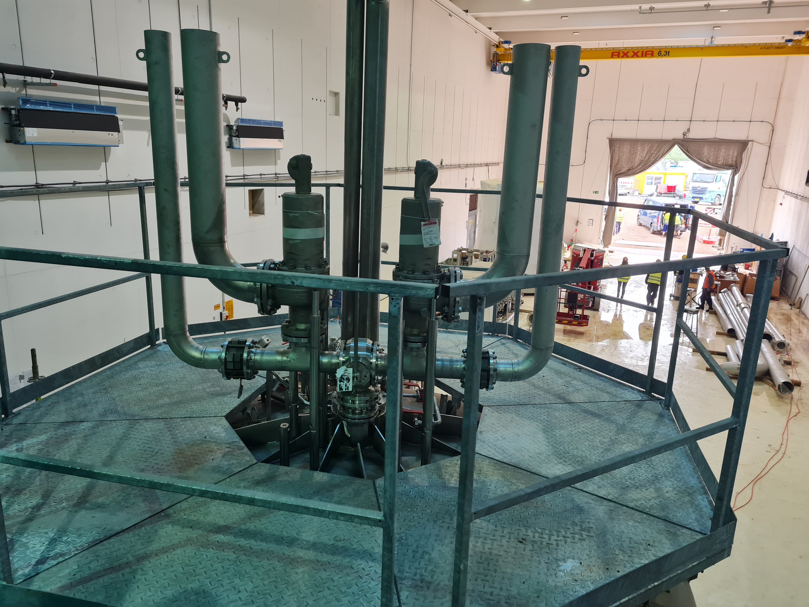
CRYO2 Installation
MC in August 2023, only a few remaining works

Slide 7
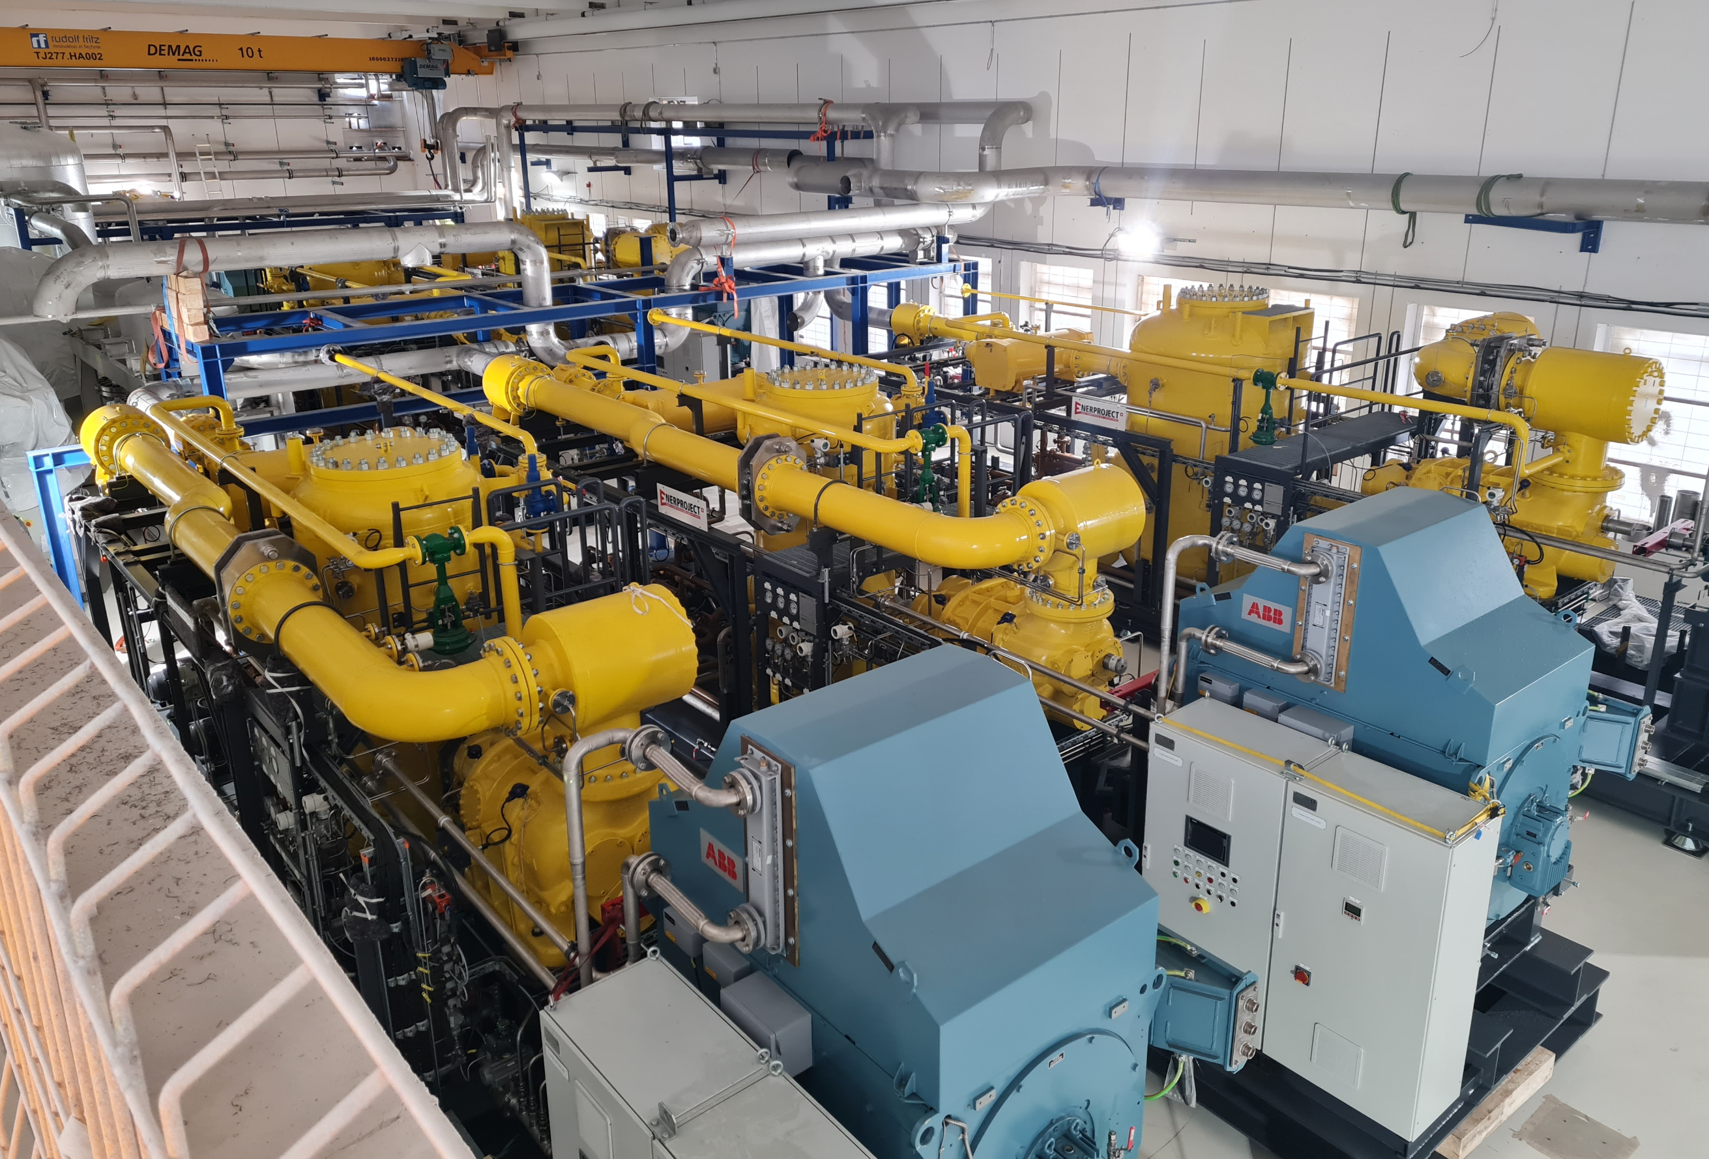
Delivery of Warm Compressor system in Q4/2022
Five Compressors
2 x LP
2 x HP
CWU (1. stage)
CWU Compressor can be used as redundancy for either HP or LP
2 Oil removal systems

Slide 8
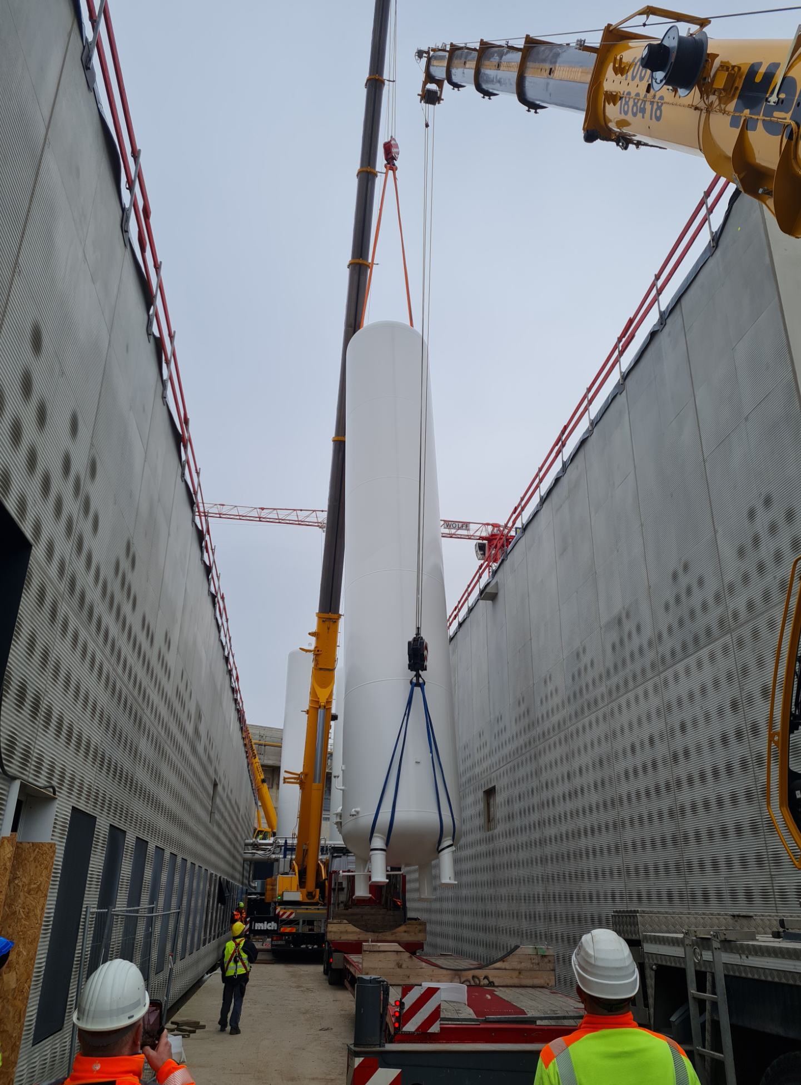
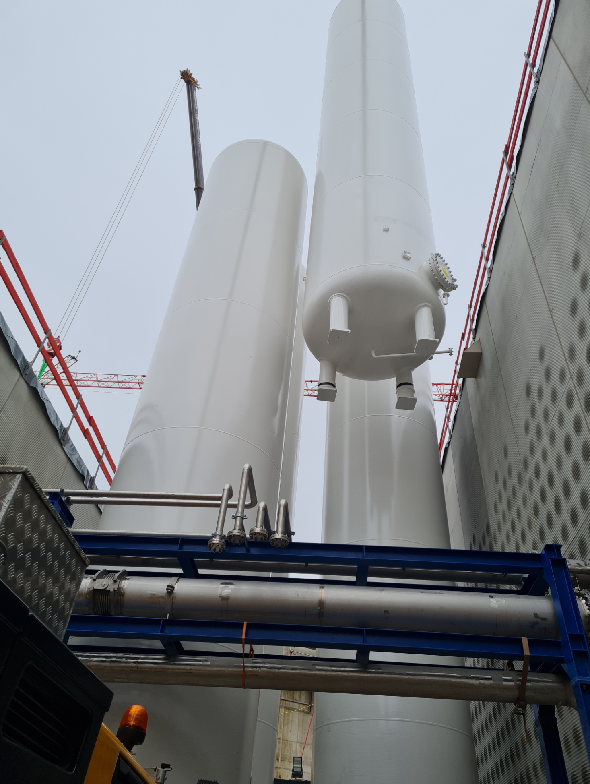
Tank installation, first six (100 m³)
Filling in November 2024, 6 x 100 m³ @ 16 bar ~10,000 m³
12 more tanks are in production (SuperFRS inventory)

Slide 9
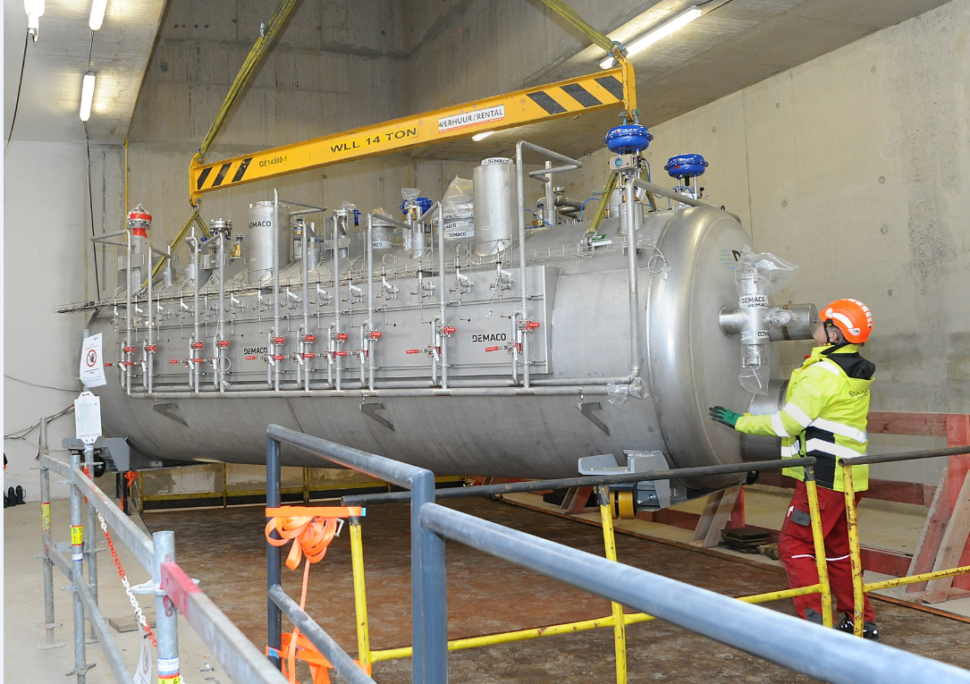
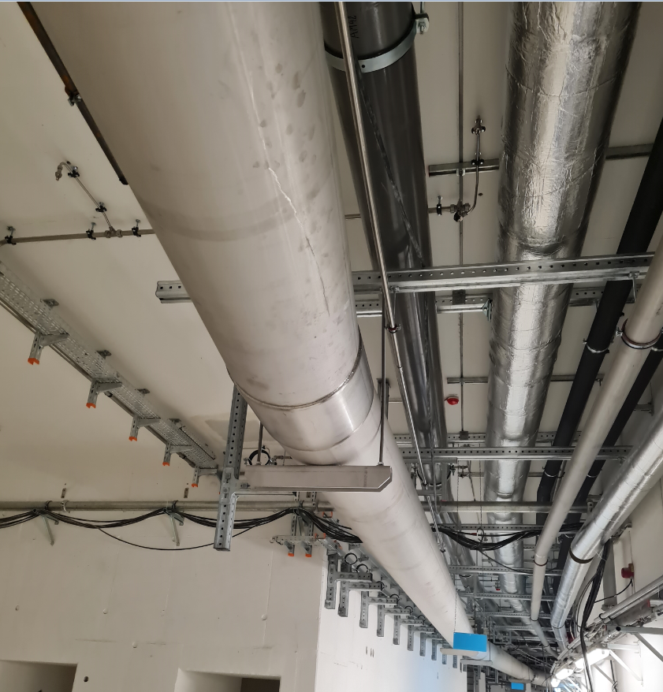
Installation SIS100 DS Started in October 2022
Delivery and Installation of DB4 in niche 5 Installation in the tunnel
SIS100 distribution system finished in October 2023

Slide 10
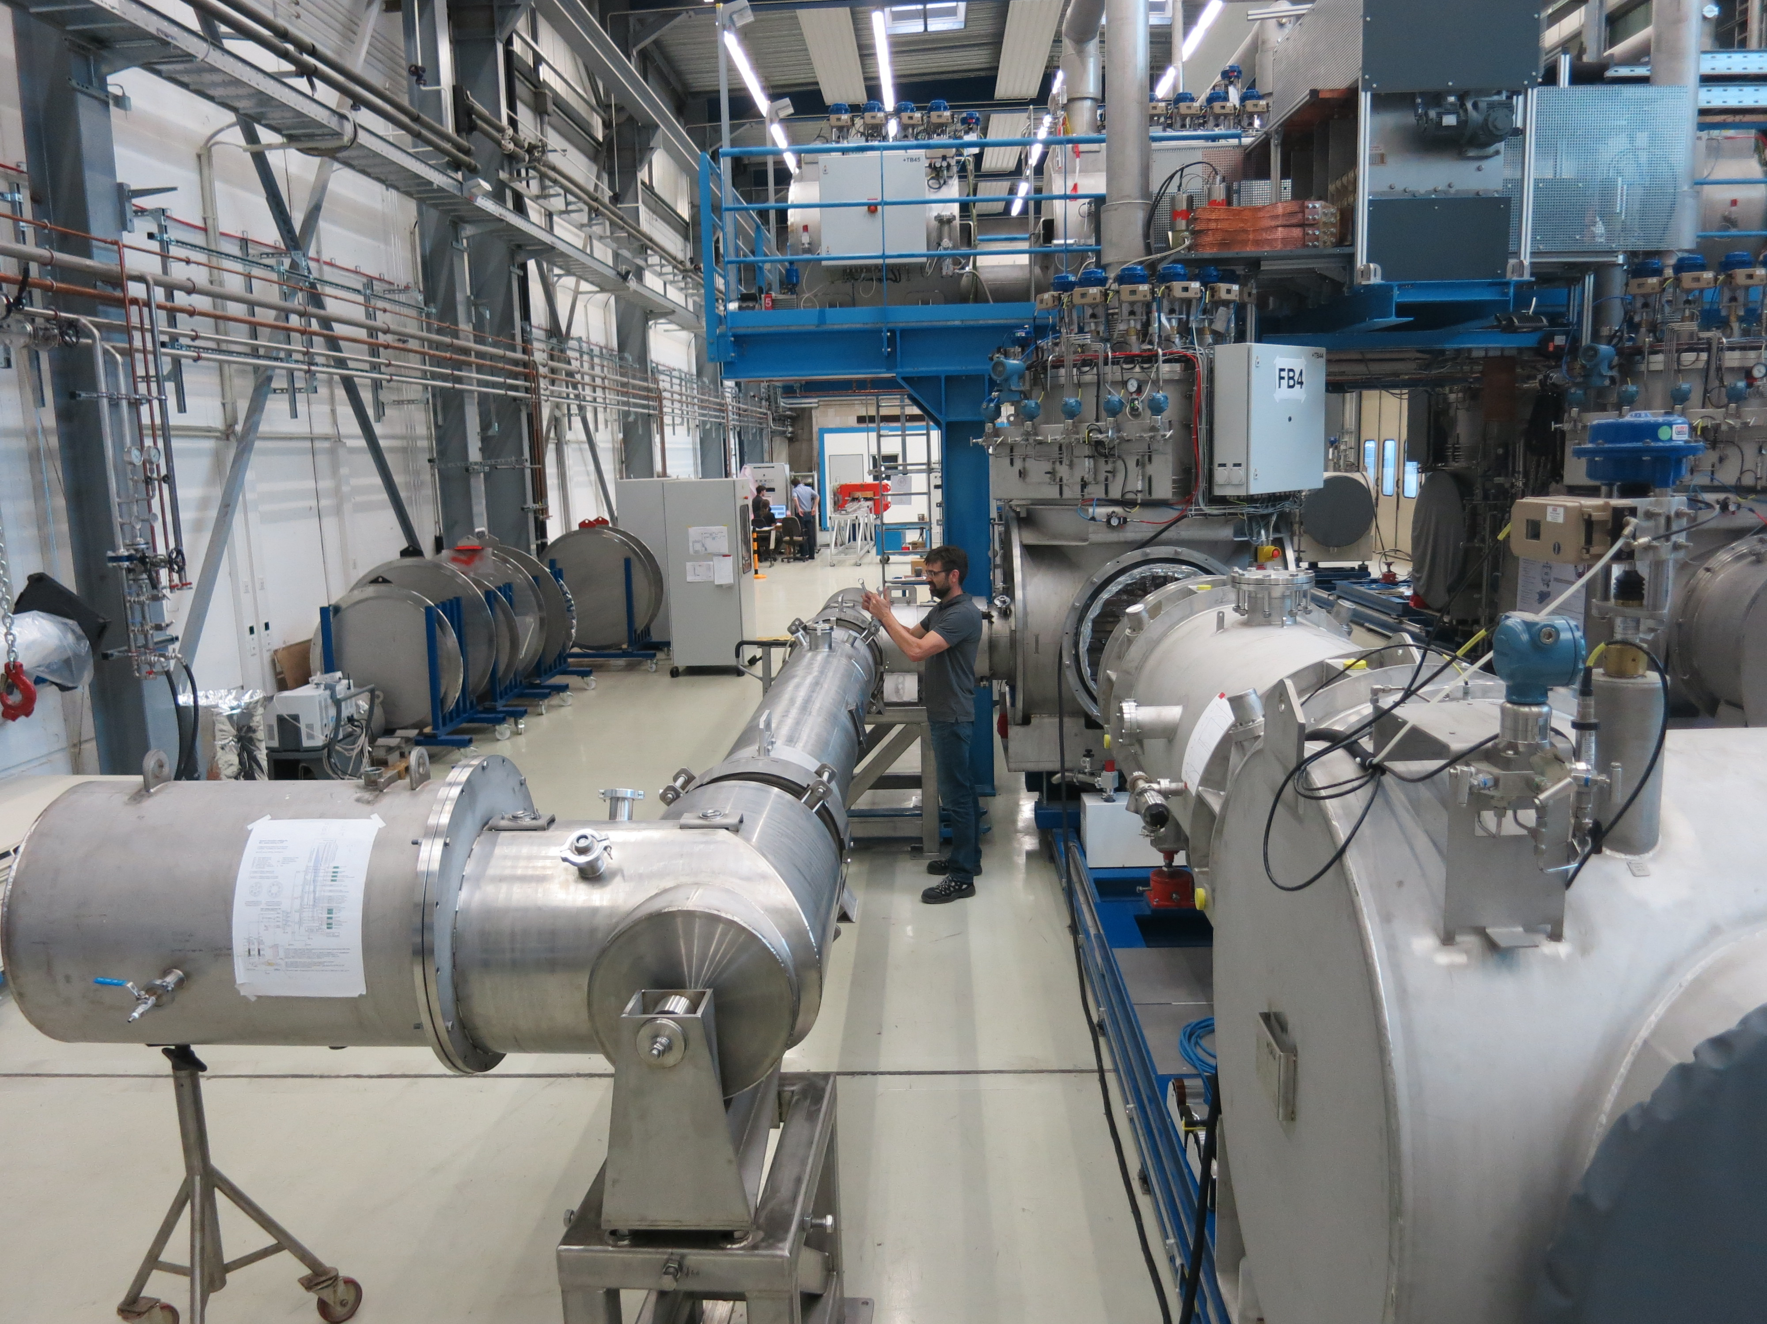
SIS100 local cryogenics
Produced at Kriosystem in Poland, finished accept feed boxes

Slide 11
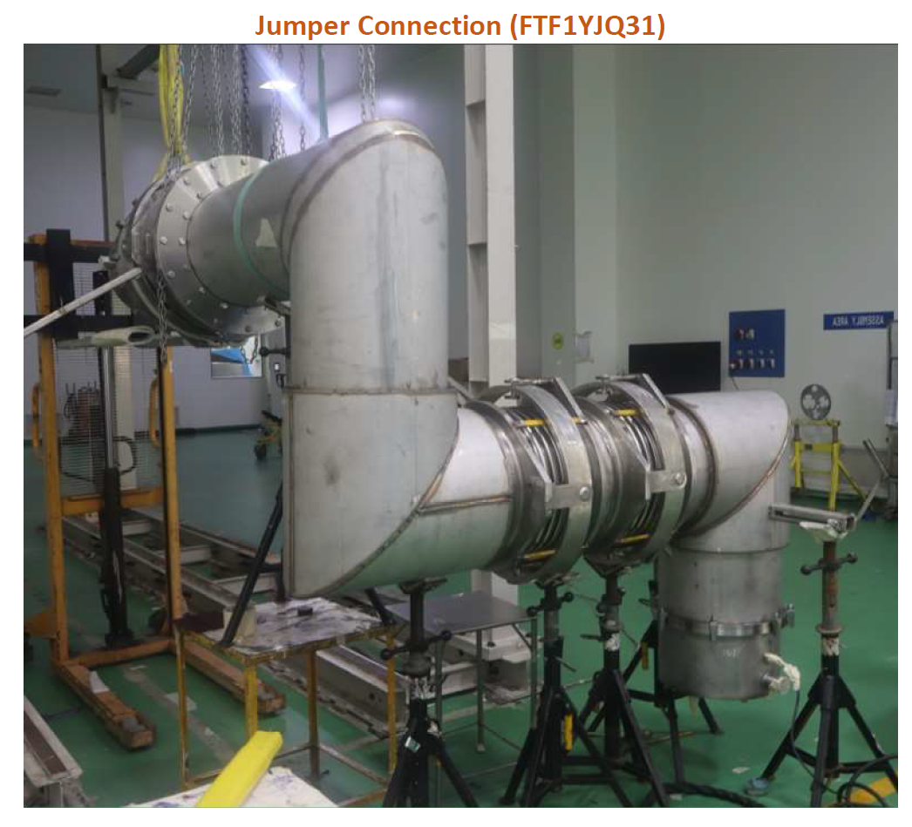
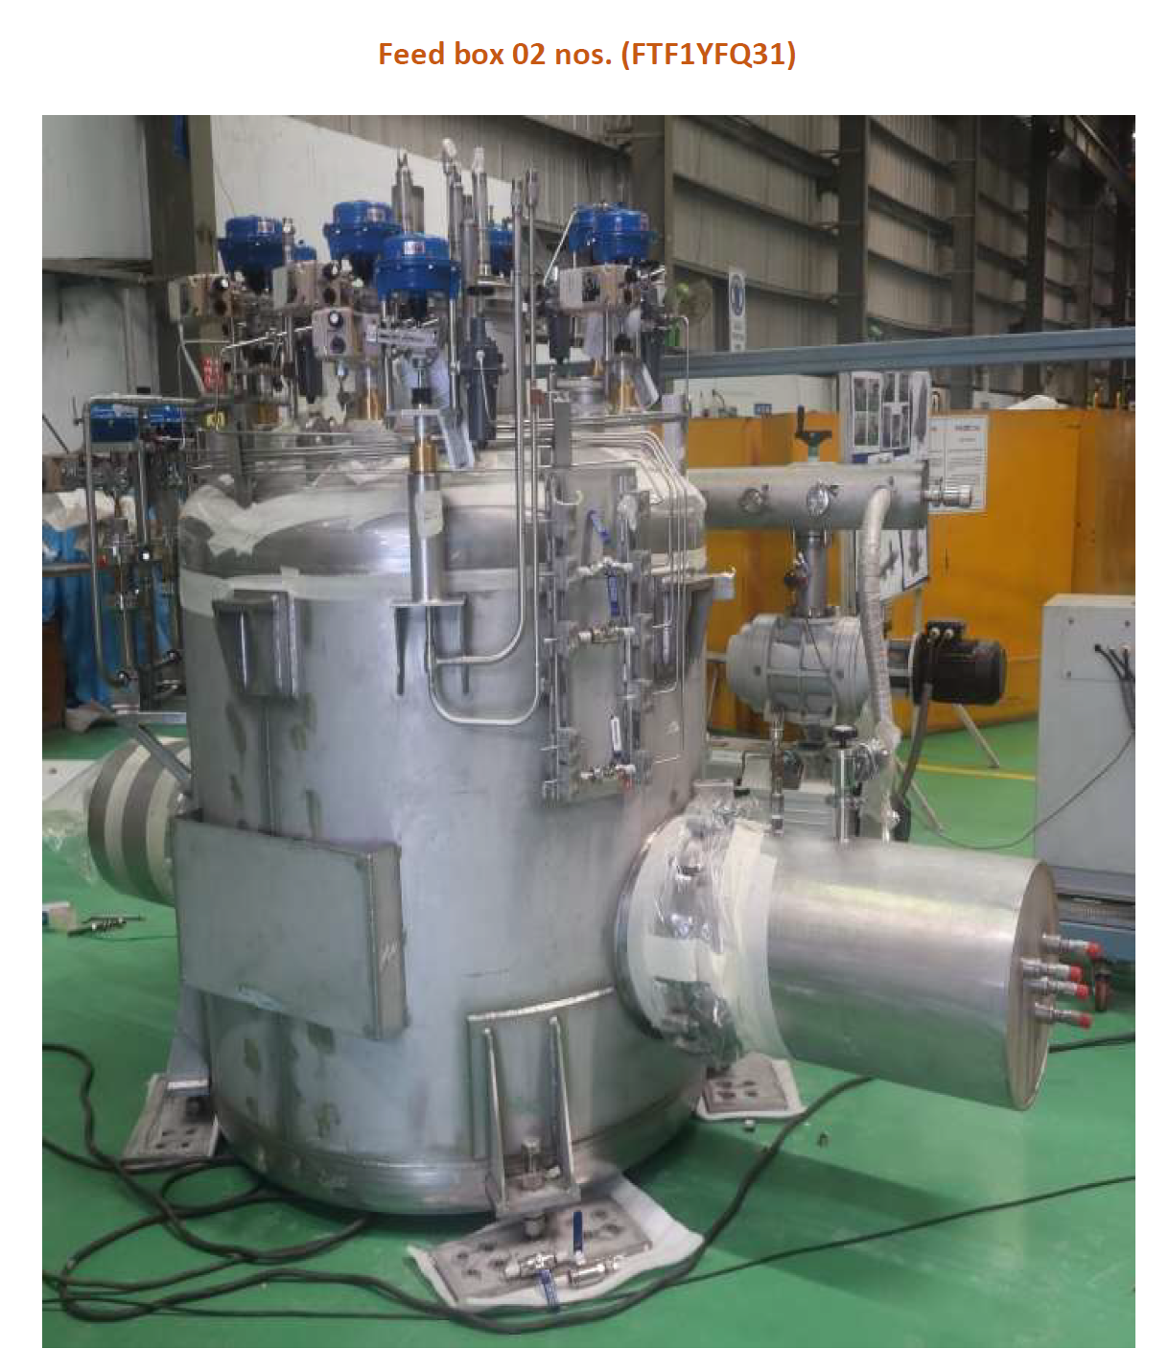
SuperFRS local cryogenic
T-Branch of SuperFRS is on the transport to FAIR, FoS testing will start in January 2025, produced at INOX, India
Branch P Polish In-Kind, production most probably INOX, India
Branch M, H, G in procurement, M4 earliest February 25

Slide 12
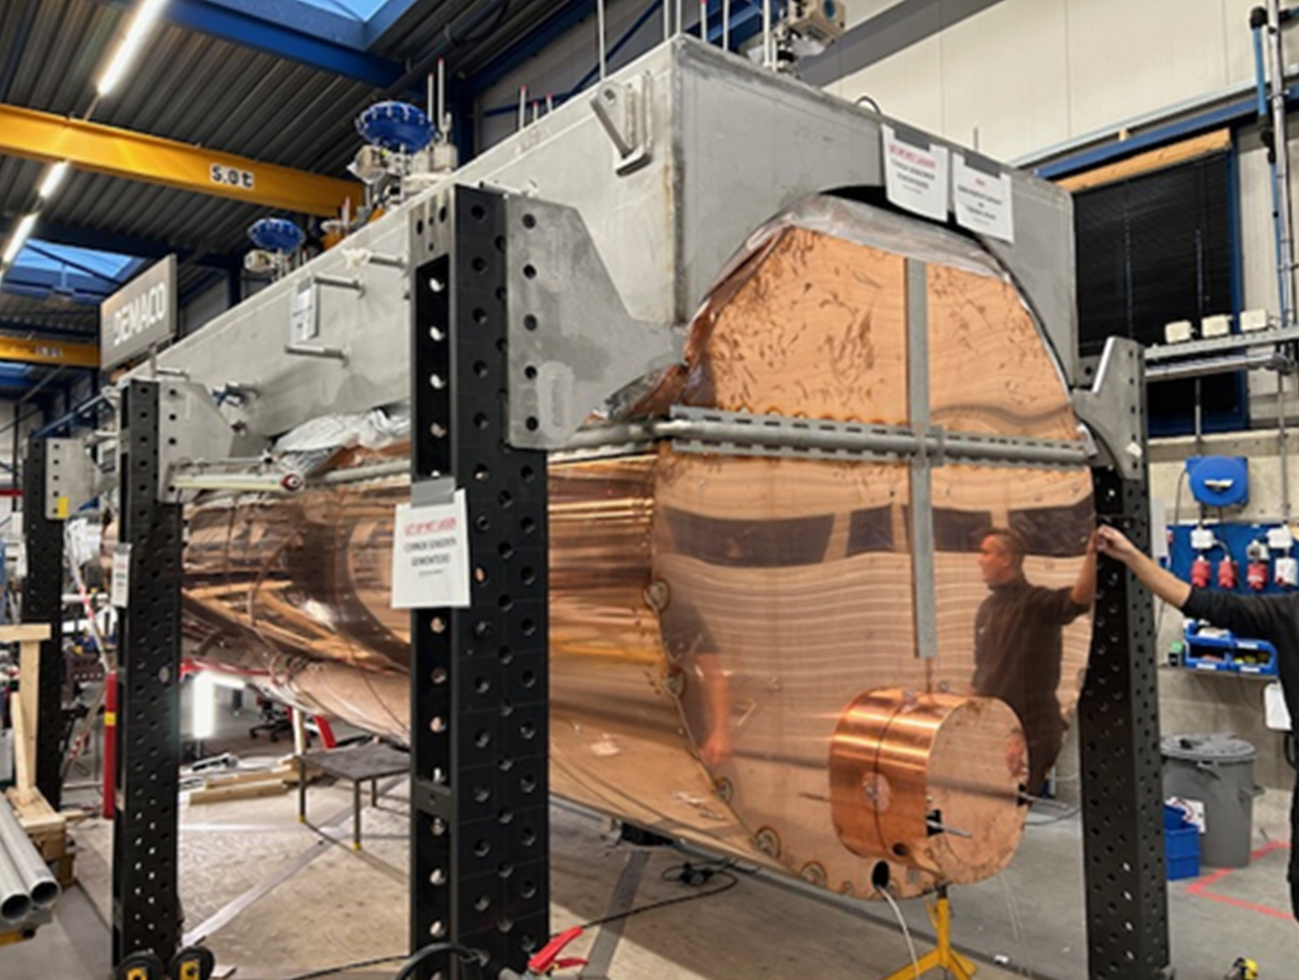
SuperFRS Branch Box (Demaco)

Slide 13
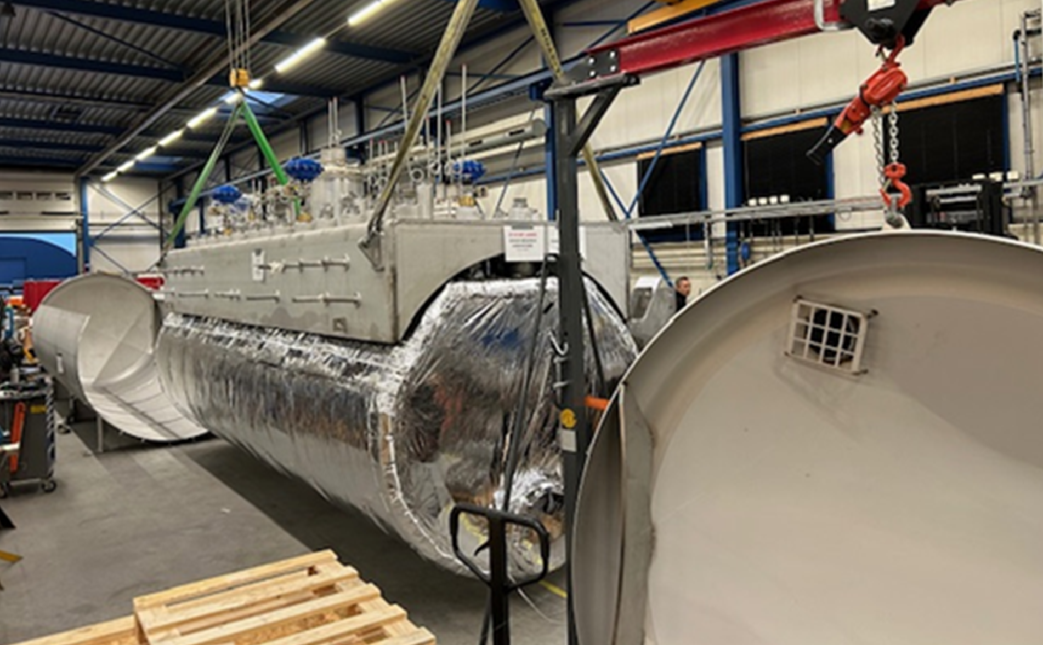
SuperFRS Branch Box (Demaco)

Slide 14
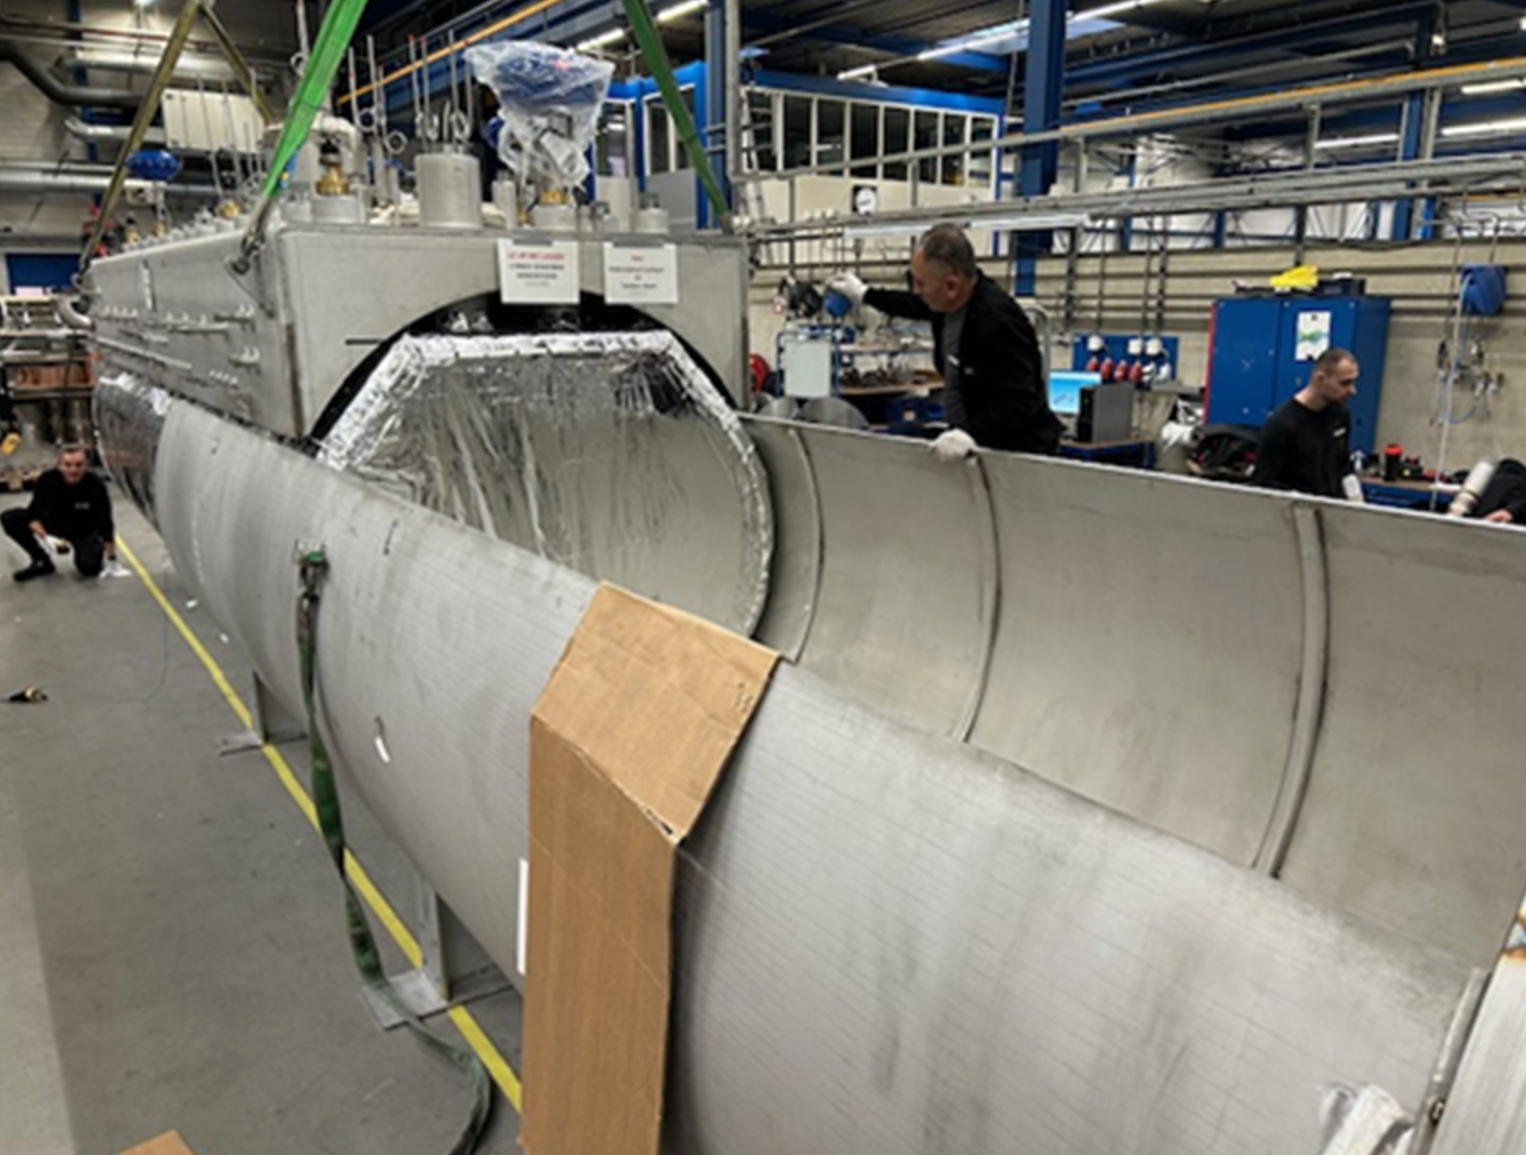
SuperFRS Branch Box (Demaco)

Slide 15
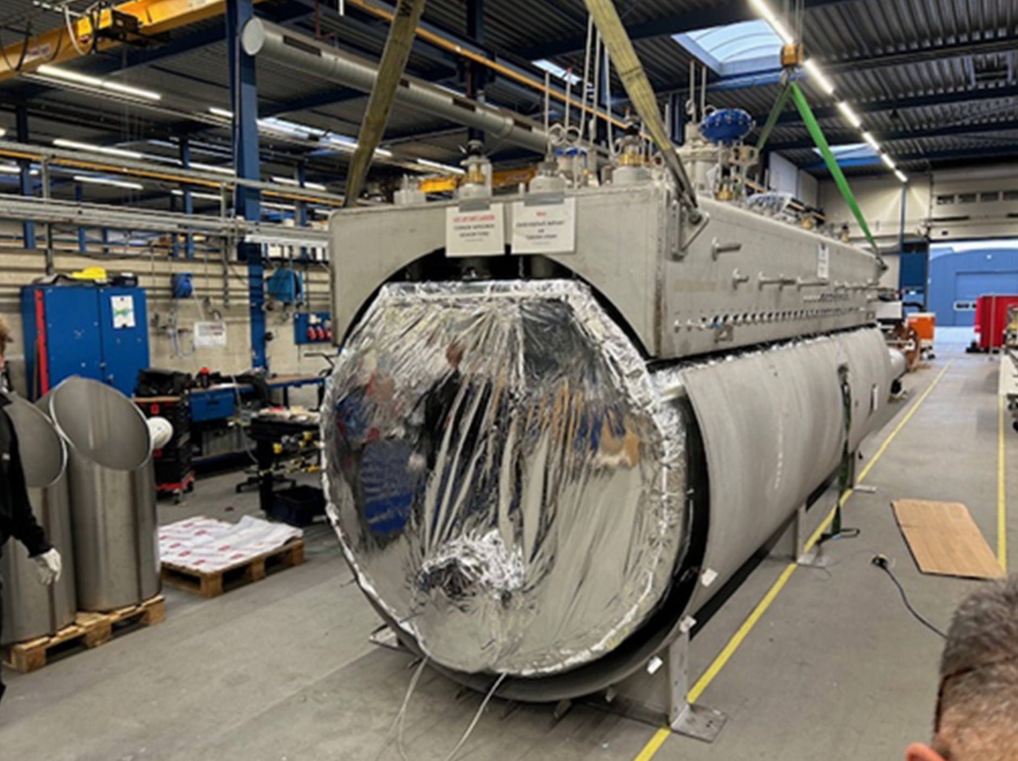
SuperFRS Branch Box (Demaco)

Slide 16
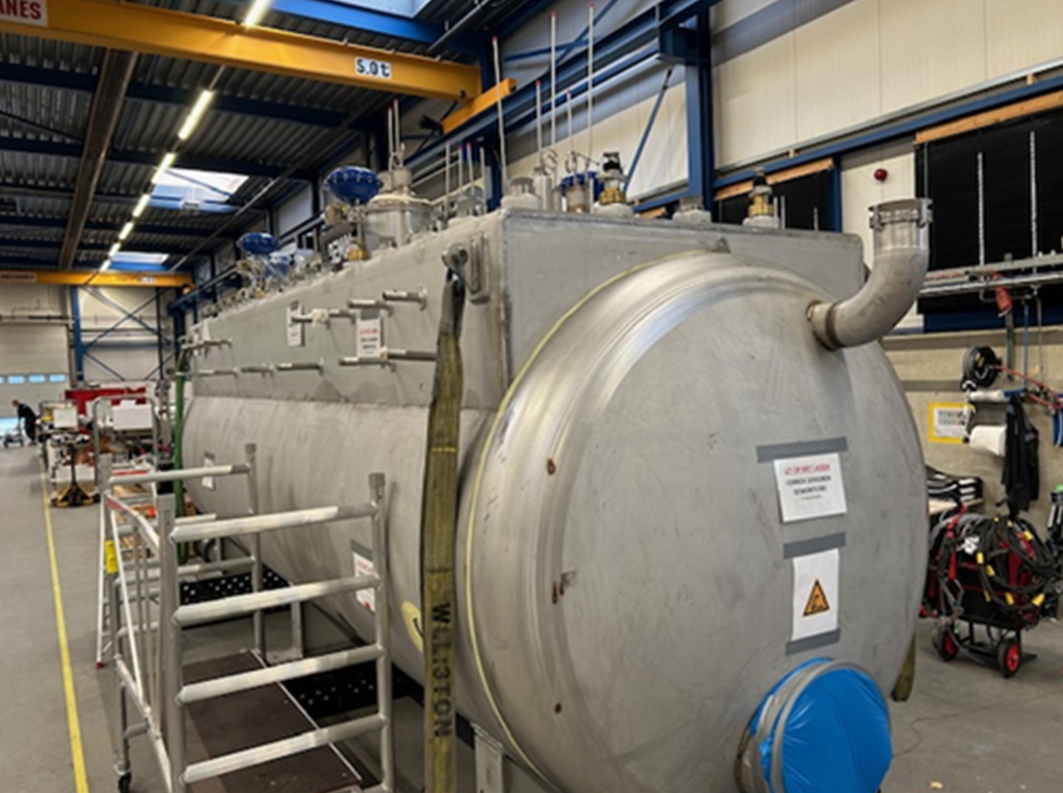
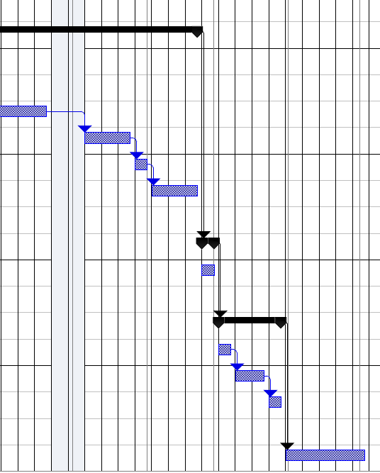
SuperFRS Branch Box (Demaco)
Production
Tests/FAT
Transport
Installation

Slide 17
Requirements for commissioning
He deliveries; remaining deliveries
Helium is ordered, filling in November 2024, 10.000 m³
All remaining deliveries of CRYO2 are on store and will be delivered just in time
charcoal still needs to be filled, 7.5 to
Declaration of conformity (HBO building supervision, TÜV)
LAN ➔ still no access to outside world (back office, mobile phone)
LN₂ needs to be contracted
Hall and machine needs to be cleaned
Fire protection concept must be approved (HBO building supervision)
Time Schedule CRYO2 depending on Techn. Infrastructure available in 2025
Electricity ➔ approx. 5 MW (April 2025, 20 kV transformer, with “Baustrom”)
Cooling water ➔ comes from the main supply building via the P-route (promised for February 2025)
Compressed air ➔ an isolated solution is to be implemented here (promised for January 2025)
Air cooling in Compressor hall (?) 5% of heat goes to the air and needs to be ventilated

Slide 18
Legal points for commissioning
During Commissioning FAIR is still a construction side without HBO acceptance!
Access control
Access with card for trained personnel only (like GSI, annual instructions for working on refrigeration systems as a supplement to general safety instructions).
CRYO_TBI interaction, roles & responsibilities, Organization during commissioning.
Access of external companies, remaining work on the building, TBI should be coordinated by CRY.
TBI ➔ Who takes care of the operation of all technical infrastructure, especially cooling. What role will GSI/GAT play at FAIR?
Organization, roles, responsibilities during remaining site existence.
At GSI there is an STV (Safety Technical Officer). He is responsible for instruction, for the access of employees and external companies, as well as for the safety and functionality of the work equipment. He is appointed by the management.
Training and integration of GSI Personnel.
Approximately 5 persons of the GSI cryogenic department are very familiar with the CRYO2 and will be trained during commissioning. Presently we are operating 4 cryo plants at GSI. There is no concept for regular 24/7 operation.

Slide 19
Commissioning sequence ES
June 25 ➔ January 26: commissioning of CRYO2 against DB3
Cold link and DB3 ➔ DB2 in procurement, first offer this week followed by a negotiation phase, M4 earliest February 25, start installation earliest January 26, ½ year of installation
July 26 ➔ October 26: cool down of transfer line towards DB2
November 26: filling the sub cooler of DB2
Ready for cool down T-Branch in November 26
December 26 ➔ April 27: cool down of T-Branch
Mai 27: cool down P, M, H and G
Branch M/H/G currently in procurement phase, first offers received, negotiation meetings under planning, M4 earliest February 25, start installation Q2/2026?

