Slide 1
Technical Building Infrastructure Commissioning
Strategy, Phases, Timeline & Status
07.11.2024
B. Redmer
FAIR Site & Buildings

Slide 2
Content
TOP 1: Commissioning Concept
TOP 2: Commissioning Strategy
TOP 3: Schedule and Status
Notes:
1

Slide 3
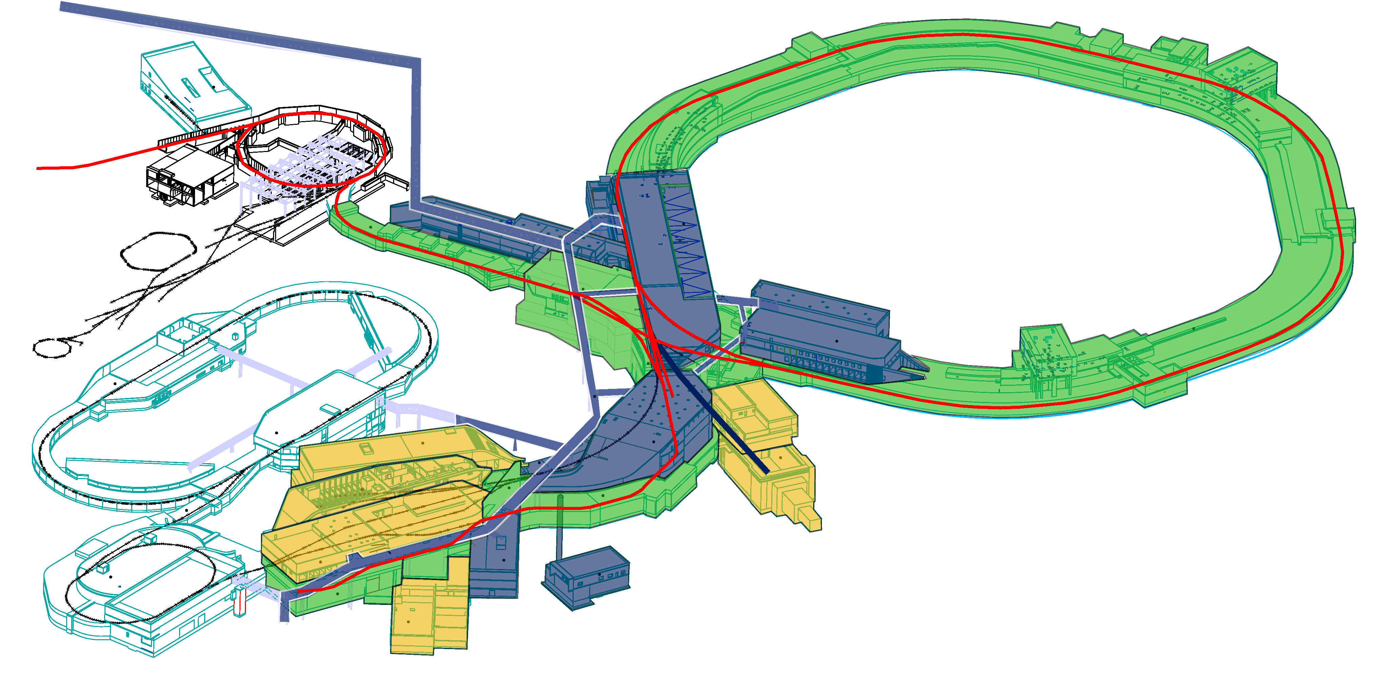
TOP 1 Commissioning Concept
Overall Operation Concept
H0705A
G0704A
H0719A
K0923A
G0702A
K0720A
K0503A
K0617A
K0519A
K0406A
K0619A
beam line / utility distribution full configuration FS
utility supply full configuration FS
L0608A
utility supply reduced configuration FS
Optionsgebäude
L0516A
beamline
K0410A
K0321A
K0308A
L0409A
K0314A
L0321A
L0317A
Optionsgebäude
Notes:
2

Slide 4
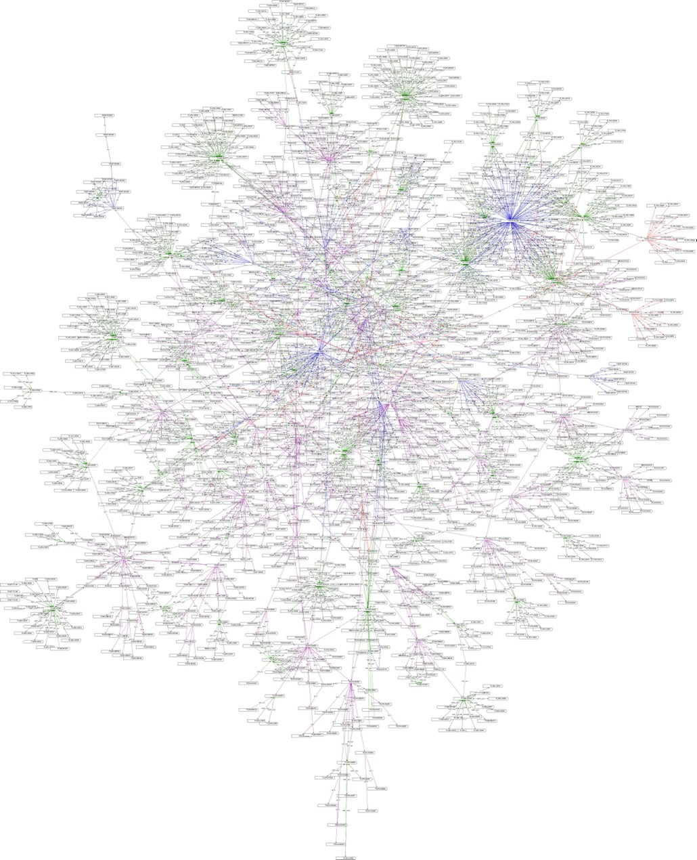
TOP 1 Commissioning Concept
The complexity of the technical facilities requires a
systematic approach while scheduling the commissioning activities.
The picture shows the systematic dependencies between the different technical facilities.
The entire configuration consists of approx. 3.000 technical facilities combining approx. 107.000 technical components.
Notes:
HTML und PDF mit einbinden.

Slide 5
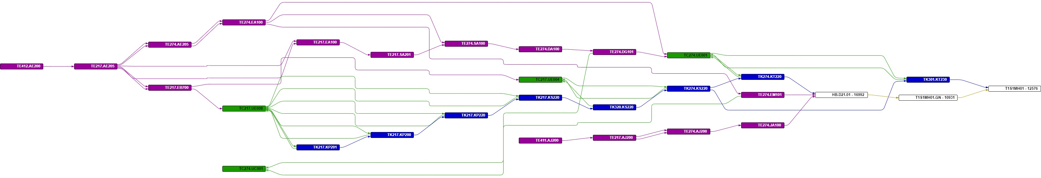
TOP 1 Commissioning Concept
Interface matrix PDB-CDB (TGA - Customer)
Example T1S1MH01 (magnet with power supply and rack)
Power Supply
Building Automation
Heating / Cooling
Customer Equipment
PDB = Planning Database FSB
CDB = Components Database Owner

Slide 6
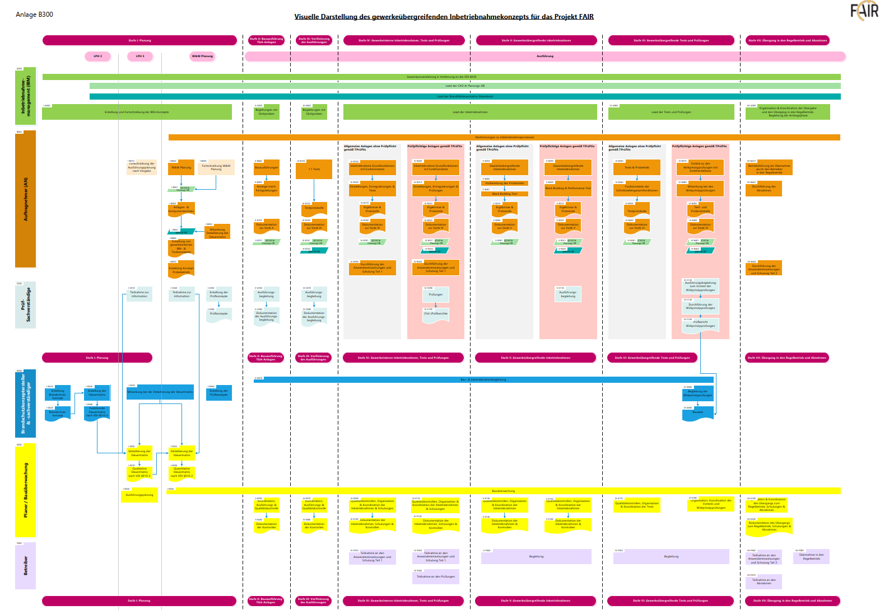
TOP 1 Commissioning Concept
Process
The commissioning process of each technical facility consists of 7 phases:
Design
Construction
Construction verification
Internal commissioning
Integrated commissioining
Plant-wide commissioing and testing (approval)
Start-up and operation
Notes:
5

Slide 7
TOP 1 Commissioning Concept
Responsibilities
I
II
III
IV
V
VI
VII
The commissioning process of each technical facility consists of 7 phases:
Design
Construction
Construction verification
Internal commissioning
Integrated commissioining
Plant-wide commissioing and testing (approval)
Start-up and operation
FSB Commissioning Management
Contractor
Design, Construction, Commissioning
Technical Experts
(design/construction)
Technical Experts and Authorities
(tests and acceptance)
Fire Safety
(Design)
Fire Safety
(during construction and commissioing)
Planner
(LPh1-5)
Planner
(LPh8-9)
Owner
(training und instruction) (turnover and operation)
Notes:
FSB IBN Management führt den Gesamtprozess
6

Slide 8
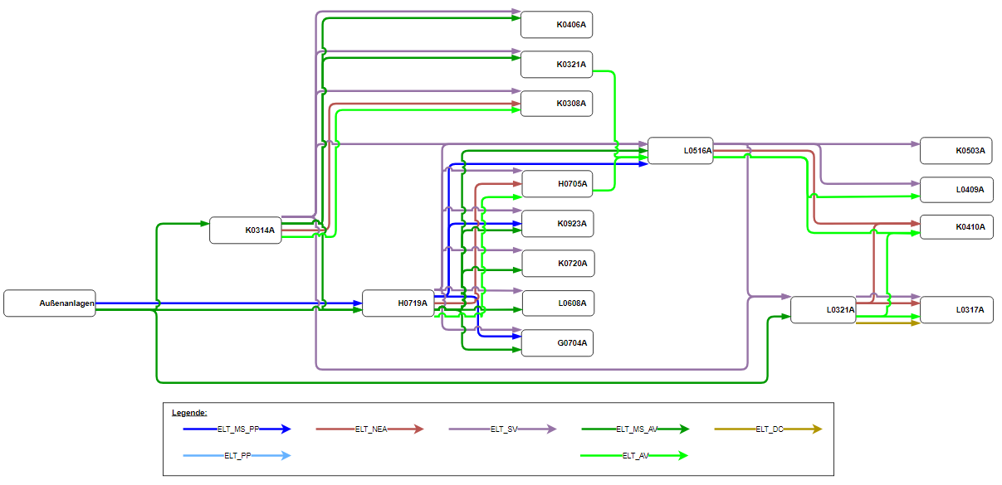
TOP 2 Commissioning Strategy
Power Supply

Slide 9
TOP 2 Commissioning Strategy
Power Supply (General Power)
UA Nord
PP
K0720A
provisional Link 12/2024
Q2/2025
K0923A
K0619A
H0719A
L0608A
K0617A
Q4/2025
H0705A
L0516A
L0409A
G0704A
G0702A
K0503A
Q4/2025
K0314A
K0308A
L0317A
L0321A
K0410A
UA Süd
AV
K0406A

Slide 10
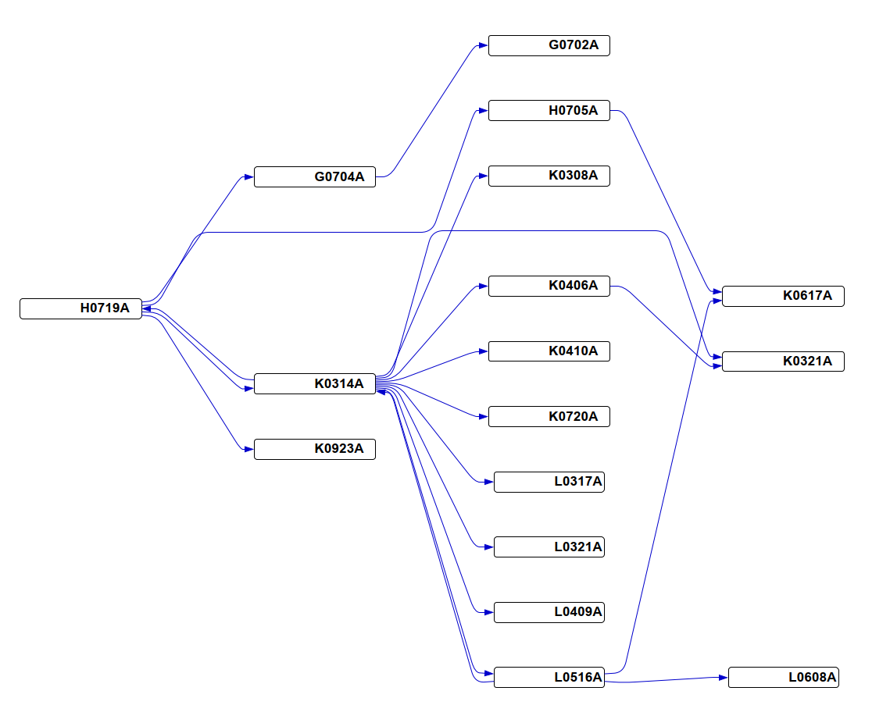
TOP 2 Commissioning Strategy
Cooling Water

Slide 11
TOP 2 Commissioning Strategy
Cooling Water (25/45)
Q1/2025
Q1/2025
Q1/2025
H0719A
K0519A (P1)
K0720A
K0923A
H0705A
K0617A
K0619A
G0704A
G0702A
L0516A
Q4/2025
K0519A (H)
K0314A
K0308A
K0410A
K0503A
L0321A
L0317A
Q4/2025
K0519A (G)
K0406A

Slide 12
TOP 3 Schedule and Status
3.1 Interface Milestone Overview
Construction / Commissioning HBO Operations
Power
Provisional link from transformer substation south to H0719A (AV)
Permament link transformer sub-station north to H0719A
(PP)
Permanent link transformer substation south to H0719A and K0314A
(AV)
u
Cooling water supply for Cryogenic plant testing and commissioing
Utility
2024 | 2025 | 2026 | 2027
 | IV | I | II | III | IV | I | II | III | IV | I | II | III | IV
v
Cooling water and instrument air for Cryogenic plant
Cryo
Provisional power supply for K0720A
HEBT
Power supply for HEBT component testing in G0702A, H0705A, K0617A
w
Utility supply for HEBT component testing in G0702A, H0705A, K0617A
SIS100
Power supply for SIS100 component testing
x
Utility supply for SIS100 component testing
y
S-FRS
Power supply for S-FRS component testing in L0516A
Utility supply for S-FRS component testing in L0516A
Notes:
HBO Abnahme und Regelbetrieb als nächste Folie.

Slide 13
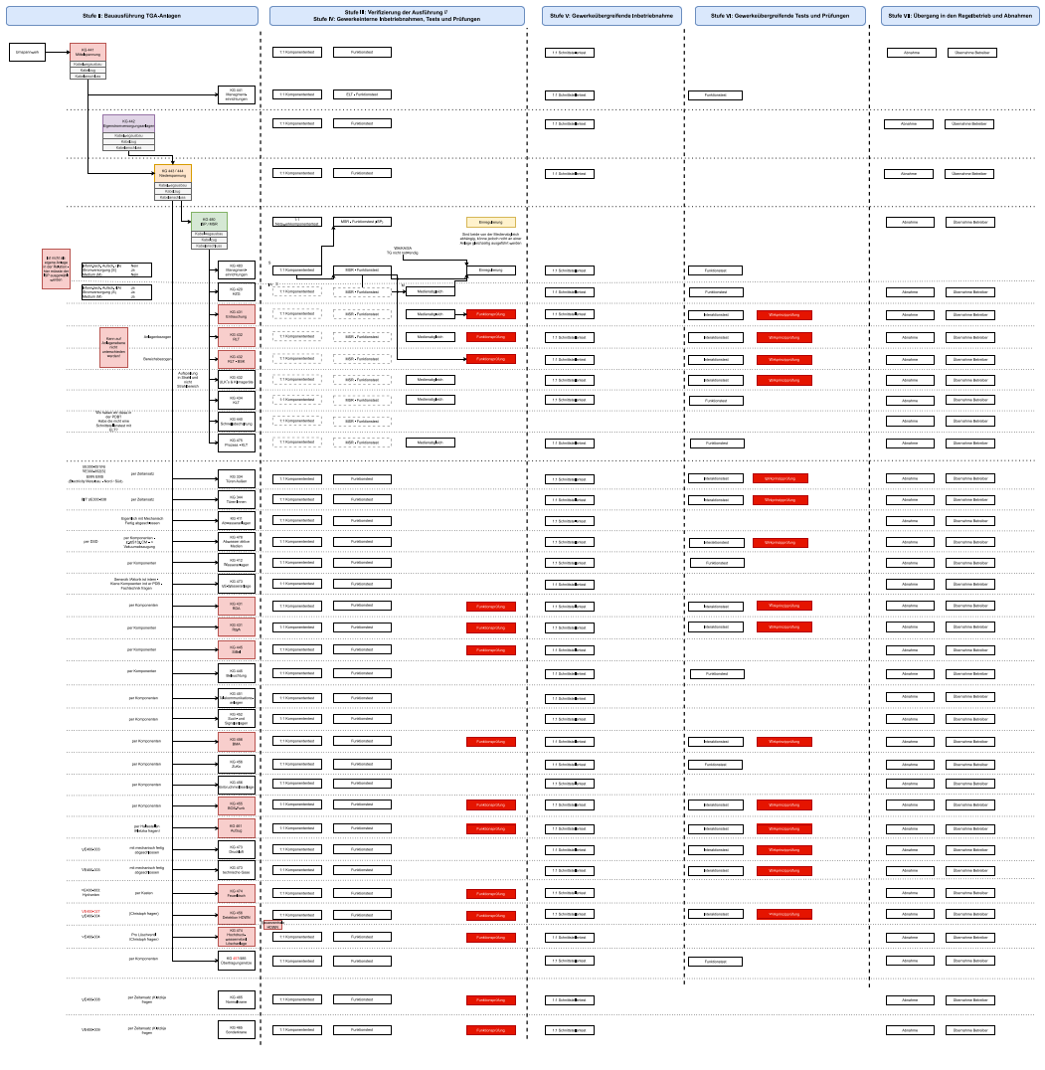
TOP 3 Schedule and Status
3.2 Detailed Schedule based on Commissioing Concept
Der Weg von Einzelanlagen zu einer Gesamtanlage
wird durch das Gewerkeübergreifende IBN Konzept
sichergestellt.
Notes:
HBO Abnahme und Regelbetrieb als nächste Folie.

Slide 14
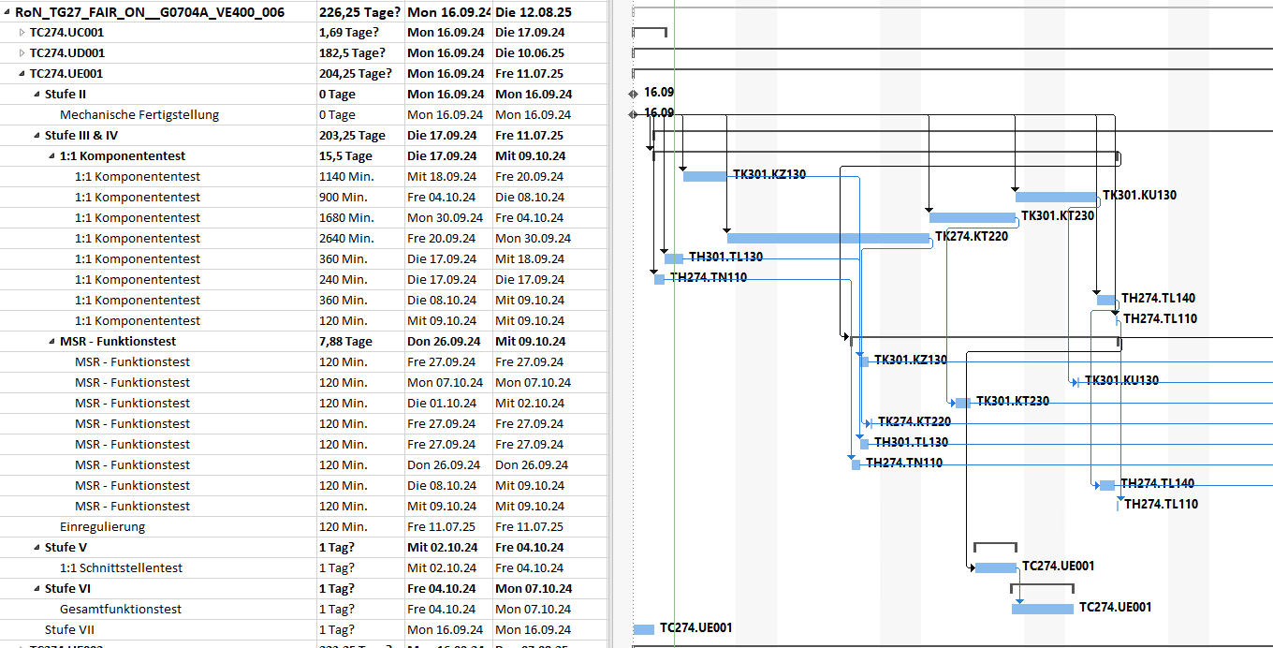
TOP 3 Schedule and Status
3.3 Detailed Schedule based on Commissioing Concept
Example G0704A HEBT supply building
Notes:
HBO Abnahme und Regelbetrieb als nächste Folie.

