Slide 1
FAIR Commissioning general strategy, definitions, organisation, roles
Stephan Reimann
1st FAIR Commissioning Workshop 07.11.-08.11. 2024

Slide 2
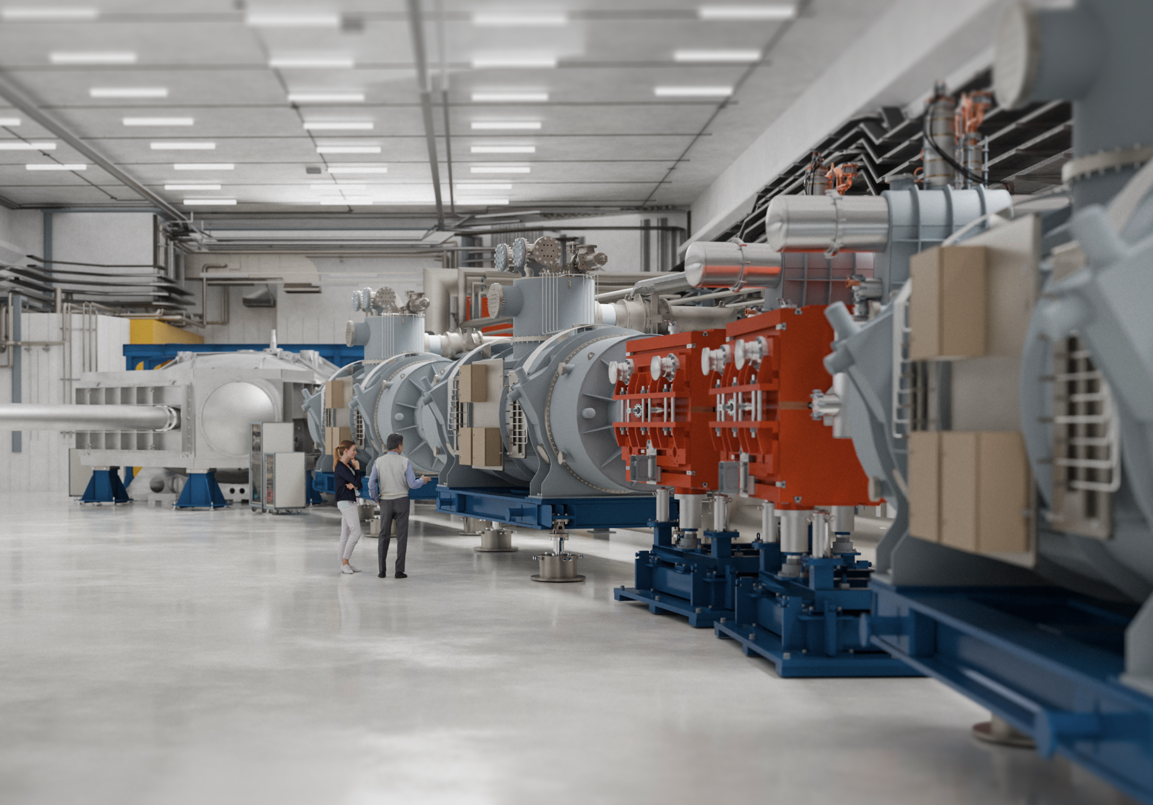
Outline
FAIR 2028 & Project Stages
Strategic Schedule
Commissioning Phases
Chains, Sections, Systems
Planning Status
Organisation of the Subproject
Preparatory Activities
Roles in Execution Phase
appendix: buildings & NE-areas
NUSTAR - visualisation - zeitenrausch

Slide 3
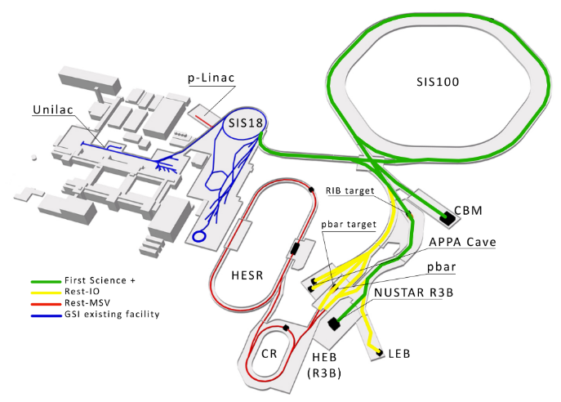


FAIR 2028
until 2028
after 2028

Slide 4
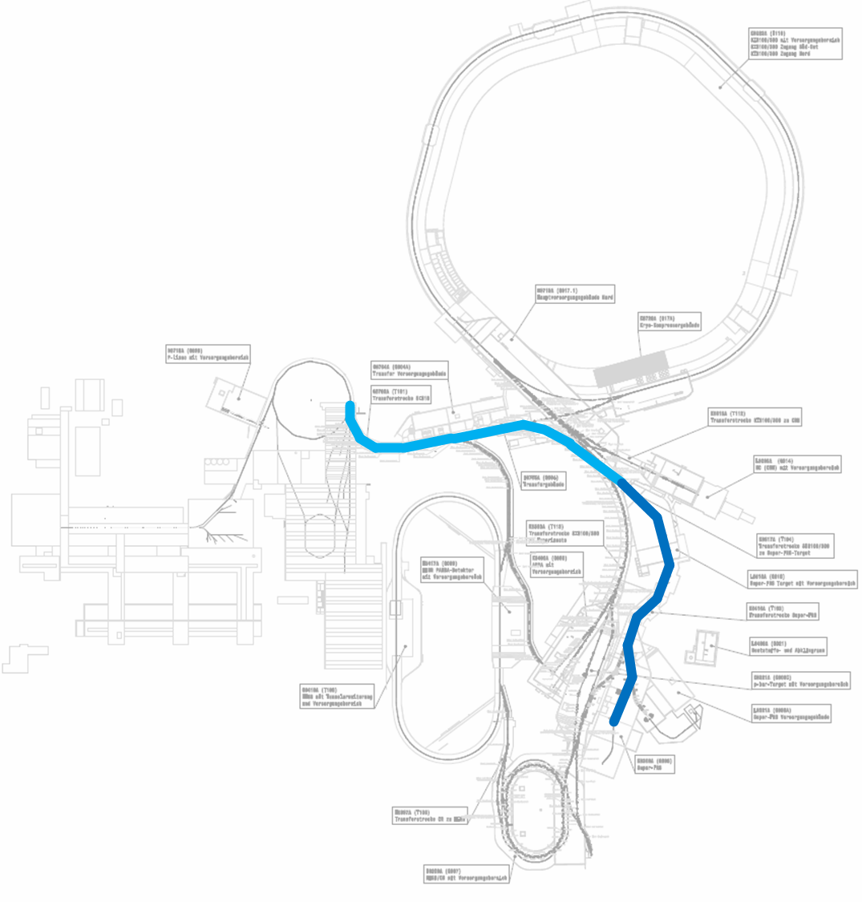
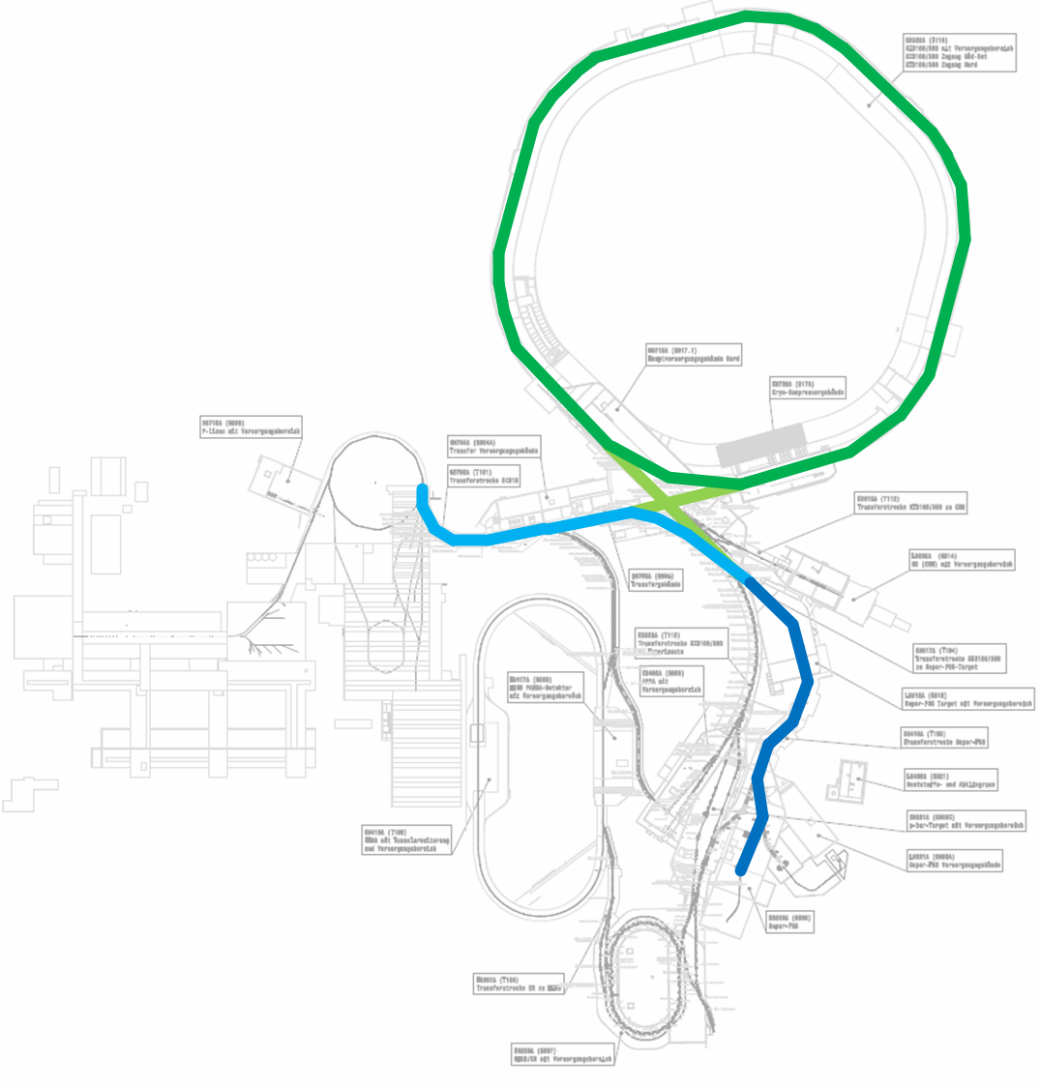
FAIR Stages – Intermediate Objectives
FAIR Early Science (ES)
FAIR First Science (FS)
HEBT (ES)
HEBT (FS+)
SFRS
SIS100
HEBT (ES)
SFRS
+ CBM

Slide 5
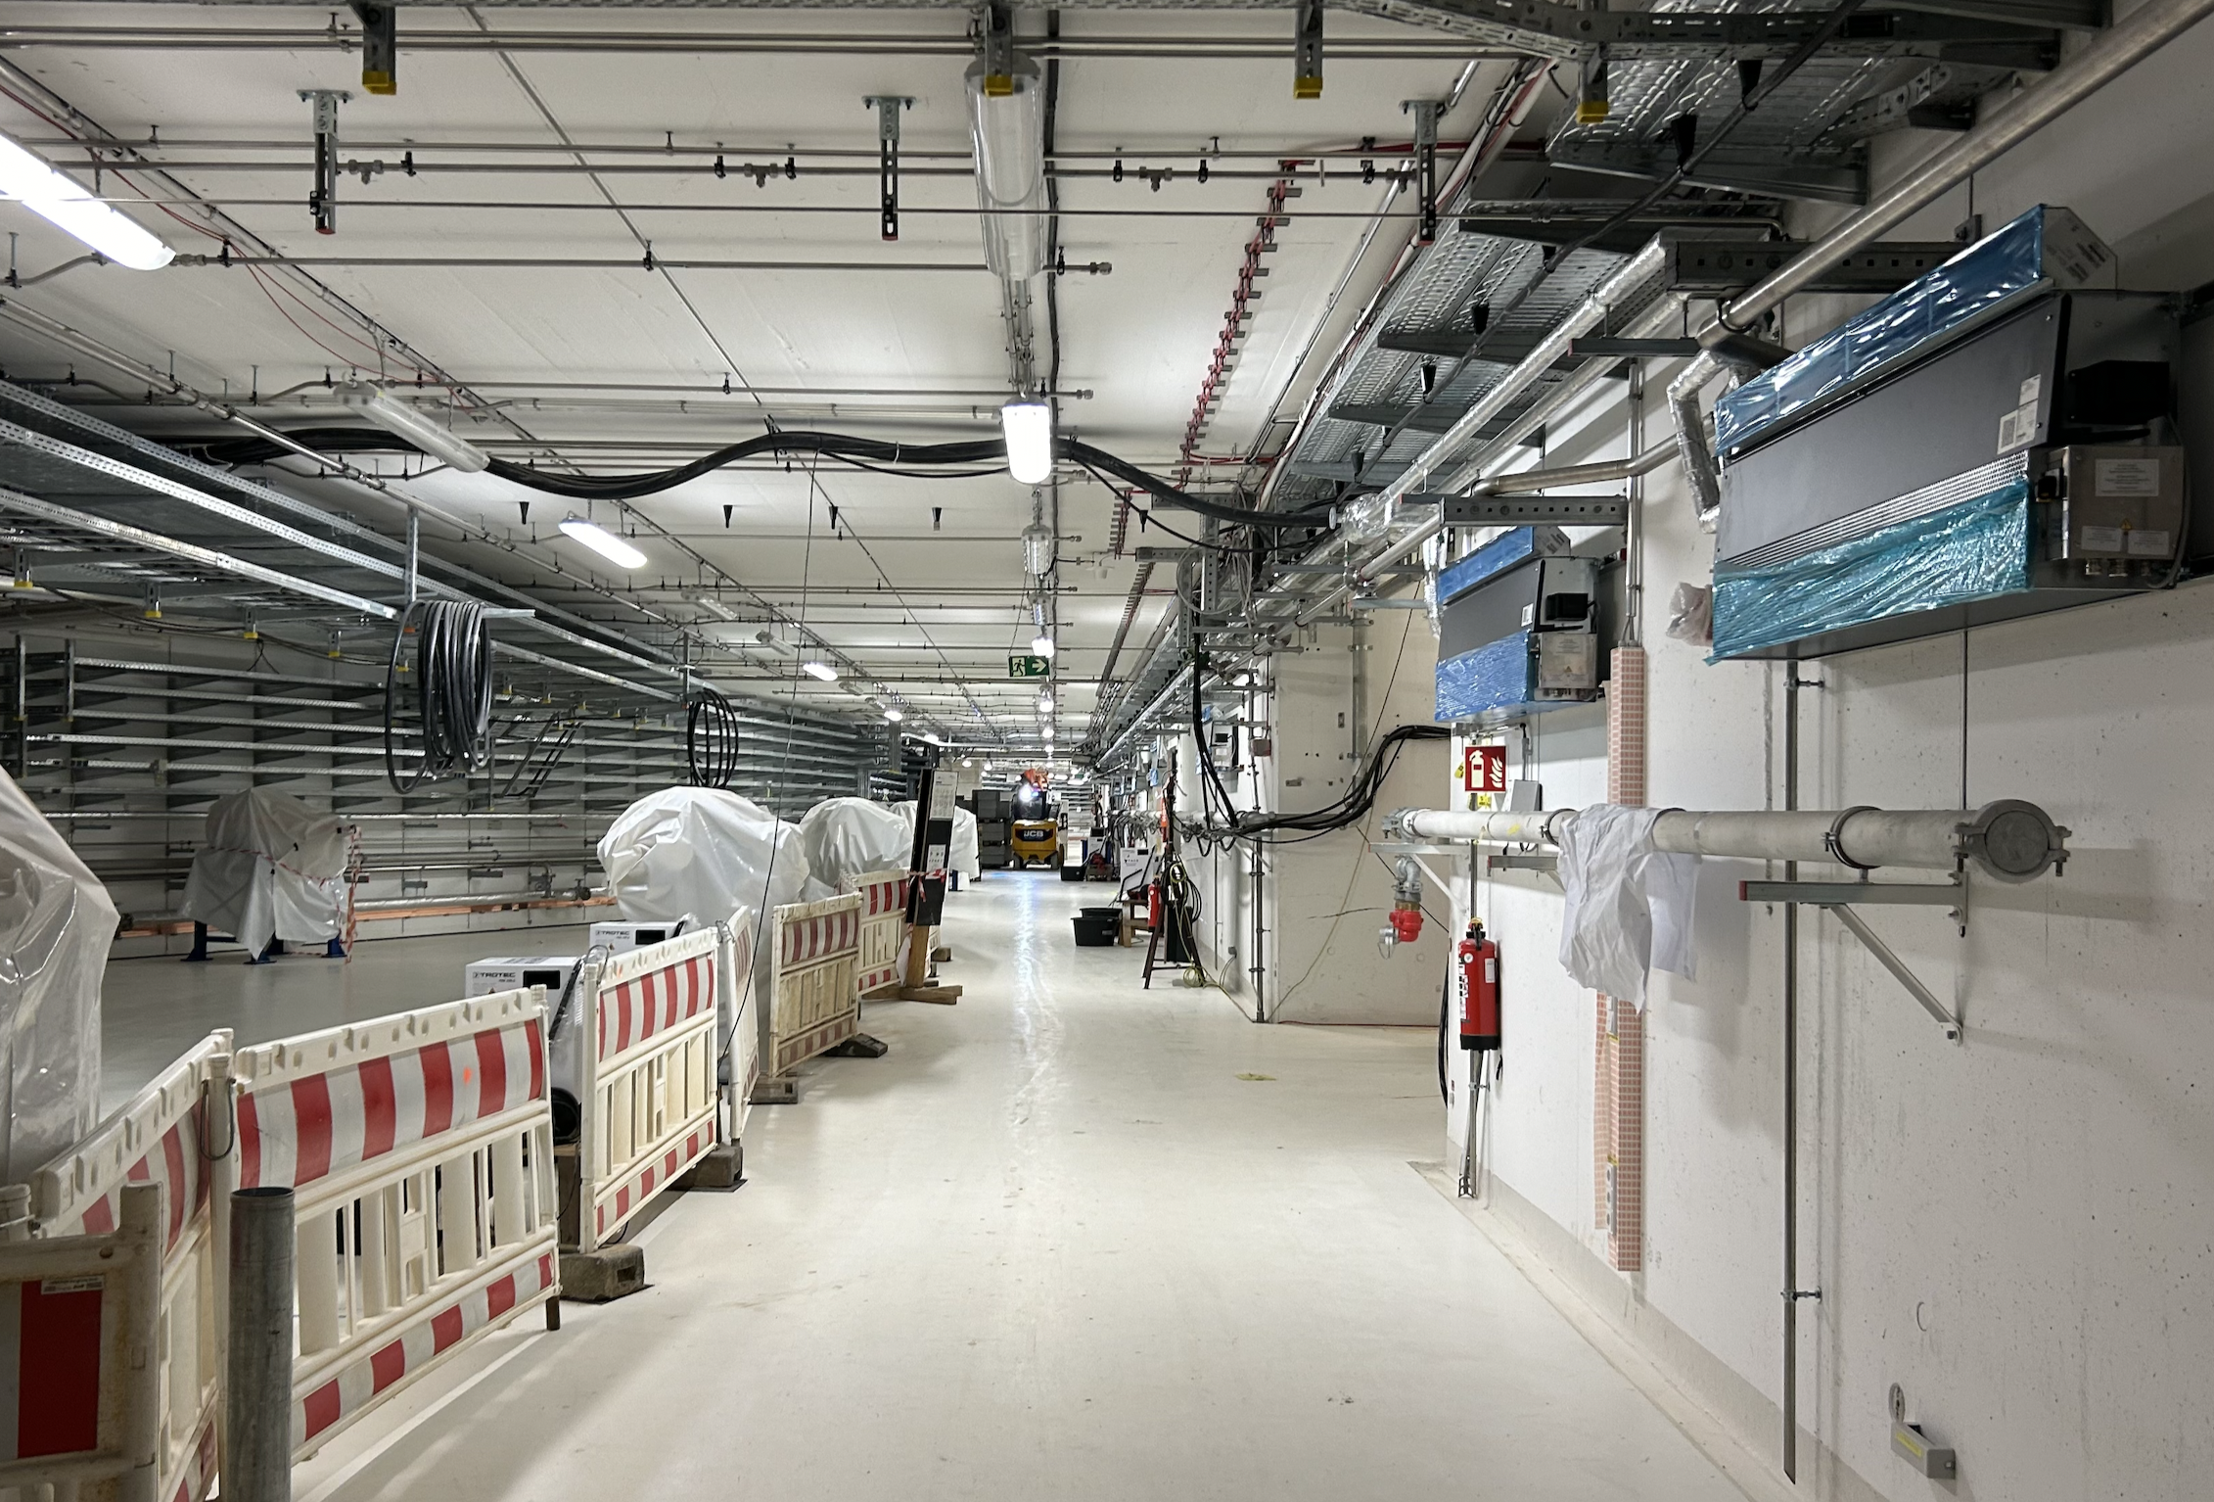
FAIR – HEBT Tunnel 30.10.2024

Slide 6
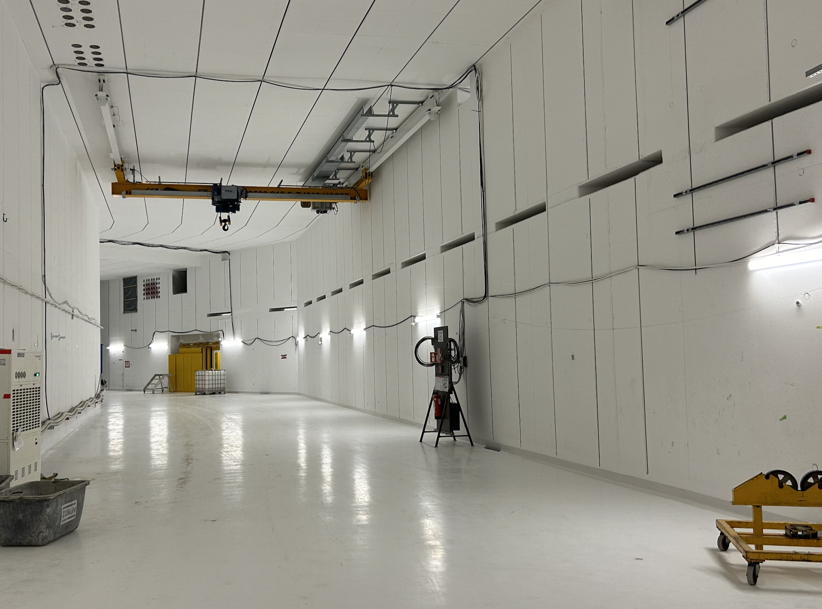
FAIR – HEBT Tunnel 30.10.2024

Slide 7
FAIR commissioning – strategic schedule
2024 2025 2026 2027 2028
Beam Time
Beam Time
Beam Time
Beam Time
FCC Construction & Procurement of Interior equipment
equipment
Installation
move to MCR & commissioning
operation from FCC
Injector Controls Upgrade: 1st version of new production system
Injector Controls Upgrade: finalization
Controls & BI Digitization UNILAC, SIS18, ESR, Cryring, HEBT
UNILAC operation
with new CS
Cryo 2
Commissioning
HEBT-ES HW-Commissioning
Dry-Runs
SFRS HW-Commissioning
ES Beam Commissioning
Dry-Runs
SFRS Cooldown
HEBT-FS HW-Commissioning
Dry-Runs
SIS100 HW-Commissioning
FS Beam Commissioning
Dry-Runs
SIS100 Cooldown

Slide 8
Commissioning phases for accelerators and detectors
inst.
# | commissioning phase | accelerators & transfer lines | detectors
1 D1 M103 | local HW- commissioning | local system tests in tunnel and supply areas Control system not needed (only in limited aspects) TBI not needed, site power is sufficient | single detector tests tests of individual components install. service & controls
2 D2 M104 | remote & system commissioning | single system test (vertical system integration test) remote testing from MCR (sequences, checklists) TBI (phase 5 and 6), control system integration and timing is needed, access control & STVs needed | system tests (with HV, gas, ...) pre-test of DAQ system local control
3 D3 M105M11 | integration | (3.1) multi system tests & (3.2) full Dry-Runs control system and accelerator models for pilot beam scenarios fully available, PAS commissioning done | full detector test and DAQ using cosmics
4 E M12 | pilot beam commissioning | pilot beam commissioning (completion parameters) operation permit | commissioning with pilot beam
Commissioning without Beam
Beam Commissioning
 | beam commission & operation | operation with PCP-beam respectively status quo beam commissioning of advanced systems and complex operation modes / intensity ramp-up accelerator development towards FAIR design parameters
handover to operations
color-codes aligned with responsibility matrices

Slide 9
Chains → Sections → Systems
Chain
(UNILAC → SIS18 →) HEBT → SFRS → HEB → NUSTAR
Sections
T1S1
T1S2
TSX1
TSF1
T1F2
FTF1
FPF0-4
FMF1-3
FHF1-2
NUSTAR
Section
T1S1
Systems
(tunnel area part)
DIP
VAC
DIAG
QUAD
DIP
DIP
DIAG
VAC
QUAD
SPEC
Systems
(supply area part)
PS
PS
DAC
PS
PS
TBI

Slide 10
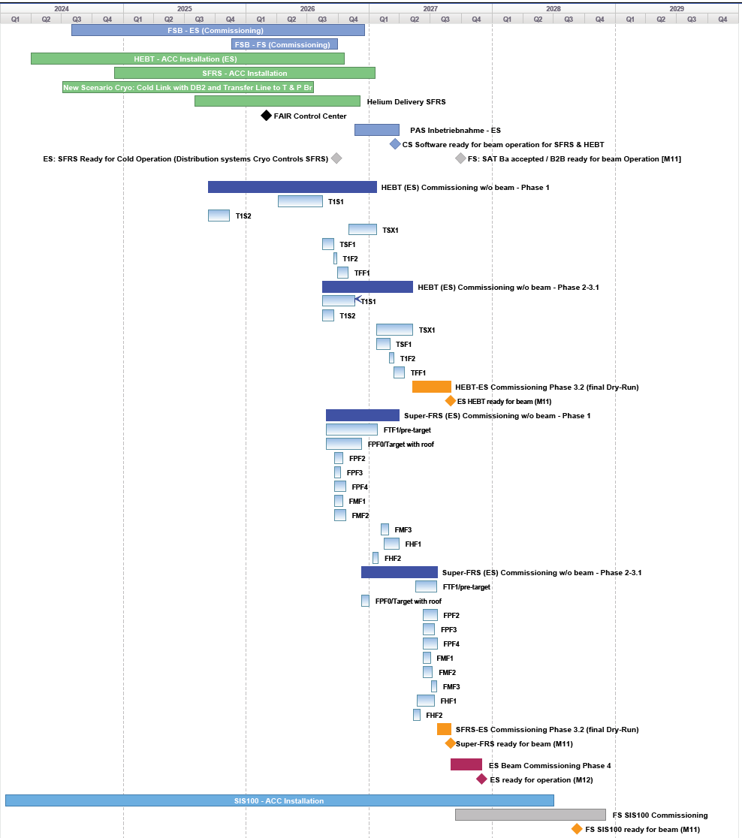
Site & Installation
Cryo-Link
Controls & Access
System
HEBT
hardware commissioning
detailed section-wise planning for ES-HEBT and SFRS is available for all commissioning phases
installation planning is linked
TBI commissioning milestones, are updated, linked
SFRS
hardware commissioning
Early Science
beam commissioning
SIS100

Slide 11
Ongoing preparatory Activities
Commissioning Workshop for each System Type
development of a commissioning procedure
collect prerequisites and boundary conditions for each commissioning step
review resources & impact on baseline schedule
write a commissioning instruction document
define a test sequence for acceptance of M11 (ready for beam)
implement test sequence in sequencer service software

Slide 12
Commissioning Organisation
FC-SPL
HEBT
commissioning responsible
SFRS
commissioning responsible
SIS100
commissioning responsible
Cryo
commissioning responsible
Controls
commissioning responsible
NUSTAR
commissioning responsible
S. Reimann
(deputy V. Kamerdzhiev)
safety &
beyond FS
F. Hagenbuck S. Pietri P. Spiller H. Kollmus R. Bär H. Albers
Commissioning responsible:
participation in bi-weekly commissioning meeting
responsible for planning (Planisware & commissioning workshops), preparation, execution of commissioning
coordinates work package leaders
Machine-SPL/SSPL:
declares/ signs readiness for beam commissioning (or operation in case of Cryo and Controls)

Slide 13
Main Roles during Commissioning
(execution phase)
Commissioning Coordinator (CC)
is rotated weekly
general coordination, weekly planning
host of daily coordination meetings / briefings
on-call over nights & weekends
Commissioner in Charge per Machine (CiC)
is rotated weekly
day to day coordination with WPLs / tech. dep. on site
on-call over nights & weekends
Definition of daily tasks for tech. groups & shift team
Safety Responsible Persons (STVs)
for tunnels and supply areas
working permits
definition of safety measures (e.g. Freischaltung)
room access control
Steering is done in weekly Commissioning Meeting hosted by FC-SPL or deputy
work schedule is determined by CC
all commissioning activity must be registered in the commissioning meeting
all work in tunnels and supply rooms must be registered in the commissioning meeting
working permits are only granted by STVs
central coordination via FAIR Control Centre

Slide 14
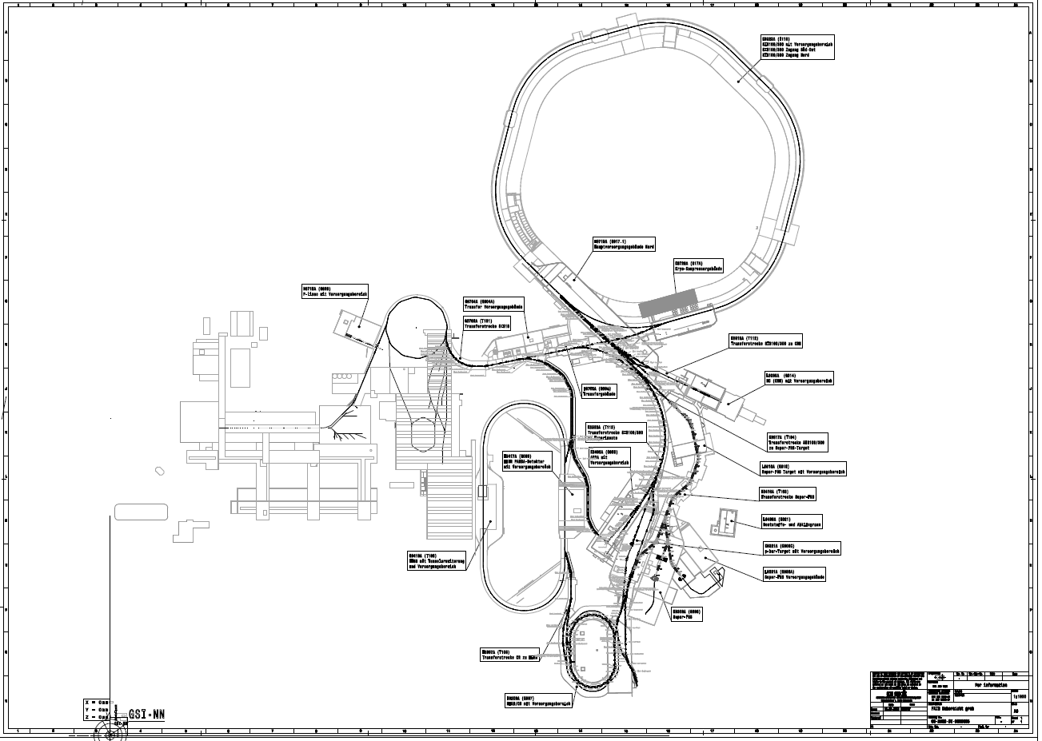
First 3 major Commissioning Milestones
June 1st 2025 Cryogenic Plant “Cryo2” (building K0720A) & parts of main supply building H0719A
Q1/2026 FAIR Control Centre and new Main Control Room
Q3 first beam in GSI from FCC
Q4/2026 First Beam Event T1S1

Slide 15
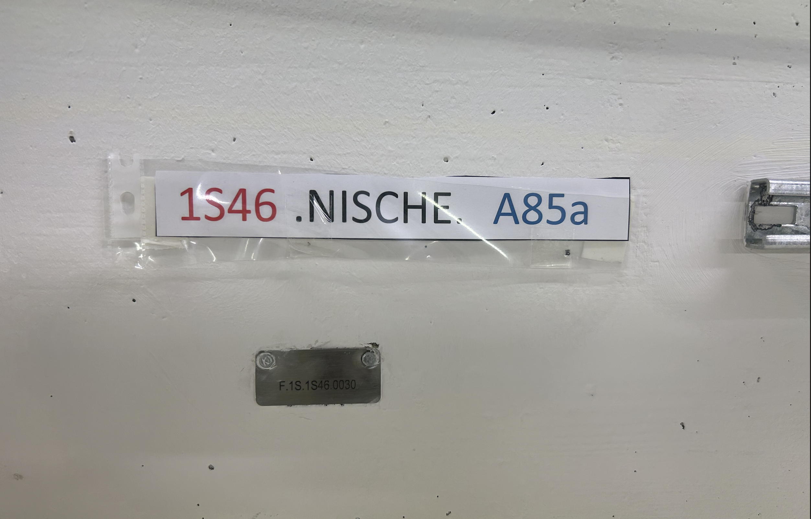
E.o.P.

Slide 16
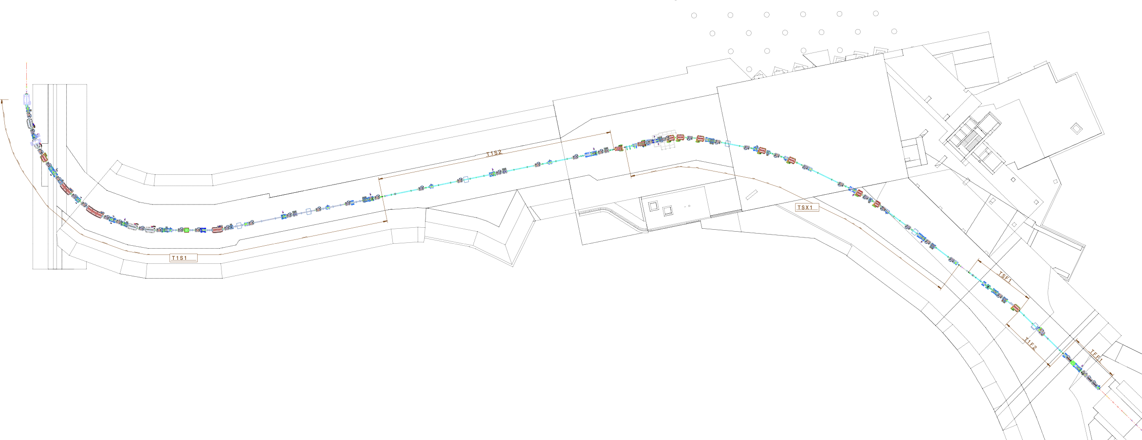
Sections of HEBT (ES)

Slide 17
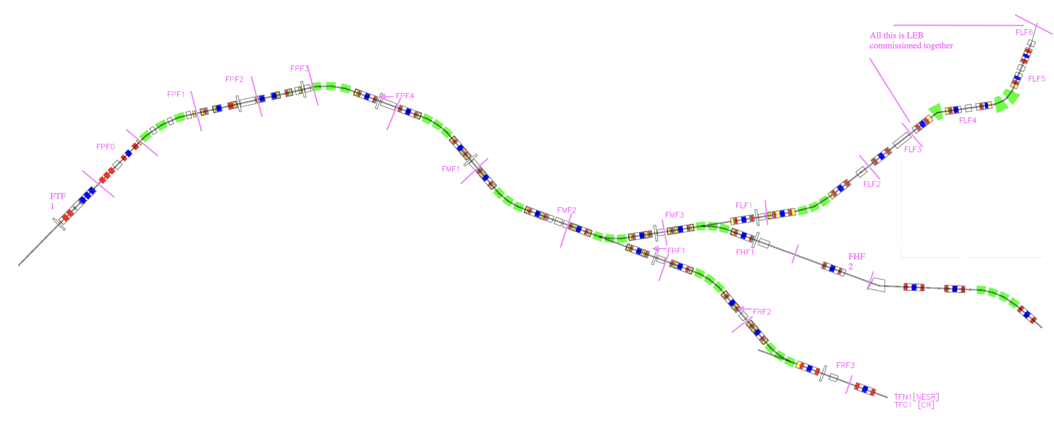
Sections of SuperFRS

Slide 18
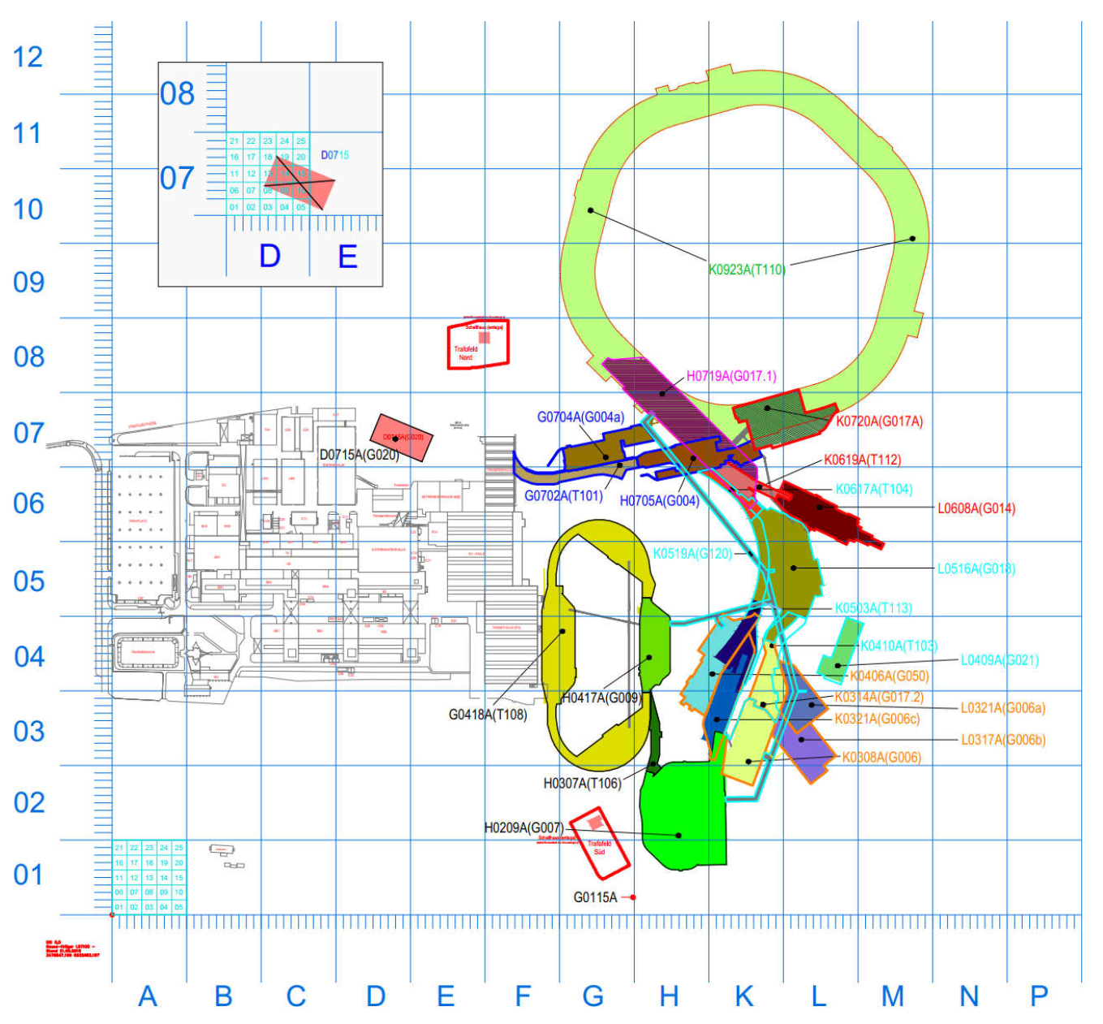
Buildings

Slide 19
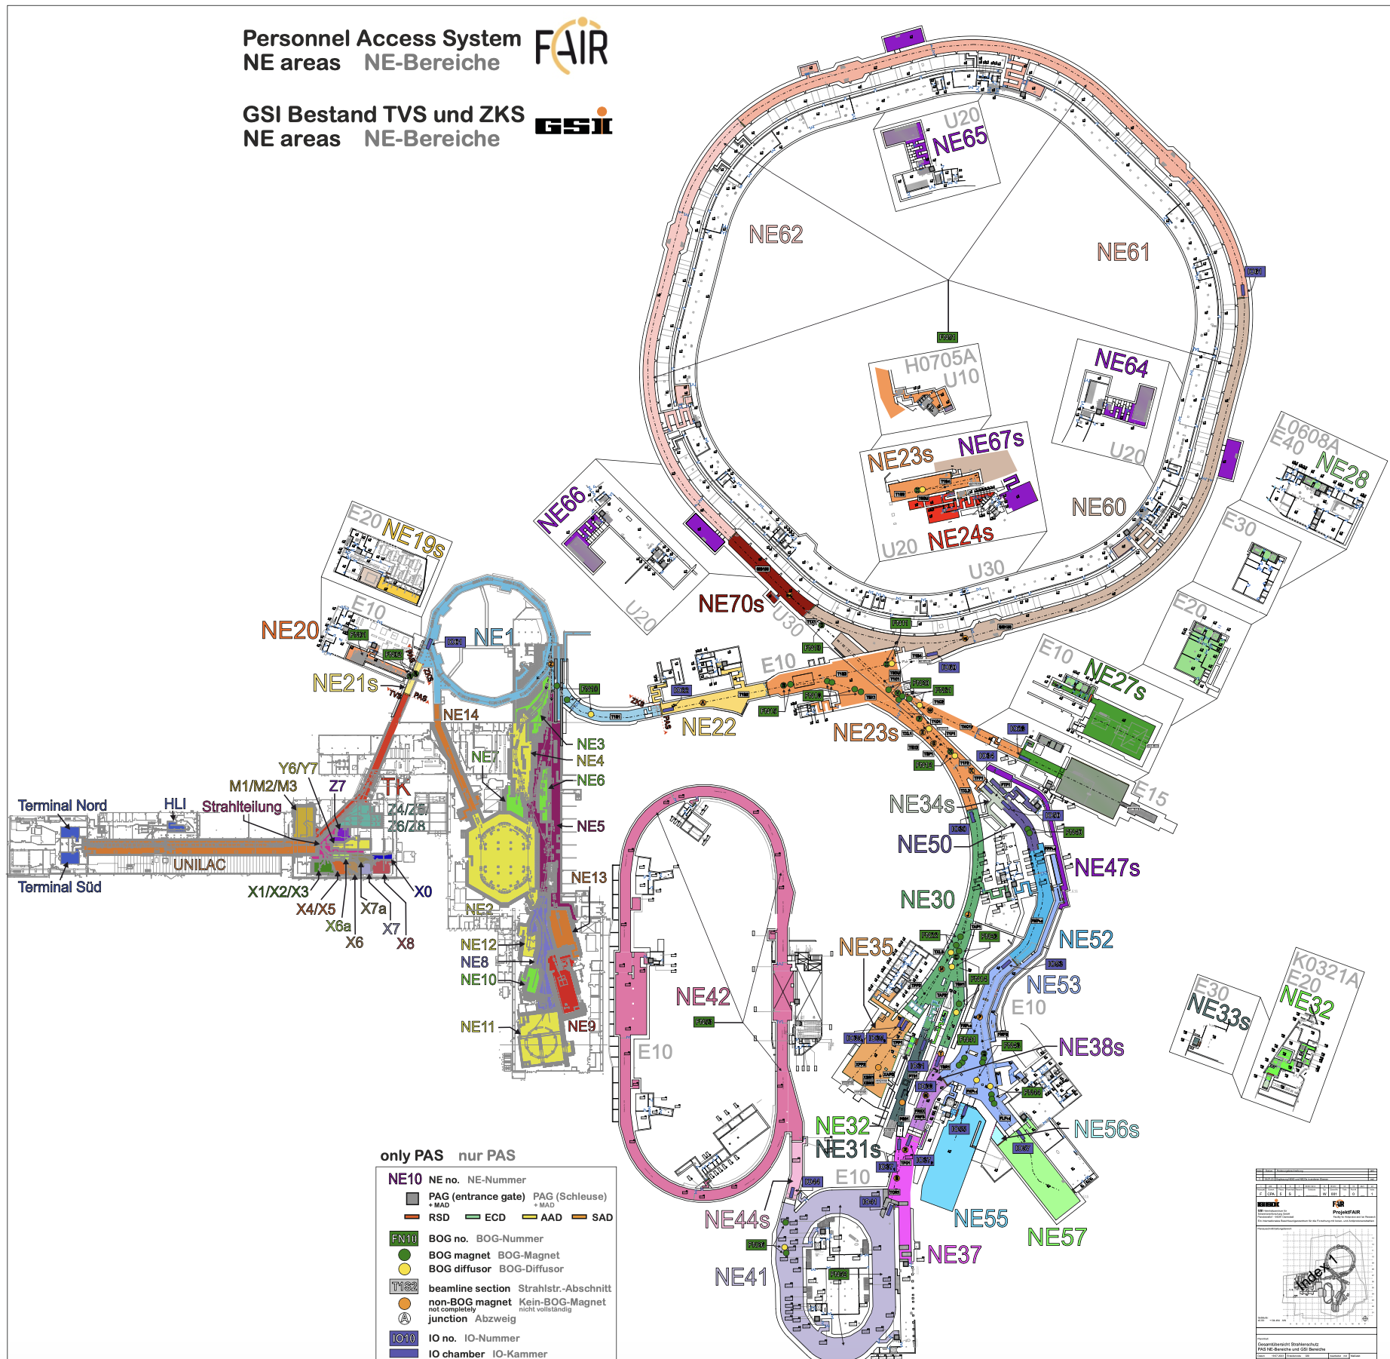
NE Areas

