Slide 1
1st FAIR Commissioning Workshop
Agenda & Goals

Slide 2
Why are we here?
The construction work is in its final stages
Installation of technical building infrastructure is ongoing
Installation of accelerator components has been underway since beginning of 2024
The cryogenic plant to be set in operation next year
We are approaching the start of the final project phase
Commissioning
It is now the right time to align our efforts and focus to make this final phase a success.

Slide 3
General Information & Agenda
Thursday Friday
start 9:00 8:30
lunch 12:50 – 13:50 12:00 – 13:00
end 17:20 16:15 bus to GSI leaves 16:30!
dinner 18:00 – 21:00
soft-drinks, beer and house wine are only included until 21:00
Group-Photo: 1st coffee break on Friday
Rooms available from: 3 pm
Check-Out: 11 am
Agenda: https://indico.gsi.de/event/20583/timetable/#20241107

Slide 4
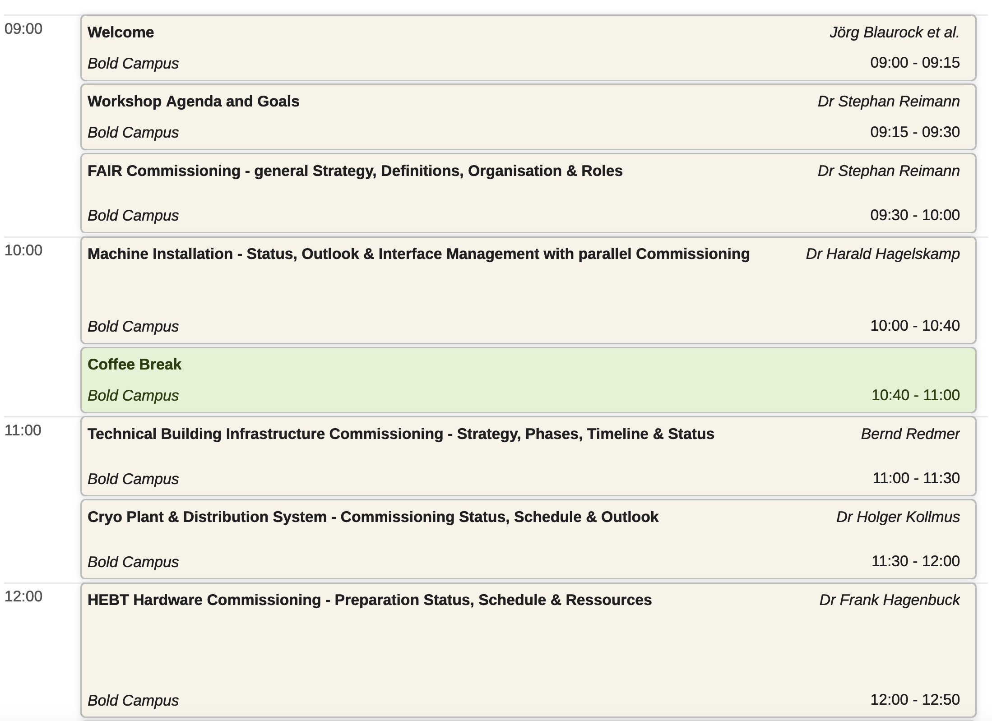
Agenda – Thursday 07.11.2025

Slide 5
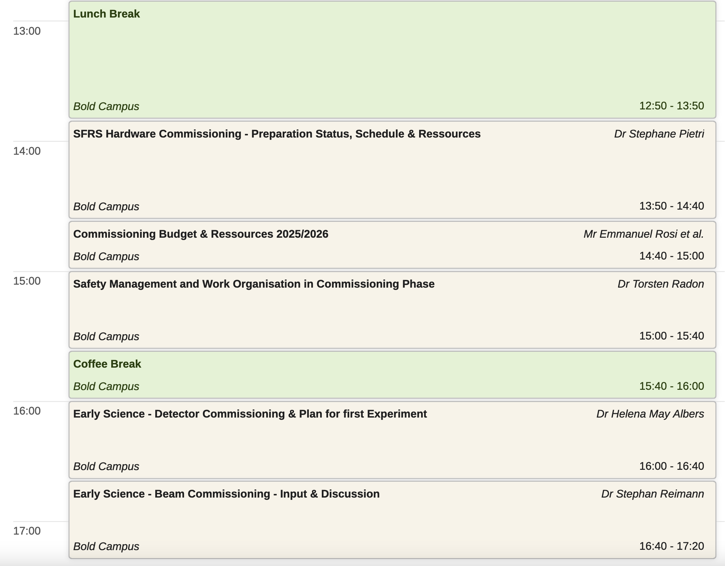
Agenda – Thursday 07.11.2025

Slide 6
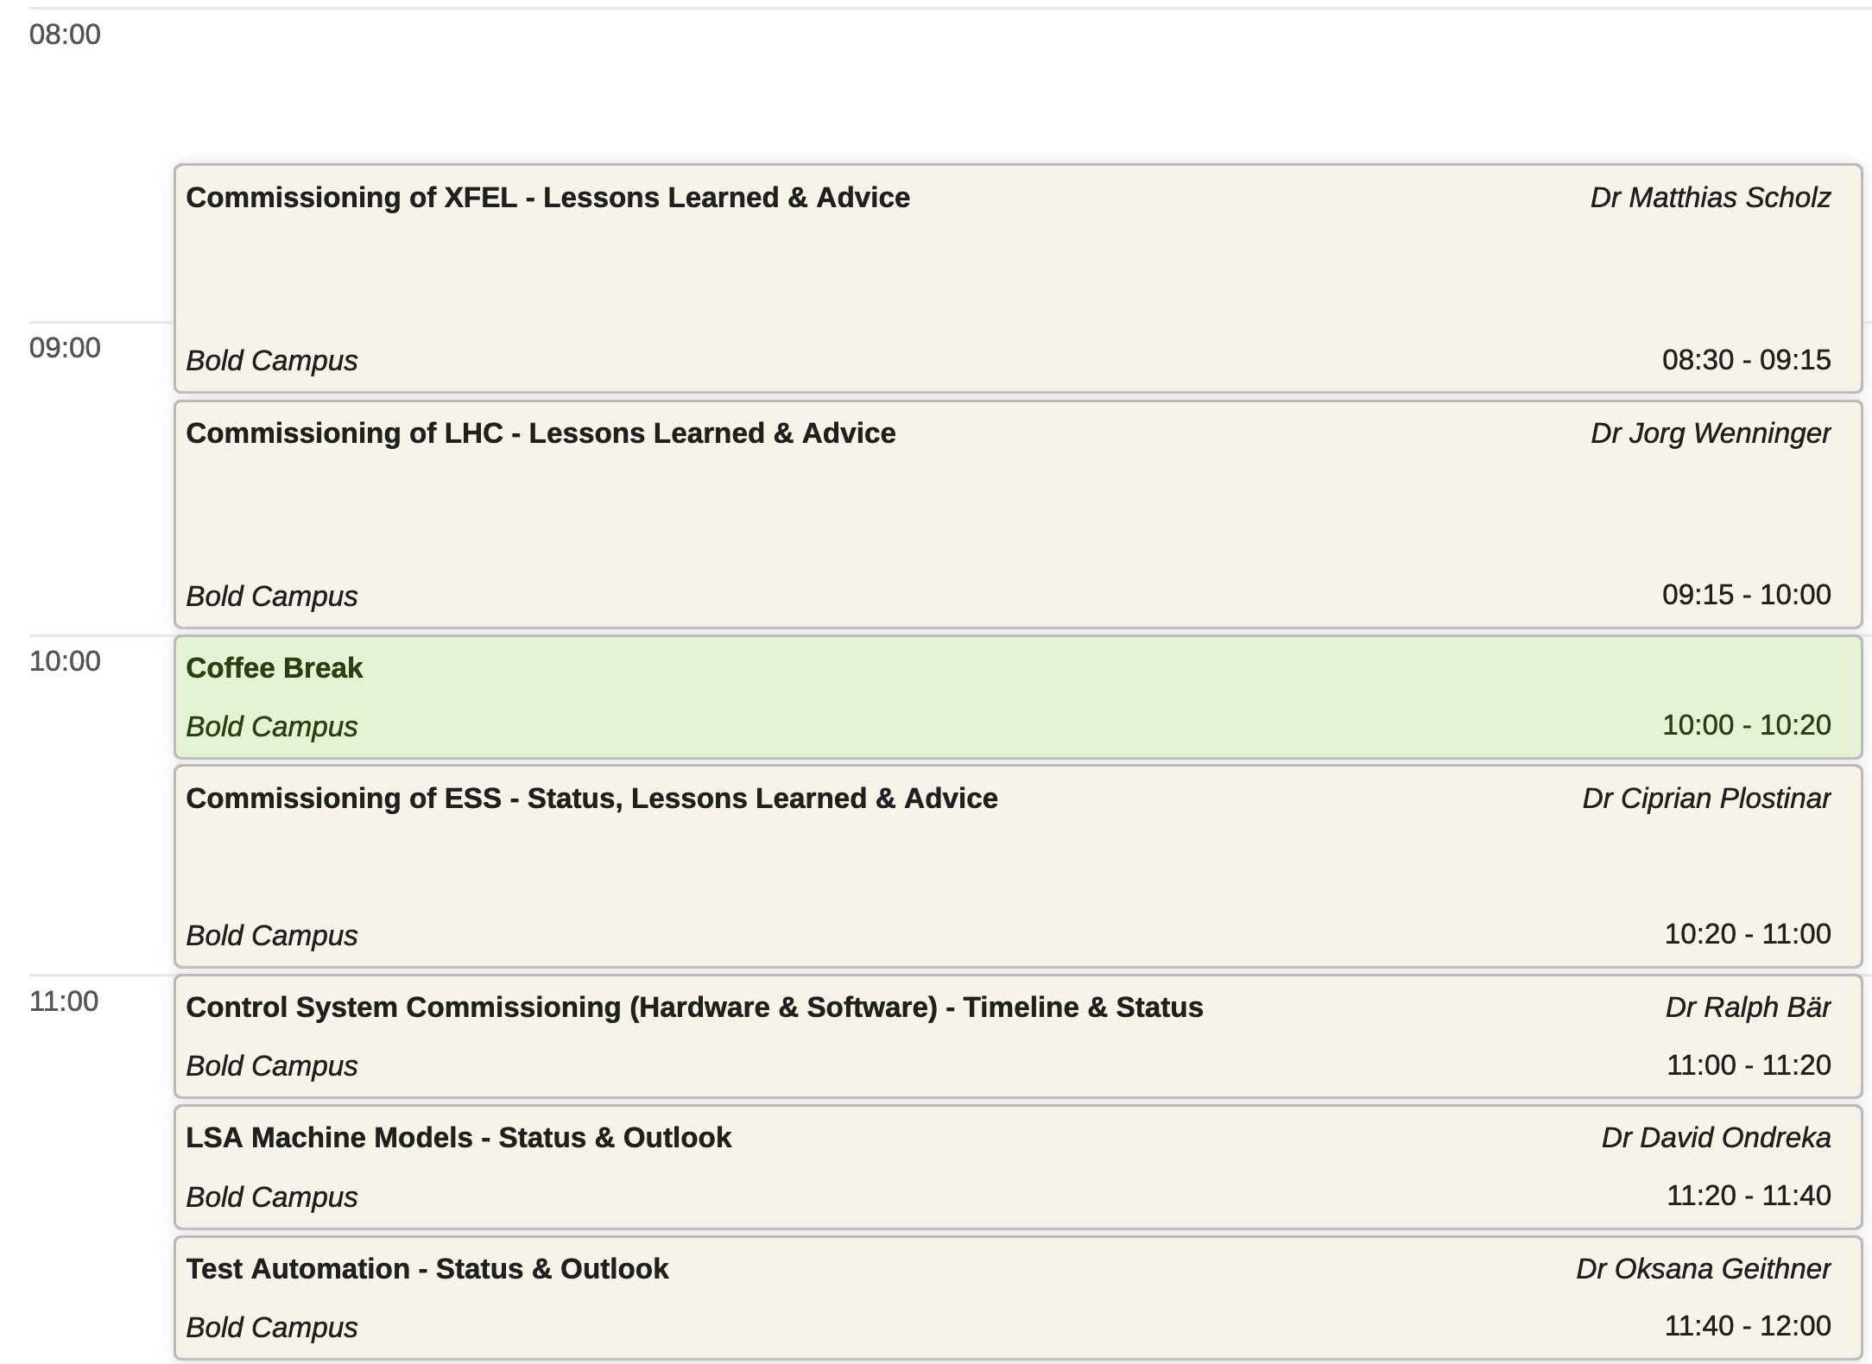
Agenda – Friday 08.11.2025

Slide 7
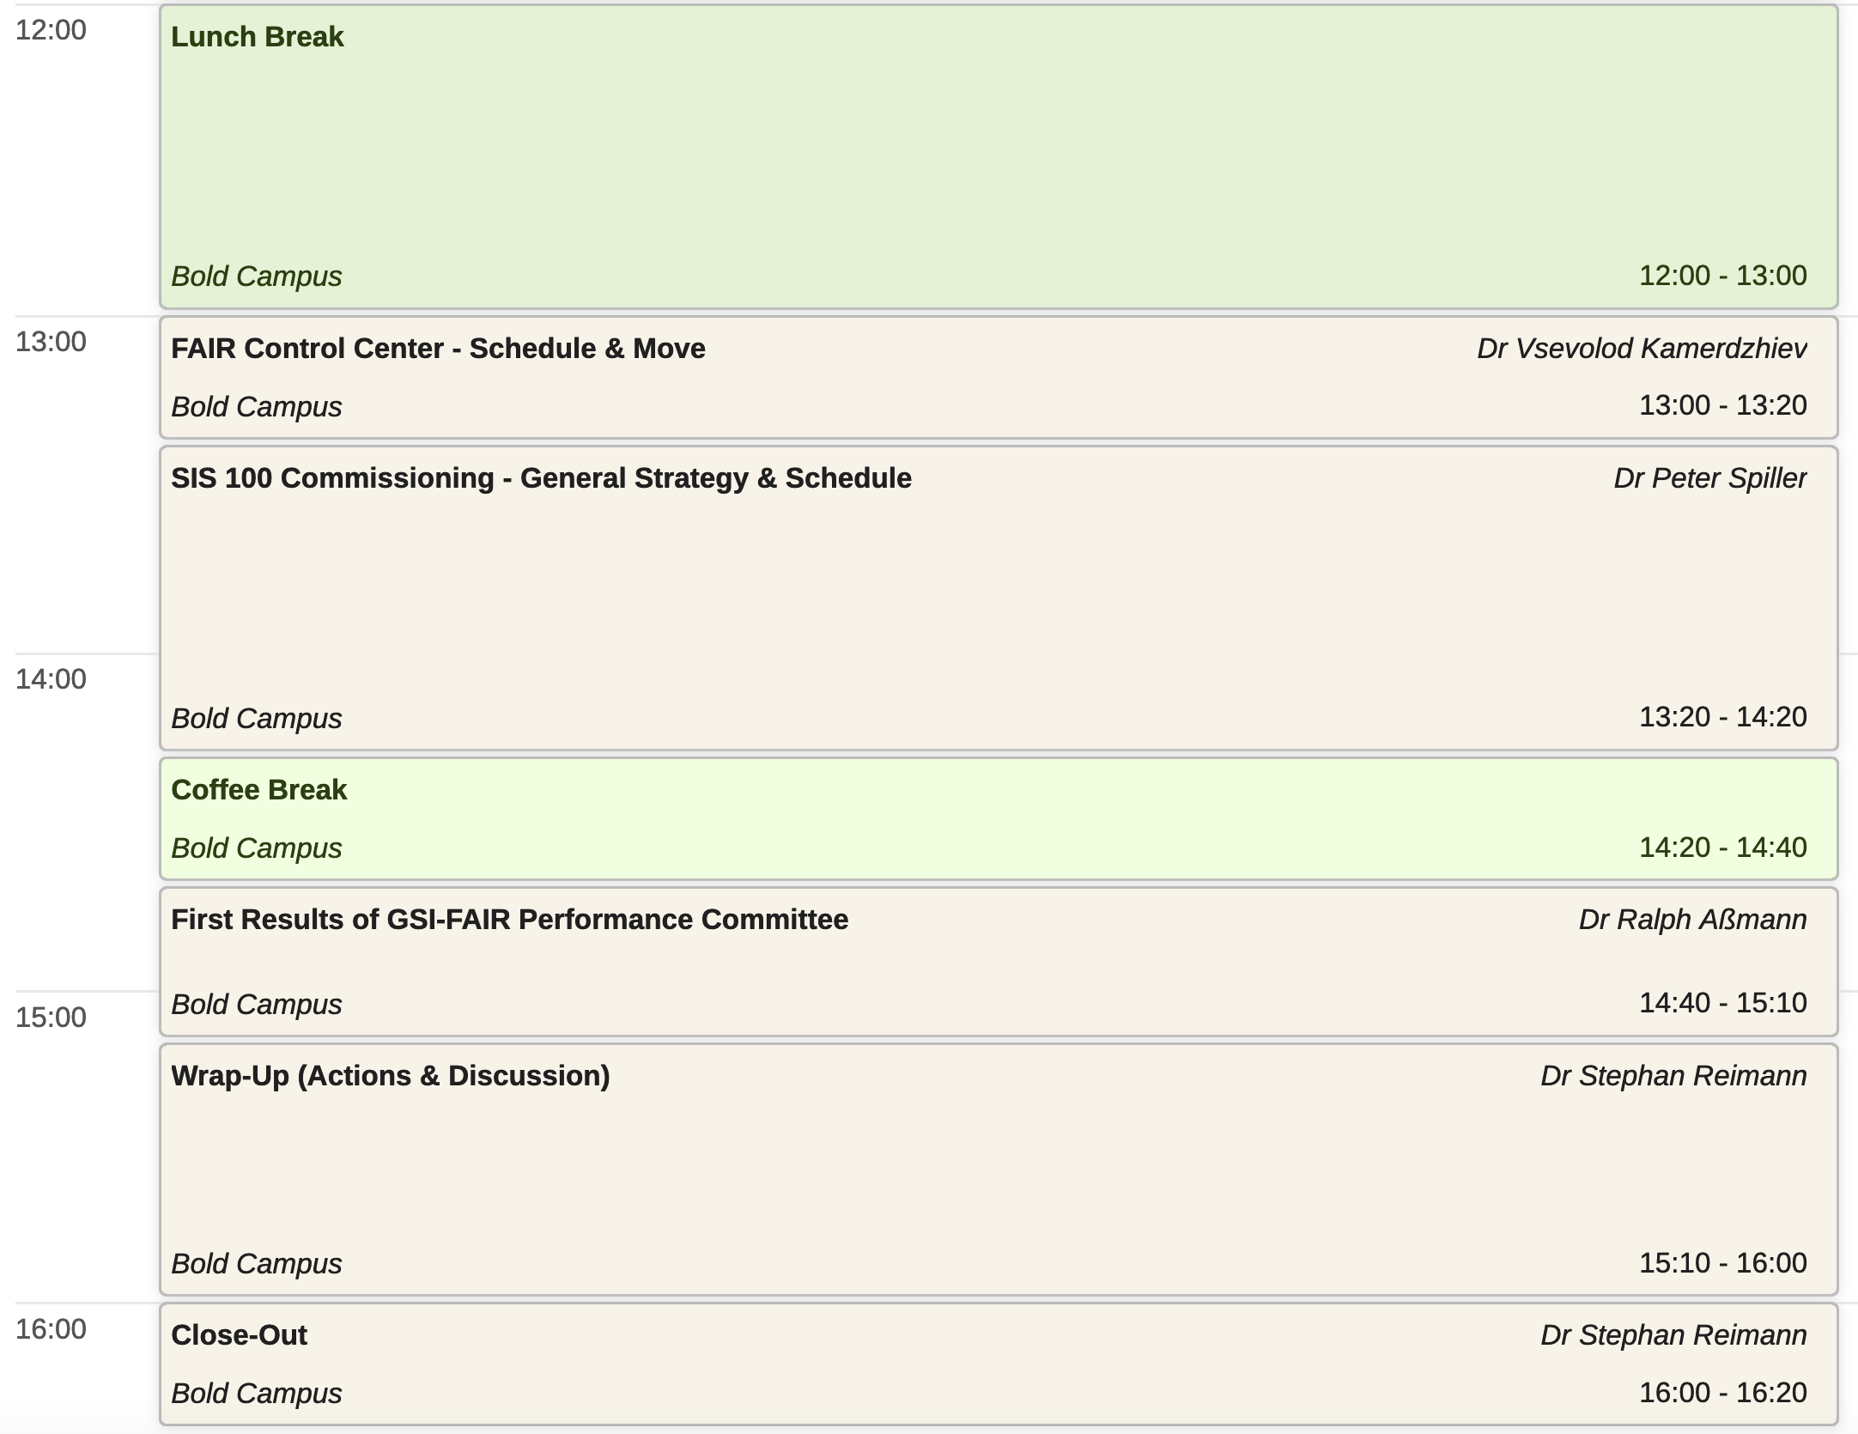
Agenda – Friday 08.11.2025

