Slide 1
FAIR Project 1st Commissioning Workshop 7. und 8. Nov. 2024 Jörg Blaurock

Slide 2
Our key objective
Focus:
Early Science at the end of the year 2027
This comprises :
Components -> Delivery of In-kind + FAIR purchases
Installation -> Preparation (incl. Lessons Learnt) and execution
Start of commissioning, first step Cryo 2
Safety -> Transition to Live-Systems
Remaining procurement and installation activities as per budget priorities

Slide 3
Overview and Big Picture
India
Poland
Russia
Germany
Opportunity: Spain

Slide 4
Overview and Big Picture
Early Science is Key – We need a first experiment end 2027
Requirements to everybody will increase -> More work will be focussed on experts in answering specific questions in a short period of time
Integrated working will further increase, especially the interface of SFRS - SMG - FSB - TGA - Commissioning
Handover and Take-Over Process to GSI HostLab

Slide 5
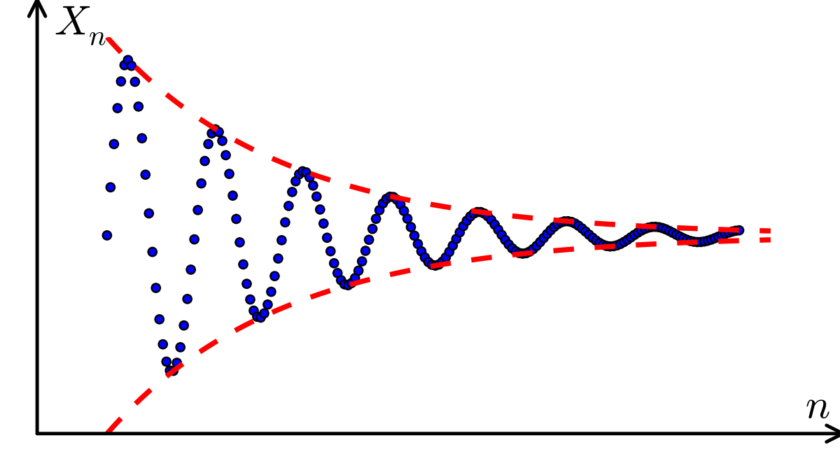
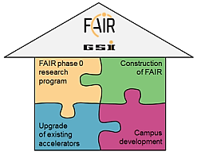
Overview and Big Picture
We are converging to our overall objective - the integrated campus GSI & FAIR - through all strategic objectives.
2016 today (2024)

Slide 6

Good discussions and decisions and a fruitful workshop!

Slide 7
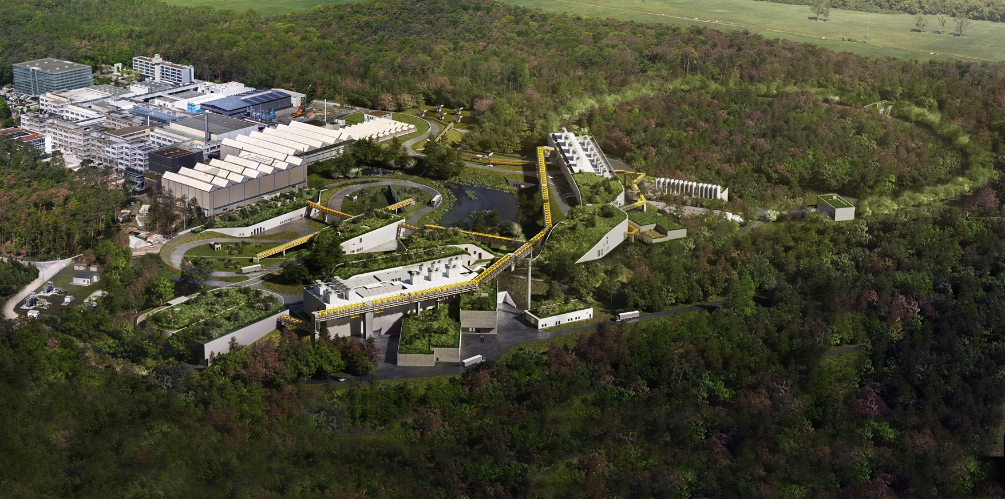
Thank you for your attention

