Slide 1
Solenoid design optimization for improved beam transport
Florian Kroll – Institute of Radiation Physics – Application-oriented Laser-plasma Accelerators
(i)LIGHT-Meeting 2024

Slide 2
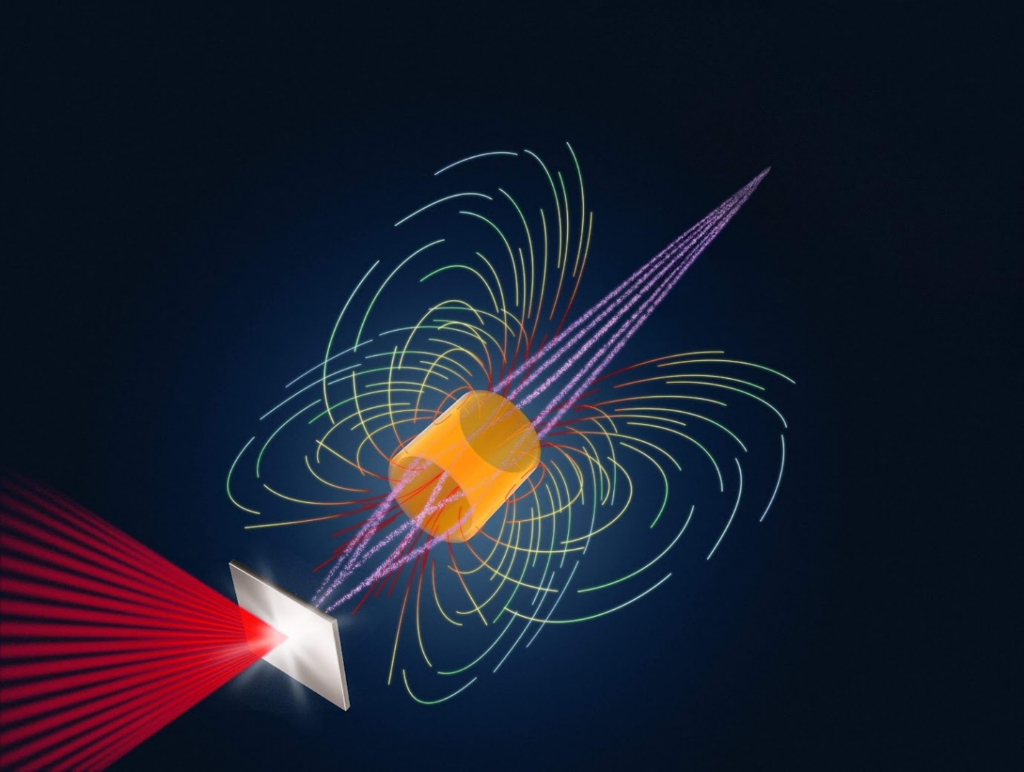
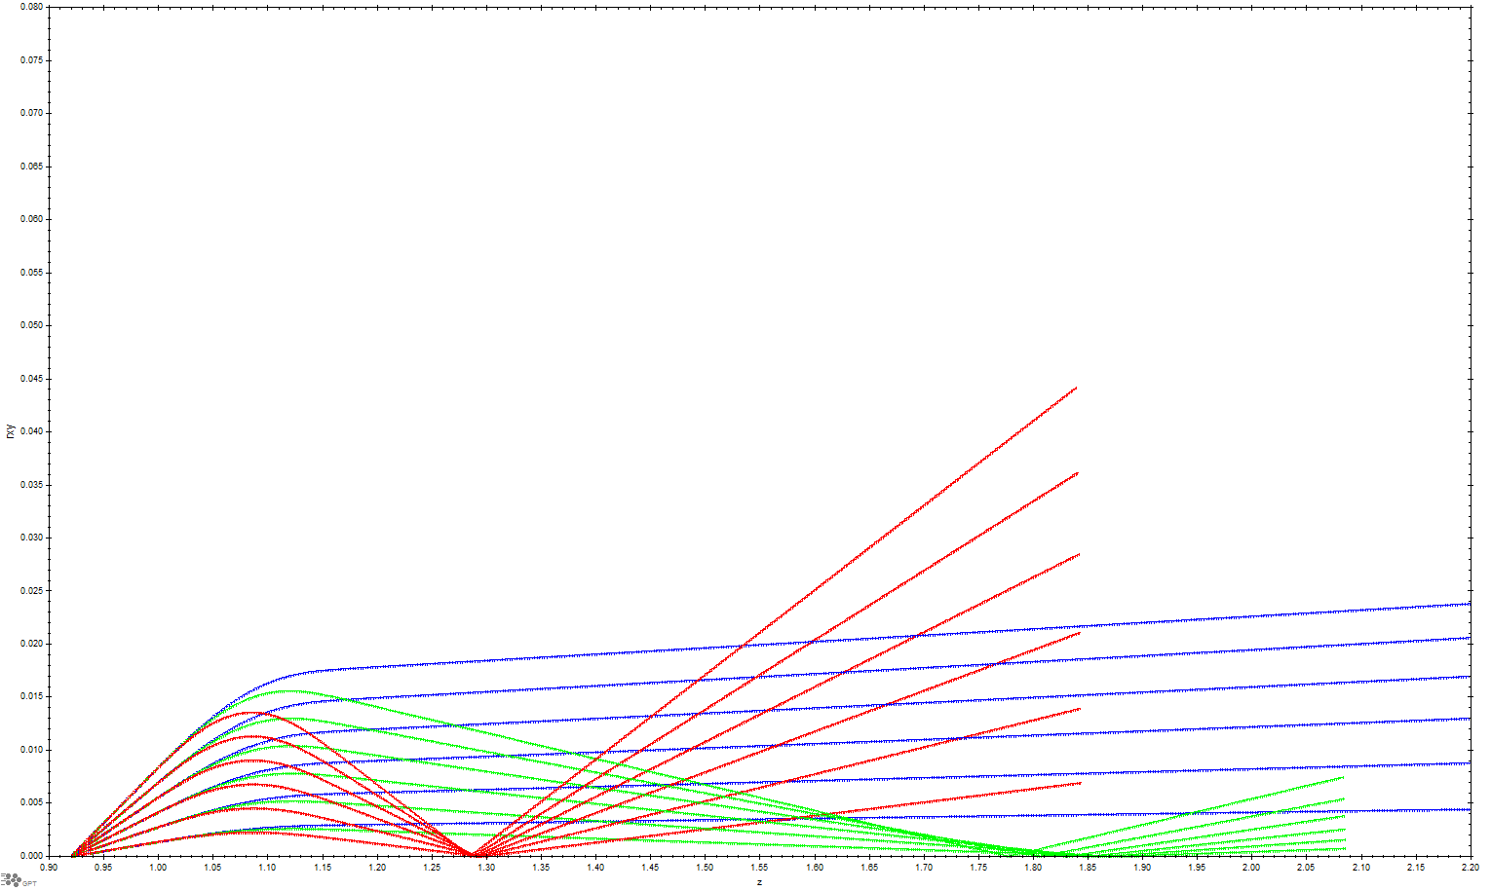
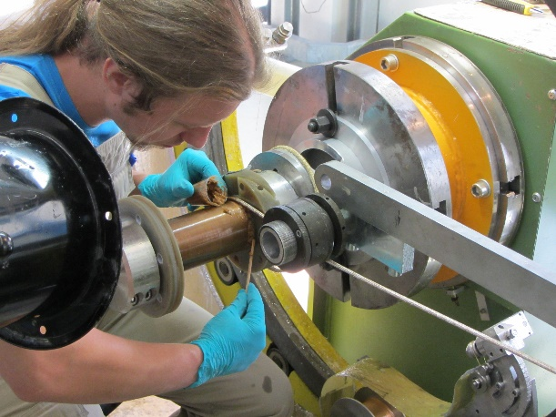
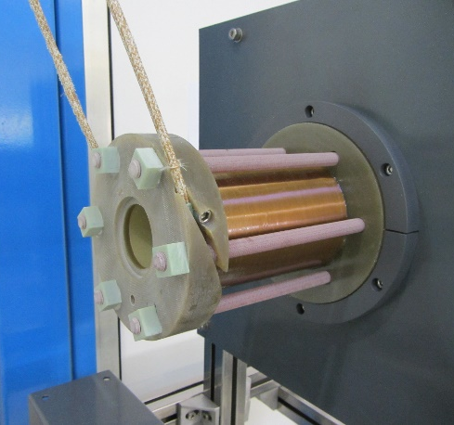
Laser accelerator meets pulsed high-field magnet
Preparing the LPA proton source for application
post-acceleration
sample
irradiation
Efficient, tunable beam transport via chromatic focusing
injection
pump/probe
radiobiology
accelerator
physics
sol
etc.
20
material
science
0
r [mm]
- 20
E1 < E2 < E3

Slide 3
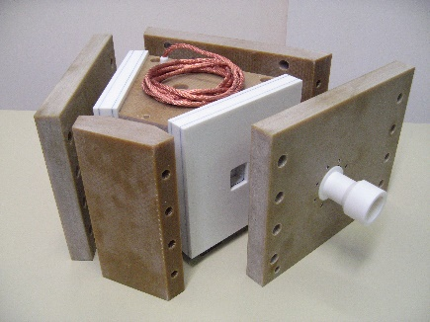
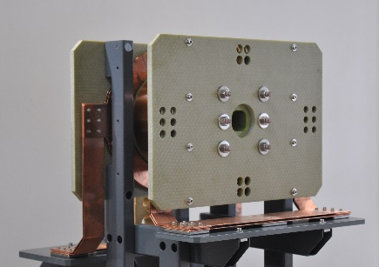
Pulsed power technology platform (ALBUS)
And associated research
Solenoid
lens (20 T)
Dipole sector
magnet (10 T)
Quadrupole
lens (250 T/m)
Split-pair
solenoid (15 T)
Portable current pulse generators (E_{el} ≤ 94 kJ)
Accelerator Physics
Laboratory Astrophysics
Nazary et al., J. Plasma Phys. 90 (2024)
Corvino et al., HPLSE 12 (2024)
Metzkes-Ng et al., Sci. Rep. 13 (2023)
Reimold et al., PMB 68 (2023)
Reimold et al., HPLSE 11 (2023)
Gerlach et al., HPLSE 11 (2023)
Reimold et al., Sci. Rep. 12 (2022)
Metternich et al., PRAB 25 (2022)
Kroll et al., Nat. Phys. 18 (2022)
Brack et al., Sci. Rep. 10 (2020)
Haffa et al., Sci. Rep. 9 (2019)
Jahn et al., PRAB 22 (2019)
Jahn et al., NIM-A 909 (2018)
Jahn et al., RSI 89 (2018)
Masood et al., PMB 62 (2017)
Busold et al., Sci. Rep. 5 (2015)
Masood et al., AP-B 117 (2014)
Busold et al., NIM-A 740 (2014)
Busold et al., PRAB 17 (2014)
Busold et al., PRAB 16 (2013)
Perez-Martin et al., HPLSE 11 (2023)
Bohlin et al., PPCF 64 (2022)
Manuel et al., MRE 6 (2021)
Mabey et al., Astrophys. J. 896 (2020)
Mabey et al., Sci. Rep. 9 (2019)
Albertazzi et al., HPLSE 6 (2018)
Albertazzi et al., Science 346 (2014)
Albertazzi et al., RSI 84 (2013)

Slide 4
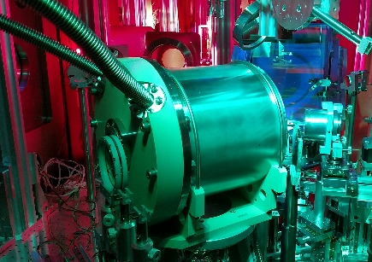
Pulsed power technology platform (ALBUS)
And associated research
Cooled
solenoid (20 T)
Solenoid
lens (20 T)
Dipole sector
magnet (10 T)
Quadrupole
lens (250 T/m)
Split-pair
solenoid (15 T)
Portable current pulse generators (E_{el} ≤ 94 kJ)
Accelerator Physics
Laboratory Astrophysics
Nazary et al., J. Plasma Phys. 90 (2024)
Corvino et al., HPLSE 12 (2024)
Metzkes-Ng et al., Sci. Rep. 13 (2023)
Reimold et al., PMB 68 (2023)
Reimold et al., HPLSE 11 (2023)
Gerlach et al., HPLSE 11 (2023)
Reimold et al., Sci. Rep. 12 (2022)
Metternich et al., PRAB 25 (2022)
Kroll et al., Nat. Phys. 18 (2022)
Brack et al., Sci. Rep. 10 (2020)
Haffa et al., Sci. Rep. 9 (2019)
Jahn et al., PRAB 22 (2019)
Jahn et al., NIM-A 909 (2018)
Jahn et al., RSI 89 (2018)
Masood et al., PMB 62 (2017)
Busold et al., Sci. Rep. 5 (2015)
Masood et al., AP-B 117 (2014)
Busold et al., NIM-A 740 (2014)
Busold et al., PRAB 17 (2014)
Busold et al., PRAB 16 (2013)
Perez-Martin et al., HPLSE 11 (2023)
Bohlin et al., PPCF 64 (2022)
Manuel et al., MRE 6 (2021)
Mabey et al., Astrophys. J. 896 (2020)
Mabey et al., Sci. Rep. 9 (2019)
Albertazzi et al., HPLSE 6 (2018)
Albertazzi et al., Science 346 (2014)
Albertazzi et al., RSI 84 (2013)

Slide 5
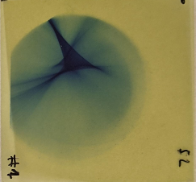
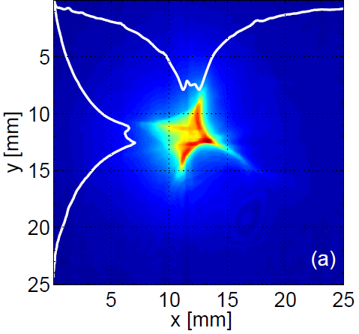
Messy focal spots
Strong astigmatism-like aberrations
Hard to model and reproduce in simulations

Slide 6
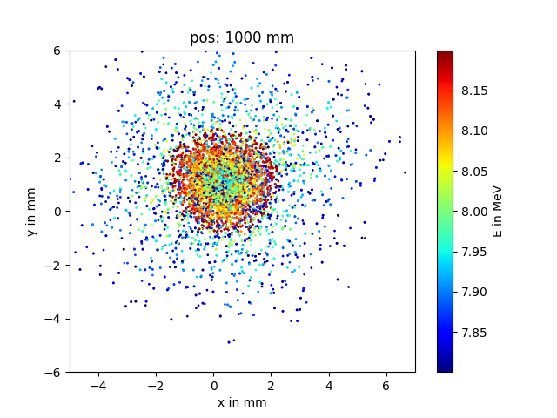
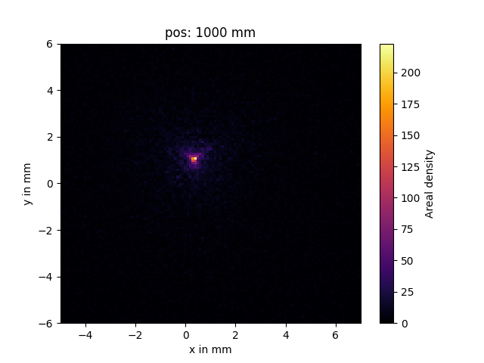
B-field and particle tracing simulations
Set 1 – reference helix
side view
front view
Helix w/o wires generates nice focal spot

Slide 7
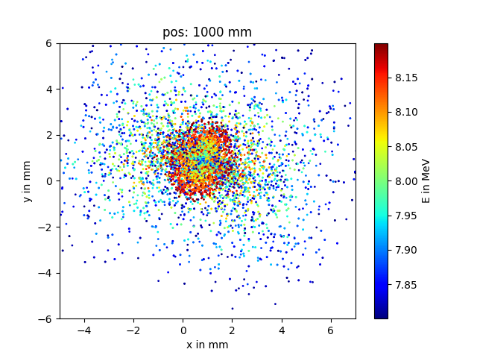
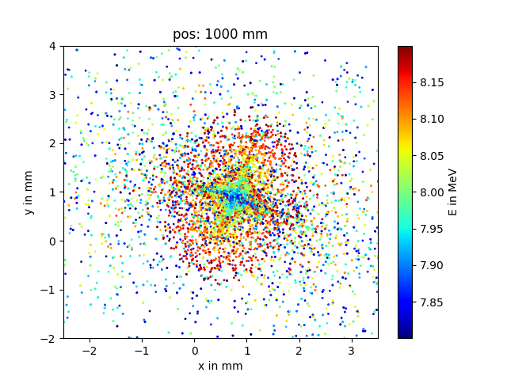
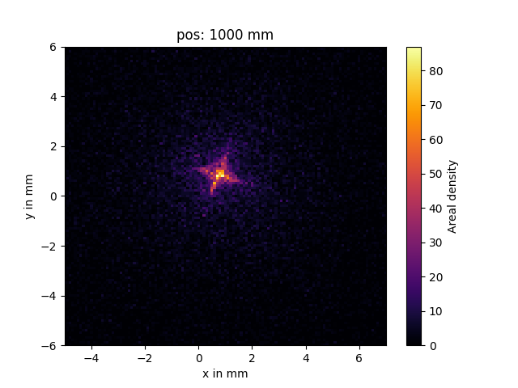
B-field and particle tracing simulations
Set 2 – helix + wires straight upwards
side view
front view
Helix w/ wires generates star-shaped focal spot

Slide 8
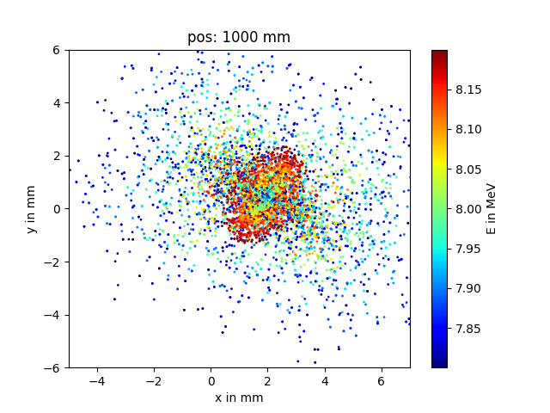
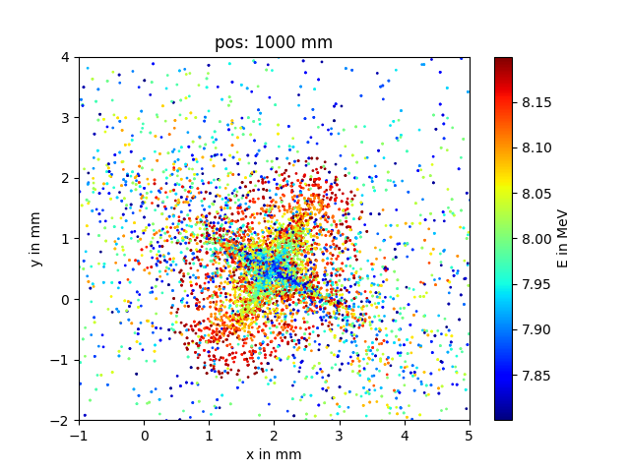
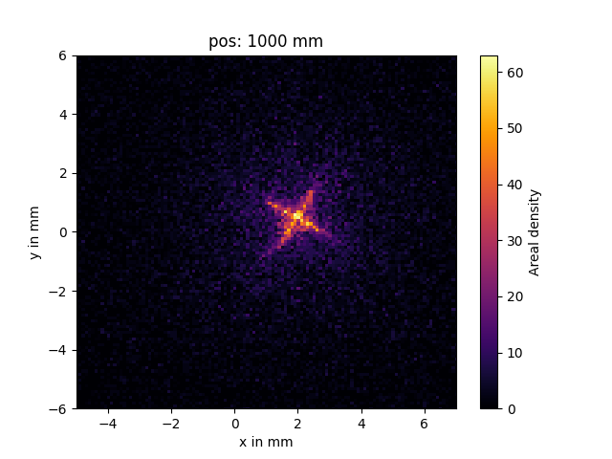
B-field and particle tracing simulations
Set 3 – helix + wires (10° in z-direction)
side view
front view
z-bend makes focal spot slightly worse

Slide 9
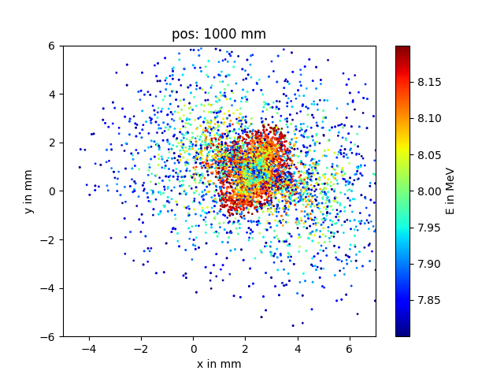
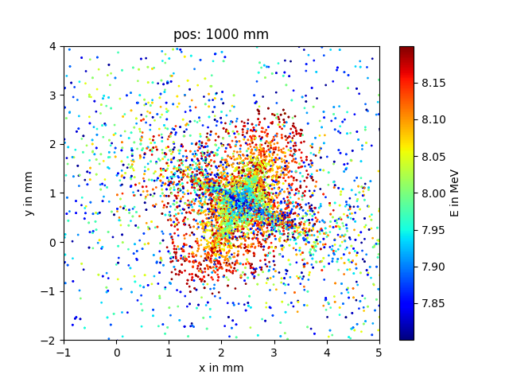
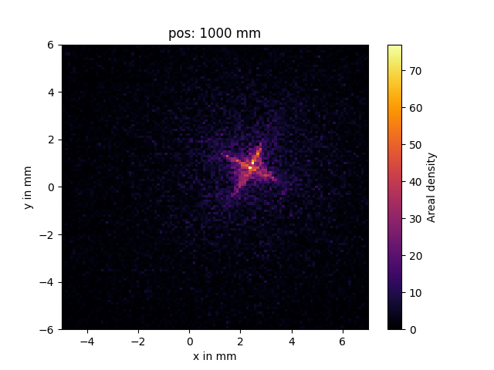
B-field and particle tracing simulations
Set 4 – helix + wires (10° in x- & z-direction)
side view
front view
Additional y-bend has almost no impact

Slide 10
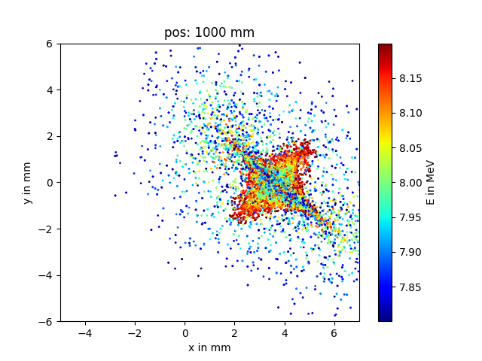
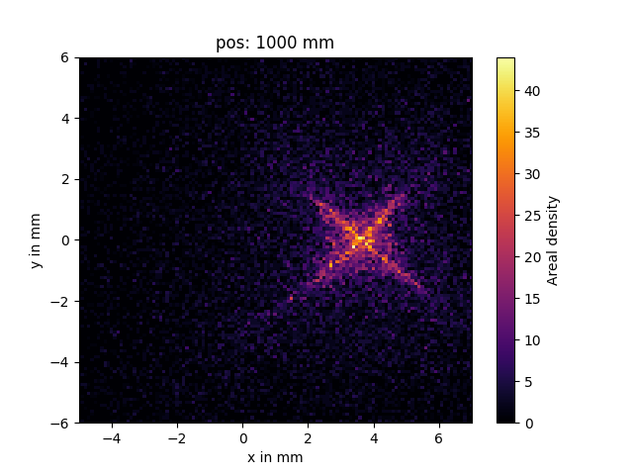
B-field and particle tracing simulations
Set 5 – helix + wires (24° in z-direction)
side view
front view
Stronger z-bend = worse focal spot

Slide 11
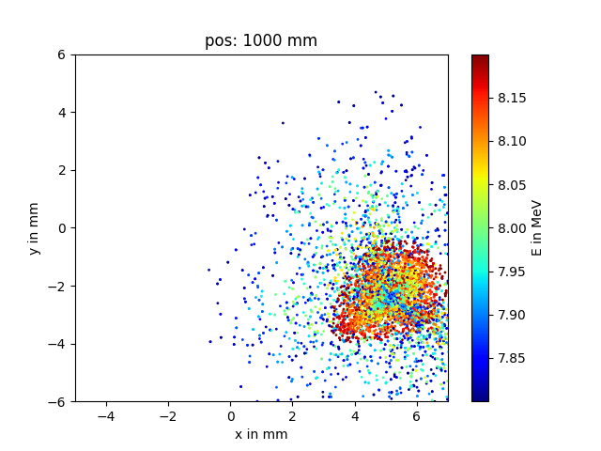
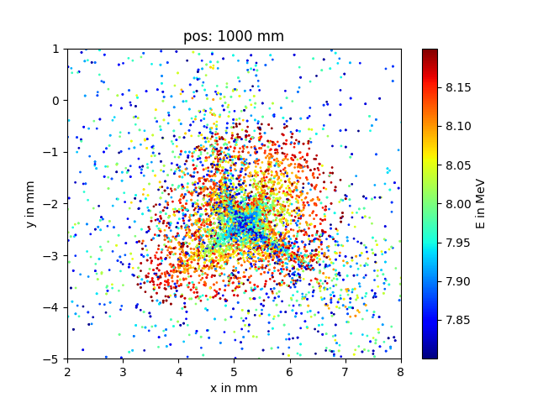
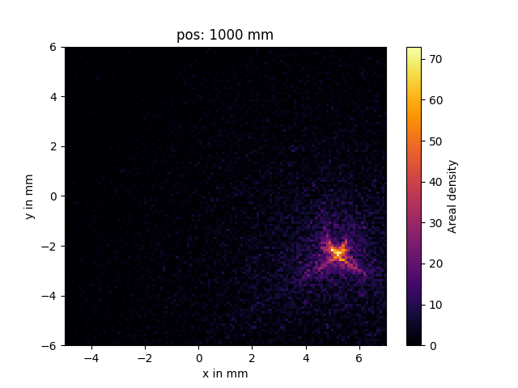
B-field and particle tracing simulations
Set 6 – helix + true wire geometry
side view
front view
Focal spot shape nicely reproduced

Slide 12
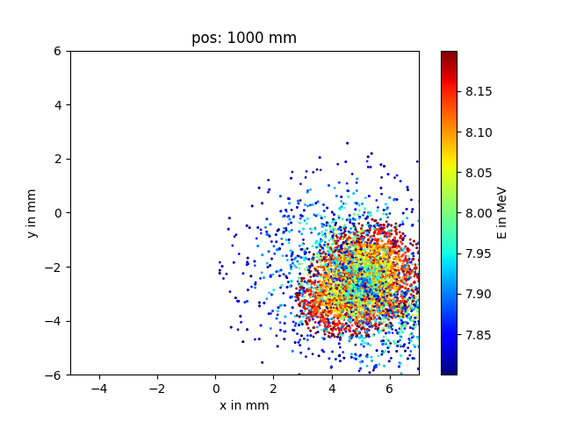
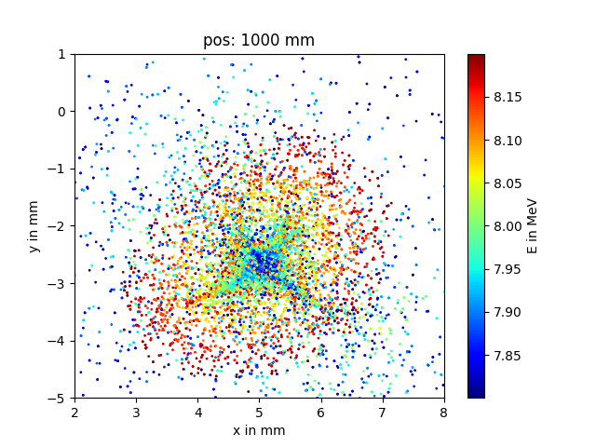
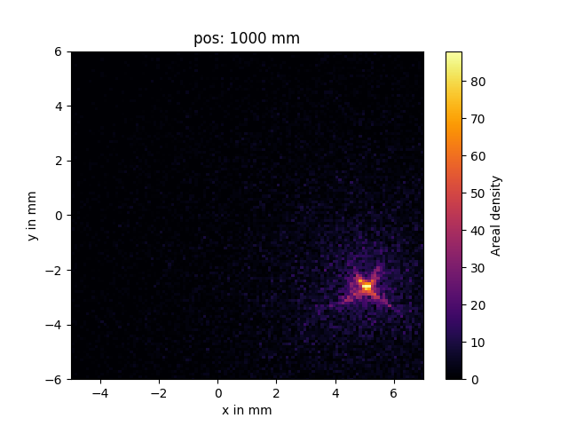
B-field and particle tracing simulations
Set 7 – 1.5 × larger helix + true wire geometry
side view
front view
Larger coil radius might help
(capture efficiency ↑ & power ↑)

Slide 13
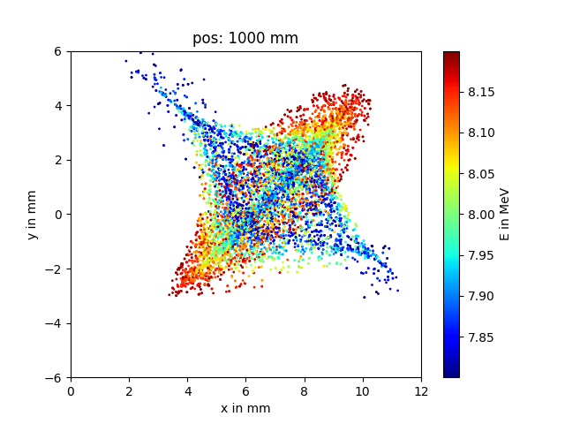
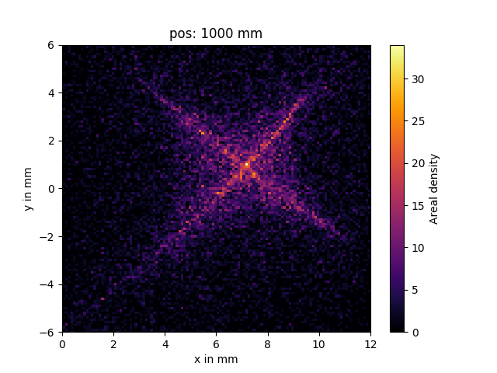
B-field and particle tracing simulations
Set 8 – 2-layer helix + wires (24° in z-direction)
side view
front view

Slide 14
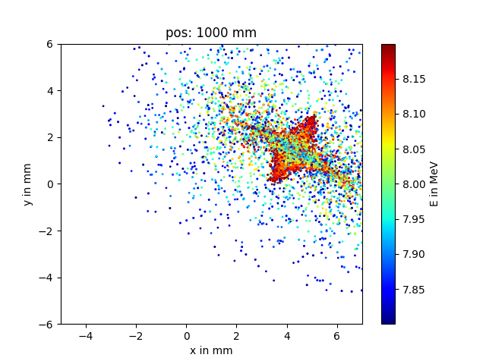
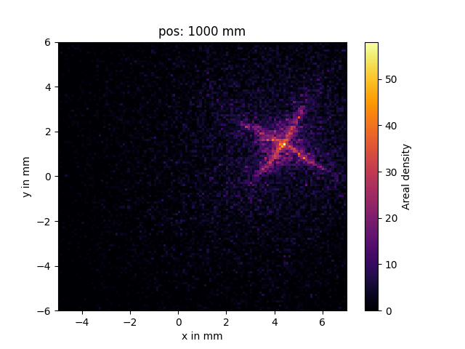
B-field and particle tracing simulations
Set 9 – large 2-layer helix + wires (24° in z-direction)
side view
front view

Slide 15
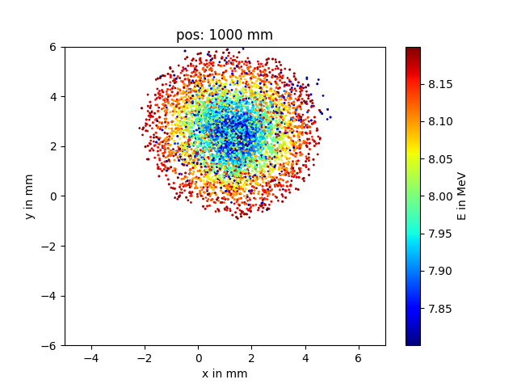
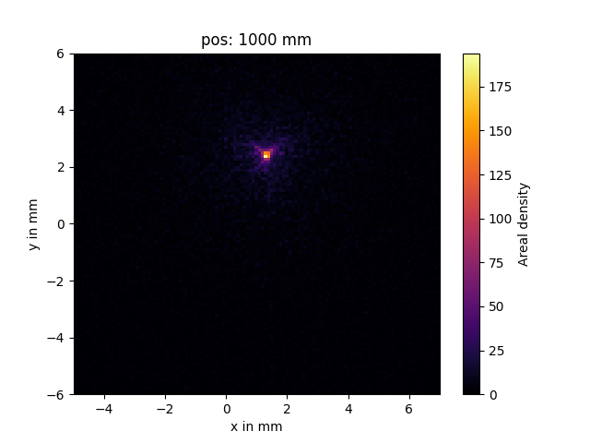
B-field and particle tracing simulations
Set 10 – large 2-layer helix, no wires
side view
front view
High number of windings is favorable (I_{wire} ↓)

Slide 16
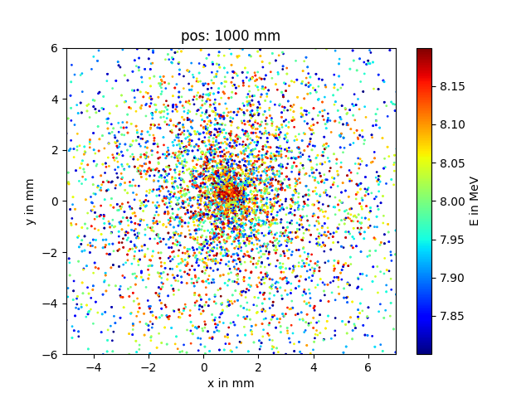
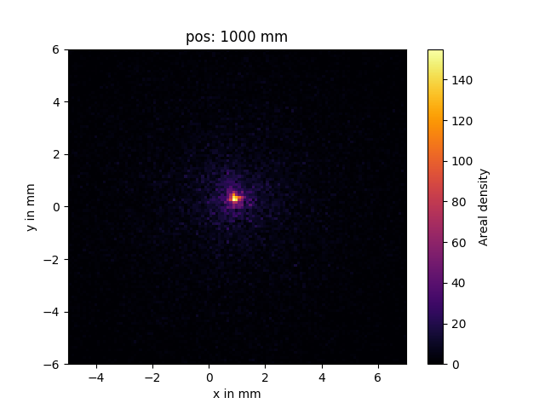
B-field and particle tracing simulations
Set 8 – like set 5 but with a twist
side view
front view
Simple solution to all our problems???

Slide 17
Maybe!
Practicability of turning the coil around
Soft copper wires with PTFE tubing allow for flexible routing away from TCC
Coil sits symmetrically in the housing (same distancer to TCC possible)
Nuts and bolts increase TCC distance
Cooling connection clearly in the way

Slide 18
What should we do next?
Should we build modified coil prototype(s) for LIGHT and Dresden?
Considerations:
Thinner wires:
more flexible wire routing vs. less mechanical strength
less steep incoming/outgoing wire
More windings per coil length
Larger coil radius:
Higher capture efficiency
Possibly better focal spot quality
Higher energy requirement
Change mounting direction with slightly adopted design!
Any wishes for future coil designs?

Slide 19
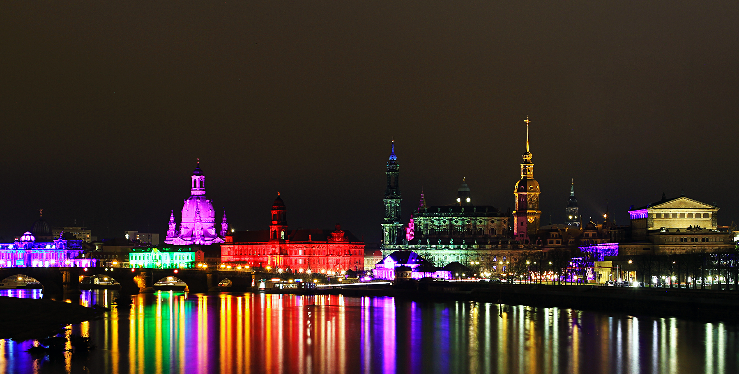
Thank you for your attention!
© Funklicht Gewitter

