Slide 1
The iLIGHT project Demonstrating injection of laser accelerated ions into SIS18
LIGHT Workshop, 30.10.2024
Abel Blažević for PPH and LIGHT collaboration
Courtesy to:
M. Metternich
S. Ratschow

Slide 2
Brief history of LIGHT
LIGHT: Laser Ion Generation Handling and Transport
2004-2008: VIPBUL-Virtual Institute for generation of intense Particle Beams with Ultra-intense Laser fields, funded by BMBF
participants: TUD, GSI, LMU, FSU and Weitzman Institute in Tel Aviv.
Set up of compressor and laser beam line to Z6 target chamber.
First experiments with solenoids and permanent quadrupoles at PHELIX
2008: foundation of LIGHT collaboration – GSI, TUD, HIJ, HZDR, GUF later LMU, LBNL, CLPU
Investigation of TNSA mechanism
Implementation of solenoid by HZDR
Implementation of rf cavity by GSI
Second target chamber for experiments
14 bachelor/master theses, 11 PhD, >17 papers

Slide 3
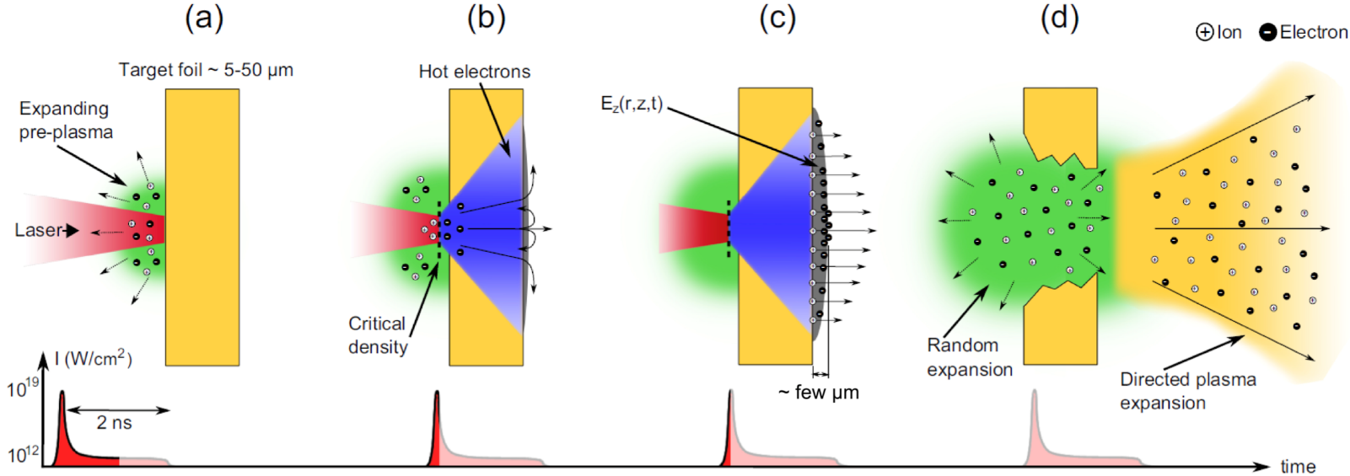
Overview of the LIGHT beamline
TNSA
y
x
PHELIX

Slide 4
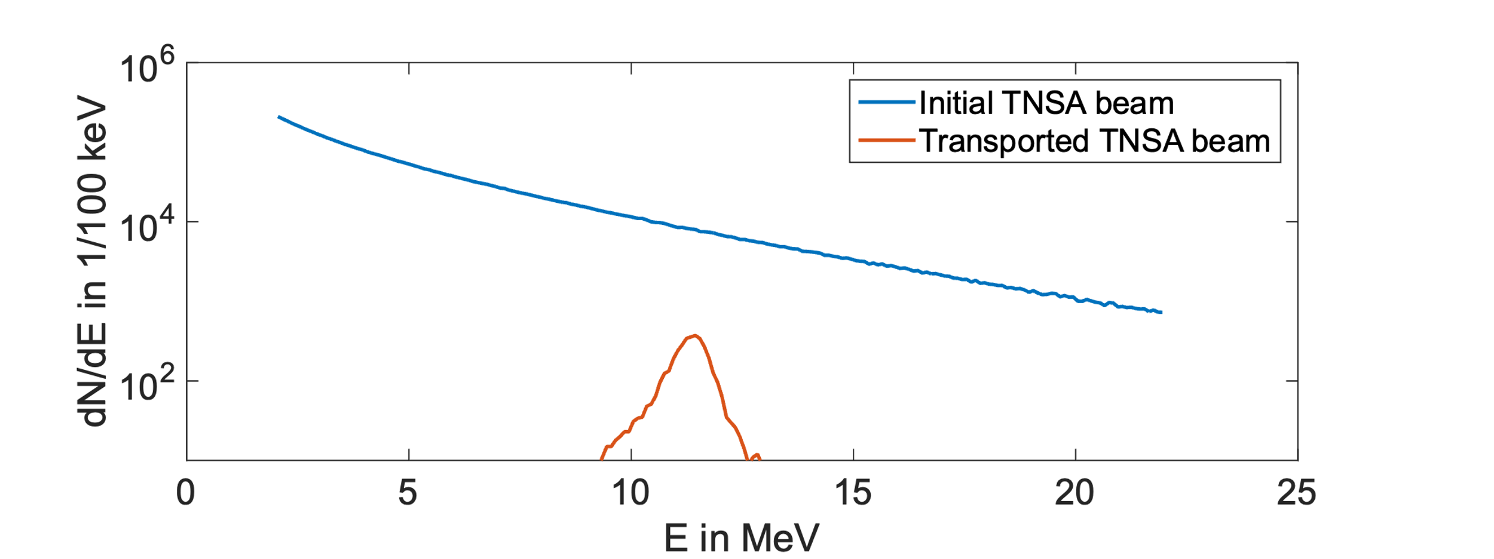
Overview of the LIGHT beamline
TNSA
y
Initial TNSA beam parameter (Z6):
E_{max} ≈ 28 MeV
$kBT$ ≈ 7 MeV
$ε_{rr′}^{2σ}$ < 1.5 mm mrad
$N_{total}$ ≈ 10¹² (protons)
x
PHELIX

Slide 5
Overview of the LIGHT beamline
Transport &
energy selection
TNSA
y
Solenoid
Transported TNSA beam:
E_{peak} = 11.4 MeV
$ΔE/E$ = 10 %
$ε_{rr′}^{2σ}$ = 83.2 mm mrad
$N_{total}$ ≈ 10⁹
x
PHELIX
$E_{1}<E_{2}<$ $E_{3}$

Slide 6
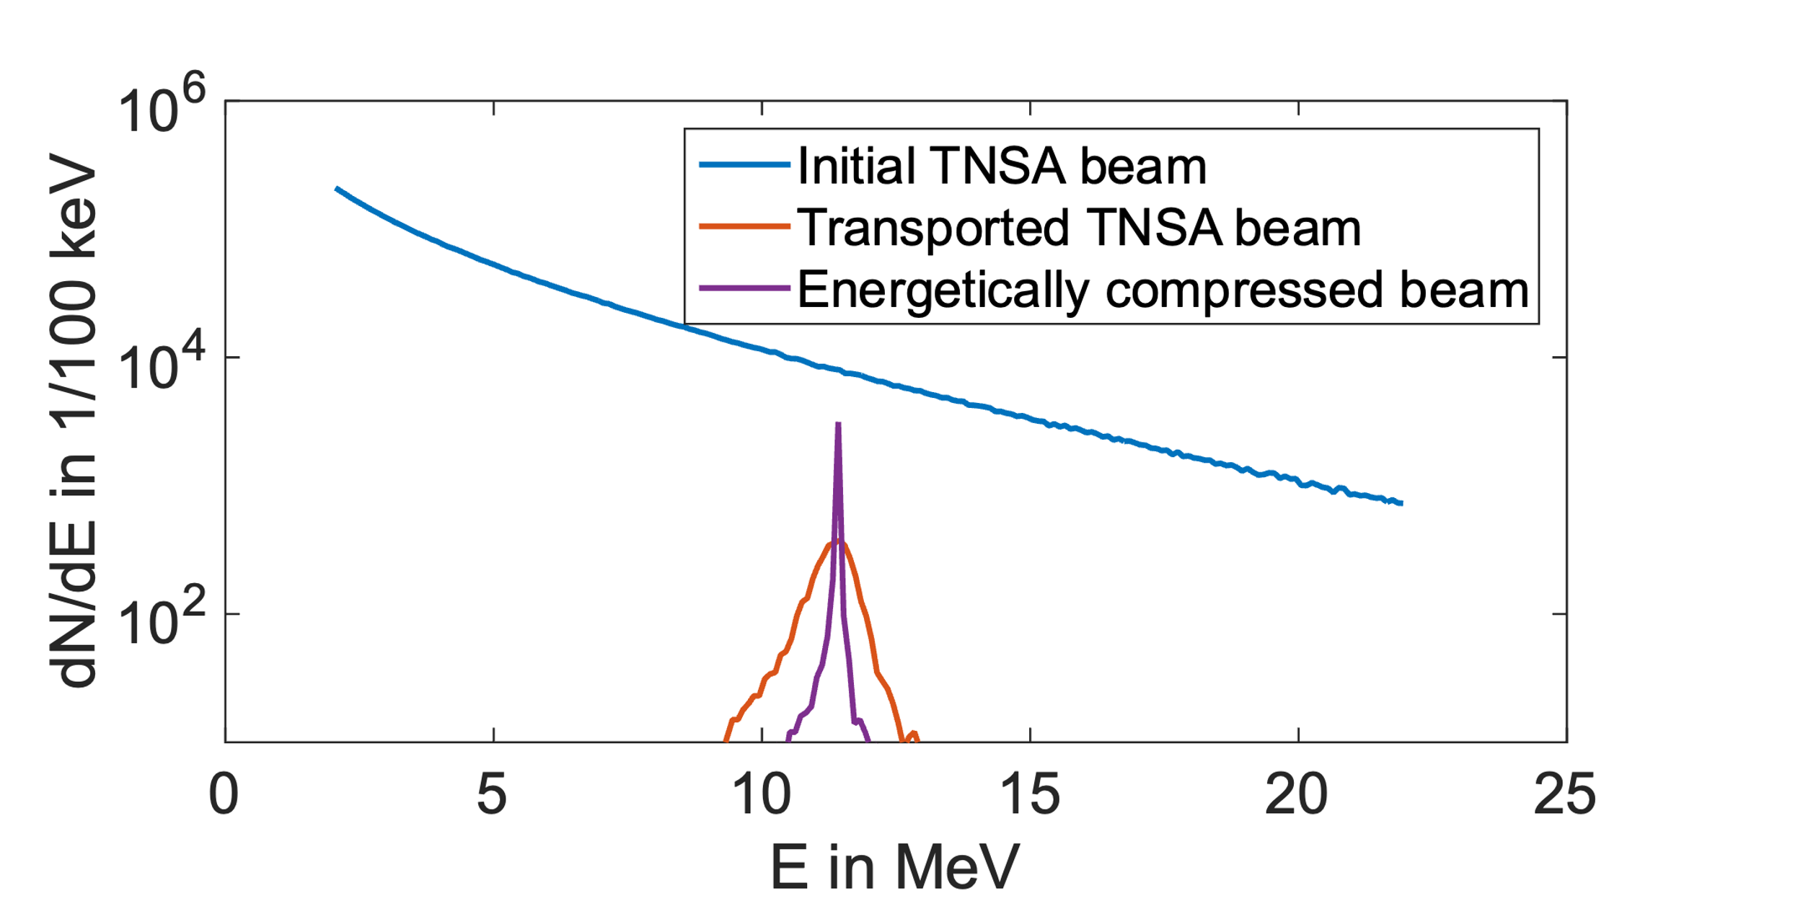
Overview of the LIGHT beamline
Transport &
energy selection
Energetic compression
TNSA
y
RF cavity
Solenoid
E_{peak} = 11.4 MeV
$ΔE/E$ = 0.21 %
$ε_{rr′}^{2σ}$ = 63.1 mm mrad
$N_{total}$ ≈ 10⁹
x
z
PHELIX
$E_{1}<E_{2}<$ $E_{3}$

Slide 7
Overview of the LIGHT beamline
Transport &
energy selection
Energetic compression
TNSA
∆E/E = 0.4 %
y
RF cavity
Solenoid
E_{peak} = 11.4 MeV
$ΔE/E$ = 0.21 %
$ε_{rr′}^{2σ}$ = 63.1 mm mrad
$N_{total}$ ≈ 8.2 x 10⁸
x
z
PHELIX
E_{peak} = 8.0 MeV
$ΔE/E$ = 0.32 %
$ε_{rr′}^{2σ}$ = 65.5 mm mrad
$N_{total}$ ≈ 1.2 x 10⁹
$E_{1}<E_{2}<$ $E_{3}$

Slide 8
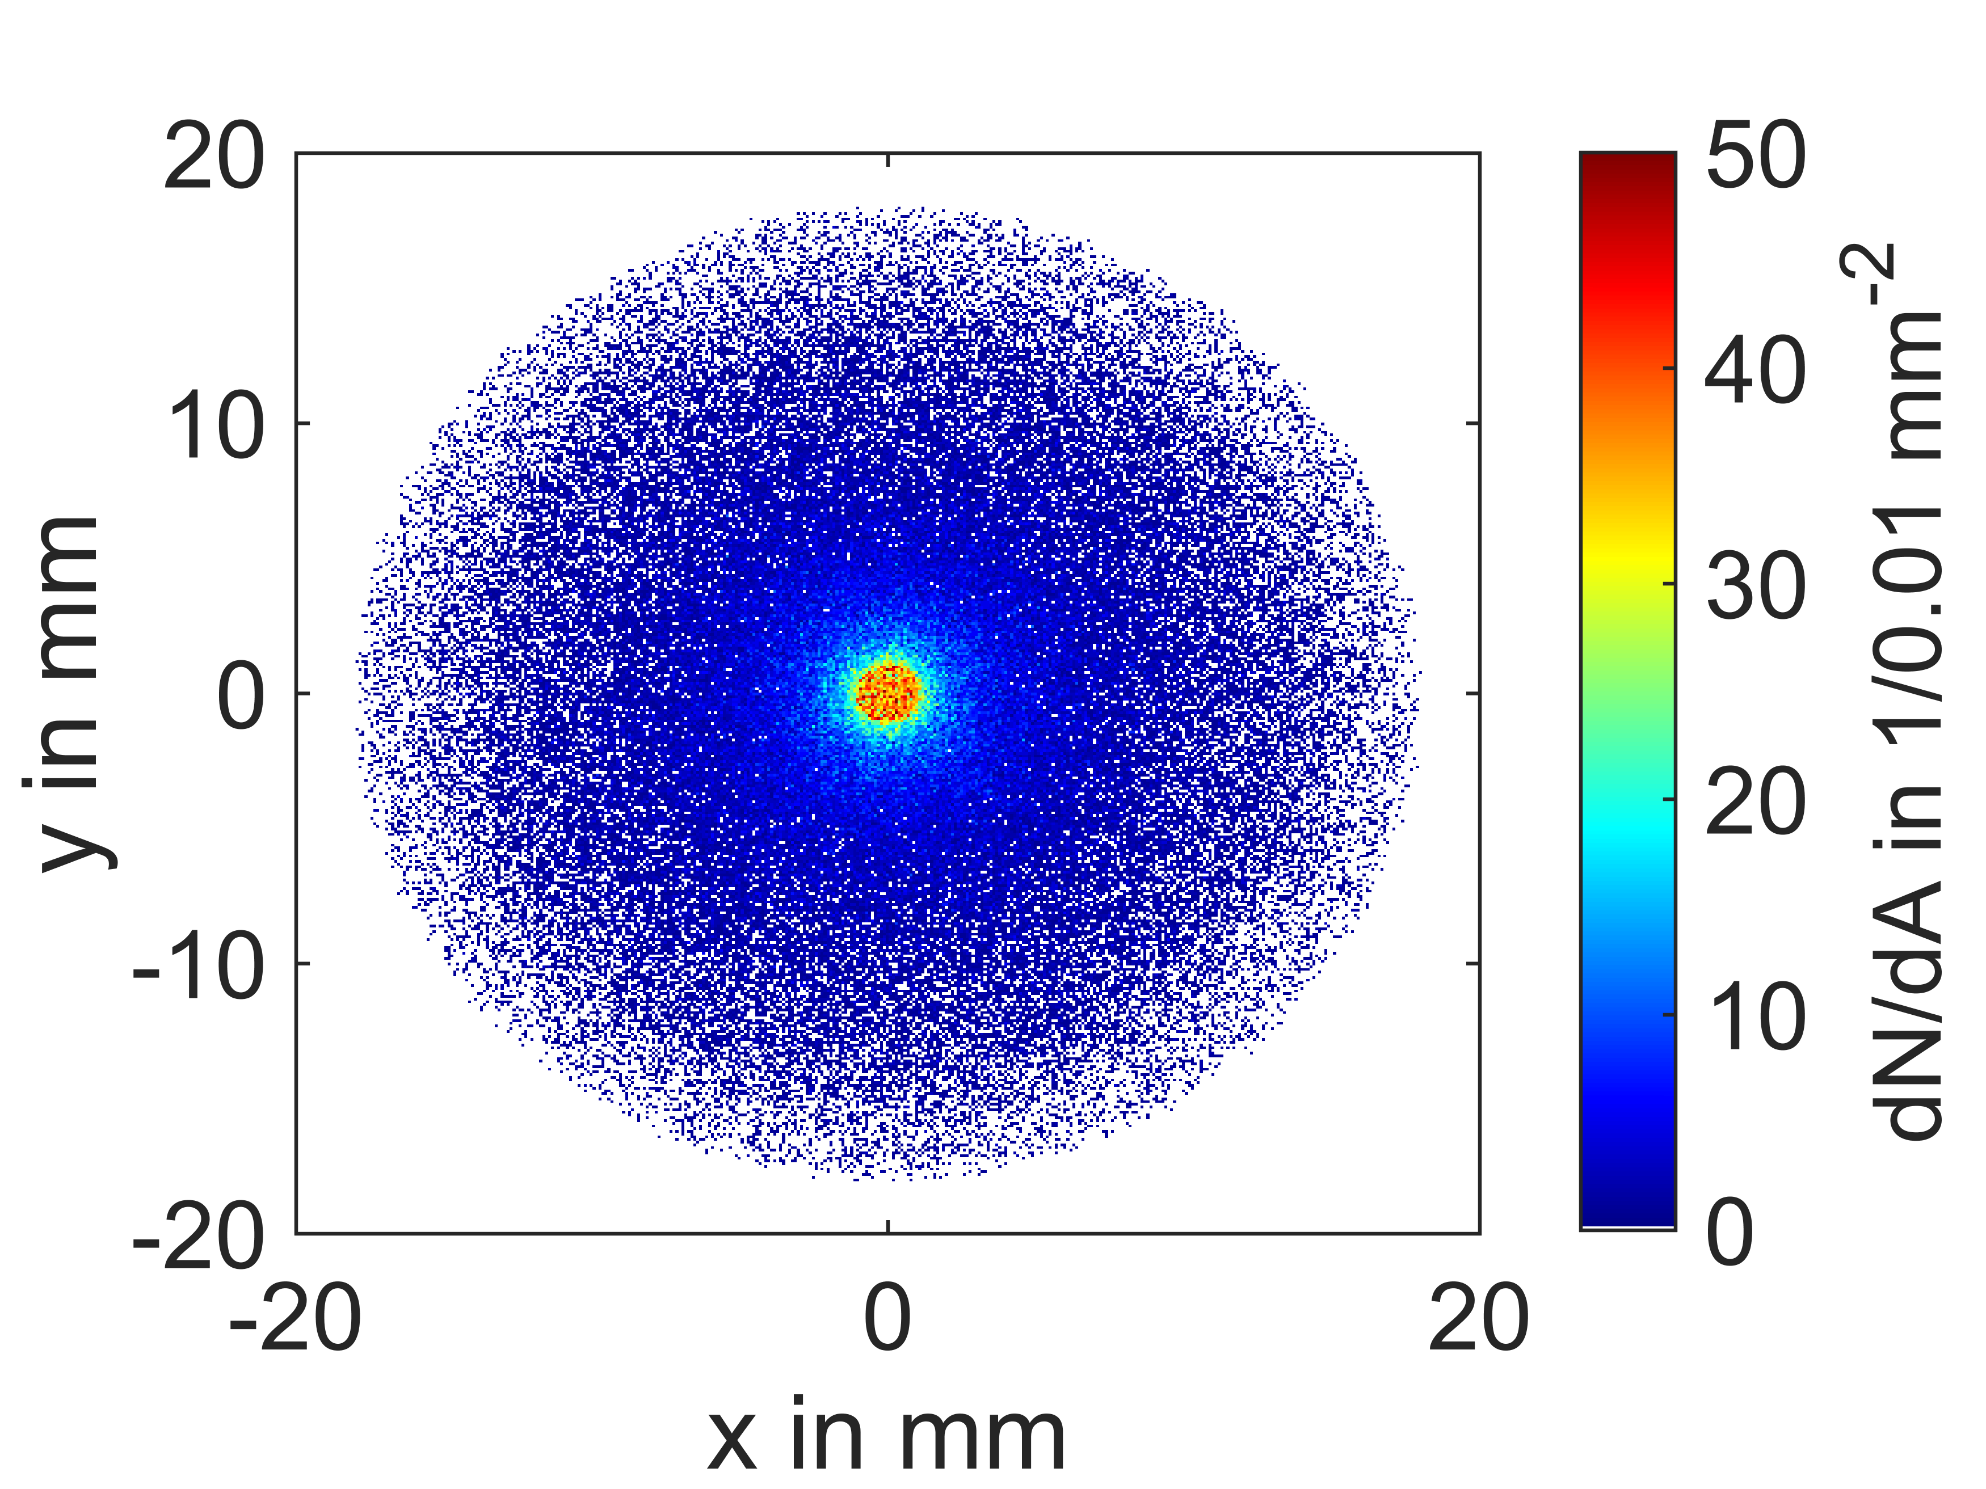
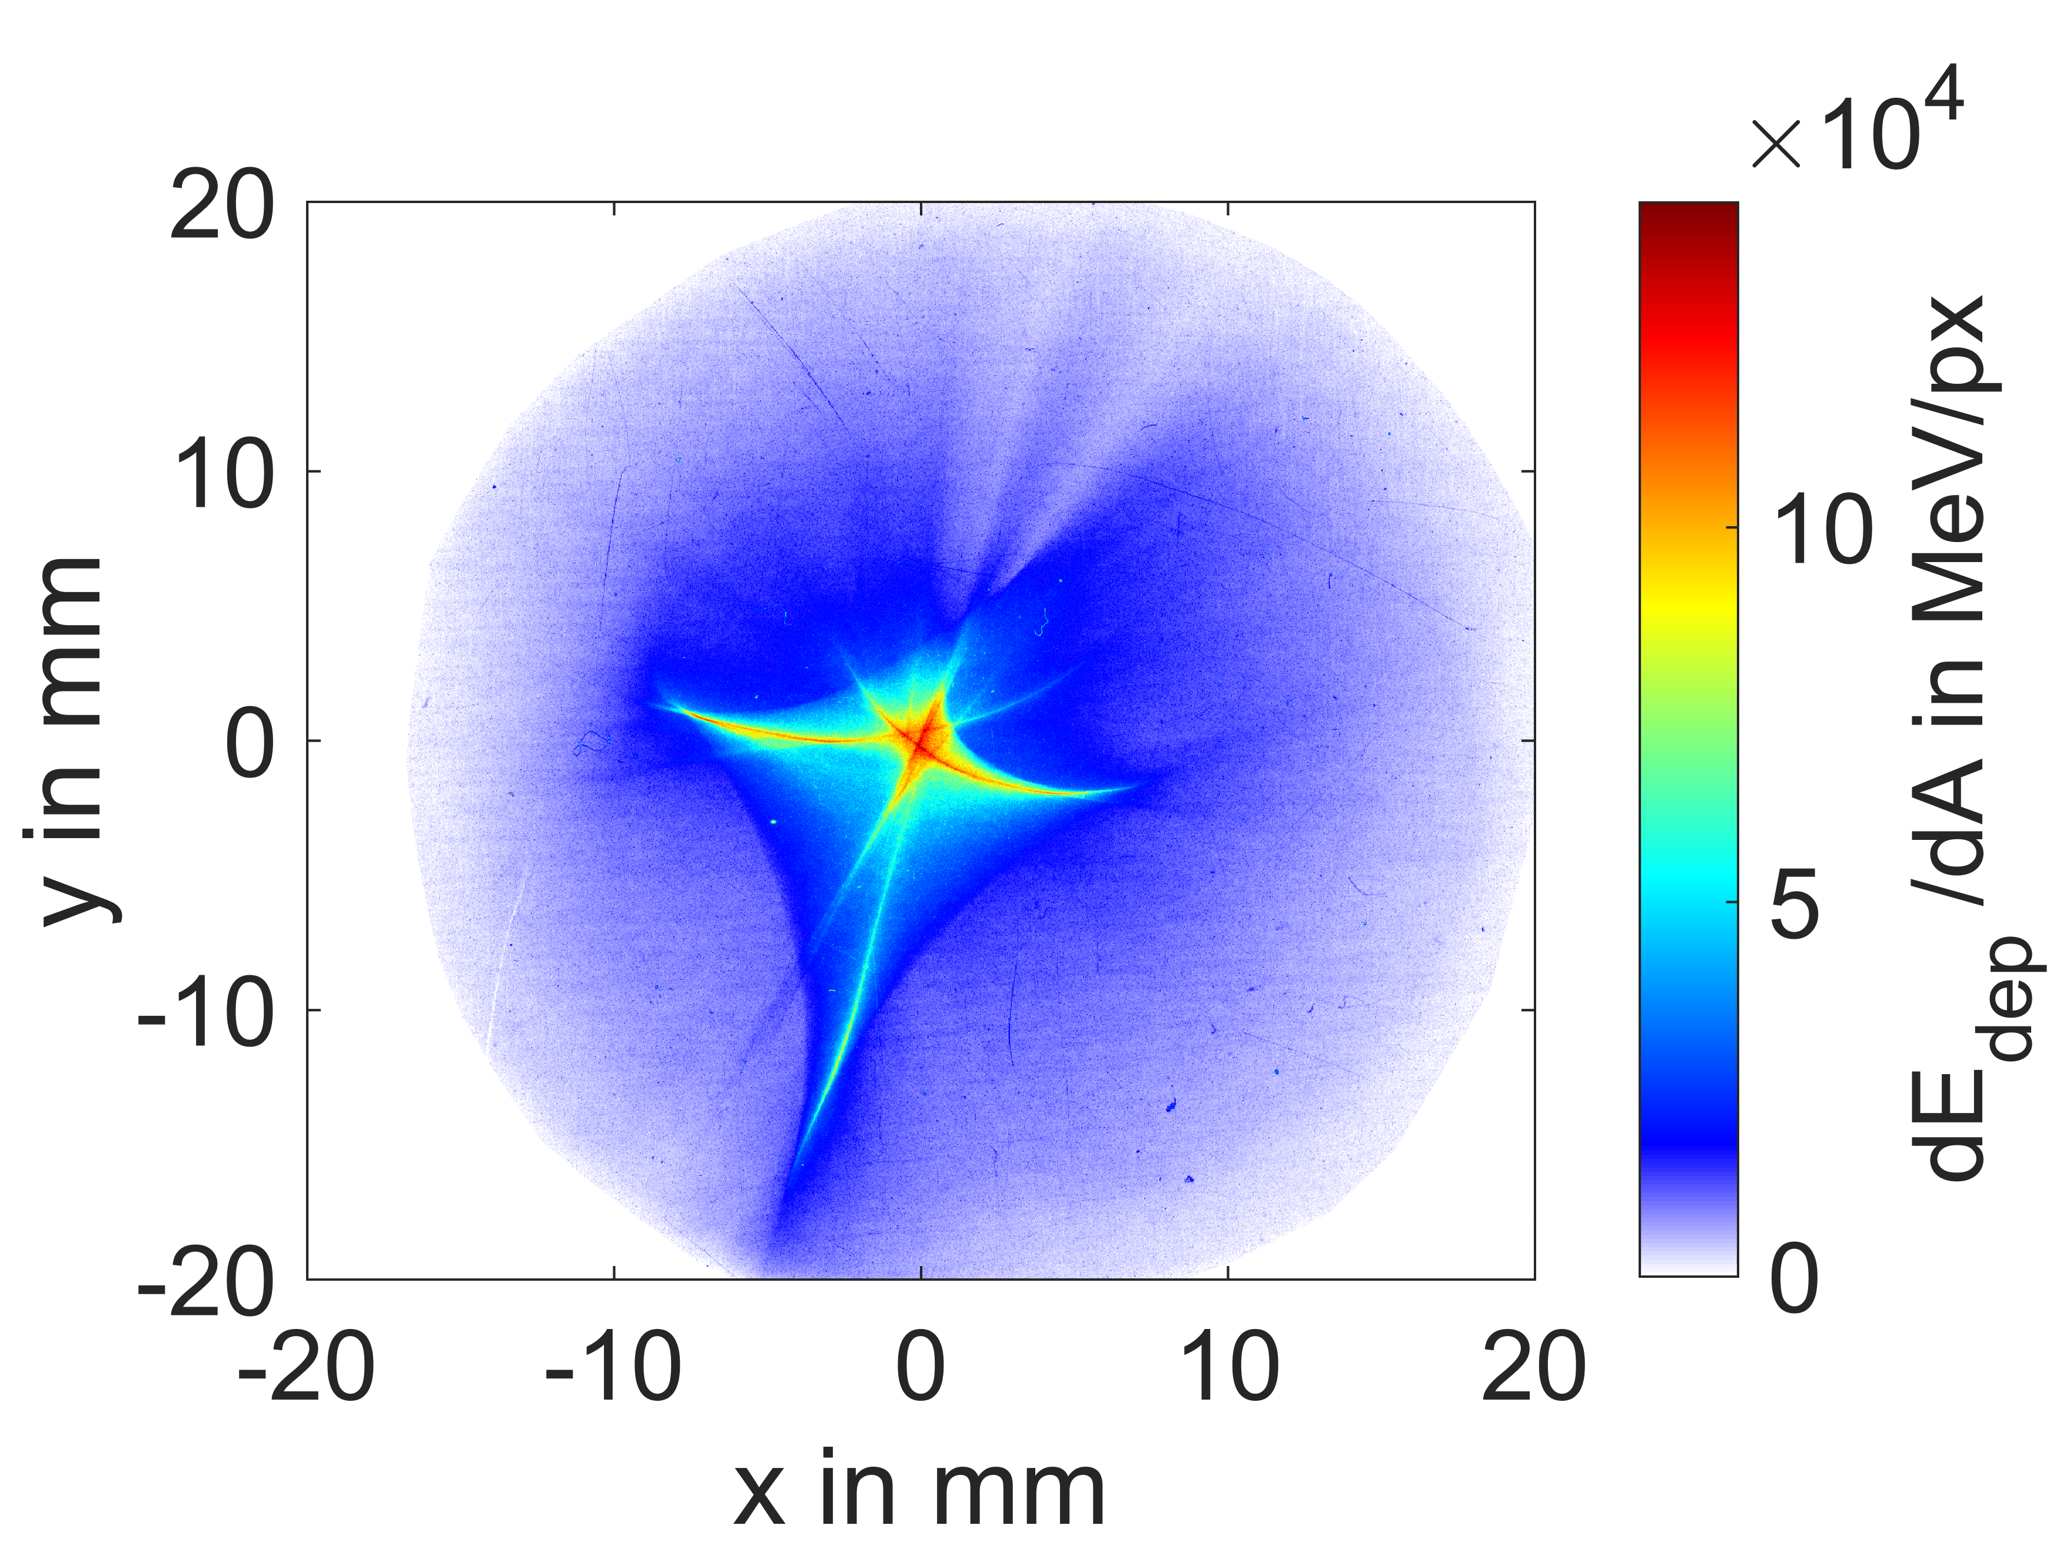
Overview of the LIGHT beamline
Transport &
energy selection
Energetic compression
TNSA
Focusing
y
RF cavity
Solenoid 2
Solenoid
x
z
PHELIX
$E_{1}<E_{2}<$ $E_{3}$

Slide 9
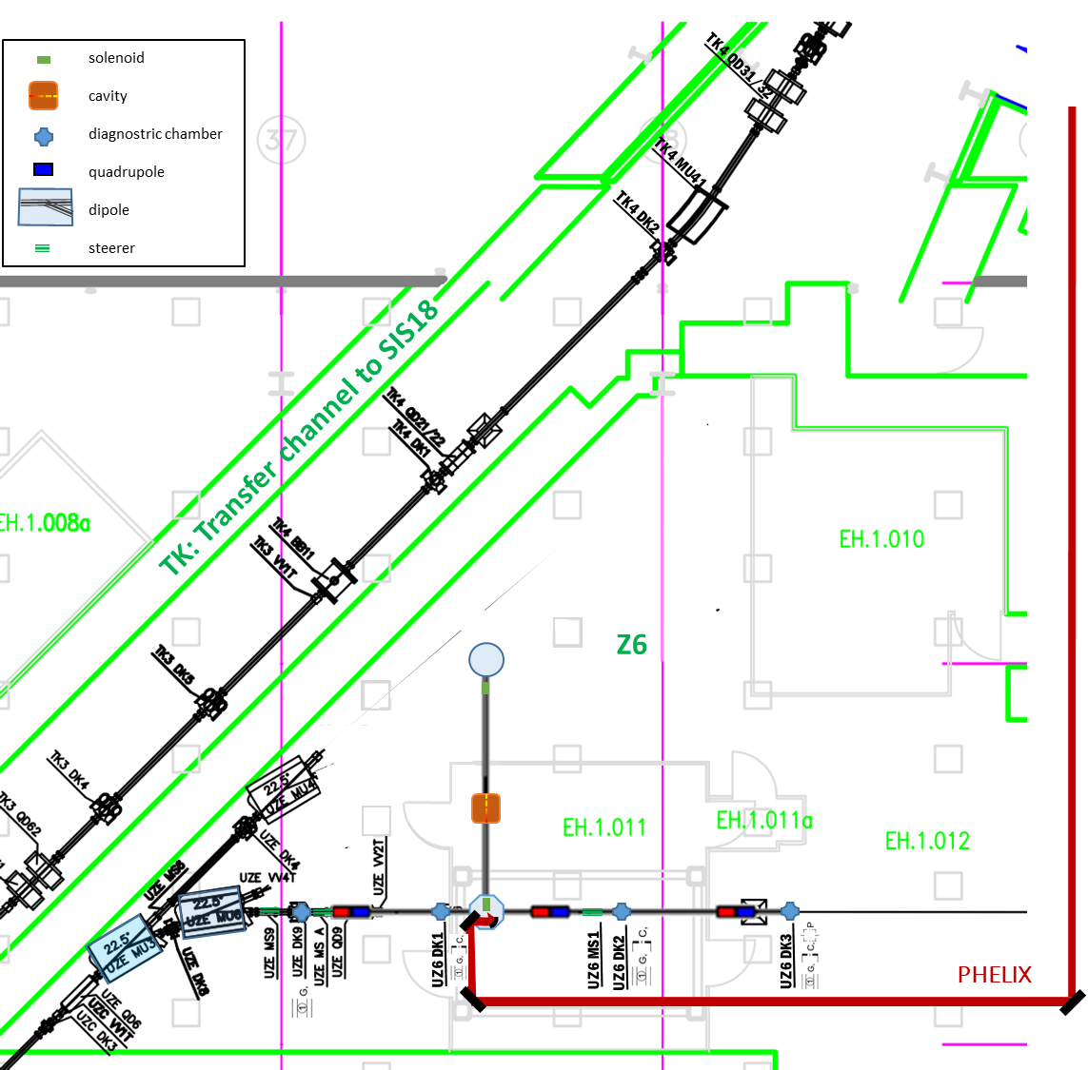
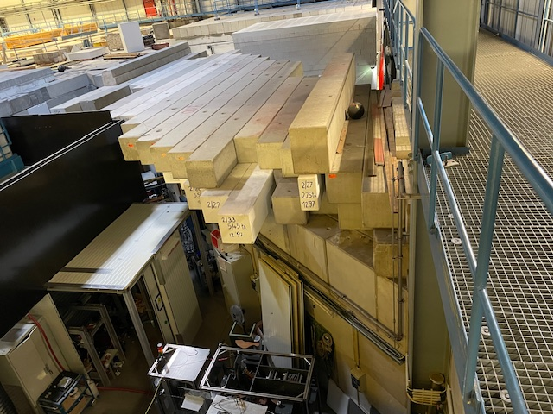
The LIGHT beam line at Z6-GSI
SIS18
TK
PHELIX
Z6
UNILAC

Slide 10
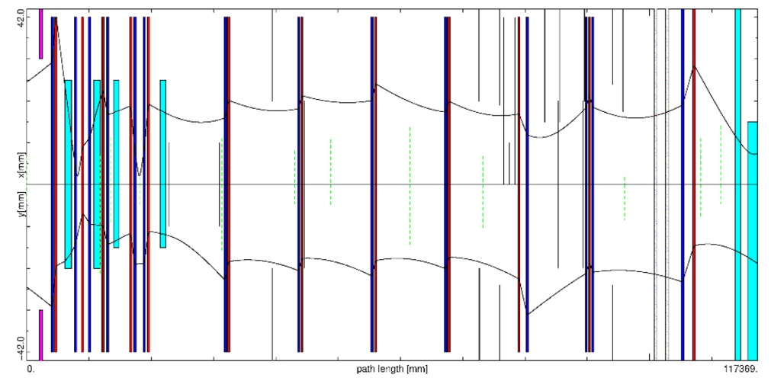
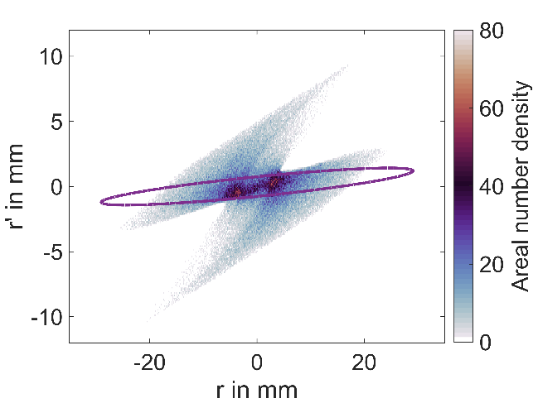
Beam Transport Simulation
$ε_{geo}=22 mm mrad$
${\left({ΔE}/E\right)}_{max}=±0.2 \%$
Simulation
SIS18
TK
MIRKO simulation by S. Ratschow
PHELIX
Z6
UNILAC
$$N_{sim}\text{ = }\text{6.14(43)}×{10}^{8}$$
(within acceptance range)

Slide 11
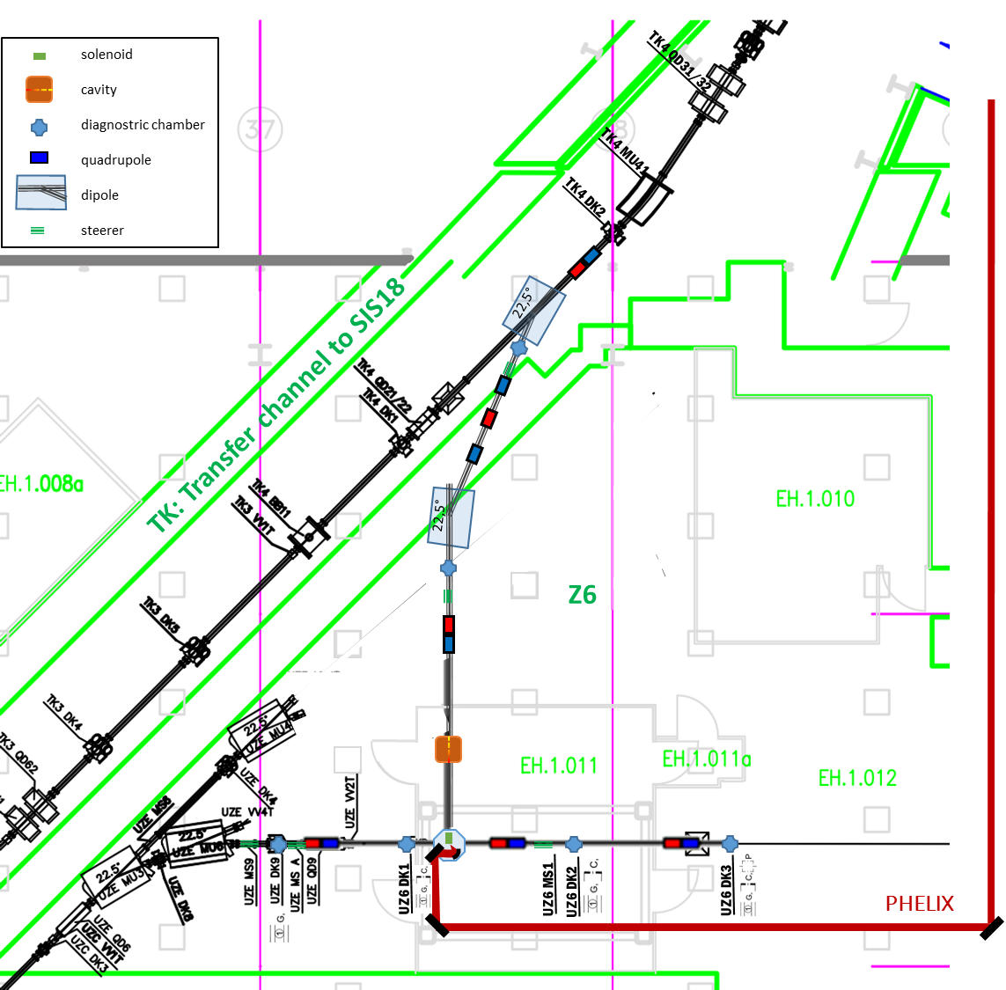
The iLIGHT beam line at GSI
Main goal:
Proof of principle
ELI: 1 Hz operation
GSI: injection
Chances:
Concept could reduce
injection time
emittance / bunch length
cost and size of injectors in the future
Benefits for GSI:
Expansion of the ion species that can be injected
Additional injector for emergency
SIS18
TK
PHELIX
Z6
UNILAC

Slide 12
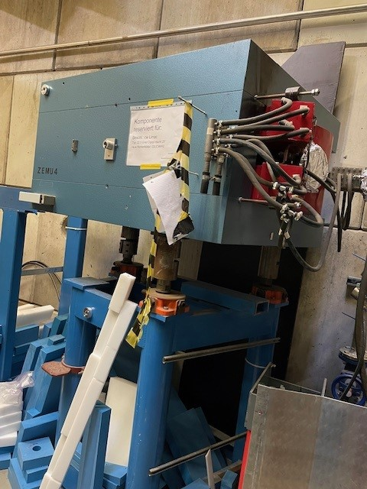
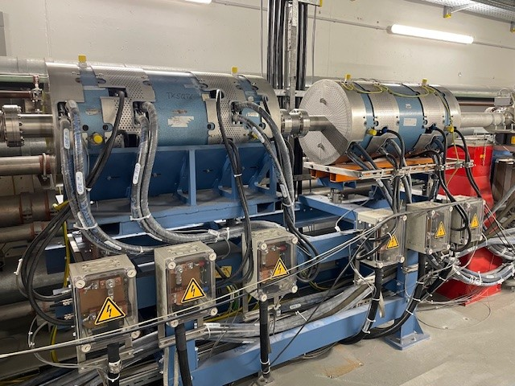
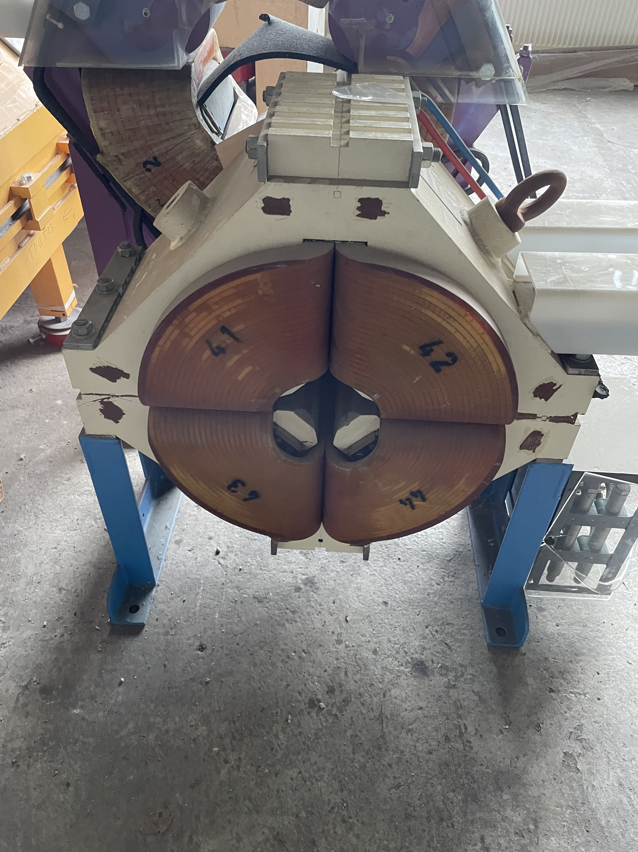
Available magnets at GSI
2 dipoles
6 quadrupoles from EmTEX
1 spare quadrupole

Slide 13
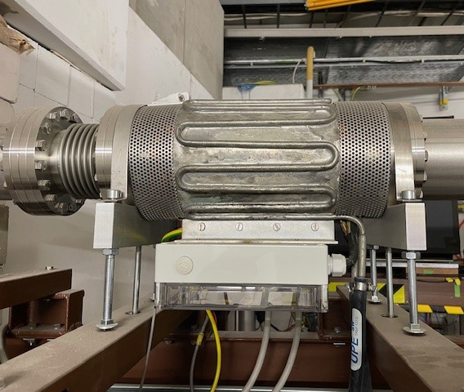
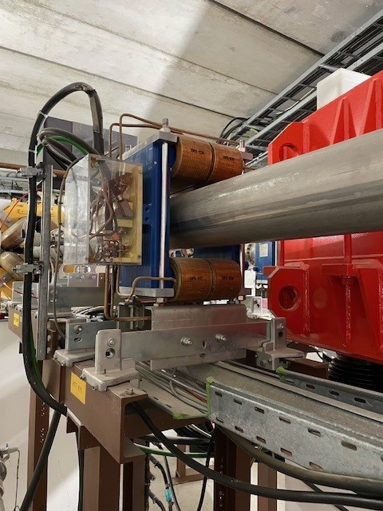
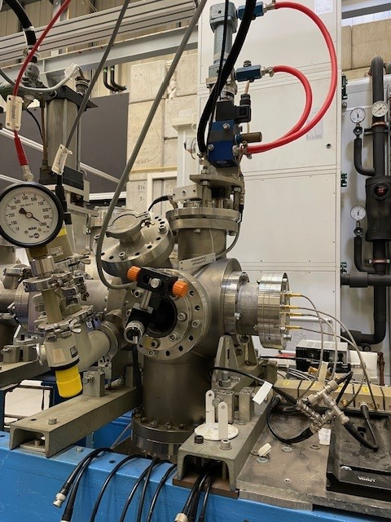
Available steerers and beam diagnostics
UNILAC steerer
SIS steerer
ion beam diagnostics

Slide 14
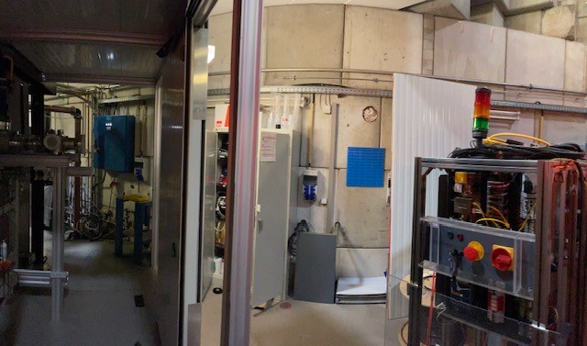
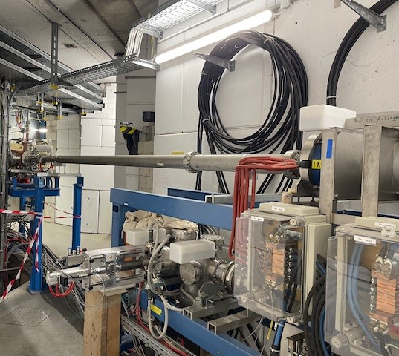
Sites at Z6 and TK

Slide 15
Needed
simulations (beam transport and radiation safety)
Digital Mock-Up (GSI)
frames for ion beam elements
single shot ion beam diagnostics, preferably non destructive
single shot emittance measurement
laser focusing parabola
optimized solenoid
rf supply for cavity (GSI-26/1)
vacuum components (pumps, controls, gauges)
valves, beam pipes, ballows
adjustment procedure for magnets with single shots
manpower: technicians, postdoc, PhD, master students

Slide 16
Time plan
 | Task | 24/2 | 25/1 | 25/2 | 26/1 | 26/2 | Responsible | Participant
Phase 1 | Theoretical investigation of injection concept, definition of ion optical layout |  |  |  |  |  | ACC, PPH | TUD, IAP
 | Upgrade of PHELIX beam line (mirrors, parabola) |  |  |  |  |  | PPH | TUD
 | Testing plasma lens as capture device |  |  |  |  |  | IAP-GUF | PPH, HZDR
 | Ion beam diagnostics R&D |  |  |  |  |  | PPH | ACC
Phase 2 | Setting up magnets, vacuum, diagnostics for LIGHT → TK |  |  |  |  |  | ACC,PPH | TUD
 | First laser accelerated proton beam transport experiments to TK |  |  |  |  |  | PPH,ACC | LIGHT
 | Measurement of ion beam parameters in TK |  |  |  |  |  | ACC
Phase 3 | Injection of laser accelerated protons into SIS18 |  |  |  |  |  | PPH,ACC, SYS | LIGHT
 | Measurements of ion transport and characteristics of the ion beam |  |  |  |  |  | PPH,ACC, SYS | LIGHT
ACC: Accelerator dep. GSI
PPH: Plasma Physics, GSI
SYS: Synchrotron dep. GSI
TUD: TU Darmstadt
HZDR: HZ Dresden-Rossendorf
LIGHT: LIGHT Collaboration

Slide 17
Thank you for your attention

