Slide 1
Plasma Lens Experiment at the LIGHT Beamline
LIGHT Collaboration Meeting
Plasmaphysik
Instituts für Angewandte Physik
Goethe Universität Frankfurt am Main

Slide 2
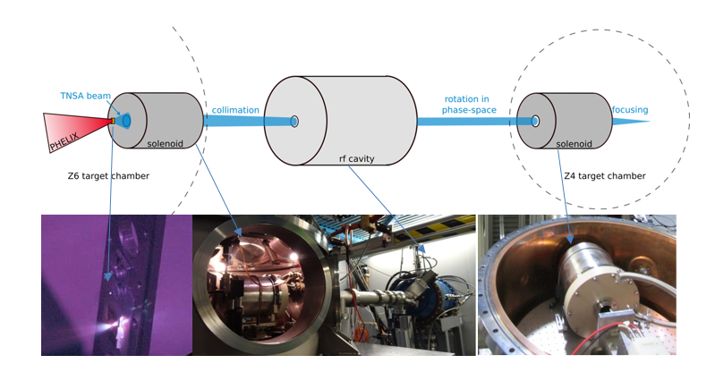
Current setup at LIGHT at FAIR
Plasma lens as a possible alternative to the solenoid in Z6
Source: GSI Helmholtzzentrum für Schwerionenforschung GmbH, PHELIX

Slide 3
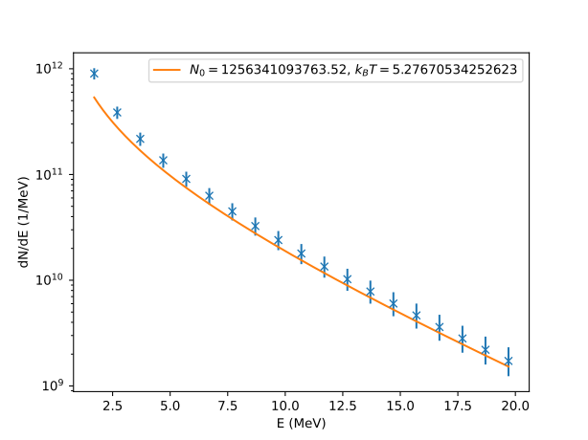
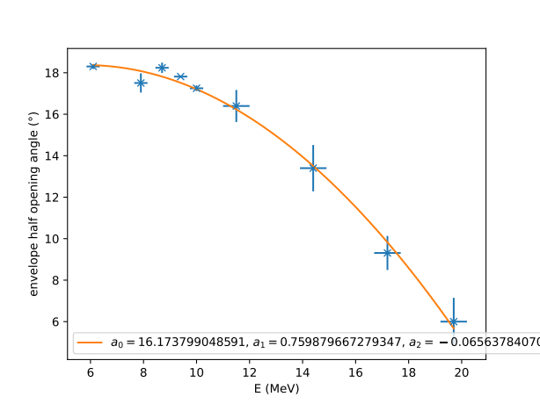
Plasma Lens vs. Solenoid
Difficulty: Strongly divergent proton spectrum at energies <28 MeV
Solenoid | Plasma Lens
+ Existing system Reproducible results | + Theoretically scalable to any extent<MT/m [2] No emittance growth (for homogeneous current distribution)
- Limited magnetic field gradient | - Difficult to handle (instabilities)
Source:[1] GSI Helmholtzzentrum für Schwerionenforschung GmbH, PHELIX, [2]Overview of plasma lens experiments and recent results at SPARC_LAB, C. A. Lindstrøm et al.

Slide 4
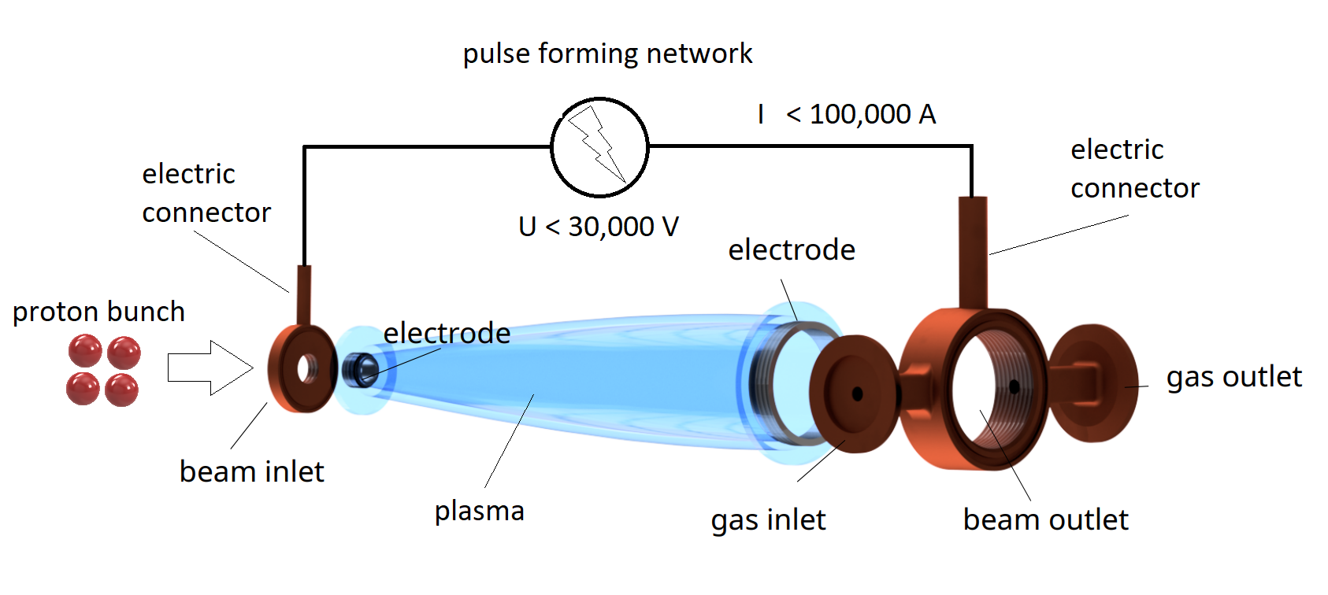
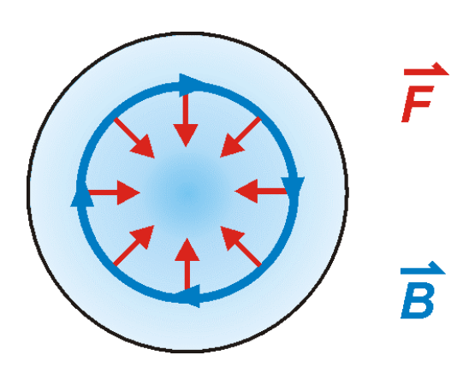
Theoretical Background | Plasma Lens
Gas discharge along the beam axis of a charged particle beam
Lorentz force acts on particle beam
Source: W. K. H. Panofsky and W. R. Baker , "A Focusing Device for the External 350‐Mev Proton Beam of the 184‐Inch Cyclotron at Berkeley", Review of Scientific Instruments 21, 445-447 (1950) https://doi.org/10.1063/1.1745611
Technical drawing of the plasma lens in the pulse-forming network

Slide 5
Simulation of the Discharge Parameters
Given : Size (solenoid), particle energy (7.5-8.5 MeV)
Goal : Maximize transmission, reach collimation
straight lens 0.5cm
Ep= 7.5-8.5 MeV
I= 50kA
R1= 2cm
R2= 2cm
dsource= 0.5cm
Llens= 20cm
transmission= 43%
straight lens 4cm
Ep= 7.5-8.5 MeV
I= 50kA
R1= 2cm
R2= 2cm
dsource= 4cm
Llens= 20cm
transmission= 42%
Simulated beam path of the averaged LIGHT spectrum for 7.5-8.5 MeV with specified lens parameters

Slide 6
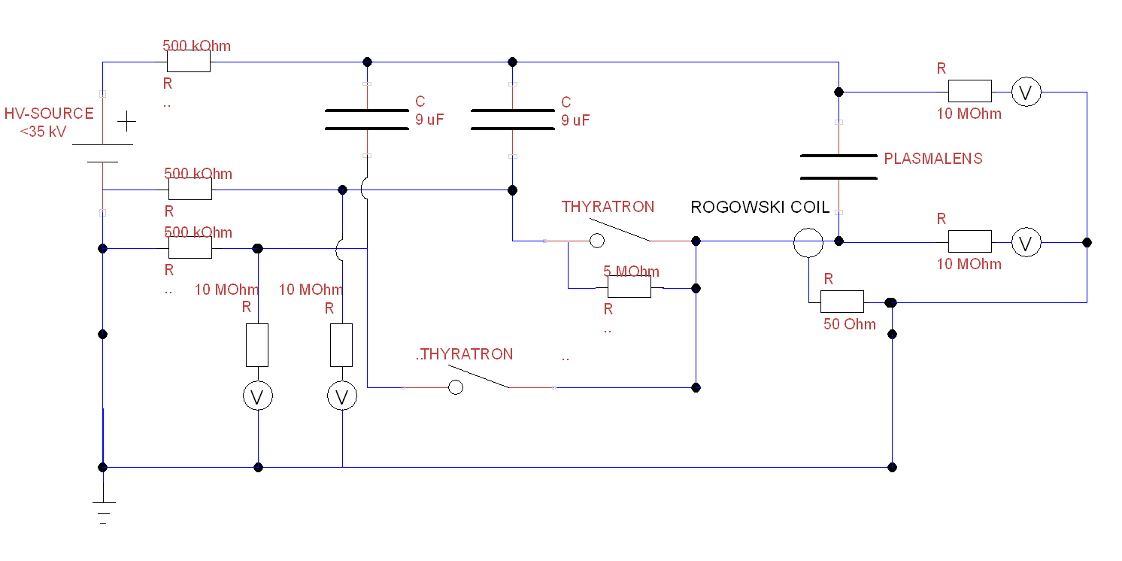
Circuit Diagram of the Plasma Lens
The circuit is designed to be quasi floating
500 kOhms to ground
$\sqrt{LC}≪RC$
Pre-ionization to guarantee reproducible
discharge by
Bridging of the thyratron
Pre-pulse $2π$ before main-pulse
Circuit diagram of the plasma lens

Slide 7
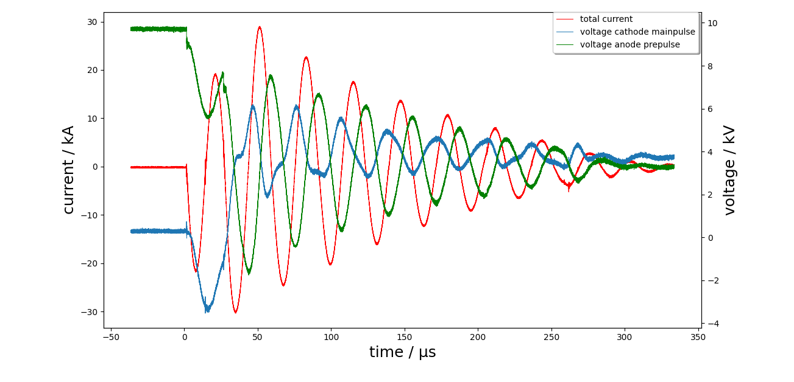
U-I-Diagram
open first thyratron
open second thyratron
proton transmission
Discharge current curve with important markers

Slide 8
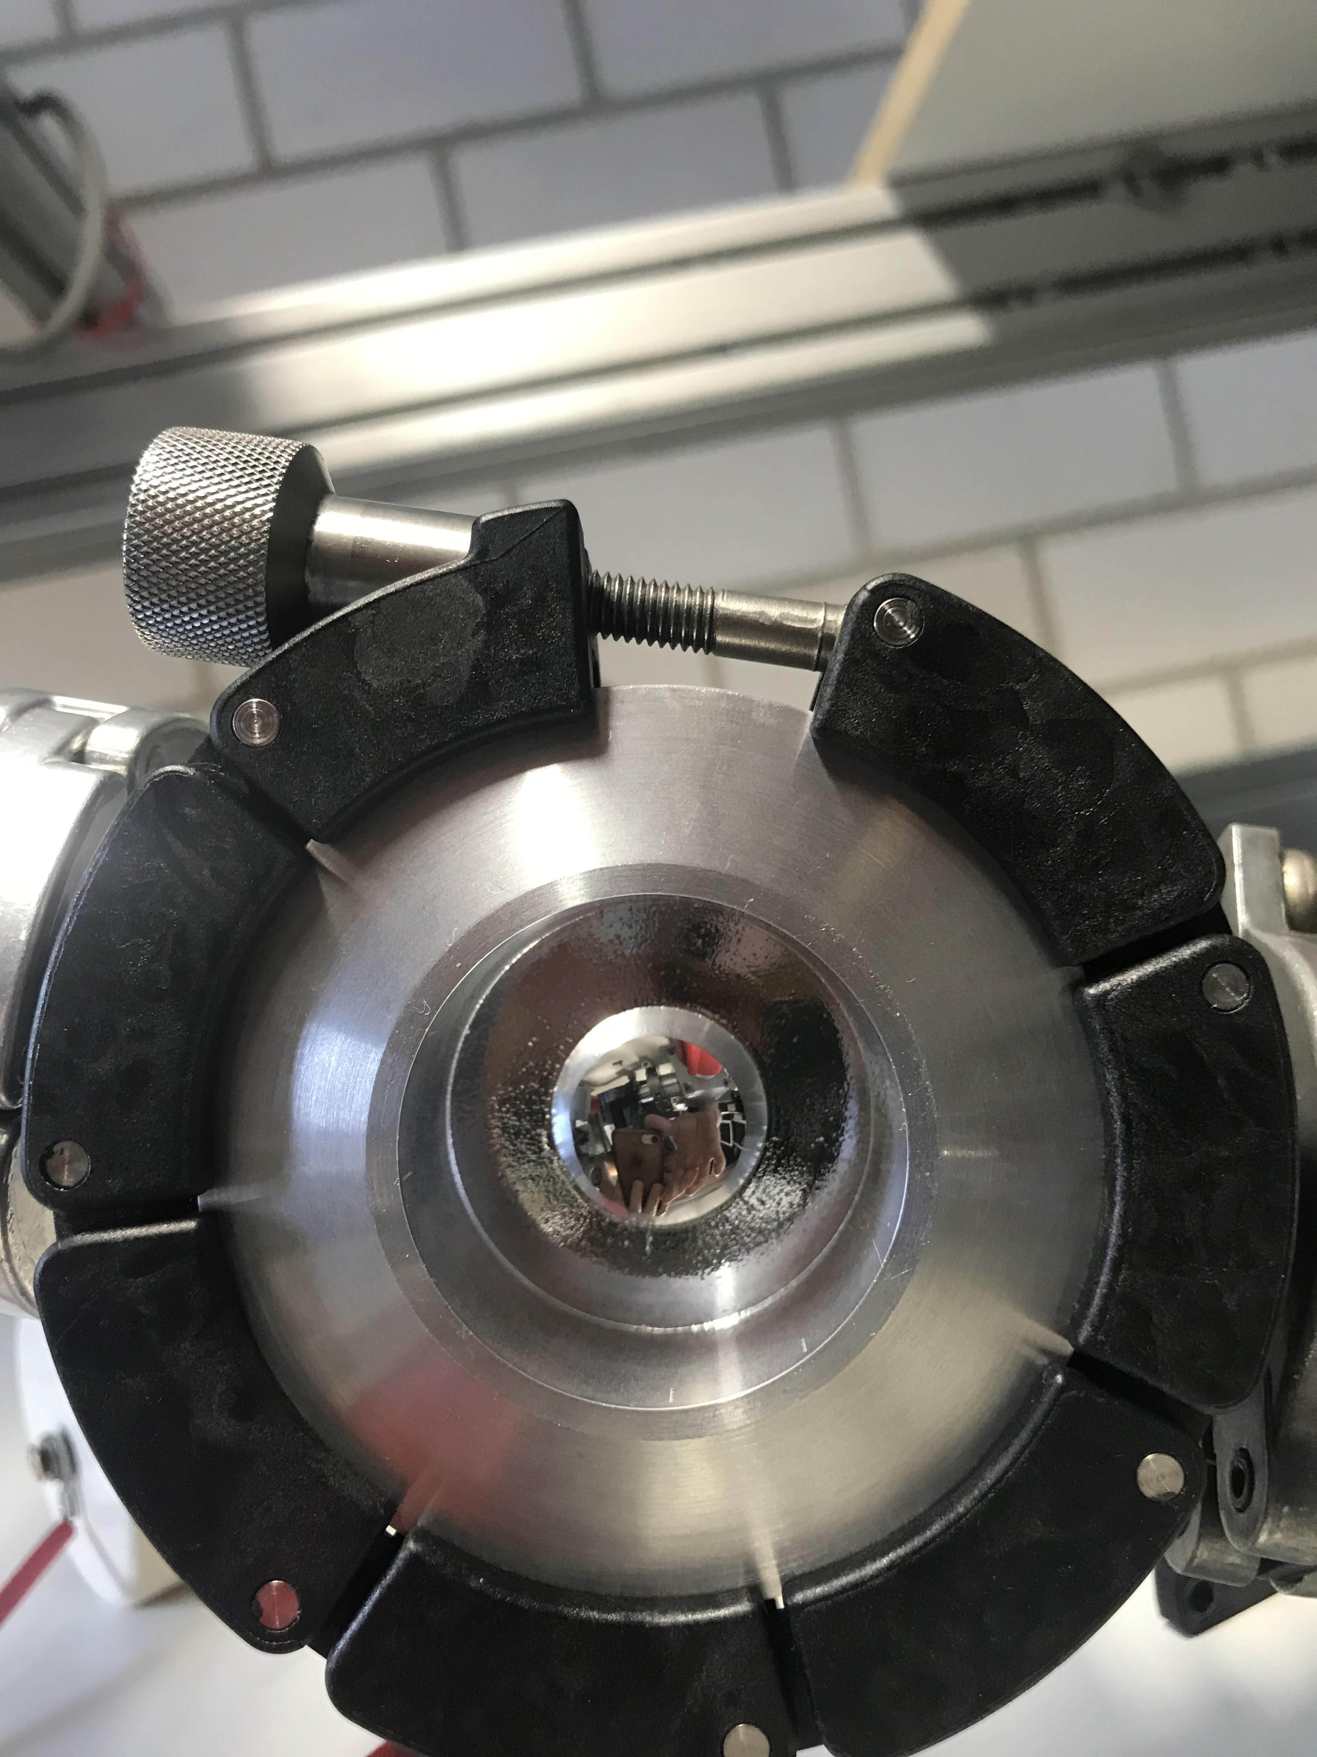
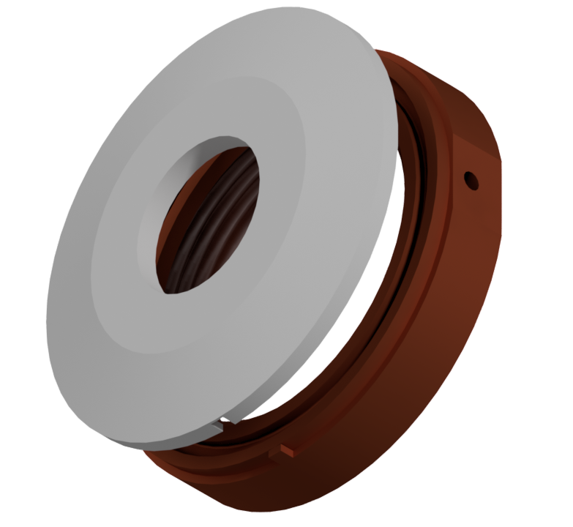
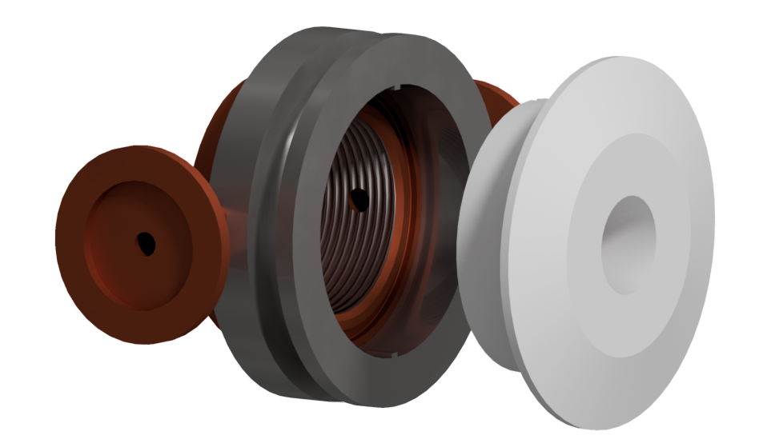
Installation of radiolucent entry windows | Haldun Arda (Bachelor Thesis)
Goals: Solution:
Confine the working gas within the plasma lens Foils ($25μm$kapton)
Allow the particle beam to propagate through the lens

Slide 9
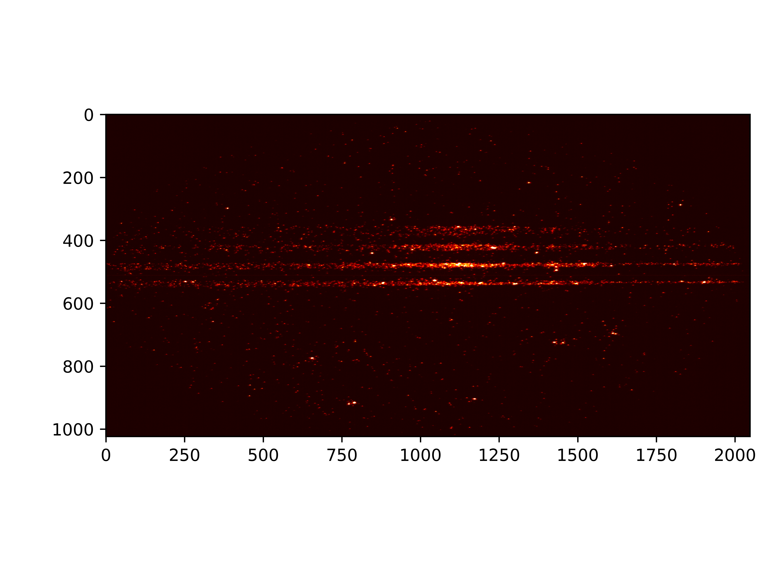
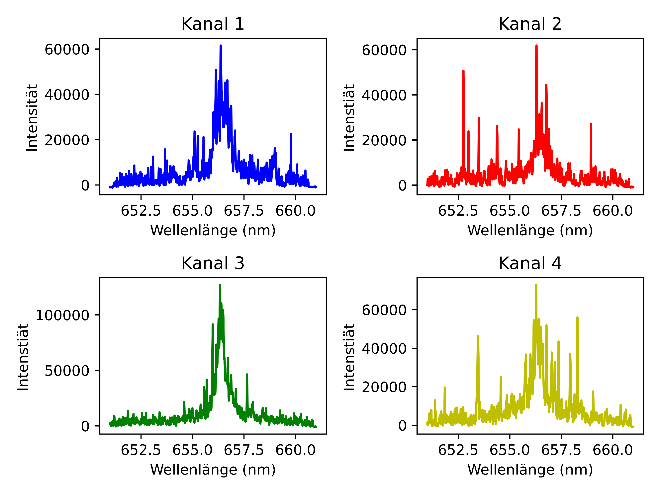
Spectroscopic Diagnostic | Sebastian Keller (Bachelor Thesis)
Examination of the symmetry of the discharge
Compare Spitzer resistivities $η\left(T_{e},n_{e},Z\right)$, $η∝\frac{1}{I}∝\frac{1}{B}$
Spectra of 4 different angles and the same radii and times along the beam axis
Heatmap of 4 spectra on one camera chip

Slide 10
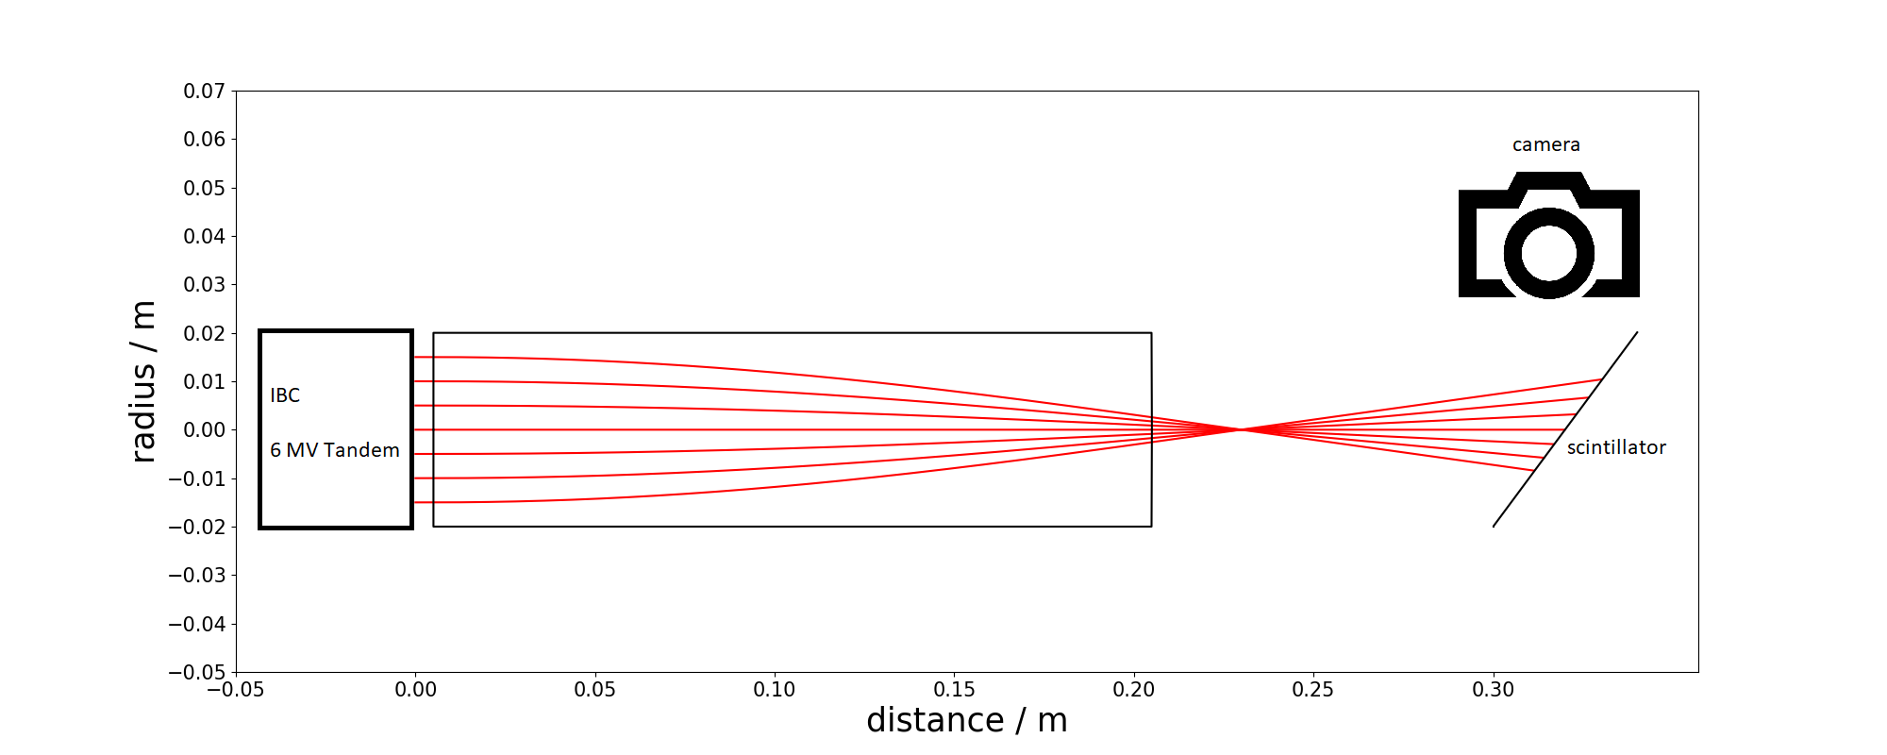
Characterization Magnetic Field | Beamtime HZDR Dresden
Use high brilliance beam (6 MV Tandem)
Mask beam to define position and momentum
Beam detection by scintillator (Diagnostics by Florian Kroll and Joshua Schilz)
Schematic Drawing of the beamtime setup

Slide 11
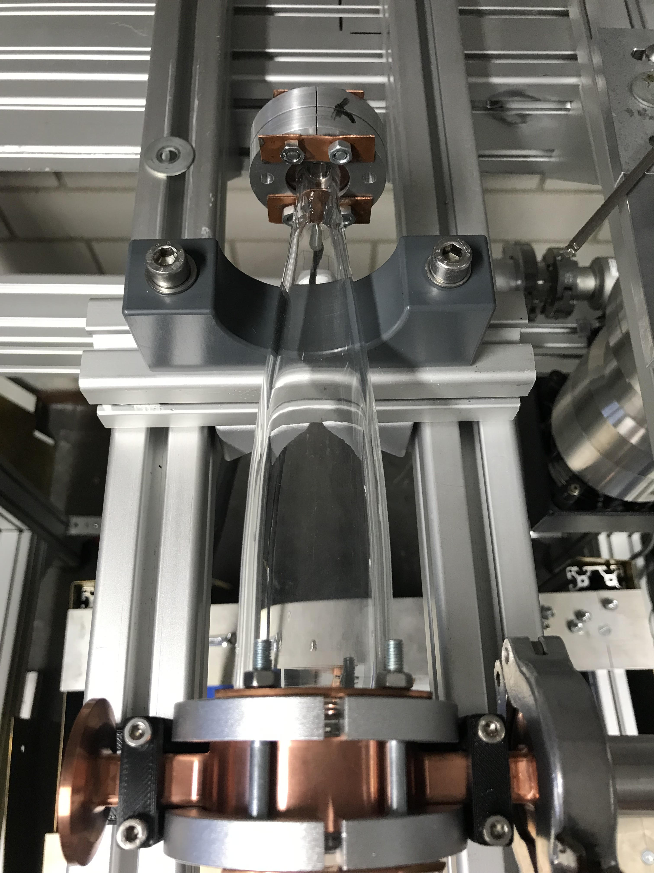
Outlook
Improve determination of plasma parameters in the laboratory
Electron density and electron temperature by spectroscopy
Current density from the ratio of the two parameters
Electron density by interferometry
Preparation for the beam
Ignition in vacuum chamber to simulate conditions of Z6
Measurements at the beam (beamtime)
Characterizing magnetic field at HZDR IBC (Dec. 2024)
Transmission and time of flight measurements at GSI LIGHT
(May 2025)
Image of the tapered plasma lens without electrical connection

