Slide 1
Motion prediction for online delivered dose verification in carbon ion therapy
K. Abu Mustafa, C. Galeone, M. Durante, C. Graeff, and L. Volz
Biophysics

Slide 2
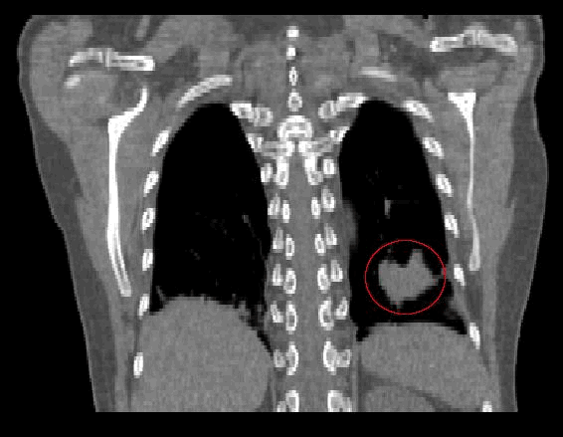
Moving tumors
High spatial precision of particle therapy requires high precision image guidance
M. Söhn, LMU

Slide 3
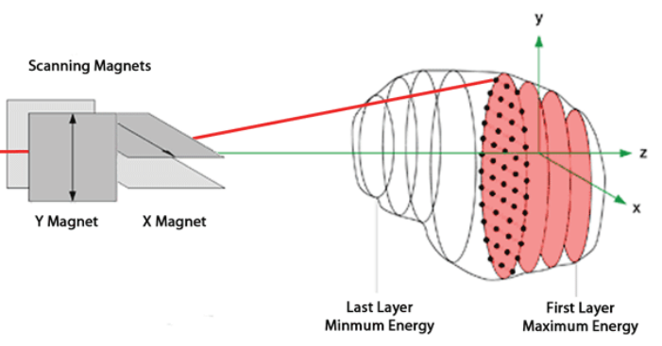
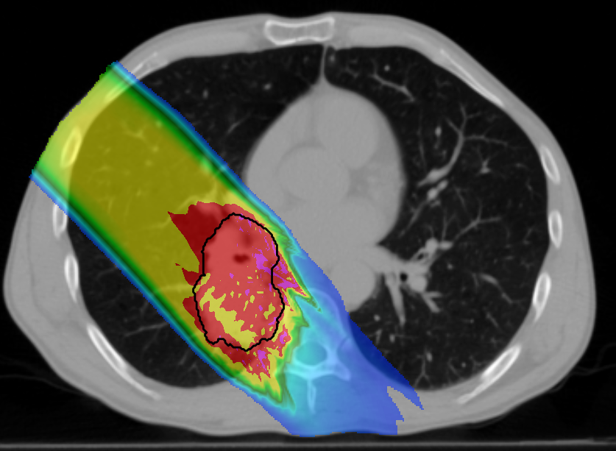
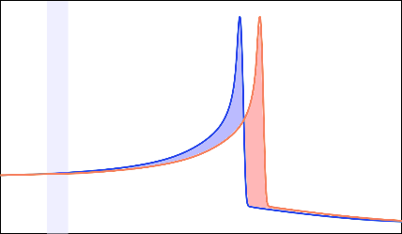
Motion management in particle therapy
Active scanned beam
Target motion
Interplay effect
B. Marchand et al., EPAC 2000
ACRF Image X Institute
Range changes
dose
overshoot
Lateral tracking alone is not enough
lung
Motion mitigation inherently a 4D problem
beam range

Slide 4
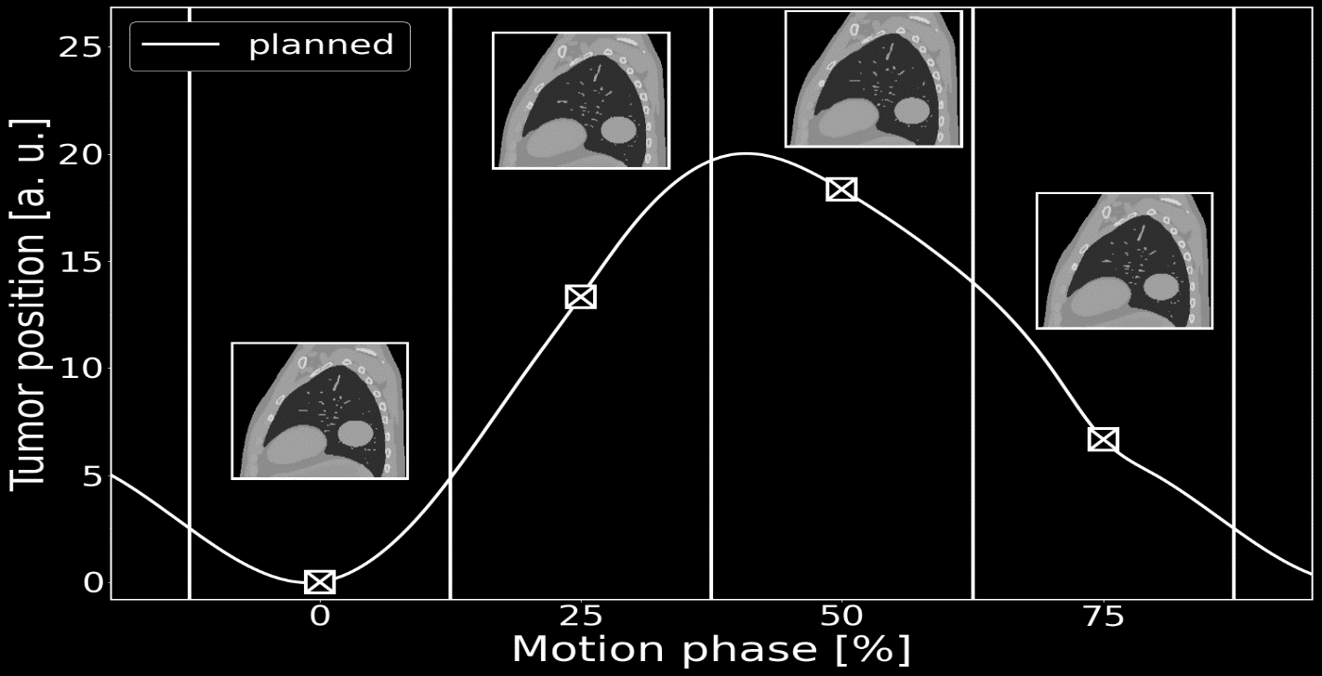
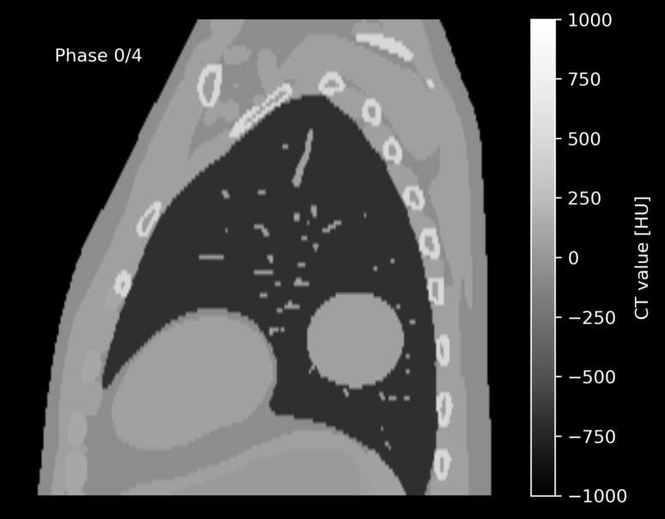
Treatment planning
Plan based on available motion information
T. Steinsberger, Doktorarbeit, GSI

Slide 5
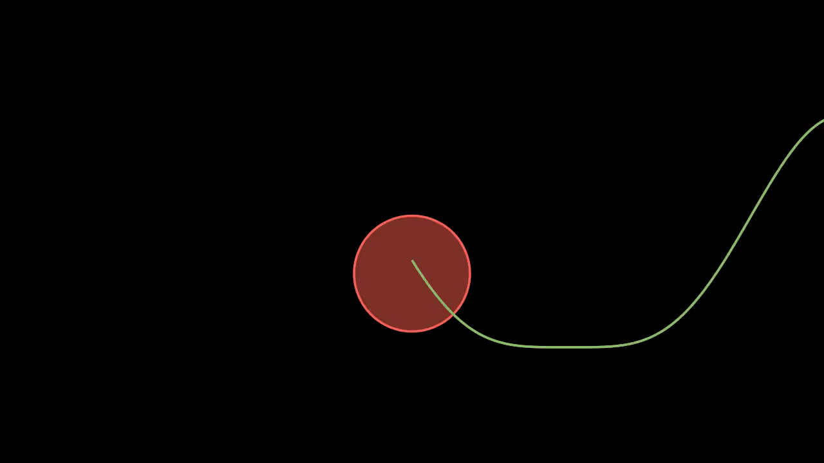
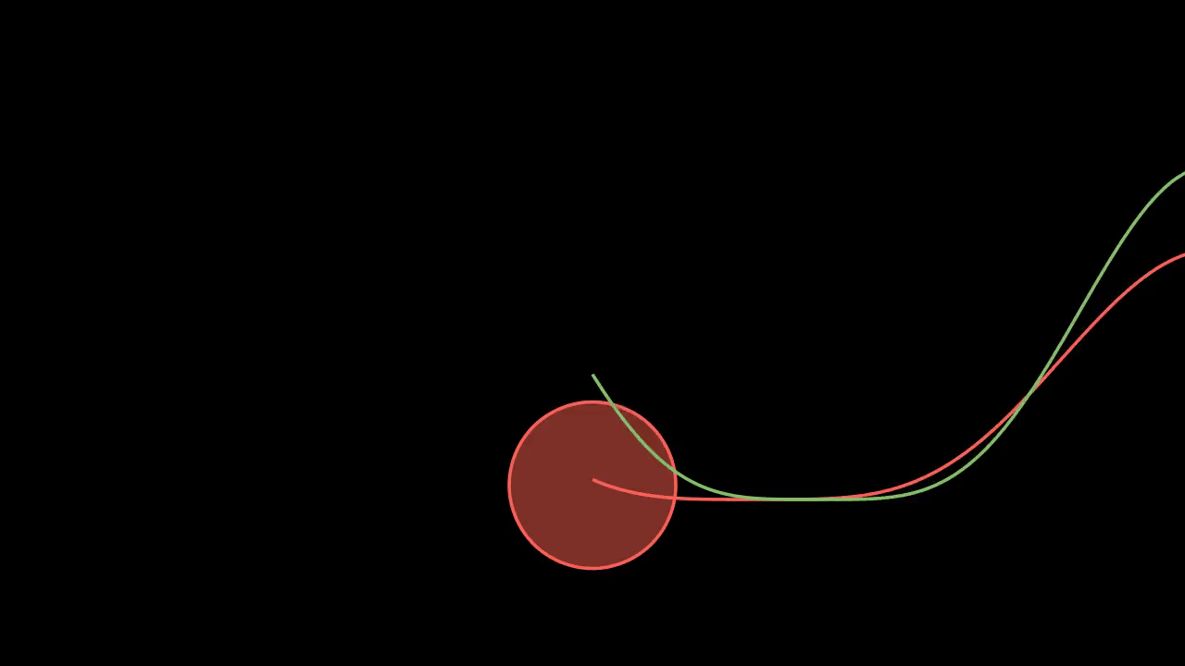

Irregular motion

Slide 6
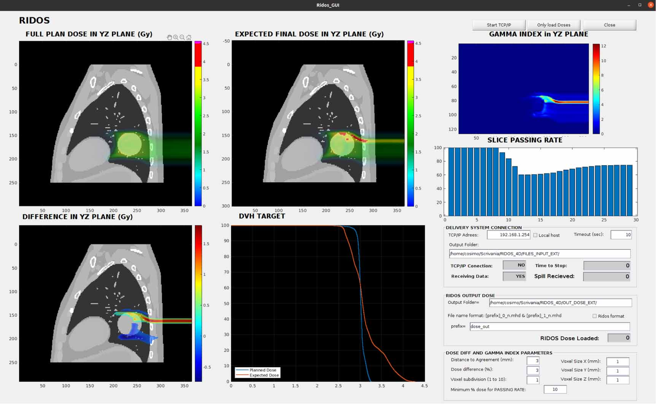
4D RIDOS: a tool for real-time online dose calculation
C. Galeone et al. (2024) Phys. Med. Biol.

Slide 7
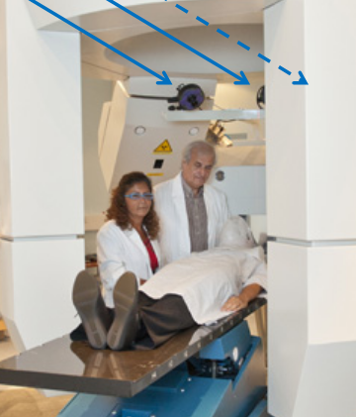
Need for motion prediction
Motion inference from optical tracking system (OTS)
Lag of the system
For RIDOS: ms speed is important to ensure real-time dose assessment
Design LSTM for tumor motion prediction
Modified from presentation by M. Desplanques (CNAO)

Slide 8
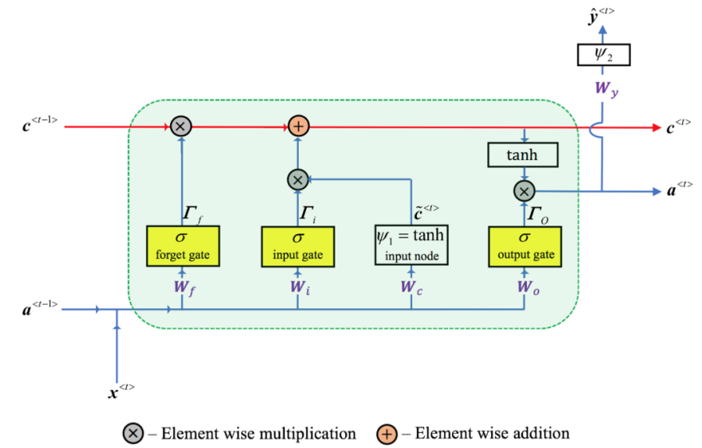
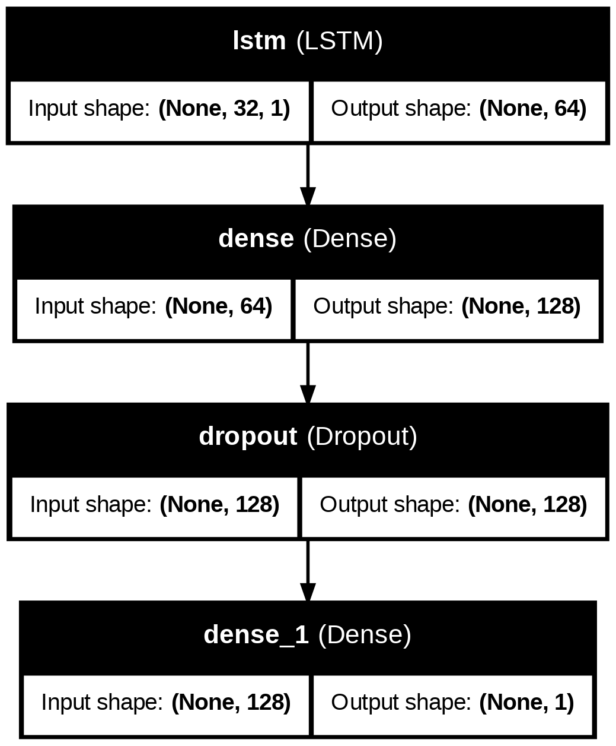
Model

Slide 9
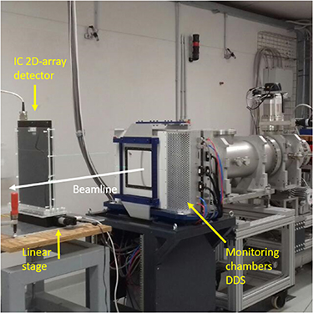
Data
Experiments at CNAO (Italian carbon ion therapy center)
Carbon plans irradiated to moving IC detector array
Recording of motion traces with optical tracking system
Sine motion with irregular variations

Slide 10
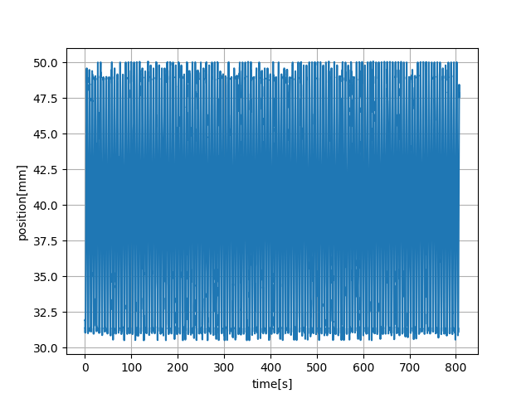
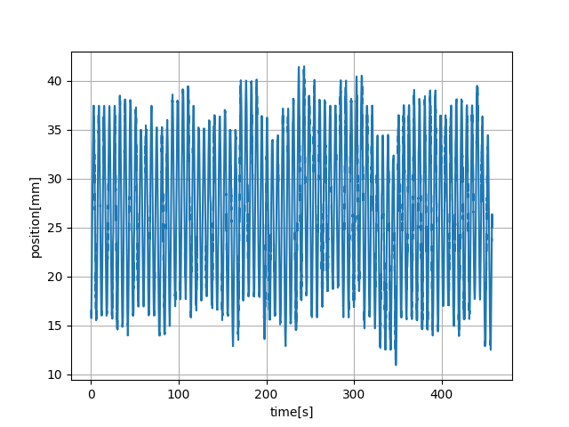
Data
9 recorded motion traces, 7/2 train test split
Total of ~1h of motion signals

Slide 11
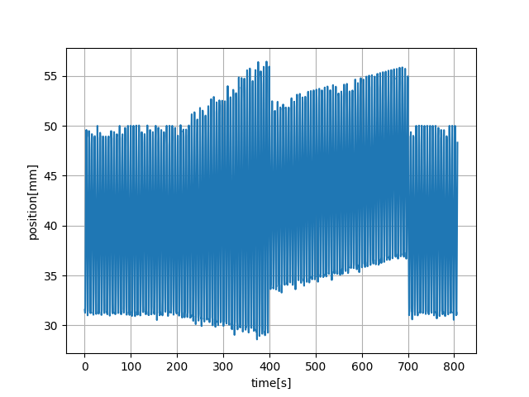
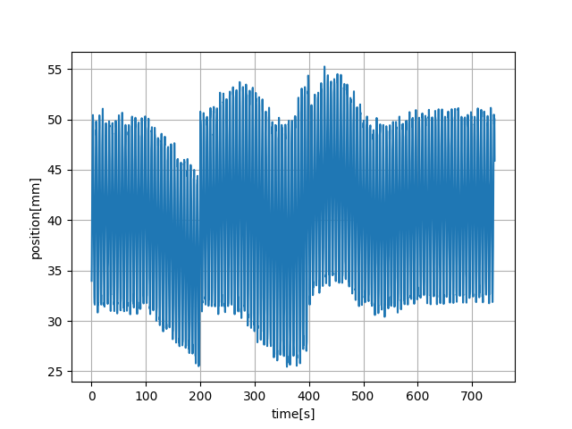
Data augmentation
Data augmentation (amplitude variation, baseline drifts) for more robust model

Slide 12
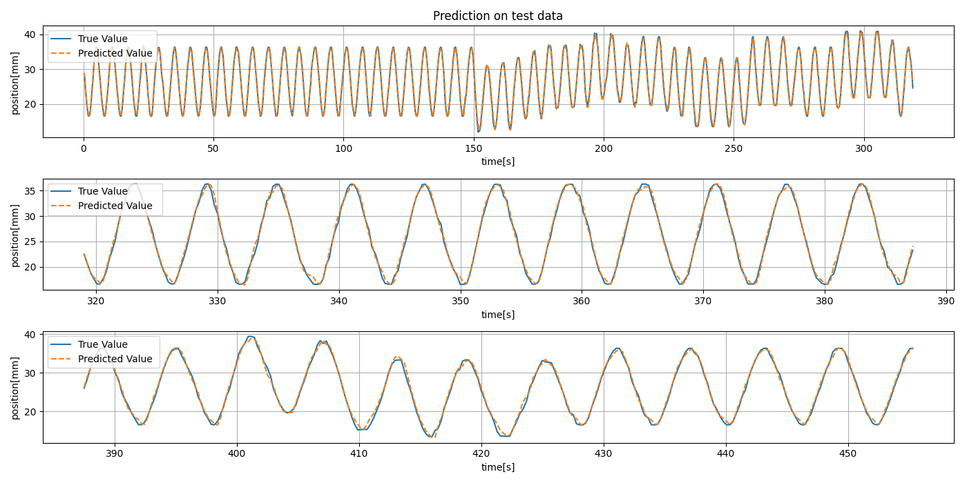
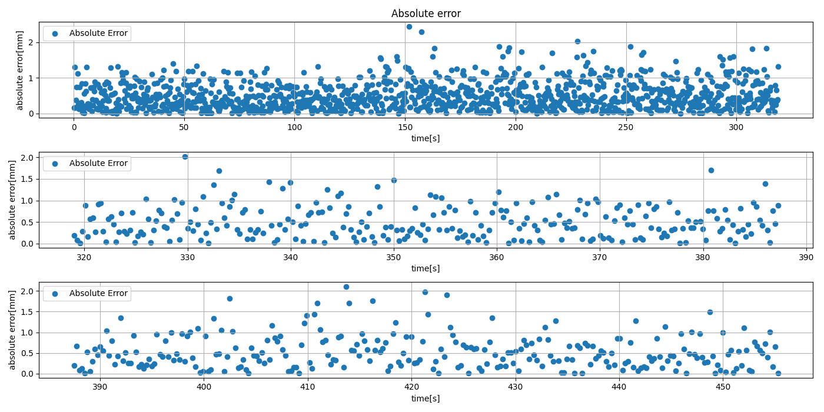
Results: Motion traces (test 1)
Prediction: 8s input, 250ms prediction (equivalent to 10 data points) into the future
Maximum error: 2.44 mm
MAE: 0.51 mm

Slide 13
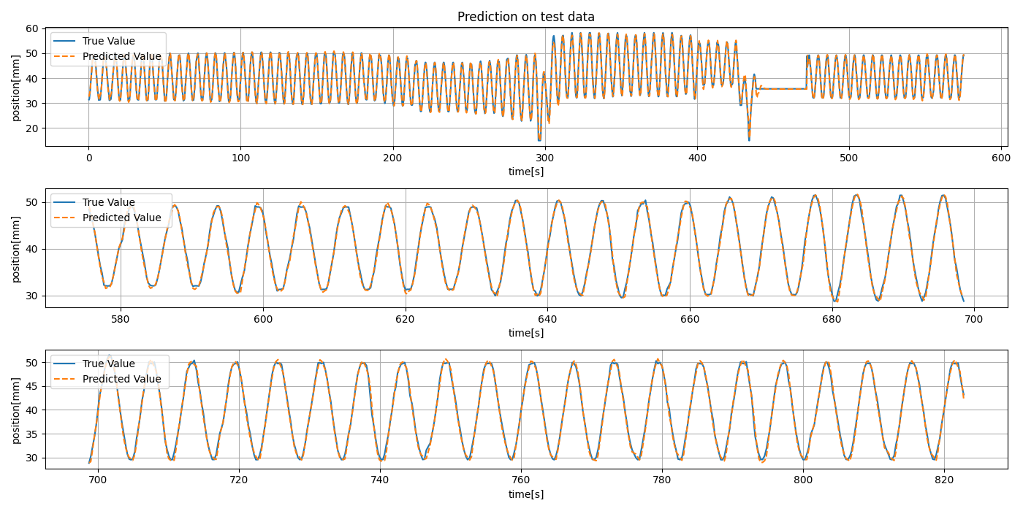
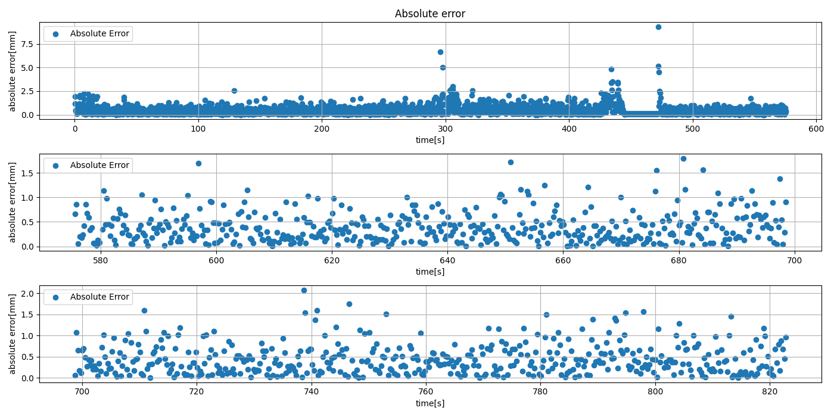
Results: Motion traces (test 2)
Prediction: 8s input, 250ms prediction (equivalent to 10 data points) into the future
Maximum error: 9.33 mm
MAE: 0.45 mm

Slide 14
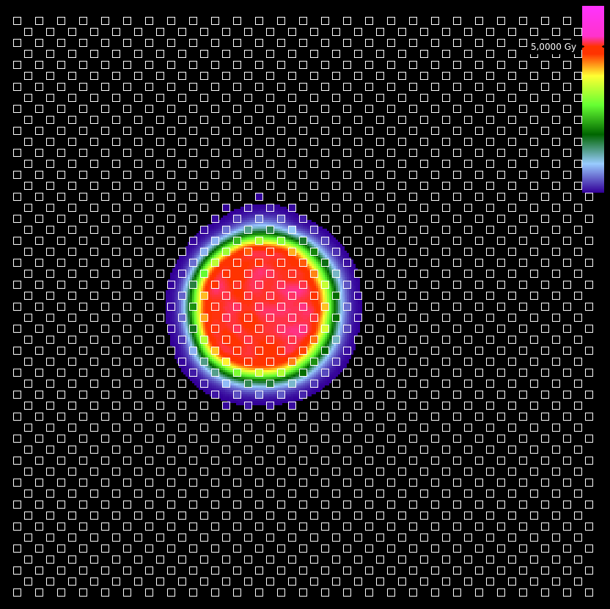

Results: comparison of dose calculation
Use predicted motion trace as input to 4D-RIDOS
No significant difference between predictions based on real and predicted motion
Real motion trace
Gamma index: 98.8%
Predicted motion trace
Gamma index: 98.8%

Slide 15
Conclusion
Motion is a challenge for precise ion beam treatments
Online dose verification is needed to ensure correct dose delivery
We designed an LSTM model to predict motion from optical tracking system to be used as input for real-time delivered dose verification
So far: promising results on test data (still idealized)
Next:
  Application to real breathing curves
  Anatomically informed model design

