Slide 1
Machine-Learning Applications
at CRYRING@ESR – Experiences and Ideas
Wolfgang Geithner, Frank Herfurth and the Decelerators Team

Slide 2
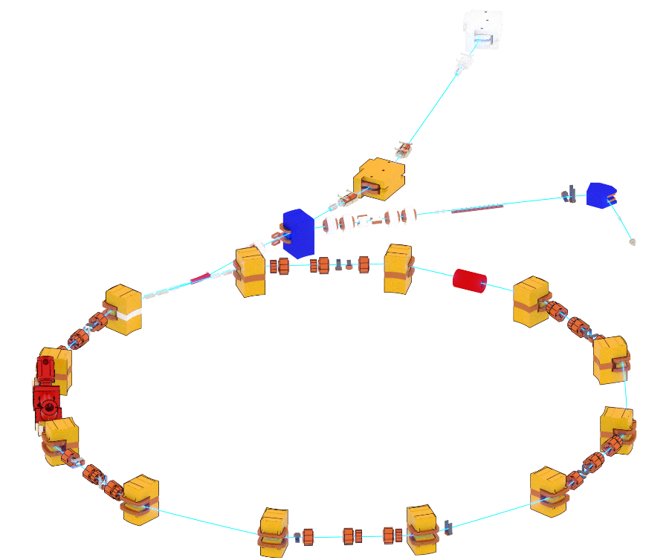
CRYRING@ESR: FAIR Phase0 Machine
Beam from ESR
E ~ 4 MeV/u
Local injector
30 keV < E < 300 keV/u
p-Linac
SIS18
Multiturn injection
UNILAC
Plasma ion source
ESR
~1.6 KeV/u → 30 MeV/u (protons)
CRYRING@ESR
HESR
CRYRING Use cases:
Atomic & nuclear physics experiments
Test bench for FAIR concepts
Ahead-development of FAIR prototypes

Slide 3
“Artificial Intelligence” in Context of CRYRING@ESR
Artificial intelligence: “a technical and scientific field devoted to the engineered system that generates outputs such as content, forecasts, recommendations or decisions for a given set of human-defined objectives” [ISO/IEC 22989:2022].
Main goal: How can we use AI to get more efficient and effective in operating our machine?
Automate repetitive manual tasks
Develop computer-tools to run CRYRING@ESR (more efficiently)
Apply AI based tools for daily machine operation.
Reduce machine setup time by running automated tasks in non-working hours (night/weekend)
Early detection of unwanted machine states to come from reactive to predictive maintenance
More global: build knowledge on AI to stay in touch with other researchers and facilities (more) active in this field

Slide 4
My Role in the DEC Team
Responsible for DEC end-user control applications ~80-90% of my time:
Device-Automator (JAVA, since 2017)
Cryring data-logging framework (JAVA, 2 Linux-Servers, Python)
HITRAP control synoptics application (LabVIEW, to be migrated to FAIR CS system stack in JAVA)
10-20% explore ways to use „artificial intelligence“ in our environment:
Integration / test optimizer algorithms into FAIR CS JAVA environment
Supervision of 2 masters theses at H_DA:
Classification of ESR cyclic beam transformer signals for discrimination purposes
Training of reinforcement learning algorithm with data collected at CRYRING@ESR injector

Slide 5
Optimizer Algorithm(s) in FAIR Control System Stack
Genetic Algorithm plugin built on „Jenetics“ Java framework^{[1]}
“Genotype” consists N LSA devices for parameter setting
“Fitness” derived from JAPC BI-devices
Evolution process is drive via the JAVA stream() interface
Evolution stop and convergence criteria are realized by implementing custom stream().limit(<criteria>)
Device-Automator:
JAVA-Program,
initially built to perform
simple automation tasks
Custom application:
Sends value
set requests
data readout by subscription
Physics/model layer:
LSA-layer (JAVA)
Java Interface layer:
JAPC (JAVA)
Middleware
Frontent-Software
Device layer (hardware):
dev
dev
dev
dev
dev
dev
dev
dev
[1] Jenetics - Advanced Genetic Algorithm, Evolutionary Algorithm and Genetic Programming library: http://jenetics.io/

Slide 6
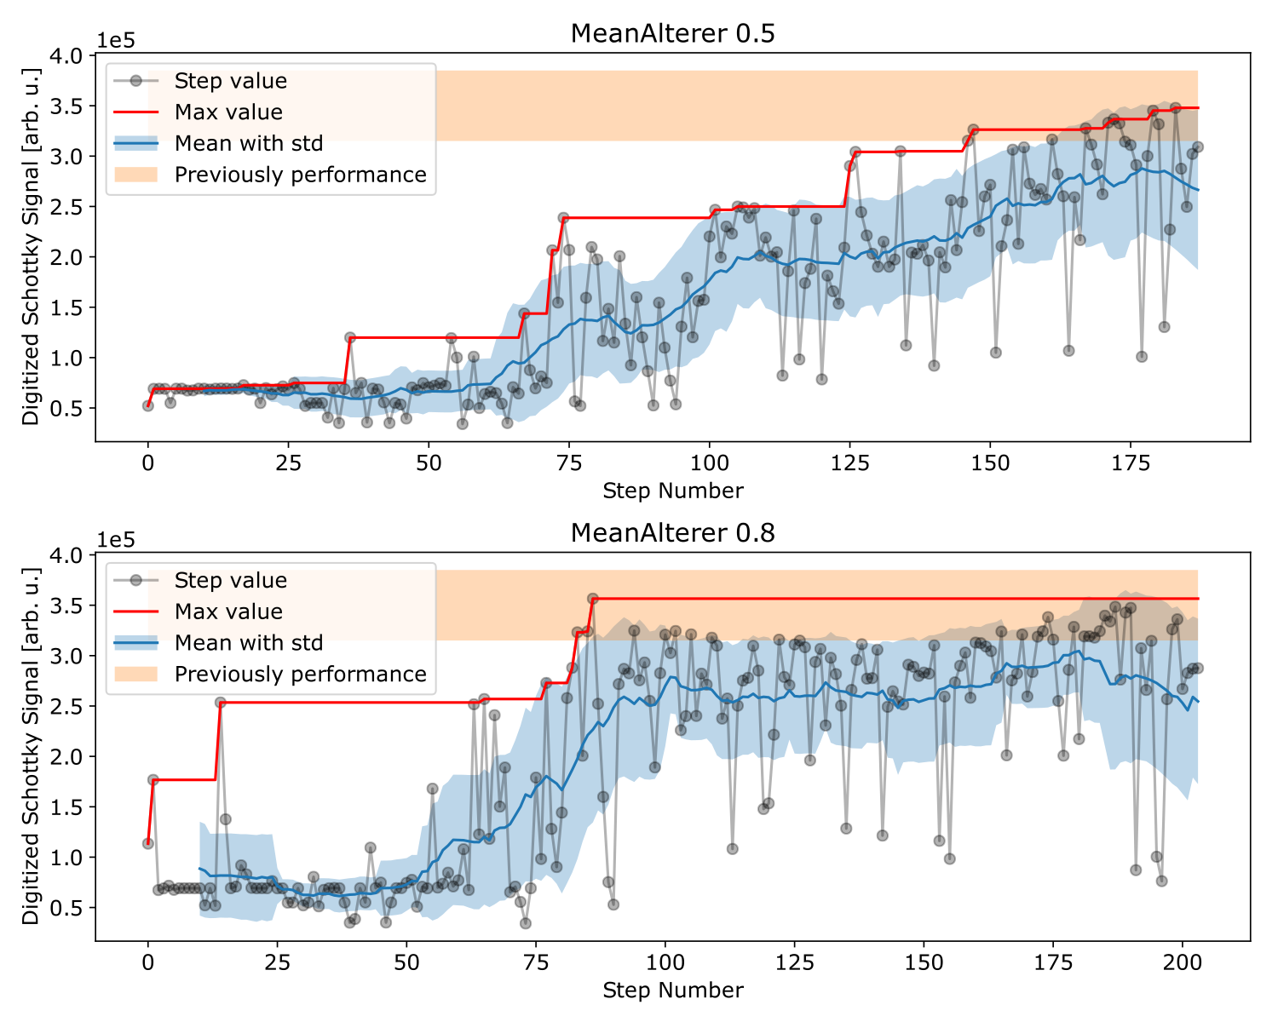
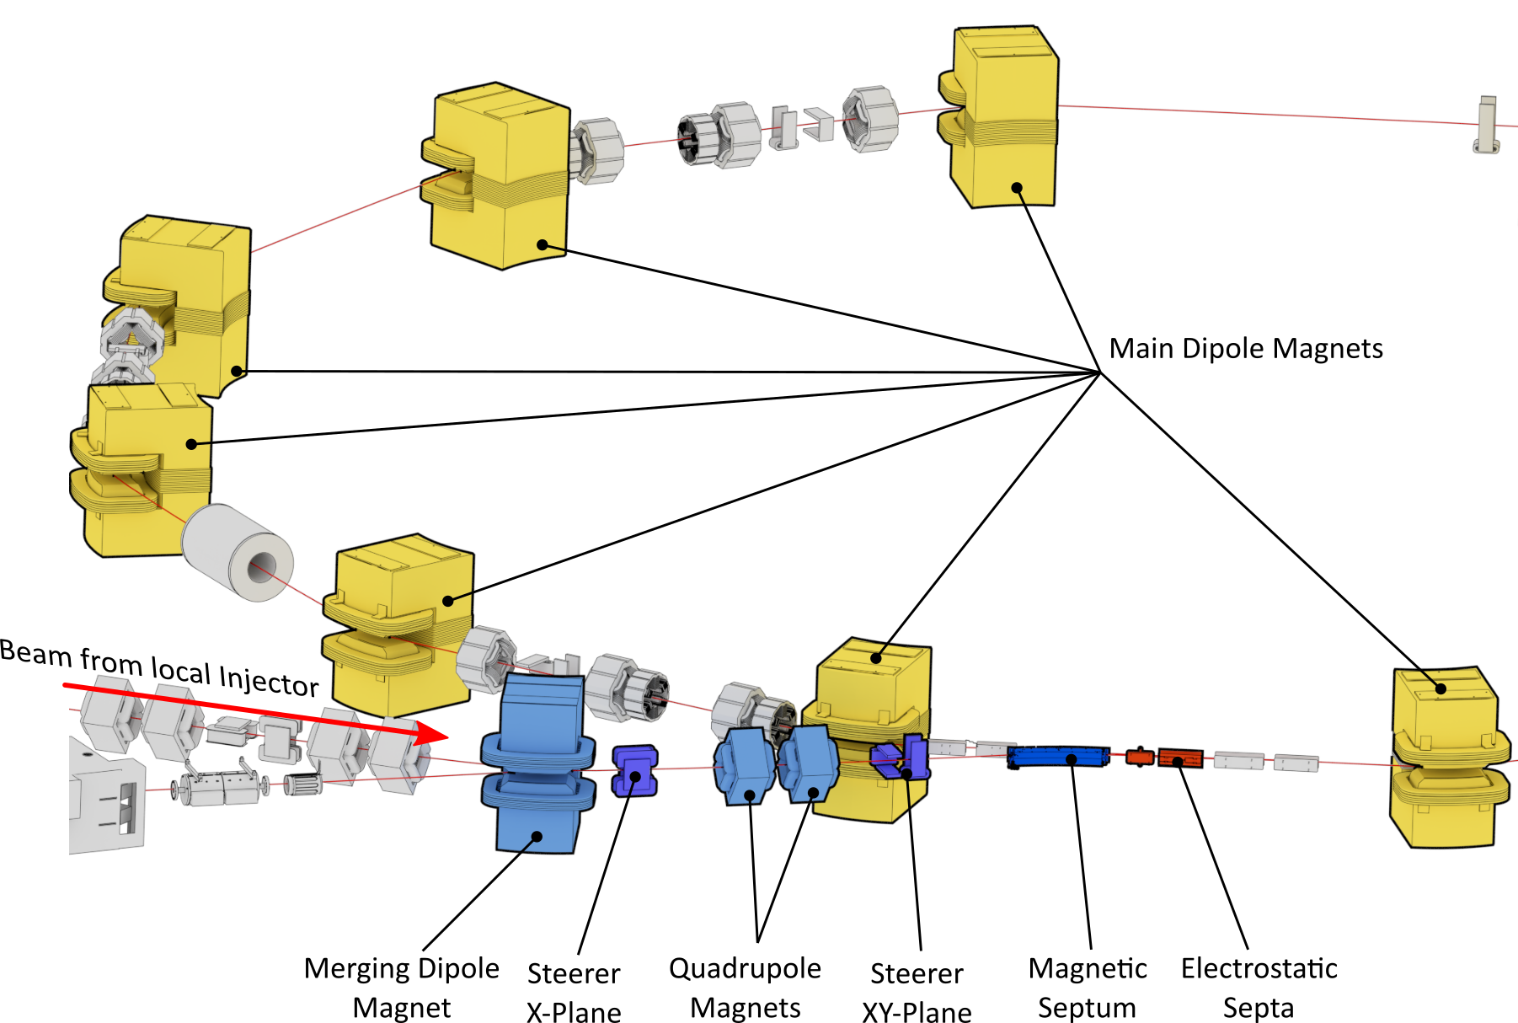
Applying Genetic Algorithms: Injection Optimization^{[1]}
Genetic algorithm controls 10 parameters
Goal parameter: beam intensity measured by Schottky signal normalized to ion source intensity
Result:
Genetic algorithm is capable to optimize injection
Optimization Performance comparable to human operator.
[1] S. Appel, W. Geithner, et al.: “Optimization of heavy-ion synchrotrons using nature-inspired algorithms and machine learning”, 13th Int. Computational Accelerator Physics Conf., doi:10.18429/JACoW-ICAP2018-SAPAF02

Slide 7
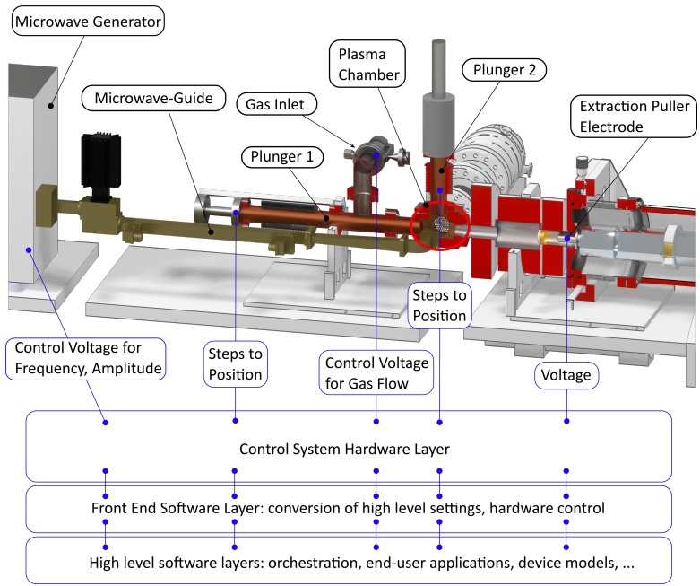
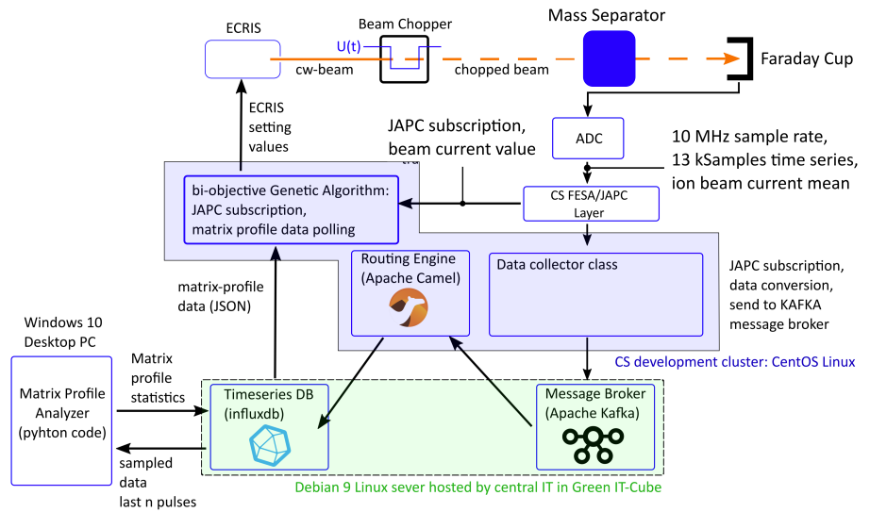
Extension to the “standard” optimization:
bi-objective optimization
Algorithm drives ECRIS control parameters
2 Objectives: intensity + source stability
Measure of source stability provided by MPDIST of last 5 time-resolved FC intensity signals

Slide 8
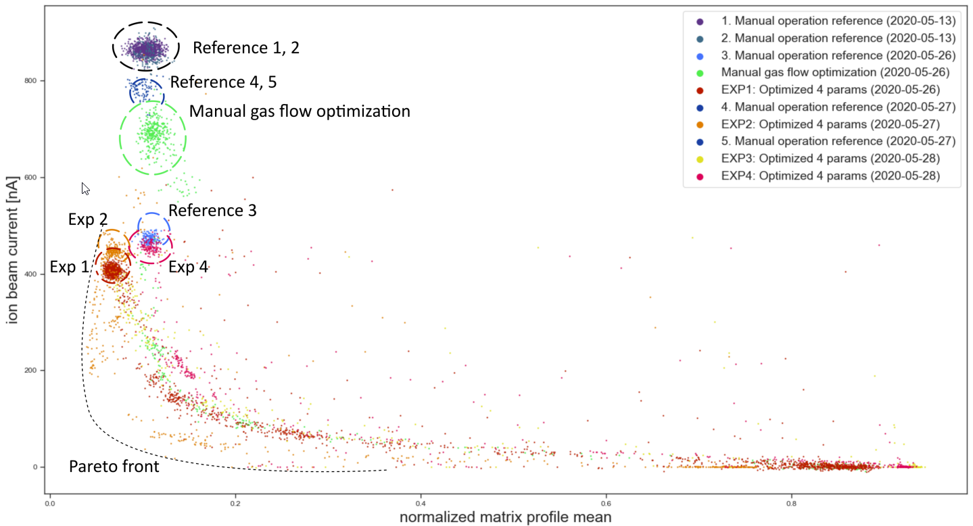
Bi-objective Optimization Result Plot

Slide 9
Classic Optimizers: Experiences
Classic optimization algorithms are „dumb“, no real learning so far => time wasted for random search, setting of scan ranges relies on human experience
Performance is mediocre in terms of
Optimizing objectives compared to experienced human operator (e.g. maximize beam current)
Repeatability of optimizing results under same conditions
Time to convergence compared to human operator (in case of well established ion species)
Determination of algorithm hyperparameters requires substantial machine time
Noise and non-statistical fluctuations impact optimizer performance severely
Tool development requires substantial effort

Slide 10
Other AI Projects where we were involved
Signal classification
Beam intensity profiles over synchrotron machine cycles. H_DA Master project at the institute of informatics (not finished)
Predictive maintenance based on optical spectra from ion main source. H_DA Master project at the institute of informatics
Reinforcement Learning
Training of reinforcement-learning optimizer for the control of CRYRING@ESR injector using historic data H_DA master project at the institute of informatics

Slide 11
Outlook: Ideas / to be Tested
Based on existing environment(s) / data
Automated classification in more complex scenarios for e.g.:
availability calculation / accounting
Provisioning of trigger / inhibit signals for successive signals
Classification of device signals: pulsed ion sources , power supplies
Predictive maintenance: monitoring of pumps, CRYRING ion source
More far fetched
Image recognition and classification (fluorescence screens)
Expert systems to support failure resolution
Information extraction based on digitized documentation

Slide 12
Difficulties for AI in FAIR CS Environment
Focus of research groups with deep AI knowledge is on publishing papers and not on providing and maintaining end-user applications
Technical gap between FAIR CS Java world and AI research Python/R world
AI frameworks in JAVA are available, but:
Lack of end-user documentation and tutorials make their application difficult
Many projects are stalled (academic projects stopped after getting the degree)
No well established user community
Building Python applications for operating running on FAIR CS consoles is currently not a viable option
=> How do we provide AI-based applications for operating?
=> Who builds these applications and who maintains them?

Slide 13
BACKUP

Slide 14
Some Advertisement on JAVA AI Frameworks
I did not use them yet, but want to make you aware that JAVA AI framework DO EXIST:
Framework | Use Cases | Comment
Deeplearning4J | Image recognition, NL* processing, predictive analysis, anomaly detection
H2O | Predictive analysis, anomaly detection, healthcare, credit scoring
Tensorflow | Big data analysis, clustering, anomaly detection, NL* processing | Discontinued?
Apache Spark MLib | Image recognition, NL* processing, real time predictions, healthcare, finance
JAVA ML | Integration into existing JAVA projects, research & experimentation
MOA | Massive online analysis, IoT data analysis, dynamic environments
Weka | Exploratory data analysis, datelining, pattern recognition, prototyping, education
Stanford Core NLP | NL* processing, text analysis, information extraction
Deep Java Learning | Image classification, NL processing | Seems to integrate with popular Python libs

Slide 15
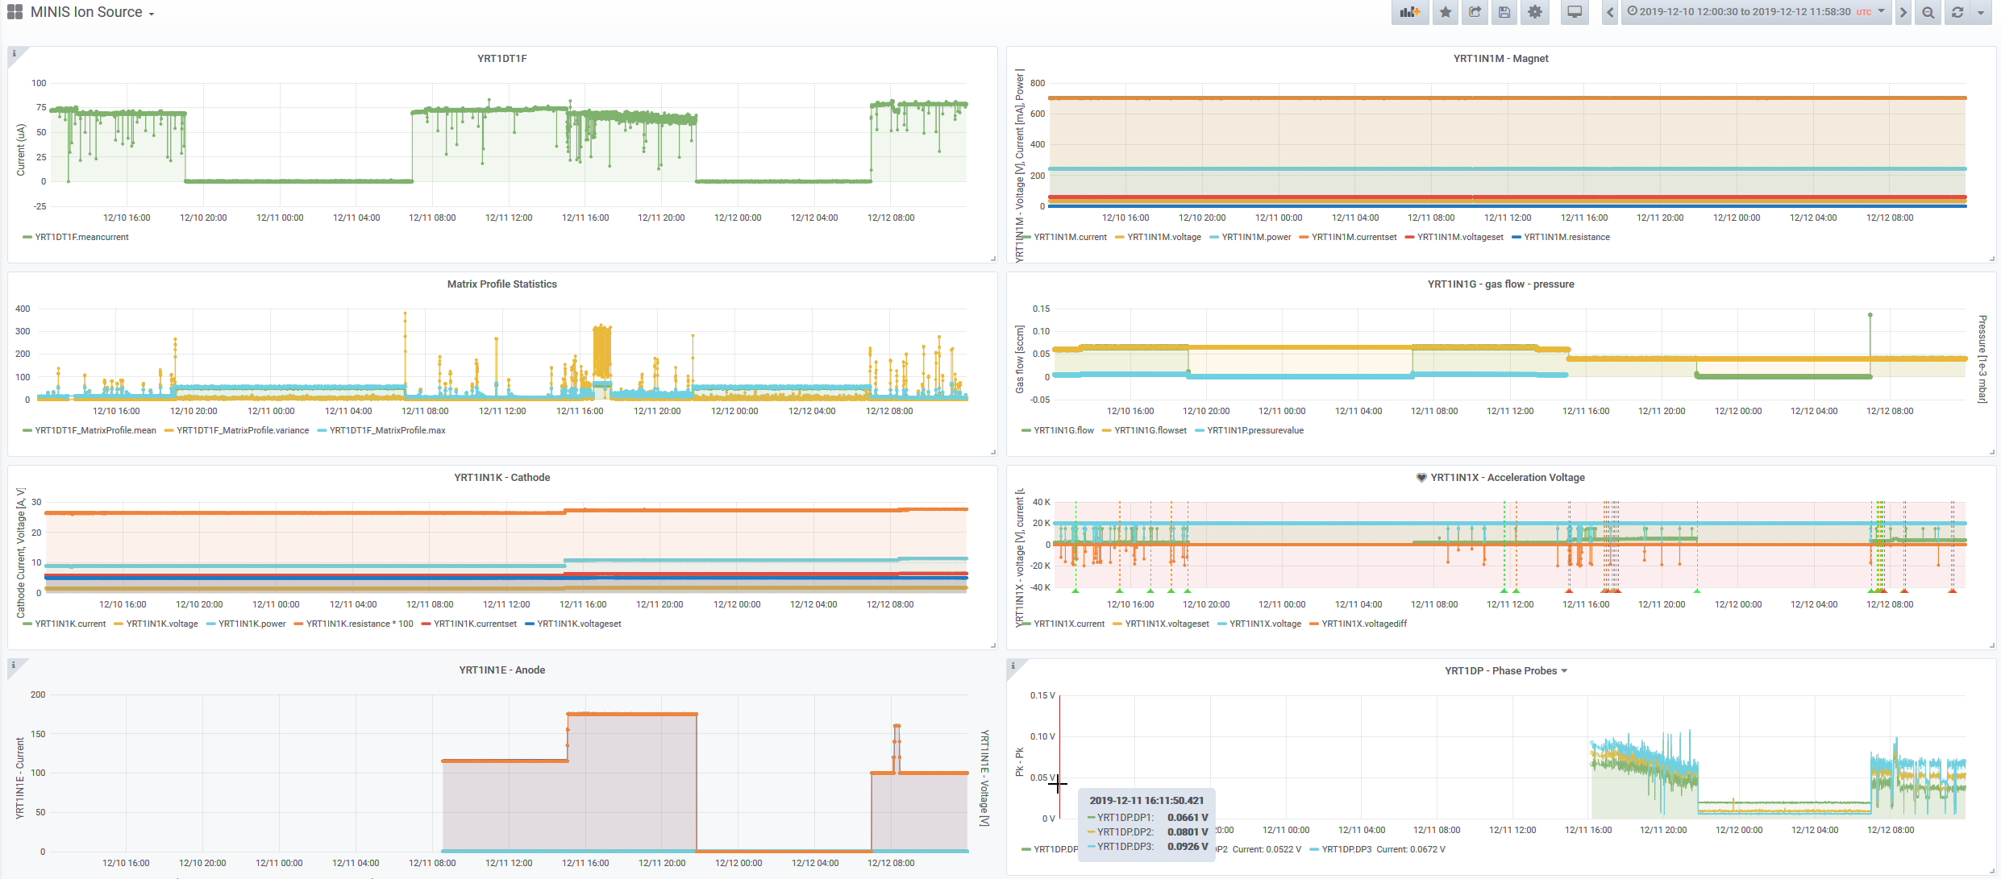
From By-Product to Important Tool: Grafana-based Data Visualization

Slide 16
From By-Product to Mission Critical Tool: Grafana-based Data Visualization
Visualization: GRAFANA
Time-Series database: InfluxDB
Data Canonizer & Router
Data Broker: Kafka
Device Data Collector
FAIR CS Archive

Slide 17
Optimization: Summary & Outlook
Achievements:
Studies with beam yield promising results
Functionality available in “device automator” tool
Systematic study of algorithm process-parameters started
Next steps:
Collect more data to determine best GA parameter values
Add more complex readout signals as target properties
Establish automated machine tuning as tool for operation
Investigate automation of ion source optimization using multivariate optimization methods
Investigate Particle Swarm Optimization (PSO) algorithm (or more?)

Slide 18
Machine Leaning@Ion Source: Summary & Outlook
Achievements:
FAIR archiving prototype as source of training-data established
Test infrastructure allowing efficient handling of data developed
Promising python prototype to apply matrix profile to existing data
Next steps:
Decide on appropriate place for data provisioning framework and set up server
Collaborate with MP developers who will provide faster implementation
Extraction of reliable signals by tuning matrix-profile
Develop machine-learning tool for ion-source state-predictions
Investigate automatic ion-source optimization built on MP

