Slide 1
ARTIFACT: AI-Driven Optimization of Accelerator Systems
Ivan Knežević, Andrew Mistry; [Sabina Appel, Nico Madysa]

Slide 2
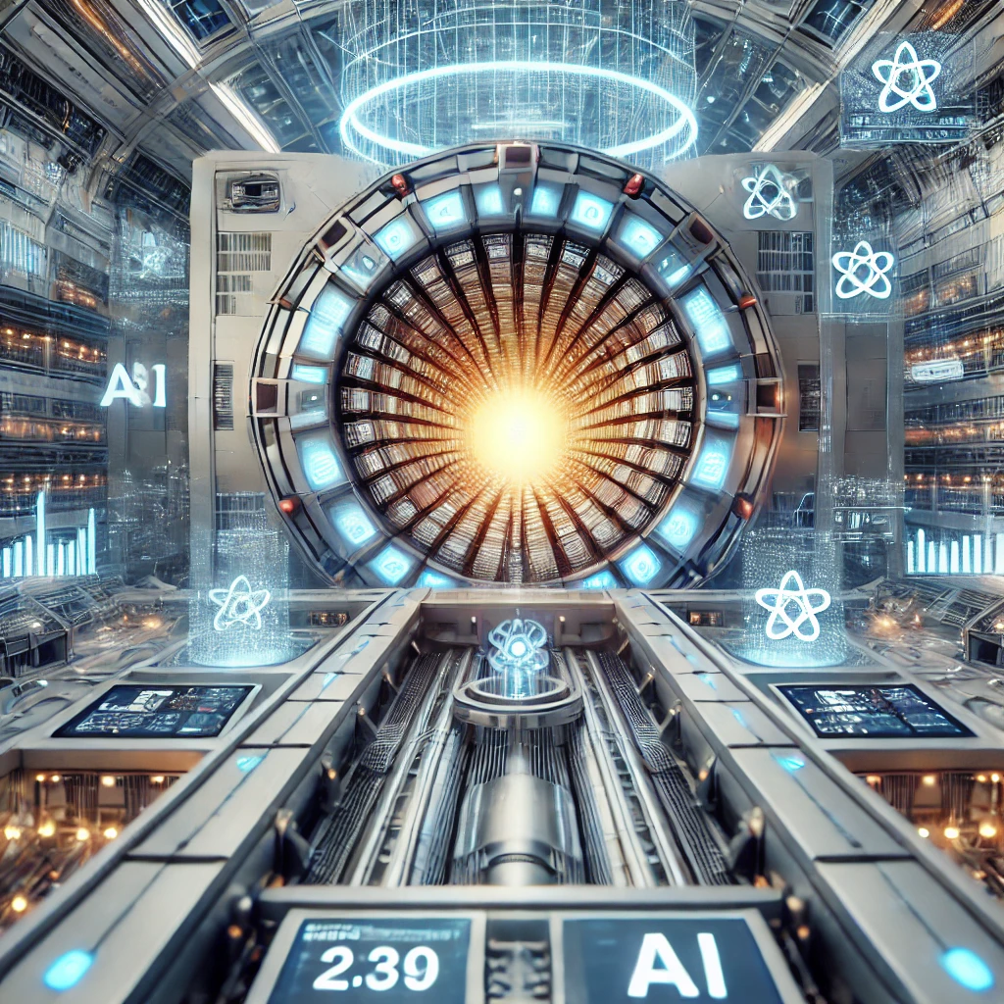
The need
Accelerators face quasi-industrial challenges in terms of operation and reliability, making it essential to adopt the right approach:
Enhancing beam performance
Considering environmental impacts
Ensuring societal benefits
Starting from the design phase and continuing throughout the machine's lifetime
However:
We spend hundreds of hours on tuning, repairs, and maintenance.
These tasks only grow more complex as technology, machines, and demands evolve.
Fortunately, we have tools to keep pace with the rapid advancements in accelerator research and user needs—and even to lead.
The challenge is this: we must transform how we collaborate and work together.
Based on slides from A. Ghribi https://aghribi1-presentation-20230911-artifact.docs.cern.ch/pres_artifact_20240305_tiara.html
Notes:
Accelerators are incredibly powerful tools, but they come with challenges that are almost industrial in nature. Operating them reliably means tackling complex problems, from enhancing beam performance to ensuring we’re mindful of environmental impacts, and ultimately delivering benefits to society. This is a commitment that starts right from the design phase and continues throughout the entire life cycle of each machine.
Yet, there’s a catch. We spend countless hours on tuning, repairs, and maintenance. As the technology and machines we work with advance, so do the complexities we face. But there's hope—we have new tools and technologies that can help us stay ahead, and even push the boundaries of what's possible in accelerator research.
The real challenge, though, is more than just technical. It's about changing how we work together, how we share knowledge and collaborate, and how we adapt our approach to make the most of these new tools. It’s time to shift our mindset and find new ways to collaborate as we move forward.

Slide 3
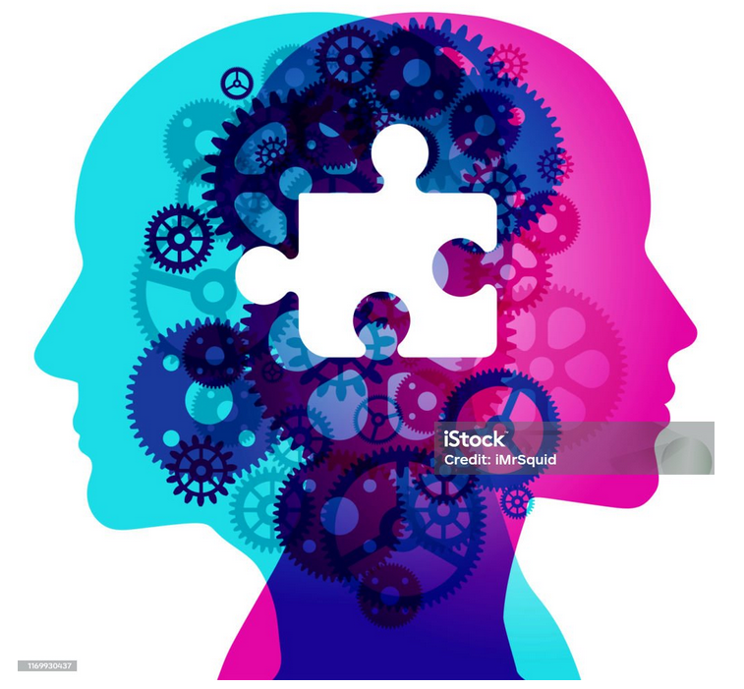
How can AI help?
How do we unlock the use of AI?
Operation and reliability ;
Detecting, preventing anomalies ;
Optimising beam time ;
Frugal, complex physics simulation ;
Developing improved models.
Bringing the missing piece of FAIRness in data, methods, and tools in ML for research infrastructure
Building on existing knowledge and experience
Notes:
Now that we’ve seen the challenges, let's talk about how AI can help us address them. Artificial intelligence offers a range of capabilities that can make our accelerator operations more efficient and reliable. It can help us improve overall operations by identifying patterns and potential issues before they become problems, enhancing reliability. AI can also detect and even prevent anomalies that could disrupt our work, keeping our systems running smoothly.
AI doesn't just make things more stable—it can also optimize beam time, ensuring that we’re getting the most out of every session, reducing waste, and improving overall productivity. It even allows us to perform complex physics simulations in a more frugal way, conserving resources while still delivering accurate results. And through continuous learning, AI can help us develop improved models that are better suited to evolving research needs.
But to truly leverage AI, we need to unlock its full potential. This means bringing the missing piece of FAIRness—making our data, methods, and tools more Findable, Accessible, Interoperable, and Reusable in the context of machine learning for research infrastructures. By doing this, we ensure that our AI tools are not just effective but also sustainable and shareable across different teams and projects. And the good news is, we don’t have to start from scratch—we can build on the knowledge and experience we already have, using AI to take us to the next level.

Slide 4
ARTIFACT: ARTificial Intelligence For Accelerators, user Communities and associated Technologies
Network
HORIZON-INFRA-2024-TECH-01
Next generation of scientific instrumentation, tools, methods, and advanced
digital solutions for RIs (2024)
AI Guidelines
Outreach and Knowledge Transfer
ARTIFACT
AI Algorithms
Data Platform
Notes:
Now, let me introduce you to the ARTIFACT project—ARTificial Intelligence For Accelerators, user Communities, and associated Technologies. This initiative is all about using the power of AI to transform the way we operate and improve accelerator systems, aiming for better efficiency, reliability, and collaboration.
At the heart of ARTIFACT is the integration of AI with different facets of our work, and this graph shows the core elements that make this possible. In the center, we have ARTIFACT, and surrounding it are the key pillars that drive our project forward:
AI Algorithms: We are developing advanced AI algorithms specifically tailored for the needs of accelerators, focusing on areas like anomaly detection, beam optimization, and predictive maintenance. These algorithms form the backbone of our AI-driven approach, enabling us to automate and optimize complex tasks.
AI Guidelines: But it's not just about building algorithms; it's about building them in the right way. That's where our AI guidelines come in. They ensure that our methods align with best practices and the FAIR principles—making sure our data and models are findable, accessible, interoperable, and reusable. This helps us maintain a high standard across our work and ensures that our solutions are sustainable and adaptable.
Network: ARTIFACT is not just a technical project; it’s a collaborative one. Key institutions like GANIL, CERN, DESY, INFN, CNRS play a central role in this network, bringing their expertise in both AI and accelerator physics. The strength of this collaboration lies in our ability to share data, insights, and best practices across these institutions. By working together and sharing data, we create a richer dataset that helps us train better AI models and draw more meaningful insights. This collective effort accelerates our progress and makes it possible to achieve goals that wouldn’t be possible in isolation.
Outreach and Knowledge Transfer: It’s also essential to ensure that the insights and breakthroughs we achieve don't stay confined within our project. Through outreach and knowledge transfer, we aim to spread what we learn to broader research communities, ensuring that others can benefit from our advancements and that we continue to grow and learn from one another.
Data Platform: Finally, the data platform is the foundation that supports everything else. It’s where we bring all our data together, structured with the right metadata to enable effective AI integration and cross-system analysis. This platform is designed to make data management smoother, enabling us to extract insights that drive our improvements and support collaboration across different teams and institutions. It embodies the FAIR principles, ensuring that our data can be shared and reused effectively across the entire network of partners.
Together, these elements make ARTIFACT a comprehensive approach to bringing AI into the world of accelerators, pushing the boundaries of what's possible in terms of performance and collaboration. It’s not just about using AI; it’s about building a foundation that supports long-term progress and fosters a spirit of cooperation across the entire community.

Slide 5
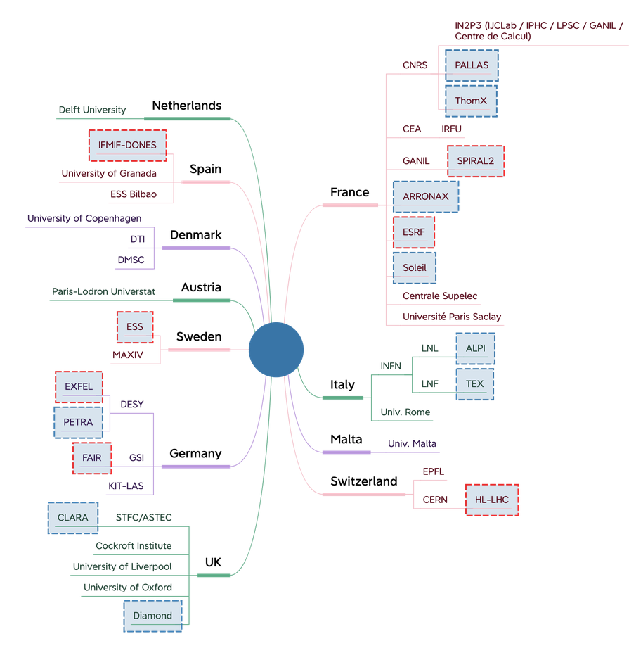
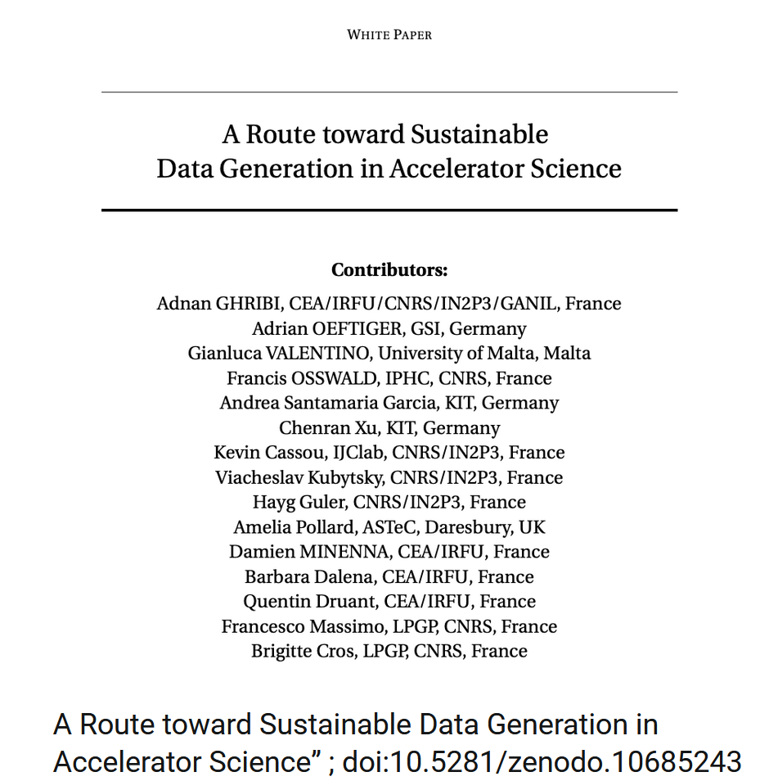
The ARTIFACT Network
Notes:
One of the key strengths of the ARTIFACT project is the breadth and diversity of its network. This is truly a collaborative effort, bringing together 33 partners from 11 countries, all contributing their expertise and resources to push the boundaries of what we can achieve with AI in accelerator science.
Our network includes some of the most renowned research institutions and universities across Europe and beyond. From CERN and DESY, leading the way in particle physics, to universities like the University of Liverpool and Paris-Saclay, to specialized research centers like the European Spallation Source and GSI Helmholtz, every partner plays a crucial role in making ARTIFACT a success. This broad network allows us to pool knowledge, share data, and tackle challenges from multiple perspectives.
But it’s not just about collaboration; it’s about building a foundation for sustainable progress. An excellent example of this is the paper 'A Route toward Sustainable Data Generation in Accelerator Science,' co-authored by members of our consortium. This paper outlines our approach to creating sustainable, shareable data practices in our field.

Slide 6
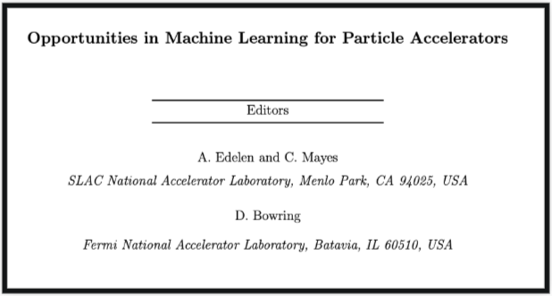
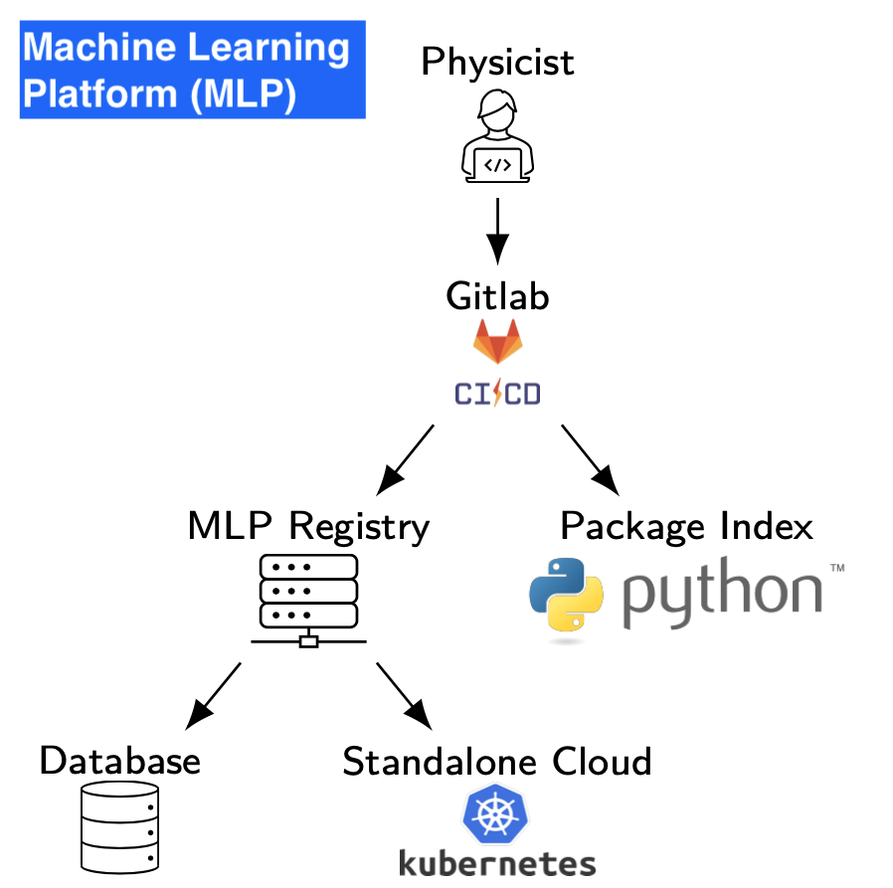
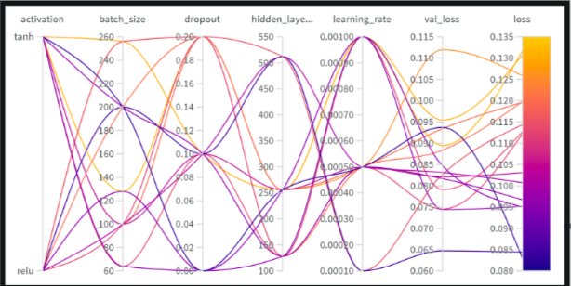
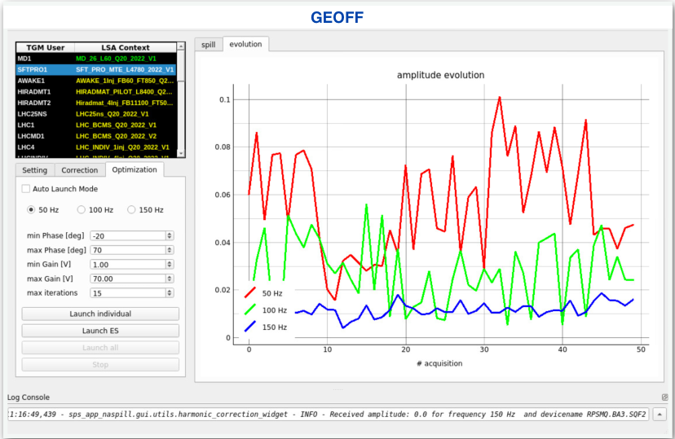
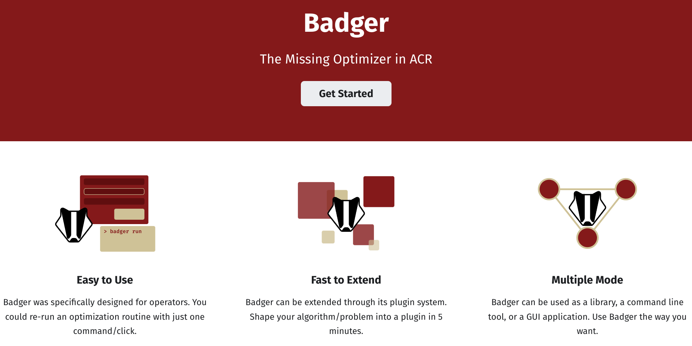
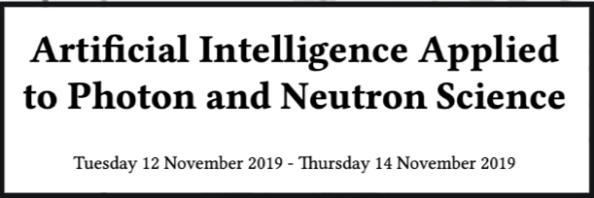
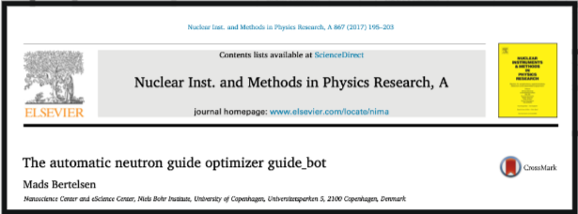
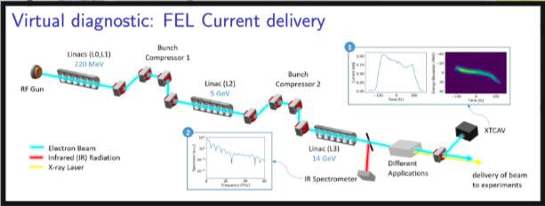
State of the art
Despite all the success stories, there are serious locks that prevent making global impact in the community !

Slide 7
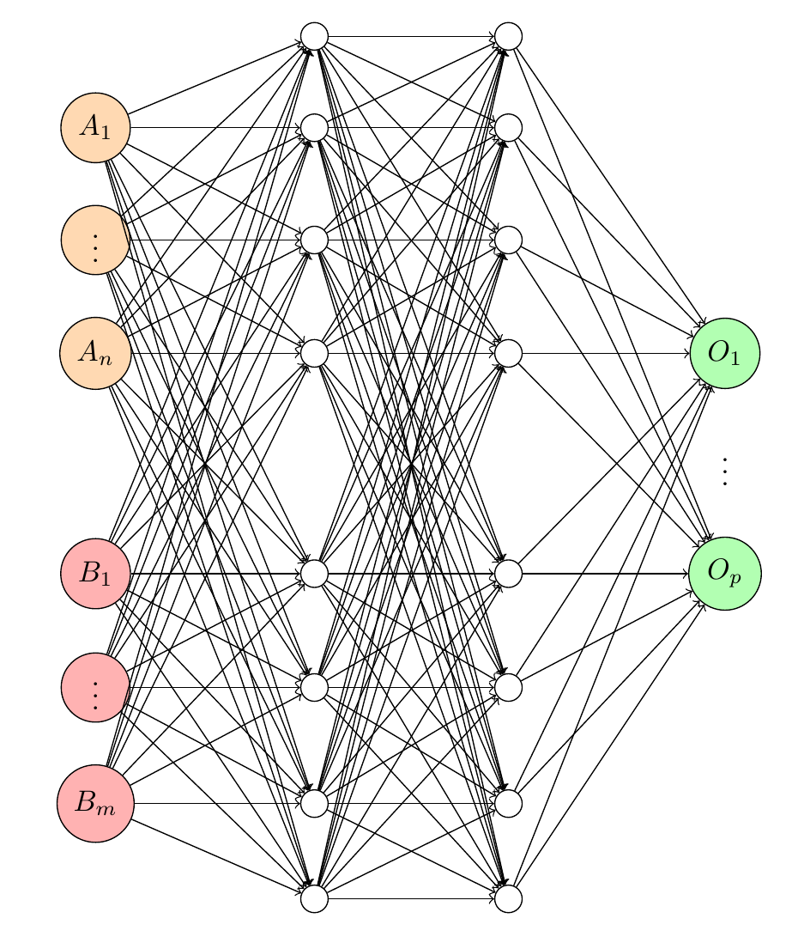
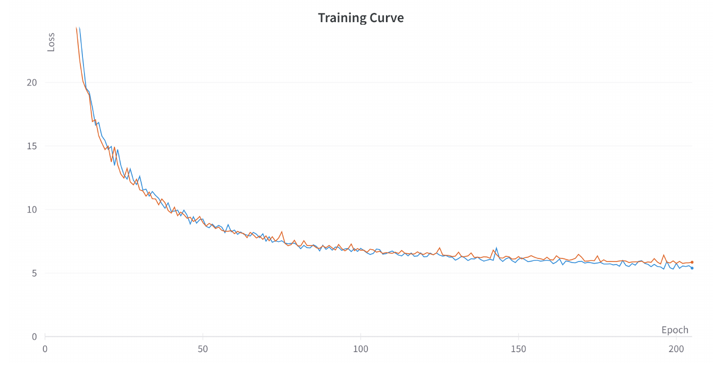
Example: Surrogate Models for Particle Accelerator
Multi Layer Perceptron
Stack all inputs and outputs
10k simulations sampling A and B
Minimization of the L2 loss
Multilayer Perception as a surrogate model of a Linac
Neural-Network-based Surrogate Simulator for Particle Accelerator with High Dimensional Control Settings. H. Guler , C. Bruni, J. Cohen, M. Sebag

Slide 8
Example: Surrogate Models for Particle Accelerator
LinacNet with 6 modules corresponding to 6 diagnostic stations on the Linac
Split input and output according to their position in the Linac
Neural Network Architecture reflecting a Linac architecture
Each Module models one Diagnostic (could be real or virtual)
Neural-Network-based Surrogate Simulator for Particle Accelerator with High Dimensional Control Settings. H. Guler , C. Bruni, J. Cohen, M. Sebag

Slide 9
Example: Surrogate Models for Particle Accelerator
MAE of the position. The accuracy of the Beam position monitors is ∼ 100μm
MAE of the charge. The accuracy of the Integrated Current Transformer is ∼ 10pC
Neural-Network-based Surrogate Simulator for Particle Accelerator with High Dimensional Control Settings. H. Guler , C. Bruni, J. Cohen, M. Sebag

Slide 10
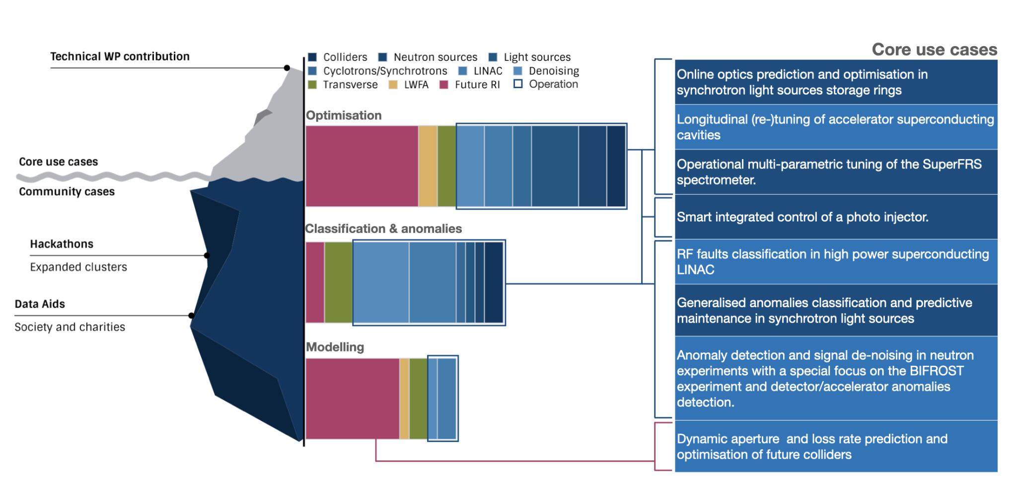
Methodology
Notes:
SuperFRS is a Fragment Separator to study rare isotope beams. The beam line consists of about 120 magnets which need to be powered in optimised fashion. A subtask in WP6 will take SuperFRS care of applying the developed Machine Learning based software framework to automate the setup procedure.

Slide 11
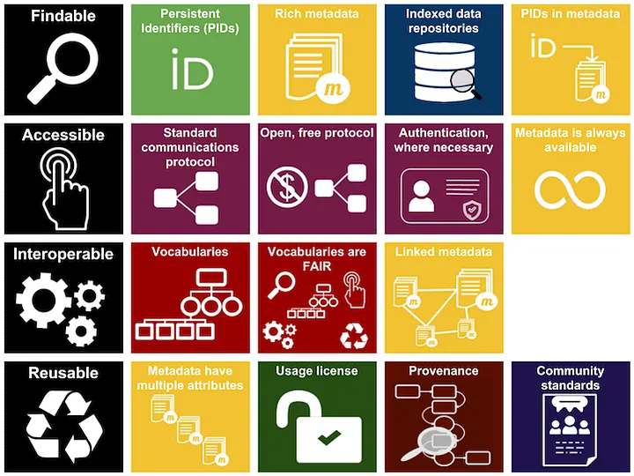
F.A.I.R. data principles and AI
Image credit: ARDC licensed under a Creative Commons Attribution 4.0 International License
Findable Centrally orchestrated storage and access of data essential to enable data/software to be findable. Usage of Persistent IDentifiers (PID e.g. DOI) -> Guarantee access to Digital Research Objects.
Accessible
Data and software produced/dedicated for F.A.I.R communities and publications centrally stored
Common & “user-friendly” interface to store and retrieve data
Interoperable
Common metadata formats
F.A.I.R-produced data operable with other datasets
Reusable Ensure (as reasonably as possible) data stored long term Metadata should be retained indefinitely
AI and the F.A.I.R. principles are mutually beneficial:
- AI algorithms thrive on accessible, interoperable, and reusable data.
- The application of AI can enhance data discoverability, improve metadata accuracy, and facilitate large-scale analysis
Notes:
Let's begin by examining the FAIR data principles, which serve as a foundational framework for effective data management and open science.
Findable: Data should be easy to find for both humans and computers. This means assigning unique identifiers and providing rich metadata.
Accessible: Once found, data should be retrievable using standardized protocols, potentially with authentication and authorization where necessary.
Interoperable: Data should be compatible with other data and tools. This involves using standardized formats and vocabularies.
Reusable: Data should be well-described so it can be replicated and/or combined in different settings. Clear usage licenses and provenance information are key.
As we can see, metadata is the common thread that weaves through all these principles. It's the descriptive information that makes data findable, accessible, interoperable, and reusable.
Metadata acts as the roadmap to our data assets. Without it, datasets are like books without titles or content pages—difficult to discover and utilize.
By providing detailed descriptions, metadata enables researchers to locate datasets relevant to their work, enhancing discoverability.
Standardized metadata ensures that data from different sources can be integrated and understood collectively, which is vital for collaborative research.
Comprehensive metadata allows others to understand the context, methodology, and parameters of data collection, making it possible to replicate studies or apply data in new analyses.
By making data easily accessible and understandable, we reduce duplication of effort and accelerate scientific discovery.

Slide 12
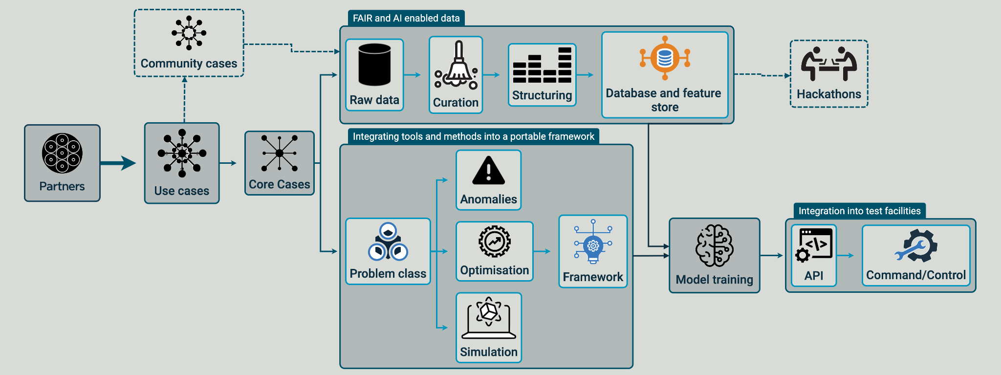
Methodology
Notes:
SuperFRS is a Fragment Separator to study rare isotope beams. The beam line consists of about 120 magnets which need to be powered in optimised fashion. A subtask in WP6 will take SuperFRS care of applying the developed Machine Learning based software framework to automate the setup procedure.

Slide 13
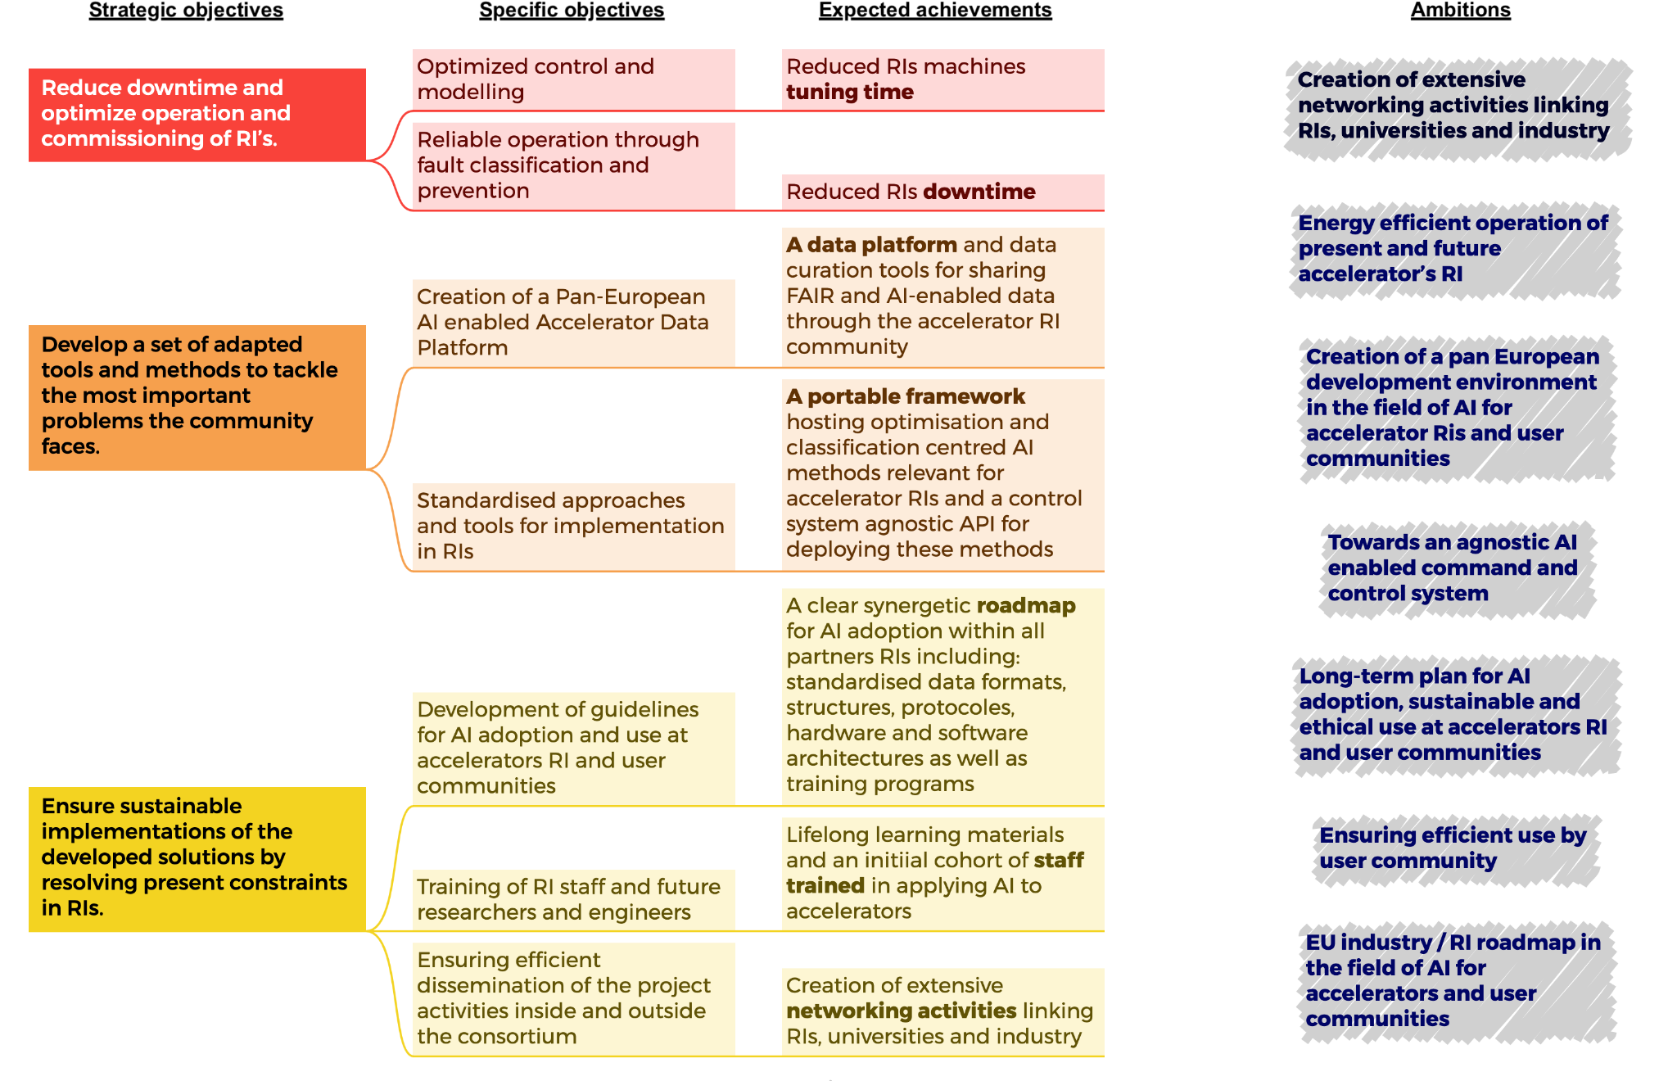
Methodology
Notes:
SuperFRS is a Fragment Separator to study rare isotope beams. The beam line consists of about 120 magnets which need to be powered in optimised fashion. A subtask in WP6 will take SuperFRS care of applying the developed Machine Learning based software framework to automate the setup procedure.

Slide 14
Implementation
Notes:
SuperFRS is a Fragment Separator to study rare isotope beams. The beam line consists of about 120 magnets which need to be powered in optimised fashion. A subtask in WP6 will take SuperFRS care of applying the developed Machine Learning based software framework to automate the setup procedure.

Slide 15
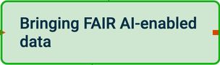
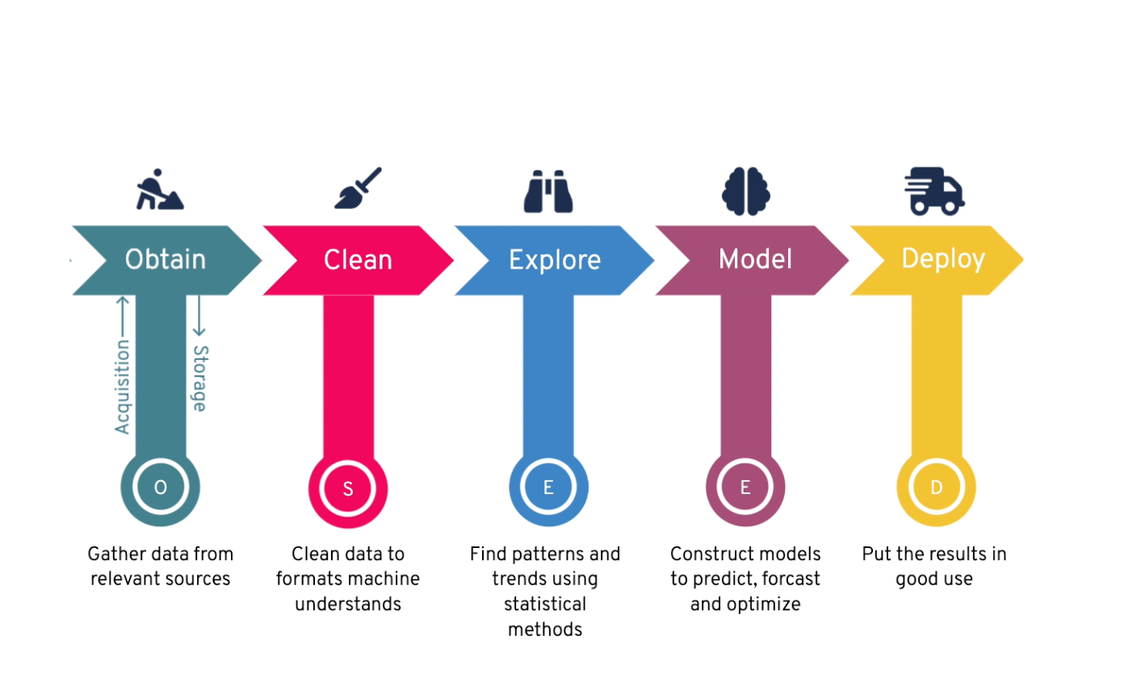
Linking F.A.I.R. Data and AI
Notes:
SuperFRS is a Fragment Separator to study rare isotope beams. The beam line consists of about 120 magnets which need to be powered in optimised fashion. A subtask in WP6 will take SuperFRS care of applying the developed Machine Learning based software framework to automate the setup procedure.

Slide 16
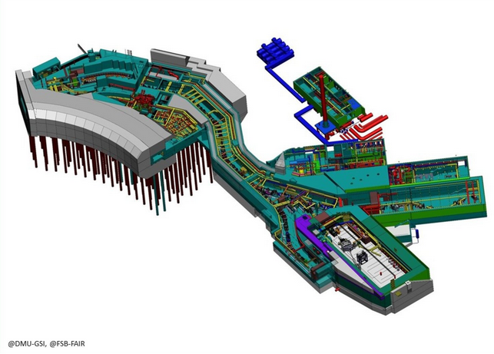
How can GSI/FAIR benefit?
E.g. Super FRS
Need to deliver beams of different rigidity, ion mass and ion charge
2nd and higher order effects
Multiple challenges
hysteresis in the dipoles
high number of objectives to be met at the same time
“cocktail beams”
Machine Learning Software framework to automate setup procedure (see talk by S. Pietri)
ARTIFACT Networking and synergies with partners
Notes:
SuperFRS is a Fragment Separator to study rare isotope beams. The beam line consists of about 120 magnets which need to be powered in optimised fashion. A subtask in WP6 will take SuperFRS care of applying the developed Machine Learning based software framework to automate the setup procedure.

Slide 17
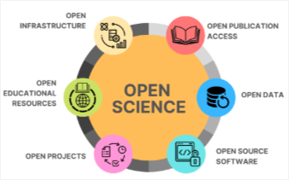
ARTIFACT Future
ARTIFACT: ARTificial Intelligence For Accelerators, user Communities and associated Technologies
Upcoming:
Structure several coordinated R&D programs
Give recommendations to research infrastructures and funding agencies
Propose and update a yearly coordinated research strategy (internal network)
Give recommendations at external networks (e.g. European strategy for particle physics)
Questions?
Contact us
open-science@gsi.de
Notes:
SuperFRS is a Fragment Separator to study rare isotope beams. The beam line consists of about 120 magnets which need to be powered in optimised fashion. A subtask in WP6 will take SuperFRS care of applying the developed Machine Learning based software framework to automate the setup procedure.

