Slide 1
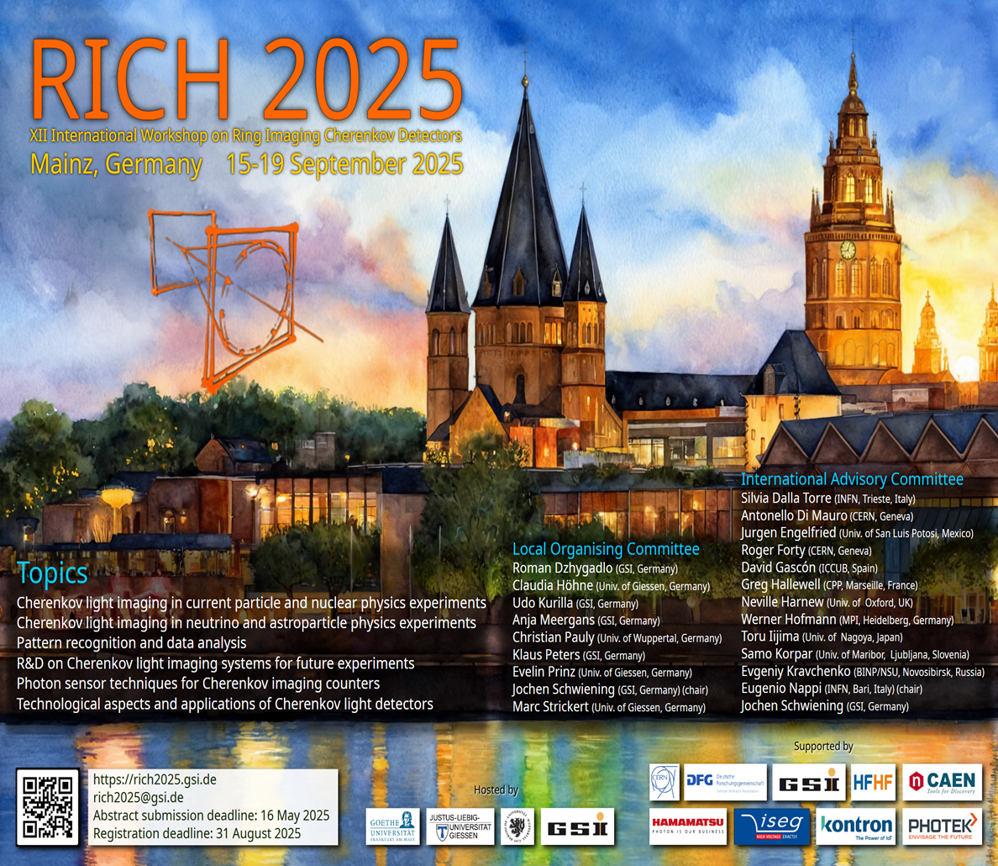
CLOSE OUT

Slide 2
RICH2025: RELEVANT FIGURES
115 participants
9 overview talks
49 contributed talks
(12 candidates to
the early career award)
- 39 posters
(15 candidates to
the early career award)

Slide 3
The RICH WS SERIES
1st Edition RICH1993
Bari (Italy) June 2-5, 1993
2nd Edition RICH1995
Uppsala (Sweden) June 12-16, 1995
3rd Edition RICH1998
Ein Gedi (Israel) November 15-20, 1998
4th Edition RICH2002
Pylos (Greece) June 5-10, 2002
5th Edition RICH2004
Playa de Carmen (Mexico) November 30 –
December 5, 2004
6th Edition RICH2007
Trieste (Italy) October 15-20, 2007
7th Edition RICH2010
Cassis (France) May 3-7, 2010
8th Edition RICH2013
Hayama (Japan) December 2-6, 2013
9th Edition RICH2016
Bled(Slovenia) September 5-9, 2016
10th Edition RICH2018
Moscow(Russia) July 29 – August 4, 2018
11th Edition RICH2022
Edinburgh (United Kingdom) September 12-16, 2022
12th Edition RICH2025
Mainz(Germany) September 15-19, 2025

Slide 4
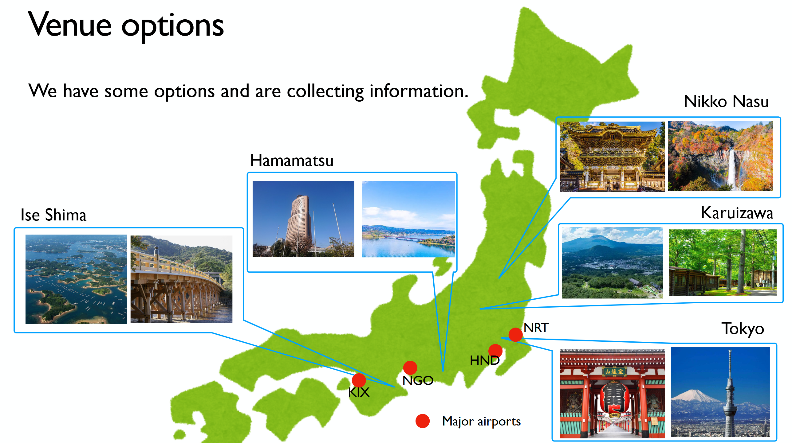
Next RICH Workshops
RICH2028: Japan
LOC:
Toru Iijima (Nagoya), Kenji Inami (Nagoya), Hidekazu Kakuno (TMU), Kodai Matsuoka (KEK), Shohei Nishida (KEK)
RICH2031: Ferrara (Italy)
LOC:
Roberto Calabrese, Giovanni Cavallero,
Marco Contalbrigo, Massimiliano Fiorini
INFN and University of Ferrara

Slide 5
Proceedings
Elsevier/North-Holland Publishing Company will publish the proceedings as a special
issue of Nuclear Instruments & Methods in Physics Research, Section A
The deadline for the paper submission is January 15, 2026
The paper must be written in LaTeX or Microsoft Word
Maximum number of pages:
Invited talks: 8 pages
Contributed talks: 4 pages
Posters: 3 pages

Slide 6
Acknowledgements
I would like to express my sincere thanks to our hosts, Jochen and his collaborators, for the impeccable and meticulous organization of the WS and a very effective collaboration with the SAC
To my colleagues in the advisory committee for the qualified support I have received in arranging a great scientific program
To all the attendees and to the speakers and poster contributors, their active participation is the heart of this series of WS

Slide 7
HAVE A SAFE TRIP HOME AND LOOK FORWARD TO SEEING YOU IN 2028 IN JAPAN

